Slide 1
Interconnection Structures
Crossbar switch

Slide 2
Crossbar switch
This organization consist of number of cross points that are placed at intersection between processor buses and memory modules.
The below figure shows a crossbar switch interconnection between four CPU’s and four memory modules.

Slide 3
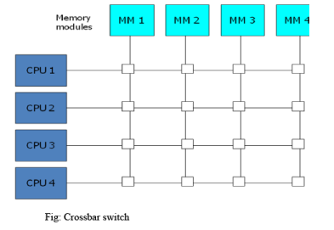
Crossbar switch

Slide 4
Crossbar switch
The small squares in each cross point is a switch that determines the path from processor to memory module.
Each point has a control logic to setup the transfer path between processor and memory.
It also resolves multiple request for access the same memory module on a priority basis.
The below figure shows the functional design of a crossbar switch connected to one memory module.

Slide 5
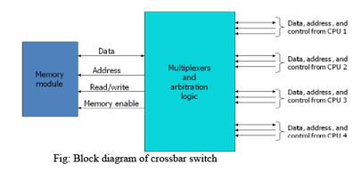
Crossbar switch

Slide 6
Crossbar switch
The circuit consist of multiplexer that selects the data, address and control from one CPU for communication with memory module.
Priority levels are established by the arbitration logic to select one CPU when two or more CPU’s attempts to access the same memory.
A crossbar switch supports simultaneous transfer from all memory modules as there is a separate path associated with each module.

