Slide 1
Interconnection structure Multistage switching Network

Slide 2
Multistage switching Network
The basic component of a multistage network is a two i/p, two o/p interchange switch.
The below fig are the 2 X 2 switch that has 2 i/p’s labelled A & B and two o/p’s labelled 0 & 1.
The control logic is associated with the switch that establish the interconnection between the i/p and o/p terminals.

Slide 3
Multistage switching Network

Slide 4
Multistage switching Network

Slide 5
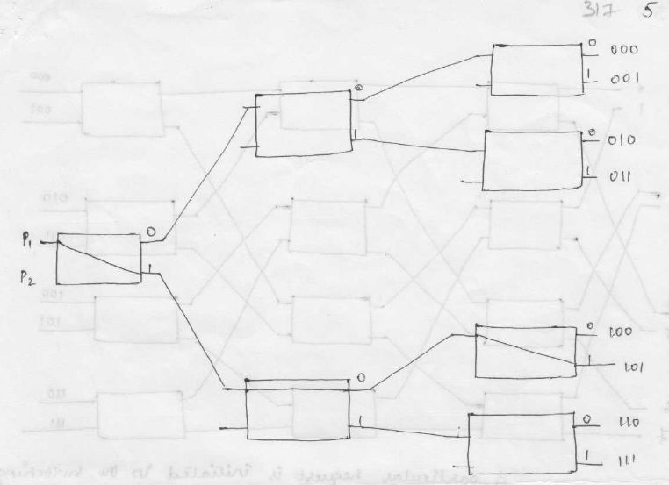
Multistage switching Network

Slide 6
Multistage switching Network

Slide 7
Omega Network

Slide 8
Omega Network

Slide 9
Omega Network

