Slide 1
Layout Planning and Design

Slide 2
General PCB Design Considerations
The basic function of a printed circuit is to provide support for circuit components and to interconnect the components electrically.
In order to achieve these objectives, various printed wiring types have been developed.
They vary in base material (laminate), conductor type, number of conductor planes, rigidity, etc.
It is therefore expected that the printed circuit designers are adequately familiar with the variations and their effect on cost, component placement, wiring density, delivery cycles and functional performance.
No finished product is ever better than its original design or the material from which it is made.
The manufacturing process, at best, can reproduce the design.
The same is true with printed circuit boards. The need for formalizing design and layout methods and procedures thus assumes critical importance

Slide 3
Design and layout broadly includes the perspective of total system hardware, which includes not only the printed circuit but each and every component in its final form.
Design and layout considerations must also address the relations between and interactions of the components and assemblies throughout the system.
Board design is an extremely important aspect of printed circuit board technology.
Quite often, designers underestimate the time and effort required to do a good job. This can cause delay in production start-up and much hidden cost during the life of the product.

Slide 4
Technical Requirements
The technical requirements that are likely to affect the design of an electrical equipment are mechanical, electrical, functional and environmental.
Mechanical design requirements include size, shape and weight; location of components and their mounting, dimensional tolerances, shielding and equipment marking.
Electrical design requirements have such parameters as circuit function and wiring distribution, component selection with respect to electrical ratings, size and tolerance, internal and external interconnections.
Functional design parameters include reliability, maintainability, accessibility, and human engineering (displays, controls).
Environmental design takes into account factors such as mechanical shock and vibration, temperature extremes, salt spray and fungus proofing and operations in space or underwater.

Slide 5
Important Design Elements
The design inputs which should be provided by the equipment designer to the PCB designer are called design elements. They are:
Type of circuit (analog or digital, etc.);
Board size
Number of layers
Pad stack sizes
Hole sizes
Layer thickness
Board thickness
External connections
Mounting holes
Supply and ground layer thickness and
Component details with specifications.

Slide 6
Important Performance Parameters
Tensile strength;
Flexural strength;
Shock and vibration;
Thermal shock and temperature cycling;
Moisture resistance;
Fungus resistance;
Salt spray;
Warp or twist;
Dielectric breakdown voltage;
Solderability and re-solderability;
Insulation resistance (surface and bulk);
Flame resistance;
Conductor temperature rise;
Machinability; and
High attitude considerations.

Slide 7
Mechanical Design Considerations
Types of Boards
Board Mounting Techniques
Board Guiding and Retaining
Input/Output Terminations
Board Extraction
Testing and Servicing
Mechanical Stress
Board Thickness
Important Specifications and Standards

Slide 8
Electrical Design Considerations
Conductor Dimensions
Resistance
Capacitance Considerations
Inductance of PCB Conductors
High Electrical Stresses

Slide 9
Fabrication and Assembly Considerations
Certain limits should be taken into account in order to maximize manufacturability and thereby minimize cost. Also, the human factors should be considered before designing is undertaken. These factors are delineated below.
Conductor spacing less than 0.1mm will not work with the etching process, because the etchant fluid does not circulate efficiently in narrower spaces resulting in incomplete metal removal.
Features with a conductor width smaller than 0.1 mm will lead to breakage and damage during etching.
The land size should be at least 0.6 mm greater than the hole size.

Slide 10
The following limitations determine the layout techniques:
Size capability of reprographic camera for film master production;
Artwork table size;
Minimum or maximum board processing size;
Drilling accuracy; and
Fine line etching facilities.

Slide 11
The following parameters are taken into considerations for design from the point of view of assembly of printed circuit boards:
Hole diameter shall be expressed in terms of maximum material conditions (MMC) and least material conditions (LMC) limits.
Properly locate smaller components so that they are not shadowed by large components.
Solder mask thickness should not be greater than 0.05 mm.
Screen print legend must not interface with any solder pad.
The top half of the board should be a mirror of the bottom half of the board to achieve a balanced construction, because asymmetrical boards tend to warp.

Slide 13
Design Rules for Analog Circuits
The three important considerations which form the basis for design rules for analog circuit PCBs are:
      Component placement;
      Signal conductors; and
      Supply and ground line conductors.

Slide 14
Component Placement
Component placement plays a crucial role, especially in analog circuits PCB design. The important guidelines to be followed in this regard are:
Components which need to be accessed from the front panel must be placed exactly according to the requirements of the equipment designer.
Components for internal adjustments such as potentiometers, trimmers, switches, etc. should be arranged near the board edge and placed in the proper direction for easy operation.
Components with metal cases should not be placed very near to potentiometers, trimmers and switches etc. otherwise while adjusting, the screwdriver may cause a short-circuit between the component and the equipment chassis.
The placing of heat-producing and heat-sensitive components must be carefully planned. Heat producing components should be placed away from the heat-sensitive components.
Heat-producing components should be uniformly distributed over the entire board area as far as possible. This will avoid local over-heating of the board.
Components likely to get heated must be separated from the board surface by suitable spacers. Provision for space for these spacers should be made on the board.
Where mounting screws need to be provided, the requisite space for nut and washer must be planned for, and no conductive track should be run underneath.

Slide 15
Signal Conductors
Signal conductors in analog circuit PCBs have to perform a variety of different tasks including input, reference level, feedback, output, etc.
Therefore, a signal line for one application has to be optimized in a different manner than for another application.
But a common consideration in all analog circuit PCB designs is to keep the signal conductor as short as possible.
This is because the magnitude of the undesirable inductive and capacitive coupling effects increases almost proportionally to the length of the signal conductor.
It may not always be possible to keep all signal conductors as short as possible.
A practical approach in such a case is to identify the most critical signal conductor and to put it first in the layout.
The signal conductor layout has to be made carefully, particularly for the following types of circuits:
    High frequency amplifiers/oscillators;
    Multi-stage amplifiers especially with high power output stage;
    High gain dc amplifiers;
    Low level signal amplifiers; and
    Differential amplifiers.

Slide 16
Supply and Ground Conductors
Power supply lines should be of sufficient width to keep the resistance and inductance to a low value. However, the capacitive coupling to ground increases with more width.
Analog and digital circuits on the same PCB should strictly have independent ground network conductors.
Similarly, reference voltage circuits, which are normally sensitive to ground potential fluctuations, should tap the supply lines directly at the input to the PCB and its ground line should be connected separately to the stable ground reference point of the equipment.
In real life, ground conductors have both resistance and inductance, and may also be carrying unpredictable currents, which will have voltage drops when they flow in the ground impedances.
CAD PCB programs are particularly bad at ground design because they tend to keep all conductors as thin as possible to conserve copper and the board area, and this, of course, results in high ground resistance.
There is an obvious alternative to thin ground leads — a continuous “ground plane” of copper covering one side of a PCB to which all ground connections are made.
The resistance of 0 .001" (0.025 mm) copper is approximately 0.67 mW/square inch so that this solution is frequently adequate — but not always.

Slide 17
General Rules for Design of Analog PCBs
A few general rules concerning design of PCBs for analog circuits are:
Keep the signal path as short as possible. This will help to minimize both voltage drops through the conductors as well as electromagnetic interference by controlling loop areas.
Provide separate analog and digital grounds and tie the two together only once.
Provide one connection from the system ground to the actual earth ground.
Connect capacitive shields once to provide a return path to the noise source.
Magnetic shields must be made out of a highly permeable material to be effective.
Metal should not be left electrically floating.
Maintain the balance of a system to prevent common mode signals from becoming differential.
Limit the bandwidth of the system to the required signal bandwidth.
Keep loop areas small and always think as to where the currents will flow.
Between the two PCBs, use twisted pair cable to improve the noise rejection of a system.

Slide 18
Design Rules for Digital Circuits
Until recently, the only task printed circuit boards were expected to perform was to provide electrical connectivity between various components and the conductors had to be of sufficient cross-sectional area to tolerate the necessary current without excessive over-heating.
The conductor separation was so arranged that it should prevent voltage breakdown. The widespread use of digital integrated circuits has now resulted in devices with extremely fast switching speeds and rise times.
Electromagnetic wave propagation characteristics have become important and need to be considered carefully.
Under these circumstances, the printed circuit boards may act as transmission lines if the rise or fall time of the driving device is less than twice the propagation delay.
It is essential to understand that it is the rise/fall time that is critical and not the operating frequency However, the frequency is dependent on rise/fall times, since the lower the value of the rise/fall time, the faster the operating frequency of the device.
Under these situations, the transmission line effects become applicable and knowledge of the electrical characteristics associated with the conductors acting as transmission lines is essential. Then, the characteristic impedance must be matched to that of the receiving device to prevent reflection.

Slide 19
Problems in Design of PCBs for Digital Circuits
High frequency performance of printed circuit boards is becoming increasingly important in digital circuits and knowledge of electrical characteristics associated with conductors acting as transmission lines is essential
The main problems that can affect digital PCBs, if they are not properly designed; are:
Reflections (causing signal delays and double pulsing, i.e. conversion of one pulse into two or more pulses);
Cross-talk (interference between neighbouring signal lines);
Ground and supply signal noise; and
Electromagnetic interference from pulse type electromagnetic fields.

Slide 20
PCB Fundamentals

Slide 21
Connectivity in electronic equipment
Electronic equipment is a combination of electrical and electronic components connected to produce a certain designed function. In the era of vacuum tubes and even later, electronic equipment was constructed by hand wiring and by point-to-point soldering.
The wires were stripped of their insulation, tinned and soldered. Each discrete component was installed by hand, electrically and mechanically.
The equipment was obviously large, awkward and bulky.
It was difficult to meet the demanding requirements for the use of this equipment in aircrafts, the health sector and home emergency uses, thereby necessitating the development of smaller and more compact electronic equipment.
A natural evolution took place in several areas.
Smaller components were developed and modular design became popular, basically intended to decrease the time between unit failure and repair due to easy replaceability.
The use of miniaturization and sub-miniaturization in electronic equipment design gave birth to a new technique in inter-component wiring and assembly that is popularly known as the printed circuit board.
The printed circuit board provides both the physical structure for mounting and holding electronic components as well as the electrical interconnection between components.
Printed circuit board is usually abbreviated as PCB and quite often referred to as board. However, in the USA, the term PWB (Printed Wiring Board) is more often used instead of PCB.

Slide 22
Advantages of Printed Circuit Boards
There are many good reasons for using printed circuit boards instead of other interconnection wiring methods and component mounting techniques, some of which are as follows:
The size of component assembly is reduced with a corresponding decrease in weight.
Quantity production can be achieved at lower unit cost.
Component wiring and assembly can be mechanized.
Circuit characteristics can be maintained without introducing variation in inter-circuit capacitance.
They ensure a high level of repeatability and offer uniformity of electrical characteristics from assembly to assembly.
The location of parts is fixed, which simplifies identification and maintenance of electronic equipment and systems.
Inspection time is reduced because printed circuitry eliminates the probability of error.
Printed wiring personnel require minimal technical skills and training. Chances of mis- wiring or short-circuited wiring are minimized.

Slide 23
Components of a Printed Circuit Board
The essential components of a printed circuit board are:
The base, which is a thin board of insulating material, rigid or flexible, which supports all conductors and components; and
The conductors, normally of high purity copper in the form of thin strips of appropriate shapes firmly attached to the base material.
The base provides mechanical support to all copper areas and all components attached to the copper. The electrical properties of the completed circuit depend upon the dielectric properties of the base material and must therefore, be known and appropriately controlled.
The conductors provide not only the electrical connections between components but also solderable attachment points for the same.
When the completed board provides mechanical support and all necessary electrical connections to the components, it is essentially a Printed Wiring Board or Printed Circuit Board. The term printed became popular because the conductive areas are usually generated by means of a printing process like screen printing or photo-engraving, which are commonly used to print drawings or inscriptions.

Slide 24
Classification of Printed Circuit Boards
Printed Circuit Boards may be classified according to their various attributes, often with ambiguous results. They were traditionally divided into three classes according to their use and applications, and were commonly referred to as
      consumer,
      professional and
      high reliability boards.

Slide 25
Consumer PCBs were generally used in consumer products such as radio, television, and cheap test and measuring equipment. They used less expensive base material and allowed greater tolerances for manufacture to keep the cost low. Much importance was not given to good and consistent electrical properties.
Professional boards were made of better quality material to achieve tighter electrical and environ- mental specifications using controlled fabrication techniques.
Higher reliability boards, normally used in strategic applications, were meant to provide the best of electrical properties through the use of high quality base material and tightly controlled manufacturing processes.

Slide 26
A more simple and understandable classification is now used, which is based on the number of planes or layers of wiring, which constitute the total wiring assembly or structures, and to the presence or absence of plated-through holes.
This method of classifying boards has the advantage of being related directly to the board specifications.
The above classification might have been applicable two or three decades ago, but presently, the distinction between consumer and professional markets has disappeared.
Many consumer products like compact discs, camcorders or cameras have become more complex, reliable and demanding than what was hitherto considered as professional equipment like personal computers.
The advent of surface mount technology and developments in automatic assembly techniques requires that the boards even for the cheapest product must be manufactured to strict mechanical tolerances.

Slide 27
Single-sided Printed Circuit Boards
Single-sided’ means that wiring is available only on one side of the insulating substrate.
The side which contains the circuit pattern is called the ‘solder side’ whereas the other side is called the ‘component side’.
These types of boards are mostly used in case of simple circuitry and where the manufacturing costs are to be kept at a minimum.
The single-sided boards are manufactured mostly by the ‘print and etch’ method or by the ‘die- cut’ technique by using a die that carries an image of the wiring pattern; and the die is either photo- engraved or machine-engraved.
Normally, components are used to jump over conductor tracks, but if this is not possible, jumper wires are used.
The number of jumper wires on a board cannot be accepted beyond a small number because of economic reasons,
resulting in the requirement
for double-sided boards.

Slide 28
Double-sided Printed Circuit Boards
‘Double-sided’ printed circuit boards have wiring patterns on both sides of the insulating material,
i.e. the circuit pattern is available both on the components side and the solder side. Obviously, the component density and the conductor lines are higher than the single-sided boards. Two types of double-sided boards are commonly used, which are:
  Double-sided board with plated through-hole connection (PTH); and
  Double-sided board without plated through-hole connection (non-PTH).

Slide 29
Double-sided PTH board
Double-sided PTH board has circuitry on both sides of an insulating substrate, which is connected by metallizing the wall of a hole in the substrate that intersects the circuitry on both sides.
This technology, which is the basis for most printed circuits produced, is becoming popular in cases where the circuit complexity and density is high. Figure shows the configuration of a plated through-hole in a printed circuit board.

Slide 30
Double-sided non-PTH board
Double-sided non-PTH board is only an extension of a single-sided board.
Its cost is considerably lower because plating can be avoided.
In this case, through contacts are made by soldering the component leads on both sides of the board, wherever required.
In the layout design of such boards, the number of solder joints on the component side should be kept to a minimum to facilitate component removal, if required. It is generally recommended that conductors should be realized as much as possible on the non-component side and only the remaining should be placed on the component side.

Slide 32
The non-plating technique in double-sided boards is shown in Figure 1.3 wherein the interconnection is made by a jumper wire. A formed insulated solid lead wire is placed through the hole, clinched and soldered to the conductor pad on each side of the board.

Slide 33
Different types of eyelets are also used for double-sided board interconnection. These are illustrated

Slide 34
Multi-layer Boards
The development of plated through-hole technology has led to a considerable reduction in conductor cross-overs on different planes, resulting in a reduction in space requirements and increased packaging density of electronic components.
However, the modern VLSI and other multi-pin configuration devices have tremendously increased the packaging density and consequently the concentration of inter-connecting lines.
This has given rise to complex design problems such as noise, cross-talk, stray capacitances and unacceptable voltage drops due to parallel signal lines.
These problems could not be satisfactorily solved in single-sided or double-sided boards, thereby necessitating an extension of the two-plane approach to the multi-layer circuit board.

Slide 35
A multi-layer board is, therefore, used in situations where the density of connections needed is too high to be handled by two layers or where there are other reasons such as accurate control of line impedances or for earth screening.
The multi-layer board makes use of more than two printed circuit boards with a thin layer of what is known as ‘prepreg’ material placed between each layer, thus making a sandwich assembly as shown in Figure 1.5.
The printed circuit on the top board is similar to a conventional printed circuit
board assembly except that the components are placed much closer to avoid having many terminals, which necessitates the use of additional board layers for the required interconnections.
The electrical circuit is completed by interconnecting the different layers with plated through-holes, placed transverse to the board at appropriate places. Multi-layer boards have three or more circuit layers, while some boards have even as many as 50 layers.
By virtue of the multi-layer conductor structure, multi-layer printed wiring has facilitated a reduction in the weight and volume of the interconnections commensurate with the size and weight of the components it interconnects.

Slide 36
Two types of multi-layer boards, one with four-layers & the other with eight-layers.

Slide 37
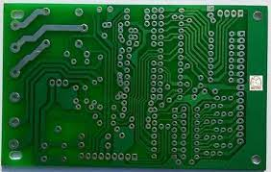
Single sided PCB

Slide 38
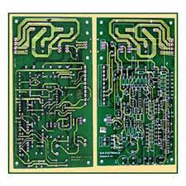
Double sided PCB

Slide 39
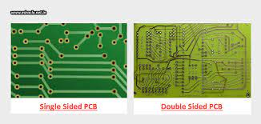
Single sided PCB Vs Double sided PCB

Slide 40
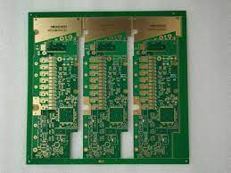
Multi layer PCB

Slide 41
Application
The following areas of application necessitate the use of multi-layer printed wiring arrangements:
  Wherever weight and volume savings in interconnections are the overriding considerations, as in military and air-borne missile and space applications;
  When the complexity of interconnection in sub-systems requires complicated and expensive wiring or harnessing;
  When frequency requirements call for careful control and uniformity of conductor wave impedances with minimum distortions and signal propagation, and where the uniformity of these characteristics from board-to-board is important;
  When coupling or shielding of a large number of connections is necessary; the high capacitance distributed between the different layers gives a good de-coupling of power supply which permits satisfactory operation of high speed circuits;
  With multi-layers, all interconnections can be placed on internal layers, and a heat sink of thick solid copper can be placed on the outer surfaces. By mounting the components directly on the metallic surfaces, the problem of heat distribution and heat removal in systems can be minimized. Also, the layout and artwork designs are greatly simplified on account of the absence of the supply and ground lines on the signal planes

Slide 42
Rigid and Flexible Printed Circuit Boards
Printed circuit boards can also be classified on the basis of the type of insulating material used, i.e. rigid or flexible.
While rigid boards are made of a variety of materials, flexible boards use flexible substrate material like polyester or polyamide.
The base material, which is usually very thin, is in the range of 0.1 mm thickness.
Laminates used in flexible boards are available with copper on one or both sides in rolls.
Rigid-flex boards, which constitute a combination of rigid and flexible boards usually bonded together, are three-dimensional structures that have flexible parts connecting the rigid boards, which usually support components.
This arrangement gives volumetrically efficient packaging and is therefore gaining widespread use in electronic equipment. Flexible PCBs may be single-sided, double-sided (PTH or non-PTH) or multi-layer.

Slide 49
Manufacturing of Basic Printed Circuit Boards

Slide 50
A variety of processes are currently used for manufacturing printed circuit boards.
However, most of the processes have identical or similar basic steps.
Variations in the basic manufacturing steps are usually made by the manufacturers to improve quality or specific yield.
The most popular process is the ‘print and etch’ method, which is a purely subtractive method.
In this process, the base material used is copper clad laminate to which all the electronic components are soldered, with one or more layers of etched metal tracks making the connection.
The etching process involves achieving a conductive pattern formed on one or both sides of the laminate.
The term ‘printed wiring’ or ‘printed circuit’ refers only to the conductive pattern that is formed on the laminate to provide point-to-point connection.
Four specific phases of the PCB manufacturing process need to be understood.
These are design, fabrication, assembly and test.

Slide 51
Single-sided Boards
The schematic diagram, also called the circuit or logic diagram, represents the electronic components and connections in the most readable form. The schematic diagram is developed while taking into consideration the specifications of components, interaction between components (especially timing and loading), physical packages and arrangement of connector pin-outs. The circuit diagram will often start on paper and finish in computer-aided design (CAD). The circuit diagram references each part on the printed circuit board with a designator (e.g. IC4) and pin numbers for each connection. A good circuit diagram includes all the essential information required to understand the circuit operation, and has descriptive net and connector labels, including all the parts on the printed circuit board. To this end, the printed circuit board CAD and schematic CAD are tied together through a net-check. In short, the finished circuit diagram, is the main reference document for design.

Slide 52
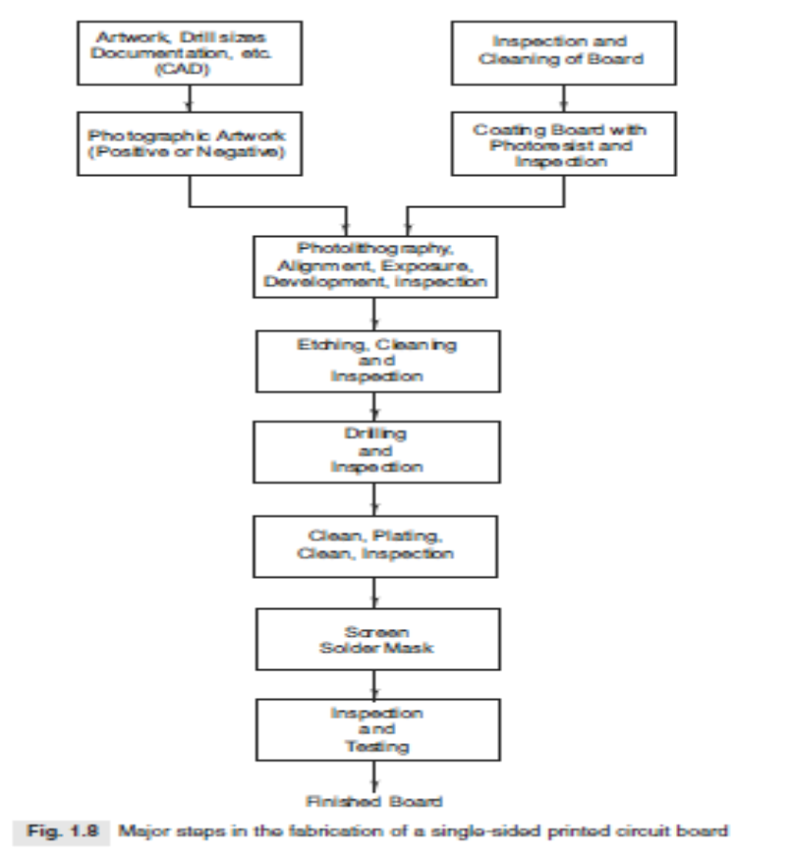

Slide 53
Schematic Diagram
The schematic diagram, also called the circuit or logic diagram, represents the electronic components and connections in the most readable form.
The schematic diagram is developed while taking into consideration the specifications of components, interaction between components (especially timing and loading), physical packages and arrangement of connector pin-outs.
The circuit diagram will often start on paper and finish in computer-aided design (CAD).
The circuit diagram references each part on the printed circuit board with a designator (e.g. IC4) and pin numbers for each connection.
A good circuit diagram includes all the essential information required to understand the circuit operation, and has descriptive net and connector labels, including all the parts on the printed circuit board.
To this end, the printed circuit board CAD and schematic CAD are tied together through a net-check. In short, the finished circuit diagram, is the main reference document for design.

Slide 54
Artwork Generation
The components and connections in the PCB layout are derived from the circuit diagram, and physically placed and routed by the designer to get the best results in term of board size and its manufacturability.
The PCB layout defines the final physical form of the circuit and labelling details are finalized as the layout is completed.
When the PCB layout is complete, the track layout information is provided on self-adhesive type crepe material tape stuck on a plastic sheet such as polyester.
The layout or artwork is usually enlarged two to four times to improve accuracy. Alternatively, the CAD file is used to generate the artwork on a computer controlled plotter, or on an electronic transfer medium such as magnetic tape or floppy disc.
The artwork is then reduced to the final size, and a positive or negative print made depending on the requirement of the manufacturer.

Slide 55
Panel Preparation
The raw material for printed circuit boards is a copper clad laminate with copper on one side only.
The sheets of the laminate are sheared to provide panels of the required size, keeping it slightly longer than the master pattern of the PCB.
The preferred size of panel is 350 ¥ 508 mm.
The commonly used laminates for general purpose applications are normally paper base type, whereas epoxy glass laminates are preferred for superior mechanical and electrical properties.
The mechanical properties include punching and drilling qualities, flexural strength, flame resistance and water absorption.
The important electrical properties include dielectric strength, dielectric constant, dissipation factor, insulation resistance, and surface and volume resistivity.
The most commonly used base material is FR-4 epoxy all woven glass laminate, thickness 1.6 mm with copper foil cladding one oz. per sq. ft. (305 g/m2).
This has a foil thickness of 35 microns.
Before any processing can be undertaken on a board, it must be cleaned to get rid of the contaminants, which may be in the form of organic material (oils and greases), particulate (dust and machining particles), and oxides and sulphides on the copper surface.
The cleaning is done in cleaning machines as the board is made to pass through de-greasing solvent solution, scrubbing stage, wet brushing and acid wash followed by a series of washes with light quality de-ionized water.

Slide 56
Image Transfer
The next step in manufacturing printed circuit boards is the transfer of original artwork pattern to the copper surface on the card.
The artwork may be in the form of a photographic negative or positive.
The photographic film consists of a transparent backing of polyester. It is 7 mil (174 microns) thick with a light sensitive silver halide emulsion, 4–8 micron thick.
Its maximum sensitivity is at 480–550 nm wavelength.
Therefore, processing of the film is usually done in a room with red light.
After the image to be printed is available on a photographic film, a screen is prepared and the panel screen printed.
All the conductive areas required on the final PCB are covered by the screening ink, which will act as an etch resist during etching.
In modern PCB manufacturing facilities, screen printing is confined to only low accuracy image transfer requirements.
A better method is to use a dry film photoresist which is sensitive to ultraviolet light (200–500 nm).
The application of the photoresist is carried out in a machine called a laminator.
The photoresist is heated to about 110 °C and then pressed to the copper surface of the board.
The photoresist may be of positive or negative type.
In case of the positive photoresist, the polymerized resist is soluble in the developer and it requires artwork in the form of a positive.
The negative type photoresist gets polymerized with ultraviolet light and becomes insoluble in the developer.
Here the artwork is in the form of a negative.
The coated board is exposed to the ultraviolet light. The resist is then developed, leaving those portions of the copper which are to be retained on the board and is covered by the resist.

Slide 57
Etching
The etching process is the core of the PCB manufacturing process, based on subtractive method which involves removal of copper from undesirable areas in order to achieve the desired circuit patterns.
Several chemical processes have been developed and used for etching.
The oldest and still used etchant is ferric chloride, which oxidizes copper to cuprous chloride from the areas which are not protected by etch resist.
Ferric chloride, however, is not regenerated and is also corrosive.
Several other chemicals such as ammonium persulphate, chromic acid, cupric chloride and alkaline ammonia have been used as etchants, with each of them having its own advantages and disadvantages.
Etching is usually done by the immersion, bubble, splash or spray method.
The spray etching method is the most common.
In this process, the etchant is pumped under pressure from a tank to the nozzles which splash the etchant on the board.

Slide 58
Board Drilling
For small scale production, boards are drilled by using single head manually controlled machines.
Jigs are used to ensure that correct drill sizes are used and that no holes are missed.
Boards can be stacked so that many of them can be drilled simultaneously.
Mass production usually utilizes numerically controlled drilling machines with several heads.
The vias and pads have copper etched from the centre to facilitate centering of the drill.
With the increasing miniaturization of electronic components, the need for smaller hole diameters has gone up.
Also, a proper drill must be selected for each type of laminate.
Tungsten carbide or diamond tipped drills are preferred for fibre glass boards.

Slide 59
Coatings
The base metal conductor used in the fabrication of printed circuit boards is copper.
Copper is chosen because of its excellent properties as a conductor of heat and electricity.
However, it quickly oxidizes in the presence of air and water.
If the copper surface on the printed circuit board is not coated or treated with a protective agent, the exposed area would rapidly become unsolderable.
Therefore, all printed circuit boards necessarily use some form of a surface finish on the exposed pads to which electronic components are to be soldered.
The current practice in PCB manufacturing also typically requires circuit traces to be protected with a masking material called soldermask.
The soldermask is removed only when electrical access to the circuitry is required for soldering of electrical components.
The areas which are not covered with soldermask must be protected with some form of a surface finish.
The purpose of the surface finish is normally to protect a copper pad and exposed traces between the time the board is manufactured and when it is subsequently assembled.
This would ensure that the board can later be soldered successfully during the assembly process.

Slide 60
Hot Air Solder Level
This process involves the application of tin/lead solder to exposed copper.
The solder and exposed copper form an inter-metalic chemical bond that protects the copper from oxidation.

Slide 61
Immersion Precious Metal Plating
This process is based on the plating of the circuit board surface with electroless nickel/immersion gold, silver or tin which provide immunity to corrosion from environmental exposure.
Although the solderability of each of the coatings is different, they provide a flat attachment surface which is essential for achieving a reliable solder joint with fine-pitch parts.

Slide 62
Organic Surface Protectant (OSP) Coating
In this process, the circuit board is coated by submersion in a chemical bath containing a nitrogen-bearing organic compound with adhesion to the exposed metal surfaces and not absorbed by the laminate or soldermask.
These coatings have a limitation that they break down during a thermal cycle in assembly and are not usually recommended for double-sided circuit boards.

Slide 63
Conformal coatings
Conformal coatings enhance the performance and reliability of printed circuit assemblies that are likely to be subjected to a hostile environment.
They are plastic film envelopes which seal out dirt and environmental contaminants.
These coatings, which come in the form of acrylics, polyurethanes, epoxies and silicones, are usually applied by spraying, manually or with computer-controlled machines.

Slide 64
Testing
There are two types of PCB tests: bare board test and loaded board tests.
The bare board test checks for shorts, opens and net list connectivity, whereas the loaded board tests include analysis of manufacturing defects and in-circuit, functional and combinational tests (Biancini, 1991).
With an increase in the track density and the number of through-holes, it has become necessary to test the printed circuit board before assembly.
It has been observed that the failure rate in highly populated printed circuits may be as high as twenty per cent.
If the boards are not tested at the pre-assembly stage, the failures at a later stage may prove to be extremely expensive in the case of high density and multi-layer boards.
Before populating a board with expensive devices such as application specific ICs and microprocessors, it is cost-effective to first check whether the bare board meets expected quality standards.
Bare board testing is thus becoming mandatory for the PCB manufacturers.
It may be noted that at each stage of the manufacturing process, it is necessary to undertake cleaning and it is desirable to carry-out inspection.
However, for the sake of simplicity, these stages are not included in the design and description.

Slide 65
Double-sided Plated Through-holes

Slide 67
The processing techniques described for single-sided boards are applicable to most board processing.
However, the process for producing double-sided printed through-holes is more complex than the print and etch method.
Although there are a number of possible variations, the important steps for their production are shown in In the following description, only those steps are explained which differ from similar steps previously described.

Slide 68
Panel Preparation
Laminate sheets with copper cladding on both sides are cut to size as per requirement.
Although the size of the panel depends upon the capacity of the plating equipment, the preferred size for many manufacturers is 305 ¥ 406 mm.
The laminate commonly used is 1 oz/ft2 copper foil, epoxy glass type or FR-3.

Slide 69
Hole Drilling:
The double-sided board is first drilled, which is followed by the removal of any burs by manual or automatic means.
The board is then thoroughly cleaned to remove chips of glass fibre and resin.
Cleaning is usually done by using a jet of water under high pressure, of the order of 20–60 atmosphere.

Slide 70
Electroless Copper Plating
The board is first sensitized by immersing it in a solution of stannous chloride.
The stannous ions are absorbed on the board surface, particularly onto the exposed resin of the hole walls.
This is followed by immersion of the board in an acidified solution of palladium chloride.
The palladium ions are reduced to the colloidal state and form a thin layer which catalyses electroless copper deposition.
Electroless copper deposition takes place in a bath with solution containing copper sulphate, sodium hydroxide, formaldehyde, a reducing agent and other special additives.,
Herethe copper ions are reduced to metallic copper.
This results in deposition of copper, whose thickness is determined by the duration of the board in the solution.
Usually, a thickness of about 40 microns of copper is built-up on the base copper and on the hole walls.

Slide 71
Image Transfer (Photolithography)
Both sides of the board are covered with a thin layer of a photoresist, which may be solid or a liquid, and either positive or negative.
A solid negative working resist is mostly used.
The image transfer process occurs with the resist removed from the area where the tracks are to be kept.
This is the reverse of the print and etch process.
The copper areas, which will remain on the finished PCB and the hole walls, are unprotected.
All other areas are covered by the hardened photoresist.
Developing of both sides is usually done in an automatic spray machine.

Slide 72
Tin-Lead Plating
The exposed track areas are electroplated with tin-lead alloy by immersing the board in an electroplating bath.
All conductive areas, i.e. all the conductors required on the PCB and within the holes, get plated to a thickness of about 20–25 microns. The minimum thickness should not be less than 10 microns.
This metal is used as a resist in the etching process.

Slide 73
Etching
The etching process is similar to the one described in the previous section except that the etchant used must not attack the tin-lead alloy.
After etching, the selective areas of the board can be plated with precious metals such as gold or nickel (e.g. tabs) followed by application of surface finish coatings such as: hot-air levelling, solder masking and organic surface protectant

Slide 74
The board is then finally inspected and tested as per the user’s specifications.
It is quite possible that some repairs or re-work may be required on the finished boards.
Their acceptance by the users would depend upon the conditions of acceptability initially agreed upon mutually by the manufacturers and users.

Slide 75
Multi-layer Boards
The most widely used method of making multi-layer boards is by laminating or bonding layers of
patterned, pre-etched, undrilled copper clad laminates together.
After lamination, the subsequent manufacturing processes for multi-layer boards are generally similar to those used for double-sided boards made with the PTH process.
Essentially, the multi-layer boards are produced by bonding together inner layers and outer layers with prepreg.
Prepreg is a fibreglass fabric impregnated with partially hardened resin.
They are formed as if they were a single-sided board.
The layers are sandwiched together with unetched copper top and bottom layers.
The individual layers, which may be as many as 50, must be arranged in a pressing tool to prevent misalignment of the layers.
The stack is laminated to form a single multi-layer board, which can then be processed as double-sided plated through-hole circuit board.
The outer layers may consist of either copper foil and prepreg or of single-sided or double-sided copper clad laminates.
The inner layers consist of double-sided copper clad, etched and through plated board material.
Bounding is performed in a hydraulic press or in an autoclave (high pressure chamber).

Slide 76
Flexible Boards
Flexible boards are usually made as single-sided boards.
They are normally punched and not drilled.
In addition to the print and etch process, there is an alternative technique called ‘additive process’ which is used for manufacturing printed circuit boards.
In this process, there is no copper on the base laminate.
The copper is deposited selectively on the base laminate wherever required, as per the design of the circuit.

Slide 77
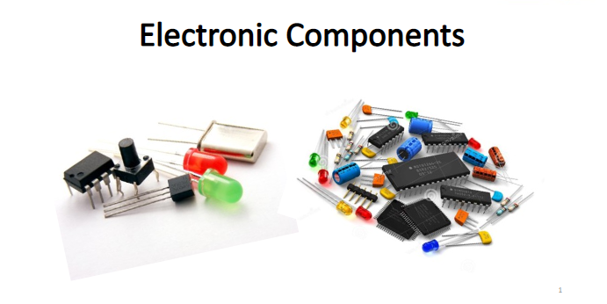

Slide 78
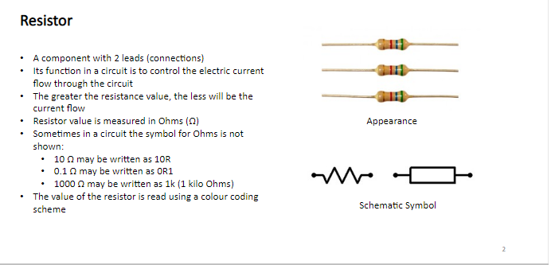

Slide 79
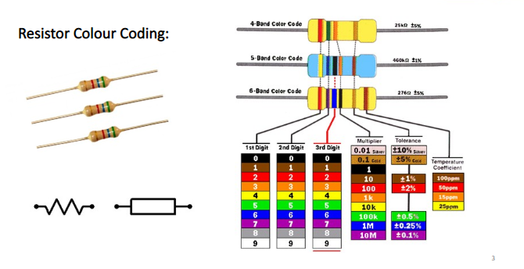

Slide 80
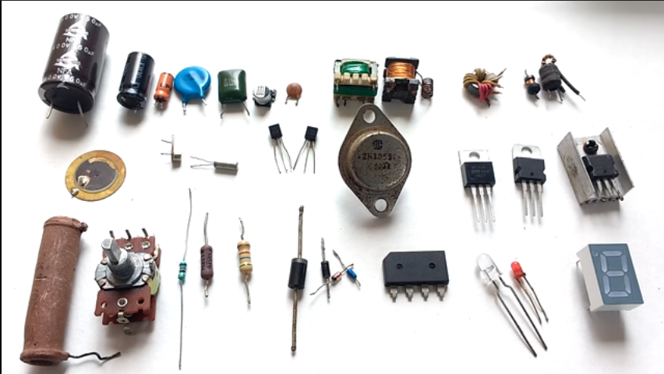

Slide 81
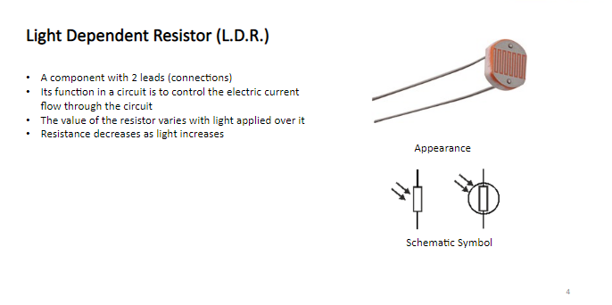

Slide 82
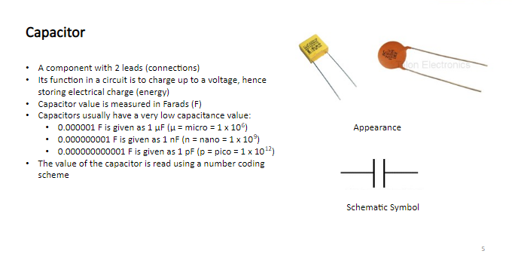

Slide 83
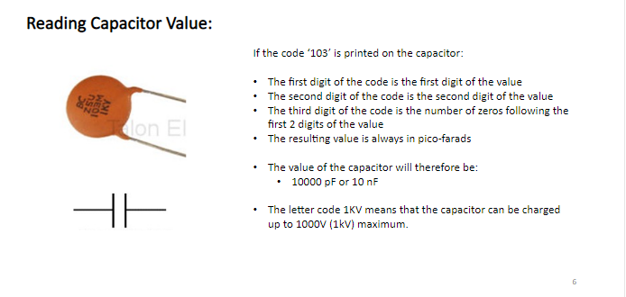

Slide 84
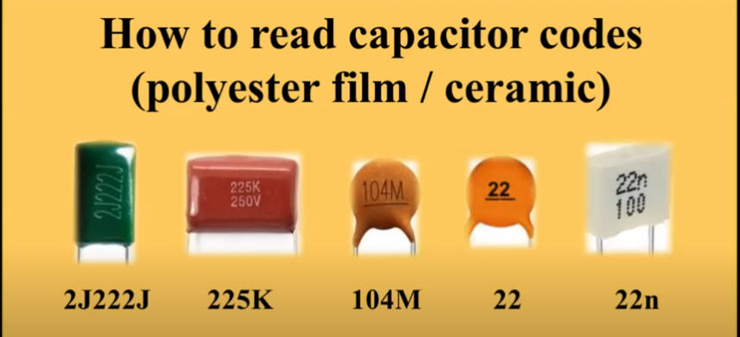

Slide 85
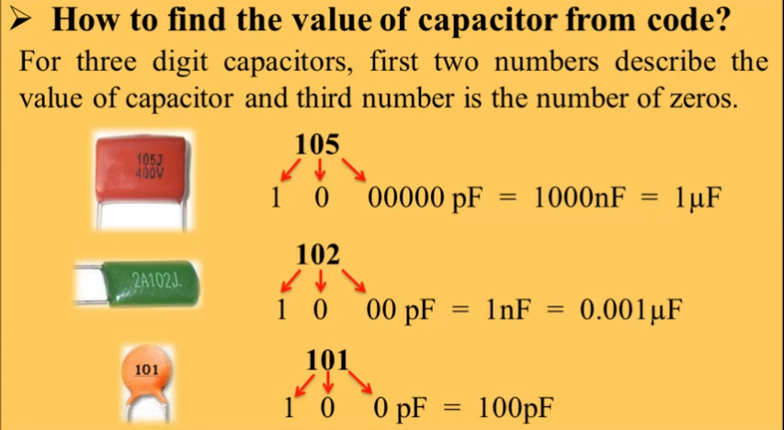

Slide 86
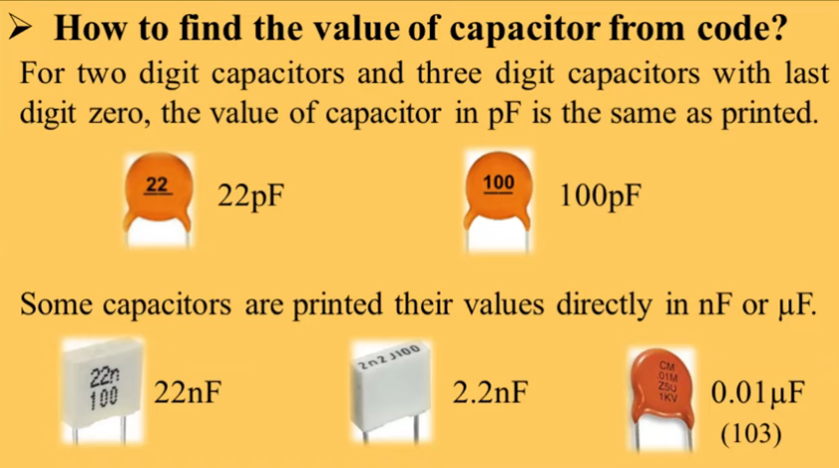

Slide 87
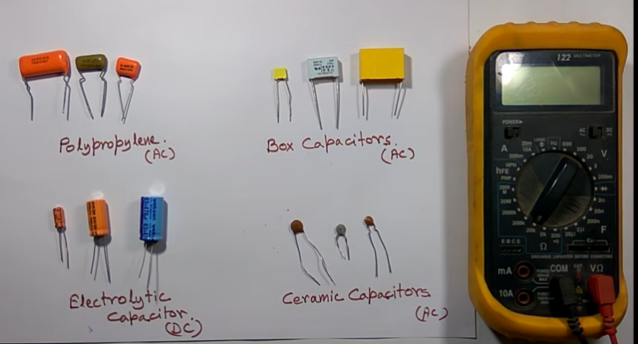

Slide 88
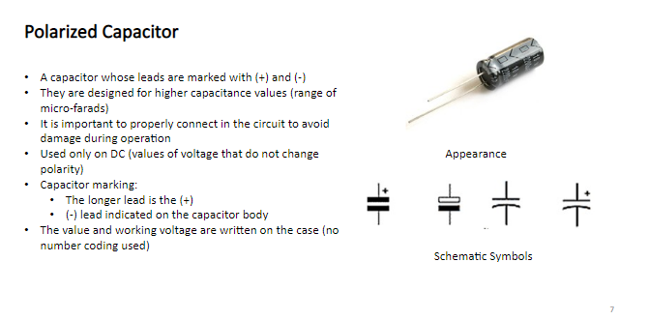

Slide 89
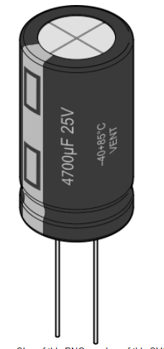

Slide 90
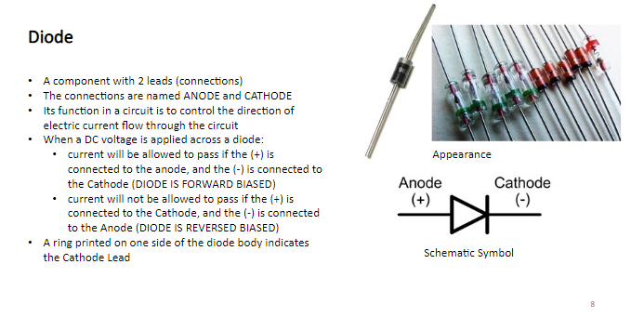

Slide 91
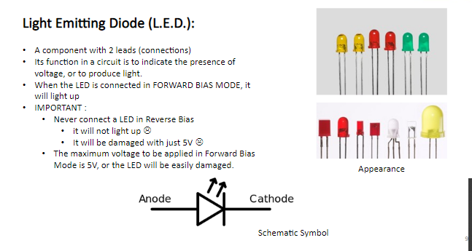

Slide 92
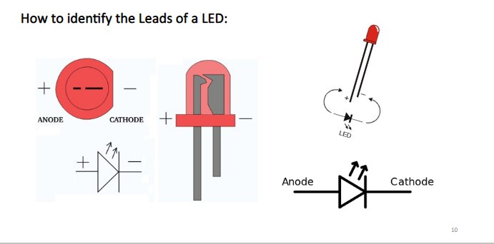

Slide 93
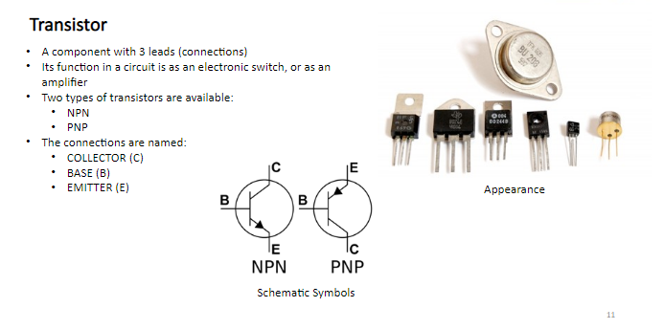

Slide 94
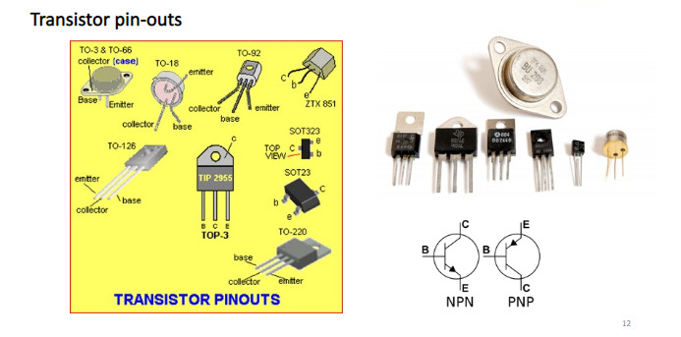

Slide 95
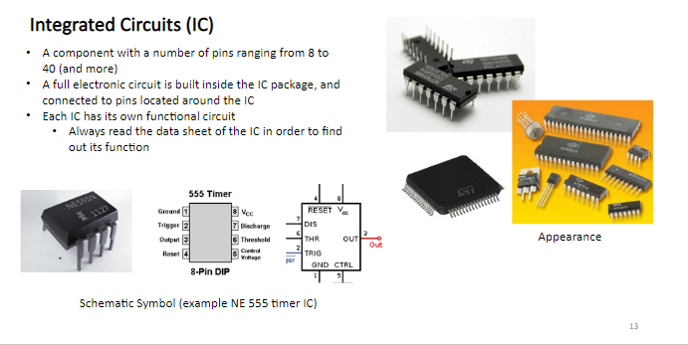

Slide 96
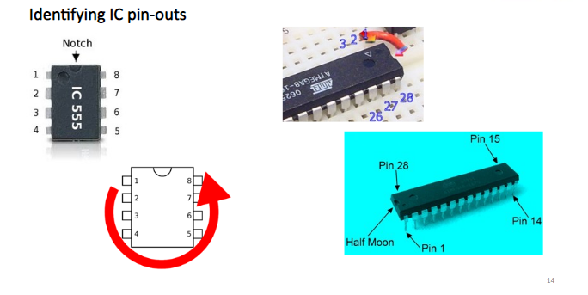

Slide 97
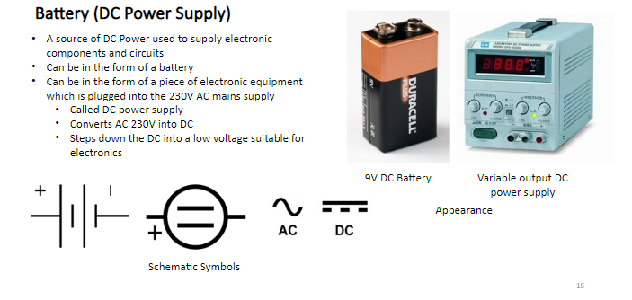

Slide 98
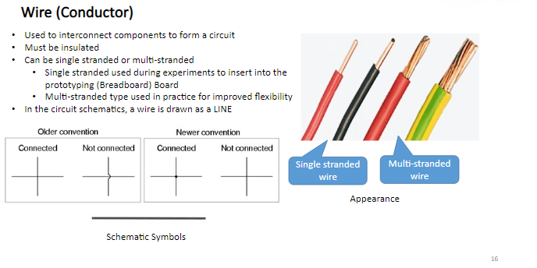

Slide 99
