Slide 1
Wireless communication Networks(WCN)
BY
Dr.K.Gopi
Associate professor
Department of ECE
SITAMS

Slide 2
Unit-1 Introduction to wireless networks
Introduction
Difference between wireless and fixed telephone networks
Development of wireless networks,
Traffic routing in wireless networks,
Multiple access techniques
FDMA, TDMA,Spread spectrum,
Packet radio protocols,
CSMA protocols

Slide 3
Introduction to wireless communication
Definition:
Wireless Communication is a method of transmitting information from one point to other, without using any connection like wires, cables or any physical medium.
(or)
Wireless communication is the electromagnetic transfer of information between two or more points that are not connected by an electrical conductor. The most common wireless technologies use radio waves.
History:
Since the use of smoke signals, flags and flashing mirrors in the pre – historic period, Wireless communication has been a part of human life and is continuously evolving.
In 1897 Gugliemo Marconi was the first to demonstrate that it was possible to establish a continuous communication stream with the ships that were sailing in the English Channel, by means of radio waves. Since then, the wireless technologies that make “on-the-move” communication possible for us have evolved remarkably.
Today, facilitated by RF circuit fabrication and digital switching techniques, affordable high speed telecommunication has been largely deployed across the world.
In this technology, the information can be transmitted through the air without requiring any cable or wires or other electronic conductors, by using electromagnetic waves like IR, RF, satellite, etc.
In the present days, the wireless communication technology refers to a variety of wireless communication devices and technologies ranging from smart phones to computers, tabs, laptops.

Slide 4
Why Wireless Communication?
The primary and important benefit of wireless communication is mobility.
Apart from mobility, wireless communication also offers flexibility and ease of use, which makes it increasingly popular day – by – day.
Wireless Communication like mobile telephony can be made anywhere and anytime with a considerably high throughput performance.
Another important point is infrastructure. The setup and installation of infrastructure for wired communication systems is an expensive and time consuming job.
The infrastructure for wireless communication can be installed easily and low cost.
In emergency situations and remote locations, where the setup of wired communication is difficult, wireless communication is a viable option.

Slide 5
Common Examples of wireless communications
Cellular phones and pagers -- provide connectivity for portable and mobile applications, both personal and business.
Global Positioning System (GPS) -- Allows drivers of cars and trucks, captains of boats and ships, and pilots of aircraft to know their location anywhere on earth
Cordless computer peripherals -- the cordless mouse is a common example; keyboards and printers can also be linked to a computer via wireless
Cordless telephone sets -- These are limited-range devices, not to be confused with cell phones
Home-entertainment-system control boxes -- the VCR control and the TV channel control are the most common examples.
Satellite television -- allows viewers in almost any location to select from hundreds of channels
Wireless LANs or local area networks -- provide flexibility and reliability for business computer users

Slide 6
Advantages of Wireless Communication
There are numerous advantage of Wireless Communication Technology, Wireless Networking and Wireless Systems over Wired Communication like Cost, Mobility, Ease of Installation, and Reliability etc.
Cost
The cost of installing wires, cables and other infrastructure is eliminated in wireless communication and hence lowering the overall cost of the system compared to wired communication system.
Installing wired network in building, digging up the Earth to lay the cables and running those wires across the streets is extremely difficult, costly and time consuming job.
Mobility
As mentioned earlier, mobility is the main advantage of wireless communication system. It offers the freedom to move around while still connected to network.
Ease of Installation
The setup and installation of wireless communication network’s equipment and infrastructure is very easy as we need not worry about the hassle of cables. Also, the time required to setup a wireless system like a Wi-Fi network for example, is very less when compared to setting up a full cabled network.

Slide 7
Reliability
Since there are no cables and wires involved in wireless communication, there is no chance of communication failure due to damage of these cables which may be caused by environmental conditions, cable splice and natural diminution of metallic conductors.
Disaster Recovery
In case of accidents due to fire, floods or other disasters, the loss of communication infrastructure in wireless communication system can be minimal.

Slide 8
Disadvantages of Wireless communication
Even though wireless communication has a number of advantages over wired communication, there are a few disadvantages as well. The most concerning disadvantages are Interference, Security and Health.
Interference
Wireless Communication systems use open space as the medium for transmitting signals. As a result, there is a huge chance that radio signals from one wireless communication system or network might interfere with other signals.
The best example is Bluetooth and Wi-Fi (WLAN). Both these technologies use the 2.4GHz frequency for communication and when both of these devices are active at the same time, there is a chance of interference.
Security
One of the main concerns of wireless communication is Security of the data. Since the signals are transmitted in open space, it is possible that an intruder can intercept the signals and copy sensitive information.
Health Concerns
Continuous exposure to any type of radiation can be hazardous. Even though the levels of RF energy that can cause the damage are not accurately established, it is advised to avoid RF radiation to the maximum.

Slide 9
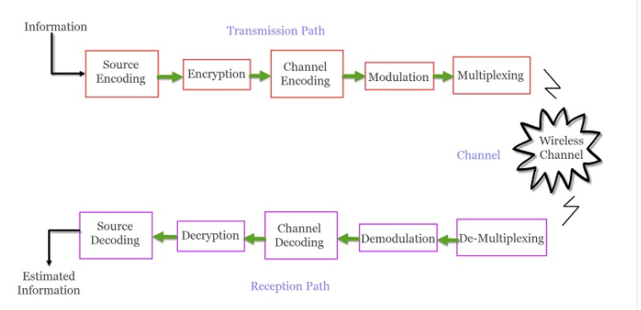
Wireless communication block diagram

Slide 10
Basic Elements of a Wireless Communication System
A typical Wireless Communication System can be divided into three elements: the Transmitter, the Channel and the Receiver. The following image shows the block diagram of wireless communication system.
Transmission path:
A typical transmission path of a Wireless Communication System consists of Encoder, Encryption, Modulation and Multiplexing. The signal from the source is passed through a Source Encoder, which converts the signal in to a suitable form for applying signal processing techniques.
The redundant information from signal is removed in this process in order to maximize the utilization of resources. This signal is then encrypted using an Encryption Standard so that the signal and the information is secured and doesn’t allow any unauthorized access.

Slide 11
Channel Encoding is a technique that is applied to the signal to reduce the impairments like noise, interference, etc. During this process, a small amount of redundancy is introduced to the signal so that it becomes robust against noise.
Then the signal is modulated using a suitable Modulation Technique (like PSK, FSK and QPSK etc.) , so that the signal can be easily transmitted using antenna.
The modulated signal is then multiplexed with other signals using different Multiplexing Techniques like Time Division Multiplexing (TDM) or Frequency Division Multiplexing (FDM) to share the valuable bandwidth.

Slide 12
The Channel
The channel in Wireless Communication indicates the medium of transmission of the signal i.e. open space. A wireless channel is unpredictable and also highly variable and random in nature. A channel maybe subject to interference, distortion, noise, scattering etc. and the result is that the received signal may be filled with errors.
The Reception Path
The job of the Receiver is to collect the signal from the channel and reproduce it as the source signal. The reception path of a Wireless Communication System comprises of Demultiplexing , Demodulation, Channel Decoding, Decryption and Source Decoding. From the components of the reception path it is clear that the task of the receiver is just the inverse to that of transmitter.

Slide 13
The signal from the channel is received by the Demultiplexer and is separated from other signals.
The individual signals are demodulated using appropriate Demodulation Techniques and the original message signal is recovered. The redundant bits from the message are removed using the Channel Decoder.
Since the message is encrypted, Decryption of the signal removes the security and turns it into simple sequence of bits.
Finally, this signal is given to the Source Decoder to get back the original transmitted message or signal.

