Slide 1
The Data Link Layer
By
Dr. M.Kalpana Devi
Professor
MCA Department
SITAMS, Chittoor

Slide 2
UNIT-2 The Data Link Layer
  2.1 Data link Layer Design Issues
  2.2 Error Detection and Correction
  2.3 Elementary Data Link Protocols
  2.4 Sliding Window Protocols
  2.5 Example Data Link Protocols.
  2.6 The Medium Access Control Sublayer:
  2.7 Multiple Access protocols
  2.8 Ethernet- Ethernet Cabling
  2.9 Manchester Encoding
  2.10 The Ethernet MAC Sublayer Protocol
  2.11 The Binary Exponential Backoff Algorithm
  2.12 Ethernet Performance
  2.13 Wireless LANs

Slide 3
  Data Link Layer Design Issues
The data link layer has a number of specific functions it can carry out. These functions include
    1. Providing a well-defined service interface to the network layer.
      2. Framing
      3. Dealing with transmission errors.
      4. Flow Control
  To accomplish these goals, the data link layer takes the packets it gets from the network layer and encapsulates them into frames for transmission.
  Each frame contains a frame header, a payload field for holding the packet, and a frame trailer, as illustrated in the following figure.
  Frame management forms the heart of what the data link layer does.

Slide 4
Fig. Relationship between packets and frames
    1. Services Provided to the Network Layer
    The function of the data link layer is to provide services to the network layer.
    The principal service is transferring data from the network layer on the source machine to the network layer on the destination machine.
    On the source machine is an entity, call it a process, in the network layer that sends some bits to the data link layer for transmission to the destination.
    The job of the data link layer is to transmit the bits to the destination machine so they can be handed over to the network layer there, as shown in the following fig.

Slide 5
The data link layer can be designed to offer various services. The actual services offered can vary from system to system. Three reasonable possibilities that are commonly provided are
Unacknowledged connectionless service
Acknowledged connectionless service
Acknowledged connection-oriented service

Slide 6
1. Unacknowledged connectionless service:
Unacknowledged connectionless service consists of having the source machine send independent frames to the destination machine without having the destination machine acknowledge them.
No logical connection is established beforehand or released afterward. If a frame is lost due to noise on the line, no attempt is made to detect the loss or recover from it in the data link layer.
This class of service is appropriate when the error rate is very low so that recovery is left to higher layers.
It is also appropriate for real-time traffic, such as voice, in which late data are worse than bad data.
Most LANs use unacknowledged connectionless service in the data link layer.

Slide 7
2. Acknowledged connectionless service:
When this service is offered, there are still no logical connections used, but each frame sent is individually acknowledged.
In this way, the sender knows whether a frame has arrived correctly.
If it has not arrived within a specified time interval, it can be sent again. This service is useful over unreliable channels, such as wireless systems.
3. Acknowledged connection-oriented service:
The most sophisticated service the data link layer can provide to the network layer is connection-oriented service.
With this service, the source and destination machines establish a connection before any data are transferred.
Each frame sent over the connection is numbered, and the data link layer guarantees that each frame sent is indeed received.
Furthermore, it guarantees that each frame is received exactly once and that all frames are received in the right order.

Slide 8
2. Framing
To provide service to the network layer, the data link layer must use the service provided to it by the physical layer.
What the physical layer does is accept a raw bit stream and attempt to deliver it to the destination.
This bit stream is not guaranteed to be error free.
The number of bits received may be less than, equal to, or more than the number of bits transmitted, and they may have different values.
It is up to the data link layer to detect and, if necessary, correct errors.
The usual approach is for the data link layer to break the bit stream up into discrete frames and compute the checksum for each frame.

Slide 9
When a frame arrives at the destination, the checksum is recomputed.
If the newly-computed checksum is different from the one contained in the frame, the data link layer knows that an error has occurred and takes steps to deal with it (e.g., discarding the bad frame and possibly also sending back an error report).
Breaking the bit stream up into frames is more difficult than it at first appears. One way to achieve this framing is to insert time gaps between frames, much like the spaces between words in ordinary text.
  1. Character count.
    2. Flag bytes with byte stuffing.
    3. Starting and ending flags, with bit stuffing.
    4. Physical layer coding violations.

Slide 10
Character count :
The first framing method uses a field in the header to specify the number of characters in the frame.
When the data link layer at the destination sees the character count, it knows how many characters follow and hence where the end of the frame is.
This technique is shown in Fig. (a) for four frames of sizes 5, 5, 8, and 8 characters, respectively.
The trouble with this algorithm is that the count can be garbled by a transmission error.

Slide 11
Flag bytes with byte stuffing.:
The second framing method gets around the problem of resynchronization after an error by having each frame start and end with special bytes.
In the past, the starting and ending bytes were different, but in recent years most protocols have used the same byte, called a flag byte, as both the starting and ending delimiter, as shown in figure(a) as FLAG.
In this way, if the receiver ever loses synchronization, it can just search for the flag byte to find the end of the current frame.
Two consecutive flag bytes indicate the end of one frame and start of the next one.
A serious problem occurs with this method when binary data, such as object programs or floating-point numbers, are being transmitted.
It may easily happen that the flag byte's bit pattern occurs in the data. This situation will usually interfere with the framing.

Slide 12
One way to solve this problem is to have the sender's data link layer insert a special escape byte (ESC) just before each ''accidental'' flag byte in the data.
The data link layer on the receiving end removes the escape byte before the data are given to the network layer.
This technique is called byte stuffing or character stuffing.
Thus, a framing flag byte can be distinguished from one in the data by the absence or presence of an escape byte before it. the next question is:
What happens if an escape byte occurs in the middle of the data?
The answer is that it, too, is stuffed with an escape byte.
Thus, any single escape byte is part of an escape sequence, whereas a doubled one indicates that a single escape occurred naturally in the data.

Slide 14
Some examples are shown in Fig.(b). In all cases, the byte sequence delivered after destuffing is exactly the same as the original byte sequence.
A major disadvantage of using this framing method is that it is closely tied to the use of 8-bit characters. Not all character codes use 8-bit characters.
The new technique allows data frames to contain an arbitrary number of bits and allows character codes with an arbitrary number of bits per character.
It works like this. Each frame begins and ends with a special bit pattern, 01111110 (in fact, a flag byte).
Whenever the sender's data link layer encounters five consecutive 1s in the data, it automatically stuffs a 0 bit into the outgoing bit stream.
This bit stuffing is analogous to byte stuffing, in which an escape byte is stuffed into the outgoing character stream before a flag byte in the data.

Slide 15
With bit stuffing, the boundary between two frames can be unambiguously recognized by the flag pattern.
Thus, if the receiver loses track of where it is, all it has to do is scan the input for flag sequences, since they can only occur at frame boundaries and never within the data

Slide 16
    Error Control
Having solved the problem of marking the start and end of each frame, come to the next problem: how to make sure all frames are eventually delivered to the network layer at the destination and in the proper order.
Suppose that the sender just kept outputting frames without regard to whether they were arriving properly.
This might be fine for unacknowledged connectionless service, but would most certainly not be fine for reliable, connection-oriented service.
The usual way to ensure reliable delivery is to provide the sender with some feedback about what is happening at the other end of the line.
Typically, the protocol calls for the receiver to send back special control frames bearing positive or negative acknowledgements about the incoming frames.

Slide 17
If the sender receives a positive acknowledgement about a frame, it knows the frame has arrived safely.
On the other hand, a negative acknowledgement means that something has gone wrong, and the frame must be transmitted again.
However, if either the frame or the acknowledgement is lost, the timer will go off, alerting the sender to a potential problem.
The obvious solution is to just transmit the frame again.
However, when frames may be transmitted multiple times there is a danger that the receiver will accept the same frame two or more times and pass it to the network layer more than once.
To prevent this from happening, it is generally necessary to assign sequence numbers to outgoing frames, so that the receiver can distinguish retransmissions from originals.

Slide 18
Flow Control
Another important design issue that occurs in the data link layer (and higher layers as well) is what to do with a sender that systematically wants to transmit frames faster than the receiver can accept them.
This situation can easily occur when the sender is running on a fast (or lightly loaded) computer and the receiver is running on a slow (or heavily loaded) machine.
The sender keeps pumping the frames out at a high rate until the receiver is completely swamped.
Even if the transmission is error free, at a certain point the receiver will simply be unable to handle the frames as they arrive and will start to lose some.
Clearly, something has to be done to prevent this situation.

Slide 19
Two approaches are commonly used. In the first one, feedback-based flow control, the receiver sends back information to the sender giving it permission to send more data or at least telling the sender how the receiver is doing.
In the second one, rate-based flow control, the protocol has a built-in mechanism that limits the rate at which senders may transmit data, without using feedback from the receiver

Slide 20
Error Detection and Correction
The telephone system has three parts: the switches, the inter office trunks, and the local loops.
The first two are now almost entirely digital in most developed countries.
The local loops are still analog twisted copper pairs and will continue to be so for years due to the enormous expense of replacing them.
While errors are rare on the digital part, they are still common on the local loops.
Furthermore, wireless communication is becoming more common, and the error rates here are orders of magnitude worse than on the interoffice fiber trunks.

Slide 21
As a result of the physical processes that generate them, errors on some media (e.g., radio) tend to come in bursts rather than singly.
Having the errors come in bursts has both advantages and disadvantages over isolated single-bit errors.
On the advantage side, computer data are always sent in blocks of bits. Suppose that the block size is 1000 bits and the error rate is 0.001 per bit.
If errors were independent, most blocks would contain an error. If the errors came in bursts of 100 however, only one or two blocks in 100 would be affected, on average.
The disadvantage of burst errors is that they are much harder to correct than are isolated errors.

Slide 22
Error-Correcting Codes
Network designers have developed two basic strategies for dealing with errors.
  1. One way is to include enough redundant information along with each block of data sent, to enable the receiver to deduce what the transmitted data must have been.
  2. The other way is to include only enough redundancy to allow the receiver to deduce that an error occurred, but not which error, and have it request a retransmission.
The former strategy uses error correcting codes and the latter uses error-detecting codes.
The use of error-correcting codes is often referred to as forward error correction.

Slide 23
On channels that are highly reliable, such as fiber, it is cheaper to use an error detecting code and just retransmit the occasional block found to be faulty.
However, on channels such as wireless links that make many errors, it is better to add enough redundancy to each block for the receiver to be able to figure out what the original block was, rather than relying on a retransmission, which itself may be in error.
To understand how errors can be handled, it is necessary to look closely at what an error really is.
Normally, a frame consists of m data (i.e., message) bits and r redundant, or check bits.
Let the total length be n (i.e., n = m + r). An n-bit unit containing data and check bits is often referred to as an n-bit codeword.

Slide 24
Given any two codewords, say, 10001001 and 10110001, it is possible to determine how many corresponding bits differ. In this case, 3 bits differ.
To determine how many bits differ, just exclusive OR the two codewords and count the number of 1 bits in the result
For example:
10001001
10110001
00111000 3 bits differ
The number of bit positions in which two codewords differ is called the Hamming distance.
Its significance is that if two codewords are a Hamming distance d apart, it will require d single-bit errors to convert one into the other.

Slide 25
Hamming Code
Hamming code is a block code that is capable of detecting up to two simultaneous bit errors and correcting single-bit errors.
It was developed by R.W. Hamming for error correction.
In this coding method, the source encodes the message by inserting redundant bits within the message.
These redundant bits are extra bits that are generated and inserted at specific positions in the message itself to enable error detection and correction.
When the destination receives this message, it performs recalculations to detect errors and find the bit position that has error.

Slide 26
Encoding a message by Hamming Code
The procedure used by the sender to encode the message encompasses the following steps −
    Step 1 − Calculation of the number of redundant bits.
    Step 2 − Positioning the redundant bits.
    Step 3 − Calculating the values of each redundant bit.
Once the redundant bits are embedded within the message, this is sent to the user.

Slide 27
Step 1 − Calculation of the number of redundant bits.
If the message contains m number of data bits, r number of redundant bits are added to it so that 2^{r} is able to indicate at least (m + r+ 1) different states.
Here, (m + r) indicates location of an error in each of (𝑚 + 𝑟) bit positions and one additional state indicates no error.
Since, r bits can indicate 𝑟 states, 2^{r} must be at least equal to (m + r + 1).
Thus the following equation should hold 2^{r} ≥ m+r+1
Step 2 − Positioning the redundant bits.
The r redundant bits placed at bit positions of powers of 2, i.e. 1, 2, 4, 8, 16 etc. They are referred in the rest of this text as r₁ (at position 1), r₂ (at position 2), r₃ (at position 4), r₄ (at position 8) and so on.

Slide 28
Step 3 − Calculating the values of each redundant bit.
The redundant bits are parity bits. A parity bit is an extra bit that makes the number of 1s either even or odd. The two types of parity are −
  Even Parity − Here the total number of bits in the message is made even.
  Odd Parity − Here the total number of bits in the message is made odd.
Each redundant bit, r_{i}, is calculated as the parity, generally even parity, based upon its bit position.
It covers all bit positions whose binary representation includes a 1 in the i^{th} position except the position of r_{i}.

Slide 29
r₁ is the parity bit for all data bits in positions whose binary representation includes a 1 in the least significant position excluding 1 (3, 5, 7, 9, 11 and so on)
r₂ is the parity bit for all data bits in positions whose binary representation includes a 1 in the position 2 from right except 2 (3, 6, 7, 10, 11 and so on)
r₃ is the parity bit for all data bits in positions whose binary representation includes a 1 in the position 3 from right except 4 (5-7, 12-15, 20-23 and so on)

Slide 30
Decoding a message in Hamming Code
Once the receiver gets an incoming message, it performs recalculations to detect errors and correct them. The steps for recalculation are −
  Step 1 − Calculation of the number of redundant bits.
  Step 2 − Positioning the redundant bits.
  Step 3 − Parity checking.
  Step 4 − Error detection and correction
Step 1 − Calculation of the number of redundant bits
Using the same formula as in encoding, the number of redundant bits are ascertained.
2^{r} ≥ m + r + 1 where m is the number of data bits and r is the number of redundant bits.

Slide 31
Step 2 − Positioning the redundant bits
  The r redundant bits placed at bit positions of powers of 2, i.e. 1, 2, 4, 8, 16 etc.
  Step 3 − Parity checking
  Parity bits are calculated based upon the data bits and the redundant bits using the same rule as during generation of c₁,c₂ ,c₃ ,c₄ etc. Thus
  c₁ = parity(1, 3, 5, 7, 9, 11 and so on)
  c₂ = parity(2, 3, 6, 7, 10, 11 and so on)
  c₃ = parity(4-7, 12-15, 20-23 and so on)
Step 4 − Error detection and correction
  The decimal equivalent of the parity bits binary values is calculated. If it is 0, there is no error. Otherwise, the decimal value gives the bit position which has error.
  For example, if c₁c₂c₃c₄ = 1001, it implies that the data bit at position 9, decimal equivalent of 1001, has error. The bit is flipped to get the correct message.

Slide 32
Hamming codes can only correct single errors. However, there is a trick that can be used to permit Hamming codes to correct burst errors.
A sequence of k consecutive codewords are arranged as a matrix, one codeword per row.
Normally, the data would be transmitted one codeword at a time, from left to right.
To correct burst errors, the data should be transmitted one column at a time, starting with the leftmost column.
When all k bits have been sent, the second column is sent, and so on, as indicated in the following Figure.
When the frame arrives at the receiver, the matrix is reconstructed, one column at a time.
If a burst error of length k occurs, at most 1 bit in each of the k codewords will have been affected, but the Hamming code can correct one error per codeword, so the entire block can be restored.

Slide 33
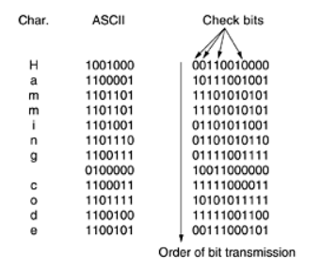
Fig. Use of a Hamming code to correct burst errors.

Slide 34
Error-Detecting codes
Error-Detecting codes are widely used on wireless links, which are notoriously noisy and error prone when compared to copper wire or optical fibers.
Without error-correcting codes, it would be hard to get anything through.
However, over copper wire or fiber, the error rate is much lower, so error detection and retransmission is usually more efficient there for dealing with the occasional error.
Another method is in widespread use: the polynomial code, also known as a CRC (Cyclic Redundancy Check).
Polynomial codes are based upon treating bit strings as representations of polynomials with coefficients of 0 and 1 only.
A k-bit frame is regarded as the coefficient list for a polynomial with k terms, ranging from x^{k-1} to x⁰ .
Such a polynomial is said to be of degree k - 1.

Slide 35
The high-order (leftmost) bit is the coefficient of x^{k-1}; the next bit is the coefficient of x^{k-2}, and so on.
For example, 110001 has 6 bits and thus represents a six-term polynomial with coefficients 1, 1, 0, 0, 0, and 1: x⁵ + x⁴ + x⁰ .
When the polynomial code method is employed, the sender and receiver must agree upon a generator polynomial, G(x), in advance.
Both the high- and low-order bits of the generator must be 1.
To compute the checksum for some frame with m bits, corresponding to the polynomial M(x), the frame must be longer than the generator polynomial.
The idea is to append a checksum to the end of the frame in such a way that the polynomial represented by the checksummed frame is divisible by G(x).
When the receiver gets the checksummed frame, it tries dividing it by G(x). If there is a remainder, there has been a transmission error.

Slide 36
The algorithm for computing the checksum is as follows:
1. Let r be the degree of G(x). Append r zero bits to the low-order end of the frame so it now contains m + r bits and corresponds to the polynomial x^{r}M(x).
2. Divide the bit string corresponding to G(x) into the bit string corresponding to x^{r}M(x), using modulo 2 division.
3. Subtract the remainder (which is always r or fewer bits) from the bit string corresponding to x^{r}M(x) using modulo 2 subtraction. The result is the checksummed frame to be transmitted.
Call its polynomial T(x). The following figure illustrates the calculation for a frame 1101011011 using the generator G(x) = x⁴ + x + 1.

Slide 38
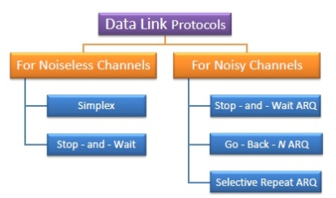
Elementary Data Link Protocols
Types of Data Link Protocols
Data link protocols can be broadly divided into two categories, depending on whether the transmission channel is noiseless or noisy.

Slide 39
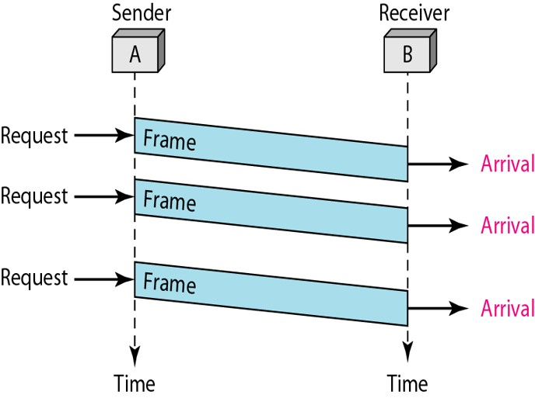
Unrestricted Simplex Protocol
The Simplex protocol is hypothetical protocol designed for unidirectional data transmission over an ideal channel, i.e. a channel through which transmission can never go wrong.
It has distinct procedures for sender and receiver. The sender simply sends all its data available onto the channel as soon as they are available its buffer.
The receiver is assumed to process all incoming data instantly. It is hypothetical since it does not handle flow control or error control.

Slide 40
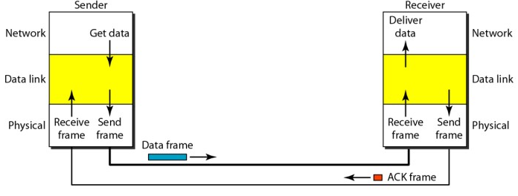
Stop – and – Wait Protocol
Stop – and – Wait protocol is for noiseless channel too. It provides unidirectional data transmission without any error control facilities.
However, it provides for flow control so that a fast sender does not drown a slow receiver.
The receiver has a finite buffer size with finite processing speed.
The sender can send a frame only when it has received indication from the receiver that it is available for further data processing.

Slide 41
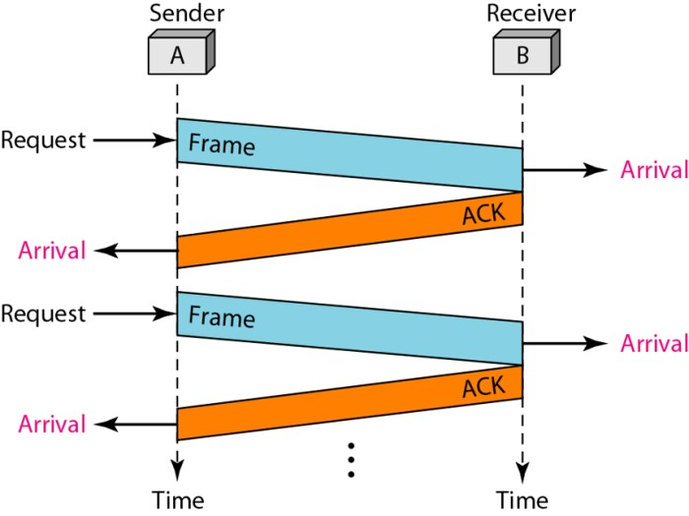

Slide 42
Simplex Protocol for Noisy Channel
Now let us consider the normal situation of a communication channel that makes errors. Frames may be either damaged or lost completely.
However, we assume that if a frame is damaged in transit, the receiver hardware will detect this when it computes the checksum.
If the frame is damaged in such a way that the checksum is nevertheless correct, an unlikely occurrence, this protocol (and all other protocols) can fail (i.e., deliver an incorrect packet to the network layer).
To see what might go wrong, remember that it is the task of the data link layer processes to provide error-free, transparent communication between network layer processes.
The network layer on machine A gives a series of packets to its data link layer, which must ensure that an identical series of packets are delivered to the network layer on machine B by its data link layer.

Slide 43
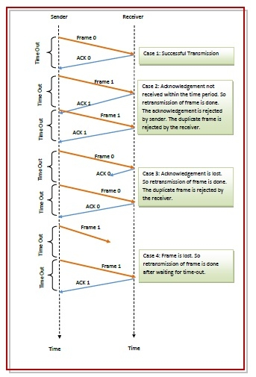

Slide 44
Sliding Window Protocols
The sliding window is a technique for sending multiple frames at a time. It controls the data packets between the two devices where reliable and gradual delivery of data frames is needed. It is also used in TCP (Transmission Control Protocol).
In the previous protocols, data frames were transmitted in one direction only.
In most practical situations, there is a need for transmitting data in both directions.
One way of achieving full-duplex data transmission is to have two separate communication channels and use each one for simplex data traffic (in different directions).
If this is done, we have two separate physical circuits, each with a ''forward'' channel (for data) and a ''reverse'' channel (for acknowledgements).
In both cases the bandwidth of the reverse channel is almost entirely wasted. In effect, the user is paying for two circuits but using only the capacity of one.

Slide 45
When a data frame arrives, instead of immediately sending a separate control frame, the receiver restrains itself and waits until the network layer passes it the next packet.
The acknowledgement is attached to the outgoing data frame (using the ack field in the frame header).
In effect, the acknowledgement gets a free ride on the next outgoing data frame.
The technique of temporarily delaying outgoing acknowledgements so that they can be hooked onto the next outgoing data frame is known as piggybacking.
The principal advantage of using piggybacking over having distinct acknowledgement frames is a better use of the available channel bandwidth.
The ack field in the frame header costs only a few bits.
If a new packet arrives quickly, the acknowledgement is piggybacked onto it; otherwise, if no new packet has arrived by the end of this time period, the data link layer just sends a separate acknowledgement frame.

Slide 46
The essence of all sliding window protocols is that at any instant of time, the sender maintains a set of sequence numbers corresponding to frames it is permitted to send.
These frames are said to fall within the sending window.
Similarly, the receiver also maintains a receiving window corresponding to the set of frames it is permitted to accept.
The sender's window and the receiver's window need not have the same lower and upper limits or even have the same size.
In some protocols they are fixed in size, but in others they can grow or shrink over the course of time as frames are sent and received.
Types of Sliding Window Protocol
  Go-Back-N ARQ
  Selective Repeat ARQ

Slide 47
Go – Back – N ARQ
Go – Back – N ARQ(Automatic Repeat ReQuest. ) provides for sending multiple frames before receiving the acknowledgement for the first frame.
It uses the concept of sliding window, and so is also called sliding window protocol.
The frames are sequentially numbered and a finite number of frames are sent.
If the acknowledgement of a frame is not received within the time period, all frames starting from that frame are retransmitted.

Slide 48
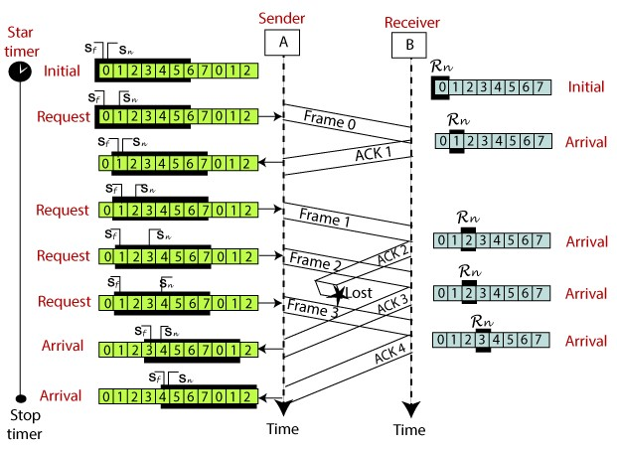

Slide 49
Selective Repeat ARQ
Selective Repeat ARQ is also known as the Selective Repeat Automatic Repeat Request.
It is a data link layer protocol that uses a sliding window method.
The Go-back-N ARQ protocol works well if it has fewer errors.
But if there is a lot of error in the frame, lots of bandwidth loss in sending the frames again.
So, we use the Selective Repeat ARQ protocol. In this protocol, the size of the sender window is always equal to the size of the receiver window.
The size of the sliding window is always greater than 1.
If the receiver receives a corrupt frame, it does not directly discard it. It sends a negative acknowledgment to the sender.
The sender sends that frame again as soon as on the receiving negative acknowledgment.
There is no waiting for any time-out to send that frame.

Slide 50
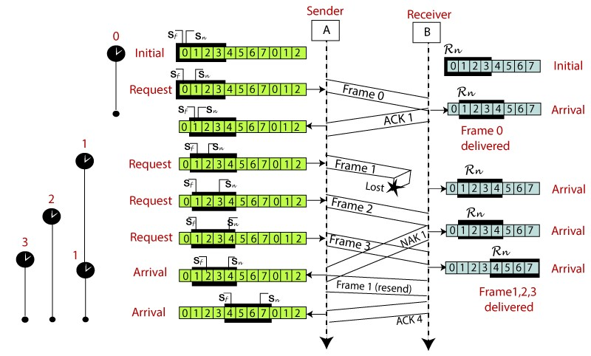

Slide 51
The Medium Access Control Sublayer
Networks can be divided into two categories: those using point-to- point connections and those using broadcast channels.
In any broadcast network, the key issue is how to determine who gets to use the channel? when there is competition for it?.
When only a single channel is available, determining who should go next is much harder.
In the literature, broadcast channels are sometimes referred to as multi access channels or random access channels.
The protocols used to determine who goes next on a multi access channel belong to a sublayer of the data link layer called the MAC (Medium Access Control) sublayer.
Technically, the MAC sublayer is the bottom part of the data link layer

Slide 52
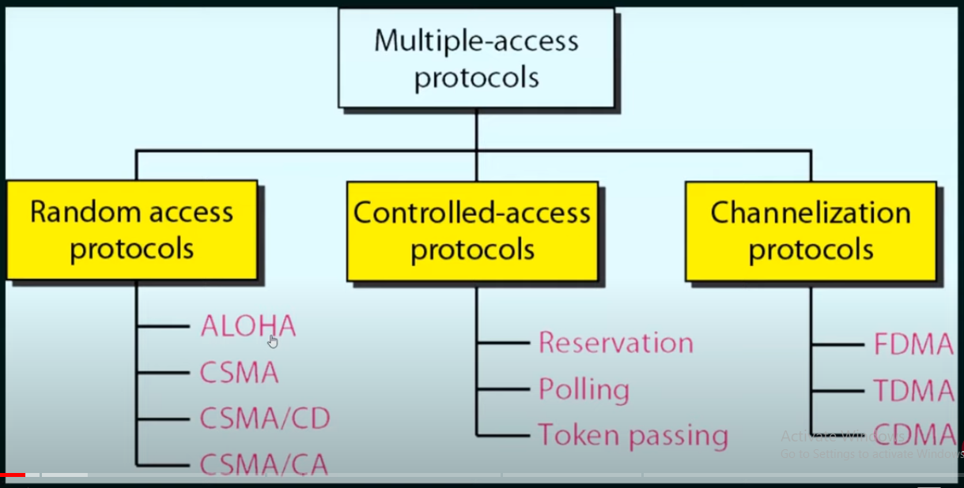

Slide 53
Multiple Access Protocols
1.1 ALOHA
In the 1970s, Norman Abramson and his colleagues at the University of Hawaii devised a new and elegant method to solve the channel allocation problem.
ALOHA system, used ground-based radio broadcasting, the basic idea is applicable to any system in which uncoordinated users are competing for the use of a single shared channel.
There are two versions of ALOHA here: pure and slotted.
1.1.1Pure ALOHA
The basic idea of an ALOHA system is simple: let users transmit whenever they have data to be sent.
There will be collisions, of course, and the colliding frames will be damaged.
With a LAN, the feedback is immediate; with a satellite, there is a delay of 270 msec before the sender knows if the transmission was successful.
If the frame was destroyed, the sender just waits a random amount of time and sends it again.

Slide 54
The waiting time must be random or the same frames will collide over and over, in lockstep.
Systems in which multiple users share a common channel in a way that can lead to conflicts are widely known as contention systems.
All frames are with the same length because the throughput of ALOHA systems is maximized by having a uniform frame size rather than by allowing variable length frames.
Whenever two frames try to occupy the channel at the same time, there will be a collision and both will be garbled.
If the first bit of a new frame overlaps with just the last bit of a frame almost finished, both frames will be totally destroyed and both will have to be retransmitted later.
The checksum cannot (and should not) distinguish between a total loss and a near miss.

Slide 55
What is the efficiency of an ALOHA channel?
Let the ''frame time'' denote the amount of time needed to transmit the standard, fixed-length Frame At high load there will be many collisions.
Under all loads, the throughput, S, is just the offered load, G, times the probability, P0, of a transmission succeeding—that is, S = GP0, where P0 is the probability that a frame does not suffer a collision.
A frame will not suffer a collision if no other frames are sent within one frame time of its start, as shown in following figure.
Under what conditions will the shaded frame arrive undamaged? Let t be the time required to send a frame.
If any other user has generated a frame between time t0 and t0 + t, the end of that frame will collide with the beginning of the shaded one.
In pure ALOHA a station does not listen to the channel before transmitting, it has no way of knowing that another frame was already underway.
Similarly, any other frame started between t0 + t and t0 + 2t will bump into the end of the shaded frame.

Slide 56
Vulnerable period for the shaded frame

Slide 57
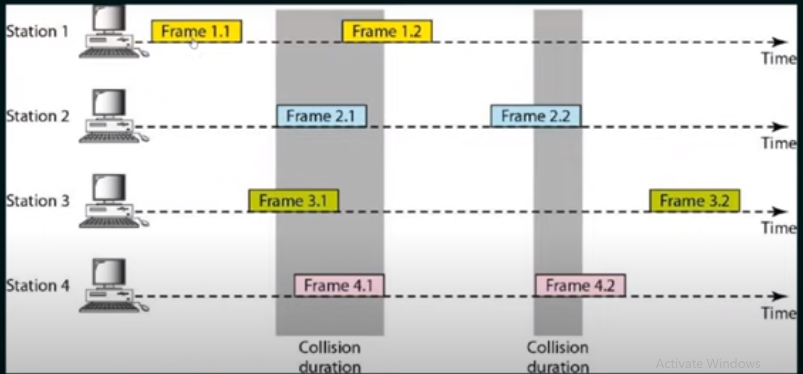

Slide 58
So the probability of zero frames is just e-G. In an interval two frame times long, the mean number of frames generated is 2G.
The probability of no other traffic being initiated during the entire vulnerable period is thus given by P0 = e -2G. Using S = GP0, we get
The maximum throughput occurs at G = 0.5, with S = 1/2e, which is about 0.184.
In other words, the best we can hope for is a channel utilization of 18 percent.

Slide 59
1.1.2 Slotted ALOHA
In 1972, Roberts published a method for doubling the capacity of an ALOHA system (Roberts, 1972).
His proposal was to divide time into discrete intervals, each interval corresponding to one frame.
This approach requires the users to agree on slot boundaries.
One way to achieve synchronization would be to have one special station emit a pip at the start of each interval, like a clock.
Since the vulnerable period is now halved, the probability of no other traffic during the same slot as our test frame is e-G which leads to
slotted ALOHA peaks at G = 1, with a throughput of S =1/e or about 0.368, twice that of pure ALOHA.
If the system is operating at G = 1, the probability of an empty slot is 0.368

Slide 60
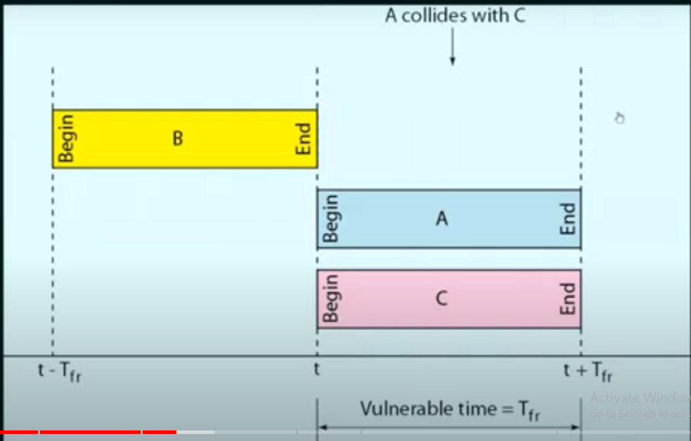

Slide 62
Slotted Aloha is important for a reason that may not be initially obvious.
It was devised in the 1970s, used in a few early experimental systems, then almost forgotten.
When Internet access over the cable was invented, all of a sudden there was a problem of how to allocate a shared channel among multiple competing users, and slotted Aloha was pulled out of the garbage can to save the day.

Slide 63
Carrier Sense Multiple Access Protocols(CSMA)
With slotted ALOHA the best channel utilization that can be achieved is 1/e.
This is hardly surprising, since with stations transmitting at will, without paying attention to what the other stations are doing.
In local area networks, it is possible for stations to detect what other stations are doing, and adapt their behavior accordingly.
These networks can achieve a much better utilization than 1/e.
Protocols in which stations listen for a carrier (i.e., a transmission) and act accordingly are called carrier sense protocols.
A number of them have been proposed.

Slide 64
1.2.1 Persistent and Non-Persistent CSMA
1-persistent CSMA:
When a station has data to send, it first listens to the channel to see if anyone else is transmitting at that moment.
If the channel is busy, the station waits until it becomes idle. When the station detects an idle channel, it transmits a frame.
If a collision occurs, the station waits a random amount of time and starts all over again.
The protocol is called 1-persistent because the station transmits with a probability of 1 when it finds the channel idle.

Slide 65
If the first station's signal has not yet reached the second one, the latter will sense an idle channel and will also begin sending, resulting in a collision.
The longer the propagation delay, the more important this effect becomes, and the worse the performance of the protocol.
Even if the propagation delay is zero, there will still be collisions.
If two stations become ready in the middle of a third station's transmission, both will wait politely until the transmission ends and then both will begin transmitting exactly simultaneously, resulting in a collision.
Even so, this protocol is far better than pure ALOHA because both stations have the decency to desist from interfering with the third station's frame.
Intuitively, this approach will lead to a higher performance than pure ALOHA. Exactly the same holds for slotted ALOHA.

Slide 66
NonPersistent CSMA:
In this protocol, before sending, a station senses the channel. If no one else is sending, the station begins doing so itself.
However, if the channel is already in use, the station does not continually sense it for the purpose of seizing it immediately upon detecting the end of the previous transmission.
Instead, it waits a random period of time and then repeats the algorithm.
Consequently, this algorithm leads to better channel utilization but longer delays than 1-persistent CSMA.
p-persistent CSMA:
It applies to slotted channels and works as follows.
When a station becomes ready to send, it senses the channel. If it is idle, it transmits with a probability p.

Slide 67
With a probability q = 1 - p, it defers until the next slot. If that slot is also idle, it either transmits or defers again, with probabilities p and q.
This process is repeated until either the frame has been transmitted or another station has begun transmitting.
In the latter case, the unlucky station acts as if there had been a collision.
If the station initially senses the channel busy, it waits until the next slot and applies the above algorithm.

Slide 68
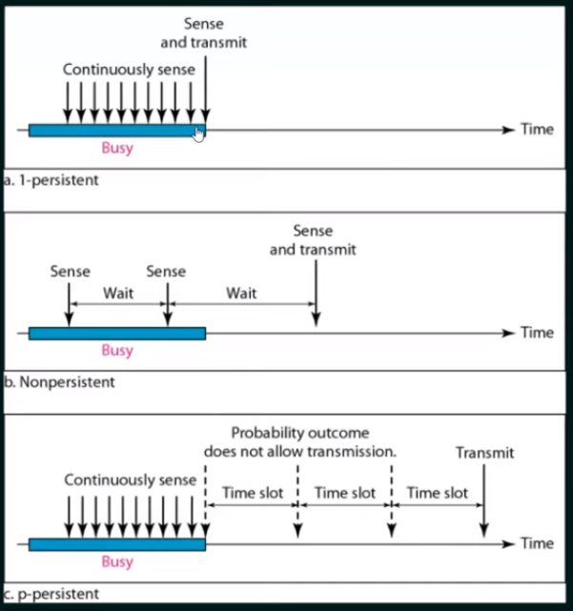

Slide 69
Comparison of the channel utilization versus load for various random access protocols.

Slide 70
1.3 CSMA with Collision Detection (CSMA/CD)
Persistent and NonPersistent CSMA protocols are clearly an improvement over ALOHA because they ensure that no station begins to transmit when it senses the channel busy.
Another improvement is for stations to abort their transmissions as soon as they detect a collision.
In other words, if two stations sense the channel to be idle and begin transmitting simultaneously, they will both detect the collision almost immediately.
Rather than finish transmitting their frames, which are irretrievably garbled anyway, they should abruptly stop transmitting as soon as the collision is detected.
Quickly terminating damaged frames saves time and bandwidth. This protocol, known as CSMA/CD (CSMA with Collision Detection) is widely used on LANs in the MAC sublayer.

Slide 71
At the point marked t0, a station has finished transmitting its frame.
Any other station having a frame to send may now attempt to do so.
If two or more stations decide to transmit simultaneously, there will be a collision.
Collisions can be detected by looking at the power or pulse width of the received signal and comparing it to the transmitted signal.
CSMA/CD can be in one of three states: contention, transmission, or idle.

Slide 72
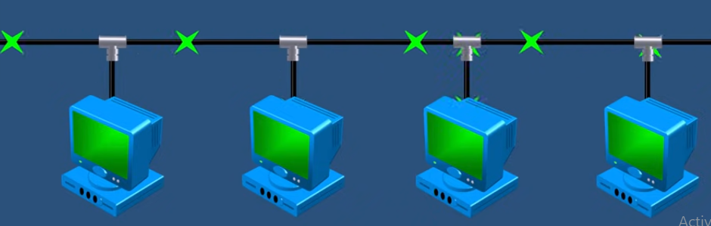
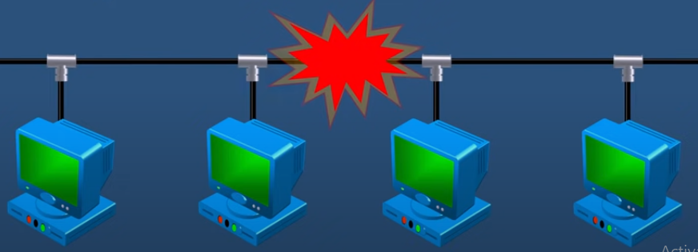

Slide 73
After a station detects a collision, it aborts its transmission, waits a random period of time, and then tries again, assuming that no other station has started transmitting in the meantime.
Therefore, our model for CSMA/CD will consist of alternating contention and transmission periods, with idle periods occurring when all stations are quiet (e.g., for lack of work).
It is important to realize that collision detection is an analog process.
The station's hardware must listen to the cable while it is transmitting.
If what it reads back is different from what it is putting out, it knows that a collision is occurring.
The implication is that the signal encoding must allow collisions to be detected.

Slide 74
1.4 Collision-Free Protocols
Although collisions do not occur with CSMA/CD once a station has unambiguously captured the channel, they can still occur during the contention period.
These collisions adversely affect the system performance, especially when the cable is long and the frames are short.
And CSMA/CD is not universally applicable.
The protocols that resolve the contention for the channel without any collisions at all, not even during the contention period.
Most of these are not currently used in major systems, but in a rapidly changing field, having some protocols with excellent properties available for future systems is often a good thing.
In the protocols to be described, we assume that there are exactly N stations, each with a unique address from 0 to N - 1 ''wired'' into it.
It does not matter that some stations may be inactive part of the time.
We also assume that propagation delay is negligible.
The basic question remains: Which station gets the channel after a successful transmission?

Slide 75
In the protocols to be described, we assume that there are exactly N stations, each with a unique address from 0 to N - 1 ''wired'' into it.
It does not matter that some stations may be inactive part of the time.
We also assume that propagation delay is negligible.
The basic question remains: Which station gets the channel after a successful transmission?
1.4.1 A Bit-Map Protocol
In our first collision-free protocol, the basic bit-map method, each contention period consists of exactly N slots.
If station 0 has a frame to send, it transmits a 1 bit during the zeroth slot. No other station is allowed to transmit during this slot.
Regardless of what station 0 does, station 1 gets the opportunity to transmit a 1 during slot 1, but only if it has a frame queued.
In general, station j may announce that it has a frame to send by inserting a 1 bit into slot j.
After all N slots have passed by, each station has complete knowledge of which stations wish to transmit.
At that point, they begin transmitting in numerical order see the following figure.

Slide 76

The basic bit-map protocol.

Slide 77
Since everyone agrees on who goes next, there will never be any collisions.
After the last ready station has transmitted its frame, an event all stations can easily monitor, another N bit contention period is begun.
If a station becomes ready just after its bit slot has passed by, it is out of luck and must remain silent until every station has had a chance and the bit map has come around again.
Protocols like this in which the desire to transmit is broadcast before the actual transmission are called reservation protocols.
Let us briefly analyze the performance of this protocol.
For convenience, we will measure time in units of the contention bit slot, with data frames consisting of d time units.
Under conditions of low load, the bit map will simply be repeated over and over, for lack of data frames.
Consider the situation from the point of view of a low-numbered station, such as 0 or 1.

Slide 78
Typically, when it becomes ready to send, the ''current'' slot will be somewhere in the middle of the bit map.
On average, the station will have to wait N/2 slots for the current scan to finish and another full N slots for the following scan to run to completion before it may begin transmitting.
The prospects for high-numbered stations are brighter.
Generally, these will only have to wait half a scan (N/2 bit slots) before starting to transmit.
High-numbered stations rarely have to wait for the next scan.
Since low-numbered stations must wait on average 1.5N slots and high numbered stations must wait on average 0.5N slots, the mean for all stations is N slots.
The channel efficiency at low load is easy to compute.
The overhead per frame is N bits, and the amount of data is d bits, for an efficiency of d/(N + d).
At high load, when all the stations have something to send all the time, the N bit contention period is prorated over N frames, yielding an overhead of only 1 bit per frame, or an efficiency of d/(d + 1).

Slide 79
  Binary Countdown
A problem with the basic bit-map protocol is that the overhead is 1 bit per station, so it does not scale well to networks with thousands of stations.
We can do better than that by using binary station addresses.
A station wanting to use the channel now broadcasts its address as a binary bit string, starting with the high-order bit.
All addresses are assumed to be the same length.
The bits in each address position from different stations are BOOLEAN ORed together.
We will call this protocol binary countdown. It was used in Datakit (Fraser, 1987).
It implicitly assumes that the transmission delays are negligible so that all stations see asserted bits essentially instantaneously.

Slide 80
To avoid conflicts, an arbitration rule must be applied: as soon as a station sees that a highorder bit position that is 0 in its address has been overwritten with a 1, it gives up.
For example, if stations 0010, 0100, 1001, and 1010 are all trying to get the channel, in the firstbit time the stations transmit 0, 0, 1, and 1, respectively.
These are ORed together to form a 1. Stations 0010 and 0100 see the 1 and know that a higher-numbered station is competing for the channel, so they give up for the current round.
Stations 1001 and 1010 continue. The next bit is 0, and both stations continue. The next bit is 1, so station 1001 gives up.
The winner is station 1010 because it has the highest address.
After winning the bidding, it may now transmit a frame, after which another bidding cycle starts.
The protocol is illustrated in the following figure. It has the property that higher-numbered stations have a higher priority than lower-numbered stations, which may be either good or bad, depending on the context.

Slide 81
The binary countdown protocol. A dash indicates silence.

Slide 82
The channel efficiency of this method is d/(d + log2 N).
If, however, the frame format has been cleverly chosen so that the sender's address is the first field in the frame, the efficiency is 100 percent.
Mok and Ward (1979) have described a variation of binary countdown using a parallel rather than a serial interface.
They also suggest using virtual station numbers, with the virtual station numbers from 0 up to and including the successful station being circularly permuted after each transmission, in order to give higher priority to stations that have been silent unusually long.
For example, if stations C, H, D, A, G, B, E, F have priorities 7, 6, 5, 4, 3, 2, 1, and 0, respectively, then a successful transmission by D puts it t the end of the list, giving a priority order of C, H, A, G, B, E, F, D.
Thus, C remains virtual station 7, but A moves up from 4 to 5 and D drops from 5 to 0. Station D will now only be able to acquire the channel if no other station wants it.

Slide 83
1.5 Limited-Contention Protocols
We have now considered two basic strategies for channel acquisition in a cable network: contention, as in CSMA, and collision-free methods.
Each strategy can be rated as to how well it does with respect to the two important performance measures, delay at low load and channel efficiency at high load.
Under conditions of light load, contention protocols are preferable due to its low delay. As the load increases, contention becomes increasingly less attractive,
Just the reverse is true for the collision-free protocols.
At low load, they have high delay, but as the load increases, the channel efficiency improves rather than gets worse as it does for contention protocols.

Slide 84
Obviously, it would be nice if we could combine the best properties of the contention and collision-free protocols, arriving at a new protocol that used contention at low load to provide low delay, but used a collision-free technique at high load to provide good channel efficiency.
Such protocols, which we will call limited-contention protocols,
The Adaptive Tree Walk Protocol
One particularly simple way of performing the necessary assignment is to use the algorithm devised by the U.S. Army for testing soldiers for syphilis during World War II (Dorfman, 1943).
In short, the Army took a blood sample from N soldiers. A portion of each sample was poured into a single test tube.
This mixed sample was then tested for antibodies. If none were found, all the soldiers in the group were declared healthy.
If antibodies were present, two new mixed samples were prepared, one from soldiers 1 through N/2 and one from the rest.
The process was repeated recursively until the infected soldiers were determined.

Slide 85
For the computerized version of this algorithm (Capetanakis, 1979), it is convenient to think of the stations as the leaves of a binary tree, as illustrated in the following figure.
In the first contention slot following a successful frame transmission, slot 0, all stations are permitted to try to acquire the channel. If one of them does so, fine.
If there is a collision, then during slot 1 only those stations falling under node 2 in the tree may compete.
If one of them acquires the channel, the slot following the frame is reserved for those stations under node 3.
If, on the other hand, two or more stations under node 2 want to transmit, there will be a collision during slot 1, in which case it is node 4's turn during slot 2. The tree for eight stations

Slide 86
In essence, if a collision occurs during slot 0, the entire tree is searched, depth first, to locate all ready stations.
Each bit slot is associated with some particular node in the tree.
If a collision occurs, the search continues recursively with the node's left and right children.
4.2.5 Wavelength Division Multiple Access Protocols
A different approach to channel allocation is to divide the channel into subchannels using FDM, TDM, or both, and dynamically allocate them as needed.
Schemes like this are commonly used on fiber optic LANs to permit different conversations to use different wavelengths (i.e., frequencies) at the same time.
In this section we will examine one such protocol (Humblet et al., 1992).
In effect, two fibers from each station are fused to a glass cylinder.
One fiber is for output to the cylinder and one is for input from the cylinder.
Light output by any station illuminates the cylinder and can be detected by all the other stations.

Slide 87
WDMA (Wavelength Division Multiple Access), each station is assigned two channels.
A narrow channel is provided as a control channel to signal the station, and a wide channel is provided so the station can output data frames.
Each channel is divided into groups of time slots, as shown in the following figure.
Let us call the number of slots in the control channel m and the number of slots in the data channel n + 1, where n of these are for data and the last one is used by the station to report on its status (mainly, which slots on both channels are free).
On both channels, the sequence of slots repeats endlessly, with slot 0 being marked in a special way so latecomers can detect it.
All channels are synchronized by a single global clock.

Slide 88
Wavelength division multiple access.

Slide 89
The protocol supports three traffic classes :
    (1) constant data rate connection-oriented traffic, such as uncompressed video
    (2) variable data rate connection-oriented traffic, such as file transfer, and
    (3) datagram traffic, such as UDP packets.
For the two connection-oriented protocols, the idea is that for A to communicate with B, it must first insert a CONNECTION REQUEST frame in a free slot on B's control channel.
If B accepts, communication can take place on A's data channel. Each station has two transmitters and two receivers, as follows:
    1. A fixed-wavelength receiver for listening to its own control channel.
    2. A tunable transmitter for sending on other stations' control channels.
    3. A fixed-wavelength transmitter for outputting data frames.
    4. A tunable receiver for selecting a data transmitter to listen to.

Slide 90
In other words, every station listens to its own control channel for incoming requests but has to tune to the transmitter's wavelength to get the data.
Let us now consider how station A sets up a class 2 communication channel with station B for, say, file transfer.
First, A tunes its data receiver to B's data channel and waits for the status slot.
This slot tells which control slots are currently assigned and which are free.
In the above example, we see that of B's eight control slots, 0, 4, and 5 are free. The rest are occupied (indicated by crosses).
A picks one of the free control slots, say, 4, and inserts its CONNECTION REQUEST message there.
Since B constantly monitors its control channel, it sees the request and grants it by assigning slot 4 to A.

Slide 91
This assignment is announced in the status slot of B's data channel.
When A sees the announcement, it knows it has a unidirectional connection.
If A asked for a two-way connection, B now repeats the same algorithm with A.
It is possible that at the same time A tried to grab B's control slot 4, C did the same thing.
Neither will get it, and both will notice the failure by monitoring the status slot in B's control channel.
They now each wait a random amount of time and try again later.

Slide 92
4.2.6 Wireless LAN Protocols
As the number of mobile computing and communication devices grows, so does the demand to connect them to the outside world.
A common configuration for a wireless LAN is an office building with base stations (also called access points) strategically placed around the building.
All the base stations are wired together using copper or fiber.
If the transmission power of the base stations and notebooks is adjusted to have a range of 3 or 4 meters, then each room becomes a single cell and the entire building becomes a large cellular system.

Slide 93
A naive approach to using a wireless LAN might be to try CSMA: just listen for other transmissions and only transmit if no one else is doing so.
The trouble is, this protocol is not really appropriate because what matters is interference at the receiver, not at the sender.
To see the nature of the problem, consider following figure, where four wireless stations are illustrated.
For our purposes, it does not matter which are base stations and which are notebooks.
The radio range is such that A and B are within each other's range and can potentially interfere with one another. C can also potentially interfere with both B and D, but not with A.

Slide 94
wireless LAN. (a) A transmitting. (b) B transmitting

Slide 95
First consider what happens when A is transmitting to B, as depicted in the above figure (a).
If C senses the medium, it will not hear A because A is out of range, and thus falsely conclude that it can transmit to B.
If C does start transmitting, it will interfere at B, wiping out the frame from A.
The problem of a station not being able to detect a potential competitor for the medium because the competitor is too far away is called the hidden station problem.
Now let us consider the reverse situation: B transmitting to A, as shown in the above figure (b).
If C senses the medium, it will hear an ongoing transmission and falsely conclude that it may not send to D, when in fact such a transmission would cause bad reception only in the zone between B and C, where neither of the intended receivers is located.
This is called the exposed station problem.

Slide 96
MACA and MACAW(MACA for Wireless)
An early protocol designed for wireless LANs is MACA (Multiple Access with Collision Avoidance) (Karn, 1990).
The basic idea behind it is for the sender to stimulate the receiver into outputting a short frame, so stations nearby can detect this transmission and avoid transmitting for the duration of the upcoming (large) data frame. MACA is illustrated in the following figure
The MACA protocol. (a) A sending an RTS to B. (b) B responding with a CTS to A.

Slide 97
Let us now consider how A sends a frame to B. A starts by sending an RTS (Request To Send) frame to B, as shown above.
This short frame (30 bytes) contains the length of the data frame that will eventually follow.
Then B replies with a CTS (Clear to Send) frame, as shown above.
The CTS frame contains the data length (copied from the RTS frame).
Upon receipt of the CTS frame, A begins transmission. Now let us see how stations overhearing either of these frames react.
Any station hearing the RTS is clearly close to A and must remain silent long enough for the CTS to be transmitted back to A without conflict.
Any station hearing the CTS is clearly close to B and must remain silent during the upcoming data transmission, whose length it can tell by examining the CTS frame.

Slide 98
In the previous Figure, C is within range of A but not within range of B. Therefore, it hears the RTS from A but not the CTS from B.
As long as it does not interfere with the CTS, it is free to transmit while the data frame is being sent.
In contrast, D is within range of B but not A. It does not hear the RTS but does hear the CTS.
Hearing the CTS tips it off that it is close to a station that is about to receive a frame, so it defers sending anything until that frame is expected to be finished.
Station E hears both control messages and, like D, must be silent until the data frame is complete.

Slide 99
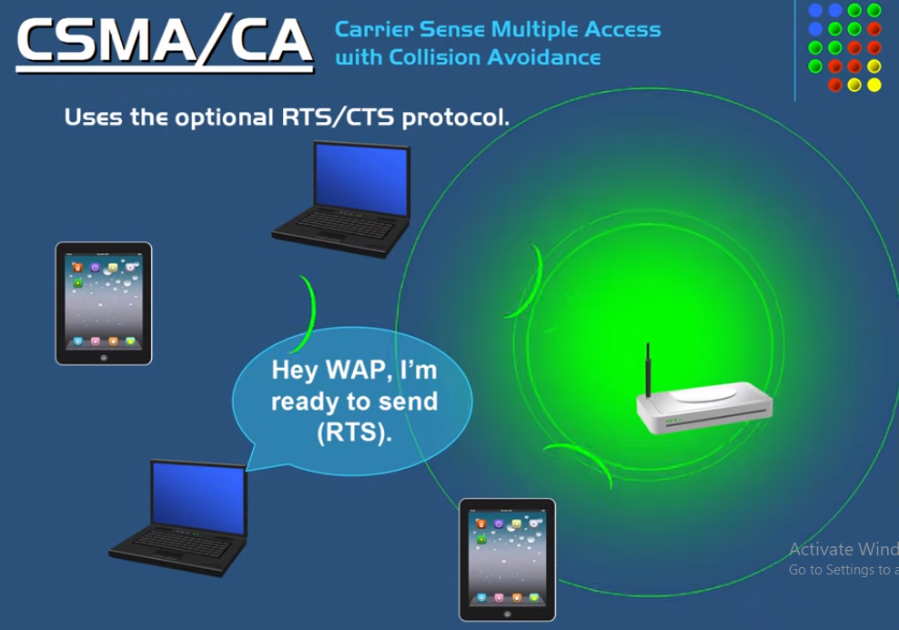

Slide 100
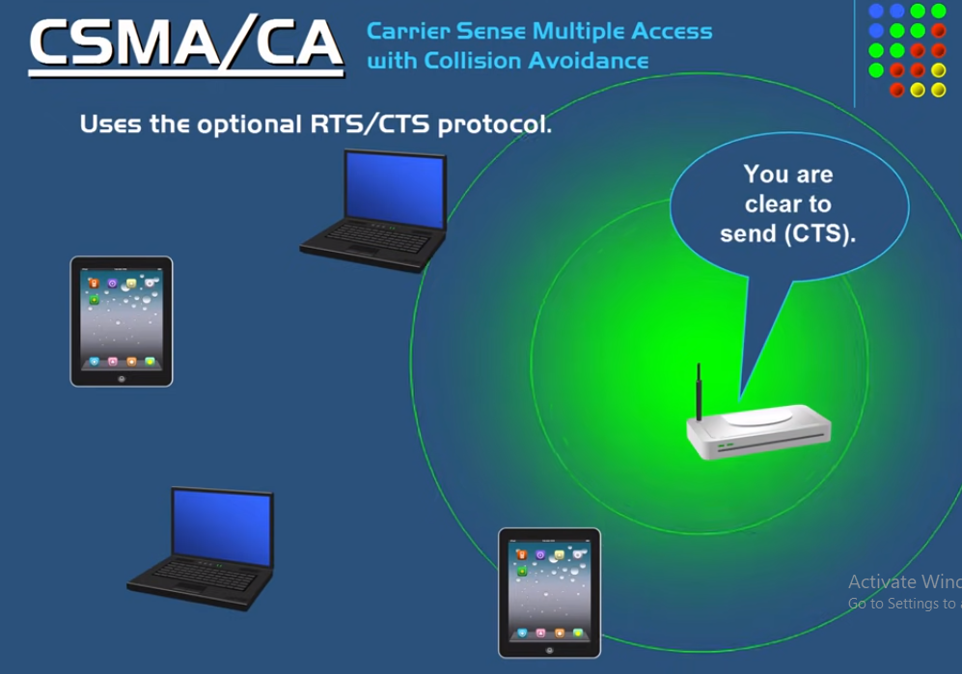

Slide 101
5. Ethernet
The IEEE has standardized a number of local area networks and metropolitan area networks under the name of IEEE 802. A few have survived but many have not,
The most important of the survivors are
  802.3 (Ethernet)
  802.11 (wireless LAN).
  802.15 (Bluetooth)
  802.16 (wireless MAN).
Ethernet and IEEE 802.3 are identical except for two minor differences many people use the terms ''Ethernet'' and ''IEEE 802.3'' interchangeably.
5.1 Ethernet Cabling
Since the name ''Ethernet'' refers to the cable (the ether), let us start our discussion there.
Four types of cabling are commonly used, as shown in the following figure

Slide 102
The most common kinds of Ethernet cabling.
10Base5
Historically, 10Base5 cabling, popularly called thick Ethernet, came first.
It resembles a yellow garden hose, with markings every 2.5 meters to show where the taps go. Connections to it are generally made using vampire taps, in which a pin is very carefully forced halfway into the coaxial cable's core.
The notation 10Base5 means that it operates at 10 Mbps, uses baseband signaling, and can support segments of up to 500 meters.

Slide 103
10Base2
Historically, the second cable type was 10Base2, or thin Ethernet, which, in contrast to the garden-hose-like thick Ethernet, bends easily.
Connections to it are made using industry standard BNC connectors to form T junctions, rather than using vampire taps.
BNC connectors are easier to use and more reliable.
Thin Ethernet is much cheaper and easier to install, but it can run for only 185 meters per segment, each of which can handle only 30 machines.
Detecting cable breaks, excessive length, bad taps, or loose connectors can be a major problem with both media.
For this reason, techniques have been developed to track them down. Basically, a pulse of known shape is injected into the cable.
If the pulse hits an obstacle or the end of the cable, an echo will be generated and sent back.
By carefully timing the interval between sending the pulse and receiving the echo, it is possible to localize the origin of the echo.
This technique is called time domain reflectometry.
Notes:
Bayonet Neill Concelman

Slide 104
10Base-T
A different kind of wiring pattern, in which all stations have a cable running to a central hub in which they are all connected electrically.
Usually, these wires are telephone company twisted pairs, since most office buildings are already wired this way, and normally plenty of spare pairs are available.
This scheme is called 10Base-T. Hubs do not buffer incoming traffic.
These three wiring schemes are illustrated in the following figure.
Three kinds of Ethernet cabling. (a) 10Base5. (b)10Base2. (c) 10Base-T.

Slide 105
For 10Base5, a transceiver is clamped securely around the cable so that its tap makes contact with the inner core.
The transceiver contains the electronics that handle carrier detection and collision detection.
When a collision is detected, the transceiver also puts a special invalid signal on the cable to ensure that all other transceivers also realize that a collision has occurred.
With 10Base5, a transceiver cable or drop cable connects the transceiver to an interface board in the computer.
The transceiver cable may be up to 50 meters long and contains five individually shielded twisted pairs.
Two of the pairs are for data in and data out, respectively. Two more are for control signals in and out.
The fifth pair, which is not always used, allows the computer to power the transceiver electronics.

Slide 106
Some transceivers allow up to eight nearby computers to be attached to them, to reduce the number of transceivers needed.
The transceiver cable terminates on an interface board inside the computer.
The interface board contains a controller chip that transmits frames to, and receives frames from, the transceiver.
The controller is responsible for assembling the data into the proper frame format, as well as computing checksums on outgoing frames and verifying them on incoming frames.
Some controller chips also manage a pool of buffers for incoming frames, a queue of buffers to be transmitted, direct memory transfers with the host computers, and other aspects of network management.

Slide 107
With 10Base2, the connection to the cable is just a passive BNC T-junction connector.
The transceiver electronics are on the controller board, and each station always has its own transceiver.
With 10Base-T, there is no shared cable at all, just the hub (a box full of electronics) to which each station is connected by a dedicated (i.e., not shared) cable.
Adding or removing a station is simpler in this configuration, and cable breaks can be detected easily.
The disadvantage of 10Base-T is that the maximum cable run from the hub is only 100 meters, maybe 200 meters if very high quality category 5 twisted pairs are used.
Nevertheless, 10Base-T quickly became dominant due to its use of existing wiring and the ease of maintenance that it offers.

Slide 108
10Base-F
10BASE-f Uses fiber optics. This alternative is expensive due to the cost of the connectors and terminators, but it has excellent noise immunity and is the method of choice when running between buildings or widely-separated hubs.
Runs of up to km are allowed. It also offers good security since wiretapping fiber is much more difficult than wiretapping copper wire. The following figure shows different ways of wiring a building. Cable topologies. (a) Linear. (b) Spine. (c) Tree. (d) Segmented.

Slide 109
A single cable is snaked from room to room, with each station tapping into it at the nearest point.
A vertical spine runs from the basement to the roof, with horizontal cables on each floor connected to the spine by special amplifiers (repeaters).
In some buildings, the horizontal cables are thin and the backbone is thick.
The most general topology is the tree, because a network with two paths between some pairs of stations would suffer from interference between the two signals.
Each version of Ethernet has a maximum cable length per segment.
To allow larger networks, multiple cables can be connected by repeaters, as shown in (d).

Slide 110
A repeater is a physical layer device.
It receives, amplifies (regenerates), and retransmits signals in both directions.
As far as the software is concerned, a series of cable segments connected by repeaters is no different from a single cable.
A system may contain multiple cable segments and multiple repeaters.

Slide 111
Manchester Encoding
None of the versions of Ethernet uses straight binary encoding with 0 volts for a 0 bit and 5 volts for a 1 bit because it leads to ambiguities.
If one station sends the bit string 0001000, others might falsely interpret it as 10000000 or 01000000 because they cannot tell the difference between an idle sender (0 volts) and a 0 bit (0 volts).
This problem can be solved by using +1 volts for a 1 and -1 volts for a 0, but there is still the problem of a receiver sampling the signal at a slightly different frequency than the sender used to generate it.
Different clock speeds can cause the receiver and sender to get out of synchronization about where the bit boundaries are, especially after a long run of consecutive 0s or a long run of consecutive 1s.
What is needed is a way for receivers to unambiguously determine the start, end, or middle of each bit without reference to an external clock.

Slide 112
Two such approaches are called Manchester encoding and differential Manchester encoding.
With Manchester encoding, each bit period is divided into two equal intervals.
A binary 1 bit is sent by having the voltage set high during the first interval and low in the second one.
binary 0 is just the reverse: first low and then high.
This scheme ensures that every bit period has a transition in the middle, making it easy for the receiver to synchronize with the sender.
A disadvantage of Manchester encoding is that it requires twice as much bandwidth as straight binary encoding because the pulses are half the width.
For example, to send data at 10 Mbps, the signal has to change 20 million times/sec. Manchester encoding is shown below

Slide 113
(a)Binary encoding. (b) Manchester encoding.
(c) Differential Manchester encoding.

Slide 114
Differential Manchester encoding is a variation of basic Manchester encoding.
In it, a 1 bit is indicated by the absence of a transition at the start of the interval.
A 0 bit is indicated by the presence of a transition at the start of the interval. In both cases, there is a transition in the middle as well.
The differential scheme requires more complex equipment but offers better noise immunity.
All Ethernet systems use Manchester encoding due to its simplicity.
The high signal is + 0.85 volts and the low signal is - 0.85 volts, giving a DC value of 0 volts.
Ethernet does not use differential Manchester encoding, but other LANs (e.g., the 802.5 token ring) do use it.

Slide 115
The Ethernet MAC Sublayer Protocol
The original DIX (DEC, Intel, Xerox) frame structure is shown in figure (a). Each frame starts with a Preamble of 8 bytes, each containing the bit pattern 10101010.
The Manchester encoding of this pattern produces a 10-MHz square wave for 6.4 μsec to allow the receiver's clock to synchronize with the sender's.
They are required to stay synchronized for the rest of the frame, using the Manchester encoding to keep track of the bit boundaries.

Slide 116
Frame formats. (a) DIX Ethernet. (b) IEEE 802.3.

Slide 117
The frame contains two addresses, one for the destination and one for the source.
The high-order bit of the destination address is a 0 for ordinary addresses and 1 for group addresses.
Group addresses allow multiple stations to listen to a single address.
When a frame is sent to a group address, all the stations in the group receive it.
Sending to a group of stations is called multicast. The address consisting of all 1 bits is reserved for broadcast.
Another interesting feature of the addressing is the use of bit 46 (adjacent to the high-order bit) to distinguish local from global addresses.
Next comes the Type field, which tells the receiver what to do with the frame.

Slide 118
Multiple network-layer protocols may be in use at the same time on the same machine, so when an Ethernet frame arrives, the kernel has to know which one to hand the frame to.
The Type field specifies which process to give the frame to.
Next come the data, up to 1500 bytes.
Ethernet requires that valid frames must be at least 64 bytes long, from destination address to checksum, including both.
If the data portion of a frame is less than 46 bytes, the Pad field is used to fill out the frame to the minimum size.
Frames with fewer than 64 bytes are padded out to 64 bytes with the Pad field. The final Ethernet field is the Checksum.
It is effectively a 32-bit hash code of the data. If some data bits are erroneously received (due to noise on the cable), the checksum will almost certainly be wrong and the error will be detected.

Slide 119
The checksum algorithm is a cyclic redundancy check (CRC) of the kind discussed earlier in this Chap. It just does error detection, not forward error correction.
When IEEE standardized Ethernet, the committee made two changes to the DIX format, as shown in FIGURE (b).
The first one was to reduce the preamble to 7 bytes and use the last byte for a Start of Frame (STF) delimiter, for compatibility with 802.4 and 802.5.
The second one was to change the Type field into a Length field.
Of course, now there was no way for the receiver to figure out what to do with an incoming frame, but that problem was handled by the addition of a small header to the data portion itself to provide this information.

Slide 120
The Binary Exponential Backoff Algorithm
Let us now see how randomization is done when a collision occurs.
After a collision, time is divided into discrete slots whose length is equal to the worst-case round-trip propagation time on the ether (2τ).
To accommodate the longest path allowed by Ethernet, the slot time has been set to 512 bit times, or 51.2 μsec as mentioned above.
After the first collision, each station waits either 0 or 1 slot times before trying again.
If two stations collide and each one picks the same random number, they will collide again.
After the second collision, each one picks either 0, 1, 2, or 3 at random and waits that number of slot times.

Slide 121
If a third collision occurs (the probability of this happening is 0.25), then the next time the number of slots to wait is chosen at random from the interval 0 to 2³ - 1.
In general, after i collisions, a random number between 0 and 2^{i}- 1 is chosen, and that number of slots is skipped.
However, after ten collisions have been reached, the randomization interval is frozen at a maximum of 1023 slots.
This algorithm, called binary exponential bakeoff, was chosen to dynamically adapt to the number of stations trying to send.

Slide 122
Wireless LANs
Wireless LANs are increasingly popular, and more and more office buildings, airports, and other public places are being outfitted with them.
Wireless LANs can operate in one of two configurations, with a base station and without a base station.
Consequently, the 802.11 LAN standard takes this into account and makes provision for both arrangements.
The 802.11 Protocol Stack
The protocols used by all the 802 variants, including Ethernet, have a certain commonality of structure.
A partial view of the 802.11 protocol stack is given in following.
The physical layer corresponds to the OSI physical layer fairly well, but the data link layer in all the 802 protocols is split into two or more sublayers.

Slide 123
In 802.11, the MAC (Medium Access Control) sublayer determines how the channel is allocated, that is, who gets to transmit next.
Above it is the LLC (Logical Link Control) sublayer, whose job it is to hide the differences between the different 802 variants and make them indistinguishable as far as the network layer is concerned.

Slide 124
The 1997 802.11 standard specifies three transmission techniques allowed in the physical layer.
The infrared method uses much the same technology as television remote controls do.
The other two use short-range radio, using techniques called FHSS and DSSS. Both of these use a part of the spectrum that does not require licensing (the 2.4-GHz ISM band).
All of these techniques operate at 1 or 2 Mbps and at low enough power that they do not conflict too much.
In 1999, two new techniques were introduced to achieve higher bandwidth.
These are called OFDM and HR-DSSS. They operate at up to 54 Mbps and 11 Mbps, respectively. In 2001, a second OFDM modulation was introduced, but in a different frequency band from the first one.
Technically, these belong to the physical, but since they are so closely tied to LANs in general and the 802.11 MAC sublayer, we treat them here instead.

Slide 125
The 802.11 Physical Layer
Each of the five permitted transmission techniques makes it possible to send a MAC frame from one station to another.
They differ, however, in the technology used and speeds achievable.
1. Infrared
This option uses diffused (i.e., not line of sight) transmission at 0.85 or 0.95 microns.
Two speeds are permitted: 1 Mbps and 2 Mbps. At 1 Mbps, an encoding scheme is used in which a group of 4 bits is encoded as a 16-bit codeword containing fifteen 0s and a single 1, using what is called Gray code.
This code has the property that a small error in time synchronization leads to only a single bit error in the output.
Infrared signals cannot penetrate walls, so cells in different rooms are well isolated from each other. Nevertheless, due to the low bandwidth this is not a popular option.

Slide 126
2. FHSS (Frequency Hopping Spread Spectrum)
Uses 79 channels, each 1-MHz wide, starting at the low end of the 2.4-GHz ISM band.
A pseudorandom number generator is used to produce the sequence of frequencies hopped to.
As long as all stations use the same seed to the pseudorandom number generator and stay synchronized in time, they will hop to the same frequencies simultaneously.
The amount of time spent at each frequency, the dwell time, is an adjustable parameter, but must be less than 400 msec.
FHSS' randomization provides a fair way to allocate spectrum in the unregulated ISM band.

Slide 127
It also provides a modicum of security since an intruder who does not know the hopping sequence or dwell time cannot eavesdrop on transmissions.
Over longer distances, multipath fading can be an issue, and FHSS offers good resistance to it.
3. DSSS (Direct Sequence Spread Spectrum)
Wireless networks typically employ the Direct Sequence Spread Spectrum (DSSS) modulation technology to spread the data stream over a wider bandwidth.
To strengthen the signal's resilience to noise and interference, this technique spreads the signal over a larger frequency range than is really required for data transmission.
DSSS is used by all wireless communication technologies, including Wi-Fi, Bluetooth, and cellular networks.
In this post, we'll go over the basics of DSSS and how it works in wireless networks.

Slide 128
The data signal is multiplied by the spreading code, which is a signal used in DSSS that looks like noise.
For this spreading code, a pseudo-random sequence of binary digits is generated at both the transmitter and the receiver. The spreading code is a sequence of 1s and -1s, which is generated using a mathematical algorithm.
When the data signal is multiplied by the spreading code, which has a far greater bit rate than the data signal does, the result is a signal that appears random and has a much wider bandwidth than the original signal.
The incoming signal is multiplied at the receiver using the same spreading code as the transmitter.
Correlation is a technique for separating the original data stream from the spread spectrum signal.
The data from the signal is subsequently extracted by the receiver using a demodulator.
DSSS can also offer a higher data rate. This qualifies it for use in high-speed data transmission-dependent applications like streaming video and huge file transfers.

Slide 129
4. OFDM (Orthogonal Frequency Division Multiplexing)
The first of the high-speed wireless LANs, 802.11a, uses this to deliver up to 54 Mbps in the wider 5-GHz ISM band. This technique emerged in May 2002.
As the term FDM suggests, different frequencies are used, 52 of them in which 48 for data and 4 for synchronization, transmissions are present on multiple frequencies at the same time, this technique is considered a form of spread spectrum.
Splitting the signal into many narrow bands has some key advantages over using a single wide band, including better immunity to narrowband interference and the possibility of using noncontiguous bands.
The technique has a good spectrum efficiency in terms of bits/Hz and good immunity to multipath fading.
Notes:
ISM bands (industrial, scientific, and medical)

Slide 130
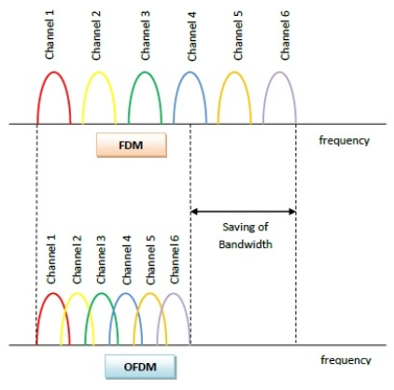

Slide 131
5. HR-DSSS (High Rate Direct Sequence Spread Spectrum),
HR/DSSS uses a higher data rate than traditional DSSS.
In HR/DSSS, the data is transmitted at a higher rate, which means that the spreading code must be generated at a higher frequency.
The higher frequency of the spreading code allows for the transmission of more data in a given amount of time.
HR/DSSS uses a pseudorandom code to spread the data signal. This code is known only to the transmitter and receiver, making it difficult for unauthorized users to intercept or decode the signal.
HR/DSSS uses a wideband signal, which makes it more resilient to interference from other wireless devices.

Slide 132
The data rate may be dynamically adapted during operation to achieve the optimum speed possible under current conditions of load and noise.
In practice, the operating speed of 802.11b is nearly always 11 Mbps. Although 802.11b is slower than 802.11a, its range is about 7 times greater, which is more important in many situations.
An enhanced version of 802.11b, 802.11g, was approved by IEEE in November 2001 after much politicking about whose patented technology it would use.
It uses the OFDM modulation method of 802.11a but operates in the narrow 2.4-GHz ISM band along with 802.11b.
What it does mean is that the 802.11 committee has produced three different high speed wireless LANs: 802.11a, 802.11b, and 802.11g (not to mention three low-speed wireless LANs).

Slide 133
The 802.11 MAC Sublayer Protocol
The 802.11 MAC sublayer protocol is quite different from that of Ethernet due to the inherent complexity of the wireless environment compared to that of a wired system.
With Ethernet, a station just waits until the ether goes silent and starts transmitting.
If it does not receive a noise burst back within the first 64 bytes, the frame has almost assuredly been delivered correctly.
With wireless, this situation does not hold. To start with, there is the hidden station problem and is illustrated in Fig. (a).

Slide 134
Figure (a) The hidden station problem. (b) The exposed station problem.

Slide 135
The exposed station problem, illustrated in Fig. (b).
In addition, most radios are half duplex, meaning that they cannot transmit and listen for noise bursts at the same time on a single frequency.
As a result of these problems, 802.11 does not use CSMA/CD, as Ethernet does. To deal with this problem, 802.11 supports two modes of operation.
PCF (Point Coordination Function), uses the base station to control all activity in its cell.
DCF (Distributed Coordination Function), does not use any kind of central control. DCF is employed, 802.11 uses a protocol called CSMA/CA (CSMA with Collision Avoidance).
In this protocol, both physical channel sensing and virtual channel sensing are used. Two methods of operation are supported by CSMA/CA.

Slide 136
In the first method, when a station wants to transmit, it senses the channel.
If it is idle, it just starts transmitting. It does not sense the channel while transmitting but emits its entire frame, which may well be destroyed at the receiver due to interference there.
If the channel is busy, the sender defers until it goes idle and then starts transmitting.
If a collision occurs, the colliding stations wait a random time, using the Ethernet binary exponential backoff algorithm, and then try again later.

Slide 137
The other mode of CSMA/CA operation is based on MACAW and uses virtual channel sensing, as illustrated in the following figure.
In this example, A wants to send to B. C is a station within range of A (and possibly within range of B, but that does not matter).
D is a station within range of B but not within range of A.
Figure. The use of virtual channel sensing using CSMA/CA

Slide 138
The protocol starts when A decides it wants to send data to B.
It begins by sending an RTS frame to B to request permission to send it a frame.
When B receives this request, it may decide to grant permission, in which case it sends a CTS frame back.
Upon receipt of the CTS, A now sends its frame and starts an ACK timer.
Upon correct receipt of the data frame, B responds with an ACK frame, terminating the exchange.
If A's ACK timer expires before the ACK gets back to it, the whole protocol is run again.
Now let us consider this exchange from the viewpoints of C and D. C is within range of A, so it may receive the RTS frame.
If it does, it realizes that someone is going to send data soon, so for the good of all it desists from transmitting anything until the exchange is completed.

Slide 139
From the information provided in the RTS request, it can estimate how long the sequence will take, including the final ACK, so it asserts a kind of virtual channel busy for itself, indicated by NAV (Network Allocation Vector) in the above figure.
D does not hear the RTS, but it does hear the CTS, so it also asserts the NAV signal for itself.
Note that the NAV signals are not transmitted; they are just internal reminders to keep quiet for a certain period of time.
To deal with the problem of noisy channels, 802.11 allows frames to be fragmented into smaller pieces, each with its own checksum.
The fragments are individually numbered and acknowledged using a stop-and-wait protocol.
Once the channel has been acquired using RTS and CTS, multiple fragments can be sent in a row, as shown in the following figure.

Slide 140
Figure . A fragment burst.

Slide 141
Fragmentation increases the throughput by restricting retransmissions to the bad fragments rather than the entire frame.
The basic mechanism is for the base station to broadcast a beacon frame periodically (10 to 100 times per second).
The beacon frame contains system parameters, such as hopping sequences and dwell times (for FHSS), clock synchronization, etc.
It also invites new stations to sign up for polling service. PCF and DCF can coexist within one cell.
At first it might seem impossible to have central control and distributed control operating at the same time, but 802.11 provides a way to achieve this goal.
It works by carefully defining the interframe time interval.

Slide 142
After a frame has been sent, a certain amount of dead time is required before any station may send a frame.
Four different intervals are defined, each for a specific purpose.
The four intervals are depicted in the following figure.
Figure. Interframe spacing in 802.11

Slide 143
The shortest interval is SIFS (Short InterFrame Spacing).
It is used to allow the parties in a single dialog the chance to go first.
This includes letting the receiver send a CTS to respond to an RTS, letting the receiver send an ACK for a fragment or full data frame, and letting the sender of a fragment burst transmit the next fragment without having to send an RTS again.
There is always exactly one station that is entitled to respond after a SIFS interval.
PIFS (PCF InterFrame Spacing), the base station may send a beacon frame or poll frame.
This mechanism allows a station sending a data frame or fragment sequence to finish its frame without anyone else getting in the way, but gives the base station a chance to grab the channel when the previous sender is done without having to compete with eager users.

Slide 144
If the base station has nothing to say and a time DIFS (DCF InterFrame Spacing) elapses, any station may attempt to acquire the channel to send a new frame.
The usual contention rules apply, and binary exponential backoff may be needed if a collision occurs.
The last time interval, EIFS (Extended InterFrame Spacing), is used only by a station that has just received a bad or unknown frame to report the bad frame.
The idea of giving this event the lowest priority is that since the receiver may have no idea of what is going on, it should wait a substantial time to avoid interfering with an ongoing dialog between two stations.

Slide 145
The 802.11 Frame Structure
The 802.11 standard defines three different classes of frames on the wire: data, control, and management.
Each of these has a header with a variety of fields used within the MAC sublayer.
The format of the data frame is shown in the following figure.
First comes the Frame Control field. It itself has 11 subfields.
The first of these is the Protocol version, which allows two versions of the protocol to operate at the same time in the same cell.
Then come the Type (data, control, or management) and Subtype fields (e.g., RTS or CTS).
The To DS and From DS bits indicate the frame is going to or coming from the intercell distribution system (e.g., Ethernet).

Slide 146
The MF bit means that more fragments will follow. The Retry bit marks a retransmission of a frame sent earlier.
The Power management bit is used by the base station to put the receiver into sleep state or take it out of sleep state.
The More bit indicates that the sender has additional frames for the receiver.
The W bit specifies that the frame body has been encrypted using the WEP (Wired Equivalent Privacy) algorithm.
Finally, the O bit tells the receiver that a sequence of frames with this bit on must be processed strictly in order.

Slide 147
Figure . The 802.11 data frame.

Slide 148
The second field of the data frame, the Duration field, tells how long the frame and its acknowledgement will occupy the channel.
This field is also present in the control frames and is how other stations manage the NAV mechanism.
The frame header contains four addresses, all in standard IEEE 802 format.
The source and destination are obviously needed, The other two addresses are used for the source and destination base stations for intercell traffic.
The Sequence field allows fragments to be numbered. Of the 16 bits available, 12 identify the frame and 4 identify the fragment.
The Data field contains the payload, up to 2312 bytes, followed by the usual Checksum.

Slide 149
Management frames have a format similar to that of data frames, except without one of the base station addresses, because management frames are restricted to a single cell.
Control frames are shorter still, having only one or two addresses, no Data field, and no Sequence field.
The key information here is in the Subtype field, usually RTS, CTS, or ACK.

Slide 150
Services
The 802.11 standard states that each conformant wireless LAN must provide nine services.
These services are divided into two categories:
  Five distribution services and
  Four station services.
Distribution services: relate to managing cell membership and interacting with stations outside the cell.
In contrast, the Station services relate to activity within a single cell.
The five distribution services are provided by the base stations and deal with station mobility as they enter and leave cells, attaching themselves to and detaching themselves from base stations. They are as follows.

Slide 151
Association. This service is used by mobile stations to connect themselves to base stations.
Typically, it is used just after a station moves within the radio range of the base station.
Upon arrival, it announces its identity and capabilities.
The capabilities include the data rates supported, need for PCF services (i.e., polling), and power management requirements.
The base station may accept or reject the mobile station.
If the mobile station is accepted, it must then authenticate itself.
Disassociation. Either the station or the base station may disassociate, thus breaking the relationship.
A station should use this service before shutting down or leaving, but the base station may also use it before going down for maintenance.

Slide 152
Reassociation. A station may change its preferred base station using this service.
This facility is useful for mobile stations moving from one cell to another.
If it is used correctly, no data will be lost as a consequence of the handover. (But 802.11, like Ethernet, is just a best-efforts service.)
Distribution. This service determines how to route frames sent to the base station.
If the destination is local to the base station, the frames can be sent out directly over the air.
Otherwise, they will have to be forwarded over the wired network.
Integration. If a frame needs to be sent through a non-802.11 network with a different addressing scheme or frame format, this service handles the translation from the 802.11 format to the format required by the destination network.
The remaining four services are intracell. They are used after association has taken place and are as follows.

Slide 153
Authentication. Because wireless communication can easily be sent or received by unauthorized stations, a station must authenticate itself before it is permitted to send data.
After a mobile station has been associated by the base station (i.e., accepted into its cell),
Deauthentication. When a previously authenticated station wants to leave the network, it is deauthenticated.
After deauthentication, it may no longer use the network.
Privacy. For information sent over a wireless LAN to be kept confidential, it must be encrypted.
This service manages the encryption and decryption.
The encryption algorithm specified is RC4, invented by Ronald Rivest of M.I.T.
Data delivery. Finally, data transmission is what it is all about, so 802.11 naturally provides a way to transmit and receive data. Since 802.11 is modeled on Ethernet and transmission over Ethernet is not guaranteed to be 100% reliable, transmission over 802.11 is not guaranteed to be reliable either.
Higher layers must deal with detecting and correcting errors.

Slide 154
Thank You

