Slide 1
UNIT - V
1) HBase - Overview
1.1) Limitations of Hadoop
1.2) What is HBase
1.3) HBase and HDFS
1.4) Storage Mechanism in HBase
1.5) Features of HBase
1.6) Applications of HBase
2) Zookeeper - Overview
2.1) Distributed Application
2.2) Benefits of Distributed Application
2.3) Challenges of Distributed Application
2.4) what is Apache Zookeeper Meant for
2.5) Benefits of Zookeeper

Slide 2
1) Hbase - Overview
HBase is a
Non-Relational Database Management System
Column-Oriented
that runs on top of HDFS

Slide 3
1) Hbase - Overview
Database are classified into 2 types
Relational Database
Non Relational Database
Relational Database | Non Relational Database
A relational database stores data in tables composed of rows and columns. | A non-relational database is a type of database that doesn’t store data in tables but instead in whatever format is best for the type of data being stored.
Relational databases are suitable for storing, retrieving, and manipulating well-defined, structured data. | used to store a mix of structured and unstructured data.
Some of the most common relational databases include: MySQL, IBM Db2, Snowflake, Amazon ,Aurora,,PostgreSQL, Microsoft SQL Server | Some of the most common non-relational databases include: MongoDB, ,IBM Cloundant, Amazon DynamoDB, Apache Cassandra , HBase
SQL, or Structured Query Language, is the most common programming language used to interface with relational databases | Non-relational databases are said to be NoSQL, meaning that they don’t use Structured Query Language, even though many NoSQL databases do support SQL queries.

Slide 4
1) Hbase - Overview
Data store are classified into 2 types
Row Oriented Data store or Row Oriented Database
Column Oriented store or Column Oriented Database
Row Oriented Database | Column Oriented Database
Row Oriented Databases are Databases that Organize data by record, keeping all of the data associated with a record next to each other in memory. | Column Oriented Databases are Databases that Organize data by field, keeping all of the data associated with a field next to each other in memory.
In a row store, or row oriented database, the data is stored row by row, such that the first column of a row will be next to the last column of the previous row. | In a Column store, or Column oriented database, the data is stored field by field
They are Optimized for reading and writing rows effectively | They are Optimized for reading and writing Columns effectively
If an application needs row wise data for processing, then better to choose row oriented database like oracle, MySQL etc.. | If an application needs Column wise data for processing, then better to choose column oriented database like Hbase,Cassandra etc..
Commonly used for OLTP style applications | Commonly used for OLAP style applications

Slide 5
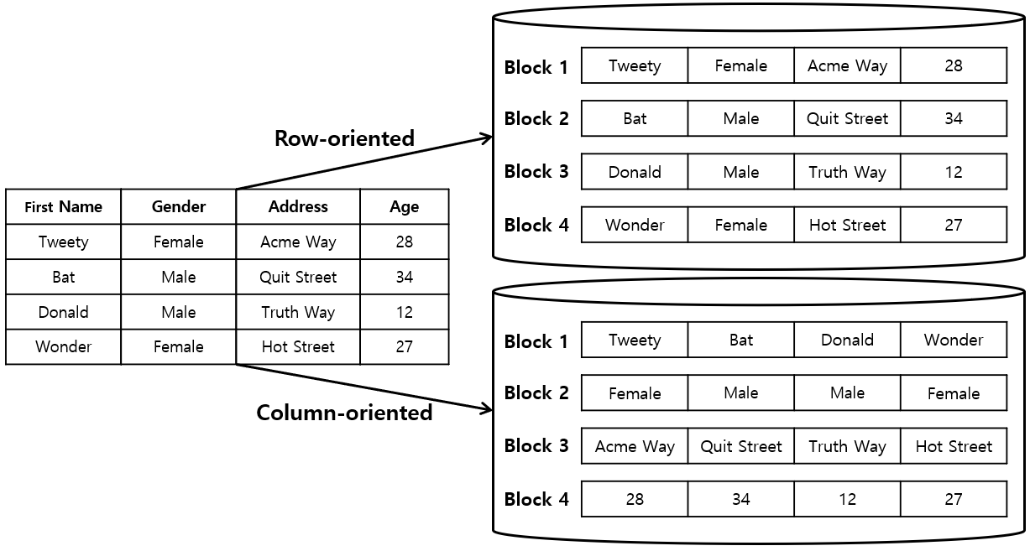
1) Hbase - Overview
Row vs Column Oriented Databases
Row Oriented Database
Column Oriented Database
100 | Ram | 20000 | 101 | Sita | 25000 | 102 | Lak | 20000
100 | 101 | 102 | 103 | Ram | Siata | Lak | Bharath | 20000

Slide 6
1) Hbase - Overview
1.1) Limitations of Hadoop
HDFS | HBase
HDFS performs Batch Processing Batch Processing : The Collection and Storage of Data, for processing at a scheduled time when a sufficient amount of data has been accumulated Example : Credit Card Bill Generation | HBase performs Real Time Processing Real Time Processing : The Immediate Processing of Data after the transaction occurs with the Database being updated at the time of the event Example : Flight Reservation processing
2) HDFS does sequential access of Data Means one has to search the entire dataset even for the simplest of Jobs2) | 2) Hbase does Random access of Data Means one can access data randomly
3) HDFS is a File System | 3) Hbase is a Database

Slide 7
1) Hbase - Overview
1.1) Limitations of Hadoop (or) HBase vs HDFS
HDFS | HBase
HDFS performs Batch Processing Batch Processing : The Collection and Storage of Data, for processing at a scheduled time when a sufficient amount of data has been accumulated Example : Credit Card Bill Generation | HBase performs Real Time Processing Real Time Processing : The Immediate Processing of Data after the transaction occurs with the Database being updated at the time of the event Example : Flight Reservation processing
2) HDFS does sequential access of Data Means one has to search the entire dataset even for the simplest of Jobs 2) | 2) Hbase does Random access of Data Means one can access data randomly

Slide 8
1) Hbase - Overview
1.4) Storage Mechanism of HBase
HBase is a column-oriented database and the tables in it are sorted by row.
The table schema defines only column families, which are the key value pairs.
A table have multiple column families and each column family can have any number of columns.
Subsequent column values are stored contiguously on the disk.
Each cell value of the table has a timestamp.
In short, in an HBase:
Table is a collection of rows.
Row is a collection of column families.
Column family is a collection of columns.
Column is a collection of key value pairs.

Slide 9
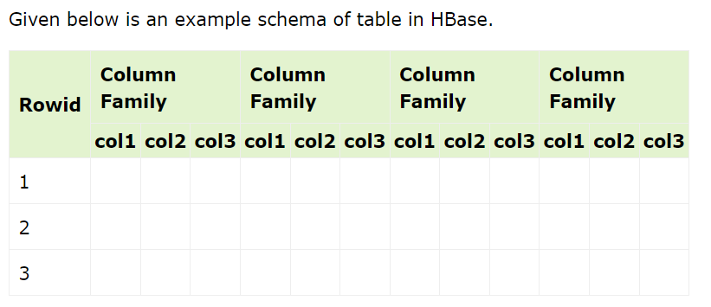
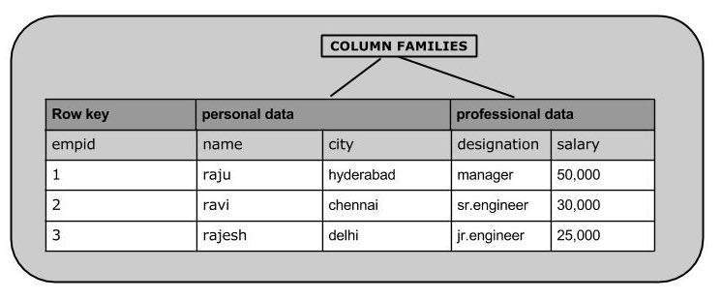
1) Hbase - Overview
1.4) Storage Mechanism of HBase

Slide 10
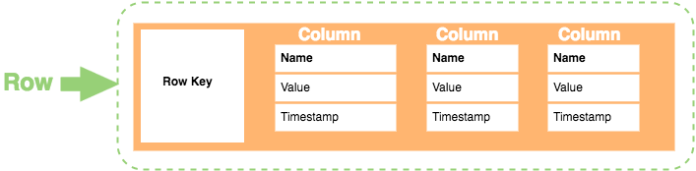
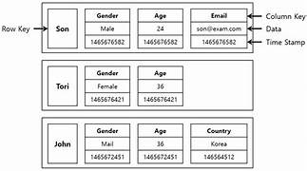
1) Hbase - Overview
1.4) Storage Mechanism of HBase
HBase uses a column-oriented storage mechanism, and its architecture is inspired by Google's Bigtable.
The storage mechanism is designed to provide high performance, scalability, and fault tolerance.
Data in HBase is organized into column families.
A column family is a logical grouping of columns, and all the columns within a column family are stored together in an HFile.
Each column family can have a different set of columns.

Slide 11
1) Hbase - Overview
1.5) Features of HBase
HBase is a Column oriented Database which is commonly used for OLAP Applications.
Hbase performs Real Time Processing
HBase is a Open source Data warehouse component built on top of Hadoop
HBase is linearly scalable.
It has automatic failure support.
It provides consistent read and writes.
It integrates with Hadoop, both as a source and a destination.
It has easy java API for client.
It provides data replication across clusters.

Slide 12
1) Hbase - Overview
1.6) Applications of HBase
Apache HBase is used to have random, real-time read/write access to Big Data.
It hosts very large tables on top of clusters of commodity hardware.
Apache HBase is a non-relational database modeled after Google's Bigtable.
Bigtable acts up on Google File System, likewise Apache HBase works on top of Hadoop and HDFS.
It is used whenever there is a need to write heavy applications.
HBase is used whenever we need to provide fast random access to available data.
Companies such as Facebook, Twitter, Yahoo, and Adobe use HBase internally.

Slide 13
2) ZOOKEEPER
WHAT IS ZOOKEEPER
ZooKeeper is a distributed co-ordination service to manage large set of hosts.
Co-ordinating and managing a service in a distributed environment is a complicated process.
ZooKeeper solves this issue with its simple architecture and API.
ZooKeeper allows developers to focus on core application logic without worrying about the distributed nature of the application.
The ZooKeeper framework was originally built at “Yahoo!” for accessing their applications in an easy and robust manner.
Later, Apache ZooKeeper became a standard for organized service used by Hadoop, HBase, and other distributed frameworks.
For example, Apache HBase uses ZooKeeper to track the status of distributed data.

Slide 14
2) ZOOKEEPER
2.1) DISTRIBUTED APPLICATIONS
A distributed application can run on multiple systems in a network at a given time (simultaneously) by coordinating among themselves to complete a particular task in a fast and efficient manner.
Normally, complex and time-consuming tasks, which will take hours to complete by a non-distributed application (running in a single system) can be done in minutes by a distributed application by using computing capabilities of all the system involved
The time to complete the task can be further reduced by configuring the distributed application to run on more systems.
A group of systems in which a distributed application is running is called a Cluster and each machine running in a cluster is called a Node.
A distributed application has two parts, Server and Client application.
Server applications are actually distributed and have a common interface so that clients can connect to any server in the cluster and get the same result.
Client applications are the tools to interact with a distributed application

Slide 15
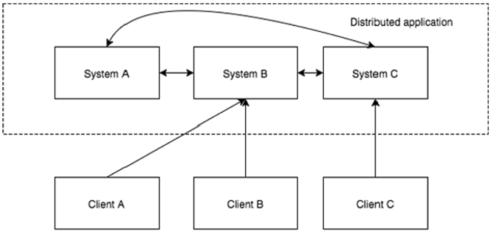
2) ZOOKEEPER
2.1) DISTRIBUTED APPLICATIONS

Slide 16
2) ZOOKEEPER
2.2) Benefits of Distributed Applications
Benefits of DistributeApplications
Reliability − Failure of a single or a few systems does not make the whole system to fail.
Scalability − Performance can be increased as and when needed by adding more machines with minor change in the configuration of the application with no downtime.
Transparency − Hides the complexity of the system and shows itself as a single entity / application.
2.3) Challenges of Distributed Applications
Challenges of Distributed Applications
Race condition − Two or more machines trying to perform a particular task, which actually needs to be done only by a single machine at any given time. For example, shared resources should only be modified by a single machine at any given time.
Deadlock − Two or more operations waiting for each other to complete indefinitely.
Inconsistency − Partial failure of data.

Slide 17
2) ZOOKEEPER
2.2) Benefits of Distributed Applications
Benefits of DistributeApplications
Reliability − Failure of a single or a few systems does not make the whole system to fail.
Scalability − Performance can be increased as and when needed by adding more machines with minor change in the configuration of the application with no downtime.
Transparency − Hides the complexity of the system and shows itself as a single entity / application.
2.3) Challenges of Distributed Applications
Challenges of Distributed Applications
Race condition − Two or more machines trying to perform a particular task, which actually needs to be done only by a single machine at any given time. For example, shared resources should only be modified by a single machine at any given time.
Deadlock − Two or more operations waiting for each other to complete indefinitely.
Inconsistency − Partial failure of data.

Slide 18
2) ZOOKEEPER
2.4) What is Apache ZooKeeper Meant For?
Apache ZooKeeper is a service used by a cluster (group of nodes) to coordinate between themselves and maintain shared data with robust synchronization techniques. ZooKeeper is itself a distributed application providing services for writing a distributed application.
The common services provided by ZooKeeper are as follows −
Naming service − Identifying the nodes in a cluster by name. It is similar to DNS, but for nodes.
Configuration management − Latest and up-to-date configuration information of the system for a joining node.
Cluster management − Joining / leaving of a node in a cluster and node status at real time.
Leader election − Electing a node as leader for coordination purpose.
Locking and synchronization service − Locking the data while modifying it. This mechanism helps you in automatic fail recovery while connecting other distributed applications like Apache HBase.
Highly reliable data registry − Availability of data even when one or a few nodes are down.

Slide 19
2) ZOOKEEPER
2.4) What is Apache ZooKeeper Meant For?
Distributed applications offer a lot of benefits, but they throw a few complex and hard-to-crack challenges as well.
ZooKeeper framework provides a complete mechanism to overcome all the challenges.
Race condition and deadlock are handled using fail-safe synchronization approach.
Another main drawback is inconsistency of data, which ZooKeeper resolves with atomicity.

Slide 20
2) ZOOKEEPER
2.5) Benefits of ZooKeeper
  Here are the benefits of using ZooKeeper −
  Simple distributed coordination process
  Synchronization − Mutual exclusion and co-operation between server processes. This process helps in Apache HBase for configuration management.
  Ordered Messages
  Serialization − Encode the data according to specific rules. Ensure your application runs consistently. This approach can be used in MapReduce to coordinate queue to execute running threads.
  Reliability
  Atomicity − Data transfer either succeed or fail completely, but no transaction is partial.

