Slide 1
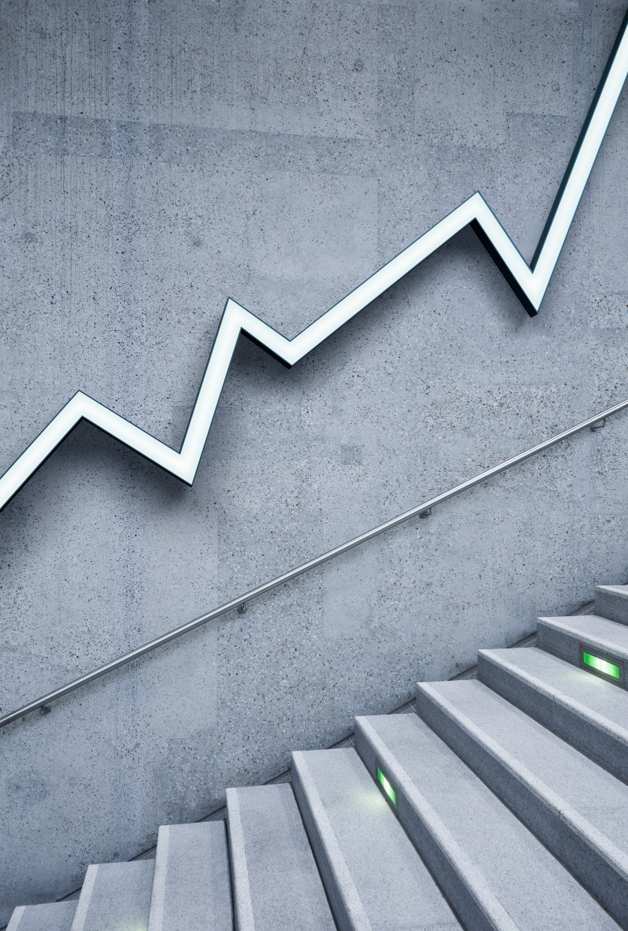
Big Data Analytics – 20MCA213
Sreenivasa Institute of Technology and Management Studies
(Autonomous)
Murukambattu, Chittoor
Mrs. R.Padmaja
Assistant Professor
MCA Department
SITAMS
UNIT - 1

Slide 2
UNIT - I
What is Big Data
Datasets
DataAnalysis
DataAnalytics
  Descriptive Analytics
  Diagnostics Analytics
  Predictive Analytics
  Prescriptive Analytics
BigData Characteristics
  Volume
  Velocity
  Variety
  Veracity
  Value
Different types of Data
  Structured Data
  UnStructuredData
  Semi-Structured Data

Slide 3
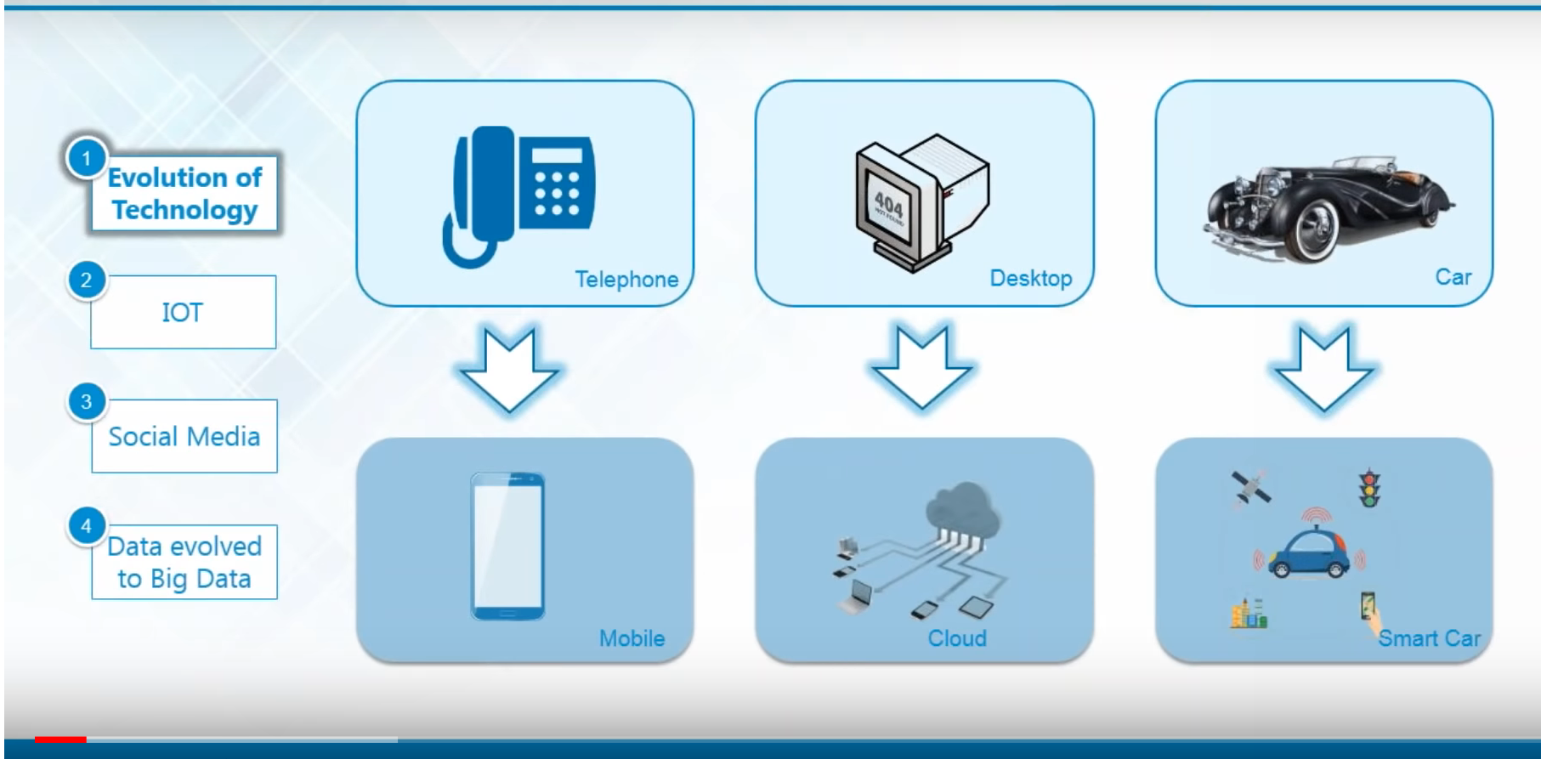
EVOLUTION OF TECHNOLOGY

Slide 4
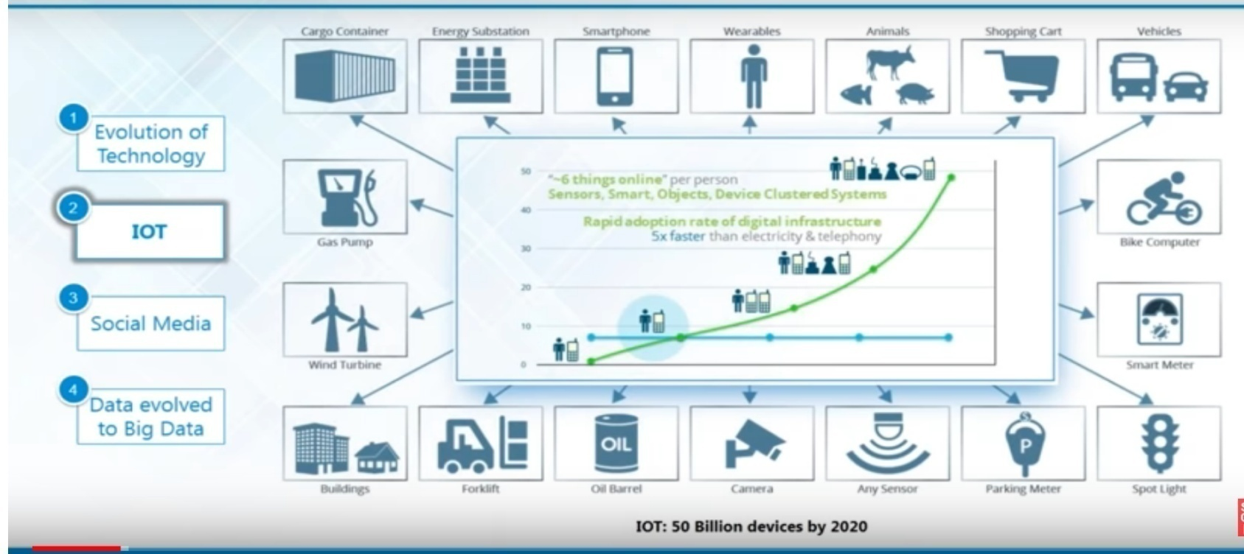
IOT
The Internet of Things (IoT) is a system of interrelated computing devices, mechanical and digital machines, objects, animals or people that are provided with unique identifiers (UIDs) and the ability to transfer data over a network without requiring human-to-human or human-to-computer interaction.^{[1][2][3][4}

Slide 5
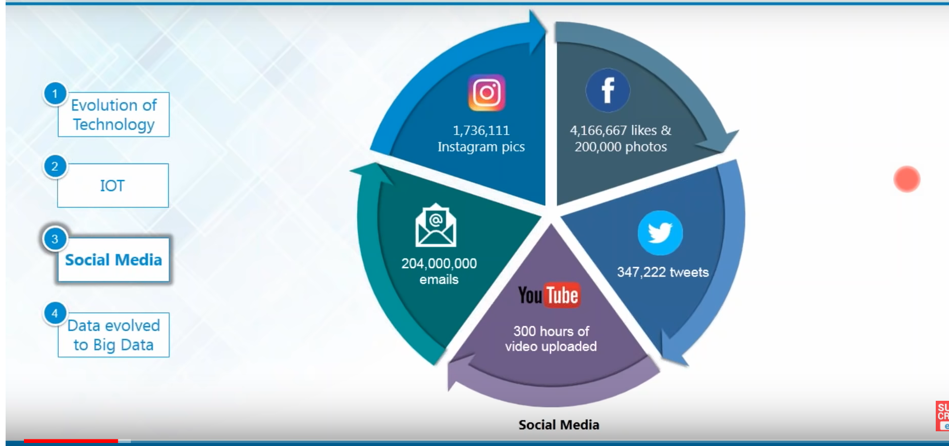
SOCIAL MEDIA
Social media is one way to generate volume ,velocity and variety of data

Slide 6
EVOLUTION OF TECHNOLOGY
The reasons behind growth of data could be numereous ever. since the enhancement of technology, data has also been growing everyday . If we go back to 70’s and 80’s, not many people were using computers there were only fraction of people who were dealing with computers that’s why the data fed into computer systems was also quite less but now everyone owns the gadget , everyone has a Mobile phone , everyone own laptop and they are generating large volumes of data everyday.
IOT is another factor for data evolved as a BigData. Now a days smart appliances are interconnected and they form a network of things . These network of smart appliances or devices are generating huge data when they are communicating with each other and that is another way of evolving big data.
Social media is another source that generates big data . Examples of social media that generate bigData are whatsapp, Twitter, Facebook

Slide 7
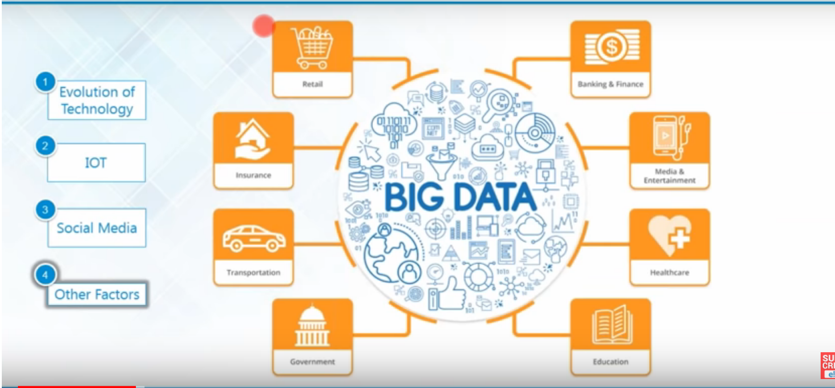
OTHER FACTORS
Other factors that evolve big data are Retail stores, Insurance companies, Government agencies, educational institutes etc..

Slide 8
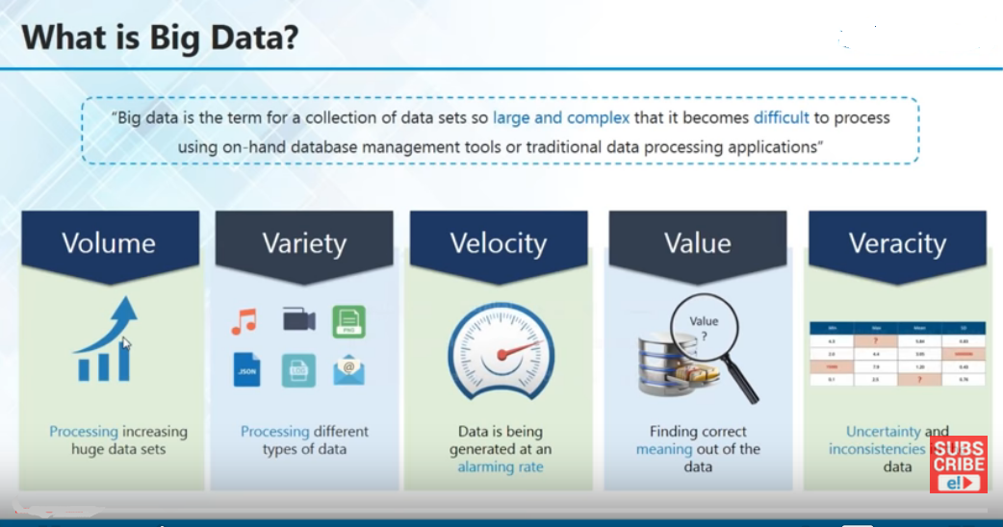
What is Big Data
Data that satisfies 5 V’s is called Big Data

Slide 9
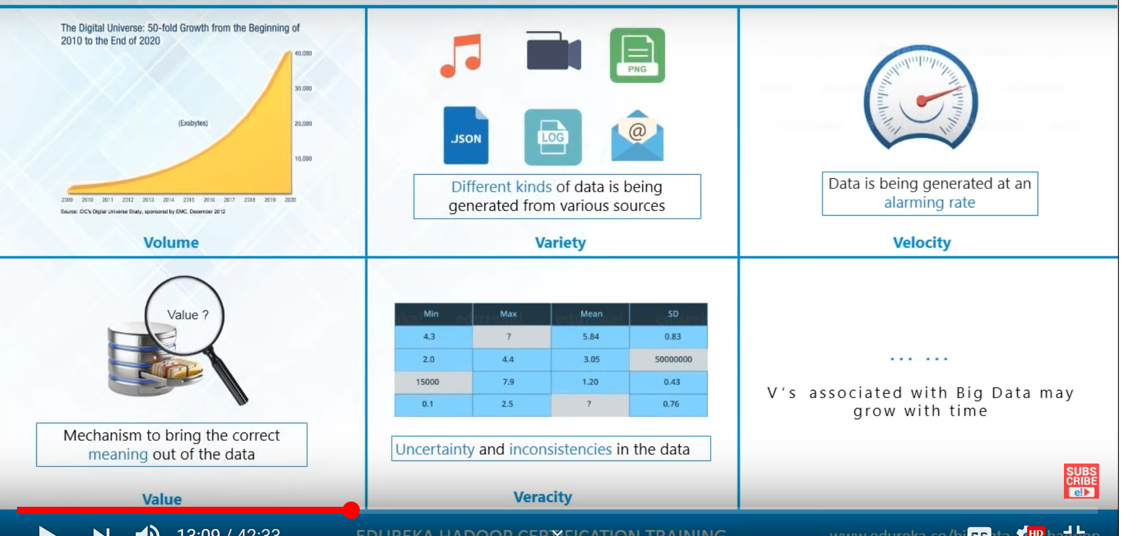
What is Big Data
Data that satisfies 5 V’s is called Big Data

Slide 10
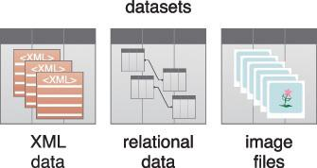
3) What is Dataset
Collection or group of related data are generally refer to as Dataset.
Each group(datum) shares the same set of attributes as others in the same dataset.
Some of the examples are:
      tweets stored in a flat file
      a collection of image files in a directory.
      an extract of rows from a database table stored in a CSV formatted file
      historical weather observations that are stored as XML files
      Datasets can be found in many different formats

Slide 11

What is Data Analysis
Data analysis is the process of examining data to find facts, relationships, patterns, insights and/or trends.
The overall goal of data analysis is to support better decision-making.
A simple data analysis example is the analysis of ice cream sales data in order to determine how the number of ice cream cones sold is related to the daily temperature.
The results of such an analysis would support decisions related to how much ice cream a store should order in relation to weather forecast information.
Following figure shows the symbol used to represent data analysis.

Slide 12

What is Data Analytics
Data analytics is a broader term that encompasses data analysis.
Data analytics is a discipline that includes the management of the complete data lifecycle, which encompasses collecting, cleansing, organizing, storing, analyzing and governing data.
Following figure shows the symbol used to represent analytics.

Slide 13
There are four general categories of analytics that are distinguished by the results they produce:
    Descriptive Analytics
    2) Diagnostic Analytics
    3) Predictive Analytics
    4) Prescriptive Analytics

Slide 14
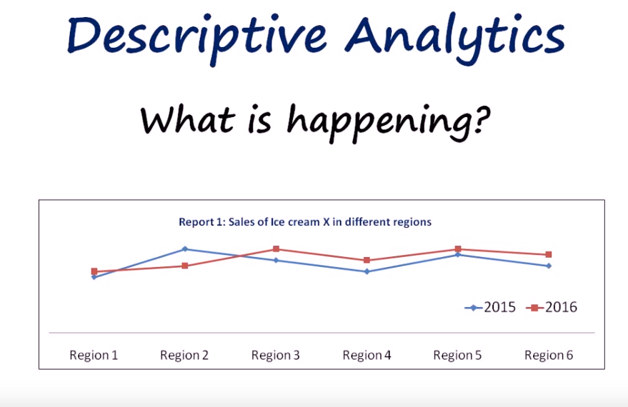
1) Descriptive Analytics
Descriptive Analytics gives you information on what is happening. Let us see a particular Example
This report gives us information about sales of ice cream x in different regions and its also compared these sales for years 2015 and 16.This is a typical descriptive analytics support which gives you information on what is happening to sales of this ice cream so this chart could infer that except for the region 2 the sales have increased from 2015 to 16 so this is the level of information one could obtain from descriptive analytics now that we know the sales have dropped in region 2 .

Slide 15
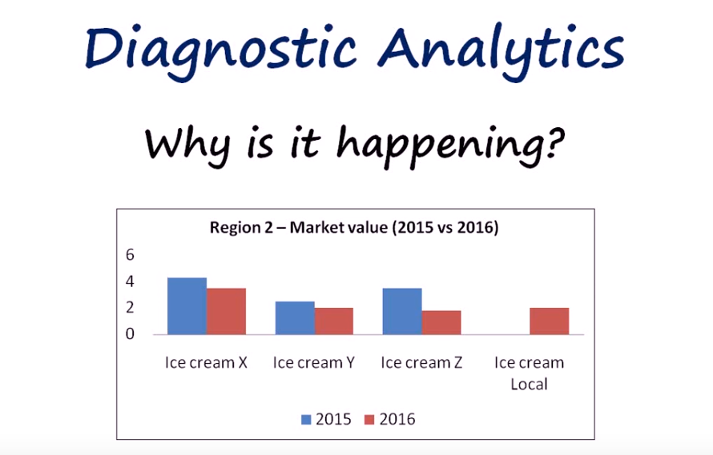
2) Diagnostic Analytics
Information on why is it happening . so our job is to deep dive into region 2 and see what exactly is going wrong for us so this is a typical report for the market share of region 2
From the graph , it is clear that the sales of ice cream brands x, y and z is dropped from 2015 to 2016 and it is because the local brand ice cream has come up in 2016.In the first step we found what is happening and here we found why it is happening. here we have diagnosed the reason of sales drop in region 2

Slide 16
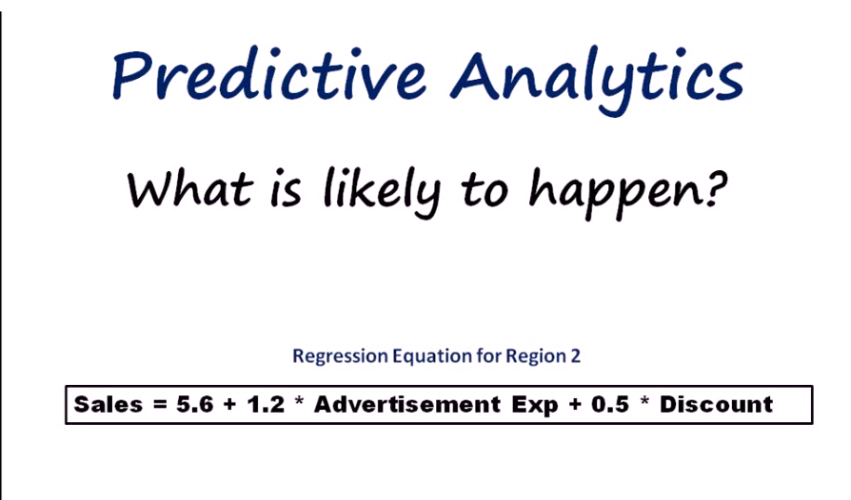
2) Predictive Analytics
Once we identified the reason of happenings , then we can take measures to improve things i.e what should be done to make things happen correct. In our example, first we identified region 2 has less sales in 2016 next, we found the reason of why region 2 sales got down and now it is the time to find the solution to increase the sales and that is called predictive data analytics
For this example what we can do is to build a regression for region 2 sales the different factors that would affect the sales of region 2 this would help us change the different factors say for example the advertisement expense or discount and see what would be the impact of the changes on sales so these are some things that u can do so using predictive analytics which essentially tells you what is likely to happen in future now we know that what had happened and why it had happened and our next job is to find what is likely to happen i.e predictive analytics

Slide 17
Precriptive Analytics
Our next step is to move to next topic i. e Prescriptive analysis there you suggest the best course of action to solve the problem.
for this particular example we can give solutions like increase the advertising expense by 10% or give 5 % discount for two months
if we are able to find out using the regression equation that these factors like advertising expense or discount has an impact on sales
so these are the four different levels of business analytics .
Now lets summarize what we have just seen

Slide 18
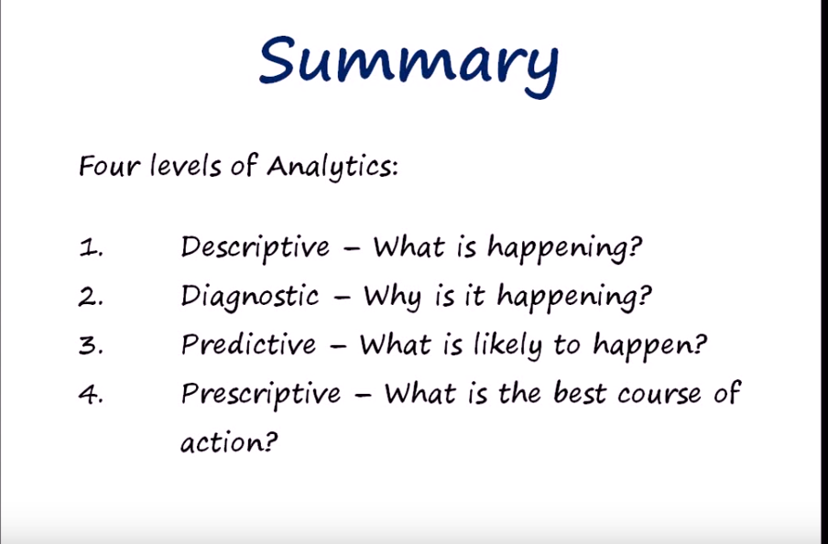

Slide 19
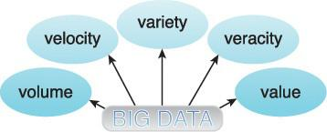
5) BigData Characteristics
  Volume
  Velocity
  Variety
  Veracity
  Value
For a dataset to be considered Big Data, it must possess one or more characteristics like volume, velocity,variety,veracity and value
(or)
We differentiate Big Data from traditional data by one or more of the five V’s: Volume, Velocity,Variety, Veracity and value
Five Big Data Characeristics that can be used to help differentiate data categorized as “Big” from other forms of data are

Slide 20

1)Volume
refers to the vast amounts of data generated every second.
we are not talking about Terabytes but zettabytes.
If we take all the data generated in the world between the beginning of time and 2008, the same amount of data will soon be generated every minute.
This makes most data sets too large to store and analyse using Traditional database technology.
Example: Amazon handles 15 million customer click stream user data per day to recommend products.
Typical data sources that are responsible for generating high data volumes can include:
online transactions, such as point-of-sale and banking
sensors, such as GPS sensors, RFIDs, smart meters and telematics
social media, such as Facebook and Twitter

Slide 21

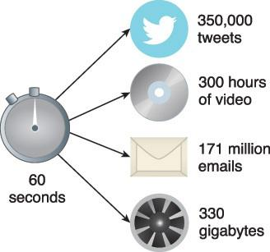
2) Velocity:
Refers to the speed at which new data is generated and the speed at which data moves around. Just think of social media messages going viral in seconds
.
Example: 72 hours of video are uploaded to YouTube every minute this is the velocity. Extremely high velocity of data is another major characteristic of big data.

Slide 22
3) Variety
Refers to the different types of data generated from different sources.
It can be structured, semi-structured or unstructured.eg: data generated by sensors, electronic devices, social media etc..
In the past we only focused on structured data that neatly fitted into tables or relational databases, such as financial data.
It can be structured, semi-structured or unstructured.

Slide 23
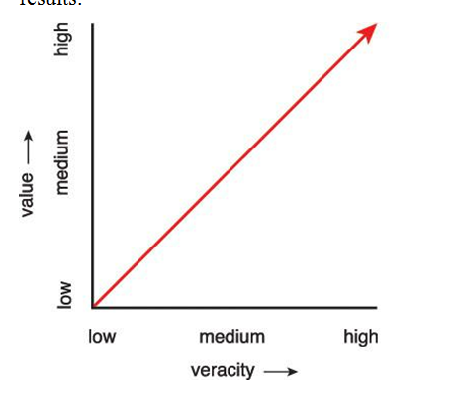
Veracity
Data should be accurate and reliable . Veracity refers to the quality or fidelity of data
5) Value
Value is defined as the usefulness of data for an enterprise. The value characteristic is intuitively related to the veracity characteristic in that the higher the data fidelity, the more value it holds for the business.

Slide 24
Types of Data
1) Structured Data
2) Semi-structured Data
3) Unstructured Data
Structured Data : data that has both Data Model and schema, eg : oracle Data
Semi-Structured : data that has only schema, eg : XML data
Unstructured : Data that doesn’t have Data Model and schema,eg: facebook data

