Slide 1
UNIT-1
Cloud Computing
By
Dr. M. Kalpana Devi
Assoc. Professor

Slide 2
UNIT-1
Cloud Computing Overview
1.1) what is Cloud Computing
1.2) Cloud Components
1.3) Infrastructure
1.3.1) Grid Computing
1.3.2) Full Virtualization
1.3.3) Para Virtualization
1.4) Services
1.4.1) Software as a Service
1.4.2) Platform as a Service
1.4.3) Hardware as a Service
2) First Movers in the cloud
2.1) Amazon
2.2) Google
2.3) Microsoft
3) When you can use Cloud Computing
3.1) scenarios
3.2) when you shouldn't use cloud computing
4) Benefits
5) Limitations
6) Security Concerns

Slide 3
CLOUD COMPUTING
Cloud Computing is the delivery of on-demand computing services over the internet on a pay –as –you-go basis
For Eg: Rather than managing files on a local storage device , cloud computing makes it possible to save them over internet

Slide 4
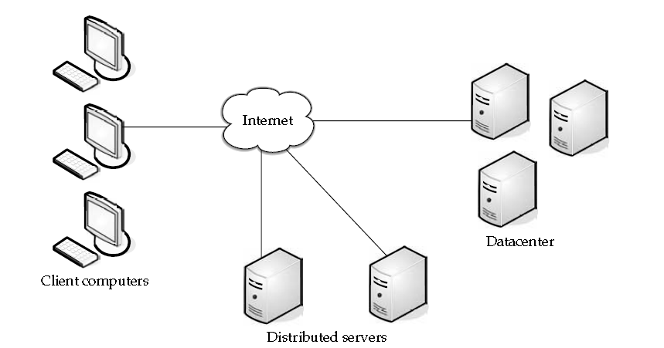
1.2) Cloud Components
Three Components that make up a cloud computing solution are
1.2.1) Clients
1.2.2) The Data Center
1.2.3) Distributed Servers

Slide 5
1.2.1) Clients
Clients are the devices that the end users used to interact with Cloud.
Clients generally fall into 3 categories
Mobile
Thin
Thick
Mobile Devices include smart phones like Blackberry, windows mobile ,iphone etc..
Thin Clients is a network computer without a hard disk drive. They act as a simple terminal to the server and require constant communication with the server as well.
Thick Client is a Regular computer, using a web browser like Firefox or Internet Explorer to connect to the cloud.

Slide 6
Thin Clients are becoming an increasingly popular solution because of their price and effect on the environment
Lower Hardware Costs
Thin Clients are cheaper than Thick Clients because
do not contain much hardware
Last for longer time because no need to upgrade or it wont get obsolete.
Lower IT Costs
Managed at the server side, so only fewer points will get failure
Security
No Hard Drive, so Processing takes place on the server, less chances of malware invading the device.
Data Security
Since data is stored on the server, less chance for data to be lost, even client computer crashes or stolen

Slide 7
Less Power Consumption
Consumes less power than thick clients
Ease of Repair or Replacement
If thin client dies, easy to repair or replace
Less Noise
No Spinning hard drive, so Less heat
Quieter fans required, so Less noise
1.2.2) Data Center
A data center is a repository that houses computing facilities like servers, routers, switches and firewalls, as well as supporting components like backup equipment, fire suppression facilities and air conditioning.
A data center may be complex (dedicated building) or simple (an area or room that houses only a few servers). Additionally, a data center may be private or shared.

Slide 8
1.2.3) Distributed Servers
Servers of Data Center need not be housed in the same location
They are often in geographically disparate locations
But to the cloud subscribers , these servers act as if they are right next to each other

Slide 9
1.3) Infrastructure
There are several different ways the infrastructure can be deployed. The infrastructure will depend on the application and how the provider has chosen to build the cloud solution.
This is one of the key advantages for using the cloud. Your needs might be so massive that the number of servers required far exceeds your desire or budget to run those in-house.
Alternatively, you may only need a sip of processing power, so you don’t want to buy and run a dedicated server for the job. The cloud fits both needs

Slide 10
Grid computing
Grid computing is often confused with cloud computing, but they are quite different.
Grid computing applies the resources of numerous computers in a network to work on a single problem at the same time.
This is usually done to address a scientific or technical problem.
A well-known example of this is the Search for Extraterrestrial Intelligence (SETI) @Home project.
In this project, people all over the world allow the SETI project to share the unused cycles of their computers to search for signs of intelligence in thousands of hours of recorded radio data.

Slide 11
Another well-used grid is the World Community Grid—Berkeley Open Infrastructure for Network Computing (BOINC; see www.worldcommunity grid.org).
Here you can dedicate as much or as little of your idle CPU processing power as you choose to help conduct protein-folding experiments in an effort to create better and more durable rice crops to feed the world’s hungry.
Grid computing necessitates the use of software that can divide and then send out pieces of the program to thousands of computers.
It can be done throughout the computers of an organization, or it can be done as a form of public collaboration.
Sun Microsystems offers Grid Engine software that allows engineers at companies to pool the computer cycles on up to 80 workstations at a time..

Slide 12
Grid computing is appealing for several reasons:
• It is a cost-effective way to use a given amount of computer resources.
• It is a way to solve problems that need a tremendous amount of computing power.
• The resources of several computers can be shared cooperatively, without one computer managing the other.
In grid computing, a large project is divided among multiple computers to make use of their resources.
Cloud computing does just the opposite. It allows multiple smaller applications to run at the same time.

Slide 13
VIRTUALIZATION
Virtualization is a component of cloud.
It is not Cloud Computing itself.
Virtualization is separating the operating system from the hardware
If we try to pull the OS from the physical hardware and put it on different hardware, it will get mess basically with device drivers and other things.
Because It will get linked with the hardware in such a way that we cannot pull it and put it on another piece of hardware . i.e migration becomes a tedious, long and annoying .

Slide 14
Virtualization is the "creation of a virtual (rather than actual) version of something, such as a server, a desktop, a storage device, an operating system or network resources".
In other words, Virtualization is a technique, which allows to share a single physical instance of a resource or an application among multiple customers and organizations.
It does by assigning a logical name to a physical storage and providing a pointer to that physical resource when demanded.
Types of Virtualization:
Hardware Virtualization.
Operating system Virtualization.
Server Virtualization.
Storage Virtualization.

Slide 15
1) Hardware Virtualization:
When the virtual machine software or virtual machine manager (VMM) is directly installed on the hardware system is known as hardware virtualization.
2) Operating System Virtualization:
When the virtual machine software or virtual machine manager (VMM) is installed on the Host operating system instead of directly on the hardware system is known as operating system virtualization.
3) Server Virtualization:
When the virtual machine software or virtual machine manager (VMM) is directly installed on the Server system is known as server virtualization.
4) Storage Virtualization:
Storage virtualization is the process of grouping the physical storage from multiple network storage devices so that it looks like a single storage device.

Slide 16
In Olden days, OS is installed directly on Hardware where as now a Hypervisor layer or Virtual Box is installed on Hardware and then n number of OS instances can be installed on the Hypervisor.
So, the instances of OS are installed on hypervisor not on the Physical hardware. i.e it is no longer tied to the Physical Hardware.
Can move instance of one of these OS over the hypervisor as easily as moving a file or picture provided the target hardware also should have the same hypervisor
Instead of having 50 servers spread over 50physical computers, we can have 50 instances of servers installed on one physical box these are the reasons why virtualization is important

Slide 18
Hypervisor
A Hypervisor or Virtual Machine Manage(VMM) is computer software, firmware or hardware that creates and runs Virtual Machines.
A Computer on which a hypervisor runs one or more virtual machines is called a Host Machine and, each virtual Machine is called a Guest Machine
Multiple instances of a variety of OS may share the virtualized hardware resources.
For example, Linux, windows, and macOS instances can all run on a single physical x86 machine.
A hypervisor is a software tool installed on the host system to provide a layer of abstraction.
Once a hypervisor is installed, OSes and applications interact with the virtualized resources abstracted by the hypervisor -- not the physical resources of the actual host computer.

Slide 19
The hypervisor is a software that can virtualize the hardware resources.
Hypervisors are classified into two types
1) Type – 1 (Native or Bare-Metal Hypervisor)
2) Type – 2 (Hosted Hypervisor)
Type – 1(Native or bare-Metal Hypervisor)
These hypervisors run directly on the hosts hardware to control the hardware and to manage guest operating systems.
For this reason, they are sometimes called Bare Metal Hypervisors.
Type – 2(Hosted Hypervisor)
These hypervisors run on a conventional Operating System just as other
computer programs do.
Type-2 hypervisors abstract guest Operating Systems from the host Operating System.

Slide 20
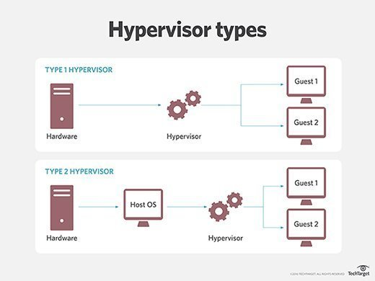

Slide 21
Different types of virtualization based on the level of isolation are
Full Virtualization
Para Virtualization
1) Full Virtualization
The hypervisor provides complete abstraction, and the guest OSes don't know -- or care -- about the presence of a hypervisor.
The OS doesn't talk to the hypervisor. Each VM and its guest OS works just as if it was running alone on independent computers, and no special modifications or adaptations are needed in the OSes.
Full Virtualization is virtualization in which the guest operating system is unaware that it is in a virtualized environment, and therefore hardware is virtualized by the host operating system so that the guest can issue commands to what it thinks is actual hardware, but really are just simulated hardware devices created by the host.

Slide 22
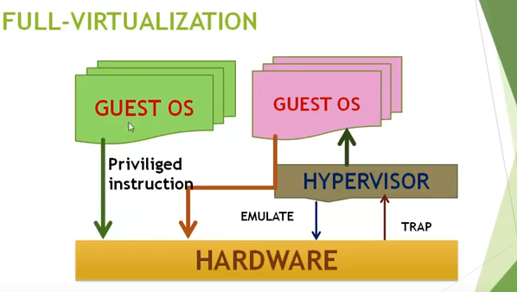

Slide 23
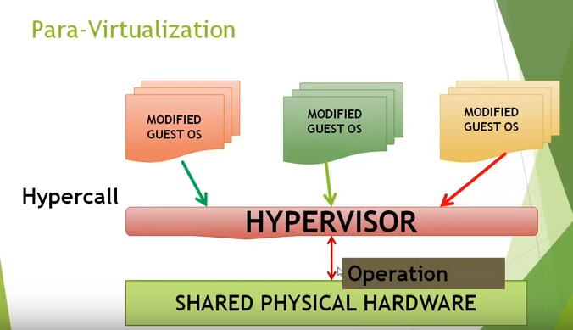
2) Para Virtualization
Paravirtualization is virtualization in which the guest operating system is aware that it is a guest.
Paravirtualization allows the guest OS to actually recognize the presence of a hypervisor and communicate directly with that hypervisor.
the guest VM OSes must be modified or adapt for exchanging hypercalls with the paravirtualization hypervisor.

Slide 24
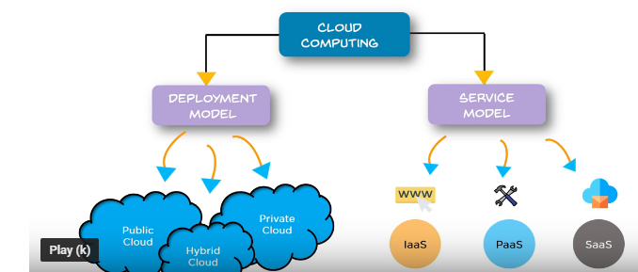
Two Models of Cloud Computing are
Deployment Models
Service Models

Slide 25
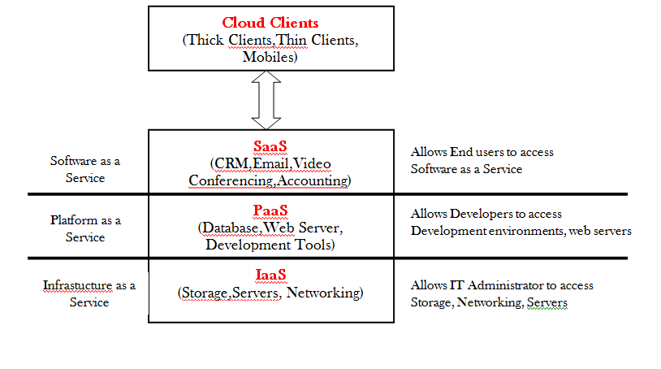
1.4) Services
1.4.1) Software as a Service(SaaS)
1.4.2) Platform as a Service(PaaS)
1.4.3) Infrastructure as a Service(IaaS)

Slide 26
The Term Service in Cloud Computing is able to use reusable, fine grained components across a vendor’s network.
Benefits with such “ as a service” are
Allows to make them available to small business
Allows to use components in large scale
Allows resources or components to be shared by many users
Allows users to access resources on different hardware

Slide 27
1.4.1) Software as a Service(SaaS)
Software as a Service(SaaS)is one of the service Model, in which an application is hosted as a service to customers who access it via the internet
The Customer doesn’t have to maintain it or support it and the provider does all patching and upgrades as well as keeping the infrastructure Running
Some of these applications include
Billing and Invoicing system
Customer Relationship Management
Accounting
Sales
SaaS removes the need for Organization to install and run applications on their own computers .
This eliminates the expense of and maintenance , as well as software licensing, installation and support

Slide 28
Characteristics of SaaS
Managed from a central location
Hosted on a remote server
Accessible over the internet
Users not responsible for hardware or software updates

Slide 30
When to Use SaaS
There are many different situations in which SaaS may be the most beneficial, including:
If you are a startup or small company that needs to launch e-commerce quickly and don’t have time for server issues or software
For short-term projects that require collaboration
If you use applications that aren’t in-demand very often, such as tax software
For applications that need both web and mobile access

Slide 31
Other Benefits of the SaaS Model Include
Flexible Payments
Scalable usage
Automatic updates
Smaller Staff
Better Marketing
Customization
1) Flexible Payments
Rather than purchasing software to install, the customers subscribe to a SaaS offering
Generally, they pay for this service on a monthly basis using a pay-as-you-go model

Slide 32
Scalable Usage
Cloud Services like SaaS offer high scalability, which gives customers the option to access more, or fewer services on-demand
Automatic Updates
Rather than purchasing new software, customers can rely on a SaaS Providers to automatically perform updates and patch management
This further reduces the burden on in-house IT Staff.
Smaller Staff
IT Systems require the overhead of salaries, benefits, insurance and building space.
The ability to get applications from cloud reduces the need for as much IT staff.

Slide 33
Better marketing
A Vendor who have developed an application for a very narrow market might have had problems marketing that application
With SaaS, the entire world is open to the providers.
Customization
Older applications were difficult to customize and required tinkering with the code
SaaS applications are much easier to customize and can give an organization exactly what they want.
Notes:
(Generally Many Organizations have some common functionalities and few specific functionalities. For Eg: Educational institutes follows same common rules for many functionalities and some specific rules for some functionalities )
For common functionalities ,cloud software’s are opt and for specific functionalities , the cloud softwares are not suitable

Slide 34
Issues or Obstacles
Organizations that has a very specific computation needs might not be able to find the application available through SaaS. In That case, they need to buy the software and install it on their local Machines
Unable to port the application to a new vendor. old vendor might charge a hefty moving fee.
Notes:
If we have committed with one service provider and we came to know that other provider’s software is more suitable for our need .To move from one provider to another , he has to pay hefty amount to the old vendor because he would have agreement for a particular period like 1 year or 2 years

Slide 35
1.4.2) Platform as a Service(PaaS)
PaaS provides cloud platforms and runtime environment for developing , testing and managing applications
In addition to storage and other computing resources, users are able to use a suite of prebuilt tools to develop, customize and test their own applications.
It allows software developers to deploy applications without requiring all the related infrastructure
PaaS has a feature of Point-and-Click tools that enables non-developers to create web applications
Google’s App Engine, Force.com are examples of PaaS Offering vendors
Developers may log on to these websites and use the built-in API to create web based applications
Users : Software Developers

Slide 36
Characteristics of PaaS
It is built on virtualization technology, meaning resources can easily be scaled up or down as your business changes
Provides a variety of services to assist with the development, testing, and deployment of apps
Numerous users can access the same development application

Slide 38
When to use PaaS
There are many situations that utilizing PaaS is beneficial or even necessary.
PaaS is beneficial if you wish to be able to create your own customized applications.
This cloud service also can greatly reduce costs and it can simplify some challenges that come up if you are rapidly developing or deploying an app.

Slide 40
Benefits of PaaS
Consumers need not bother about the administrative tasks because it’s the responsibility of Cloud Provider
Customers need not purchase expensive hardware, servers and Data Storage
It is very easy to scale up or down automatically based on application resource demands.
It is the responsibility of providers to maintain software versions and patch installations

Slide 42
Issues of PaaS
Lack of Portability between PaaS Clouds
One of the disadvantage of PaaS is that the developer lock-in with a particular vendor
For Eg: an application written in python using Google App Engine is likely to work only in that environment.
Therefore the vendor lock –in is the biggest problem in PaaS
Security Engineering of PaaS Applications
Since the PaaS Applications are dependent on network, PaaS applications must explicitly use crypography and manage security exposures
Notes:
The vendor lock-in problem incloud computing is the situation where customers are dependent (i.e. locked-in) on a single cloud provider technology implementation and cannot easily move in the future to a different vendor without substantial costs, legal constraints, or technical incompatibilities

Slide 43
Not easy to switch service providers
Cloud service providers promises vendors that the cloud will be flexible to use and integrate, however switching cloud services is not easy.
Most organizations may find it difficult to host and integrate current cloud applications on another platform.
Interoperability and support issues may arise such as applications developed on Linux platform may not work properly on Microsoft Development Framework (.Net).
Notes:
The vendor lock-in problem incloud computing is the situation where customers are dependent (i.e. locked-in) on a single cloud provider technology implementation and cannot easily move in the future to a different vendor without substantial costs, legal constraints, or technical incompatibilities

Slide 44
Notes:
The vendor lock-in problem incloud computing is the situation where customers are dependent (i.e. locked-in) on a single cloud provider technology implementation and cannot easily move in the future to a different vendor without substantial costs, legal constraints, or technical incompatibilities

Slide 45
1.4.1)Infrastructure as a Service(IaaS)
A vendor provides clients pay-as-you-go access to storage, networking, servers and other computing resources in the cloud.
Organizations use their own platforms and applications within a service provider’s infrastructure.
IaaS is a cloud service that provides basic computing infrastructure
Services are available on PAY-FOR-WHAT-YOU-USE Model
IaaS Providers include Amazon Web Services, Microsoft Azure and Google Compute Engine
Users: IT Administrator

Slide 46
Characteristics of IaaS
Virtual Machines with pre-installed software
Virtual machines with pre-installed OS such as windows, linux etc..
Resources are available as a service
The cost varies depending on consumption
Services are highly scalable
Typically includes multiple users on a single piece of hardware
Provides complete control of the infrastructure to organizations
Dynamic and flexible

Slide 48
When to use IaaS
Just as with SaaS and PaaS, there are specific situations when it is the most advantageous to use IaaS.
If you are a startup or a small company, IaaS is a great option so you don’t have to spend the time or money trying to create hardware and software.
For rapidly growing companies, IaaS can be a good option as you don’t have to commit to a specific hardware or software as your needs change and evolve.
It also helps if you are unsure what demands a new application will need as there is a lot of flexibility to scale up or down as needed.

Slide 49
Benefits of IaaS
Is the most flexible cloud computing model
Easily allows for automated deployment of storage, networking, servers, and processing power
Hardware can be purchased based on consumption
Gives clients complete control of their infrastructure
Resources can be purchased as-needed
Is highly scalable

Slide 51
Issues of IaaS
Compatability with legacy security vulnerabilities
Because IaaS offers the consumer to run legacy software in providers infrastructure, therefore it exposes consumers to all of the security vulnerabilities of such legacy software.
Virtual Machine sprawl
The VM sometimes become out of data w.r.t security updates. however , the provider can automatically update such VM’s, but this mechanism is hard and complex
Data Erase Practice
The consumer uses virtual machine’s that in turn uses the common disk resources provided by the cloud provider
When the consumer releases the resources, the cloud provider must ensure that next consumer to rent the resource does not observe data residue from previous consumer

Slide 53
Software
Platform
Infrastructure
Notes:
Flour, sugar,butter and eggs are infrastructure. electricity, oven,cakepan comes under platform and dining table, water comes under software .Having dining table, water , electricity, oven, and cake pan and Getting infrastructure like flour, sugar, butter, eggs for making cake is an example of IaaS, e

Slide 54
Deployment Models

Slide 55
Cloud is the future of computing. It is about outsourcing of IT services and infrastructure to make them accessible remotely via the Internet.
Utilizing cloud-computing models boosts not only productivity but also provide a competitive edge to organizations.
The growing popularity of cloud computing has given rise to different types of cloud service deployment models and strategies.
Therefore, today there exists a variety of enterprise cloud solutions depending on the degree of desired outsourcing needs.

Slide 57
Public Cloud
Public clouds are available to the general public, and data are created and stored on third-party servers.
Server infrastructure belongs to service providers that manage it and administer pool resources, which is why there is no need for user companies to buy and maintain their own hardware.
Provider companies offer resources as a service both free of charge or on a pay-per-use basis via the Internet. Users can scale resources as required.
The public cloud deployment model is the first choice for businesses with low privacy concerns.

Slide 59
The Advantages of a Public Cloud
Hassle-free infrastructure management.
You do not need to develop and maintain your software because the service provider does it for you.
High scalability.
You can easily extend the cloud’s capacity as your company requirements increase.
Reduced costs.
You pay only for the service you use, so there’s no need to invest in hardware or software.
24/7 uptime.
The extensive network of your provider’s servers ensures your infrastructure is constantly available and has improved operation time.

Slide 60
The Disadvantages of a Public Cloud
Compromised reliability.
That same server network is also meant to ensure against failure But often enough, public clouds experience outages and malfunction, as in the case of the 2016 Salesforce CRM disruption that caused a storage collapse.
Data security and privacy issues give rise to concern.
Although access to data is easy, a public deployment model deprives users of knowing where their information is kept and who has access to it.
The lack of a bespoke service.
Service providers have only standardized service options, which is why they often fail to satisfy more complex requirements.

Slide 61
2. Private Cloud
Only one specific company owns a private cloud. That is why it is also called an internal or corporate model.
The server can be hosted externally or on the premises of the owner company.
Regardless of their physical location, these infrastructures are maintained on a designated private network and use software and hardware that are intended for use only by the owner company.
A clearly defined scope of people have access to the information kept in a private repository, which prevents the general public from using it.
In light of numerous breaches in recent years, a growing number of large corporations has decided on a closed private cloud model, as this minimizes data security issues.

Slide 62
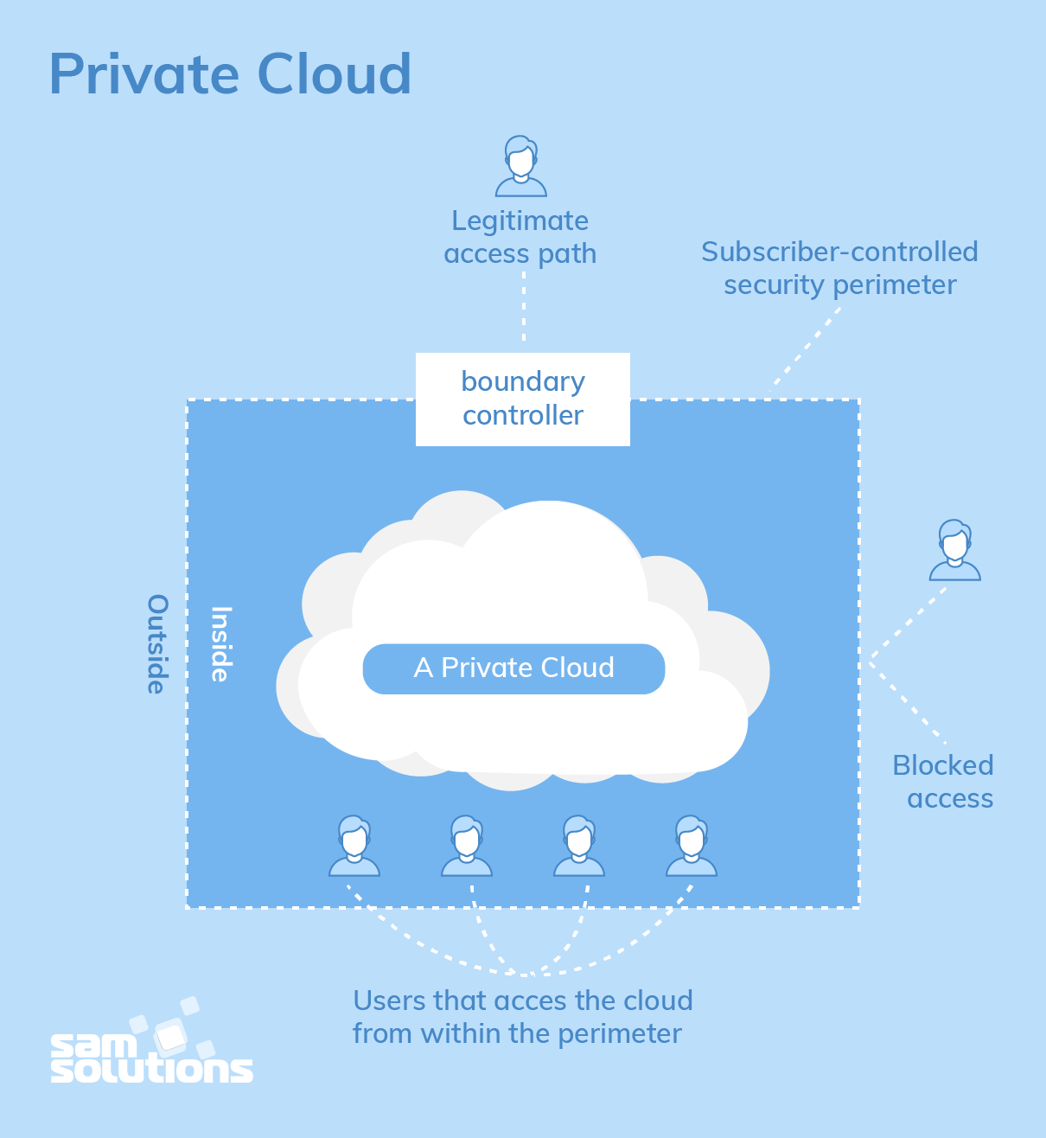
A private model is especially suitable for companies that seek to safeguard their mission-critical operations or for businesses with constantly changing requirements.

Slide 63
The Benefits of a Private Cloud
All the benefits of this deployment model result from its autonomy. They are the following:
Bespoke and flexible development and high scalability, which allows companies to customize their infrastructures in accordance with their requirements
High security, privacy and reliability, as only authorized persons can access resources

Slide 64
The Drawbacks of a Private Cloud
The major disadvantage of the private cloud deployment model is its cost, as it requires considerable expense on hardware, software and staff training.
That is why this secure and flexible computing deployment model is not the right choice for small companies.

Slide 65
3. Community Cloud
A community deployment model largely resembles the private one; the only difference is the set of users.
Whereas only one company owns the private cloud server, several organizations with similar backgrounds share the infrastructure and related resources of a community cloud.
If all the participating organizations have uniform security, privacy and performance requirements, this multi-tenant data center architecture helps these companies enhance their efficiency, as in the case of joint projects.
A centralized cloud facilitates project development, management and implementation. The costs are shared by all users.

Slide 67
The Strengths of a Community Cloud
Cost reduction
Improved security, privacy and reliability
Ease of data sharing and collaboration
The Shortcomings of a Community Cloud
High cost compared to the public deployment model
Sharing of fixed storage and bandwidth capacity
Not commonly used yet

Slide 68
4. Hybrid Cloud
As is usually the case with any hybrid phenomenon, a hybrid cloud encompasses the best features of the abovementioned deployment models (public, private and community).
It allows companies to mix and match the facets of the three types that best suit their requirements.
As an example, a company can balance its load by locating mission-critical workloads on a secure private cloud and deploying less sensitive ones to a public one.
The hybrid cloud deployment model not only safeguards and controls strategically important assets but does so in a cost- and resource-effective way.
In addition, this approach facilitates data and application portability.

Slide 70
The Benefits of a Hybrid Cloud
Improved security and privacy
Enhanced scalability and flexibility
Reasonable price
However, the hybrid deployment model only makes sense if companies can split their data into mission-critical and non-sensitive.

Slide 71
 | Public | Private | Community | Hybrid
Ease of setup and use | Easy | Requires IT proficiency | Requires IT proficiency | Requires IT proficiency
Data security and privacy | Low | High | Comparatively high | High
Data control | Little to none | High | Comparatively high | Comparatively high
Reliability | Low | High | Comparatively high | High
Scalability and flexibility | High | High | Fixed capacity | High
Cost-effectiveness | The cheapest | Cost-intensive; the most expensive model | Cost is shared among community members | Cheaper than a private model but more costly than a public one
Demand for in-house hardware | No | Depends | Depends | Depends

Slide 73
First Movers in the cloud
There are scores of vendors who offer cloud services
The well known vendors are:
2.1 Amazon
2.2 Google
2.3 Microsoft

Slide 74
2.1 Amazon:
Amazon was one of the first companies to offer cloud services to the public, and they are very sophisticated.
Amazon offers a number of cloud services, including
1) Elastic Compute Cloud (EC2)
Offers virtual machines and extra CPU cycles for your organization. •
Simple Storage Service (S3)
Allows you to store items up to 5GB in size in Amazon’s virtual storage service. •
Simple Queue Service (SQS)
Allows your machines to talk to each other using this message-passing API. •

Slide 75
SimpleDB
A web service for running queries on structured data in real time.
This service works in close conjunction with Amazon Simple Storage Service (Amazon S3) and Amazon Elastic Compute Cloud (Amazon EC2), collectively providing the ability to store, process, and query data sets in the cloud.
These services can be difficult to use, because they have to be done through the command line.
if you are used to working in a command-line environment, you shouldn’t have much trouble using the services.
Amazon is the most extensive cloud service to date.
You can see more about Amazon’s cloud services at http://aws.amazon.com.

Slide 76
2.2) Google
In contrast to Amazon’s offerings is Google.
On Amazon you get root privileges, but on App Engine, you can’t write a file in your own directory.
i.e in Google, to store data you must use Google’s database.

Slide 77
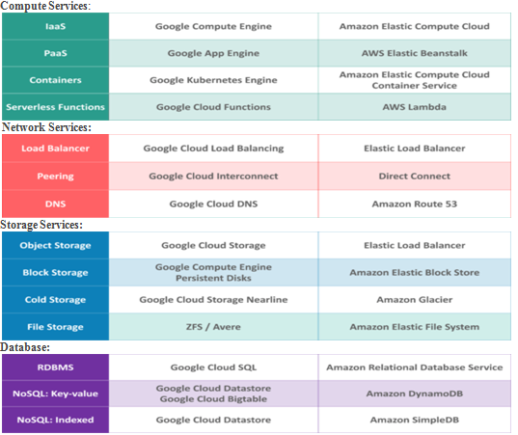
Let us see the various Services offered by AWS and GCP

Slide 79
These are some common services offered by both the platforms.
In terms of Services AWS is the clear winner, as the amount of services offered by AWS is way more than offered by GCP.
Services available on AWS is extremely broad and wide.
Now Google Cloud Platform is a clear winner when it comes to the cost of Services.
For Example, 2CPU 8GB RAM instance for GCP is priced at $50 per month whereas AWS instance is priced at $69 per month. You save 25% on the same instance selected.

Slide 80
AWS: Total of 18 Regions, with more than 3 zones per Region
GCP: Total of 15 Regions, with more than 2 zones per Region
If we talk about the scope of customization of instances, GCP wins this category as it provides a wide range of customization for any Instance, whereas the amount of customization available on AWS is limited.

Slide 81
2.3) Microsoft
Microsoft Azure, formerly known as Windows Azure, is Microsoft's public cloud computing platform. It provides a range of cloud services, including those for compute, analytics, storage and networking.
Users can pick and choose from these services to develop and scale new applications, or run existing applications, in the public cloud.
Microsoft is a little late to the cloud party and isn’t a leader in cloud computing. That honor goes to Google and Amazon

Slide 82
Key components of Azure Services Platform include
Microsoft SQL Services Provides database services and reporting.
Microsoft .NET Services Provides service-based implementations of .NET Framework concepts such as workflow.
Live Services Used to share, store, and synchronize documents, photos, and files across PCs, phones, PC applications, and web sites.

Slide 83
When You Can Use Cloud Computing
Whether or not you should use cloud computing depends on a number of factors, including
Cost/benefit ratio
Speed of delivery
How much capacity you will use
Whether your data is regulated
Your organization’s corporate and IT structure
There may be times when the need you have is a perfect match for cloud computing.
Notes:
How much cost u can spend what type of benefit we will get, how much speed we require and how much it can help us, the capacity we want , how much the data is regulated in the organizations and how the organization is structured . Based on these, we should decide whetehr we have to got o cloud or no need

Slide 84
But there may also be times when cloud computing is simply not a good match for your needs.
Cloud Computing provides the following basic solutions so, organizations which are in need of these solutions can go for Cloud Computing solutions
Scenarios
There are three different major implementations of Cloud Computing
Compute Cloud
Cloud Storage
Cloud Applications

Slide 85
a) Compute Cloud
Compute Cloud is one of the Cloud Computing solution, which allows to access highly scalable, inexpensive, on-demand computing resources to run the code given to it.
Some Examples of Compute Cloud are
Amazon’s EC2
Google App Engine
b) Cloud Storage
Cloud Storage allows to store your data on a vendor’s equipment
One of the first cloud offerings is cloud storage and it remains a popular solution.
Notes:
How much cost u can spend what type of benefit we will get, how much speed we require and how much it can help us, the capacity we want , how much the data is regulated in the organizations and how the organization is structured . Based on these, we should decide whetehr we have to got o cloud or no need

Slide 86
There are already in excess of 100 vendors offering cloud storage
This is an ideal solution if we want to maintain files off-site
Security and cost are the top issues in this field and vary greatly , depending on the vendor you choose
Currently Amazon S3 is leading towards storage
c) Cloud Applications
Cloud applications differ from compute clouds in that they utilize software applications that rely on cloud infrastructure.
Notes:
How much cost u can spend what type of benefit we will get, how much speed we require and how much it can help us, the capacity we want , how much the data is regulated in the organizations and how the organization is structured . Based on these, we should decide whetehr we have to got o cloud or no need

Slide 87
Cloud applications are versions of Software as a Service (SaaS) and include such things as web applications that are delivered to users via a browser or application like Microsoft Online Services.
Cloud applications often eliminate the need to install and run the applications on the customer’s own computer .
Thus , eliminating the burden of software maintenance, ongoing operation and support

Slide 88
When you shouldn’t use Cloud Computing
There are plenty of cases where cloud computing may not be appropriate for any reason ranging from cost to hardware requirements
Minding the Details
if you want to put HIPAA(Health Insurance Portability and Accounting Act) data on a cloud , you should not because the sensitive information in that data may get revealed when such data is mingled with another organization’s data in the server.
Notes:
How much cost u can spend what type of benefit we will get, how much speed we require and how much it can help us, the capacity we want , how much the data is regulated in the organizations and how the organization is structured . Based on these, we should decide whetehr we have to got o cloud or no need

Slide 89
Legislative Issues
Data that contains sensitive information should not be uploaded in cloud because there are laws and policies that allow the government freer access to data on a cloud than on a private server.
For example, the Stored Communications Act allows the FBI access to data without getting a warrant or the owner’s consent.

Slide 90
Geopolitical Concerns
Organizations should not post their legal data to another countries cloud because the Organizations does not know the legal policies or Acts of the country.
For Eg., if you are in canada and you should not post your data to American Cloud.
Canadian Government has declared there government workers, not post their government details to cloud because it may get revealed according to other countries Act.
Notes:
How much cost u can spend what type of benefit we will get, how much speed we require and how much it can help us, the capacity we want , how much the data is regulated in the organizations and how the organization is structured . Based on these, we should decide whetehr we have to got o cloud or no need

Slide 91
Hardware Dependencies
if an application requires specific hardware, chips, drivers then cloud is not a right choice because the service provider may not have exact hardware we require, it will have precise(approximate) hardware we require.
This will significantly narrow our options.
Server Control
Some applications need full control over server i.e. detailed control over amount of memory , CPU, Hard drive specification etc..then cloud is not an appropriate match for such applications'

Slide 92
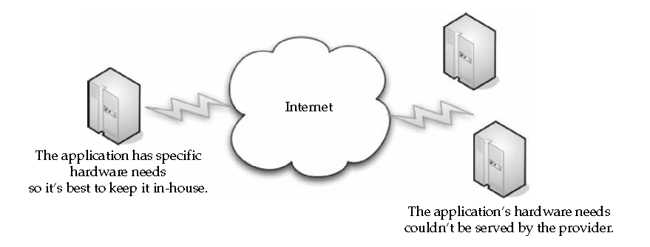
Cost
One of the Biggest Benefit of Cloud Computing is Cost.
Generally its less expensive to run an application , than to invest on infrastructure , buy the application and manage it.
However, overtime, it may cost more to pay the cloud subscription than to have simply bought the servers yourself.
Notes:
How much cost u can spend what type of benefit we will get, how much speed we require and how much it can help us, the capacity we want , how much the data is regulated in the organizations and how the organization is structured . Based on these, we should decide whetehr we have to got o cloud or no need

Slide 93
Lack of need
If there is no need to get services from cloud then no need to go for cloud
If we just want to use cloud for fashion sake, then cloud is not an appropriate choice
Integration with Existing Apps
Integration between on-premises and cloud based systems can be problematic
i.e integration an application from our system with an application in the cloud leads to problem like security, speed, reliabilitiy.
Latency Concerns
In Cloud, the data and application are located on a series of servers geographically disparate from our own site
Notes:
How much cost u can spend what type of benefit we will get, how much speed we require and how much it can help us, the capacity we want , how much the data is regulated in the organizations and how the organization is structured . Based on these, we should decide whetehr we have to got o cloud or no need

Slide 94
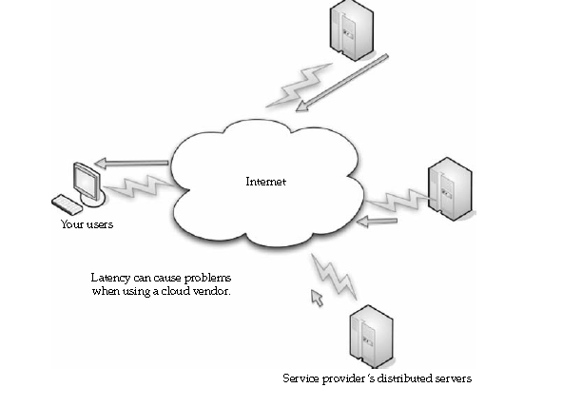
If end user requests for a data, it is going to take some time for the data to reach you.
But if you require data instantaneously, the cloud might not be our best option
Notes:
How much cost u can spend what type of benefit we will get, how much speed we require and how much it can help us, the capacity we want , how much the data is regulated in the organizations and how the organization is structured . Based on these, we should decide whetehr we have to got o cloud or no need

Slide 95
Throughput Demands
Throughput – how much data can be transferred from one location to another in a given amount of time
Cloud computing is generally billed based on pay-as-you-go model but that is great and fair until we didn’t go for more throughput
Once we demand more throughputs, the more we have to pay
So, cloud is not the right choice when we demand more throughputs
Notes:
How much cost u can spend what type of benefit we will get, how much speed we require and how much it can help us, the capacity we want , how much the data is regulated in the organizations and how the organization is structured . Based on these, we should decide whetehr we have to got o cloud or no need

Slide 97
Benefits of Cloud Computing
1) Efficiency / cost reduction
By using cloud infrastructure, you don’t have to spend huge amounts of money on purchasing and maintaining equipment.
This drastically reduces capex costs.
You don’t have to invest in hardware, facilities, utilities, or building out a large data center to grow your business.
You do not even need large IT teams to handle your cloud data center operations, as you can enjoy the expertise of your cloud provider’s staff.
Scalability
Cloud Computing allows to scale up and scale down the computing resources based on requirements.
i.e cloud infrastructure scales on demand to support fluctuating workloads
Notes:
How much cost u can spend what type of benefit we will get, how much speed we require and how much it can help us, the capacity we want , how much the data is regulated in the organizations and how the organization is structured . Based on these, we should decide whetehr we have to got o cloud or no need

Slide 98
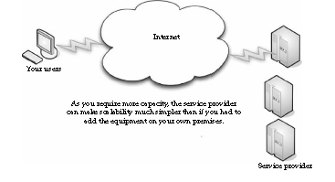
For Example: a sales promotion might be widely popular, so sales of a particular organization will get increased,. To do so , capacity can be added quickly to avoid crashing servers and to lose profit.
When the sale is over, capacity can shrink to reduce costs.
Notes:
How much cost u can spend what type of benefit we will get, how much speed we require and how much it can help us, the capacity we want , how much the data is regulated in the organizations and how the organization is structured . Based on these, we should decide whetehr we have to got o cloud or no need

Slide 99
Simplicity
The first advantage of cloud computing is its simplicity
Instead of buying, installing and configuring a resource, cloud simplifies the process of using a computing resource by accessing it through the internet using pay-as-you-go-model
4) Knowledgeable Vendors
When new technology becomes popular, there are plenty of vendors who pop up to offer their version of that technology. But the technology they are offering are not reliable.
Whereas cloud providers like Amazon, Google, Microsoft are reliable because they are branded organizations so they offer reliable services and provide plenty of capacity
4) More Internal resources
By shifting non-important or non-critical data to cloud, the IT department staff are freed up to work on important, business related work
Notes:
How much cost u can spend what type of benefit we will get, how much speed we require and how much it can help us, the capacity we want , how much the data is regulated in the organizations and how the organization is structured . Based on these, we should decide whetehr we have to got o cloud or no need

Slide 100
So, no need to add more man power and training to do business works.
Thus, cloud reduces more Internal Resources
5) Storage options
Users can choose public, private or hybrid storage offerings, depending on security needs and other considerations.
6) Control choices
Organizations can determine their level of control with as-a-service options.
These include software as a service (SaaS), platform as a service (PaaS) and infrastructure as a service (IaaS).
7) Data Security
storing data on the cloud is safer than storing it on physical servers and data centers
Notes:
How much cost u can spend what type of benefit we will get, how much speed we require and how much it can help us, the capacity we want , how much the data is regulated in the organizations and how the organization is structured . Based on these, we should decide whetehr we have to got o cloud or no need

Slide 101
One of the major concerns of every business, regardless of size and industry, is the security of its data.
Data breaches and other cybercrimes can destroy a company’s profit, customer loyalty and brand positioning.
Cloud offers many advanced security features that guarantee that data is securely stored and handled.
8) Disaster recovery
Data loss is a major concern for all organizations, along with data security.
Storing your data in the cloud guarantees that data is always available, even if your equipment like laptops or PCs, is damaged.
Cloud-based services provide quick data recovery for all kinds of emergency scenarios — from natural disasters to power outages.
9) Competitive edge
Not every company will migrate to the cloud, at least not yet.
However, organizations which adopt cloud find that many benefits that cloud offers positively impacts their business .
Notes:
How much cost u can spend what type of benefit we will get, how much speed we require and how much it can help us, the capacity we want , how much the data is regulated in the organizations and how the organization is structured . Based on these, we should decide whetehr we have to got o cloud or no need

Slide 102
Cloud adoption increases every year, since companies realize that it offers them access to world-class enterprise technology.
And, if you implement a cloud solution now, you’ll be ahead of your competitors.
Limitations
These are other cases when cloud computing is not the best solution for our computing needs.
It is good to know about cloud issues before getting it too deep. Some of them are
1) Requires a constant Internet connection:
Cloud computing is impossible if you cannot connect to the Internet because all the cloud services are accessed through internet.
A dead Internet connection means no work and in areas where Internet connections are few or inherently unreliable, this could be a deal-breaker.
Notes:
How much cost u can spend what type of benefit we will get, how much speed we require and how much it can help us, the capacity we want , how much the data is regulated in the organizations and how the organization is structured . Based on these, we should decide whetehr we have to got o cloud or no need

Slide 103
Your Sensitive Information
Client should take more care when storing data that contains sensitive information in cloud because once data leaves our hands and lands in the lap of a service provider ., then we lost a layer of control
What’s the worry
When data is uploaded in cloud, then it has become much easier for the government to get information from third parties than from a privately owned server.
i.e the door is wide open for government investigators to access the information
Notes:
How much cost u can spend what type of benefit we will get, how much speed we require and how much it can help us, the capacity we want , how much the data is regulated in the organizations and how the organization is structured . Based on these, we should decide whetehr we have to got o cloud or no need

Slide 104
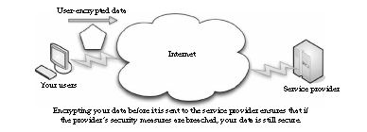
Protect your Data
It doesn’t mean organization cant maintain data on cloud but organizations need to be safe.
The best way is to encrypt the data before sending it to a third party
i.e encrypting the data before sending can protect data.
Of course it applies only to those data created on-house but not the case with data that is edited through online.
Its not possible to encrypt such data (i.e data downloaded from online and edited)
Notes:
How much cost u can spend what type of benefit we will get, how much speed we require and how much it can help us, the capacity we want , how much the data is regulated in the organizations and how the organization is structured . Based on these, we should decide whetehr we have to got o cloud or no need

Slide 105
3) Applications Not Ready
In some cases the applications themselves are not ready to be used on the cloud
First, the application might require a lot of bandwidth to communicate with users.
The application might also take a lot of effort to integrate with your other applications
Some applications may not be able to communicate securely across the Internet. If they cannot communicate securely or through a tunnel, then your data is at risk.
Developing Your Own Applications
Often cloud provides required applications.
However, sometimes we need a very specific application.
And in that case, it becomes necessary to develop application by ourselves
Notes:
How much cost u can spend what type of benefit we will get, how much speed we require and how much it can help us, the capacity we want , how much the data is regulated in the organizations and how the organization is structured . Based on these, we should decide whetehr we have to got o cloud or no need

Slide 106
Rolling Up Your Sleeves
Developing your own applications can certainly be a problem if you don’t know how to program, or if you don’t have programmers on staff.
In such a case, you’ll have to hire a software company (or developer) or be left to use whatever applications the provider offers.
5) Can be slow:
Even with a fast connection, web-based applications can sometimes be slower than accessing a similar software program on your desktop PC.
Everything about the program, has to be sent back and forth from your computer to the computers in the cloud.
If the cloud servers happen to be backed up at that moment, or if the Internet is having a slow day, you would not get the instantaneous access you might expect from desktop applications.
Notes:
How much cost u can spend what type of benefit we will get, how much speed we require and how much it can help us, the capacity we want , how much the data is regulated in the organizations and how the organization is structured . Based on these, we should decide whetehr we have to got o cloud or no need

Slide 107
Security Concerns
Security is a two-sided coin in the world of cloud computing—there are pros and cons. Let’s examine security in the cloud and talk about what’s good, and where you need to take extra care.
IDC(International Data Corporation) conducted a survey of 244 IT executives about cloud services.
As in the following Figure, security led the pack of cloud concerns with 74.5 percent.

Slide 109
Privacy Concerns with a Third Party
The first and most obvious concern is for privacy considerations. That is, if another party is housing all your data, how do you know that it’s safe and secure? You really don’t.
As a starting point, assume that anything you put on the cloud can be accessed by anyone.
But in reality, even if providers are doing their best to secure data, it can still be hacked, and then your sensitive information is at the mercy of whoever broke in.
The best plan of attack is to not perform mission-critical work or work that is highly sensitive on a cloud platform without extensive security controls managed by your organization.

Slide 110
Are They Doing Enough to Secure It?
There is a school of thought that says, in fact, that vendors will be going above and beyond to ensure that your data is secure. This is a simple matter of doing business.
There’s also an issue of performance and efficiency. Since you pay as you go, if you spend an inordinate amount of time on CPU cycles using their security tools, you’ll go looking to the competition
Hackers
There’s a lot they can do if they’ve compromised your data. It ranges from selling your proprietary information to your competition to surreptitiously encrypting your storage until you pay them off.
Or they may just erase everything to damage your business and justify the action based on their ideological beliefs, you may be at the mercy of whatever security measures they support.

Slide 111
Bot Attackers
In a commonly recognized worst-case scenario, attackers use botnets to perform distributed denial of service (DDOS) attacks.
In order to get the hackers to stop attacking your network, you face blackmail.
In Japan, blackmail involving DDOS is on the rise. One major Tokyo firm had to pay 3 million yen (about U.S. $31,000) after the network was brought to a screeching halt by a botnet attack.
Because the attack was so dispersed, police have been unable to track down the attackers.

Slide 113
Security Benefits
This is not to suggest that your data is unsecure on the cloud. Providers do endeavor to ensure security.
But the very nature of the cloud lends it to needing some very strong security practices.
Centralized Data
There are some good security traits that come with centralizing your data. Just in practice, you make your system more inherently secure.

Slide 114
Reduced Data Loss
More than 12,000 laptops are lost in American airports every year.
Also, how many laptops employ really strong security measures, like whole-disk data encryption?
If the laptop can be effectively compromised, the information will be in the hands of the thief.
By maintaining data on the cloud, employing strong access control, and limiting employee downloading to only what they need to perform a task, cloud computing can limit the amount of information that could potentially be lost.

Slide 115
Monitoring
If your data is maintained on a cloud, it is easier to monitor security than have to worry about the security of numerous servers and clients.
Of course, the chance that the cloud would be breached puts all the data at risk, but if you are mindful of security and keep up on it, you only have to worry about one location, rather than several.
Instant Swapover
If your data is compromised, while you are conducting your investigation to find the culprits, you can instantly move your data to another machine.
You also don’t need to spend the time explaining to your C-level management that the system will be down due to an incident.
When you perform the swapover, it’s seamless to your users. You don’t have to spend hours trying to replicate the data or fix the breach. Abstracting the hardware allows you to do it instantly.

Slide 116
Logging
Logging is usually thought of late in the game, and issues develop with storage space.
On a cloud, you don’t need to guess how much storage you’ll need and you will likely maintain logs from the get-go.
Also, you can use more advanced logging techniques.

Slide 117
Secure Builds
When you developed your own network, you had to buy third-party security software to get the level of protection you want.
With a cloud solution, those tools can be bundled in and available to you and you can develop your system with whatever level of security you desire.
Finally, the ability to test the impact of your security changes is enhanced. You simply perform and offline-test the version of your production environment.
This allows you to make sure the changes you make aren’t harm to your network before you put it online.

Slide 118
Improved Software Security
Vendors are likely to develop more efficient security software. Since you’re charged for your CPU cycles.
As such, the vendor doesn’t want to lose your business and is going to be more inclined to develop more efficient security software.
Additionally, the vendor will be likely to look at the entire security setup and tune wherever possible for a more efficient system.
They know that the security vendor who delivers the more efficient product will win the game.

Slide 119
Security Testing
SaaS providers don’t bill you for all of the security testing they do. It’s shared among the cloud users.
The end result is that because you are in a pool with others (you never see them, but they are there), you get to realize lower costs for security testing.
This is also the case with PaaS where your developers create their own code, but the cloud code–scanning tools check the code for security weaknesses.

Slide 120
Thank You

Slide 121
UNIT-2 Cloud Computing Technology
By
Dr. M. Kalpana Devi
Assoc. Professor

Slide 122
UNIT-2
2 Cloud Computing Technology
2.1 Hardware and Infrastructure:
2.1.1 Clients
2.1.2 Security
2.1.3 Network
2.1.4 Services
2.2 Accessing the Cloud:
2.2.1 Platforms
2.2.2 Web Applications
2.2.3 Web APIs
2.2.4 Web Browsers
2.3 Cloud Storage:
2.3.1 Overview
2.3.2 Cloud Storage Providers
2.4 Standards:
2.4.1 Application
2.4.2 Client
2.4.3 Infrastructure
2.4.4 Service
Notes:
2.1 Hardware and Infrastructure:
2.1.1 Clients
2.1.2 Security
2.1.3 Network
2.1.4 Services

Slide 123
2.1 Hardware and Infrastructure
In order to get the most out of your cloud computing solution, it’s important to have the right hardware and infrastructure in place.
2.1.1 Clients
There are different types of clients that can link to the cloud, and each one offers a different ways to interact with the data and applications, depending on the organization and its needs.
Notes:
2.1 Hardware and Infrastructure:
2.1.1 Clients
2.1.2 Security
2.1.3 Network
2.1.4 Services

Slide 124
1 Mobile
Mobile clients run the applications from laptops to PDAs and smartphones, like an iPhone or BlackBerry.
Mobile clients, of course, have security and speed concerns.
Because the clients will be connecting to the cloud from various locations that may not have an optimized connection.
Most of the applications in the cloud, they can be crafted with a mobile client in mind.
While a mobile user won’t put tons of information into a database, an application can still be developed to let them access it.
Notes:
2.1 Hardware and Infrastructure:
2.1.1 Clients
2.1.2 Security
2.1.3 Network
2.1.4 Services

Slide 125
Security is a major concern, but it’s a two-sided issue.
On the one hand, it’s easier to lose or misplace a laptop, and whatever information is on it could be compromised.
On the other hand, if data is maintained on the cloud and if the laptop were to be stolen, only a minimal set of data would be compromised
2. Thin
Thin clients, as we’ve mentioned before, are client computers that have no hard drives and simply display what’s on the server.
Thins may have a role in the organization, but likely only if you have an in-house cloud.
Of course, it depends on what applications and services you’re accessing on the cloud.

Slide 126
If a client only needs to access cloud-based services or is accessing a virtualized server, then thin clients are a great option.
They’re less expensive than thick clients, are much less expensive to maintain, and use less energy.
There’s also a high level of security, because no data is stored on the thin client.
All the data resides in your datacenter or on the cloud, so the risk of a physical breach is small.
3. Thick
Clients are already have applications installed on the end users’ machines.
While offloading some of the applications to the cloud, chances are there are still going to be some mission-critical applications that simply need to stay in-house.
These machines can certainly still connect to a virtualized server.

Slide 127
Thick clients are good choices if users need to maintain files on their own machines or run programs that don’t exist on the cloud.
Security-wise, thick clients are more vulnerable to attack than thins.
Since data is stored on the machine’s hard drive, if the machine is stolen then the data could be compromised.
There’s also an issue of reliability. If a thin client fails, all it takes is for another thin to get plugged in and the user’s work environment is right there.
If a thick client fails, whatever data is stored on the machine, including the operating system and all the configuration settings, is lost and a new computer will have to be configured for the user.

Slide 128
2.1.2 Security
Security is the number one issue when it comes to cloud computing, and that only makes sense. Since a third party stores your data.
1. Data Leakage
The biggest benefit is the centralization of data. Organizations have an issue with asset protection, in no small part because of data being stored in numerous places, like laptops and the desktop.
Thick clients are apt to download files and maintain them on the hard drive, and there are plenty of laptops out there with nonencrypted files.
Using thin clients creates a better chance for centralized data storage. As such, there’s less chance for data leakage.
Centralization also provides the opportunity for better monitoring. That data is in one place makes it easier to check in and see that everything is okay.
Notes:
2.1 Hardware and Infrastructure:
2.1.1 Clients
2.1.2 Security
2.1.3 Network
2.1.4 Services

Slide 129
2. Offloading Work
It’s up to the cloud provider to provide adequate security.
Can all the organizations afford 24/7 IT security staffing?
The fact of the matter is that the cloud provider might offer more security features than it had before.
The fact that so many clients are paying allows cloud providers to have best security, simply because of the economy of scale involved, because they want to get a good reputation
3. Logging
In the virtualized world of cloud computing, providers can add as much memory as they need to extend logging.

Slide 130
4. Forensics
If there is a breach, the cloud provider can respond to the incident with less downtime than if you had to investigate the breach locally.
If there is a problem, the virtual machine can be cloned for easy offline analysis.
Further, many companies don’t have a dedicated in-house incident response team.
If there is a problem, IT staff have to quickly figure out their new job of taking the server down, quickly investigating, and getting it back online for minimal production downtime.
5. Development
Security vendors aren’t in the dark about this whole cloud thing, they are actively developing products that can apply to virtual machines and the cloud.

Slide 131
6. Auditing
As an IT professional, you already know the headache of securing your own local network.
But when you send your data to the cloud, a whole new set of issues arise.
This is largely because your data is being stored on someone else’s equipment.
7. Compliance
The security issues that the organization deals with are the sorts of issues that SaaS providers face—
securing the network,
hardware issues,
applications, and data.
But compliance adds another level of headache.

Slide 132
Regulations like
Sarbanes-Oxley (SOX),
Gramm-Leach-Bliley (GLBA), and
HIPAA
industry standards like the Payment Card Industry Data Security Standard (PCI DSS)
make things particularly challenging.
Prior to SaaS, compliance could be managed by a few tasks:
Identify users and access privileges
Identify sensitive data
Identify where it’s located
Identify how it is encrypted
Document this for auditors and regulators

Slide 133
The Sarbanes-Oxley (SOX) Act of 2002 The act created strict new rules for accountants, auditors, and corporate officers and imposed more stringent recordkeeping requirements. The act also added new criminal penalties for violating securities laws.
The Gramm-Leach-Bliley Act (GLB Act or GLBA) is also known as the Financial Modernization Act of 1999. It is a United States federal law that requires financial institutions to explain how they share and protect their customers’ private information.
The Health Insurance Portability and Accountability Act (HIPAA) of 1996 sets the standard for sensitive patient data protection. Companies that deal with protected health information (PHI) must have physical, network, and process security measures in place and follow them to ensure HIPAA Compliance.

Slide 134
The Payment Card Industry Data Security Standard (PCI DSS) is a set of requirements intended to ensure that all companies that process, store, or transmit credit card information maintain a secure environment. It was launched on September 7, 2006, to manage PCI security standards and improve account security throughout the transaction process.
The Open Web Application Security Project® (OWASP) is a nonprofit foundation that works to improve the security of software.

Slide 135
SaaS makes these steps even more complicated.
If you store compliance-sensitive data with an SaaS provider, it is difficult to know where the data is being stored.
It could be on the provider’s equipment, or it could even be on the equipment of one of the provider’s partners.
SaaS brings with it a number of regulations, including PCI DSS.
The PCI DSS Appendix A goes into even more depth laying out rules and regulations

Slide 136
8. Web Application Breaches
Because service providers use so many web connections, they should be asked about the security of their web applications.
This should include whether they follow Open Web Application Security Project (OWASP) guidelines for secure application development.
This is similar to Requirement 6.5 of PCI, which requires compliance with OWASP coding procedures.
Given the wide range of server deployment, your data could be sitting on a server in Brazil, Germany, or Thailand.

Slide 137
9. VPNs
VPN stands for "Virtual Private Network“ which enables users to protect their online privacy and prevent their internet service provider (ISP) from tracking their browsing activity.
It works by connecting a user's device to the VPN server, then passing their internet traffic through the VPN provider's internet connection.
Thus, the organization doesn’t have to lease as much space, pay as much for utilities.
But the more applications get offloaded to the cloud, the fewer things you have to worry about in-house.

Slide 138
You have file storage, email, productivity applications, and anything else that doesn’t lend itself to being web-based.
But in any event, whether your employees access the cloud across the public Internet or from your office, you need a secure remote access solution, like an SSL VPN.
What SSL Is
An SSL VPN (Secure Sockets Layer virtual private network) is a VPN that can be used with a standard web browser.
As compared to the traditional IPsec (Internet Protocol Security) VPN, an SSL VPN does not require you to install specialized client software on end users’ computers.

Slide 139
SSL is a protocol for managing the security of message transmission on the Internet.
SSL is included as part of popular web browsers and most web server products.
It employs a public and private key encryption system from RSA.
Most SSL VPN gateways provide an on-demand client, so there’s very little management overhead on the client side and it’s easy for the end user to use.

Slide 140
10. Key Management
With your data stored off-site, there’s certainly opportunity for the data to be compromised.
And in the event of a hardware or software failure, some cloud providers may not destroy data on failed machines.
Additionally, it’s not just the cloud provider who might be at fault if your data gets out.
There are also concerns stemming from man-in-the-middle attacks.
And in this case, it’s imperative that you cryptographically authenticate remote services and servers.
This is accomplished through client and server certificates that let you know you are connecting securely to your cloud assets.

Slide 141
This includes encrypting the data you store and ensuring that data is set up to be destroyed when the storage key is destroyed.
This process will make your data more secure, but it also requires a lot of keys.
Consider the network diagram in following Figure.
Obviously this doesn’t show every element of your network, but you’ll notice a key management server, which is critical to have to keep track of all your keys.

Slide 143
Keys on the server include
Transport keys
Authentication keys
Authorization tokens
File encryption keys
Hardware storage keys
Revocation keys
Certificates

Slide 144
2.1.3 Network
In order for the cloud to deliver its best resources, there are differing levels of connectivity needed. Research firm Gartner identified four different levels in a June 2008 study.
1. Basic Public Internet
The public Internet is the most basic choice for cloud connectivity.
This is the type of access that you buy from an Internet service provider (ISP) and connect with via broadband or dial-up, based on your location.
But “basic public Internet” is just that—basic. There are no extras like Transmission Control Protocol (TCP) acceleration, advanced compression, or application-specific optimization.
Notes:
2.1 Hardware and Infrastructure:
2.1.1 Clients
2.1.2 Security
2.1.3 Network
2.1.4 Services

Slide 145
This model has the following advantages:
There’s a large audience. Anyone with Internet access can use this solution.
It’s highly fault tolerant.
Many provider options are available.
Secure Sockets Layer (SSL)–based, Hypertext Transport Protocol Over Secure Sockets Layer (HTTPS), encrypted access provides confidentiality.
It’s cost-effective.
It also has the following disadvantages:
Lack of end-to-end quality of service (QoS), thus making end-to-end service-level agreements (SLAs) difficult to reach.
Probability of poor response over high-latency connections. This is worsened by protocol inefficiencies in TCP, HTTP, and web services.
Downtime that might be out of your control (cable cuts, problems at the ISP, and so forth).
This aids in speed, reliability, and a better chance of success with an SLA

Slide 146
2. The Accelerated Internet
Employing advanced application delivery features on top of your Internet connection can benefit both the service provider and the client.
Cloud improvement can increase by 20 percent to 50 percent by offloading network-related functions from the server.
SSL termination and TCP connection management remove a significant amount of processing from the front-line servers.
Additionally, dynamic caching, compression, and prefetching results in better than a 50 percent performance increase for end users.
Some providers offering this service include
AT&T Hosting
Citrix NetScaler
F5’s WebAccelerator
This method is mostly oriented toward the cloud service provider, but in the end it benefits the end user.

Slide 147
3. Optimized Internet Overlay
An optimized Internet overlay approach allows customers to access the cloud via the public Internet, but enhancement occurs on the provider’s cloud.
Enhancements at these points of presence (POP) (Network interface points) include
Optimized real-time routing. This helps avoid slowdowns, helping to make SLAs easier to attain.
An SSL session can be stopped so that protocols and payload can be optimized and re-encrypted.
Some of the application logic can reside on the POP. This allows for better scalability, fault tolerance, and response time, usually in excess of 80 percent.
Content that is frequently accessed can be delivered from local caches.
Disadvantages of this method include
It is costlier than public Internet connectivity, sometimes as much as four times as much.
There is a strong vendor lock-in if the application is distributed into the carrier’s network

Slide 148
4. Site-to-Site VPN
The fourth option is to connect to the service provider directly using a private wide area network (WAN) (normally an MPLS/VPN connection).
MPLS(Multi-Protocol Label Switching) is a traffic routing mechanism within telecom networks. It allows each customer's data to be kept separate from other data streams through the use of specific labels that direct packets along pre-determined paths through the network.
This setup allows confidentiality, guaranteed bandwidth, and SLAs for availability, latency, and packet loss.
MPLS can also scale to meet changing bandwidth needs, and SoS(Security of Software) can also be written into the SLAs. reliable than Internet connections, especially redundany
On the downside, private WANs are not normally more connections to multiple ISPs. Following table compares all four connections.

Slide 149
Connection Method | Description | Examples of Use
Basic public internet | Anyone can use it Fault tolerant Multiple providers Cost-effective Performance issues for globally delivered applications | Consumer applications Advertising supported services . Applications where “best effort” service is sufficient
Accelerated internet | Improved end-user performance Inconsistent performance, based on provider and ISP configuration Low cost | Best for cost-sensitive service where improved response times and bandwidth are necessary
Optimized overlay | Consistent performance Ability to have strong SLAs Expensive Limited provider options Provider risk | Business-critical applications that require SLAs delivering Promised response times and bandwidth
Site-to-site VPN | Ability to have strong SLAs Site- specific delivery Consistent performance Lowest latency Limited reach | Business-critical applications, including server-to-server traffic

Slide 150
Cloud Providers
Cloud providers that use services dispersed across the cloud need a robust connection method.
Private tunnels make sure that bandwidth, latency, and loss aren’t as likely to affect performance.
Encryption and strong authentication offer another benefit.
Cloud providers that are growing might face big costs as network bandwidth charges increase.
This traffic is from traffic both to and from clients as well as traffic among provider sites.
Big providers, like Google, are able to sidestep these charges by building their own WANs with multiple peering points with major ISPs.
Unfortunately, most cloud providers aren’t able to do this. Smaller providers can use WAN optimization controllers (WOCs) to reduce bandwidth requirements by up to 80 percent.

Slide 151
Cloud Consumers
Large companies can build their own scalable distributed IT infrastructure in which datacenters are connected with their own private fiber optic connections.
This depends on distance, bandwidth requirements, and—of course—their budgets.
Clients located at major sites normally access applications over the corporate WAN.
For smaller offices or mobile workers, VPN connections across optimized and accelerated Internet services provide a more robust solution.
VPN tunnels across the Internet are best as a primary link only when high performance is not crucial.

Slide 152
Pipe Size
Bandwidth is, simply put, the transmission speed or throughput of your connection to the Internet.
But, measuring bandwidth can be difficult, since the lowest point of bandwidth between your computer and the site you’re looking at is what your speed is at that moment.
There are three factors that are simply out of your control when it comes to how much bandwidth you need:
The Internet bandwidth between your organization and the cloud
The round-trip time between your organization and the cloud
The response time of the cloud

Slide 153
Upstream/Downstream
Another factor to consider is whether it is okay for the transfers to be symmetric or asymmetric.
If your connection with the cloud is symmetric, then that means you are sending and receiving data at the same rate.
If your connection is asymmetric, then data is sent from your organization at a slower rate than you’re receiving it.
For instance, ADSL (Asymmetric Digital Subscriber Line) connections send and receive data at different rates. The “A” in ADSL stands for asymmetric
Your organization is likely connecting to its ISP using something more robust than DSL, and in most cases those connections are symmetrical.
Data moves through different routers and network appliances, so your speed will vary from time to time.

Slide 155
Redundancy
When formulating your cloud infrastructure, be sure to consider the issue of reliability and uptime and ask your service provider to configure your computing infrastructure for redundancy and failover.
In your LAN, redundancy used to mean that another server or two were added to the datacenter in case there was a problem.
These days with virtualization, redundancy might mean a virtual server being cloned onto the same device, or all the virtual servers of one machine being cloned onto a second physical server.
Parts of your data may be housed in one location and other parts scattered throughout the country (possibly even the world).
And when the provider adds a redundant system, again the data is scattered throughout their cloud.

Slide 156
2.1.4 Services
There are different services you will need to run, depending on your cloud provider and what your organization does, these services will likely affect how your cloud infrastructure is deployed.
1. Identity
No matter where an application runs—in-house or on the cloud—it needs to know about its users.
To accomplish this, the application asks for a digital identity—a set of bytes—to describe the user.
Based on this information, the application can determine who the user is and what he or she is allowed to do.
In-house applications rely on services like Active Directory to provide this information. Clouds, however, have to use their own identity services.
Notes:
2.1 Hardware and Infrastructure:
2.1.1 Clients
2.1.2 Security
2.1.3 Network
2.1.4 Services

Slide 157
For instance, if you sign on to Amazon cloud services, you have to sign on using an Amazon-defined identity, Google’s App Engine requires a Google account.
OpenID is an open, decentralized, single sign on standard that allows users to log in to many services using the same digital identity.
An OpenID is in the form of a uniform resource locator (URL) and does not rely on a central authority to authenticate a user’s identity.
Since a specific type of authentication is not required, nonstandard forms of authentication may be used, including smart cards, biometric, or passwords.

Slide 158
2. Integration
Applications talking among themselves have become highly common.
Vendors come up with all sorts of on-premises infrastructure services to accomplish it.
These range from technologies like message queues to complex integration servers.
For example, Amazon’s Simple Queue Service (SQS) provides a way for applications to exchange messages via queues in the cloud.
Another example of cloud-based integration is BizTalk Services.
Instead of using queuing, BizTalk Services utilizes a relay service in the cloud, allowing applications to communicate through firewalls.
Since cloud-based integration requires communicating through different organizations, the ability to tunnel through firewalls is an important problem to solve.

Slide 159
3. Mapping
Maps are becoming more and more popular in web applications.
For instance, hotel and restaurant web sites show their locations on their web sites and allow visitors to enter their addresses to get customized directions.
But the guy who developed the web site likely didn’t have the time or money (not to mention the interest) to make his own mapping database.
Such services as Google Maps and Microsoft’s Virtual Earth provide this cloud-based function, allowing developers to embed maps in web pages.

Slide 160
4. Payments
Another cloud service that you might want to plan for and configure your hardware appropriately for is payments.
Depending on your organization, you may or may not want to accept online payments from customers.
You can simply sign up with a service to accept credit cards, or you can go the route of PayPal.
With an online payment service, customers can send money directly to your organization.
5. Search
The ability to embed search options in a web site is certainly nothing new, but it is a rich feature that you might want to employ in your own web or application development.

Slide 161
Microsoft’s Live Search allows on-site and cloud applications to submit searches and then get the results back.
Searchability is limited only to the organization and what it does.
For instance, a company might develop an application that does both.
For instance, let’s say a company has a database of movie information.
By typing in the name of the movie, you can search its own database as well as a search of the Internet to give you two types of results—what’s stored in the company database as well as what’s on the entire Web.

Slide 162
2.2 Accessing the Cloud
A closer look at the tools you can use to connect with the cloud so you can realize which tools will work best for your organization and your particular needs.
2.2.1 Platforms
A platform is how a cloud computing environment is delivered to you.
1. Web Application Framework
A web application framework is used to support the development of dynamic web sites, web applications, and web services.
The point of a framework is to reduce the overhead that comes with common activities in web development.
For instance, frameworks provide libraries that are already written so the developer doesn’t have to reinvent the wheel every time a web site is developed.
Notes:
2.1 Hardware and Infrastructure:
2.1.1 Clients
2.1.2 Security
2.1.3 Network
2.1.4 Services
2.2 Accessing the Cloud:
2.2.1 Platforms
2.2.2 Web Applications
2.2.3 Web APIs
2.2.4 Web Browsers
2.3 Cloud Storage:
2.3.1 Overview
2.3.2 Cloud Storage Providers

Slide 163
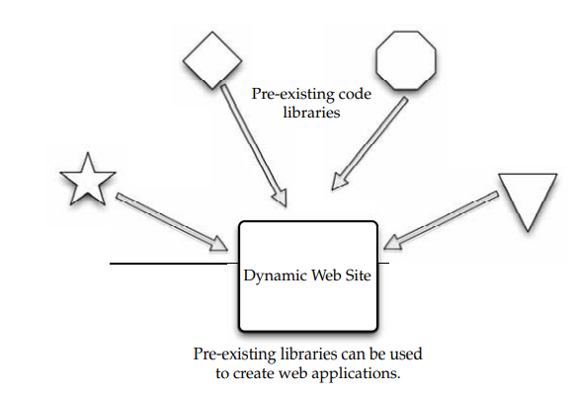
Early in the Web’s life, hypertext was mostly hand-coded Hypertext Markup Language (HTML) that was published on Web servers.
If a published page needed to be changed, it had to be done by the page’s author.
As the Web grew up, it became more dynamic with the addition of the Common Gateway Interface (CGI). This allowed external applications to interface with web servers.

Slide 164
1.1 AJAX
Asynchronous JavaScript and XML is a group of web development techniques used for creating interactive web applications.
By using AJAX, web applications can retrieve data from the server asynchronously.
Because it is being done in the background, it won’t interfere with the display and behavior of the current page.
Technologies AJAX is a term that represents a wide range of web technologies that can be used to help web applications communicate with a server, but without interfering with the current state of that page.

Slide 165
AJAX refers to these technologies:
Extensible Hypertext Markup Language (XHTML) and Cascading Style Sheets (CSS) for presentation
The Document Object Model for dynamic display of and interaction with data
XML and Extensible Style Sheet Language Transformations (XSLT) for the interchange and manipulation of data, respectively
The XMLHttp Request object for asynchronous communication
JavaScript to bring these technologies together
AJAX continues to evolve. For instance, while JavaScript claims a place in the acronym for AJAX, it is not the only client-side language that can be used for developing an AJAX application.
Languages like VBScript can be used, as well. Further, XML is not required for data exchange.
JavaScript Object Notation (JSON) is a widely used alternative. HTML and plain text can also be used.

Slide 166
Pros and Cons
Often, multiple pages on a web site contain the same information. If those pages were coded by hand, the same content would have to be written into each and every page.
AJAX allows a web application to simply retrieve new information and adjust how the content is presented.
This is very efficient and reduces the amount of bandwidth consumed and reduces load times.
Disadvantages to AJAX include
Dynamically created web pages do not show up in the browser’s history engine, so clicking on the Back button would not re-create the last seen page.
It is difficult to bookmark a dynamically created web page.
If a browser does not support AJAX or if JavaScript is disabled, AJAX functionality cannot be used.

Slide 167
1.2 Python Django
Django is an open-source web application framework written in Python.
Originally it was created to manage news sites for The World Company. Core framework are
A lightweight, stand-alone web server for development and testing
A caching framework, which can use any of several cache methods
An internal dispatcher system that allows an application’s components to communicate using predefined signals
An internationalization system that translates Django’s components into multiple languages

Slide 168
2 Web Hosting Service
You will need a web hosting service that will allow you to store your data and applications.
This is the organization that will host your data. Some web hosting services include Amazon Elastic Compute Cloud and Mosso.
2.1 Amazon Elastic Compute Cloud
Amazon Elastic Compute Cloud is a web service that provides resizable compute capacity in the cloud.
Amazon EC2’s web service interface allows you to obtain and configure capacity with minimal friction.
It provides complete control of your computing resources and lets you run on Amazon’s computing environment.
Notes:
2.1 Hardware and Infrastructure:
2.1.1 Clients
2.1.2 Security
2.1.3 Network
2.1.4 Services
2.2 Accessing the Cloud:
2.2.1 Platforms
2.2.2 Web Applications
2.2.3 Web APIs
2.2.4 Web Browsers

Slide 169
Amazon EC2 reduces the time required to obtain and boot new server instances to minutes, allowing you to quickly scale capacity, both up and down, as a client’s computing requirements change.
Amazon EC2 changes the economics of computing by allowing you to pay only for capacity that you actually use.
2.2 Mosso
Mosso is the home of The Hosting Cloud and CloudFS, providing enterprise-grade hosting and storage services.
Mosso provides an easily managed interface so that developers, designers, and IT managers can deploy reliable web applications quickly and easily as well as a high-performance cloud-based storage service.

Slide 170
Founded by two Rackspace employees, The Hosting Cloud is built upon a cross platform, clustered-computing architecture.
There are three components to Mosso’s offering:
Cloud Sites: Advertised as “the fastest way to put sites on the cloud”; runs Windows or Linux applications across hundreds of servers.
Cloud Files: Provides unlimited online storage for media (examples include backups, video files, user content), which is served out via Limelight Networks’ Content Delivery Network.
Cloud Servers: Able to deploy from one to hundreds of cloud servers instantly and creates advanced, high-availability architectures.

Slide 171
3 Proprietary Methods
In addition to the widely used standards (like AJAX and Django), individual companies offer their own, proprietary methods to connect to the cloud.
3.1 Azure
The Azure Services Platform is Microsoft’s cloud solution that spans from the cloud to the enterprise datacenter.
Further, it delivers content across the PC, web, and phone.
The platform combines cloud-based developer capabilities with storage, computational, and networking infrastructure services, all hosted on servers operating within Microsoft’s global datacenter network.
This provides developers with the ability to deploy applications in the cloud or on-premises and enables experiences across a broad range of business and consumer scenarios.

Slide 172
3.2 Force.com
Force.com, a PaaS from Salesforce.com, is another way to create and deploy business applications.
By replacing the complexity of software platforms with a complete, scalable service, Force.com provides developers a fast path to turn ideas into business impact.
3.2.1 Visualforce
As part of the Force.com platform, Visualforce gives customers the ability to design application user interfaces for any experience on any screen.
Using the logic and workflow intelligence provided by Apex Code, Visualforce offers the flexibility to meet the requirements of applications that feature many different types of users on a variety of devices.
Visualforce uses HTML, AJAX, and Flex for business applications.

Slide 173
2.2.2 Web Applications
If you are going to use applications on the cloud, there are many to choose from.
Much of your decision-making process will come down to your provider and what they offer.
There are tons of options when it comes to finding online applications.
Notes:
2.1 Hardware and Infrastructure:
2.1.1 Clients
2.1.2 Security
2.1.3 Network
2.1.4 Services
2.2 Accessing the Cloud:
2.2.1 Platforms
2.2.2 Web Applications
2.2.3 Web APIs
2.2.4 Web Browsers

Slide 174
1 Sample Applications
Different companies offer different things, but for the sake of understanding the market, let’s take a closer look at cloud giant Google and their offerings.
Google Apps, launched as a free service in August 2006, is a suite of applications that includes
Gmail webmail services
Google Calendar shared calendaring
Google Talk instant messaging and Voice Over IP
Start Page for creating a customizable home page on a specific domain
More than 100,000 small businesses and hundreds of universities now use the service.

Slide 175
2.2.3 Web APIs
An application programming interface (API) is a set of programming instructions and standards for accessing a web-based program.
Software companies release their APIs to the public so that other software developers can design products that are powered by its service.
You are likely to use APIs when building your apps.
APIs allow one program to speak with another. They are not user interfaces. Using APIs, programs can speak to each other without the user having to be involved.
Notes:
2.1 Hardware and Infrastructure:
2.1.1 Clients
2.1.2 Security
2.1.3 Network
2.1.4 Services
2.2 Accessing the Cloud:
2.2.1 Platforms
2.2.2 Web Applications
2.2.3 Web APIs
2.2.4 Web Browsers

Slide 176
1.Google Data APIs
The Google Data APIs provide a simple standard protocol for reading and writing data on the Web. They encompass a broad range of business functions that can be used to link your applications within and outside of the cloud.
2. GoGrid
GoGrid’s API is a web service that allows developers to control their interaction with GoGrid’s cloud hosting infrastructure. The GoGrid API provides two-way communication for controlling GoGrid’s control panel functionality.
3. Apex
The Apex Web Services API is one of the world’s most widely used enterprise web services, handling more than 50 percent of Salesforce.com’s 3.7 billion service transactions.

Slide 177
2.2.4. Web Browsers
To connect to the cloud, most likely you and your users will utilize a web browser.
Browsers tend to be mostly the same, but with some subtle functional differences.
1 Internet Explorer
Internet Explorer enjoys the highest market share of browser usage—69.77 percent (according to a December 2008 study released by the web metrics firm Net Applications).
Notes:
2.1 Hardware and Infrastructure:
2.1.1 Clients
2.1.2 Security
2.1.3 Network
2.1.4 Services
2.2 Accessing the Cloud:
2.2.1 Platforms
2.2.2 Web Applications
2.2.3 Web APIs
2.2.4 Web Browsers

Slide 178
2 Firefox
In June 2008 Mozilla released Firefox 3, a major update to its popular, free, open-source web browser.
3 Safari
Apple claims that Safari 3.1 is the world’s fastest web browser for Mac and Windows PCs, loading web pages 1.9 times faster than Internet Explorer 7 and 1.7 times faster than Firefox 2.
Safari also runs JavaScript up to six times faster than other browsers, and is the first browser to support the latest innovative web standards needed to deliver the next generation of highly interactive Web 2.0 experiences.

Slide 179
4 Chrome
Chrome is Google’s foray into the open-source browser market.
In the early days of the Internet, web pages were frequently little more than text.
But today the Web has evolved into a powerful platform that enables users to collaborate with friends and colleagues through email and other web applications, edit documents, watch videos, listen to music, manage finances, and much more.
Google Chrome was built for today’s Web and for the applications of tomorrow.

Slide 180
2.3 Cloud Storage
Cloud storage has a number of advantages over traditional data storage.
If you store your data on a cloud, you can get at it from any location that has Internet access.
This makes it especially appealing to road warriors. Workers don’t need to use the same computer to access data nor do they have to carry around physical storage devices.
Also, if your organization has branch offices, they can all access the data from the cloud provider.
1. Storage as a Service
The term Storage as a Service (another Software as a Service, or SaaS, acronym) means that a third-party provider rents space on their storage to end users who lack the budget or capital budget to pay for it on their own.
Notes:
2.1 Hardware and Infrastructure:
2.1.1 Clients
2.1.2 Security
2.1.3 Network
2.1.4 Services
2.2 Accessing the Cloud:
2.2.1 Platforms
2.2.2 Web Applications
2.2.3 Web APIs
2.2.4 Web Browsers
2.3 Cloud Storage:
2.3.1 Overview
2.3.2 Cloud Storage Providers

Slide 181
It is also ideal when technical personnel are not available or have inadequate knowledge to implement and maintain that storage infrastructure.
The biggest advantage this is cost savings.
Storage is rented from the provider using a cost-per-gigabyte-stored or cost-per-data-transferred model.
The end user doesn’t have to pay for infrastructure; they simply pay for how much they transfer and save on the provider’s servers.
2.Providers
As we noted earlier, there are hundreds of cloud storage providers on the Web, and more seem to be added each day.
Not only are there general-purpose storage providers, but there are some that are very specialized in what they store.
We’ll look more closely at some big players later, but here are some examples of specialized cloud providers:

Slide 182
Google Docs allows users to upload documents, spreadsheets, and presentations to Google’s data servers. Those files can then be edited using a Google application.
Web email providers like Gmail, Hotmail, and Yahoo! Mail store email messages on their own servers. Users can access their email from computers and other devices connected to the Internet.
Flickr and Picasa host millions of digital photographs. Users can create their own online photo albums.
YouTube hosts millions of user-uploaded video files.
Hostmonster and GoDaddy store files and data for many client web sites.
Facebook and MySpace are social networking sites and allow members to post pictures and other content. That content is stored on the company’s servers.
MediaMax and Strongspace offer storage space for any kind of digital data.

Slide 183
3. Security
To secure data, most systems use a combination of techniques:
Encryption
A complex algorithm is used to encode information.
To decode the encrypted files, a user needs the encryption key.
While it’s possible to crack encrypted information, it’s very difficult and most hackers don’t have access to the amount of computer processing power they would need to crack the code.
Authentication processes
This requires a user to create a name and password.
Authorization practices
The client lists the people who are authorized to access information stored on the cloud system.
Many corporations have multiple levels of authorization.
For example, a front-line employee might have limited access to data

Slide 184
4. Reliability
The other concern is reliability. If a cloud storage system is unreliable, it becomes a liability.
No one wants to save data on an unstable system, nor would they trust a company that is financially unstable.
Most cloud storage providers try to address the reliability concern through redundancy, but the possibility still exists that the system could crash and leave clients with no way to access their saved data.
Reputation is important to cloud storage providers. If there is a perception that the provider is unreliable, they won’t have many clients.
And if they are unreliable, they won’t be around long, as there are so many players in the market.

Slide 185
2.3.2 Cloud Storage Providers
This is simply a listing of what some of the big players in the game have to offer, and you can use it as a starting guide to determine if their services match your needs.
Amazon and Nirvanix are the current industry top providers, but many others are in the field, including some well-known names.
Google is ready to launch its own cloud storage solution called GDrive.
EMC is readying a storage solution, and IBM already has a number of cloud storage options called Blue Cloud.
Notes:
2.1 Hardware and Infrastructure:
2.1.1 Clients
2.1.2 Security
2.1.3 Network
2.1.4 Services
2.2 Accessing the Cloud:
2.2.1 Platforms
2.2.2 Web Applications
2.2.3 Web APIs
2.2.4 Web Browsers
2.3 Cloud Storage:
2.3.1 Overview
2.3.2 Cloud Storage Providers

Slide 186
1. Amazon Simple Storage Service (S3)
The best-known cloud storage service is Amazon’s Simple Storage Service (S3), which launched in 2006.
Amazon S3 is intentionally built with a minimal feature set that includes the following functionality:
Write, read, and delete objects containing from 1 byte to 5 gigabytes of data each. The number of objects that can be stored is unlimited.
Each object is stored and retrieved via a unique developer-assigned key.
Objects can be made private or public, and rights can be assigned to specific users.
Uses standards-based REST(Representational State Transfer) and SOAP(Simple Object Access Protocol) interfaces designed to work with any Internet-development toolkit.

Slide 187
2. Nirvanix
Nirvanix uses custom-developed software and file system technologies running on Intel storage servers at six locations on both coasts of the United States.
They continue to grow, and expect to add dozens more server locations
3. Google Bigtable Datastore
In cloud computing, it’s important to have a database that is capable of handling numerous users on an on-demand basis.
To serve that market, Google introduced its Bigtable.
Google started working on it in 2004 and finally went public with it in April 2008.
Bigtable was developed with very high speed, flexibility, and extremely high scalability in mind.
A Bigtable database can be petabytes in size and span thousands of distributed servers.
Bigtable is available to developers as part of the Google App Engine, their cloud computing platform.

Slide 188
4. MobileMe
MobileMe is Apple’s solution that delivers push email, push contacts, and push calendars from the MobileMe service in the cloud to native applications on iPhone, ipod touch, Macs, and PCs.
MobileMe also provides a suite of ad-free web applications that deliver a desktop like experience through any modern browser.
MobileMe applications (www.me.com) include Mail, Contacts, and Calendar, as well as Gallery for viewing and sharing photos and iDisk for storing and exchanging documents online.
5. Live Mesh
Live Mesh is Microsoft’s “software-plus-services” platform and experience that enables PCs and other devices to be aware of each other through the Internet, enabling individuals and organizations to manage, access, and share their files and applications seamlessly on the Web and across their world of devices.

Slide 189
2.4 Standards
2.4.1 Application
A cloud application is the software architecture that the cloud uses to eliminate the need to install and run on the client computer.
There are many applications that can run, but there needs to be a standard way to connect between the client and the cloud.
Here a closer look at the protocols that are used to manage connections between both parties.
1.Communication
Computers need a common way to speak with one another.
Notes:
2.1 Hardware and Infrastructure:
2.1.1 Clients
2.1.2 Security
2.1.3 Network
2.1.4 Services
2.2 Accessing the Cloud:
2.2.1 Platforms
2.2.2 Web Applications
2.2.3 Web APIs
2.2.4 Web Browsers
2.3 Cloud Storage:
2.3.1 Overview
2.3.2 Cloud Storage Providers
2.4 Standards:
2.4.1 Application
2.4.2 Client
2.4.3 Infrastructure
2.4.4 Service

Slide 190
1.1 HTTP
To get a web page from your cloud provider, you’ll likely be using the Hypertext Transfer Protocol (HTTP) as the computing mechanism to transfer data between the cloud and your organization.
HTTP is a stateless protocol. This is beneficial because hosts do not need to retain information about users between requests, but this forces web developers to use alternative methods for maintaining users’ states.
For example, when a host needs to customize the content of a web site for a user, the web application must be written to track the user’s progress from page to page.

Slide 191
The most common method for solving this problem is sending and receiving cookies. HTTP is the language that the cloud and your computers use to communicate.
This language isn’t hard to understand, and you’ve probably seen it before. Say your browser wants to get a given web page.
1.2 XMPP
The Extensible Messaging and Presence Protocol (XMPP) is being talked about as the next big thing for cloud computing.
The problem is that current cloud services—including SOAP and other HTTP-based protocols—are all one-way information exchanges.
This means that clouds do not operate in real time and might have difficulties clearing a firewall. XMPP allows for two-way communication and eliminates polling.

Slide 193
XMPP was developed for instant messaging and presence, and it is widely used in those circles. It includes the following features:
• XMPP allows for easy two-way communication, eliminating the need for polling.
• It is XML-based and easily extensible, which makes it ideal for cloud services.
• It is efficient and able to scale to millions of concurrent users on a single service.

Slide 194
2. Security
Securing your cloud sessions is especially important as security is one of the top reasons businesses are reluctant to join the cloud.
Securing your cloud sessions can be accomplished via encryption and authentication.
Here we’ll talk about the widely used Secure Sockets Layer (SSL) for encryption, and one means of authentication, OpenID.
Notes:
2.1 Hardware and Infrastructure:
2.1.1 Clients
2.1.2 Security
2.1.3 Network
2.1.4 Services
2.2 Accessing the Cloud:
2.2.1 Platforms
2.2.2 Web Applications
2.2.3 Web APIs
2.2.4 Web Browsers
2.3 Cloud Storage:
2.3.1 Overview
2.3.2 Cloud Storage Providers
2.4 Standards:
2.4.1 Application
2.4.2 Client
2.4.3 Infrastructure
2.4.4 Service

Slide 195
2.1 SSL
SSL is the standard security technology for establishing an encrypted link between a web server and browser.
This ensures that data passed between the browser and the web server stays private.
To create an SSL connection on a web server requires an SSL certificate.
When your cloud provider starts an SSL session, they are prompted to complete a number of questions about the identity of their company and web site.
The cloud provider’s computers then generate two cryptographic keys—a public key and a private key.
The public key does not need to be secret and is placed into a Certificate Signing Request (CSR).

Slide 196
This is a file that contains your details. You then submit the CSR. During the SSL certificate application process, the certification authority will validate your details and issue an SSL certificate, containing your details, allowing you to use SSL.
The cloud provider will then match your issued SSL certificate to your private key. Your web browser will be able to establish an encrypted link between your computer and the cloud provider.
Normally, the SSL certificate will contain your cloud provider’s domain name, company name, address, city, state, and country.
It will also contain the expiration date of the certificate and details of the certification authority responsible for issuing the certificate.

Slide 198
2.2 OpenID
OpenID is an open-source solution for the problem of needing a unique username and password for access to different web sites, thus making your life simpler.
This allows you to choose the OpenID provider that best meets your need and that you trust.
OpenID is free, this is good for businesses, because it means a lower cost for password and account management.
OpenID is a lightweight way to authenticate users, using the same technology that is used to identify web sites.

Slide 199
2.3 PCI DSS
Payment Card Industry Data Security Standards (PCI DSS) requirement 2.2.1 is a vague area for many, especially as it relates to cloud computing.
is a set of requirements intended to ensure that all companies that process, store, or transmit credit card information maintain a secure environment.
It was launched on September 7, 2006, to manage PCI security standards and improve account security throughout the transaction process.
The requirement states that an organization can “implement only one primary function per server.”
You can have multiple systems that are virtualized; you just have to ensure that they are segmented and isolated from each other.
In the past, copyright law was written to prevent you from making copies of movies and music.

Slide 200
2.4.2.Client
When your clients connect to the cloud, they need to run certain software on their machines, and most often it’ll be a web browser, or a similarly equipped application.
Web browsers use a number of ways to store and display data, like the widely known Hypertext Markup Language (HTML).
1 HTML
Since so much of cloud computing is based on connecting via the World Wide Web, it’s important to talk about the main standard to communicate data—HTML.
When you click on a link in a web page, you are accessing HTML code in the form of a hyperlink, which then takes you to another page.
Notes:
2.1 Hardware and Infrastructure:
2.1.1 Clients
2.1.2 Security
2.1.3 Network
2.1.4 Services
2.2 Accessing the Cloud:
2.2.1 Platforms
2.2.2 Web Applications
2.2.3 Web APIs
2.2.4 Web Browsers
2.3 Cloud Storage:
2.3.1 Overview
2.3.2 Cloud Storage Providers
2.4 Standards:
2.4.1 Application
2.4.2 Client
2.4.3 Infrastructure
2.4.4 Service

Slide 201
2 Dynamic HTML
Dynamic HTML (DHTML) is not a new specification of HTML, but rather a different way of looking at and controlling the standard HTML codes and commands.
When a regular HTML page loads, it will not change until another request comes to the server.
DHTML gives you more control over the HTML elements, allowing them to change without returning to the web server.
There are four parts to DHTML:
• Document Object Model (DOM): The DOM specifies every part of a web page, and provides consistent naming conventions, allowing you to access your web pages and change their properties.
• Scripts :The most common scripting languages in DHTML are JavaScript and ActiveX. Scripts are used to control the objects specified in the DOM

Slide 202
Cascading Style Sheets (CSS):CSS is used in DHTML to control the look and feel of the web page. Style sheets list the colors and fonts of text, the background colors and images, and the placement of objects on the page.
XHTML: DHTML web pages are actually written in XHTML or HTML 4.x.
XHTML is HTML documents written to conform with XML syntax.
But it is important to have valid XHTML, because there are more things working from it than just the browser.

Slide 203
3 JavaScript
Basic HTML does only basic stuff. It’s when you use JavaScript to write functions that are embedded in the HTML pages and interact with the DOM that you start adding pizzazz and specific user-entered data that adds functionality to your web pages.
Here are some examples of the uses of JavaScript:
• Opening or popping up new windows, and having control of the size and attributes of the window (whether to include menus, toolbars, and so on).
• Validating web form input values to ensure that they will be accepted before submitting them to the server.
• Changing images as the cursor rolls over them.

Slide 204
2.4.3. Infrastructure
Infrastructure is a way to deliver virtualization to your cloud computing solution.
Both across the Internet (having your machines running on a remote server and displayed at your organization) and locally (having your clients’ sessions run on a local server and displayed at their desktops).
A fairly new computing solution—is being standardized and how major players are working and playing together to make it come together
Notes:
2.1 Hardware and Infrastructure:
2.1.1 Clients
2.1.2 Security
2.1.3 Network
2.1.4 Services
2.2 Accessing the Cloud:
2.2.1 Platforms
2.2.2 Web Applications
2.2.3 Web APIs
2.2.4 Web Browsers
2.3 Cloud Storage:
2.3.1 Overview
2.3.2 Cloud Storage Providers
2.4 Standards:
2.4.1 Application
2.4.2 Client
2.4.3 Infrastructure
2.4.4 Service

Slide 205
1 Virtualization
Virtualization is somewhat different, and major players worked together to develop a standard.
1.1 VMware
AMD, BEA Systems, BMC Software, Broadcom, Cisco, Computer Associates International, Dell, Emulex, HP, IBM, Intel, Mellanox, Novell, QLogic, and Red Hat all worked together to advance open virtualization standards.
VMware says that it will provide its partners with access to VMware ESX Server source code and interfaces under a new program called VMware Community Source.

Slide 206
This program is designed to help partners influence the direction of VMware ESX Server through a collaborative development model and shared governance process.
1.2 OVF
As the result of VMware and its industry partners’ efforts, a standard has already been developed called the Open Virtualization Format (OVF).
OVF describes how virtual appliances can be packaged in a vendor-neutral format to be run on any hypervisor.
It is a platform-independent, extensible, and open specification for the packaging and distribution of virtual appliances composed of one or more virtual machines.

Slide 207
2.4.4.Service
A web service, as defined by the World Wide Web Consortium (W3C), “is a software system designed to support interoperable machine-to-machine interaction over a network” that may be accessed by other cloud computing components.
Web services are often web APIs that can be accessed over a network, like the Internet, and executed on a remote system that hosts the requested services
Here we’ll talk about some of the popular web services, like REST, SOAP, and JSON.
1 Data
Data can be stirred and served up with a number of mechanisms; two of the most popular are JSON and XML.
Both are based on leading industry standards—HTML and JavaScript— to help deliver and present data.
Notes:
2.1 Hardware and Infrastructure:
2.1.1 Clients
2.1.2 Security
2.1.3 Network
2.1.4 Services
2.2 Accessing the Cloud:
2.2.1 Platforms
2.2.2 Web Applications
2.2.3 Web APIs
2.2.4 Web Browsers
2.3 Cloud Storage:
2.3.1 Overview
2.3.2 Cloud Storage Providers
2.4 Standards:
2.4.1 Application
2.4.2 Client
2.4.3 Infrastructure
2.4.4 Service

Slide 208
1.1 JSON
JSON is short for JavaScript Object Notation and is a lightweight computer data interchange format.
It is used for transmitting structured data over a network connection in a process called serialization.
It is often used as an alternative to XML
2 Web Services
Web services describe how data is transferred from the cloud to the client.
See how REST and SOAP work, and which would be best for your cloud needs.

Slide 209
2.1 REST
Representational state transfer (REST) is a way of getting information content from a web site by reading a designated web page that contains an XML file that describes and includes the desired content.
For instance, REST could be used by your cloud provider to provide updated subscription information.
Subscribers only need to know the uniform resource locator (URL) for the page where the XML file is located, read it with a web browser, understand the content using XML information, and display it appropriately.
REST is similar in function to the Simple Object Access Protocol (SOAP), but is easier to use. SOAP requires writing or using a data server program and a client program (to request the data). However, SOAP offers more capability.

Slide 210
2.2 SOAP
Simple Object Access Protocol (SOAP) is a way for a program running in one kind of operating system (such as Windows Vista) to communicate with a program in the same or another kind of an operating system (such as Linux) by using HTTP and XML as the tools to exchange information.
One of the advantages of SOAP is that program calls are more likely to get through firewalls that normally screen out requests for those applications.
Because HTTP requests are normally allowed through firewalls, programs using SOAP can communicate with programs anywhere.

Slide 211
Thank You

Slide 212
Common Standards in Cloud Computing

Slide 213
UNIT-3
4.1 The open cloud consortium
4.1.1 Interoperability for clouds.
4.1.2 Wide Area Cloud and impact of network protocols on clouds.
4.1.3 Test-Beds.
4.1.4 development of Benchmarks for Information sharing and security.
4.2 The distributed management task force
Open Virtual Format(OVF)
4.3 Standards for application developers
4.3.1 Browsers(Ajax)
4.3.2 Data (XML, JSON)
4.3.3 Solution Stack (LAMP and LAPP)
4.3.4 Syndication (Atom, AtomPP& RSS)
4.4 Standards for messaging
4.4.1 Simple Message Transfer Protocol (SMTP)
4.4.2 Post Office Protocol (POP):
4.4.3 Internet Messaging Access Protocol (IMAP):
4.5 Standards for security
4.5.1 Security Assertion Markup Language (SAML):
4.5.2 Open Authentication (OAuth):
4.5.3 OpenID:
4.5.4 SSL/TLS:
4.6 YouTube
4.6.1 Widgets and custom player.
4.6.2 Player APIs.
4.6.3 Data APIs.
4.7 Facebook
4.8 What is Smartphone
4.8.1 Mobile operating systems for smart phones
4.8.2 Mobile platform virtualization.

Slide 219
What Does Internet Standard (STD) Mean?
In computer network engineering, an Internet Standard is a normative specification of a technology or methodology applicable to the Internet. ... An Internet Standard is characterized by technical maturity and usefulness.
An internet standard (STD) is a specification that has been approved by the Internet Engineering Task Force (IETF). Such standard helps to promote a consistent and universal use of the internet worldwide.
The Internet Engineering Task Force (IETF) is an open standards organization, which develops and promotes voluntary Internet standards, in particular the standards that comprise the Internet protocol suite (TCP/IP).

Slide 222
Working Groups
In Internet everything eventually gets driven by a Working Group.
A Working Group is an assembled, cooperative collaboration of researchers working on new research activities.
WG can exist for anywhere between few months and many years.
They strive to create an informational document a standard or find resolutions for problems related to Systems and Networks
WG also referred as Task Group or Technical Adisory Group

Slide 223
1. Open Cloud Consotium(OCC)

Slide 226
Open Cloud Consortium
OCC is organized into several different working groups
On Interoperability for clouds.
On Wide Area Cloud and impact of network protocols on clouds.
On Test-Beds.
On development of Benchmarks for Information sharing and security.

Slide 227
1.Interoperability for clouds
Provide On-Demand Computing Capacity focuses on developing standards for interoperating clouds that provide on-demand computing capacity. One architecture that was popularized by Google technical reports describes
a Storage cloud providing Distributed File System
a Compute cloud supporting MapReduce
a Data cloud supporting Table services
The open source Hadoop Distributed File System(HDFS) follows this architecture.

Slide 228
2. Wide Area cloud and Network protocols
Main aim of this working group is to develop technology for Wide Area Clouds and the Impact of Network Protocols on Clouds
including Creation of Methodology and Benchmarks to be used for evaluating Wide Area Clouds
They study applicability of variants of TCP and the use of other network protocols for clouds.

Slide 229
3. Open Cloud Test-beds
This working group uses Cisco-Cwave and UIC (University of Illinois at Chicago) Teraflow Networks for its network connection.
C-Wave makes network resources available to research group at no cost and allow them to access to 10G waves.
Teraflow Test-bed (TFT) is an international application networks for exploring, integrating, analyzing and detecting changes in massive and distributed data.
TFT analyzes streaming data with the goal of developing innovative technology for data streams at very high speeds.

Slide 230
4. Benchmarks for Information Sharing and Security
Primary focus is on standards and standards-based architectures for information sharing between clouds.
Here exchanging information between two clouds, each cloud is administered by different organizations with different policies.
This group is also concerned with security architectures for clouds.
An example is exchanging information between two clouds, each of which is HIPAA-compliant(Health Insurance Portability and Accountability Act)

Slide 231
2. Distributed Management Task Force(DMTF)

Slide 232
DMTF
DMTF enables effective management of millions of IT systems world wide by bringing the IT industry together to collaborate on
Developing
Validation
and Promotion
of systems management standards

Slide 234
DMTF started Virtual Management (VMAN) initiative
DMTF unleashes the power of virtualization by developing broadly supported interoperability and portability standards to virtual computing environments.
Virtualization has enhanced the IT industry by optimizing use of existing physical resources and helping reduce the number of systems deployed and managed by
reduce hardware costs
mitigate power
and cooling needs

Slide 236
With this VMAN initiative, companies now have standardized approach to
Deploy virtual computing systems
Inventory of virtual computing systems
Manage lifecycle of virtual computing systems
Add/change/delete virtual resources
Monitor virtual systems for health and performance.

Slide 238
Open Virtual Format(OVF)
OVF is a new standard that has emerged within the VMAN initiative.
OVF simplifies
Interoperability
Security
and Virtual lifecycle management
by describing an Open, Secure, Portable ,Efficient and Extensible format for the packaging and distribution of one or more virtual appliances.
OVF simplifies procedures and technologies to permit integrity checking of virtual machines.

Slide 241
The OVF specifies Procedures and Technology to permit Integrity Checking of the Virtual machine to ensure that they have not been modified.
This enhances the security of the format produced by third party.
Key feature of OVF is VM packaging portability and simplifies installation and deployment process.
OVF is designed to be extended for further development in Virtual appliance technology.

Slide 242
3. Standards for Application Development
Main purpose is to develop high quality software and meets industry standards.
If you ship source code as a product, it is important to ensure that it is a well-packaged.
Applications commonly used across the internet browsers:
For transferring data
Sending messages
Securing data

Slide 243
1. Browsers(Ajax): Asynchronous java script and XML:
Ajax is a group of interrelated web development techniques used to create interactive web applications or rich internet applications.
Using Ajax , web applications can access data asynchronously without interfering with the display and behavior of the browser.
The use of Ajax has led to an increase in interactive animation on web pages.
Related pages contains same content, earlier entire page must be reloaded, using Ajax only content need to be updated
reduces N/w bandwidth & page loading time.

Slide 244
Data sent to & from server are usually written in Javascript, but some processing is required on the server side to handle Ajax requests.
This is accomplished with the use of a framework ICE faces.
ICE faces Ajax application framework
ICEfaces is an open-source Software development kit that extends Java Server Faces (JSF) by employing Ajax.
Using this it is easy to create and deploy Thin-Client rich internet applications.
To run ICE applications, users need to install
J2SE
ANT(Adoptive Network Topology)
ICE faces
Tomcat
Any Web Browser

Slide 245
ICEfaces is an open-source Rich Internet Application (RIA) development framework for Java EE.
It improves developer efficiency all while reducing time to market and operating costs.
ICEfaces is the most successful enterprise Ajax framework available under open source.
ICE faces is the most secure Ajax solutions compatible with SSL (Secure Socket Layer) protocol
It prevents
Cross-site scripting
Malicious code injection
Unauthorized data mining

Slide 246
2. Data (XML, JSON):
Extensible Markup Language (XML) allows the user to define markup elements.
XML is often used to describe structured data and to serialize objects.
Various XML-based protocols exits to represents data structures for data interchange purposes.
Using XML is arguably more complex than using JSON, which represents data structures in simple text formatted specifically for data interchange in an uncompressed form.
Both XML and JSON lack mechanism for representing large binary data types such as images.

Slide 247
An XML document has two correctness levels,
well-formed
valid.
A well-formed document conforms to the XML syntax rules.
A valid document is well formed and additionally conforms to semantic rules which can be user-defined or exist in an XML schema.

Slide 248
JavaScript Object Notation (JSON):
JSON is a lightweight computer data interchange format.
It is a text-based, human-readable format for representing simple data structures and associative arrays (called objects).
The JSON format is often used for transmitting structured data over a network connection in a process called serialization.
Its main application is in Ajax web application programming, where it serves as an alternative to the XML format.
JSON is based on a subset of the JavaScript programming language.

Slide 249
3. Solution Stack (LAMP and LAPP) :
Linux, Apache, MySQL, and PHP (or Perl or Python):
LAMP is a popular open source solution commonly used to run dynamic web sites and servers.
LAMP is considered by many to be the platform of choice for development and deployment of high-performance web applications which require a solid and reliable foundation.
The combination of these technologies is used primarily to define a web server infrastructure or for creating a programming environment for developing software.
The LAMP combination has become popular because of its open source nature, low cost, and the wide distribution of its components.

Slide 250
Linux, Apache, PostgreSQL, and PHP (or Perl or Python):
The LAPP stack is an open source web platform that can be used to run dynamic web sites and servers.
It is considered by many to be a more powerful alternative to the more popular LAMP stack.
These advanced and mature components provide a rock-solid foundation for the development and deployment of high-performance web applications.
LAMP offers SSL, PHP, Python, and Perl support for Apache2 and PostgreSQL.
These are an administration front-end for PostgreSQL as well as web-based administration modules for configuring Apache2 and PHP.
In PostgreSQL password encryption is enabled by default.

Slide 251
4. Standards for Messaging
A message is a unit of information that is moved from one place to another.
A true standard is usually characterized by certain traits, such as being managed by an international standards body or an industry consortium, and the standard is created jointly by a community of interested parties.
The Internet Engineering Task Force (IETF) is the most open standards body on the planet and their work is available online for free.

Slide 252
1. Simple Message Transfer Protocol (SMTP):
SMTP is arguably the most important protocol is used today for basic messaging.
Before SMTP was created, email messages were sent using File Transfer Protocol (FTP).
SMTP was designed so that sender and recipient information could be transmitted with the message.
SMTP was initially defined in 1973. It has evolved over the years.
SMTP is a two-way protocol that usually operates using TCP port 25.

Slide 253
2. Post Office Protocol (POP):
SMTP can be used both to send and receive messages, but a client must have a constant connection to the host to receive SMTP messages.
POP is a lightweight protocol whose single purpose is to download messages from a server.
This allows a server to store messages until a client connects and requests them.
Once the client connects, POP servers being to download the messages and subsequently delete them from the server (a default setting) in order to make room for more messages.
Users respond to a message that was downloaded using SMTP.
The POP protocol is defined by RFC 1939 and usually functions on TCP port 110.

Slide 254
3. Internet Messaging Access Protocol (IMAP):
Once mail message are downloaded with POP, they are automatically deleted from the server when the download process has finished.
Thus POP users have to save their messages locally, which can present backup challenges when it is important to store or save messages.
Many businesses have compulsory compliance guideline that require saving messages.
It also becomes a problem if user moves from computer to computer or uses mobile networking, since their messages do not automatically move where they go.
To get around these problems, a standard IMAP allows messages to be kept on the server but viewed and manipulated (usually via a browser) as though they were stored locally.
IMAP is a part of the RFC 2060 specification, and functions over TCP port 143.

Slide 255
4. Syndication (Atom, AtomPP& RSS)
The Atom Syndication Format is an XML language used for web feeds, while the Atom Publishing Protocol (AtomPub or APP) is a simple HTTP-based protocol for creating and updating web resources.
Content syndication provides citizens convenient access to new content and headlines from government via RSS (Really Simple Syndication) and other online syndication standards.
Governments are providing access to more and more information online.
Through RSS (the little orange [XML] button, ATOM, and others) government allows to control a small window of content across web sites that choose to display the government's headlines.
Headlines may also be aggregated and displayed through “newsreaders" by citizens through standalone applications or as part of their personal web pages.

Slide 256
RSS (Really Simple Syndication):

Slide 257
Â How to Subscribe to an RSS Feed
Install a feed reader (see the list of links below).
Go to a site you want to get updates from and click the button that looks like this:
You may get a page that asks if you want to add the feed to your feed reader. Yep, you do.

Slide 258
As RSS documents includes full or summarized text, plus metadata such as publishing dates and authorship.
Web feed benefit publishers by letting them syndicate content automatically.
They benefit readers who want to subscribe to timely updates from favored web sites or to aggregate feeds from many sites into one place.
RSS feeds can be read using software called a reader that can be web-based, desktop-based, a mobile device, or any computerized Internet-connected device.

Slide 259
Benefits: Ability to scan headlines from many sources, all in one place, through a newsreader.
Journalists and others locally focused web sites will be among the primary feed users.
Limitations: Popular RSS feeds can use significant amounts of bandwidth.
Details on how often or when a feed is usually updated.
They “ping" it once a day instead of every hour.
Automated syndication requires use of a content management system.

Slide 260
Atom and Atom Publishing Protocol (APP):
The name Atom applies to a pair of related standards.
The Atom Syndication Format is an XML language used for web feed
The Atom Publishing Protocol (AtomPub or APP) is a simple HTTP-based protocol for creating and updating web resources, sometimes known as web feeds.
The Atom format was developed as an alternative to RSS.
A program known as a feed reader or aggregator can check web pages on behalf of a user and display any updated articles that it finds.
Web-based feed readers and news aggregators require no software installation and make the user's feeds available on any computer with web access. Some aggregator’s syndicate’s web feeds into new feeds.

Slide 261
5. Communication(HTTP, SIMPLE & XMPP)
Hypertext Transfer Protocol (HTTP):
HTTP is a request/response standard between a client and a server.
A client is the end-user; the server is the web site.
The client making a HTTP request – using a web browser, spider, or other end-user tool – is referred to as the user agent.
The responding server – which stores or creates resources such as HTML files and images – is called the origin server.
HTTP can be implemented on top of any other protocol; all it requires is reliable transport, so any protocol, on the Internet or any other network that provides reliable transport can be used.

Slide 262
SIMPLE: Session Initiation Protocol for Instant Messaging and Presence Leveraging Extensions :
SIMPLE is an instant messaging (IM) and presence protocol suite based on the Session Initiation Protocol (SIP).
Like XMPP, SIMPLE is an open standard.
SIMPLE makes use of SIP for registering for presence information and receiving notifications when presence-related events occur.
It is also used for sending short messages and managing a session of real-time messages between two or more participants.
Implementation of the SIMPLE-based protocols can be found in SIP softphones and also hard-phones.
The SIMPLE presence specifications can be broken up into core protocol methods, presence information, and the handling of privacy policy and provisioning.

Slide 263
XMPP: Extensible Messaging and Presence Protocol
XMPP is an XML-based protocol used for near-real-time, extensible instant messaging and presence information.
XMPP remains the core protocol of the Jabber Instant Messaging and Presence technology.
Jabber provides a carrier-grade, best-in-class presence and messaging platform.
XMPP -based software is deployed on thousands of servers across the Internet.
The Internet Engineering Task Force has formalized XMPP as an approved instant messaging and presence technology under the name XMPP.
Custom functionality can be built on top of XMPP, and common extensions are managed by the XMPP Software Foundation.

Slide 264
XMPP is inherently client-server. It expects something between two XMPP-aware clients to manage state and offline messages. On the other hand, SIMPLE, like SIP, was designed to work in a peer-to-peer mode where intelligence lives at the endpoints.

Slide 265
5. Standards for Security:
A basic philosophy of security is to have layers of defense, a concept known as defense in depth.
This means having overlapping systems designed to provide security even if one system fails.
Traditionally, security was implemented at the endpoints, where the user controlled access.
An organization has no choice except to put firewalls, IDSs, and antivirus software inside its own network.
Today, with the advent of managed security services offered by cloud providers, additional security can be provided inside the cloud.

Slide 266
Security Assertion Markup Language (SAML):
SAML is an XML-based standard for communicating authentication, authorization, and attribute information among online partners.
It allows businesses to securely send assertions between partner organizations regarding the identity and entitlements of a principal.
The Organization for the Advancement of Structured Information Standards (OASIS) Security Services Technical Committee is in charge of defining, enhancing and maintaining the SAML specifications.

Slide 267
SAML assertions are usually transferred from identity providers to service providers.
Assertions contain statements that service providers use to make access control decisions.
Three types of statements are provided by SAML:
authentication statements
attribute statements, and
authorization decision statements.

Slide 268
Open Authentication (OAuth):
OAuth is a method for publishing and interacting with protected data.
For developers, OAuth provides users access to their data while protecting account credentials.
OAuth allows users to grant access to their information, which is shared by the service provider and consumer without sharing all of their identity.
The Core designation is used to stress that this is the baseline, and other extensions and protocols can be build on it.

Slide 271
OpenID:
OpenID is an open, decentralized standard for user authentication and access control that allows user to log onto many services using the same digital identity.
It is a single-sign-on (SSO) method of access control. As such, it replaces the common log-in process (i.e., a log-in name and password) by allowing users to log in once and gain access to resources across participating systems.
An OpenID is in the form of a unique URL and is authenticated by the entity hosting the OpenID URL. The OpenID protocol does not rely on a central authority to authenticate a user's identity.

Slide 272
scenario for OpenID;
User wants to access his account on example.com
example.com (the “Relying Party” in OpenID lingo) asks the user for his OpenID
User enters his OpenID
example.com redirects the user to his OpenID provider
User authenticates himself to the OpenID provider
OpenID provider redirects the user back to example.com
example.com allows the user to access his account
scenario for OAuth:
User is on example.com and wants to import his contacts from mycontacts.com
example.com (the “Consumer” in OAuth lingo) redirects the user to mycontacts.com (the “Service Provider”)
User authenticates himself to mycontacts.com (which can happen by using OpenID)
mycontacts.com asks the user whether he wants to authorize example.com to access his contacts
User makes his choice
mycontacts.com redirects the user back to example.com
example.com retrieves the contacts from mycontacts.com
example.com informs the user that the import was successful

Slide 273
SSL/TLS:
Transport Layer Security (TLS) and its predecessor, Secure Sockets Layer (SSL), are cryptographically secure protocols designed to provide security and data integrity for communications over TCP/IP.
TLS and SSL encrypt the segments of network connections at the transport layer.
The TLS protocol allows client/server applications to communicate across a network in a way specifically designed to prevent eavesdropping, tampering, and message forgery.

Slide 274
TLS provides endpoint authentication and data confidentiality by using cryptography.
TLS authentication is one-way – the server is authenticated, because the client already knows the server's identity, the client remains unauthenticated.
At the browser level it has checked the digital signatures of the server certificate's issuing chain of Certification Authorities (CAs).

Slide 275
End-User Access to Cloud Computing
By
Dr. M. Kalpana Devi

Slide 276
Overview
Innovation behind the success of cloud services ultimately depends on the acceptance of the offering by the user community.
Acceptance of an offering by users changes the economics considerably.
As more users accept such innovation, economies of scale for a product allow implementers to lower the costs, removing a barrier to entry and enabling even more widespread adoption of the innovation.

Slide 277
We will take a look at some of the most popular Software-as-a-Service (SaaS) offerings for consumers.
. Some of the applications that are beneficial to end users, two such successful and familiar SaaS offerings looking at both user perspective and developer perspective are
Youtube
Facebook

Slide 278
YouTube
YouTube is the leader in online video, and a premier destination to watch and share original videos worldwide across the Internet through web sites, mobile devices, blogs, and email.
YouTube allows people to easily upload and share video clips on the YouTube web site.
The following Figure shows YouTube’s home page.

Slide 280
Founded in February 2005, YouTube received funding from Sequoia Capital and was officially launched in December 2005.
Chad Hurley and Steve Chen were the first members of the YouTube management team and currently serve as chief executive officer and chief technology officer, respectively.
Within a year of its launch, in November 2006, YouTube was purchased by Google in one of the most talked-about acquisitions to date.
Since then, YouTube has struck partnership deals with content providers such as CBS(Core Banking Solutions), the BBC, Universal Music Group, Sony Music Group, Warner Music Group, the NBA, and many more.

Slide 281
YouTube has become so popular that it now provides a set of development application programming interfaces (APIs) to enable developers to integrate YouTube functionality into their web sites.
The YouTube APIs and tools allow programmers to bring the YouTube experience to their web pages, applications, and devices.

Slide 284
YouTube API Overview
First, developers need to decide which APIs and tools best meet their needs.
For those familiar with HTML but not so familiar with JavaScript, consider looking at the Widgets and custom player.
If the development team is comfortable with JavaScript and/or FlashPlayer, they should examine the Player APIs.
For those who are programming a device or developing server-side logic for a web site, look at the Data API.

Slide 285
Widgets
Widgets are simple page elements that developers can embed in a web site to give it YouTube functionality.
All of this can be done just by adding a few lines of JavaScript to a web page.
Unlike the custom player, which does not require programming skills to use, these widgets.
Two widgets are currently available, the Video Bar and Video Search Control.

Slide 286
The Video Bar:
The Video Bar is a simple way to integrate a strip of video thumbnails into your site.
Just clicking on a thumbnail opens a floating player for playing video locally.
The Video Bar is implemented using the Google AJAX Search API.
It is designed to let you easily add a strip of playable videos to web pages and blogs.
Control is highly customizable, allowing developers to specify
the orientation of the video bar,
the number of videos displayed,
the size of the thumbnails,
the location and size of the video player,
the list of search expressions that drive the video bar, etc.

Slide 288
Video Search Control:
The Video Search Control also uses the Google AJAX Search API.
It provides the ability to search through massive amounts of YouTube content.
Clicking on a thumbnail of video search results will play it without leaving the page.
Like the Video Bar, you can use a wizard to get started;
The Video Search Control is highly customizable, allowing you to configure the initial set of video search terms,
the size and location of the player,
the number of results,
color schemes, etc.
You can also save user searches for future use.

Slide 290
You tube Player API
The Player APIs let you control the YouTube player using JavaScript or ActionScript.
There is a basic embedded player and there is also a “chromeless” player that lets you create your own player controls.
The Player APIs allow you to establish how users can control YouTube video playback on your web site.
By simply configuring some basic settings for the player interface, you can build a highly customized player control.
The player APIs provide mechanisms that enable you to control how YouTube videos will look on your site.
It is important to distinguish between the two types of players,

Slide 291
Embedded Player:
The Embedded Player is the simplest way to place YouTube videos on a web page.
To customize the behavior and color of the player, developers can use well-documented embedded player parameters.
The code needed to display the embedded player and preconfigured parameters can be quickly generated using a wizard.
This makes it possible to find a video by leveraging the Data API and subsequently displaying it using the embedded player.
Once the embedded player has been added to a web page, it can be controlled using JavaScript.

Slide 292
Chromeless Player
Chromeless Player Interface elements and controls (such as toolbars and buttons) placed around content are sometimes referred to as “chrome,” so a chromeless player is, by definition, a YouTube video player without such controls.
This makes it easy to customize a player used within a Flash or HTML environment.
The chromeless player exposes the same JavaScript and ActionScript APIs as the embedded player.

Slide 293
Youtube custom player
The custom player goes even further than just using scripted API calls to paste videos into your site.
Developers can easily configure the custom player to show playlists, favorites, or custom, locally available videos.
Sometimes it’s nice to have control over your web site without having to edit it.
Many web sites benefit from having video content, but updating this content can be difficult.
The YouTube custom player allows you to customize a YouTube player and populate it with videos you specify.
Once the custom player is on your site, you can easily update the appearance or content by logging into your YouTube account and clicking on Custom Video Players.

Slide 294
Youtube Data API
The YouTube Data API lets you incorporate YouTube functionality into your own application or web site.
You can perform searches, upload videos, create playlists, and more.
It is possible to search for videos, retrieve standard feeds, and see related content.
A program can also authenticate as a user to upload videos, modify user playlists, and more.
The Data API is primarily for developers who are used to programming in server-side languages.
It is useful for sites or applications that want deeper integration with YouTube

Slide 295
This integration might be a web application to allow users to upload video to YouTube, or a device or desktop application that brings the YouTube experience to a new platform.
The Data API gives you programmatic access to the video and user information stored on YouTube.
With this, you can personalize your site or application with users’ existing information as well as perform actions on their behalf (such as commenting on and rating videos).
The Google Data Protocol and the Atom Publishing Protocol, which are the standards on which the Data API is built.

Slide 296
FACE BOOK
Facebook, Inc., is a leading engineering company located in the heart of Silicon Valley.
Facebook was formerly called Thefacebook and is a free-access social networking web site that is operated and privately owned by Facebook, Inc.
While Mark Zuckerberg was a student at Harvard University, he founded Facebook with his roommates, Dustin Moskovitz and Chris Hughes, fellow computer science majors at Harvard.
Initially, site membership was limited to Harvard students.
Later, membership access was expanded to other colleges in the greater Boston area, the Ivy League, and Stanford University.
It later expanded to include any university student, then to any high school student, and, finally, to anyone 13 years old and over.

Slide 297
The Facebook web site currently has more than 175 million active users worldwide.
The web site’s name refers to the paper facebooks depicting members of a campus community that some U.S. colleges and preparatory schools give to incoming students, faculty, and staff as a way to get to know other people on campus.
Facebook serves up over 50 billion page views a month while employing fewer than 200 engineers.
It is the second most-trafficked PHP hypertext preprocessor site in the world (Yahoo is number 1), and it is one of the world’s largest MySQL installations, running thousands of databases.

Slide 298
The Facebook default home page

Slide 299
Finding friends on Facebook.

Slide 300
In terms of total photo page views, Facebook exceeds all of the next-largest photo sites combined.
It is the largest photo-sharing site in the United States, with over a billion photos.
Facebook is the fourth most-trafficked web site in the United States, and Facebook users upload more than 14 million new photos every day.
It is obvious from these statistics that the engineering team at Facebook is pushing the limits of IT engineering.
They have created a custom-built search engine capable of processing millions of queries a day, completely distributed and entirely in-memory with real-time updates.

Slide 302
Facebook Development
Facebook provides anyone the ability to create Facebook applications.
A user can get a basic application up and running in minutes.
To create a Facebook application, you should be well versed in PHP or some other coding language such as Ruby on Rails, JavaScript, or Python.
It is preferable to know one that already has a client library for the Facebook API.
You will need to have a basic understanding of the Internet, SSH, MySQL, and Unix.

Slide 303
Facebook products
The Facebook Products include
Facebook (including the Facebook mobile app and in-app browser),
Messenger, (Facebook Messenger is an instant messaging feature built into Facebook. Messenger originally launched in 2011)
Instagram (including apps like Direct and Boomerang), (Boomerangs are like animated GIFs, but instead of playing an animation in a loop, they repeatedly play an animation forward and backward.)
Portal-branded devices, (Portal (also known as Meta Portal) is a brand of smart displays and videophones released in 2018 by Meta Platforms )
Bonfire (Facebook has been quietly testing a new standalone group video chat app, called Bonfire, which allows up to eight friends to engage in conversation as well as use special effects, similar to those you'd find in apps like Instagram and Snapchat.)

Slide 304
Facebook Mentions, (a new Facebook Creative Labs app that makes it easy for public figures to talk with their fans and each other on the go. As a public figure, Facebook Mentions lets you: See what fans are saying about you and join the conversation.)
Spark AR Studio,(Spark AR Hub is the product creators use to publish, manage, track and understand the performance of their AR effects across Facebook's family of apps and devices.)
Audience Network, (Audience Network extends Facebook's people-based advertising beyond the Facebook platform. With Audience Network, publishers can make money by showing ads from Facebook advertisers in their apps. In order to manage your monetisation with Audience Network, you'll need to set up Monetisation Manager)
NPE(New Product Experimentation) Team apps (Today, Facebook announced a New Product Experimentation (NPE) Team that will be responsible for developing new apps. The goal is to give people "entirely new experiences for building community" and to do so outside of Facebook's existing platforms)
any other features, apps, technologies, software, products, or services
offered by Facebook Inc. or Facebook Ireland Limited under our Data Policy.

Slide 305
The Facebook Products also include Facebook Business Tools, which are tools used by website owners and publishers, app developers, business partners (including advertisers) and their customers to support business services and exchange information with Facebook, such as social plugins (like the "Like" or "Share" button) and our SDKs and APIs.
Facebook Products does not include some Facebook-offered products or services that have their own separate privacy policies and terms of service – such as Workplace, Free Basics, and Messenger Kids.

Slide 306
Mobile Internet Devices
and the Cloud

Slide 309
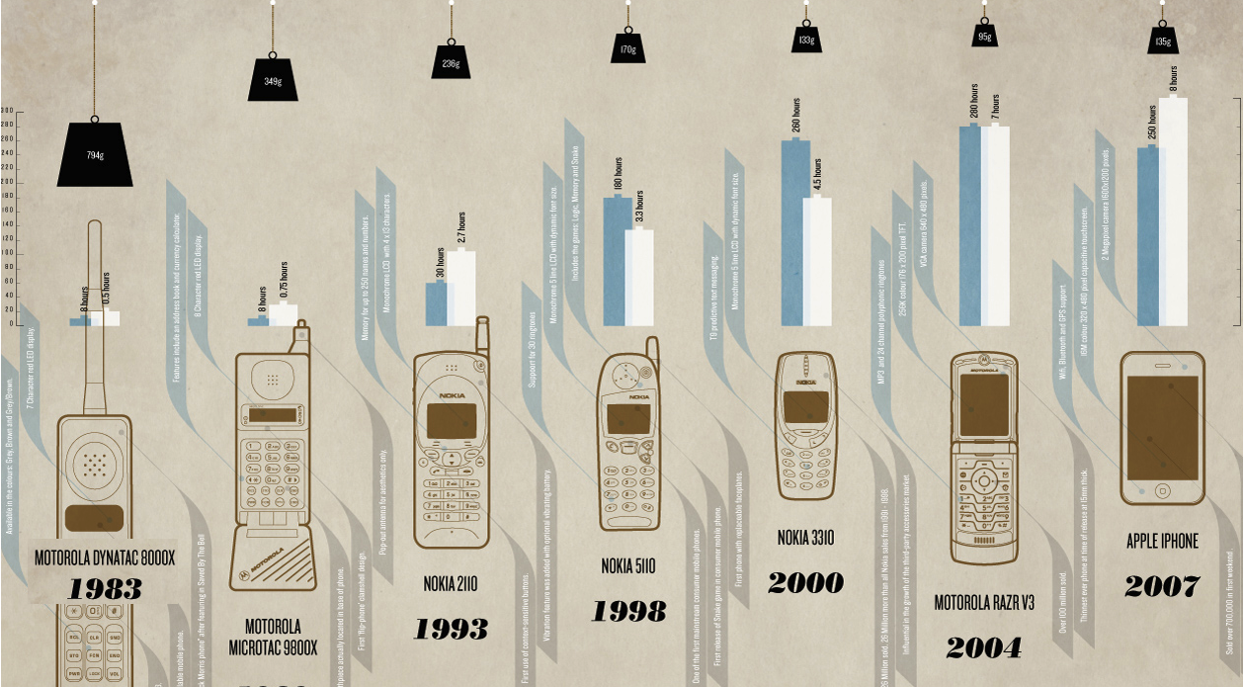

Slide 310
What is a Smartphone
A Smartphone is a mobile device that offers advanced capabilities beyond those offered by a typical mobile phone
Modern versions come with PC-like functionality, such as internet access, instant messaging, allow you to sync your data with your desktop computer.
You can store and work on documents from your smartphone and can receive and reply to emails as they arrive in your inbox.

Slide 311
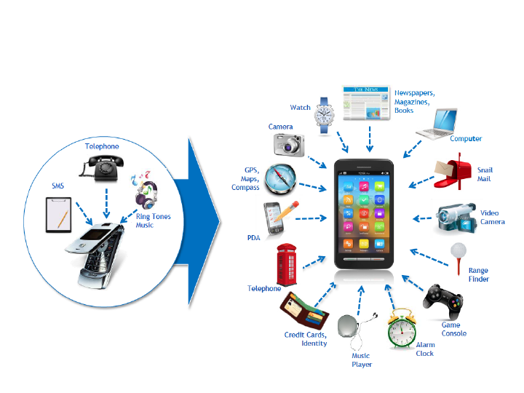

Slide 312
Smartphone applications may be developed by the manufacturer of the device or by any other third party provider or developer capable of accessing the open source operating system.
Such smartphone capabilities transform the common cellphone into a mobile multimedia platform for your entertainment.

Slide 313
Mobile Operating Systems for Smartphones
Smartphone works as a minicomputer with a phone.
Most smartphones use an identifiable and open source operating system, often with the ability to add user applications.
This is a major factor differentiating smartphones from traditional mobile phones, which only support dedicated, proprietary applications.
Let us take a look at several popular mobile devices and the operating systems used with them.

Slide 314
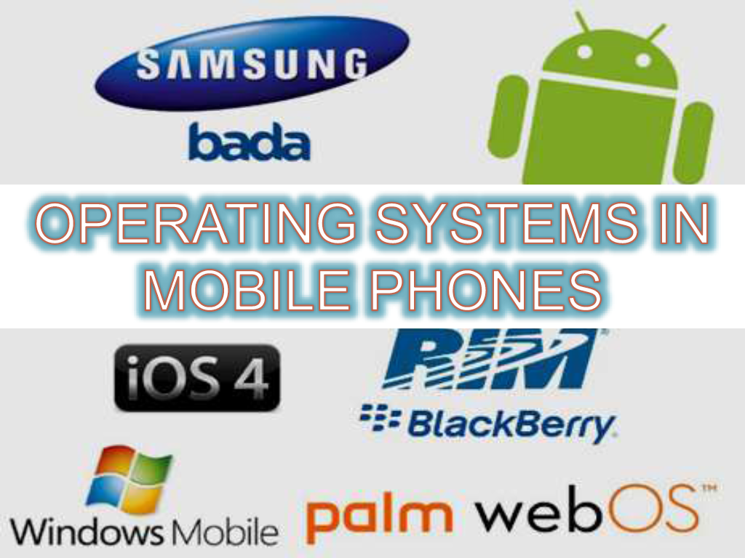

Slide 320
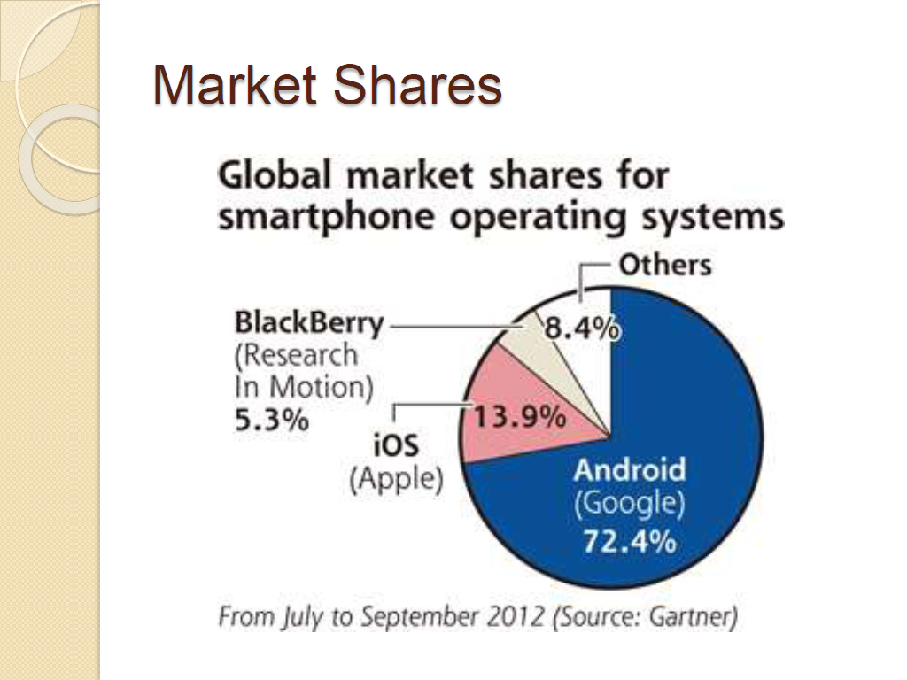

Slide 322
iPhone
Iphone has Features such as
Global Positioning System (GPS) mapping
Support for enterprise applications such as Microsoft Exchange
The new App store
Wide screen mobile device very much like Ipod.
It provides rich interface with HTML email and outstanding web browser.
You can customize your home screen.
It supports more than dozen file and image formats, PDF, MS Word, Excel, Power Point and iWork attachments.

Slide 323
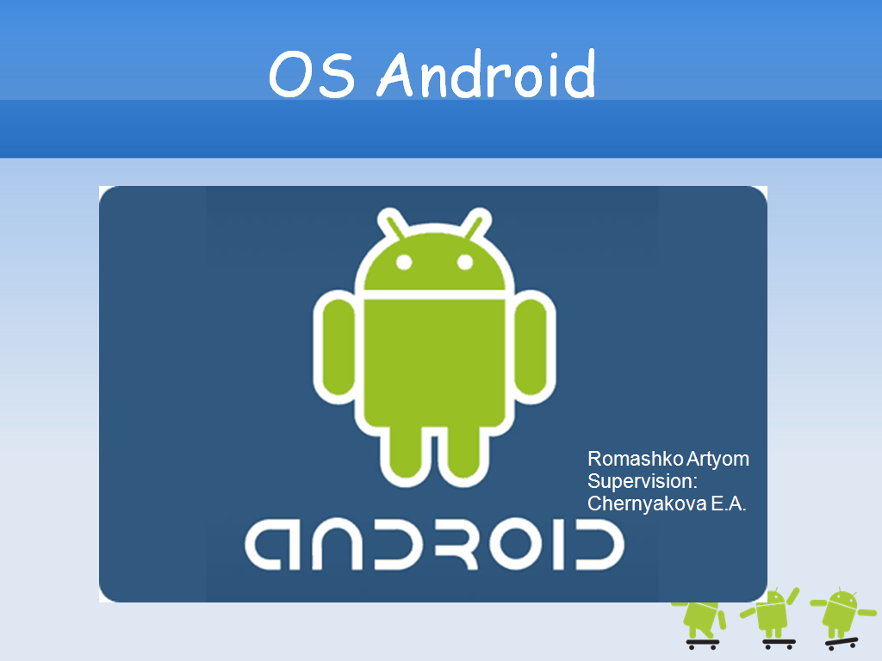

Slide 324
An Android Software Development Kit is available to help developers
get started on new applications.
Developers can distribute their applications to users of Android
mobile phones.
There is a marketplace called Android Market that enables developers
to easily publish and distribute their applications directly to users of
Android-compatible phones.

Slide 328
A rich ,extensible set of views that can be used to build an application(i.e grids ,textboxes, buttons and embedded web browser )
Content provider that allows applications to access data from other applications or share their own data.
A resource manager to manage access to localized strings, graphs and layout files.
A notification manager that enables all applications to display custom alerts.
An activity manager to manage applications and provide a common navigation stack.

Slide 335
black
The blackberry offers an end-to-end encryption solution with two transport encryption options for all data transmitted between BlackBerry Enterprise Server and BlackBerry smartphone, they are:
Advanced encryption standard(AES)
Triple Data Encryption Standard(Triple DES)

Slide 336
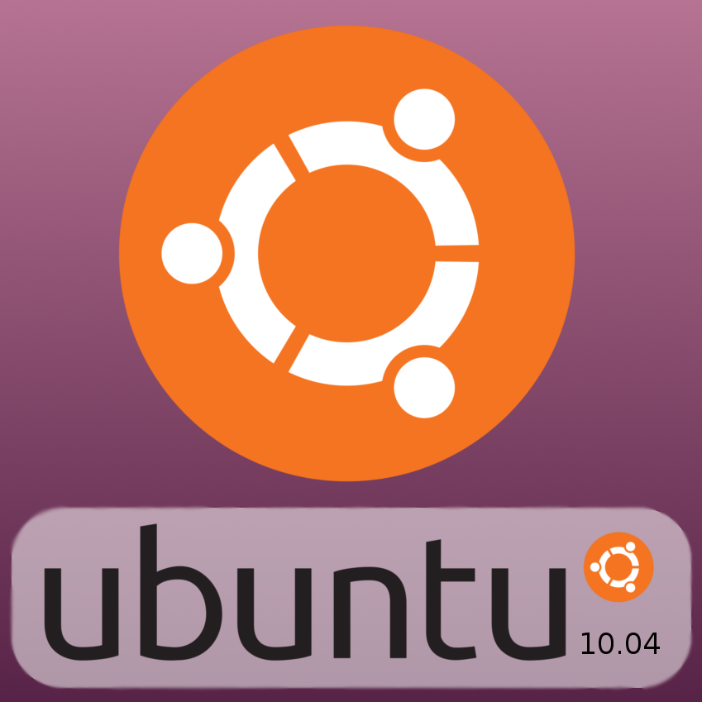

Slide 339
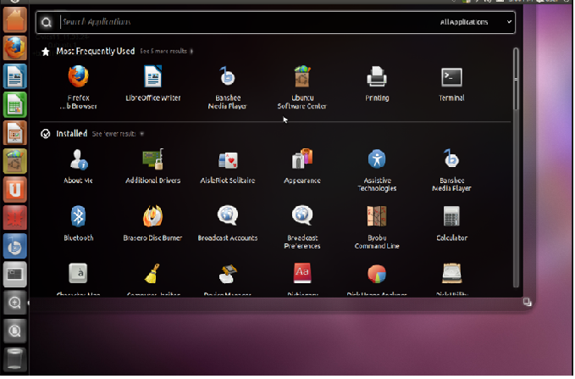

Slide 340
Ubuntu MID common features and attributes
Small size/form factor, typically a 4 to 7 inch touch screen.
Physical and / or virtual key board
Wi-Fi , 3G, Bluetooth, GPS, WiMAX
2-to- 8 GB Flash or Disk storage
Open GL 3D graphics support
USB , camera, head phones jack, speaker, microphone
Customizable user interface

Slide 341
Other features
Automatically generated contents table
Embedded image support
Foot notes / hyperlink support
Position indicator
List of last opened books
Text search and full screen mode including screen rotation.

Slide 342
Mobile Platform Virtualization
Smart phones with rich and open operating systems are growing in popularity, resulting tremendous innovation and change.
The pressure to reduce development costs and get phones to market faster has increased competitive pressure to migrate from proprietary operating systems to open operating systems without compromising the security of trusted services.

Slide 343
The ability to protect and migrate personas will become an important purchasing decision.
The risk of not securing and managing employee-owned devices if they contain confidential information is significant, and managing a wide variety of devices is complex in terms of both cost and security.
Virtualization is a key enabling technology to address these issues.
Security is a serious issue for mobile handsets running an open source operating systems.
There are already a significant number of known viruses, and their numbers are growing fast for mobile phones but still lag far behind the number of known PC viruses.

Slide 345
Real-time virtualization solutions offer robust security via hardware-enforced memory isolation of partitions, isolating each operating system from the others and preventing cross-corruption.
In addition, specific partitions may be added and used to execute secure applications in small certifiable environments protected from the larger open environment or real-time operating system (RTOS) executing in other partitions.

Slide 346
Virtual Mobile Infrastructure (VMI) is a mobile-centric technology that runs mobile apps on a mobile operating system (OS)/virtual machine that is located on a remote server.
This essentially creates a virtual device running in the data center that can be accessed by a thin client app on mobile endpoints.
Two examples of virtualization software being used on smartphones are discussed in the following.

Slide 347
KVM
Kernel-based Virtual Machine (KVM) is open source software that is a full virtualization solution for Linux on x86 hardware containing virtualization extensions (Intel VT or AMD-V).
KVM consists of a
kernel module - kvm.ko, which provides the core virtualization infrastructure, and
a processor- specific module - kvm-intel.ko or kvm-amd.ko,
depending on the CPU manufacturer (Intel or AMD(advanced micro devices)).

Slide 348
A wide variety of guest operating systems work with KVM, including many versions of Linux, BSD, Solaris, Windows, Haiku, ReactOS, and the AROS Research Operating System.
Each virtual machine has private virtualized hardware: a network card, disk, graphics adapter, etc.
KVM’s performance is good, but not as good as that of some of the more mature products, such as VMware or VirtualBox.

Slide 349
VMWare
VMware Mobile Virtualization Platform (MVP) is a thin layer of software that is embedded on a mobile phone to separate the applications and data from the underlying hardware.
It is optimized to run efficiently on lowpower, low-memory mobile phones.
VMware MVP benefits end users by being able to run multiple profiles (e.g., one for personal use and one for work use) on the same phone.

Slide 350
For virtual teams and telecommuters with a steady Internet connection, VMware View (formerly VMware Virtual Desktop Infrastructure, VDI) can be used to deliver remote access to server-based virtual desktop PCs through a secure network connection.
Mobile users with intermittent access to the Internet can use Vmware ACE(assured computing environments) and workers can use on corporate-owned laptops, employee-owned PCs, or even iPods and USB memory sticks without putting sensitive corporate information at risk.

Slide 351
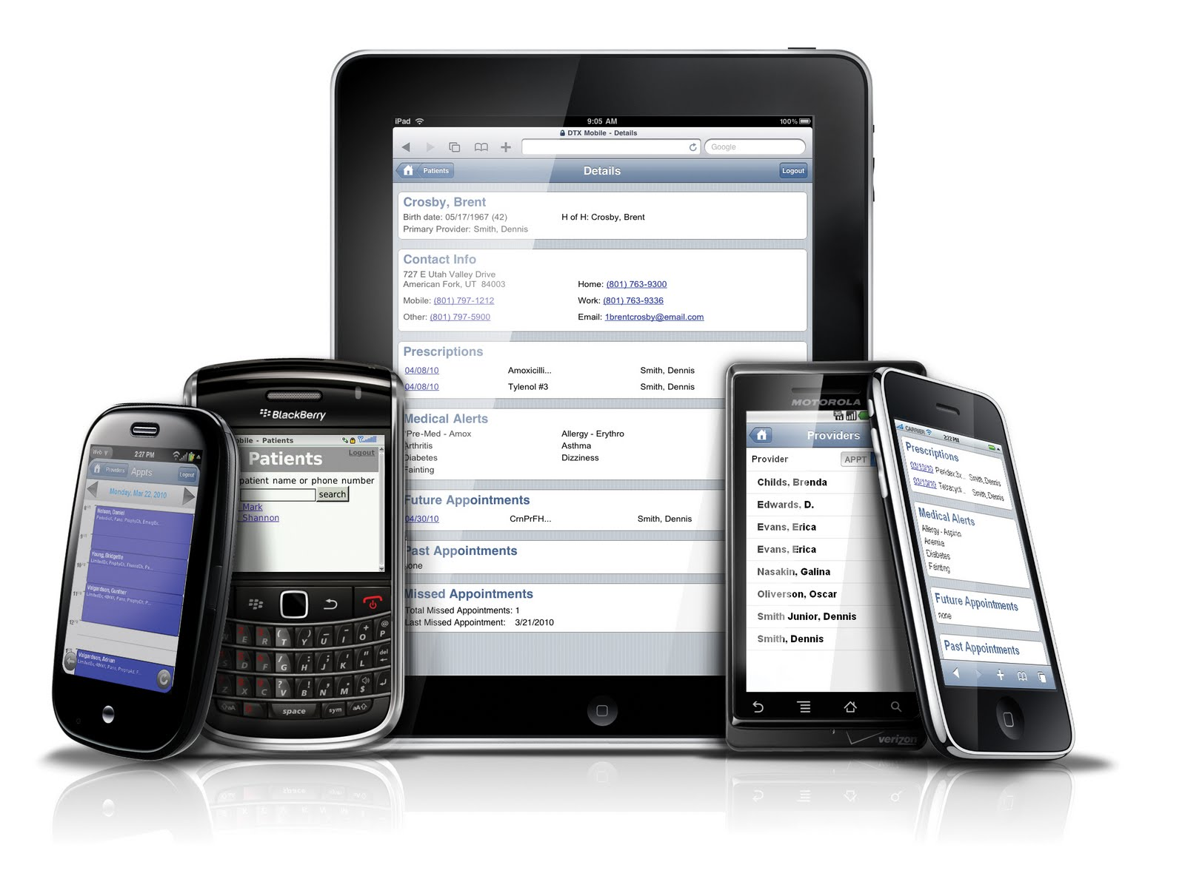
Thank You

Slide 352
Cloud Computing with the Titans
By
Dr. M. Kalpana Devi
Assoc. Professor

Slide 353
UNIT-4
Cloud Computing with the Titans
1. Google
1.1 Google APP Engine
1.2 Google Web Toolkit
2. Microsoft
2.1 Azure Services Platform
2.2 Windows Live
2.3 Exchange Online
2.4 Sharepoint Services
2.5 Microsoft Dynamics CRM
3. Amazon
3.1 Amazon Elastic Compute Cloud( Amazon EC2)
3.2 Amazon SimpleDB
3.3 Amazon Simple Storage Service(Amazon s3)
3.4 Amazon Simple Queue Service( Amazon SQS)
4. Salesforce.com-
4.1 Force.com
4.2 Salesforce.com CRM
4.3 AppExchange.

Slide 354
Google
The cloud is certainly one of Google’s biggest business ventures, and they offer many tools to help draw customers to their cloud.
Google launched its cloud computing service in 2008.
In April 2008, Google announced a preview release of App Engine, a developer tool that allowed users to run their web applications on Google infrastructure.
Google Cloud Platform services are robust. One way to navigate them is to consider which solutions are available based on your primary computing needs: infrastructure as a service (IaaS), platform as a service (PaaS), and software-as-a-service (SaaS).

Slide 355
Core service categories include:
Compute
Networking
Storage and Databases
Artificial Intelligence (AI) / Machine Learning (ML)
Big Data
Identity and Security
Management Tools

Slide 356
Why is Google Cloud Platform such a popular public cloud vendor?
Security: Google’s security model goes the extra mile with scalable infrastructure and innovation capabilities to help keep your organization secure and compliant.
Support: Each and every GCP customer gets basic support for free. If you need extra help, you can upgrade to a premium support package and get greater access to support engineers.
Flexibility: Its openness and interoperability makes Google at the forefront.
Analytics: Data is behind everything Google does.

Slide 357
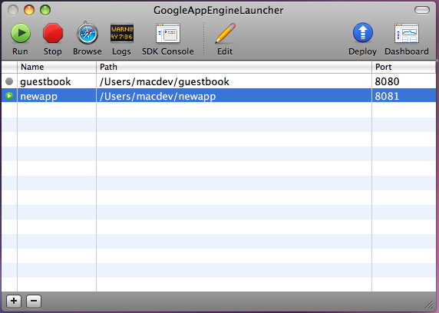
Google App Engine
Google App Engine enables developers to build their web apps on the same infrastructure that powers Google’s own applications.

Slide 358
Features
Leveraging Google App Engine, developers can accomplish the following tasks:
Write code once and deploy: Provisioning and configuring multiple machines for web serving and data storage can be expensive and time-consuming.
Google App Engine makes it easier to deploy web applications by dynamically providing computing resources as they are needed.
Developers write the code, and Google App Engine takes care of the rest.
Absorb spikes in traffic When a web app surges in popularity, the sudden increase in traffic can be overwhelming for applications of all sizes, from startups to large companies that find themselves re-architecting their databases and entire systems several times a year.
With automatic replication and load balancing, Google App Engine makes it easier to scale from one user to one million by taking advantage of Bigtable and other components of Google’s scalable infrastructure.

Slide 359
Easily integrate with other Google services It’s unnecessary and inefficient for developers to write components like authentication and email from scratch for each new application.
Developers using Google App Engine can make use of built-in components and Google’s broader library of APIs that provide plug-and-play functionality for simple but important features.

Slide 360
B E N E F I T S
Open and familiar languages and tools
Build and deploy apps quickly using popular languages or bring your own language runtimes and frameworks. You can also manage resources from the command line, debug source code, and run API back ends easily.
Just add code
Focus on writing code without having to manage underlying infrastructure. Protect your apps from security threats using firewall capabilities, IAM rules, and managed SSL/ TLS certificates.
Pay only for what you use
Operate in a serverless environment without worrying about over or under provisioning. App Engine automatically scales depending on your app traffic and consumes resources only when your code is running.

Slide 361
Cost
Google is offering the App Engine for free, when it launched, but after a few months slapped on some fees. As of this writing, developers using Google App Engine can expect to pay:
• Free quota to get started: 500MB storage and enough CPU and bandwidth for about 5 million pageviews per month
• $0.10–$0.12 per CPU core-hour
• $0.15–$0.18 per GB-month of storage
• $0.11–$0.13 per GB of outgoing bandwidth
• $0.09–$0.11 per GB of incoming bandwidth
In response to developer feedback, Google App Engine will provide new APIs. The image-manipulation API enables developers to scale, rotate, and crop images on the server.

Slide 362
Google Web Toolkit
With Google Web Toolkit, developers can develop and debug web applications in the familiar Java programming language, and then deploy them as highly optimized JavaScript.
In doing so, developers sidestep common AJAX headaches like browser compatibility and enjoy significant performance and productivity gains.
Google Health is one recently launched application to use Google Web Toolkit.

Slide 364
What is GWT?
Google Web Toolkit (GWT) is a development toolkit to create RICH Internet Applications (RIA). Here are some of its notable features −
GWT provides developers option to write client side application in JAVA.
GWT compiles the code written in JAVA to JavaScript code.
Application written in GWT is cross-browser compliant.
GWT automatically generates javascript code suitable for each browser.
GWT is open source, completely free, and used by thousands of developers around the world.
It is licensed under the Apache License version 2.0.
Overall, GWT is a framework to build large scale and high performance web application while keeping them as easy-to-maintain.

Slide 365
Google Web Toolkit includes Java 5 language support so that developers can enjoy using the full capabilities of the Java 5 syntax.
The compiler in Google Web Toolkit 1.5 produces faster code than ever, delivering performance gains big enough for end users to notice.
Google Web Toolkit 1.5 accomplishes this by performing deep inlining, better dead-code elimination, and other forms of enhanced static analysis.
Google Web Toolkit also continues to provide a rich and growing set of libraries that help developers build world-class AJAX, data structures, client/server communication, internationalization, testing, and accessibility.

Slide 366
Why to use GWT?
Developers can debug the client side application just as a Java Application.
Again being Java based, GWT has a low learning curve for Java Developers.
GWT generates optimized javascript code, produces browser's specific javascript code by self.
GWT provides Widgets library provides most of tasks required in an application.
GWT is extensible and custom widget can be created to cater to application needs.
On top of everything, GWT applications can run on all major browsers and smart phones including Android and iOS based phones/tablets.

Slide 367
Disadvantages of GWT
Although GWT offers plenty of advantages, it suffers from the following disadvantages −
Not Indexable − Web pages generated by GWT would not be indexed by search engines because these applications are generated dynamically.
Not Degradable − If your application user disables Javascript then user will just see the basic page and nothing more.
Not Designer's Friendly − GWT is not suitable for web designers who prefer using plain HTML with placeholders for inserting dynamic content at later point in time.

Slide 368
Google App Engine (GAE) is a platform and SDK for developing and hosting web applications, using Google's servers and infrastructure.
Google Web Toolkit (GWT) is a development toolkit for building complex AJAX-based web applications using Java, which is then compiled to optimized JavaScript. Used together, GAE/Java and GWT provide an end-to-end Java solution for AJAX web applications, which can solve many of the problems that arise in developing, maintaining, and scaling web applications.
GWT is a Java library. You write Java code using the GWT API. That java code gets compiled into javascript that can be run in a web browser. The compilation step is provided by software in the GWT.
GAE is completely different. GAE is a server platform for deploying web applications to Google's server infrastructure. You can use GWT in a GAE app; you do not have to do this. You can create a GAE app that does not use GWT.

Slide 369
Microsoft
Microsoft offers a number of cloud services for organizations of any size—from enterprises all the way down to mom-and-pop shops or individuals.
Microsoft has moved into cloud computing with Windows Azure platform which was announced in 2008.
The Windows Azure platform lets consumers build computing infrastructure in the “cloud” and offer it to its users.
In 2011, Office 365, a cloud version of Office business software suite was released which included applications such as Word and Excel.
Another popular product, Microsoft's SQL Server 2012, featured many enhancements to previous versions.
This included Always On which provided options to improve the database availability and easy cloud set up and compatibility.
Features also included performance and programmability enhancements.

Slide 370
Azure Services Platform
The Azure Services Platform is a cloud computing and services platform hosted in Microsoft datacenters.
The Azure Services Platform supplies a broad range of functionality to build applications to serve individuals or large enterprises, and everyone in between.
The platform offers a cloud operating system and developer tools.
Applications can be developed with industry standard protocols like REST and SOAP.
Azure services can be used individually or in conjunction with one another to build new applications or to enhance existing ones.

Slide 374
Windows Azure
Windows Azure is a cloud-based operating system that enables the development, hosting, and service management environment for the Azure Services Platform.
Windows Azure gives developers an on-demand compute and storage environment that they can use to host, scale, and manage web applications through Microsoft datacenters.
To build applications and services, developers can use the Visual Studio skills they already have.
Further, Azure supports existing standards like SOAP, REST, and XML.

Slide 375
Windows Azure can be used to
Add web service capabilities to existing applications
Build and modify applications and then move them onto the Web
Make, test, debug, and distribute web services efficiently and inexpensively
Reduce the costs of IT management.

Slide 376
SQL Services
Microsoft SQL Services extends SQL Server capabilities to the cloud as web-based services.
This allows the storage of structured, semistructured, and unstructured data.
SQL Services delivers a set of integrated services that allow relational queries, search, reporting, analytics, integration, and synchronization of data.
This can be done by mobile users, remote offices, or business partners.

Slide 377
.NET Services
Microsoft .NET Services are a set of Microsoft-hosted, developer-oriented services that provide the components required by many cloud-based and cloud-aware applications.
.NET Services are similar to the .NET Framework, providing high-level class libraries that make development much more robust.
.NET Services can help developers focus more on their end product than on building and deploying their own cloud-based infrastructure.
.NET Services are also available to other development technologies through the use of industry-standard protocols, like REST, SOAP, and HTTP.

Slide 378
Live Services
Live Services is a development center and supplier of software development kits for Windows Live and Azure Services platforms.
It gives information about getting started with Windows Live services, current documentation and APIs, and samples.
Windows Live
Windows Live is an integrated set of online services that makes it easier and more fun for consumers to communicate and share with others.
The new generation of Windows Live includes updated experiences for photo sharing, email, and instant messaging, as well as integration with multiple third-party sites.

Slide 379
The release also includes Windows Live Essentials, free downloadable software that enhances consumers’ Windows experience by helping them simplify and enjoy digital content scattered across their PC, phone, and on web sites.
Consumers can create online content and share it in many places across the Web.
The new Windows Live also gives consumers the added convenience of having a central place to organize and manage information

Slide 380
To help make it simple for Windows Live customers to keep their friends up to date, Microsoft collaborated with companies including
Flickr
LinkedIn Corp.
Pandora Media Inc.
Photobucket Inc.
Twitter
WordPress
Yelp Inc
to integrate activities on third-party sites into Windows Live through a new profile and What’s New feed.

Slide 381
Extending Live’s Reach
The ability for Windows Live customers to add third-party sites to their profiles and have those activities appear in a Windows Live feed across their network was made possible through collaboration with more than 50 leading web companies,
As Windows Live customers share photos, update their profiles, and write reviews, these activities will automatically publish to their Windows Live network.
In addition to partnering with leading web companies, Microsoft announced alliances with HP and China Telecom Corporation Ltd. to deliver Windows Live services to more people across the globe.

Slide 382
HP, the worldwide leader in printing solutions, will distribute Windows Live Photo Gallery with its consumer printers, including Photosmart and Deskjet lines.
The combined offer provides HP customers with Windows Live Photo Gallery, an end-to-end photo management and printing solution.
Communicating and Collaborating
Windows Live makes it easier for consumers to manage their digital life and keep their life in sync. These are some of the highlights:
Windows Live provides social features available to all customers, including an updated profile, a “what’s new” feed of activities across the network, and web, photo sharing, and on-the-go access from virtually any device with Windows Live Sky Drive.
Online storage is increased from 5GB to 25GB.

Slide 383
Windows Live Messenger includes more personalization, a “what’s new” feed with updates from contacts across the Web, drag-and-drop photo sharing in the conversation window, a Favorites list to designate the most important contacts, and group IM to chat simultaneously with up to 20 people at the same time.
Windows Live Hotmail was recently upgraded and is now faster and has 80 percent more effective spam filtering compared with previous versions of Hotmail.
Upcoming changes include the ability to bring multiple email accounts together, the ability to put multiple email addresses onto almost any device, increased storage, and a revamped calendar that makes it easier to share calendars with others, subscribe to multiple calendars, and use your calendar with Microsoft Outlook.

Slide 384
Windows Live Groups, a place for groups to collaborate online, includes a shared calendar, shared storage, a shared email address, and shared instant messaging.
All these services work with Windows Live Essentials, a free suite of applications for communication and sharing that also works with leading email, photo, and blogging services worldwide.

Slide 385
Exchange Online
Messaging is a crucial business application, and to help facilitate that in a cloud environment, Microsoft offers Exchange Online.
Microsoft Exchange Online is a Microsoft-hosted enterprise messaging service based on Microsoft Exchange Server 2007. Because it is a cloud service, you and your employees can access messages from anywhere.
Exchange Online servers are geographically dispersed.
The service is aimed at easing IT’s management duties by removing your need to deploy, configure, monitor, and upgrade on-site email solutions.
Customers using Active Directory can use a synchronization tool to keep the online and local Active Directories in sync.
This allows for a mix of users, from on-site users to users traveling and checking in with a mobile device.

Slide 386
These are the key features of the online standard version of the solution:
A 5GB mailbox (additional storage available for purchase—up to 25GB), shared calendar, contacts, tasks
Outlook Client Connectivity including Outlook Anywhere
Outlook Web Access Virus/spam filtering via Exchange Hosted Filtering
Push email for Microsoft Windows Mobile 6.0/6.1 and Exchange ActiveSync 12 devices
Built-in business continuity and disaster recovery capabilities

Slide 387
Scheduled uptime of 99.9 percent with financially backed service level agreements
Use of HTTPS to help keep Internet access secure
Tier 2 support 24/7 (web form and phone based) for IT administrators
Sign-In Tool for single sign-on capability
Directory Synchronization Tool to help keep on-premise and online Active Directories in sync
Coexistence, or the ability for some users to be on mail servers on premises and for some to be online

Slide 388
SharePoint Services
Microsoft offers its SharePoint Services to aid collaboration efforts.
SharePoint Services provides communities for team collaboration and makes it easy for users to work together on documents, tasks, contacts, events, and other information.
Additionally, team and site managers can coordinate site contents and user activity.
SharePoint sites are made up of Web Parts and Windows ASP.NET-based components.
Web Parts are designed to be add-ons to web pages and configured by site administrators and users to create complete page-based applications.

Slide 389
Document collaboration controls allow you to check in, check out, and control document versioning.
A site’s collaborative content—like documents, lists, events, and so forth—can be read and edited with Microsoft Office Word. Picture editing is also possible.
Microsoft Office Outlook allows SharePoint site event calendars to be viewed side by side with personal calendars.
SharePoint Services can scale to thousands of sites within an organization.

Slide 390
Site usage can be monitored to detect and retire inactive sites.
SharePoint Services servers, sites, and site contents are managed by using a .NET-based object model.
Sites can be customized even by nondevelopers by using Microsoft Office FrontPage.

Slide 391
Microsoft Dynamics CRM
Microsoft Dynamics CRM Online is an on-demand customer relationship management service hosted and managed by Microsoft.
The Internet service delivers a full suite of marketing, sales, and service capabilities through a web browser or directly into Microsoft Office and Outlook.
It provides “instant-on” access to businesses that want a full-featured CRM solution with no IT infrastructure investment or setup required.
In addition to full access through a zero-footprint browser client, the new service delivers marketing, sales, and service information within a native Microsoft Office experience, integrated with the desktop tools that employees already use every day.

Slide 392
Microsoft Dynamics CRM Online is initially packaged in two service offerings:
Microsoft Dynamics CRM Online Professional delivers a full suite of CRM capabilities with extensive configurability and extensibility options.
Businesses get 5GB of data storage, 100 configurable workflows, and 100 custom entities.
The Professional edition is priced at US$44 per user per month, with an introductory offer of US$39 per user per month.
Microsoft Dynamics CRM Online Professional Plus delivers all the capabilities of the Professional version plus offline data synchronization with expanded data storage, workflow, and customization options that give businesses 20GB of data storage, 200 configurable workflows, and 200 custom entities.
The Professional Plus edition is priced at US$59 per user per month.

Slide 393
Amazon
Amazon may be the most widely known cloud vendor.
They offer services on many different fronts, from storage to platform to databases.
Amazon seems to have their finger in a number of cloud technologies.

Slide 394
Amazon Elastic Compute Cloud (Amazon EC2)
Amazon Elastic Compute Cloud (Amazon EC2) is a web service that offers resizable compute capacity in the cloud and is designed to make web scaling easier for developers.
Amazon EC2 provides a simple web interface that allows you to obtain and configure capacity with little difficulty.
It allows you control of your computing resources.
Amazon EC2 cuts the time it takes to obtain and boot new server instances to a few minutes, allowing you to change scale as your needs change.
For instance, Amazon EC2 can run Microsoft Windows Server 2003 and is a way to deploy applications using the Microsoft Web Platform, including ASP.NET, ASP.NET AJAX, Silverlight, and Internet Information Server (IIS).

Slide 395
Amazon EC2 allows you to run Windows-based applications on Amazon’s cloud computing platform.
This might be web sites, web-service hosting, high-performance computing, data processing, media transcoding, ASP.NET application hosting, or any other application requiring Windows software.
EC2 also supports SQL Server Express and SQL Server Standard and makes those offerings available to customers on an hourly basis.

Slide 396
Amazon SimpleDB
For database services, Amazon offers its Amazon SimpleDB.
It provides core database functions of data indexing and querying.
This service works closely with Amazon Simple Storage Service (Amazon S3) and Amazon EC2.
This provides the ability to store, process, and query data sets in the cloud.
Amazon offers the feature because traditional relational databases require a sizable upfront expense.
They are also complex to design and often require the employment of a database administrator.
Amazon SimpleDB is-as the name says-simpler.
It requires no schema, automatically indexes data, and provides a simple API for storage and access.
This makes the process easier to manage and eliminates the administrative burden of data modeling, index maintenance, and performance tuning.

Slide 397
Amazon Simple Storage Service (Amazon S3)
Amazon Simple Storage Service (Amazon S3) is Amazon’s storage solution for the Internet.
It is designed to make web-scale computing easier for developers.
Amazon S3 utilizes a simple web services interface that can be used to store and retrieve any amount of data from anywhere on the Web.
It gives developers access to the same data storage infrastructure that Amazon uses to run its own retail empire.

Slide 398
Amazon CloudFront
Amazon CloudFront is a web service for content delivery.
It works in conjunction with other Amazon Web Services to give developers and businesses an easy way to distribute content to clients.
Amazon promises low latency, high data transfer speeds, and no commitments.
The service delivers content using a global network of edge locations.
Object requests are automatically routed to the nearest edge location, so content is delivered with the best performance possible.

Slide 399
Amazon Simple Queue Service (Amazon SQS)
Amazon Simple Queue Service (Amazon SQS) offers a scalable, hosted queue for storing messages as they travel between computers.
Developers can move data between distributed components of their applications that perform different tasks, without losing messages or requiring each component to be always available.
Amazon SQS allows an automated workflow to be created and works closely with Amazon EC2 and other Amazon Web Services.
Amazon SQS exposes Amazon’s web-scale messaging infrastructure as a web service.
As such, any computer on the Internet can add or read messages without any specially installed software or special firewall configurations.
Amazon SQS components can run independently, and need not be on the same network, developed with the same technologies, or running at the same time.

Slide 400
Elastic Block Store
Amazon also launched its Amazon Elastic Block Store (Amazon EBS), a persistent storage feature for the Amazon EC2.
Amazon EC2 is an infrastructure service that provides resizable compute capacity in the cloud.
With Amazon EBS, storage volumes can be programmatically created, attached to Amazon EC2 instances, and if even more durability is desired, can be backed with a snapshot to the Amazon Simple Storage Service (Amazon S3).
Prior to Amazon EBS, storage within an Amazon EC2 instance was tied to the instance itself so that when the instance was terminated, the data within the instance was lost.
With Amazon EBS, users can choose to allocate storage volumes that persist reliably and independently from Amazon EC2 instances.

Slide 401
Additionally, for even more durable backups and an easy way to create new volumes, Amazon EBS provides the ability to create point-intime, consistent snapshots of volumes that are then stored to Amazon S3.
“ShareThis” has received tremendous benefits from working with Amazon Web Services, a service providing a one-click way to instantly post, tag, and send content via email, instant messaging, and text messaging.
“Sun’s MySQL is the one of the most popular databases on Amazon EC2.
With the introduction of EBS, MySQL users will be able to increase the durability and portability of their database applications deployed in the cloud,” said Juan Carlos Soto, vice president of Global Market Development at Sun Microsystems.

Slide 402
Salesforce.com
Salesforce.com made its name with the success of its flagship Salesforce.com automation application. Today, the company has three primary areas of focus:
The Sales Cloud The popular cloud computing sales application
The Service Cloud The platform for customer service that lets companies tap into the power of customer conversations no matter where they take place
Your Cloud Powerful capabilities to develop custom applications on its cloud computing platform, Force.com The company has made its platform available to other companies as a place to build and deploy their software services.

Slide 403
This makes it possible to store, classify, and share information in a manner similar to Microsoft SharePoint.
The company employs a multitenant architecture, similar to Google, Amazon, and eBay.
As such, servers and other resources are shared by customers, rather than given to a single account.
It allows for better performance, better scalability, better security, and faster innovation through automatic upgrades.
Multitenancy also allows apps to be elastic—they can scale up to tens of thousands of users, or down to just a few—always something to consider when moving to cloud-based solutions.
As with other providers, upgrades are taken care of by Salesforce.com for their customers, so apps get security and performance enhancements automatically.
Because the company generates all its income based on cloud computing.

Slide 404
Force.com
Force.com is Salesforce.com’s on-demand cloud computing platform—billed by Salesforce .com as the world’s first PaaS.
Force.com features Visualforce, a technology that makes it much simpler for end customers, developers, and independent software vendors (ISVs) to design almost any type of cloud application for a wide range of uses.
The Force.com platform offers global infrastructure and services for database, logic, workflow, integration, user interface, and application exchange.
Visualforce is essentially a framework for creating new interface designs and enables user interactions that can be built and delivered with no software or hardware infrastructure requirements. More on that later in the chapter

Slide 405
Force.com offers
• A relational database
• User interface options
• Business logic
• Apex, an integrated development environment
• Workflow and approvals engine
• Programmable interface
• Automatic mobile device deployment
• Web services integration
• Reporting and analytics

Slide 406
Using Apex, programmers can test their applications in Force.com’s Sandboxes and then offer the finalized code on Salesforce.com’s site.
Developers initially used Force.com to create add-ons to the Salesforce CRM, but now it is possible to develop applications that are unrelated to Salesforce.com’s offerings.
For instance, gaming giant Electronic Arts created an employee-recruiting application on Force.com and software vendor Coda made a general ledger application.
Meanwhile, Salesforce.com promotes its own applications, which are used by more than 1.1 million people.

Slide 407
PaaS
Force.com delivers PaaS, a way to create and deploy business apps that allows companies and developers to focus on what their applications do, rather than the software and infrastructure to run them.
The Force.com platform can run multiple applications within the same Salesforce.com instance, allowing all of a company’s Salesforce.com applications to share a common security model, data model, and user interface.
In addition to that an on-demand operating system, the ability to create any database on demand, a workflow engine for managing collaboration between users, and a programming language for building complex logic.
A web services API for programmatic access, mash-ups, and integration with other applications and data is another key feature.

Slide 408
Visualforce
As part of the Force.com platform, Visualforce provides the ability to design application user interfaces for practically any experience on any screen.
Visualforce uses HTML, AJAX, and Flex, for business applications.
Visualforce provides a page-based model, built on standard HTML and web presentation technologies, and is complemented with both a component library for implementing common user interface elements, and a controller model for creating new interactions between those elements.
Visualforce features and capabilities include:
Pages Enables the design definition of an application’s user interface.
Components Provides the ability to create new applications that automatically match the look and feel of Salesforce.com applications or easily customize and extend the Salesforce.com user interface to specific requirements.
Logic Controllers The controller enables customers to build any user interface behavior.

Slide 409
Salesforce.com CRM
Salesforce.com is a leader in cloud computing customer relationship management (CRM) applications.
Its CRM offering consists of the Sales Cloud and the Service Cloud and can be broken down into five core applications:
Sales Easily the most popular cloud computing sales application, Salesforce.com says that CRM Sales is used by more than 1.1 million customers around the world.
Its value proposition is that it empowers companies to manage people and processes more effectively.
Marketing With Salesforce.com CRM Marketing, marketers can put the latest web technologies to work building pipeline while collaborating seamlessly with their sales organization.
The application empowers customers to manage multichannel campaigns and provide up-to-date messaging to sales.

Slide 410
Service The Service Cloud is the new platform for customer service.
Companies can tap into the power of customer conversations no matter where they take place.
Because it’s on the Web, the Service Cloud allows companies to instantly connect to collaborate in real time, share sales information, and follow joint processes.
Connecting with partners is made to be as easy as connecting with people on LinkedIn: companies instantly share leads, opportunities, accounts, contacts, and tasks with their partners.
Collaboration Salesforce.com CRM can help an organization work more efficiently with customers, partners, and employees by allowing them to collaborate among themselves in the cloud.

Slide 411
Some of the capabilities include
Create and share content in real time using Google Apps and Salesforce.com
Track and deliver presentations using Content Library
Give your community a voice using Ideas and Facebook
Tap into the collective wisdom of the sales team with Genius
Analytics Force.com offers real-time reporting, calculations, and dashboards so a business is better able to optimize performance, decision making, and resource allocation.
Custom Applications Custom applications can be quickly created by leveraging one data model, one sharing model, and one user interface.

Slide 412
AppExchange
Launched in 2005, AppExchange is a directory of applications built for Salesforce.com by third-party developers.
Users can purchase and add to their Salesforce.com environment.
When it launched, AppExchange offered 70 applications.
As of September 2008, there were over 750 applications available from over 450 ISVs.
With AppExchange, companies have access to new applications that potentially bring the benefits of Salesforce.com to an entire business, letting them manage and share all of a company’s information on demand.
Using AppExchange, companies are able to easily add new applications to their existing Salesforce.com deployments.

Slide 413
This allows for the development of applications serving a broad range of business requirements:
• Finance
• Electronic signatures
• Document management
• Project management
• Credit and collections
• Mobile workforce management
• Data cleansing
• Professional services management
• Human resources

Slide 414
A feature called “Get It Now” makes that application instantly available to all subscribers within that customer’s Salesforce.com account.
Once installed, AppExchange applications will sit alongside their existing on-demand applications, and may be further customized to meet customers’ unique business needs.
Applications built for the Force.com platform can run entirely on demand, eliminating the need for developers or partners to create and manage their own datacenter or infrastructure.
Salesforce.com expects that developers and business experts around the world will be able to contribute applications to the AppExchange and take advantage of the most compelling community of success in on-demand computing.

Slide 415
Thank You

Slide 416
The Business Case for Going to the Cloud
By
Dr. M. Kalpana Devi
Assoc. Professor

Slide 417
UNIT- 5
The Business Case for Going to the Cloud:
5.1 Cloud Computing Services,
5.1.1 IaaS
5.1.2 PaaS
5.1.3 SaaS
5.2 How Those Applications Help Your Business,
5.2.1 Operational benefits
5.2.2 Economic benefits
5.2.3 Staffing benefits
5.3 Deleting Your Datacenter,
5.3.1 What you can delete
5.3.2 What you can keep
5.4 Case Study of Salesforce.com
5.5 Case Study of Thomson Reuters
5.6 Case Study of American Airlines

Slide 418
Whether or not organizations move to the cloud depends on what the organization need to accomplish, and whether or not the cloud can help them to do it.
In fact, there are instances where the organizations should not move to the cloud. But there are also instances that an organization certainly should add cloud computing to their IT.
In this chapter we’ll talk about how the organizations would benefit from a cloud move and how different cloud services (PaaS, SaaS, and so on) can serve the organizations..

Slide 419
5.1 Cloud Computing Services
Your organization can benefit from the cloud in different ways.
5.1.1. Infrastructure as a Service:
In this scenario, you’re using the cloud provider’s machines.
Another term for this type of computing is Everything as a Service.
That is, you are using a virtualized server and running software on it.
One of the most prevalent is Amazon Elastic Compute Cloud (EC2).
Another player in the field is GoGrid.

Slide 420
Amazon EC2
Amazon Elastic Compute Cloud is a web service that provides resizable computing capacity in the cloud.
Amazon EC2 reduces the time required to obtain and boot new server instances to minutes, allowing quick scaling capacity, both up and down, as computing requirements change.
Amazon EC2 changes the economics of computing by allowing you to pay only for capacity that you actually use.
“Amazon EC2 has given us the ability to easily spin up tailored computing environments that can quickly and cost-effectively process tremendous amounts of research data and now that Amazon EC2 runs Windows and SQL Server.

Slide 421
Windows and SQL Server Support for Amazon EC2
Customers can employ Amazon EC2 running Windows Server or SQL Server with all of the benefits of Amazon EC2.
Windows with Amazon EC2 has been a common request of AWS customers since the service launched.
Amazon EC2 Service Level Agreement
With over two years of operation Amazon EC2 exited its beta into general availability and offers customers a Service Level Agreement (SLA).
The Amazon EC2 SLA guarantees 99.95 percent availability of the service within a region over a trailing 365-day period, or customers are eligible to receive service credits back.

Slide 422
Recent Features
In 2009, AWS announced plans for several new features that make managing cloud-based applications easier.
AWS will deliver additional features that automate customer usage of Amazon EC2 for more cost-efficient consumption of computing power and provide greater visibility into the operational health of an application running in the AWS cloud.
These features include
Load balancing Enables customers to balance incoming requests and distribute traffic across multiple Amazon EC2 compute instances.
Auto-scaling Automatically grows and shrinks usage of Amazon EC2 compute capacity based on application requirements.
Monitoring Enables customers to monitor operational metrics of Amazon EC2, providing even better visibility into usage of the AWS cloud.
Management Console Provides a simple, point-and-click web interface that lets customers manage and access their AWS cloud resources

Slide 423
GoGrid
GoGrid is a service provider of Windows and Linux cloud-based server hosting, and offers 32-bit and 64-bit editions of Windows Server 2008 within its cloud computing infrastructure.
Parent company ServePath is a Microsoft Gold Certified Partner, and launched Windows Server 2008 dedicated hosting in February 2008
GoGrid becomes one of the first Infrastructure as a Service (IaaS) providers to offer Windows Server 2008 “in the cloud.”
GoGrid enables system administrators to quickly and easily create, deploy, load-balance, and manage Windows and Linux cloud servers within minutes.
GoGrid users select the desired operating system and then choose preconfigured templates in order to minimize time to deploy. Preconfigurations include
Windows Server 2008 Standard with Internet Information Services 7.0 (IIS 7)
Windows Server 2008 Standard with IIS 7 and SQL Server 2005 Express Edition
Windows Server 2008 Standard with IIS 7, SQL Server 2005 Express Edition, and ASP.NET

Slide 424
5.1.2. Platform as a Service
Platform as a Service (PaaS) is a way to build applications and have them hosted by the cloud provider.
RightScale
RightScale entered into a strategic product and partnership, broadening its cloud management platform to support emerging clouds from new vendors, including FlexiScale and GoGrid, while continuing its support for Amazon’s EC2.
RightScale is also working with Rackspace to ensure compatibility with their cloud offerings, including Mosso and CloudFS.
RightScale offers an integrated management dashboard, where applications can be deployed once and managed across these and other clouds.
They gain the capabilities of built-in redundancy, fault tolerance, and geographical distribution of resources—key enterprise demands for cloud providers.

Slide 425
Salesforce.com
Salesforce.com offers Force.com as its on-demand platform.
Force.com features breakthrough Visualforce technology, which allows customers, developers, and ISVs to design any app, for any user, anywhere with the world’s first User Interface-as-a-Service.
The Force.com platform offers global infrastructure and services for database, logic, workflow, integration, user interface, and application exchange.
“With Force.com, customers, developers and ISVs can choose innovation, not infrastructure, With Visualforce we’re giving developers the power to revolutionize any interface, and any industry, on demand.” said Marc Benioff, chairman and CEO, Salesforce.com.

Slide 426
On Demand
The Force.com platform gives customers the power to run multiple applications within the same Salesforce instance, allowing all of a company’s Salesforce applications to share a common security model, data model, and user interface.
The multitenant Force.com platform encompasses a feature set for the creation of business applications such as
an on-demand operating system,
the ability to create any database on demand,
a workflow engine for managing collaboration between users,
the Apex Code programming language for building complex logic,
the Force.com Web Services API for programmatic access,
integration with other applications and data,
and now Visualforce for a framework to build any user interface.

Slide 427
Delivery
Using the logic and workflow intelligence provided by Apex Code, Visualforce offers the ability to meet the requirements of applications that feature different types of users on a variety of devices.
Visualforce uses Internet technology, including HTML, AJAX and Flex, for business applications.
As part of the larger Force.com platform, the user experiences created in Visualforce directly leverage the data, logic, and workflow created in the other Force.com features.

Slide 428
Visualforce includes the following features and capabilities:
• Pages
This enables developers to create new pages using standard web technologies including HTML, AJAX, and Flex.
Visualforce automatically detects a user’s device, and gives them the ability to automatically deliver the right experience to the right device.
• Components
This provides the ability to create new applications that automatically match the look and feel of Salesforce applications or customize and extend the Salesforce user interface to specific customer and user requirements.
Visualforce provides the means to reuse predefined standard Salesforce and custom-designed UI components.
• Logic controllers
The standard controller gives customers the ability to inherit and reuse any standard Salesforce UI behavior like new, edit, and save.

Slide 429
5.1.3. Software as a Service
The line between SaaS and PaaS gets a little blurry, but the delineation is whether the provider supplies the application (SaaS) or simply provides a mechanism to develop your own applications (PaaS).
For instance, not only can you build an application with Salesforce, but you can also allow others to use the application you developed.
Google has partnered with Salesforce to make it easy for companies of all sizes to run their business in the cloud with Salesforce for Google Apps.
The combination of the Googl`e Apps suite of productivity applications and the Salesforce suite of Customer Relationship Management (CRM) applications enables businesses to effectively communicate and collaborate without any hardware or software to download, install, or maintain.

Slide 430
Salesforce for Google Apps
Salesforce for Google Apps is a combination of essential applications for business productivity (email, calendaring, documents, spreadsheets, presentations, instant messaging) and CRM (sales, marketing, service and support, partners) that enables an entirely new way for business professionals to communicate, collaborate, and work together in real time over the Web.
The following features are included in Salesforce for Google Apps:
• Salesforce and Gmail Businesses can now easily send, receive, and store email communication, keeping a complete record of customer interactions for better sales execution and improved customer satisfaction.
• Salesforce and Google Docs Create, manage, and share online Google Documents, Google Spreadsheets, and Google Presentations within your sales organization, marketing group, or support team for instant collaboration.
• Salesforce and Google Talk Instantly communicate with colleagues or customers from Salesforce and optionally attach Google Talk conversations to customer or prospect records stored in Salesforce.
• Salesforce and Google Calendar Expose sales tasks and marketing campaigns from Salesforce on Google Calendar. Built by Appirio, this application is one example of a new category of partner extensions to Salesforce for Google Apps.

Slide 431
Force.com and Google Platform
The Force.com Platform-as-a-Service encompasses a feature set for the creation of business applications and Google’s open APIs enable integration and extension of the applications in Google Apps.
The integration of the two creates opportunities for developers and partners to build and run business applications that help customers run their entire business smarter in the cloud.
Applications like sales quote generation and business forecasting are now easy to build and test, and can be deployed by customers with just a few clicks via the AppExchange.

Slide 432
Software plus Services
Microsoft’s take on SaaS is slightly different with their Software plus Services (sometimes they shorten it to S+S).
In this model, typical SaaS is padded support with software running locally.
That is, you run some software on-site and reach out to the cloud for additional services.
This provides the flexibility of using a cloud provider, and also the reliability of having data stored on-site, as well.
Microsoft’s Business Productivity Online Suite, part of Microsoft Online Services, is available for trial to businesses of all sizes in 19 countries.
In addition, Microsoft offers its Microsoft Office Communications Online, for instant messaging and presence, and the Business Productivity Online Deskless Worker Suite, an email, calendaring, and collaboration service for the occasional user.

Slide 433
5.2. How Those Applications Help Your Business
Cloud computing offers a number of benefits that your organization can realize. It helps your organization on a number of levels, not the least of which is the bottom line.
Operational Benefits
There are benefits to the way you operate. You can change business processes (for the better) by moving some applications and storage to the cloud. The following are some of the operational benefits:
Reduced cost Since technology is paid incrementally, your organization saves money in the long run.
Increased storage You can store more data on the cloud than on a private network. Plus, if you need more it’s easy enough to get that extra storage.
Automation Your IT staff no longer needs to worry that an application is up to date—that’s the provider’s job. And they know they have to keep it up to date or they’ll start losing customers.
Flexibility You have more flexibility with a cloud solution. Applications can be tested and deployed with ease, and if it turns out that a given application isn’t getting the job done, you can switch to another.
Better mobility Users can access the cloud from anywhere with an Internet connection. This is ideal for road warriors or telecommuters—or someone who needs to access the system after hours.
Better use of IT staff IT staff no longer has to worry about server updates and other computing issues. They can focus on duties that matter, rather than being maintenance staff.

Slide 434
Economic Benefits
And with cloud computing, cost is a huge factor. But it isn’t just in equipment savings; it is realized throughout the organization. These are some benefits to consider:
People By having fewer staff members, you can look at your team and decide if such-and-such a person is necessary. This gives you an opportunity to find the best people to remain on staff.
Hardware If you need more storage, it’s just a matter of upping your subscription costs with your provider, instead of buying new equipment. If you need more computational cycles, you needn’t buy more servers; rather you just buy more from your cloud provider.
Pay as you go you just pay for what you use. But, also like leasing a car, at the end of the lease you don’t own the car. That might be a good thing—the car may be a piece of junk, and in the case of a purchased server, it’s sure to be obsolete.
Time to market Before the cloud, launching a startup meant using either an underpowered or inflexible host or an overpriced self-host. The former was a bad option, because it was inflexible. The latter cost a lot of money: You had to find a host, configure the machine, ship the machine, and manage the machine. With a cloud, you can spin up a new instance in seconds.

Slide 435
Staffing Benefits
There are a number of benefits the people in your organization will realize when you shift some applications to the cloud. For the most part their lives should be easier with the ease and convenience cloud computing offers. Not only do your workers benefit, but there are also benefits in being a cloud provider.
For the Consumer The consumer benefits from cloud computing in a number of ways, for example:
No software installation or maintenance That means no more 1,000-page planning and implementation guides.
Shorter deployment time It takes only a few minutes to spin up a new server, rather than the months it would normally take to plan, prepare, test, and deploy.
Worldwide availability By using a cloud, your users can access data and applications from anywhere they have Internet access.
Service Level Agreement (SLA) commitment If you have an SLA, then you’re guaranteed that level of service. And if you report any bugs, the vendor will fix them, but you don’t have to hassle with the patch yourself—it’ll likely be done in a way that is transparent to you.
Upgrades The provider wants to keep you happy, so it’s in their best interests to ensure the application is constantly improved. With SaaS this can be in the guise of small changes that you don’t see that add up over time.
Make life easier on your IT staff SaaS offloads a lot of the maintenance duties onto your cloud provider so that your IT staff can focus on improving the day-to-day technical operations of your company
More money Your organization saves money by using a cloud vendor, both in operational costs and the IT budget.

Slide 436
For the Provider However, there is benefit to the cloud providers as well, and it isn’t just money. Here are some of the ways that cloud computing is a plus for the provider:
Operating environment The provider owns their domain. They aren’t just sending technicians to fix or customize software because it doesn’t fit on a client’s unique (or antique) infrastructure. The provider has the control to optimize an infrastructure to their specific SaaS needs.
Predictable revenue stream Because customers will be paying a subscription for their cloud use, it is easy to get a handle on forecasting revenues.
Study use The provider is able to study how their SaaS is used and is then able to give customers more of what they want. This isn’t possible if software is housed on customers’ networks.
Small, regular upgrades This isn’t just a benefit for customers, but the providers, as well. The provider’s development teams can focus on fixing bugs with incremental patch rollouts, rather than saving them for one, monstrous rollout.
Customer relationship management Providers also must develop strong relationships with their customers. Since they are providing a subscription-based service, it is important to keep customers happy, rather than try to score the next big deal. While it is important to keep customers coming in, it is just as important to keep existing customers happy

Slide 437
Tips for Evaluating SaaS
You should evaluate not only the SaaS provider and its service, but also what your organization wants from SaaS. Be sure the following factors are present as you evaluate your SaaS provider:
Time to value As we mentioned earlier, one of the great benefits of using cloud services is the ability to shorten the time it takes to get a new system or application up and running. Unlike traditional software that might require complex installation, configuration, administration, and maintenance, SaaS only requires a browser. This allows you to get up and running much more quickly than by using traditional software.
Trial period Most SaaS providers offer a 30-day trial of their service. This usually doesn’t happen with traditional software—and certainly you wouldn’t move everyone enmasse to the trial. However, you can try out the SaaS vendor’s offering and if it feels like a good fit, you can start making the move.
Low entry costs Another appeal of SaaS is the low cost to get started using it. Rather than laying out an enormous amount of money, you can get started relatively inexpensively. Using an SaaS solution is much less expensive than rolling out a complex software deployment across your organization.
Service In SaaS, the vendor serves the customer. That is, the vendor becomes your IT department—at least for the applications they’re hosting. If the vendor isn’t responsive to your needs, pack up your toys and move to a different service. It is in the vendor’s best interests to keep you and other customers happy.

Slide 438
Wiser investment SaaS offers a less risky option than traditional software installed locally. There is no long-term financial commitment. The monetary risk is greatly lessened in an SaaS environment.
Security In reality it is in your vendor’s best interests to keep you as secure as possible. Most SaaS vendors understand that application data must be backed up often and that security is a top concern. Since the cloud vendor wants to keep customers safe and secure, they will have staff dedicated to ensuring that your data is safe.
Your voice your SaaS vendor wants to keep you happy so that you will not jump ship for another provider. As such, they will listen to your wants and respond. Because you will have a closer relationship, you have a greater ability to influence the product and its features.
Reduced capital expense This makes it faster to get approval for a project when the need to buy hardware is taken out of the equation.
Meet short-term needs Quite often organizations experience busy times, or they launch a new product, a new office opens, or something else occurs that requires more computational power. SaaS provider can instantly expand and offer you more resources.

Slide 439
5.3. Deleting Your Datacenter
When you move to the cloud, you won’t need to maintain some things on-site. But what and when you delete it is a complicated issue. Certainly, you can back up the data and file it away on some DVDs somewhere, but that’s just a snapshot in time of your organization. As you continue to use the cloud, your data will evolve and change.
What You Can Delete Desktop applications are one of the areas perfect for a move to the cloud.
A key component in making desktops cloud capable and helping client virtualization go mainstream is the introduction of so-called bare metal hypervisors for clients.
These hypervisors allow the desktop to run locally without network access to take advantage of the Pac’s computing power, rather than just relying on the server.
What You Should Keep As we have noted time and again, security might be an issue for you.
Are you really comfortable moving mission-critical or sensitive information to the cloud.
If you have even a glimmer of doubt, it’s not worth the sleepless nights, worrying about the potential for compromised information.
You should also keep large files and things like media on-site. If you are storing more than you access online, you get a bigger bill from the vendor each month.
Better to let those infrequently accessed files sit on a local drive than to pay the vendor bill each month.

Slide 440
Steps Does your vendor have a solid disaster recovery plan in place?
This is important because, obviously, you don’t want to lose important data.
There are a lot of reasons to make a move to the cloud, but inevitably cost is the way that companies get into the cloud.
However, once they’re there, convenience and reliability is what will keep them.
For instance, all you need to do is call up a web browser and make adjustments to the amount of processing power, memory, and disk space each virtual server gets.
AppZero provides a set of tools for creating Virtual Application Appliances (VAAs).
This approach to provisioning and deploying applications on physical or virtual servers running anywhere is designed for the cloud environment and for movement of server applications and datacenter to cloud, hosting environment, or cloud to cloud.
VAAs package a server application with all of its dependencies, but no operating system component (zero OS).
AppZero’s first public demonstration of its VAA technology showed a live production application provisioned in seconds on an Amazon EC2 cloud, and moved in less than one minute to a GoGrid cloud computing environment.
Designed for instant server-based application provisioning and deployment.

Slide 441
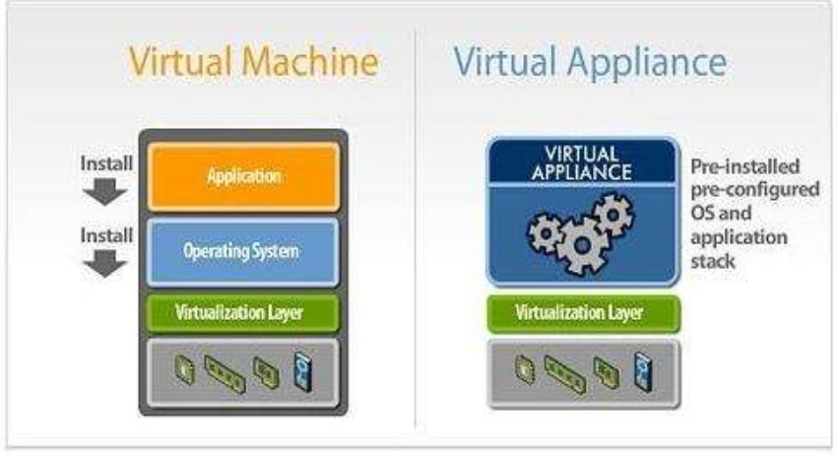

Slide 442
5.4 Case Study- Salesforce.com
Salesforce.com offers SaaS with a host of different applications, many of which are created and shared by other Salesforce customers.
Steve Fisher, senior vice president of AppExchange at Salesforce.com, talked about his company as well as the best way for companies considering a move to the cloud to get the most out of their move.
Fisher emphasizes the differences between Salesforce and other cloud vendors.
The chief difference is in what the vendors supply and how they supply it.
Amazon has Linux boxes, Salesforce offer different applications.
Salesforce has the good fortune to have a broad variety of customers, existing in different industries and having different needs.
In a multitenant environment, the vendor can see what and how users are taking advantage of applications and can make changes based on their observations.
Getting started is especially easy, especially when compared to traditional deployments.

Slide 443
Best Business Practices
So what’s the best way for a company to move to the cloud?
You can go to Salesforce.com and get a free trial. Pilot it first with a single department. Bring on 25 to 100 users to test it out, But not to jump to the cloud if you don’t need to.
Don’t follow trends or do it just because the other guy is doing it. “Only do it if there is a need.
Once you are on the cloud, don’t expect to have a static experience. Your applications and how you use them will evolve.
Another benefit is the ability to really get what an organization wants out of an application.
Traditional software is hard to customize.
It is believed that one day all computing will be done on the cloud. But it’ll take time.

Slide 444
5.5. Case Study- Thomson Reuters
Thomson Reuters is a company that provides information to a wide range of clients— lawyers, accountants, scientists, reporters, and a host of others.
For the most part, they have nothing in common but the need to get information.
Thomson Reuters calls itself “the world’s leading provider of ‘intelligent information’ for businesses and professionals.”
They pull distributed information together; they analyze the information first to ensure it is what the customer wants; and they provide methods of data delivery and retrieval that help their customers get what they want.

Slide 445
Their Cloud Use
Thomson Reuters wanted to give its customers a better, more intelligent way to search for information than they were providing at the time.
Their solution was to adopt a Microsoft Software-plus-Services solution.
They integrated Microsoft Live Search with their own search engines and databases.
When information is requested, both Live Search and Thomson Reuters’s databases are scanned for the information, and Thomson Reuters analyzes the results to return the best information to the client.
Thomson Web outlined its requirements for teaming with an existing web search engine provider:
The company needed an engine that could return results in 200 milliseconds. This gave Thomson Reuters time to apply business logic to make the results more meaningful.
The engine also needed to accept hundreds of thousands of search requests from a single IP address—theirs—without it being seen as a Denial of Service attack.

Slide 446
The system works this way:
A customer accesses the Thomson Reuters information service, which can be a web application or a Windows-based application.
Once a search is initiated, that request is passed to the Thomson Reuters intranet to the Thomson Reuters Web Plus service layer.
The service layer begins two actions concurrently: It applies its custom business logic to the request, culling relevant information from it.
The service layer returns the information to the client

Slide 447
Cloud Computing and Web 2.0
Arguably, MySpace and Facebook—like Hotmail, Live Search, Yahoo and Google—are now application clouds in their own right.
Their sheer scale, the massive compute platform they reside upon is an application on-demand, which is another definition of cloud computing
It is interesting that all of these applications are funded through advertising revenue.
The relationship between massive scale, massive user populations results in large multimillion page view counts that enable the micro transactions of advertising revenue to add up to the vast incomes we now see reported by these companies.
Salesforce.com and other business applications are another category of on-demand computing in the cloud.
These models are mainly focused around business process automation, user access based pricing and individual business process customization.
Substantial proportions of these companies’ revenue comes from the customization and integration of their cloud platforms into the customer’s applications and back office systems.

Slide 448
Applications and the Cloud
When it comes to what type of application is best suited for the cloud, Stateless architectures are far more tolerant of massively scaled out infrastructure without needing custom state management software development.
Additionally, stateless architectures can survive hardware failure very cleanly.
Cloud’s relatively low SLA and unknown quality of infrastructure require applications to be designed for survivability of data and transactions.
Cloud development can be done at a lower cost initially than dedicated infrastructure.
Another buzzword in the world of computing these days is “virtualization.” And it is simply that—virtualization—that can help a business move to the cloud.
Businesses should start developing applications designed to run within virtual machines; they should become comfortable with the agility created by being able to spin up and down VMs on demand and adapt their application architectures to allow for this.

Slide 449
Be Realistic
Service levels are now being defined for cloud infrastructure, but generally your recourse is minimal (a refund of hosting fees as an example).
Also, when hosting your own infrastructure, you get to decide how to maintain it, how to ensure it is resilient and robust. In the cloud you don’t. It’s a matter of buyer beware.
Many commercial clouds are maintaining high uptimes, and while most companies have nothing in the cloud.
Many smaller startup technology companies are completely in the cloud, also seeing a trend for companies to be moving their staff to thin client, low performance, desktop PCs, as more companies opt for office productivity solutions like Google Docs, and hosted Office solutions.

Slide 450
5.6 Case Study- American Airlines
The route to customer experience transformation is through the cloud
To become more responsive to customer needs, American Airlines needed a new technology platform and a new approach to development that would help it deliver digital self-service tools and customer value more rapidly across its enterprise.
IBM is helping the airline migrate some of its critical applications to the IBM Cloud while using new methodology to create innovative applications quickly while improving the customer experience.
Business challenge
Customer experience is a key competitive differentiator for airlines, and increasingly depends on digital channels. How could American meet its customers’ appetite for instant information and services?
Transformation
Working with IBM to migrate some of their key legacy customer-facing applications to VMware HCX on IBM Cloud, while simultaneously transforming them to a cloud-native based microservices architecture is enabling the world's largest airline to innovate faster in response to changing customer needs.
Results
Cost savings : by avoiding existing upgrade costs via a migration to the IBM Cloud
Improved: operational reliability, productivity and end customer response times
Faster: development and release of new apps

Slide 451
Business challenge story
Taking to the digital skies
In the highly competitive airline industry, customer experience is a major point of differentiation.
American Airlines wanted to provide convenient digital services for customers and understood there was an opportunity to remove the constraints of the existing legacy architecture, platform, organization, development and operations approaches.
Customer-facing applications were based on monolithic code, duplicated and managed in silos. Every change required the same work in up to three places, each managed by different teams.
To respond better and faster to customer needs, American Airlines needed to transform the way they worked to take advantage of new technology features.
There was a need to update its technology stack, further increase agility, and introduce DevOps concepts while leveraging an open and flexible cloud platform.

Slide 452
Transformation story
Migrate: IBM’s comprehensive proposal addressed American’s immediate and long term operational concerns through a seamless migration of on-premise servers to IBM Cloud’s Infrastructure as a Service with VMware Cloud Foundation solution.
Transform: IBM also proposed to accelerate the transformation of American’s application development, organization and skills, based on its IBM Garage Method. As IBM and American jointly developed the new cloud-native apps in Cloud Foundry on IBM Public Cloud Platform as a Service, the old components would be retired.
Operate: The solution brings operations into the development squads, and leverages IBM’s Cloud Solutions Operations Center to provide 24-hour application support and management services, with the IBM team located both onsite at American’s location and at an IBM off-shore location.
Accelerated development: The move to microservices
During the negotiations for the big-picture transformation contract, American Airlines asked IBM for help with an urgent requirement – which would also act as a proof-point for IBM’s proposed way of working.
The airline wanted to give customers better self-service capabilities in the event of a forced rebooking due to a major weather event disrupting operations.

Slide 453
While American’s algorithms typically rebook passengers on the next best flight, customers had to call the reservation desk or visit an airport agent if they wanted to discuss other options.
American wanted customers to be able to see other possibilities and update their flight selection via the website, mobile app or at a self-service kiosk.
With the busy summer season approaching, the company president challenged American to deliver a new customer-facing Dynamic Rebooking app within just a few months.
After just four and a half months, the Dynamic Rebooking app was released to production in eight airports, and steadily rolled out to more airports while testing, development and updates continued in the background.
Jason Hobbs, Senior Manager, Application Development at American Airlines, says: “IBM was pivotal in helping us work in a different way. I think we even surprised ourselves on how fast we could put the app into customers' hands.”
American has received great customer feedback on the new app, which provides vital information and control to customers when travel plans are disrupted.

Slide 454
Thank You

