Slide 1
Computer Networks
By
Dr. M. Kalpana Devi
Professor
MCA Department
SITAMS, Chittoor

Slide 2
UNIT - 1 : Introduction to Computer Networks
  1.1 Uses of Computer Networks
    1.1.1 Business Applications
    1.1.2 Home Applications
    1.1.3 Mobile Users
    1.1.4 Social Issues
  1.2. Network Hardware
    1.2.1 Local Area Networks
    1.2.2 Metropolitan Area Networks
    1.2.3 Wide Area Networks
    1.2.4 Wireless Networks
    1.2.5 Home Networks
    1.2.6 Internetworks
  1.3 Network Software
    1.3.1 Protocol Hierarchies
  1.4. References Models
    1.4.1 The OSI Reference Model
    1.4.2 The TCP/IP Reference Model
    1.4.3 A Comparison of the OSI and TCP/IP Reference Models
    1.4.4 A Critique of the OSI Model and Protocols
    1.4.5 A Critique of the TCP/IP Reference Model

Slide 3
  1.5 The Physical Layer
    1.5.1 Guided Transmission Media
      1.5.1.1 Magnetic Media
      1.5.1.2 Twisted Pair
      1.5.1.3 Coaxial Cable
      1.5.1.4. Fiber Optics
    1.5.2 Wireless Transmission
      1.5.2.1. The Electromagnetic Spectrum
      1.5.2.2 Radio Transmission
      1.5.2.3 Microwave Transmission
      1.5.2.4 Infrared and Millimeter Waves
      1.5.2.5 Lightwave Transmission
  1.6 Communication Satellites
    1.6.1 Geostationary Satellites
    1.6.2 Medium-Earth Orbit Satellites
    1.6.3 Low-Earth Orbit Satellites

Slide 4
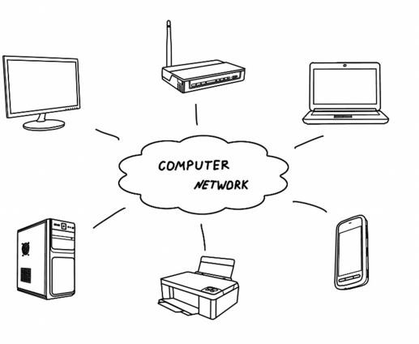
Computer Networks
A computer network is a system in which multiple computers are connected to each other to share information and resources.
The physical connection between networked computing devices is established using either cable media or wireless media.
The best-known computer network is the Internet.

Slide 5
Advantages of Computer Networks
1. File sharing
The major advantage of a computer network is that is allows file sharing and remote file access. A person sitting at one workstation that is connected to a network can easily see files present on another workstation, provided he is authorized to do so.
2. Resource sharing
All computers in the network can share resources such as printers, fax machines, modems, and scanners.
3. Better connectivity and communications
It allows users to connect and communicate with each other easily. Various communication applications included e-mail and groupware are used. Through e-mail, members of a network can send message and ensure safe delivery of data to other members, even in their absence.
4. Internet access
Computer networks provide internet service over the entire network. Every single computer attached to the network can experience the high speed internet.

Slide 6
5. Entertainment
Many games and other means of entertainment are easily available on the internet. Furthermore, Local Area Networks (LANs) offers and facilitates other ways of enjoyments, such as many players are connected through LAN and play a particular game with each other from remote location.
6. Inexpensive system
Shared resources mean reduction in hardware costs. Shared files mean reduction in memory requirement, which indirectly means reduction in file storage expenses. A particular software can be installed only once on the server and made available across all connected computers at once. This saves the expense of buying and installing the same software as many times for as many users.
7. Flexible access
A user can log on to a computer anywhere on the network and access his files. This offers flexibility to the user as to where he should be during the course of his routine.
8. Instant and multiple access
Computer networks are multiply processed .many of users can access the same information at the same time. Immediate commands such as printing commands can be made with the help of computer networks.

Slide 7
Disadvantages of Computer Networks
1. Lack of data security and privacy
Because there would be a huge number of people who would be using a computer network to get and share some of their files and resources, a certain user’s security would be always at risk. There might even be illegal activities that would occur, which you need to be careful about and aware of.
2. Presence of computer viruses and malwares
If even one computer on a network gets affected by a virus, there is a possible threat for the other systems getting affected too. Viruses can spread on a network easily, because of the inter- connectivity of workstations. Moreover, multiple systems with common resources are the perfect breeding ground for viruses that multiply.
3. Lack of Independence
Since most networks have a centralized server and dependent clients, the client users lack any freedom whatsoever. Centralized decision making can sometimes hinder how a client user wants to use his own computer.

Slide 8
4. Lack of Robustness
As previously stated, if a computer network’s main server breaks down, the entire system would become useless. Also, if it has a bridging device or a central linking server that fails, the entire network would also come to a standstill.
5. Need an efficient handler
For a computer network to work efficiently and optimally, it requires high technical skills and know-how of its operations and administration. A person just having basic skills cannot do this job. Take note that the responsibility to handle such a system is high, as allotting permissions and passwords can be daunting. Similarly, network configuration and connection is very tedious and cannot be done by an average technician who does not have advanced knowledge.

Slide 9
Uses of Computer Networks
Business Applications:
To keep track of inventories, to monitor production and do the payroll in the Companies that have separate computers. Initially, each of these computers may have worked in isolation from the others.
At some point, management may have decided to connect them to be able to extract and correlate information about the entire company.
More important thing in this context is sharing physical resources such as printers, scanners, and CD burners, and sharing information.
A second goal of setting up a computer network has to do with people rather than information or even computers.
Yet another form of computer-assisted communication is videoconferencing. Using this technology, employees at distant locations can hold a meeting, seeing and hearing each other and even writing on a shared virtual blackboard.
A third goal for increasingly many companies is doing business electronically with other companies, especially suppliers and customers.
A fourth goal that is starting to become more important is doing business with consumers over the Internet. Airlines, bookstores, and music vendors have discovered that many customers like the convenience of shopping from home.

Slide 10
    Home Applications
Initially, for word processing and games, but in recent years that picture has changed radically. Probably the biggest reason now is for Internet access. Some of the more popular uses of the Internet for home users are as follows:
  1. Access to remote information.
  2. Person-to-person communication.
  3. Interactive entertainment.
  4. Electronic commerce.
1. Access to remote information comes in many forms. It can be surfing the World Wide Web for information or just for fun.
  Information available includes the arts, business, cooking, government, health, history, hobbies, recreation, science, sports, travel, and many others.

Slide 11
2. Another type of person-to-person communication often goes by the name of peer-to-peer communication, to distinguish it from the client-server model.
  In this form, individuals who form a loose group can communicate with others.
  Every person can, in principle, communicate with one or more other people; there is no fixed division into clients and servers.
3. Our third category is entertainment, which is a huge and growing industry. The killer application here is video on demand.
  A decade or so hence, it may be possible to select any movie or television program ever made, in any country, and have it displayed on your screen instantly.
  Live television may also become interactive, with the audience participating in quiz shows, choosing among contestants, and so on.
4. Our fourth category is electronic commerce in the broadest sense of the term.
  Home shopping is already popular and enables users to inspect the on-line catalogs of thousands of companies.
  Some of these catalogs will soon provide the ability to get an instant video on any product by just clicking on the product's name.
  After the customer buys a product electronically but cannot figure out how to use it, on-line technical support may be consulted.

Slide 12
Mobile Users
Mobile computers, such as notebook computers and personal digital assistants (PDAs), are one of the fastest growing segments of the computer industry.
Many users of these computers have desktop machines back at the office and want to be connected to their home base even when away from home or en route.
There is a lot of interest in wireless networks.
Wireless networks are also important to the military. Another area in which wireless could save money is utility meter reading.
If electricity, gas, water, and other meters in people's homes were to report usage over a wireless network.
Wireless smoke detectors could call the fire department instead of making a big noise

Slide 13
Client-Server Model:
For smaller companies, all the computers are likely to be in a single office or perhaps a single building, but for larger ones, the computers and employees may be scattered over dozens of offices and plants in many countries.
In the simplest of terms, one can imagine a company's information system as consisting of one or more databases and some number of employees who need to access them remotely.
In this model, the data are stored on powerful computers called servers.
Often these are centrally housed and maintained by a system administrator.
In contrast, the employees have simpler machines, called clients, on their desks, with which they access remote data.
The client and server machines are connected by a network, as illustrated in the following figure.

Slide 14
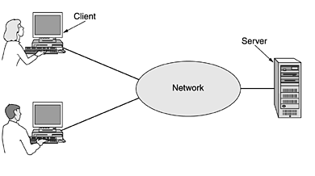

Slide 15
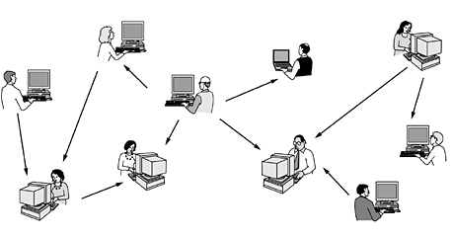
Peer-to-peer communication:
In this form, individuals who form a loose group can communicate with others in the group, as shown in the following figure. Every person can, in principle, communicate with one or more other people; there is no fixed division into clients and servers.

Slide 16
Network Hardware
There are two dimensions of taxonomy stand out as important for computer networks fit: transmission technology and scale.
Classification based on Transmission Technology
Broadly speaking, there are two types of transmission technology that are in widespread use. They are as follows:
  1. Broadcast links.
  2. Point-to-point links.
Broadcast networks
Broadcast networks have a single communication channel that is shared by all the machines on the network.
Short messages, called packets in certain contexts, sent by any machine are received by all the others.
An address field within the packet specifies the intended recipient.
Upon receiving a packet, a machine checks the address field. If the packet is intended for the receiving machine, that machine processes the packet; if the packet is intended for some other machine, it is just ignored.
When a packet is sent to a certain group, it is delivered to all machines subscribing to that group.
As a general rule smaller, geographically localized networks tend to use broadcasting, whereas larger networks usually are point-to-point.

Slide 17
Point-to-point network
Point-to-point transmission with one sender and one receiver is sometimes called unicasting.
Internetwork
Finally, the connection of two or more networks is called an internetwork. The worldwide Internet is a well-known example of an internetwork.
Classification based on Size
Distance is important as a classification metric because different techniques are used at different scales.

Slide 18
LAN (Local Area Network)
It is privately-owned networks within a single building or campus of up to a few kilometres in size.
They are widely used to connect personal computers and workstations in company offices and factories to share resources (e.g., printers) and exchange information.
LANs are easy to design and troubleshoot
In LAN, all the machines are connected to a single cable.
Different types of topologies such as Bus, Ring, Star and Tree are used.
The data transfer rates for LAN is up to 10 Gbits/s.
They transfer data at high speeds. High transmission rate are possible in LAN because of the short distance between various computer networks.
They exist in a limited geographical area.

Slide 19
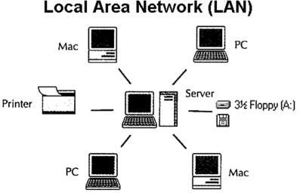
Advantages
  LAN transfers data at high speed.
  LAN technology is generally less expensive.

Slide 20
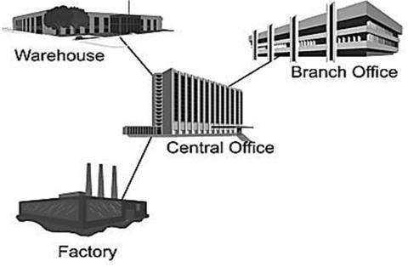
MAN (Metropolitan Area Network)
MAN is a larger version of LAN which covers an area that is larger than the covered by LAN but smaller than the area covered by WAN.
A metropolitan area network or MAN covers a city. The best-known example of a MAN is the cable television network available in many cities.
MAN connects two or more LANs.
At first, the companies began jumping into the business, getting contracts from city governments to wire up an entire city.
The next step was television programming and even entire channels designed for cable only.

Slide 21
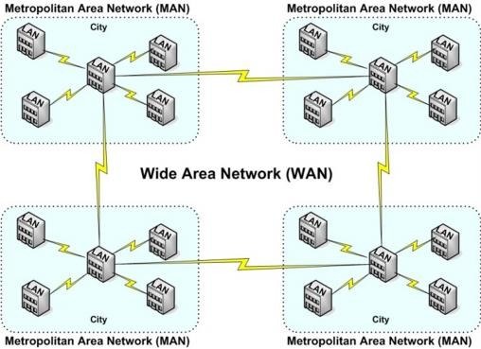
WAN (Wide Area Network)
WAN spans a large geographical area, often a country or region.
WAN links different metropolitan’s countries and national boundaries there by enabling easy communication.
It may be located entirely with in a state or a country or it may be interconnected around the world.
It contains a collection of machines intended for running user (i.e., application) programs. We will follow traditional usage and call these machines hosts.
The communication between different users of WAN is established using leased telephone lines or satellite links and similar channels.

Slide 22
Internet
The internet is a type of world-wide computer network.
The internet is the collection of infinite numbers of connected computers that are spread across the world.
We can also say that, the Internet is a computer network that interconnects hundreds of millions of computing devices throughout the world.
It is established as the largest network and sometimes called network of network that consists of numerous academic, business and government networks, which together carry various information.
Internet is a global computer network providing a variety of information and communication facilities, consisting of interconnected networks using standardized communication protocols.
When two computers are connected over the Internet, they can send and receive all kinds of information such as text, graphics, voice, video, and computer programs.

Slide 23
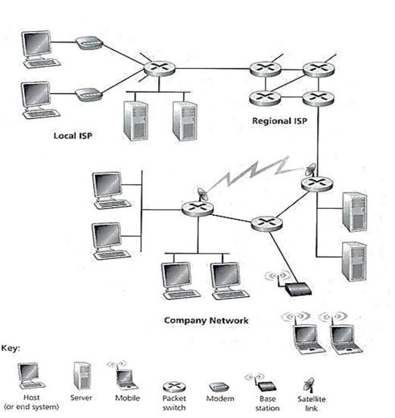

Slide 24
Topologies (Network Topologies)
  Network Topology is the schematic description of a network arrangement, connecting various nodes (sender and receiver) through lines of connection.
  A Network Topology is the arrangement with which computer systems or network devices are connected to each other.
  Types of network topologies :
      Bus
      Ring
      Star
      Mesh
      Tree
      Hybrid

Slide 25
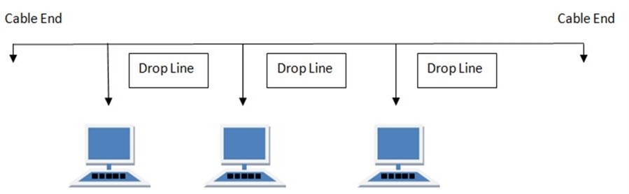
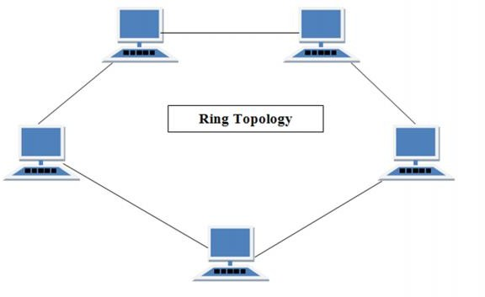
  Bus Topology
  Bus topology is a network type in which every computer and network device is connected to single cable.
Ring Topology
  It is called ring topology because it forms a ring as each computer is connected to another computer, with the last one connected to the first. Exactly two neighbours for each device.

Slide 26
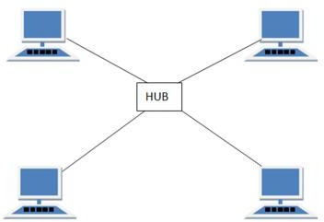
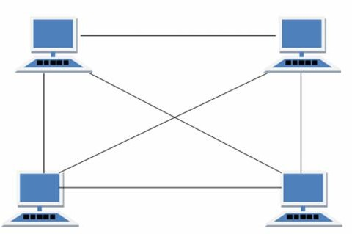
Star Topology
  In this type of topology all the computers are connected to a single hub through a cable. This hub is the central node and all others nodes are connected to the central node.
Mesh Topology
  It is a point-to-point connection to other nodes or devices.
  Traffic is carried only between two devices or nodes to which it is connected.

Slide 27
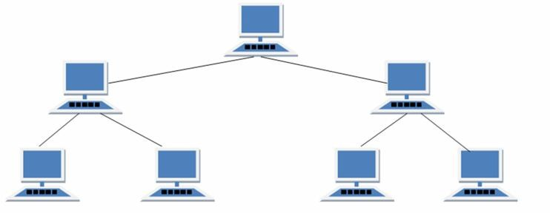
Tree Topology
  It has a root node and all other nodes are connected to it forming a hierarchy.
  It is also called hierarchical topology.
  It should at least have three levels to the hierarchy.
Hybrid Topology
  A network structure whose design contains more than one topology is said to be hybrid topology.
  For example if in an office in one department ring topology is used and in another star topology is used, connecting these topologies will result in Hybrid Topology (ring topology and star topology).

Slide 28
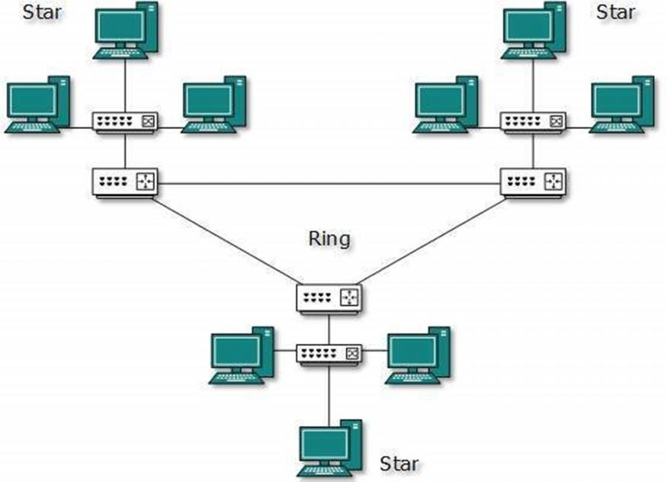

Slide 29
Wireless Networks
Digital wireless communication was there in 1901 itself, the Italian physicist Guglielmo Marconi demonstrated a ship-to-shore wireless telegraph, using Morse Code (dots and dashes are binary, after all).
Modern digital wireless systems have better performance, but the basic idea is the same.
To a first approximation, wireless networks can be divided into three main categories:
    1. System interconnection.
    2. Wireless LANs.
    3. Wireless WANs.

Slide 30
System interconnection:
System interconnection is all about interconnecting the components of a computer using short-range radio.
Almost every computer has a monitor, keyboard, mouse, and printer connected to the main unit by cables.
Some companies got together to design a short-range wireless network called Bluetooth to connect these components without wires.
No cables, no driver installation, just put them down, turn them on, and they work. For many people, this ease of operation is a big plus
(a) Bluetooth configuration. (b) Wireless LAN.

Slide 31
Wireless LANs
The next step up in wireless networking are the wireless LANs.
These are systems in which every computer has a radio modem and antenna with which it can communicate with other systems.
Often there is an antenna on the ceiling that the machines talk to, as shown in figure.
Wireless LANs are becoming increasingly common in small offices and homes, where installing Ethernet is considered too much trouble, as well as in older office buildings, company cafeterias, conference rooms, and other places.
There is a standard for wireless LANs, called IEEE 802.11, which most systems implement and which is becoming very widespread.

Slide 32
Wireless WANs
The third kind of wireless network is used in wide area systems.
The radio network used for cellular telephones is an example of a low-bandwidth wireless system.
This system has already gone through three generations.
  The first generation was analog and for voice only.
  The second generation was digital and for voice only.
  The third generation is digital and is for both voice and data.
In a certain sense, cellular wireless networks are like wireless LANs, except that the distances involved are much greater and the bit rates much lower.
In addition to these low-speed networks, high-bandwidth wide area wireless networks are also being developed.
Almost all wireless networks hook up to the wired network at some point to provide access to files, databases, and the Internet.

Slide 33
Home Networks
Every device in the home will be capable of communicating with every other device, and all of them will be accessible over the Internet.
Many devices are capable of being networked. Some of the more obvious categories (with examples) are as follows:
  1. Computers (desktop PC, notebook PC, PDA, shared peripherals).
  2. Entertainment (TV, DVD, VCR, camcorder, camera, stereo, MP3).
  3. Telecommunications (telephone, mobile telephone, intercom, fax).
  4. Appliances (microwave, refrigerator, clock, furnace, airco, lights).
  5. Telemetry (utility meter, smoke/burglar alarm, thermostat, babycam).

Slide 34
Internetworks
Many networks exist in the world, often with different hardware and software.
People connected to one network often want to communicate with people attached to a different one.
The fulfillment of this requires that different, and frequently incompatible networks, be connected, sometimes by means of machines called gateways to make the connection and provide the necessary translation, both in terms of hardware and software.
A collection of interconnected networks is called an internetwork or internet.
Subnet makes the most sense in the context of a wide area network, where it refers to the collection of routers and communication lines owned by the network operator.
The combination of a subnet and its hosts forms a network. An internetwork is formed when distinct networks are interconnected.

Slide 35
Network Software
Protocol Hierarchies
To reduce their design complexity, most networks are organized as a stack of layers or levels, each one built upon the one below it.
The number of layers, the name of each layer, the contents of each layer, and the function of each layer differ from network to network.
The purpose of each layer is to offer certain services to the higher layers, shielding those layers from the details of how the offered services are actually implemented.
Layer n on one machine carries on a conversation with layer n on another machine.
The rules and conventions used in this conversation are collectively known as the layer n protocol.
A protocol is an agreement between the communicating parties on how communication is to proceed. A five-layer network is illustrated in the following figure.

Slide 36
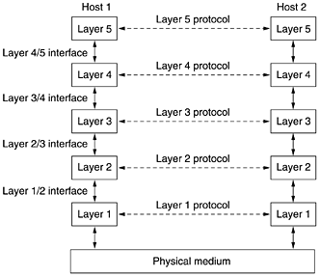

Slide 37
Reference Models
The OSI Reference Model
This model is based on a proposal developed by the International Standards Organization (ISO) as a first step toward international standardization of the protocols used in the various layers
The OSI model has seven layers. The principles that were applied to arrive at the seven layers can be briefly summarized as follows:
  1. A layer should be created where a different abstraction is needed.
  2. Each layer should perform a well-defined function.
  3. The function of each layer should be chosen with an eye toward defining internationally standardized 37 protocols.
  4. The layer boundaries should be chosen to minimize the information flow across the interfaces.
  5. The number of layers should be large enough that distinct functions need not be thrown together in the same layer out of necessity and small enough that the architecture does not become unwieldy.

Slide 38
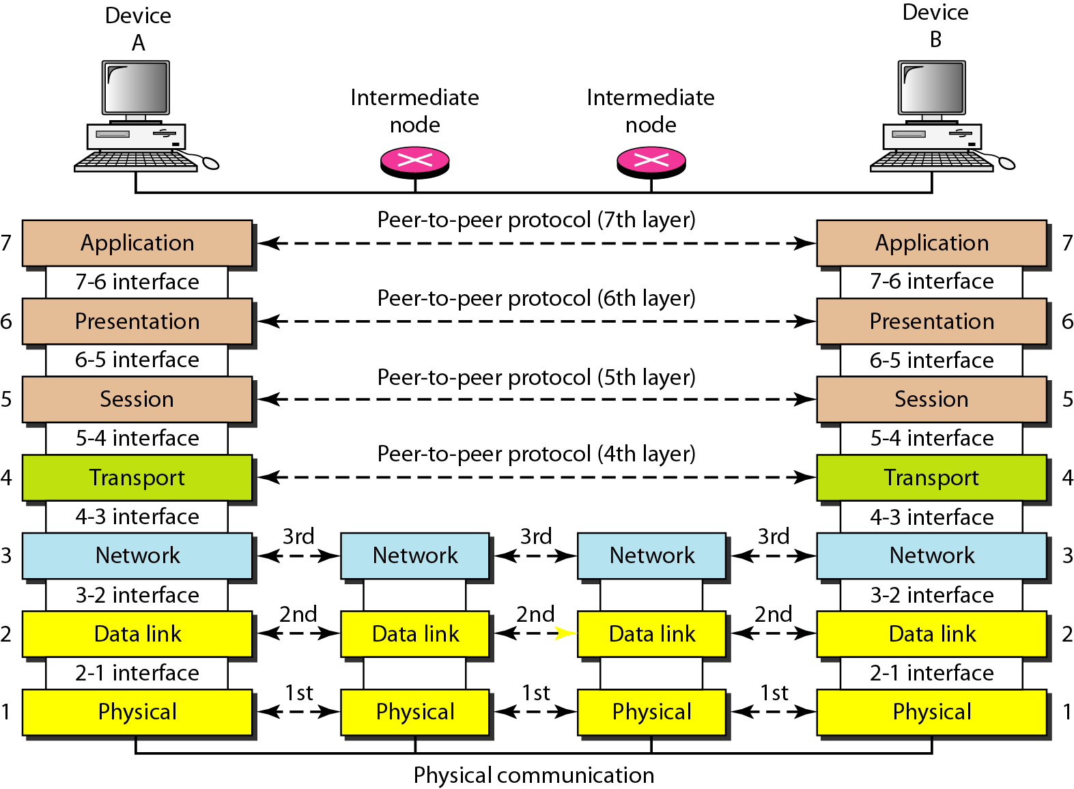

Slide 39
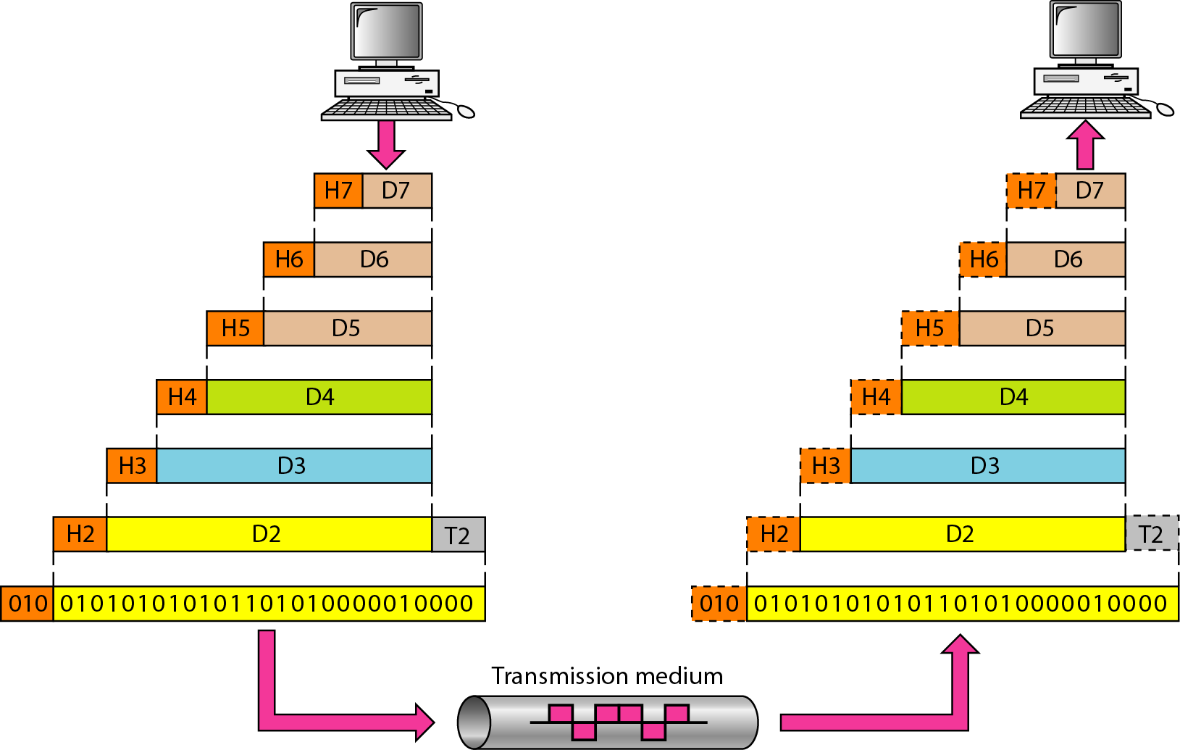
The passing of the data and network information down through the layers of the sending device and backup through the layers of the receiving device is made possible by interface between each pair of adjacent layers
Interface defines what information and services a layer must provide for the layer above it.

Slide 40
The Relationship of Services to Protocols
Services and protocols are distinct concepts, although they are frequently confused.
This distinction is so important, however, that we emphasize it again here.
A service is a set of primitives (operations) that a layer provides to the layer above it.
The service defines what operations the layer is prepared to perform on behalf of its users, but it says nothing at all about how these operations are implemented.
A service relates to an interface between two layers, with the lower layer being the service provider and the upper layer being the service user.
A protocol, in contrast, is a set of rules governing the format and meaning of the packets, or messages that are exchanged by the peer entities within a layer.
Entities use protocols to implement their service definitions.

Slide 42
Physical Layer
The physical layer coordinates the functions required to carry a bit stream over a physical medium. It deals with the mechanical and electrical specifications of the interface and transmission medium.
The physical layer is also concerned with the following:
Physical characteristics of interfaces and medium. The physical layer defines the characteristics of the interface between the devices and the transmission medium
Representation of bits. The physical layer data consists of a stream of bits (sequence of Os or 1s) with no interpretation.
Data rate. The transmission rate-the number of bits sent each second-is also defined by the physical layer.
Synchronization of bits. The sender and receiver not only must use the same bit rate but also must be synchronized at the bit level.

Slide 43
Physical topology. The physical topology defines how devices are connected to make a network.
Transmission mode. The physical layer also defines the direction of transmission between two devices: simplex(one-way communication), half-duplex(two devices can send and receive, but not at the same time), or full-duplex(two devices can send and receive at the same time).
Data Link Layer
The data link layer transforms the physical layer, a raw transmission facility, to a reliable link. It makes the physical layer appear error-free to the upper layer (network layer).
Other responsibilities of the data link layer include the following:
Framing. The data link layer divides the stream of bits received from the network layer into manageable data units called frames.

Slide 44
Physical addressing. If frames are to be distributed to different systems on the network, the data link layer adds a header to the frame to define the sender and/or receiver of the frame.
Flow control. If the rate at which the data are absorbed by the receiver is less than the rate at which data are produced in the sender, the data link layer imposes a flow control mechanism to avoid overwhelming the receiver.
Error control. The data link layer adds reliability to the physical layer by adding mechanisms to detect and retransmit damaged or lost frames.
Access control. When two or more devices are connected to the same link, data link layer protocols are necessary to determine which device has control over the link at any given time.

Slide 45
Network Layer
The network layer is responsible for the source-to-destination delivery of a packet, possibly across multiple networks (links).
Other responsibilities of the network layer include the following:
Logical addressing. The physical addressing implemented by the data link layer handles the addressing problem locally. If a packet passes the network boundary, we need another addressing system to help distinguish the source and destination systems. The network layer adds a header to the packet coming from the upper layer that, among other things, includes the logical addresses of the sender and receiver.
Routing. When independent networks or links are connected to create intemetworks (network of networks) or a large network, the connecting devices (called routers or switches) route or switch the packets to their final destination.

Slide 46
Transport Layer
The transport layer is responsible for process-to-process delivery of the entire message.
Other responsibilities of the transport layer include the following:
Service-point addressing. Computers often run several programs at the same time. For this reason, source-to-destination delivery means delivery not only from one computer to the next but also from a specific process (running program) on one computer to a specific process (running program) on the other. The transport layer header must therefore include a type of address called a service-point address (or port address). The network layer gets each packet to the correct computer; the transport layer gets the entire message to the correct process on that computer.
Segmentation and reassembly. A message is divided into transmittable segments, with each segment containing a sequence number.

Slide 47
Connection control. The transport layer can be either connectionless or connection oriented.
Flow control. Like the data link layer, the transport layer is responsible for flow control. However, flow control at this layer is performed end to end rather than across a single link.
Error control. Like the data link layer, the transport layer is responsible for error control. However, error control at this layer is performed process-to process rather than across a single link.
Session Layer
The services provided by the first three layers (physical, data link, and network) are not sufficient for some processes. The session layer is the network dialog controller. It establishes, maintains, and synchronizes the interaction among communicating systems.
Specific responsibilities of the session layer include the following:

Slide 48
Dialog control. The session layer allows two systems to enter into a dialog. It allows the communication between two processes to take place in either half-duplex (one way at a time) or full-duplex (two ways at a time) mode.
Synchronization. The session layer allows a process to add checkpoints, or synchronization points, to a stream of data. For example, if a system is sending a file of 2000 pages, it is advisable to insert checkpoints after every 10.
Presentation Layer
The presentation layer is concerned with the syntax and semantics of the information exchanged between two systems.
Specific responsibilities of the presentation layer include the following:
Translation. The processes (running programs) in two systems are usually exchanging information in the form of character strings, numbers, and so on. The information must be changed to bit streams before being transmitted.

Slide 49
Encryption. To carry sensitive information, a system must be able to ensure privacy. Encryption means that the sender transforms the original information to another form and sends the resulting message out over the network. Decryption reverses the original process to transform the message back to its original form.
Compression. Data compression reduces the number of bits contained in the information. Data compression becomes particularly important in the transmission of multimedia such as text, audio, and video.
Application Layer
The application layer enables the user, whether human or software, to access the network. It provides user interfaces and support for services.
Specific services provided by the application layer include the following:

Slide 50
Network virtual terminal. A network virtual terminal is a software version of a physical terminal, and it allows a user to log on to a remote host. To do so, the application creates a software emulation of a terminal at the remote host. The user's computer talks to the software terminal which, in turn, talks to the host, and vice versa. The remote host believes it is communicating with one of its own terminals and allows the user to log on.
File transfer, access, and management. This application allows a user to access files in a remote host (to make changes or read data), to retrieve files from a remote computer for use in the local computer, and to manage or control files in a remote computer locally.
Mail services. This application provides the basis for e-mail forwarding and storage.
Directory services. This application provides distributed database sources and access for global information about various objects and services.

Slide 51
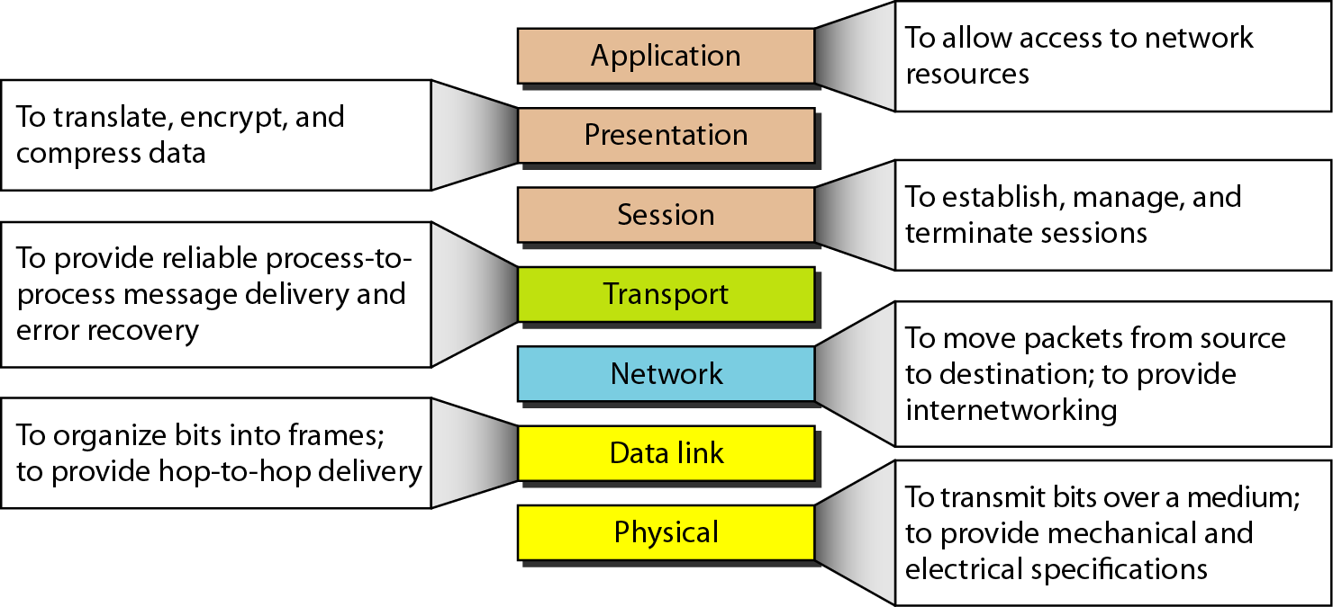
Summary of layers

Slide 52
OSI Model
 | Data unit | Layer | Function
User support layers | Data | 7. Application | Network process to application
 |  | 6. Presentation | Data representation and encryption
 |  | 5. Session | Inter-host communication
User⬄ Network | Segment | 4. Transport | End-to-end connections and reliability
Network support layers | Packet | 3. Network | Path determination and logical addressing
 | Frame | 2. Data Link | Physical addressing
 | Bit | 1. Physical | Media, signal and binary transmission

Slide 53
The TCP/IP Reference Model
The ARPANET was a research network sponsored by the DoD (U.S. Department of Defense).
It eventually connected hundreds of universities and government installations, using leased telephone lines.
When satellite and radio networks were added later, the existing protocols had trouble interworking with them, so a new reference architecture was needed.
Thus, the ability to connect multiple networks in a seamless way was one of the major design goals from the very beginning.
This architecture later became known as the TCP/IP Reference Model

Slide 54
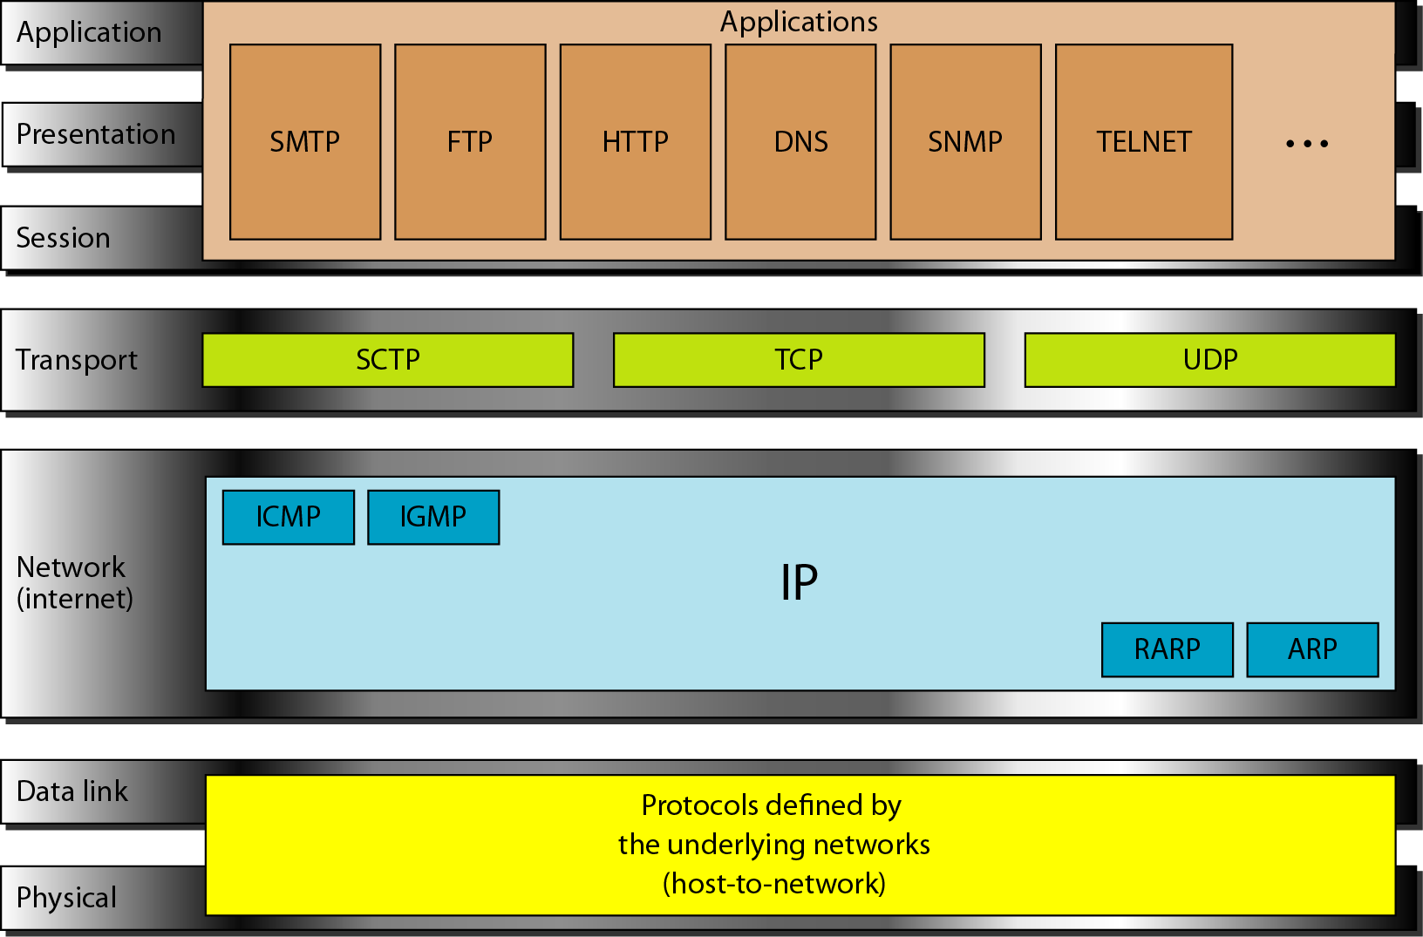

Slide 55
The Internet Layer
Its job is to permit hosts to inject packets into any network and have them travel independently to the destination. They may even arrive in a different order than they were sent, in which case it is the job of higher layers to rearrange them, if in-order delivery is desired.
The internet layer defines an official packet format and protocol called IP (Internet Protocol).
Packet routing is clearly the major issue here, as is avoiding congestion.

Slide 56
The Transport Layer
It is designed to allow peer entities on the source and destination hosts to carry on a conversation, just as in the OSI transport layer.
Two end-to-end transport protocols have been defined here.
The first one, TCP (Transmission Control Protocol), is a reliable connection-oriented protocol that allows a byte stream originating on one machine to be delivered without error on any other machine in the internet.
It fragments the incoming byte stream into discrete messages and passes each one on to the internet layer.
At the destination, the receiving TCP process reassembles the received messages into the output stream.
TCP also handles flow control to make sure a fast sender cannot swamp a slow receiver with more messages than it can handle.
The second protocol in this layer, UDP (User Datagram Protocol), is an unreliable, connectionless protocol for applications that do not want TCP's sequencing or flow control and wish to provide their own.

Slide 57
The Application Layer
On top of the transport layer is the application layer. It contains all the higher-level protocols. The early ones included virtual terminal (TELNET), file transfer (FTP), and electronic mail (SMTP)
The file transfer protocol provides a way to move data efficiently from one machine to another.
Electronic mail was originally just a kind of file transfer, but later a specialized protocol (SMTP) was developed for it.
Many other protocols have been added to these over the years: the Domain Name System (DNS) for mapping host names onto their network addresses.
NNTP, the protocol for moving USENET news articles around.
HTTP, the protocol for fetching pages on the World Wide Web, and many others.

Slide 58
The Host-to-Network Layer
The TCP/IP reference model does not really say much about what happens here, except to point out that the host has to connect to the network using some protocol so it can send IP packets to it.
This protocol is not defined and varies from host to host and network to network.

Slide 59
The Physical Layer
The purpose of the physical layer is to transport a raw bit stream from one machine to another.
Various physical media can be used for the actual transmission.
Each one has its own importance in terms of bandwidth, delay, cost, and ease of installation and maintenance.
Media are roughly grouped into
  Guided media, such as copper wire and fiber optics.
  Unguided media, such as radio and lasers through the air.
Guided Transmission Media
1. Magnetic Media
One of the most common ways to transport data from one computer to another is to write them onto magnetic tape or removable media (e.g., recordable DVDs), physically transport the tape or disks to the destination machine, and read them back in again.

Slide 60
2. Twisted Pair
One of the oldest and still most common transmission media is twisted pair.
A twisted pair consists of two insulated copper wires, typically about 1 mm thick.
The wires are twisted together in a helical form, just like a DNA molecule.
Twisting is done because two parallel wires constitute a fine antenna.
When the wires are twisted, the waves from different twists cancel out, so the wire radiates less effectively.
The most common application of the twisted pair is the telephone system.
Twisted pairs can run several kilometers without amplification, but for longer distances, repeaters are needed.
Twisted pairs can be used for transmitting either analog or digital signals.
The bandwidth depends on the thickness of the wire and the distance traveled, but several megabits/sec can be achieved for a few kilometers in many cases.
Due to their adequate performance and low cost, twisted pairs are widely used and are likely to remain so for years to come.

Slide 61
Twisted pair cabling comes in several varieties, two of which are important for computer networks. Category 3 twisted pairs consist of two insulated wires gently twisted together.
Four such pairs are typically grouped in a plastic sheath to protect the wires and keep them together.
Category 5 twisted pairs were introduced. They are similar to category 3 pairs, but with more twists per centimeter, which results in less crosstalk and a better-quality signal over longer distances, making them more suitable for high-speed computer communication.
(a) Category 3 UTP. (b) Category 5 UTP.

Slide 62
3 Coaxial Cable
Another common transmission medium is the coaxial cable. It has better shielding than twisted pairs, so it can span longer distances at higher speeds.
Two kinds of coaxial cable are widely used. One kind, 50-ohm cable, is commonly used when it is intended for digital transmission from the start.
The other kind, 75-ohm cable, is commonly used for analog transmission and cable television but is becoming more important with the advent of Internet over cable.
A coaxial cable consists of a stiff copper wire as the core, surrounded by an insulating material.
The insulator is encased by a cylindrical conductor, often as a closely-woven braided mesh.
The outer conductor is covered in a protective plastic sheath. A cutaway view of a coaxial cable is shown in following figure.

Slide 63
The construction and shielding of the coaxial cable give it a good combination of high bandwidth and excellent noise immunity. Coax is still widely used for cable television and metropolitan area networks.
Coaxial cable

Slide 64
4 Fiber Optics
Fiber optics transmission technology works using optical transmission system. An optical transmission system has three key components:
  the light source
  the transmission medium
  the detector
Conventionally, a pulse of light indicates a 1 bit and the absence of light indicates a 0 bit.
The transmission medium is an ultra-thin fiber of glass. The detector generates an electrical pulse when light falls on it.
By attaching a light source to one end of an optical fiber and a detector to the other, we have a unidirectional data transmission system that accepts an electrical signal, converts and transmits it by light pulses, and then reconverts the output to an electrical signal at the receiving end.

Slide 65
When a light ray passes from one medium to another, for example, from fused silica to air, the ray is refracted (bent) at the silica/air boundary, as shown in the following figure(a).
Here we see a light ray incident on the boundary at an angle a1 emerging at an angle b1. The amount of refraction depends on the properties of the two media.
For angles of incidence above a certain critical value, the light is refracted back into the silica; none of it escapes into the air. Thus, a light ray incident at or above the critical angle is trapped inside the fiber, and can propagate for many kilometers with virtually no loss (figure (b)).
(a) Three examples of a light ray from inside a silica fiber impinging on the air/silica boundary at different angles.
(b) Light trapped by total internal reflection.

Slide 66
Multi Mode Fiber:
Many different rays will be bouncing around at different angles. Each ray is said to have a different mode, so a fiber having this property is called a multimode fiber.
Single Mode Fiber:
If the fiber's diameter is reduced to a few wavelengths of light, the fiber acts like a wave guide, and the light can propagate only in a straight line, without bouncing, yielding a single-mode fiber.
Single-mode fibers are more expensive but are widely used for longer distances. Currently available single-mode fibers can transmit data at 50 Gbps for 100 km without amplification.

Slide 67
2 Fiber Cables
Fiber optic cables are similar to coax, except without the braid. The following figure shows a single fiber viewed from the side.
At the center is the glass core through which the light propagates. In multimode fibers, the core is typically 50 microns in diameter, about the thickness of a human hair. In single-mode fibers, the core is 8 to 10 microns.
(a) Side view of a single fiber. (b) End view of a sheath with three fibers.

Slide 68
5 Comparison of Fiber Optics and Copper Wire
Fiber can handle much higher bandwidths than copper.
Due to the low attenuation, repeaters are needed only about every 50 km on long lines, versus about every 5 km for copper, a substantial cost saving.
Fiber also has the advantage of not being affected by power surges, electromagnetic interference, or power failures. Nor is it affected by corrosive chemicals in the air, making it ideal for harsh factory environments.
Telephone companies like fiber for a different reason: it is thin and lightweight.
Fiber is much lighter than copper. One thousand twisted pairs 1 km long weigh 8000 kg. Two fibers have more capacity and weigh only 100 kg, which greatly reduces the need for expensive mechanical support systems that must be maintained.

Slide 69
For new routes, fiber wins hands down due to its much lower installation cost. Finally, fibers do not leak light and are quite difficult to tap. These properties gives fiber excellent security against potential wire tappers.
On the downside, fiber is a less familiar technology requiring skills not all engineers have, and fibers can be damaged easily by being bent too much.
Since optical transmission is inherently unidirectional, two-way communication requires either two fibers or two frequency bands on one fiber.
Finally, fiber interfaces cost more than electrical interfaces. The future of all fixed data communication for distances of more than a few meters is clearly with fiber.

Slide 70
Wireless Transmission
1. The Electromagnetic Spectrum
When electrons move, they create electromagnetic waves that can propagate through space.
These waves were predicted by the British physicist James Clerk Maxwell in 1865 and first observed by the German physicist Heinrich Hertz in 1887.
When an antenna of the appropriate size is attached to an electrical circuit, the electromagnetic waves can be broadcast efficiently and received by a receiver some distance away.
In vacuum, all electromagnetic waves travel at the same speed, no matter what their frequency is.
This speed, usually called the speed of light, c, is approximately 3 x 108 m/sec, or about 1 foot (30 cm) per nanosecond.
In copper or fiber the speed slows to about 2/3 of this value and becomes slightly frequency dependent. The fundamental relation between f(Frequency), λ(Wavelength) , and c (in vacuum) is,

Slide 71
The radio, microwave, infrared, and visible light portions of the spectrum can all be used for transmitting information by modulating the amplitude, frequency, or phase of the waves.
Ultraviolet light, X-rays, and gamma rays would be even better, due to their higher frequencies, but they are hard to produce and modulate, do not propagate well through buildings, and are dangerous to living things.
The bands listed at the bottom of the spectrum are the official ITU (International Telecommunication Union) names and are based on the wavelengths.

Slide 72
Clearly, when the names were assigned, nobody expected to go above 10 MHz, so the higher bands were later named the Very, Ultra, Super, Extremely, and Tremendously High Frequency bands.
Beyond that there are no names, but Incredibly, Astonishingly, and Prodigiously high frequency (IHF, AHF, and PHF) would sound nice.
The amount of information that an electromagnetic wave can carry is related to its bandwidth. The wider the band, the higher the data rate. A wide band is used, with two variations.
  1. Frequency hopping spread spectrum: The transmitter hops from frequency to frequency hundreds of times per second. It is popular for military communication because it makes transmissions hard to detect and next to impossible to jam.
  2. Direct sequence spread spectrum: which spreads the signal over a wide frequency band, is also gaining popularity in the commercial world.

Slide 73
2 Radio Transmission
Radio waves are easy to generate, can travel long distances, and can penetrate buildings easily, so they are widely used for communication, both indoors and outdoors.
Radio waves also are omni directional, meaning that they travel in all directions from the source, so the transmitter and receiver do not have to be carefully aligned physically.
The properties of radio waves are frequency dependent.
At low frequencies, radio waves pass through obstacles well, but the power falls off sharply with distance from the source, roughly as 1/r2 in air.
At high frequencies, radio waves tend to travel in straight lines and bounce off obstacles. They are also absorbed by rain.
In the VLF, LF, and MF bands, radio waves follow the ground, as illustrated in the following figure.
Radio waves in these bands pass through buildings easily, which is why portable radios work indoors.

Slide 74
(a) In the VLF, LF, and MF bands, radio waves follow the curvature of the earth.
(b) In the HF band, they bounce off the ionosphere.

Slide 75
3 Microwave Transmission
Above 100 MHz, the waves travel in nearly straight lines and can therefore be narrowly focused.
Concentrating all the energy into a small beam by means of a parabolic antenna gives a much higher signal-to-noise ratio, but the transmitting and receiving antennas must be accurately aligned with each other.
This directionality allows multiple transmitters lined up in a row to communicate with multiple receivers in a row without interference, provided some minimum spacing rules are observed.
Before fiber optics, for decades these microwaves formed the heart of the long-distance telephone transmission system.
Since the microwaves travel in a straight line, if the towers are too far apart, the earth will get in the way, repeaters are needed periodically. The higher the towers are, the farther apart they can be.
For 100-meter-high towers, repeaters can be spaced 80 km apart. Unlike radio waves at lower frequencies, microwaves do not pass through buildings well even though the beam may be well focused at the transmitter, there is still some divergence in space.

Slide 76
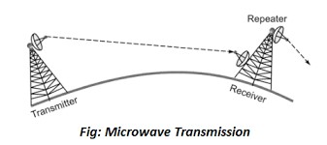

Slide 77
3 Infrared and Millimeter Waves
Unguided infrared and millimeter waves are widely used for short-range communication.
The remote controls used on televisions, VCRs, and stereos all use infrared communication. They are relatively directional, cheap, and easy to build but have a major drawback: they do not pass through solid objects.
In general, as we go from long-wave radio toward visible light, the waves behave more and more like light and less and less like radio.
Infrared communication has a limited use on the desktop, for example, connecting notebook computers and printers, but it is not a major player in the communication game.
4. Light wave Transmission
Unguided optical signaling has been in use for centuries. A more modern application is to connect the LANs in two buildings via lasers mounted on their rooftops.
Coherent optical signaling using lasers is inherently unidirectional, so each building needs its own laser and its own photo detector.

Slide 78
This scheme offers very high bandwidth and very low cost. It is also relatively easy to install and, unlike microwave, does not require an FCC license.
A disadvantage is that laser beams cannot penetrate rain or thick fog, but they normally work well on sunny days.
Convection currents can interfere with laser communication systems. A bidirectional system with two lasers is pictured here.

Slide 79
Communication Satellites
In the 1950s and early 1960s, people tried to set up communication systems by bouncing signals off metalized weather balloons.
The received signals were too weak to be of any practical use. Then the U.S. Navy noticed a kind of permanent weather balloon in the sky—the moon—and built an operational system for ship-to-shore communication by bouncing signals off it.
Further progress in the celestial communication field had to wait until the first communication satellite was launched.
The key difference between an artificial satellite and a real one is that the artificial one can amplify the signals before sending them back, turning a strange curiosity into a powerful communication system.
Communication satellite can be thought of as a big microwave repeater in the sky.

Slide 80
It contains several transponders, each of which listens to some portion of the spectrum, amplifies the incoming signal, and then rebroadcasts it at another frequency to avoid interference with the incoming signal.
The downward beams can be broad, covering a substantial fraction of the earth's surface, or narrow, covering an area only hundreds of kilometers in diameter.
This mode of operation is known as a bent pipe. The higher the satellite, the longer the period. It is not the only issue in determining where to place it.
Another issue is the presence of the Van Allen belts, layers of highly charged particles trapped by the earth's magnetic field.
Any satellite flying within them would be destroyed fairly quickly by the highly-energetic charged particles trapped there by the earth's magnetic field.
These factors lead to three regions in which satellites can be placed safely. These regions and some of their properties are illustrated in the following figure.

Slide 81
Communication satellites and some of their properties, including altitude above the earth, round-trip delay time, and number of satellites needed for global coverage.

Slide 82
Geostationary Satellites
In 1945, the science fiction writer Arthur C. Clarke calculated that a satellite at an altitude of 35,800 km in a circular equatorial orbit would appear to remain motionless in the sky. so it would not need to be tracked (Clarke, 1945).
The first artificial communication satellite, Telstar, was launched in July 1962.
These high-flying satellites are often called GEO (Geostationary Earth Orbit) satellites.
The effects of solar, lunar, and planetary gravity tend to move them away from their assigned orbit slots and orientations, an effect countered by on-board rocket motors.
This fine-tuning activity is called station keeping.
However, when the fuel for the motors has been exhausted, typically in about 10 years, the satellite drifts and tumbles helplessly, so it has to be turned off.

Slide 83
Eventually, the orbit decays and the satellite reenters the atmosphere and burns up or occasionally crashes to earth.
The first geostationary satellites had a single spatial beam that illuminated about 1/3 of the earth's surface, called its footprint.
A new development in the communication satellite world is the development of low-cost microstations, sometimes called VSATs (Very Small Aperture Terminals). These tiny terminals have 1-meter or smaller antennas and can put out about 1 watt of power.
In many VSAT systems, the microstations do not have enough power to communicate directly with one another. Instead, a special ground station, the hub, with a large, high-gain antenna is needed to relay traffic between VSATs, as shown in the following figure.

Slide 84
Medium-Earth Orbit Satellites
At much lower altitudes, between the two Van Allen belts, we find the MEO (Medium-Earth Orbit) satellites.
They have a smaller footprint on the ground and require less powerful transmitters to reach them.
Currently they are not used for telecommunications, the 24 GPS (Global Positioning System) satellites orbiting at about 18,000 km are examples of MEO satellites.
Low-Earth Orbit Satellites
Moving down in altitude, the LEO (Low-Earth Orbit) satellites.
Due to their rapid motion, large numbers of them are needed for a complete system.
In the other hand, because the satellites are so close to the earth, the ground stations do not need much power, and the round-trip delay is only a few milliseconds.
Three examples, two aimed at voice communication and one aimed at Internet service.

Slide 85
1 Iridium
In 1990, Motorola broke new ground by filing an application with the FCC (Federal Communication Commission) asking for permission to launch 77 low-orbit satellites for the Iridium project (element 77 is iridium).
The plan was later revised to use only 66 satellites, so the project should have been renamed Dysprosium (element 66), but that probably sounded too much like a disease.
The idea was that as soon as one satellite went out of view, another would replace it.
Iridium's business was providing worldwide telecommunication service using hand-held devices that communicate directly with the Iridium satellites.
It provides voice, data, paging, fax, and navigation service everywhere on land, sea, and air.
The Iridium satellites are positioned at an altitude of 750 km, in circular polar orbits.
They are arranged in north south necklaces, with one satellite every 32 degrees of latitude. With six satellite necklaces, the entire earth is covered,

Slide 86
  (a) The Iridium satellites form six necklaces around the earth.
  (b) 1628 moving cells cover the earth.

Slide 87
An interesting property of Iridium is that communication between distant customers takes place in space, with one satellite relaying data to the next one, as illustrated in the following figure.
Here we see a caller at the North Pole contacting a satellite directly overhead. The call is relayed via other satellites and finally sent down to the callee at the South Pole.
Relaying in space. (b) Relaying on the ground

Slide 88
Globalstar
An alternative design to Iridium is Globalstar. It is based on 48 LEO satellites but uses a different switching scheme than that of Iridium.
Whereas Iridium relays calls from satellite to satellite, which requires sophisticated switching equipment in the satellites.
The advantage of this scheme is that it puts much of the complexity on the ground, where it is easier to manage.
Teledesic
Teledesic, is targeted at bandwidth-hungry Internet users all over the world.
It was conceived in 1990 by mobile phone pioneer Craig McCaw and Microsoft founder Bill Gates.
The goal of the Teledesic system is to provide millions of concurrent Internet users with an uplink of as much as 100 Mbps and a downlink of up to 720 Mbps using a small, fixed, VSAT-type antenna, completely bypassing the telephone system.
The original design was for a system consisting of 288 small-footprint satellites arranged in 12 planes just below the lower Van Allen belt at an altitude of 1350 km.

Slide 89
Thank You

