Slide 1
UNIT-3 Network Layer
By
Dr.M. Kalpana Devi
Professor
MCA Department
SITAMS
Chittoor

Slide 2
UNIT-3
3 The Network Layer
3.1 Network Layer Design Issues-
3.2 Routing Algorithms:
3.2.1 The Optimality Principle,
3.2.2 Shortest Path Routing,
3.2.3 Flooding,
3.2.4 Distance Vector Routing,
3.2.5 Link State Routing,
3.2.6 Hierarchical Routing,
3.2.7 Broadcast Routing,
3.2.8 Multicast Routing,
3.2.9 Routing for Mobile hosts-
3.3 Congestion Control Algorithms-
3.4 Quality of Service:
3.4.1 Leaky Bucket Algorithm,
3.4.2 Token Bucket Algorithm-
3.5 Internetworking-
3.6 The Network Layer in the Internet:
3.6.1 The IP Protocol,
3.6.2 IP Addresses.

Slide 3
3.1 Design issues
Goal of Network layer is get packets from source host to destination host
Routing: should know about topology of subnet
Congestion: should avoid overloading some communication lines and routers
Quality of service: offer the appropriate service
Internetworking: deal with network differences, if source and destination are connected to different networks

Slide 4
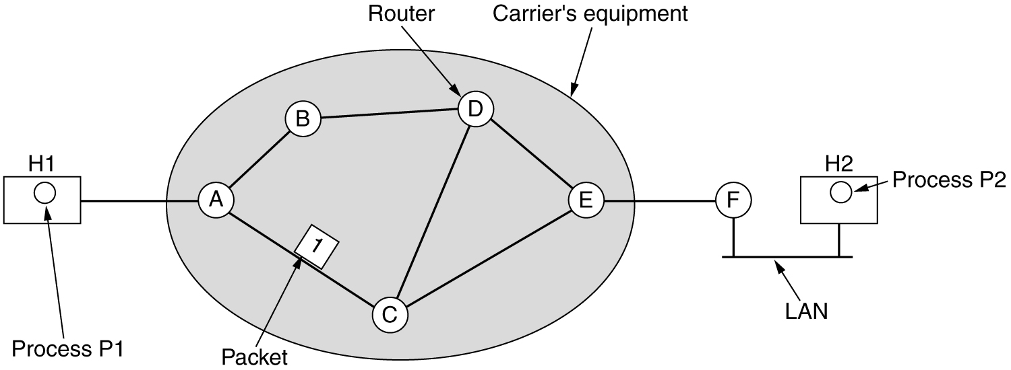
3.1.1 Store-and-forward packet switching
Equipment of: carrier <> customer
Algorithm at router
Receive packet
Check packet (e.g. checksum)
Forward packet

Slide 5
The major components of the system are the carrier's equipment (routers connected by transmission lines), shown inside the shaded oval, and the customers' equipment, shown outside the oval.
Host H1 is directly connected to one of the carrier's routers, A, by a leased line.
In contrast, H2 is on a LAN with a router, F, owned and operated by the customer.
This router also has a leased line to the carrier's equipment.
F has shown as being outside the oval because it does not belong to the carrier, but in terms of construction, software, and protocols, it is probably no different from the carrier's routers.

Slide 6
3.1.2 Services Provided to the Transport Layer:
The network layer provides services to the transport layer at the network layer/transport layer interface.
The network layer services have been designed with the following goals in mind.
1. The services should be independent of the router technology.
2. The transport layer should be shielded from the number, type and topology of the routers present.
3. The network addresses made available to the transport layer should use a uniform numbering plan, even across LANs and WANs.
Given these goals, the designers of the network layer have a lot of freedom in writing detailed specifications of the services to be offered to the transport layer.

Slide 7
3.1.3 Implementation of Connectionless Service
If connectionless service is offered, packets are injected into the subnet individually and routed independently of each other. No advance setup is needed.
In this context, the packets are frequently called datagrams (in analogy with telegrams) and the subnet is called a datagram subnet.
Let us now see how a datagram subnet works. Suppose that the process P1 in Figure has a long message for P2.
It hands the message to the transport layer with instructions to deliver it to process P2 on host H2.
The transport layer code runs on H1, typically within the operating system.
It prepares a transport header to the front of the message and hands the result to the network layer, probably just another procedure within the operating system.

Slide 8
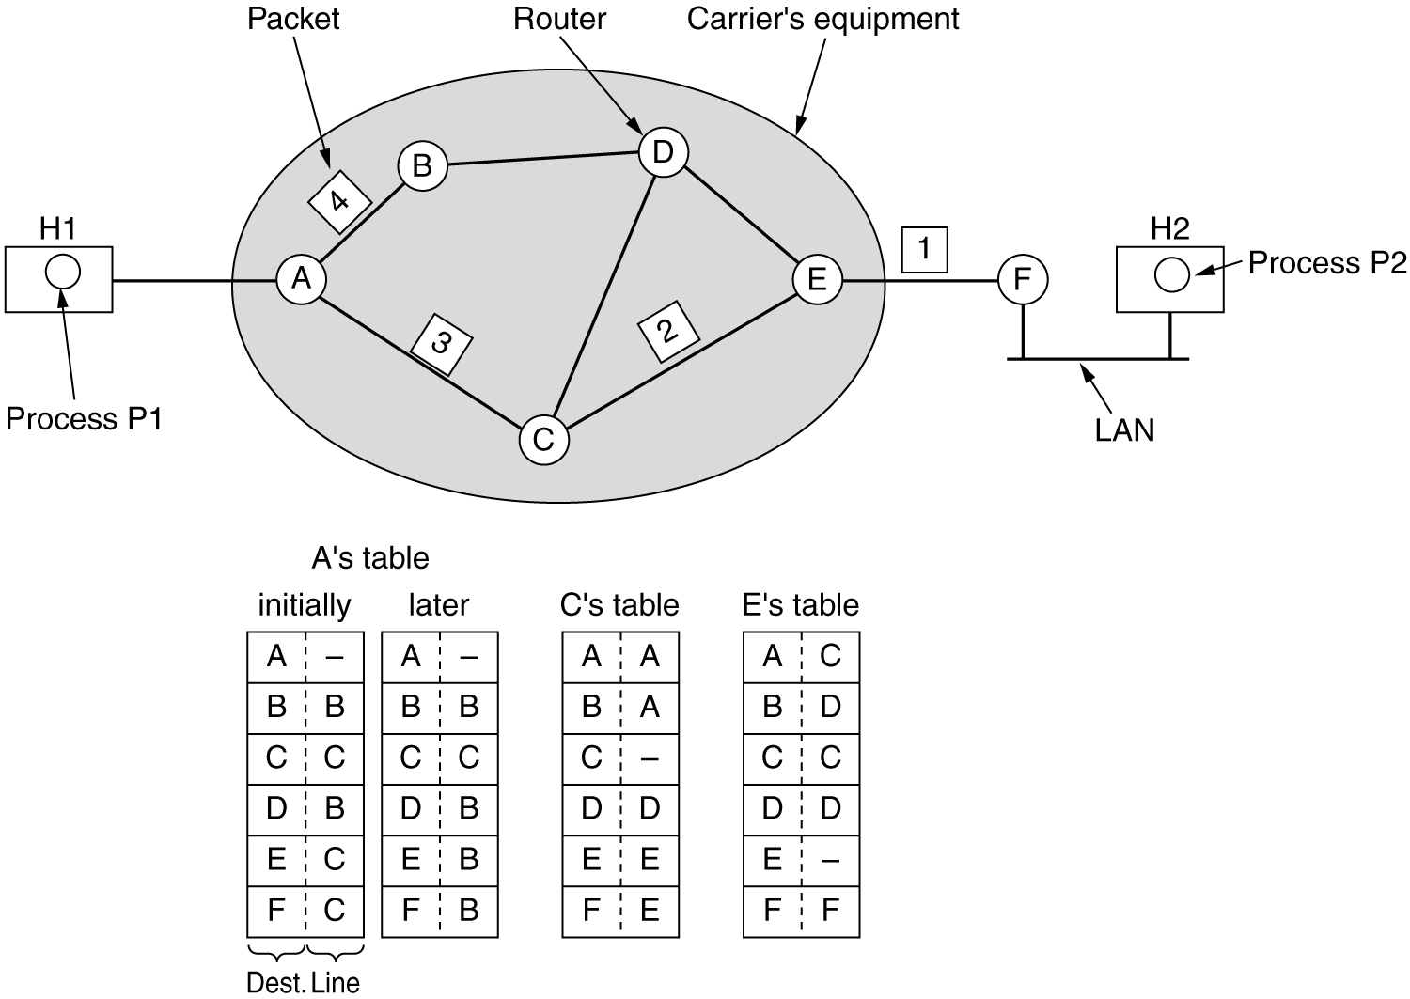

Slide 9
Let us assume that the message is four times longer than the maximum packet size, so the network layer has to break it into four packets, 1, 2, 3, and 4 and sends each of them in turn to router
A using some point-to-point protocol, for example, PPP. At this point the carrier takes over.
Every router has an internal table telling it where to send packets for each possible destination.
Each table entry is a pair consisting of a destination and the outgoing line to use for that destination.
Only directly-connected lines can be used. For example, in Figure,
A has only two outgoing lines—to B and C—so every incoming packet must be sent to one of these routers, even if the ultimate destination is some other router.

Slide 10
A's initial routing table is shown in the figure under the label ''initially.''
However, something different happened to packet 4.
When it got to A it was sent to router B, even though it is also destined for F.
For some reason, A decided to send packet 4 via a different route than that of the first three.
Perhaps it learned of a traffic jam somewhere along the ACE path and updated its routing table, as shown under the label ''later.''
The algorithm that manages the tables and makes the routing decisions is called the routing algorithm

Slide 11
3.1.4 Implementation of Connection-Oriented Service
The idea behind virtual circuits is to avoid having to choose a new route for every packet sent, as in Figure.
Instead, when a connection is established, a route from the source machine to the destination machine is chosen as part of the connection setup and stored in tables inside the routers.
That route is used for all traffic flowing over the connection, exactly the same way that the telephone system works.
When the connection is released, the virtual circuit is also terminated.
With connection-oriented service, each packet carries an identifier telling which virtual circuit it belongs to.
As an example, consider the situation of Figure. Here, host H1 has established connection 1 with host H2.
It is remembered as the first entry in each of the routing tables.

Slide 12
The first line of A's table says that if a packet bearing connection identifier 1 comes in from H1, it is to be sent to router C and given connection identifier 1.
Similarly, the first entry at C routes the packet to E, also with connection identifier 1.
Now let us consider what happens if H3 also wants to establish a connection to H2. It chooses connection identifier 1 and tells the subnet to establish the virtual circuit.
This leads to the second row in the tables. Note that we have a conflict here because although A can easily distinguish connection 1 packets from H1 from connection 1 packets from H3, C cannot do this. For this reason,
A assigns a different connection identifier to the outgoing traffic for the second connection.
Avoiding conflicts of this kind is why routers need the ability to replace connection identifiers in outgoing packets. In some contexts, this is called label switching.

Slide 14
3.1.5 Comparison of Virtual-Circuit and Datagram Subnets
Both virtual circuits and datagrams have their supporters and their detractors.
Issue | Datagram subnet | VC subnet
Circuit setup | Not needed | required
Addressing | Full addresses (source + destination) in each packet | Short VC number in each packet
State information | No state held in subnet | State held for each VC
Routing | Done for each packet independently | Route chosen at connection setup
Effect of router failures | None, except for packet losses | All VCs passing failed router are terminated
Congestion control | difficult | Easy if enough buffers can be allocated in advance

Slide 15
3.2 Routing Algorithms
The routing algorithm is that part of the network layer software responsible for deciding which output line an incoming packet should be transmitted on.
If the subnet uses datagrams internally, this decision must be made anew for every arriving data packet since the best route may have changed since last time.
If the subnet uses virtual circuits internally, routing decisions are made only when a new virtual circuit is being set up.
Thereafter, data packets just follow the previously-established route.
The latter case is sometimes called session routing because a route remains in force for an entire user session (e.g., a login session at a terminal or a file transfer).

Slide 16
It is sometimes useful to make a distinction between routing, which is making the decision which routes to use, and forwarding, which is what happens when a packet arrives.
One can think of a router as having two processes inside it.
One of them handles each packet as it arrives, looking up the outgoing line to use for it in the routing tables, this process is called forwarding.
The other process is responsible for filling in and updating the routing tables. That is where the routing algorithm comes into play.

Slide 17
Regardless of whether routes are chosen independently for each packet or only when new connections are established, certain properties are desirable in a routing algorithm:
Correctness
Simplicity
Robustness
Stability
Fairness, and
Optimality.
Conflict!
Notes:
Robustness: the routing algorithm should be able to cope with changes in topology and traffic without requiring all jobs in all hosts to be aborted and the network to be rebooted every time some router crashes.
Stability: is also an important goal for the routing algorithm. A stable algorithm reaches equilibrium and stays there.
Fairness and optimality: may sound obvious – surely no reasonable person would oppose them – but as it turn out, they are often contradictory goals.

Slide 18
The need for robustness may be less obvious at first.
Once a major network comes on the air, it may be expected to run continuously for years without system wide failures.
A stable algorithm reaches equilibrium and stays there.
Fairness and optimality may sound obvious—surely no reasonable person would oppose them—but as it turns out, they are often contradictory goals.
As a simple example of this conflict, look at the above figure.
Suppose that there is enough traffic between A and A', between B and B', and between C and C' to saturate the horizontal links.
To maximize the total flow, the X to X' traffic should be shut off altogether.
Unfortunately, X and X' may not see it that way.
Evidently, some compromise between global efficiency and fairness to individual connections is needed.

Slide 19
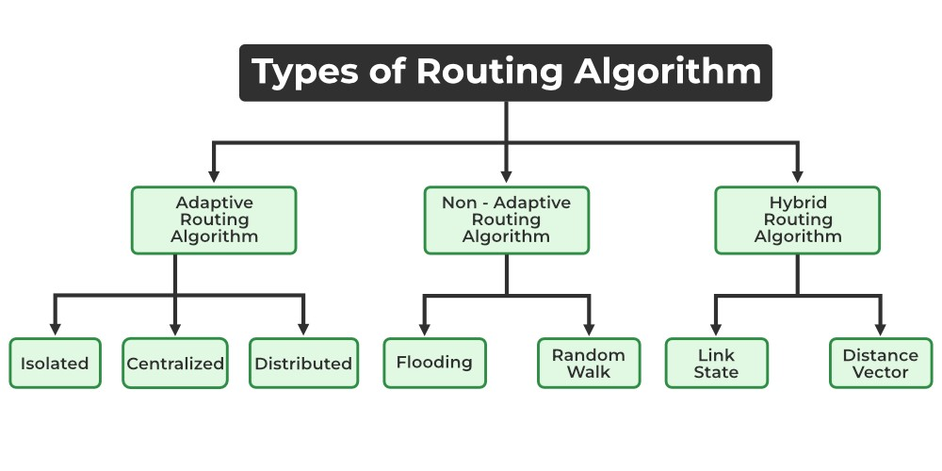
Routing algorithms can be grouped into two major classes: nonadaptive and adaptive.

Slide 20
1. Adaptive Routing algorithm: Adaptive routing algorithm is also called a dynamic routing algorithm.
In this algorithm, the routing decisions are made based on network traffic and topology.
The parameters which are used in adaptive routing algorithms are distance, hop, estimated transit time and count.
2. Non-Adaptive Routing algorithm: Non-adaptive routing algorithm is also called a static routing algorithm.
In a non-adaptive routing algorithm, the routing decisions are not made based on network traffic and topology.
This algorithm is used by static routing.
Non-adaptive routing algorithms are simple as compared to Adaptive routing algorithms in terms of complexity.

Slide 21
The Optimality Principle:
The purpose of a routing algorithm at a router is to decide which output line an incoming packet should go.
The optimal path from a particular router to another may be the least cost path, the least distance path, the least time path, the least hops path or a combination of any of the above.
As a direct consequence of the optimality principle, we can see that the set of optimal routes from all sources to a given destination form a tree rooted at the destination.
Such a tree is called a sink tree and is illustrated in Figure, where the distance metric is the number of hops.
Note that a sink tree is not necessarily unique; other trees with the same path lengths may exist.
The goal of all routing algorithms is to discover and use the sink trees for all routers.

Slide 22
Destination
(a) A subnet. (b) A sink tree for router B.
Since a sink tree is indeed a tree, it does not contain any loops, so each packet will be delivered within a finite and bounded number of hops

Slide 23
3.2.1 Shortest Path Routing:
The idea is to build a graph of the subnet, with each node of the graph representing a router and each arc of the graph representing a communication line (often called a link).
To choose a route between a given pair of routers, the algorithm just finds the shortest path between them on the graph.
The concept of a shortest path deserves some explanation.
One way of measuring path length is the number of hops.
Using this metric, the paths ABC and ABE in Figure are equally long.
Another metric is the geographic distance in kilometers, in which case ABC is clearly much longer than ABE.

Slide 25
However, many other metrics besides hops and physical distance are also possible.
For example, each arc could be labeled with the mean queueing and transmission delay for some standard test packet as determined by hourly test runs.
With this graph labeling, the shortest path is the fastest path rather than the path with the fewest arcs or kilometers.
In the general case, the labels on the arcs could be computed as a function of the distance, bandwidth, average traffic, communication cost, mean queue length, measured delay, and other factors.
By changing the weighting function, the algorithm would then compute the ''shortest'' path measured according to any one of a number of criteria or to a combination of criteria.

Slide 26
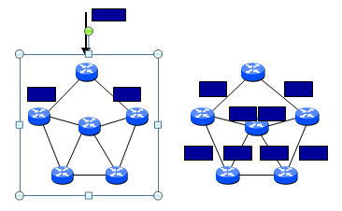
3.2.2 Flooding:
Another static algorithm is flooding, in which every incoming packet is sent out on every outgoing line except the one it arrived on.
Flooding obviously generates vast numbers of duplicate packets, in fact, an infinite number unless some measures are taken to damp the process.

Slide 27
Duplicates!! How to limit?
1. Hop counter
Ideally, the hop counter should be initialized to the length of the path from source to destination.
If the sender does not know how long the path is, it can initialize the counter to the worst case, namely, the full diameter of the subnet.
2. Sequence number in packet
achieve this goal is to have the source router put a sequence number in each packet it receives from its hosts.
Each router then needs a list per source router telling which sequence numbers originating at that source have already been seen. If an incoming packet is on the list, it is not flooded.

Slide 28
A variation of flooding that is slightly more practical is selective flooding.
In this algorithm the routers do not send every incoming packet out on every line, only on those lines that are going approximately in the right direction.
Flooding is not practical in most applications, but it does have some uses.
For example, in military applications, where large numbers of routers may be blown to bits at any instant, the tremendous robustness of flooding is highly desirable.
In distributed database applications, it is sometimes necessary to update all the databases concurrently, in which case flooding can be useful.
In wireless networks, all messages transmitted by a station can be received by all other stations within its radio range, which is, in fact, flooding, and some algorithms utilize this property.

Slide 29
3.2.3 Distance Vector Routing
Distance vector routing algorithms( referred as Bellman-Ford routing algorithm and the Ford-Fulkerson algorithm) operate by having each router maintain a table (i.e, a vector) giving the best known distance to each destination and which line to use to get there.
These tables are updated by exchanging information with the neighbors.
In distance vector routing, each router maintains a routing table indexed by, and containing one entry for, each router in the subnet.
This entry contains two parts: the preferred outgoing line to use for that destination and an estimate of the time or distance to that destination.
The metric used might be number of hops, time delay in milliseconds, total number of packets queued along the path, or something similar.
Notes:
The distance vector routing algorithm is sometimes called by other names, most commonly the distributed Bellman-Ford routing algorithm and the Ford-Fulkerson algorithm, after the researchers who developed it (Bellman, 1957; and Ford and Fulkerson, 1962). It was the original ARPANET routing algorithm and was also used in the Internet under the name RIP.

Slide 30
The router is assumed to know the ''distance'' to each of its neighbors.
If the metric is hops, the distance is just one hop. If the metric is queue length, the router simply examines each queue.
If the metric is delay, the router can measure it directly with special ECHO packets that the receiver just timestamps and sends back as fast as it can.
As an example, assume that delay is used as a metric and that the router knows the delay to each of its neighbors.
Once every T msec each router sends to each neighbor a list of its estimated delays to each destination.
It also receives a similar list from each neighbor.
This updating process is illustrated in Figure, Part (a) shows a subnet.
The first four columns of part (b) show the delay vectors received from the neighbors of router J.

Slide 31
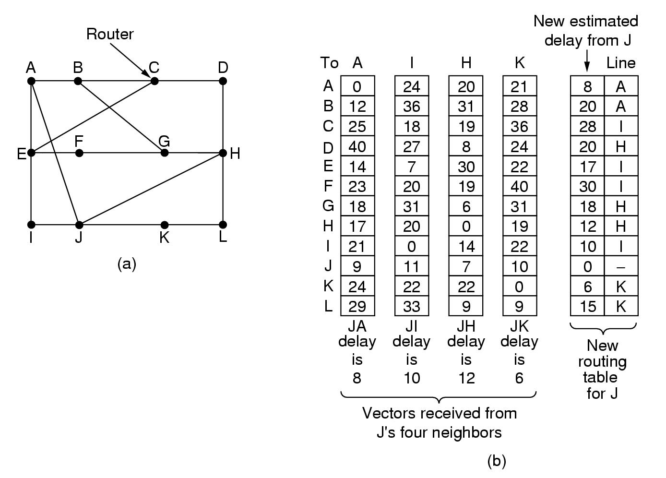
A claims to have a 12-msec delay to B, a 25-msec delay to C, a 40-msec delay to D, etc.
Suppose that J has measured or estimated its delay to its neighbors, A, I, H, and K as 8, 10, 12, and 6 msec, respectively.

Slide 32
Consider how J computes its new route to router G
d _{x}(y) = min_{v} ((c(x,v) + d_{y}(y))
d _{x}(y) - The least distance from x to y
d_{v}(y) – Distance of each neighbor from initial node
c(x,v)- Node x’s cost from each of its neighbor v
min_{v} – Selecting the minimum distance for the data packet
It knows that it can get to A in 8 msec, and A claims to be able to get to G in 18 msec, so J knows it can count on a delay of 26 msec to G if it forwards packets bound for G to A.
Similarly, it computes the delay to G via I, H, and K as 41 (31 + 10), 18 (6 + 12), and 37 (31 + 6) msec, respectively.
The best of these values is 18, so it makes an entry in its routing table that the delay to G is 18 msec and that the route to use is via H.
The same calculation is performed for all the other destinations, with the new routing table shown in the last column of the figure.

Slide 33
The Count-to-Infinity Problem
Distance vector routing works in theory but has a serious drawback in practice: although it converges to the correct answer, it may do so slowly.
In particular, it reacts rapidly to good news, but leisurely to bad news.
To see how fast good news propagates, consider the five-node (linear) subnet of Figure, where the delay metric is the number of hops.
Suppose A is down initially and all the other routers know this. In other words, they have all recorded the delay to A as infinity.

Slide 34
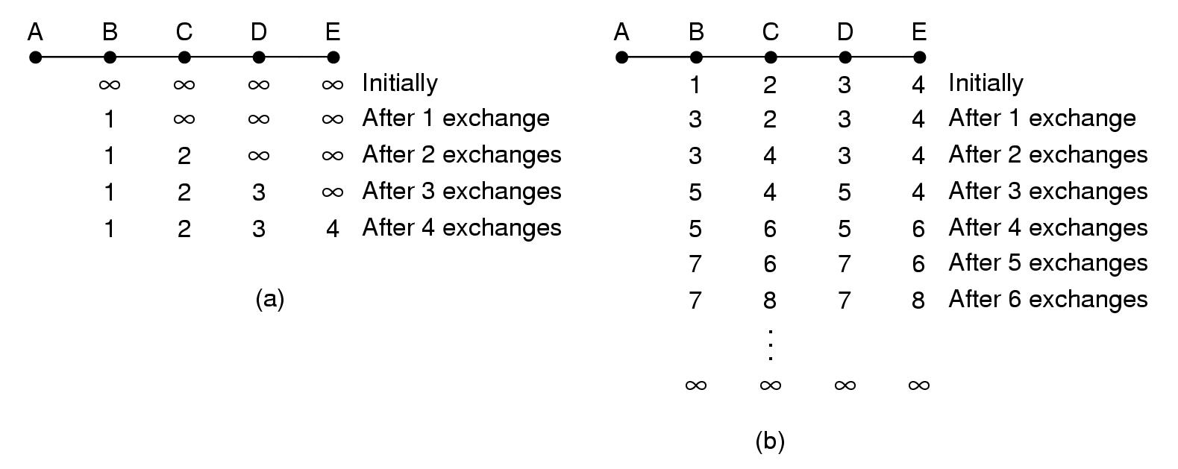

Slide 35
When A comes up, the other routers learn about it via the vector exchanges.
For simplicity we will assume that there is a gigantic gong somewhere that is struck periodically to initiate a vector exchange at all routers simultaneously. At the time of the first exchange,
B learns that its left neighbor has zero delay to A. B now makes an entry in its routing table that A is one hop away to the left.
All the other routers still think that A is down. At this point, the routing table entries for A are as shown in the second row of Figure (a).
On the next exchange, C learns that B has a path of length 1 to A, so it updates its routing table to indicate a path of length 2, but D and E do not hear the good news until later.
Clearly, the good news is spreading at the rate of one hop per exchange. In a subnet whose longest path is of length N hops, within N exchanges everyone will know about newly-revived lines and routers.

Slide 36
Now let us consider the situation of Figure (b), in which all the lines and routers are initially up.
Routers B, C, D, and E have distances to A of 1, 2, 3, and 4, respectively.
Suddenly A goes down, or alternatively, the line between A and B is cut, which is effectively the same thing from B's point of view.
At the first packet exchange, B does not hear anything from A.
Fortunately, C says: Do not worry; I have a path to A of length 2. Little does B know that C's path runs through B itself.
For all B knows, C might have ten lines all with separate paths to A of length 2. As a result, B thinks it can reach A via C, with a path length of 3.
D and E do not update their entries for A on the first exchange.
On the second exchange, C notices that each of its neighbors claims to have a path to A of length 3.
It picks one of the them at random and makes its new distance to A 4, as shown in the third row of Figure(b).
Subsequent exchanges produce the history shown in the rest of Figure(b).

Slide 37
3.2.4 Link State Routing
The idea behind link state routing is simple and can be stated as five parts. Each router must do the following:
1. Discover its neighbors and learn their network addresses.
2. Measure the delay or cost to each of its neighbors.
3. Construct a packet telling all it has just learned.
4. Send this packet to all other routers.
5. Compute the shortest path to every other router.
In effect, the complete topology and all delays are experimentally measured and distributed to every router.
Then Dijkstra's algorithm can be run to find the shortest path to every other router.

Slide 38
Learning about the Neighbors
When a router is booted, its first task is to learn who its neighbors are.
It accomplishes this goal by sending a special HELLO packet on each point-to-point line.
The router on the other end is expected to send back a reply telling who it is.
These names must be globally unique because when a distant router later hears that three routers are all connected to F, it is essential that it can determine whether all three mean the same F.
When two or more routers are connected by a LAN, the situation is slightly more complicated.
Figure(a) illustrates a LAN to which three routers, A, C, and F, are directly connected.
Each of these routers is connected to one or more additional routers, as shown.

Slide 39
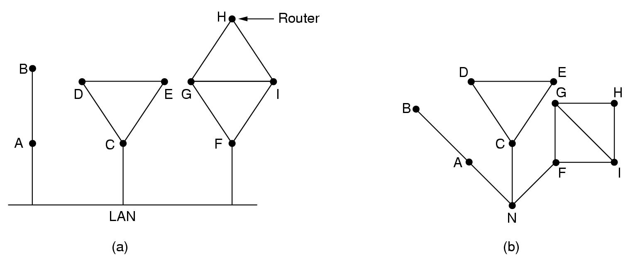
One way to model the LAN is to consider it as a node itself, as shown in Figure(b).
Here we have introduced a new, artificial node, N, to which A, C, and F are connected.
The fact that it is possible to go from A to C on the LAN is represented by the path ANC here.

Slide 40
Measuring Line Cost
The link state routing algorithm requires each router to know, or at least have a reasonable estimate of, the delay to each of its neighbors.
The most direct way to determine this delay is to send over the line a special ECHO packet that the other side is required to send back immediately.
By measuring the round-trip time and dividing it by two, the sending router can get a reasonable estimate of the delay.
For even better results, the test can be conducted several times, and the average used.
An interesting issue is whether to take the load into account when measuring the delay. To factor the load in, the round-trip timer must be started when the ECHO packet is queued.
To ignore the load, the timer should be started when the ECHO packet reaches the front of the queue.

Slide 41
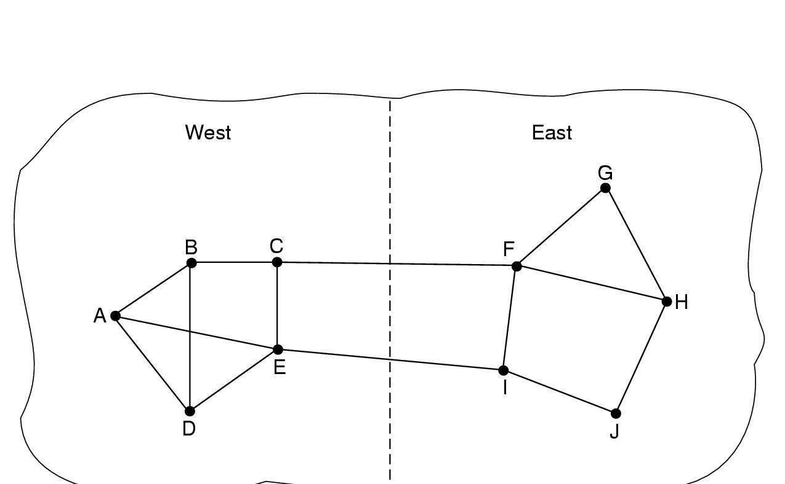
Arguments can be made both ways.
Including traffic-induced delays in the measurements means that when a router has a choice between two lines with the same bandwidth, one of which is heavily loaded all the time and one of which is not, the router will regard the route over the unloaded line as a shorter path.
This choice will result in better performance.
Unfortunately, there is also an argument against including the load in the delay calculation.
Consider the subnet of following Figure, which is divided into two parts, East and West, connected by two lines, CF and EI.

Slide 42
Suppose that most of the traffic between East and West is using line CF, and as a result, this line is heavily loaded with long delays.
Including queueing delay in the shortest path calculation will make EI more attractive.
After the new routing tables have been installed, most of the East-West traffic will now go over EI, overloading this line.
Consequently, in the next update, CF will appear to be the shortest path.
As a result, the routing tables may oscillate wildly, leading to erratic routing and many potential problems.
If load is ignored and only bandwidth is considered, this problem does not occur.
Alternatively, the load can be spread over both lines, but this solution does not fully utilize the best path.
Nevertheless, to avoid oscillations in the choice of best path, it may be wise to distribute the load over multiple lines, with some known fraction going over each line.

Slide 43
Building Link State Packets
Once the information needed for the exchange has been collected, the next step is for each router to build a packet containing all the data.
The packet starts with the identity of the sender, followed by a sequence number and age (to be described later), and a list of neighbors.
For each neighbor, the delay to that neighbor is given.
An example subnet is given in following Figure(a) with delays shown as labels on the lines.
The corresponding link state packets for all six routers are shown in Figure(b).
Building the link state packets is easy. The hard part is determining when to build them. One possibility is to build them periodically, that is, at regular intervals.
Another possibility is to build them when some significant event occurs, such as a line or neighbor going down or coming back up again or changing its properties appreciably.

Slide 44
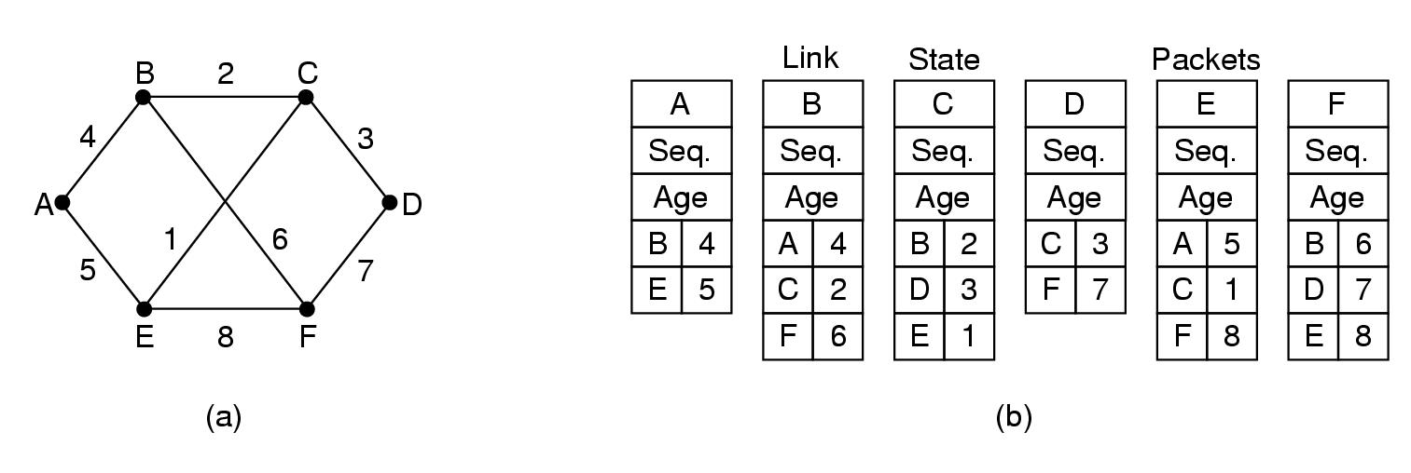
Distributing the Link State Packets
The trickiest part of the algorithm is distributing the link state packets reliably.
As the packets are distributed and installed, the routers getting the first ones will change their routes.
Consequently, the different routers may be using different versions of the topology, which can lead to inconsistencies, loops, unreachable machines, and other problems.

Slide 45
The fundamental idea is to use flooding to distribute the link state packets.
To keep the flood in check, each packet contains a sequence number that is incremented for each new packet sent.
Routers keep track of all the (source router, sequence) pairs they see.
When a new link state packet comes in, it is checked against the list of packets already seen.
If it is new, it is forwarded on all lines except the one it arrived on. If it is a duplicate, it is discarded.
If a packet with a sequence number lower than the highest one seen so far ever arrives, it is rejected.
This algorithm has a few problems, but they are manageable.

Slide 46
First, if the sequence numbers wrap around, confusion will reign. The solution here is to use a 32-bit sequence number.
With one link state packet per second, it would take 137 years to wrap around, so this possibility can be ignored.
Second, if a router ever crashes, it will lose track of its sequence number. If it starts again at 0, the next packet will be rejected as a duplicate.
Third, if a sequence number is ever corrupted and 65,540 is received instead of 4
The solution to all these problems is to include the age of each packet after the sequence number and decrement it once per second.
When the age hits zero, the information from that router is discarded.
Normally, a new packet comes in, say, every 10 sec, so router information only times out when a router is down
The Age field is also decremented by each router during the initial flooding process, to make sure no packet can get lost and live for an indefinite period of time.

Slide 47
When a link state packet comes in to a router for flooding, it is not queued for transmission immediately.
Instead it is first put in a holding area to wait a short while.
If another link state packet from the same source comes in before the first packet is transmitted, their sequence numbers are compared.
If they are equal, the duplicate is discarded. If they are different, the older one is thrown out.
To guard against errors on the router-router lines, all link state packets are acknowledged.
When a line goes idle, the holding area is scanned in round-robin order to select a packet or acknowledgement to send.

Slide 48
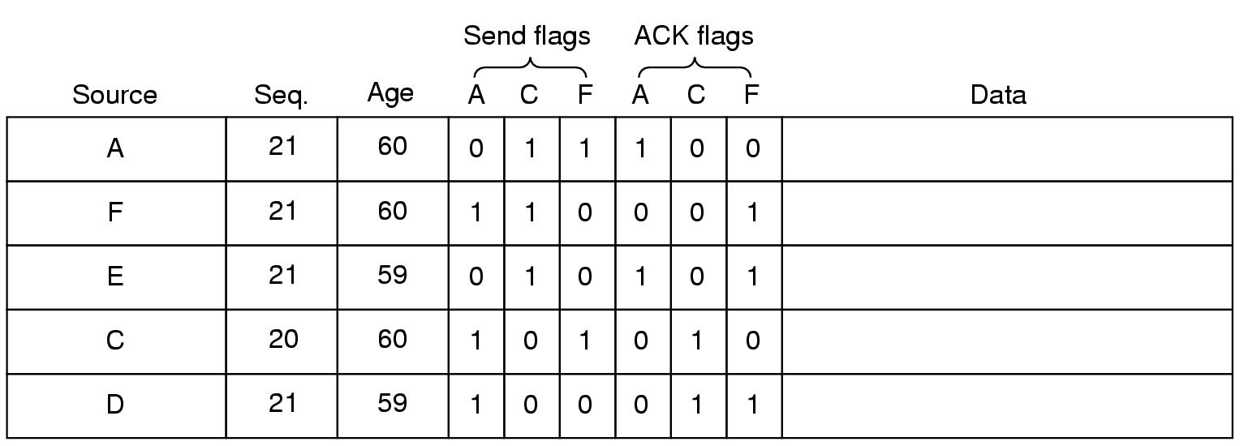
The data structure used by router B for the subnet shown in Figure(a).
Each row here corresponds to a recently-arrived, but as yet not fully-processed, link state packet.
The table records where the packet originated, its sequence number and age, and the data.
In addition, there are send and acknowledgement flags for each of B's three lines (to A, C, and F, respectively).

Slide 49
The send flags mean that the packet must be sent on the indicated line.
The acknowledgement flags mean that it must be acknowledged there.
In the above Figure, the link state packet from A arrives directly, so it must be sent to C and F and acknowledged to A, as indicated by the flag bits.
Similarly, the packet from F has to be forwarded to A and C and acknowledged to F.

Slide 50
3.2.5 Hierarchical Routing
As networks grow in size, the router routing tables grow proportionally.
Not only is router memory consumed by ever-increasing tables, but more CPU time is needed to scan them and more bandwidth is needed to send status reports about them.
At a certain point the network may grow to the point where it is no longer feasible for every router to have an entry for every other router, so the routing will have to be done hierarchically, as it is in the telephone network.
When hierarchical routing is used, the routers are divided into what we will call regions, with each router knowing all the details about how to route packets to destinations within its own region, but knowing nothing about the internal structure of other regions.
When different networks are interconnected, it is natural to regard each one as a separate region in order to free the routers in one network from having to know the topological structure of the other ones.

Slide 51
For huge networks, a two-level hierarchy may be insufficient; it may be necessary to group the regions into clusters, the clusters into zones, the zones into groups, and so on, until we run out of names for aggregations.
Figure below gives a quantitative example of routing in a two-level hierarchy with five regions.
The full routing table for router 1A has 17 entries, as shown in Figure(b).
When routing is done hierarchically, as in Figure(c), there are entries for all the local routers as before, but all other regions have been condensed into a single router, so all traffic for region 2 goes via the 1B -2A line, but the rest of the remote traffic goes via the 1C -3B line.
Hierarchical routing has reduced the table from 17 to 7 entries. As the ratio of the number of regions to the number of routers per region grows, the savings in table space increase.

Slide 53
3.2.5Broadcast Routing
In some applications, hosts need to send messages to many or all other hosts.
For example, a service distributing weather reports, stock market updates, or live radio programs might work best by broadcasting to all machines and letting those that are interested read the data.
Sending a packet to all destinations simultaneously is called broadcasting; various methods have been proposed for doing it.
1. Broadcasting method, that requires no special features from the subnet is for the source to simply send a distinct packet to each destination.
Not only is the method wasteful of bandwidth, but it also requires the source to have a complete list of all destinations.
In practice this may be the only possibility, but it is the least desirable of the methods.

Slide 54
2. Flooding is ill-suited for ordinary point-to-point communication, for broadcasting it might rate serious consideration, it generates too many packets and consumes too much bandwidth.
3. A third algorithm is multidestination routing. If this method is used, each packet contains either a list of destinations or a bit map indicating the desired destinations.
When a packet arrives at a router, the router checks all the destinations to determine the set of output lines that will be needed.
The router generates a new copy of the packet for each output line to be used and includes in each packet only those destinations that are to use the line.
Multidestination routing is like separately addressed packets, except that when several packets must follow the same route, one of them pays full fare and the rest ride free.

Slide 55
4. A fourth broadcast algorithm makes explicit use of the Sink tree for the router initiating the broadcast—or any other convenient spanning tree for that matter.
A spanning tree is a subset of the subnet that includes all the routers but contains no loops.
If each router knows which of its lines belong to the spanning tree, it can copy an incoming broadcast packet onto all the spanning tree lines except the one it arrived on.
This method makes excellent use of bandwidth, generating the absolute minimum number of packets necessary to do the job.
The only problem is that each router must have knowledge of some spanning tree for the method to be applicable.

Slide 56
Our last broadcast algorithm is an attempt to approximate the behavior of the previous one, even when the routers do not know anything at all about spanning trees.
5. The idea, called reverse path forwarding, is remarkably simple once it has been pointed out.
When a broadcast packet arrives at a router, the router checks to see if the packet arrived on the line that is normally used for sending packets to the source of the broadcast.
If so, there is an excellent chance that the broadcast packet itself followed the best route from the router and is therefore the first copy to arrive at the router.
This being the case, the router forwards copies of it onto all lines except the one it arrived on.
If, however, the broadcast packet arrived on a line other than the preferred one for reaching the source, the packet is discarded as a likely duplicate.

Slide 57
An example of reverse path forwarding is shown in Figure Part (a) shows a subnet, part (b) shows a sink tree for router I of that subnet, and part (c) shows how the reverse path algorithm works.
On the first hop, I sends packets to F, H, J, and N, as indicated by the second row of the tree. Each of these packets arrives on the preferred path to I (assuming that the preferred path falls along the sink tree) and is so indicated by a circle around the letter.
On the second hop, eight packets are generated, two by each of the routers that received a packet on the first hop.
As it turns out, all eight of these arrive at previously unvisited routers, and five of these arrive along the preferred line.
Of the six packets generated on the third hop, only three arrive on the preferred path (at C, E, and K); the others are duplicates.
After five hops and 24 packets, the broadcasting terminates, compared with four hops and 14 packets had the sink tree been followed exactly.

Slide 59
2.3.6 Multicast Routing
Some applications require that widely-separated processes work together in groups, for example, a group of processes implementing a distributed database system.
In these situations, it is frequently necessary for one process to send a message to all the other members of the group.
If the group is small, it can just send each other member a point-to-point message.
If the group is large, this strategy is expensive.
Sometimes broadcasting can be used, but using broadcasting to inform 1000 machines on a million-node network is inefficient because most receivers are not interested in the message
Thus, we need a way to send messages to well-defined groups that are numerically large in size but small compared to the network as a whole.

Slide 60
Sending a message to such a group is called multicasting, and its routing algorithm is called multicast routing.
Multicasting requires group management. Some way is needed to create and destroy groups, and to allow processes to join and leave groups.
How these tasks are accomplished is not of concern to the routing algorithm.
What is of concern is that when a process joins a group, it informs its host of this fact.
It is important that routers know which of their hosts belong to which groups.
Either hosts must inform their routers about changes in group membership, or routers must query their hosts periodically.
Either way, routers learn about which of their hosts are in which groups.

Slide 61
Routers tell their neighbors, so the information propagates through the subnet.
To do multicast routing, each router computes a spanning tree covering all other routers.
For example, in Figure(a) we have two groups, 1 and 2.
Some routers are attached to hosts that belong to one or both of these groups, as indicated in the figure.
A spanning tree for the leftmost router is shown in Figure(b).
When a process sends a multicast packet to a group, the first router examines its spanning tree and prunes it, removing all lines that do not lead to hosts that are members of the group.
In our example, Figure(c) shows the pruned spanning tree for group 1.
Similarly, Figure(d) shows the pruned spanning tree for group 2.
Multicast packets are forwarded only along the appropriate spanning tree.

Slide 62
Various ways of pruning the spanning tree are possible.
The simplest one can be used if link state routing is used and each router is aware of the complete topology, including which hosts belong to which groups.
Then the spanning tree can be pruned, starting at the end of each path, working toward the root, and removing all routers that do not belong to the group in question.

Slide 63
3.2.7 Routing for Mobile Hosts
Millions of people have portable computers nowadays, and they generally want to read their email and access their normal file systems wherever in the world they may be.
These mobile hosts introduce a new complication: to route a packet to a mobile host, the network first has to find it.
The subject of incorporating mobile hosts into a network is very young, but in this section we will sketch some of the issues and give a possible solution.
The model of the world that network designers typically use is shown in Figure.
Here we have a WAN consisting of routers and hosts. Connected to the WAN are LANs, MANs, and wireless cells of the type

Slide 65
When a new host enters an area, either by connecting to it (e.g., plugging into the LAN) or just wandering into the cell, his computer must register itself with the foreign agent there.
The registration procedure typically works like this:
1. Periodically, each foreign agent broadcasts a packet announcing its existence and address.
A newly-arrived mobile host may wait for one of these messages, but if none arrives quickly enough, the mobile host can broadcast a packet saying: Are there any foreign agents around?
2. The mobile host registers with the foreign agent, giving its home address, current data link layer address, and some security information.

Slide 66
3. The foreign agent contacts the mobile host's home agent and says:
One of your hosts is over here. The message from the foreign agent to the home agent contains the foreign agent's network address.
It also includes the security information to convince the home agent that the mobile host is really there.
4. The home agent examines the security information, which contains a timestamp, to prove that it was generated within the past few seconds.
If it is happy, it tells the foreign agent to proceed.
5. When the foreign agent gets the acknowledgement from the home agent, it makes an entry in its tables and informs the mobile host that it is now registered.

Slide 67
Ideally, when a host leaves an area, that, too, should be announced to allow deregistration, but many users abruptly turn off their computers when done.
When a packet is sent to a mobile host, it is routed to the host's home LAN because that is what the address says should be done, as illustrated in step 1 of following Figure.
Here the sender, in the northwest city of Seattle, wants to send a packet to a host normally across the United States in New York.
Packets sent to the mobile host on its home LAN in New York are intercepted by the home agent there.
The home agent then looks up the mobile host's new (temporary) location and finds the address of the foreign agent handling the mobile host, in Los Angeles.

Slide 69
The home agent then does two things.
First, it encapsulates the packet in the payload field of an outer packet and sends the latter to the foreign agent (step 2 in Figure).
This mechanism is called tunneling;
After getting the encapsulated packet, the foreign agent removes the original packet from the payload field and sends it to the mobile host as a data link frame.
Second, the home agent tells the sender to henceforth send packets to the mobile host by encapsulating them in the payload of packets explicitly addressed to the foreign agent instead of just sending them to the mobile host's home address (step 3).
Subsequent packets can now be routed directly to the host via the foreign agent (step 4), bypassing the home location entirely.

Slide 70
Congestion Control Algorithms
When too many packets are present in (a part of) the subnet, performance degrades. This situation is called congestion.
When the number of packets dumped into the subnet by the hosts is within its carrying capacity, they are all delivered and the number delivered is proportional to the number sent.
However, as traffic increases too far, the routers are no longer able to cope and they begin losing packets.
This tends to make matters worse. At very high traffic, performance collapses completely and almost no packets are delivered.

Slide 71
Congestion can be brought on by several factors.
If all of a sudden, streams of packets begin arriving on three or four input lines and all need the same output line, a queue will build up.
If there is insufficient memory to hold all of them, packets will be lost.
Slow processors can also cause congestion. If the routers' CPUs are slow at performing the bookkeeping tasks required of them queues can build up, even though there is excess line capacity.
4. Similarly, low-bandwidth lines can also cause congestion. Upgrading the lines but not changing the processors, or vice versa, often helps a little but not fequently.

Slide 72
General Principles of Congestion Control
Many problems in complex systems, such as computer networks, can be viewed from a control theory point of view.
This approach leads to dividing all solutions into two groups: open loop and closed loop.
1 Open loop solutions attempt to solve the problem by good design, in essence, to make sure it does not occur in the first place.
Once the system is up and running, midcourse corrections are not made.
Tools for doing open-loop control include
Deciding when to accept new traffic,
Deciding when to discard packets and which ones,
Making scheduling decisions at various points in the network.
All of these have in common the fact that they make decisions without regard to the current state of the network.

Slide 73
2. Closed loop solutions are based on the concept of a feedback loop. This approach has three parts when applied to congestion control:
Monitor the system to detect when and where congestion occurs.
Pass this information to places where action can be taken.
Adjust system operation to correct the problem.
A variety of metrics can be used to monitor the subnet for congestion.
Chief among these are
the percentage of all packets discarded for lack of buffer space,
the average queue lengths,
the number of packets that time out and are retransmitted,
the average packet delay, and the standard deviation of packet delay.
In all cases, rising numbers indicate growing congestion.

Slide 74
They further divide the open loop algorithms into ones that act at the source versus ones that act at the destination.
The closed loop algorithms are also divided into two subcategories: explicit feedback versus implicit feedback.
1. In Explicit feedback algorithms, packets are sent back from the point of congestion to warn the source.
2. In Implicit algorithms, the source deduces the existence of congestion by making local observations, such as the time needed for acknowledgements to come back.

Slide 75
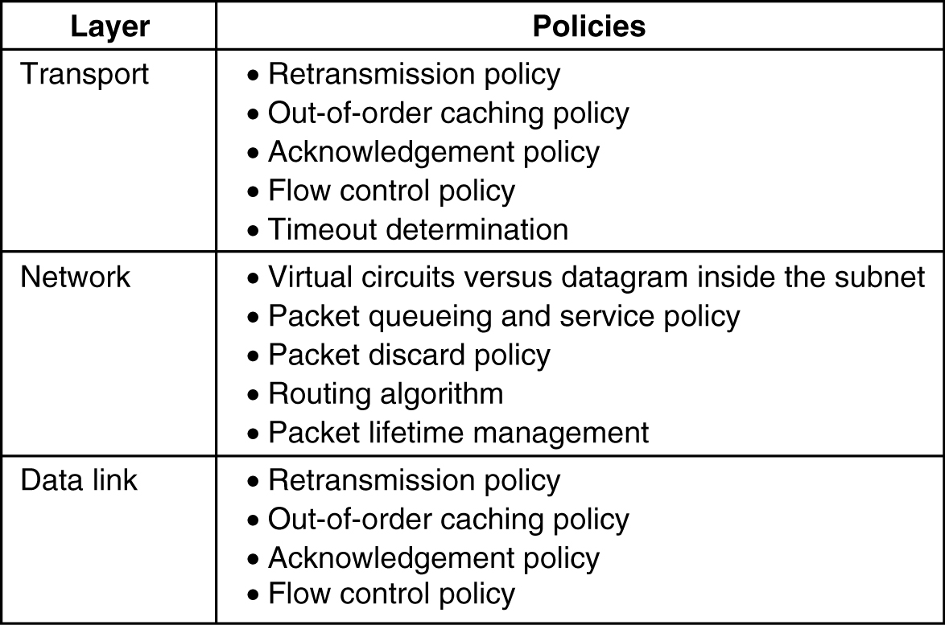
Congestion Prevention Policies:
There are methods to control congestion by looking at open loop systems.
These systems are designed to minimize congestion in the first place, rather than letting it happen and reacting after the fact.
They try to achieve their goal by using appropriate policies at various levels.

Slide 76
Data Link Layer Policies:
Retransmission policy, is concerned with how fast a sender times out and retransmits. A jumpy sender that times out quickly and retransmits all outstanding packets using go back n will put a heavier load on the system than will a leisurely sender that uses selective repeat.
Out of order packets management depends upon buffering policy. If receivers routinely discard all out-of-order packets, these packets will have to be transmitted again later, creating extra load i.e prefer selective repeat instead of GoBackN.
Acknowledgement packets generate extra traffic. Solution? Piggyback.
Flow Control: Tight Flow and Loose Flow. Tight flow means smaller windows protocols, reduces data rate, helps fight congestion.
.

Slide 77
Network layer Policies:
Choice between using virtual circuits and using datagram's affects congestion since many congestion control algorithms work only with virtual-circuit subnets.
Packet queuing and service policy relates to whether routers have one queue per input line, one queue per output line, or both. round robin or priority based?
Discard policy is the rule telling which packet is dropped when there is no space.
Routing policy ,following various routing algorithms.
Packet lifetime management deals with how long a packet may live before being discarded.

Slide 78
Transport layer Policies:
Same issues occur as in the data link layer
If the timeout interval is too short, extra packets will be sent unnecessarily. If it is too long, congestion will be reduced but the response time will suffer whenever a packet is lost.

Slide 79
Congestion Control in Virtual-Circuit Subnets:
Once congestion has been signaled, no more virtual circuits are set up until the problem has gone away.
Thus, attempts to set up new transport layer connections fail.
In the telephone system, when a switch gets overloaded, it also practices admission control by not giving dial tones.
An alternative approach is to allow new virtual circuits but carefully route all new virtual circuits around problem areas.
For example, consider the subnet of Figure(a), in which two routers are congested, as indicated.
Suppose that a host attached to router A wants to set up a connection to a host attached to router B.
Normally, this connection would pass through one of the congested routers.
To avoid this situation, we can redraw the subnet as shown in Fig.ure(b), omitting the congested routers and all of their lines.
The dashed line shows a possible route for the virtual circuit that avoids the congested routers.

Slide 80
Another strategy relating to virtual circuits is to negotiate an agreement between the host and subnet when a virtual circuit is set up.
This agreement normally specifies the volume and shape of the traffic, quality of service required, and other parameters.
To keep its part of the agreement, the subnet will typically reserve resources along the path when the circuit is set up.
These resources can include table and buffer space in the routers and bandwidth on the lines.
In this way, congestion is unlikely to occur on the new virtual circuits because all the necessary resources are guaranteed to be available.

Slide 81
Congestion Control in Datagram Subnets
Each router can easily monitor the utilization of its output lines and other resources.
For example, it can associate with each line a real variable, u, whose value, between 0.0 and 1.0, reflects the recent utilization of that line.
To maintain a good estimate of u, a sample of the instantaneous line utilization, f (either 0 or 1), can be made periodically and u updated according to
where the constant a determines how fast the router forgets recent history.
Whenever u moves above the threshold, the output line enters a ''warning'' state.
Each newly arriving packet is checked to see if its output line is in warning state. If it is, some action is taken. The action taken can be one of several alternatives,

Slide 82
Warning Bit
The old DECNET(Digital Equipment Corporation to connect mini computers) and frame relay networks:
A warning bit is sent back in the ack(A special bit in the header) to the source in the case of congestion.
Every router on the path can set the warning bit.
As long as the router was in warning state , it will continue to set it.
Source will adjust its transmission rate accordingly

Slide 83
Choke Packets
A router detects congestion and it sends choke packets across the network to all the data sources associated with the congestion.
Source will reduce the traffic sent to the specified destination by X percent.
The host listens for more choke packets for another interval, host may increase or decrease the flow.

Slide 84
Hop-by-Hop Choke Packets
At high speeds or over long distances, sending a choke packet to the source hosts does not work well because the reaction is so slow.
Consider, for example, router A that is sending traffic to router D in Figure (a) at 155 Mbps.
If the node B begins to run out of buffers, it will take about 30 msec for a choke packet to get back to nodeA to tell it to slow down.
The choke packet propagation is shown as the second, third, and fourth steps in Fig(a).
In those 30 msec, another 4.6 megabits will have been sent.
Even if the nodeA completely shuts down immediately, the 4.6 megabits in the pipe will continue to pour in and have to be dealt with.

Slide 85
An alternative approach is to have the choke packet take effect at every hop it passes through, as shown in the sequence of Fig(b).
Here, as soon as the choke packet reaches F, F is required to reduce the flow to D.
Doing so will require F to devote more buffers to the flow, since the source is still sending away at full blast, but it gives D immediate relief

Slide 86
Load shedding: Wine Vs. Milk
Load shedding is a fancy way of saying that when routers cannot handle packets, they just throw them away.
Wine: drop new packets (keep old); good for file transfer
Milk: drop old packets (keep new); good for multimedia
Random Early Detection
The idea is discarding packets before all the buffer space is really exhausted.
When the average queue length exceeds a threshold, packets are picked at random from the queue and discarded.

Slide 87
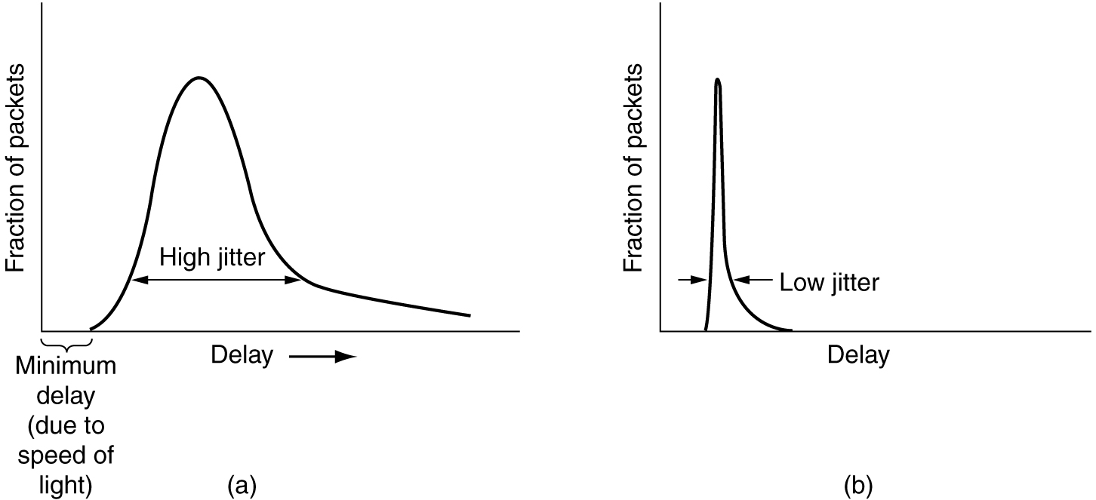
Jitter Control
For applications such as audio and video streaming, The variation in the packet arrival times is called jitter.
In some applications, such as video on demand, jitter can be eliminated by buffering at the receiver and then fetching data for display from the buffer instead of from the network in real time.
High jitter. (b) Low jitter.

Slide 88
Quality of Service
A stream of packets from a source to a destination is called a flow.
In a connection-oriented network, all the packets belonging to a flow follow the same route; in a connectionless network, they may follow different routes.
The needs of each flow can be characterized by four primary parameters:
Reliability,
Delay,
Jitter, and
Bandwidth.
Together these determine the QoS (Quality of Service) the flow requires.
Several common applications and the stringency of their requirements are listed in Figure

Slide 90
Techniques for Achieving Good Quality of Service
Overprovisioning
Buffering
Traffic Shaping
1.Overprovisioning:
An easy solution is to provide so much router capacity, buffer space, and bandwidth that the packets just fly through easily.
The trouble with this solution is that it is expensive.
As time goes on and designers have a better idea of how much is enough, this technique may even become practical.
To some extent, the telephone system is overprovisioned.
It is rare to pick up a telephone and not get a dial tone instantly.
There is simply so much capacity available there that demand can always be met.

Slide 91
2. Buffering:
Flows can be buffered on the receiving side before being delivered.
Buffering them does not affect the reliability or bandwidth, and increases the delay, but it smooths out the jitter.
For audio and video on demand, jitter is the main problem, so this technique helps a lot.
In the following figure, we see a stream of packets being delivered with substantial jitter.
Unfortunately, packet 8 has been delayed so much that it is not available when its play slot comes up, so playback must stop until it arrives, creating an annoying gap in the music or movie.
This problem can be alleviated by delaying the starting time even more, although doing so also requires a larger buffer.
Commercial Web sites that contain streaming audio or video all use players that buffer for about 10 seconds before starting to play.

Slide 93
3. Traffic Shaping :
In the above example, the source outputs the packets with a uniform spacing between them, but in other cases, they may be emitted irregularly, which may cause congestion to occur in the network.
Also, the approach buffering is not always possible, for example, with videoconferencing.
Now let us examine a technique, traffic shaping, which smooths out the traffic on the server side, rather than on the client side.
Traffic shaping is about regulating the average rate (and burstiness) of data transmission.
In contrast, the sliding window protocols limit the amount of data in transit at once, not the rate at which it is sent.
When a connection is set up, the user and the subnet agree on a certain traffic pattern (i.e., shape) for that circuit.
Sometimes this is called a service level agreement. As long as the customer fulfills her part of the bargain and only sends packets according to the agreed-on contract, the carrier promises to deliver them all in a timely fashion.
Traffic shaping reduces congestion and thus helps the carrier live up to its promise.

Slide 94
The Leaky Bucket Algorithm
There are 2 types of traffic shaping algorithms:
Leaky Bucket
Token Bucket
Imagine a bucket with a small hole in the bottom, as illustrated in Figure(a).
No matter the rate at which water enters the bucket, the outflow is at a constant rate, ρ, when there is any water in the bucket and zero when the bucket is empty.
Also, once the bucket is full, any additional water entering it spills over the sides and is lost (i.e., does not appear in the output stream under the hole).
The same idea can be applied to packets, as shown in Figure(b).
Conceptually, each host is connected to the network by an interface containing a leaky bucket, that is, a finite internal queue.

Slide 95
If a packet arrives at the queue when it is full, the packet is discarded.
In other words, if one or more processes within the host try to send a packet when the maximum number is already queued, the new packet is unceremoniously discarded.

Slide 96
This arrangement can be built into the hardware interface or simulated by the host operating system.
It was first proposed by Turner (1986) and is called the leaky bucket algorithm.
The host is allowed to put one packet per clock tick onto the network.
Again, this can be enforced by the interface card or by the operating system.
This mechanism turns an uneven flow of packets from the user processes inside the host into an even flow of packets onto the network, smoothing out bursts and greatly reducing the chances of congestion.

Slide 97
Implementing the original leaky bucket algorithm is easy.
The leaky bucket consists of a finite queue. When a packet arrives, if there is room on the queue it is appended to the queue; otherwise, it is discarded.
At every clock tick, one packet is transmitted (unless the queue is empty).
As an example of a leaky bucket, imagine that a computer can produce data at 25 million bytes/sec (200 Mbps) and that the network also runs at this speed.
For long intervals, they work best at rates not exceeding 2 million bytes/sec.
Now suppose data comes in 1-million-byte bursts, one 40-msec burst every second.
To reduce the average rate to 2 MB/sec, we could use a leaky bucket with ρ=2 MB/sec and a capacity, C, of 1 MB.
This means that bursts of up to 1 MB can be handled without data loss and that such bursts are spread out over 500 msec, no matter how fast they come in.

Slide 99
The Token Bucket Algorithm
The leaky bucket algorithm enforces a rigid output pattern at the average rate, no matter how bursty the traffic is.
For many applications, it is better to allow the output to speed up somewhat when large bursts arrive, so a more flexible algorithm is needed, preferably one that never loses data.
One such algorithm is the token bucket algorithm.
In this algorithm, the leaky bucket holds tokens, generated by a clock at the rate of one token every ∆T sec.
In Figure(a) a bucket holding three tokens, with five packets waiting to be transmitted.
For a packet to be transmitted, it must capture and destroy one token.
In Figure(b) three of the five packets have gotten through, but the other two are stuck waiting for two more tokens to be generated.

Slide 101
The token bucket algorithm provides a different kind of traffic shaping than that of the leaky bucket algorithm.
The leaky bucket algorithm does not allow idle hosts to save up permission to send large bursts later.
The token bucket algorithm does allow saving, up to the maximum size of the bucket, n.
This property means that bursts of up to n packets can be sent at once, allowing some burstiness in the output stream and giving faster response to sudden bursts of input.
Another difference between the two algorithms is that the token bucket algorithm throws away tokens (i.e., transmission capacity) when the bucket fills up but never discards packets.
In contrast, the leaky bucket algorithm discards packets when the bucket fills up.
Here, too, a minor variant is possible, in which each token represents the right to send not one packet, but k bytes.
A packet can only be transmitted if enough tokens are available to cover its length in bytes. Fractional tokens are kept for future use.

Slide 102
Leaky Bucket | Token Bucket
When the host has to send a packet , packet is thrown in bucket. | In this, the bucket holds tokens generated at regular intervals of time.
Bucket leaks at constant rate | Bucket has maximum capacity.
Bursty traffic is converted into uniform traffic by leaky bucket. | If there is a ready packet , a token is removed from Bucket and packet is send.
In practice bucket is a finite queue outputs at finite rate | If there is no token in the bucket, then the packet cannot be sent.

Slide 103
Internetworking
Many different networks exist, including LANs, MANs, and WANs. Numerous protocols are in widespread use in every layer.
a variety of different networks (and thus protocols) will always be around, for the following reasons.
First of all, the installed base of different networks is large.
Nearly all personal computers run TCP/IP.
Many large businesses have mainframes running IBM's SNA.
A substantial number of telephone companies operate ATM networks.
Some personal computer LANs still use Novell NCP/IPX or AppleTalk.
Finally, wireless is an up-coming area with a variety of protocols.
This trend will continue for years due to legacy problems, new technology, and the fact that not all vendors perceive it in their interest for their customers to be able to easily migrate to another vendor's system.
Notes:
ATM- Asynchronous Transfer Mode
SNA – System Network Architecture
NCP/IPX – Network Control Protocol- Internetwork Packet Exchange

Slide 104
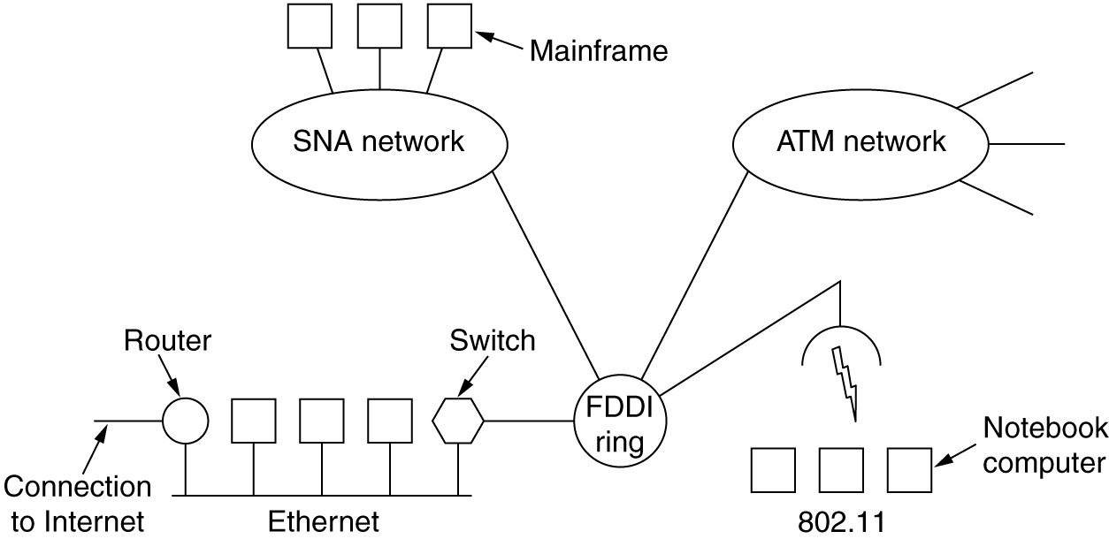
As an example of how different networks might be connected, consider the example in the following Figure.
Here we see a corporate network with multiple locations tied together by a wide area ATM network.
At one of the locations, an FDDI optical backbone is used to connect an Ethernet, an 802.11 wireless LAN, and the corporate data center's SNA mainframe network.
The purpose of interconnecting all these networks is to allow users on any of them to communicate with users on all the other ones.
Notes:
FDDI- Fiber Distributed Data Interface

Slide 105
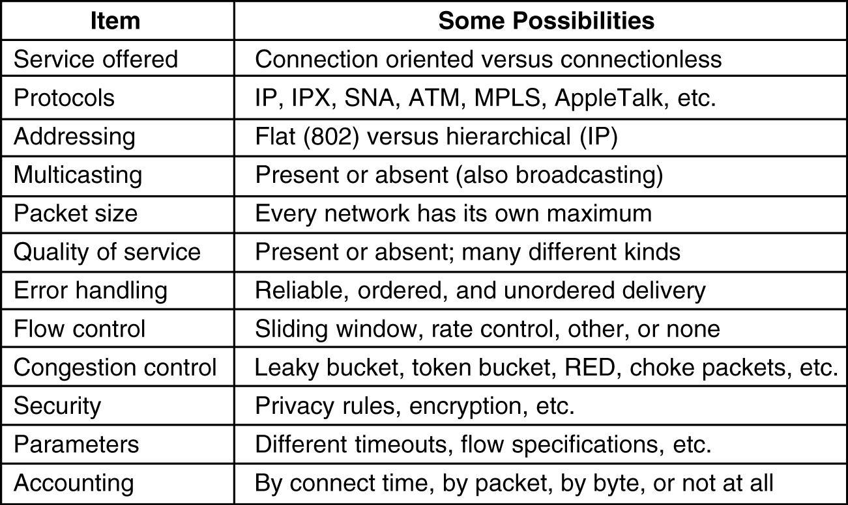
How Networks Differ
Networks can differ in many ways.
Some of the differences, such as different modulation techniques or frame formats, are in the physical and data link layers,
Notes:
MPLS- Multiprotocol label switching

Slide 106
How Networks Can Be Connected
Networks can be interconnected by different devices.
In the physical layer, networks can be connected by repeaters or hubs, which just move the bits from one network to an identical network.
These are mostly analog devices and do not understand anything about digital.
One layer up data link layer, we find bridges and switches.
They can accept frames, examine the MAC addresses, and forward the frames to a different network while doing minor protocol translation in the process, for example, from Ethernet to FDDI or to 802.11.
In the network layer, we have routers that can connect two networks.
If two networks have dissimilar network layers, the router may be able to translate between the packet formats,

Slide 107
A router that can handle multiple protocols is called a multiprotocol router.
In the transport layer we find transport gateways, which can interface between two transport connections.
For example, a transport gateway could allow packets to flow between a TCP network and an SNA network, which has a different transport protocol, by essentially gluing a TCP connection to an SNA connection.
Finally, in the application layer, application gateways translate message semantics.
As an example, gateways between Internet e-mail (RFC 822) and X.400 e-mail must parse the email messages and change various header fields.

Slide 108
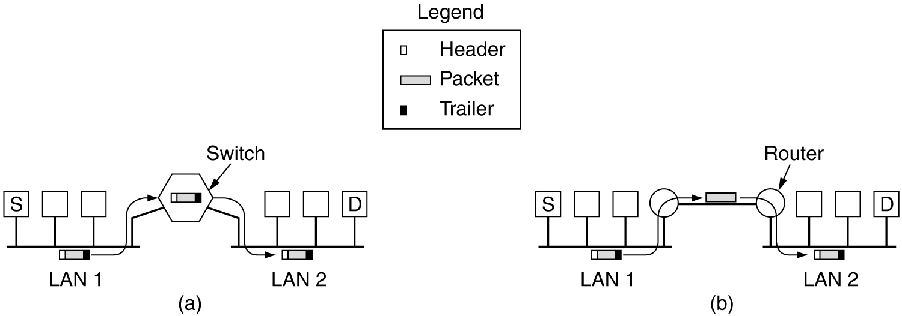
In the following Figure(a), the source machine, S, wants to send a packet to the destination machine, D.
These machines are on different Ethernets, connected by a switch.
S encapsulates the packet in a frame and sends it on its way.
The frame arrives at the switch, which then determines that the frame has to go to LAN 2 by looking at its MAC address.
The switch just removes the frame from LAN 1 and deposits it on LAN 2.

Slide 109
Now let us consider the same situation but with the two Ethernets connected by a pair of routers instead of a switch.
The routers are connected by a point-to-point line, possibly a leased line thousands of kilometers long.
An essential difference between the switched (or bridged) case and the routed case is this.
With a switch (or bridge), the entire frame is transported on the basis of its MAC address.
With a router, the packet is extracted from the frame and the address in the packet is used for deciding where to send it.
Switches do not have to understand the network layer protocol being used to switch packets. Routers do.

Slide 110
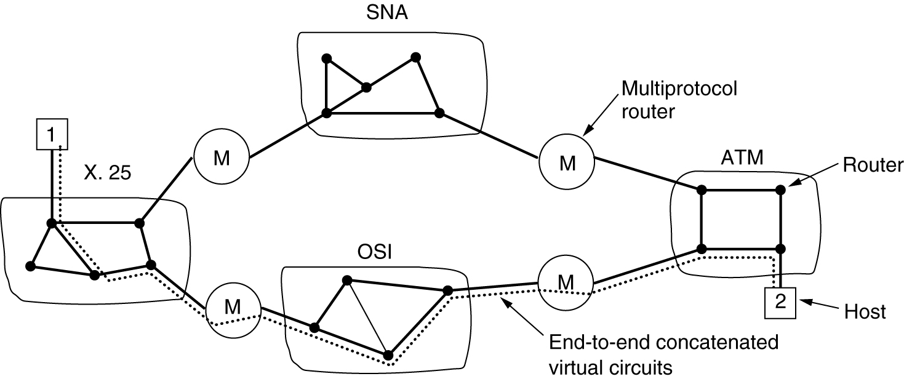
Concatenated Virtual Circuits
Networks can be connected using connection-oriented techniques. This allows easier QoS between disparate networks.
Only subnets internally using VCs can be connected this way.
Internetworking using concatenated virtual circuits
with gateways (multiprotocol routers).

Slide 111
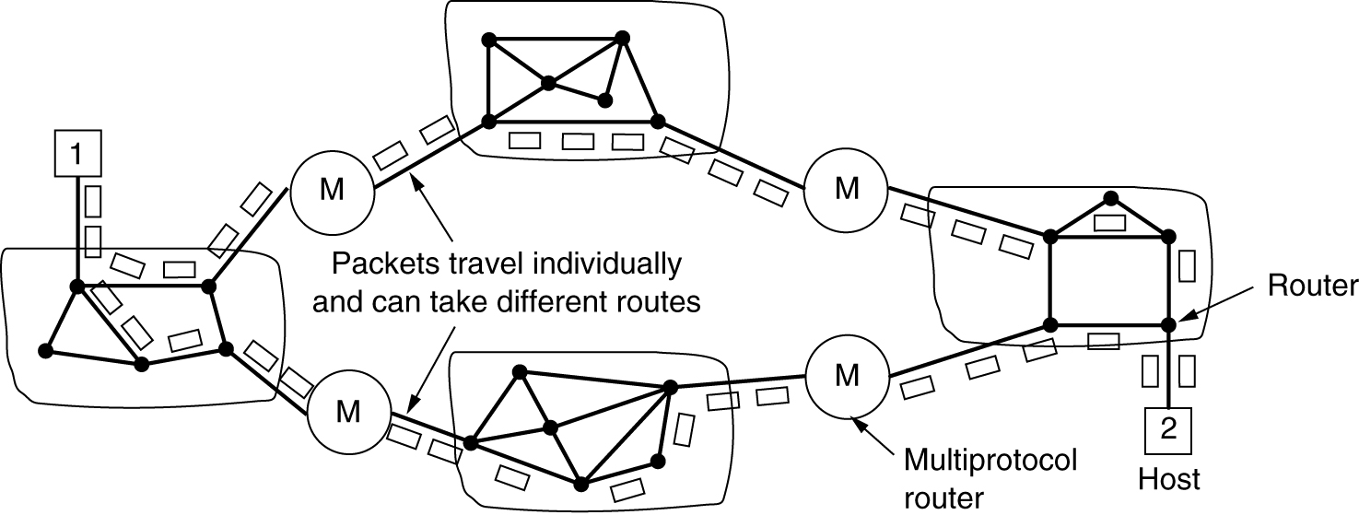
Connectionless Internetworking
The alternative internetwork model is the datagram model, shown in the following Figure.
In this model, the only service the network layer offers to the transport layer is the ability to inject datagrams into the subnet and hope for the best.
A routing decision is made separately for each packet, possibly depending on the traffic at the moment the packet is sent.
On the other hand, there is no guarantee that the packets arrive at the destination in order, assuming that they arrive at all.

Slide 112
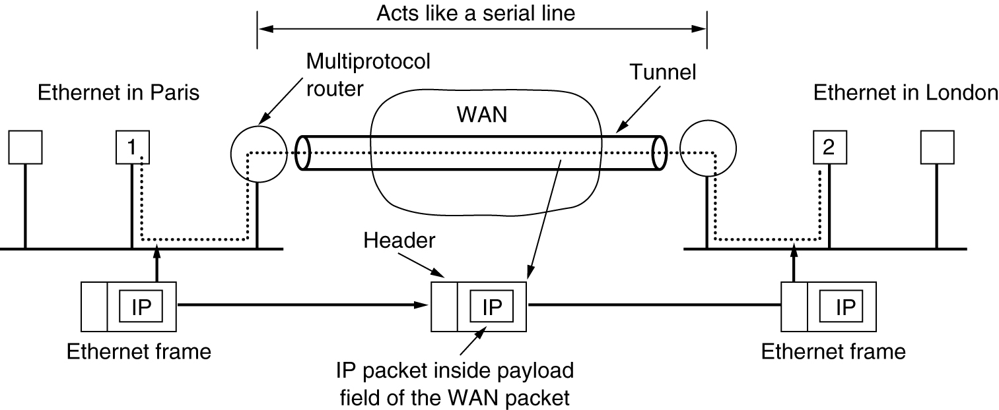
Tunneling
Handling the general case of making two different networks interwork is exceedingly difficult.
However, there is a common special case that is manageable.
This case is where the source and destination hosts are on the same type of network, but there is a different network in between.
As an example, think of an international bank with a TCP/IP-based Ethernet in Paris, a TCP/IP-based Ethernet in London, and a non-IP wide area network (e.g., ATM) in between, as shown in the following Figure.

Slide 113
Internetwork Routing
This gives a two level routing algorithm: within each network an interior gateway protocol is used, but between the networks, an exterior gateway protocol is used (''gateway'' is an older term for ''router'').
In fact, since each network is independent, they may all use different algorithms.
Because each network in an internetwork is independent of all the others, it is often referred to as an Autonomous System (AS).

Slide 114
Fragmentation
The network designers are not free to choose any maximum packet size they wish.
Maximum payloads range from 48 bytes (ATM cells) to 65,515 bytes (IP packets), although the payload size in higher layers is often larger.
An obvious problem appears when a large packet wants to travel through a network whose maximum packet size is too small.
What happens if the original source packet is too large to be handled by the destination network? The routing algorithm can hardly bypass the destination.
Basically, the only solution to the problem is to allow gateways to break up packets into fragments, sending each fragment as a separate internet packet.
However, as every parent of a small child knows, converting a large object into small fragments is considerably easier than the reverse process.

Slide 115
Two opposing strategies exist for recombining the fragments back into the original packet.
This option is shown in Figure(a). When an oversized packet arrives at a gateway, the gateway breaks it up into fragments.
Each fragment is addressed to the same exit gateway, where the pieces are recombined.
The other fragmentation strategy is to refrain from recombining fragments at any intermediate gateways.
Once a packet has been fragmented, each fragment is treated as though it were an original packet.
All fragments are passed through the exit gateway (or gateways), as shown in Figure(b). Recombination occurs only at the destination host. IP works this way.

Slide 117
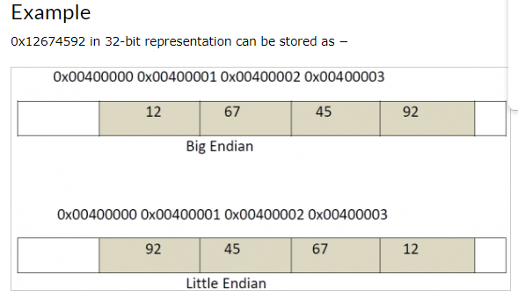
The Network Layer in the Internet
The IP Protocol
An IP datagram consists of a header part and a text part.
The header has a 20-byte fixed part and a variable length optional part.
The header format is shown in Figure. It is transmitted in big-endian order: from left to right, with the high-order bit of the Version field going first. (The SPARC is big endian; the Pentium is little-endian.)
On little endian machines, software conversion is required on both transmission and reception.

Slide 119
Version field: It keeps track of which version of the protocol the datagram belongs to
IHL: It is provided to tell how long the header is in 32 bit words
Type of service: Allows the host, to tell the subnet , what kind of service it wants
Example:
-> For digitized voice, fast delivery beats accurate delivery
-> For file transfer, error free transmission is more important than fast transmission
Total Length: It includes everything in the datagram -> both header and data. The maximum length is 65535 bytes
Identification Field: It allows the destination host, to determine which datagram a newly arrived fragment belongs to
DF: It stands for Don’t Fragment It is an order to the routers not to fragment the datagram, because the destination is incapable of putting the pieces back together again

Slide 120
MF: It stands for More fragments All fragments except the last one, have this bit set It is needed to know when all fragments of a datagram have arrived
Fragment Offset: It tells where in the current datagram this fragment belongs
Time to Live: It is a counter, used to limit packet life times
Protocol field: It tells which transport process, to give it to TCP is one possibility, but so are UDP and others
Header Checksum: It verifies the header only. It is useful for detecting errors generated by bad memory words, Inside a router
Source Address and Destination Address: It indicate the network number and host Number
Option Field: It was designed to allow subsequent versions of the protocol, to include Information not present in the original design Currently five options are defined, but not all routers support all of them

Slide 121
IP Addresses:
Every host and the router on the internet has an IP address which encodes its network number and host number.
The combination is unique: in principle, no two machines on the Internet have the same IP address
All IP addresses are 32 bit long and are used in the source address and destination address fields of IP packet.
It is important to note that an IP address does not actually refer to a host.
It really refers to a network interface, so if a host is on two networks, it must have two IP addresses.
However, in practice, most hosts are on one network and thus have one IP address.
For several decades, IP addresses were divided into the five categories[i.e. Class A, B, C, D, E]

Slide 123
Network numbers are assigned by the Network Information Centre [NIC] to avoid conflicts
Network address which are 32 bit numbers are usually written in dotted decimal notation
In this format each of the 4 byte is written in decimal from 0 to 255
The lowest IP address is 0.0.0.0 and the highest is 255.255.255.255
The values 0 and -1 have special meanings 0 -> means This Network or This Host -1 -> Used as a broadcast address to mean all hosts on the indicated network

Slide 125
As we have seen, all the hosts in a network must have the same network number.
This property of IP addressing can cause problems as networks grow.
For example, consider a university that started out with one class B network used by the Computer Science Dept. for the computers on its Ethernet.
A year later, the Electrical Engineering Dept. wanted to get on the Internet, so they bought a repeater to extend the CS Ethernet to their building.
As time went on, many other departments acquired computers and the limit of four repeaters per Ethernet was quickly reached.
Getting a second network address would be hard to do since network addresses are scarce.
The solution is to allow a network to be split into several parts for internal use but still act like a single network to the outside world.
A typical campus network nowadays might look like that of Figure

Slide 127
In the Internet literature, the parts of the network (in this case, Ethernets) are called subnets.
When a packet comes into the main router, how does it know which subnet (Ethernet) to give it to?
One way would be to have a table with 65,536 entries in the main router telling which router to use for each host on campus.
This idea would work, but it would require a very large table in the main router and a lot of manual maintenance as hosts were added, moved, or taken out of service.
Basically, instead of having a single class B address with 14 bits for the network number and 16 bits for the host number, some bits are taken away from the host number to create a subnet number.
For example, if the university has 35 departments, it could use a 6-bit subnet number and a 10-bit host number, allowing for up to 64 Ethernets, each with a maximum of 1022 hosts (0 and -1 are not available, as mentioned earlier).
This split could be changed later if it turns out to be the wrong one.

Slide 128
To implement subnetting, the main router needs a subnet mask that indicates the split between network + subnet number and host, as shown in Figure.
Subnet masks are also written in dotted decimal notation, with the addition of a slash followed by the number of bits in the network + subnet part.
CIDR—Classless InterDomain Routing
IP has been in heavy use for decades. It has worked extremely well, as demonstrated by the exponential growth of the Internet.
Unfortunately, IP is rapidly becoming a victim of its own popularity: it is running out of addresses.
The basic idea behind CIDR, which is described in RFC 1519, is to allocate the remaining IP addresses in variable-sized blocks, without regard to the classes.

Slide 129
If a site needs, say, 2000 addresses, it is given a block of 2048 addresses on a 2048-byte boundary.
Classless Inter-Domain Routing (CIDR) is a method of IP address allocation and IP routing that allows for more efficient use of IP addresses.
CIDR is based on the idea that IP addresses can be allocated and routed based on their network prefix rather than their class, which was the traditional way of IP address allocation.
CIDR addresses are represented using a slash notation, which specifies the number of bits in the network prefix.
For example, an IP address of 192.168.1.0 with a prefix length of 24 would be represented as 192.168.1.0/24.
This notation indicates that the first 24 bits of the IP address are the network prefix and the remaining 8 bits are the host identifier.

Slide 130
IPv4
Internet Protocol Version 4 (IPv4) is the fourth revision of the Internet Protocol and a widely used protocol in data communication over different kinds of networks.
IPv4 is a connectionless protocol used in packet-switched layer networks, such as Ethernet.
It provides the logical connection between network devices by providing identification for each device.
There are many ways to configure IPv4 with all kinds of devices – including manual and automatic configurations – depending on the network type.
IPv4 uses 32-bit addresses for Ethernet communication in five classes: A, B, C, D and E. Classes A, B and C have a different bit length for addressing the network host.
Class D addresses are reserved for multicasting, while class E addresses are reserved for future use.

Slide 131
IPv6
IPv6 or Internet Protocol Version 6 is a network layer protocol that allows communication to take place over the network.
IPv6 was designed by Internet Engineering Task Force (IETF) in December 1998 with the purpose of superseding the IPv4 due to the global exponentially growing internet users.
The next generation Internet Protocol (IP) address standard, known as IPv6, is meant to work in tandem with IPv4, which is still in widespread use today, and eventually replace it. the original IP address scheme, known as IPv4, is running out of addresses.
This new IP address version is being deployed to fulfil the need for more Internet addresses. With 128-bit address space.

Slide 132
Difference between IPv4 & IPv6
IPv6 | IPv4
IPv6 has a 128-bit address length | IPv4 has a 32-bit address length
It supports Auto and renumbering address configuration | It Supports Manual and DHCP address configuration
The address space of IPv6 is quite large it can produce 3.4×10³⁸ address space | It can generate 4.29×10⁹ address space
Address Representation of IPv6 is in hexadecimal | Address representation of IPv4 is in decimal
In IPv6 checksum field is not available | In IPv4 checksum field is available
IPv6 has a header of 40 bytes fixed | IPv4 has a header of 20-60 bytes.
IPv6 does not support VLSM. | IPv4 supports VLSM(Variable Length subnet mask).

