Slide 1
The Transport Layer
By
Dr. M. Kalpana Devi
Professor & HOD
MCA Department
SITAMS

Slide 2
Unit-4
4.1 The Transport Service
  4.1.1 Services Provided to the Upper Layers
  4.1.2 Transport Service Primitives
  4.1.3 Berkeley Sockets
4.2 Elements of Transport Protocols
  4.2.1 Addressing
  4.2.2 Connection Establishment
  4.2.3 Connection Release
  4.2.4 Flow Control and Buffering
  4.2.5 Multiplexing
4.3 The Internet Transport Protocols: UDP
  4.3.1 Introduction to UDP
  4.3.2 Remote Procedure Call
  4.3.3 The Real-Time Transport Protocol
4.4 The Internet Transport Protocols : TCP
  4.4.1 Introduction to TCP,
  4.4.2 The TCP Service Model,
  4.4.3 The TCP Protocol,
  4.4.4 The TCP Segment Header,
  4.4.5 TCP Connection Establishment,
  4.4.6 TCP Connection Release,
  4.4.7 TCP Transmission Policy,
  4.4.8 TCP Congestion Control

Slide 3
Layer overview
The ultimate goal of the transport layer is to provide efficient, reliable, and cost-effective service to its users, normally processes in the application layer.
The hardware and/or software within the transport layer that does the work is called the transport entity.
The transport entity can be located in the operating system kernel, in a separate user process, in a library package bound into network applications, or conceivably on the network interface card.
The (logical) relationship of the network, transport, and application layers is illustrated in Figure.

Slide 4
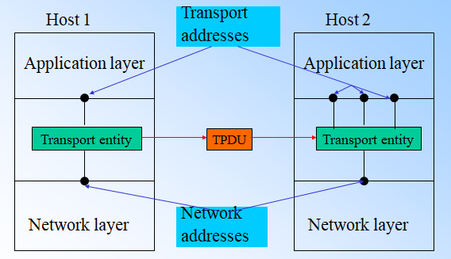

Slide 5
Transport Service Primitives
To allow users to access the transport service, the transport layer must provide some operations to application programs, that is, a transport service interface.
Each transport service has its own interface. The transport service is similar to the network service, but there are also some important differences.
The main difference is that the network service is intended to model the service offered by real networks.
Real networks can lose packets, so the network service is generally unreliable, transport service, in contrast is reliable.
To get an idea of what a transport service might be like, consider the five primitives listed in Figure.
This transport interface is truly bare bones, but it gives the essential flavor of what a connection-oriented transport interface has to do.
It allows application programs to establish, use, and then release connections, which is sufficient for many applications.

Slide 6
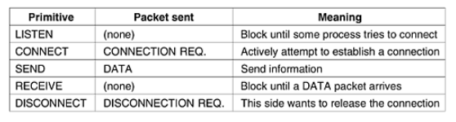
To see how these primitives might be used, consider an application with a server and a number of remote clients.
To start with, the server executes a LISTEN primitive, typically by calling a library procedure that makes a system call to block the server until a client turns up.
When a client wants to talk to the server, it executes a CONNECT primitive.
The transport entity carries out this primitive by blocking the caller and sending a packet to the server.
Encapsulated in the payload of this packet is a transport layer message for the server's transport entity

Slide 7
TPDU (Transport Protocol Data Unit), messages sent from transport entity to transport entity.
Thus, TPDUs are contained in packets (exchanged by the network layer). In turn, packets are contained in frames (exchanged by the data link layer).
When a frame arrives, the data link layer processes the frame header and passes the contents of the frame payload field up to the network entity.
The network entity processes the packet header and passes the contents of the packet payload up to the transport entity. This nesting is illustrated in Figure.

Slide 8
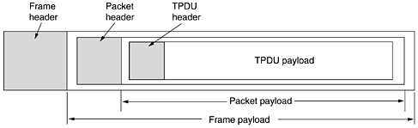
Nesting of TPDUs, packets, and frames
TPDU (Transport Protocol Data Unit) for messages sent from transport entity to transport entity.

Slide 9
When a connection is no longer needed, it must be released to free up table space within the two transport entities.
Disconnection has two variants: asymmetric and symmetric. In the asymmetric variant, either transport user can issue a DISCONNECT primitive, which results in a DISCONNECT TPDU being sent to the remote transport entity. Upon arrival, the connection is released.
In the symmetric variant, each direction is closed separately, independently of the other one
A state diagram for connection establishment and release for these simple primitives is given in Figure.
Each transition is triggered by some event, either a primitive executed by the local transport user or an incoming packet.
For simplicity, we assume here that each TPDU is separately acknowledged.
We also assume that a symmetric disconnection model is used, with the client going first.

Slide 10
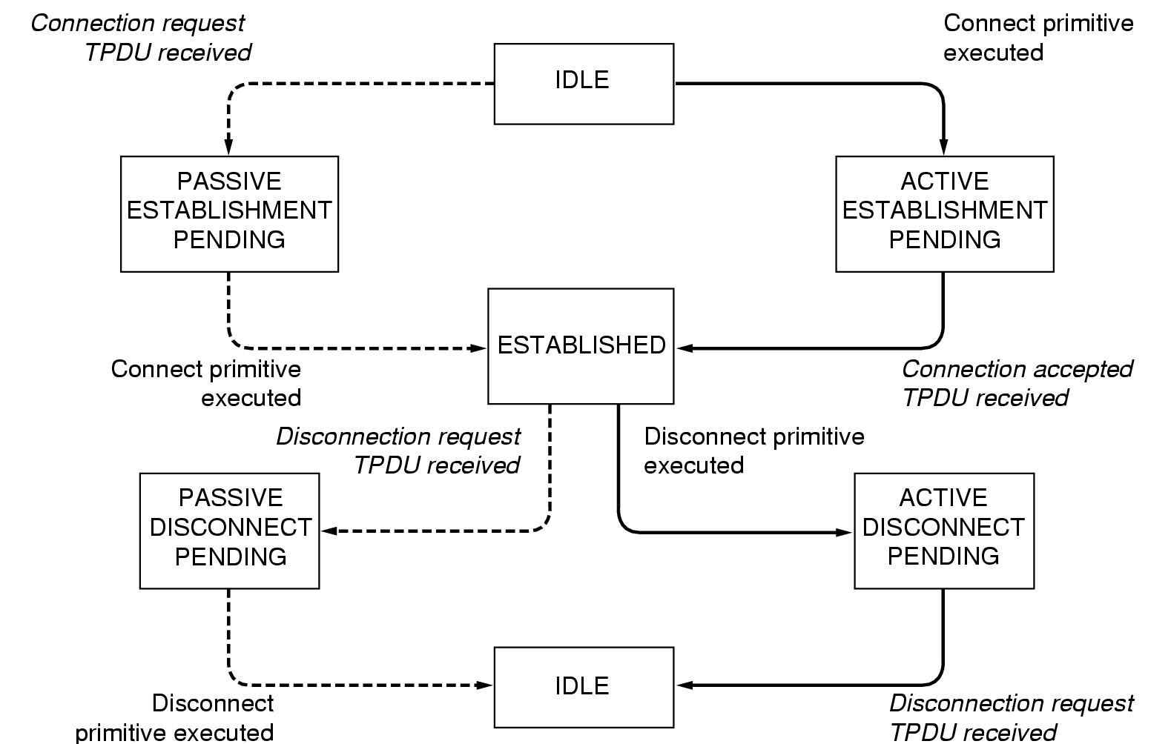
A state diagram for a simple connection management scheme. Transitions labeled in italics are caused by packet arrivals. The solid lines show the client's state sequence. The dashed lines show the server's state sequence.

Slide 11
Berkeley Sockets
The socket primitives used in Berkeley UNIX for TCP.
These primitives are widely used for Internet programming.
They are listed in Figure. Roughly speaking, they follow the model of our first example but offer more features and flexibility.
socket | create new communication end point
bind | attach a local address to a socket
listen | announce willingness to accept connections; give queue size
accept | block caller until a connection request arrives
connect | actively attempt to establish a connection
send | send some data over the connection
receive | receive some data from the connection
close | release the connection

Slide 12
The first four primitives in the list are executed in that order by servers.
The SOCKET primitive creates a new end point and allocates table space for it within the transport entity.
The parameters of the call specify the addressing format to be used, the type of service desired (e.g., reliable byte stream), and the protocol.
A successful SOCKET call returns an ordinary file descriptor for use in succeeding calls, the same way an OPEN call does.
Newly-created sockets do not have network addresses. These are assigned using the BIND primitive.
Once a server has bound an address to a socket, remote clients can connect to it.
The reason for not having the SOCKET call create an address directly is that some processes care about their address (e.g., they have been using the same address for years and everyone knows this address), whereas others do not care.

Slide 13
Next comes the LISTEN call, which allocates space to queue incoming calls for the case that several clients try to connect at the same time.
To block waiting for an incoming connection, the server executes an ACCEPT primitive.
When a TPDU asking for a connection arrives, the transport entity creates a new socket with the same properties as the original one and returns a file descriptor for it.
The server can then fork off a process or thread to handle the connection on the new socket and go back to waiting for the next connection on the original socket.
ACCEPT returns a normal file descriptor, which can be used for reading and writing in the standard way, the same as for files.

Slide 14
Now let us look at the client side. Here, too, a socket must first be created using the SOCKET primitive, but BIND is not required since the address used does not matter to the server.
The CONNECT primitive blocks the caller and actively starts the connection process.
When it completes (i.e., when the appropriate TPDU is received from the server), the client process is unblocked and the connection is established.
Both sides can now use SEND and RECV to transmit and receive data over the full-duplex connection.
The standard UNIX READ and WRITE system calls can also be used if none of the special options of SEND and RECV are required.
Connection release with sockets is symmetric. When both sides have executed a CLOSE primitive, the connection is released.

Slide 15
Elements of Transport Protocols
The transport service is implemented by a transport protocol used between the two transport entities.
In some ways, transport protocols resemble the data link protocols. Both have to deal with error control, sequencing, and flow control, among other issues.
However, significant differences between the two also exist.
These differences are due to major dissimilarities between the environments in which the two protocols operate, as shown in the Figure.
At the data link layer, two routers communicate directly via a physical channel, whereas at the transport layer, this physical channel is replaced by the entire subnet.
This difference has many important implications for the protocols

Slide 16
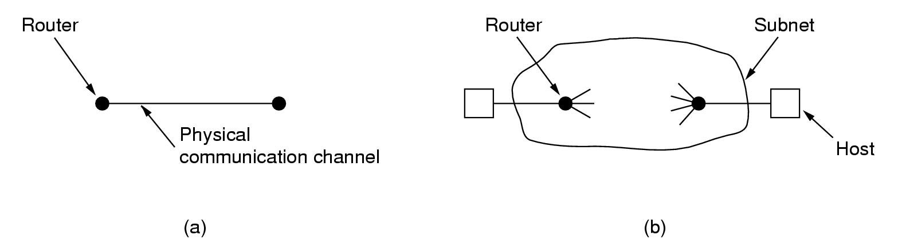
For one thing, in the data link layer, it is not necessary for a router to specify which router it wants to talk to—each outgoing line uniquely specifies a particular router.
In the transport layer, explicit addressing of destinations is required.
For another thing, the process of establishing a connection over the wire of Figure(a) is simple: the other end is always there (unless it has crashed, in which case it is not there).
Either way, there is not much to do. In the transport layer, initial connection establishment is more complicated.
Buffering and flow control are needed in both layers, but the presence of a large and dynamically varying number of connections in the transport layer may require a different approach than we used in the data link layer.

Slide 17
Addressing
When an application (e.g., a user) process wishes to set up a connection to a remote application process, it must specify which one to connect to.
The method normally used is to define transport addresses to which processes can listen for connection requests.
In the Internet, these end points are called ports. In ATM networks, they are called AAL-SAPs. Also referred with the generic term TSAP, (Transport Service Access Point).
The analogous end points in the network layer are then called NSAPs. IP addresses are examples of NSAPs.
The following Figure illustrates the relationship between the NSAP, TSAP and transport connection.
Application processes, both clients and servers, can attach themselves to a TSAP to establish a connection to a remote TSAP. These connections run through NSAPs on each host, as shown.
The purpose of having TSAPs is that in some networks, each computer has a single NSAP, so some way is needed to distinguish multiple transport end points that share that NSAP.

Slide 18
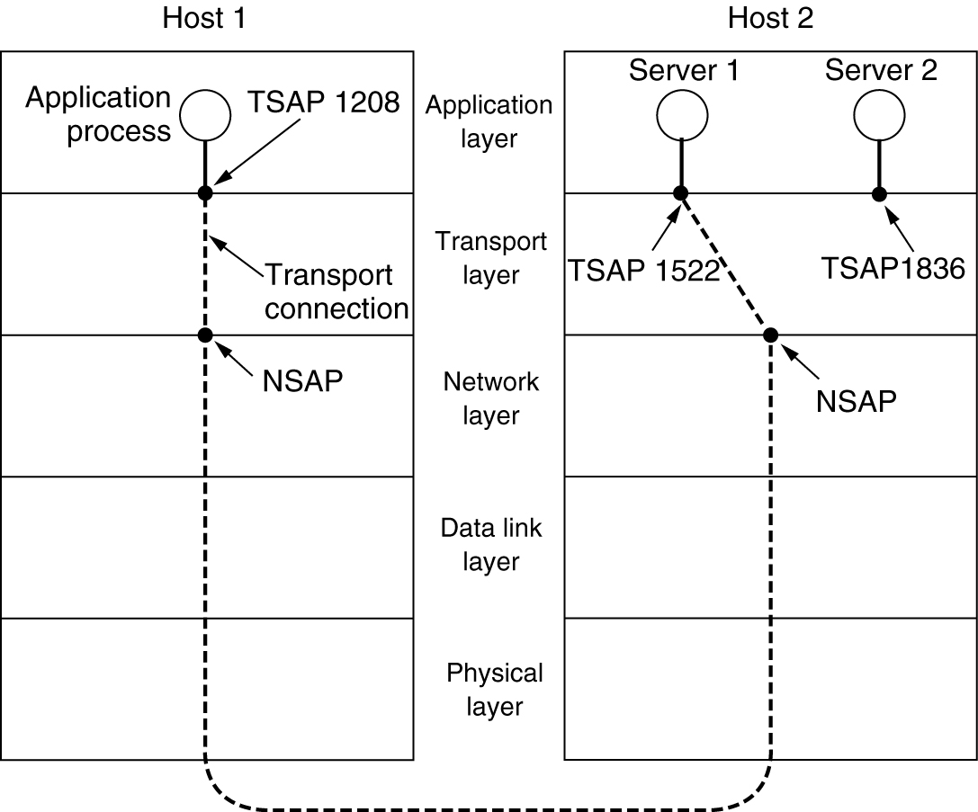

Slide 19
Connection scenario
  Host 2 (server)
    server attaches itself to TSAP 1522 to wait for an incoming call
  Host 1 (client)
    Connect from TSAP 1208 to TSAP 1522
    Setup network connection to host 2
    Send transport connection request
  Host 2
    Accept connection request
  The transport connection is then released.
  How does the user process on host 1 know that the time-of-day server is attached to TSAP 1522?
  In this model, services have stable TSAP addresses that are listed in files in well-known places, such as the /etc/services file on UNIX systems, which lists which servers are permanently attached to which ports.

Slide 20
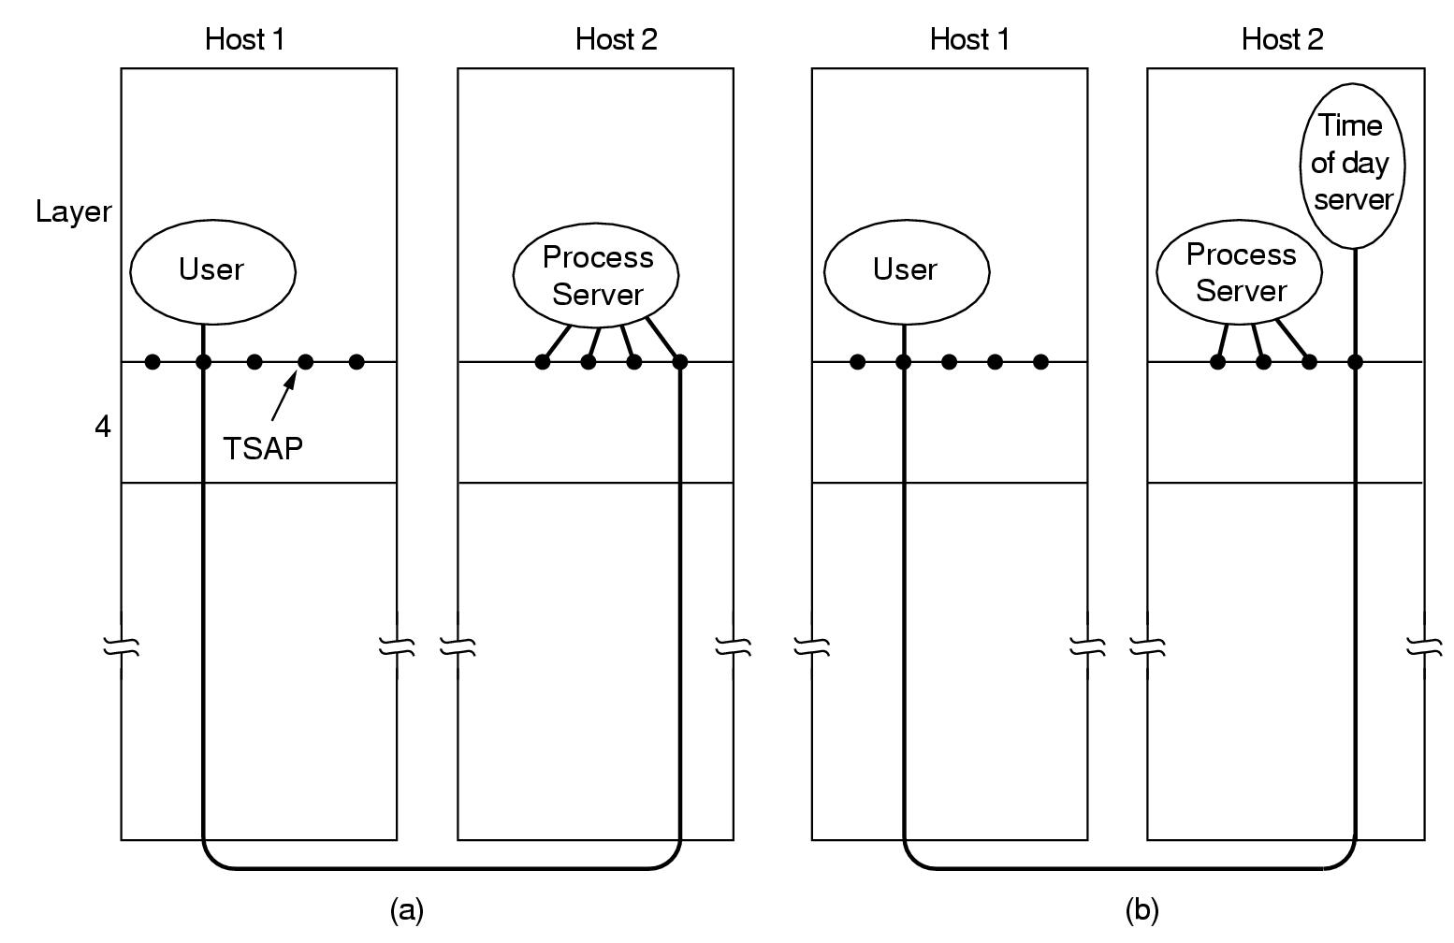
Instead of every conceivable server listening at a well-known TSAP, each machine that wishes to offer services to remote users has a special process server that acts as a proxy for less heavily used servers.
It listens to a set of ports at the same time, waiting for a connection request. Potential users of a service begin by doing a CONNECT request, specifying the TSAP address of the service they want.
If no server is waiting for them, they get a connection to the process server, as shown in Figure(a).

Slide 21
After it gets the incoming request, the process server spawns the requested server, allowing it to inherit the existing connection with the user.
The new server then does the requested work, while the process server goes back to listening for new requests, as shown in Figure(b).
An alternative scheme is often used. In this model, there exists a special process called a name server or sometimes a directory server.
To find the TSAP address corresponding to a given service name, such as ''time of day,'' a user sets up a connection to the name server (which listens to a well-known TSAP).
The user then sends a message specifying the service name, and the name server sends back the TSAP address.
Then the user releases the connection with the name server and establishes a new one with the desired service.
In this model, when a new service is created, it must register itself with the name server, giving both its service name (typically, an ASCII string) and its TSAP.
The name server records this information in its internal database so that when queries come in later, it will know the answers.

Slide 22
Connection Establishment
Establishing a connection sounds easy, but it is actually surprisingly tricky. At first glance, it would seem sufficient for one transport entity to just send a CONNECTION REQUEST TPDU to the destination and wait for a CONNECTION ACCEPTED reply.
The problem occurs when the network can lose, store, and duplicate packets.
This behavior causes serious complications. The worst possible nightmare is as follows.
A user establishes a connection with a bank, sends messages telling the bank to transfer a large amount of money to the account of a not entirely-trustworthy person, and then releases the connection.
Unfortunately, each packet in the scenario is duplicated and stored in the subnet.
After the connection has been released, all the packets pop out of the subnet and arrive at the destination in order, asking the bank to establish a new connection, transfer money (again), and release the connection.

Slide 23
The bank has no way of telling that these are duplicates. It must assume that this is a second, independent transaction, and transfers the money again.
Unfortunately, this scheme has a basic flaw: it requires each transport entity to maintain a certain amount of history information indefinitely.
If a machine crashes and loses its memory, it will no longer know which connection identifiers have already been used.
Packet lifetime can be restricted to a known maximum using one (or more) of the following techniques:
    1. Restricted subnet design.
    2. Putting a hop counter in each packet.
    3. Timestamping each packet.

Slide 24
In practice, we will need to guarantee not only that a packet is dead, but also that all acknowledgements to it are also dead, so we will now introduce T, which is some small multiple of the true maximum packet lifetime.
To get around the problem of a machine losing all memory of where it was after a crash, Tomlinson proposed equipping each host with a time-of-day clock. The clocks at different hosts need not be synchronized.
The sequence space should be so large that by the time sequence numbers wrap around, old TPDUs with the same sequence number are long gone.
This linear relation between time and initial sequence numbers is shown in Figure.
A problem occurs when a host crashes. When it comes up again, its transport entity does not know where it was in the sequence space.
One solution is to require transport entities to be idle for T sec after a recovery to let all old TPDUs die off..

Slide 25
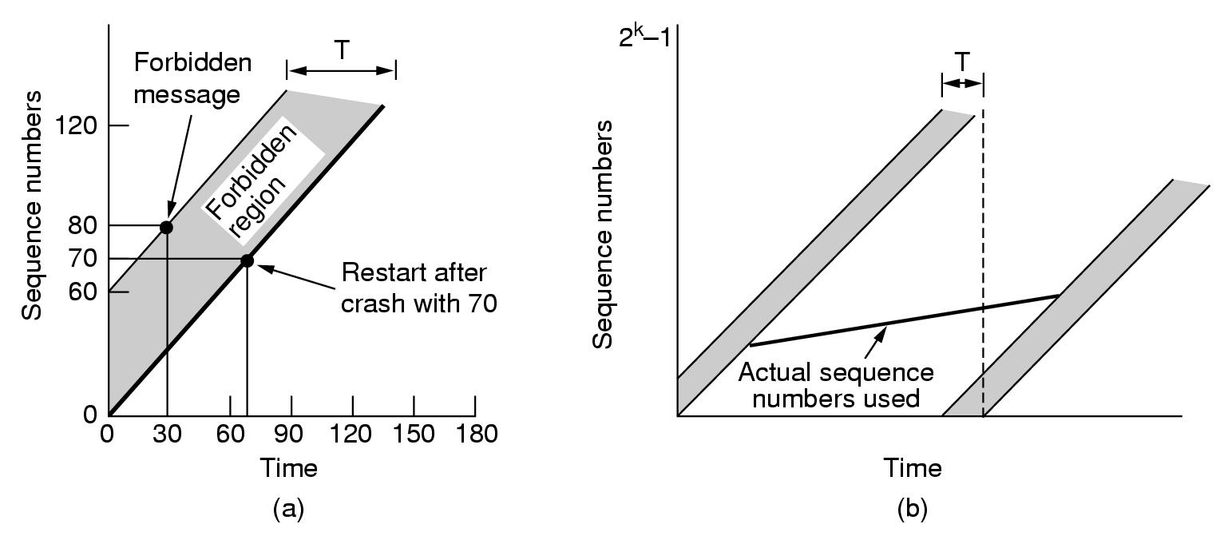
TPDUs may not enter the forbidden region.
(b) The resynchronization problem.

Slide 26
To avoid requiring T sec of dead time after a crash, it is necessary to introduce a new restriction on the use of sequence numbers.
The illegal combinations of time and sequence number are shown as the forbidden region in Figure(a).
Before sending any TPDU on any connection, the transport entity must read the clock and check to see that it is not in the forbidden region.
The protocol can get itself into trouble in two distinct ways.
If a host sends too much data too fast on a newly-opened connection, the actual sequence number versus time curve may rise more steeply than the initial sequence number versus time curve.
This means that the maximum data rate on any connection is one TPDU per clock tick.
It also means that the transport entity must wait until the clock ticks before opening a new connection after a crash restart, lest the same number be used twice.
Both of these points argue in favor of a short clock tick (a few µsec or less).

Slide 27
Unfortunately, entering the forbidden region from underneath by sending too fast is not the only way to get into trouble.
From Figure(b), we see that at any data rate less than the clock rate, the curve of actual sequence numbers used versus time will eventually run into the forbidden region from the left.
The greater the slope of the actual sequence number curve, the longer this event will be delayed.
As we stated above, just before sending every TPDU, the transport entity must check to see if it is about to enter the forbidden region, and if so, either delay the TPDU for T sec or resynchronize the sequence numbers.
The clock-based method solves the delayed duplicate problem for data TPDUs, but for this method to be useful, a connection must first be established.
Since control TPDUs may also be delayed, there is a potential problem in getting both sides to agree on the initial sequence

Slide 28
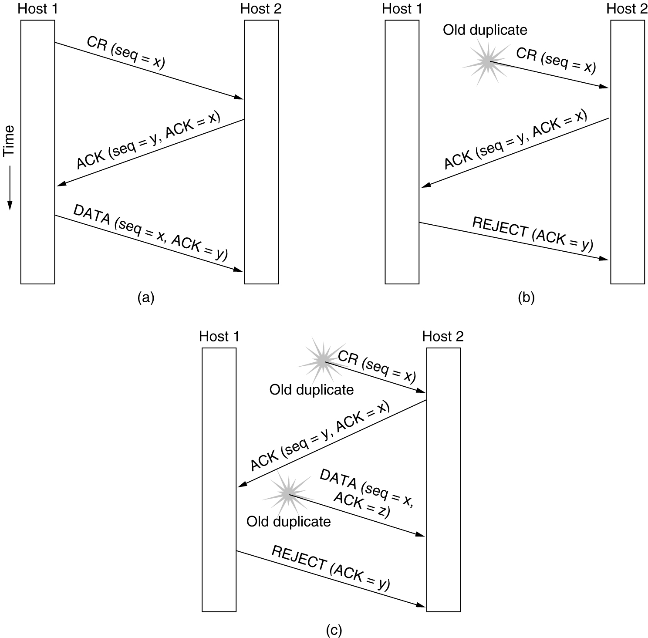
To solve this problem, Tomlinson (1975) introduced the three-way handshake.
This establishment protocol does not require both sides to begin sending with the same sequence number, so it can be used with synchronization methods other than the global clock method.
The normal setup procedure when host 1 initiates is shown in Figure(a).
Host 1 chooses a sequence number, x, and sends a CONNECTION REQUEST TPDU containing it to host 2.
Host 2 replies with an ACK TPDU acknowledging x and announcing its own initial sequence number, y.
Finally, host 1 acknowledges host 2's choice of an initial sequence number in the first data TPDU that it sends.

Slide 29
Now let us see how the three-way handshake works in the presence of delayed duplicate control TPDUs.
In Figure(b), the first TPDU is a delayed duplicate CONNECTION REQUEST from an old connection.
This TPDU arrives at host 2 without host 1's knowledge. Host 2 reacts to this TPDU by sending host 1 an ACK TPDU, in effect asking for verification that host 1 was indeed trying to set up a new connection.
When host 1 rejects host 2's attempt to establish a connection, host 2 realizes that it was tricked by a delayed duplicate and abandons the connection.
In this way, a delayed duplicate does no damage.

Slide 30
The worst case is when both a delayed CONNECTION REQUEST and an ACK are floating around in the subnet.
This case is shown in Figure(c). As in the previous example, host 2 gets a delayed CONNECTION REQUEST and replies to it.
At this point it is crucial to realize that host 2 has proposed using y as the initial sequence number for host 2 to host 1 traffic, knowing full well that no TPDUs containing sequence number y or acknowledgements to y are still in existence.
When the second delayed TPDU arrives at host 2, the fact that z has been acknowledged rather than y tells host 2 that this, too, is an old duplicate.
The important thing to realize here is that there is no combination of old TPDUs that can cause the protocol to fail and have a connection set up by accident when no one wants it.

Slide 31
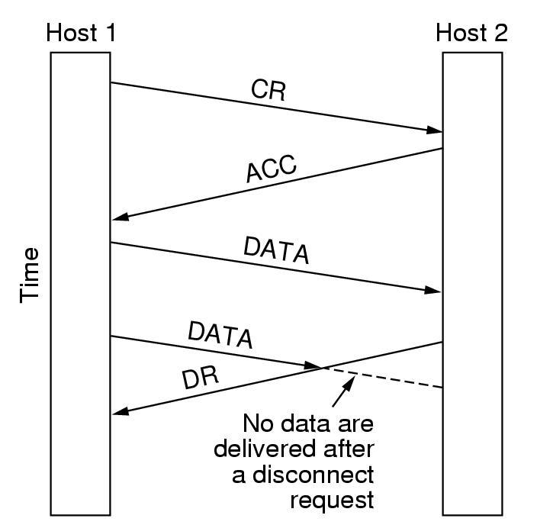
Connection Release
There are two styles of terminating a connection:
  1 Asymmetric release : Asymmetric release is the way the telephone system works: when one party hangs up, the connection is broken. Asymmetric release is abrupt and may result in data loss.
  2 Symmetric release : Symmetric release treats the connection as two separate unidirectional connections and requires each one to be released separately.
Consider the scenario of Figure. After the connection is established, host 1 sends a TPDU that arrives properly at host 2.
Then host 1 sends another TPDU. Unfortunately, host 2 issues a DISCONNECT before the second TPDU arrives. The result is that the connection is released and data are lost.

Slide 32
Symmetric release does the job when each process has a fixed amount of data to send and clearly knows when it has sent it, protocol in which host 1 says: I am done. Are you done too? If host 2 responds: I am done too. Goodbye, the connection can be safely released.
Unfortunately, this protocol does not always work.
There is a famous problem that illustrates this issue. It is called the two-army problem.
Imagine that a white army is encamped in a valley, as shown in Figure.
On both of the surrounding hillsides are blue armies.
The white army is larger than either of the blue armies alone, but together the blue armies are larger than the white army.
If either blue army attacks by itself, it will be defeated, but if the two blue armies attack simultaneously, they will be victorious.

Slide 33
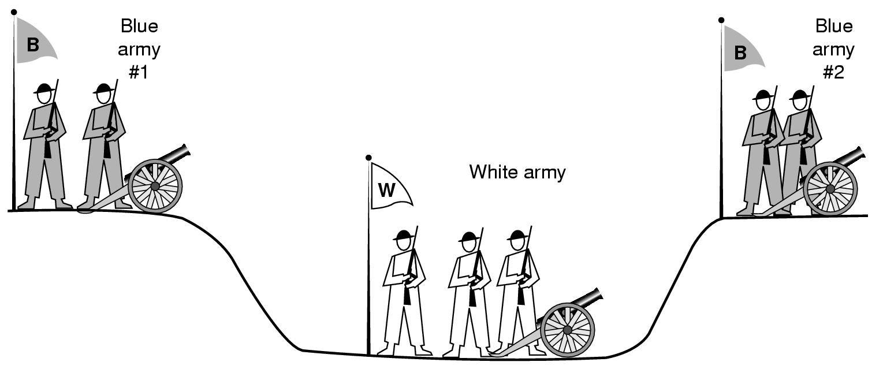

Slide 34
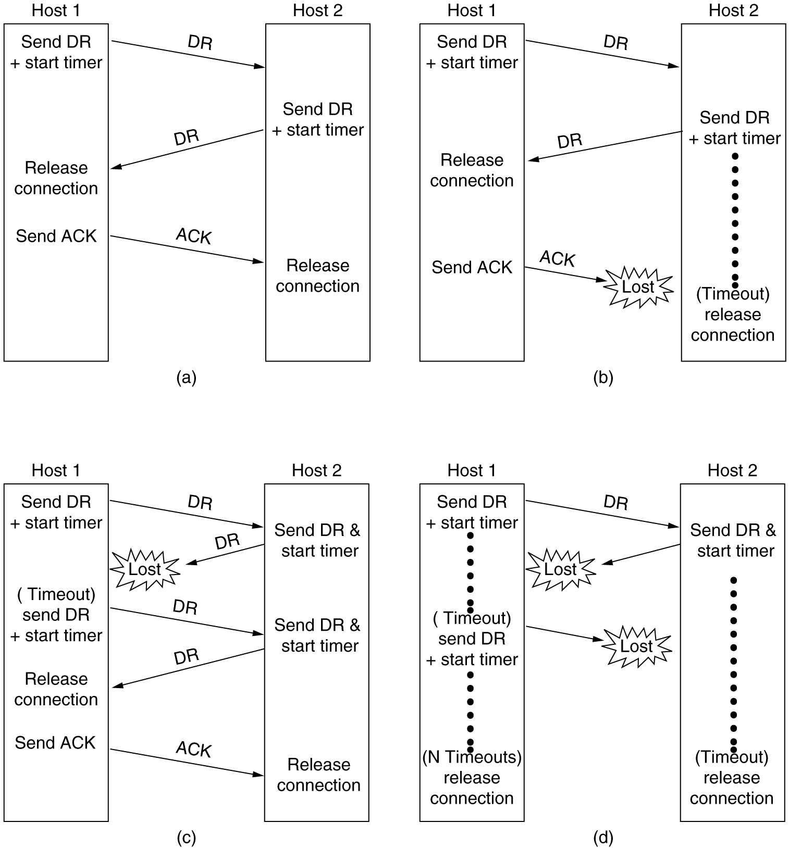
The following figures illustrates four scenarios of releasing using a three-way handshake.

Slide 36
In Figure(a), we see the normal case in which one of the users sends a DR (DISCONNECTION REQUEST) TPDU to initiate the connection release.
If the final ACK TPDU is lost, as shown in Figure(b), the situation is saved by the timer.
When the timer expires, the connection is released anyway.
Now consider the case of the second DR being lost.
The user initiating the disconnection will not receive the expected response, will time out, and will start all over again.
In Figure(c) we see how this works, assuming that the second time no TPDUs are lost and all TPDUs are delivered correctly and on time.
Our last scenario, Figure(d), is the same as Figure(c) except that now we assume all the repeated attempts to retransmit the DR also fail due to lost TPDUs.
After N retries, the sender just gives up and releases the connection. Meanwhile, the receiver times out and also exits.

Slide 37
Flow Control and Buffering
In some ways the flow control problem in the transport layer is the same as in the data link layer, but in other ways it is different.
The basic similarity is that in both layers a sliding window or other scheme is needed on each connection to keep a fast transmitter from overrunning a slow receiver.
The main difference is that a router usually has relatively few lines, whereas a host may have numerous connections.
This difference makes it impractical to implement the data link buffering strategy in the transport layer.
In the data link protocols, frames were buffered at both the sending router and at the receiving router.
For a host with a maximum of, say, 64 connections, and a 4-bit sequence number, this protocol would require 1024 buffers.

Slide 38
Even if the receiver has agreed to do the buffering, there still remains the question of the buffer size.
If most TPDUs are nearly the same size, it is natural to organize the buffers as a pool of identically-sized buffers, with one TPDU per buffer, as in Figure(a).
However, if there is wide variation in TPDU size, from a few characters typed at a terminal to thousands of characters from file transfers, a pool of fixed-sized buffers presents problems.
If the buffer size is chosen equal to the largest possible TPDU, space will be wasted whenever a short TPDU arrives.
If the buffer size is chosen less than the maximum TPDU size, multiple buffers will be needed for long TPDUs, with the attendant complexity.

Slide 39
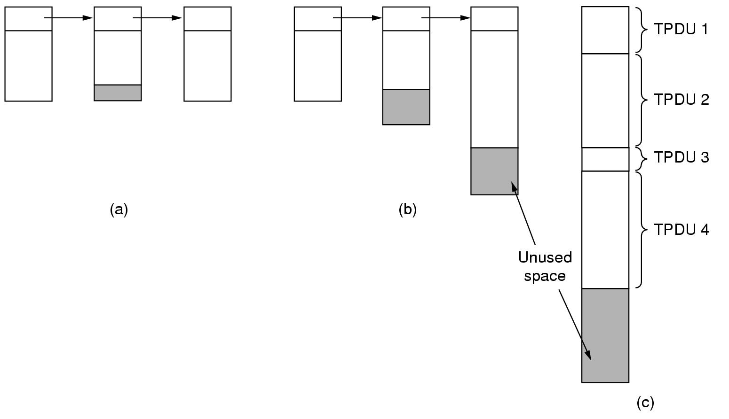
Another approach to the buffer size problem is to use variable-sized buffers, as in Figure(b).
The advantage here is better memory utilization, at the price of more complicated buffer management.
A third possibility is to dedicate a single large circular buffer per connection, as in Figure(c).
This system also makes good use of memory, provided that all connections are heavily loaded, but is poor if some connections are lightly loaded.

Slide 40
Multiplexing
Multiplexing several conversations onto connections, virtual circuits, and physical links plays a role in several layers of the network architecture.
In the transport layer the need for multiplexing can arise in a number of ways.
For example, if only one network address is available on a host, all transport connections on that machine have to use it.
When a TPDU comes in, some way is needed to tell which process to give it to.
This situation, called upward multiplexing, is shown in Figure(a).
In this figure, four distinct transport connections all use the same network connection (e.g., IP address) to the remote host.

Slide 41
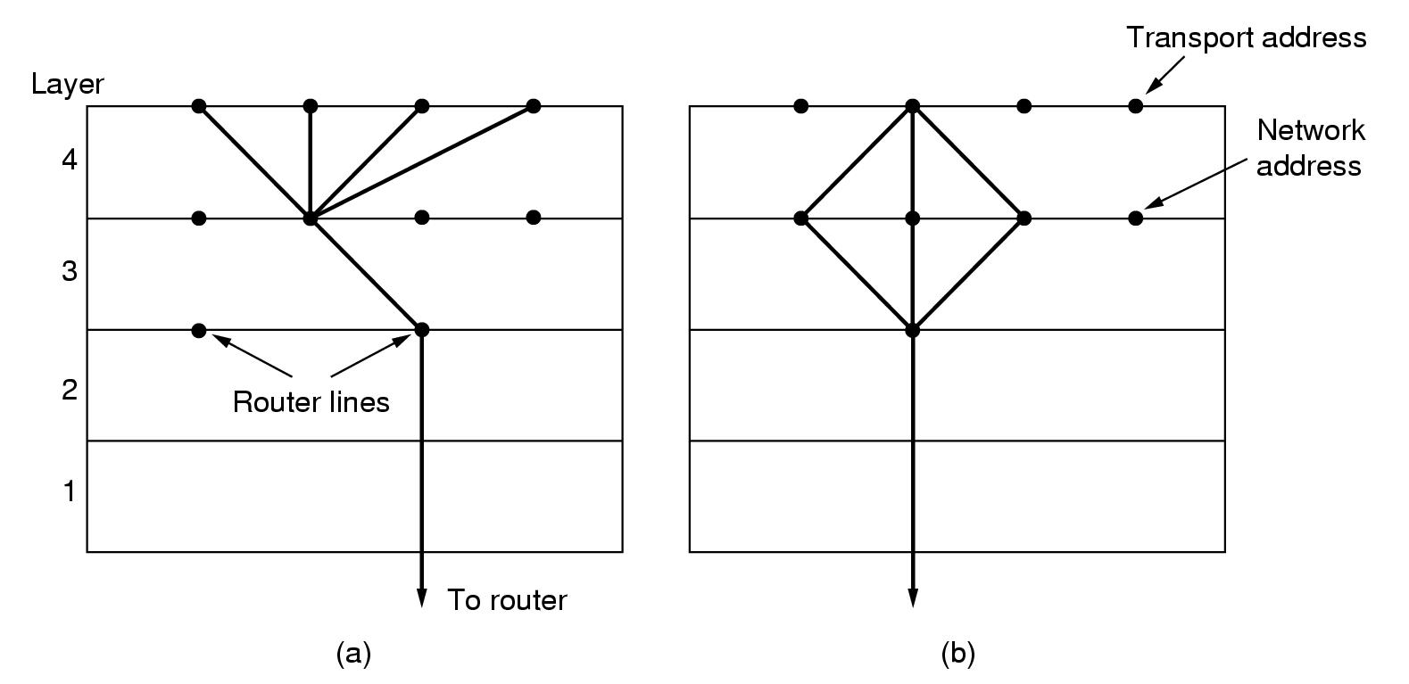
(a) Upward multiplexing. (b) Downward multiplexing.
Multiplexing can also be useful in the transport layer for another reason.
Suppose, for example, that a subnet uses virtual circuits internally and imposes a maximum data rate on 390 each one.
If a user needs more bandwidth than one virtual circuit can provide, a way out is to open multiple network connections and distribute the traffic among them on a round-robin basis, as indicated in Figure(b).
This modus operandi is called downward multiplexing.

Slide 42
Crash Recovery
If hosts and routers are subject to crashes, recovery from these crashes becomes an issue.
If the transport entity is entirely within the hosts, recovery from network and router crashes is straightforward.
If the network layer provides datagram service, the transport entities expect lost TPDUs all the time and know how to cope with them.
If the network layer provides connection-oriented service, then loss of a virtual circuit is handled by establishing a new one and then probing the remote transport entity to ask it which TPDUs it has received and which ones it has not received.
The latter ones can be retransmitted.
A more troublesome problem is how to recover from host crashes.
In particular, it may be desirable for clients to be able to continue working when servers crash and then quickly reboot.

Slide 43
To illustrate the difficulty, let us assume that one host, the client, is sending a long file to another host, the file server, using a simple stop-and-wait protocol.
The transport layer on the server simply passes the incoming TPDUs to the transport user, one by one.
Partway through the transmission, the server crashes.
When it comes back up, its tables are reinitialized, so it no longer knows precisely where it was.
In an attempt to recover its previous status, the server might send a broadcast TPDU to all other hosts, announcing that it had just crashed and requesting that its clients inform it of the status of all open connections.
Each client can be in one of two states: one TPDU outstanding, S1, or no TPDUs outstanding, S0.
Based on only this state information, the client must decide whether to retransmit the most recent TPDU.

Slide 44
Recovery from a layer N crash can only be done by layer N + 1, and then only if the higher layer retains enough status information.
As mentioned above, the transport layer can recover from failures in the network layer, provided that each end of a connection keeps track of where it is.
This problem gets us into the issue of what a so-called end-to-end acknowledgement really means.
In principle, the transport protocol is end-to-end and not chained like the lower layers.
Now consider the case of a user entering requests for transactions against a remote database.
Suppose that the remote transport entity is programmed to first pass TPDUs to the next layer up and then acknowledge.
Even in this case, the receipt of an acknowledgement back at the user's machine does not necessarily mean that the remote host stayed up long enough to actually update the database.
A truly end-to-end acknowledgement, whose receipt means that the work has actually been done and lack thereof means that it has not, is probably impossible to achieve.

Slide 45
The Internet Transport Protocols: UDP
The Internet protocol suite supports a connectionless transport protocol, UDP (User Datagram Protocol).
UDP provides a way for applications to send encapsulated IP datagrams and send them without having to establish a connection.
UDP transmits segments consisting of an 8-byte header followed by the payload. The header is shown in the figure.
The two ports serve to identify the end points within the source and destination machines.
When a UDP packet arrives, its payload is handed to the process attached to the destination port.
This attachment occurs when BIND primitive or something similar is used.
Without the port fields, the transport layer would not know what to do with the packet. With them, it delivers segments correctly.

Slide 46
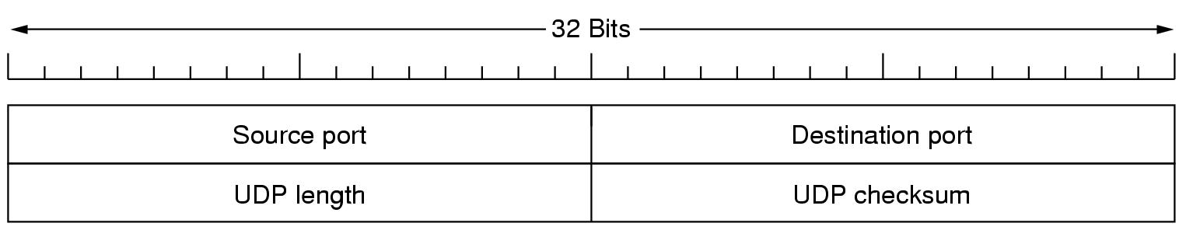
The source port is primarily needed when a reply must be sent back to the source.
By copying the source port field from the incoming segment into the destination port field of the outgoing segment, the process sending the reply can specify which process on the sending machine is to get it.
The UDP length field includes the 8-byte header and the data.
The UDP checksum is optional and stored as 0 if not computed
It does not do flow control, error control, or retransmission upon receipt of a bad segment.
All of that is up to the user processes. What it does do is provide an interface to the IP protocol with the added feature of demultiplexing multiple processes using the ports.

Slide 47
One area where UDP is especially useful is in client-server situations.
Often, the client sends a short request to the server and expects a short reply back.
If either the request or reply is lost, the client can just time out and try again.
An application that uses UDP this way is DNS (the Domain Name System)
Remote Procedure Call
In a certain sense, sending a message to a remote host and getting a reply back is a lot like making a function call in a programming language.
In both cases you start with one or more parameters and you get back a result.
When a process on machine 1 calls a procedure on machine 2, the calling process on 1 is suspended and execution of the called procedure takes place on 2.
Information can be transported from the caller to the callee in the parameters and can come back in the procedure result.
No message passing is visible to the programmer.
This technique is known as RPC (Remote Procedure Call) and has become the basis for many networking applications.

Slide 48
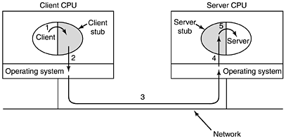
To call a remote procedure, the client program must be bound with a small library procedure, called the client stub, that represents the server procedure in the client's address space.
Similarly, the server is bound with a procedure called the server stub. These procedures hide the fact that the procedure call from the client to the server is not local.

Slide 49
The actual steps in making an RPC are shown in the above Figure. Step 1 is the client calling the client stub.
This call is a local procedure call, with the parameters pushed onto the stack in the normal way.
Step 2 is the client stub packing the parameters into a message and making a system call to send the message.
Packing the parameters is called marshaling.
Step 3 is the kernel sending the message from the client machine to the server machine.
Step 4 is the kernel passing the incoming packet to the server stub.
Finally, step 5 is the server stub calling the server procedure with the unmarshaled parameters.
The reply traces the same path in the other direction

Slide 50
The Real-Time Transport Protocol
UDP is also used in real time multimedia applications.
  Internet radio
  Internet telephony
  Music on demand
  Video conferencing
  Video on demand etc.
The basic function of RTP is to multiplex several real-time data streams onto a single stream of UDP packets.
The position of RTP in the protocol stack is somewhat strange.
RTP is a transport protocol that is implemented in the application layer

Slide 51
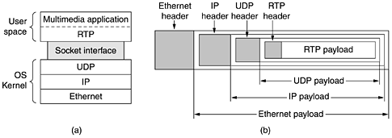

Slide 52
Each packet sent in an RTP stream is given a number one higher than its predecessor to determine if any packets are missing
Approximate the missing value by interpolation
Each RTP payload may contain multiple samples, which are encoded using
  Delta encoding
  Predictive encoding
  GSM encoding
  MP3, and so on

Slide 53
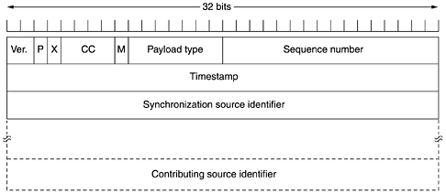
P bit indicates that the packet has been padded to a multiple of 4 bytes
X bit indicates that an extension header is present
CC field tells how many contributing sources are present
M bit is an application-specific marker bit. It can be used to mark the start of a video frame, the start of a word in an audio channel

Slide 54
Payload type field tells which encoding algorithm has been used
Sequence number is just a counter that is incremented on each RTP packet sent. It is used to detect lost packets
Timestamp is produced by the stream's source to note when the first sample in the packet was made. This value can help reduce jitter
Synchronization source identifier tells which stream the packet belongs to
Contributing source identifiers, if any, are used when mixers are present in the studio
RTP has a sister protocol called RTCP (Realtime Transport Control Protocol). It handles feedback, synchronization, and the user interface but does not transport any data.

Slide 55
The Internet Transport Protocols: TCP
TCP (Transmission Control Protocol) was specifically designed to provide a reliable end-to-end byte stream over an unreliable internetwork.
An internetwork differs from a single network because different parts may have wildly different topologies, bandwidths, delays, packet sizes, and other parameters.
TCP was designed to dynamically adapt to properties of the internetwork and to be robust in the face of many kinds of failures.
Each machine supporting TCP has a TCP transport entity, either a library procedure, a user process, or part of the kernel.
In all cases, it manages TCP streams and interfaces to the IP layer.

Slide 56
A TCP entity accepts user data streams from local processes, breaks them up into pieces not exceeding 64 KB and sends each piece as a separate IP datagram.
When datagrams containing TCP data arrive at a machine, they are given to the TCP entity, which reconstructs the original byte streams.
For simplicity, we will sometimes use just ''TCP'' to mean the TCP transport entity (a piece of software) or the TCP protocol (a set of rules).
From the context it will be clear which is meant. For example, in ''The user gives TCP the data,'' the TCP transport entity is clearly intended.
In short, TCP must furnish the reliability that most users want and that IP does not provide.

Slide 57
The TCP Service Model
TCP service is obtained by both the sender and receiver creating end points, called sockets.
Each socket has a socket number (address) consisting of the IP address of the host and a 16-bit number local to that host, called a port.
A port is the TCP name for a TSAP. For TCP service to be obtained, a connection must be explicitly established between a socket on the sending machine and a socket on the receiving machine.
Port numbers below 1024 are called well-known ports and are reserved for standard services.
For example, any process wishing to establish a connection to a host to transfer a file using FTP can connect to the destination host's port 21 to contact its FTP daemon.
The list of well-known ports is given at www.iana.org. Over 300 have been assigned.
All TCP connections are full duplex and point-to-point.
Full duplex means that traffic can go in both directions at the same time.
Point-to-point means that each connection has exactly two end points. TCP does not support multicasting or broadcasting.
Notes:
Both Socket and Port are the terms used in Transport Layer. A port is a logical construct assigned to network processes so that they can be identified within the system. A socket is a combination of port and IP address. Port number can be represented by a single number ( example: 1028) on the other hand socket address can be represented by (tcp, hostname ,1028). An incoming packet has a port number which is used to identify the process that needs to consume the packet. The lowest numbered 1024 port numbers are used for the most commonly used services. These ports are called the well-known ports. Higher-numbered ports are available for general use by applications and are known as ephemeral ports.
File Transfer Protocol - FTP-21
Telephone Network - TELNET- 23 (remote login)
Simple Message Transport Protocol- SMTP- 25 (e-mail)
Trivial FTP - TFTP- 69
Hyper Text Transfer Protocol - HTTP- 80 (WWW)
Post Office Protocol - POP-101 (Remote e-mail access)

Slide 58
The TCP Protocol
A key feature of TCP, and one which dominates the protocol design, is that every byte on a TCP connection has its own 32-bit sequence number.
The sending and receiving TCP entities exchange data in the form of segments.
A TCP segment consists of a fixed 20-byte header (plus an optional part) followed by zero or more data bytes.
The TCP software decides how big segments should be. It can accumulate data from several writes into one segment or can split data from one write over multiple segments.
Two limits restrict the segment size. First, each segment, including the TCP header, must fit in the 65,515-byte IP payload.
Second, each network has a maximum transfer unit, or MTU, and each segment must fit in the MTU.
In practice, the MTU is generally 1500 bytes (the Ethernet payload size) and thus defines the upper bound on segment size.
The basic protocol used by TCP entities is the sliding window protocol.

Slide 59
The TCP Segment Header
The following figure shows the layout of a TCP segment.
Every segment begins with a fixed-format, 20-byte header.
The fixed header may be followed by header options.
After the options, if any, up to 65,535 - 20 - 20 = 65,495 data bytes may follow, where the first 20 refer to the IP header and the second to the TCP header.
Segments without any data are legal and are commonly used for acknowledgements and control messages.

Slide 60
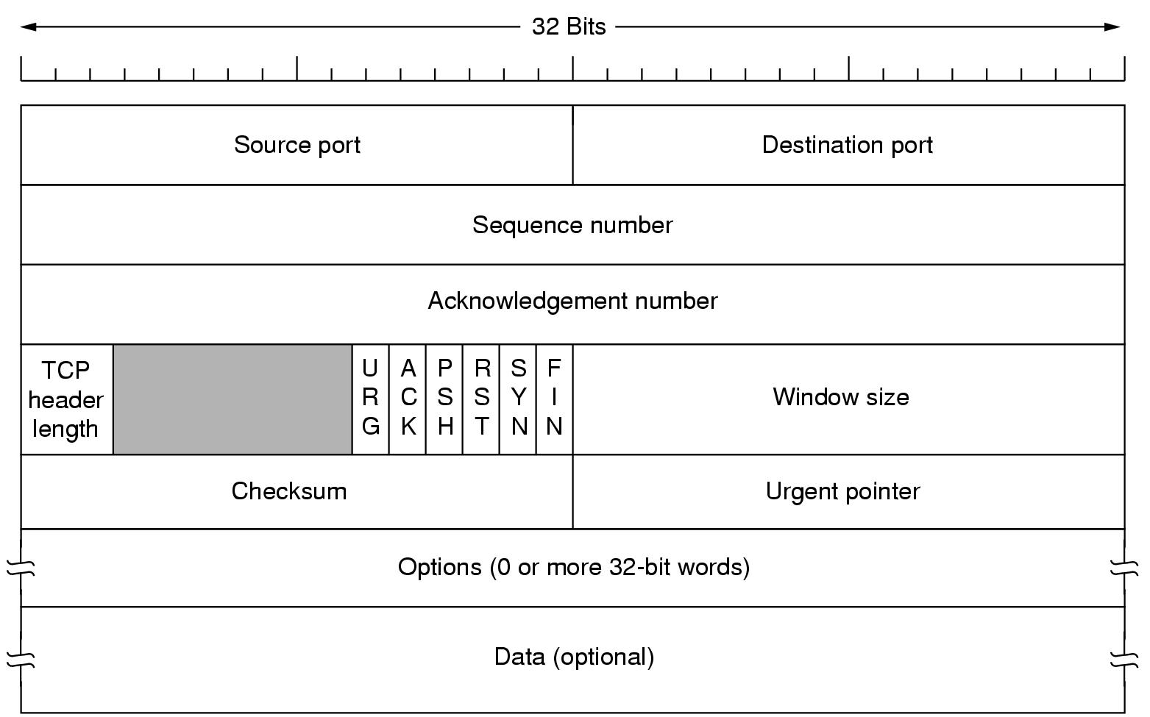

Slide 61
The Source port and Destination port fields identify the local end points of the connection.
A port plus its host's IP address forms a 48-bit unique end point.
The source and destination end points together identify the connection.
The Sequence number and Acknowledgement number fields perform their usual functions.
Note that the latter specifies the next byte expected, not the last byte correctly received.
Both are 32 bits long because every byte of data is numbered in a TCP stream.
The TCP header length tells how many 32-bit words are contained in the TCP header.
This information is needed because the Options field is of variable length, so the header is, too.
Technically, this field really indicates the start of the data within the segment, measured in 32- bit words, but that number is just the header length in words, so the effect is the same.

Slide 62
Next comes a 6-bit field that is not used.
Now come six 1-bit flags. URG is set to 1 if the Urgent pointer is in use.
The Urgent pointer is used to indicate a byte offset from the current sequence number at which urgent data are to be found.
This facility is in lieu of interrupt messages.
As we mentioned above, this facility is a bare-bones way of allowing the sender to signal the receiver without getting TCP itself involved in the reason for the interrupt.
The ACK bit is set to 1 to indicate that the Acknowledgement number is valid.
If ACK is 0, the segment does not contain an acknowledgement so the Acknowledgement number field is ignored.

Slide 63
The PSH bit indicates PUSHed data.
The receiver is hereby kindly requested to deliver the data to the application upon arrival and not buffer it until a full buffer has been received
The RST bit is used to reset a connection that has become confused due to a host crash or some other reason.
It is also used to reject an invalid segment or refuse an attempt to open a connection.
The SYN bit is used to establish connections.
The connection request has SYN = 1 and ACK = 0 to indicate that the piggyback acknowledgement field is not in use.
The connection reply does bear an acknowledgement, so it has SYN = 1 and ACK = 1.
In essence the SYN bit is used to denote CONNECTION REQUEST and CONNECTION ACCEPTED, with the ACK bit used to distinguish between those two possibilities.

Slide 64
The FIN bit is used to release a connection.
It specifies that the sender has no more data to transmit.
However, after closing a connection, the closing process may continue to receive data indefinitely.
Both SYN and FIN segments have sequence numbers and are thus guaranteed to be processed in the correct order.
Flow control in TCP is handled using a variable-sized sliding window.
The Window size field tells how many bytes may be sent starting at the byte acknowledged.
A Window size field of 0 is legal and says that the bytes up to and including Acknowledgement number - 1 have been received, but that the receiver is currently badly in need of a rest and would like no more data for the moment, thank you.
The receiver can later grant permission to send by transmitting a segment with the same Acknowledgement number and a nonzero Window size field.

Slide 65
TCP Connection Establishment
Connections are established in TCP by means of the three-way handshake.
To establish a connection, one side, say, the server, passively waits for an incoming connection by executing the LISTEN and ACCEPT primitives, either specifying a specific source or nobody in particular.
The other side, say, the client, executes a CONNECT primitive, specifying the IP address and port to which it wants to connect, the maximum TCP segment size it is willing to accept, and optionally some user data (e.g., a password).
The CONNECT primitive sends a TCP segment with the SYN bit on and ACK bit off and waits for a response.

Slide 66
When this segment arrives at the destination, the TCP entity there checks to see if there is a process that has done a LISTEN on the port given in the Destination port field.
If not, it sends a reply with the RST bit on to reject the connection.
If some process is listening to the port, that process is given the incoming TCP segment.
If it accepts, an acknowledgement segment is sent back.
The sequence of TCP segments sent in the normal case is shown in Figure(a).
Note that a SYN segment consumes 1 byte of sequence space so that it can be acknowledged unambiguously.

Slide 67
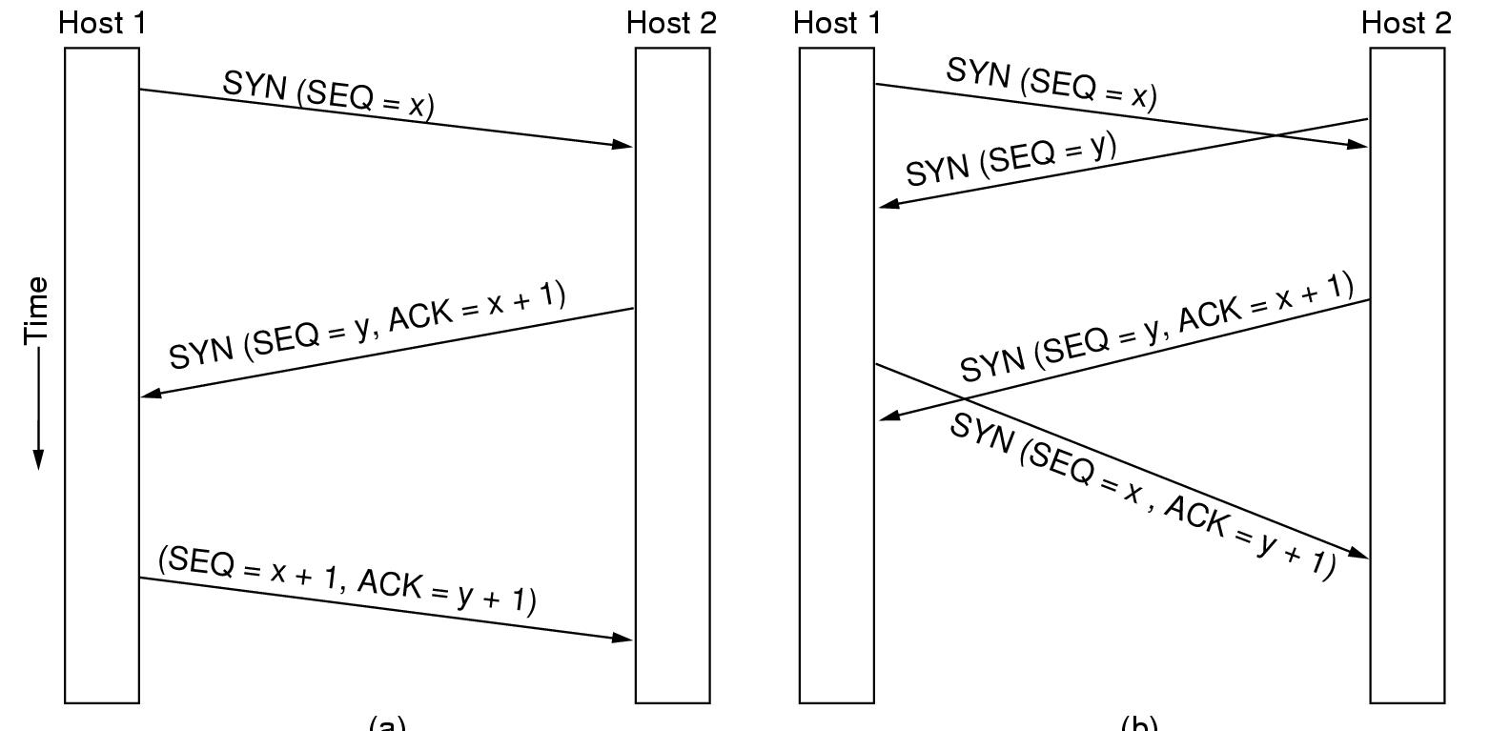

Slide 68
In the event that two hosts simultaneously attempt to establish a connection between the same two sockets, the sequence of events is as illustrated in Figure(b).
The result of these events is that just one connection is established, not two because connections are identified by their end points.
If the first setup results in a connection identified by (x, y) and the second one does too, only one table entry is made, namely, for (x, y).
A clock-based scheme is used, with a clock tick every 4 µsec. For additional safety, when a host crashes, it may not reboot for the maximum packet lifetime to make sure that no packets from previous connections are still roaming around the Internet somewhere.

Slide 69
TCP Connection Release
Although TCP connections are full duplex, to understand how connections are released it is best to think of them as a pair of simplex connections.
Each simplex connection is released independently of its sibling.
To release a connection, either party can send a TCP segment with the FIN bit set, which means that it has no more data to transmit.
When the FIN is acknowledged, that direction is shut down for new data.
Data may continue to flow indefinitely in the other direction, however.
When both directions have been shut down, the connection is released.
Normally, four TCP segments are needed to release a connection, one FIN and one ACK for each direction.
However, it is possible for the first ACK and the second FIN to be contained in the same segment, reducing the total count to three.

Slide 70
TCP Transmission Policy
As mentioned earlier, window management in TCP is not directly tied to acknowledgements as it is in most data link protocols.
For example, suppose the receiver has a 4096-byte buffer, as shown in Figure.
If the sender transmits a 2048-byte segment that is correctly received, the receiver will acknowledge the segment.
However, since it now has only 2048 bytes of buffer space, it will advertise a window of 2048 starting at the next byte expected.
Now the sender transmits another 2048 bytes, which are acknowledged, but the advertised window is 0.
The sender must stop until the application process on the receiving host has removed some data from the buffer, at which time TCP can advertise a larger window.

Slide 71
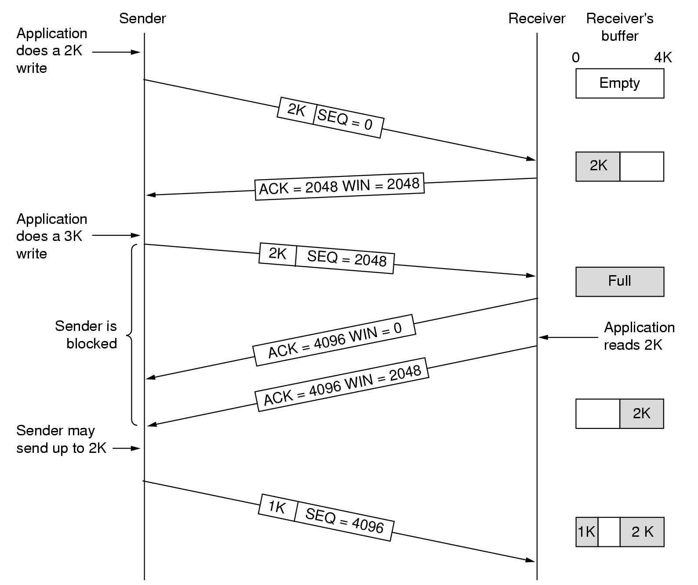

Slide 72
When the window is 0, the sender may not normally send segments, with two exceptions.
  First, urgent data may be sent, for example, to allow the user to kill the process running on the remote machine.
  Second, the sender may send a 1-byte segment to make the receiver reannounce the next byte expected and window size.
The TCP standard explicitly provides this option to prevent deadlock if a window announcement ever gets lost.
Although this rule reduces the load placed on the network by the receiver.
A way to reduce this usage is known as Nagle's algorithm.
What Nagle suggested is simple: when data come into the sender one byte at a time, just send the first byte and buffer all the rest until the outstanding byte is acknowledged.
Then send all the buffered characters in one TCP segment and start buffering again until they are all acknowledged.

Slide 73
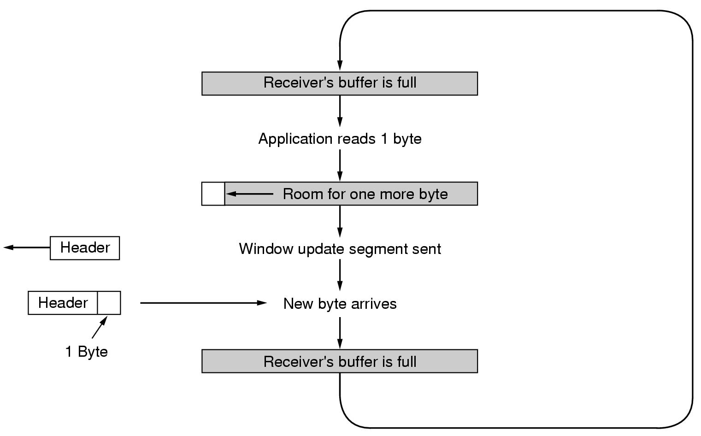
Another problem that can degrade TCP performance is the silly window syndrome.
This problem occurs when data are passed to the sending TCP entity in large blocks, but an interactive application on the receiving side reads data 1 byte at a time. To see the problem, look at Figure.

Slide 74
Clark's solution is to prevent the receiver from sending a window update for 1 byte.
Instead it is forced to wait until it has a decent amount of space available and advertise that instead.
Specifically, the receiver should not send a window update until it can handle the maximum segment size it advertised when the connection was established or until its buffer is half empty, whichever is smaller.
TCP Congestion Control
When the load offered to any network is more than it can handle, congestion builds up. The Internet is no exception.
The first step in managing congestion is detecting it. In the old days, detecting congestion was difficult. A timeout caused by a lost packet could have been caused by either
  (1) noise on a transmission line or
  (2) packet discard at a congested router. Telling the difference was difficult.

Slide 75
Most transmission timeouts on the Internet are due to congestion. All the Internet TCP algorithms assume that timeouts are caused by congestion.
Before discussing how TCP reacts to congestion, let us first describe what it does to try to prevent congestion from occurring in the first place.
When a connection is established, a suitable window size has to be chosen.
The receiver can specify a window based on its buffer size.
In the following figure, we see a thick pipe leading to a small-capacity receiver.
As long as the sender does not send more water than the bucket can contain, no water will be lost.
In Figure(b), the limiting factor is not the bucket capacity, but the internal carrying capacity of the network.
If too much water comes in too fast, it will back up and some will be lost

Slide 76
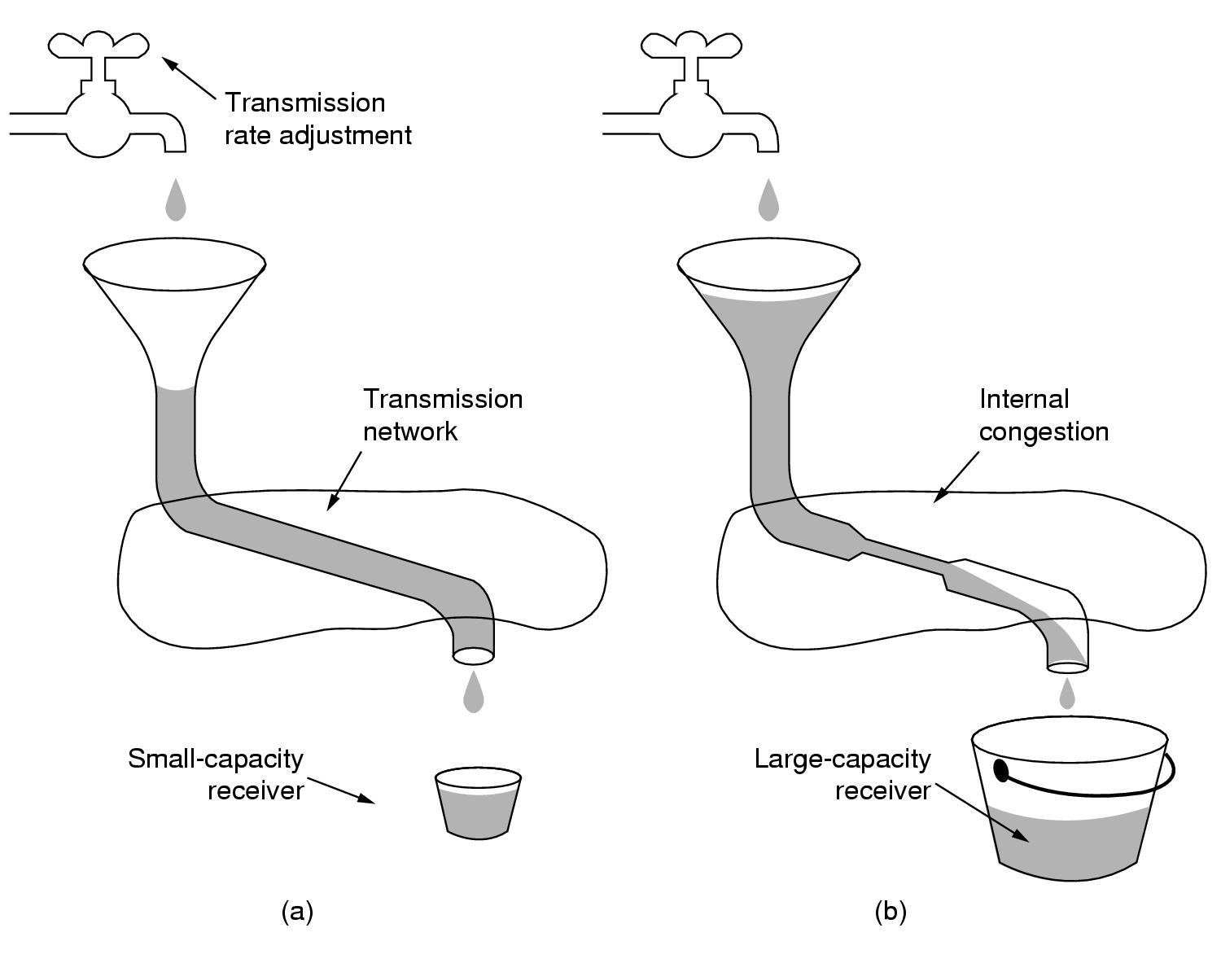
The Internet solution is to realize that two potential problems exist—network capacity and receiver capacity—and to deal with each of them separately.
To do so, each sender maintains two windows: the window the receiver has granted and a second window, the congestion window.
Each reflects the number of bytes the sender may transmit. The number of bytes that may be sent is the minimum of the two windows.

Slide 77
When a connection is established, the sender initializes the congestion window to the size of the maximum segment in use on the connection. It then sends one maximum segment.
If this segment is acknowledged before the timer goes off, it adds one segment's worth of bytes to the congestion window to make it two maximum size segments and sends two segments.
As each of these segments is acknowledged, the congestion window is increased by one maximum segment size.
When the congestion window is n segments, if all n are acknowledged on time, the congestion window is increased by the byte count corresponding to n segments.
In effect, each burst acknowledged doubles the congestion window.
Now let us look at the Internet congestion control algorithm.
It uses a third parameter, the threshold, initially 64 KB, in addition to the receiver and congestion windows.

Slide 78
When a timeout occurs, the threshold is set to half of the current congestion window, and the congestion window is reset to one maximum segment.
Slow start is then used to determine what the network can handle, except that exponential growth stops when the threshold is hit.
From that point on, successful transmissions grow the congestion window linearly instead of one per segment.
In effect, this algorithm is guessing that it is probably acceptable to cut the congestion window in half, and then it gradually works its way up from there.
As an illustration of how the congestion algorithm works, see the followig Figure.
The maximum segment size here is 1024 bytes. Initially, the congestion window was 64 KB, but a timeout occurred, so the threshold is set to 32 KB and the congestion window to 1 KB for transmission 0 here.
The congestion window then grows exponentially until it hits the threshold (32 KB). Starting then, it grows linearly.

Slide 79
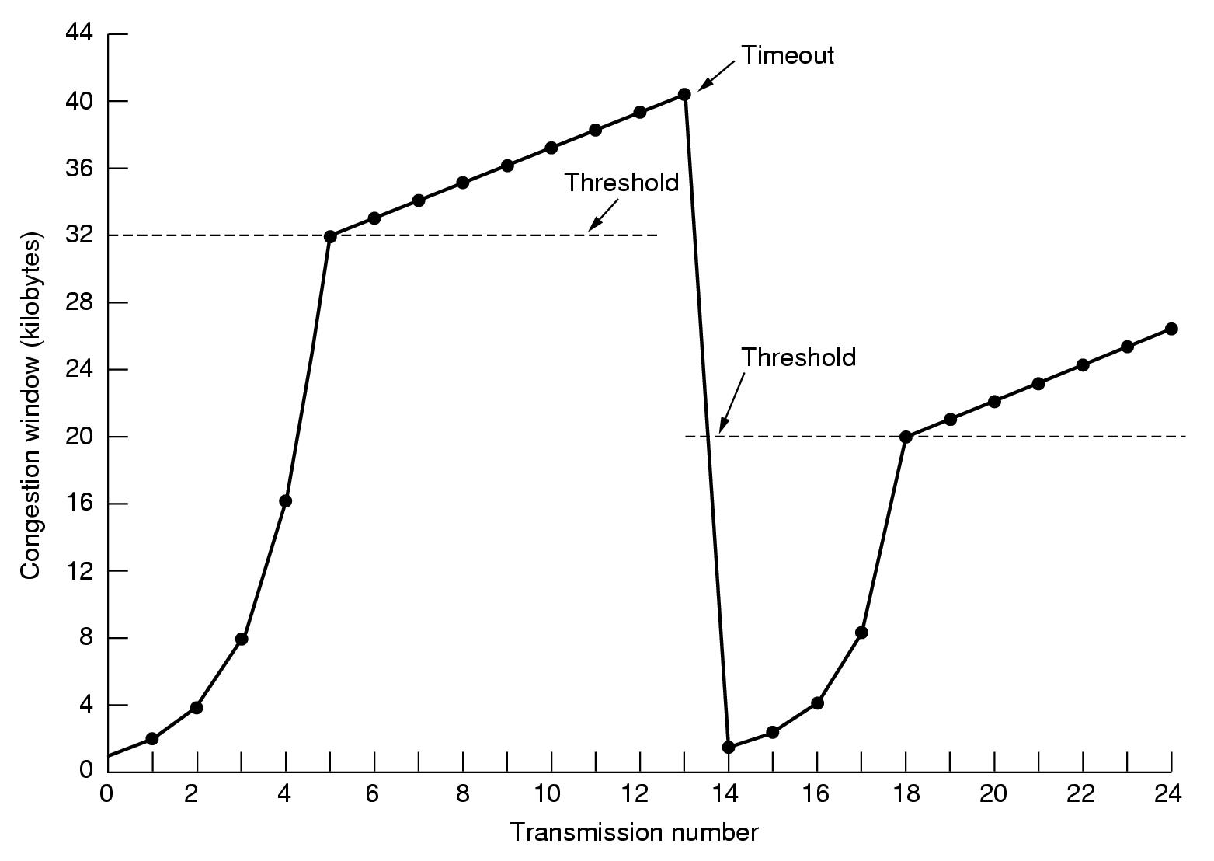

Slide 80
Transmission 13 is unlucky (it should have known) and a timeout occurs.
The threshold is set to half the current window (by now 40 KB, so half is 20 KB), and slow start is initiated all over again.
When the acknowledgements from transmission 14 start coming in, the first four each double the congestion window, but after that, growth becomes linear again.
If no more timeouts occur, the congestion window will continue to grow up to the size of the receiver's window.
At that point, it will stop growing and remain constant as long as there are no more timeouts and the receiver's window does not change size.

Slide 81
THANK YOU

