Slide 1
The Application Layer
By
Dr. M. Kalpana Devi
Professor & HOD
MCA Department
SITAMS

Slide 2
UNIT-5
5.1 DNS-The domain name system
  5.1.1 The DNS Name Space
  5.1.2 Resource Records
  5.1.3 Name Servers
5.2 Electronic mail
  5.2.1 Architecture and Services
  5.2.2 The User Agent
  5.2.3 Message Formats
  5.2.4 Message Transfer
  5.2.5Final Delivery
5.3 The World Wide Web
  5.3.1 Architectural Overview
  5.3.2 Static Web Documents
  5.3.3 Dynamic Web Documents
  5.3.4 HTTP-The Hypertext Transfer Protocol

Slide 3
The layers below the application layer are there to provide reliable transport, but they do not do real work for users.
However, even in the application layer there is a need for support protocols, to allow the applications to function
Some network applications
  DNS: handles naming within the Internet
  Electronic mail
  FTP: File Transfer over the Internet
  WWW – HTTP: Web world web
  Multimedia

Slide 4
5.1 DNS—The Domain Name System
Although programs theoretically could refer to hosts, mailboxes, and other resources by their network addresses(e.g., IP), these addresses are hard for people to remember.
Also, sending e-mail to tana@128.111.24.41 means that if Tana's ISP or organization moves the mail server to a different machine with a different IP address, her e-mail address has to change.
Consequently, ASCII names were introduced to decouple machine names from machine addresses.
In this way, Tana's address might be something like tana@art.ucsb.edu.
The network itself understands only numerical addresses, so some mechanism is required to convert the ASCII strings to network addresses.
When thousands of minicomputers and PCs were connected to the net, host name conflicts would occur constantly unless names were centrally managed.

Slide 5
To solve these problems, DNS (the Domain Name System) was invented.
The essence of DNS is the invention of a hierarchical, domain-based naming scheme and a distributed database system for implementing this naming scheme.
It is primarily used for mapping host names and e-mail destinations to IP addresses but can also be used for other purposes.
To map a name onto an IP address, an application program calls a library procedure called the resolver, passing it the name as a parameter.
The resolver sends a UDP packet to a local DNS server, which then looks up the name and returns the IP address to the resolver, which then returns it to the caller.
Armed with the IP address, the program can then establish a TCP connection with the destination or send it UDP packets

Slide 6
5.1.1 The DNS Name Space
Managing a large and constantly changing set of names is a nontrivial problem.
In the postal system, name management is done by requiring letters to specify (implicitly or explicitly) the country, state or province, city, and street address of the addressee.
Conceptually, the Internet is divided into over 200 top-level domains, where each domain covers many hosts.
Each domain is partitioned into subdomains, and these are further partitioned, and so on.
All these domains can be represented by a tree, as shown in Figure.
The leaves of the tree represent domains that have no subdomains (but do contain machines, of course). A leaf domain may contain a single host, or it may represent a company and contain thousands of hosts.

Slide 7
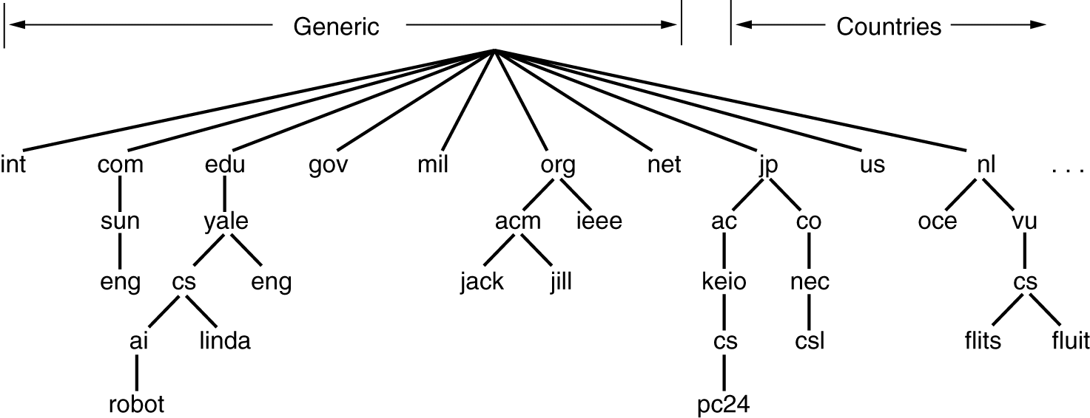

Slide 8
The top-level domains come in two flavors: generic and countries.
The original generic domains were
  com (commercial),
  edu (educational institutions),
  gov (the U.S. Federal Government),
  int (certain international organizations),
  mil (the U.S. armed forces),
  net (network providers), and
  org (nonprofit organizations).
The country domains include one entry for every country.

Slide 9
In November 2000, ICANN ((Internet Corporation for Assigned Names and Numbers)approved four new, general-purpose, top-level domains, namely,
    biz (businesses),
    info (information),
    name (people's names), and
    pro (professions, such as doctors and lawyers).
In addition, three more specialized top-level domains were introduced at the request of certain industries. These are
    aero (aerospace industry),
    coop (co-operatives), and
    museum (museums).
Other top-level domains will be added in the future

Slide 10
5.1.2 Resource Records
Every domain, whether it is a single host or a top-level domain, can have a set of resource records associated with it.
For a single host, the most common resource record is just its IP address, but many other kinds of resource records also exist.
When a resolver gives a domain name to DNS, what it gets back are the resource records associated with that name.
Thus, the primary function of DNS is to map domain names onto resource records.
A resource record is a five-tuple. Although they are encoded in binary for efficiency, in most expositions, resource records are presented as ASCII text, one line per resource record.
The format we will use is as follows:

Slide 11
Domain_name Time_to_live Class Type Value
Domain_name tells the domain to which this record applies
The Time_to_live field gives an indication of how stable the record is.
The third field of every resource record is the Class. For Internet information, it is always IN.
The Type field tells what kind of record this is, The most important types are listed in the following table.

Slide 12
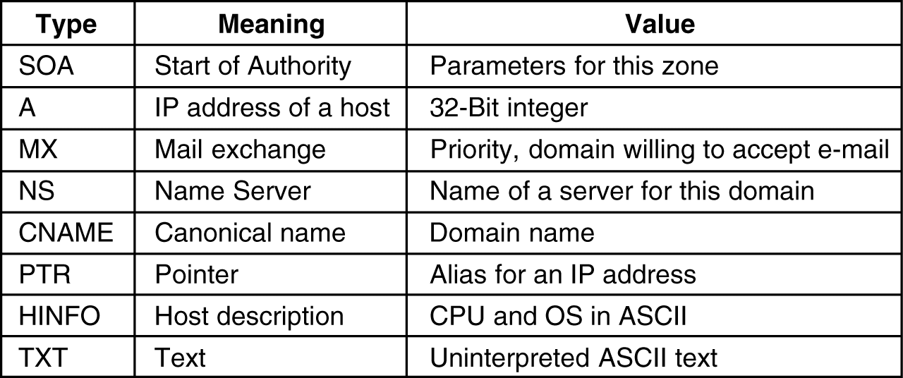
The principal DNS resource records types for IPv4.

Slide 13
5.1.3 Name Servers
In theory at least, a single name server could contain the entire DNS database and respond to all queries about it.
In practice, this server would be so overloaded as to be useless.
Furthermore, if it ever went down, the entire Internet would be crippled.
To avoid the problems associated with having only a single source of information, the DNS name space is divided into nonoverlapping zones.
One possible way to divide the name space of above Figure is shown in the following Figure.
Each zone contains some part of the tree and also contains name servers holding the information about that zone.
Normally, a zone will have one primary name server, which gets its information from a file on its disk, and one or more secondary name servers, which get their information from the primary name server.
To improve reliability, some servers for a zone can be located outside the zone.

Slide 14
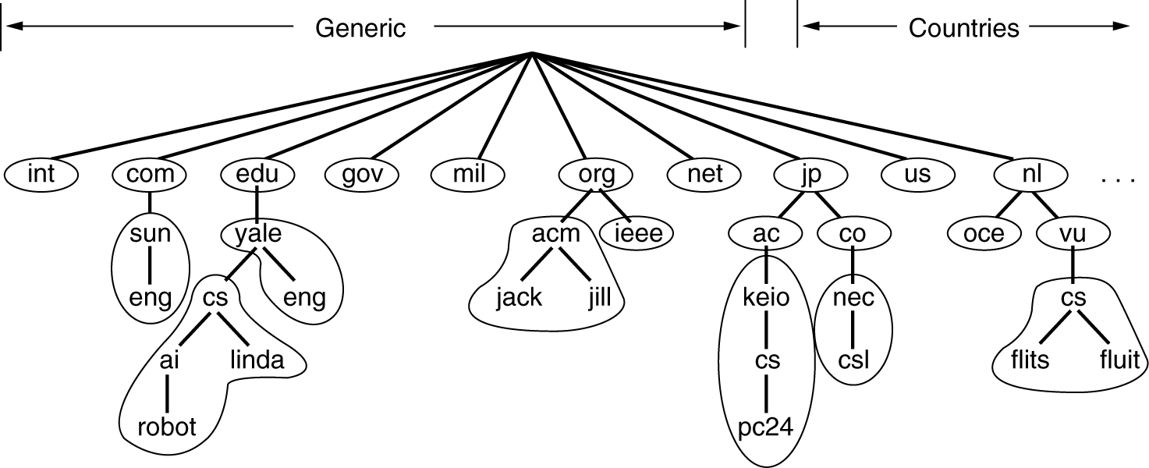

Slide 15
When a resolver has a query about a domain name, it passes the query to one of the local name servers.
If the domain being sought falls under the jurisdiction of the name server, however, the domain is remote and no information about the requested domain is available locally, the name server sends a query message to the top-level name server for the domain requested.
To make this process clearer, consider the example of the following Figure.
Here, a resolver on flits.cs.vu.nl wants to know the IP address of the host linda.cs.yale.edu.
In step 1, it sends a query to the local name server, cs.vu.nl.
This query contains the domain name sought, the type (A) and the class (IN).

Slide 16
It sends a UDP packet to the server for edu given in its database , edu-server.net.
It is unlikely that this server knows the address of linda.cs.yale.edu, and probably does not know cs.yale.edu either, but it must know all of its own children, so it forwards the request to the name server for yale.edu.
In turn, this one forwards the request to cs.yale.edu, which must have the authoritative resource records.

Slide 17

root name server
edu-server.net
2
iterated query
3
4
7
local name server
cs.vu.nl
intermediate name server
yale.edu
1
5
6
8
authoritative name server
cs.yale.edu
requesting host
flits.cs.vu.nl
linda.cs.yale.edu

Slide 18
5.2 Electronic Mail
Electronic Mail (e-mail) is one of most widely used services of Internet.
Before 1990, it was mostly used in academia.
During the 1990s, it became known to the public at large and grew exponentially.
This service allows an Internet user to send a message in formatted manner (mail) to the other Internet user in any part of world.
Message in mail not only contain text, but it also contains images, audio and videos data.
The person who is sending mail is called sender and person who receives mail is called recipient.
It is just like postal mail service.
Components of E-Mail System : The basic components of an email system are : User Agent (UA), Message Transfer Agent (MTA), Mail Box, and Spool file.

Slide 19
5.2.1 Architecture and Services
E-mail systems consist of two subsystems:
  The user agents, which allow people to read and send e-mail, and
  The message transfer agents, which move the messages from the source to the destination.
User Agent (UA) : The UA is normally a program which is used to send and receive mail.
Sometimes, it is called as mail reader.
It accepts variety of commands for composing, receiving and replying to messages as well as for manipulation of the mailboxes.
Some user agents have a fancy menu- or icon-driven interface that requires a mouse.
Message Transfer Agent (MTA) : MTA is actually responsible for transfer of mail from one system to another.
To send a mail, a system must have client MTA and system MTA.

Slide 20
It transfer mail to mailboxes of recipients if they are connected in the same machine.
It delivers mail to peer MTA if destination mailbox is in another machine.
The delivery from one MTA to another MTA is done by Simple Mail Transfer Protocol(SMTP).
Typically, e-mail systems support five basic functions. Let us take a look at them.
1. Composition refers to the process of creating messages and answers. Although any text editor can be used for the body of the message, the system itself can provide assistance with addressing and the numerous header fields attached to each message.
2. Transfer refers to moving messages from the originator to the recipient. In large part, this requires establishing a connection to the destination or some intermediate machine, outputting the message, and releasing the connection. The e-mail system should do this automatically, without bothering the user.

Slide 21
3. Reporting has to do with telling the originator what happened to the message. Was it delivered? Was it rejected? Was it lost? Numerous applications exist in which confirmation of delivery is important and may even have legal significance
5. Displaying incoming messages is needed so people can read their e-mail. Sometimes conversion is required or a special viewer must be invoked,
6. Disposition is the final step and concerns what the recipient does with the message after receiving it. Possibilities include throwing it away before reading, throwing it away after reading, saving it, and so on. It should also be possible to retrieve and reread saved messages, forward them, or process them in other ways
mailbox – storage where incoming emails are saved for later processing
mailing list – a representative email address of a group of people. Email sent to this address will be forwarded to all of its participants CC, BCC ...

Slide 22
Sending E-mail
To send an e-mail message, a user must provide the message, the destination address, and possibly some other parameters.
The message can be produced with a free-standing text editor, a word processing program, or possibly with a specialized text editor built into the user agent.
The destination address must be in a format that the user agent can deal with.
Many user agents expect addresses of the form user@dns-address.
Most e-mail systems support mailing lists, so that a user can send the same message to a list of people with a single command.
If the mailing list is maintained locally, the user agent can just send a separate message to each intended recipient.
However, if the list is maintained remotely, then messages will be expanded there.

Slide 23
Reading E-mail
Typically, when a user agent is started up, it looks at the user's mailbox for incoming e-mail before displaying anything on the screen.
Then it may announce the number of messages in the mailbox or display a one-line summary of each one and wait for a command.
As an example of how a user agent works, let us take a look at a typical mail scenario.
After starting up the user agent, the user asks for a summary of his e-mail.
Each line refers to one message.

Slide 24
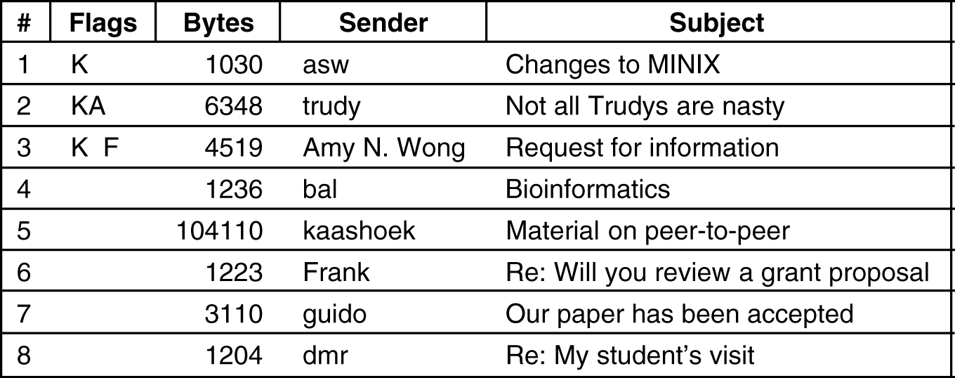

Slide 25
Each line of the display contains several fields extracted from the envelope or header of the corresponding message.
In a simple e-mail system, the choice of fields displayed is built into the program.
In a more sophisticated system, the user can specify which fields are to be displayed by providing a user profile, a file describing the display format.
In this basic example, the first field is the message number.
The second field, Flags, can contain a
  K, meaning that the message is not new but was read previously and kept in the mailbox;
  an A, meaning that the message has already been answered;
  an F, meaning that the message has been forwarded to someone else.
Other flags are also possible.

Slide 26
The third field tells how long the message is, and the fourth one tells who sent the message.
Since this field is simply extracted from the message, this field may contain first names, full names, initials, login names, or whatever else the sender chooses to put there.
Finally, the Subject field gives a brief summary of what the message is about.
After the headers have been displayed, the user can perform any of several actions, such as displaying a message, deleting a message, and so on.
The older systems were text based and typically used one-character commands for performing these tasks, such as
  T (type message),
  A (answer message),
  D (delete message), and
  F (forward message).

Slide 27
5.2.3 Message Formats
There are two message formats are there .
    Basic ASCII e-mail using RFC 822.
    Multimedia extensions to RFC 822.
1. RFC 822
Messages consist of a primitive envelope, some number of header fields, a blank line, and then the message body. Each header field (logically) consists of a single line of ASCII text containing the field name, a colon, and, for most fields, a value.
RFC 822 was designed decades ago and does not clearly distinguish the envelope fields from the header fields.
Although it was revised in RFC 2822, completely redoing it was not possible due to its widespread usage.
In normal usage, the user agent builds a message and passes it to the message transfer agent, which then uses some of the header fields to construct the actual envelope, a somewhat old-fashioned mixing of message and envelope.

Slide 28
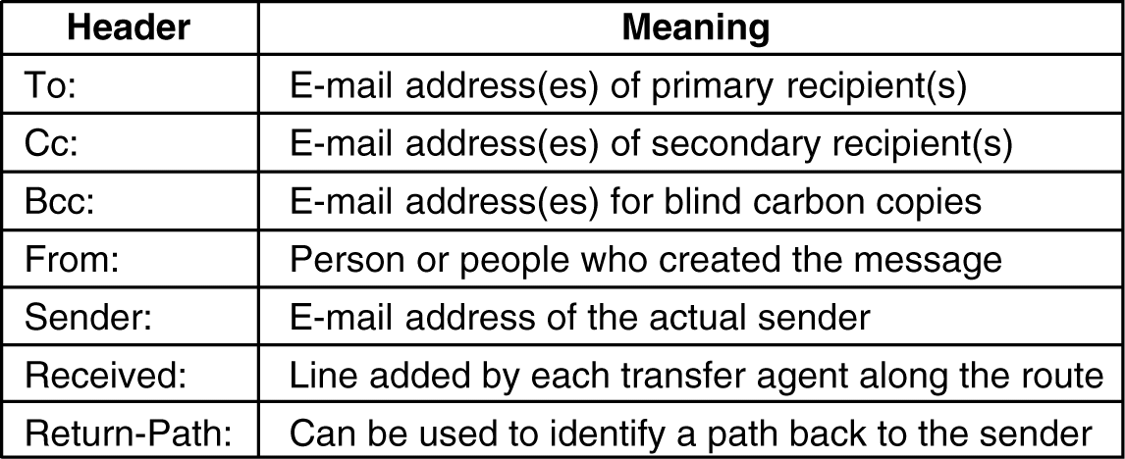
The principal header fields related to message transport are listed in Figure.
The To: field gives the DNS address of the primary recipient. Having multiple recipients is also allowed.
The Cc: field gives the addresses of any secondary recipients.
In terms of delivery, there is no distinction between the primary and secondary recipients.

Slide 29
The next two fields, From: and Sender:, tell who wrote and sent the message, respectively.
These need not be the same. For example, a business executive may write a message, but her secretary may be the one who actually transmits it.
A line containing Received: is added by each message transfer agent along the way.
The line contains the agent's identity, the date and time the message was received, and other information that can be used for finding bugs in the routing system.
The Return-Path: field is added by the final message transfer agent and was intended to tell how to get back to the sender.
In addition to the fields of the above Figure, RFC 822 messages may also contain a variety of header fields used by the user agents or human recipients.

Slide 30
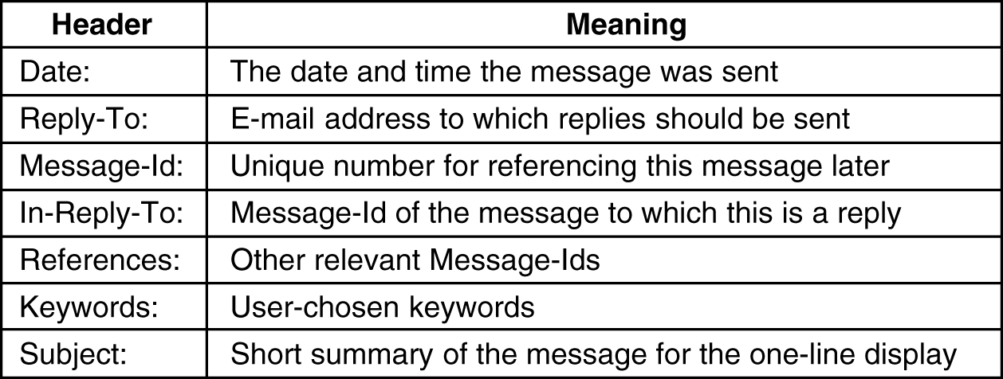

Slide 31
MIME—The Multipurpose Internet Mail Extensions
In the early days of the ARPANET, e-mail consisted exclusively of text messages written in English and expressed in ASCII.
For this environment, RFC 822 did the job completely: it specified the headers but left the content entirely up to the users.
Nowadays, on the worldwide Internet, this approach is no longer adequate.
The problems include sending and receiving
  1. Messages in languages with accents (e.g., French and German).
  2. Messages in non-Latin alphabets (e.g., Hebrew and Russian).
  3. Messages in languages without alphabets (e.g., Chinese and Japanese).
  4. Messages not containing text at all (e.g., audio or images).
Notes:
Advanced Research Projects Agency Network (ARPANET)

Slide 32
A solution was proposed in RFC 1341 and updated in RFCs 2045–2049.
This solution, called MIME (Multipurpose Internet Mail Extensions) is now widely used.
The basic idea of MIME is to continue to use the RFC 822 format, but to add structure to the message body and define encoding rules for non-ASCII messages.
MIME defines five new message headers, as shown in Figure.
The first of these simply tells the user agent receiving the message that it is dealing with a MIME message, and which version of MIME it uses.
Any message not containing a MIME-Version: header is assumed to be an English plaintext message and is processed as such.

Slide 33
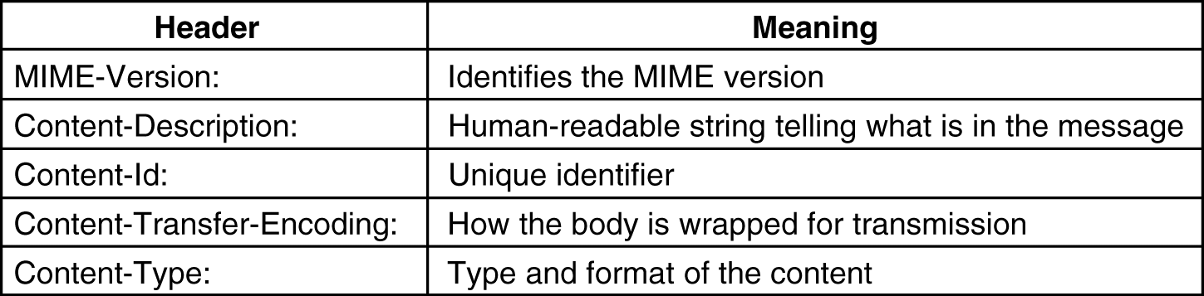
The Content-Description: header is an ASCII string telling what is in the message.
This header is needed so the recipient will know whether it is worth decoding and reading the message.
The Content-Id: header identifies the content. It uses the same format as the standard Message-Id: header.
The Content-Transfer-Encoding: tells how the body is wrapped for transmission through a network that may object to most characters other than letters, numbers, and punctuation marks.

Slide 34
Content-Type: It specifies the nature of the message body.
Seven types are defined in RFC 2045, each of which has one or more subtypes.
The type and subtype are separated by a slash, as in Content-Type: video/mpeg
The subtype must be given explicitly in the header; no defaults are provided.
The initial list of types and subtypes specified in RFC 2045 is given in the following Figure.

Slide 35
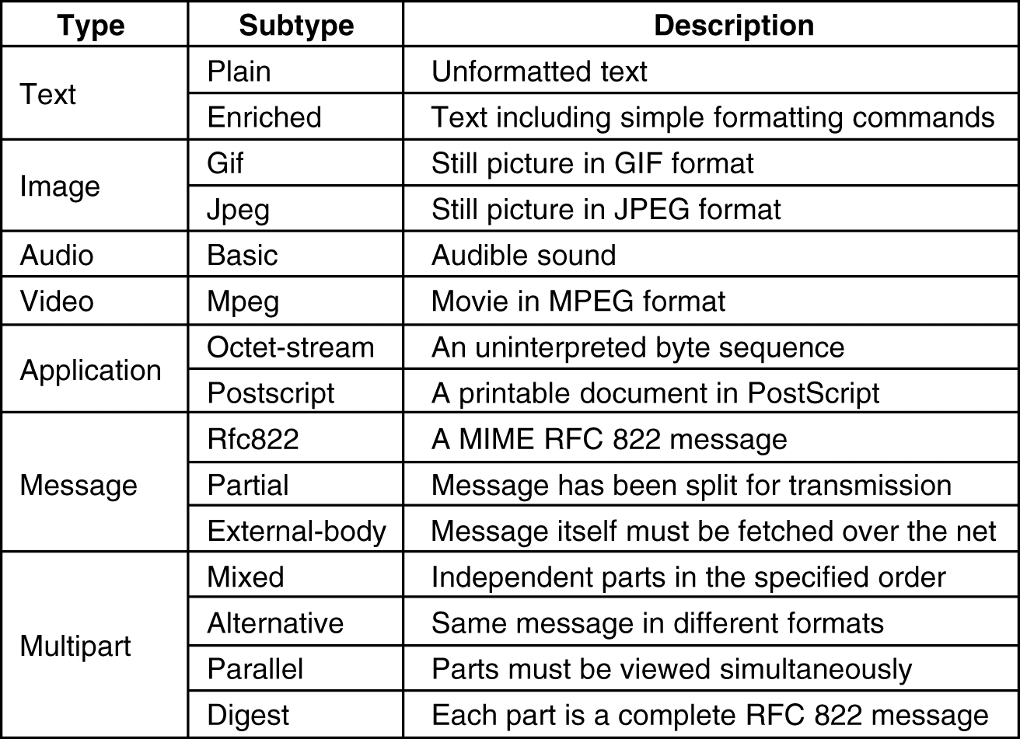

Slide 36
5.2.4 Message Transfer
SMTP—The Simple Mail Transfer Protocol:
Within the Internet, e-mail is delivered by having the source machine establish a TCP connection to port 25 of the destination machine.
Listening to this port is an e-mail daemon that speaks SMTP (Simple Mail Transfer Protocol).
This daemon accepts incoming connections and copies messages from them into the appropriate mailboxes.
If a message cannot be delivered, an error report containing the first part of the undeliverable message is returned to the sender.
The server starts by sending a line of text giving its identity and telling whether it is prepared to receive mail.
If it is not, the client releases the connection and tries again later.
If the server is willing to accept e-mail, the client announces whom the e-mail is coming from and whom it is going to.
If such a recipient exists at the destination, the server gives the client the go-ahead to send the message.
Then the client sends the message and the server acknowledges it.

Slide 37
No checksums are needed because TCP provides a reliable byte stream.
If there is more e-mail, that is now sent. When all the e-mail has been exchanged in both directions, the connection is released.
Even though the SMTP protocol is completely well defined, a few problems can still arise.
One problem relates to message length.
Some older implementations cannot handle messages exceeding 64 KB.
Another problem relates to timeouts. If the client and server have different timeouts, one of them may give up while the other is still busy, unexpectedly terminating the connection.
To get around some of these problems, extended SMTP (ESMTP) has been defined in RFC 2821.
Clients wanting to use it should send an EHLO message instead of HELO initially.
If this is rejected, then the server is a regular SMTP server, and the client should proceed in the usual way.
If the EHLO is accepted, then new commands and parameters are allowed.

Slide 38
5.2.5 Final Delivery
E-mail is delivered by having the sender establish a TCP connection to the receiver and then ship the e-mail over it.
This model worked fine for decades when all ARPANET hosts were, in fact, on-line all the time to accept TCP connections.
However, with the advent of people who access the Internet by calling their ISP over a modem, it breaks down.
The problem is this: what happens when sender wants to send receiver e-mail and receiver is not currently on-line?
Sender cannot establish a TCP connection to receiver and thus cannot run the SMTP protocol.
One solution is to have a message transfer agent on an ISP machine accept e-mail for its customers and store it in their mailboxes on an ISP machine.
Since this agent can be on-line all the time, e-mail can be sent to it 24 hours a day.

Slide 39
POP3(Post Office Protocol Version 3)
Unfortunately, this solution creates another problem: how does the user get the e-mail from the ISP's message transfer agent?
The solution to this problem is to create another protocol that allows user transfer agents (on client PCs) to contact the message transfer agent (on the ISP's machine) and allow e-mail to be copied from the ISP to the user.
One such protocol is POP3 (Post Office Protocol Version 3)
The situation that used to hold (both sender and receiver having a permanent connection to the Internet) is illustrated in the following Figure(a).
A situation in which the sender is (currently) on-line but the receiver is not is illustrated is in Figure(b).

Slide 40
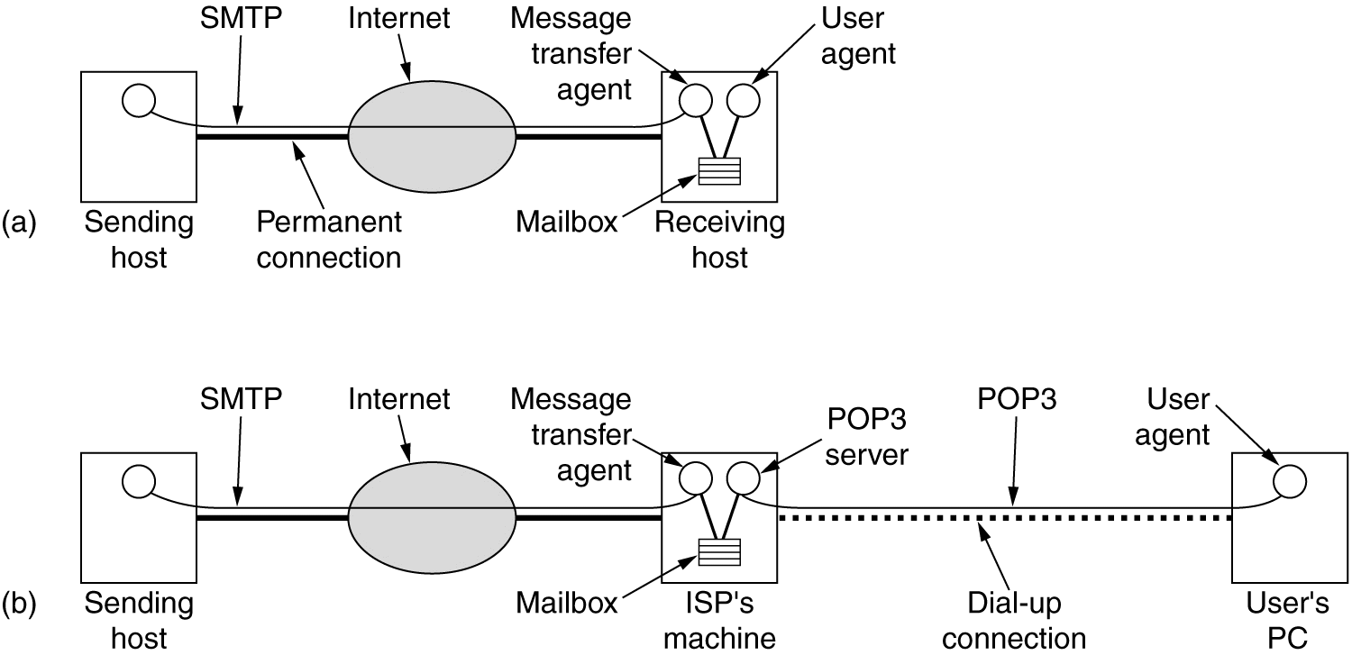

Slide 41
POP3 begins when the user starts the mail reader.
The mail reader calls up the ISP (unless there is already a connection) and establishes a TCP connection with the message transfer agent at port 110.
Once the connection has been established, the POP3 protocol goes through three states in sequence:
    1. Authorization.
    2. Transactions.
    3. Update.
The authorization state deals with having the user log in.
The transaction state deals with the user collecting the e-mails and marking them for deletion from the mailbox.
The update state actually causes the e-mails to be deleted.

Slide 42
IMAP(Internet Message Access Protocol)
For a user with one e-mail account at one ISP that is always accessed from one PC, POP3 works fine and is widely used due to its simplicity and robustness.
That happened with e-mail, too. For example, many people have a single e-mail account at work or school and want to access it from work, from their home PC, from their laptop when on business trips, and from cybercafes when on so-called vacation.
While POP3 allows this, since it normally downloads all stored messages at each contact, the result is that the user's e-mail quickly gets spread over multiple machines, more or less at random, some of them not even the user's.

Slide 43
This disadvantage gave rise to an alternative final delivery protocol, IMAP (Internet Message Access Protocol), which is defined in RFC 2060.
Unlike POP3, which basically assumes that the user will clear out the mailbox on every contact and work off-line after that, IMAP assumes that all the e-mail will remain on the server indefinitely in multiple mailboxes.
IMAP provides extensive mechanisms for reading messages or even parts of messages, a feature useful when using a slow modem to read the text part of a multipart message with large audio and video attachments.
Since the working assumption is that messages will not be transferred to the user's computer for permanent storage, IMAP provides mechanisms for creating, destroying, and manipulating multiple mailboxes on the server.
In this way a user can maintain a mailbox for each correspondent and move messages there from the inbox after they have been read.

Slide 44
IMAP has many features, such as the ability to address mail not by arrival number, but by using attributes (e.g., give me the first message from Bobbie).
Unlike POP3, IMAP can also accept outgoing e-mail for shipment to the destination as well as deliver incoming e-mail.
The general style of the IMAP protocol is similar to that of POP3, except that are there dozens of commands.
The IMAP server listens to port 143. A comparison of POP3 and IMAP is given in the following Figure.
It should be noted, however, that not every ISP supports both protocols and not every e-mail program supports both protocols.
Thus, when choosing an e-mail program, it is important to find out which protocol(s) it supports and make sure the ISP supports at least one of them.

Slide 45
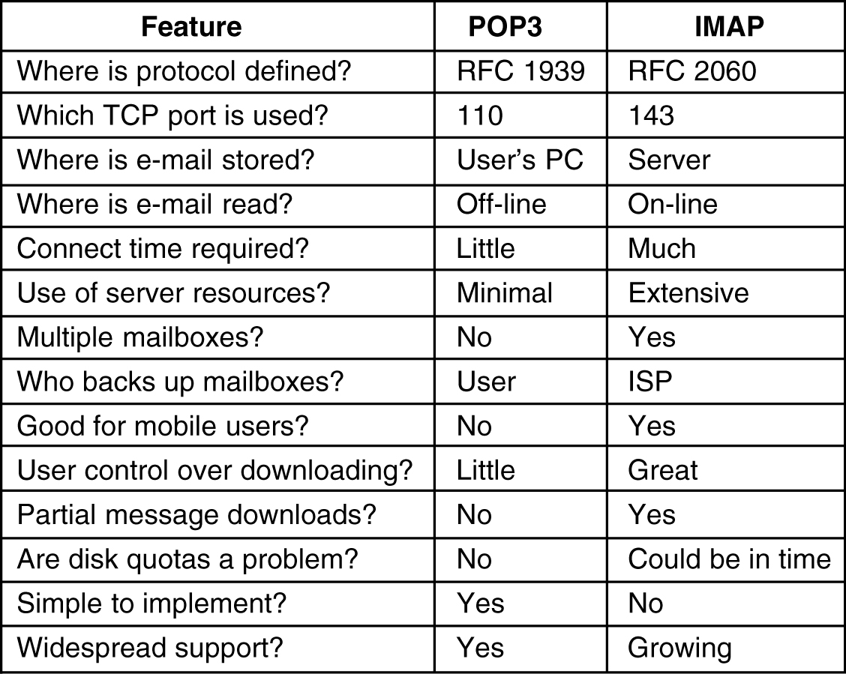

Slide 46
Delivery Features
An especially valuable feature for many e-mail users is the ability to set up filters.
These are rules that are checked when e-mail comes in or when the user agent is started.
Each rule specifies a condition and an action. For example, a rule could say that any message received from the boss goes to mailbox number 1, any message from a select group of friends goes to mailbox number 2, and any message containing certain objectionable words in the Subject line is discarded without comment.
Another delivery feature often provided is the ability to (temporarily) forward incoming e-mail to a different address.
Still another common feature of final delivery is the ability to install a vacation daemon.
This is a program that examines each incoming message and sends the sender an insipid reply such as
“Hi. I'm on vacation, I'll be back on the 24th of August. Have a nice summer”
Such replies can also specify how to handle urgent matters in the interim, other people to contact for specific problems, etc.

Slide 47
5.3 The World Wide Web
The World Wide Web is an architectural framework for accessing linked documents spread over millions of machines all over the Internet.
Its enormous popularity stems from the fact that it has a colorful graphical interface that is easy for beginners to use, and it provides an enormous wealth of information on almost every conceivable subject.
The Web (also known as WWW) began in 1989 at CERN (European Council for Nuclear Research), it has several accelerators at which large teams of scientists from the participating European countries carry out research in particle physics.
These teams often have members from half a dozen or more countries.
In 1994, CERN and M.I.T. signed an agreement setting up the World Wide Web Consortium (sometimes abbreviated as W3C), an organization devoted to further developing the Web, standardizing protocols, and encouraging interoperability between sites.

Slide 48
5.3.1 Architectural Overview
From the users' point of view, the Web consists of a vast, worldwide collection of documents or Web pages, often just called pages for short.
Each page may contain links to other pages anywhere in the world.
Users can follow a link by clicking on it, which then takes them to the page pointed to.
This process can be repeated indefinitely.
The idea of having one page point to another, now called hypertext, was invented by a visionary M.I.T. professor of electrical engineering, Vannevar Bush, in 1945, long before the Internet was invented.
Pages are viewed with a program called a browser, of which Internet Explorer and Netscape Navigator are two popular ones.
The browser fetches the page requested, interprets the text and formatting commands on it, and displays the page, properly formatted, on the screen.

Slide 49
Like many Web pages, this one starts with a title, contains some information, and ends with the e-mail address of the page's maintainer.
Strings of text that are links to other pages, called hyperlinks, are often highlighted, by underlining, displaying them in a special color, or both.
To follow a link, the user places the mouse cursor on the highlighted area, which causes the cursor to change, and clicks on it.
The user cannot tell. Page fetching is done by the browser, without any help from the user.
If the user ever returns to the main page, the links that have already been followed may be shown with a dotted underline (and possibly a different color) to distinguish them from links that have not been followed.

Slide 50
The basic model of how the Web works is shown in Figure.
Here the browser is displaying a Web page on the client machine.
When the user clicks on a line of text that is linked to a page on the abcd.com server, the browser follows the hyperlink by sending a message to the abcd.com server asking it for the page.
When the page arrives, it is displayed. If this page contains a hyperlink to a page on the xyz.com server that is clicked on, the browser then sends a request to that machine for the page, and so on indefinitely.

Slide 51
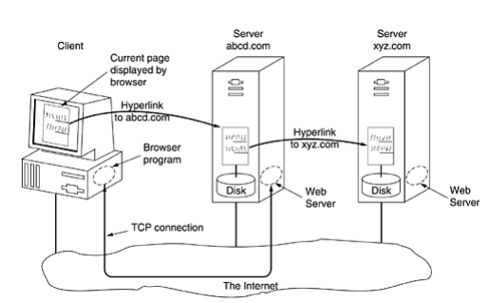

Slide 52
The Client Side
Let us now examine the client side of Figure in more detail.
In essence, a browser is a program that can display a Web page and catch mouse clicks to items on the displayed page.
When an item is selected, the browser follows the hyperlink and fetches the page selected.
Therefore, the embedded hyperlink needs a way to name any other page on the Web.
Pages are named using URLs (Uniform Resource Locators). A typical URL is http://www.abcd.com/products.html
URL has three parts:
    1. The name of the protocol (http).
    2. The DNS name of the machine where the page is located (www.abcd.com).
    3. The name of the file containing the page (products.html).

Slide 53
When a user clicks on a hyperlink, the browser carries out a series of steps in order to fetch the page pointed to.
Suppose that a user is browsing the Web and finds a link on Internet telephony that points to ITU's home page, which is http://www.itu.org/home/index.html.
Let us trace the steps that occur when this link is selected.
  1. The browser determines the URL (by seeing what was selected).
  2. The browser asks DNS for the IP address of www.itu.org.
  3. DNS replies with 156.106.192.32.
  4.The browser makes a TCP connection to port 80 on 156.106.192.32.
  5. It then sends over a request asking for file /home/index.html.
  6. The www.itu.org server sends the file /home/index.html.
  7. The TCP connection is released.
  8. The browser displays all the text and all images in this file /home/index.html.

Slide 54
Not all pages contain HTML. A page may consist of a formatted document in PDF format, an icon in GIF format, a photograph in JPEG format, a song in MP3 format, a video in MPEG format, or any one of hundreds of other file types.
When a server returns a page, it also returns some additional information about the page.
This information includes the MIME type of the page.
If the MIME type is not one of the built-in ones, the browser consults its table of MIME types to tell it how to display the page.
This table associates a MIME type with a viewer.
There are two possibilities: plug-ins and helper applications. A plug-in is a code module that the browser fetches from a special directory on the disk and installs as an extension to itself, as illustrated in Figure(a).
Because plug-ins run inside the browser, they have access to the current page and can modify its appearance.
After the plug-in has done its job (usually after the user has moved to a different Web page), the plug-in is removed from the browser's memory.

Slide 55
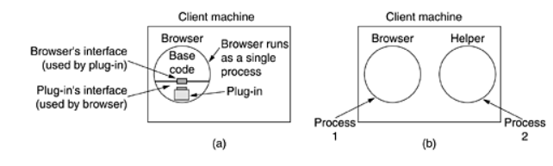

Slide 56
Before a plug-in can be used, it must be installed.
The usual installation procedure is for the user to go to the plug-in's Web site and download an installation file.
On Windows, this is typically a self-extracting zip file with extension .exe. The other way to extend a browser is to use a helper application.
This is a complete program, running as a separate process. It is illustrated in Figure(b).
Since the helper is a separate program, it offers no interface to the browser and makes no use of browser services.
Typically, helpers are large programs that exist independently of the browser, such as Adobe's Acrobat Reader for displaying PDF files or Microsoft Word.

Slide 57
The Server Side
So much for the client side. Now let us take a look at the server side.
As we saw above, when the user types in a URL or clicks on a line of hypertext, the browser parses the URL and interprets the part between http:// and the next slash as a DNS name to look up.
Armed with the IP address of the server, the browser establishes a TCP connection to port 80 on that server.
Then it sends over a command containing the rest of the URL, which is the name of a file on that server.
The server then returns the file for the browser to display.

Slide 58
That server, like a real Web server, is given the name of a file to look up and return.
In both cases, the steps that the server performs in its main loop are:
  1. Accept a TCP connection from a client (a browser).
  2. Get the name of the file requested.
  3. Get the file (from disk).
  4. Return the file to the client.
  5. Release the TCP connection.
  Modern Web servers have more features, but in essence, this is what a Web server does.

Slide 59
The next step for building a faster server is to make the server multithreaded.
In one design, the server consists of a front-end module that accepts all incoming requests and k processing modules, as shown in Figure.
The k + 1 threads all belong to the same process so the processing modules all have access to the cache within the process' address space.
When a request comes in, the front end accepts it and builds a short record describing it.
It then hands the record to one of the processing modules.
In another possible design, the front end is eliminated and each processing module tries to acquire its own requests, but a locking protocol is then required to prevent conflicts.

Slide 60
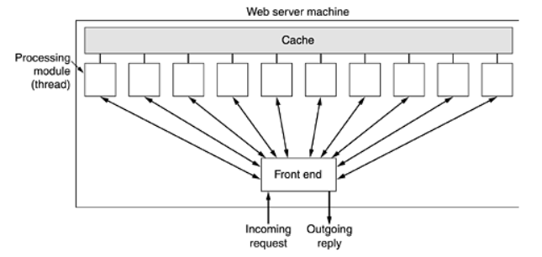

Slide 61
The processing module first checks the cache to see if the file needed is there.
If so, it updates the record to include a pointer to the file in the record.
If it is not there, the processing module starts a disk operation to read it into the cache (possibly discarding some other cached files to make room for it).
When the file comes in from the disk, it is put in the cache and also sent back to the client.
The advantage of this scheme is that while one or more processing modules are blocked waiting for a disk operation to complete (and thus consuming no CPU time), other modules can be actively working on other requests.
Of course, to get any real improvement over the single threaded model, it is necessary to have multiple disks, so more than one disk can be busy at the same time.

Slide 62
URLs—Uniform Resource Locators
We have repeatedly said that Web pages may contain pointers to other Web pages.
Now it is time to see in a bit more detail how these pointers are implemented.
When the Web was first created, it was immediately apparent that having one page point to another Web page required mechanisms for naming and locating pages.
In particular, three questions had to be answered before a selected page could be displayed:
    1. What is the page called?
    2. Where is the page located?
    3. How can the page be accessed?

Slide 63
If every page were somehow assigned a unique name, there would not be any ambiguity in identifying pages.
The solution chosen identifies pages in a way that solves all three problems at once.
Each page is assigned a URL (Uniform Resource Locator) that effectively serves as the page's worldwide name.
URLs have three parts: the protocol (also known as the scheme), the DNS name of the machine on which the page is located, and a local name uniquely indicating the specific page (usually just a file name on the machine where it resides).
As an example, the Web site for the author's department contains several videos about the university and the city of Amsterdam.
The URL for the video page is http://www.cs.vu.nl/video/index-en.html

Slide 64
Many sites have built-in shortcuts for file names.
At many sites, a null file name defaults to the organization's main home page.
Typically, when the file named is a directory, this implies a file named index.html.
Finally, ~user/ might be mapped onto user's WWW directory, and then onto the file index.html in that directory.
Thus, the author's home page can be reached at http://www.cs.vu.nl/~ast/ even though the actual file name is index.html in a certain default directory.

Slide 65
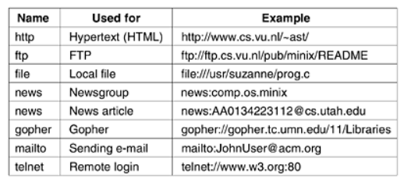
Now we can see how hypertext works.
To make a piece of text clickable, the page writer must provide two items of information: the clickable text to be displayed and the URL of the page to go to if the text is selected.
In fact, URLs for various other common protocols have been defined. Slightly simplified forms of the more common ones are listed in the following Figure.

Slide 66
Let us briefly go over the list. The http protocol is the Web's native language, the one spoken by Web servers. HTTP stands for HyperText Transfer Protocol.
The ftp protocol is used to access files by FTP, the Internet's file transfer protocol.
It is possible to access a local file as a Web page, either by using the file protocol, or more simply, by just naming it.
This approach is similar to using FTP but does not require having a server.
The news protocol can be used to call up a news article as though it were a Web page.
Two formats are supported for the news protocol.
The first format specifies a newsgroup and can be used to get a list of articles from a preconfigured news site.

Slide 67
The second one requires the identifier of a specific news article to be given.
The browser then fetches the given article from its preconfigured news site using the NNTP (Network News Transfer Protocol)
The gopher protocol was used by the Gopher system, which was designed at the University of Minnesota and named after the school's athletic teams, the Golden Gophers (as well as being a slang expression meaning ''go for'', i.e., go fetch).
The last two protocols do not really have the flavor of fetching Web pages, but are useful anyway.
The mailto protocol allows users to send e-mail from a Web browser.
The telnet protocol is used to establish an on-line connection to a remote machine.

Slide 68
Statelessness and Cookies
The Web is basically stateless. There is no concept of a login session.
The browser sends a request to a server and gets back a file.
Then the server forgets that it has ever seen that particular client.
Many users work on shared computers, especially at companies, and the IP address merely identifies the computer, not the user.
Second, and even worse, many ISPs use NAT(Network Address Translation), so all outgoing packets from all users bear the same IP address.
To solve this problem, Netscape devised a much-criticized technique called cookies.
The name derives from ancient programmer slang in which a program calls a procedure and gets something back that it may need to present later to get some work done.
In this sense, a UNIX file descriptor or a Windows object handle can be considered as a cookie.
When a client requests a Web page, the server can supply additional information along with the requested page.

Slide 69
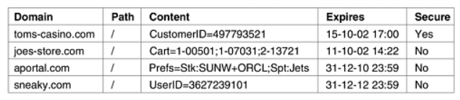
This information may include a cookie, which is a small (at most 4 KB) file (or string).
Browsers store offered cookies in a cookie directory on the client's hard disk unless the user has disabled cookies.
Cookies are just files or strings, not executable programs.
However, it is always possible for some hacker to exploit a browser bug to cause activation.
A cookie may contain up to five fields, as shown in the following Figure.
The Domain tells where the cookie came from.
Each domain may store no more than 20 cookies per client.
The Path is a path in the server's directory structure that identifies which parts of the server's file tree may use the cookie.

Slide 70
5.3.2 Static Web Documents
The basis of the Web is transferring Web pages from server to client.
In the simplest form, Web pages are static, that is, are just files sitting on some server waiting to be retrieved.
HTML—The HyperText Markup Language
Web pages are currently written in a language called HTML (HyperText Markup Language).
HTML allows users to produce Web pages that include text, graphics, and pointers to other Web pages.
HTML is a markup language, a language for describing how documents are to be formatted.
The term ''markup'' comes from the old days when copyeditors actually marked up documents to tell the printer—in those days, a human being—which fonts to use, and so on.
Markup languages thus contain explicit commands for formatting.

Slide 71
XHTML—The eXtended HyperText Markup Language
HTML keeps evolving to meet new demands. Many people in the industry feel that in the future, the majority of Web-enabled devices will not be PCs, but wireless, handheld PDA-type devices.
These devices have limited memory for large browsers full of heuristics that try to somehow deal with syntactically incorrect Web pages.
Thus, the next step after HTML 4 is a language that is Very Picky.
It is called XHTML (eXtended HyperText Markup Language) rather than HTML 5 because it is essentially HTML 4 reformulated in XML.
By this we mean that tags such as have no intrinsic meaning.
To get the HTML 4 effect, a definition is needed in the XSL file. XHTML is the new Web standard and should be used for all new Web pages to achieve maximum portability across platforms and browsers.

Slide 72
5.3.3 Dynamic Web Documents
In recent years, more and more content has become dynamic, that is, generated on demand, rather than stored on disk.
Content generation can take place either on the server side or on the client side.
Server-Side Dynamic Web Page Generation
To see why server-side content generation is needed, consider the use of forms,
When a user fills in a form and clicks on the submit button, a message is sent to the server indicating that it contains the contents of a form, along with the fields the user filled in.
This message is not the name of a file to return. What is needed is that the message is given to a program or script to process.

Slide 73
Usually, the processing involves using the user-supplied information to look up a record in a database on the server's disk and generate a custom HTML page to send back to the client.
For example, in an e-commerce application, after the user clicks on PROCEED TO CHECKOUT, the browser returns the cookie containing the contents of the shopping cart, but some program or script on the server has to be invoked to process the cookie and generate an HTML page in response.
The HTML page might display a form containing the list of items in the cart and the user's last-known shipping address along with a request to verify the information and to specify the method of payment.
The steps required to process the information from an HTML form are illustrated in the following Figure.

Slide 74
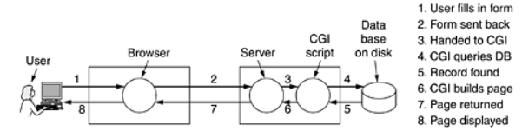
The traditional way to handle forms and other interactive Web pages is a system called the CGI (Common Gateway Interface).
It is a standardized interface to allow Web servers to talk to back-end programs and scripts that can accept input (e.g., from forms) and generate HTML pages in response.
Usually, these back-ends are scripts written in the Perl scripting language because Perl scripts are easier and faster to write than programs (at least, if you know how to program in Perl).
By convention, they live in a directory called cgi-bin, which is visible in the URL. Sometimes another scripting language, Python, is used instead of Perl.

Slide 75
Client-Side Dynamic Web Page Generation
CGI, PHP, JSP, and ASP scripts solve the problem of handling forms and interactions with databases on the server.
They can all accept incoming information from forms, look up information in one or more databases, and generate HTML pages with the results.
What none of them can do is respond to mouse movements or interact with users directly.
For this purpose, it is necessary to have scripts embedded in HTML pages that are executed on the client machine rather than the server machine.
Starting with HTML 4.0, such scripts are permitted using the tag.
JavaScript is a scripting language, very loosely inspired by some ideas from the Java programming language.
It is definitely not Java. Like other scripting languages, it is a very high level language.

Slide 76
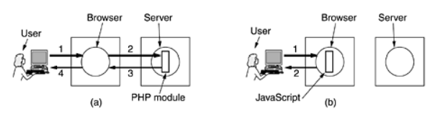
The difference between server-side scripting and client-side scripting is illustrated in the following Figure, including the steps involved.
In both cases, the numbered steps start after the form has been displayed. Step 1 consists of accepting the user input.
Then comes the processing of the input, which differs in the two cases.

Slide 77
This difference does not mean that JavaScript is better than PHP.
Their uses are completely different. PHP (and, by implication, JSP and ASP) are used when interaction with a remote database is needed.
JavaScript is used when the interaction is with the user at the client computer.
It is certainly possible to have HTML pages that use both PHP and JavaScript, although they cannot do the same work.
JavaScript is a full-blown programming language, with all the power of C or Java.
It also has a large number of facilities specific for Web pages, including the ability to manage windows and frames, set and get cookies, deal with forms, and handle hyperlinks.

Slide 78
5.3.4 HTTP—The HyperText Transfer Protocol
The transfer protocol used throughout the World Wide Web is HTTP (HyperText Transfer Protocol).
It specifies what messages clients may send to servers and what responses they get back in return.
Each interaction consists of one ASCII request, followed by one RFC 822 MIME-like response.
All clients and all servers must obey this protocol.
Connections
The usual way for a browser to contact a server is to establish a TCP connection to port 80 on the server's machine, although this procedure is not formally required.
The value of using TCP is that neither browsers nor servers have to worry about lost messages, duplicate messages, long messages, or acknowledgements.
All of these matters are handled by the TCP implementation.

Slide 79
Methods
Although HTTP was designed for use in the Web, it has been intentionally made more general than necessary with an eye to future object-oriented applications.
For this reason, operations, called methods, other than just requesting a Web page are supported.
This generality is what permitted SOAP (Simple Object Access Protocol) to come into existence.
Each request consists of one or more lines of ASCII text, with the first word on the first line being the name of the method requested.
The built-in methods are listed in the following Figure.
For accessing general objects, additional object-specific methods may also be available.
The names are case sensitive, so GET is a legal method but get is not.

Slide 80
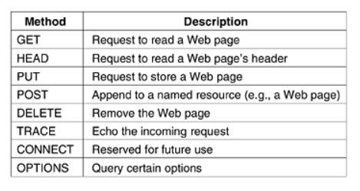

Slide 81
The GET method requests the server to send the page (by which we mean object, in the most general case, but in practice normally just a file).
The page is suitably encoded in MIME. The vast majority of requests to Web servers are GETs.
The usual form of GET is GET filename HTTP/1.1 where filename names the resource (file) to be fetched and 1.1 is the protocol version being used.
The HEAD method just asks for the message header, without the actual page.
This method can be used to get a page's time of last modification, to collect information for indexing purposes, or just to test a URL for validity.

Slide 82
The PUT method is the reverse of GET: instead of reading the page, it writes the page.
This method makes it possible to build a collection of Web pages on a remote server.
The body of the request contains the page.
It may be encoded using MIME, in which case the lines following the PUT might include Content-Type and authentication headers, to prove that the caller indeed has permission to perform the requested operation.
Somewhat similar to PUT is the POST method.
It, too, bears a URL, but instead of replacing the existing data, the new data is ''appended'' to it in some generalized sense.
Posting a message to a newsgroup or adding a file to a bulletin board system are examples of appending in this context.

Slide 83
DELETE does what you might expect: it removes the page. As with PUT, authentication and permission play a major role here.
There is no guarantee that DELETE succeeds, since even if the remote HTTP server is willing to delete the page, the underlying file may have a mode that forbids the HTTP server from modifying or removing it.
The TRACE method is for debugging. It instructs the server to send back the request.
This method is useful when requests are not being processed correctly and the client wants to know what request the server actually got.
The CONNECT method is not currently used. It is reserved for future use.
The OPTIONS method provides a way for the client to query the server about its properties or those of a specific file.

Slide 84
Message Headers
The request line (e.g., the line with the GET method) may be followed by additional lines with more information.
They are called request headers.
This information can be compared to the parameters of a procedure call.
Responses may also have response headers.
Some headers can be used in either direction.
A selection of the most important ones is given in the following Figure

Slide 85
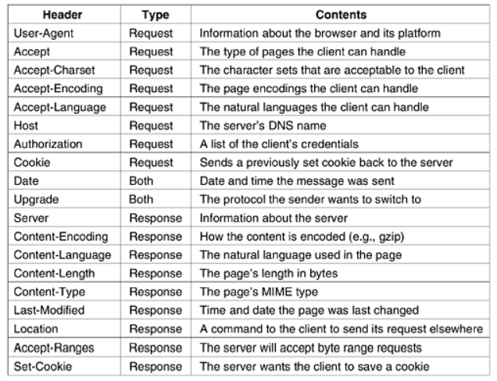

Slide 86
Thank You

