Slide 1
Fundamentals of Computers
By
Dr. M. Kalpana Devi

Slide 2
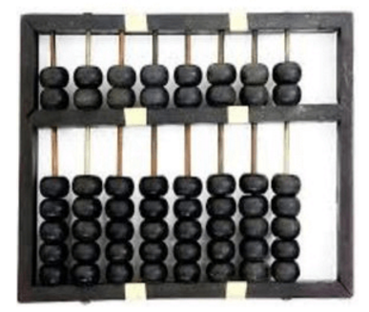
History of Computers
Abacus
The history of computer begins with the birth of abacus which is believed to be the first computer. It is said that Chinese invented Abacus around 4,000 years ago.

Slide 3
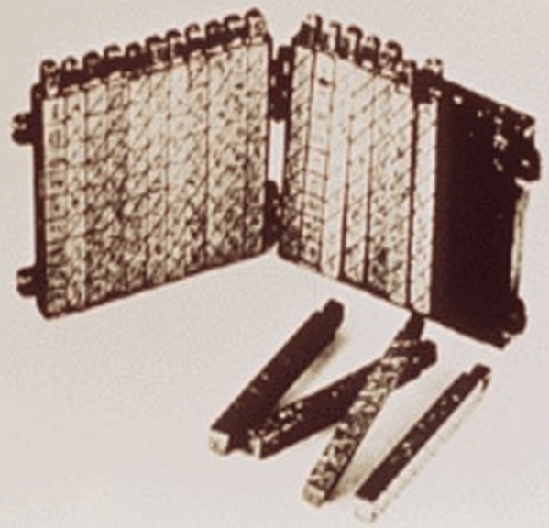
Napier's Bones
It was a manually-operated calculating device which was invented by John Napier (1550-1617) of Merchiston. In this calculating tool, he used 9 different ivory strips or bones marked with numbers to multiply and divide. So, the tool became known as "Napier's Bones. It was also the first machine to use the decimal point.

Slide 4
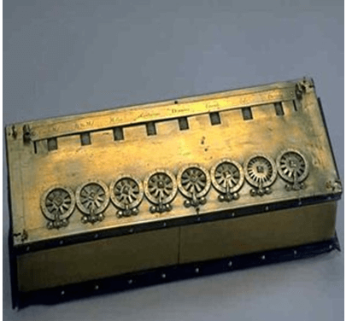
Pascaline
Pascaline is also known as Arithmetic Machine or Adding Machine. It was invented between 1642 and 1644 by a French mathematician-philosopher Biaise Pascal. It is believed that it was the first mechanical and automatic calculator.

Slide 5
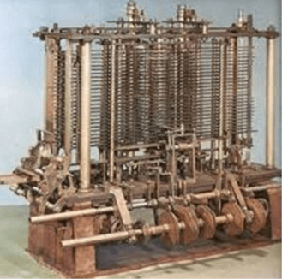
Analytical Engine
This calculating machine was also developed by Charles Babbage in 1830. It was a mechanical computer that used punch-cards as input. It was capable of solving any mathematical problem and storing information as a permanent memory.

Slide 6
Generations of Computers
A generation of computers refers to the specific improvements in computer technology with time.
First Generation Computers
The first generation (1946-1959) computers were slow, huge and expensive. In these computers, vacuum tubes were used as the basic components of CPU and memory. These computers were mainly depended on batch operating system and punch cards. Magnetic tape and paper tape were used as output and input devices in this generation;
Some of the popular first generation computers are;
ENIAC ( Electronic Numerical Integrator and Computer)
EDVAC ( Electronic Discrete Variable Automatic Computer)
UNIVACI( Universal Automatic Computer)
IBM-701 (International Business Machines Corporation)
IBM-650

Slide 7
Second Generation Computers
The second generation (1959-1965) was the era of the transistor computers. These computers used transistors which were cheap, compact and consuming less power; it made transistor computers faster than the first generation computers.
Some of the popular second generation computers are;
IBM 1620
IBM 7094
CDC 1604(Control Data Corporation)
CDC 3600
UNIVAC 1108 (Universal Automatic Computer)

Slide 8
Third Generation Computers
The third generation computers used integrated circuits (ICs) instead of transistors. A single IC can pack huge number of transistors which increased the power of a computer and reduced the cost.
Some of the popular third generation computers are;
IBM-360 series
Honeywell-6000 series
PDP(Personal Data Processor)
IBM-370/168
TDC-316

Slide 9
Fourth Generation Computers
The fourth generation (1971-1980) computers used very large scale integrated (VLSI) circuits; a chip containing millions of transistors and other circuit elements. These chips made this generation computers more compact, powerful, fast and affordable.
Some of the popular fourth generation computers are;
DEC 10
STAR 1000
PDP 11
CRAY-1(Super Computer)
CRAY-X-MP(Super Computer)

Slide 10
Fifth Generation Computers
In fifth generation (1980-till date) computers, the VLSI technology was replaced with ULSI (Ultra Large Scale Integration). It made possible the production of microprocessor chips with ten million electronic components. This generation computers used parallel processing hardware and AI (Artificial Intelligence) software.
Some of the popular fifth generation computers are;
Desktop
Laptop
NoteBook
UltraBook
ChromeBook

Slide 11
Types of Computer
We can categorize computer by two ways: data handling capabilities and size.
1) Analogue Computer
Analogue computers are designed to process the analogue data. Analogue data is continuous data that changes continuously and cannot have discrete values such as speed, temperature, pressure and current.
2) Digital Computer
Digital computer is designed to perform calculations and logical operations at high speed. It accepts the raw data as digits or numbers and processes it with programs stored in its memory to produce output. All modern computers like laptops and desktops that we use at home or office are digital computers.
3) Hybrid Computer
Hybrid computer has features of both analogue and digital computer. It is fast like analogue computer and has memory and accuracy like digital computers. It can process both continuous and discrete data. So it is widely used in specialized applications where both analogue and digital data is processed.

Slide 12
On the basis of size, the computer can be of five types:
1) Supercomputer
Supercomputers are the biggest and fastest computers.
Supercomputers are particularly used in scientific and engineering applications such as weather forecasting, scientific simulations and nuclear energy research.
First supercomputer was developed by Roger Cray in 1976.

Slide 14
2) Mainframe computer
Mainframe computers are designed to support hundreds or thousands of users simultaneously.
They can support multiple programs at the same time
3) Miniframe computer
It is a midsize multiprocessing computer. It consists of two or more processors and can support 4 to 200 users at one time.
Miniframe computers are used in institutes and departments for the tasks such as billing, accounting and inventory management.

Slide 15
4) Workstation
Workstation is a single user computer that is designed for technical or scientific applications.
It has faster microprocessor, large amount of RAM and high speed graphic adapters.
5) Microcomputer
Microcomputer is also known as personal computer. It is a general purpose computer that is designed for individual use.

Slide 16
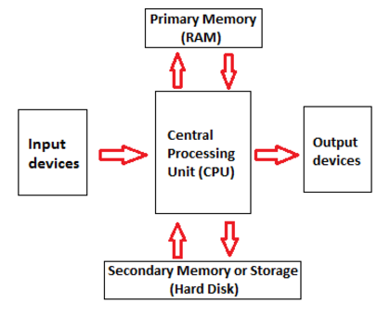
Computer Components
There are 5 main computer components that are given below:
Input Devices
CPU
Output Devices
Primary Memory
Secondary Memory

Slide 17
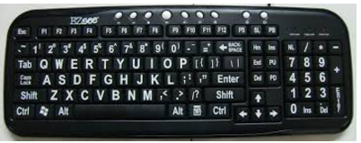
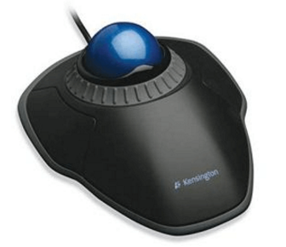
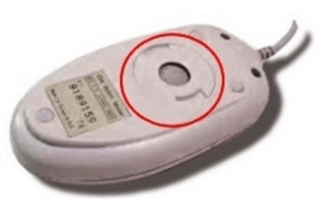
Input Devices
Input device enables the user to send data, information, or control signals to a computer.
1) Keyboard
The keyboard is a basic input device that is used to enter data into a computer or any other electronic device by pressing keys.
QWERTY Keyboard:
2) Mouse
The mouse is a hand-held input device which is used to move cursor or pointer across the screen.
Trackball Mouse:
Mechanical Mouse:
Optical Mouse:

Slide 18
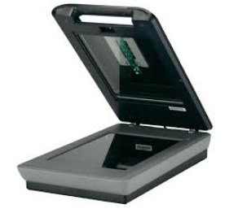
3) Scanner
The scanner uses the pictures and pages of text as input. It scans the picture or a document. The scanned picture or document then converted into a digital format or file and is displayed on the screen as an output.
Flatbed Scanner:
Handheld Scanner:

Slide 19
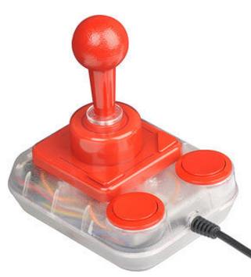
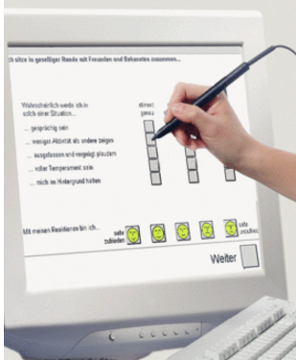
4) Joystick
A joystick is also a pointing input device like a mouse. It is made up of a stick with a spherical base. The base is fitted in a socket that allows free movement of the stick. The movement of stick controls the cursor or pointer on the screen.
5) Light Pen
A light pen is a computer input device that looks like a pen. The tip of the light pen contains a light-sensitive detector that enables the user to point to or select objects on the display screen.

Slide 20
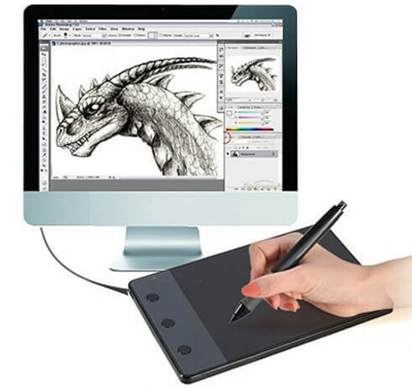
6)Digitizer
Digitizer is a computer input device that has a flat surface and usually comes with a stylus. It enables the user to draw images and graphics using the stylus as we draw on paper with a pencil.
7) Microphone
The microphone is a computer input device that is used to input the sound. It receives the sound vibrations and converts them into audio signals or sends to a recording medium.
The audio signals are converted into digital data and stored in the computer.
Dynamic
Condenser

Slide 21
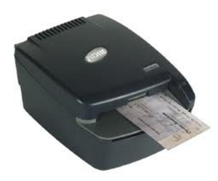
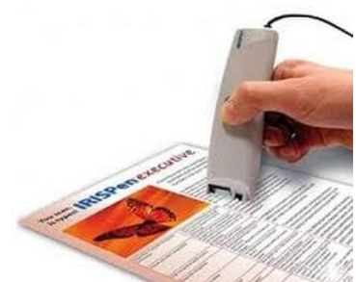
8) Magnetic Ink Character Recognition (MICR)
MICR computer input device is designed to read the text printed with magnetic ink.
MICR is a character recognition technology that makes use of special magnetized ink which is sensitive to magnetic fields.
It is widely used in banks to process the cheques
9)Optical Character Reader (OCR)
OCR computer input device is designed to convert the scanned images of handwritten, typed or printed text into digital text.
It is widely used in offices and libraries to convert documents and books into electronic files.

Slide 22
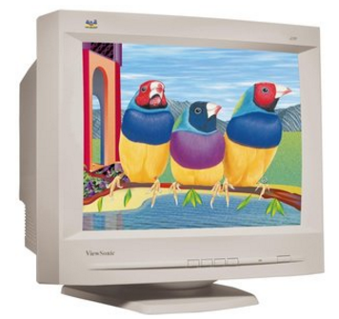
Output Devices
1) Monitor
The monitor is the display unit or screen of the computer. It is the main output device that displays the processed data or information as text, images, audio or video.
CRT Monitor:
CRT monitors are based on the cathode ray tubes. They are like vacuum tubes which produce images in the form of video signals.
LCD Monitor:
The LCD monitor is a flat panel screen that is compact and light-weight as compared to CRT monitors. It is based on liquid crystal display technology which is used in the screens of laptops, tablets, smart phones, etc.

Slide 23
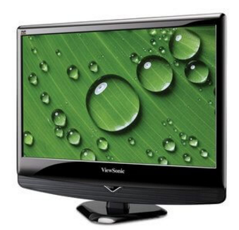
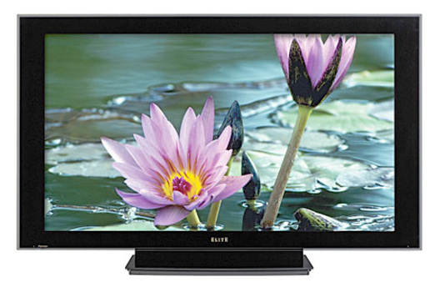
LED monitor:
The LED monitor is an improved version of an LCD monitor. The LED monitor has many LED panels, and each panel has several LEDs to backlight the display, it produces more brilliance and greater light intensity but also consumes less power.
Plasma Monitor:
The plasma monitor is also a flat panel display that is based on plasma display technology. It has small tiny cells between two glass panels. These cells contain mixtures of noble gases and a small amount of mercury. When voltage is applied, the gas in the cells turns into a plasma and emits ultraviolet light that creates images on the screen, i.e., the screen is illuminated by a tiny bit of plasma

Slide 24
Printers
Based on the printing mechanism, the printers are of two types: Impact Printers and Non-impact Printers.
Impact Printers: They are of two types:
Character Printers
Dot Matrix printers
Daisy Wheel printers
Line printers
Drum printers
Chain printers
Non-impact printers: They are of two types:
Laser printers
Inkjet printers

Slide 25
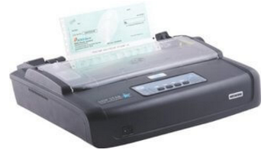
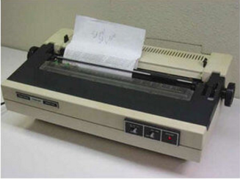
Impact Printers: The impact printer uses a hammer or print head to print the character or images onto the paper. The hammer or print head strikes or presses an ink ribbon against the paper to print characters and images.
Character Printers:
Character printer prints a single character at a time or with a single stroke of the print head or hammer. It does not print one line at a time.
Dot Matrix Printer
Daisy Wheel Printer

Slide 26
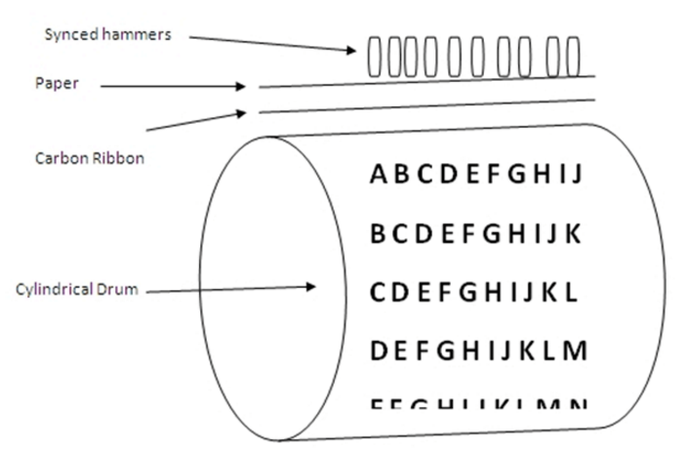
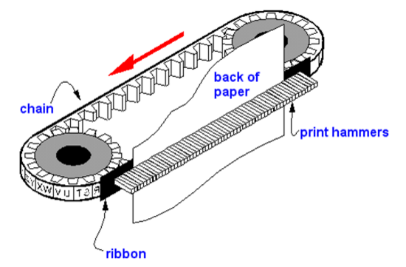
B) Line Printers:
Line printer, which is also as a bar printer, prints one line at a time. It is a high-speed impact printer as it can print 500 to 3000 lines per minute.
Drum Printer:
Chain Printer:

Slide 27
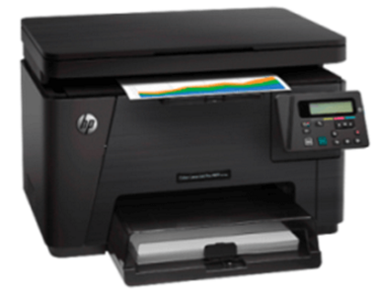
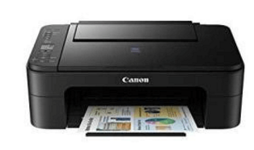
Non-Impact Printer:
Non-impact printers don't print characters or images by striking a print head or hammer on the ink ribbon placed against the paper.
These printers can print a complete page at a time
Laser Printer: uses a laser beam to print the characters.
Inkjet Printer: prints images and characters by spraying fine, ionized drops of ink. The print head has tiny nozzles to spray the ink.

Slide 28
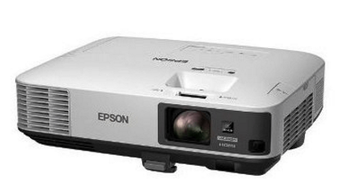
Projector
A projector is an output device that enables the user to project the output onto a large surface such as a big screen or wall.

Slide 29
Motherboard

Slide 30
PCI- Peripheral Component Interface
AGP- Accelerated Graphics Port
IDE- Integrated Drive Electronics
CMOS- Complementary Metal Oxide Semiconductor
ATX – Advanced Technology Extended
DRAM- Dynamic Random Access Memory

Slide 31
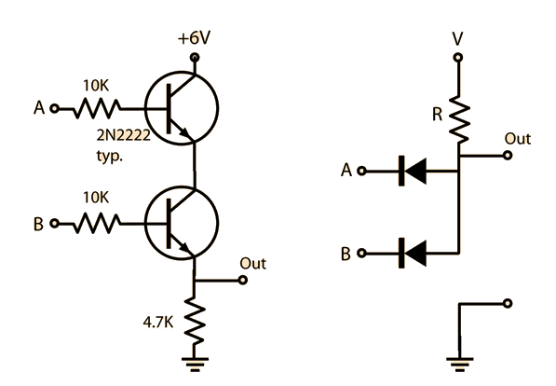
LOGIC GATES

Slide 32
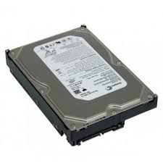
HARD DISK

Slide 33
EXTERNAL HARD DISK

Slide 34
RAM

Slide 35
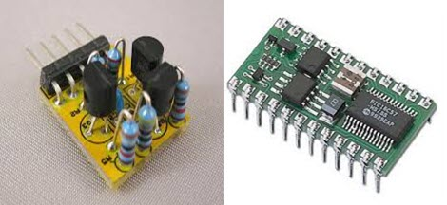
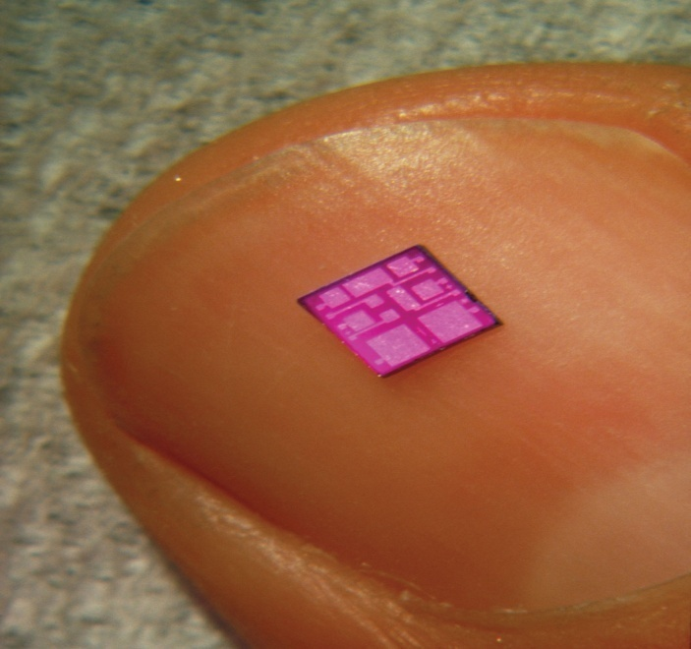
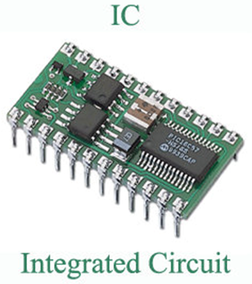
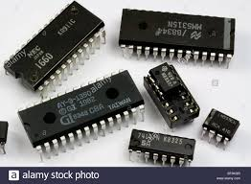
INTEGRATED CIRCUIT CHIPS (IC Chip)

Slide 36
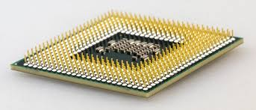
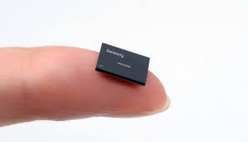
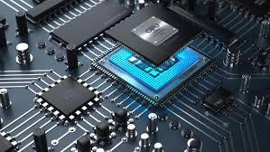
PROCESSOR

Slide 37
Parallel Processing
By
Dr. M. Kalpana Devi
Assoc. Professor

Slide 38
Pipelining Conflicts
Whenever a pipeline has to stall due to some reason it is called pipeline hazards or conflicts.
In general there are three major difficulties that cause the instruction pipeline to deviate from its normal operation:
1. Resource conflicts
2. Data dependency
3. Branch difficulties
4. Memory delay
5. Resource limitation
Resource conflicts:
Which is caused by access to memory by two segments at a time. Most of these conflicts can be resolved by using separate instruction and data memories

Slide 39
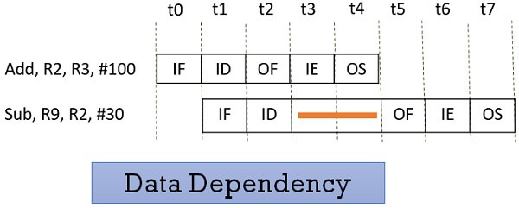
2. Data dependency
Conflicts arise when an instruction depends on the result of a previous instruction, but the result is not yet available.

Slide 40
Pipeline Computers deal with this conflict in variety of ways, few of them are:
1. Hardware interlocks: The most strait forward method is to use Hardware interlocks.
An interlock is a circuit that detect instructions whose source operands are not available and those instructions will be delayed by inserting enough clock cycles to resolve the conflict.
2. Operator forwarding: uses special hardware to detect the conflict and avoid it by routing the data through special paths between pipeline segments.
For example instead of transferring the result into destination register, if it is needed as source to the next instruction, it passes the result directly to the ALU input.
This method requires additional hardware paths and circuit to detect the conflict.

Slide 41
3. Delayed load: Some computers resolve this conflict by giving the responsibility to the compiler that translates the high level programming language to machine level programming language.
The compiler is designed in such a way that it detects the conflict and reorder the instructions as necessary to delay the loading of the conflicting data by inserting no operation instructions.

Slide 42
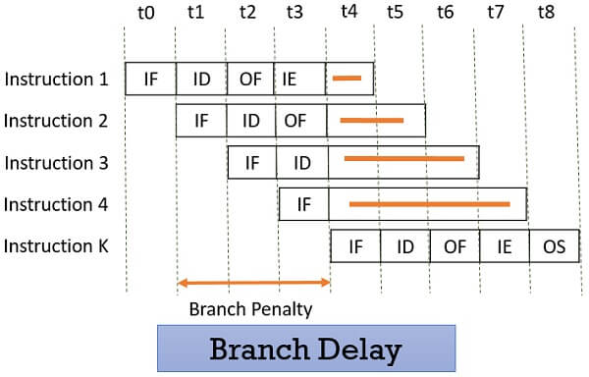
3. Branch difficulties
Conflict arise from branch or other instructions that change the value of PC.
In the following example instruction-1 is a branch instruction and its target instruction is k.
As I₁ is found to be a branch instruction, the instructions I₂, I_{3,} I₄ has to be discarded because the instruction I_{k} has to be processed next to I₁. So, this delay of three cycles 1, 2, 3 is a branch delay.

Slide 43
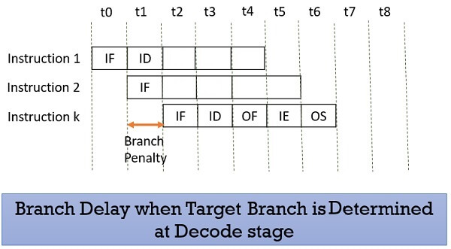
Prefetching the target branch address will reduce the branch delay. Like if the target branch is identified at the decode stage then the branch delay will reduce to 1 clock cycle.

Slide 44
Pipeline computers employ various hardware techniques to handle branch instruction conflict.
1. Prefetching target instruction: One way to handle the conditional branching is to prefetch the target instruction in addition to the instruction following the branch.
Both are saved until the branch instruction is executed.
2. Branch target buffer: The BTB is an associative memory included in the fetch segment of the pipeline.
Each entry in the BTB consists of the address of the previously executed branch instruction and the target instruction for that branch.
It also stores the next few instructions after branch target instruction.
When the pipeline decodes the branch instruction, it searches associative memory BTB for the address of the target instruction. If it is in BTB the instruction is available directly. If it not available the pipeline shifts to the new instruction stream and stores the target instruction in the BTB.

Slide 45
3. Loop Buffer: is a small very high speed register file maintained by the instruction fetch segment of the pipeline. When a program loop is detected it is stored in the loop buffer in its entirety, including all branches.
The program loop can be executed directly without having to access memory.
4. Branch prediction: A pipeline with branch prediction uses some additional logic to guess the outcome of a conditional branch before it is executed.
The pipeline then begins prefetching the instruction stream from the predicted path.
5. Delayed branch: The procedure employed in most RISC processors is delayed branch.
In this procedure the compiler detects the branch instructions and rearranges the machine language code sequence by inserting useful instructions that keep pipeline operates without interrupts.

Slide 46
4. Memory Delay
When an instruction or data is required, it is first searched in the cache memory if not found then it is a cache miss.
The data is further searched in the memory which may take ten or more cycles.
So, for that number of cycle the pipeline has to stall and this is a memory delay hazard.
The cache miss, also results in the delay of all the subsequent instructions.
5. Resource Limitation
If the two instructions request for accessing the same resource in the same clock cycle, then one of the instruction has to stall and let the other instruction to use the resource.
This stalling is due to resource limitation. However, it can be prevented by adding more hardware.

Slide 47
RISC Pipeline
RISC is an abbreviation of Reduced Instruction Set Computer.
RISC processor has ‘instruction sets’ that are simple and have simple ‘addressing modes’.
A RISC style instruction engages “one word” in memory.
Execution of the RISC instructions are faster and take one clock cycle per instruction.
The simplicity of the instruction set can be utilized to implement an instruction pipeline using a small number of sub operations, with each being executed in one clock cycle.

Slide 48
Therefore the total operations can be categorized as one segment will be fetching the instruction from program memory.
The second segment executes the instruction in the ALU.
The third segment may be used to store the result of the ALU operation in a destination register.
The data transfer instructions in RISC are limited to only Load and Store instructions.

Slide 49
To prevent conflicts in data transfer, we will be using two separate buses one for storing the instructions and other for storing the data.
Therefore as per the instruction cycle, we will be having the following steps:
1. I: Instruction Fetch
2. A: ALU Operation
3. E: Execute Instruction.
The I segment will be fetching the instruction from program memory. The instruction is decoded and an ALU operation is performed in the A segment.
In the A segment the ALU operation instruction will be fetched and the effective address will be retrieved and finally in the E segment the instruction will be executed.

Slide 50
Pipeline conflict handling
Delayed Load:
Consider the following instructions:
1. LOAD: R1 ← M[address 1]
2. LOAD: R2 ← M[address 2]
3. ADD: R3 ← R1 + R2
4. STORE: M[address 3] ← R3
The below tables will be showing the pipelining concept with the data conflict and without data conflict.

Slide 51
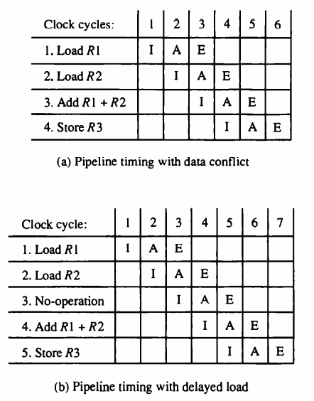

Slide 52
Delayed Branch:
Several techniques for branch penalties were there, but the method used in the RISC processors is to relay on the compiler to redefine the branches so that they effect at the proper time in the pipeline.
For example the following program consists of five instructions:
1. Load from memory to R1.
2. Increment R2.
3. Add r3 to R4.
4. Subtract R5 from R6.
5. Branch to address X

Slide 53
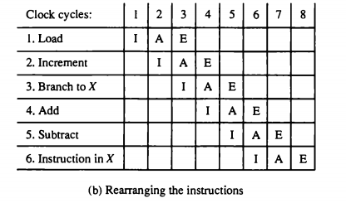

Slide 54
Vector Processing:
Normal computational systems are not enough in some special processing requirements.
Special processing systems like
Artificial intelligence systems and some
Weather forecasting systems,
Terrain analysis etc.,
In such systems the data processing will be involving on very high amount of data, we can classify the large data as a very big arrays.
Now if we want to process this data, naturally we will need new methods of data processing.
These numbers are usually formulated as vectors and matrices of floating point numbers.
The vector is an ordered set of large one dimensional array of data items.

Slide 55
A vector V of length n is represented as a row vector as
V=[V1,V2,V3 …Vn]
The term vector processing involves the data processing on the vectors of such large data.
The vector processing system can be understand by the example below.
Consider a program which is adding two arrays A and B of length 100; Machine level program.
Initialize I=0
20: Read A(I)
Read B(I)
Store C(I)=A(I)+B(I)
Increment I=I+1 If I<=100 go to 20 continue
So in this above program we can see that the two arrays are being added in a loop format.
First we are starting from the value of 0 and then we are continuing the loop with the addition operation until the I value has reached to 100.
In the above program there are 4 loop statements which will be executing 100 times.
Therefore the total cycles of the CPU taken is 500 cycles.

Slide 56
But if we use the concept of vector processing then we can reduce the unnecessary fetch cycles, since the fetch cycles are used in the creation of the vector.
The same program written in the vector processing statement is given below.
C(1:100)=A(1:100)+B(1:100)
In the above statement, when the system is creating a vector like this the original source values are fetched from the memory into the vector, therefore the data is readily available in the vector.
So when a operation is initiated on the data, naturally the operation will be performed directly on the data and will not wait for the fetch cycle.
So the total no of CPU Cycles taken by the above instruction is only 100.
The floating point addition is done as in the following figure.

Slide 58
The instruction format for vector instruction is as follows
It is also possible to design the processor with large number of registers and store more number of operands in the registers prior to the addition operation.

Slide 59
Matrix multiplication
Now let us see the implementation of the vector processing concept on the following matrix multiplication.
The multiplication of two nxn matrices consists of n2 inner products or n3 multiply-add operations.
An nxm matrix of numbers may be considered as constituting a set of n row vectors and m column vectors. For example a 3x3 matrix multiplication.

Slide 60
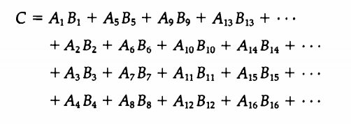
The following figure shows how the inner product calculation on pipeline vector processor is doing.
Now from the source A vector we will be taking the first 4 values and will be sending to the multiplier pipeline along with the 4 values from the vector B. The resultant 1 value is stored in the adder pipeline. The resultant 1 value is stored in the adder pipeline.
Like wise remaining values from a row and column multiplication will be brought into the adder pipeline, which will be performing the addition of all the things finally we will have the result of one row to column multiplication.

Slide 61
Micro Programmed Control And Central Processing Unit
By
Dr. M. Kalpana Devi

Slide 62
Introduction
The function of the control unit in a digital computer is to initiate sequence of microoperations.
Control unit can be implemented in two ways
Hardwired control
Microprogrammed control
Hardwired Control:
When the control signals are generated by hardware using conventional logic design techniques, the control unit is said to be hardwired.
The key characteristics are
High speed of operation
Expensive
Relatively complex
No flexibility of adding new instructions

Slide 63
Examples of CPU with hardwired control unit are
Intel 8085,
Motorola 6802,
Zilog 80,
and any RISC CPUs.
Microprogrammed Control:
Control information is stored in control memory.
Control memory is programmed to initiate the required sequence of micro-operations.
The key characteristics are
Speed of operation is low when compared with hardwired
Less complex
Less expensive
Flexibility to add new instructions

Slide 64
Examples of CPU with microprogrammed control unit are
Intel 8080,
Motorola 68000
and any CISC CPUs.

Slide 65
1. Control Memory:
A control memory is a part of the control unit. Any computer that involves microprogrammed control consists of two memories. They are the main memory and the control memory.
Programs are usually stored in the main memory by the users. Whenever the programs change, the data is also modified in the main memory. They consist of machine instructions and data.
The control memory consists of microprograms that are fixed and cannot be modified frequently. They contain microinstructions that specify the internal control signals required to execute register micro-operations.
The machine instructions generate a chain of microinstructions in the control memory. Their function is to generate micro-operations that can fetch instructions from the main memory, compute the effective address, execute the operation, and return control to fetch phase and continue the cycle.

Slide 66
The control function that specifies a microoperation is called as control variable.
When control variable is in one binary state, the corresponding microoperation is executed. For the other binary state the state of registers does not change.
The active state of a control variable may be either 1 state or the 0 state, depending on the application.
Control Word: The control variables at any given time can be represented by a string of 1’s and 0's called a control word.
All control words can be programmed to perform various operations on the components of the system.

Slide 67
Microprogram control unit: A control unit whose binary control variables are stored in memory is called a microprogram control unit.
The control word in control memory contains a microinstruction.
The microinstruction specifies one or more micro-operations for the system.
A sequence of microinstructions constitutes a microprogram.
The control unit consists of control memory used to store the microprogram.
Control memory is a permanent i.e., read only memory (ROM).
The general configuration of a micro-programmed control unit organization is shown as block diagram below.

Slide 69
The control memory is ROM so all control information is permanently stored.
The control memory address register (CAR) specifies the address of the microinstruction and the control data register (CDR) holds the microinstruction read from memory.
The next address generator is sometimes called a microprogram sequencer. It is used to generate the next micro instruction address.
The location of the next microinstruction may be the one next in sequence or it may be located somewhere else in the control memory.
So it is necessary to use some bits of the present microinstruction to control the generation of the address of the microinstruction.
Sometimes the next address may also be a function of external input conditions.
The control data register holds the present microinstruction while next address is computed and read from memory. The data register is times called a pipeline register.

Slide 70
2. Address Sequencing:
Microinstructions are stored in control memory in groups, with each group specifying a routine.
Each computer instruction has its own microprogram routine to generate the microoperations.
The hardware that controls the address sequencing of the control memory must be capable of sequencing the microinstructions within a routine and be able to branch from one routine to another
Control must undergo the following steps during the execution of a single computer instruction:

Slide 71
Load an initial address into the CAR when power is turned on in the computer. This address is usually the address of the first microinstruction that activates the instruction fetch routine – IR holds instruction
The control memory then goes through the routine to determine the effective address of the operand – AR holds operand address
The next step is to generate the microoperations that execute the instruction by considering the opcode and applying a mapping process.
The transformation of the instruction code bits to an address in control memory where the routine of instruction located is referred to as mapping process.
After execution, control must return to the fetch routine by executing an unconditional branch.
The below figure shows a block diagram of a control memory and the associated hardware needed for selecting the next microinstruction address.

Slide 73
The microinstruction in control memory contains a set of bits to initiate microoperations in computer registers and other bits to specify the method by which the next address is obtained.
In the figure four different paths form which the control address register (CAR) receives the address.
The incrementer increments the content of the control register address register by one, to select the next microinstruction in sequence.
Branching is achieved by specifying the branch address in one of the fields of the microinstruction.
Conditional branching is obtained by using part of the microinstruction to select a specific status bit in order to determine its condition.
An external address is transferred into control memory via a mapping logic circuit.
The return address for a subroutine is stored in a special register, that value is used when the micoprogram wishes to return from the subroutine.

Slide 74
Conditional Branching:
Conditional branching is obtained by using part of the microinstruction to select a specific status bit in order to determine its condition.
The status conditions are special bits in the system that provide parameter information such as the carry-out of an adder, the sign bit of a number, the mode bits of an instruction, and i/o status conditions.
The status bits, together with the field in the microinstruction that specifies a branch address, control the branch logic.
The branch logic tests the condition, if met then branches, otherwise, increments the CAR.
If there are 8 status bit conditions, then 3 bits in the microinstruction are used to specify the condition and provide the selection variables for the multiplexer.
For unconditional branching, fix the value of one status bit to be one load the branch address from control memory into the CAR.

Slide 75
Mapping of Instruction:
A special type of branch exists when a microinstruction specifies a branch to the first word in control memory where a microprogram routine is located.
The status bits for this type of branch are the bits in the opcode.
Assume an opcode of four bits and a control memory of 128 locations. The mapping process converts the 4-bit opcode to a 7-bit address for control memory shown in below figure

Slide 76
Mapping consists of placing a 0 in the most significant bit of the address, transferring the four operation code bits, and clearing the two least significant bits of the control address register.
This provides for each computer instruction a microprogram routine with a capacity of four microinstructions.

Slide 77
Subroutines:
Subroutines are programs that are used by other routines to accomplish a particular task and can be called from any point within the main body of the microprogram.
Frequently many microprograms contain identical section of code.
Microinstructions can be saved by employing subroutines that use common sections of microcode.
Microprograms that use subroutines must have a provision for storing the return address during a subroutine call and restoring the address during a subroutine return.
A subroutine register is used as the source and destination for the addresses

Slide 78
3. Microprogram Example:
The process of code generation for the control memory is called microprogramming.
The block diagram of the computer configuration is shown in the figure.
Two memory units:
Main memory – stores instructions and data
Control memory – stores microprogram
Four processor registers
Program counter – PC
Address register – AR
Data register – DR
Accumulator register – AC

Slide 79
Two control unit registers
Control address register – CAR
Subroutine register – SBR
Transfer of information among registers in the processor is through MUXs rather than a bus.

Slide 81
The computer instruction format is shown in below figure.
Three fields for an instruction:
1-bit field for indirect addressing
4-bit opcode
11-bit address field
The example will only consider the following 4 of the possible 16 memory instructions

Slide 83
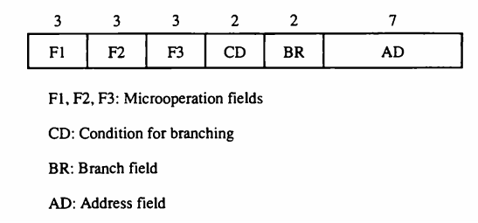
The microinstruction format for the control memory is shown in below figure.

Slide 84
The microinstruction format is composed of 20 bits with four parts to it
Three fields F1, F2, and F3 specify microoperations for the computer [3 bits each]
The CD field selects status bit conditions [2 bits]
The BR field specifies the type of branch to be used [2 bits]
The AD field contains a branch address [7 bits]
Each of the three microoperation fields can specify one of seven possibilities.
No more than three microoperations can be chosen for a microinstruction.
If fewer than three are needed, the code 000 = NOP.
The three bits in each field are encoded to specify seven distinct microoperations listed in below table

Slide 85
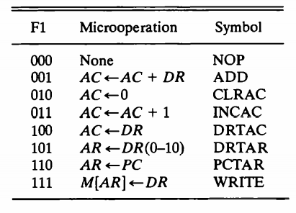
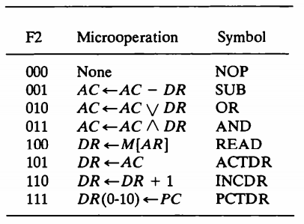
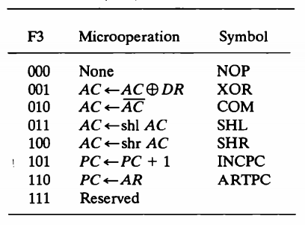

Slide 86
Five letters to specify a transfer-type microoperation
First two designate the source register
Third is a ‘T’
Last two designate the destination register AC ← DR
F1 = 100 = DRTAC
The condition field (CD) is two bits to specify four status bit conditions shown below
The branch field (BR) consists of two bits and is used with the address field to choose the address of the next microinstruction

Slide 88
Fetch Routine:
The control memory has 128 locations, each one is 20 bits.
The first 64 locations are occupied by the routines for the 16 instructions, addresses 0-63.
Can start the fetch routine at address 64.
The fetch routine requires the following three microinstructions (locations 64-66).
The microinstructions needed for fetch routine are:

Slide 89
It’s Symbolic microprogram:
It’s Binary microprogram:

Slide 90
4. Design of control Unit
The control memory out of each subfield must be decoded to provide the distinct microoperations.
The outputs of the decoders are connected to the appropriate inputs in the processor unit.
The below figure shows the three decoders and some of the connections that must be made from their outputs.
The three fields of the microinstruction in the output of control memory are decoded with a 3x8 decoder to provide eight outputs.
Each of the output must be connected to proper circuit to initiate the corresponding microoperation as specified in previous topic.

Slide 92
When F1 = 101 (binary 5), the next pulse transition transfers the content of DR (0-10) to AR.
Similarly, when F1= 110 (binary 6) there is a transfer from PC to AR (symbolized by PCTAR). As shown in Fig, outputs 5 and 6 of decoder F1 are connected to the load input of AR so that when either one of these outputs is active, information from the multiplexers is transferred to AR.
The multiplexers select the information from DR when output 5 is active and from PC when output 5 is inactive.
The transfer into AR occurs with a clock transition only when output 5 or output 6 of the decoder is active.
For the arithmetic logic shift unit the control signals are instead of coming from the logical gates, now these inputs will now come from the outputs of AND, ADD and DRTAC respectively

Slide 93
Microprogram Sequencer:
The basic components of a microprogrammed control unit are the control memory and the circuits that select the next address.
The address selection part is called a microprogram sequencer.
The purpose of a microprogram sequencer is to present an address to the control memory so that a microinstruction may be read and executed.
The next-address logic of the sequencer determines the specific address source to be loaded into the control address register.
The block diagram of the microprogram sequencer is shown in below figure.

Slide 95
The control memory is included in the diagram to show the interaction between the sequencer and the memory attached to it.
There are two multiplexers in the circuit.
The first multiplexer selects an address from one of four sources and routes it into control address register CAR.
The second multiplexer tests the value of a selected status bit and the result of the test is applied to an input logic circuit.
The output from CAR provides the address for the control memory.
The content of CAR is incremented and applied to one of the multiplexer inputs and to the subroutine register SBR.

Slide 96
The other three inputs to multiplexer come from
The address field of the present microinstruction
From the out of SBR
From an external source that maps the instruction
The CD (condition) field of the microinstruction selects one of the status bits in the second multiplexer.
If the bit selected is equal to 1, the T variable is equal to 1; otherwise, it is equal to 0.
The T value together with two bits from the BR (branch) field goes to an input logic circuit.
The input logic in a particular sequencer will determine the type of operations that are available in the unit.

Slide 97
The input logic circuit in above figure has three inputs I0, I1, and T, and three outputs, S0, S1, and L.
Variables S0 and S1 select one of the source addresses for CAR. Variable L enables the load input in SBR.
The binary values of the selection variables determine the path in the multiplexer.
For example, with S1,S0 = 10, multiplexer input number 2 is selected and establishes transfer path from SBR to CAR.
The truth table for the input logic circuit is shown in Table below.

Slide 98
Inputs I1 and I0 are identical to the bit values in the BR field.
The bit values for S1 and S0 are determined from the stated function and the path in the multiplexer that establishes the required transfer.
The subroutine register is loaded with the incremented value of CAR during a call microinstruction (BR = 01) provided that the status bit condition is satisfied (T = 1).
The truth table can be used to obtain the simplified Boolean functions for the input logic circuit:
S1=I1
S0=I1I0+I’ 1T
L = I ’ 1T I0

Slide 99
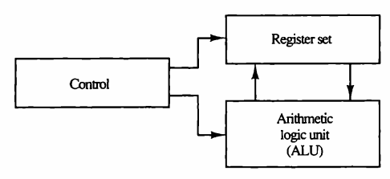
Central Processing Unit
Introduction:
The main part of the computer that performs the bulk of data-processing operations is called the central processing unit and is referred to as the CPU.
The CPU is made up of three major parts, as shown in Figure

Slide 100
The register set stores intermediate data used during the execution of the instructions.
The arithmetic logic unit (ALU) performs the required microoperations for executing the instructions.
The control unit supervises the transfer of information among the registers and instructs the ALU as to which operation to perform

Slide 101
General Register organization
Generally CPU has seven general registers.
Register organization show how registers are selected and how data flow between register and ALU.
A decoder is used to select a particular register.
The output of each register is connected to two multiplexers to form the two buses A and B.
The selection lines in each multiplexer select the input data for the particular bus.

Slide 102
The A and B buses form the two inputs of an ALU.
The operation select lines decide the micro operation to be performed by ALU.
The result of the micro operation is available at the output bus.
The output bus connected to the inputs of all registers, thus by selecting a destination register it is possible to store the result in it.

Slide 104
EXAMPLE:
To perform the operation R3 = R1+R2 We have to provide following binary selection variable to the select inputs.
1. SEL A : 001 -To place the contents of R1 into bus A.
2. SEL B : 010 - to place the contents of R2 into bus B
3. SEL OPR : 10010 – to perform the arithmetic addition A+B
4. SEL REG or SEL D : 011 – to place the result available on output bus in R3.

Slide 107
CONTROL WORD?
The combined value of a binary selection inputs specifies the control word.
It consist of four fields SELA, SELB,and SELD or SELREG contains three bit each and SELOPR field contains four bits thus the total bits in the control word are 13-bits.
Control Word For Operation R2 = R1+r3

Slide 108
Stack Organization:
Stack: A stack is a storage device that stores information in such a manner that the item stored last is the first item retrieved.
In the computer stack is a memory unit with an address register that can count the address only.
The register that holds the address for the stack is called a stack pointer (SP). It always points at the top item in the stack

Slide 109
The two operations that are performed on stack are the insertion and deletion.
The operation of insertion is called PUSH.
The operation of deletion is called POP.
These operations are simulated by incrementing and decrementing the stack pointer register (SP)
Register Stack:
A stack can be placed in a portion of a large memory or it can be organized as a collection of a finite number of memory words or registers.
The below figure shows the organization of a 64-word register stack

Slide 111
The stack pointer register SP contains a binary number whose value is equal to the address of the word is currently on top of the stack. Three items are placed in the stack: A, B, C, in that order.
In above figure C is on top of the stack so that the content of SP is 3.
For removing the top item, the stack is popped by reading the memory word at address 3 and decrementing the content of stack SP.
Now the top of the stack is B, so that the content of SP is 2.
Similarly for inserting the new item, the stack is pushed by incrementing SP and writing a word in the next higher location in the stack.
In a 64-word stack, the stack pointer contains 6 bits because 26 = 64.

Slide 112
Since SP has only six bits, it cannot exceed a number greater than 63 (111111 in binary).
When 63 is incremented by 1, the result is 0 since 111111 + 1. = 1000000 in binary, but SP can accommodate only the six least significant bits.
Then the one-bit register FULL is set to 1, when the stack is full.
Similarly when 000000 is decremented by 1, the result is 111111, and then the one-bit register EMTY is set 1 when the stack is empty of items.
DR is the data register that holds the binary data to be written into or read out of the stack

Slide 113
PUSH:
Initially, SP is cleared to 0, EMTY is set to 1, and FULL is cleared to 0, so that SP points to the word at address 0 and the stack is marked empty and not full.
If the stack is not full (if FULL = 0), a new item is inserted with a push operation.
The push operation is implemented with the following sequence of microoperations

Slide 114
The stack pointer is incremented so that it points to the address of next-higher word.
A memory write operation inserts the word from DR the top of the stack.
The first item stored in the stack is at address 1.
The last item is stored at address 0.
If SP reaches 0, the stack is full of items, so FULL is to 1.
This condition is reached if the top item prior to the last push way location 63 and, after incrementing SP, the last item is stored in location 0.
Once an item is stored in location 0, there are no more empty registers in the stack, so the EMTY is cleared to 0.

Slide 115
POP:
A new item is deleted from the stack if the stack is not empty (if EMTY = 0).
The pop operation consists of the following sequence of min operations:

Slide 116
The top item is read from the stack into DR.
The stack pointer is then decremented. If its value reaches zero, the stack is empty, so EMTY is set 1.
This condition is reached if the item read was in location 1. Once this it is read out, SP is decremented and reaches the value 0, which is the initial value of SP.
If a pop operation reads the item from location 0 and then is decremented, SP changes to 111111, which is equivalent to decimal 63 in above configuration, the word in address 0 receives the last item in the stack.

Slide 117
Memory Stack:
In the above discussion a stack can exist as a stand-alone unit.
But in the CPU implementation of a stack is done by assigning a portion of memory to a stack operation and using a processor register as stack pointer.
The below figure shows a portion computer memory partitioned into three segments: program, data, and stack.

Slide 119
The program counter PC points at the address of the next instruction in program.
The address register AR points at an array of data.
The stack pointer SP points at the top of the stack.
The three registers are connected to a common address bus, and either one can provide an address for memory.
PC is used during the fetch phase to read an instruction.
AR is used during the exec phase to read an operand.
SP is used to push or pop items into or from stack.

Slide 120
As shown in Fig. 8-4, the initial value of SP is 4001 and the stack grows with decreasing addresses.
Thus the first item stored in the stack is at address 4000, the second item is stored at address 3999, and the last address that can be used for the stack is 3000.
No provisions are available for stack limit checks.
The items in the stack communicate with a data register DR. A new item is inserted with the push operation as follows:
SP
SP-1 M [SP]
DR

Slide 121
The stack pointer is decremented so that it points at the address of the next word.
A memory write operation inserts the word from DR into the top of stack. A new item is deleted with a pop operation as follows:
DR
M [SP] SP
SP+1
The top item is read from the stack into DR. The stack pointer is then decremented to point at the next item in the stack.
Most computers do not provide hardware to check for stack overflow (full stack) or underflow (empty stack)

Slide 122
The stack limits can be checked by using processor registers:
One to hold the upper limit (3000 in this case)
Other to hold the lower limit (4001 in this case).
After a push operation, SP compared with the upper-limit register and after a pop operation, SP is a compared with the lower-limit register.
The two microoperations needed for either the push or pop are
An access to memory through SP
Updating SP.
The advantage of a memory stack is that the CPU can refer to it without having specify an address, since the address is always available and automatically updated in the stack pointer.

Slide 123
Reverse Polish Notation:
A stack organization is very effective for evaluating arithmetic expressions.
The common arithmetic expressions are written in infix notation, with each operator written between the operands.
Consider the simple arithmetic expression. A*B+C*D
For evaluating the above expression it is necessary to compute the product A*B, store this product result while computing C*D, and then sum the two products.
For doing this type of infix notation, it is necessary to scan back and forth along the expression to determine the next operation to be performed.

Slide 124
The Postfix notation, referred to as reverse Polish notation (RPN), places the operator after the operands.
The following examples demonstrate the three representations
Eg: A+B -----> Infix notation
+AB ------> Prefix or Polish notation
AB+ -------> Post or reverse Polish notation
The reverse Polish notation is in a form suitable for stack manipulation.
The expression A*B+C*D Is written in reverse polish notation as AB* CD* + And it is evaluated as follows

Slide 125
Scan the expression from left to right. When operator is reached, perform the operation with the two operands found on the left side of the operator.
Remove the two operands and the operator and replace them by the number obtained from the result of the operation.
Continue to scan the expression and repeat the procedure for every operation encountered until there are no more operators.

Slide 126
For the expression above it find the operator * after A and B. So it perform the operation A*B and replace A, B and * with the result.
The next operator is a * and it previous two operands are C and D, so it perform the operation C*D and places the result in places C, D and *.
The next operator is + and the two operands to be added are the two products, so we add the two quantities to obtain the result.
The conversion from infix notation to reverse Polish notation must take into consideration the operational hierarchy adopted for infix notation.
This hierarchy dictates that we first perform all arithmetic inside inner parentheses, then inside outer parentheses, and do multiplication and division operations before addition and subtraction operations.

Slide 127
Evaluation of Arithmetic Expressions:
Reverse Polish notation, combined with a stack arrangement of registers, is the most efficient way known for evaluating arithmetic expressions.
This procedure is employed in some electronic calculators and also in some computer.
The following numerical example may clarify this procedure. Consider the arithmetic expression
(3*4) + (5*6)
In reverse polish notation, it is expressed as
34 * 56* +
Now consider the stack operations shown in Figure.

Slide 128
Each box represents one stack operation and the arrow always points to the top of the stack.
Scanning the expression from left to right, we encounter two operands.
First the number 3 is pushed into the stack, then the number 4.
The next symbol is the multiplication operator *.
This causes a multiplication of the two top most items the stack.

Slide 129
The stack is then popped and the product is placed on top of the stack, replacing the two original operands.
Next we encounter the two operands 5 and 6, so they are pushed into the stack. The stack operation results from the next * replaces these two numbers by their product.
The last operation causes an arithmetic addition of the two topmost numbers in the stack to produce the final result of 42.

Slide 130
Computers may have instructions of several different lengths containing varying number of addresses.
The number of address fields in the instruct format of a computer depends on the internal organization of its registers.
Most computers fall into one of three types of CPU organizations:
Single accumulator organization.
General register organization.
Stack organization.

Slide 131
Single Accumulator Organization:
In an accumulator type organization all the operations are performed with an implied accumulator register.
The instruction format in this type of computer uses one address field.
For example, the instruction that specifies an arithmetic addition defined by an assembly language instruction as
ADD X
Where X is the address of the operand. The ADD instruction in this case results in the operation AC
AC +M[X]. AC is the accumulator register and M[X] symbolizes the memory word located at address X.

Slide 132
General register organization:
The instruction format in this type of computer needs three register address fields.
Thus the instruction for an arithmetic addition may be written in an assembly language as ADD R1, R2, R3 to denote the operation R1
R2 + R3. The number of address fields in the instruction can be reduced from three to two if the destination register is the same as one of the source registers.
Thus the instruction ADD R1, R2 would denote the operation R1
R1 + R2. Only register addresses for R1 and R2 need be specified in this instruction.

Slide 133
General register-type computers employ two or three address fields in their instruction format.
Each address field may specify a processor register or a memory word.
An instruction symbolized by ADD R1, X would specify the operation R1
R1 + M[X].
It has two address fields, one for register R1 and the other for the memory address X.

Slide 134
Stack organization:
The stack-organized CPU has PUSH and POP instructions which require an address field.
Thus the instruction PUSH X will push the word at address X to the top of the stack.
The stack pointer is updated automatically.
Operation-type instructions do not need an address field in stack-organized computers.
This is because the operation is performed on the two items that are on top of the stack.
The instruction ADD in a stack computer consists of an operation code only with no address field.
This operation has the effect of popping the two top numbers from the stack, adding the numbers, and pushing the sum into the stack.
There is no need to specify operands with an address field since all operands are implied to be in the stack.

Slide 135
Most computers fall into one of the three types of organizations.
Some computers combine features from more than one organizational structure.
The influence of the number of addresses on computer programs, we will evaluate the arithmetic statement X= (A+B) * (C+D)
Using zero, one, two, or three address instructions and using the symbols
ADD, SUB, MUL and DIV for four arithmetic operations;
MOV for the transfer type operations; and
LOAD and STORE for transfer to and from memory and AC register.
Assuming that the operands are in memory addresses A, B, C, and D and the result must be stored in memory ar address X and also the CPU has general purpose registers R1, R2, R3 and R4.

Slide 136
Instruction Formats:
Three Address Instructions:
Three-address instruction formats can use each address field to specify either a processor register or a memory operand.
The program assembly language that evaluates
X = (A+B) * (C+D)
is shown below, together with comments that explain the register transfer operation of each instruction

Slide 137
The symbol M [A] denotes the operand at memory address symbolized by A.
The advantage of the three-address format is that it results in short programs when evaluating arithmetic expressions.
The disadvantage is that the binary-coded instructions require too many bits to specify three addresses.

Slide 138
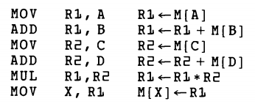
Two Address Instructions:
Two-address instructions formats use each address field can specify either a processor register or memory word.
The program to evaluate X = (A+B) * (C+D) is as follows
The MOV instruction moves or transfers the operands to and from memory and processor registers.
The first symbol listed in an instruction is assumed be both a source and the destination where the result of the operation transferred

Slide 139
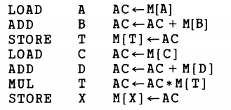
One Address Instructions:
One-address instructions use an implied accumulator (AC) register for all data manipulation.
For multiplication and division there is a need for a second register. But for the basic discussion we will neglect the second register and assume that the AC contains the result of all operations.
The program to evaluate X=(A+B) * (C+D) is
All operations are done between the AC register and a memory operand.
T is the address of a temporary memory location required for storing the intermediate result

Slide 140
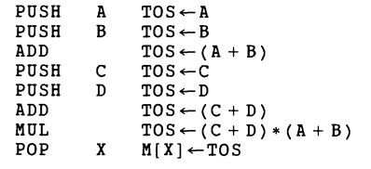
Zero Address Instructions:
A stack-organized computer does not use an address field for the instructions ADD and MUL.
The PUSH and POP instructions, however, need an address field to specify the operand that communicates with the stack.
The following program shows how X = (A+B) * (C+D) will be written for a stack-organized computer. (TOS stands for top of stack).

Slide 141
To evaluate arithmetic expressions in a stack computer, it is necessary to convert the expression into reverse Polish notation.
The name "zero-address” is given to this type of computer because of the absence of an address field in the computational instructions.

Slide 142
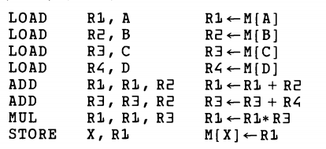
RISC Instructions:
The instruction set of a typical RISC processor is used to only load and store instructions for communicating between memory and CPU.
All other instructions are executed within the registers of CPU without referring to memory.
LOAD and STORE instructions that have one memory and one register address, and computational type instructions that have three addresses with all three specifying processor registers.
The following is a program to evaluate X=(A+B)*(C+D)

Slide 143
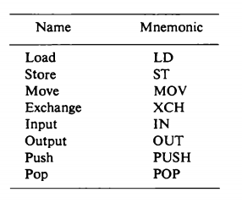
Data Transfer and Manipulation
Data Transfer Instructions:
Data transfer instructions move data from one place in the computer to another without changing the data content.
The most common transfers are between memory and processor registers, between processor registers and input or output, and between the processor registers themselves.
The following table gives a list of eight data transfer instructions used in many computers.

Slide 144
The load instruction has been used mostly to designate a transfer from memory to a processor register, usually an accumulator.
The store instruction designates a transfer from a processor register into memory.
The move instruction has been used in computers with multiple CPU registers to designate a transfer from one register to another and also between CPU registers and memory or between two memory words.
The exchange instruction swaps information between two registers or a register and a memory word.
The input and output instructions transfer data among processor registers and input or output terminals.

Slide 145
The push and pop instructions transfer data between processor registers and a memory stack.
Different computers use different mnemonics symbols for differentiate the addressing modes.
As an example, consider the load to accumulator instruction when used with eight different addressing modes.
The following table shows the recommended assembly language convention and actual transfer accomplished in each case

Slide 147
ADR stands for an address.
NBA a number or operand.
X is an index register.
R1 is a processor register.
AC is the accumulator register.
The @ character symbolizes an indirect addressing.
The $ character before an address makes the address relative to the program counter PC.
The # character precedes the operand in an immediate-mode instruction.

Slide 148
An indexed mode instruction is recognized by a register that placed in parentheses after the symbolic address.
The register mode is symbolized by giving the name of a processor register.
In the register indirect mode, the name of the register that holds the memory address is enclosed in parentheses.
The auto-increment mode is distinguished from the register indirect mode by placing a plus after the parenthesized register.
The auto-decrement mode would use a minus instead.

Slide 149
Data Manipulation Instructions:
Data manipulation instructions perform operations on data and provide the computational capabilities for the computer.
The data manipulation instructions in a typical computer are usually divided into three basic types:
Arithmetic instructions
Logical and bit manipulation instructions
Shift instructions

Slide 150
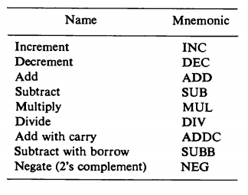
Arithmetic instructions
The four basic arithmetic operations are addition, subtraction, multiplication and division.
Most computers provide instructions for all four operations.
Some small computers have only addition and possibly subtraction instructions. The multiplication and division must then be generated by mean software subroutines.
A list of typical arithmetic instructions is given in Table.

Slide 151
The increment instruction adds 1 to the value stored in a register or memory word.
A number with all 1's, when incremented, produces a number with all 0's.
The decrement instruction subtracts 1 from a value stored in a register or memory word.
A number with all 0's, when decremented, produces number with all 1's.
The add, subtract, multiply, and divide instructions may be use different types of data.
The data type assumed to be in processor register during the execution of these arithmetic operations is defined by an operation code.

Slide 152
An arithmetic instruction may specify fixed-point or floating-point data, binary or decimal data, single-precision or double-precision data.
The mnemonics for three add instructions that specify different data types are shown below.
ADDI - Add two binary integer numbers
ADDF - Add two floating-point numbers
ADDD - Add two decimal numbers in BCD
A special carry flip-flop is used to store the carry from an operation.
The instruction "add carry" performs the addition on two operands plus the value of the carry the previous computation.
Similarly, the "subtract with borrow" instruction subtracts two words and borrow which may have resulted from a previous subtract operation.
The negate instruction forms the 2's complement number, effectively reversing the sign of an integer when represented it signed-2's complement form.

Slide 153
2. Logical and bit manipulation instructions
Logical instructions perform binary operations on strings of bits store, registers.
They are useful for manipulating individual bits or a group of that represent binary-coded information.
The logical instructions consider each bit of the operand separately and treat it as a Boolean variable.
By proper application of the logical instructions it is possible to change bit values, to clear a group of bits, or to insert new bit values into operands stored in register memory words.
Some typical logical and bit manipulation instructions are listed in Table

Slide 154
There are three bit manipulation operations possible:
a selected bit can cleared to 0,
or can be set to 1,
or can be complemented.

Slide 155
3. Shift Instructions:
Shifts are operations in which the bits of a word are moved to the left or right.
The bit shifted in at the end of the word determines the type of shift used.
Shift instructions may specify logical shifts, arithmetic shifts, or rotate-type operations.
In either case the shift may be to the right or to the left.
The following table lists four types of shift instructions.

Slide 157
The logical shift insert 0 to the end bit position.
The end position is the leftmost bit position for shift rights the rightmost bit position for the shift left.
Arithmetic shifts usually conform to the rules for signed-2's complement numbers.
The arithmetic shift-right instruction must preserve the sign bit in the leftmost position.
The sign bit is shifted to the right together with the rest of the number, but the sign bit itself remains unchanged.
This is a shift-right operation with the end bit remaining the same.

Slide 158
The arithmetic shift-left instruction inserts 0 to the end position and is identical to the logical shift-instruction.
The rotate instructions produce a circular shift. Bits shifted out at one of the word are not lost as in a logical shift but are circulated back into the other end.
The rotate through carry instruction treats a carry bit as an extension of the register whose word is being rotated.
Thus a rotate-left through carry instruction transfers the carry bit into the rightmost bit position of the register, transfers the leftmost bit position into the carry, and at the same time, shift the entire register to the left.

Slide 159
6. Reduced Instruction Set Computer (RISC):
A computer with large number instructions is classified as a complex instruction set computer, abbreviated as CISC.
The computer which is having the fewer instructions is classified as a reduced instruction set computer, abbreviated as RISC.

Slide 160
RISC Characteristics:
Relatively few instructions
Relatively few addressing modes
Memory access limited to load and store instructions
All operations done within the registers of the CPU
Fixed-length, easily decoded instruction format
Single-cycle instruction execution
Hardwired rather than microprogrammed control
A relatively large number of registers in the processor unit
Efficient instruction pipeline

Slide 161
CISC Characteristics:
A large number of instructions--typically from 100 to 250 instructions.
Some instructions that perform specialized tasks and are used infrequently.
A large variety of addressing modes—typically from 5 to 20 differ modes.
Variable-length instruction formats
Instructions that manipulate operands in memory

Slide 162
SREENIVASA INSTITUTE OF TECHNOLOGY AND MANAGEMENT STUDIES. (AUTONOMOUS) MCA DEPARTMENT Computer Organization and Architecture UNIT-5 Memory Organization
By
Dr. M. Kalpana Devi

Slide 163
A memory is just like a human brain.
It is used to store data and instructions.
Computer memory is the storage space in the computer, where data is to be processed and instructions required for processing are stored.
The memory is divided into large number of small parts called cells.
Each location or cell has a unique address, which varies from zero to memory size minus one.
For example, if the computer has 64k words, then this memory unit has 64 * 1024 = 65536 memory locations. The address of these locations varies from 0 to 65535.
Memory is primarily of three types −
Cache Memory
Primary Memory/Main Memory
Secondary Memory

Slide 164
If the smallest addressable unit of information is a memory word, the machine is called word-addressable.
If individual memory bytes are assigned distinct addresses, the computer is called byte-addressable.
Most of the commercial machines are byte addressable.
For example in a byte-addressable 32-bit computer, each memory word contains 4 bytes.
A possible word-address assignment would be: Word Address Byte Address

Slide 166
Memory Hierarchy
The term memory hierarchy is used in computer architecture when discussing performance issues in computer architectural design, algorithm predictions, and the lower level programming constructs such as involving locality of reference.
A "memory hierarchy" in computer storage distinguishes each level in the "hierarchy" by response time.
Since response time, complexity, and capacity are related, the levels may also be distinguished by the controlling technology.

Slide 168
Register:
This is a part of Central Processor Unit, so they reside inside the CPU.
The information from main memory is brought to CPU and keep the information in register.
Due to space and cost constraints, we have got a limited number of registers in a CPU.
These are basically faster devices.
Cache Memory:
Cache memory is a storage device placed in between CPU and main memory.
These are semiconductor memories.
These are basically fast memory device, faster than main memory.
We can not have a big volume of cache memory due to its higher cost and some constraints of the CPU.
Due to higher cost we can not replace the whole main memory by faster memory.
Generally, the most recently used information is kept in the cache memory.
It is brought from the main memory and placed in the cache memory. Now a days, we get CPU with internal cache.

Slide 169
Main Memory:
Like cache memory, main memory is also semiconductor memory.
But the main memory is relatively slower memory. We have to first bring the information (whether it is data or program), to main memory.
CPU can work with the information available in main memory only.
Magnetic Disk:
This is bulk storage device. We have to deal with huge amount of data in many application.
But we don't have so much semiconductor memory to keep these information in our computer.
On the other hand, semiconductor memories are volatile in nature. It loses its content once we switch off the computer.
For permanent storage, we use magnetic disk.
The storage capacity of magnetic disk is very high.
Removable media:
For different application, we use different data.
It may not be possible to keep all the information in magnetic disk.
So, which ever data we are not using currently, can be kept in removable media.
Magnetic tape is one kind of removable medium. CD is also a removable media, which is an optical device.

Slide 170
CPU-Main Memory Connection – A block schematic:
From the system standpoint, the Main Memory (MM) unit can be viewed as a “block box”.
Data transfer between CPU and MM takes place through the use of two CPU registers, usually called MAR (Memory Address Register) and MDR (Memory Data Register).
This transfer takes place over the processor bus, which has k address lines (address bus), n data lines (data bus) and control lines like Read, Write, Memory Function completed (MFC), Bytes specifiers etc (control bus).
For a read operation, the CPU loads the address into MAR, set READ to 1 and sets other control signals if required.
The data from the MM is loaded into MDR and MFC is set to 1.

Slide 171
For a write operation, MAR, MDR are suitably loaded by the CPU, write is set to 1 and other control signals are set suitably.
The MM control circuitry loads the data into appropriate locations and sets MFC to 1.
This organization is shown in the following block schematic.

Slide 172
Internal Organization of Semiconductor Memory Chips
Memory chips are usually organized in the form of an array of cells, in which each cell is capable of storing one bit of information.
A row of cells constitutes a memory word, and the cells of a row are connected to a common line referred to as the word line, and this line is driven by the address decoder on the chip.
The cells in each column are connected to a sense/write circuit by two lines known as bit lines.
The sense/write circuits are connected to the data input/output lines of the chip.
During a READ operation, the Sense/Write circuits sense, or read, the information stored in the cells selected by a word line and transmit this information to the output lines.

Slide 173
During a write operation, they receive input information and store it in the cells of the selected word.
A memory cell is capable of storing 1-bit of information. A number of memory cells are organized in the form of a matrix to form the memory chip. One such internal organization of memory chip is shown in the Figure.

Slide 175
Each row of cells constitutes a memory word, and all cell of a row are connected to a common line which is referred as word line.
An address decoder is used to drive the word line.
At a particular instant, one word line is enabled depending on the address present in the address bus.
The cells in each column are connected by two lines. These are known as bit lines.
These bit lines are connected to data input line and data output line through a Sense/ Write circuit.
During a Read operation, the Sense/Write circuit sense, or read the information stored in the cells selected by a word line and transmit this information to the output data line.
During a write operation, the sense/write circuit receive information and store it in the cells of the selected word

Slide 176
The data input and data output line of each Sense/Write circuit are connected to a single bidirectional data line in order to reduce the pin required.
For 16 words, we need an address bus of size 4. In addition to address and data lines, two control lines, R/W and CS, are provided.
The line is to used to specify the required operation about read or write.
The CS (Chip Select) line is required to select a given chip in a multi chip memory system.

Slide 177
The following figure shows such an organization of a memory chip consisting of 16 words of 8 bits each, which is usually referred to as a 16 x 8 organization.
The data input and the data output of each Sense/Write circuit are connected to a single bi-directional data line in order to reduce the number of pins required.
One control line, the R/W (Read/Write) input is used a specify the required operation and another control line, the CS (Chip Select) input is used to select a given chip in a multichip memory system.
This circuit requires 14 external connections, and allowing 2 pins for power supply and ground connections, can be manufactured in the form of a 16-pin chip.
It can store 16 x 8 = 128 bits. Another type of organization for 1k x 1 format is shown below

Slide 179
Depending on the technology used to construct a RAM, there are two types of RAM –
SRAM: Static Random Access Memory.
DRAM: Dynamic Random Access Memory.
Static RAM (SRAM):
In an SRAM, binary values are stored using traditional flip-flop constructed with the help of transistors.
A static RAM will hold its data as long as power is supplied to it.
A typical SRAM constructed with transistors is shown in the figure.

Slide 180
Fig. Static RAM Cell

Slide 181
Fig. CMOS Memory Cell

Slide 183
Dynamic Ram (DRAM):
There are two types of DRAM available they are
Asynchronous DRAM
Synchronous DRAM
Asynchronous DRAM
A DRAM is made with cells that store data as charge on capacitors. The presence or absence of charge in a capacitor is interpreted as binary 1 or 0.
Because capacitors have a natural tendency to discharge due to leakage current, dynamic RAM require periodic charge refreshing to maintain data storage.
The term dynamic refers to this tendency of the stored charge to leak away, even with power continuously applied.
A typical DRAM structure for an individual cell that stores one bit information is shown in the figure.

Slide 184
Fig. Dynamic RAM Cell

Slide 185
For the write operation, a voltage signal is applied to the bit line, a high voltage represents 1 and a low voltage represents 0.
A signal is then applied to the address line, which will turn on the transistor T, allowing a charge to be transferred to the capacitor.
For the read operation, when a signal is applied to the address line, the transistor T turns on and the charge stored on the capacitor is fed out onto the bit line.

Slide 186
Typical Organization of a Dynamic
Memory Chip

Slide 187
The cells are organized in the form of a square array such that the high-and lower-order 8 bits of the 16-bit address constitute the row and column addresses of a cell, respectively.
In order to reduce the number of pins needed for external connections, the row and column address are multiplexed on 8 pins.
To access a cell, the row address is applied first.
It is loaded into the row address latch in response to a single pulse on the Row Address Strobe (RAS) input.
This selects a row of cells.
Now, the column address is applied to the address pins and is loaded into the column address latch under the control of the Column Address Strobe (CAS) input and this address selects the appropriate sense/write circuit.
If the R/W signal indicates a Read operation, the output of the selected circuit is transferred to the data output. Do.
For a write operation, the data on the DI line is used to overwrite the cell selected.

Slide 188
Synchronous DRAM
Most recent developments in memory technology has resulted in DRAMs whose operation is directly synchronized with a clock signal. Such memories known as Synchronous DRAMs.
Cell array is same as Asynchronous DRAM.

Slide 196
Latency and Bandwidth

Slide 199
Structure of Larger Memories
Static Memory System:
Consider a memory consisting of 2M (2,097,152) words of 32 bits each.
The following figure shows how we can implement this memory using 512K x 8 static memory chips.
Each column in the figure consists of four chips, which implement one byte position.
Four of these sets provide the required 2M x 32 memory.
Each chip has a control input called Chip Select.
When this input is set to 1, it enables the chip to accept data from or to place data on its data lines.
Notes:
One M B= 1,048,576, 512K= 524,288 , 512K*4=2,097,152

Slide 200
The data output for each chip is of the three-state type.
Only the selected chip places data on the data output line, while all other outputs are in the high-impedance state.
Twenty one address bits are needed to select a 32-bit word in this memory.
The high-order 2 bits of the address are decoded to determine which of the four Chip Select control signals should be activated and the remaining 19 address bits are used to access specific byte locations inside each chip of the selected row.
The R/W inputs of all chips are tied together to provide a common Rea d/Write control (not shown in the figure).

Slide 201
Notes:
One M B= 1,048,576, 512K= 524,288 , 512K*4=2,097,152

Slide 202
Memory System Considerations

Slide 205
Read Only Memory

Slide 206
ROM Cell

Slide 213
Speed, Size and Cost of Memories
An ideal memory would be fast, large, and inexpensive.
A very fast memory can be implemented if SRAM chips are used.
But these chips are expensive because their basic cells have six transistors, which preclude packing a very large number of cells onto a single chip.
Thus, for cost reasons, it is impractical to build a large memory using SRAM chips.
The alternative is to use Dynamic RAM chips, which have much simpler basic cells and thus are much less expensive.
But such memories are significantly slower.
Although dynamic memory units in the range of hundreds of megabytes can be implemented at a reasonable cost, the affordable size is still small compared to the demands of large programs with voluminous data.
A solution is provided by using secondary storage, mainly magnetic disks, to implement large memory spaces.

Slide 214
Very large disks are available at a reasonable price, and they are used extensively in computer systems.
However, they are much slower than the semiconductor memory units.
So A huge amount of cost-effective storage can be provided by magnetic disks.
A large, yet affordable, main memory can be built with dynamic RAM technology.
This leaves SRAMs to be used in smaller units where speed is of the essence, such as in cache memories.
All of these different types of memory units are employed effectively in a computer.
The entire computer memory can be viewed as the hierarchy depicted in the next slide.

Slide 216
Cache Memory
Analysis of large number of programs has shown that a number of instructions are executed repeatedly.
This may be in the form of a simple loops, nested loops, or a few procedures that repeatedly call each other.
It is observed that many instructions in each of a few localized areas of the program are repeatedly executed, while the remainder of the program is accessed relatively less.
This phenomenon is referred to as locality of reference.
Now, if it can be arranged to have the active segments of a program in a fast memory, then the total execution time can be significantly reduced.
It is the fact that CPU is a faster device and memory is a relatively slower device. Memory access is the main bottleneck for the performance efficiency.
If a faster memory device can be inserted between main memory and CPU, the efficiency can be increased.
The faster memory that is inserted between CPU and Main Memory is termed as Cache memory.

Slide 218
The memory control circuitry is designed to take advantage of the property of locality of reference.
Some assumptions are made while designing the memory control circuitry:
The CPU does not need to know explicitly about the existence of the cache.
The CPU simply makes Read and Write request. The nature of these two operations are same whether cache is present or not.
The address generated by the CPU always refer to location of main memory.
The memory access control circuitry determines whether or not the requested word currently exists in the cache.
When a Read request is received from the CPU, the contents of a block of memory words containing the location specified are transferred into the cache.
When any of the locations in this block is referenced by the program, its contents are read directly from the cache.

Slide 219
The cache memory can store a number of such blocks at any given time.
The correspondence between the Main Memory Blocks and those in the cache is specified by means of a mapping function.
When the cache is full and a memory word is referenced that is not in the cache, a decision must be made as to which block should be removed from the cache to create space to bring the new block to the cache that contains the referenced word.
Replacement algorithms are used to make the proper selection of block that must be replaced by the new one.
When a write request is received from the CPU, there are two ways that the system can proceed. In the first case, the cache location and the main memory location are updated simultaneously.
This is called the store through method or write through protocol.

Slide 220
Mapping Functions
The mapping functions are used to map a particular block of main memory to a particular block of cache.
This mapping function is used to transfer the block from main memory to cache memory.
Three different mapping functions are available:
Direct mapping:
Associative mapping:
Set-associative mapping:

Slide 221
Direct Mapping Technique:
The simplest way of associating main memory blocks with cache block is the direct mapping technique.
In this technique, block k of main memory maps into block k modulo m of the cache, where m is the total number of blocks in cache.
In this example, the value of m is 128.
In direct mapping technique, one particular block of main memory can be transferred to a particular block of cache which is derived by the modulo function.
Thus, whenever one of the main memory blocks 0, 128, 256,… is loaded in the cache, it is stored in cache block 0. Blocks 1, 129, 257,… are stored in cache block 1, and so on.
Since more than one main memory block is mapped onto a given cache block position, contention may arise for that position.
This situation may occurs even when the cache is not full.
Contention is resolved by allowing the new block to overwrite the currently resident block.
So the replacement algorithm is trivial. The detail operation of direct mapping technique is as follows:

Slide 223
The main memory address is divided into three fields.
The field size depends on the memory capacity and the block size of cache.
In this example, the lower 5 bits of address is used to identify a word within a block. Next 7 bits are used to select a block out of 128 blocks (which is the capacity of the cache).
The remaining 4 bits are used as a TAG to identify the proper block of main memory that is mapped to cache.
When a new block is first brought into the cache, the high order 4 bits of the main memory address are stored in four TAG bits associated with its location in the cache.
When the CPU generates a memory request, the 7-bit block address determines the corresponding cache block.
The TAG field of that block is compared to the TAG field of the address.
If they match, the desired word specified by the low-order 5 bits of the address is in that block of the cache.

Slide 224
If there is no match, the required word must be accessed from the main memory, that is, the contents of that block of the cache is replaced by the new block that is specified by the new address generated by the CPU and correspondingly the TAG bit will also be changed by the high order 4 bits of the address.

Slide 225
Associated Mapping Technique:
In the associative mapping technique, a main memory block can potentially reside in any cache block position.
In this case, the main memory address is divided into two groups, low-order bits identifies the location of a word within a block and high-order bits identifies the block.
In the example here, 11 bits are required to identify a main memory block when it is resident in the cache , high-order 11 bits are used as TAG bits and low-order 5 bits are used to identify a word within a block.
The TAG bits of an address received from the CPU must be compared to the TAG bits of each block of the cache to see if the desired block is present.

Slide 227
In the associative mapping, any block of main memory can go to any block of cache, so it has got the complete flexibility and we have to use proper replacement policy to replace a block from cache if the currently accessed block of main memory is not present in cache.
It might not be practical to use this complete flexibility of associative mapping technique due to searching overhead, because the TAG field of main memory address has to be compared with the TAG field of all the cache block.
In this example, there are 128 blocks in cache and the size of TAG is 11 bits.

Slide 228
Set-Associative Mapping Technique:
A combination of the direct- and associative mapping techniques can be used.
Blocks of the cache are grouped into sets, and the mapping allows a block of main memory to reside in any block of a specific set.
Therefore, the flexibility of associative mapping is reduced from full freedom to a set of specific blocks.
This also reduces the searching overhead, because the search is restricted to number of sets, instead of number of blocks.
Also the contention problem of the direct mapping is eased by having a few choices for block replacement.
Consider the same cache memory and main memory organization of the previous example.
Organize the cache with 4 blocks in each set.
The TAG field of associative mapping technique is divided into two groups, one is termed as SET bit and the second one is termed as TAG bit.

Slide 230
Since each set contains 4 blocks, total number of set is 32.
The main memory address is grouped into three parts: low-order 5 bits are used to identifies a word within a block.
Since there are total 32 sets present, next 5 bits are used to identify the set. High-order 6 bits are used as TAG bits.
The 5-bit set field of the address determines which set of the cache might contain the desired block.
This is similar to direct mapping technique, in case of direct mapping, it looks for block, but in case of set-associative mapping, it looks for set.
The TAG field of the address must then be compared with the TAGs of the four blocks of that set.

Slide 231
If a match occurs, then the block is present in the cache; otherwise the block containing the addressed word must be brought to the cache.
This block will potentially come to the corresponding set only.
Since, there are four blocks in the set, we have to choose appropriately which block to be replaced if all the blocks are occupied.
Since the search is restricted to four block only, so the searching complexity is reduced.
It is clear that if we increase the number of blocks per set, then the number of bits in SET field is reduced.
Due to the increase of blocks per set, complexity of search is also increased.
The extreme condition of 128 blocks per set requires no set bits and corresponds to the fully associative mapping technique with 11 TAG bits.
The other extreme of one block per set is the direct mapping method

Slide 232
Replacement Algorithms
When a new block must be brought into the cache and all the positions that it may occupy are full, a decision must be made as to which of the old blocks is to be overwritten.
In general, a policy is required to keep the block in cache when they are likely to be referenced in near future.
However, it is not easy to determine directly which of the block in the cache are about to be referenced.
The property of locality of reference gives some clue to design good replacement policy.
Least Recently Used (LRU) Replacement policy:
When a block is to be overwritten, it is a good decision to overwrite the one that has gone for longest time without being referenced.
This is defined as the least recently used (LRU) block.

Slide 233
For Example:
Consider a specific cache with a four-block set.
It is required to track the LRU block of this four-block set.
A 2-bit counter may be used for each block.
When a hit occurs, that is, when a read request is received for a word that is in the cache, the counter of the block that is referenced is set to 0.
All counters which values originally lower than the referenced one are incremented by 1 and all other counters remain unchanged.
When a miss occurs, that is, when a read request is received for a word and the word is not present in the cache, we have to bring the block to cache.

Slide 234
There are two possibilities
In case of a miss: If the set is not full, the counter associated with the new block loaded from the main memory is set to 0, and the values of all other counters are incremented by 1.
If the set is full and a miss occurs, the block with the counter value 3 is removed , and the new block is put in its place.
The counter value is set to zero. The other three block counters are incremented by 1.
It is easy to verify that the counter values of occupied blocks are always distinct.
Also it is trivial that highest counter value indicates least recently used block.

Slide 235
First In First Out (FIFO) replacement policy:
A reasonable rule may be to remove the oldest from a full set when a new block must be brought in.
While using this technique, no updation is required when a hit occurs.
When a miss occurs and the set is not full, the new block is put into an empty block and the counter values of the occupied block will be increment by one.
When a miss occurs and the set is full, the block with highest counter value is replaced by new block and counter is set to 0, counter value of all other blocks of that set is incremented by 1.
The overhead of the policy is less, since no updation is required during hit.

Slide 236
Random replacement policy:
The simplest algorithm is to choose the block to be overwritten at random.
Interestingly enough, this simple algorithm has been found to be very effective in practice.

Slide 237
Fig: An array stored in main memory

Slide 238
Fig: Task to run

Slide 239
Fig: Contents of direct mapped data cache

Slide 240
Fig: Contents of an associative mapped data cache

Slide 241
Fig: Contents of an set-associative mapped data cache

Slide 242
Fig: Data Cache organization in the 68040 microprocessor

Slide 243
Other than set bits, tag bits there is a control bits Valid Bit and Dirty Bit provided for each block.
Valid bit indicates whether the block contains valid data or not.
Dirty bit indicates whether the block has been modified during its cache residency.
Valid bits all set to 0, when power is initially applied to the system or when main memory is loaded with new programs and data from the disk.
Transfers from the disk to main memory is carried out by DMA mechanism.
The valid bit of a particular cache block is set to 1,the first time this block is loaded from the main memory.

Slide 244
Performance Considerations
Two key factors in the commercial success of a computer are performance and cost; the best possible performance at the lowest cost is the objective.
The challenge in considering design alternatives is to improve the performance without increasing the cost.
A common measure of success is the price/performance ratio

Slide 247
Access Time Reduction:
Consider the time needed to transfer a block of data from the main memory to the cache when a read miss occurs. 
Suppose that a cache with 8-word blocks is used.
On a read miss, the block that contains the desired word must be copies from the memory into the cache .
Assume that the hardware has the following properties.
It takes one clock cycle to send an address to the main memory.
The main memory allows the first word to be accessed in 8 cycles, but subsequent words of the block area accessed in 4 cycles per word 
Also, one clock cycle is needed to send one block to the cache.
If a single memory module is used, then the time needed to load the desired block into the cache is  1+8+(7x4)+1=38 cycles

Slide 248
Suppose now that the memory is constructed as four interleaved modules, using the scheme shown above.
When the starting address of the block arrives at the memory, all four modules begin accessing the required data, using the high-order bits of the address.
After 8 cycles, each module has one word of data in its data buffer register (DBR).
These words are transferred to the cache, one word at a time, during the next 4 cycles.
During this time, the next word in each module is accessed.
Then it takes another 4 cycles to transfer these words to the cache.
Therefore, the total time needed to load the block from the interleaved memory is  1+8+4+4=17 cycles

Slide 249
Hit Rate and Miss Penalty
A successful access to data in a cache is called a hit.
The number of hits stated as a fraction of all attempted accesses is called the hit rate, and the miss rate is the number of misses stated as a fraction of attempted accesses.
High hit rates, well over 0.9, are essential for high-performance computers.
Performance is adversely affected by the actions that must be taken after a miss.
The extra time needed to bring the desired information into the cache is called the miss penalty

Slide 255
Virtual Memory
Paging is a method of writing and reading data from a secondary storage(Drive) for use in primary storage(RAM).
When a computer runs out of RAM, the operating system (OS) will move pages of memory over to the computer’s hard disk to free up RAM for other processes.
This ensures that the operating system will never run out of memory and crash.
Too much reliance on memory paging can impair performance, however, because RAM operates much faster than disk memory.
This means the operating system has to wait for the disk to catch up every time a page is swapped;

Slide 257
The concept of paging helps us to develop truly effective multiprogramming systems.
Since a process need not be loaded into contiguous memory locations, it helps us to put a page of a process in any free page frame.
On the other hand, it is not required to load the whole process to the main memory, because the execution may be confined to a small section of the program. (eg. a subroutine).
It would clearly be wasteful to load in many pages for a process when only a few pages will be used before the program is suspended.
Instead of loading all the pages of a process, each page of process is brought in only when it is needed, i.e on demand.
This scheme is known as demand paging

Slide 258
Demand paging also allows us to accommodate more process in the main memory, since we are not going to load the whole process in the main memory.
Pages will be brought into the main memory as and when it is required.
This concept leads us to an important consequence – It is possible for a process to be larger than the size of main memory.
So, while developing a new process, it is not required to look for the main memory available in the machine.
Because, the process will be divided into pages and pages will be brought to memory on demand.

Slide 259
Because a process executes only in main memory, so the main memory is referred to as real memory or physical memory.
A programmer or user perceives a much larger memory that is allocated on the disk.
This memory is referred to as virtual memory.
The program enjoys a huge virtual memory space to develop his or her program or software.
The execution of a program is the job of operating system and the underlying hardware.
To improve the performance some special hardware is added to the system.

Slide 260
This hardware unit is known as Memory Management Unit (MMU).
In paging system, we make a page table for the process.
Page table helps us to find the physical address from virtual address.
The virtual address space is used to develop a process.
The special hardware unit , called Memory Management Unit (MMU) translates virtual address to physical address.
When the desired data is in the main memory, the CPU can work with these data.
If the data are not in the main memory, the MMU causes the operating system to bring into the memory from the disk.

Slide 262
Address Translation
The basic mechanism for reading a word from memory involves the translation of a virtual or logical address, consisting of page number and offset, into a physical address, consisting of frame number and offset, using a page table.
There is one page table for each process. But each process can occupy huge amount of virtual memory.
But the virtual memory of a process cannot go beyond a certain limit which is restricted by the underlying hardware of the MMU.
One of such component may be the size of the virtual address register.
The sizes of pages are relatively small and so the size of page table increases as the size of process increases.
Therefore, size of page table could be unacceptably high

Slide 263
To overcome this problem, most virtual memory scheme store page table in virtual memory rather than in real memory.
When a process is running, at least a part of its page table must be in main memory, including the page table entry of the currently executing page.

Slide 265
Each virtual address generated by the processor is interpreted as virtual page number (high order list) followed by an offset (lower order bits) that specifies the location of a particular word within a page.
Information about the main memory location of each page kept in a page table.

Slide 266
Translation Look aside Buffer (TLB)
Every virtual memory reference can cause two physical memory accesses.
One to fetch the appropriate page table entry One to fetch the desired data.
Thus a straight forward virtual memory scheme would have the effect of doubling the memory access time.
To overcome this problem, most virtual memory schemes make use of a special cache for page table entries, usually called Translation Lookaside Buffer (TLB).
This cache functions in the same way as a memory cache and contains those page table entries that have been most recently used.
In addition to the information that constitutes a page table entry, the TLB must also include the virtual address of the entry

Slide 268
Set-associative mapped TLBs are also found in commercial products.
An essential requirement is that the contents of the TLB be coherent with the contents of the page table in the main memory.
When the operating system changes the contents of the page table it must simultaneously invalidate the corresponding entries in the TLB.
One of the control bits in the TLB is provided for this purpose.

Slide 269
Address Translation proceeds as follows:
● Given a virtual address, the MMU looks in the TLB for the reference page.
● If the page table entry for this page is found in the TLB, the physical address is obtained immediately.
● If there is a miss in the TLB, then the required entry is obtained from the page table in the main memory and the TLB is updated.
● When a program generates an access request to a page that is not in the main memory, a page fault is said to have occurred.
● The whole page must be brought from the disk into the memory before access can proceed.
● When it detects a page fault, the MMU asks the operating system to intervene by raising an exception. (interrupt).

Slide 270
● Processing of active task is interrupted, and control is transferred to the operating system.
● The operating system then copies the requested page from the disk into the main memory and returns control to the interrupted task.
Because a long delay occurs due to a page transfer takes place, the operating system may suspend execution of the task that caused the page fault and begin execution of another task whose page are in the main memory.

Slide 271
Thank You

