Slide 1
SUBJECT CODE : 20MCA125
SUBJECT NAME : OBJECT ORIENTED PROGRAMMING THROUGH JAVA
UNIT I
BY
Mrs. R.PADMAJA
Assistant Professor
MCA Department
SITAMS

Slide 2

Fundamentals of Object Oriented Programming & Java Evolution
Introduction
Object Oriented Paradigm
Basic concepts of Object Oriented Programming
Benefits of OOPs
Applications of OOP
Java History
Java Features
Java Environment
Constants
Data Types
Variables
Type conversion and Casting
Automatic Type Promotion in Expression
Arrays
Operators and Expressions
Control Statements

Slide 3
1. Introduction
Programming languages are classified into three types:
Un Structured Programming Languages:
-- has sequential flow of control
-- code is repeated throughout the program
Structured Programming Languages:
-- has non-sequentially flow of control.
--Use of functions allows for re-use of code.
Object Oriented Programming :
-- Combines data & action together.

Slide 4

2. Object Oriented Paradigm
The major objective of object-oriented approach is to eliminate some of the flaws encountered in the procedural approach.
OOP treats data as a critical element in the program development and does not allow it to flow freely around the system.
It ties data more closely to the functions that operate on it and protects it from unintentional modification by other functions.
OOP allows us to decompose a problem into a number of entities called Objects and then build data and functions (known as methods in Java) around these entities.
The combination of data and the methods make up an object.

Slide 5
Some of the Features of object-oriented paradigm are:
Emphasis is on data rather than procedure.
Programs are divided into what are known as Objects.
Data Structures are designed such that they characterize the objects.
Methods that operate on the data of an object are tied together in the data structure.
Data is hidden and cannot be accessed by external functions.
Objects may communicate with each other through methods.
New data and methods can be easily added wherever necessary .
Follow bottom-up approach in program design.

Slide 6
3. Basic Concepts of Object Oriented Programming
Object Oriented Programming is a programming concept that works on the principle that objects are the most important part of your program.
It allows users create the objects that they want and then create methods to handle those objects.
Manipulating these objects to get results is the goal of Object Oriented Programming. Object Oriented Programming popularly known as OOP, is used in a modern programming languages like Java.
Object :
Any real world entity that has state and behaviour is called as Object .(or) Objects have state and behaviour. Example: Apple, Orange, Bat, Table, etc..
In Java, An Object is an Instance of class.
Class :
Collection of similar objects is called Class . For Example, Apple, orange, Papaya are grouped into a class called “Fruits” where as Apple, Table, Bat cannot be grouped as class because they are not similar groups. It is only an logical component not as physical entity.

Slide 7
Inheritance :
One object acquires all properties and behaviour of the parent object.
It’s creating a parent-child relationship between two classes. It offers robust and natural mechanism for organizing and structure of any software.
Polymorphism :
It refers as “ one interface and many forms” (or) the ability of a variable , object or function to take on multiple forms.
Ex:- In English, the verb “run” has a different meaning if you see it with a “laptop”, and “a foot race”.
Abstraction :
Abstraction is a process of hiding the implementation details from the user.
Ex:- while driving a car, you do not have to be concerned with its internal working.
Abstraction can be achieved using Abstract Class and Abstract Method in Java.
Encapsulation :
Encapsulation is a principle of wrapping data (Variables) and code together as a single unit. In this OOPS concept, variables of a class are always hidden from other classes. It can only be accessed using the methods of their current classes.

Slide 8
4. Benefits of OOPs
OOP offers several benefits to both the program designer and user. The principal advantages are:
OOP offers easy to understand and a clear modular structure for programs.
Objects created for Object-Oriented Programs can be reused in other programs. Thus it saves significant development cost.
Large programs are difficult to write, but if the development and designing team follow OOPs concept then they can better design with minimum flaws.
It also enhances program modularity because every object exists independently.
Through inheritance, we can eliminate redundant code and extend the use of existing classes.
We can build programs from the standard working modules that communicate with one another, rather than having to start writing the code from scratch. This leads to saving of development time and higher productivity.
The principle of data hiding helps the programmer to build secure programs that cannot be invaded by code in other parts of the program.
It is possible to map objects in the problem domain to those objects in the program.
It is easy to partition the work in a project based on objects.
Software complexity can be easily managed.

Slide 9
5. Applications of OOP
OOP is one of the programming buzz word today. Some of the applications that OOP includes are:
  Real-time systems
  Simulation and modelling
  Object-oriented databases
  Hypertext, hypermedia and expertext.
  AI and expert systems
  Neural networks and parallel programming
  Decision support and office automation systems
  CIM/CAD/CAD systems
It is believed that the richness of OOP environment will enable the software industry to improve not only the quality of software systems but also its productivity.

Slide 10
6. Java History
In 1990, sun Microsystems has conceived a project to develop software for consumer electronic devices like TVS and VCRs that could be controlled by a remote.
This project was called Stealth Project but later its name was changed to Green Project .
In January of 1991, Bill Joy, James Gosling, Mike Sheradin, Patrick Naughton and several others met in Colorado to discuss this project.
Mike sheradin was to focus on business development, Patrick was on begin work on graphic system , and James Gosling was to identify the proper programming language for this project.
Gosling thought C and C++ could be used to develop the project.
But the problem he faced with them is that they were system dependent languages and hence could not be used on various processors , which electronic devices use.
So he decided to develop new language which is completely system independent. This language was initially called “Oak”. Later it changed to “Java”.
James gosling and his team members were consume a lot of coffee while preparing this language. They felt that they were able to develop a better language of good quality coffee they consumed.
So the coffee has its own role in developing this language and good quality was exported in the entire world from a place called “Java Island”.
Hence they fixed name as “Java” and the symbol for that language is Coffee cup and saucer.

Slide 11
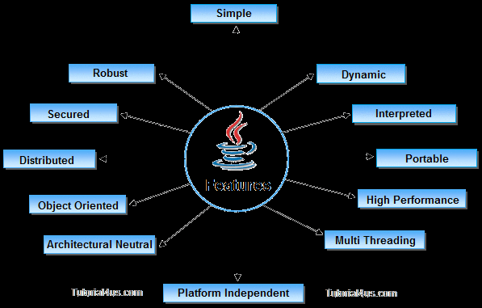
7. Java Features
Features of a language are nothing but the set of services or facilities provided by the language vendors to the industry programmer.
Some important features of java are:

Slide 12
Simple
Platform Independent
Architectural Neutral
Portable
Multi Threading
Distributed
Networked
Robust
Dynamic
Secured
Interpreted & High Performed
Object Oriented

Slide 13
Simple
According to sun, Java language is simple because
It have Rich Set of API (Application Protocol Interface)
It have Garbage Collector which is always used to collect un-Referenced memory location for improving performance of a Java program.
It has user friendly syntax for developing any applications.
It is free from Pointer due to execution time of application is improve .

Slide 14
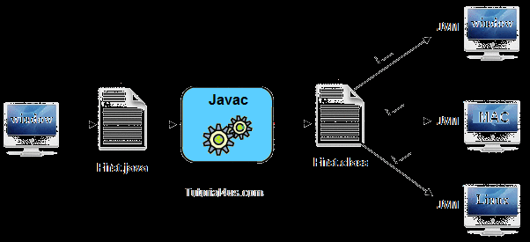
Platform Independent :
A language or technology is said to be perform independent if and only if which can run on any available operating systems with respective to its development and compilation.

Slide 15
Architectural Neutral :
Architecture represents processor.
Language or technology is said to be architectural neutral which can run on any available processors in the real world without considering there architecture and vendor with respect to its development and compilation.
Portable :
If any language supports platform independent and architectural neutral then that language is known as portable.
Portability= Platform Independent + Architecture
Multithreaded :
Multithreaded means handling multiple tasks simultaneously. Java helps to handle multiple task simultaneously with the help of threads.

Slide 16
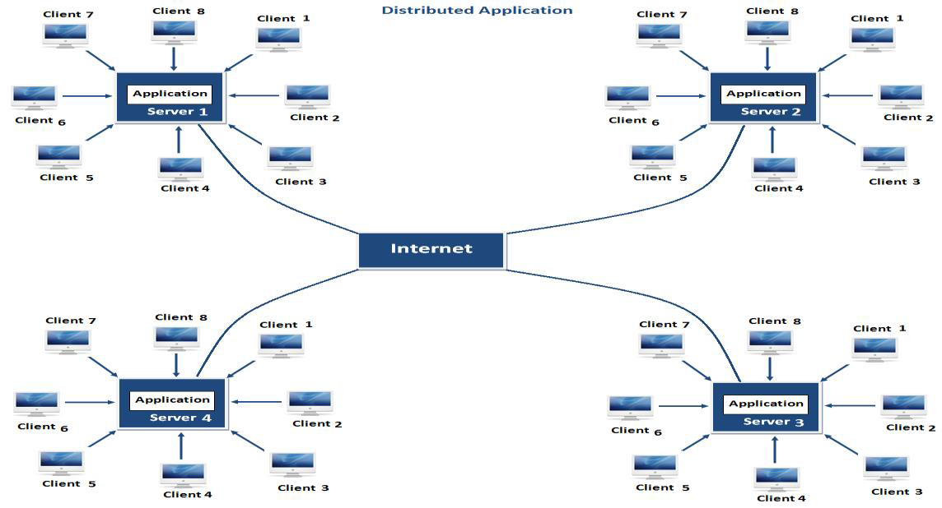
Distributed :
Using this language we can create distributed application. In distributed application multiple client system are depends on multiple server system so that even problem occurred in one server will never be reflected on any client system.

Slide 17
Networked : It is mainly design for web based applications. J2EE is used for developing network based applications.
Robust :Robust means Strong. Java is robust because
    It uses strong memory management.
    There is a lack of pointers that avoids security problems.
    There is automatic garbage collection in java.
    java has strong exception handling mechanism.
Object Oriented :Java is an OOP language. Every thing in java is an object . OOP is a methodology or paradigm to design a program using classes and objects. It simplifies the software development and maintenance by providing some concepts:
    class
    Inheritance
    Polymorphism
    Object
    Encapsulation
    Abstraction

Slide 18
8. Java Environment
Java Environment include a large number of
Development tools and
Hundreds of classes and Methods.
The Development Tools are part of the system known as Java Development Kit (JDK) and
The classes and methods are part of Java Standard Library (JSL) also known as Application Programming Interface.
Java Development Kit :
The Java Development Kit comes with a collection of tools that are used for developing and running java programs. They include
    Applet viewer (for viewing java applets)
    Javac (java compiler)
    Java (java interpreter)
    Javap (java dissembler)
    Javah (for c header files)
    Javadoc (for creating html documents)
    Jdb (java debugger)

Slide 19
Tool Description
appletviewer Enables us to run java applets
java Java Interpreter, runs application
javac Java compiler, which translates java source code into byte code
javadoc Creates HTML_format documentation from java source code files
javah Produces header files for use with native methods
javap Java dissembler, which enables us to convert bytecode files into a program description
jdb Java debugger, which helps us to find errors in our program

Slide 20
API
The Java Standard Library (or API) includes hundreds of classes and methods grouped into several functional packages. Most commonly used packages are:
  Language Support Package : A collection of classes and methods required for implementing basic features of java.
  Utilities Package : A Collection of classes to provide utility functions such as date and time functions.
  Networking Package : A collection of classes for communicating with other computers via internet.
  Input/output Package : A collection of classes required for input/output manipulation.
  AWT Package : The Abstract Window Tool Kit Package contains classes that implements platform-independent graphical user interface.
  Applet Package : This include a set of classes that allows us to create Java Applets.

Slide 21
9. Constants
Entities that do not change their values in a program are called Constants or Literals.
Java Literals are classified into 5 types:
  Integer Literals
  Floating Point Literals
  Character Literals
  Boolean Literals
  String Literals
Integer Literals :
  A whole number is called an integer. Eg: 25,27 etc…are integers
  Java supports 3 types of integer literals Decimal, Octal, Hexadecimal.
  25, 27 are decimal integers
  Octal stats from 0 and followed by 0 to 7 . Eg: 0.037, 0.08656 are octal integer
  Hexadecimal start with OX and followed by digits 0 to 9 , A to F. Eg: 0*29, 0*2AB9 are hexadecimal integer literals

Slide 22
Floating Point Literals :
  Numbers with decimal point and fractional values are called floating point literals.
  They can be expressed in either standard or scientific notation.
  Standard notation consists of a whole number component followed by a decimal point followed by a fractional component.
  A Floating point number followed by letter E (or) and a signed integer. Eg: 6.237E-35 stands for 6.237*10^-35.
  Floating point literals in java defaults to double precision.
Boolean literals :
  In java, Boolean literals take two values false or true.
  These two values are not related to any numeric value as in C or C++.
  The Boolean value true is not equal to 1 and false is not value is not equal to 0.
Character literals :
  Single characters in java are called character literals.
  In java characters belong to 16-bit character set called Unicode.
  Java characters literals are written within a pair of single quote. Eg: ‘a’, ‘z’, represent character literals.
  To represent such characters, java provides a set of character literals called escape sequence.

Slide 23
Escape Sequence Description
\ddd Octal character represented in add
\uxxx Hexadecimal unicode character
\’ Single quote
\” Double quote
\\ Back slash
\r Carriage return
\n New line
\f Form feed
\t Tab
\b Backspace
String Literals :
  A sequence of characters written within a pair of double quote is called String Literal.
  Eg: “This is String”.
  String Literals are to be started and ended in one line only.

Slide 24
10. Data Types
Every variable in java has a data type.
Data type specify the size and type of values that can be stored.
Data type in java under various categories are shown as:

Slide 25
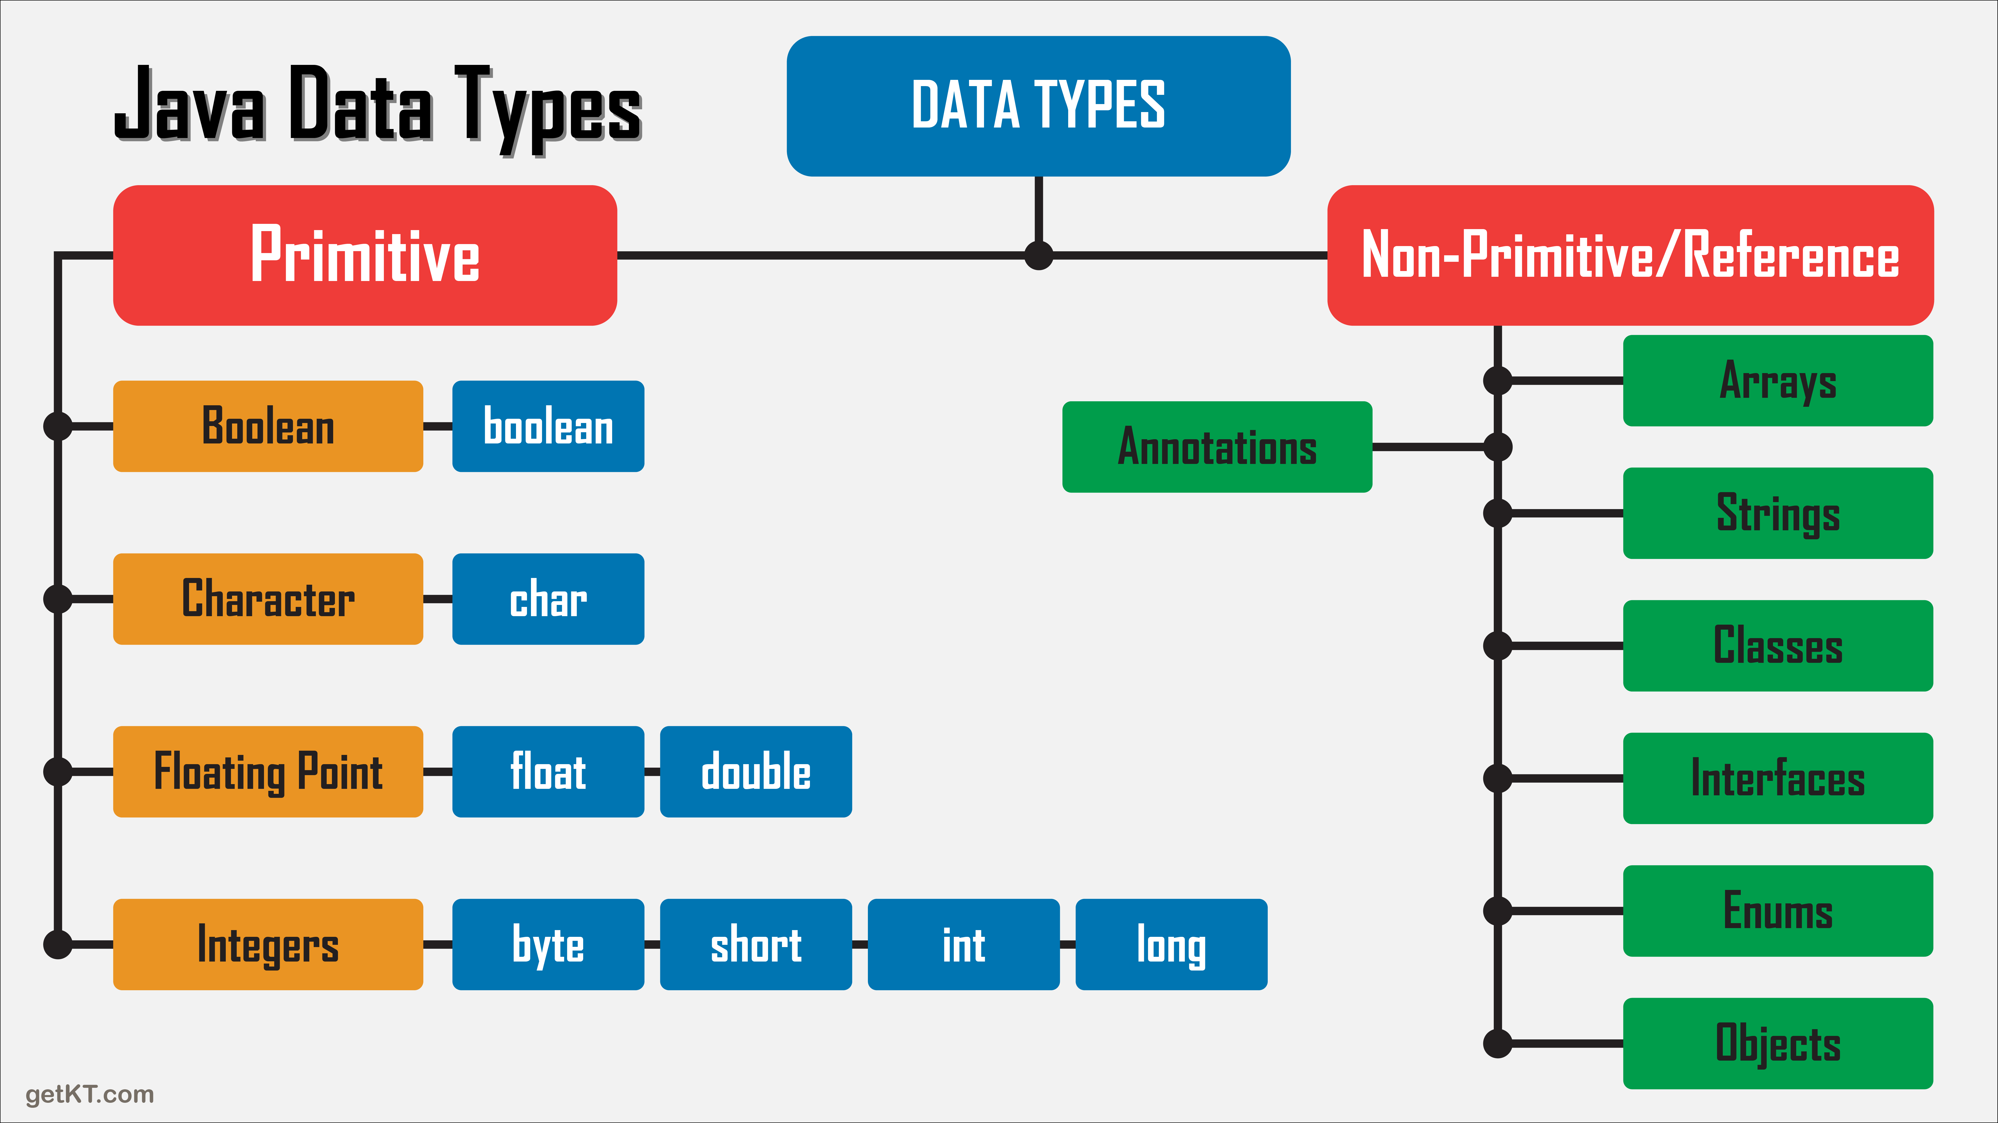

Slide 26
Primitive data types :
Primitive data types are whose variables allows us to store only one value but they never allow us to store multiple values of same type. This is a data type whose variables can hold maximum one value at a time.
Example:
int a;
a=10;//valid
a=10,20,30;//invalid
Non Primitive Data Types or Derived
Derived data types are those which are developed by programmers by making use of appropriate features of the language. User defined data types related variables allow us to store multiple values either of same type or different type or both.
Example:
Student s=new Student();

Slide 27
Java defines some primitive types of data. They are:
Integer types
Character types
Floating type
Boolean type
Integer Types :
This type indicates byte, short, int, long which are for whole-valued signed numbers.
The width and ranges of these integer types vary widely as shown in below :
      Name Width Range
      Long 64 -9,223,372,036,854,775,808 TO 9,223,372,036,854,775,807
      Int 32 -2.147,483,648 to 2.147,483,647
      Short 16 -32,768 to 32,767
      Byte 8 -128 to 127
Integer
Byte
Short
Int
Long

Slide 28
Byte :
  Smallest integer type is byte.
  This is signed 8-bit type that has range from -128 to 127
  It is declared by byte keyword
Short :
  Short is signed as 16 bit type
  It has range from -32,768 to 32,767
  It is declared by short keyword.
Int :
  The most commonly used type is integer type as int.
  It is signed as 32 bit type and has range from -2,147,483,648 to 2,147,483,647
Long :
  long is signed as 64-bit type and is useful for those occasions where as int.
  The range of long is quite large.
  This makes it useful when big, whole numbers are needed.

Slide 29
Floating Point Types :
  This group includes float and double which represented numbers in fractional precision.
  They are two types of floating point types ,float and double, which represents single and double precision numbers
Name Width in bits Approximate range
Double 64 4.9e-324 to 1.8e+308
Float 32 1.4e-045 to 3.4e+038
Characters :
  In Java, the data type is used to store characters is char.
  Char in java is not same as C or C++
  In C/C++ char is 8 bit type whereas in java char is 16-bit type
Boolean Type :
Java has a primitive data type called Booleans, for logical values.
It can have only one of two possible values true or false.

Slide 30
11. Variables
A Variable is an identifier that denote s a storage location used to store a data value . (or) Variables are the names of storage locations.
Variable names may consist of alphabets, digits, the underscore and dollar characters.
  They must not begin with a digit.
  Uppercase and Lowercase are distinct. This means that the variable Total is not same as total or TOTAL.
  It should not be a keyword.
  White space is not allowed.
  Variable names can be any length.
Declaration of Variables :
A Variable must be declared before it is used in the program. The general form of declaration of a variable is
Type variable1, variable2,…………variable
Variables are separated by commas. A declaration statement must end with a semicolon. Some valid declarations are:
Int count;
float x, y;

Slide 31
Giving values to Variables :
A Variable must be given a value after it has been declared but before it is used in an expression. This can be in two ways:
By using an Assignment statement
VariableName=value
By using a read statement
we may also give values to variables interactively through the keyword using the readLine().
Scope of the variable :
  the scope refers to validity across the java program.
  The scope of a variable is limited to the block defined within the braces { and }
  It means a variable cannot be accessed outside the scope (Or) The scope or a particular variable is the range within a program ‘s source code in which that variable is recognized by the compiler.

Slide 32
12. Type Conversion and Casting
Assigning a value of one two type to a variable of another type is known as Type Casting.
Example:
int x=10;
byte y=(byte)x;
In Java, type casting is classified into two types.
  Widening Casting (Implicit) : Process of Converting lower data type into higher data type
byte --->short --->int --->long ---->float ---->double
----------------------------->
Widening
  Narrowing Casting (Explicitly done) : Process of converting Higher Data type into Lower Data Type
double --->float ---->long ----> int ---->short --->byte
------------------------------>
Narrowing

Slide 33
Widening or Automatic type conversion :
Automatic Type casting take place when,
  The two types are compatible.
  The target type is larger than the source type
Narrowing or Explicit type Conversion :
When you are assigning a larger type value to a variable of smaller type. Then you need to perform explicit type casting.

Slide 34
13. Automatic Type Promotion Expression
Java permits mixing of constants and variables of different types in an expression, but during evaluation it adheres to very strict rules of type conversion.
If the operands are of different types, the ‘lower’ type is automatically converted to the ‘higher’ type before the operation proceeds the result is of the higher type.
If byte, short and int variables are used in an a expression, the result is always promoted to int, to avoid overflow.
If a single long is used in the expression, the whole expression is promoted to long. If a expression contains a float operand.
The entire expression is promoted to float. If any operand id double, result is double.
    Float to int causes truncation of the fractional part
    Double to float causes rounding of digits.
    Long to int causes dropping the excess higher order bits.

Slide 35
14. Arrays
An array is a group of continuous or related items that share a common name.
For instance, we can define an array name salary to represent a set of salaries of a group of employees.
A particular value is indicated by writing a number called index number or subscript in brackets after the array name.
One –Dimensional Arrays
A list of items can be given one variable name using only one subscript and such a variable is called a single-subscripted variable or a one-dimensional array.
Declaring Array Variables :
Arrays in java may be declared in two forms
Form1
type arrayname[ ];
Form2
type[ ] arrayname;

Slide 36
Creating Arrays :
you can create an array by using the new operator by using syntax
Syntax:
arrayname=new type[array_Size];
  It creates an array using new type[array_Size]’
  It assigns the reference of the newly created array to the variable arrayname.
Declaring , Creating and assigning an array to the variable can be combined in one statement as:
type[]=arrayname=new type[array_Size];
(or)
type[] arrayname={value0, value 1,…..value k};
Array indices are start from 0 to arrayname.length-1
Two Dimensional Array :
It is used to store two dimensional data. It is also used to store data, which contains rows and columns.
If the data is linear we can use one dimensional array to work with multi-level data we have to use Multi-Dimensional Array.

Slide 37
Creating Two Dimensional Array :
Data_Type[][] Array_Name=new int[Row_Size][Column_Size];
Initialization of Two Dimensional Array :
We can initialize the Two Dimensional Array in some ways
Example :
int[][] Student_Marks = new int[2][3];
int[][] Employees = { {10,20,30}, {15,25,35}, {22,44,66}, {33,55,77} };

Slide 38
15. OPERATORS AND EXPRESSIONS
In java Operators are symbols that are used to perform some operations on the operands.
Combination of operands and operators are known as Expressions.
Java provides, a rich set of operators to manipulate the variables. There are three types of operators in java.
1. Unary operators
2. Binary operators
3. Ternary operators

Slide 39
UNARY OPERATORS:
In which we use one operand is called unary operator. It has two types:
1.1 Increment Unary operator
1.2 Decrement Unary operator
1.1 INCREMENT UNAY OPERATOR:
This is used to increase the value one by one. It has two types:
* Post-fix Increment operator
* pre-fix Increment operator
1.1.1 POST-FIX INCREMENT OPERATOR:
“++” symbol is used to represent Post-fix Increment operator. This symbol is used after the operand.
In this operator, value is first assign to a variable and then incremented the value.
EX: int a , b;
a=10;
b=a++;
In the above example first the value of “a” is assign to the variable “b”, then increment the value, so the value of b variable is “10”.

Slide 40
1.1.2 PRE-FIX INCREMENT OPERATOR:
“++” symbol is used to represent Pre-Fix operator, this symbol is used after the operand. In this operator value is incremented first and then assigned to a variable.
EX: int a,b;
a=10;
b=++a;
In the above example first the increment is done then the value of “a” variable is assigned to the variable “b”, so the value of “b” variable is “11”.
1.2 DECREMENT UNARY OPERATOR:
“-” symbol is used to decrease the value by one. It has two types:
1.Post-fix decrement operator
2.pre-fix decrement operator
1.2.1 POST_FIX DECREMENT OPEATOR:
“-” symbol is used to represent post-fix decrement operator, this symbol is used after the operand. In this operator, value is first assigned to a variable and then decrement the value.
EX: int a , b;
a=10;
b=a--;
In the above example first the value of “a” is assign to the variable ” b”, then decrement the value. So the value of “b” variable is “10”.

Slide 41
1.2.2 PRE-FIX DECREMENT OPERATOR:
“-” Symbol is used to represent the pre-fix decrement operator. This symbol is used after the operand. In this operator, value is decremented first and then decremented value is used in expression.
EX: int a,b;
a=10;
b=--a;
In the above example first the value of “a” is decrement then assign to the variable “b”. So the value of b variable is “9”.
BINARY OPERATOR:
In which we use two operand is called Binary operator. Java supports many types of Binary operators:
* Assignment operator
* Arithmetic operator
* Logical operator
* Comparison operator
2.1 ASSIGNMENT OPERATOR:
This operator is used to assign the value. This symbol “=“ is used to assign the value .
EX: int a=12;
2.2 ARITHMETIC OPERATOR:
This operator is used to perform mathematical operand. Arithmetic operator are:

Slide 42
 | Operators | Description | Use
1. | Additional operator (“+”) : | Used to add the value of two operand. | a+b
2. | Subtract operator (“-“) : | Used to subtract the value of two operand. | a-b
3. | Multiply operator (“*”) : | Used to multiply the value of two operand. | a*b
4. | Division operator (“/”) : | Used to divide the value of two operand. | a/b
5. | Modulus operator(“%”) : | Used returns the remainder of a division operation. | a%b

Slide 43
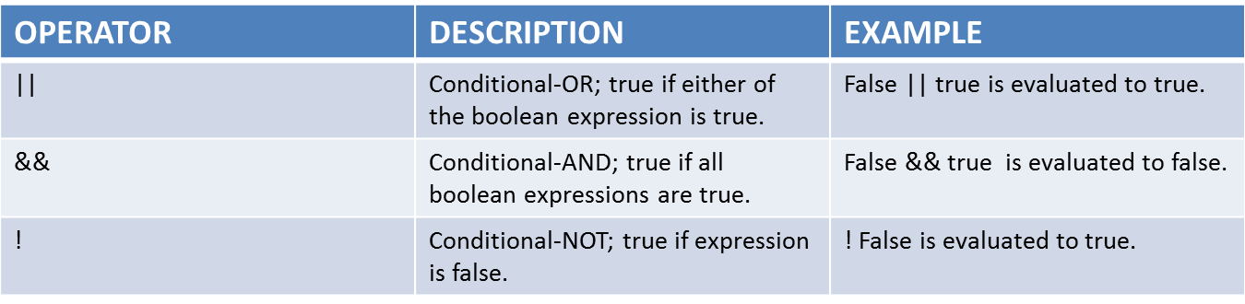
LOGICAL OPERATOR:
The logical operator ||(conditional-OR),&&(conditional-AND),!(conditional-NOT) operates on boolean expressions, here’s how they work:
JAVA LOGICAL OPERATORS

Slide 44
EX: int number1=1,number2=2,number3=9;
boolean result;
result=(number1>number2)&&(number3>number1)
LOGICAL NOT OPERATOR:
Logical NOT operator is used to reverse the logical state of its operand. If a condition is true then
logical NOT operator will make false. If a condition is false then Logical NOT operator will make true.
Then NOT operator is probably the easiest to understand. It is simply the opposite of what the condition says.
EX: boolean a=true;
if(!a)
System.out.println(“u r win”);
else
System.out.println(“u r not win”);
In above example “if not true” is asking if the variable “a” variable is not true, otherwise known as false.
If “a” variable is false, java will displays ”u r win” “a” variable is not true , so that code will not execute, then the else part is execute shown in output.
RELATIONAL OPERATOR:
This operator is used to compare the two values, so this operator is also known as “comparison operator”
Conditional symbols and their meanings for comparison operator are below:

Slide 45
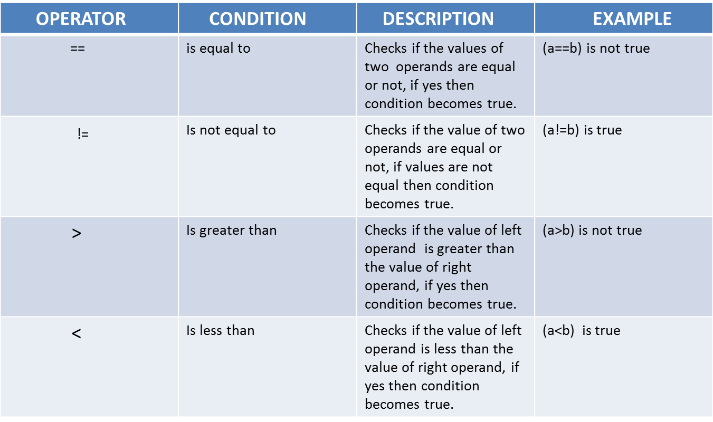

Slide 46
EX: int a=10, b=5;
if(a>b)
System.out.println(“a is greater”);
else if(a==b)
System.out.println(“a is not equal to b”);
else
System.out.prinln(“enter 1 to 10 number”);
TERNARY OPERATOR:
In ternary operator use three operands. It is also called Conditional assignment statement because the value assigned to a variable depends upon a logical expression.
SYNTAX:
variable=(test expression)?Expression 1: Expression 2
EX:
c=(a>b)?a:b:
c= (a>b) ? a:b;
Test condition ? Expression1 : Expression2;

Slide 47
BITWISE OPERATORS:
Java provides 4 bitwise and 3 bit shift operators to perform bit operations.
* | Bitwise OR
* & Bitwise AND
* - Bitwise Complement
* ^ Bitwise XOR
* << Left shift
* >> Right shift
* >>> Unsigned Right Shift
Bitwise and bit shift operators are used on integral types (byte, short, int and long) to perform bit-level operations.

Slide 48
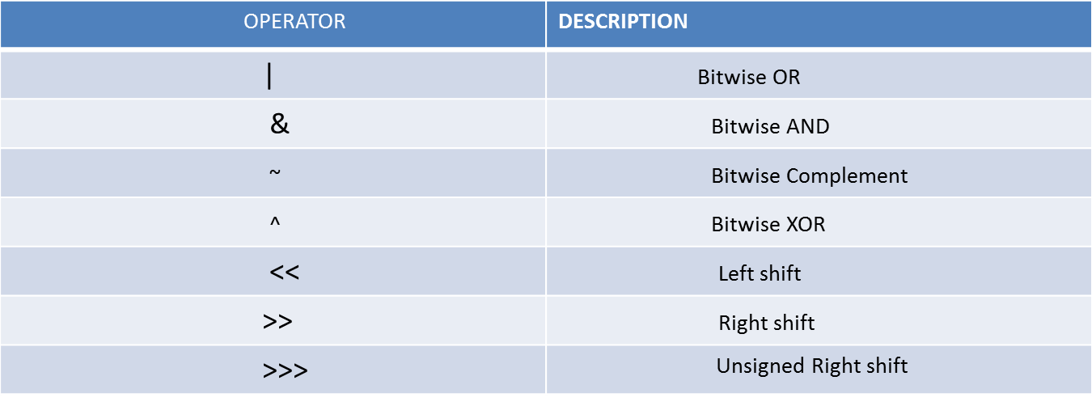

Slide 49
BITWISE OR:
Bitwise OR is a binary operator(operates on two operands). It’s denoted by |. The | operator compares corresponding bits of two operands. If their of the bits is 1. If not, it gives 0.
EX:
12= 00001100
25= 00011001
Bitwise OR Operation of 12 and 25
00001100
00011001
----------------
00011101 =29(In decimal)
----------------
BITWISE AND :
Bitwise AND is a binary operator (operates on two operands). It’s denoted by &. The & operator compares corresponding bits of two operands. If both bits are 1. If either of the bits is not 1, it gives 0.
EX: 12= 00001100
25=00011001
Bit operation of 12 and 25
00001100
00011001
----------------
00001000 = 8(in decimal)
----------------

Slide 50
BITWISE COMPLIMENT :
Bitwise compliment is an unary operator(works on only one operand). It is denoted by ~. The ~ operator inverts the bit pattern. It makes every 0 to 1, and every 1 to 0.
EX: 35= 00100011(in binary)
bitwise complement of 35
~ 00100011
------------------
11011100 = 220(in decimal)
--------------------
BITWISE XOR :
Bitwise XOR is a binary operator( operates on two operands). It’s denoted by “^” . The operator compares corresponding bits of two operands. If corresponding bits are different, It gives 1. If corresponding bits are same, it gives 0.
EX: 12=00001100
25=00011001
Bitwise XOR operation of 12 and 25 is:
00001100
1 00011001
-----------------------
00010101 =21(in decimal)
-----------------------

Slide 51
SIGNED LEFT SHIFT :
The left shift operator “<<“ shifts a bit pattern to the left by certain number of specified bits, and zero bits are shifted into the lower-order positions.
EX: int number=212 ,result;
System.out.println(“number <<1”);
System.out.println(“number <<0”);
System.out.println(“number <<4”);
SIGNED RIGHT SHIFT :
The right shift operator “>>” shifts a bit pattern to the right by certain number of specified bits.
EX: int number=212,result;
System.out.println(“number >>1”);
System.out.println(“number >>0”);
System.out.println(“number >>8”);

Slide 52
16. Control Statements
Causes the flow of execution to advance and branch based on changes to the state of a program.
In Java, control statements can be divided into the following three categories:
  Selection Statements
  Iteration Statements
  Jump Statements
1) Selection Statements
Selection statements allow you to control the flow of program execution on the basis of the
outcome of an expression or state of a variable known during runtime.Selection statements can be divided into the following categories:
The if and if-else statements
The if-else statements
The if-else-if statements
The switch statements

Slide 53
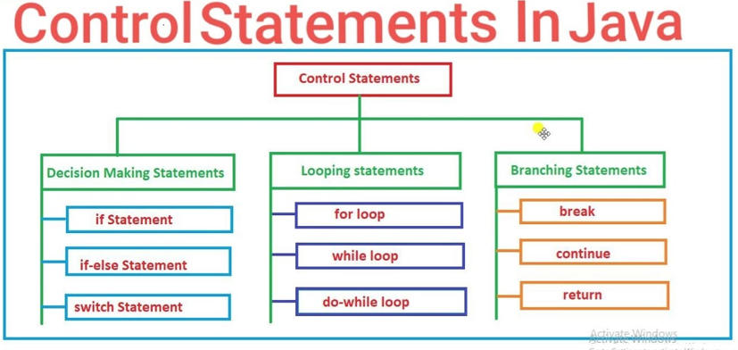
16. Control Statements

Slide 54
The if statements :
The first contained statement (that can be a block) of an if statement only executes when the specified condition is true. If the condition is false and there is not else keyword then the first contained statement will be skipped and execution continues with the rest of the program. The condition is an expression that returns a boolean value.
General form of simple if statement is
if<expression>
{
Statement-block;
}
The statement-block may be single statement or a group of statements .
if the expression is true, the statement block will be executed, otherwise the statement block will be skipped to the statement-x.

Slide 55
if else statement:-
if else statement is an extension of the simple if statement. The general form is
if(expression)
{
True-block statements
}
Else
{
False-block statements
}
if the test expression is true, then the true-block statements immediately following the if statement are executed. Otherwise, the false-block statements are executed .
In either case, Either true-block or false-block will be executed, not both.
In both the cases, the control is transferred subsequently to the statement-x Diagram
Nested if else statement :-
A nested if is an if statement that is the target of another if or else.
Nested ifs are very common in programming
General form of Nested if looks like
Nested if else statement is made by placing one if else in another if else statement.
Nested if else statement helps to select one out of many chooses.
General form of Nested if else is

Slide 56
if<cond1>
{
if<cond2>
{
if<cond3>
stmt 4
else
stmt3
}
else
stmt2
}
else
stmt 1
In the nested if else statement, the outermost if is evaluated first.
If the condition1 is false, the statement is the outermost else is evaluated and if else ends.
If the conditon1 is true, the control goes to execute the next inner if statement.
If conditon2 is false, statement2 is executed otherwise conditon3 is evaluated
If condition3 is false statement3 is executed. Otherwise statement is executed.

Slide 57
else if ladder:-
A common programming construct that is based a sequence of nested is based upon a sequence of nested ifs is the if else if ladder.
• General form of if else ladder
if<condition>
stmt
else if<condition>
stmt;
else if<condition>
stmt;
else
stmt;
The if statements are Executed from the top down. As soon as one of the conditions controlling the if is true, the stmt associated with that if is Executed, and the rest of the ladder is bypassed.
If none of the condition is true, then the final else stmt will be executed.
The final else acts as a default condition; i.e if all other conditional tests fail, then the last else stmt is performed.
If there is no final else and all other condition are false.

Slide 58
Switch statement:-
• The switch statement helps to select one out of many chooses.
• It often provides a better alternative than a large d=series of if else if statements
• General form of switch statement is
Switch(expression)
{
Case value 1:stmt1;
Break;
Case value 2:stmt2;
Break;
.
.
Case value N: stmt N;
Break;
Default: stmt;
}
• The expression must be of type byte, short, int or char.
• Each of the values specified in the case stmts must be of a type compatible with the expression.
• Each case value must be unique literal.
• Duplicate case value are not allowed.
• The switch stmt works like this

Slide 59
The value of the expression is compared with each of the literal values in the case stmt.
It a match is found, the code sequence following that case stmt is executed.
If none of the constants matches the value of the expression, then the default stmt is executed.
However, the default stmt is optional, if no case matches and no default is present, then no further action is taken.
The break stmt is used inside the switch to terminate a stmt sequence.
When a break stmt is encountered, execution branches to the first case of code that follows the entire switch stmt.
A switch stmt is usually more efficient than a set of nested ifs faster than the equivalent logic coded using a sequence of if else.

Slide 60
ITERATION STMTS:-
Java’s iteration stmts are
1. for
2. while
3. do-while.
These stmts creates what we commonly call loops .
A loop repeatedly executes the same set of instruction until a termination condition is met
while:-
The while loop is java’s most fundamental loop stmt
• It repeats a stmt or block while its controlling expression is true.
• The general form of while stmt is
While <condition>
{
Body of the loop
}
The condition can be any Boolean expression.
The body of the loop will be executed as long as the conditional expression is true
When condition becomes false, control passes to the next line of code immediately following the loop.
The curly braces are unnecessary if only a single stmt is being repeated.

Slide 61
Do-while:-
If the conditional expression controlling a while loop is initially false, then the body of the loop will not executed at all
However, it is desirable to execute the of a loop at least once even if condition expression is false to begin with
Fortunately, java supplies a loop that does just that : the do while
The do while loop always execute its body at least once, because its conditional expression is at bottom of loop
The general form of do while is
do
{
Body of the loop
}
While<condition>

Slide 62
For statement
General form of traditional for statement is
      for(initialization; condition; iteration)
      {
      Body of the loop
      }
It is important to understand that initialization expression is only executed once. Next, condition is evaluated. This must be a Boolean expression .i.e the loop control variable against a target value.
If this expression is true, then the body of the loop is executed.
If it is false, the loop terminates.
Next, the iteration portion of the loop executed
This is usually an expression that increments or decrements the loop controls variable.
This loop then ITERATES
First evaluating the conditional expression , then executing the body of the loop , and then executing the iteration expression with each pass.
This process repeats until the controlling expression is false.

Slide 63
Nested loop:-
Like all other programming languages, java allows loops to be nested.
i.e one loop may be inside another
Eg:-
For(i=0 ; i<10 ; i++)
{
For(j=I ; j<10 ; j++)
{
statement block
}
}

Slide 64
2. Jump stmts:_
Java supports 3 jump stmts
1. break
2. continue
3. return.
Break stmt:-
It has 3 uses.
1. It terminates a stmts sequence in a switch stmt.
2. If can be used to exit a loop.
3. If can be used as a “civilized” form of goto.
When a break stmt is encountered inside a loop. The loop is terminated and program control
resumes at the next stmt following the loop.
i.e by using break, we can force immediate termination of a loop, by passing the conditional
expression (eg: i<=10) and any Remaining code in the body of the loop.

Slide 65
Eg:-
For(int i=0;i<100;i++)
{
If(i==0)break;
S.o.p(“i=”+i);
}
continue:-
sometimes, you might want to continue running the loop but stop continue running the
remainder of the code in its body for this particular iteration
the continue stmt performs such as an action
Return:-
Return stmt is used to explicitly return from a method
i.e it causes program control to transfer back to the caller of the method
return stmt can be used to cause execution to branch back to the caller at the method.

