Slide 1
SUBJECT CODE : 20MCA125
SUBJECT NAME : OBJECT ORIENTED PROGRAMMING THROUGH JAVA
UNIT III
BY
Mrs. R.PADMAJA
Assistant Professor
MCA Department
SITAMS

Slide 2
UNIT III
1.Interfaces
1.1 Defining an Interface
1.2 Implementing Interfaces
1.3 Interfaces can be extended
2.Collection Framework
2.1 Collection Overview
2.2 The Collection Interfaces
2.3 The Collection Classes
2.4 Accessing a Collection via an Iterator
3.Utility Classes
3.1 StringTokenizer
3.2 Scanner

Slide 3
1.1 Defining an Interface
An Interface is basically a kind of class
Like classes, interface contain methods and variables but with a major difference.
The difference is that interfaces define only
    Abstract Method &
    Final and Static Variables
i.e methods are declared without any body and variables are implicitly final and static, meaning they cannot be changed by the implementing class. They must also be initialized.
All Methods and Variables in the interface are implicitly public.
1.1 Defining an Interface
An Interface is basically a kind of class
Like classes, interface contain methods and variables but with a major difference.
The difference is that interfaces define only
    Abstract Method &
    Final and Static Variables
i.e methods are declared without any body and variables are implicitly final and static, meaning they cannot be changed by the implementing class. They must also be initialized.
All Methods and Variables in the interface are implicitly public.

Slide 4
The syntax for defining an interface is very similar to that of defining a class
Interface InterfaceName
{
static and final Variables
Abstract Methods
}
Where Interface is the keyword and InterfaceName is any valid java variable
Example:
Interface Item
{
static final int code = 1001;
static final String name = “Fan”;
void display();
}

Slide 5
1.2 Implementing Interface
An Interface will have 0 or more abstract methods which are all public and abstract by default.
An Interface can have variables which are public, static and final by default, means all the variables of the interface are constants.
Objects cannot be created to an interface whereas reference can be created.
Once interface is defined, any number of classes can implement an interface.
Also one class can implement any number of interfaces.
To Implement an interface, a class must create the complete set of methods defined by the interface.

Slide 6
To implement an interface, include the implements clause in a class definition, and then create the methods defined by the interface.
General form of a class that includes the implements clause looks like
Class ClassName [extends SuperClass] [implements Interface1[,... Interface N]]
{
// class body
}
Example
Class A Extends B Implements I1,I2
{
}
i.e if a class implements more than one interface, the interfaces are separated with a comma.

Slide 7
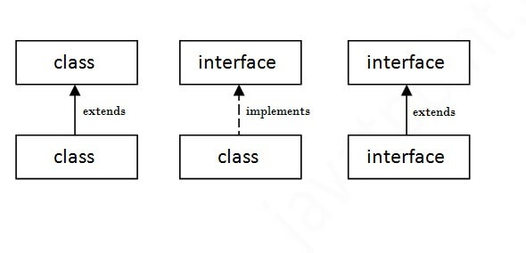
The Relationship between classes and Interfaces are

Slide 8
Interface Bank
{
float rateOfInterest();
}
Class SBI implements Bank
{
public float reateOfInterest()
{
return (7.8f);
}
}
class ICICI implements Bank
{
public float reateOfInterest()
{
return (9.8f);
}
}

Slide 9
class IB implements Bank
{
public float reateOfInterest()
{
return (8.8f);
}
}
class InterfaceDemo
{
public staticvoid main(String args[])
{
SBI obj1 = new SBI();
float sbi_roi = obj1.rateOfInterest();
ICICI obj1 = new ICICI();
float icici_roi = obj1.rateOfInterest();
IB obj1 = new IB();
float ib_roi = obj1.rateOfInterest();
System.out.println(“SBI rate of Interest is “+ sbi_roi);
System.out.println(“ICICI rate of Interest is “+ sbi_icici);
System.out.println(“IB rate of Interest is “+ sbi_ib);
}
}

Slide 10
Interface helps to Achieve the functionality of Multiple Inheritance
Example
interface I1
{
void mi();
}
interface I2
{
void m2();
}
Class A implements I1, I2
{
void m1()
{
System.out.println(“Method 1 is invoked”);
}
void m2()
{
System.out.println(“Method2 is invoked”);
}
}

Slide 11
Class MutipleInheritanceDemo
{
public static void main(String args[])
{
A obj1 = new A();
obj1.m1();
obj1.m2());
}
}

Slide 12
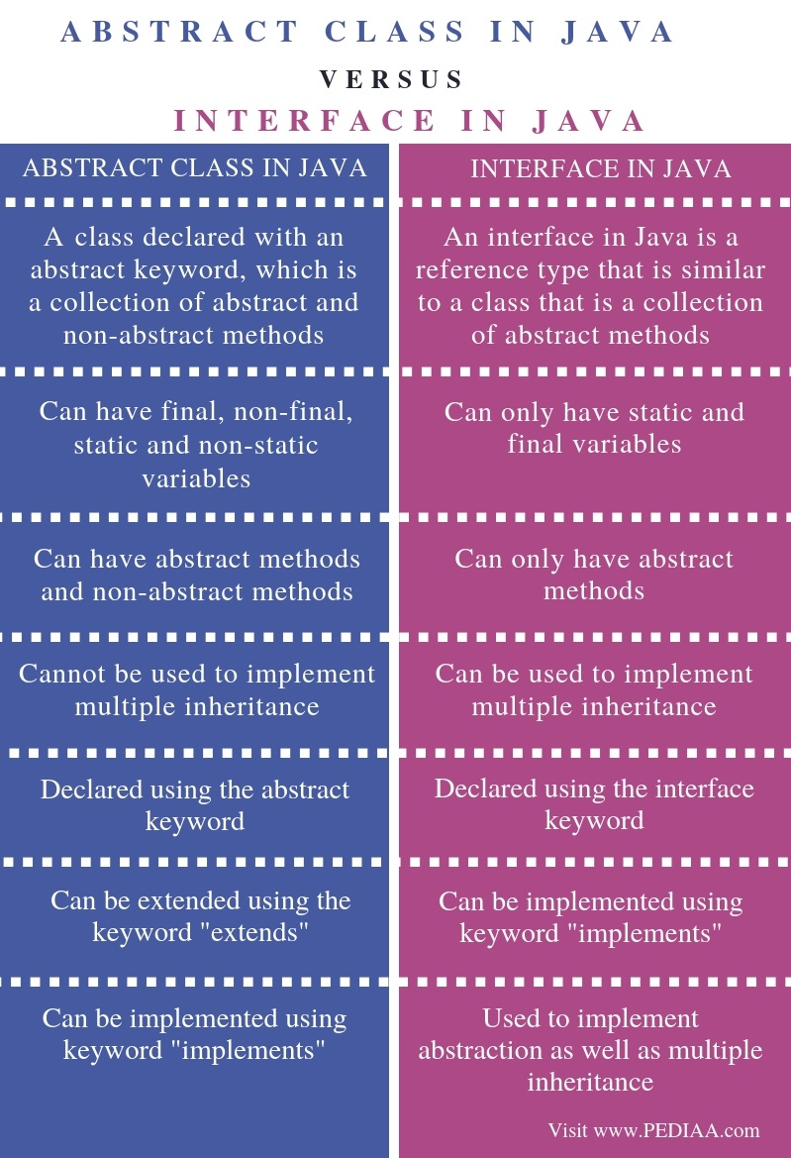

Slide 13
1.3 Interfaces can be Extended
Like classes, interface can also be extended.
i.e an interface can be sub interfaced from other interfaces.
The new sub interface will inherit all the members of the super interface in the manner similar to subclasses.
This is achieved using the keyword “extends”.
General form of extending interfaces is
Interface NameNew extends name1[,…nameN]
{
Body of Interface
}

Slide 14
interface A
{
void meth1();
void meth2();
}
interface B extends A
{
void meth3();
}
Class MyClass implements B
{
public void meth1()
{
System.out.println(“implementing meth1()…..”);
}
public void meth2()
{
System.out.println(“Implementing meth2()….”);
}
public void meth3()
{
System.out.println(“Implementing meth3()….”);
}
}
Class InterfaceDemo
{
Public static void main(string args[])
{
MyClass obj = new MyClass();
obj.meth1();
obj.meth2();
obj.meth3();
}
}

Slide 15
When a class implements an interface that inherits another interface, it must provide implementations for all methods defined within the interface inheritance chain.
Note : if a class that implements an interface and the class does not give implementations to all the methods of the interface, then the class becomes an abstract class and cannot be instantiated.

Slide 16
Interface Area
{
final static float PI = 3.145;
float compute(float x);
}
Class Square implements Area
{
public float compute(float x)
{
return (x*x);
}
}
Class Circle implements Area
{
public float compute(float x)
{
return (PI*x*x);
}
}
Class InterfaceDemo
{
Public static void main(String args[])
{
Square s = new Square();
double asqr = s.compute(10);
Circle c = new Circle();
double acir = c.compute(10);
System.out.println(“Area of Square:”+asqr);
System.out.println(“Area of Circle:”+acir);
}
}

Slide 17
2. COLLECTION FRAMEWORK
2.1 Collection Overview
2.2 The Collection Interfaces
2.3 The Collection Classes
2.4 Accessing a Collection via an Iterator
2.1 Collection Overview
Array is used to store a group of elements.
Array is also used to store a group of Objects.
But we cannot store different class objects in an array
Java Soft people introduces Classes such as stack, vector, LinkedList, ArrayList etc.. which can store different Objects.sucjh classes are called Collection Clasess.
A Group of collection classes is called a “Collection Framework”

Slide 18
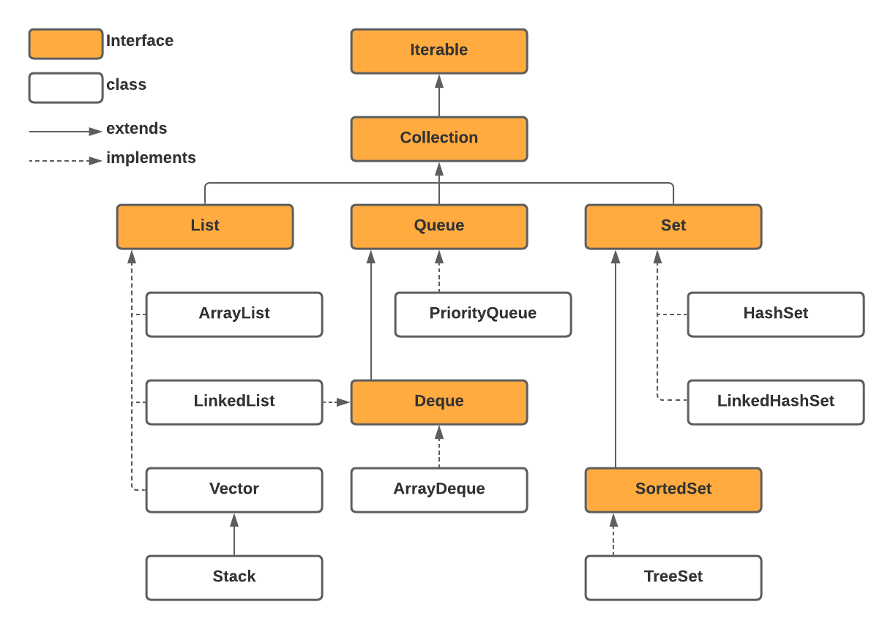
2.

Slide 19
2.2 The Collection Interfaces
Collection framework defines several interfaces.
2.2.1) The List Interface:
List Interface is the subinterface of Collection.
It guarantees the Order of Elements
It Allows Duplicate Elements
LinkedList, ArrayList, Vector are the implementation classses of List Interface
Stack is a Subclass of Vector
Some of the methods of List Interface are

Slide 20
Method | Description
void add(int index, E element) | It is used to insert the specified element at the specified position in a list.
boolean add(E e) | It is used to append the specified element at the end of a list.
void clear() | It is used to remove all of the elements from this list.
boolean equals(Object o) | It is used to compare the specified object with the elements of a list.
E get(int index) | It is used to fetch the element from the particular position of the list.
boolean isEmpty() | It returns true if the list is empty, otherwise false.
int lastIndexOf(Object o) | It is used to return the index in this list of the last occurrence of the specified element, or -1 if the list does not contain this element.

Slide 21
2.2.2) The Set Interface:
Set is an interface which extends Collection.
It is an unordered collection of objects
List does not allow duplicate values
Basically, Set is implemented by HashSet, LinkedHashSet or TreeSet (sorted representation).
Set Interface declaration
public interface Set<E> extends Collection<E>
Set has various methods to add, remove clear, size, etc to enhance the usage of this interface.

Slide 22
Method | Description
add( ) | Adds an object to the collection.
clear( ) | Removes all objects from the collection.
contains( ) | Returns true if a specified object is an element within the collection.
isEmpty( ) | Returns true if the collection has no elements.
iterator( ) | Returns an Iterator object for the collection, which may be used to retrieve an object.
remove( ) | Removes a specified object from the collection.
size( ) | Returns the number of elements in the collection.

Slide 23
2.3 The Collection Classes
Some of the collection classes provide full implementations that can be used as - is. Others are abstract, providing skeletal implementations that are used as starting points for creating concrete collections. The standard collection classes are summarised in the following table.
CLASS | DESCRIPTION
HashSet | Extends AbstractSet for use with the Hash table.
LinkedHashSet | Extends Hashset to allow insertion order itereations.
LinkedList | Implements a LinkedList by extending AbstractSequentialList
ArrayList | Implements a dynamic array by extending AbstractList.
Stack | Implements List interface
Vector | Implement List Interface

Slide 24
1. ArrayList Class
An ArrayList is like an array, which can grow in memory dynamically.
It means that when we stored elements into the ArrayList, depending on the number of elements, the memory is dynamically allotted and re-allotted to accommodate all the elements.
ArrayList is not synchronized. This means that when more than one thread acts simultaneously on the ArrayList object, the results may incorrect in some cases.
ArrayList can be written as
class ArrayList<E>
For Example, to store String type elements, we can create an objects to ArrayList as:
ArrayList<String>arl = new ArrayList<String>();

Slide 25
ArrayList class includes the following methods:
METHOD | DESCRIPTION
void add(intposition, element obj) | This method inserts the specified elements at the specified position in the ArrayList
element remove(int position) | This method removes an element at the specified position in array list.
boolean remove (Object obj) | This method removes the first occurrence of the specified element obj from the ArrayList, if it present
void clear() | This method removes all the elements from the ArrayList.
set(int position, element obj) | This method replaces an element at the specified position in the ArrayList with the specified element obj
boolean contains(Object obj) | This method returns the element available at the specified position in the ArrayList.
element get(int position) | this method returns the element available at the specified position in the ArrayList.
Int indexOf(Object obj) | method returns the position of the first occurrence of the specified element obj in the list, or -1 if the element is bot found in the list.
intlastIndexOf(Object obj) | This method returns the position of the last occurrence of the specified element obj in the list, or -1 if the element is bot found in the list.
int size(): | This method returns the number of elements present in the ArrayList.

Slide 26
Program:
import java.util.*;
Class ArraylistDemo
{
public static void main(String args[])
{
ArrayList<String>arl=new ArrayList<String();
arl.add("JAVA");
arl.add("CN");
arl.add("OS");
arl.add("PSQT");
arl.add("AFM");
System.out.println("Element in ArrayList are" +arl);
//remove two objects
arl.remove(3);
boolean b=arl.remove("JAVA");
//display again
System.out.println("Element in Array list after removing are “+arl);
Iterator it =arl.iterator();
while(it.hasNext())
{
String s=(String)it.next();
System.out.println(s);
}
}
}

Slide 27
OUTPUT:
Element in ArrayList are[JAVA, CN, OS, PSQT, AFM]
Element in Array list after removing are [CN, OS, AFM]
CN
OS
AFM

Slide 28
LinkedList Class
A Linked list contains a group of elements in the form of nodes.
Each node will have three fields- the data field contains data and the link fields contain references to previous and next nodes.
Linked list is very convenient to store data.
Inserting the elements into the linked list and removing the elements from the linked list is done quickly and takes the same amount of time.
A linked list is written in the form of
class LinkedList<E>
For Example, to store String type elements, we can create an objects to LinkedList as:
LinkedList<String>ll = new LinkedList<String>();

Slide 29
LinkedList class includes the following methods
METHOD | DESCRIPTION
boolean add(element obj) | This method add an element to the linked list. It returns true if the element is added successfully
void add(int position, element obj) | This method inserts the specified elements at the specified position in the linked List.
void addFirst(element obj) | This method adds the element obj at the first position of the linked list.
void addLast(element obj) | This method appends the specified element to the end of the linked list.
Element removeFirst() | This method removes the first element from the linked list and returns it.
element removeLast() | This method removes the last element from the linked list and returns.
element remove(int position) | This method removes an element at the specified position in the linked list.
void clear() | This method removes all the elements from the linked list.

Slide 30
LinkedList class includes the following methods
METHOD | DESCRIPTION
element get(int position) | This method returns the element at the specified position in the linked list
element getFirst() | This method returns the first element from the list.
Element getLast() | This method returns the last element from the list
int indexOf(Object obj) | This method returns the position of the first occurrence of the specified element obj in the list, or -1 if the element is not found in the list
intlastIndexOf(Object obj) | This method returns the position of the last occurrence of the specified element obj in the list, or -1 if the element is not found in the list.
int size() | This method returns the number of elements present in the linked List.

Slide 31
Program:
//Demonstrate Linkedlist class
import java.util.*;
class LLDemo
{
public static void main(String args[])
{
LinkedList<String>ll= new LinkedList<String>();
ll.add("Java");
ll.add("Computer Network");
ll.add("Operating System");
ll.add("Accounts");
ll.add("Statistics");
System.out.println("LinkedList elements are:");
for(String i:ll);
{
System.out.println(i);
}
}
}
OUTPUT:
LinkedList Elements are:
Java
Computer Network
Operating System
Accounts
Statistics

Slide 32
3) HashSet Class
A HashSet represents a set of elements (objects).
It does not guarantee the order of elements.
Also it does not allow the duplicate elements to be stored.A HashSet is written in the form of
class HashSet<E>
For Example, to store String type elements, we can create an objects toHashSetas:
HashSet<String>hs= new HashSet<String>();
HashSet class includes the following methods.

Slide 33
METHOD | DESCRIPTION
boolean add(obj) | This method add an element obj to the HashSet. It returns true if the element is removed successfully,else it return false.
boolean remove(obj): | This methods removes the element obj from the HashSet. If it is present. It returns true if the element is removed successfully otherwise false.
void clear() | This removes all the elements from the HashSet.
boolean contains(obj) | This returns true if the HashSet contains the specified element obj.
booleanisEmpty() | This returns true if the HashSet contains no elements.
int size() | This returns the number of elements present in the Hashset.

Slide 34
Program// Hashset Demo
import java.util.*;
class HSDemo
{
public static void main(String args[])
{
HashSet<string> hs= new HashSet<String>();
hs.add(“Java”);
hs.add(“Computer Network”);
hs.add(“Operating System”);
hs.add(“Accounts”);
hs.add(‘Statistics”);
System.out.println(“HashSet elements are:”);
for(String i:hs);
{
System.out.println(i);
}
}
}
OUTPUT:
Hash elements are:
Java
Computer Network
Operating System
Accounts
Statistics

Slide 35
4) LinkedHashSet:
This is a subclass of HashSet class and does not contain any additional members on its own. It is a generic class that has the declaration:
class LinkedList<E>
For Example, to store String type elements, we can create an objects toLinkedHashSetas:
LinkedHashSet<String>lh= new LinkedHashSet<String>();
LinkedHashSet class includes the following methods.

Slide 36
Program:
//Demonstrate linkedHashset Class
import java.util.*;
class LinkedHashDemo
{
public static void main(String args[])
{
LinkedHashSet<String> lhs= new LinkedHashSet<String>();
lhs.add("Mango");
lhs.add("Banana");
lhs.add("Apple");
lhs.add("Grapes");
lhs.add("Orange");
System.out.println("LinkedHashSet Elements are:");
iterator it=lhs.iterator();
while(it.hasNext())
{
String s=(String)it.next();
System.out.println(s);
}
}
}
OUTPUT:
LinkedHashSet Elements are:
Mango
Banana
Apple
Grapes
Orange

Slide 37
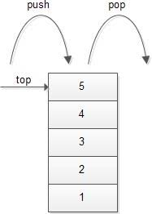
5) Stack class:
A stack represents a group of elements stored in LIFO(Last In First Out) order
This means that the element which is stored as a last element into the stack will be first element to be removed from the stack.
Inserting elements (objects) into the stack is called “push operation” and removing elements from stack is called “pop operation”.
Searching for an element in the stack is called a side of the stack, called ‘top’ of the stack, as shown in the following figure:

Slide 38

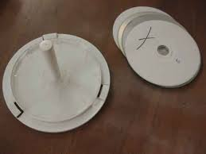
A pile of places in a cafeteria where the lastly washed plate will be coming out first can be taken as an example for a stack.
For Example, if we take the top plate (the 3rd plate) from the pile, the weight on the spring will be lessened and the next plate will come up.
Similarly, a compact Disk Holder where the CDs are arranged such that the last CD is available first is also an example for a stack.
We can write a stack class as: class Stack<E>
where E stands for element type. Suppose, we want to create a stack object that contains Integer objects, we can do so as shown here:
Stack<Integer> obj= new Stack<Integer>( );
Stack class includes the following methods:

Slide 39
METHOD | DESCRIPTION
Boolean empty() | This method tests whether the stack is empty or not. If the stack is empty then true is returned otherwise false.
element peek() | This method returns the top-most object from the stack without removing it.
element pop() | This method pops the top-most element form the stack and returns it
element push(element obj) | This method pushes an element obj onto the top of the stack and returns that element.
int search(Object obj): | This method returns the positionof an element obj form the top of the stack. If the element is not found in the stack then returns -1

Slide 40
Example of using the Stack class:
import java.util.*;
public class Stackex
{
Public static void main(String args[])
{
Stack st=new Stack( );
st.push(“Java”);
st.push(“Latest”);
st.push(“Edition”);
st.push(“Fifth”);
System.out.println(“The elements in the stack:”+st);
System.out.println(“The element at the top:”+st.peek( ));
System.out.println(“The element popped out of the stack:”st.pop( ));
System.out.println(“The element in a stack after pop out anelement:”+st);
System.out.println(“The result of searching:”+st.search(“seond”));
}
}
Output:
The elements in the stack:[Java, Latest, Edition, -Fifth]
The element at the top: -Fifth
The element popped out of the stack: -Fifth
The element in a stack after pop out anelement: :[Java, Latest, Edition]
The result of searching: -1

Slide 41
6) Vector class:
A vector also stores elements(objects) similar to ArrayList, but vector is synchronized.
It means even if several threads act on vector object simultaneously, the results will be reliable.
We can write a Vector class as:
class Vector<E>
where E, represents the type of elements stored into the vector.
For example, if we want to create an empty Vector that can be used to store Float type objects, we can write as:
Vector<Float> v= new Vector<Float>( );
vector class includes the following methods

Slide 42
METHOD | DESCRIPTION
void add(int index, object element) | Inserts the specified element at the specified position in this vector
boolean add(Object 0) | Appends the specified element to the end of the vecot
boolean contains(Object elem) | Returns true if the vector contains the specified element obj
int indexOf(Object elem) | returns the position of the first occurrence of the specified element elem in the vector;or -1 if the element is not found
Element remove(Object obj) | This method removes the element at the specified position
Void clear() | This method removes all the elements from the vector
int lastIndexOf(Object elem) | returns the position of the last occurrence of the specified element elem in the
int size() | returns the no. of elements in the vector

Slide 43
Example of using the Vector class:
/* PROGRAM TO ILLUSTRATE Vector CLASS*/
import java.util.*;
import java.awt.*;
class VectorDemo
{
public static void main(String args[])
{
Vector<Integer> V=new Vector<Integer>();
int x[ ]={22,20,10,40,15,60};
for(int i=0;i<x.length;i++)
{
V.add(x[i]);
}
System.out.println("Vector Elements:");
for(int i=0;i<V.size();i++)
{
System.out.println(V.get(i));
}
System.out.println("Retrieving Elements using ListIterator Interface:");
ListIterator Lit= V.listIterator();
System.out.println(" In Forward direction:");
while(Lit.hasNext())
System.out.print(Lit.next()+"\t");
System.out.println("\n In BackWard direction:");
while(Lit.hasPrevious())
System.out.print(Lit.previous()+"\t");
}
}

Slide 44
OUTPUT:
Z:\>javac VectorDemo.java
Z:\>java VectorDemo
Vector Elements:
22
20
10
40
15
60
Retrieving Elements using ListIterator Interface
In Forward direction:
22 20 10 40 15 60
In BackWard direction:
60 15 40 10 20 22

Slide 45
2.4 Retrieving elements from Collections
Following are the 4 ways to retrieve any elements form a collection object:
Using for-each loop.
Using Iterator interface.
Using ListIterator interface.
Using Enumeration interface.
1) For-each Loop: for-each loop is like for loop which repeatedly executes a group of statements for each element of the collection. The format is
  for(variable: collection-object)
  {
  Statements;
  }
Here, the variable assumes each element of the collection-object and the loop is executed as many times as there are number of elements in the collection-object.
If collection-object has n elements the loop is executed exactly n times and the variable stores each element in each step.

Slide 46
2) Using Iterator interface
Iterator is an interface that contains methods to retrieve the elements one by one from a collection object. It has 3 methods:
boolean hasNext(): This method returns true if the iterator has more elements.
element next(): This method returns the next element in the iterator.
void remove(): This method removes form the collection the last element returned by the iterator.

Slide 47
3) ListIterator Interface:
ListIterator is an interface that contains methods to retrieve the elements from a collection object, both in forward and reverse directions. It has the following methods
boolean hasNext():This returns true if the ListIterator has more elements when traversing the list in the forward direction.
boolean hasPrevious():This returns true if the ListIterator has more elements when traversing the list in the reverse direction.
element next():This returns the next element in the list.
element previous():This returns the previous elemnt.
void remove():This removes from the list the last element that was returned by the next() or previous() methods.
Note : Difference between Iterator and ListIterator : Both are useful to retrieve elements from collection. Iterator can retrieve the elements only in forward direction. But ListIterator can retrieve the elements in forward and backward direction also. So ListIterator is preffered to iterator.

Slide 48
3. UTILITY CLASSES
3.1 StringTokenizer Class
This class is useful to break a string into pieces, called ‘tokens’.
These tokens are then stored in the StringTokenizer object from where it can be retrieved.
The code to create an object to StringTokenizer class is:
StringTokenizerst= new StringTokenizer (str, “delimiter”0;
The actual string str is broken into pieces at the positions marked by a group of characters, called ‘delimiters’.
For example, to break the string wherever a comma is found, we can write:
StringTokenizerst =new StringTokenizer (“Keep, Smiling, Always”,”,”);

Slide 49
StringTokenizer Class Methods
StringTokenizer class includes the following methods:
IntcountTokens(): This method counts and returns the number of tokens available in a StringTokenizer object.
Boolean hasMoretokens(): This method test if there are more tokens available in the StringTokenizer object or not. If next token is there then it returns true.
String nextToken():This method returns the next token form the StringTokenizer.

Slide 50
Program:
//Demonstrate StringTokenizer class
import java.util.*;
class StringTokenizerDemo
{
public static void main(String args())
{
int sum=0,c=0;
String str =”Keep Smiling Always”;
StringTokenizer st =new StringTokenizer(str);
System.out.println(“The given string is: ”+str);
c=st.CountTokens();
While(st.hasMoreTokens())
{
Stringtoken=st.nextToken();
System.out.println(token);
}
System.out.println(“ Total No. of tokens in the given string is “+c);
}
}

Slide 51
Output
The given string is: Keep Smiling Always
Keep
Smiling
Always
Total no. of tokenin the given string is 3

Slide 52
3.2 Scanner
Scanner is the complement of Formatter. Added by JDK 5, Scanner reads formatted input and converts it into its binary form. It is used to read input from different sources like disk file , keyboard etc. It makes easy to read all types of numeric values, strings and other types of data, whether it comes from a disk file keyboard, another source.
When the scanner class receives the input into it breaks the input into several tokens.
The tokens can be retrieve from the scanner object using the following methods:
      next(): to read a string
      nextByte(): to read byte value
      nextInt(): to read an integer value
      nextFloat(): to read a float value
      nextLong(): to read long value
      nextDouble:(): to read double value

Slide 53
Program:
//Demonstrate Scanner Class
import java.util.Scanner;
class ScannerDemo
{
public static void main(String args[])
{
System.out.println(“Enter ID, Name,Course,Salary”);
Scanner sc=new Scanner(System.in);
int id=sc.nextInt();
String name=sc.next();
String course=sc.next();
float salary=sc.nextFloat();
System.out.println(“ID of Employee:” +id)
System.out.println(“Name of the Employee:” +name);
System.out.println(“Qualification: +course);
System.out.println(“Salary: “ +salary);
}
}

Slide 54
Output:
Z:\>javac ScannerDemo.java
Z:\>java ScannerDemo
Enter ID, Name, Course,Salary : 001 GoldSmith MCA 15000
ID of Employee: 001
Name of the Employee: GoldSmith
Qualification: MCA
Salary: 15000

