Slide 1
SUBJECT CODE : 20MCA125 SUBJECT NAME : OBJECT ORIENTED PROGRAMMING THROUGH JAVA
UNIT IV
BY
Mrs. R.PADMAJA
Assistant Professor
MCA Department
SITAMS

Slide 2
UNIT IV- EXCEPTION HANDLING, MULTITHREADING AND APPLETS
Exception Handling Fundamentals
Exception Types
Uncaught Exception
Using try and catch
Multiple Catch Clauses
Nested try Statements
Throw
Throws
Finally
Java’s Built-in Exception
Creating your Own Exception Subclasses

Slide 3
INTRODUCTION
Java Errors are classified into 3 types
Compile -Time Errors
Run -Time Errors
Logical Errors
1) Compile-Time Errors
Errors occurred at Compile Time are called Compile Time Errors
Syntax Errors are detected at Compile Time.
These are Syntactical Errors found in the code, due to which a program fails to compile.
For Example, forgetting a semicolon at the end of a Java statement, or writing a statement without proper syntax will result in compile-time error.
Detecting and Correcting compile-time errors is easy as the Java Compiler displays the list of errors with the line numbers along with their description

Slide 4
Run Time Errors
Errors occurred at Run Time are called Run Time Errors
Run time errors are not detected by the java compiler.
It is the JVM which detects it while the program is running.
Semantic Errors like division by zero, Index out of Bound are detected by JVM at runtime.
Logical Errors
These errors are due to the mistakes made by the programmer.
It will not be detected by a compiler nor by the JVM.
Errors may be due to wrong idea or concept used by a programmer while coding.

Slide 5
EXCEPTION HANDLING FUNDAMENTALS
An Exception is a Run Time Error (or) An exception is abnormal condition that arises in a code sequence at the run time.
When the jvm encounter an Run Time Error such as Division by zero, JVM creates an object to the Corresponding Class and throws it.
If the Programmer does not catch the thrown object and handles properly, the interpreter will display an error message and the program gets terminated abnormally.
In order to stop abnormal termination of the program and to fix the error, exceptions should be caught and handled.

Slide 6
EXCEPTION HANDLING FUNDAMENTALS
Java exception handling is managed via five keywords
Try
Catch
Throw
Throws
Finally
Statements that need to be monitored for exceptions should be placed within a try block
If an exception occurs within the try block, it is thrown and Your code can catch this exception using catch block and handles it in some rational manner.

Slide 7
EXCEPTION HANDLING FUNDAMENTALS
System generated exception are automatically thrown by the jvm. To manually throw an exception, use the keyword throw.
Any exception that is thrown out of method must be specified as such by a throws clause.
Any code that obsolutely must be executed after a try block completes is put in a finally block.

Slide 8
EXCEPTION HANDLING FUNDAMENTALS
Java supplies several built in exception types that match the various sorts of run time error that can be generated.
RUNTIME ERROR | Corresponding Built in Exception
Dividing an Integer by Zero | ArithmeticException
Accessing an element that is out of bound | ArrayIndexOutOfBoundsException
Trying to store a value into an array of an incompatible class or type | ArrayStoreException

Slide 9
EXCEPTION HANDLING FUNDAMENTALS
class ExceptionDemo
{
Public static void main(String args[])
{
int d,a;
d=0;
a=42/d;
System.out.println(“statement 1”);
}
}
ArithmeticException raised and thrown but nobody to catch and handle . So, the default handler catches and terminates the program.
OutPut:
Z:>javac ExceptionDemo.java
Z:>java ExceptionDemo
Exception in thread "main" java.lang.ArithmeticException: / by zero at ExceptionDemo.main(ExceptionDemo.java:7)
Since Division by zero abnormal condition is raised here, JVM creates object to Arthimetic Exception class and throws it to the program and program will get terminated
Statement will not be executed

Slide 10
EXCEPTION HANDLING FUNDAMENTALS
class ExceptionDemo
{
Public static void main(String args[])
{
int d,a;
try
{
d=0;
a=42/d;
}
catch(ArthimeticException ae)
{
System.out.println(“Division by Zero Occurred”);
}
System.out.println(“statement 1”);
}
}
Since Division by zero abnormal condition is raised here, JVM creates object to Arthimetic Exception class and throws it to the program
Thrown Object is caught
Exception is handled
This Statement will be executed
By handling Exception, we are able to fix Errors and stops abnormal Terminate

Slide 11
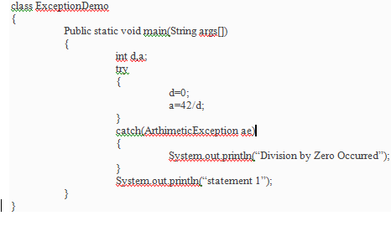
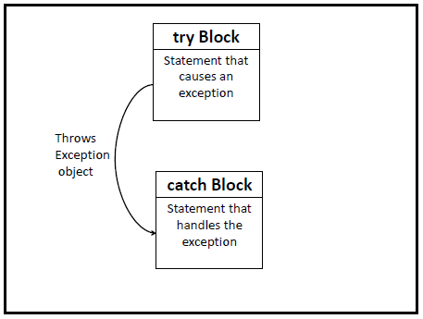
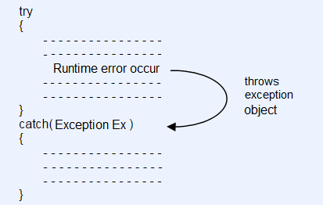
EXCEPTION HANDLING FUNDAMENTALS

Slide 12
EXCEPTION HANDLING FUNDAMENTALS
Once an exception is thrown, program control transfers out of the try block into the catch block.
Once the catch statement has executed program control continues with in the next line in the program following the entire try/catch block mechanism.

Slide 13
EXCEPTION HANDLING FUNDAMENTALS
General Form Of An Exception Handling Block
try
{
Block of code to moniter for errors
}
Catch(Exception type1 exod)
{ Exception handler for Exception type1
}
Catch(Exception type2 exob)
{
Exception handler for Exception tpye2
}
Finally
{
Block of code to be executed after
Try block ends
}

Slide 14
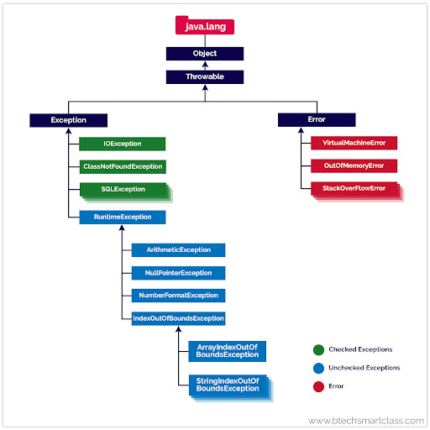
2) EXCEPTION TYPES

Slide 15
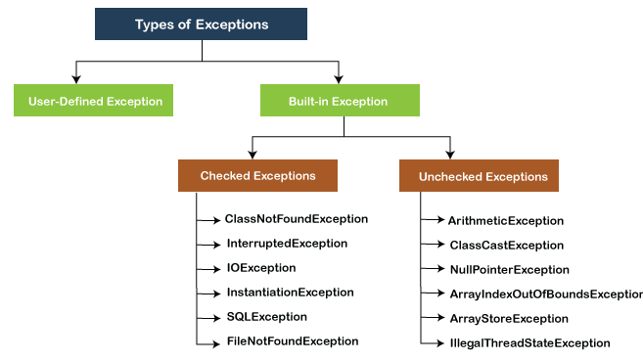
2) EXCEPTION TYPES

Slide 16
3) UNCAUGHT EXCEPTION
class ExceptionDemo
{
Public static void main(String args[])
{
int d,a;
d=0;
a=42/d;
System.out.println(“statement 1”);
}
}
ArithmeticException raised and thrown but nobody to catch and handle . So, the default handler catches and terminates the program.
OutPut:
Z:>javac ExceptionDemo.java
Z:>java ExceptionDemo
Exception in thread "main" java.lang.ArithmeticException: / by zero at ExceptionDemo.main(ExceptionDemo.java:7)

Slide 17
3) UNCAUGHT EXCEPTION
Any Exception that is not caught by the program will ultimately be processed by the default handler.
The Default Handler displays a string describing the exception, prints a stack trace from the point at which the exception occurred, and terminates the program.
Here is the Exception generated when the above example is executed java.lang.ArithmeticException: /by Zero
at Exc0.main(Exc0.java:4)
the class name, Exc0; the method name, main; the filename,Exc0.java;and the line number,4, are all included in the simple stack trace.

Slide 18
Using Try and Catch
class ExceptionDemo
{
Public static void main(String args[])
{
int d,a;
try
{
d=0;
a=42/d;
}
catch(ArthimeticException ae)
{
System.out.println(“Division by Zero Occurred”);
}
System.out.println(“statement 1”);
}
}
Since Division by zero abnormal condition is raised here, JVM creates object to Arthimetic Exception class and throws it to the program
Thrown Object is caught
Exception is handled
This Statement will be executed
By handling Exception, we are able to fix Errors and stops abnormal Terminate

Slide 19
EXCEPTION HANDLING FUNDAMENTALS

Slide 20
MULTITHREADING PROGRAMMING
Introduction
Thread States
Creating a Multiple Threads
Thread Priorities

Slide 21
1) INTRODUCTION
Java is a multithreaded programming language means - we can develop multithreaded programs using Java.
A multithreaded program contains two or more parts that can run concurrently and each part can handle different task at the same time making optimal use of the available resources specially the processor.
By definition multitasking is when multiple processes share common processing resources such as a CPU.
Multithreading extends the idea of multitasking into applications where you can subdivide specific operations within a single application into individual threads.
Each of the threads can run in parallel.
The OS divides processing time not only among different applications, but also among each thread within an application

Slide 22
2) Thread states
During the life time of a thread there are many states it can enter. They are
NewBorn state
Runnable state
Running State
Blocked state
Dead state
A thread is always in any one of these five states.It can move from one state to another via a variety of ways as shown below

Slide 23
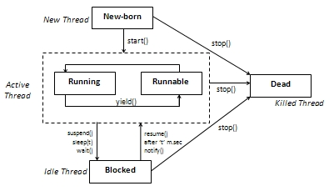
2) Thread states

Slide 24
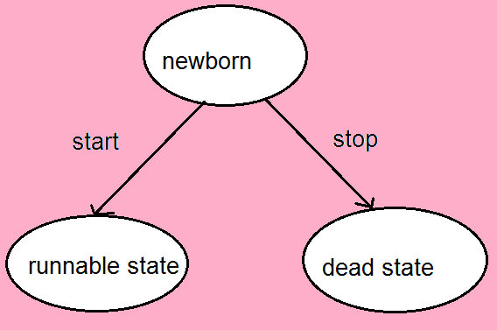
2) Thread states
New Born state :
when we create a thread object, the thread is born and is said to be in new born state.
The thread is not yet scheduled for running .At this state, we can do only one of the following things with it.
Schedule it for running using start() method.
Kill it using stop() method.
If scheduled ,it moves to the runnable state.

Slide 25
2) Thread states
B. Runnable State:
The runnable state means that the thread is ready for execution and is waiting for availability of the processor .i.e the thread has joined the queue of threads that are waiting for execution.
If all threads have equal priority, then they are given time slots for execution in Round Robin fashion,i.e FCFS manner.
The thread that relinguishes control joins the queue at the end & again waits for its turn

Slide 26
2) Thread states
C. Running State:
Running means that the processor has given its time to the thread for its execution.
The thread runs until it relinguishes its control in one of the following situations.
1) It has been suspended using suspend().
a suspended thread can be received by using the resume() method.
It has been made wait by using wait() method
A thread that is waiting will get resumed after notify() method
It has been slept for a t seconds
A thread will get invoked after t second

Slide 27
2) Thread states
Example :

Slide 28
2) Thread states
D. Blocked state:
A thread can also be temporarily suspended or blocked from entering into the runnable and subsequently running state by using either of the following thread methods.
Sleep() // blocked for a specified time
Suspended() // blocked until further orders
Wait() // blocked until certain condition occurs.
These methods cause the thread to go into the blocked sate. The thread will return to runnable state when the specified time is elapsed in the case of sleep(),the resume() method is invoked in case of suspend(),and notify() method is called in case of wait(). E. Dead State:

Slide 29
2) Thread states
E. Dead State
Every thread has a life cycle .
A running thread ends its life when it has completed executing its run().it is natural death.
However, we can kill it by using stop message to it at any stage.Thus causing premature death to it.

Slide 30
3) Creating a Multiple Threads
Creating threads in java is simple. Threads in java can be created in two ways
1) By extending the thread class.
2) By implementing the runnable interface.
Creating threads by extending the thread class:
Define a class that extends thread class and override its run()with the code required by the thread.
Steps to create thread by extending thread class are
Declaring the class
Implementing the run() method.
Starting New Thread.

Slide 31
3) Creating a Multiple Threads
a) Declaring the class:
• declare the class by extending the thread class as:
Class MyThread extends Thread
{
----------
----------
}
b) Implementing the run() method:
the run method is the heart and soul of any thread.
We have to override this method in order to implement the code to be executed by our thread.
It makes up the entire body of a thread and is the only method in which the threads behavior can be implemented.
The basic implementation of run() will look like
public void run()
{
Thread code
}
When we start new thread ,java calls the threads run() method.

Slide 32
3) Creating a Multiple Threads
C )Starting New Thread:
create a thread object and call the start() method to initiate the thread execution.
To create and run an instance of our thread class, we must write the following:
MyThread t1=new MyThread();
T1.start();
The first line instantiates a new object of class MyThread.
The second line calls start() causing the thread to move into runnable state.
Then, the java runtime will schedule the thread to run by invoking its run().Hence the thread is said to be in Running state.

Slide 33
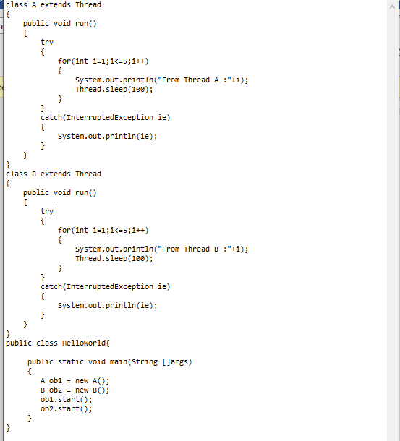
3) Creating a Multiple Threads

Slide 34
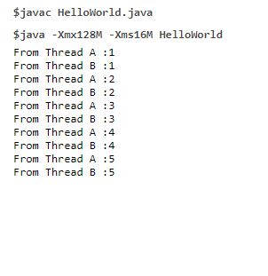
3) Creating a Multiple Threads

Slide 35
3) Creating a Multiple Threads
Creating Thread using Runnable Interface
A) Create a Class that implements Runnable Interface
B) override run() method
C) create a thread by passing an object to the implementation class of runnable interface

Slide 36
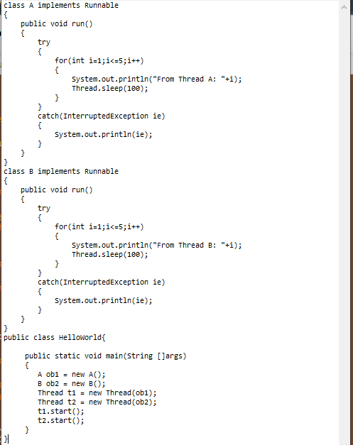
3) Creating a Multiple Threads

Slide 37
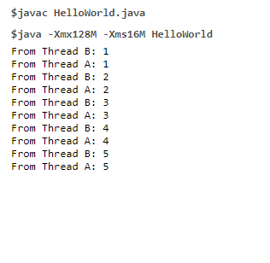
3) Creating a Multiple Threads

Slide 38
3) Creating a Multiple Threads

Slide 39
3) Creating a Multiple Threads
Among two ways of creating threads i.e
By extending Thread class
Implements Runnable interface
if you will not be over riding any of threads methods other than run() method ,it is probably best simply to implement runnable.
In short,if we want to override only run() method better to use Runnable interface .
If it requires to extend other than Thread class, we have no choice but to implement the runnable interface since java classes cannot have two super class.

Slide 40
4) THREAD PRIORITIES
In java, each thread is assigned a priority,which affects the order in which it is scheduled for running.
The thread of the same priority are given equal treatment by java scheduler and therefore they share the processor on a first come, first serve basis.
Java permits us to set and get priority of a thread using setPriority() and getPriority() as follows
ThreadName.setPriority(int Number)
ThreadName.getPriority()
Thread class constants are
MIN_PRIORITY=1
MAX_PRIORITY=10
NORM_PRIORITY=5
NORM_PRIORIty is the default priority.

Slide 41
3) THREAD PRIORITIES
Java run time system usually applies one of the two following strategies
Preemptive scheduling:if the thread has a higher priority then the current running thread leaves runnable state and higher priority enter to runnable state.
Time-sliced(Round robin):A running thread is allowed to be execute for the fixed time, after completion of time , current thread indicates to the another thread to enter it in the runnable state

Slide 42
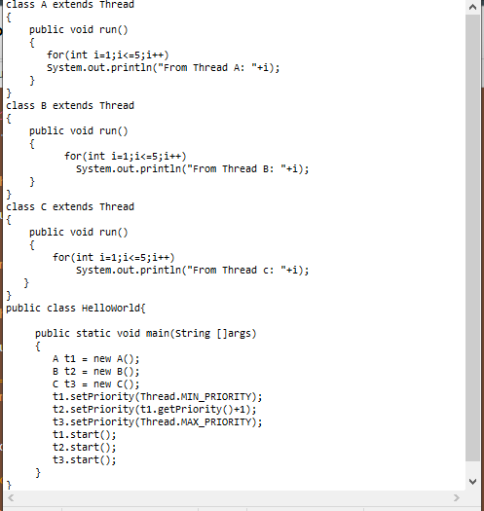
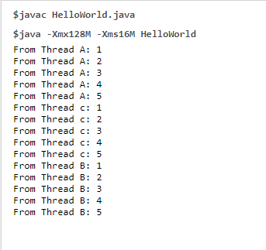
3) THREAD PRIORITIES

Slide 43
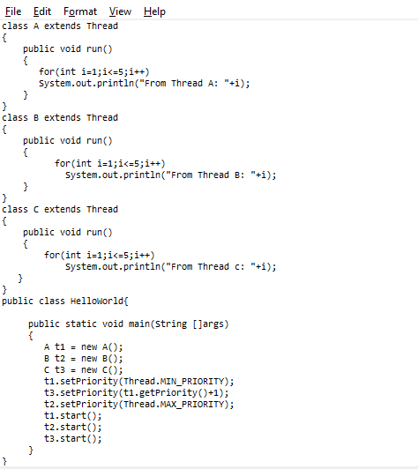
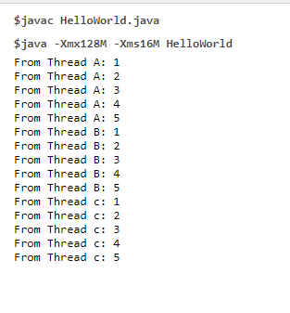
3) THREAD PRIORITIES

Slide 44
APPLETS
Applets
How Applets differ from Applications
Building Applet Code
Applet Life Cycle
Designing a web page
Applet tag,
Adding Applet to HTML File,
Running the Applet.
An applet is a Java program that runs in a Web browser.

Slide 45
2) How Applets differ from Applications
Application | Applet
Applications are stand-alone programs that can be run independently without having to use a web browser. | Applets are small Java programs that are designed to be included in a HTML web document. They require a Java-enabled browser for execution.
Java Applications can read ,write or access the file from local file system | Applets cannot read ,write or access the file from local file system
It requires a main method() for its execution. | It does not require a main method() for its execution.
Applications can run programs from the local system. | Applets cannot run programs from the local machine.
An application program is used to perform some task directly for the user. | An applet program is used to perform small tasks or part of it.
Java Applications programs can access all the resources of the system including data and information on that system | Applets cannot access or modify any resource on the system except only the browser specific services
Applications are not restricted rom using libraries from other languages | Applets are restricted rom using libraries from other languages

Slide 46
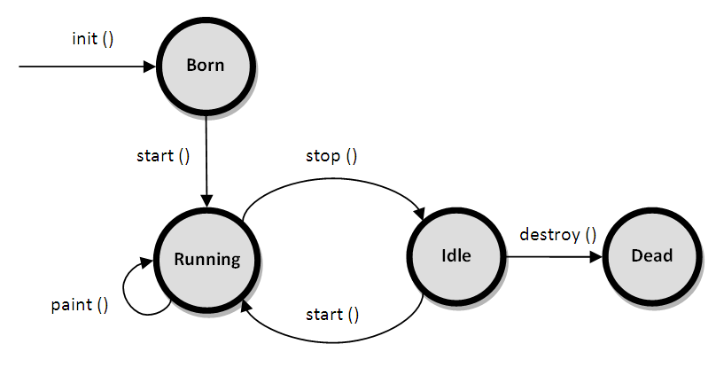
Applet Life Cycle
Applet is a java program executed on web browser
Applet is a special type of program that is embedded in the webpage to generate the dynamic content. It runs inside the browser and works at client side.
The life cycle of an applet is as shown in the figure below:

Slide 47
As shown in the above diagram, the life cycle of an applet starts with init() method and ends with destroy() method.
Other life cycle methods are start(), stop() and paint().
The methods to execute only once in the applet life cycle are init() and destroy(). Other methods execute multiple times.
init(): The init() method is the first method to execute when the applet is executed. Variable declaration and initialization operations are performed in this method.
start(): The start() method contains the actual code of the applet that should run. The start() method executes immediately after the init() method. It also executes whenever the applet is restored, maximized or moving from one tab to another tab in the browser.
stop(): The stop() method stops the execution of the applet. The stop() method executes when the applet is minimized or when moving from one tab to another in the browser.

Slide 48
4) destroy(): The destroy() method executes when the applet window is closed or when the tab containing the webpage is closed. stop() method executes just before when destroy() method is invoked. The destroy() method removes the applet object from memory.
5) paint(): The paint() method is used to redraw the output on the applet display area. The paint() method executes after the execution of start() method and whenever the applet or browser is resized.

Slide 49
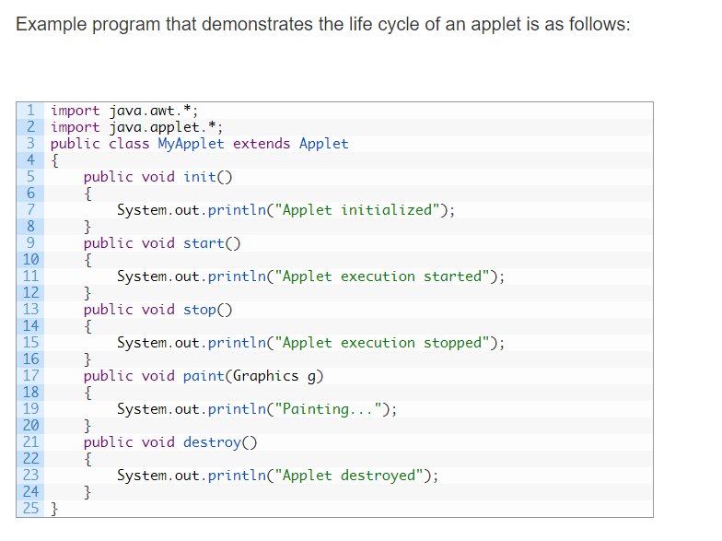
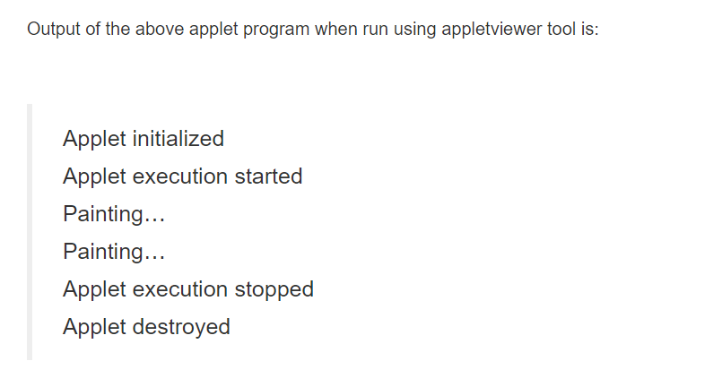

Slide 50
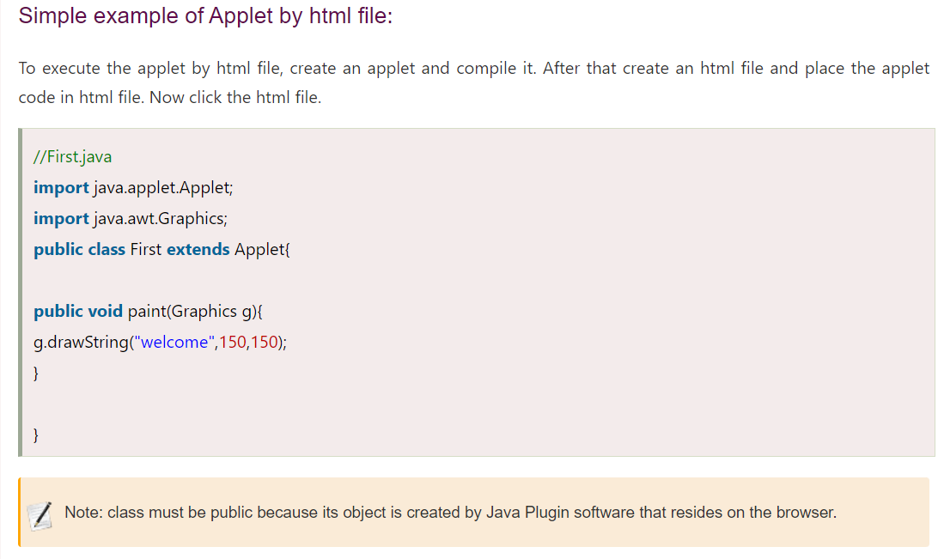
How to run an Applet?
There are two ways to run an applet
By html file.
By appletViewer tool (for testing purpose).

Slide 51
