Slide 1
Mobile Applications using Android
Dr. M. Kalpana Devi
Associate Professor
MCA Department
SITAMS
Notes:
1

Slide 2
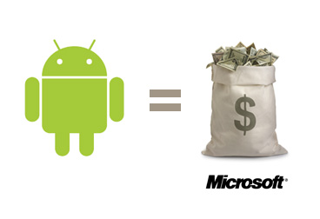
1.Android Operating System
Android is a Linux-based operating system designed primarily for
touchscreen mobile devices such as smartphones and tablet computers.
Initially developed by Android, Inc., whom Google financially backed and later purchased in 2005.
Android was unveiled in 2007 along with the founding of the
Open Handset Alliance: a consortium of hardware, software,
and telecommunication companies devoted to advancing open
standards for mobile devices.
The first Android-powered phone
was sold in October 2008.
Notes:
2

Slide 3
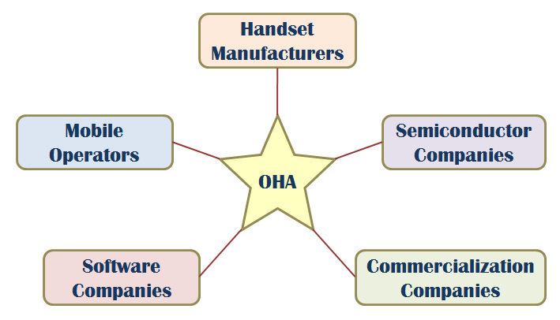
OHA (Open Handset Alliance)
A business alliance consisting of 47 companies to develop open standards for mobile devices
https://www.openhandsetalliance.com/oha_members.html

Slide 4
Android (operating system)
Android is open source and Google releases the code under the Apache License.
This open source code and permissive licensing allows the software to be freely modified and distributed by device manufacturers, wireless carriers and enthusiast developers.
Additionally, Android has a large community of developers writing applications ("apps") that extend the functionality of devices, written primarily in a customized version of the Java programming language.
In October 2012, there were approximately 700,000 apps
available for Android, and the estimated number of applications
downloaded from Google Play, Android's primary app store, was 25 billion.
Notes:
4

Slide 5
Android (operating system)
These factors have allowed Android to become the world's most
widely used smartphone platform and the software of choice
for technology companies who require a low-cost, customizable,
lightweight operating system for high tech devices without
developing one from scratch.
As a result, despite being primarily designed for phones and tablets, it has seen additional applications on televisions, games consoles and other electronics.
Android's open nature has further encouraged a large community of developers
And enthusiasts to use the open source code as a for community-driven projects, which add new features for advanced users or bring Android to devices which were officially released running other operating systems.

Slide 6
Android (operating system)
Android had a worldwide smartphone market share of 75% during the third quarter of 2012, with 500 million devices activated in total and 1.3 million activations per day.
However, the operating system's success has made it a target for patent litigation as part of the so-called "smartphone wars" between technology companies.

Slide 7
1.1 A LITTLE BACKGROUND
Android, Inc. was founded in Palo Alto, California in October 2003 by Andy Rubin (co-founder of Danger), Rich Miner (co-founder of Wildfire Communications, Inc.), Nick Sears (once VP at T-Mobile), and Chris White (headed design and interface development at WebTV)
Android Inc. operated secretly, revealing only that it was working on software for mobile phones.
That same year, Rubin ran out of money. Steve Perlman, a close friend of Rubin, brought him $10,000 in cash in an envelope and refused a stake in the company.

Slide 8
A LITTLE BACKGROUND
In more recent years, the biggest advance in mobile phone development was the introduction of Java hosted MIDlets.
MIDlets are executed on a Java virtual machine (JVM), a process that abstracts the underlying hardware and lets developers create applications that run on the wide variety of devices that support the Java run time.
Unfortunately, this convenience comes at the price of restricted access to the device hardware.

Slide 9
History
On November 5, 2007, the Open Handset Alliance, a consortium of technology companies including Google, device manufacturers such as HTC and Samsung, wireless carriers such as Sprint Nextel and T-Mobile, and chipset makers such as Qualcomm and Texas Instruments, unveiled itself, with a goal to develop open standards for mobile devices.
That day, Android was unveiled as its first product, a mobile device platform built on the Linux kernel version 2.6. The first commercially available phone to run Android was the HTC Dream, released on October 22, 2008.

Slide 10
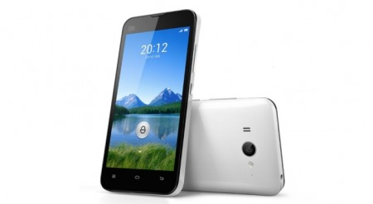
Android Versions
Since 2008, Android has seen numerous updates which have incrementally improved the operating system, adding new features and fixing bugs in previous releases. Each major release is named in alphabetical order after a dessert or sugary treat;
Android versions and their names
Android 1.5: Android Cupcake
Android 1.6: Android Donut
Android 2.0: Android Eclair
Android 2.2: Android Froyo
Android 2.3: Android Gingerbread
Android 3.0: Android Honeycomb
Android 4.0: Android Ice Cream Sandwich
Android 4.1 to 4.3.1: Android Jelly Bean
Android 4.4 to 4.4.4: Android KitKat
Android 5.0 to 5.1.1: Android Lollipop
Android 6.0 to 6.0.1: Android Marshmallow
Android 7.0 to 7.1: Android Nougat
Android 8.0 to Android 8.1: Android Oreo
Android 9.0: Android Pie

Slide 11
Interface
Android's user interface is based on direct manipulation, using touch inputs that loosely correspond to real-world actions, like swiping, tapping, pinching and reverse pinching to manipulate on-screen objects.
The response to user input is designed to be immediate and provides a fluid touch interface, often using the vibration capabilities of the device to provide haptic feedback to the user.
Internal hardware such as accelerometers, gyroscopes and proximity sensors are used by some applications to respond to additional user actions, for example adjusting the screen from portrait to landscape depending on how the device is oriented, or allowing the user to steer a vehicle in a racing game by rotating the device, simulating control of a steering wheel.
Android devices boot to the homescreen, the primary navigation and information point on the device, which is similar to the desktop found on PCs.

Slide 12
Interface
Android homescreens are typically made up of app icons and widgets; app icons launch the associated app, whereas widgets display live, auto-updating content such as the weather forecast, the user's email inbox, or a news ticker directly on the homescreen.
A homescreen may be made up of several pages that the user can swipe back and forth between, though Android's homescreen interface is heavily customisable, allowing the user to adjust the look and feel of the device to their tastes.
Third party apps available on Google Play and other app stores can extensively re-theme the homescreen, and even mimic the look of other operating systems, such as Windows Phone.
Most manufacturers, and some wireless carriers, customise the look and feel of their Android devices to differentiate themselves from the competition.

Slide 13
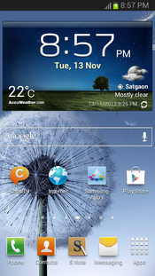
Interface
Present along the top of the screen is a status bar, showing information about the device and its connectivity.
This status bar can be "pulled" down to reveal a notification screen where apps display important information or updates, such as a newly received email or SMS text, in a way that doesn't immediately interrupt or inconvenience the user.
In early versions of Android, these notifications could be tapped to open the relevant app, but recent updates have provided enhanced functionality, such as the ability to call a number back directly from the missed call notification without having to open the dialer app first.
Notifications are persistent until read or dismissed by the user.
A Samsung Galaxy Note II's homescreen, showing the status bar, a clock and weather widget, a Google search bar, and several app shortcuts.

Slide 14
Applications
Android has a growing selection of third party applications, which can be acquired by users either through an app store such as Google Play or the Amazon Appstore, or by downloading and installing the application's APK file from a third-party site.
The Play Store application allows users to browse, download and update apps published by Google and third-party developers, and is pre-installed on devices that comply with Google's compatibility requirements.
The app filters the list of available applications to those that are compatible with the user's device, and developers may restrict their applications to particular carriers or countries for business reasons.
Purchases of unwanted applications can be refunded within 15 minutes of the time of download, and some carriers offer direct carrier billing for Google Play application purchases, where the cost of the application is added to the user's monthly bill.

Slide 15
Applications
Applications are developed in the Java language using the Android software development kit (SDK).
The SDK includes a comprehensive set of development tools, including a debugger, software libraries, a handset emulator, documentation, sample code, and tutorials.
The officially supported integrated development environment (IDE) is Eclipse using the Android Development Tools (ADT) plugin. Other development tools are available, including a Native Development Kit for applications or extensions in C or C++.
Google App Inventor, a visual environment for novice programmers, and various cross platform mobile web applications frameworks.

Slide 16
1.2 WHAT ANDROID ISN’T
A Java ME implementation
Android applications are written using the Java language, but they are not run within a Java ME (Mobile Edition) VM, and Java-compiled classes and executables will not run natively in Android.
Part of the Linux Phone Standards Forum (LiPS) or the Open Mobile Alliance (OMA)
Android runs on an open-source Linux kernel, but, while their goals are similar, Android’s complete software stack approach goes further than the focus of these standards-defining organizations.
Simply an application layer (such as UIQ or S60)
Although Android does include an application layer, “Android’’ also describes the entire software stack, encompassing the underlying operating system, the API libraries, and the applications themselves.

Slide 17
WHAT ANDROID ISN’T
A mobile phone handset
Android includes a reference design for mobile handset manufacturers, but there is no single “Android phone.” Instead, Android has been designed to support many alternative hardware devices.
Google’s answer to the iPhone
The iPhone is a fully proprietary hardware and software platform released by a single company (Apple), whereas Android is an open-source software stack produced and supported by the Open Hansdset Alliance (OHA) and designed to operate on any compatible device.

Slide 18
1.3 ANDROID: AN OPEN PLATFORM FOR MOBILE DEVELOPMENT
Android is an ecosystem made up of a combination of three components:
A free, open-source operating system for embedded devices
An open-source development platform for creating applications
Devices, particularly mobile phones, that run the Android operating system and the applications created for it.

Slide 19
ANDROID: AN OPEN PLATFORM FOR MOBILE DEVELOPMENT
Android is made up of several necessary and dependent parts, including the following:
A Compatibility Definition Document (CDD) and Compatibility Test Suite (CTS) that describe the capabilities required for a device to support the software stack.
A Linux operating system kernel that provides a low-level interface with the hardware, memory management, and process control, all optimized for mobile and embedded devices.
Open-source libraries for application development, including SQLite, WebKit, OpenGL, and a media manager.
A run time used to execute and host Android applications, including the Dalvik Virtual Machine (VM) and the core libraries that provide Android-specific functionality. The run time is designed to be small and efficient for use on mobile devices.

Slide 20
ANDROID: AN OPEN PLATFORM FOR MOBILE DEVELOPMENT
An application framework that agnostically exposes system services to the application layer, including the window manager and location manager, databases, telephony, and sensors.
A user interface framework used to host and launch applications.
A set of core pre-installed applications.
A software development kit (SDK) used to create applications, including the related tools, plug-ins, and documentation.

Slide 21
1.4 NATIVE ANDROID APPLICATIONS
Android devices typically come with a suite of preinstalled applications that form part of the Android Open Source Project (AOSP), including, but not necessarily limited to, the following:
An e-mail client
An SMS management application
A full PIM (personal information management) suite, including a calendar and contacts list
A WebKit-based web browser
A music player and picture gallery
A camera and video recording application
A calculator
A home screen
An alarm clock

Slide 22
NATIVE ANDROID APPLICATIONS
Android devices also ship with the following proprietary Google mobile applications:
The Google Play Store for downloading third-party Android applications
A fully featured mobile Google Maps application, including Street View, driving directions, and turn-by-turn navigation, satellite views, and traffic conditions
The Gmail email client
The Google Talk instant-messaging client
The YouTube video player

Slide 23
1.5 ANDROID SDK FEATURES
GSM, EDGE, 3G, 4G, and LTE networks for telephony or data transfer, enabling you to make or receive calls or SMS messages, or to send and retrieve data across mobile networks
Comprehensive APIs for location-based services such as GPS and network-based location detection
Full support for applications that integrate map controls as part of their user interfaces
Wi-Fi hardware access and peer-to-peer connections
Full multimedia hardware control, including playback and recording with the camera and microphone
Media libraries for playing and recording a variety of audio/video or still-image formats
APIs for using sensor hardware, including accelerometers, compasses, and barometers
Libraries for using Bluetooth and NFC hardware for peer-to-peer data transfer
Notes:
Global System for Mobile Communications 114 kbps
Enhanced Data GSM Evolution 384 kbps
Long Term Evolution 2G- 64 kbps, 3G- 14 mbps, 4G- 100 mbps, 5G – 10gbps

Slide 24
ANDROID SDK FEATURES
IPC message passing
Shared data stores and APIs for contacts, social networking, calendar, and multi-media
Background Services, applications, and processes
Home-screen Widgets and Live Wallpaper
The ability to integrate application search results into the system searches
An integrated open-source HTML5 WebKit-based browser
Mobile-optimized, hardware-accelerated graphics, including a path-based 2D graphics library and support for 3D graphics using OpenGL ES 2.0
Localization through a dynamic resource framework
An application framework that encourages the reuse of application components and the replacement of native applications

Slide 25
1.6 What Android Has That Other Platforms Don’t Have
The following non comprehensive list details some of the features available on Android that may not be available on all modern mobile development platforms:
Google Maps applications
Background services and applications
Shared data and inter-process communication
All applications are created equal
Wi-Fi Direct and Android Beam
Home-screen Widgets, Live Wallpaper, and the quick search box

Slide 26
1.7 THE DEVELOPMENT FRAMEWORK
Android applications normally are written using Java as the programming language but executed by means of a custom VM called Dalvik, rather than a traditional Java VM.
Each Android application runs in a separate process within its own Dalvik instance, relinquishing all responsibility for memory and process management to the Android run time, which stops and kills processes as necessary to manage resources.
Dalvik and the Android run time sit on top of a Linux kernel that handles low-level hardware interaction, including drivers and memory management, while a set of APIs provides access to all the underlying services, features, and hardware.

Slide 27
THE DEVELOPMENT FRAMEWORK
The Android SDK includes everything you need to start developing, testing, and debugging Android applications:
The Android APIs — The core of the SDK is the Android API libraries that provide developer access to the Android stack. These are the same libraries that Google uses to create native Android applications.
Development tools — The SDK includes several development tools that let you compile and debug your applications so that you can turn Android source code into executable applications.
The Android Virtual Device Manager and emulator — The Android emulator is a fully interactive mobile device emulator, that simulates a device hardware configuration.

Slide 28
THE DEVELOPMENT FRAMEWORK
Full documentation — The SDK includes extensive code-level reference information detailing exactly what’s included in each package and class and how to use them.
Sample code — The Android SDK includes a selection of sample applications that demonstrate some of the possibilities available with Android, as well as simple programs that highlight how to use individual API features.
Online support — Android has rapidly generated a vibrant developer community. The Google Groups are active forums of Android developers with regular input from the Android engineering and developer relations teams at Google.

Slide 29
1.8 Understanding the Android Software Stack
A S/W stack for mobile devices developed and managed by OHA
A free S/W under Apache License
Android
Key Applications
Middleware
Operating System (Linux Kernel 2.6)

Slide 30
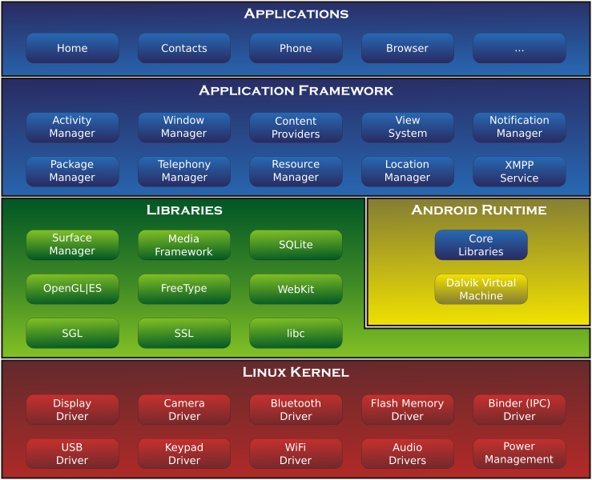
Development
Notes:
Surface Manager- manages different windows for different applications
SGL – Scalable Graphics Library
Libc- Library functions using C
Free type- Bitmap and vectors

Slide 31
Android Software Stack

Slide 32
Android S/W Stack - Application
Android provides a set of core applications:
Email Client
SMS Program
Calendar
Maps
Browser
Contacts
Etc
All applications are written using the Java language.

Slide 33
Android S/W Stack – App Framework
Enabling and simplifying the reuse of components
Developers have full access to the same framework APIs used by the core applications.
Users are allowed to replace components.

Slide 34
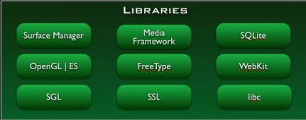
Android S/W Stack - Libraries
Including a set of C/C++ libraries used by components of the Android system
Exposed to developers through the Android application framework

Slide 35
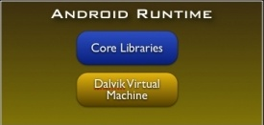
Android S/W Stack - Runtime
Core Libraries
Providing most of the functionality available in the core libraries of the Java language
APIs
Data Structures
Utilities
File Access
Network Access
Graphics
Etc

Slide 36
The Dalvik Virtual Machine(DVM)
One of the key elements of Android is the Dalvik VM. Rather than using a traditional Java VM such as Java ME, Android uses its own custom VM designed to ensure that multiple instances run efficiently on a single device.
The Dalvik VM uses the device’s underlying Linux kernel to handle low-level functionality, including security, threading, and process and memory management.
If the speed and efficiency of C/C++ is required for your application, Android provides a native development kit (NDK). The NDK is designed to enable you to create C++ libraries using the libc and libm libraries, along with native access to OpenGL.

Slide 37
Android S/W Stack – Linux Kernel
Relying on Linux Kernel 2.6 for core system services
Memory and Process Management
Network Stack
Driver Model
Security
Providing an abstraction layer between the H/W and the rest of the S/W stack

Slide 38
Memory management
Since Android devices are usually battery-powered, Android is designed to manage memory (RAM) to keep power consumption at a minimum, in contrast to desktop operating systems which generally assume they are connected to unlimited mains electricity.
When an Android app is no longer in use, the system will automatically suspend it in memory - while the app is still technically "open," suspended apps consume no resources (e.g. battery power or processing power) and sit idialy in the background until needed again.
This has the dual benefit of increasing the general responsiveness of Android devices, since apps don't need to be closed and reopened from scratch each time, but also ensuring background apps don't waste power needlessly.

Slide 39
Memory management
Android manages the apps stored in memory automatically: when memory is low, the system will begin killing apps and processes that have been inactive for a while, in reverse order since they were last used (i.e. oldest first).
This process is designed to be invisible to the user, such that users do not need to manage memory or the killing of apps themselves.
However, confusion over Android memory management has resulted in third-party task killers becoming popular on the Google Play store; these third-party task killers are generally regarded as doing more harm than good.

Slide 40
Usage share of Android versions

Slide 41
Android Application Architecture
Android’s architecture encourages component reuse, enabling you to publish and share Activities, Services, and data with other applications, with access managed by the security restrictions you define.
The following application services are the architectural cornerstones of all Android applications, providing the framework you’ll be using for your own software:
Activity Manager and Fragment Manager — Control the lifecycle of your Activities and Fragments, respectively, including management of the Activity stack
Views — Used to construct the user interfaces for your Activities and Fragments

Slide 42
Android Application Architecture
Notification Manager — Provides a consistent and nonintrusive mechanism for signaling your users
Content Providers — Lets your applications share data
Resource Manager — Enables non-code resources, such as strings an d graphics, to be externalized
Intents — Provides a mechanism for transferring data between applications and their components.

Slide 43
Types of Android Applications
1. Foreground — An application that’s useful only when it’s in the foreground and is effectively suspended when it’s not visible. Games are the most common examples.
2. Background — An application with limited interaction that, apart from when being configured, spends most of its lifetime hidden. These applications are less common, but good examples include call screening applications, SMS auto-responders, and alarm clocks.
3. Intermittent — Most well-designed applications fall into this category. At one extreme are applications that expect limited interactivity but do most of their work in the background. A common example would be a media player.
4. Widgets and Live Wallpapers — Some applications are represented only as a home-screen Widget or as a Live Wallpaper. Complex applications are often difficult. Such an application needs to be aware of its state when interacting with the user.

Slide 44
Hardware-Imposed Design Considerations
Compared to desktop or notebook computers, mobile devices have relatively:
Low processing power
Limited RAM
Limited permanent storage capacity
Small screens with low resolution
High costs associated with data transfer
Intermittent connectivity, slow data transfer rates, and high latency
Unreliable data connections
Limited battery life

Slide 45
Expect Limited Capacity
Advances in flash memory and solid-state disks have led to a dramatic increase in mobile-device storage capacities.
Although an 8GB flash drive or SD card is no longer uncommon in mobile devices, optical disks offer more than 32GB, and terabyte drives are now commonly available for PCs.
Given that most of the available storage on a mobile device is likely to be used to store music and movies, many devices offer relatively limited storage space for your applications.
You should carefully consider how you store your application data.
To make life easier, you can use the Android databases and Content Providers to persist, reuse, and share large quantities of data,

Slide 46
Design for Different Screens
The small size and portability of mobiles are a challenge for creating good interfaces, particularly when users are demanding an increasingly striking and information-rich graphical user experience.
Combined with the wide range of screen sizes that make up the Android device ecosystem, creating consistent, intuitive, and pleasing user interfaces can be a significant challenge.
Write your applications knowing that users will often only glance at the screen.
Make your applications intuitive and easy to use by reducing the number of controls and putting the most important information front and center.
Expect Low Speeds, High Latency The ability to incorporate some of the wealth of online information within your applications is incredibly powerful.

Slide 47
Unfortunately, the mobile Web isn’t as fast, reliable, or readily available as we would like; so, when you’re developing your Internet-based applications, it’s best to assume that the network connection will be slow, intermittent, and expensive.
With unlimited 4G data plans and citywide Wi-Fi, this is changing, but designing for the worst case ensures that you always deliver a high-standard user experience.
This also means making sure that your applications can handle losing (or not finding) a data connection.
The Android Emulator enables you to control the speed and latency of your network connection.

Slide 48
Thank You
Notes:
48

Slide 49
Application Manifest File

Slide 53
Each Android project includes a manifest file, AndroidManifest.xml, stored in the root of its project hierarchy.
The manifest defines the structure and metadata of your application, its components, and its requirements.
The manifest can also specify application metadata (such as its icon, version number, or theme)
And additional top-level nodes can specify any required permissions, unit tests, and define hardware, screen, or platform requirements

Slide 54
The Manifest file does the following:
It names the Java package for the application. The package name serves as a unique identifier for the application.
It describes the components of the application- the activities, services, broadcast receivers and content providers that the application is composed of.
It determines which processes will host application components.
It declares which permissions the application must have in order to access protected parts of the API and interact with other application.

Slide 55
It also declares the permissions that others are required to have in order to interact with the application’s components.
It declares the minimum level of the Android API that the application requires.
It lists the libraries that the application must be linked against.
It lists the instrumentation classes. The instrumentation classes provides profiling and other information. These information are removed just before the application is published etc.

Slide 56
A Closer Look at the Application Manifest
The following XML snippet shows a typical manifest node:
<manifest xmlns: android=”http://schemas.android.com/apk/res/android”
package=“com.paad.myapp“
android:versionCode=“1“
android:versionName=“0.9 Beta“
android:installLocation=“preferExternal“>
[... manifest nodes ... ]
</manifest>

Slide 57
The following list gives a summary of the available manifest sub-node tags and provides an XML snippet demonstrating how each tag is used:
uses-sdk — This node enables you to define a minimum and maximum SDK version that must be available on a device for your application to function properly, and target SDK for which it has been designed using a combination of minSDKVersion, maxSDKVersion, and targetSDKVersion attributes, respectively.

Slide 58
Setting a target SDK version tells the system that there is no need to apply any forward- or backward-compatibility changes to support that particular version.
The maximum SDK defines an upper limit you are willing to support and your application will not be visible on the Google Play Store for devices running a higher platform release.
Devices running on platforms higher than Android 2.0.1 (API level 6) will ignore any maximum SDK values at installation time.
<uses-sdk android:minSdkVersion=”6”
android:targetSdkVersion=”15”/>

Slide 59
uses-configuration —
The uses-configuration nodes specify each combination of input mechanisms are supported by your application.
You shouldn’t normally need to include this node, though it can be useful for games that require particular input controls.
You can specify any combination of input devices that include the following:

Slide 60
reqFiveWayNav — Specify true for this attribute if you require an input device capable of navigating up, down, left, and right and of clicking the current selection. This includes both trackballs and directional pads (D-pads).
reqHardKeyboard — If your application requires a hardware keyboard, specify true.
reqKeyboardType — Lets you specify the keyboard type as one of nokeys, qwerty, twelvekey, or undefined.
reqNavigation — Specify the attribute value as one of nonav, dpad, trackball, wheel, or undefined as a required navigation device.
reqTouchScreen — Select one of no touch, stylus, finger, or undefined to specify the required touch screen input.

Slide 61
You can specify multiple supported configurations, for example, a device with a finger touch screen, a trackball, and either a QUERTY or a twelve-key hardware keyboard, as shown here:
<uses-configuration
android:reqTouchScreen=”finger”
android:reqNavigation=”trackball”
android:reqHardKeyboard=”true”
android:reqKeyboardType=”qwerty”/>
<uses-configuration
android:reqTouchScreen=”finger”
android:reqNavigation=”trackball”
android:reqHardKeyboard=”true”
android:reqKeyboardType=”twelvekey”/>

Slide 62
uses-feature — Android is available on a wide variety of hardware platforms.
Use multiple uses-feature nodes to specify which hardware features your application requires.
This prevents your application from being installed on a device that does not include a required piece of hardware, such as NFC hardware, as follows:
<uses-feature
android:name=”android.hardware.nfc” />

Slide 63
You can require support for any hardware that is optional on a compatible device.
Audio — For applications that requires a low-latency audio pipeline.
Bluetooth — Where a Bluetooth radio is required.
Camera — For applications that require a camera. You can also require (or set as options) autofocus, flash, or a front-facing camera.
Location — If you require location-based services. You can also specify either network or GPS support explicitly.

Slide 64
Microphone — For applications that require audio input.
NFC — Requires NFC (near-field communications) support.
Sensors — Enables you to specify a requirement for any of the potentially available hardware sensors.
Telephony — Specify that either telephony in general, or a specific telephony radio (GSM or CDMA) is required.
Touchscreen — To specify the type of touch-screen your application requires.
USB — For applications that require either USB host or accessory mode support.
Wi-Fi — Where Wi-Fi networking support is required.

Slide 65
In particular, requesting permission to access Bluetooth, the camera, any of the location service permissions, audio recording, Wi-Fi, and telephony-related permissions implies the corresponding hardware features.
You can override these implied requirements by adding a required attribute and setting it to false for example, a note-taking application that supports recording an audio note:
<uses-feature android:name=”android.hardware.microphone”
android:required=”false” />

Slide 66
The camera hardware also represents a special case. For compatibility reasons requesting permission to use the camera, or adding a uses-feature node requiring it, implies a requirement for the camera to support autofocus. You can specify it as optional as appropriate:
<uses-feature android:name=”android.hardware.camera” />
<uses-feature android:name=”android.hardware.camera.autofocus
android:required=”false” />
<uses-feature android:name=”android.hardware.camera.flash”
android:required=”false” />

Slide 67
You can also use the uses-feature node to specify the minimum version of OpenGL required by your application. Use the glEsVersion attribute, specifying the OpenGL ES version as an integer.
The higher 16 bits represent the major number and the lower 16 bits represent the minor number, so version 1.1 would be represented as follows:
<uses-feature android:glEsVersion=”0x00010001” />

Slide 68
supports-screens — The first Android devices were limited to 3.2" HVGA hardware.
Since then, hundreds of new Android devices have been launched including tiny 2.55"
QVGA phones, 10.1" tablets, and 42" HD televisions.
smallScreens — Screens with a resolution smaller than traditional HVGA (typically, QVGA screens).
normalScreens — Used to specify typical mobile phone screens of at least HVGA, including WVGA and WQVGA.
largeScreens — Screens larger than normal. In this instance a large screen is considered to be significantly larger than a mobile phone display.
xlargeScreens — Screens larger than large-typically tablet devices.
Notes:
VGA is a video transmission standard launched by IBM in 1987.(640X480)
HVGA-- Half video graphics array (480X320)
QVGA– Quarter video graphics array (240X320)
WVGA– Wide video graphics array (800X480)
XGA– Extended Graphics array

Slide 69
requiresSmallestWidthDp — Enables you to specify a minimum supported screen width in device independent pixels.
compatibleWidthLimitDp — Specifies the upper bound beyond which your application may not scale.
largestWidthLimitDp — Specifies the absolute upper bound beyond which you know your application will not scale appropriately.

Slide 70
<supports-screens android:smallScreens=”false”
android:normalScreens=”true”
android:largeScreens=”true”
android:xlargeScreens=”true”
android:requiresSmallestWidthDp=”480”
android:compatibleWidthLimitDp=”600”
android:largestWidthLimitDp=”720”/>

Slide 71
supports-gl-texture — Declares that the application is capable of providing texture assets that are compressed using a particular GL texture compression format.
You must use multiple supports-gl-texture elements if your application is capable of supporting multiple texture compression formats.
You can find the most up-to-date list of supported GL texture compression format values at
http://developer.android.com/guide/topics/manifest/
supports-gl-texture-element.html.
<supports-gl-texture android:name =”GL_OES_compressed_ETC1_RGB8_texture” />

Slide 72
uses-permission — As part of the security model, it declare the user permissions your application requires.
Permissions are required for many APIs and method calls, generally those with an associated cost or security implication (such as dialing, receiving SMS, or using the location-based services).
Your application components can also create permissions to restrict access to shared application components
<uses-permission
android:name="ANDROID.PERMISSION.INTERNET" />
<uses-permission
android:name =”android.permission.
ACCESS_FINE_LOCATION”/>

Slide 73
Your application components can then create permissions by adding an android:permission
attribute.
Then you can include a uses-permission tag in your manifest to use these protected components
<permission android:name=”com.paad.DETONATE_DEVICE”
android:protectionLevel=”dangerous”
android:label=”Self Destruct”
android:description=”@string/ detonate_description”>
</permission>

Slide 74
instrumentation — Instrumentation classes provide a test framework for your application components at run time.
They provide hooks to monitor your application and its interaction with the system resources. Create a new node for each of the test classes you’ve created for your application.
<instrumentation
android:label=”My Test”
android:name=”.MyTestClass”
android:targetPackage=”com.paad.apackage”>
</instrumentation>

Slide 75
application — A manifest can contain only one application node. It uses attributes to specify the metadata for your application (including its title, icon, and theme).
During development you should include a debuggable attribute set to true to enable debugging, then be sure to disable it for your release builds.
<application android:icon=”@drawable/icon”
android:logo=”@drawable/logo”
android:theme=”@android:style/Theme.Light”
android:name=”.MyApplicationClass”
android:debuggable=”true”>
[ ... application nodes ... ]
</application>

Slide 76
activity — An activity tag is required for every Activity within your application.
Use the android:name attribute to specify the Activity class name.
You must include the main launch Activity and any other Activity that may be displayed.
Trying to start an Activity that’s not defined in the manifest will throw a runtime exception.
Each Activity node supports intent-filter child tags that define the Intents that can be used to start the Activity

Slide 77
<activity android:name=”.MyActivity” android:label=”@string/app_name”>
<intent-filter>
<action android:name =”android.intent.action.MAIN”/> <category android:name =»android.intent.category. LAUNCHER» />
</intent-filter>
</activity>

Slide 78
service — As with the activity tag, add a service tag for each Service class used in your application.
<service android:name=”.MyService”>
</service>
provider — Provider tags specify each of your application’s Content Providers.
Content Providers are used to manage database access and sharing.
<provider android:name=”.MyContentProvider”
android:authorities= ”com.paad.myapp.MyContentProvider”/>

Slide 79
receiver — By adding a receiver tag, you can register a Broadcast Receiver without having to launch your application first.
Broadcast Receivers are like global event listeners that, when registered, will execute whenever a matching Intent is broadcast by the system or an application.
Each receiver node supports intent-filter child tags that define the Intents that can be used to trigger the receiver:
<receiver android:name=”.MyIntentReceiver”>
<intent-filter>
<action android:name= ”com.paad.mybroadcastaction” />
</intent-filter>
</receiver>

Slide 80
uses-library — Used to specify a shared library that this application requires.
For example “Maps, Geocoding, and Location-Based Services,” are packaged as a separate library that is not automatically linked.
<uses-library android:name=”com.google.android.maps”
android:required=”false”/>

Slide 81
Android Manifest Editor:
The Android Development Tools (ADT) plug-in includes a Manifest Editor, so you don’t have to manipulate the underlying XML directly.
right-click the AndroidManifest.xml fi le in your project folder, and select Open With Android Manifest Editor.
This presents the Android Manifest Overview screen
It also provides shortcut links to the Application, Permissions, Instrumentation, and raw XML screens.

Slide 83
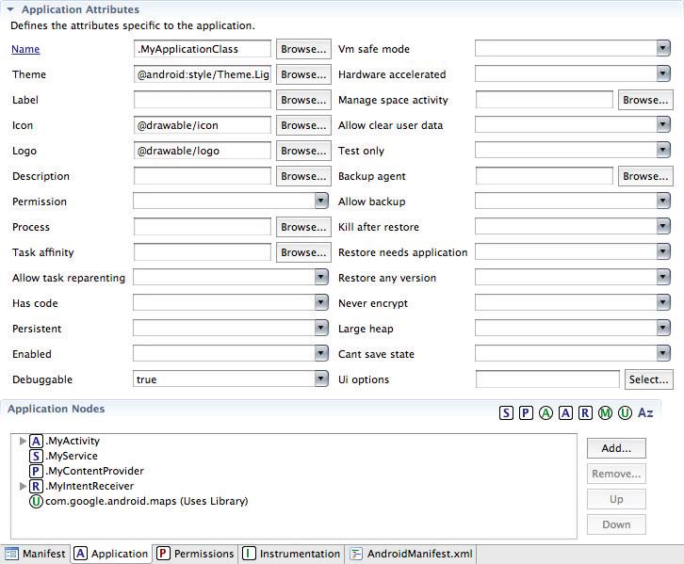

Slide 84
EXTERNALIZING RESOURCES
It’s always good practice to keep non-code resources, such as images and string constants, external to your code.
Android supports the externalization of resources, ranging from simple values such as strings and colors to more complex resources such as images (Drawables), animations, themes, and menus, most powerful resources are layouts.
By externalizing resources, you make them easier to maintain, update, and manage also easily define alternative resource values to support variations in hardware — particularly, screen size and resolution.

Slide 85
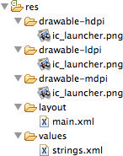
Creating Resources:
Application resources are stored under the res folder in your project hierarchy.
Each of the available resource types is stored in subfolders, grouped by resource type.
drawable-ldpi, drawable-mdpi,
drawable-hdpi- application icon
Layout – layouts
Values- simple values for resource definitions such as strings, colors, dimensions, styles, and integer and String arrays.

Slide 86
<?xml version=”1.0” encoding=”utf-8”?>
<resources>
<string name=”app_name”>To Do List</string>
<plurals name=”androidPlural”>
<item quantity=”one”>One android</item>
<item quantity=”other”>%d androids</item>
</plurals>
<colorname=”app_background”>#FF0000FF</co lor>
<dimen name=”default_border”>5px</dimen>
<string-array name=“string_array“>
<item>Item 1</item>
<item>Item 2</item>
<item>Item 3</item>
</string-array>
<array name=“integer_array“>
<item>3</item>
<item>2</item>
<item>1</item>
</array>
</resources>
When your application is built, these resources will be compiled and compressed as efficiently as possible and included in your application package.
This process also generates an R class file that contains references to each of the resources you include in your project with the advantage of design-time syntax checking.
Within each XML file, you indicate the type of value being stored using tags

Slide 87
Strings:
String resources are specified with the string tag, as shown in the following XML snippet:
<string name=”stop_message”>Stop.</string>
Android supports simple text styling, so you can use the HTML tags <b>, <i>, and <u> to apply bold, italics, or underlining.
<string name=”stop_message”><b>Stop.</b></string>

Slide 88
Colors
Use the color tag to define a new color resource with any of the following notations:
#RGB
#RRGGBB
#ARGB
#AARRGGBB
The following example shows how to specify a fully opaque blue and a partially transparent green:
<color name=”opaque_blue”>#00F</color>
<color name=”transparent_green”>#7700FF00</color>

Slide 89
Dimensions
Dimensions are most commonly referenced within style and layout resources.
They’re useful for creating layout constants, such as borders and font heights.
To specify a dimension resource, use the dimen tag, specifying the dimension value, followed by an identifier describing the scale of your dimension:
px (screen pixels)
in (physical inches)
pt (physical points)
mm (physical millimeters)
dp (density-independent pixels)
sp (scale-independent pixels)
The following XML snippet shows how to specify dimension values for a large font size and a standard border:
<dimen name=”standard_border”>5dp</dimen>
<dimen name=”large_font_size”>16sp</dimen>

Slide 90
Styles and Themes
Style resources let your applications maintain a consistent look and feel by enabling you to specify the attribute values used by Views.
To create a style, use a style tag that includes a name attribute and contains one or more item tags.
Each item tag should include a name attribute used to specify the attribute (such as font size or color) being defined.
<?xml version=”1.0” encoding=”utf-8”?>
<resources>
<style name=”base_text”>
<item name=”android:textSize”>14sp</item>
<item name=”android:textColor”>#111</item>
</style>
</resources>

Slide 91
Drawables
Drawable resources include bitmaps and NinePatches (stretchable PNG images).
They also include complex composite Drawables, such as LevelListDrawables and StateListDrawables, that can be defined in XML.
All Drawables are stored as individual files in the res/drawable folder.
Layouts
Layout resources enable you to decouple your presentation layer from your business logic by designing UI layouts in XML rather than constructing them in code, which enables you to create optimized layouts for different hardware configurations, such as varying screen sizes, orientation, or the presence of keyboards and touchscreens
You can use layouts to define the UI for any visual component, including Activities, Fragments and Widgets.
Once defined in XML, the layout must be “inflated” into the user interface.
Within an Activity this is done using setContentView (usually within the onCreate method), whereas Fragment Views are inflated using the inflate method from the Inflator object passed in to the Fragment’s onCreateView handler.

Slide 92
Animations
Android supports three types of animation:
Property animations —
A tweened animation that can be used to potentially animate any property on the target object by applying incremental changes between two values.
This can be used for anything from changing the color or opacity of a View to gradually fade it in or out, to changing a font size, or increasing a character’s hit points.
View animations —
Tweened animations that can be applied to rotate, move, and stretch a View.
Frame animations —
Frame-by-frame “cell” animations used to display a sequence of Drawable images.

Slide 93
Property Animations:
Property animators were introduced in Android 3.0 (API level 11). It is a powerful framework that can be used to animate almost anything.
Each property animation is stored in a separate XML file in the project’s res/animator folder.
<?xml version=”1.0” encoding=”utf-8”?>
<objectAnimator xmlns:android= ”http://schemas.android.com/apk/res/android”
android:propertyName=”alpha”
android:duration=”1000”
android:valueFrom=”0.0”
android:valueTo=”1.0”
/>

Slide 94
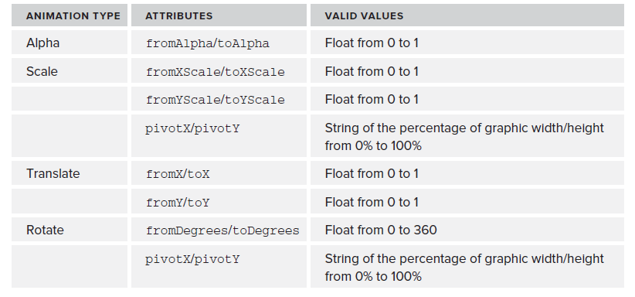
View Animations
Each view animation is stored in a separate XML file in the project’s res/anim folder.
Table shows the valid attributes, and attribute values, supported by each animation type

Slide 95
You can create a combination of animations using the set tag. The following list shows some of the set tags available:
duration — Duration of the full animation in milliseconds.
startOffset — Millisecond delay before the animation starts.
fillBeforetrue — Applies the animation transformation before it begins.
fillAftertrue — Applies the animation transformation after it ends.
interpolator — Sets how the speed of this effect varies over time.
Frame-by-Frame Animations
Frame-by-frame animations produce a sequence of Drawables, each of which is displayed for a specified duration.

Slide 96
Menus
Create menu resources to design your menu layouts in XML, rather than constructing them in code.
You can use menu resources to define both Activity and context menus within your applications, and provide the same options you would have when constructing your menus in code.
A menu is inflated within your application via the inflate method of the MenuInflator Service, usually within the onCreateOptionsMenu method.
Each menu definition is stored in a separate file, each containing a single menu, in the res/menu folder

Slide 97
<?xml version=”1.0” encoding=”utf-8”?>
<menu xmlns:android= ”http://schemas.android.com/apk/res/android”>
<item android:id=”@+id/menu_refresh”
android:title=”@string/refresh_mi” />
<item android:id=”@+id/menu_settings”
android:title=”@string/settings_mi” />
</menu>

Slide 98
Using Resources
In addition to the resources you supply, the Android platform includes several system resources that you can use in your applications.
All resources can be used directly from your application code and can also be referenced from within other resources.
It’s important to note that when using resources, you shouldn’t choose a particular specialized version.
Android will automatically select the most appropriate value for a given resource identifier based on the current hardware, device, and language configurations.

Slide 99
Using Resources in Code
Access resources in code using the static R class. R is a generated class based on your external resources, and created when your project is compiled.
Each of the subclasses within R exposes its associated resources as variables, with the variable names matching the resource identifiers — for example, R.string.app_name or R.drawable.icon.
The value of these variables is an integer that represents each resource’s location in the resource table, not an instance of the resource itself.

Slide 100
setContentView, accepts a resource identifier, you can pass in the resource variable, as shown in the following code snippet:
// Inflate a layout resource.
setContentView(R.layout.main);
// Display a transient dialog box that displays the
// error message string resource.
Toast.makeText(this, R.string.app_error,
Toast.LENGTH_LONG).show();

Slide 101
When you need an instance of the resource itself, you need to use helper methods to extract them from the resource table.
The resource table is represented within your application as an instance of the Resources class.
Resources myResources = getResources();
The Resources class includes getters for each of the available resource types and generally works by passing in the resource ID you’d like an instance of.
CharSequence styledText =myResources.getText(R.string.stop_message);
Drawable icon = myResources.getDrawable(R.drawable.app_icon);
int opaqueBlue = myResources.getColor(R.color.opaque_blue);
float borderWidth = myResources.getDimension(R.dimen.standard_border);

Slide 102
Referencing Resources Within Resources
You can also use resource references as attribute values in other XML resources.
To reference one resource from another, use the @ notation, as shown in the following snippet:
attribute=”@[packagename:]resourcetype/resourceidentifier”
Example:
android:padding=”@dimen/standard_border”>
android:text=”@string/stop_message”
android:textColor=”@color/opaque_blue”

Slide 103
Using System Resources
Accessing the system resources in code is similar to using your own resources.
The difference is that you use the native Android resource classes available from android.R, rather than the application specific R class.
The following code snippet uses the getString method available in the application context to retrieve an error message available from the system resources:
CharSequence httpError = getString(android.R.string.httpErrorBadUrl);

Slide 104
Referring to Styles in the Current Theme
Using themes is an excellent way to ensure consistency for your application’s UI. Rather than fully define each style, Android provides a shortcut to enable you to use styles from the currently applied theme.
To do this, use ?android: rather than @ as a prefix to the resource you want to use. The following example shows a snippet of the preceding code but uses the current theme’s text color rather than a system resource:
<EditText
android:id=”@+id/myEditText”
android:layout_width=”match_parent”
android:layout_height=”wrap_content”
android:text=”@android:string/httpErrorBadUrl”
android:textColor=”?android:textColor”
/>

Slide 105
Creating Resources for Different Languages and Hardware:
Using the directory structure described here, you can create different resource values for specific languages, locations, and hardware configurations.
Android chooses from among these values dynamically at run time using its dynamic resource-selection mechanism.
You can specify alternative resource values using a parallel directory structure within the res folder.
A hyphen (-) is used to separate qualifiers that specify the conditions you provide alternatives for

Slide 106
Values with French language and French Canadian location variations:
Project/
res/
values/
strings.xml
values-fr/
strings.xml
values-fr-rCA/
strings.xml
The following list gives the qualifiers you can use to customize your resource values:
Mobile Country Code and Mobile Network Code (MCC/MNC) —The MCC is specified by mcc followed by the three-digit country code. You can optionally add the MNC using mnc and the two- or three-digit network code (for example, mcc234-mnc20 or mcc310). You can find a list of MCC/MNC codes on Wikipedia at http://en.wikipedia.org/wiki/MobileNetworkCode.

Slide 107
2. Language and Region —for example, en, en-rUS, or en-rGB
3. Smallest Screen Width — The lowest of the device’s screen dimensions (height and width) specified in the form sw<Dimension value>dp (for example, sw600dp, sw320dp, or sw720dp).
4. Available Screen Width — The minimum screen width required to use the contained resources, specified in the form w<Dimension value>dp.
The available screen width changes to reflect the current screen width when the device orientation changes.
Android selects the largest value that doesn’t exceed the currently available screen width.
5. Available Screen Height — The minimum screen height required to use the contained resources, specified in the form h<Dimension value>dp (for example, h720dp, h480dp, or h1280dp)
6. Screen Size — One of small (smaller than HVGA), medium (at least HVGA and typically smaller than VGA), large (VGA or larger), or xlarge (significantly larger than HVGA).

Slide 108
Screen Aspect Ratio — Specify long or notlong for resources designed specifically for wide screen. (For example, WVGA is long; QVGA is notlong.)
Screen Orientation: One of port (portrait), land (landscape), or square (square).
Dock Mode — One of car or desk. Introduced in API level 8.
Screen Pixel Density — Pixel density in dots per inch (dpi). Best practice is to supply ldpi,
mdpi, hdpi, or xhdpi to specify low (120 dpi), medium (160 dpi), high (240 dpi), or extra high (320 dpi) pixel density assets, respectively.
Keyboard Availability — One of keys-exposed, keys-hidden, or keyssoft.
Keyboard Input Type — One of nokeys, qwerty, or 12key.
Navigation Key Availability — One of navexposed or navhidden.
UI Navigation Type — One of nonav, dpad, trackball, or wheel.
Platform Version — The target API level, specified in the form v<API Level> (for example, v7). Used for resources restricted to devices running at the specified API level or higher.

Slide 109
Any combination is supported; however, they must be used in the order given in the preceding list
The following example shows valid and invalid directory names for alternative layout resources.
VALID
layout-large-land
layout-xlarge-port-keyshidden
layout-long-land-notouch-nokeys
INVALID
values-rUS-en (out of order)
values-rUS-rUK (multiple values for a single qualifier)

Slide 110
Runtime Configuration Changes
Android handles runtime changes to the language, location, and hardware by terminating and restarting the active Activity.
This forces the resource resolution for the Activity to be reevaluated and the most appropriate resource values for the new configuration to be selected.
To have an Activity listen for runtime configuration changes, add an android:configChanges attribute
to its manifest node, specifying the configuration changes you want to handle.
The following list describes some of the configuration changes you can specify:
mcc and mnc — A SIM has been detected and the mobile country or network code (respectively) has changed.
locale — The user has changed the device’s language settings.
keyboardHidden — The keyboard, d-pad, or other input mechanism has been exposed or hidden.
keyboard — The type of keyboard has changed; for example, the phone may have a 12-key keypad that flips out to reveal a full keyboard, or an external keyboard might have been plugged in.

Slide 111
fontScale — The user has changed the preferred font size.
uiMode — The global UI mode has changed. This typically occurs if you switch between car mode, day or night mode, and so on.
orientation — The screen has been rotated between portrait and landscape.
screenLayout — The screen layout has changed; typically occurs if a different screen has been activated.
screenSize — Introduced in Honeycomb MR2 (API level 12), occurs when the available screen size has changed, for example a change in orientation between landscape and portrait.
smallestScreenSize — Introduced in Honeycomb MR2 (API level 12), occurs when the physical screen size has changed, such as when a device has been connected to an external display.

Slide 112
android:configChanges=”screenSize|orientation|keyboardHidden”>
Adding an android:configChanges attribute suppresses the restart for the specified configuration changes, instead triggering the onConfigurationChanged handler in the associated Activity.
Override this method to handle the configuration changes yourself, using the passed-in Configuration object
@Override
public void onConfigurationChanged(Configuration newConfig) {
super.onConfigurationChanged(newConfig);
// [ ... Update any UI based on resource values ... ]
if (newConfig.orientation == Configuration.ORIENTATION_LANDSCAPE){
// [ ... React to different orientation ...
if (newConfig.keyboardHidden == Configuration.KEYBOARDHIDDEN_NO) {
// [ ... React to changed keyboard visibility ... ]
}
}

Slide 113
THE ANDROID APPLICATION LIFECYCLE
Unlike many traditional application platforms, Android applications have limited control over their own lifecycles.
Instead, application components must listen for changes in the application state and react accordingly, taking particular care to be prepared for untimely termination.
Each Android application runs in its own process, each of which is running a separate instance of Dalvik.
Memory and process management is handled exclusively by the run time.
Android aggressively manages its resources, doing whatever’s necessary to ensure a smooth and stable user experience.
In practice that means that processes will be killed, in some case without warning, to free resources for higher-priority applications.

Slide 114
UNDERSTANDING AN APPLICATION’S PRIORITY AND ITS PROCESS’ STATES
The order in which processes are killed to reclaim resources is determined by the priority of their hosted applications.
An application’s priority is equal to that of its highest-priority component.
If two applications have the same priority, the process that has been at that priority longest will be killed first.
Process priority is also affected by interprocess dependencies; if an application has a dependency on a Service or Content Provider supplied by a second application, the secondary application has at least as high a priority as the application it supports.

Slide 115
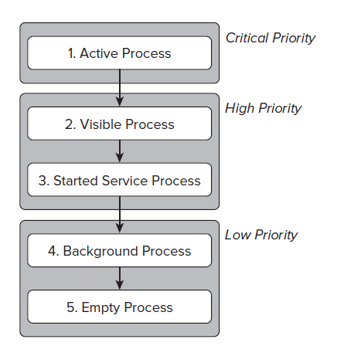
The following figure shows the priority tree used to determine the order of application termination.
1.Active processes —
Active (foreground) processes
have application components
the user is interacting with
Active processes include
the following:
Activities in an active state
Broadcast Receivers executing
Services executing
Running Services

Slide 116
2. Visible processes:
Visible but inactive processes are those hosting “visible” Activities This happens when an Activity is only partially obscured.
There are generally very few visible processes, and they’ll be killed only under extreme circumstances to allow active processes to continue.
3. Started Service processes:
Processes hosting Services that have been started. Because these Services don’t interact directly with the user, they receive a slightly lower priority than visible
Activities or foreground Services. Applications with running Services are still considered foreground processes and won’t be killed unless resources are needed for active or visible processes.

Slide 117
4. Background processes —
Processes hosting Activities that aren’t visible and that don’t have any running Services.
There will generally be a large number of background processes that Android will kill using a last-seen-fi rst-killed pattern in order to obtain resources for foreground processes.
5. Empty processes —
To improve overall system performance, Android will often retain an application in memory after it has reached the end of its lifetime.
Android maintains this cache to improve the start-up time of applications when they’re relaunched.
These processes are routinely killed, as required.

Slide 118
INTRODUCING THE ANDROID APPLICATION CLASS
Your application’s Application object remains instantiated whenever your application runs.
The Application class provides event handlers for application creation and termination, low memory conditions, and configuration changes
Unlike Activities, the Application is not restarted as a result of configuration changes.
Extending the Application class with your own implementation enables you to do three things:
1. Respond to application level events broadcast by the Android run time such as low memory conditions.
2. Transfer objects between application components.
3. Manage and maintain resources used by several application components.
Of these, the later two can be better achieved using a separate singleton class
Notes:
singleton class:
In object-oriented programming, a singleton class is a class that can have only one object (an instance of the class) at a time. After the first time, if we try to instantiate the Singleton class, the new variable also points to the first instance created. So whatever modifications we do to any variable inside the class through any instance, affects the variable of the single instance created and is visible if we access that variable through any variable of that class type defined.
The primary purpose of a Singleton class is to restrict the limit of the number of object creation to only one. This often ensures that there is access control to resources, for example, socket or database connection.
For example, there is a license with us, and we have only one database connection or suppose if our JDBC driver does not allow us to do multithreading, t
The other difference is that a normal class vanishes at the end of the lifecycle of the application while the singleton class does not destroy with the completion of an application.Then Singleton class comes into the picture and makes sure that at a time, only a single connection or a single thread can access the connection.

Slide 119
Extending and Using the Application Class
import android.app.Application;
import android.content.res.Configuration;
public class MyApplication extends Application {
private static MyApplication singleton;
// Returns the application instance
public static MyApplication getInstance() {
return singleton;
}
@Override
public final void onCreate() {
super.onCreate();
singleton = this;
}
}

Slide 120
When created, you must register your new Application class in the manifest’s application node using a name attribute, as shown in the following snippet:
<application android:icon=”@drawable/icon”
android:name=”.MyApplication”>
[... Manifest nodes ...]
</application>
Create new state variables and global resources for access from within the application components:
MyObjectvalue = MyApplication.getInstance().getGlobalStateValue();
MyApplication.getInstance().setGlobalStateValue(myObjectValue);
Although this can be an effective technique for transferring objects between your loosely coupled application components, or for maintaining application state or shared resources, it is often better to create your own static singleton class rather than extending the Application class specifically unless you are also handling the lifecycle events described in the following section.

Slide 121
Overriding the Application Lifecycle Events
By overriding these methods, you can implement your own application-specific behavior for each of these circumstances:
onCreate — Called when the application is created. Override this method to initialize your application singleton and create and initialize any application state variables or shared resources.
onLowMemory — Provides an opportunity for well-behaved applications to free additional memory when the system is running low on resources.
This will generally only be called when background processes have already been terminated and the current foreground applications are still low on memory. Override this handler to clear caches or release unnecessary resources.

Slide 122
onTrimMemory — An application specific alternative to the onLowMemory handler introduced in Android 4.0 (API level 13).
Called when the run time determines that the current application should attempt to trim its memory overhead – typically when it moves to the background.
It includes a level parameter that provides the context around the request.
onConfigurationChanged — Unlike Activities Application objects are not restarted due to configuration changes.
If your application uses values dependent on specific configurations, override this handler to reload those values and otherwise handle confi guration changes at an application level.

Slide 123
You must always call through to the superclass event handlers when overriding these methods.
@Override
public final void onCreate() {
super.onCreate();
singleton = this;
}
@Override
public final void onLowMemory() {
super.onLowMemory();
}
@Override
public final void onTrimMemory(int level) {
super.onTrimMemory(level);
}
@Override
public final void onConfigurationChanged(Configuration newConfig) {
super.onConfigurationChanged(newConfig);
}

Slide 124
ANDROID ACTIVITIES
Each Activity represents a screen that an application can present to its users.
The more complicated your application, the more screens you are likely to need.
Typically, this includes at least a primary interface screen that handles the main UI functionality of your application.
This primary interface generally consists of a number of Fragments that make up your UI and is generally supported by a set of secondary Activities.
To move between screens you start a new Activity

Slide 125
Creating Activities
Extend Activity to create a new Activity class.
Within this new class you must define the UI and implement your functionality.
The following code shows the basic skeleton code for a new Activity.
package com.paad.activities;
import android.app.Activity;
import android.os.Bundle;
public class MyActivity extends Activity {
/** Called when the activity is first created. */
@Override
public void onCreate(Bundle savedInstanceState) {
super.onCreate(savedInstanceState);
}
}

Slide 126
Views are the UI controls that display data and provide user interaction.
Android provides several layout classes, called View Groups, which can contain multiple Views to help you layout your UIs.
Fragments are used to encapsulate segments of your UI, making it simple to create dynamic interfaces that can be rearranged to optimize your layouts for different screen sizes and orientations.
To assign a UI to an Activity, call setContentView from the onCreate method of your Activity. In this first snippet, an instance of a TextView is used as the Activity’s UI:
@Override
public void onCreate(Bundle savedInstanceState) {
super.onCreate(savedInstanceState);
TextView textView = new TextView(this);
setContentView(textView);
}

Slide 127
You want to use a more complex UI design. You can create a layout in code using layout View Groups, or you can use the standard Android convention of passing a resource ID for a layout defined in an external resource, as shown in the following snippet:
@Override
public void onCreate(Bundle savedInstanceState) {
super.onCreate(savedInstanceState);
setContentView(R.layout.main);
}

Slide 128
To use an Activity in your application, you need to register it in the manifest.
Add a new activity tag within the application node of the manifest; the activity tag includes attributes for metadata, such as the label, icon, required permissions, and themes used by the Activity.
An Activity without a corresponding activity tag can’t be displayed — attempting to do so will result in a runtime exception.
<activity android:label=”@string/app_name”
android:name=”.MyActivity”>
</activity>

Slide 129
Activity Lifecycle

Slide 131
Activity Lifecycle
An activity is the single screen in android. It is like window or frame of Java.
By the help of activity, you can place all your UI components or widgets in a single screen.
The 7 lifecycle method of Activity describes how activity will behave at different states.
Android Activity Lifecycle is controlled by 7 methods of android.app.Activity class. The android Activity is the subclass of ContextThemeWrapper class.

Slide 132
An activity represents a single screen in your app with which your user can perform a single, focused task.
An app usually consists of multiple activities that are loosely bound to each other.
Typically, one activity in an application is specified as the "main" activity, which is presented to the user when the app is launched.
Each activity can then start other activities in order to perform different actions.

Slide 133
Method | Description
onCreate | called when activity is first created.
onStart | called when activity is becoming visible to the user.
onResume | called when activity will start interacting with the user.
onPause | called when activity is not visible to the user.
onStop | called when activity is no longer visible to the user.
onRestart | called after your activity is stopped, prior to start.
onDestroy | called before the activity is destroyed.

Slide 134
Activity Stacks
The state of each Activity is determined by its position on the Activity stack, a last-in–first-out collection of all the currently running Activities.
When a new Activity starts, it becomes active and is moved to the top of the stack.
If the user navigates back using the Back button, or the foreground Activity is otherwise closed, the next Activity down on the stack moves up and becomes active.

Slide 136
Activity States
As Activities are created and destroyed, they move in and out of the stack, as shown in Figure As they do so, they transition through four possible states:
Active — When an Activity is at the top of the stack it is the visible, focused, foreground Activity that is receiving user input. Android will attempt to keep it alive at all costs, killing Activities further down the stack as needed
Paused — In some cases your Activity will be visible but will not have focus; at this point it’s paused. This state is reached if a transparent or non-full-screen Activity is active in front of it. In extreme cases Android will kill a paused Activity to recover resources for the active Activity. When an Activity becomes totally obscured, it is stopped.

Slide 137
Stopped — When an Activity isn’t visible, it “stops.” The Activity will remain in memory, retaining all state information; however, it is now a candidate for termination when the system requires memory elsewhere. Once an Activity has exited or closed, it becomes inactive.
Inactive — After an Activity has been killed, and before it’s been launched, it’s inactive. Inactive Activities have been removed from the Activity stack and need to be restarted before they can be displayed and used.

Slide 138
Monitoring State Changes
To ensure that Activities can react to state changes, Android provides a series of event handlers that are fired when an Activity transitions through its full, visible, and active lifetimes. Figure summarizes these lifetimes in terms of the Activity states described in the previous section.

Slide 139
1. The Full Lifetime
The full lifetime of your Activity occurs between the first call to onCreate and the final call to onDestroy. It’s not uncommon for an Activity’s process to be terminated without the onDestroy method being called. Use the onCreate method to
initialize your Activity:
inflate the user interface,
get references to Fragments,
allocate references to class variables,
bind data to controls, and start Services and Timers.

Slide 140
2. The Visible Lifetime
An Activity’s visible lifetimes are bound between calls to onStart and onStop.
Between these calls your Activity will be visible to the user, although it may not have focus and may be partially obscured.
Activities are likely to go through several visible lifetimes during their full lifetime because they move between the foreground and background.
Although it’s unusual, in extreme cases the Android run time will kill an Activity during its visible lifetime without a call to onStop.

Slide 141
3. The Active Lifetime
The active lifetime starts with a call to onResume and ends with a corresponding call to onPause.
An active Activity is in the foreground and is receiving user input events.
Your Activity is likely to go through many active lifetimes before it’s destroyed, as the active lifetime will end when a new Activity is displayed, the device goes to sleep, or the Activity loses focus.

Slide 142
Thank You

Slide 143
Building User Interfaces
By
Dr. M. Kalpana Devi
Associate Professor
MCA Department

Slide 144
The individual elements of an Android UI are arranged on screen by means of a variety of Layout Managers derived from the ViewGroup class.
The range of screen sizes and display resolutions your application may be used on has expanded along with the range of Android devices now available to buy.
Android 3.0 introduced the Fragment API to provide better support for creating dynamic layouts that can be optimized for tablets as well as a variety of different smartphone displays.
Finally, examine Adapters and learn how to use them to bind your presentation layer to the underlying data sources.

Slide 145
FUNDAMENTAL ANDROID UI DESIGN
Android introduces some new terminology for familiar programming metaphors
Views — Views are the base class for all visual interface elements (commonly known as controls or widgets). All UI controls, including the layout classes, are derived from View.
View Groups — View Groups are extensions of the View class that can contain multiple child Views. Extend the ViewGroup class to create compound controls made up of interconnected child Views.
Layouts - The ViewGroup class is also extended to provide the Layout Managers that help you lay out controls within your Activities.
Fragments — Fragments, introduced in Android 3.0 (API level 11), are used to encapsulate portions of your UI. This encapsulation makes Fragments particularly useful when optimizing your UI layouts for different screen sizes and creating reusable UI elements.
Activities — Activities, described till now, represent the window, or screen, being displayed. Activities are the Android equivalent of Forms in traditional Windows desktop development. To display a UI, you assign a View (usually a layout or Fragment) to an Activity.

Slide 146
Assigning User Interfaces to Activities
A new Activity starts with an empty screen onto which you place your UI. To do so, call setContentView, passing in the View instance, or layout resource to display.
The setContentView method accepts either a layout’s resource ID or a single View instance resource.
@Override
public void onCreate(Bundle savedInstanceState) {
super.onCreate(savedInstanceState);
setContentView(R.layout.main);
}

Slide 147
Using layout resources decouples your presentation layer from the application logic, providing the flexibility to change the presentation without changing code.
You can obtain a reference to each of the Views within a layout using the findViewById method:
TextView myTextView =
(TextView)findViewById(R.id.myTextView);

Slide 148
INTRODUCING LAYOUTS
Layout Managers (or simply layouts) are extensions of the ViewGroup class and are used to position child Views within your UI.
Layouts can be nested, letting you create arbitrarily complex UIs using a combination of layouts.
The Android SDK includes a number of layout classes
It’s up to you to select and use the right combination of layouts to make your UI aesthetically pleasing, easy to use, and efficient to display.

Slide 149
Some of the most commonly used layout classes available in the Android SDK:
Constraint Layout - Constraint Layout is a ViewGroup (i.e. a view that holds other views) which allows you to create large and complex layouts with a flat view hierarchy, and also allows you to position and size widgets in a very flexible way. It was created to help reduce the nesting of views and also improve the performance of layout files.
FrameLayout — The simplest of the Layout Managers, the Frame Layout pins each child view within its frame. The default position is the top-left corner, though you can use the gravity attribute to alter its location. Adding multiple children stacks each new child on top of the one before, with each new View potentially obscuring the previous ones.
LinearLayout — A Linear Layout aligns each child View in either a vertical or a horizontal line. A vertical layout has a column of Views, whereas a horizontal layout has a row of Views. The Linear Layout supports a weight attribute for each child View that can control the relative size of each child View within the available space.

Slide 150
RelativeLayout — One of the most flexible of the native layouts, the Relative Layout lets you define the positions of each child View relative to the others and to the screen boundaries.
GridLayout — Introduced in Android 4.0 (API level 14), the Grid Layout uses a rectangular grid of infinitely thin lines to lay out Views in a series of rows and columns.
The Grid Layout is incredibly flexible and can be used to greatly simplify layouts and reduce or eliminate the complex nesting often required to construct UIs using the layouts described above.
Table Layout - In Android, Table Layout is used to arrange the group of views into rows and columns. Table Layout containers do not display a border line for their columns, rows or cells. A Table will have as many columns as the row with the most cells.
Absolute Layout - In Android, an Absolute Layout is a layout used to design the custom layouts. In this layout you can specify the exact location of its children by using x and y coordinates.

Slide 151
Defining Layouts
The preferred way to define a layout is by using XML external resources.
Each layout XML must contain a single root element.
This root node can contain as many nested layouts and Views as necessary to construct an arbitrarily complex UI.
The following snippet shows a simple layout that places a TextView above an EditText control using a vertical LinearLayout.
It’s good practice to use the Layout Editor to construct your Grid Layouts rather than relying on tweaking the XML manually.
Android documentation describes the features and properties of each layout class in detail in the following URL
http://developer.android.com/guide/topics/ui/layout-objects.html

Slide 152
<?xml version=”1.0” encoding=”utf-8”?>
<LinearLayout xmlns:android=”http://schemas.android.com/apk/res/android”
android:orientation=”vertical”
android:layout_width=”match_parent”
android:layout_height=”match_parent”>
<TextView
android:layout_width=”match_parent”
android:layout_height=”wrap_content”
android:text=”Enter Text Below”/>
<EditText
android:layout_width=”match_parent”
android:layout_height=”wrap_content”
android:text=”Text Goes Here!”/>
</LinearLayout>

Slide 153
For each of the layout elements, the constants wrap_content and match_parent are used rather than an exact height or width in pixels, technique for ensuring your layouts are screen-size and resolution independent.
When assigning Views to layouts in code, it’s important to apply LayoutParameters using the setLayoutParams method, or by passing them in to the addView call:

Slide 154
LinearLayout lilay = new LinearLayout(this);
lilay.setOrientation(LinearLayout.VERTICAL);
TextView myTextView = new TextView(this);
EditText myEditText = new EditText(this);
myTextView.setText(“Enter Text Below”);
myEditText.setText(“Text Goes Here!”);
int layHeight =
LinearLayout.LayoutParams.MATCH_PARENT;
int layWidth =
LinearLayout.LayoutParams.WRAP_CONTENT;
lilay.addView(myTextView, new
LinearLayout.LayoutParams(layHeight, layWidth));
lilay.addView(myEditText, new
LinearLayout.LayoutParams(layHeight, layWidth));
setContentView(ll);

Slide 155
Using Layouts to Create Device Independent User Interfaces
1.Using a Linear Layout
The Linear Layout is one of the simplest layout classes.
It allows you to create simple UIs (or UI elements) that align a sequence of child Views in either a vertical or a horizontal line.

Slide 156
<?xml version=”1.0” encoding=”utf-8”?>
<LinearLayout
xmlns:android=”http://schemas.android.com/apk/res/android”
android:layout_width=”match_parent”
android:layout_height=”match_parent”
android:orientation=”vertical”>
<LinearLayout
android:layout_width=”fill_parent”
android:layout_height=”wrap_content”
android:orientation=”horizontal”
android:padding=”5dp”>
<Button
android:text=”@string/cancel_button_text”
android:layout_width=”fill_parent”
android:layout_height=”wrap_content”
android:layout_weight=”1”/>
<Button
android:text=”@string/ok_button_text”
android:layout_width=”fill_parent”
android:layout_height=”wrap_content”
android:layout_weight=”1”/>
</LinearLayout>
<ListView
android:layout_width=”match_parent”
android:layout_height=”match_parent”/>
</LinearLayout>

Slide 157
2. Using Relative Layout
The Relative Layout provides a great deal of flexibility for your layouts, allowing you to define the position of each element within the layout in terms of its parent and the other Views.

Slide 158
<?xml version=”1.0” encoding=”utf-8”?>
<RelativeLayout
xmlns:android=”http://schemas.android.com/apk/res/android”
android:layout_width=”match_parent”
android:layout_height=”match_parent”>
<LinearLayout
android:id=”@+id/button_bar”
android:layout_alignParentBottom=”true”
android:layout_height=”wrap_content”
android:orientation=”horizontal”
android:padding=”5dp”>
<Button
android:text=”@string/cancel_button_text”
android:layout_width=”fill_parent”
android:layout_height=”wrap_content”
android:layout_weight=”1”/>
<Button
android:text=”@string/ok_button_text”
android:layout_width=”fill_parent”
android:layout_height=”wrap_content”
android:layout_weight=”1”/>
</LinearLayout>
<ListView
android:layout_above=”@id/button_bar”
android:layout_alignParentLeft=”true”
android:layout_width=”match_parent”
android:layout_height=”match_parent”>
</ListView>
</RelativeLayout>

Slide 159
3. Using a Grid Layout
The Grid Layout uses an arbitrary grid to position Views.
By using row and column spanning, the Space View, and Gravity attributes, you can create complex without resorting to the often complex nesting required to construct UIs using the Relative Layout described previously.
For performance reasons it’s good practice to use the Grid Layout in preference to creating the same UI using a combination of nested layouts.

Slide 161
<?xml version=”1.0” encoding=”utf-8”?>
<GridLayout
xmlns:android= http:// schemas.android.com/apk/res/android
android:layout_width=”match_parent”
android:layout_height=”match_parent”
android:orientation=”vertical”>
<ListView
android:background=”#FF444444”
android:layout_gravity=”fill”>
</ListView>
<LinearLayout
android:layout_gravity=”fill_horizontal”
android:orientation=”horizontal”
android:padding=”5dp”>
<Button
android:text=”Cancel”
android:layout_width=”fill_parent”
android:layout_height=”wrap_content”
android:layout_weight=”1”/>
<Button
android:text=”OK”
android:layout_width=”fill_parent”
android:layout_height=”wrap_content”
android:layout_weight=”1”/>
</LinearLayout>
</GridLayout>

Slide 162
Constraint Layout:

Slide 163
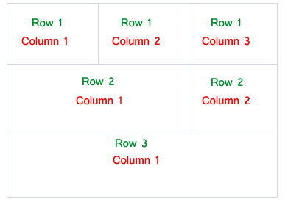
Table Layout:

Slide 164
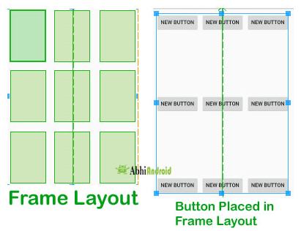
Frame Layout

Slide 165
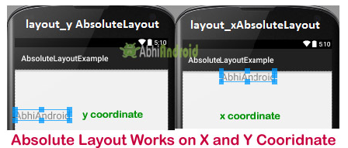
Absolute Layout

Slide 166
Optimizing Layouts
Inflating layouts is an expensive process; each additional nested layout and included View directly impacts on the performance and responsiveness of your application.
To keep your applications smooth and responsive, it’s important to keep your layouts as simple as possible and to avoid inflating entirely new layouts for relatively small UI changes.

Slide 167
A Linear Layout within a Frame Layout, both of which are set to MATCH_PARENT, does nothing but add extra time to inflate.
Look for redundant layouts, particularly if you’ve been making significant changes to an existing layout or are adding child layouts to an existing layout.
Layouts can be arbitrarily nested, so it’s easy to create complex, deeply nested hierarchies.
Although there is no hard limit, it’s good practice to restrict nesting to fewer than 10 levels.

Slide 168
Avoid Using Excessive Views Each additional View takes time and resources to inflate.
To maximize the speed and responsiveness of your application, none of its layouts should include more than 80 Views.
When you exceed this limit, the time taken to inflate the layout becomes significant.
To minimize the number of Views inflated within a complex layout, you can use a ViewStub.
A View Stub works like a lazy include — a stub that represents the specified child Views within the parent layout — but the stub is only inflated explicitly via the inflate method or when it’s made visible.

Slide 169
// Find the stub
View stub = findViewById(R.id.
download_progress_panel_stub);
// Make it visible, causing it to inflate the child layout
stub.setVisibility(View.VISIBLE);
// Find the root node of the inflated stub layout
View downloadProgressPanel =
findViewById(R.id.download_progress_panel);

Slide 170
Using Lint to Analyze Your Layouts
To assist you in optimizing your layout hierarchies, the Android SDK includes
Lint — a powerful tool that can be used to detect problems within you application, including layout performance issues.
The lint tool is available as a command-line tool or as a window within Eclipse supplied as part of the ADT plug-in, as shown in the figure.

Slide 172
In addition to using Lint to detect each optimization issue, you can also use Lint to
detect missing translations,
unused resources,
inconsistent array sizes,
accessibility and internationalization problems,
missing or duplicated image assets,
usability problems,
and manifest errors.

Slide 173
Fragments
By
Dr. M. Kalpana Devi

Slide 174
A Fragment is a piece of an activity which enable more modular activity design, a fragment is a kind of sub-activity.
A fragment, like an activity, has an XML layout file and a Java class that represents the Fragment controller.
A fragment has its own layout and its own behavior with its own life cycle callbacks.
You can add or remove fragments in an activity while the activity is running. You can combine multiple fragments in a single activity to build a multi-pane UI.
A fragment can be used in multiple activities.
Fragments were added to the Android API in Honeycomb version of Android which API version 11.

Slide 175
Importance of Fragments
Reusing View and Logic Components - Fragments enable re-use of parts of your screen including views and event logic over and over in different ways across many disparate activities.
Tablet Support - Often within apps, the tablet version of an activity has a substantially different layout from the phone version which is different from the TV version.
Screen Orientation - Often within apps, the portrait version of an activity has a substantially different layout from the landscape version. Fragments enable both orientations to reuse shared elements while also having differences.

Slide 176
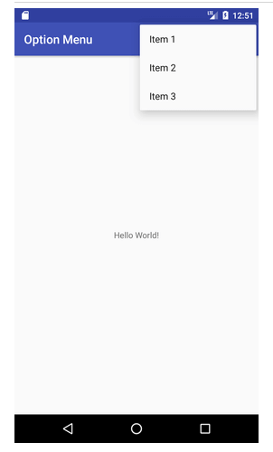

Slide 177
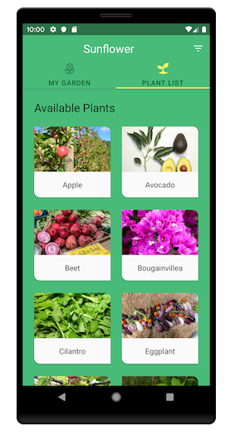

Slide 178
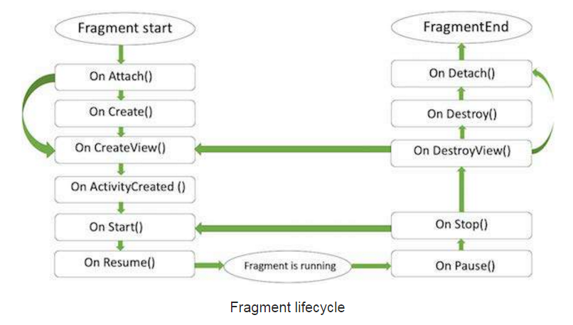
Fragment Life Cycle
Android fragments have their own life cycle very similar to an android activity.

Slide 179
onAttach()The fragment instance is associated with an activity instance.
onCreate() The system calls this method when creating the fragment.
onCreateView() The system calls this callback when it's time for the fragment to draw its user interface for the first time.
onActivityCreated() is called after the onCreateView() method when the host activity is created.
onStart() The onStart() method is called once the fragment gets visible.
onResume() Fragment becomes active.
onPause() The system calls this method as the first indication that the user is leaving the fragment.
onStop()Fragment going to be stopped by calling onStop()
onDestroyView()Fragment view will destroy after call this method
onDestroy() called to do final clean up of the fragment's state but Not guaranteed to be called by the Android platform.

Slide 180
Fragment-Specific Lifecycle Events
Attaching and Detaching Fragments from the Parent Activity: The full lifetime of your Fragment begins when it’s bound to its parent Activity and ends when it’s been detached using onAttach and onDetach.
Creating and Destroying Fragments: The created lifetime of your Fragment occurs between the first call to onCreate and the final call to onDestroy.
Creating and Destroying User Interfaces: Fragment’s UI is initialized and destroyed within a new set of event handlers, onCreateView and onDestroyView, respectively.

Slide 181
Fragment States
Fragment state transitions are closely related to the corresponding Activity state transitions.
When an Activity is paused or stopped, the Fragments it contains are also paused and stopped. When an Activity is finally destroyed, each Fragment it contains is likewise destroyed.
The advantages of using Fragments is the flexibility to dynamically add or remove Fragments from an active Activity, each Fragment can progress through its full, visible, and active lifecycle several times within the active lifetime of its parent Activity.

Slide 182
Fragment Manager
Each Activity includes a Fragment Manager to manage the Fragments it contains.
The Fragment Manager is a class which provides the methods used to access the Fragments currently added to the Activity, and to perform Fragment Transaction to add, remove, and replace Fragments.
FragmentManager fragmentManager =
getFragmentManager();

Slide 183
Adding Fragments to Activities
The simplest way to add a Fragment to an Activity is by including it within the Activity’s layout using the fragment tag.
<?xml version=”1.0” encoding=”utf-8”?>
<LinearLayout xmlns:android=”http://schemas.android.com/apk/res/android”
android:orientation=”horizontal”
android:layout_width=”match_parent”
android:layout_height=”match_parent”>
<fragment android:name=”com.paad.weatherstation.MyListFragment”
android:id=”@+id/my_list_fragment”
android:layout_width=”match_parent”
android:layout_height=”match_parent”
android:layout_weight=”1”
/>
</LinearLayout>

Slide 184
Once the Fragment has been inflated, it becomes a ViewGroup laying out and managing its UI within the Activity.
If you plan to dynamically modify your layouts by adding, removing, and replacing Fragments at run time, a better approach is to create layouts that use container Views into which Fragments can be placed at runtime.
You then need to create and add the corresponding Fragments to their appropriate parent containers within the onCreate handler of your Activity using FragmentTransactions

Slide 185
<FrameLayout
android:id=”@+id/ui_container”
android:layout_width=”match_parent”
android:layout_height=”match_parent”
android:layout_weight=”1”
/>
<FrameLayout
android:id=”@+id/details_container”
android:layout_width=”match_parent”
android:layout_height=”match_parent”
android:layout_weight=”3”
/>

Slide 186
Using Fragment Transactions
Fragment Transactions can be used to add, remove, and replace Fragments within an Activity at run time.
Each Fragment Transaction can include any combination of supported actions, including adding, removing, or replacing Fragments.
A new Fragment Transaction is created using the beginTransaction method from the Activity’s Fragment Manager.
FragmentTransaction fragmentTransaction =
fragmentManager.beginTransaction();
// Add, remove, and/or replace Fragments.
// Specify animations.
// Add to back stack if required.
fragmentTransaction.commit();

Slide 187
Adding, Removing, and Replacing Fragments
When adding a new UI Fragment, specify the Fragment instance to add, along with the containerView into which the Fragment will be placed.
FragmentTransaction fragmentTransaction =
fragmentManager.beginTransaction();
fragmentTransaction.add(R.id.ui_container, new
MyListFragment());
fragmentTransaction.commit();
FragmentTransaction fragmentTransaction =
fragmentManager.findFragmentById(R.id.details_fragment);
fragmentTransaction.remove(fragment);
fragmentTransaction.commit();

Slide 188
You can also replace one Fragment with another.
Specify the container ID containing the Fragment to be replaced, the Fragment with which to replace it, and (optionally) a tag to identify the newly inserted Fragment.
FragmentTransaction fragmentTransaction =
fragmentManager.beginTransaction();
fragmentTransaction.replace(R.id.details_fragment,
new DetailFragment(selected_index));
fragmentTransaction.commit();

Slide 190
Using the Fragment Manager to Find Fragments
If you have added your Fragment to the Activity layout in XML, you can use the Fragment’s resource identifier:
If you’ve added a Fragment using a Fragment Transaction, you should specify the resource identifier of the containerView to which you added the Fragment you want to find (the tag you specified in the Fragment Transaction).
MyFragment myFragment = (MyFragment)fragmentManager.findFragmentById(R.id.MyFragment);
DetailsFragment detailsFragment = (DetailsFragment)fm.findFragmentById(R.id.details_container);

Slide 191
Alternatively, You can specify a tag that can later be used to find the Fragment by using the findFragmentByTag method:
Populating Dynamic Activity Layouts with Fragments
If you’re dynamically changing the composition and layout of your Fragments at run time, it’s good practice to define only the parent containers within your XML layout and populate it exclusively using Fragment Transactions at run time to ensure consistency when configuration changes (such as screen rotations) cause the UI to be re-created.
MyFragment myFragment =
(MyFragment)fragmentManager.findFragmentByTag(MY_FRAGMENT_TAG);

Slide 192
public void onCreate(Bundle savedInstanceState) {
super.onCreate(savedInstanceState);
// Inflate the layout containing the Fragment containers
setContentView(R.layout.fragment_container_layout);
FragmentManager fm = getFragmentManager();
// Check to see if the Fragment back stack has been populated
// If not, create and populate the layout.
DetailsFragment detailsFragment =
(DetailsFragment)fm.findFragmentById(R.id.details_container);
if (detailsFragment == null) {
FragmentTransaction ft = fm.beginTransaction();
ft.add(R.id.details_container, new DetailsFragment());
ft.add(R.id.ui_container, new MyListFragment());
ft.commit();
}
}

Slide 193
it’s good practice to include any view containers involved in any transactions in all the layout variations.
Failing to do so may result in the Fragment Manager attempting to restore Fragments to containers that don’t exist in the new layout.
To remove a Fragment container in a given orientation layout, simply mark its visibility attribute as gone in your layout definition.
<FrameLayout
android:id=”@+id/details_container”
android:layout_width=”match_parent”
android:layout_height=”match_parent”
android:layout_weight=”3”
android:visibility=”gone”
/>

Slide 194
Fragments and the Back Stack
The logical stacking of Activities that are no longer visible — which allow users to navigate back to previous screens using the back button.
This involves reversing previously executed Fragment Transactions.
To add the Fragment Transaction to the back stack, call addToBackStack on a Fragment Transaction before calling commit.
FragmentTransaction fragmentTransaction = fragmentManager.beginTransaction();
fragmentTransaction.add(R.id.ui_container, new MyListFragment());
Fragment fragment = fragmentManager.findFragmentById(R.id.details_fragment);
fragmentTransaction.remove(fragment);
String tag = null;
fragmentTransaction.addToBackStack(tag);
fragmentTransaction.commit();

Slide 195
Animating Fragment Transactions
To apply one of the default transition animations, use the setTransition method on any Fragment
You can also apply custom animations to Fragment Transactions by using the setCustomAnimations method. This method accepts two animation XML resources: one for Fragments that are being added to the layout by this transaction, and another for Fragments being removed:
This is a particularly useful way to add seamless dynamic transitions when you are replacing Fragments within your layout.
transaction.setTransition(FragmentTransaction.TRANSIT_FRAGMENT_OPEN);
fragmentTransaction.setCustomAnimations(R.animator.slide_in_left,R.animator.slide_out_right);

Slide 196
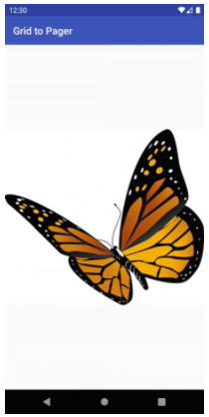

Slide 197
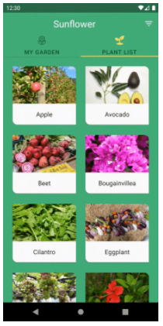

Slide 198
Interfacing Between Fragments and Activities
Use the getActivity method within any Fragment to return a reference to the Activity within which it’s embedded.
This is particularly useful for ﬁnding the current Context, accessing other Fragments using the Fragment Manager, and ﬁnding Views within the Activity’s View hierarchy.
TextView textView =
(TextView)getActivity().findViewById(R.id.textview);

Slide 199
Although it’s possible for Fragments to communicate directly using the host Activity’s Fragment Manager, it’s generally considered better practice to use the Activity as an intermediary.
This allows the Fragments to be as independent and loosely coupled as possible, with the responsibility for deciding how an event in one Fragment should affect the overall UI falling to the host Activity.

Slide 200
public interface OnSeasonSelectedListener {
public void onSeasonSelected(Season season);
}
private OnSeasonSelectedListener onSeasonSelectedListener;
private Season currentSeason;
@Override
public void onAttach(Activity activity) {
super.onAttach(activity);
try { onSeasonSelectedListener = (OnSeasonSelectedListener)activity;
}
catch (ClassCastException e) {
throw new ClassCastException(activity.toString() + “
must implement OnSeasonSelectedListener”); } }
private void setSeason(Season season) {
currentSeason = season; onSeasonSelectedListener.onSeasonSelected(season); }

Slide 201
Android Fragment Classes
The Android SDK includes a number of Fragment subclasses that encapsulate some of the most common Fragment implementations. Some of the more useful ones are listed here:
DialogFragment — A Fragment that you can use to display a ﬂ oating Dialog over the parent Activity. You can customize the Dialog’s UI and control its visibility directly via the Fragment API. Dialog Fragments are covered in more detail in Chapter 10, “Expanding the User Experience.”
ListFragment — A wrapper class for Fragments that feature a ListView bound to a data source as the primary UI metaphor. It provides methods to set the Adapter to use and exposes the event handlers for list item selection. The List Fragment is used as part of the To-Do List example in the next section.
WebViewFragment — A wrapper class that encapsulates a WebView within a Fragment. The child WebView will be paused and resumed when the Fragment is paused and resumed.

Slide 202
Creating New Views by Dr. M. Kalpana Devi

Slide 203
THE ANDROID WIDGET TOOLBOX
Android supplies a toolbox of standard Views to help you create your UIs.
TextView — A standard read-only text label that supports multiline display, string formatting, and automatic word wrapping.
EditText — An editable text entry box that accepts multiline entry, word-wrapping, and hint text.
Chronometer — A Text View extension that implements a simple count-up timer.
ListView — A View Group that creates and manages a vertical list of Views, displaying them as rows within the list.
Spinner — A composite control that displays a Text View and an associated List View that lets you select an item from a list to display in the textbox.
Button — A standard push button.
ToggleButton — A two-state button that can be used as an alternative to a check box. It’s particularly appropriate where pressing the button will initiate an action as well as changing a state

Slide 204
Spinner

Slide 205
Toggle Button

Slide 206
ImageButton — A push button for which you can specify a customized background image (Drawable).
CheckBox — A two-state button represented by a checked or unchecked box.
RadioButton — A two-state grouped button. A group of these presents the user with a number of possible options, of which only one can be enabled at a time.
ViewFlipper — A View Group that lets you define a collection of Views as a horizontal row in which only one View is visible at a time, and in which transitions between visible views can be animated.
VideoView — Handles all state management and display Surface configuration for playing videos more simply from within your Activity.
QuickContactBadge — Displays a badge showing the image icon assigned to a contact you specify using a phone number, name, email address, or URI. Clicking the image will display the quick contact bar, which provides shortcuts for contacting the selected contact.
ViewPager — Released as part of the Compatibility Package, the View Pager implements a horizontally scrolling set of Views similar to the UI used in Google Play and Calendar. The View Pager allows users to swipe or drag left or right to switch between different Views.

Slide 207
CREATING NEW VIEWS
It is possible to implement beautiful UIs optimized for your application’s workflow.
The best approach to use when creating a new View depends on what you want to achieve:
Modify or extend the appearance and/or behavior of an existing View when it supplies the basic functionality you want.
By overriding the event handlers and/or onDraw, but still calling back to the superclass’s methods, you can customize a View without having to re-implement its functionality.
Combine Views to create atomic, reusable controls that leverage the functionality of several interconnected Views.
For example, you could create a stopwatch timer by combining a TextView and a Button that resets the counter when clicked.
Create an entirely new control when you need a completely different interface that you can’t get by changing or combining existing controls.

Slide 208
Modifying Existing Views
To create a new View based on an existing control, create a new class that extends it, as shown with the TextView derived class
Import ...
public class MyTextView extends TextView {
public MyTextView (Context context, AttributeSet attrs, int defStyle) {
super(context, attrs, defStyle);
}
public MyTextView (Context context) {
super(context);
}
public MyTextView (Context context, AttributeSet attrs) {
super(context, attrs);
}
}

Slide 209
To override the appearance or behavior of your new View, override and extend the event handlers associated with the behavior you want to change.
@Override
public void onDraw(Canvas canvas) {
[ ... Draw things on the canvas under the text ... ]
// Render the text as usual using the TextView base class. super.onDraw(canvas);
[ ... Draw things on the canvas over the text ... ]
}
@Override
public boolean onKeyDown(int keyCode, KeyEvent keyEvent) {
[ ... Perform some special processing ... ]
[ ... based on a particular key press ... ]
// Use the existing functionality implemented by
// the base class to respond to a key press event.
return super.onKeyDown(keyCode, keyEvent);
}
}

Slide 211
Creating Compound Controls
Compound controls are atomic, self-contained View Groups that contain multiple child Views laid out and connected together
When you create a compound control, you define the layout, appearance, and interaction of the Views it contains.
As with Activities, the preferred way to design compound View UI layouts is by using an external resource.
public class MyCompoundView extends LinearLayout {
public MyCompoundView(Context context) {
super(context);
}
public MyCompoundView(Context context, AttributeSet attrs) {
super(context, attrs);
}
}

Slide 212
<?xml version=”1.0” encoding=”utf-8”?>
<LinearLayout xmlns:android=”http://schemas.android.com/apk/res/android”
android:orientation=”vertical”
android:layout_width=”match_parent”
android:layout_height=”wrap_content”>
<EditText
android:id=”@+id/editText”
android:layout_width=”match_parent”
android:layout_height=”wrap_content”
/>
<Button
android:id=”@+id/clearButton”
android:layout_width=”match_parent”
android:layout_height=”wrap_content”
android:text=”Clear”
/>
</LinearLayout>

Slide 213
To use this layout in your new compound View, override its constructor to inflate the layout resource using the inflate method from the LayoutInflater system service. The inflate method takes the layout resource and returns the inflated View.
public class ClearableEditText extends LinearLayout {
EditText editText;
Button clearButton;
public ClearableEditText(Context context) {
super(context);
// Inflate the view from the layout resource.
String infService = Context.LAYOUT_INFLATER_SERVICE;
LayoutInflater li;
li = (LayoutInflater)getContext().getSystemService(infService);
li.inflate(R.layout.clearable_edit_text, this, true);
// Get references to the child controls.
editText = (EditText)findViewById(R.id.editText);
clearButton = (Button)findViewById(R.id.clearButton);
// Hook up the functionality
hookupButton();
} }}

Slide 214
You can create a reusable layout by creating an XML resource that encapsulates the UI pattern you want to reuse.
You can then import these layout patterns when creating the UI for Activities or Fragments by using the include tag within their layout resource definitions.
The include tag also enables you to override the id and layout parameters of the root node of the included layout:
<include layout=”@layout/clearable_edit_text”/>
<include layout=”@layout/clearable_edit_text”
android:id=”@+id/add_new_entry_input”
android:layout_width=”match_parent”
android:layout_height=”wrap_content”
android:layout_gravity=”top”/>

Slide 215
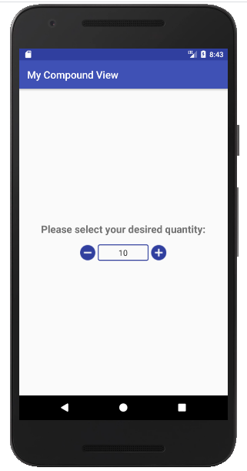

Slide 216
Creating Custom Views
Creating new Views gives you the power to fundamentally shape the way your applications look and feel. By creating your own controls, you can create UIs that are uniquely suited to your needs.
you extend either the View or SurfaceView class. The View class provides a Canvas object with a series of draw methods and Paint classes.
Use them to create a visual interface with bitmaps and raster graphics. You can then override user events, including screen touches or key presses to provide interactivity.
The SurfaceView class provides a Surface object that supports drawing from a background thread and optionally using openGL to implement your graphics.

Slide 218
Handling User Interaction Events
For your new View to be interactive, it will need to respond to user-initiated events such as key presses, screen touches, and button clicks.
onKeyDown — Called when any device key is pressed; includes the D-pad, keyboard, hang-up, call, back, and camera buttons
onKeyUp — Called when a user releases a pressed key
onTrackballEvent — Called when the device’s trackball is moved
onTouchEvent — Called when the touchscreen is pressed or released, or when it detects movement
Skeleton class that overrides each of the user interaction handlers in a View is shown in the next slide.

Slide 219
@Override
public boolean onKeyDown(int keyCode, KeyEvent keyEvent) {
// Return true if the event was handled. return true;
}
@Override
public boolean onKeyUp(int keyCode, KeyEvent keyEvent) {
// Return true if the event was handled. return true;
}
@Override
public boolean onTrackballEvent(MotionEvent event ) {
// Get the type of action this event represents
int actionPerformed = event.getAction();
// Return true if the event was handled.
return true;
}
@Override
public boolean onTouchEvent(MotionEvent event) {
// Get the type of action this event represents
int actionPerformed = event.getAction();
// Return true if the event was handled.
return true;
}

Slide 220
Introduction to Adapters

Slide 221
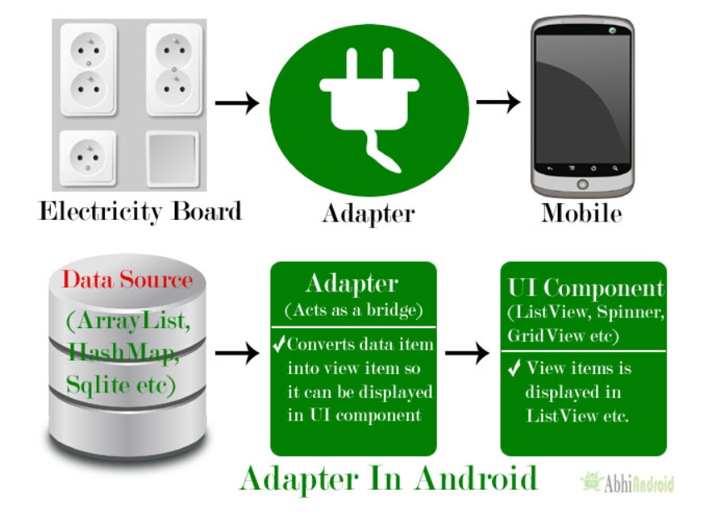
INTRODUCING ADAPTERS
Adapters are the link between a set of data and the AdapterView that displays the data.
Adapters are used to bind data to View Groups that extend the AdapterView class

Slide 222
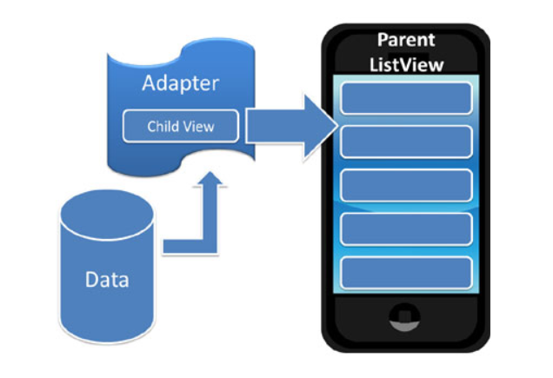
Adapters are responsible for creating child Views that represent the underlying data within the bound parent View.
It is incapable of displaying any data on its own. Its contents are always determined by another object, an adapter.
An adapter is an object of a class that implements the Adapter interface. It acts as a link between a data set and an adapter view, an object of a class that extends the abstract AdapterView class. The data set can be anything that presents data in a structured manner. Arrays, List objects, and Cursor objects are commonly used data sets.

Slide 223
Introducing Some Native Adapters:
In most cases you won’t have to create your own Adapters from scratch.
Android supplies a set of Adapters that can pump data from common data sources (including arrays and Cursors) into the native controls that extend Adapter View.
The following list highlights two of the most useful and versatile native Adapters:
ArrayAdapter — The Array Adapter uses generics to bind an Adapter View to an array of objects of the specified class.
By default, the Array Adapter uses the toString value of each object in the array to create and populate Text Views.
Alternative constructors enable you to use more complex layouts, or you can extend the class (as shown in the next section) to bind data to more complicated layouts.

Slide 224
2. SimpleCursorAdapter — The Simple Cursor Adapter enables you to bind the Views within a layout to specific columns contained within a Cursor (typically returned from a Content Provider query).
You specify an XML layout to inflate and populate to display each child, and then bind each column in the Cursor to a particular View within that layout.
The adapter will create a new View for each Cursor entry and inflate the layout into it, populating each View within the layout using the Cursor’s corresponding column value.
You can create your own Adapter classes and build your own AdapterView-derived controls.

Slide 225
ArrayAdapter
ArrayAdapter consists of two elements- Array and Adapter.
Array is a list or array of Java objects and objects can be anything like- string, integer etc., .
Adapter is a collection handler that returns each item in the collection as a view. It is used for managing the items in the list (the data model or data source).
ArrayAdapter class can handle a list or array of Java objects as input. Every Java object is mapped to one row. By default it maps the toString() method of the object to a view in the row layout.

Slide 227
Customizing the Array Adapter
is the implementation of a ArrayAdapter.
Parameters used in ArrayAdapter Class:
1. Context:
The first parameter is used to pass the context, means the reference of current class. Here this is a keyword used to show the current class reference. We can also use getApplicationContext(), getActivity() in the place of this keyword.
getApplicationContext() is used in a Activity and getActivity() is used in a Fragment.
Below is the example code in which we set the current class reference in a adapter.
ArrayAdapter(Context context, int resource, int textViewResourceId, T[] objects)
ArrayAdapter arrayAdapter = new ArrayAdapter(this, int resource, int textViewResourceId, T[] objects);

Slide 228
2. resource:
The second parameter is resource id used to set the layout(xml file) for list items in which you have a text view.
3. textViewResourceId:
The third parameter is textViewResourceId which is used to set the id of TextView where you want to display the actual text.
4. objects:
The fourth parameter is an array of objects, used to set the array of elements in the textView. We can set the object of array or array list here.
ArrayAdapter arrayAdapter = new ArrayAdapter(this, R.layout.list_view_items, int textViewResourceId, T[] objects);
ArrayAdapter arrayAdapter = new ArrayAdapter(this, R.layout.list_view_items, R.id.textView, T[] objects);
String animalList[] = {"Lion","Tiger","Monkey","Elephant","Dog","Cat","Camel"};
ArrayAdapter arrayAdapter = new ArrayAdapter(this, R.layout.list_view_items, R.id.textView, animalList);

Slide 229
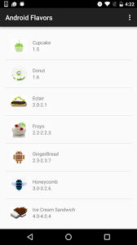

Slide 230
Using the Simple Cursor Adapter
The SimpleCursorAdapter is used to bind a Cursor to an Adapter View using a layout to define the UI of each row/item.
The content of each row’s View is populated using the column values of the corresponding row in the underlying Cursor.
Construct a Simple Cursor Adapter by passing in the current context, a layout resource to use for each item, a Cursor that represents the data to display, and two integer arrays:
one that contains the indexes of the columns from which to source the data, and
a second (equally sized) array that contains resource IDs to specify which Views within the layout should be used to display the contents of the corresponding columns.

Slide 231
public void onLoadFinished(Loader<Cursor> loader, Cursor cursor) {
String[] fromColumns = new String[]{ CallLog.Calls.CACHED_NAME,
CallLog.Calls.NUMBER};
int[] toLayoutIDs = new int[] { R.id.nameTextView, R.id.numberTextView
};
SimpleCursorAdapter myAdapter;
myAdapter = new SimpleCursorAdapter(MyActivity.this,
R.layout.mysimplecursorlayout,
cursor,fromColumns,toLayoutIDs);
myListView.setAdapter(myAdapter);
}

Slide 232
Introduction
To
Android DataBases

Slide 233
INTRODUCING ANDROID DATABASES
Android provides structured data persistence through a combination of SQLite relational databases and Content Providers.
SQLite databases can be used to store application data using a managed, structured approach.
Every application can create its own databases over which it has complete control.
Android databases are stored in the /data/data/<package_name>/databases folder on your device (or emulator).
Content Providers offer a generic, well-defined interface for using and sharing data that provides a consistent abstraction from the underlying data source.
Content Providers provide an interface for publishing and consuming data, based around a simple URI addressing model using the content:// schema

Slide 235
SQLite Databases
SQLite is a well-regarded relational database management system (RDBMS). It is:
Open-source
Standards-compliant
Lightweight
Single-tier
It has been implemented as a compact C library that’s included as part of the Android software stack implemented as a library, rather than running as a separate ongoing process.
This reduces external dependencies, minimizes latency, and simplifies transaction locking and synchronization.
Lightweight and powerful, SQLite differs from many conventional database engines by loosely typing each column, meaning that column values are not required to conform to a single type;
Each value is typed individually in each row. As a result, type checking isn’t necessary when assigning or extracting values from each column within a row.

Slide 236
CONTENT VALUES AND CURSORS
Content Values are used to insert new rows into tables. Each ContentValues object represents a single table row as a map of column names to values.
Database queries are returned as Cursor objects. Rather than extracting and returning a copy of the result values
Cursors are pointers to the result set within the underlying data.
The Cursor class includes a number of navigation functions, including, but not limited to, the following:
moveToFirst — Moves the cursor to the first row in the query result
moveToNext — Moves the cursor to the next row
moveToPrevious — Moves the cursor to the previous row
getCount — Returns the number of rows in the result set
getColumnIndexOrThrow — Returns the zero-based index for the column with the specified name (throwing an exception if no column exists with that name)
getColumnName — Returns the name of the specified column index
getColumnNames — Returns a string array of all the column names in the current Cursor
moveToPosition — Moves the cursor to the specified row
getPosition — Returns the current cursor position

Slide 237
WORKING WITH SQLITE DATABASES
Introducing the SQLiteOpenHelper:
SQLiteOpenHelper is an abstract class used to implement the best practice pattern for creating, opening, and upgrading databases.
By implementing an SQLite Open Helper, you hide the logic used to decide if a database needs to be created or upgraded before it’s opened, as well as ensure that each operation is completed efficiently.
The SQLite Open Helper caches database instances after they’ve been successfully opened, so you can make requests to open the database immediately prior to performing a query or transaction.
There is no need to close the database manually unless you no longer need to use it again.

Slide 238
private static class HoardDBOpenHelper extends SQLiteOpenHelper {
private static final String DATABASE_NAME = “myDatabase.db”;
private static final String DATABASE_TABLE = “GoldHoards”;
private static final int DATABASE_VERSION = 1;
private static final String DATABASE_CREATE = “create table “ +DATABASE_TABLE + “ (“ + KEY_ID +“integer primary key autoincrement, “ +KEY_GOLD_HOARD_NAME_COLUMN + “ text not null, “ +KEY_GOLD_HOARDED_COLUMN + “ float, “ +KEY_GOLD_HOARD_ACCESSIBLE_COLUMN + “ integer);”;
public HoardDBOpenHelper(Context context, String name, CursorFactory factory, int version) {
super(context, name, factory, version);
}
@Override
public void onCreate(SQLiteDatabase db) {
db.execSQL(DATABASE_CREATE);
}
@Override
public void onUpgrade(SQLiteDatabase db, int oldVersion,int newVersion) {
Log.w(“TaskDBAdapter”, “Upgrading from version “ +oldVersion + “ to “ +newVersion + “,which will destroy all old data”);
db.execSQL(“DROP TABLE IF IT EXISTS “ + DATABASE_TABLE);
onCreate(db);
}}

Slide 239
To access a database using the SQLite Open Helper, call getWritableDatabase or getReadableDatabase to open and obtain a writable or read-only instance of the underlying database, respectively.
If the database version has changed, the onUpgrade handler will fire. In either case, the get<read/ writ>ableDatabase call will return the cached, newly opened, newly created, or upgraded database, as appropriate.
When a database has been successfully opened, the SQLite Open Helper will cache it, so you can(and should) use these methods each time you query or perform a transaction on the database, rather than caching the open database within your application.

Slide 241
Opening and Creating Databases Without the SQLiteOpen Helper
If you would prefer to manage the creation, opening, and version control of your databases directly, rather than using the SQLite Open Helper, you can use the application Context’s openOrCreateDatabase method to create the database itself:
After you have created the database, you must handle the creation and upgrade logic handled within the onCreate and onUpgrade handlers of the SQLite Open Helper — typically using the database’s execSQL method to create and drop tables, as required.
SQLiteDatabase db = context.openOrCreateDatabase(DATABASE_NAME,
Context.MODE_PRIVATE,null);

Slide 242
It’s good practice to defer creating and opening databases until they’re needed, and to cache database instances after they’re successfully opened to limit the associated efficiency costs.
Sqlitedb=openOrCreateDatabase(“EmployeeDB”, context.MODEPRIVATE, null);
Sqlitedb.execSQL(“CREATE TABLE IF NOT EXISTS EmpRegistration(EmpID
integer PRIMARY KEY AUTOINCREMENT, EmpName
VARCHAR(225), EmpMail VARCHAR(225), EmpAge VARCHAR(25));”);

Slide 243
Android Database Design Considerations
Files (such as bitmaps or audio files) are not usually stored within database tables. Use a string to store a path to the file, preferably a fully qualified URI.
Although not strictly a requirement, it’s strongly recommended that all tables include an auto-increment key field as a unique index field for each row.
If you plan to share your table using a Content Provider, a unique ID field is required.

Slide 244
Querying a Database
Each database query is returned as a Cursor. This lets Android manage resources more efficiently by retrieving and releasing row and column values on demand.
To execute a query on a Database object, use the query method, passing in the following:
An optional Boolean that specifies if the result set should contain only unique values.
The name of the table to query.
A projection, as an array of strings, that lists the columns to include in the result set.

Slide 245
A where clause that defines the rows to be returned. You can include ? wildcards that will be replaced by the values passed in through the selection argument parameter.
An array of selection argument strings that will replace the ? wildcards in the where clause.
A group by clause that defines how the resulting rows will be grouped.
A having clause that defines which row groups to include if you specified a group by clause.
A string that describes the order of the returned rows.
A string that defines the maximum number of rows in the result set.

Slide 246
To return a selection of rows from within an SQLite database table
String[] result_columns = new String[] {
KEY_ID, KEY_GOLD_HOARD_ACCESSIBLE_COLUMN, KEY_GOLD_HOARDED_COLUMN };
String where = KEY_GOLD_HOARD_ACCESSIBLE_COLUMN + “=” + 1;
String whereArgs[] = null;
String groupBy = null;
String having = null;
String order = null;
SQLiteDatabase db = hoardDBOpenHelper.getWritableDatabase();
Cursor cursor =
db.query(HoardDBOpenHelper.DATABASE_TABLE,result_columns, where, whereArgs, groupBy, having, order);

Slide 247
Extracting Values from a Cursor
To extract values from a Cursor, first use the moveTo<location> methods to position the cursor at the correct row of the result Cursor, and then use the type-safe get<type> methods to return the value stored at the current row for the specified column.
To find the column index of a particular column within a result Cursor, use its getColumnIndexOrThrow and getColumnIndex methods.
float totalHoard = 0f;
float averageHoard = 0f;
int GOLD_HOARDED_COLUMN_INDEX =cursor.getColumnIndexOrThrow( KEY_GOLD_HOARDED_COLUMN);
while (cursor.moveToNext()) {
float hoard = cursor.getFloat(GOLD_HOARDED_COLUMN_INDEX);
totalHoard += hoard;
}
float cursorCount = cursor.getCount();
averageHoard = cursorCount > 0 ?(totalHoard / cursorCount) : Float.NaN;
cursor.close();

Slide 248
Adding, Updating, and Removing Rows
Inserting Rows
To create a new row, construct a ContentValues object and use its put methods to add name/value pairs representing each column name and its associated value.
ContentValues newValues = new ContentValues();
newValues.put(KEY_GOLD_HOARD_NAME_COLUMN, hoardName); newValues.put(KEY_GOLD_HOARDED_COLUMN, hoardValue); newValues.put(KEY_GOLD_HOARD_ACCESSIBLE_COLUMN,
hoardAccessible);
SQLiteDatabase db = hoardDBOpenHelper.getWritableDatabase(); db.insert(HoardDBOpenHelper.DATABASE_TABLE, null, newValues);

Slide 249
Updating Rows
Updating rows is also done with Content Values. Create a new ContentValues object, using the put methods to assign new values to each column you want to update.
ContentValues updatedValues = new ContentValues();
updatedValues.put(KEY_GOLD_HOARDED_COLUMN, newHoardValue);
String where = KEY_ID + “=” + hoardId;
String whereArgs[] = null;
SQLiteDatabase db = hoardDBOpenHelper.getWritableDatabase(); db.update(HoardDBOpenHelper.DATABASE_TABLE, updatedValues, here, whereArgs);

Slide 250
Deleting Rows
To delete a row, simply call the delete method on a database, specifying the table name and a where clause that returns the rows you want to delete
String where = KEY_GOLD_HOARDED_COLUMN + “=” + 0;
String whereArgs[] = null;
SQLiteDatabase db = hoardDBOpenHelper.getWritableDatabase(); db.delete(HoardDBOpenHelper.DATABASE_TABLE, where, whereArgs);

Slide 251
Content Providers

Slide 252
A Content provider coordinates access to the data storage layer in your application for a number of different APIs and components as illustrated in the figure
Sharing access to your application data with other applications
Sending data to a widget
Returning custom search suggestions for your application through the search framework using SearchRecentSuggestionsProvider
Synchronizing application data with your server using an implementation of AbstractThreadedSyncAdapter
Loading data in your UI using a CursorLoader

Slide 254
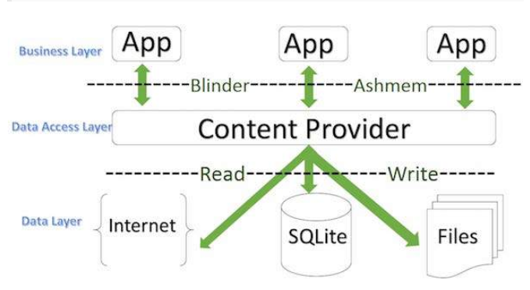
Content Provider
Binder

Slide 255
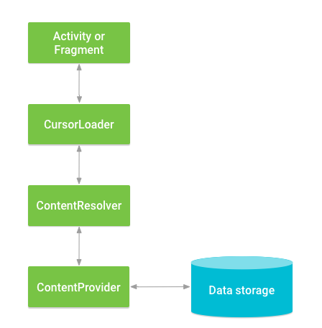
To access data in a content provider,use the ContentResolver object in your application's Context to communicate with the provider as a client.
The ContentResolver object communicates with the provider object, an instance of a class that implements ContentProvider.
The provider object receives data requests from clients, performs the requested action, and returns the results.
To query a content provider, you specify the query string in the form of a URI which has following format
<prefix>://<authority>/<data_type>/<id>

Slide 257
1. prefix
This is always set to content://
2. authority
This specifies the name of the content provider, for example contacts, browser etc. For third-party content providers, this could be the fully qualified name, such as com.tutorialspoint.statusprovider.
3. data_type
This indicates the type of data that this particular provider provides. For example, if you are getting all the contacts from the Contacts content provider, then the data path would be people and URI would look like this content://contacts/people
4. id
This specifies the specific record requested. For example, if you are looking for contact number 5 in the Contacts content provider then URI would look like this content://contacts/people/5.

Slide 258
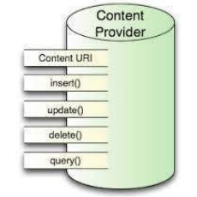
CREATING CONTENT PROVIDERS
This involves number of simple steps to create your own content provider.
First of all you need to create a Content Provider class that extends the ContentProviderbaseclass.
Second, you need to define your content provider URI address which will be used to access the content.
Next you will need to create your own database to keep the content. Usually, Android uses SQLite database and framework needs to override onCreate() method which will use SQLite Open Helper method to create or open the provider's database.
When your application is launched, the onCreate() handler of each of its Content Providers is called on the main application thread.
Next you will have to implement Content Provider queries to perform different database specific operations.
Finally register your Content Provider in your activity file using <provider> tag.
Here is the list of methods which you need to override in Content Provider class to have your Content Provider working

Slide 259
Registering Content Providers
To create a new Content Provider, extend the abstract ContentProvider class:
public class MyContentProvider extends ContentProvider
Like Activities and Services, Content Providers must be registered in your application manifest before the Content Resolver can discover them.
This is done using a provider tag that includes a name attribute describing the Provider’s class name and an authorities tag.
The general form for defining a Content Provider’s authority is as follows:
com.<CompanyName>.provider.<ApplicationName>
The completed provider tag should follow the format shown in the following XML snippet:
<provider android:name=”.MyContentProvider”
android:authorities=”com.paad.skeletondatabaseprovider”/>

Slide 260
Publishing Your Content Provider’s URI Address
Each Content Provider should expose its authority using a public static CONTENT_URI property to make it more easily discoverable. This should include a data path to the primary content — for example:
public static final Uri CONTENT_URI = Uri.parse(“content://com.paad.skeletondatabaseprovider/ elements”);
The following snippet, represents a request for a single record:
content://com.paad.skeletondatabaseprovider/elements/5

Slide 261
Creating the Content Provider’s Database
To initialize the data source you plan to access through the Content Provider, override the onCreate method.
MySQLiteOpenHelper myOpenHelper;
@Override
public boolean onCreate() {
myOpenHelper = new MySQLiteOpenHelper(getContext(),
MySQLiteOpenHelper.DATABASE_NAME, null,
MySQLiteOpenHelper.DATABASE_VERSION);
return true;
}

Slide 262
Implementing Content Provider Queries
To support queries with your Content Provider, you must implement the query and getType methods.
Content Resolvers use these methods to access the underlying data, without knowing its structure or implementation.
These methods enable applications to share data across application boundaries without having to publish a specific interface for each data source.

Slide 263
@Override
public Cursor query(Uri uri, String[] projection, String selection, String[] selectionArgs, String ,sortOrder) {
SQLiteDatabase db;
try {
db = myOpenHelper . getWritableDatabase();
} catch (SQLiteException ex) {
db = myOpenHelper . getReadableDatabase();
}
String groupBy = null;
String having = null;
SQLiteQueryBuilder queryBuilder = new SQLiteQueryBuilder();
switch (uriMatcher . match(uri)) {
case SINGLE_ROW :
String rowID = uri.getPathSegments().get(1);
queryBuilder . appendWhere(KEY_ID + “=” + rowID);
default: break;
}
queryBuilder . setTables(MySQLiteOpenHelper . DATABASE_TABLE);
Cursor cursor = queryBuilder .query(db, projection, selection, selectionArgs, groupBy, having, sortOrder);
return cursor;
}

Slide 264
Content Provider Transactions
To expose delete, insert, and update transactions on your Content Provider, implement the corresponding delete, insert, and update methods.
Like the query method, these methods are used by Content Resolvers to perform transactions on the underlying data without knowing its implementation — allowing applications to update data across application boundaries.

Slide 265
Storing Files in a Content Provider
Rather than store large files within your Content Provider, you should represent them within a table as fully qualified URIs to a file stored somewhere else on the file system.
To support files within your table, you must include a column labeled _data that will contain the path to the file represented by that record.
This column should not be used by client applications. Override the openFile handler to provide a ParcelFileDescriptor when the Content Resolver requests the file associated with that record.
public ParcelFileDescriptor openFile(Uri uri, String mode)
--------------------------------------------
if (mode.contains(“w”))
fileMode |= ParcelFileDescriptor.MODE_WRITE_ONLY;
if (mode.contains(“r”))
fileMode |= ParcelFileDescriptor.MODE_READ_ONLY;
if (mode.contains(“+”))
fileMode |= ParcelFileDescriptor.MODE_APPEND;

Slide 266
USING CONTENT PROVIDERS
When Content Providers are used to expose data, Content Resolvers are the corresponding class used to query and perform transactions on those Content Providers.
Whereas Content Providers provide an abstraction from the underlying data, Content Resolvers provide an abstraction from the Content Provider being queried or transacted.
Introducing the Content Resolver
Each application includes a ContentResolver instance, accessible using the getContentResolver method, as follows:
ContentResolver cr = getContentResolver();

Slide 267
The Content Resolver includes query and transaction methods corresponding to those defined within your Content Providers.
The Content Resolver does not need to know the implementation of the Content Providers it is interacting with — each query and transaction method simply accepts a URI that specifies the Content Provider to interact with.
Content Providers usually accept two forms of URI, one for requests against all data and another that specifies only a single row.
Querying Content Providers
Content Provider queries take a form very similar to that of database queries. Query results are returned as Cursors over a result set.
To extract values from a result Cursor, use the moveTo<location> methods in combination with the get<type> methods to extract values from the specified row and column.

Slide 268
Querying for Content Asynchronously Using the Cursor Loader
Database operations can be time-consuming, so it’s particularly important that any database and Content Provider queries are not performed on the main application thread.
It can be difficult to manage Cursors, synchronize correctly with the UI thread, and ensure all queries occur on a background.
To help simplify the process, Android 3.0 introduced the Loader class.

Slide 269
Introducing Loaders
Loaders are available within every Activity and Fragment via the LoaderManager.
They are designed to asynchronously load data and monitor the underlying data source for changes.
While loaders can be implemented to load any kind of data from any data source, of particular interest is the CursorLoader class.
The Cursor Loader allows you to perform asynchronous queries against Content Providers, returning a result Cursor and notifications of any updates to the underlying provider.
Using the Cursor Loader
The Cursor Loader handles all the management tasks required to use a Cursor within an Activity or Fragment,
This includes managing the Cursor lifecycle to ensure Cursors are closed when the Activity is terminated.

Slide 274
Implementing Cursor Loader Callbacks
The Loader Callbacks consist of three handlers:
1. onCreateLoader — Called when the loader is initialized, this handler should create and return new Cursor Loader object. Accordingly, when this handler is executed, the query parameters you specify will be used to perform a query using the Content Resolver.
2. onLoadFinished — When the Loader Manager has completed the asynchronous query, the onLoadFinished handler is called, with the result Cursor passed in as a parameter. Use this Cursor to update adapters and other UI elements.
3. onLoaderReset — When the Loader Manager resets your Cursor Loader, onLoaderReset is called. Within this handler you should release any references to data returned by the query and reset the UI accordingly. The Cursor will be closed by the Loader Manager, so you shouldn’t attempt to close it.

Slide 275
Each Activity and Fragment provides access to its Loader Manager through a call to getLoaderManager.
LoaderManager loaderManager = getLoaderManager();
To initialize a new Loader, call the Loader Manager’s initLoader method, passing in a reference to your Loader Callback implementation, an optional arguments Bundle, and a loader identifier.
Bundle args = null;
loaderManager .initLoader(LOADER_ID, args, myLoaderCallbacks);
This is generally done within the onCreate method of the host Activity.
To discard the previous Loader and re-create it, use the restartLoader method.
loaderManager.restartLoader(LOADER_ID, args, myLoaderCallbacks);

Slide 276
Adding, Deleting, and Updating Content
Inserting Content
The Content Resolver offers two methods for inserting new records into a Content Provider: insert and bulkInsert.
Both methods accept the URI of the Content Provider into which you’re inserting; the insert method takes a single new ContentValues object, and the bulkInsert method takes an array.
The insert method returns a URI to the newly added record, whereas the bulkInsert method returns the number of successfully added rows.

Slide 277
ContentValues newValues = new ContentValues();
newValues .put(MyHoardContentProvider.KEY_GOLD_ HOARD_NAME_COLUMN, hoardName);
newValues.put(MyHoardContentProvider.KEY_GOLD_ HOARDED_COLUMN, hoardValue);
newValues.put(MyHoardContentProvider.KEY_GOLD_ HOARD_ACCESSIBLE_COLUMN, hoardAccessible);
ContentResolver cr = getContentResolver();
Uri myRowUri = cr .insert (MyHoardContentProvider.CONTENT_URI, newValues);

Slide 278
Deleting Content
To delete a single record, call delete on the Content Resolver, passing in the URI of the row you want to remove.
Alternatively, you can specify a where clause to remove multiple rows.
String where = MyHoardContentProvider. KEY_GOLD_HOARDED_COLUMN +“=” + 0;
String whereArgs[] = null;
ContentResolver cr = getContentResolver();
int deletedRowCount =cr .delete (MyHoardContentProvider.CONTENT_URI, where, whereArgs);

Slide 279
Updating Content
You can update rows by using the Content Resolver’s update method.
The update method takes the URI of the target Content Provider, a ContentValues object that maps column names to updated values, and a where clause that indicates which rows to update.
When the update is executed, every row matched by the where clause is updated using the specified Content Values, and the number of successful updates is returned.
ContentValues updatedValues = new ContentValues();
updatedValues. put(MyHoardContentProvider . KEY_GOLD_HOARDED_COLUMN, newHoardValue);
Uri rowURI = ContentUris. withAppendedId(MyHoardContentProvider.CONTENT_URI,
hoardId);
String where = null;
String whereArgs[] = null;

Slide 280
Accessing Files Stored in Content Providers
Content Providers represent large files as fully qualified URIs rather than raw file blobs; however, this is abstracted away when using the Content Resolver.
To access a file stored in, or to insert a new file into, a Content Provider, simply use the Content Resolver’s openOutputStream or openInputStream methods, respectively, passing in the URI to the Content Provider row containing the file you require.
The Content Provider will interpret your request and return an input or output stream to the requested file,

Slide 281
ADDING SEARCH TO YOUR APPLICATION

Slide 282
On mobile devices speed is everything, and search provides a mechanism for users to quickly find the content they need.
Android includes a framework that simplifies the process of making your Content Providers searchable, adding search functionality to your Activities, and surfacing application search results on the home screen.
Until Android 3.0 (API level 11) most Android devices featured a hardware search key. In more recent releases this has been replaced with on-screen widgets, typically placed on your application’s Action Bar.

Slide 283
You can provide search capabilities for your application in three ways:
Search bar — When activated, the search bar is displayed over the title bar of your Activity. The search bar is activated when the user presses the hardware search button, or it can be initiated programmatically with a call to your Activity’s onSearchRequested method.
Search View — Introduced in Android 3.0 (API level 11), the Search View is a search widget that can be placed anywhere within your Activity. Typically represented as an icon in the Action Bar.
Quick Search Box — The Quick Search Box is a home screen search Widget that performs searches across all supported applications. You can configure your application’s search results to be surfaced for searches initiated through the Quick Search Box.

Slide 285
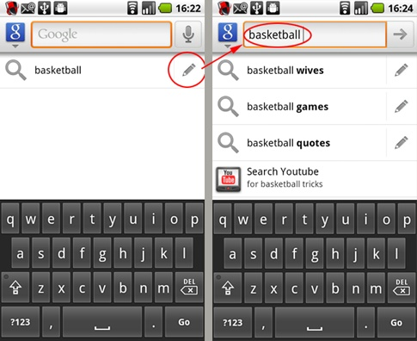

Slide 286
Making Your Content Provider Searchable
Creating searchable configuration
Before you can enable the search dialog or use a Search View widget within your application, you need to define what is searchable.
The first step is to create a new searchable metadata XML resource in your project’s res/xml folder.
Best practice suggests you also include an android:hint attribute to help users understand what they can search for.
<?xml version=”1.0” encoding=”utf-8”?>
<searchable xmlns:android=”http://schemas.android.com/apk/res/android”
android:label=”@string/app_name”
android:hint=”@string/search_hint”>
</searchable>

Slide 287
Creating a Search Activity for Your Application
After defining the Content Provider to search, you must now create an Activity that will be used to display search results.
This will most commonly be a simple List View-based Activity, but you can use any user interface, provided that it has a mechanism for displaying search results.
To indicate that an Activity can be used to provide search results, include an Intent Filter registered for the android.intent.action.SEARCH action and
android.intent.category.DEFAULT category.
You must also include a meta-data tag that includes a name attribute that specifies android.app .searchable, and a resource attribute that specifies a searchable XML resource

Slide 288
<activity android:name=”.DatabaseSkeletonSearchActivity”
android:label=”Element Search”
android:launchMode=”singleTop”>
<intent-filter>
<action android:name=”android.intent.action .SEARCH” />
<category android:name= ”android.intent.category .DEFAULT” />
</intent-filter>
<meta-data
android:name=”android.app.searchable”
android:resource=”@xml/searchable”/>
</activity>

Slide 289
Extracting the search query
Searches initiated from within the search results Activity will result in new Intents being received — you can capture those Intents and extract the new queries from the onNewIntent handler
@Override
public void onCreate(Bundle savedInstanceState) {
super.onCreate(savedInstanceState);
parseIntent(getIntent());
}
@Override
protected void onNewIntent(Intent intent) {
super.onNewIntent(intent);
parseIntent(getIntent());
}
private void parseIntent(Intent intent) {
if (Intent.ACTION_SEARCH.equals(intent.getAction())) {
String searchQuery = intent.getStringExtra(SearchManager.QUERY);
performSearch(searchQuery);
}
}

Slide 290
Making Your Search Activity the Default Search Provider for Your Application
It is good practice to use the same search results form for your entire application.
To set a search Activity as the default search result provider for all Activities within your application, add a meta-data tag within the application manifest node. Set the name attribute to android. app.default_searchable and specify your search Activity using the value attribute.
<meta-data
android:name=”android.app.default_searchable”
android:value=”.DatabaseSkeletonSearchActivity”
/>

Slide 291
Performing a Search and Displaying the Results
When the search Activity receives a new search query, it must execute the search and display the results within the Activity.
If you are searching a Content Provider, it’s good practice to use a Cursor Loader to execute a query whose result Cursor is bound to a List View.
In most circumstances you’ll need to provide some functionality beyond simply displaying the search results. If you are using a List Activity or List Fragment, you can override the onListItemClick handler to react to user’s selecting a search result, such as displaying the result details

Slide 292
public class DBSkeletonSearchActivity extends ListActivity implements LoaderManager. LoaderCallbacks<Cursor> {
public void onCreate(Bundle savedInstanceState) {
// Create a new adapter and bind it to the List View
setListAdapter(adapter);
// Initiate the Cursor Loader
getLoaderManager().initLoader(0, null, this);
}
private void performSearch(String query) {
Bundle args = new Bundle();
// Pass the search query as an argument to the Cursor Loader
args.putString(QUERY_EXTRA_KEY, query);
getLoaderManager(). restartLoader(0, args, this);
}
public Loader<Cursor> onCreateLoader(int id, Bundle args) {
// Extract the search query from the arguments.
// Construct the new query in the form of a Cursor Loader.
}
public void onLoadFinished(Loader<Cursor> loader, Cursor cursor) {
// Replace the result Cursor displayed by the Cursor Adapter with the new result set.
adapter.swapCursor(cursor);
}
public void onLoaderReset(Loader<Cursor> loader) {
// Remove the existing result Cursor from the List Adapter.
adapter.swapCursor(null);
} }

Slide 293
Providing actions for search result selection
In most circumstances you’ll need to provide some functionality beyond simply displaying the search results.
@Override
protected void onListItemClick(ListView listView, View view, int position, long id) {
super.onListItemClick(listView, view, position, id);
// Create a URI to the selected item.
Uri selectedUri =ContentUris. withAppendedId (MyContentProvider.CONTENT_URI, id);
// Create an Intent to view the selected item.
Intent intent = new Intent(Intent.ACTION_VIEW);
intent.setData(selectedUri);
// Start an Activity to view the selected item.
startActivity(intent);
}

Slide 294
Using the Search View Widget
Android 3.0 (API level 11) introduced the SearchView widget as an alternative to the Activity search bar.
The Search View appears and behaves as an Edit Text View, but it can be configured to offer search suggestions and to initiate search queries within your application in the same way as the search bar in earlier versions of Android.
To connect your Search View to your search Activity, you must first extract a reference to its SearchableInfo using the Search Manager’s getSearchableInfo method.
Use the Search View’s setSearchableInfo method to bind this Activities searchable object to your Search View.

Slide 295
SearchManager searchManager =
(SearchManager)getSystemService(Context.SEARCH_SERVICE);
SearchableInfo searchableInfo =
searchManager. getSearchableInfo(getComponentName());
// Bind the Activity’s SearchableInfo to the Search View
SearchView searchView = (SearchView)findViewById(R.id.searchView);
searchView. setSearchableInfo(searchableInfo);
By default, the Search View will be displayed as an icon that, when clicked, expands to the search edit box.
You can use its setIconifiedByDefault method to disable this and have it always display as an edit box. searchView.setIconifiedByDefault(false);
By default a Search View query is initiated when the user presses Enter. You can choose to also display a button to submit a search using the setSubmitButtonEnabled method.
searchView.setSubmitButtonEnabled(true);

Slide 296
Supporting Search Suggestions from a Content Provider
One of the most engaging innovations in search is the provision of real-time search suggestions as users type their queries, allowing them to bypass the search result Activity and jump directly to the search result.
To support search suggestions, you need to configure your Content Provider to recognize specific URI paths as search queries.
Although your search Activity can structure its query and display the results Cursor data in any way, if you want to provide search suggestions, you need to create (or modify) a Content Provider to receive search queries and return suggestions using the expected projection.

Slide 297
private static final int ALLROWS = 1;
private static final int SINGLE_ROW = 2;
private static final int SEARCH = 3;
private static final UriMatcher uriMatcher;
static {
uriMatcher = new UriMatcher(UriMatcher.NO_MATCH);
uriMatcher.addURI(“com.paad.skeletondatabaseprovider”, “elements”, ALLROWS);
uriMatcher.addURI(“com.paad.skeletondatabaseprovider”,“elements/ #”, SINGLE_ROW);
uriMatcher.addURI(“com.paad.skeletondatabaseprovider”,
SearchManager. SUGGEST_URI_PATH_QUERY, SEARCH);
uriMatcher.addURI(“com.paad.skeletondatabaseprovider”,
SearchManager.SUGGEST_URI_PATH_QUERY + “/*”, SEARCH);
uriMatcher.addURI(“com.paad.skeletondatabaseprovider”,
SearchManager.SUGGEST_URI_PATH_SHORTCUT, SEARCH);
uriMatcher.addURI(“com.paad.skeletondatabaseprovider”,
SearchManager.SUGGEST_URI_PATH_SHORTCUT + “/*”, SEARCH);
}

Slide 298
The Search Manager requests your search suggestions by initiating a query on your Content Provider, passing in the query value as the last element in the URI path.
There are two required columns, SUGGEST_COLUMN_TEXT_1, which displays the search result text, and _id, which indicates the unique row ID.
It’s also useful to include a SUGGEST_COLUMN_INTENT_DATA_ID column. The value returned in this column can be appended to a specified URI path and used to populate an Intent that will be fired if the suggestion is selected.
As speed is critical for real-time search results, in many cases it’s good practice to create a separate table specifically to store and provide them.

Slide 299
Native Android Content Providers

Slide 300
Android exposes several native Content Providers, which you can access directly
the most useful Content Providers, including the following:
1. Media Store — Provides centralized, managed access to the multimedia on your device, including audio, video, and images. You can store your own multimedia within the Media Store and make it globally available.
2. Browser — Reads or modifies browser and browser search history.
3. Contacts Contract — Retrieves, modifies, or stores contact details and associated social stream updates.
4. Calendar — Creates new events, and deletes or updates existing calendar entries. That includes modifying the attendee lists and setting reminders.
5. Call Log — Views or updates the call history, including incoming and outgoing calls, missed calls, and call details, including caller IDs and call durations.

Slide 301
Using the Media Store Content Provider
The Android Media Store is a managed repository of audio, video, and image files.
Whenever you add a new multimedia file to the file system, it should also be added to the Media Store using the Content Scanner, this will expose it to other applications, including media players.
the MediaStore class includes Audio, Video, and Images subclasses, which in turn contain subclasses that are used to provide the column names and content URIs for the corresponding media providers.
The Media Store segregates media kept on the internal and external volumes of the host device.
Each Media Store subclass provides a URI for either the internally or externally stored media using the forms:
MediaStore.<mediatype>.Media.EXTERNAL_CONTENT_URI
MediaStore.<mediatype>.Media.INTERNAL_CONTENT_URI

Slide 302
Using the Contacts Contract Content Provider
Android makes the full database of contact information available to any application that has been granted the READ_CONTACTS permission.
The Contacts Contract Provider provides an extensible database of contact-related information.
This allows users to specify multiple sources for their contact information.
More importantly, it allows developers to arbitrarily extend the data stored against each contact, or even become an alternative provider for contacts and contact details.

Slide 303
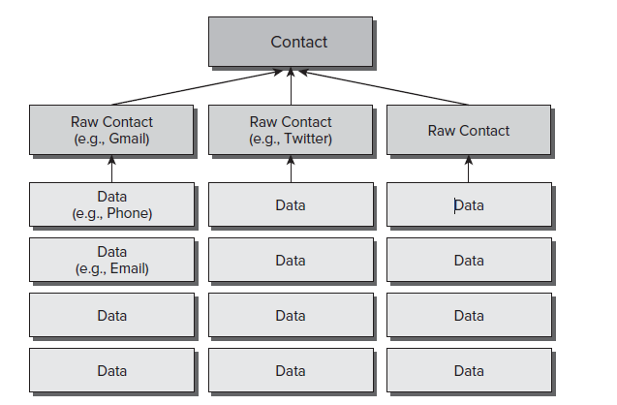
Introducing the Contacts Contract Content Provider
The contract between the contacts provider and applications. Contains definitions for the supported URIs and columns.
This allows users to specify multiple sources for their contact information.
More importantly, it allows developers to arbitrarily extend the data stored against each contact
Rather than providing a single, fully defined table of contact detail columns, the Contacts Contract provider uses a three-tier data model to store data, associate it with a contact, and aggregate it to a single person using the following ContactsContract subclasses

Slide 304
Data — Each row in the underlying table defines a set of personal data (phone numbers, email addresses, and so on)
Although there is a predefined set of common column names for each personal data-type available, this table can be used to store any value.
When adding new data to the Data table, you specify a Raw Contact to which a set of data will be associated.
RawContacts — From Android 2.0 (API level 5) forward, users can add multiple contact account providers to their device. Each row in the Raw Contacts table defines an account to which a set of Data values is associated.
Contacts — The Contacts table aggregates rows from Raw Contacts that all describe the same person

Slide 305
Reading Contact Details
To access any contact details, you need to include the READ_CONTACTS uses-permission in your application manifest:
<uses-permission android:name=”android.permission.READ_CONTACTS”/>
Use the Content Resolver to query any of the three Contact Contracts Providers using their respective CONTENT_URI static constants.
The ContactsContract.Data Content Provider is used to store all the contact details, such as addresses, phone numbers, and email addresses.
To simplify this lookup, Android provides the query URI ContactsContract.Contacts.CONTENT_FILTER_URI
To extract the associated contact details, find the _ID value from the returned Cursor, and use it to create a query on the Data table.
Use ContactsContract.PhoneLookup.CONTENT_FILTER_URI, appending the number to look up as an additional path segment
Uri lookupUri =Uri.withAppendedPath ( ContactsContract.PhoneLookup. CONTENT_FILTER_URI, incomingNumber);

Slide 306
Creating and Picking Contacts Using Intents
The Contacts Contract Content Provider includes an Intent-based mechanism that can be used to view, insert, or select a contact using an existing contact application.
To display a list of contacts for your users to select from, you can use the Intent.ACTION_PICK action along with the ContactsContract.Contacts.CONTENT_URI.
private static int PICK_CONTACT = 0;
private void pickContact() {
Intent intent = new Intent(Intent.ACTION_PICK,
ContactsContract.Contacts.CONTENT_URI);
startActivityForResult(intent, PICK_CONTACT);
}

Slide 307
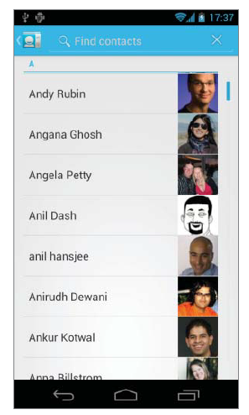
This will display a List View of the contacts available as shown in the picture
When the user selects a contact, it will be returned as a URI within the data property of the returned Intent as
@Override
protected void onActivityResult(int requestCode, int resultCode, Intent data) {
super.onActivityResult(requestCode, resultCode, data);
if ((requestCode == PICK_CONTACT) && (resultCode == RESULT_OK)) {
resultTextView.setText(data.getData().toString());
}
}

Slide 308
There are two alternatives to insert a new contact, both of which will prepopulate the new contact form using the values you specify as extras in your Intent.
The ContactsContract.Intents.SHOW_OR_CREATE_CONTACT action will search the contacts Provider for a particular email address or telephone number URI, offering to insert a new entry only if a contact with the specified contact address doesn’t exist.
Use the constants in the ContactsContract.Intents.Insert class to include Intent extras that can be used to prepopulate contact details, including the name, company, email, phone number, notes, and postal address of the new contact.
Intent intent =
new Intent(ContactsContract.Intents.SHOW_OR_CREATE_CONTACT,
ContactsContract.Contacts.CONTENT_URI);
intent.setData(Uri.parse(“tel:(650)253-0000”));
intent.putExtra(ContactsContract.Intents.Insert.COMPANY, “Google”);
intent.putExtra(ContactsContract.Intents.Insert.POSTAL,
“1600 Amphitheatre Parkway, Mountain View, California”);
startActivity(intent);

Slide 309
Modifying and Augmenting Contact Details Directly
You can use the contact Content Providers to modify, delete, or insert contact records after adding the WRITE_CONTACTS uses-permission to your application manifest.
<uses-permission android:name=”android.permission.WRITE_CONTACTS”/>

Slide 310
Using the Calendar Content Provider
Android 4.0 (API level 14) introduced a supported API for accessing the Calendar Content Provider.
The Calendar API allows you to insert, view, and edit the complete Calendar database, providing access to calendars, events, attendees, and event reminders using either Intents or through direct manipulation of the Calendar Content Providers.
Like the Contacts Contract Content Provider, the Calendar Content Provider is designed to support multiple synchronized accounts.

Slide 311
Querying the Calendar
To access the Calendar Content Provider, you must include the READ_CALENDAR uses-permission in your application manifest:
<uses-permission android:name=”android.permission.READ_CALENDAR”/>
Use the Content Resolver to query any of the Calendar Provider tables using their CONTENT_URI static constant.
Each table is exposed from within the CalendarContract class, including:

Slide 312
Calendars — The Calendar application can display multiple calendars associated with multiple accounts.
This table holds each calendar that can be displayed, as well as details such as the calendar’s display name, time zone, and color.
Events — The Events table includes an entry for each scheduled calendar event, including the name, description, location, and start/end times.
Instances — Each event has one or (in the case of recurring events) multiple instances.
The Instances table is populated with entries generated by the contents of the Events table and includes a reference to the event that generated it.
Attendees — Each entry in the Attendees table represents a single attendee of a given event.
Each attendee can include a name, email address, and attendance status, and if they are optional or required guests.
Reminders — Event reminders are represented within the Reminders table, with each row representing one reminder for a particular event.
Each class includes its column names as static properties.

Slide 313
Creating and Editing Calendar Entries Using Intents
The Calendar Content Provider includes an Intent-based mechanism
Using Intents, you can open the Calendar application to a specific time, view event details, insert a new event, or edit an existing event.
Like the Contacts API, using Intents is the best practice to direct manipulation of the underlying tables whenever possible.

Slide 314
Creating New Calendar Events
Using the Intent.ACTION_INSERT action, specifying the CalendarContract. Events. CONTENT_URI, you can add new events to an existing calendar without requiring any special permissions.
When triggered, the Intent will be received by the Calendar application, which will create a new entry prepopulated with the data provided
.
Intent intent = new Intent(Intent.ACTION_INSERT, CalendarContract. Events. CONTENT_URI);
intent.putExtra(CalendarContract.Events.TITLE, “Launch!”);
intent.putExtra(CalendarContract.Events.DESCRIPTION, “Professional Android 4 “ + “Application Development release!”);
intent.putExtra(CalendarContract.Events.EVENT_LOCATION, “Wrox.com”);
Calendar startTime = Calendar.getInstance();
startTime.set(2012, 2, 13, 0, 30);
intent.putExtra(CalendarContract.EXTRA_EVENT_BEGIN_TIME, startTime. getTimeInMillis());
intent.putExtra(CalendarContract.EXTRA_EVENT_ALL_DAY, true);
startActivity(intent);

Slide 315
Editing Calendar Events
To edit a calendar event, you must first know its row ID.
To find this, you need to query the Events Content Provider
When you have the ID of the event you want to edit, create a new Intent using the Intent.ACTION_EDIT action and a URI that appends the event’s row ID to the end of the Events table’s CONTENT_URI,
long rowID = 760;
Uri uri = ContentUris.withAppendedId( CalendarContract.Events. CONTENT_URI, rowID);
Intent intent = new Intent(Intent.ACTION_EDIT, uri);
// Modify the calendar event details
Calendar startTime = Calendar.getInstance();
startTime.set(2012, 2, 13, 0, 30);
intent.putExtra(CalendarContract.EXTRA_EVENT_BEGIN_TIME, startTime.getTimeInMillis());
intent.putExtra(CalendarContract.EXTRA_EVENT_ALL_DAY, true);
// Use the Calendar app to edit the event.
startActivity(intent);

Slide 316
Displaying the Calendar and Calendar Events
You can also use Intents to display a particular event or to open the Calendar application to display a specific date and time using the Intent.ACTION_VIEW action.
To view an existing event, specify the Intent’s URI using a row ID, as you would when editing an event.
To view a specific date and time, the URI should be of the form
content://com.android.calendar/time/[milliseconds since epoch]
as shown below
// Create a URI that specifies a particular time to view.
Calendar startTime = Calendar.getInstance();
startTime.set(2012, 2, 13, 0, 30);
Uri uri = Uri.parse(“content://com.android.calendar/time/” +
String.valueOf(startTime.getTimeInMillis()));
Intent intent = new Intent(Intent.ACTION_VIEW, uri);
// Use the Calendar app to view the time.
startActivity(intent);

Slide 317
Modifying Calendar Entries Directly
If you are building your own contacts application, or want to build a Sync Adapter to integrate events from your own cloud-based calendar service, you can use the Calendar Content Providers to modify, delete, or insert contact records after adding the WRITE_CONTACTS uses-permission to your application manifest.
<uses-permission android:name=”android.permission.WRITE_CALENDAR”/>

Slide 318
Working in the Background

Slide 319
INTRODUCING SERVICES
Android offers the Service class to create application components that handle long-lived operations and include functionality that doesn’t require a user interface.
Services run invisibly —
doing Internet lookups,
processing data,
updating your Content Providers,
firing Intents, and
triggering Notifications.

Slide 320
Running Services have a higher priority than inactive or invisible (stopped) Activities, making them less likely to be terminated by the run time’s resource management.
The only reason Android will stop a Service prematurely is to provide additional resources for a foreground component (usually an Activity).
When that happens, your Service can be configured to restart automatically when resources become available.

Slide 321
Services Lifecycle
A service has life cycle callback methods that you can implement to monitor changes in the service's state and you can perform work at the appropriate stage.
The following diagram on the left shows the life cycle when the service is created with startService() and
The diagram on the right shows the life cycle when the service is created with bindService():

Slide 323
A service can essentially take two states
1. Started
A service is started when an application component, such as an activity, starts it by calling startService().
Once started, a service can run in the background indefinitely, even if the component that started it is destroyed.
2. Bound
A service is bound when an application component binds to it by calling bindService().
A bound service offers a client-server interface that allows components to interact with the service, send requests, get results, and even do so across processes with interprocess communication (IPC).

Slide 324
Creating and Controlling Services
To define a Service, create a new class that extends Service. You’ll need to override the onCreate and onBind methods.
import android.app.Service;
import android.content.Intent;
import android.os.IBinder;
public class MyService extends Service {
@Override
public void onCreate() {
super.onCreate();
// TODO: Actions to perform when service is created.
}
@Override
public IBinder onBind(Intent intent) {
// TODO: Replace with service binding implementation.
return null;
}
}

Slide 325
After you’ve constructed a new Service, you must register it in the application manifest.
<service android:enabled=”true”
android:name= ”.MyService”/>
service tag within the application node
To ensure your Service can be started and stopped only by your own application, add a permission attribute to its Service node.
<service android:enabled=”true”
android:name=”.MyService”
android:permission=”com.paad. MY_SERVICE_PERMISSION”/>
This will require any third-party applications to include a uses-permission in their manifests in order to access this Service.

Slide 326
Executing a Service and Controlling Its Restart Behavior
Override the onStartCommand event handler to execute the task (or begin the ongoing operation) encapsulated by your Service.
You can also specify your Service’s restart behavior within this handler.
The onStartCommand method is called whenever the Service is started using startService, so it may be executed several times within a Service’s lifetime. You should ensure that your Service accounts for this.

Slide 327
Services are launched on the main Application Thread, meaning that any processing done in the onStartCommand handler will happen on the main GUI Thread.
The standard pattern for implementing a Service is to create and run a new Thread from onStartCommand to perform the processing in the background, and then stop the Service when it’s been completed.
@Override
public int onStartCommand(Intent intent, int flags, int startId) {
startBackgroundTask(intent, startId);
return Service.START_STICKY;
}

Slide 328
This pattern lets onStartCommand complete quickly, and it enables you to control the restart behavior by returning one of the following Service constants:
1. START_STICKY — Describes the standard behavior, which is similar to the way in which onStart was implemented prior to Android 2.0.
If you return this value, onStartCommand will be called any time your Service restarts after being terminated by the run time.
Note that on a restart the Intent parameter passed in to onStartCommand will be null.
This mode typically is used for Services that handle their own states and that are explicitly started and stopped as required (via startService and stopService).
This includes Services that play music or handle other ongoing background tasks.
Example: Media players

Slide 329
2. START_NOT_STICKY — This mode is used for Services that are started to process specific actions or commands. Typically, they will use stopSelf to terminate once that command has been completed.
Following termination by the run time, Services set to this mode restart only if there are pending start calls.
If no startService calls have been made since the Service was terminated, the Service will be stopped without a call being made to onStartCommand.
Rather than restarting the Service during a period of resource contention, it’s often more prudent to let the Service stop and retry at the next scheduled interval.

Slide 330
3. START_REDELIVER_INTENT — In some circumstances you will want to ensure that the commands you have requested from your Service are completed — for example when timeliness is important.
This mode is a combination of the first two; if the Service is terminated by the run time, it will restart only if there are pending start calls or the process was killed prior to its calling stopSelf.
In the latter case, a call to onStartCommand will be made, passing in the initial Intent whose processing did not properly complete.
Example: Downloading a file

Slide 331
The flag parameter can be used to discover how the Service was started. In particular, you determine if either of the following cases is true:
START_FLAG_REDELIVERY — Indicates that the Intent parameter is a redelivery caused by the system run time’s having terminated the Service before it was explicitly stopped by a call to stopSelf.
START_FLAG_RETRY — Indicates that the Service has been restarted after an abnormal termination. It is passed in when the Service was previously set to START_STICKY.

Slide 332
Starting and Stopping Services
To start a Service, call startService. Much like Activities, you can either use an action to implicitly start a Service with the appropriate Intent Receiver registered, or you can explicitly specify the Service using its class.
If the Service requires permissions that your application does not have, the call to startService will throw a SecurityException.
private void explicitStart() {
// Explicitly start My Service
Intent intent = new Intent(this, MyService.class);
// TODO Add extras if required.
startService(intent);
}
private void implicitStart() {
// Implicitly start a music Service
Intent intent = new Intent(MyMusicService.PLAY_ALBUM);
intent.putExtra(MyMusicService.ALBUM_NAME_EXTRA, “United”);
intent.putExtra(MyMusicService.ARTIST_NAME_EXTRA, “Pheonix”);
startService(intent);
}

Slide 333
To stop a Service, use stopService, specifying an Intent that defines the Service to stop
// Stop a service explicitly.
stopService(new Intent(this, MyService.class));
// Stop a service implicitly.
Intent intent = new Intent(MyMusicService.PLAY_ALBUM);
stopService(intent);

Slide 334
Self-Terminating Services
Due to the high priority of Services, they are not commonly killed by the run time, so self-termination can significantly improve the resource footprint of your application.
By explicitly stopping the Service when your processing is complete by making a call to stopSelf, you allow the system to recover the resources otherwise required to keep it running.
You can call stopSelf either without a parameter to force an immediate stop, or by passing in a startId value to ensure processing has been completed for each instance of startService called so far.

Slide 335
Binding Services to Activities
Binding is useful for Activities that would benefit from a more detailed interface with a Service.
To support binding for a Service, implement the onBind method, returning the current instance of the Service being bound.
@Override
public IBinder onBind(Intent intent) {
return binder;
}
public class MyBinder extends Binder {
MyMusicService getService() {
return MyMusicService.this;
}
}
private final IBinder binder = new MyBinder();

Slide 336
The connection between the Service and another component is represented as a ServiceConnection.
To bind a Service to another application component, you need to implement a new ServiceConnection, overriding the onServiceConnected and onServiceDisconnected methods to get a reference to the Service instance after a connection has been established.

Slide 337
// Reference to the service
private MyMusicService serviceRef;
// Handles the connection between the service and activity
private ServiceConnection mConnection = new ServiceConnection() {
public void onServiceConnected(ComponentName className,
IBinder service) {
// Called when the connection is made.
serviceRef = ((MyMusicService.MyBinder)service).getService();
}
public void onServiceDisconnected(ComponentName className) {
// Received when the service unexpectedly disconnects.
serviceRef = null;
}
};

Slide 338
To perform the binding, call bindService within your Activity, passing in an Intent (either explicit or implicit) that selects the Service to bind to, and an instance of a ServiceConnection implementation.
You can also specify a number of binding flags,
// Bind to the service
Intent bindIntent = new Intent(MyActivity.this, MyMusicService.class);
bindService(bindIntent, mConnection, Context.BIND_AUTO_CREATE);

Slide 339
Android 4.0 introduced a number of new flags that can be used and combined when binding a Service to an application:
BIND_ADJUST_WITH_ACTIVITY — Causes the Service’s priority to be adjusted based on the relative importance of the Activity to which it is bound.
BIND_ABOVE_CLIENT and BIND_IMPORTANT — Specify that the bound Service is so important to the binding client that it should become a foreground process when the client is in the foreground — in the case of BIND_ABOVE_CLIENT, you are specifying that the run time should terminate the Activity before the bound Service in cases of low memory.
BIND_NOT_FOREGROUND — Ensures the bound Service is never brought to foreground priority. By default, the act of binding a Service increases its relative priority.
BIND_WAIVE_PRIORITY — Indicates that binding the specified Service shouldn’t alter its priority.

Slide 340
Android applications do not (normally) share memory, but in some cases your application may want to interact with (and bind to) Services running in different application processes.
You can communicate with a Service running in a different process by using broadcast Intents or through the extras Bundle in the Intent used to start the Service.
If you need a more tightly coupled connection, you can make a Service available for binding across application boundaries by using Android Interface Definition Language (AIDL).
AIDL defines the Service’s interface in terms of OS-level primitives, allowing Android to transmit objects across process boundaries

Slide 341
Creating Foreground Services
Only active, foreground Activities are considered a higher priority
In cases where your Service is interacting directly with the user, it may be appropriate to lift its priority to the equivalent of a foreground Activity’s.
You can do this by setting your Service to run in the foreground by calling its startForeground method.
Because foreground Services are expected to be interacting directly with the user (for example, by playing music), calls to startForeground must specify an ongoing Notification.
This notification will be displayed for as long as your Service is running in the foreground.

Slide 342
private void startPlayback(String album, String artist) {
int NOTIFICATION_ID = 1;
// Create an Intent that will open the main Activity
// if the notification is clicked.
Intent intent = new Intent(this, MyActivity.class);
PendingIntent pi = PendingIntent.getActivity(this, 1, intent, 0);
// Set the Notification UI parameters
Notification notification = new Notification(R.drawable.icon,
“Starting Playback”, System.currentTimeMillis());
notification.setLatestEventInfo(this, album, artist, pi);
// Set the Notification as ongoing
notification.flags = notification.flags | Notification. FLAG_ONGOING_EVENT;
// Move the Service to the Foreground
startForeground(NOTIFICATION_ID, notification);
}

Slide 343
It’s good practice to provide a simple way for users to disable a foreground Service
When your Service no longer requires foreground priority, you can move it back to the background, and optionally remove the ongoing notification using the stopForeground method,
public void pausePlayback() {
// Move to the background and remove the Notification
stopForeground(true);
}

Slide 344
USING BACKGROUND THREADS
By
Dr. Kalpana Devi

Slide 345
Responsiveness is one of the most critical attributes of a good Android application.
To ensure that your application responds quickly to any user interaction or system event, it’s vital that you move all processing and I/O operations off the main application Thread and into a child Thread.
In Android, Activities that don’t respond to an input event (such as a key press) within 5 seconds, and Broadcast Receivers that don’t complete their onReceive handlers within 10 seconds, are considered unresponsive.
In practice, users will notice input delays and UI pauses of more than a couple of 100 ms.
It’s important to use background Threads for any nontrivial processing that doesn’t directly interact with the user interface.

Slide 346
It’s particularly important to schedule
file operations,
network lookups,
database transactions,
and complex calculations on a background Thread.
Android offers a number of alternatives for moving your processing to the background.
You can implement your own Threads and use the Handler class to synchronize with the GUI Thread before updating the UI.
Alternatively, the AsyncTask class lets you define an operation to be performed in the background and provides event handlers that enable you to monitor progress and post the results on the GUI Thread.

Slide 347
Using AsyncTask to Run Asynchronous Tasks
The AsyncTask class implements a best practice pattern for moving your time-consuming operations onto a background Thread and synchronizing with the UI Thread for updates and when the processing is complete.
AsyncTask handles all the Thread creation, management
AsyncTasks are a good solution for short-lived background processing whose progress and results need to be reflected on the UI.
However, they aren’t persisted across Activity restarts.
For longer running background processes, such as downloading data from the Internet, a Service component is a better approach.

Slide 348
Creating New Asynchronous Tasks
Each AsyncTask implementation can specify parameter types that will be used for input parameters, the progress-reporting values, and result values.
If you don’t need or want to take input parameters, update progress, or report a final result, simply specify Void for any or all the types required.
To create a new asynchronous task, extend the AsyncTask class, specifying the parameter types to use.

Slide 349
private class MyAsyncTask extends AsyncTask<String, Integer, String> {
@Override
protected String doInBackground(String... parameter) {
String result = “”;
int myProgress = 0;
int inputLength = parameter[0].length();
for (int i = 1; i <= inputLength; i++) {
myProgress = i;
result = result + parameter[0].charAt(inputLength-i);
try {
Thread.sleep(100);
} catch (InterruptedException e) { }
publishProgress(myProgress);
}
return result;
}
@Override
protected void onProgressUpdate(Integer... progress) {
asyncProgress.setProgress(progress[0]);
}
@Override
protected void onPostExecute(String result) {
asyncTextView.setText(result);
}
}

Slide 350
Your subclass should also override the following event handlers:
1. doInBackground — This method will be executed on the background Thread, so place long-running code here, and don’t attempt to interact with UI objects from within this handler.
publishProgress method can be used from within this handler to pass parameter values to the onProgressUpdate handler, and when your background task is complete, you can return the final result as a parameter to the onPostExecute handler, which can update the UI accordingly.
2. onProgressUpdate — Override this handler to update the UI with interim progress updates.
This handler receives the set of parameters passed in to publishProgress (typically from within the doInBackground handler).
This handler is synchronized with the GUI Thread when executed, so you can safely modify UI elements.

Slide 351
3. onPostExecute — When doInBackground has completed, the return value from that method is passed in to this event handler.
Use this handler to update the UI when your asynchronous task has completed.
This handler is synchronized with the GUI Thread when executed, so you can safely modify UI elements.
Running Asynchronous Tasks
After you’ve implemented an asynchronous task, execute it by creating a new instance and calling execute.
You can pass in a number of parameters, each of the type specified in your implementation.
String input = “redrum ... redrum”;
new MyAsyncTask().execute(input);

Slide 352
Introducing the Intent Service
The Intent Service is a convenient wrapper class that implements the best practice pattern for background Services that perform set tasks on demand, such as recurring Internet updates or data processing.
The Intent Service queues request Intents as they are received and processes them consecutively on an asynchronous background Thread.
After every received Intent has been processed, the Intent Service will terminate itself.
The Intent Service handles all the complexities around queuing multiple requests, background Thread creation, and UI Thread synchronization.
To implement a Service as an Intent Service, extend IntentService and override the onHandleIntent handler
The onHandleIntent handler will be executed on a worker Thread, once for each Intent received.
The Intent Service is the best-practice approach to creating Services that perform set tasks either on-demand or at regular intervals.

Slide 353
import android.app.IntentService;
import android.content.Intent;
public class MyIntentService extends IntentService {
public MyIntentService(String name) {
super(name);
// TODO Complete any required constructor tasks.
}
@Override
public void onCreate() {
super.onCreate();
// TODO: Actions to perform when service is created.
}
@Override
protected void onHandleIntent(Intent intent) {
// This handler occurs on a background thread.
// TODO The time consuming task should be implemented here.
// Each Intent supplied to this IntentService will be
// processed consecutively here. When all incoming Intents
// have been processed the Service will terminate itself.
}
}

Slide 354
Introducing Loaders
The abstract Loader class was introduced in Android 3.0 (API level 11) to encapsulate the best practice technique for asynchronous data loading within UI elements, such as Activities and Fragments.
Loaders are also available within the Android Support Library.
When creating your own Loader implementation, it is typically best practice to extend the AsyncTaskLoader class rather than the Loader class directly.
In general custom Loaders should:
Asynchronously load data
Monitor the source of the loaded data and automatically provide updated results

Slide 355
Manual Thread Creation and GUI Thread Synchronization
Although using Intent Services and creating AsyncTasks are useful shortcuts, there are times when you want to create and manage your own Threads to perform background processing.
This is often the case when you have long-running or inter-related Threads that require more subtle or complex management than is provided by the two techniques described so far.
You can create and manage child Threads using Android’s Handler class and the Threading classes available within java.lang.Thread.
Simple skeleton code for moving processing onto a child Thread.

Slide 356
// This method is called on the main GUI thread.
private void backgroundExecution() {
// This moves the time consuming operation to a child thread.
Thread thread = new Thread(null, doBackgroundThreadProcessing,“Background”);
thread.start();
}
// Runnable that executes the background processing method.
private Runnable doBackgroundThreadProcessing = new Runnable() {
public void run() {
backgroundThreadProcessing();
}
};
// Method which does some processing in the background.
private void backgroundThreadProcessing() {
// [ ... Time consuming operations ... ]
}

Slide 357
Whenever you’re using background Threads in a GUI environment, it’s important to synchronize child Threads with the main application (GUI) Thread before attempting to create or modify UI elements.
Within your application components, Notifications and Intents are always received and handled on the GUI Thread.
In all other cases, operations that explicitly interact with objects created on the GUI Thread (such as Views) or that display messages (such as Toasts) must be invoked on the main Thread.
If you are running within an Activity, you can also use the runOnUiThread method, which lets you force a method to execute on the same Thread as the Activity UI, as shown in the following code snippet:

Slide 358
runOnUiThread(new Runnable() {
public void run() {
// Update a View or other Activity UI element.
}
});
You can also use the Handler class to post methods onto the Thread in which the Handler was created.
Using the Handler class, you can post updates to the user interface from a background Thread using the Post method.
The outline for using the Handler to update the GUI Thread.

Slide 359
private void backgroundExecution() {
Thread thread = new Thread(null, doBackgroundThreadProcessing, “Background”);
thread.start();
}
private Runnable doBackgroundThreadProcessing = new Runnable() {
public void run() {
backgroundThreadProcessing();
}
};
private void backgroundThreadProcessing() {
// [ ... Time consuming operations ... ]
handler.post(doUpdateGUI);
}
private Handler handler = new Handler();
private Runnable doUpdateGUI = new Runnable() {
public void run() {
updateGUI();
}
};
private void updateGUI() {
// [ ... Open a dialog or modify a GUI element ... ]
}

Slide 360
The Handler class also enables you to delay posts or execute them at a specific time, using the postDelayed and postAtTime methods, respectively:
// Post a method on the UI thread after 1sec.
handler.postDelayed(doUpdateGUI, 1000);
// Post a method on the UI thread after the device has been in
// use for 5mins.
int upTime = 1000*60*5;
handler.postAtTime(doUpdateGUI, SystemClock. uptimeMillis() + upTime);

Slide 361
USING ALARMS

Slide 362
Alarms are a means of firing Intents at predetermined times or intervals.
Unlike Timers, Alarms operate outside the scope of your application, so you can use them to trigger application events or actions even after your application has been closed.
Alarms are particularly powerful when used in combination with Broadcast Receivers, enabling you to set Alarms that fire broadcast Intents, start Services, or even open Activities, without your application need to be open or running.
Alarms are an effective means to reducing your application’s resource requirements, by enabling you to stop Services and eliminate timers while maintaining the ability to perform scheduled actions.

Slide 363
You can use Alarms to schedule regular updates based on network lookups, to schedule time-consuming or cost-bound operations at “off-peak” times, or to schedule retries for failed operations.
Alarm operations are handled through the AlarmManager, a system Service accessed via getSystemService, as follows:
AlarmManager alarmManager = (AlarmManager) getSystemService(Context.ALARM_SERVICE);

Slide 364
Creating, Setting, and Canceling Alarms
To create a new one-shot Alarm, use the set method and specify an alarm type, a trigger time, and a Pending Intent to fire when the Alarm triggers.
If the trigger time you specify for the Alarm occurs in the past, the Alarm will be triggered immediately.
The following four alarm types are available:
RTC_WAKEUP — Wakes the device from sleep to fire the Pending Intent at the clock time specified.
RTC — Fires the Pending Intent at the time specified but does not wake the device.
ELAPSED_REALTIME — Fires the Pending Intent based on the amount of time elapsed since the device was booted but does not wake the device. The elapsed time includes any period of time the device was asleep.
ELAPSED_REALTIME_WAKEUP — Wakes the device from sleep and fires the Pending Intent after a specified length of time has passed since device boot.

Slide 365
Creating a waking Alarm that triggers in 10 seconds
// Get a reference to the Alarm Manager
AlarmManager alarmManager = (AlarmManager) getSystemService (Context.ALARM_SERVICE);
// Set the alarm to wake the device if sleeping.
int alarmType = AlarmManager.ELAPSED_REALTIME_WAKEUP;
// Trigger the device in 10 seconds.
long timeOrLengthofWait = 10000;
// Create a Pending Intent that will broadcast and action
String ALARM_ACTION = “ALARM_ACTION”;
Intent intentToFire = new Intent(ALARM_ACTION);
PendingIntent alarmIntent = PendingIntent.getBroadcast(this, 0,
intentToFire, 0);
// Set the alarm
alarmManager.set(alarmType, timeOrLengthofWait, alarmIntent);

Slide 366
Setting a second Alarm using the same Pending Intent replaces the preexisting Alarm.
To cancel an Alarm, call cancel on the Alarm Manager, passing in the Pending Intent you no longer want to trigger,
alarmManager.cancel(alarmIntent);

Slide 367
Setting Repeating Alarms
Repeating alarms work in the same way as the one-shot alarms but will trigger repeatedly at the specified interval.
Because alarms are set outside your Application lifecycle, they are perfect for scheduling regular updates or data lookups so that they don’t require a Service to be constantly running in the background.
To set a repeating alarm, use the setRepeating or setInexactRepeating method on the Alarm Manager.
Both methods support an alarm type, an initial trigger time, and a Pending Intent to fire when the alarm triggers

Slide 368
The interval value passed in to this method lets you specify an exact interval for your alarm,down to the millisecond.
The setInexactRepeating method helps to reduce the battery drain associated with waking the device on a regular schedule to perform updates.
At run time Android will synchronize multiple inexact repeating alarms and trigger them simultaneously.

Slide 369
Rather than specifying an exact interval, the setInexactRepeating method accepts one of the following Alarm Manager constants:
INTERVAL_FIFTEEN_MINUTES
INTERVAL_HALF_HOUR
INTERVAL_HOUR
INTERVAL_HALF_DAY
INTERVAL_DAY
Using an inexact repeating alarm, prevents each application from separately waking the device in a similar but nonoverlapping period.
By synchronizing these alarms, the system is able to limit the impact of regularly repeating events on battery resources.

Slide 370
// Get a reference to the Alarm Manager
AlarmManager alarmManager = (AlarmManager) getSystemService (Context.ALARM_SERVICE);
// Set the alarm to wake the device if sleeping.
int alarmType = AlarmManager. ELAPSED_REALTIME_WAKEUP;
// Schedule the alarm to repeat every half hour.
long timeOrLengthofWait = AlarmManager .INTERVAL_HALF_HOUR;
// Create a Pending Intent that will broadcast and action
String ALARM_ACTION = “ALARM_ACTION”;
Intent intentToFire = new Intent(ALARM_ACTION);
PendingIntent alarmIntent = PendingIntent. getBroadcast (this, 0,intentToFire, 0);
// Wake up the device to fire an alarm in half an hour, and every half-hour after that.
alarmManager.setInexactRepeating(alarmType,
timeOrLengthofWait, timeOrLengthofWait, alarmIntent);

Slide 371
Thank You

