Slide 1

Subject Code : 20MCA124
Subject Name : Programming Using Python
BY
R.PADMAJA,
ASSISTANT PROFESSOR,
MCA DEPARTMENT, SITAMS
UNIT – I

Slide 2
UNIT - I
The Python Programming Language
What is a Program
Debugging
Types of Errors
Experimental Debugging
Formal and Normal Languages
The First Python Program
Comments
Variables
Expressions and Statements
Program Flow Conditionals
Iterations.

Slide 3
Python is a high-level, interpreted, and general-purpose programming language that was first released in 1991 by Guido van Rossum.
It is designed to emphasize code readability, with a syntax that allows programmers to express concepts in fewer lines of code than would be possible in languages like C++ or Java.
Python is used for a wide range of applications, including web development, data analysis, artificial intelligence, machine learning, and scientific computing.
It is known for its simplicity, flexibility, and ease of use, making it a popular choice among developers of all skill levels.
Python is an open-source language, which means that the source code is available to the public, and anyone can contribute to its development.
The creator of Python, Guido van Rossum, was a big fan of Monty Python's Flying Circus, a popular British television comedy show that aired in the 1970s.
1. The Python Programming Language

Slide 4
Python Features
Easy to Code
Python is a very high-level programming language, yet it is effortless to learn because Python syntax is very easy, as compared to other popular languages like C, C++, and Java.
Easy to Read
Python code looks like simple English words.
There is no use of semicolons or brackets, and the indentations define the code block.
Free and Open-Source
Python is developed under an OSI-approved open source license.
Hence, it is completely free to use, even for commercial purposes.
It doesn't cost anything to download Python or to include it in your application.
It can also be freely modified and re-distributed. Python can be downloaded from the official Python website.
4. Robust Standard Library
Python has an extensive standard library available for anyone to use.
This means that programmers don’t have to write their code for every single thing unlike other programming languages.

Slide 5
Python Features
Interpreted
When a programming language is interpreted, it means that the source code is executed line by line, and not all at once.
6. Portable
Python is portable in the sense that the same code can be used on different machines.
Suppose you write a Python code on a Mac.
If you want to run it on Windows or Linux later, you don’t have to make any changes to it.
7. Object-Oriented and Procedure-Oriented
A programming language is object-oriented if it focuses design around data and objects, rather than functions and logic.
On the contrary, a programming language is procedure-oriented if it focuses more on functions (code that can be reused).
One of the critical Python features is that it supports both object-oriented and procedure-oriented programming.

Slide 6
Python Features
8. Expressive
Python needs to use only a few lines of code to perform complex tasks.
For example, to display Hello World, you simply need to type one line - print(“Hello World”).
Other languages like Java or C would take up multiple lines to execute this.
9. Support for GUI
One of the key aspects of any programming language is support for GUI .
Python offers various toolkits, such as Tkinter, wxPython and JPython, which allows for fast and easy GUI's development.
10. Dynamically Typed
Many programming languages need to declare the type of the variable before using it .
With Python, the type of the variable can be decided during runtime. This makes Python a dynamically typed language.

Slide 7
Python Features
11. Simplify Complex Software Development
Python can be used to develop both desktop and web apps and complex scientific and numerical applications.
Python's data analysis features help to create custom big data solutions without so much time and effort.
Python also helps to use the Python data visualization libraries and APIs to present data in a more appealing way.
Several advanced software developers use Python to accomplish high-end AI and natural language processing tasks.

Slide 8
Python IDE’s
IDE stands for Integrated Development Environment . It is a programming environment that contains a lot of things in a single package i.e. code editor, compiler, debugger.
It has a user-friendly interface consisting of an editor and a compiler. We can write the code in the editor window and compile it using the compiler.
Consequently, we can run it to check the output of the program on the output terminal.
IDEs increase programmer productivity by introducing features like editing source code, building executables, and debugging.
IDEs and code editors are tools that software developers use to write and edit code.
  IDEs, or Integrated Development Environments, are usually more feature-rich and include tools for debugging, building and deploying code.
  Code editors are generally more straightforward and focused on code editing. Many developers use IDEs and code editors, depending on the task

Slide 9
Features of IDE’s
Code editor: IDEs provide a code editor with advanced features such as syntax highlighting, code completion, and code refactoring. These features help developers write code more efficiently and accurately.
Integrated debugger: IDEs have a built-in debugger that allows developers to identify and fix errors in their code. This feature saves time by reducing the need for manual debugging.
Version control integration: IDEs can be integrated with version control systems such as Git or SVN, allowing developers to manage changes to their code and collaborate with others.
Project management: IDEs provide tools for managing projects, such as file organization, project templates, and code generation.
Build automation: IDEs can automate the build process, allowing developers to compile and run their code without having to use command-line tools.
Testing tools: IDEs provide testing tools that help developers test their code and identify defects early in the development cycle.
Plugins and extensions: IDEs often support plugins and extensions that can be used to extend their functionality, adding new features or integrating with other tools.
  Overall, IDEs provide a complete environment for software development, making it easier and more efficient for developers to write, test, and debug their code.

Slide 10
IDLE | PyCharm | Spyder | Thonny
Jupyter | PyDev | Vim | GNU Emacs
Wing | Geany | Sublime Text | Eric Python
List of Python IDE’s

Slide 11
IDLE
Python IDLE is an integrated development environment (IDE) for Python that provides an interactive mode and a script mode for writing and running Python code.
Here are the differences between interactive mode and script mode in Python IDLE:
Interactive mode: In interactive mode, you can type Python code directly into the IDLE shell, and the code is executed immediately after you press the Enter key. This allows you to experiment with Python code, test out ideas, and get immediate feedback.
Script mode: In script mode, you write Python code in a file with a .py extension, and then run the file from within IDLE or from the command line. This mode is used for writing larger programs that require multiple lines of code and need to be saved for later use.

Slide 12
2. What is a Program
A program is a set of instructions that tell a computer what to do.
These instructions are written in a programming language, which is a special type of language that humans use to communicate with computers.
Programs can be used to perform a wide range of tasks, from simple calculations to complex data analysis, web development, and artificial intelligence.
Once a program has been written, it needs to be translated into machine code, which is the language that the computer can understand and execute.
This translation process is typically done by a special program called a compiler or interpreter.
Overall, programs are an essential part of modern computing, and they allow us to automate tasks, process data, and build complex systems that can perform a wide range of functions.

Slide 13
3. What is DEBUGGING
A debugger is a software tool that helps developers identify and fix errors in their code.
Debuggers are typically integrated into integrated development environments (IDEs) or can be standalone applications.
The main purpose of a debugger is to allow developers to step through their code line by line and inspect the state of the program at each step.
This can help identify logic errors, syntax errors, and other types of bugs that can cause a program to behave incorrectly or crash.
Debuggers typically provide a range of features to help developers diagnose and fix bugs, including:
Breakpoints: A breakpoint is a point in the code where the debugger will pause the program's execution, allowing the developer to inspect the program's state at that point.
Step-through execution: Debuggers allow developers to step through the code line by line, executing each line and inspecting the program's state at each step.
Variable inspection: Debuggers allow developers to inspect the values of variables at any point in the program's execution, helping to identify logic errors or incorrect values.
Call stack inspection: Debuggers allow developers to inspect the call stack, which is a list of functions that have been called up to the current point in the program's execution.
Overall, debuggers are an essential tool for any developer, as they can help identify and fix errors in code, saving time and reducing frustration.

Slide 14
3. What is DEBUGGING
A debugger is a software tool that helps developers identify and fix errors in their code.
Debuggers are typically integrated into integrated development environments (IDEs) or can be standalone applications.
The main purpose of a debugger is to allow developers to step through their code line by line and inspect the state of the program at each step.
This can help identify logic errors, syntax errors, and other types of bugs that can cause a program to behave incorrectly or crash.
Debuggers typically provide a range of features to help developers diagnose and fix bugs, including:
Breakpoints: A breakpoint is a point in the code where the debugger will pause the program's execution, allowing the developer to inspect the program's state at that point.
Step-through execution: Debuggers allow developers to step through the code line by line, executing each line and inspecting the program's state at each step.
Variable inspection: Debuggers allow developers to inspect the values of variables at any point in the program's execution, helping to identify logic errors or incorrect values.
Call stack inspection: Debuggers allow developers to inspect the call stack, which is a list of functions that have been called up to the current point in the program's execution.
Overall, debuggers are an essential tool for any developer, as they can help identify and fix errors in code, saving time and reducing frustration.

Slide 15
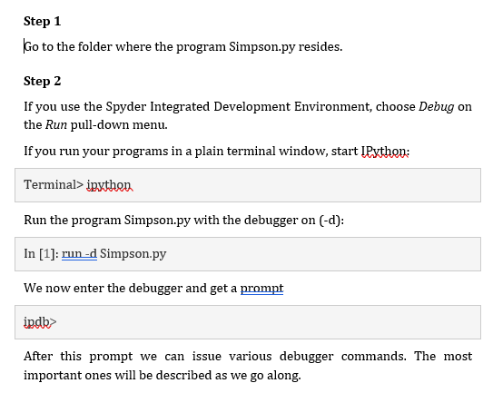
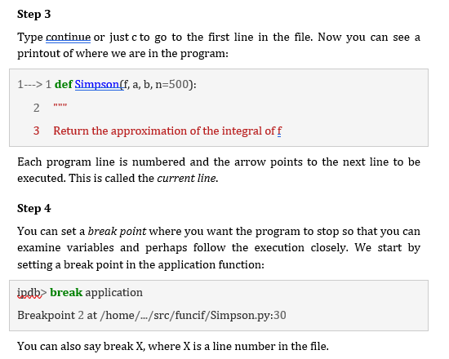
:
3. What is DEBUGGING
Continue……

Slide 16
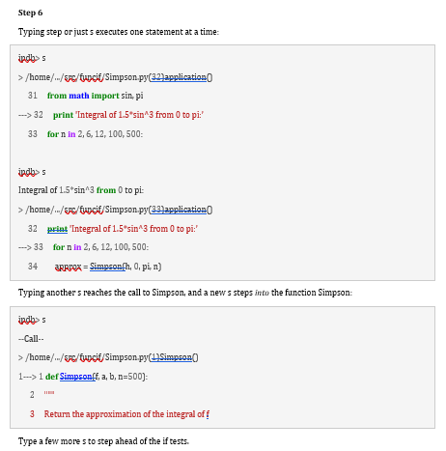
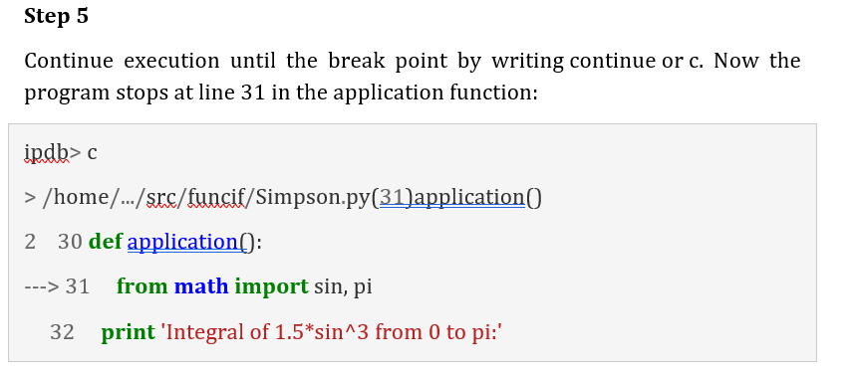
:
3. What is DEBUGGING
Continue……

Slide 17
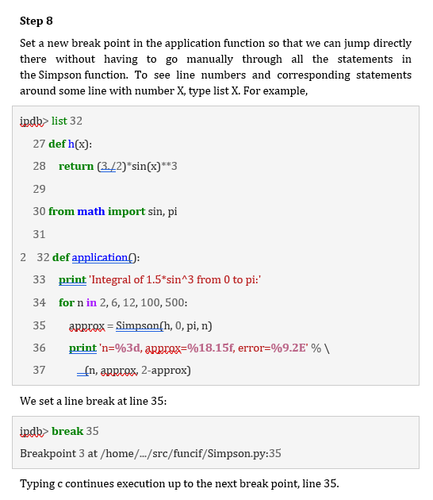
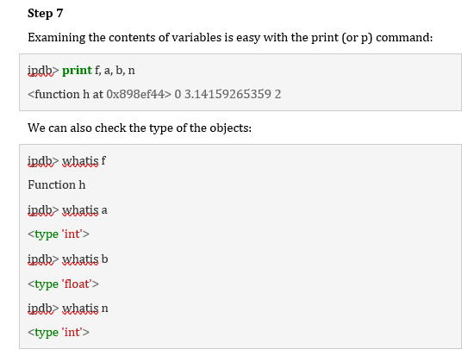
:
3. What is DEBUGGING
Continue……

Slide 18
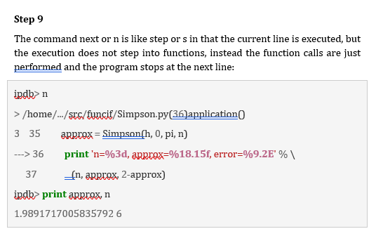
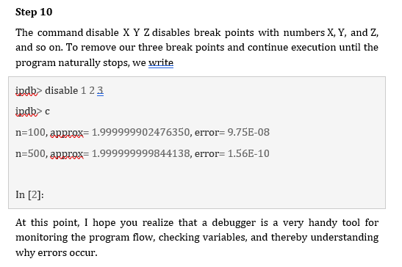
:
3. What is DEBUGGING
Continue……

Slide 19
4 types of errors
5.1) Syntax Errors
5.2) Runtime Errors
5.2.1) Name Error
5.2.2) Type Error
5.2.3) Index Error
5.2.4) Attribute Error
5.3) Logical Errors

Slide 20
4 types of errors
Continuation……
5.1) Syntax Errors
  A syntax error occurs when the code given does not follow the syntax rules of the programming language.
  Syntax errors prohibit the code from running, and the interpreter displays an error message that specifies the problem and where it occurred in the code.
  Error
  Here's an example of a Python syntax error:
        x = 10
        if x == 10
        print("x is 10")
  When the above code is executed in an IDE, we get the following output message that describes the error and the location in the code where it occurred:
        File "c:\Users\name\OneDrive\Desktop\demo.py", line 2
        If x == 10
        ^
        SyntaxError: expected ':'
  It shows that there is a SyntaxError on line 2 of the file demo.py.
Solution
The SyntaxError occurs on line 2 because the if statement is missing a colon : at the end of the line. The correct code should be:
        x = 10
            if x == 10:
            print("x is 10")
This code will execute correctly and print x is 10 to the console because the SyntaxError has been fixed.

Slide 21
4 types of errors
Continuation……
5.2) Runtime Errors
A runtime error is an error that takes place during the running of a program.
An example is writing a program that tries to access the sixth item in an array that only contains five items.
In Python, a runtime error occurs when the program is executing and encounters an unexpected condition that prevents it from continuing.
Runtime errors are also known as exceptions and can occur for various reasons such as division by zero, attempting to access an index that is out of range, or calling a function that does not exist.
Types of runtime errors
  Runtime errors can be challenging to debug because they occur at runtime and can be difficult to reproduce.
  To fix a runtime error, we need to identify the cause of the error and modify the code to handle the error or avoid it altogether.
  Below are some specific types of runtime errors.
  5.2.1) Name Error
  5.2.2) Type Error
  5.2.3) Index Error
  5.2.4) Attribute Error

Slide 22
4 types of errors
Continuation……
5.2.1) Name Error
A NameError in Python is raised when the interpreter encounters a variable or function name that it cannot find in the current scope.
This can happen for a variety of reasons, such as misspelling a variable or function name, using a variable or function before it is defined, or referencing a variable or function that is outside the current scope.
Error:
Here's an example of a NameError in Python:
        def calculate_sum(a, b):
        total = a + b
        return total
        x = 5
        y = 10
        z = calculate_sum(x, w)
        print(z)
When the above code is run in an IDE, we get the following output:
          Traceback (most recent call last):
          File "c:\Users\name\OneDrive\Desktop\demo.py", line 7, in <module> Z = calculate_sum(x, w) ^NameError:
          name 'w' is not defined
  Solution:
      This error message indicates that the interpreter could not find the variable w in the current scope.
      To fix this error, we need to correct the misspelling of the variable name to y , like so:
          def calculate_sum(a, b):
          total = a + b
          return total
          x = 5
          y = 10
          z = calculate_sum(x, y)
          print(z)
      Now the code will run without any errors, and the output will be 15 , which is the correct result of adding xand y.

Slide 23
4 types of errors
Continuation……
5.2.1) Type Error
In Python, a TypeError is raised when an operation or function is applied to an object of an inappropriate type.
This can happen when trying to perform arithmetic or logical operations on incompatible data types or when passing arguments of the wrong type to a function.
Error
Here's an example of a TypeError in Python:
x = "10“
y = 5
Z = x + y
print(z)
Whether above code is executed in an IDE, we get the following error message:
            Traceback (most recent call last):
            File "c:\Users\name\OneDrive\Desktop\demo.py", line 3, in <module> Z = x + y
            ~~^~~ TypeError: can only concatenate str (not "int") to str
Solution
  This error message indicates that we cannot concatenatea string and an integer using the + operator.
  To fix this error, we need to convert the integer y to a string before concatenating it with x , like so:
    x = "10“
    y = 5
    Z = x + str(y)
    print(z)
  Here, we have used the str() method to convert our integer to a string.
  Now the code will run without any errors, and the output will be 105 , which is the result of concatenating x and y as strings.

Slide 24
4 types of errors
3
Continuation……
5.2.3) Index Error
An IndexError is raised in Python when we try to access an index of a sequence (such as a string, list, or tuple) that is out of range.
This can happen when we try to access an element that doesn't exist in the sequence or when we try to access an element at an index that is greater than or equal to the length of the sequence.
Error
Here's an example of an IndexError in Python:
my_list = [100, 200, 300, 400, 500]
print(my_list[5])
    When the above code is executed in an IDE, we get the following error message:
      Traceback (most recent call last):
      File "c:\Users\name\OneDrive\Desktop\demo.py", line 2, in <module> print(my_list[p
      ~~^~~
          IndexError: list index out of range
Solution
This error message indicates that we are trying to access an index that is outside the range of valid indices for the list.
To fix this error, we need to make sure that we are only accessing valid indices of the list, like so:
  my_list = [100, 200, 300, 400, 500]print(my_list[4])
Now the code will run without any errors, and the output will be 500 , which is the element at index 4 of the list.

Slide 25
4 types of errors
3
Continuation……
5.2.4) Attribute Error
In Python, an AttributeError is raised when you try to access an attribute or method of an object that does not exist or is not defined for that object.
This can happen when you misspell the name of an attribute or method or when you try to access an attribute or method that is not defined for the type of object you are working with.
Error
Here's an example of an AttributeError in Python:
      my_string = "Hello, world!“
      my_string.reverse()
Output for the above code:
      Traceback (most recent call last):
      File "c:\Users\name\OneDrive\Desktop\demo.py", line 2, in <module> my_string.reverse()
      ^^^^^^^^^^^^^^^^^
      AttributeError: 'str' object has no attribute 'reverse’
    This error message indicates that we are trying to access an attribute (reverse) that is not defined for the type of object (str) we are working with.
Solution
To fix this error, we need to use a different method or attribute that is defined for strings, like [::-1] to reverse the string:
my_string = "Hello, world!“
reversed_string = my_string[::-1]
print(reversed_string)
Now the code will run without any errors, and the output will be !dlrow ,olleH , which is the reversed string of my_string.

Slide 26
4 types of errors
3
Continuation……
5.3) Logical Errors
A logical error occurs in Python when the code runs without any syntax or runtime errors but produces incorrect results due to flawed logic in the code.
Unlike syntax or runtime errors, logical errors can be challenging to detect and fix because the code runs without producing any error messages. The results may seem correct, but the code might produce incorrect output in certain situations. Here is an example of a logical error in Python:
The program can run but does not do what it is expected to do.
Logic errors can be caused by the programmer:
incorrectly using logical operators, eg expecting a program to stop when the value of a variable reaches 5, but using <5 instead of <=5
incorrectly using Boolean operators
unintentionally creating a situation where an infinite loop may occur
unintentionally using the same variable name at different points in the program for different purposes

Slide 27
4 types of errors
3
Continuation……
Solution
To fix this logical error, we need to change the range of the for loop to include the number n itself. Here's the corrected code:
  def calculate_factorial(n):
  result = 1
  for i in range(1, n+1):
  result = result * i
  return result
  print(calculate_factorial(5))
Output:
120
Though we have discussed only 7 types of errors that are encountered frequently, the list doesn’t end here. There are many more built-in errors in Python, like KeyError , MemoryError , ImportError, etc.
  Error
  def calculate_factorial(n):
  result = 1
  for i in range(1, n):
  result = result * i
  return result
  print(calculate_factorial(5))
Output:
  24
In this example, the function calculate_factorial() is designed to calculate the factorial of a given number n.
So when we run it, let's say for n = 5 , it runs without any problem but gives an output of 24 instead of 120.
The reason is a logical error in the code that causes it to produce incorrect results.
The for loop is iterating from 1to n-1instead of from 1 to n , causing the issue.
This means that the factorial is being calculated incorrectly, resulting in an incorrect output.

Slide 28
5 Experimental Debugging
3
one of the most important skills you will acquire is debugging. Although it can be frustrating, debugging is one of the most intellectually rich, challenging, and interesting parts of programming.
In some ways, debugging is like detective work. You are confronted with clues, and you have to infer the processes and events that led to the results you see.
Debugging is also like an experimental science.
Once you have an idea about what is going wrong, you modify your program and try again.
If your hypothesis was correct, then you can predict the result of the modification, and you take a step closer to a working program. If your hypothesis was wrong, you have to come up with a new one.
As Sherlock Holmes pointed out, “When you have eliminated the impossible, whatever remains, however improbable, must be the truth.”

Slide 29
6 Formal and Normal Languages
3
Natural Language
Natural language is the language that we use in our everyday conversations and interactions.
It is the language that we speak and write to communicate with each other in a social context.
it is often less structured and more informal than formal languages.
Formal Language
Formal languages are languages that are designed by people for specific applications.
For example,
  the notation that mathematicians use is a formal language that is particularly good at denoting relationships among numbers and symbols.
  Chemists use a formal language to represent the chemical structure of molecules

Slide 30
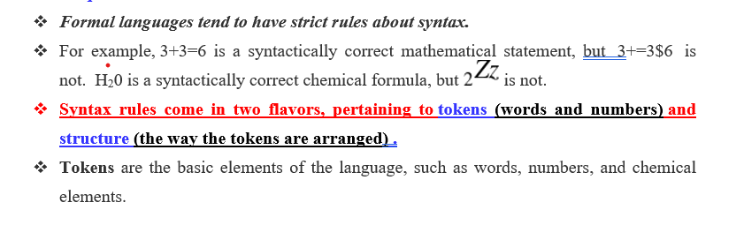
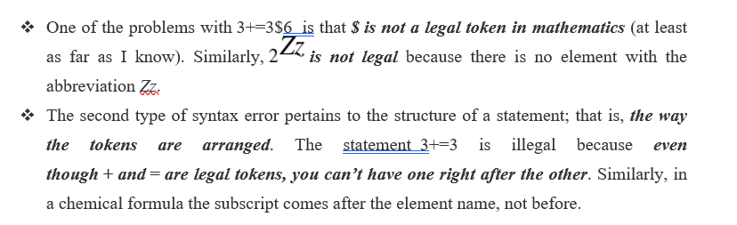
6 Formal and Normal Languages
3

Slide 31
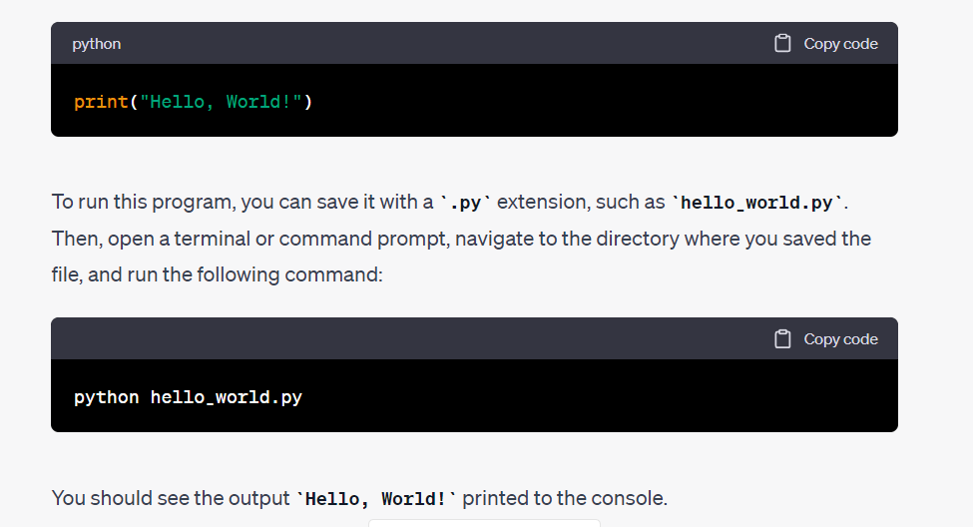
7 The First Program
3

Slide 32
8 Python Comments
3
Comments in Python are the lines in the code that are ignored by the interpreter during the execution of the program.
Comments enhance the readability of the code and helps the programmers to understand the code very carefully.
Comments can be used to explain Python code.
Comments can be used to prevent execution when testing code.
There are three types of comments in Python:
  8.1) Single line Comments
  8.2) Multiline Comments
  8.3) Docstring Comments

Slide 33
8 Python Comments
3
8.1) Single-line Comment
A single-line comment of Python is the one that has a hashtag # at the beginning of it and continues until the finish of the line.
Comments enhance the readability of the code | Comments can be used to explain Python code. | Comments can be used to prevent execution when testing code
CODE: # This code is to show an example of a single-line comment print( 'This statement does not have a hashtag before it' ) | CODE: print( 'This is an example of a comment' ) # this code is to show an example of a single-line comment | CODE : #print("Hello, World!") print("Cheers, Mate!")
OUTPUT: This statement does not have a hashtag before it | OUTPUT: This is an example of a comment | OUTPUT: Cheers, Mate!

Slide 34
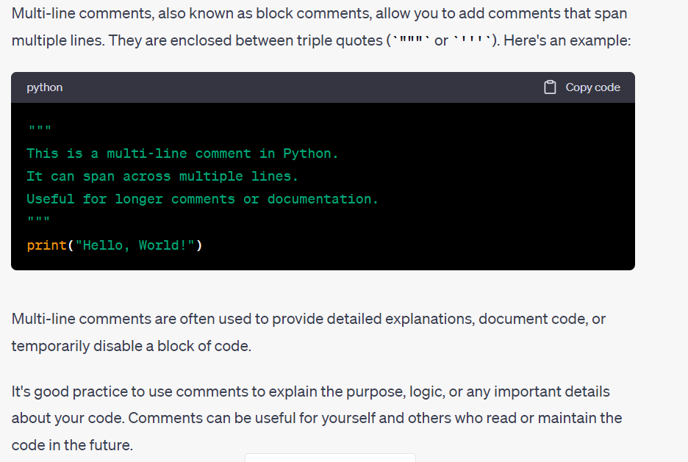
8 Python Comments
3
8.2) Multi-line Commentst

Slide 35
8 Python Comments
3
8.3) Docstring Comments
The strings enclosed in triple quotes that come immediately after the defined function are called Python docstring.
Code
      # Code to show how we use docstrings in Python
      def add(x, y):
      """This function adds the values of x and y"""
      return x + y
      # Displaying the docstring of the add function
      print( add.__doc__ )
Output:
This Thisfunction adds the values of x and y

Slide 36
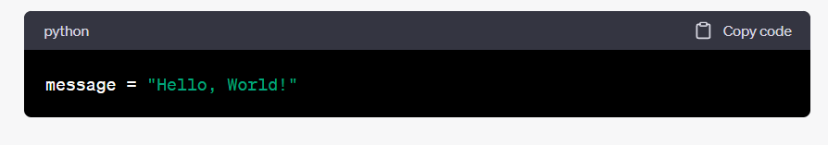
9 variables
3
A variable is a named identifier that represents a memory location used to store a value.
It is a fundamental concept in programming and allows you to store and manipulate data.
Variables are used to store different types of values, such as numbers, text, or objects.
To create a variable in Python, you simply assign a value to a name using the assignment operator (=). Here's an example:
In the above example, the variable message is created and assigned the value "Hello, World!".
Now, you can use the variable message to access or modify the stored value.
Python is a dynamically typed language, which means no need to explicitly declare the type of a variable.
The type of the variable is inferred based on the value assigned to it.
For example, in the previous code snippet, the variable message is inferred to be of type str (string) because it was assigned a string value.
Variables can be reassigned with s a different value or change its type later in the code:

Slide 37
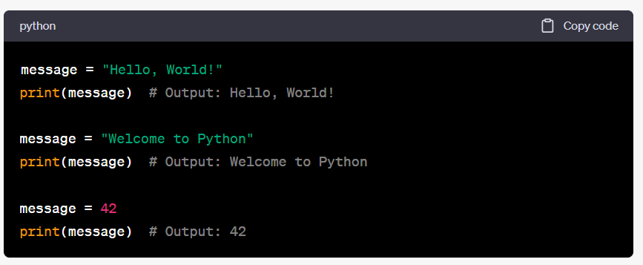
9 variables
3
In this example, the variable message is initially assigned a string value, then reassigned to a different string value, and finally reassigned to an integer value.
Variables provide a way to store and manipulate data throughout your program, making your code more flexible and dynamic. They play a crucial role in programming and are widely used to store and retrieve information.

Slide 38
9 variables
3
In this example, the variable message is initially assigned a string value, then reassigned to a different string value, and finally reassigned to an integer value.
Variables provide a way to store and manipulate data throughout your program, making your code more flexible and dynamic. They play a crucial role in programming and are widely used to store and retrieve information.

Slide 39
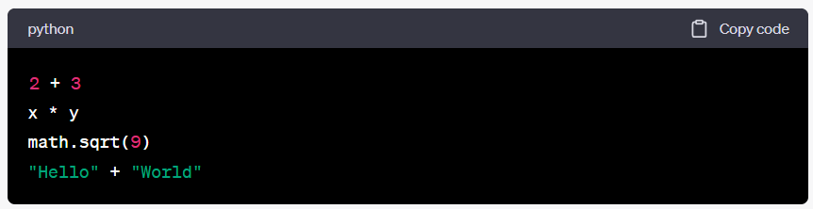
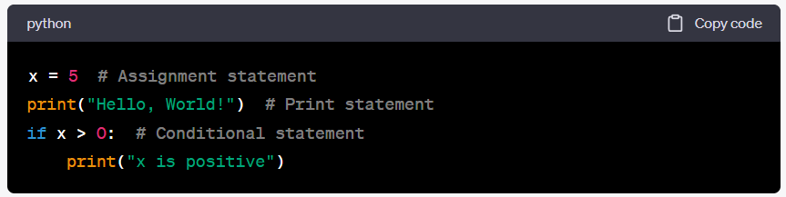
10.Expressions and Statements
3
In Python, expressions and statements are key components of the language that allow you to perform operations and control the flow of your program
EXPRESSONS | STATEMENTS
An expression is a combination of values, variables, operators, and function calls that evaluates to a single value | A statement is a complete line of code that performs an action or controls the execution flow of your program. Unlike expressions, statements do not necessarily evaluate to a value
In these examples, the expressions perform addition, multiplication, function invocation, and string concatenation. The evaluated expressions produce a value as a result. | In these examples, the statements assign a value to a variable, print a message to the console, and control the flow of execution based on a condition.
expressions produce a value | while statements perform an action or control the flow of the program.

Slide 40
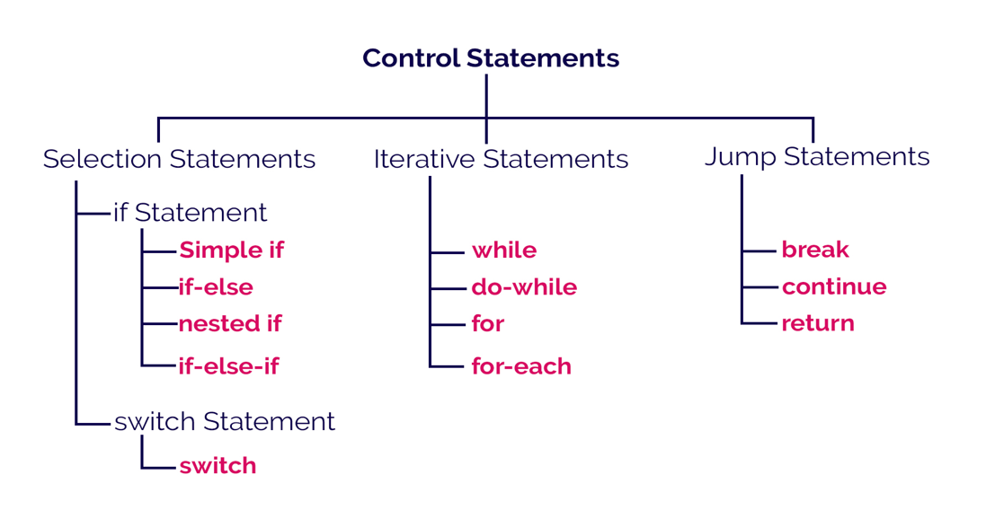
11. Program Flow Conditionals
3
In Python, conditional statements are used to control the flow of a program based on certain conditions.

Slide 41
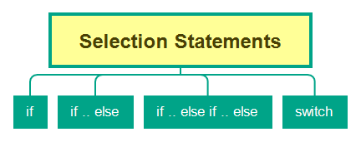
11. Program Flow Conditionals
3
Selection Statements (or) Branching Statements

Slide 42
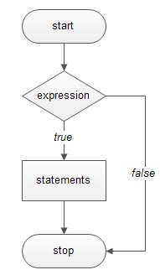
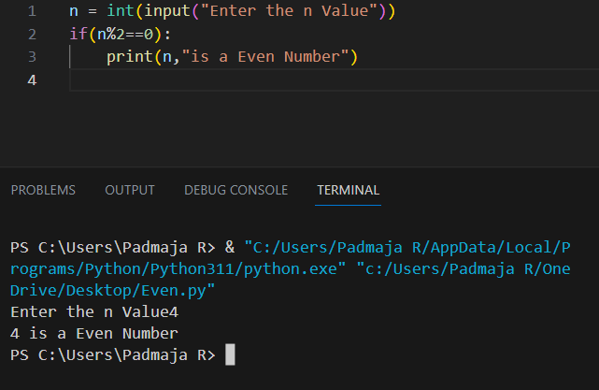
11. Program Flow Conditionals
3
Python If statements
This construct of python program consist of one if condition with one block of statements. When condition becomes true then executes the block given below it.
Find the Given Number is Even
Example-1:
n=int(input(“Enter n Value: “))
if (n%2==0):
print(n,” is a Even Number”)
Syntax:
if ( condition):
…………………..
Flowchart

Slide 43
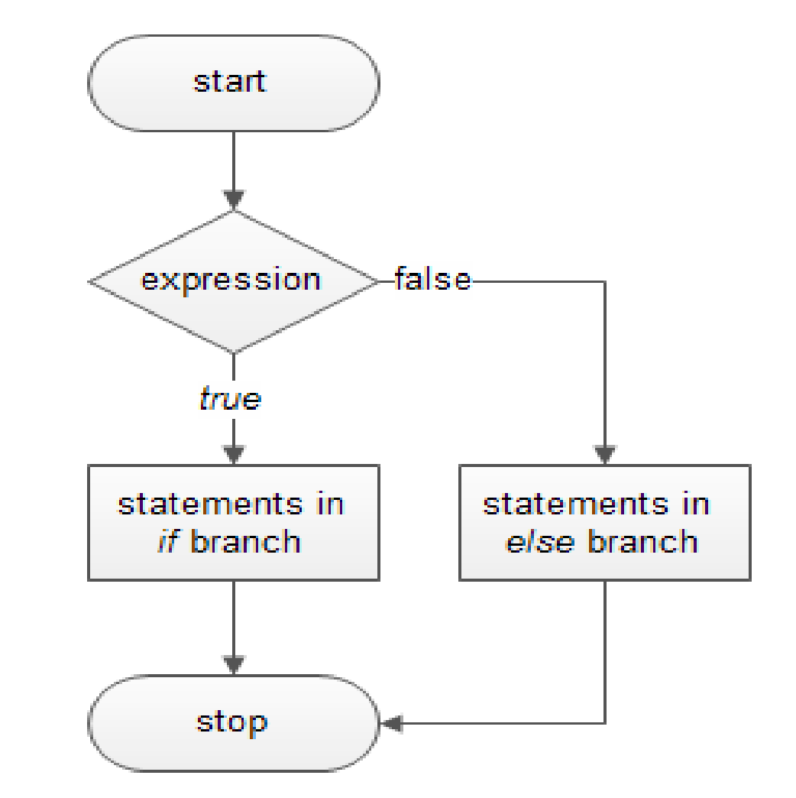
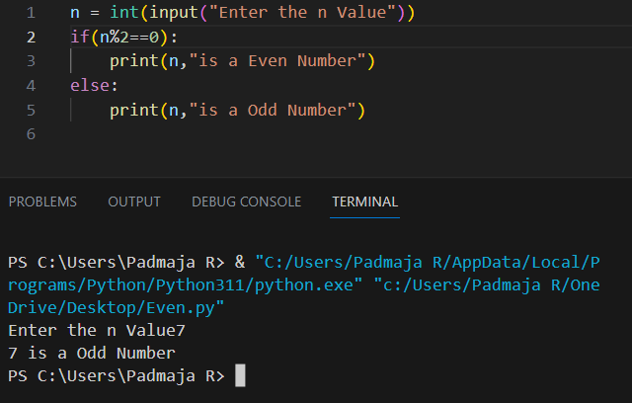
11. Program Flow Conditionals
3
Python if - else statements
This construct of python program consist of one if condition with two blocks. When condition becomes true then executes the block given below it. If condition evaluates result as false, it will executes the block given below else.
Syntax:
To Check Given Number is Even or Odd
Example-1:
n=int(input(“Enter n Value: “))
if ( n%2==0):
print(n, “is Even”)
else:
print(n, ”is Odd”)
if ( condition):
…………………..
e
lse:
…………………..
Flowchart
To Check Given age is eligible for voting or not
Example-2:
Age=int(input(“Enter Age: “))
if ( age>=18):
print(“You are eligible for vote”)
else:
print(“You are not eligible for vote”)

Slide 44
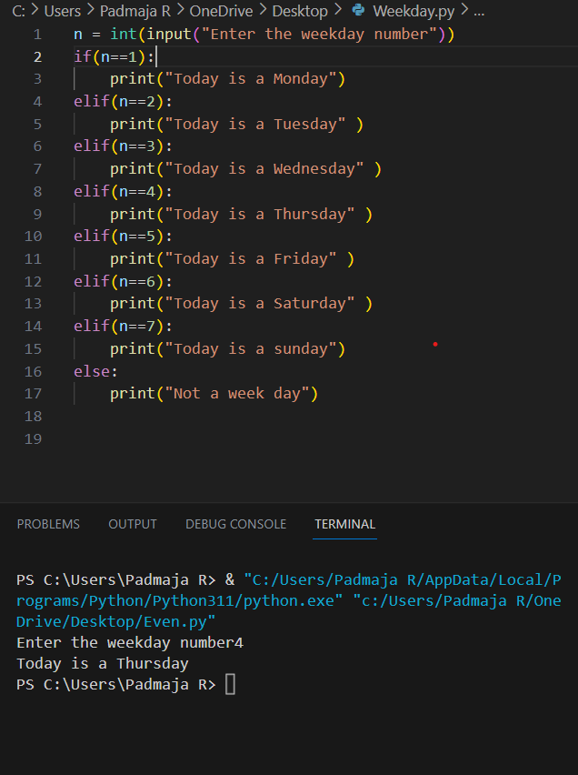
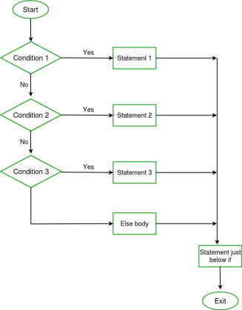
11. Program Flow Conditionals
3
Python Ladder if else statements (if-elif-else)
This construct of python program consist of more than one if condition. When first condition evaluates result as true then executes the block given below it. If condition evaluates result as false, it transfer the control at else part to test another condition. So, it is multi-decision making construct.
Syntax
Flow Chart
Example
if ( condition-1):
…………………..
…………………..
elif (condition-2):
…………………..
…………………..
elif (condition-3):
…………………..
…………………..
else:
…………………..
…………………..

Slide 45
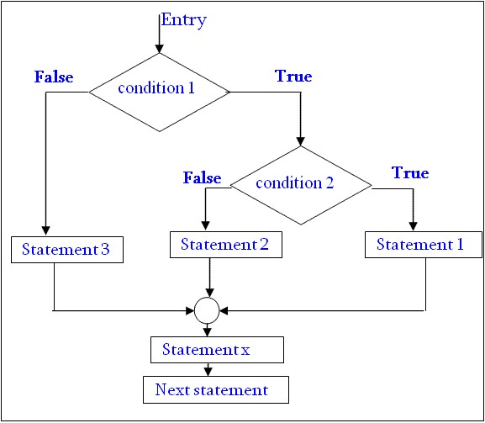
11. Program Flow Conditionals
3
Python Nested if statements
It is the construct where one if condition take part inside of other if condition. This construct consist of more than one if condition. Block executes when condition becomes false and next condition evaluates when first condition became true.
So, it is also multi-decision making construct.
if ( condition
-
1):
if (condition
-
2):
……………
……………
else:
……………
……………
else:
…………………..
…………………..

Slide 46
11. Program Flow Conditionals
3
Example: to check the given number is negative, zero or positive
num=int(input(“Enter Number:“))
If ( num<=0):
if ( num<0):
Print(“You entered Negative number”)
else:
Print(“You entered Zero ”)
else:
Print(“You entered Positive number”)

Slide 47
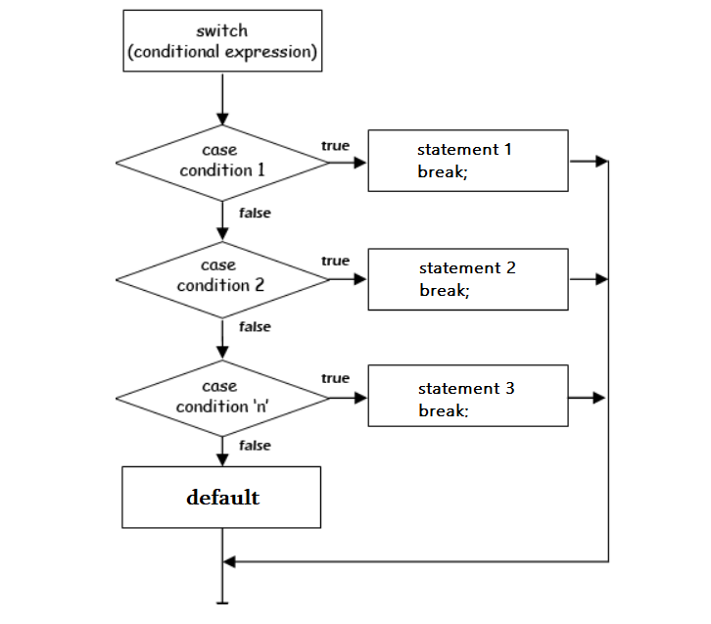
11. Program Flow Conditionals
3
Python Switch Case is a selection control statement.
The switch expression is evaluated once. The value of the expression is compared with the values of each case; if there is a match, the associated block of code is executed.
Then it makes a decision based on whether the condition is true or not.
If the condition is true, it evaluates the indented expression; however, if the condition is false, the indented expression under else will be evaluated.
When we need to run several conditions, you can place as many elif conditions as necessary between the if condition and the else condition.
Switch case statements are a substitute for long if statements that compare a variable to several integral values
The switch statement is a multiway branch statement. It provides an easy way to dispatch execution to different parts of code based on the value of the expression.

Slide 48
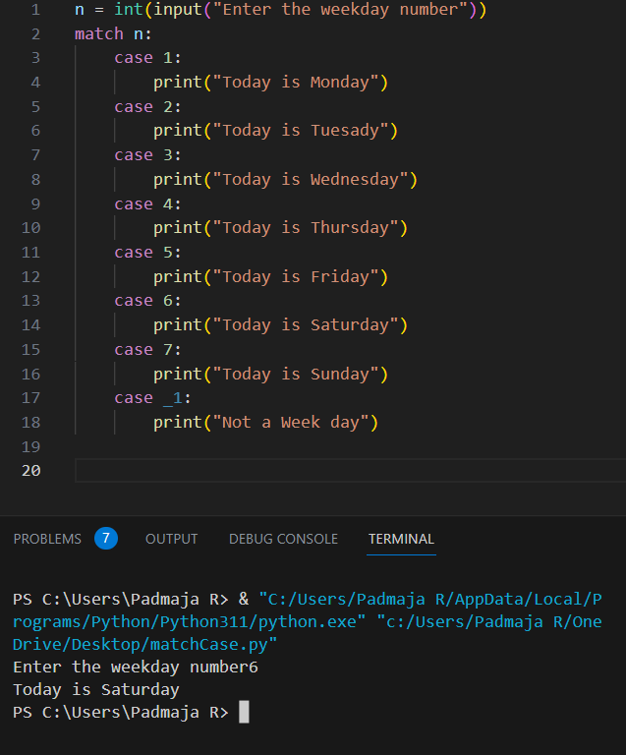
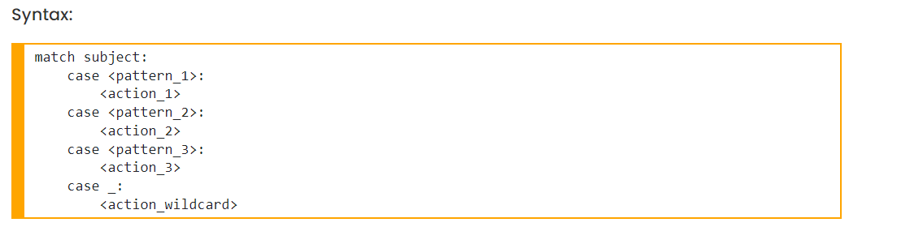
11. Program Flow Conditionals
3
Since Python 3.10, we can now use a new syntax to implement this type of functionality with a match case. The match case statement allows users to implement code snippets exactly to switch cases.

Slide 49
12. Iterations
3
The flow of the programs written in any programming language is sequential by default.
The first statement of the program is executed first, followed by the second, and so on.
There may be a situation when the programmer needs to execute a block of code several times.
For this purpose, The programming languages provide various kinds of loops that are able to repeat some particular code numerous numbers of times.
Looping simplifies complicated problems into smooth ones.
It allows programmers to modify the flow of the program so that rather than writing the same code, again and again, programmers are able to repeat the code a finite number of times.
In Python, there are three different types of loops:
12.1) For Loop
12.2) While Loop and
12.3) Nested Loop.

Slide 50
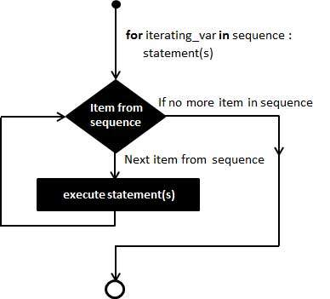
12. Iterations
3
12.1) For Loop
The for loop is used in the case where a programmer needs to execute a part of the code until the given condition is satisfied.
The for loop is also called a pre-tested loop.
It is best to use for loop if the number of iterations is known in advance.
12.1.1) Iterating from Sequence
for val in sequence:
statements
Here, val accesses each item of sequence on each iteration.
The loop continues until we reach the last item in the sequence.

Slide 51
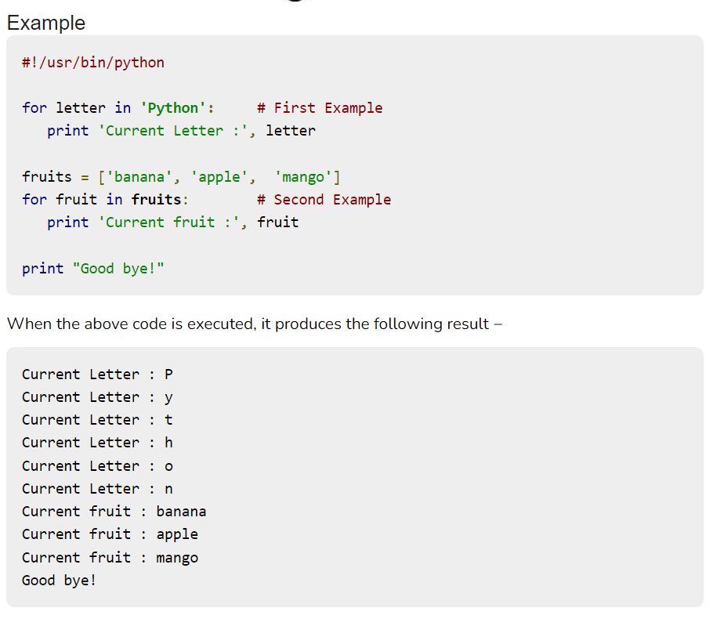
12. Iterations
3

Slide 52
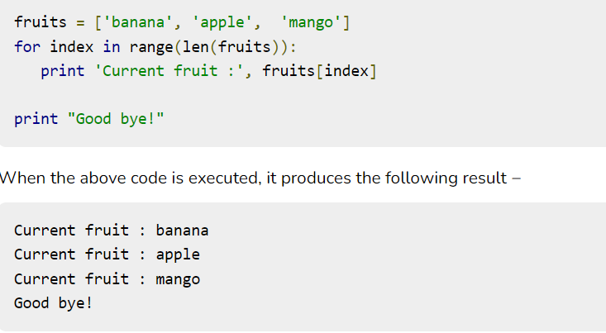
12. Iterations
3
12.1.2) Iterating by Sequence Index
An alternative way of iterating through each item is by index offset into the sequence itself. Following is a simple example −
Here, len() is a built-in function, which provides the total number of elements in the tuple as well as the range() is another built-in function to give us the actual sequence to iterate over.

Slide 53
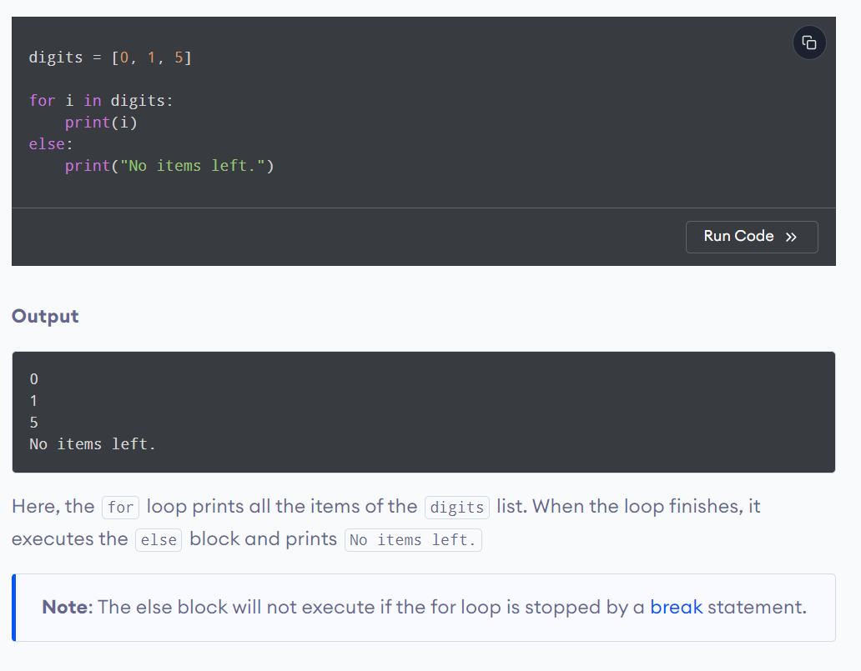
12. Iterations
3
12.1.3) Using else Statement with For Loop
Python supports to have an else statement associated with a loop statement
If the else statement is used with a for loop, the else statement is executed when the loop has exhausted iterating the list.

Slide 54
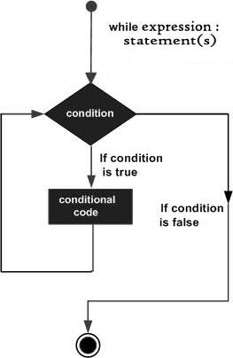
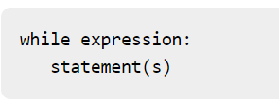
12. Iterations
3
12.2.1) While Loop
A while loop statement in Python programming language repeatedly executes a target statement as long as a given condition is true.
The syntax of a while loop in Python programming language is
Here, statement(s) may be a single statement or a block of statements.
The loop iterates while the condition is true.
When the condition becomes false, program control passes to the line immediately following the loop.
In Python, all the statements indented by the same number of character spaces after a programming construct are considered to be part of a single block of code.
Python uses indentation as its method of grouping statements.

Slide 55
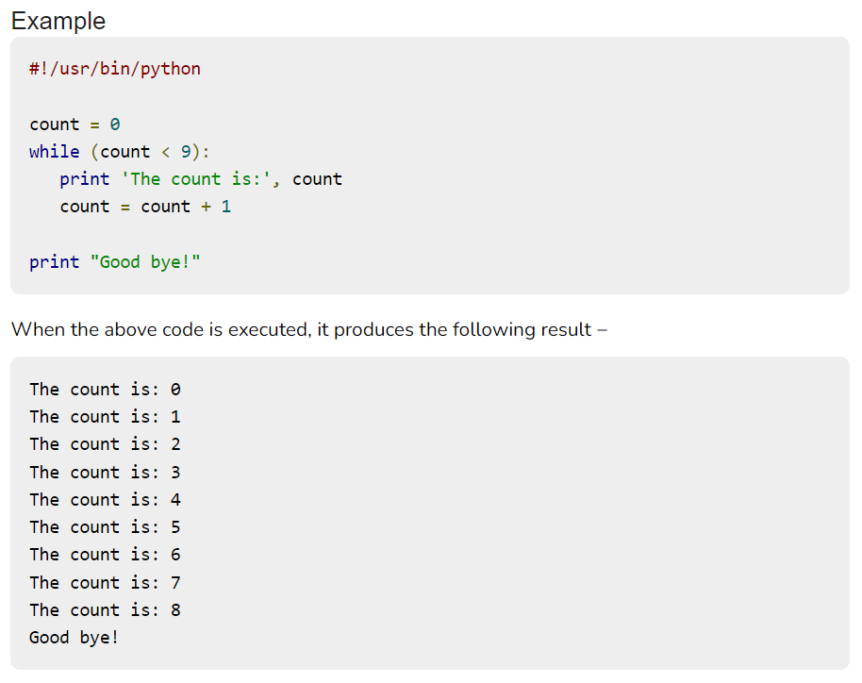
12. Iterations
3
12.2) While Loop

Slide 56
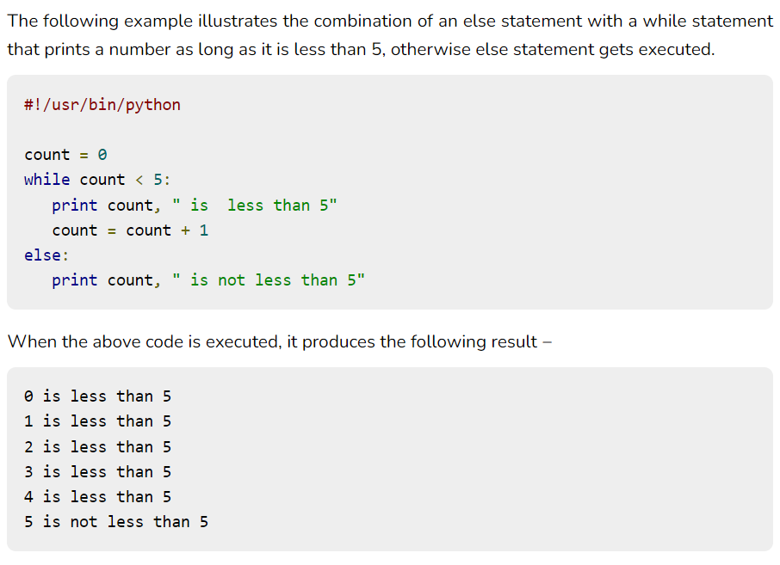
12. Iterations
3
12.2.2) Using else Statement with While Loop
Python supports to have an else statement associated with a loop statement.
If the else statement is used with a while loop, the else statement is executed when the condition becomes false.

Slide 57
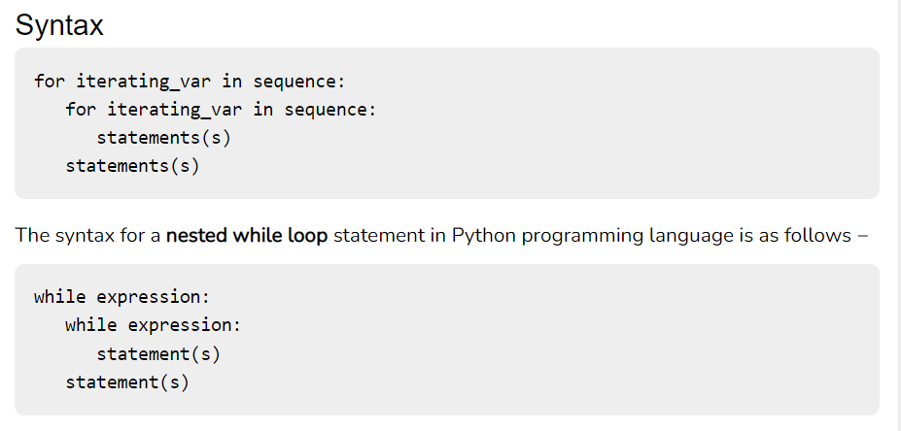
12. Iterations
3
12.3) Nested Loop
Python programming language allows to use one loop inside another loop.

Slide 58
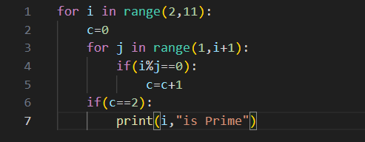
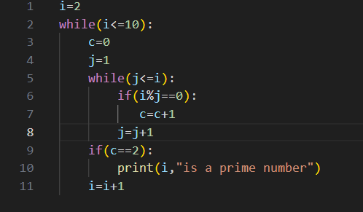


12. Iterations
3
12.3) Nested Loop
Nested For Example
Nested While Example
OUTPUT
OUTPUT

Slide 59
END OF THE UNIT - I

