Slide 1

Subject Code : 20MCA124
Subject Name : Programming Using Python
BY
R.PADMAJA,
ASSISTANT PROFESSOR,
MCA DEPARTMENT, SITAMS
UNIT – Ii

Slide 2
Functions
Function Calls
Flow of Execution
Functions that require Arguments
Functions that return values
Program Development
Debugging with print
Composition
Boolean Functions
Local Variables
Strings, String handling
UNIT II

Slide 3
INTRODUCTION TO PYTHON FUNCTIONS
In Python, a function is a block of reusable code that performs a specific task.
It allows you to organize your code into modular and reusable units, making your programs more structured and easier to understand.
Benefits of Using Functions
Increase Code Readability
Increase Code Reusability

Slide 4
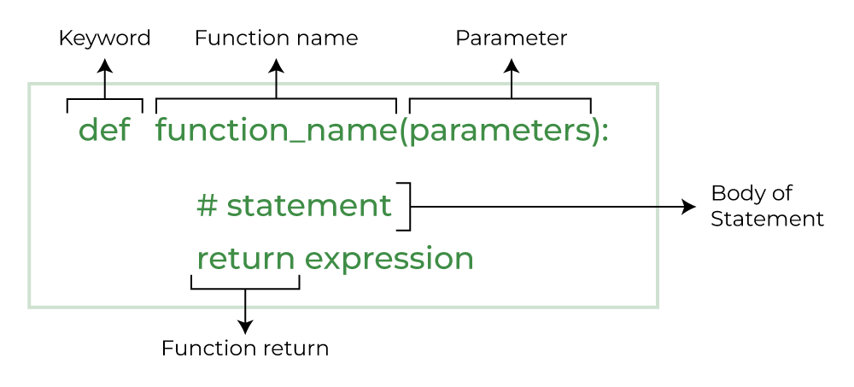
INTRODUCTION TO PYTHON FUNCTIONS
def: It's the keyword used to define a function in Python.
function_name: It's the name given to the function. You can choose any valid name that follows Python’s naming conventions.
parameters: They are optional input values that can be passed to the function for it to perform its tasks . Parameters are placed inside parentheses and separated by commas. If a function doesn’t require any input, you can leave the parentheses empty.
Function body: It consists of one or more statements that are indented under the function definition. These statements define the tasks the function performs.
Return statement: It's optional and is used to specify the value that the function should return when it is called. If a function doesn't have a return statement, it will implicitly return None
Python Function Declaration

Slide 5
INTRODUCTION TO PYTHON FUNCTIONS
Python Functions are classified into
Function with No Arguments
Function with Arguments
2.1) Default arguments
2.2) Keyword arguments
2.3) Positional arguments
2.4) Arbitrary Keyword arguments
3) Function with return statement
4) Function without Return statement

Slide 6
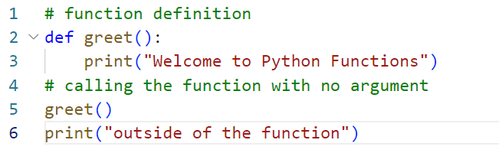

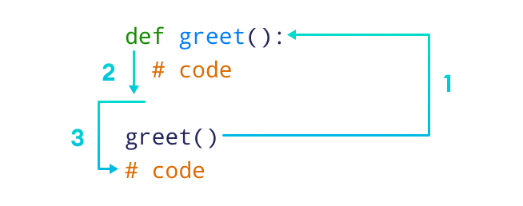
Function with no arguments
Function with No Arguments
writing Function with No arguments
Sample Code :
Output:

Slide 7
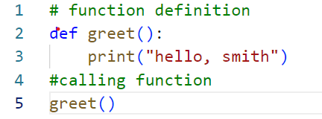
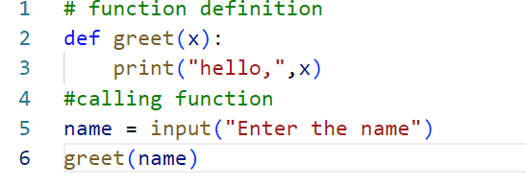


Function with arguments
2) Function with Arguments
Function with No Argument
Function with Argument

Slide 8
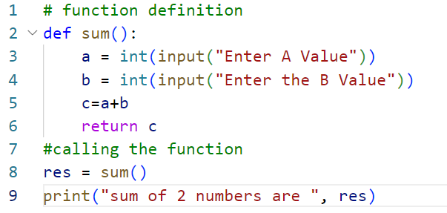

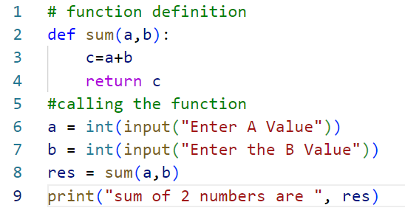

Function with arguments - Example
2) Function with Arguments
Function with No Arguments
Function with Arguments

Slide 9
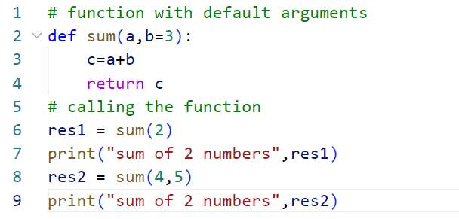

Default argument
Function with Arguments
2.1) Default Arguments
A default argument is a parameter that assumes a default value if a value is not provided in the function call for that argument. The following example illustrates Default arguments
Code
Output

Slide 10
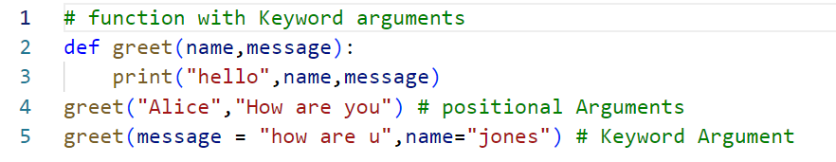

Keyword argument
Function with Arguments
2.2) Keyword arguments
function by specifying the argument name along with its value (or) The idea is to allow the caller to specify the argument name with values so that the caller does not need to remember the order of parameters.
Code
Output

Slide 11
Positional arguments
Function with Arguments
2.3) Positional arguments
Positional arguments, also known as positional parameters, are a type of argument in programming that are passed to a function or method based on their position or order. In contrast to keyword arguments, which are identified by their names, positional arguments rely on their position in the argument list.
Code
Output

Slide 12
Arbitary keyword argument
Function with Arguments
2.4) Arbitrary Keyword arguments
Sometimes, we do not know in advance the number of arguments that will be passed into a function.
To handle this kind of situation, we can use arbitrary arguments in Python.
Arbitrary arguments allow us to pass a varying number of values during a function call.
We use an asterisk (*) before the parameter name to denote this kind of argument.
In Python Arbitrary Keyword Arguments, *args, and **kwargs can pass a variable number of arguments to a function using special symbols.
There are two special symbols:
      *args in Python (Non-Keyword Arguments)
      **kwargs in Python (Keyword Arguments)

Slide 13
INTRODUCTION TO PYTHON FUNCTIONS
# program to find sum of multiple numbers
def find_sum(*numbers):
result = 0
for num in numbers:
result = result + num
print("Sum = ", result)
# function call with 3 arguments
find_sum(1, 2, 3)
# function call with 2 arguments
find_sum(4, 9)
OUTPUT
Sum =6
Sum=13

Slide 14
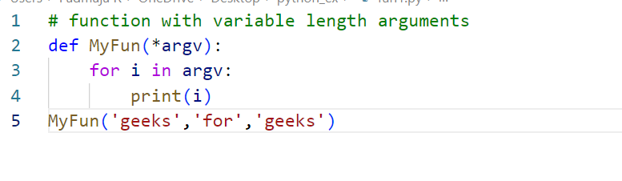
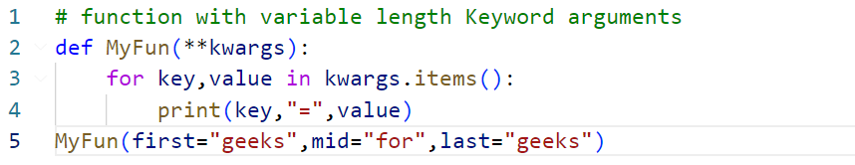


INTRODUCTION TO PYTHON FUNCTIONS
Variable Length Arguments
Variable Length Keyword Arguments
Code
Code
Output
Output

Slide 15
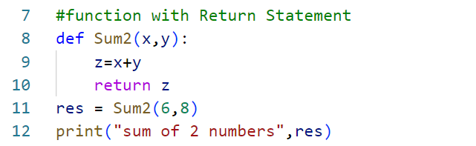
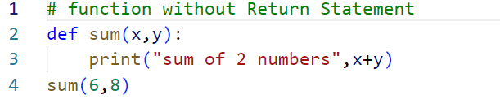
INTRODUCTION TO PYTHON FUNCTIONS
Function without Return Statement
Function with Return Statement

Slide 16
Debugging with print
7. Debugging with print
Debugging with print statements is a common technique used by developers to understand the flow of a program and to identify issues or errors.
By strategically placing print statements in the code, you can output specific values or messages to the console or log file at different points during the program execution.
Here are some steps you can follow to debug your code using print statements:
Identify the area or functionality in your code that you suspect is causing the issue or where you want to track the flow.
Determine the variables or values that are relevant to that area or functionality.
Insert print statements at key locations, just before or after critical lines of code, or within loops or conditionals.
Include meaningful messages or variable values in your print statements to help you understand what's happening.
Run the program and observe the output in the console or log file.
Analyze the output to identify any unexpected or incorrect values, or to verify the sequence of actions.
Adjust the placement or content of your print statements as needed to get a clearer picture of the problem.
Repeat steps 5 to 7 until you have pinpointed the issue or resolved the problem.
Here's an example to illustrate how print statements can be used for debugging:

Slide 17
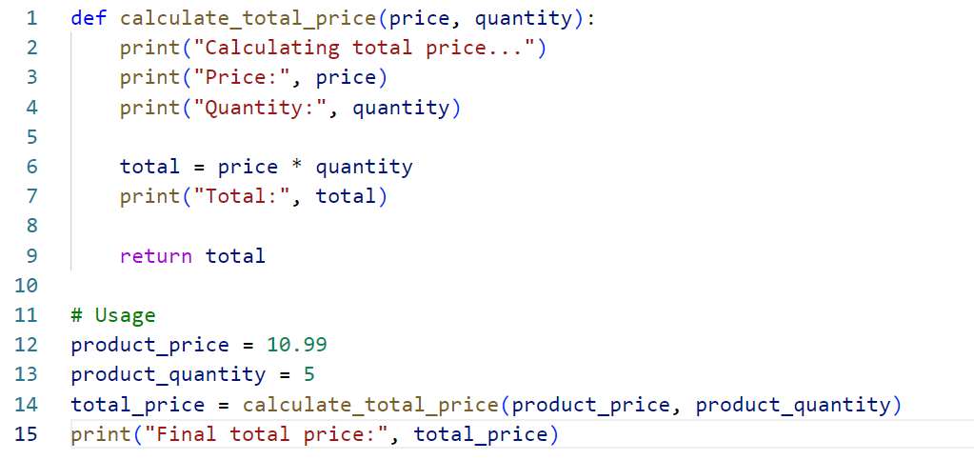
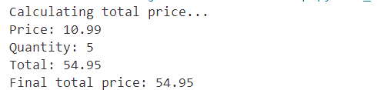
Debugging with print

Slide 18
Debugging with print
In Python, boolean functions are functions that return a boolean value (True or False) based on certain conditions or criteria. These functions typically perform some kind of test or evaluation and provide a result indicating whether the condition is satisfied or not.
Equality Comparison:
Membership Test:
def is_equal(a, b):
return a == b
print(is_equal(5, 5)) # Output: True
print(is_equal(3, 7)) # Output: False
def is_in_list(item, lst):
return item in lst
print(is_in_list(3, [1, 2, 3, 4])) # Output: True
print(is_in_list(5, [1, 2, 3, 4])) # Output: False
String Check:
Numeric Comparison:
def is_positive(num):
return num > 0
print(is_positive(5)) # Output: True
print(is_positive(-2)) # Output: False
print(is_positive(0)) # Output: False
def is_palindrome(word):
return word == word[::-1]
print(is_palindrome("radar")) # Output: True
print(is_palindrome("python")) # Output: False

Slide 19
Local vs global variables
Local Variable
Local variables in Python are those which are initialized inside a function and belong only to that particular function. It cannot be accessed anywhere outside the function.
Code
OUTPUT
def f():
s = “Welcome to Python”
print(s)
f()
“Welcome to Python”
Code
OUTPUT
def f():
# local variable
s = " Welcome to Python "
print("Inside Function:", s)
f()
print(s)
NameError: name 's' is not defined

Slide 20
Local vs global variables
Global Variable
Variables that are defined outside any function and which are accessible throughout the program, i.e., inside and outside of every function is called Global Variable
Code
OUTPUT
# This function uses global variable s
def f():
print("Inside Function", s)
# Global scope
s = “Welcome to Python World"
f()
print("Outside Function", s)
Inside Function Welcome to Python World Outside Function Welcome to Python World
Code
OUTPUT
# This function has a variable with name same as s.
def f():
s = "Me too."
print(“Inside Function”,s)
# Global scope
s = " Welcome to Python World "
f()
print(“Outside Function”,s)
Inside Function Me too
Outside Function Welcome to Python World

Slide 21
Local vs global variables
Global Variable
Now, what if we try to change the value of a global variable inside the function?
CODE
OUTPUT
# This function uses global variable s
def f():
s += 'GFG'
print("Inside Function", s)
# Global scope
s = “Welcome to Python World"
f()
UnboundLocalError: local variable 's' referenced before assignment

Slide 22
Local vs global variables
Global Variable
To make the above program work, we need to use the “global” keyword in Python.
CODE
OUTPUT
# This function modifies the global variable 's'
def f():
global s
s += ' GFG'
print(s)
s = "Look for Geeksforgeeks Python Section"
print(s)
# Global Scope
s = "Python is great!"
f()
print(s)
Python is great! GFG
Look for Geeksforgeeks Python Section
Look for Geeksforgeeks Python Section
Note : global keyword in a function is used when we want to do assignments or change the global variable. global is not needed for printing and accessing.

Slide 23
Local vs global variables
Global Variable
CODE
OUTPUT
a = 1
# Uses global because there is no local 'a'
def f():
print('Inside f() : ', a)
# Variable 'a' is redefined as a local
def g():
a = 2
print('Inside g() : ', a)
# Uses global keyword to modify global 'a'
def h():
global a
a = 3
print('Inside h() : ', a)
# Global scope
print('global : ', a)
f()
print('global : ', a)
g()
print('global : ', a)
h()
print('global : ', a)
global : 1
Inside f() : 1
global : 1
Inside g() : 2
global : 1
Inside h() : 3
global : 3

Slide 24
Local vs global variables
DIFFERENCE B/W LOCAL VARIABLE VS. GLOBAL VARIABLES
Comparision Basis | Global Variable | Local Variable
Definition | declared outside the functions | declared within the functions
Lifetime | They are created the execution of the program begins and are lost when the program is ended | They are created when the function starts its execution and are lost when the function ends
Data Sharing | Offers Data Sharing | It doesn’t offers Data Sharing
Scope | Can be access throughout the code | Can access only inside the function
Parameters needed | parameter passing is not necessary | parameter passing is necessary
Storage | A fixed location selected by the compiler | They are kept on the stack
Value | Once the value changes it is reflected throughout the code | once changed the variable don’t affect other functions of the program

Slide 25
STRING HANDLING
Python string is the collection of the characters surrounded by single quotes, double quotes, or triple quotes.
The computer does not understand the characters; internally, it stores manipulated character as the combination of the 0's and 1's.
Each character is encoded in the ASCII or Unicode character.
So we can say that Python strings are also called the collection of Unicode characters.

Slide 26
Creating a String in Python
STRINGS IN PYTHON CAN BE CREATED USING SINGLE QUOTES OR DOUBLE QUOTES OR EVEN TRIPLE QUOTES.
# Creating a String with single Quotes
String1 = 'Welcome to the Python World'
print("String with the use of Single Quotes: “ ,String1)
# Creating a String # with double Quotes
String1 = “Python Strings"
print("String with the use of Double Quotes: “,String1)
# Creating a String # with triple Quotes
String1 = '''I'm a Geek and I live in a world of "Geeks"'''
print("String with the use of Triple Quotes: “,String1)

Slide 27
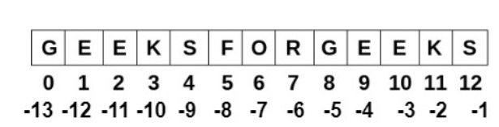
Accessing characters in Python String
In Python, individual characters of a String can be accessed by using the method of Indexing.
CODE | OUTPUT
# Python Program to Access characters of String String1 = “Python World" print("Initial String: “,String1) # Printing First character print("First character of String is: “,String1[0]) # Printing Last character print("Last character of String is: “,String1[-1]) | Initial String: Python World First character of String is: P Last character of String is: d

Slide 28
END OF THE UNIT - II

