Slide 1

Subject Code : 20MCA124
Subject Name : Programming Using Python
BY
R.PADMAJA,
ASSISTANT PROFESSOR,
MCA DEPARTMENT, SITAMS
UNIT – Iii

Slide 2
1) Recursive Functions
2) Recursive Problem Solving
3) Iteration Vs Recursion
4) List Structures
5) Lists in Python
6) Iterating over Lists in Python
7) More on Python Lists
8) Dictionaries and Sets
8.1) Dictionary Type in Python
8.2) Set Data Type
UNIT -III

Slide 3
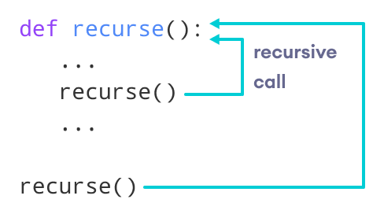
A Function can call other Functions
It is even possible for a function to call itself and so
Function that calls itself is called Recursive Function.
Factorial of a number is the product of all the integers from 1 to that number. For example, the factorial of 6 (denoted as 6!) is 1*2*3*4*5*6 = 720
      def factorial(x):
      """This is a recursive function
      to find the factorial of an integer"""
      if x == 1:
      return 1
      else:
      return (x * factorial(x-1))
      num = 3
      print("The factorial of", num, "is", factorial(num))
Recursive Functions

Slide 4
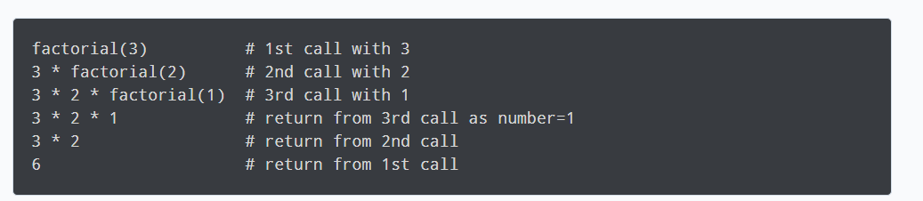
In the above example, factorial() is a recursive function as it calls itself.
When we call this function with a positive integer, it will recursively call itself by decreasing the number.
Each function multiplies the number with the factorial of the number below it until it is equal to one. This recursive call can be explained in the following steps.
Recursive Functions

Slide 5
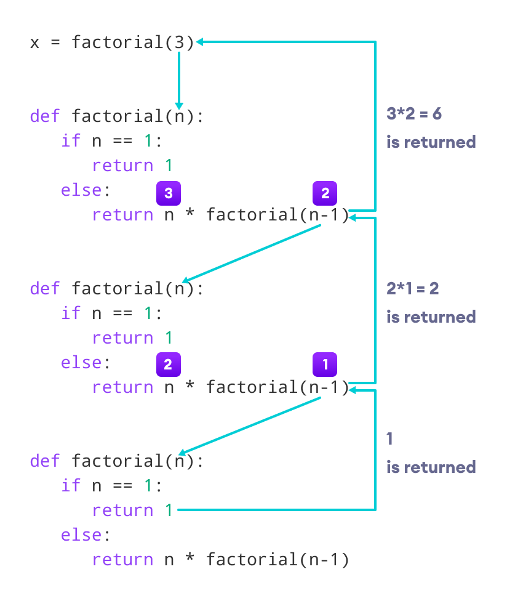
Recursive Functions

Slide 6
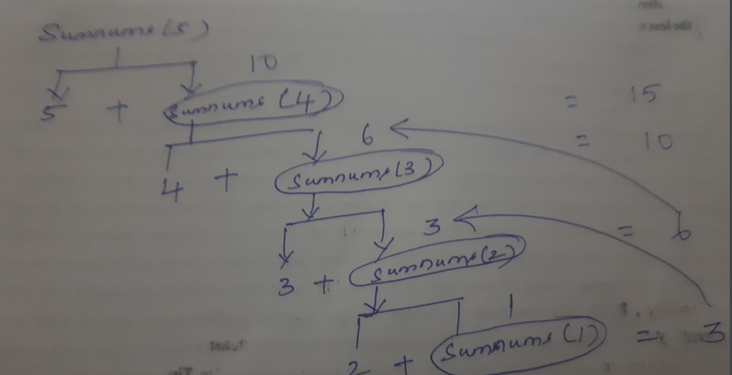
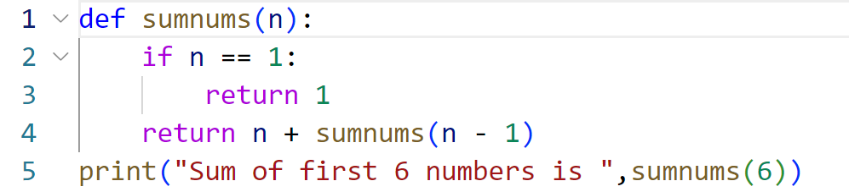
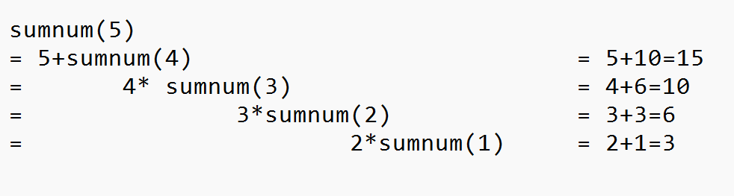
Code
Sum of n natutal numbers Recursive Functions
Trace Out
output
Sum of first 5 numbers is 15

Slide 7
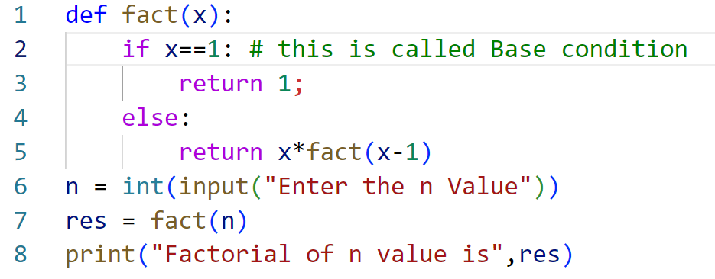
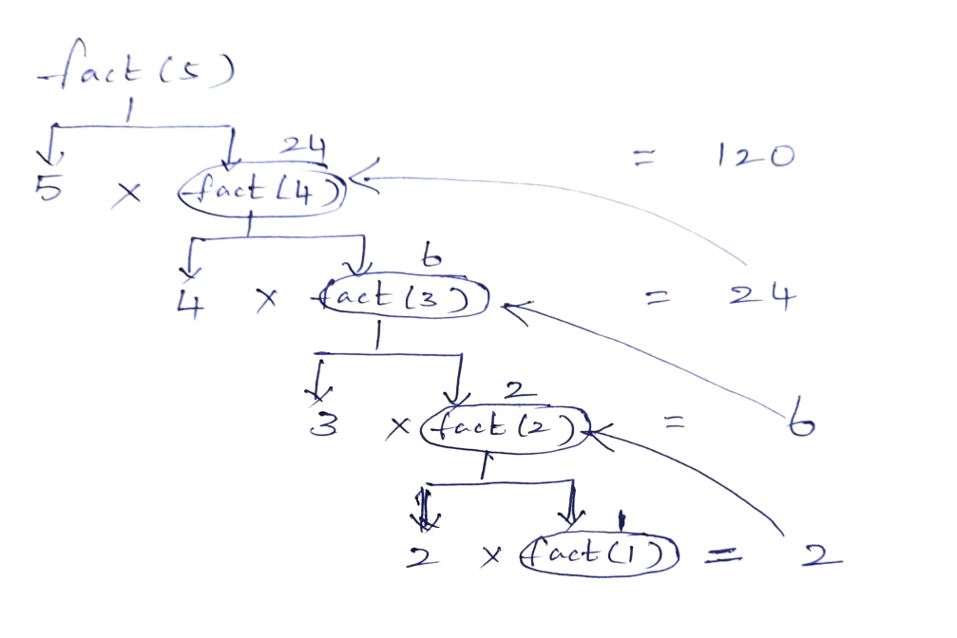
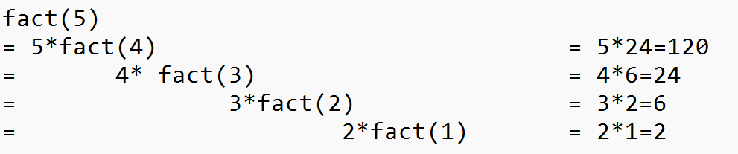
Code
Recursive Functions
Trace Out
output
Enter the n Value 5
Factorial of n value is 120

Slide 8
“Data + structures" says it all.
A data structure structures the data.
It is a storage unit that organizes and stores data in a way the programmer can easily access.
In the real world, a programmer/ coder's work involves huge amounts of data.
Analyzing and using the data is made easy for the programmer when it is arranged the right way.
Apart from organizing the data, Data structures also makes processing and accessing the data easy.
Data Structures are a way of organizing data so that it can be accessed more efficiently depending upon the situation.
Data Structures are fundamentals of any programming language around which a program is built.
Types of Data Structures in Python are
1) Built in Data Structures
2) User Defined Data Structures
List Structures

Slide 9
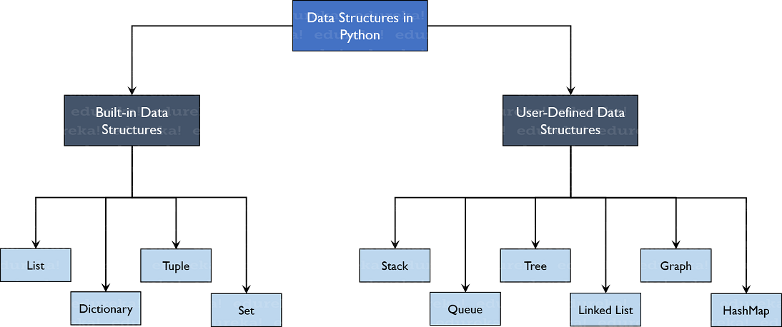
Types of data Structures in Python
List Structures

Slide 10
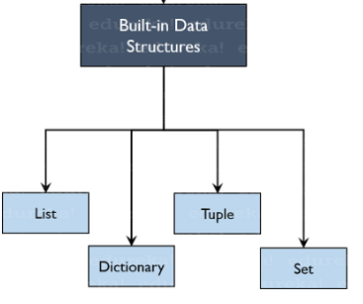
As the name suggests, these Data Structures are built-in with Python which makes programming easier and helps programmers use them to obtain solutions faster.
Let’s discuss each of them in detail.
List Structures

Slide 11
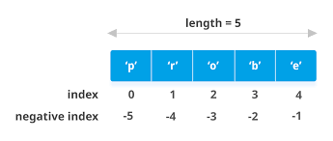
List
List are one of the Built in Data Structure in Python
Lists are ordered collection of data
Lists are mutable, meaning that after creation, we can modify their elements.
Lists allow duplicate elements.
Lists are used to store data of different data types in a sequential manner.
There are addresses assigned to every element of the list, which is called as Index.
The index value starts from 0 and goes on until the last element called the positive index.
There is also negative indexing which starts from -1 enabling you to access elements from the last to first
List Structures

Slide 12
1. Creating Lists
6. Sorting List Elements
List Structures
2. Adding elements to Lists
7.Concatenating the List
OPERATIONS
ON
LIST
3. Removing elements from Lists
8. Slicing the List
4. Modifying List elements
9. Built in Functions
5.Accessing elements From Lists
10.Two Dimensional List

Slide 13
1. Creating Lists
A list is created in Python by placing items inside [], separated by commas . For example,
A list can have any number of items and they may be of different types (integer, float, string, etc.). For example,
A List can be Created with Duplicate evalues
Output:
List Structures
Output:
Output:

Slide 14
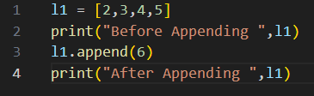
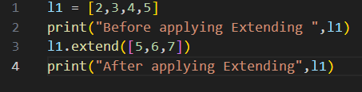
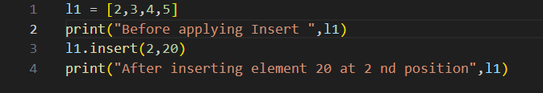


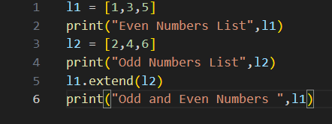

2. Adding elements to Lists
List has 3 Methods to Add Elements
append → To Add Single element at the end of the List
extend → To Add Multiple Elements at the end of the List
insert → To Add Element at a specified Position in the List
List Structures
append | extend | insert
Example | Example | Example
Output | Output | Output
Extend can also be used to concatenate two Lists

Slide 15
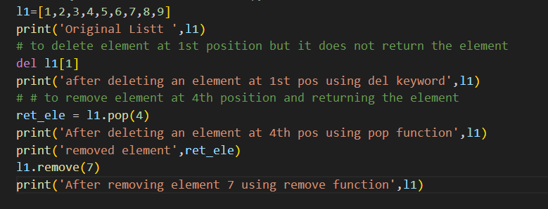
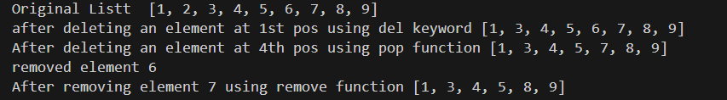
3. Removing elements from Lists
To delete elements, use the del keyword which is built-in into Python but this does not return anything back to us.
To get the element back, use the pop() function which takes the index value.
To remove an element by its value, use the remove() function.
List Structures
Output

Slide 16
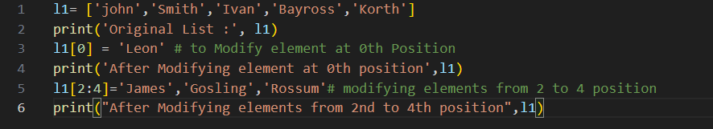
4. Modifying List elements
The List Elements can be modified using Index of the element
List Structures
Output

Slide 17
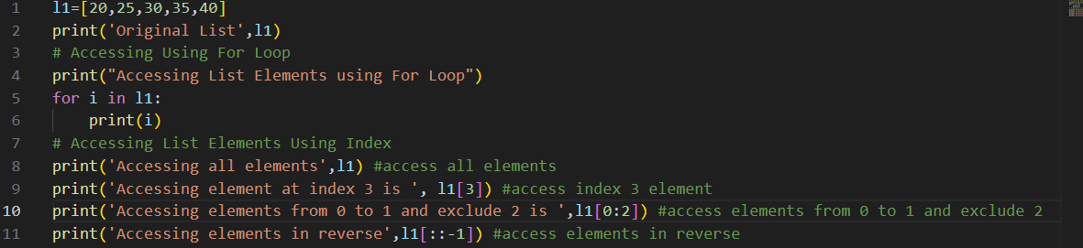
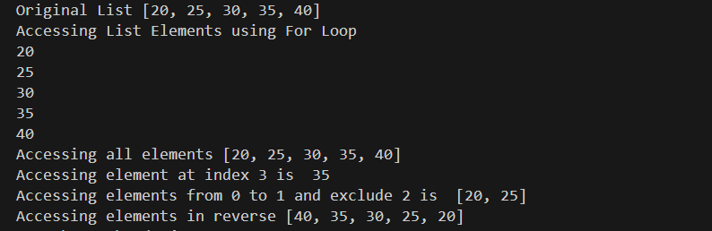
5.Accessing elements From Lists
For Loop - One way to Access elements from the Lists
Index - Another Way to Access Elements from the Lists
Code
List Structures
Output

Slide 18
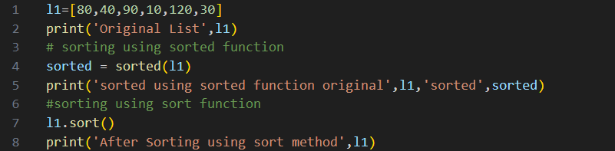
6.Sorting List Elements
List Elements can be sorted using 2 ways
Sorted – is a function – where Sorting does not done at In-Place
Sort – is a List method – where Sorting done at In-Place
List Structures
Code
Output

Slide 19
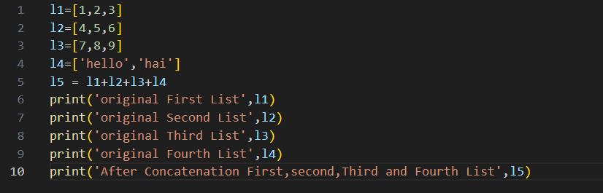
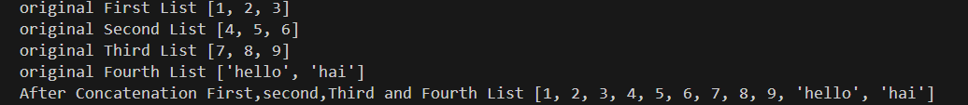
7. Concatenating one or More List Elements
+ Operator is used to concatenate one or more List Elements
Code
List Structures
Output

Slide 20
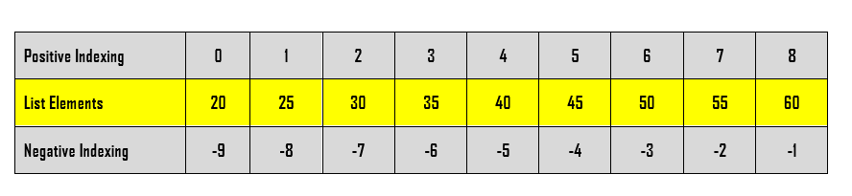
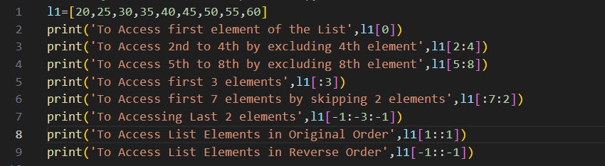
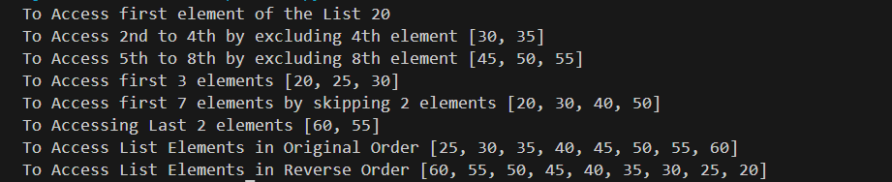
8. Slicing List Elements
Index is used to Slice the List Elements
Code
List Structures
Output

Slide 21
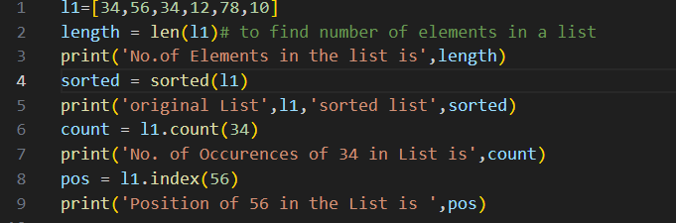
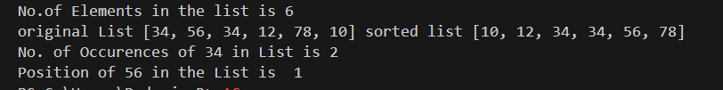
9. Built In Functions/other Methods
Built in Functions
len Helps to find Number of elements in a List
Sorted Helps to sort the List Elements (Not In-Place)
Other Methods
Count Helps to find Number of Occurrences of the Given Element
Index Helps to find the Index of the specified element
List Structures
Code
Output

Slide 22
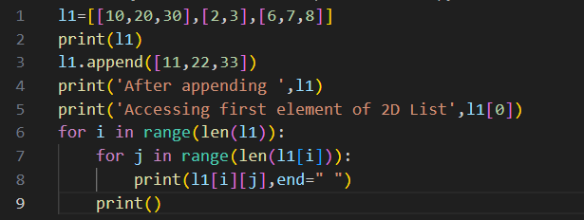
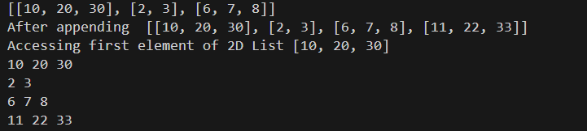
10. Two Dimensional Lists
Lists are a very widely use data structure in python.
They contain a list of elements separated by comma.
But sometimes lists can also contain lists within them.
These are called nested lists or multidimensional lists.
List Structures
Code
Output

Slide 23
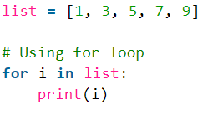

Iterate over a list in Python
There are multiple ways to iterate over a list in Python.
1) Using For Loop
2) For Loop and Range
3) Using a While Loop
4) Using list comprehension
Using For Loop
Simple For Loop can be used to iterate over a list in python
Iterating Over a Lists in python
Code
Output

Slide 24
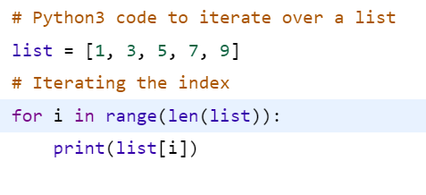

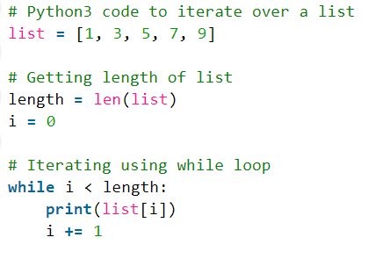

Iterate over a list in Python
2) For Loop and Range
Code
Output
Iterating Over a Lists in python
3) Using While Loop
Code
Output

Slide 25
Iterate over a list in Python
4) Using list comprehension
Code
Output
Iterating Over a Lists in python

Slide 26
Void Methods of List
1) sort list.sort()
2) remove list.remove(element)
3) insert list.insert(pos, element)
4) append list.append(element)
5) extend list.extend([elements])
Return Type Methods of List
1) pop() element = list.pop(position)
2) count() var = list.count(element)
3) index() var = list.index(element)
List functions
1) len var = len(list)
2) sorted var = sorted(list)
List - Summary

Slide 27
Tuple is a Built in Data Structure in Python
Tuple items are Ordered, means that the items have a defined order, and that order will not change.
Tuple items are Unchangeable (Immutable), meaning that we cannot change, add or remove items after the tuple has been created
Tuple allows Duplicates
Tuple
Structures

Slide 28
1. Creating Tuples
6. Sorting Tuple Elements
Tuple
Structures
2. Adding elements to Tuples
7.Concatenating theTuple elements
OPERATIONS
ON
LIST
3. Removing elements from Tuples
8. Slicing the tuple Elements
4. Modifying Tuple elements
9. Built in Functions
5.Accessing elements From Tuples
10.Packing and unpacking Tuples

Slide 29
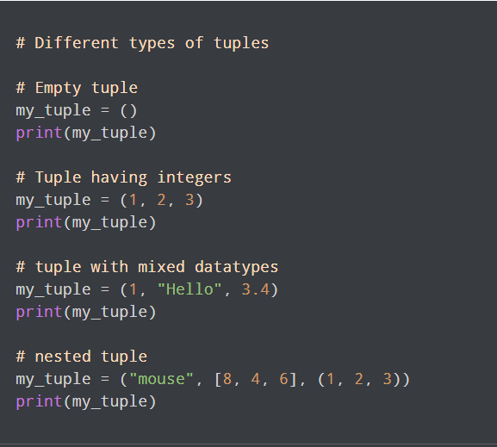
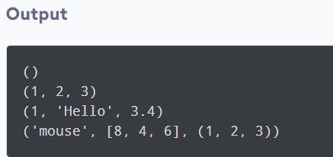
1) Creating a Tuple
A tuple is created by placing all the items (elements) inside parentheses (), separated by commas.
The parentheses are optional, however, it is a good practice to use them.
A tuple can have any number of items and they may be of different types (integer, float, list, string, etc.).
Tuple

Slide 30
2) Adding elements to a Tuple
Since tuples are immutable, they do not have a built-in append() method, but there are other ways to add items to a tuple.
1) Convert into a list: convert tuple into a list,, add item(s), and convert it back into a tuple.
2) Add tuple to a tuple. add tuples to tuples, create a new tuple with the item(s), and add it to the existing tuple:
        t2 = ("apple", "banana", "cherry")
        y = ("orange",)
        t2 += y
        print(t2)
t1 = ("apple", "banana", "cherry")
y = list(t1)
y.append("orange")
t1 = tuple(y)
Tuple

Slide 31
Removing Elements from the Tuple
You cannot remove elements from the Tuple
Tuple

Slide 32
4. Modifying Tuple elements
Once a tuple is created, you cannot change its values. Tuples are unchangeable, or immutable as it also is called.
It is possible to convert the tuple into a list, change the list, and convert the list back into a tuple.
x = ("apple", "banana", "cherry")
y = list(x)
y[1] = "kiwi"
x = tuple(y)
print(x)
Tuple

Slide 33
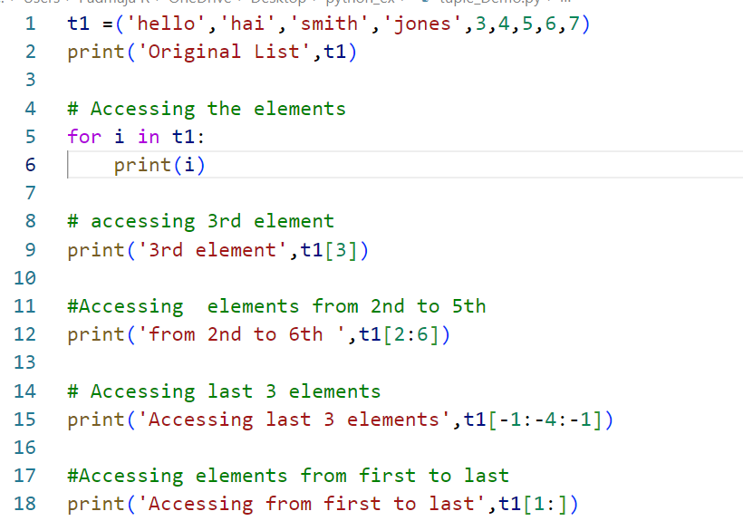
5.Accessing elements From Tuples
For Loop - One way to Access elements from the Lists
Index - Another Way to Access Elements from the Lists
Tuple

Slide 34
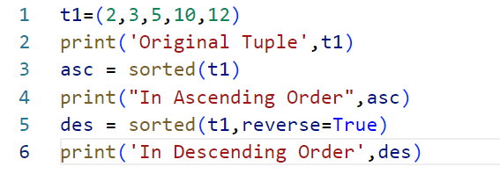

6. Sorting Tuple Elements
Sorted built in function is used to sort tuple elements
To sort in descending order, pass reverse=True to sorted() function.
Tuple
OUTPUT

Slide 35
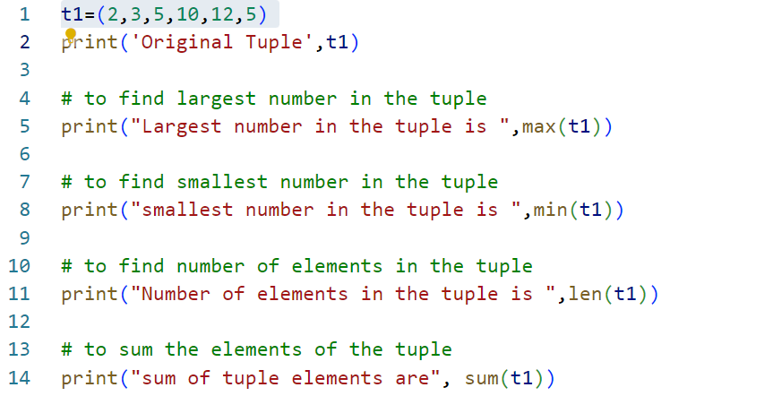
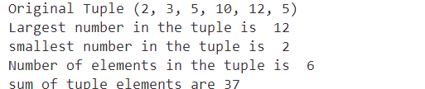
9, Built In functions
Tuple Functions | Description
len(tuple) | Gives Number of elements in the tuple
max(tuple) | Returns the largest number from the tuple
min(tuple) | Returns the smallest number from the tuple
sum(tuple) | Returns the sum of tuple elements
Tuple
output

Slide 36
Packing and unpacking Tuple
When a tuple is created, we normally assign values to it. This is called "packing" a tuple:
fruits = ("apple", "banana", "cherry")
(a,b,c) = fruits
print(a)
print(b)
print(c)
output
apple
banana
cherry
Tuple
fruits = ("apple", "banana", "cherry", "strawberry", "raspberry")
(a, b, *c) = fruits
print(a)
print(b)
print(c)
output
apple
banana
['cherry', 'strawberry', 'raspberry']

Slide 37
SET is a Built in Data Structure in Python
SET items are UnOrdered, means that the items will not have a defined order, and that order will change.
SET items are Unchangeable (Immutable), meaning that we cannot change, add or remove items after the tuple has been created
SET do not allow Duplicates
set

Slide 38
1. Creating Sets
6. Sorting Tuple Elements
2. Adding elements to sets
7.Concatenating theTuple elements
set
OPERATIONS
ON
LIST
3. Removing elements from sets
8. Slicing the tuple Elements
4.Accessing elements From Tuples
9. Built in Functions
10.Packing and unpacking Tuples

Slide 39

Creating sets
Sets are created by placing all the elements inside curly braces {}, separated by comma.
Output
Tuple

Slide 40
Adding elements to sets
Elements can be added to sets using add() method
student_id = {110,111,112,114}
print('student ids are ',student_id)
student_id.add(115)
print("after adding new student is",student_id)
Tuple
Output
student ids are {112, 114, 110, 111}
after adding new student is {110, 111, 112, 114, 115}

Slide 41
Accessing elements from the sets
Elements can be accessed through For loop
student_id = {110,111,112,114}
print('student ids are ',student_id)
# one way of accessing Set Elements
student_id.add(115)
print("after adding new student is",student_id)
#another way of accessing Set Elements
for i in student_id:
print(i)
Tuple
Output
student ids are {112, 114, 110, 111}
after adding new student is {110, 111, 112, 114, 115}
110
111
112
114
115

Slide 42
Remove element from the set
remove() and discard() methods are used to remove elements from the set
student_id = {110,111,112,114}
print('Before Removing student ids are ',student_id)
student_id.remove(111)
print("After removing element",student_id)
student_id.discard(112)
print("After Removing element from set",student_id)
Tuple
Output
Before Removing student ids are {112, 114, 110, 111}
After removing element {112, 114, 110}
After Removing element from set {114, 110}

Slide 43
List is a collection which is ordered and changeable. Allows duplicate members.
Tuple is a collection which is ordered and unchangeable. Allows duplicate members.
Set is a collection which is unordered, unchangeable*, and unindexed. No duplicate members.
Dictionary is a collection which is ordered** and changeable. No duplicate members.
Python Data structures summary

Slide 44
END OF THE UNIT - III

