Slide 1

Subject Code : 20MCA211
Subject Name : Web Programming
UNIT – ii
BY
R.PADMAJA,
ASSISTANT PROFESSOR,
MCA DEPARTMENT, SITAMS

Slide 2
UNIT II
SERVELTS
&
JSP (Java Server Pages)

Slide 3
Client makes request to the server thro browser
i.e by typing the URL in the URL bar or by submitting the form
Once client makes request, the browser generates the HTTP REQUEST MESSAGE and sends to the server.
Server once it receives the HTTP REQUEST MESSAGE, interprets , processes the request and formulates the HTTP RESPONSE MESSAGE and sends the message to the browser.
Browser interprets the message and displays the output

Slide 4
Client sends Request by typing url or submitting a form
Browser creates a HTTP Request message and sends to server
HTTP Request Message
GET Index,html HTTP /1.1
Host : www.University.com
User-Agent:Mozilla
Accept_Image : jpeg,png
Accept_language:English
Usr =scott&pwd=tiger
Request Line : Method Resource protocol version
Request Header : host,user_agent,Accept_image etc..
Blank line
Request Body : query string (if method = post)

Slide 5
Server after processing the request , generates the response and
Formulates the HTTP Response Message and sends the response to browser
HTTP Response Message
HTTP 1.1 200 ok
Status : ok
Content_type : html/text
Servlet:engine : tomcat server
<html> <body> <h1> welcome </h1> </body> </html>
status Line : Protocol version status code status
Response Header : status, content_type, servlet_engine
Blank line
Response Body : Output webpage

Slide 6
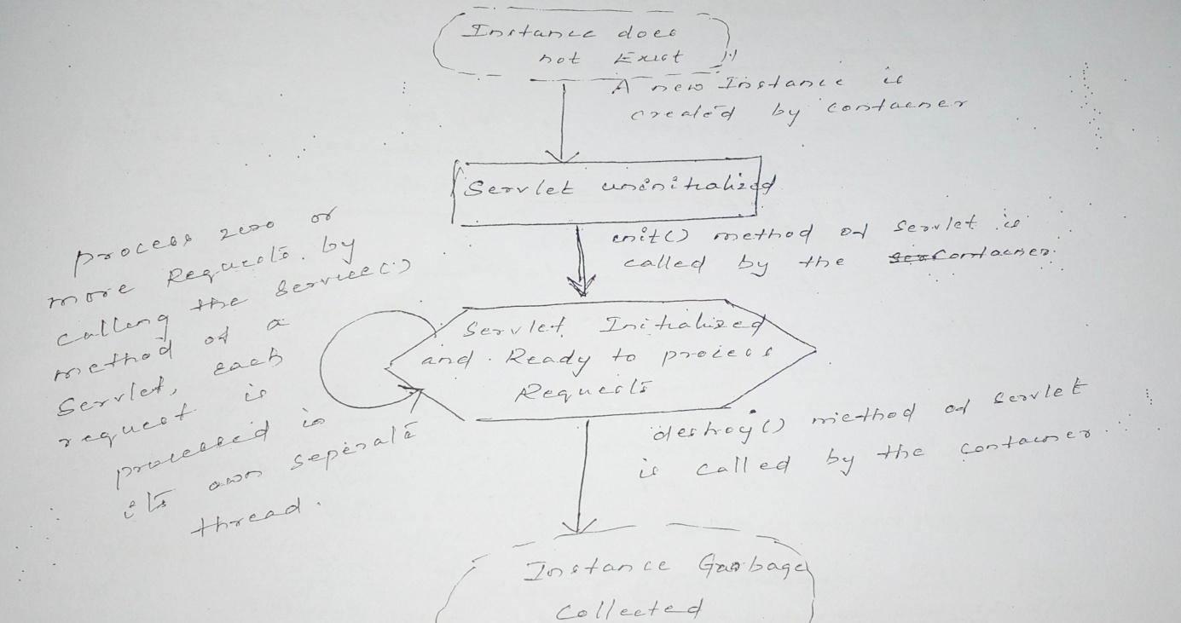
LIFE CYCLE OF A SERVLET

Slide 7
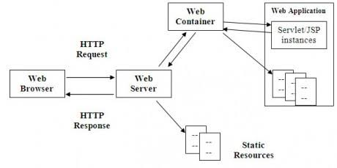
LIFE CYCLE OF A SERVLET

Slide 8
The servlet life cycle consists of the following steps.
The client enter the URL in the web browser and makes a request
The browser then generates the HTTP request and sends it to the web server.
Whenever the web server receives a HTTP request for a resource, web server determines if the request should be handled by a servlet
If the Request is to be handled by a servlet, the web container checks to see if the instance of the servlet is already available. If an instance is available the container delegates the request to that instance. If no instance of the servlet is available, container creates a new instance of the class of servlet and delegates the request to that newly created.
The container calls the init () method this method initializes the servlet and must be called before the servlet can service any request. In the entire life of a servlet, the init () method is called only once.
After initialization the servlet can service client Request. Each Request is serviced in its own separate threads. The container calls the service() method of the servlet for every Request.
And finally if the servlet is not needed any more, the container calls the destroy() method which takes the servlet out of service. The destroy() method is also called only once in the life cycle of a servlet.

Slide 9
Javax.servlet.*
Servlet – Interface
(init,service,destroy)
Service is the important method of servlet Interface., which contains request processing code

Slide 10
A SIMPLE SERVLET PROGRAM
import java.io.*;
import javax.servlet.*;
public class HelloServlet extends GenericServlet
{
public void service(ServletRequest Req, ServletResponse Res)throws ServletException, IOException
{
Res.setContentType(“text/html”);
PrinterWriter pw=res.getWriter();
pw.println(“<b>Hello Servlet World”);
pw.close();
}
}

Slide 11
SERVLET API
Two packages contain the classes and interfaces that are required to build servlets. These are:
javax.servlet
javax.servlet.http
They constitute the servlet API
These packages are not part of the Java core packages. Instead, they are standard extensions provided by Tomcat. Therefore they are not include with Java SE6.
Protocol independent classes and interfaces execute in the package javax.servlet whereas HTTP specific classes and interfaces exist in javax.servlet. Http
The servlet API contains -20 interfaces (13 of javax.servlet and 7 of javax.servlet. Http) -15 classes (9 of javax.servlet and 6 of javax.servlet. Http)

Slide 12
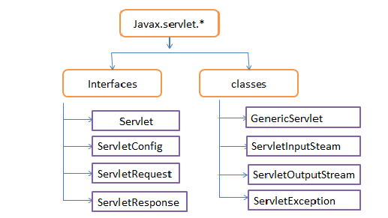
javax.servlet.*
Protocol independent classes and interfaces exists in the package javax.servlet

Slide 13
1) Servlet Interface
Contains the declaration of servlet life cycle methods.
All servlet must implement this interfaces.
It declares the init(), service() and destroy() methods
2) ServletConfig Interface
The ServletConfig interface allows a servlet to obtain configuration data when it is loaded
The methods declared by this interface are:
String getInitParameter(string param): This method returns the value of the parameter named “param”
Enumeration getInitParameterNames():Returns an enumeration of all initialization parameter names.
String getServletName():Returns the name of the invoking servlet

Slide 14
3) ServletRequest Interface
The ServletRequest interface enables a servlet to obtain information about a client request
Several of it methods are:
String getParameter(string pname):Returns the value of the Requested parameter named “pname”
Enumeration getParameterNames(): Returns an enumeration of the requested parameter names for this request.
String getServerName():Returns the name of the server.
String getProtocol():Returns a description of the protocol.
4) The ServletResponse Interface
The ServletResponse interface enables a servlet to formulate a response for a client.
Several of its methods:
PrintWriter getWriter() throws IOException: Return a PrintWriter that can be used to write character data to the response. An illegal StateException is thrown if getOutputStream() has already been involved for this Request.
void setContentLength(int size): Sets the content length for the response of size.
void setContentType(string type): Sets the content type for the response of type

Slide 15
1) GenericServlet :
  GenericServlet class provides implementation of the basic life cycle methods for a servlet.
  GenericServlet implements the servlet and ServletConfig interfaces
The ServletInputStream class:
  The ServletInputStream class extends InputStream
  It is implemented by the servlet container and provides an input stream that a
  servlet developer can use to read the data from a client request
The ServletOutputStream class:
  The servletOutputStream class extends OutputStream
  It is implemented by the servlet container and provides an output stream that a servlet developer can use to write data to a client response.
  It also defines the print() and println() methods, which output data to the stream.
The ServletException class: j
javax.servlet defines two exceptions.
  The first is ServletException which indicates that a servlet problem has occurred
  The second is UnavailableException which extends ServletException. If indicates that a servlet is unavailable.

Slide 16
javax.servlet
Interfaces
Servlet
Servletconfig
classes
GenericServlet
ServletRequest
ServletResponse
ServletInputStream
ServletOutPutStream
ServletException
UnavailableException
getInitParameter() - to get name of a specified initization parament
getInitParameters() - to get initilization Parameter Names
getServletName - to get name of the invoking Servlet Name
getParameter() - get value of a specified parameter
getParameterNames() - get names of the parameters
getServerName() - To get name of the Server
getWriter() - returns of object of PrintWriter
setContentLength() - to set length of the response content
setContentType-toset response content Type
Implementation of all methods of Servlet and ServletConfig Interface
extends InputStream
provides an input stream that a servlet developer can use to read the data from the client request
to create a servlet
init() - to Initialize Servlet
service() - to process client request
destroy()-to send servlet to garabage
To get configuration data
to get data from client request
to send response to client
extends OutputStraem
provides an output stream that a servlet developer can use to write data to a client response
indicates that a servlet problem has occured
Indicates that the a servlet is unavailable

Slide 17
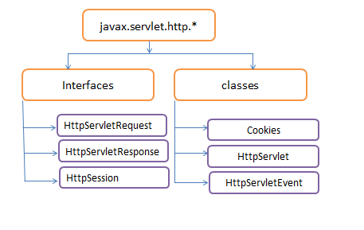
2) javax.servlet.http.*
Protocol dependent classes and interfaces exists in the package javax.servlet.http package

Slide 18
1) HttpServletRequest interface
  This interface enables a servlet to obtain information about a client request.
  Some of the methods in this interface are
  String getHeader(string field): Returns the value of the header field named field
  Enumeration getHeaderNames(): Returns an enumeration of the header names.
  String getMethod():Returns the HTTP method for this Request.
2) HttpServletResponse Interface
  This interface enables a servlet to formulate an HTTP response to a client
  Some of the methods in this interface are
  boolean containsHeader(String field):Return true if the HTTP response header contains a field named field
3) The HttpSession interface
  The HttpSession interface enables a servlet to read and write the state information that is associated with an Http session
  Some of the methods in this interface are:
  Enumeration getAttributeNames(): Returns an enumeration of the attribute names associated with the session

Slide 19
1) Cookie class
The cookie class encapsulates a cookie. A cookie is stored on a client and contains state informations.
Cookie are valuable for tracking user activities
Important methods in cookie class are:
String getComment():Returns the comment
String getDomain(): Returns the domain
2) The HTTPServlet class
  The Httpservlet class extends GenericServlet
  It is commonly used when developing servlets that receive and process HTTP requests
  Core methods of this class are:
  void doDelete(HttpServletRequest req, HttpServletResponse res)throws IOException, ServletException: Handles an HTTP Delete Request
  void doGet(HttpServletRequest req, HttpServletResponse res)throws IOException, ServletException: Handles an HTTP Get Request
  void doPost(HttpServletRequest req, HttpServletResponse res)throws IOException, ServletException: Handles an HTTP Post Request

Slide 20
SESSION TRACKING
HTTP is a stateless protocol . This means when browser sends a request to the server, the server processes it and sends the response to the browser and does not remember anything about the request.
So when browser sends the same request to the server, server take it as a new request process it once again and then sends it as response to browser. If there are all static web pages then this doesn’t matter much. But if there is a interactive web application (such as online shopping) then it is required that server should keep track of the user or the request made by the user.
To solve the problem there are three methods that are normally used:
  Use of cookies
  Embedding Hidden fields in a HTML form
  Sending URL string in response body

Slide 21
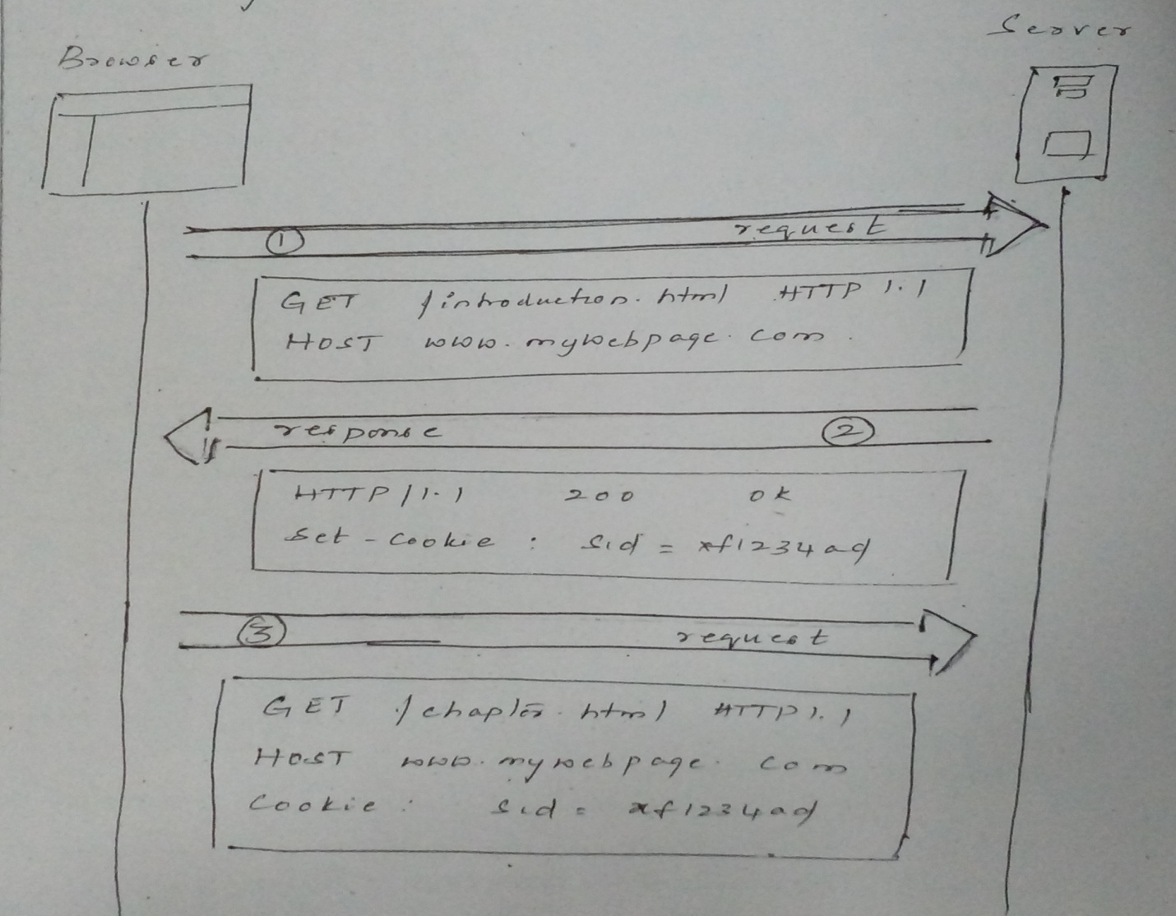
A Cookie is a name-value pair information. This information is passed from server to browser in response header
The browser s then returns these cookies unchanged to the server by including the state.
By returning a cookie to a web server, the browser provides the server a means of connection the current page view with previous page view.

Slide 22
JSP
Motivation for JSP
JSP Documents
Scriptlets
Expression Language
JSTL Control Action Elements

Slide 23
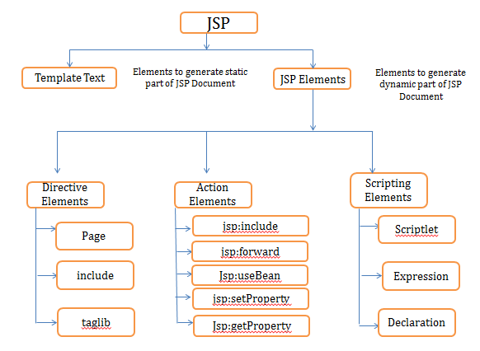

Slide 24
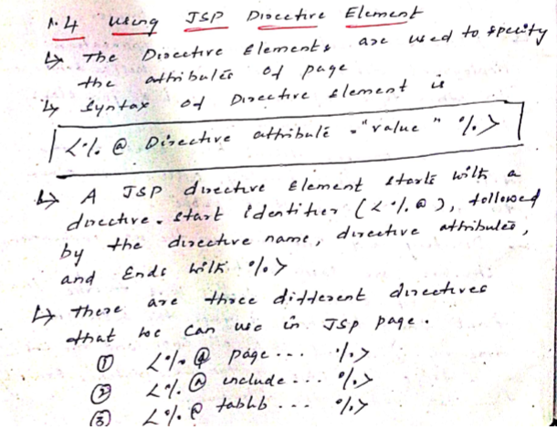

Slide 25
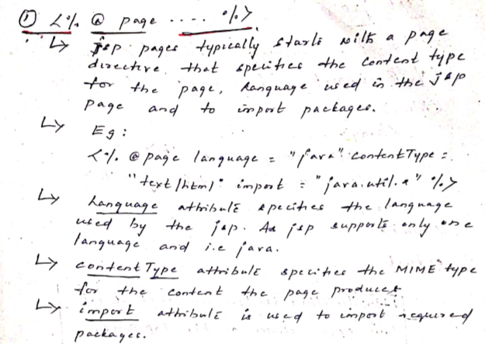

Slide 26
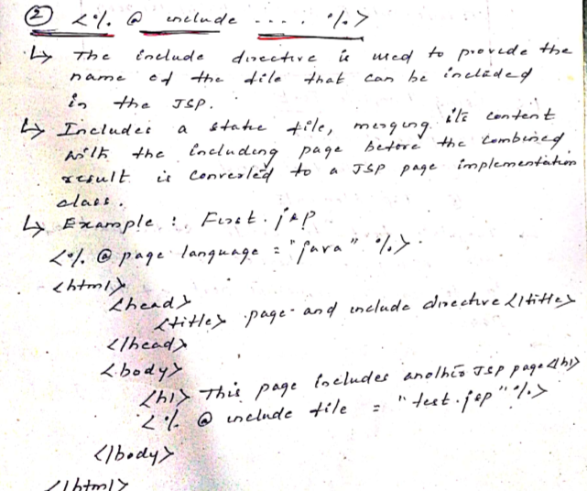

Slide 27
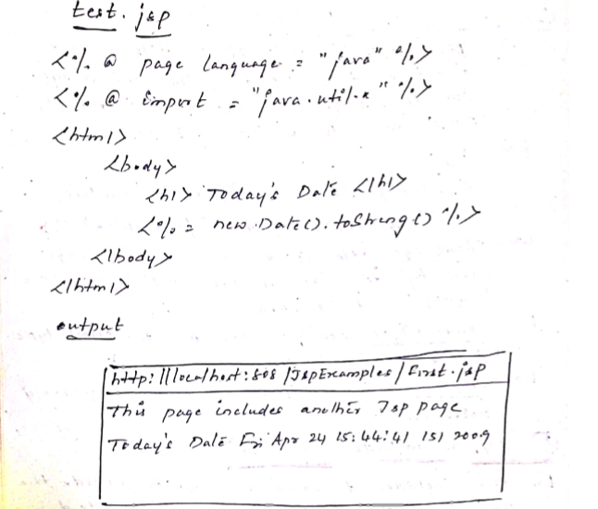

Slide 28
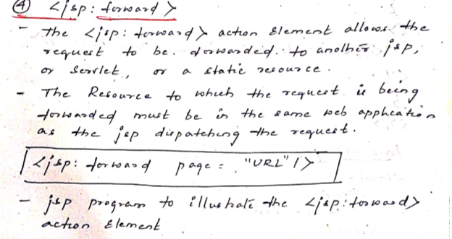
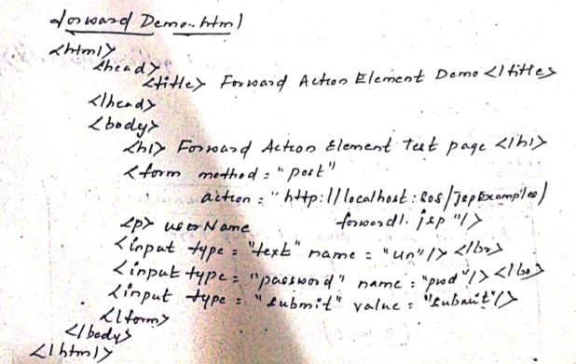

Slide 29
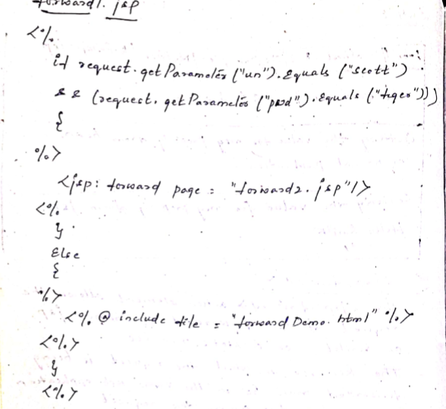

Slide 30
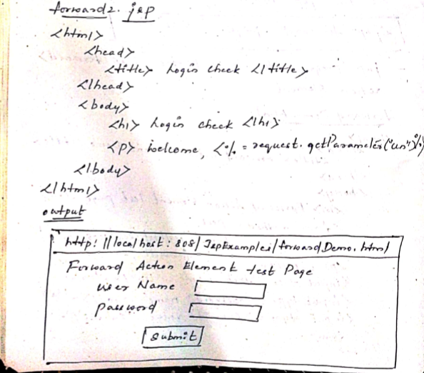

Slide 31
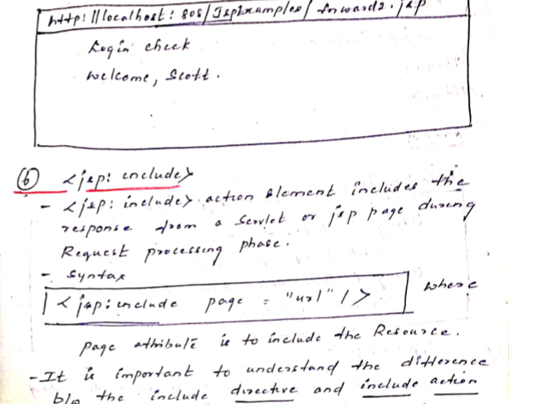

Slide 33
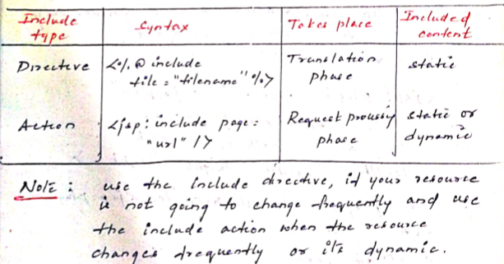
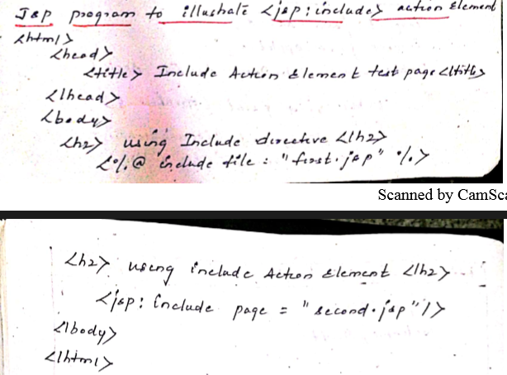

Slide 34
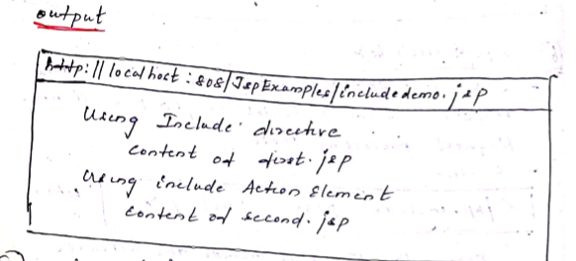

Slide 35
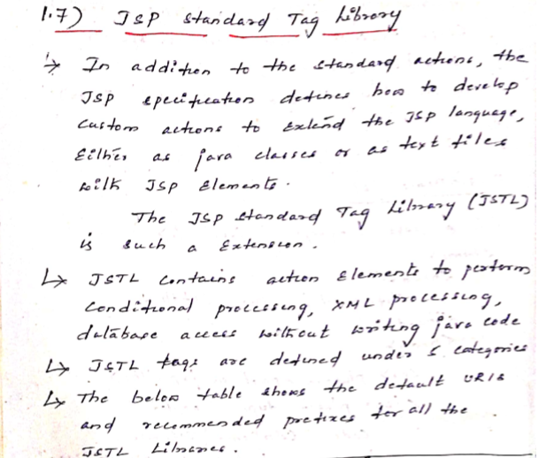

Slide 36
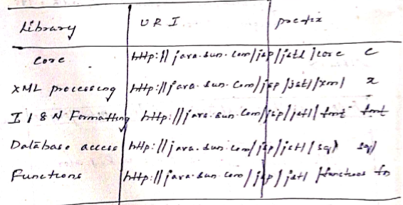

Slide 37
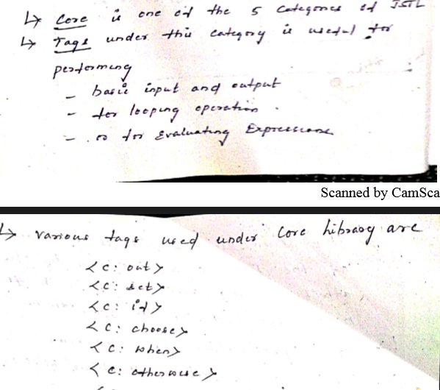

Slide 38
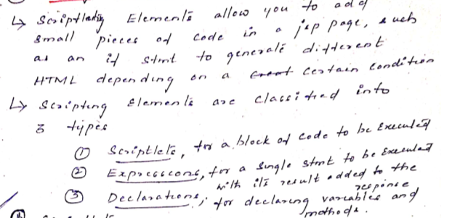

Slide 39
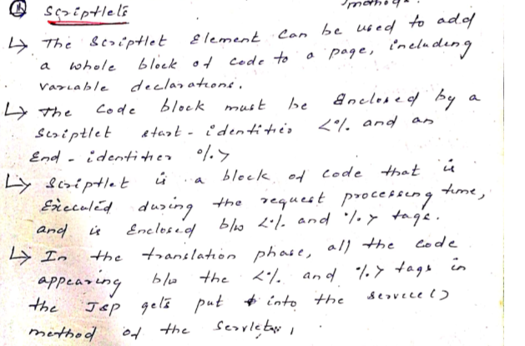

Slide 40
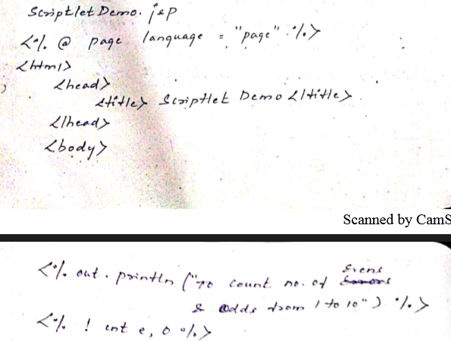
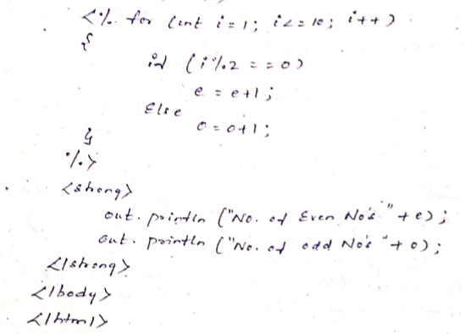

Slide 41
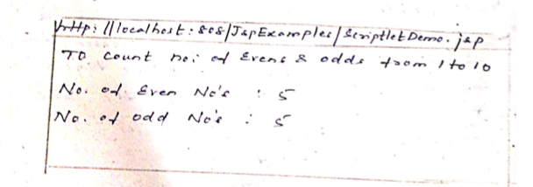

Slide 42
