Slide 1

Subject Code : 20MCA211
Subject Name : Web Programming
UNIT – v
BY
R.PADMAJA,
ASSISTANT PROFESSOR,
MCA DEPARTMENT, SITAMS

Slide 2
UNIT –V
An Overview of MySQL Architecture
The MySQL Engine
MySQL Data Types
MySQL Operators
MySQL Functions
Accessing Database in PHP
Updating Database
Creating a new Database
Working with Data
Joins

Slide 3
INTRODUCTION TO MySQL
With PHP, you can connect to and manipulate databases.
MySQL is the most popular database system used with PHP.
MySQL is an open source relational database management system (RDBMS).
MySQL is the world's most used RDBMS, and runs as a server providing multi-user access to a number of databases
Both the Oracle Database and MySQL are database management systems currently produced and managed by the Oracle Corporation.
MySQL is a popular choice of database for use in web applications.
It is a central component of the widely used ‘LAMP’ open source web application software stack, as well as other AMP stacks.
LAMP stands for "Linux, Apache, MySQL, Perl/PHP/Python.”

Slide 4
The main difference between Oracle and MySQL is the fact that MySQL is open source, while Oracle is not.
However, Oracle is considered to be much more powerful software than MySQL.
Oracle Support Pl-SQL, in addition to SQL. MySQL support only SQL
Oracle provides security features such as row lock while MySQL provides column lock.

Slide 5
1. An Overview of MySQL Architecture
  1.1) Primary Subsystems
  1.2) Support Components
  1.3) Subsystem/Component Interaction and Control Flow
  MySQL consists of both primary Subsystems and support components that interact with each other to read, parse, execute and return query results.
1.1) Primary SubSystems
The MySQL Architecture consists of five primary subsystems, which work together to respond to the request made to the MySQL database server.
    1.1.1) The Query Engine
    1.1.2) The Storage Manager
    1.1.3) The Buffer Manager
    1.1.4) The Transaction Manager
    1.1.5) The Recovery Manager

Slide 6
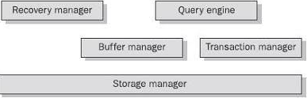
MySQL Architecture

Slide 7
    1.1 The Query Engine
This subsystem contains 3 interrelated components
          The Syntax Parser
          The Query Optimizer
          The Execution Component
The Syntax Parser decomposes the SQL commands it receives from calling programs into a form that can be understood by the MYSQL engine.
The Query Optimizer , streamlines the syntax and then prepares the most efficient plan of query execution.
The Execution Component then interprets the execution plan , and based on the information it has received, makes request of the other components to retrieve the record.

Slide 8
    1.1.2) The Storage Manager
The Storage Manager interfaces with the operating System(OS) to write data to the disk efficiently.
    1.1.3) The Buffer Manager
This Subsystem handles all memory management issues between requests for data by the Query Engine and the Storage Manager.
MySQL makes aggressive use of memory to cache result sets that can be returned as rather than making duplicate requests to the Storage Manager.
This cache is maintained in the Buffer Manager.
    1.1.4) The Transaction Manager
The function of the Transaction Manager is to facilitate concurrency in Data access.
This subsystem provides a locking facility to ensure that multiple simultaneous users access the data in a consistent way, without corrupting or damaging the data in any way.

Slide 9
1.1.5) The Recovery Manager
The Recovery Manager’s job is to keep copies of data for retrieval later, in case of a loss of data.
It also logs commands that modify the data and other significant events inside the Database.

Slide 10
1.2) Support Components
In Addition to the five primary subsystems, the MySQL Architecture contains the following two support components.
  The Process Manager
  Function Libraries
The Process Manager
This component performs two functions in the system.
First, it manages user connections via network connection management.
Second, it it synchronizes competing tasks and processes via multithreading modules.
Function Libraries
This component contains general-purpose routines that are used by all the other subsystems.
It includes String manipulation, sorting etc.. functions

Slide 11
1.3) Subsystem/Component Interaction and Control Flow
The Query engine requests the data to be read or written to buffer manager to satisfy a users query.
It depend on the transaction manager for locking of the data so that the concurrency is ensured.
To perform table creation and drop operations, the query engine accesses the storage manager directly, bypassing the buffer manager ,to create or delete the files in the file system.
The buffer manager caches data from the storage manager for efficient retrieval by the query engine. It depends on the transaction manager to check the locking status of data before it performs any modification action.
The Transaction manager depends on the Query cache and storage manager to place locks on data in memory and in the file system.
The recovery manager uses the Storage manager to store command/event logs and backups of the data in the file system. It depends on the transaction manager to obtain locks on the log files being written. The recovery manager also needs to use the buffer information manager during recovery from crashes.
The storage manager depends on the operating system file system for persistent storage and retrieval of data. It depends on the transaction manager to obtain locking status

Slide 12
2) The MySQL Engine
  2.1) Connectivity
  2.2) SQL
  2.3) Data Integrity
  2.4) Transactions
  2.5) Extensibility
  2.6) Symmetric Multiprocessing with MySQL
  2.7) Security
  2.8) Replication
  2.9) Application Programming Interface
  2.10) Add-on Tools

Slide 13
2) The MySQL Engine
MySQL engine has been designed for Maximum Scalability, Maximum resource efficiency and easy portability to various platforms and Architectures.
The Important Characteristics of the SQL Engine are
2.1) Connectivity
MySQL is designed on the assumption that the vast majority of its applications will be running on a TCP/IP network.
This is a fairly good assumption , given that TCP/IP is not only highly robust and secure but is also common to unix , windows and almost any other serious operating systems .
2.2) SQL
Its fair to say that SQL is today one of the most widely used cross-vendor language.
As with other Implementation , such as SQL Server’s T-SQL and Oracle’s SQL, MySQL has its own variations of the SQL standard that add power beyond what is available within the standard.

Slide 14
2.4) Data Integrity
MySQL supports engine-level data integrity through the use of Primary key and foreign key constraints.
Columns can be defined so that explicit NULL values cannot be entered into them.
2.5) Transactions
MySQL is a Transaction-safe Database System, means we can perform Safe Transactions , i.e every transaction will get qualified thro ACID Test
An ACID –compliant database must support the following characteristics
        Atomicity
        Consistency
        Isolation
        Durability

Slide 15
2.6) Extensibility
In most RDBMS Products, we can extend the capabilities of the database by using stored procedures.
The programmability is usually further extended by enhancements to SQL that contains control-of-flow statements and conditional logic, as SQL Server does with T-SQL and oracle with PL/SQL.
As of yet, MySQL includes no support for stored procedures, but one of the great benefits of this RDBMS is its extensibility .
Since it is an open source code, it permits the developers to add new functions and features that are compiled into the engine as part of the core product.
2.7) Symmetric Multiprocessing with MySQL
To Take advantage of multiprocessor architecture, MySQL is built using a multi-threaded design, which allows threads to be allocated between process to achieve a higher degree of parallelism.

Slide 16
2.8) Security
The process of accessing a MySQL database can be broken down into two tasks
      Connecting to the MySQL server itself
      And Accessing individual objects, such as tables or columns in a database.
2.9) Application Programming Interfaces
For application developers, MySQL provides set of APIs that provide an understandable set of rules by which host languages can connect to MySQL and send commands.
Currently, MySQL APIs are available for Perl, PHP, C ,C++, Java, Visual Basic,Python, Ruby and .NET
2.10) Add-On Tools
List of Software Programs that work with MySQL are
  MySQL CC, is an excellent front-end query and Database Management tool for MySQL
  DBTools Manager Professional, Tool which helps to import data from other RDBMS and provide a point-and-click interface to query and report design

Slide 17
  MySQL Data Types
  3.1) Numeric data Type
ata Type Syntax | Description
INT | A normal-sized integer that can be signed or unsigned. If signed, the allowable range is from -2147483648 to 2147483647. If unsigned, the allowable range is from 0 to 4294967295. You can specify a width of up to 11 digits.
TINYINT | A very small integer that can be signed or unsigned. If signed, the allowable range is from -128 to 127. If unsigned, the allowable range is from 0 to 255. You can specify a width of up to 4 digits.
SMALLINT | A small integer that can be signed or unsigned. If signed, the allowable range is from -32768 to 32767. If unsigned, the allowable range is from 0 to 65535. You can specify a width of up to 5 digits.
MEDIUMINT | A medium-sized integer that can be signed or unsigned. If signed, the allowable range is from -8388608 to 8388607. If unsigned, the allowable range is from 0 to 16777215. You can specify a width of up to 9 digits.
BIGINT | A large integer that can be signed or unsigned. If signed, the allowable range is from -9223372036854775808 to 9223372036854775807. If unsigned, the allowable range is from 0 to 18446744073709551615. You can specify a width of up to 20 digits.
FLOAT(m,d) | A floating-point number that cannot be unsigned. You can define the display length (m) and the number of decimals (d). This is not required and will default to 10,2, where 2 is the number of decimals and 10 is the total number of digits (including decimals). Decimal precision can go to 24 places for a float.
DOUBLE(m,d) | A double precision floating-point number that cannot be unsigned. You can define the display length (m) and the number of decimals (d). This is not required and will default to 16,4, where 4 is the number of decimals. Decimal precision can go to 53 places for a double. Real is a synonym for double.

Slide 18
3.2) Date and Time Data Type:
Data Type Syntax | Maximum Size | Explanation
DATE | Values range from '1000-01-01' to '9999-12-31'. | Displayed as 'yyyy-mm-dd'.
DATETIME | Values range from '1000-01-01 00:00:00' to '9999-12-31 23:59:59'. | Displayed as 'yyyy-mm-dd hh:mm:ss'.
TIME | Values range from '-838:59:59' to '838:59:59'. | Displayed as 'HH:MM:SS'.
YEAR[(2|4)] | Year value as 2 digits or 4 digits. | Default is 4 digits.

Slide 19
3.3) String Data Types:
Data Type Syntax | Maximum Size | Explanation
CHAR(size) | Maximum size of 255 characters. | Where size is the number of characters to store. Fixed-length strings. Space padded on right to equal size characters.
VARCHAR(size) | Maximum size of 255 characters. | Where size is the number of characters to store. Variable-length string.
TEXT(size) | Maximum size of 65,535 characters. | Where size is the number of characters to store.
MEDIUMTEXT(size) | Maximum size of 16,777,215 characters. | Where size is the number of characters to store.
LONGTEXT(size) | Maximum size of 4GB or 4,294,967,295 characters. | Where size is the number of characters to store.
BINARY(size) | Maximum size of 255 characters. | Where size is the number of binary characters to store. Fixed-length strings. Space padded on right to equal size characters.(introduced in MySQL 4.1.2)
VARBINARY(size) | Maximum size of 255 characters. | Where size is the number of characters to store. Variable-length string.(introduced in MySQL 4.1.2)

Slide 20
MySQL Operators
MySQL comes with more than 25 operators , each designed for a specific task.These operators can be classified, according to their function, into the following four categories
4.1) Arithmetic Operators
4.2) Comparision Operators
4.3) Logical Operators

Slide 21
4.1) Arithmetic Operators
MySQL supports the following Arithmetic Operators
Examples :
Select 10+5, 1000000+64763; // returns 15 and 1064763
Select 5-1; // returns 4
Select 7 *10 , 10/2, 10%2; //returns 70 and 5 and 0

Slide 22
4.2) Comparision Operators
MySQL provides Numerous Comparisions operators, which allows to compare the left side of an expression with its right side.
The result of such a comparision operation is always 1(true), 0(false), or NULL(Could not be determined)

Slide 24
4.3) Logical Operators
MySQL also comes with 4 Logical operators

Slide 25
5.MySQL Functions
MySQL Built-in functions are broadly classified into the following groups
    5.1) Math Functions
    5.2) Aggregate Functions
    5.3) String Manipulation Functions
    5.4) Date and Time Manipulation Functions
    5.5) Data Encryption Functions

Slide 26
5.1) Math Functions
MySQL supports the following Math Functions
Function Description
ABS Returns the absolute value of a number
AVG Returns the average value of an expression
CEIL Returns the smallest integer value that is greater than or equal to a number
COS Returns the cosine of a number
COUNT Returns the number of records in a select query
EXP Returns e raised to the power of number
FLOOR Returns the largest integer value that is less than or equal to a number
GREATEST Returns the greatest value in a list of expressions
LEAST Returns the smallest value in a list of expressions
MAX Returns the maximum value of an expression
MIN Returns the minimum value of an expression
MOD Returns the remainder of n divided by m
PI Returns the value of PI displayed with 6 decimal places
POW Returns m raised to the nth power
ROUND Returns a number rounded to a certain number of decimal places
SQRT Returns the square root of a number
SUM Returns the summed value of an expression
TRUNCATE Returns a number truncated to a certain number of decimal places

Slide 27
Examples
SELECT GREATEST(100,99,158,63); // Returns 158
SELECT LEAST(-2,5,99); //Returns -2
SELECT FLOOR(75.1),CEILING(75.1); //Returns 75,76
SELECT ROUND(10.33),TRUNCATE(1.78509765,3) //Returns 10,1.785
SELECT POW(4,4); //Returns 256.000
SELECT SQRT(49), //Returns 7
5.2) Aggregate Functions
Aggragate functions are most commonly used with SELECT queries containing GROUP BY clauses.
MySQL supports the following Aggregate Functions

Slide 28
Examples
SELECT COUNT(*) FROM employee; // Returns 30
SELECT MIN(age),MAX(sal) FROM employee; // Returns 25, 50000
SELECT SUM(sal) FROM employee; //Returns 1,50,000

Slide 29
5.3) String Manipulation Functions
Function Description
ASCII Returns the number code that represents the specific character
CHAR_LENGTH Returns the length of the specified string (in characters)
CONCAT Concatenates two or more expressions together
FIELD Returns the position of a value in a list of values
FIND_IN_SET Returns the position of a string in a string list
INSERT Inserts a substring into a string at a specified position for a certain number of characters
INSTR Returns the position of the first occurrence of a string in another string
LENGTH Returns the length of the specified string (in bytes)
LOCATE Returns the position of the first occurrence of a substring in a string
LOWER Converts a string to lower-case
LPAD Returns a string that is left-padded with a specified string to a certain length
LTRIM Removes leading spaces from a string
MID Extracts a substring from a string (starting at any position)
POSITION Returns the position of the first occurrence of a substring in a string
REVERSE Reverses a string and returns the result
SUBSTR Extracts a substring from a string (starting at any position)
SUBSTRING Extracts a substring from a string (starting at any position)
TRIM Removes leading and trailing spaces from a string
UCASE Converts a string to upper-case
UPPER Converts a string to upper-case

Slide 30
Examples
SELECT LENGTH(‘Rama’); // Returns 4
SELECT SUBSTRING(‘market’,2,3) //Returns ark
SELECT CONCAT(‘sita’,’rama’); //Returns sitarama
SELECT REPLACE(‘I am Joe Cool’,’Cool’,’Camel’); //Returns I am Joe Camel
SELECT UCASE(‘rama’),LCASE(‘SITA’); //Returns RAMA, sita

Slide 31
Function Description
ADDDATE Returns a date after a certain time/date interval has been added
ADDTIME Returns a time/datetime after a certain time interval has been added
CURDATE Returns the current date
CURRENT_DATE Returns the current date
CURRENT_TIME Returns the current time
DATE Extracts the date value from a date or datetime expression
DATEDIFF Returns the difference in days between two date values
DATE_ADD Returns a date after a certain time/date interval has been added
DATE_FORMAT Formats a date as specified by a format mask
DAY Returns the day portion of a date value
DAYNAME Returns the weekday name for a date
DAYOFMONTH Returns the day portion of a date value
DAYOFWEEK Returns the weekday index for a date value
DAYOFYEAR Returns the day of the year for a date value
EXTRACT Extracts parts from a date
HOUR Returns the hour portion of a date value
LAST_DAY Returns the last day of the month for a given date
MINUTE Returns the minute portion of a date value
MONTH Returns the month portion of a date value
MONTHNAME Returns the full month name for a date
NOW Returns the current date and time
SYSDATE Returns the current date and time
TO_DAYS Converts a date into numeric days
WEEK Returns the week portion of a date value
YEAR Returns the year portion of a date value
YEARWEEK Returns the year and week for a date value

Slide 33
5.5) Encryption Functions

Slide 34
Working with Data
9.1) Inserting, Updating and Deleting Records
9.1.1) Inserting Records
9.1.2) Updating Records
9.1.3) Deleting Records
9.2) Retrieving Records
9.2.1) Retrieving Specific Rows and Columns
9.2.2) Using Built-In Functions
9.2.3) Aliasing Table and column Names
9.2.4) Limiting Query Results
9.2.5) Sorting Query Results
9.2.6) Grouping Query Results
9.2.7) Using Variables
9.2.8) Using Sub queries
9.2.9) Controlling SELECT behavior
9.3) Copying, Importing, and Exporting Records
9.3.1) Copying Records
9.3.2) Importing Records
9.3.3) Exporting Records

Slide 35
9.1) Inserting, Updating and Deleting Records
9.1.1) Inserting Records
In MySQL, the INSERT INTO statement is used to insert data to your database table.
With INSERT INTO statement of MySQL, you insert single row or multiple rows into database table.
Syntax
INSERT INTO table_name ( field1, field2,…fieldN ) VALUES ( value1, value2,…valueN );
Params
  Fields :- It’s a database column name. You can insert value into in it.
  table_name :- It’s a database table name.
  Value :- It’s your column values, that you want to insert into database

Slide 36
INSERT INTO Statement Example
Here, we will insert single row into database table name users.
INSERT INTO users(id,name) VALUES (1, 'test');
Here, we will insert multiple rows into database table name users.
INSERT INTO users (id, first_name, last_name) VALUES (5, 'wis', 'check'), (6, 'joy', 'son'), (7, 'kemal', 'case');
INSERT INTO users VALUES (&id,’&name’)

Slide 37
9.1.2) UPDATE Statement MySQL
In MySQL, the UPDATE statement is used to update or change data in the database table.
With UPDATE statement of MySQL, we can change or modify table data by using MySQL WHERE Clause.
Syntax
UPDATE table_name SET field1=new-value1, field2=new-value2 [WHERE Clause]
Params
    table_name: – This is the name of a database table.
    Fields: – This is a database column name. Where you can update the value in it
    Value: – These are your column values, which you want to update in the database.
    WHERE: – In MySQL, where the clause is used to update specific rows in a table.
UPDATE Statement Example
UPDATE users SET first_name = 'Michel' WHERE id = 501;

Slide 38
9.1.3) DELETE Statement MySQL
In MySQL, DELETE statement is used to delete/remove all the data from database table.
DELETE Statement also helps to remove specific records from database tables
Syntax
    DELETE FROM table_name;
    OR
    DELETE FROM table_name WHERE Condition;
Params
    table_name: – This is the name of a database table.
    WHERE: – In MySQL, where the clause is used to delete specific rows in a table.
    DELETE Statement Example
    DELETE from emp;
    DELETE from emp where sal > 30000

Slide 39
9.2) RETRIEVING RECORDS
9.2.1)Retrieving Specific Rows and Columns
The SQL SELECT command is used to fetch data from the MySQL database.
Here is generic SQL syntax of SELECT command to fetch data from the MySQL table −
SELECT field1, field2,...fieldN FROM table_name1, table_name2... [WHERE Clause] [LIMIT N]
    You can use one or more tables separated by comma to include various conditions using a WHERE clause, but the WHERE clause is an optional part of the SELECT command.
    You can fetch one or more fields in a single SELECT command.
    You can specify star (*) in place of fields. In this case, SELECT will return all the fields.
    You can specify any condition using the WHERE clause.
    You can limit the number of returns using the LIMIT attribute.

Slide 40
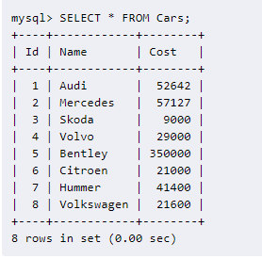
Retrieving all data from database table

Slide 41
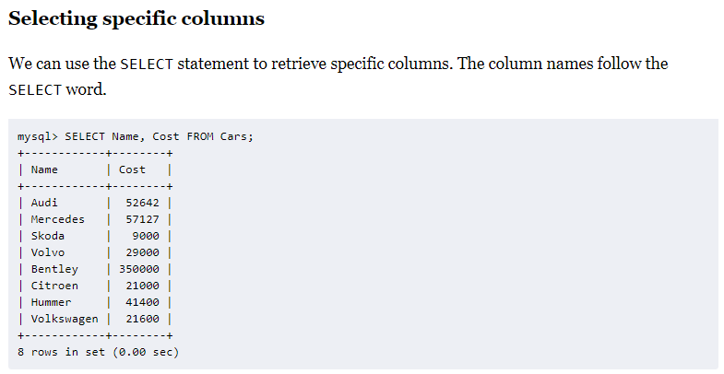

Slide 42
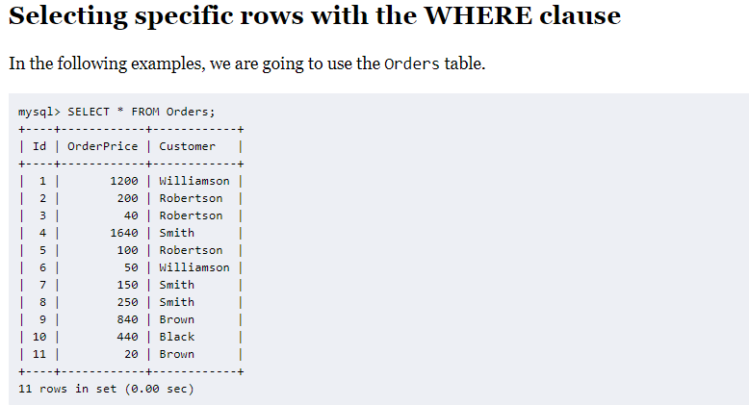
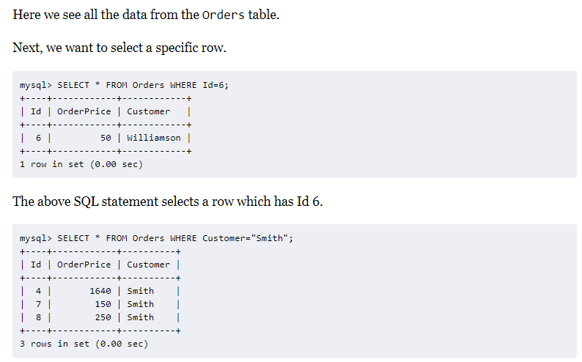

Slide 43
9.2.2) Using Built-In Functions

Slide 44
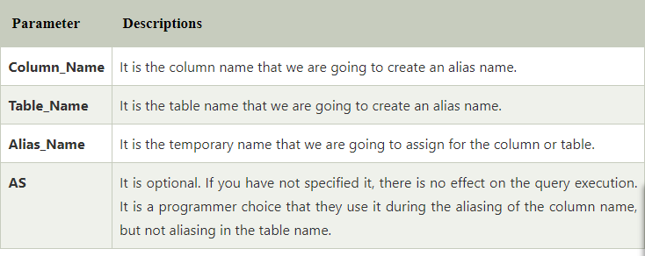
9.2.3) Aliasing Table and column Names
Aliases in MySQL is used to give a temporary name to a table or a column in a table for the purpose of a particular query.
It works as a nickname for expressing the tables or column names. It makes the query short and neat.
    Syntax
    Following are the basic syntax of aliases used in MySQL:
    For Column
    SELECT col_name AS alias_name FROM table_name;
    For Table
    SELECT col_name1, col_name2,... FROM table_name AS alias_name;

Slide 45
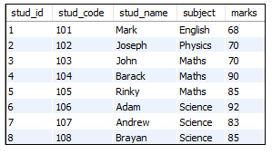
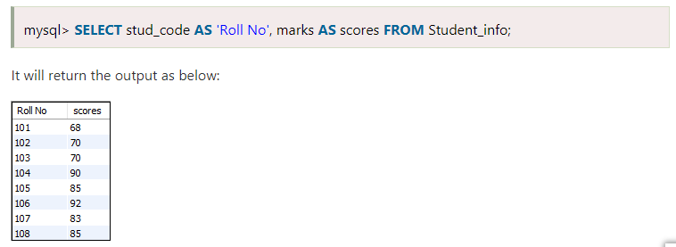
Aliasing the Column Names
To Rename stud_code as Roll No and marks as scores,

Slide 46
Illustrating Table Aliases
It allows us to specify the table name with a different name. Mostly, table aliases used for more than single tables and connect them using JOIN operations.
Table_name :emp
Table_name : dept
eno | ename | sal | deptno
100 | A | 40000 | 10
101 | B | 25000 | 20
102 | C | 30000 | 10
103 | D | 24000 | 30
deptno | dname
10 | HR
20 | System
30 | Marketing
Select eno, ename, sal, e.deptno, dname from emp as e, dept as d where e.deptno = d.deptno
eno | ename | sal | deptno | dname
100 | A | 40000 | 10 | HR
101 | B | 25000 | 20 | System
102 | C | 30000 | 10 | HR
103 | D | 24000 | 30 | Marketing

Slide 47
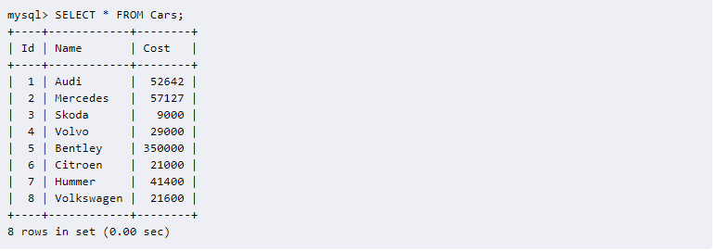
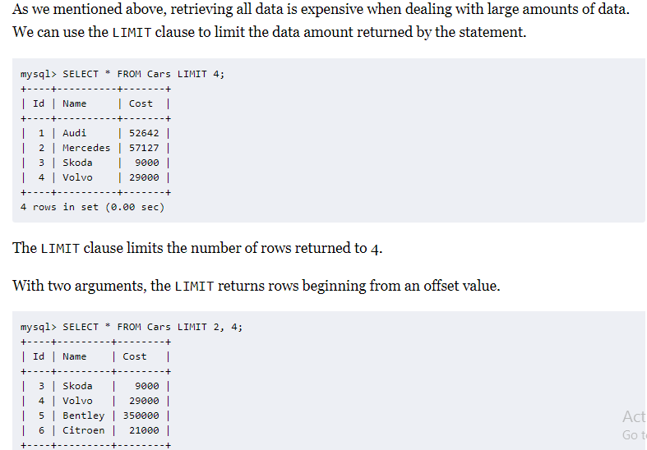
9.2.4) Limiting Query Results

Slide 48
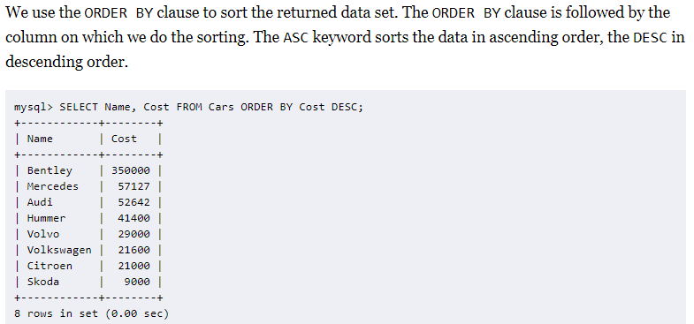
9.2.5) Sorting Query Results

Slide 49
9.2.6) Grouping Query Results
The GROUP BY clause is used to combine database records with identical values into a single record. It is often used with the aggregation functions.

Slide 50
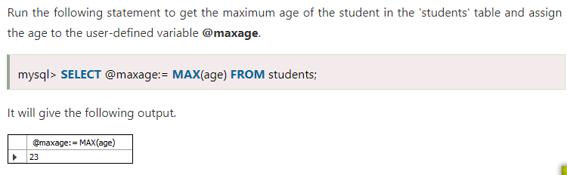
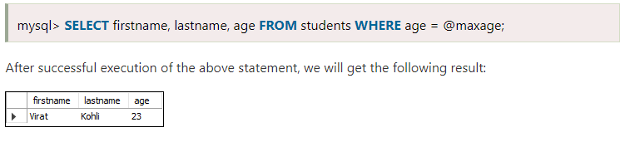
9.2.7) Using Variables
Variables are used for storing data or information during the execution of a program.
It is a way of labeling data with an appropriate name that helps to understand the program more clearly by the reader.

Slide 51
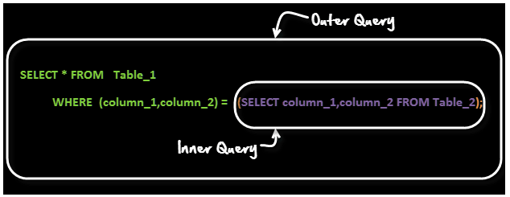
9.2.8) Using Sub queries
A sub query is a select query that is contained inside another query. The inner select query is usually used to determine the results of the outer select query.

Slide 52
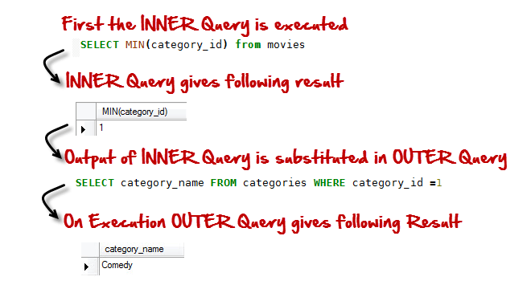
Subqueries are embedded queries inside another query. The embedded query is known as the inner query and the container query is known as the outer query.
MySQL supports three types of subqueries, scalar, row and table subqueries.
Scalar sub queries only return a single row and single column.
Row sub queries only return a single row but can have more than one column.
Table subqueries can return multiple rows as well as columns.
Subqueries can also be used in INSERT, UPDATE and DELETE queries.
SELECT category_name FROM categories WHERE category_id =( SELECT MIN(category_id) from movies);

Slide 53
9.3) Copying, importing and exporting records
9.3.1) Copying records
Create table NewTable as ( select * from OldTable)
// NewTable is created with same structure as that of OldTable and the data is copied from OldTable to NewTable
INSERT INTO NewTable VALUES (SELECT * FROM OldTable)
// Already a Table called NewTable is created
Examples
Create table emp_dummy as (select * from emp);
insert into emp_dummy values( select * from emp);

Slide 54
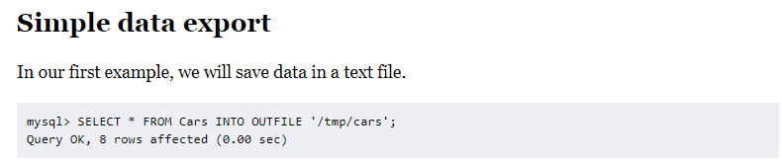
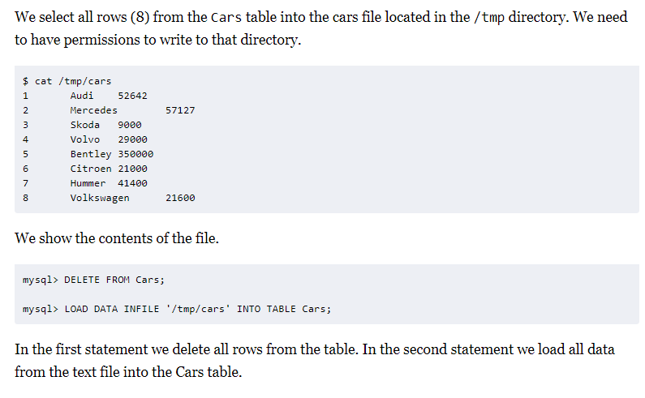
9.3.2) Exporting and Importing records

Slide 55
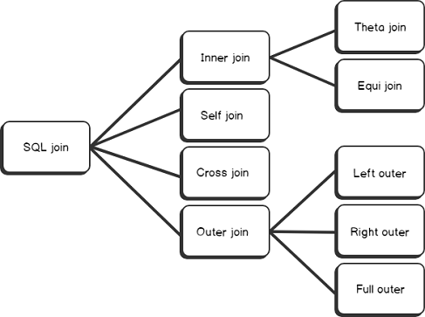
JOINS
A JOIN clause is used to combine rows from two or more tables, based on a related column between them.

Slide 56
Inner Join
It returns matching rows from two or more tables that satisfy the join predicate
INNER JOIN
THETA JOIN
EQUI JOIN
NATURAL JOIN

Slide 57
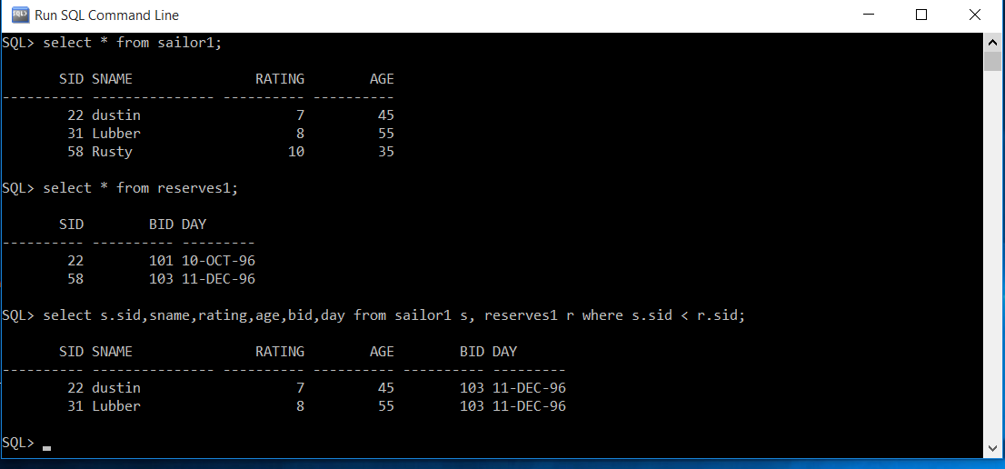
Theta Join
THETA JOIN allows you to merge two tables based on the condition . And the conditions can contain any comparison operators like (<,>,<=,>= etc..)
syntax
Select table1.colname1, table1.colname2, table2.colname1 from table1, table2 where table1.colname1 < table2.colname2
Example

Slide 58
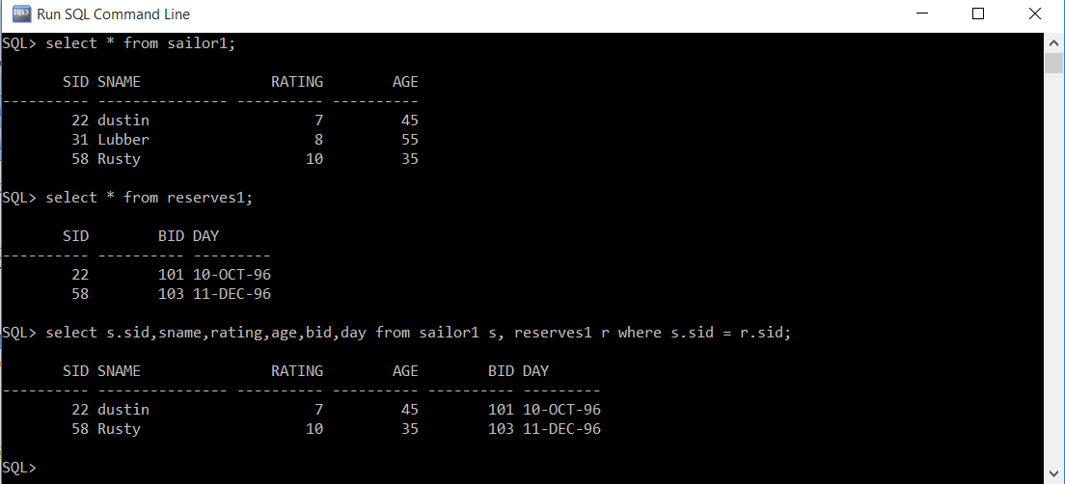
Equi Join
Special case of Theta join. Combines rows from two or more tables based on condition and the condition should contain only one operator i.e equals to
syntax
Select table1.colname1, table1.colname2, table2.colname1 from table1, table2 where table1.colname1 = table2.colname2
Example

Slide 59
Natural Join
Natural Join can only be performed if there is at least one common attribute that exists between two relations.
In addition, the attribute must have the same name and domain.
It is same as equi join which occurs implicitly by comparing all the common attributes in both tables, but difference is that in natural join the common attribute appears only once.
The result of natural join is that set of all combinations of tuples in two relations A and B that are equal on their common attribute name .
syntax
select * from table1 NATURAL JOIN table2;
Example

Slide 60
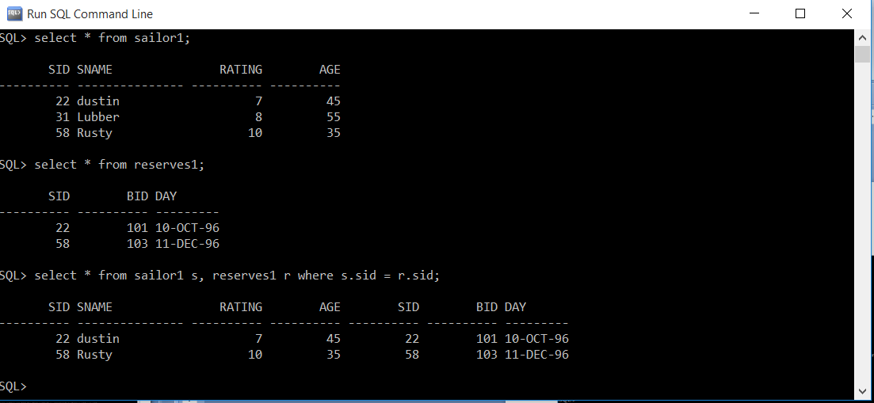
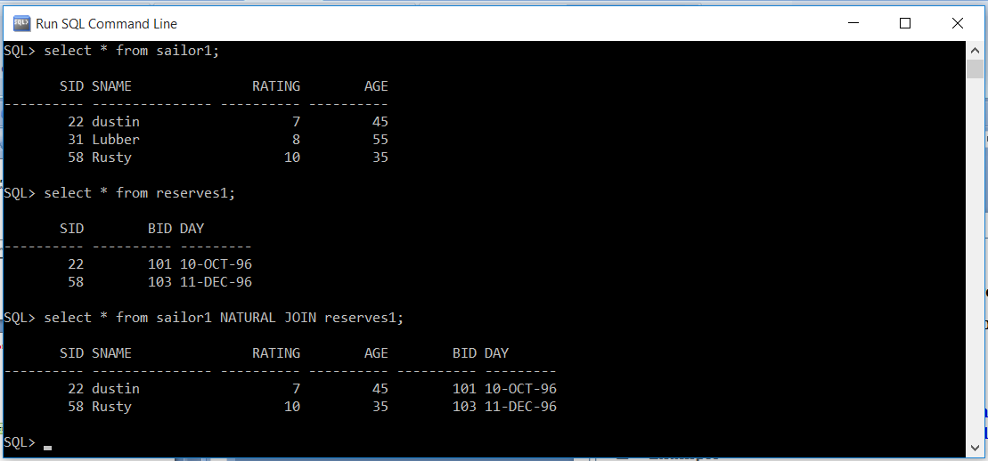
EQUI JOIN
NATURAL JOIN

Slide 61
OUTER JOIN
Contains matching rows that satisfy the matching condition, along with same or all rows that do not satisfy the matching condition.
OUTER JOIN
LEFT OUTER JOIN
RIGHT OUTER JOIN
FULL OUTER JOIN

Slide 62
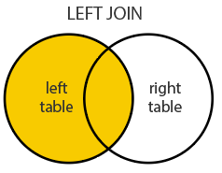
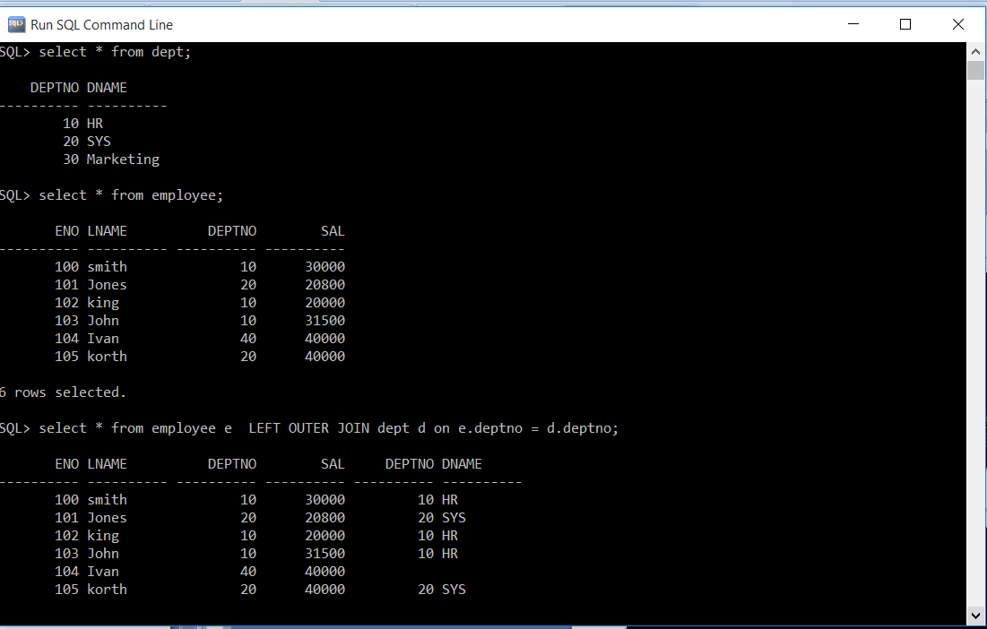
LEFT OUTER JOIN
Returns
All Matching records from T1 and T2
And also T1 records that does not have matching records in T2
Syntax
select * from table1 LEFT OUTER JOIN select * from table2 on table1.colname = table2.colname

Slide 63
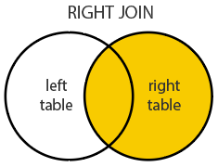
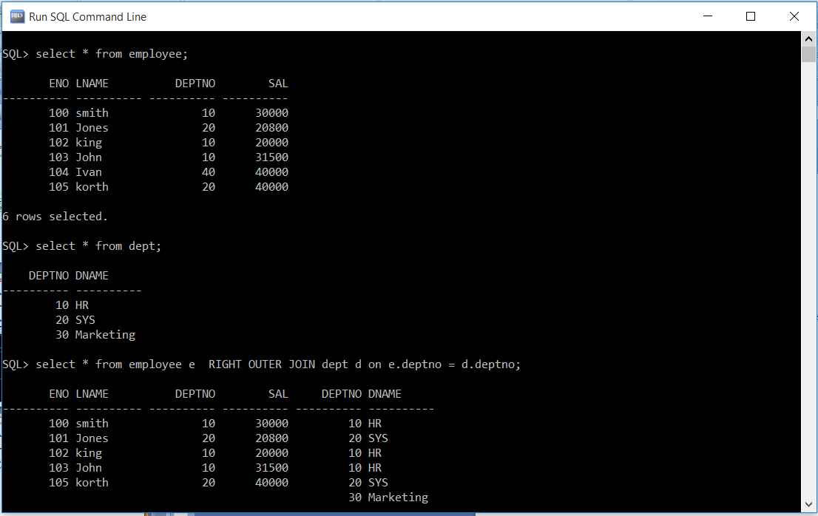
RIGHT OUTER JOIN
Returns
All Matching records from T1 and T2
And also T2 records that does not have matching records in T1
Syntax
select * from table1 RIGHT OUTER JOIN select * from table2 on table1.colname = table2.colname

Slide 64
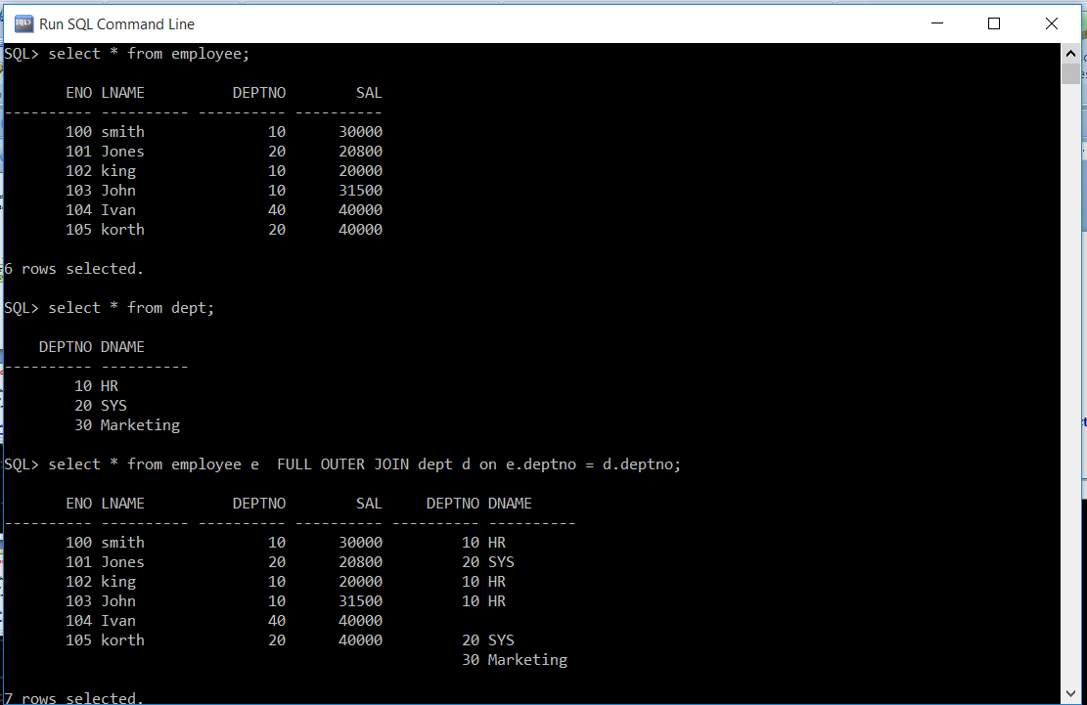
FULL OUTER JOIN
Returns
All Matching records from T1 and T2
And T2 records that does not have matching records in T1
And also T1 records that does not have matching records in T2.
Syntax
select * from table1 FULL OUTER JOIN select * from table2 on table1.colname = table2.colname

