Slide 1
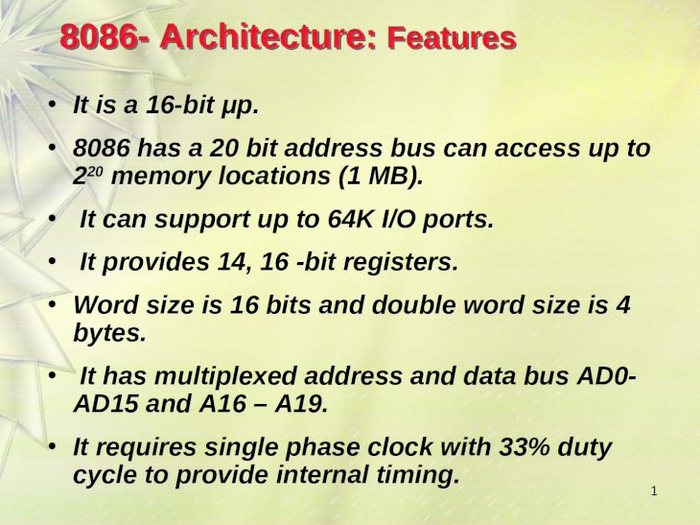
8086 – ARCHICTECTURE

Slide 2
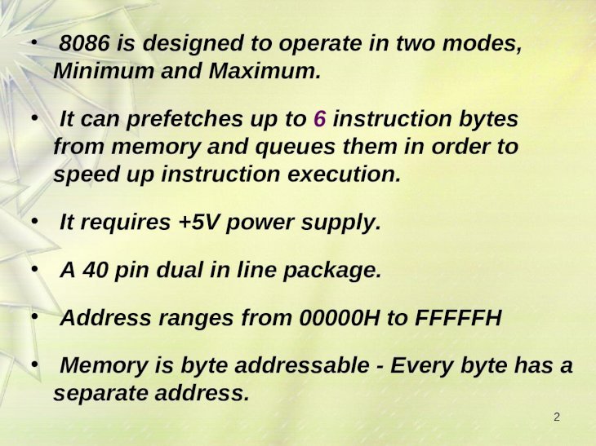

Slide 3
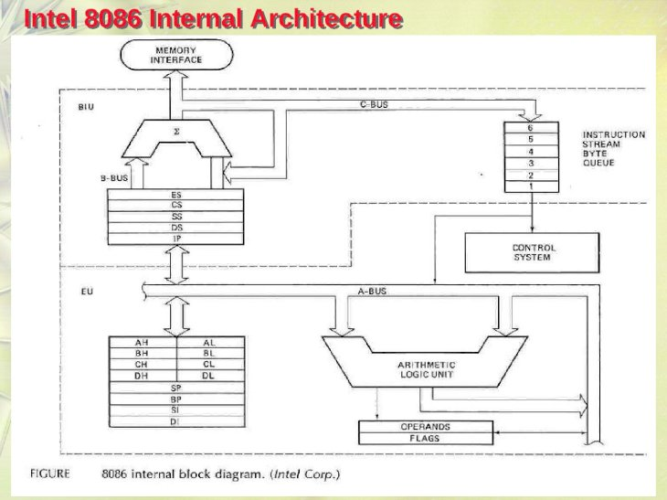
INTEL 8086 INTERNAL ARCHITECTURE

Slide 4
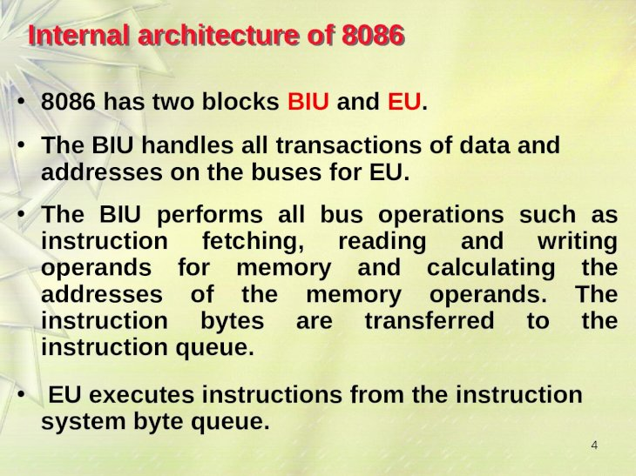
INTEL 8086 INTERNAL ARCHITECTURE

Slide 5
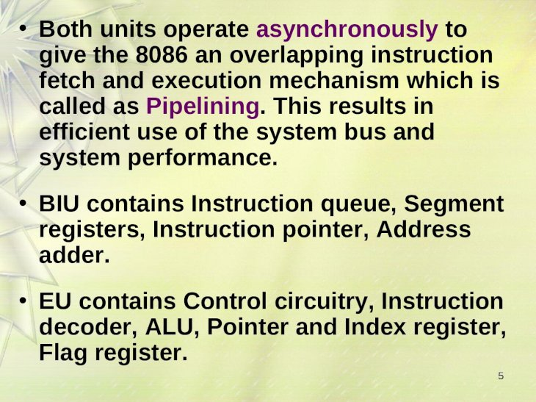

Slide 6
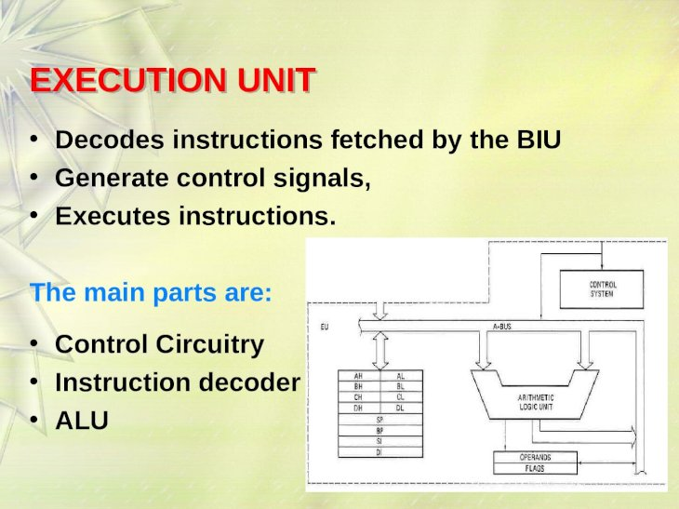
EXECUTION UNIT

Slide 7
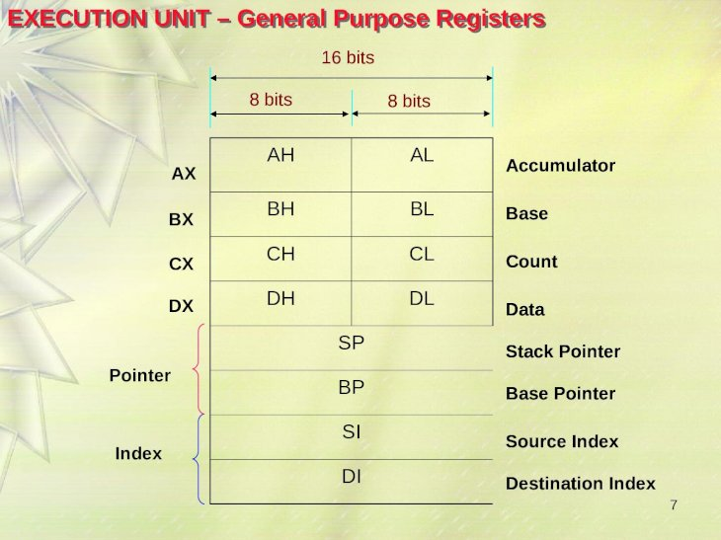
GENERAL PURPOSE REGISTERS

Slide 8
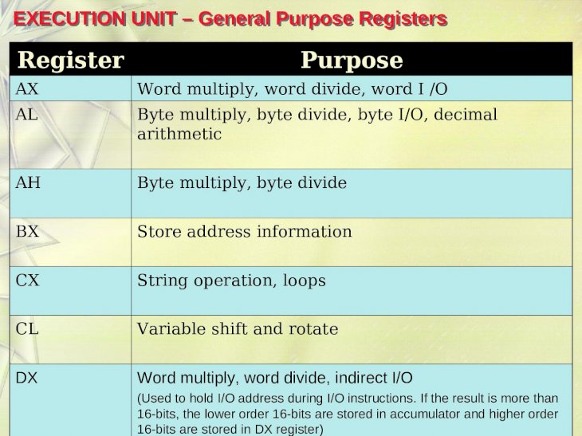
GENERAL PURPOSE REGISTERS

Slide 9
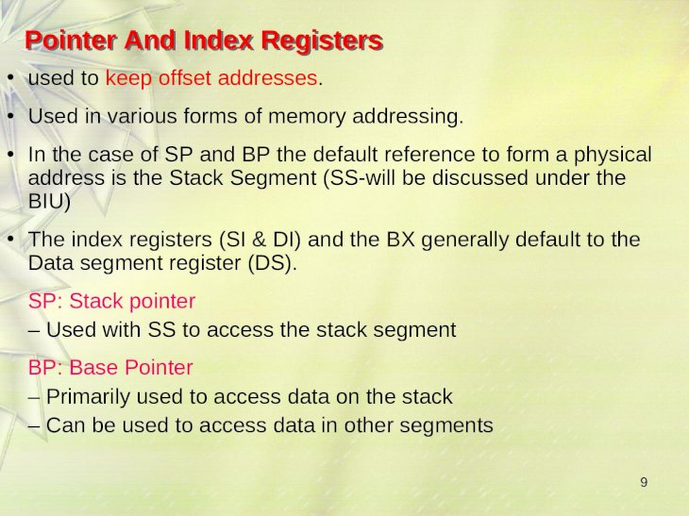
POINTER AND INDEX REGISTERS

Slide 10
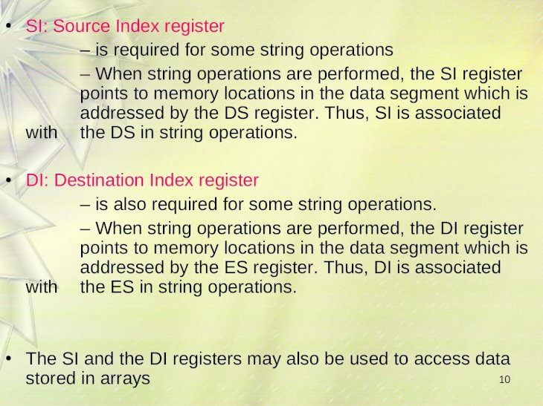
INDEX REGISTERS

Slide 11
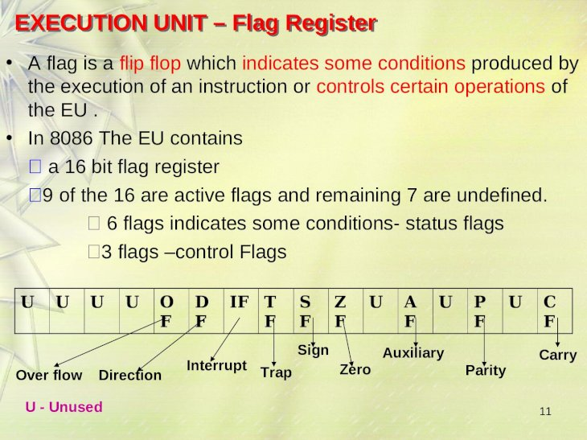
FLAG REGISTER

Slide 12
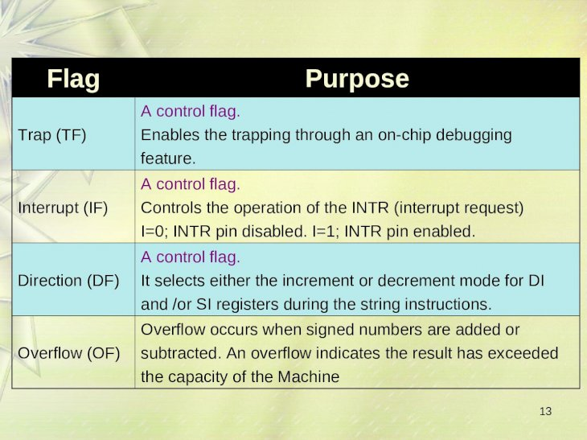
FLAG

Slide 13
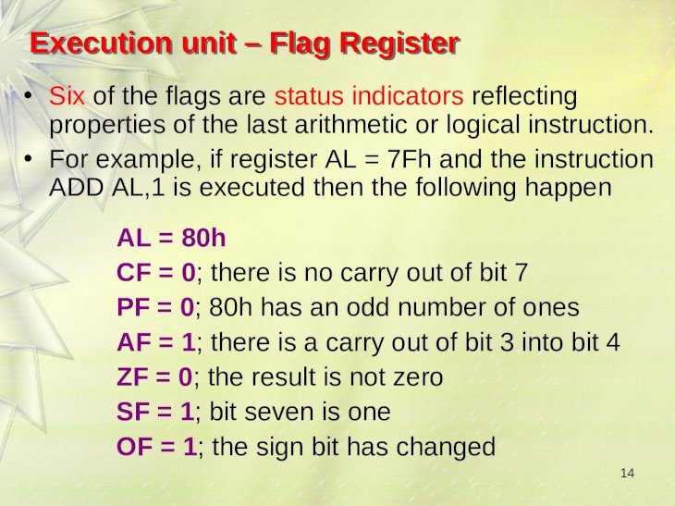
EXECUTION UNIT – FLAG REGISTER

Slide 14
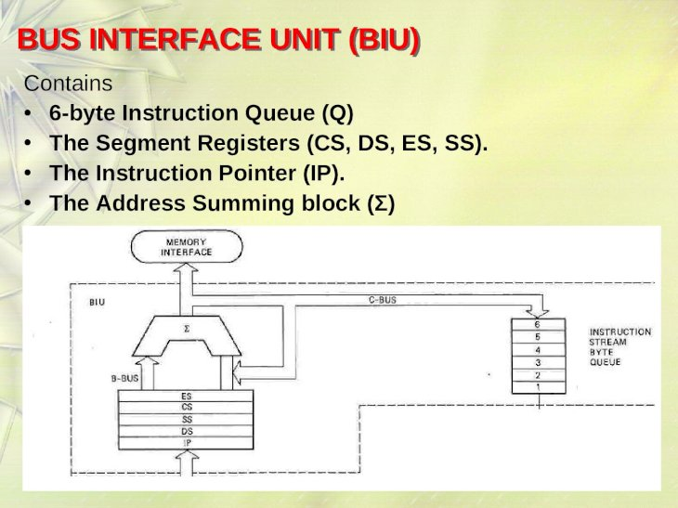
BUS INTERFACE UNIT

Slide 15
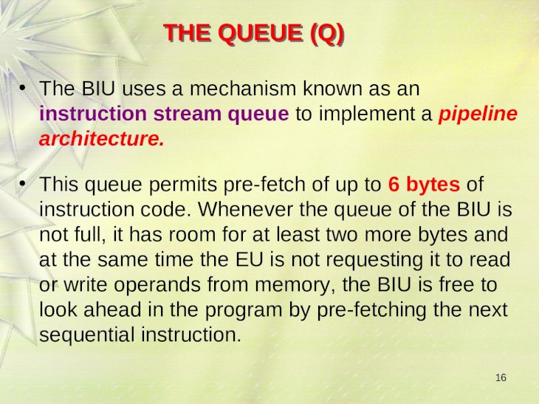
QUEUE

Slide 16
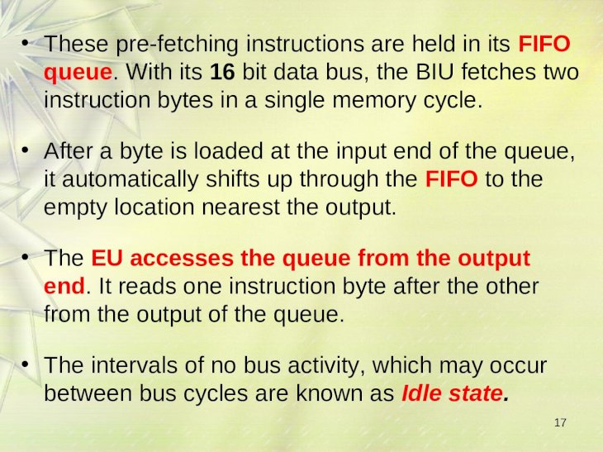
QUEUE

Slide 17
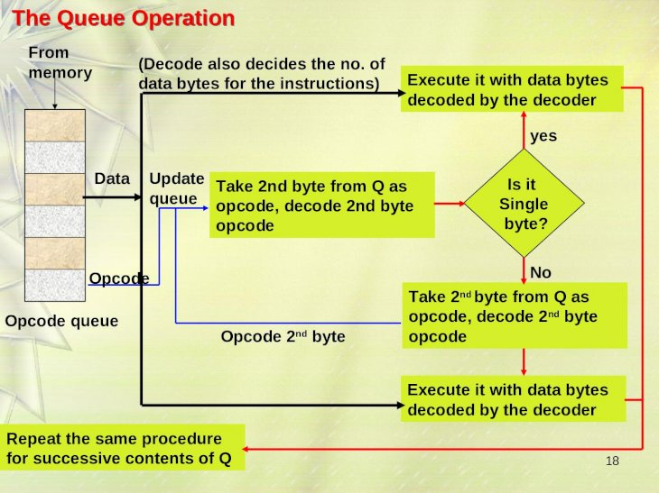
QUEUE OPERATION

Slide 18
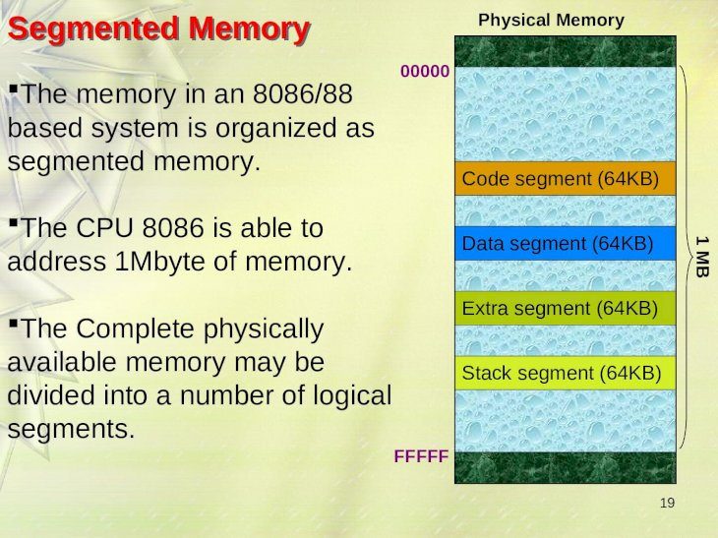
SEGMENTED MEMORY

Slide 19
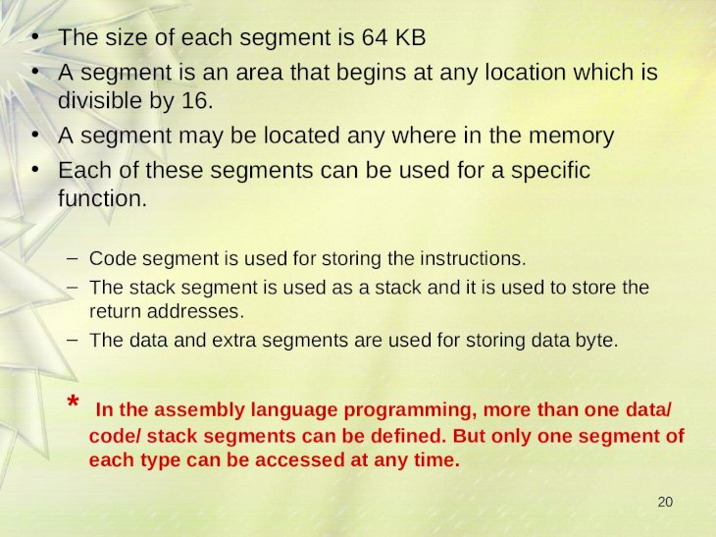
SEGMENTED MEMORY

Slide 20
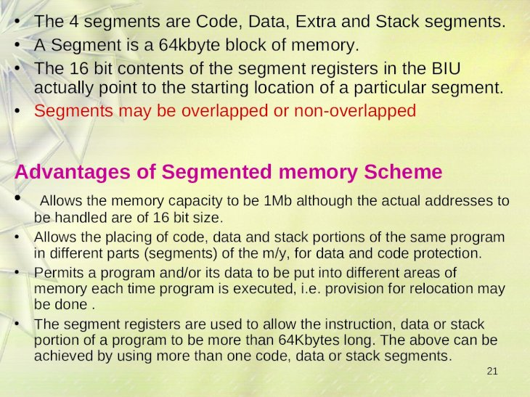
ADVANTAGES OF SEGMENTED MEMORY

Slide 21
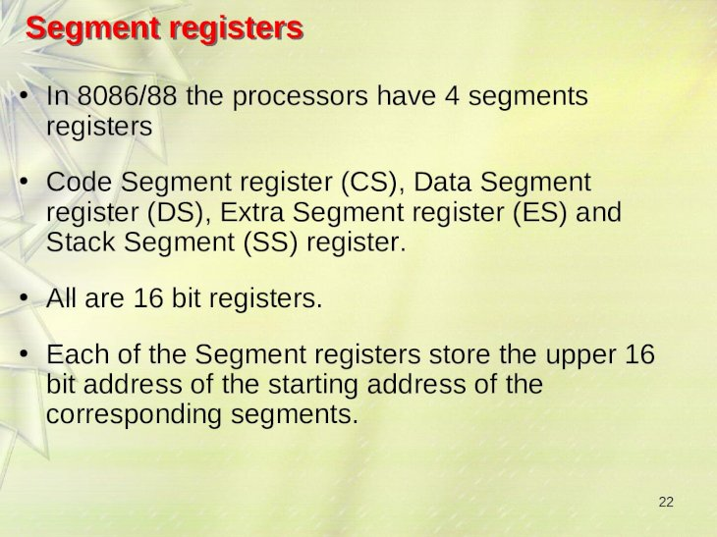
SEGMENT REGISTERS

Slide 22
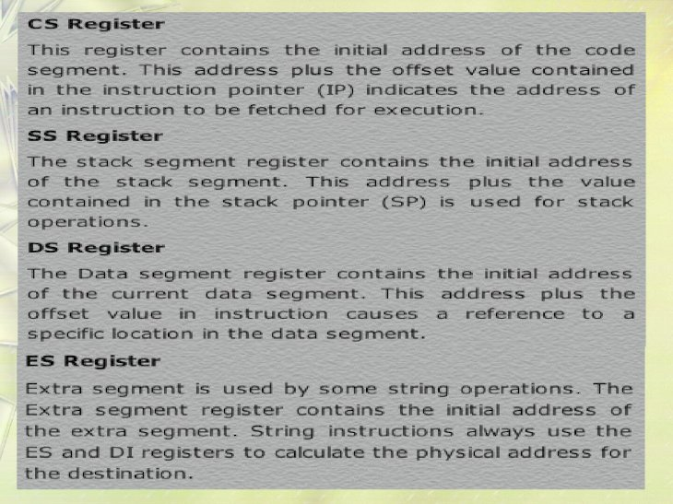
SEGMENT REGISTERS

Slide 23
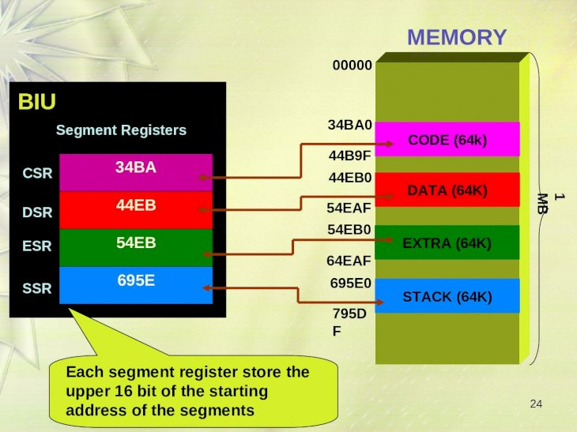

Slide 25
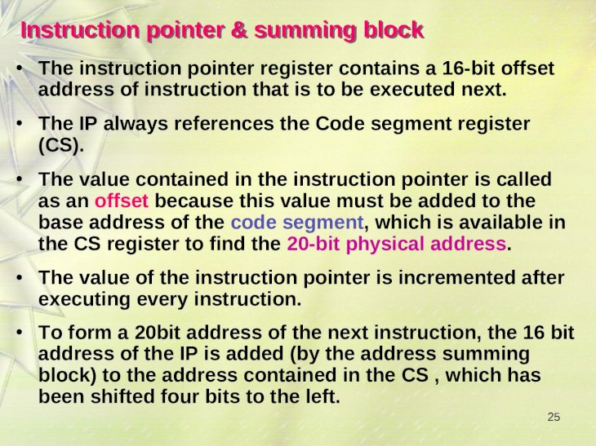
INSTRUCTION POINTER

Slide 26
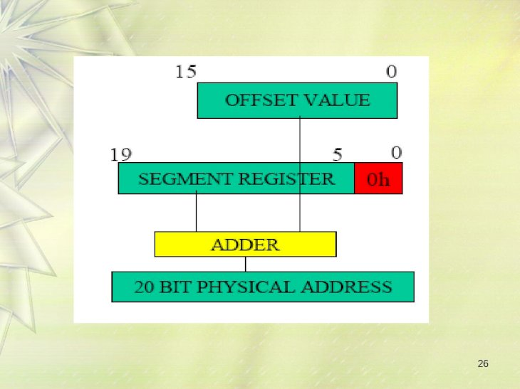

Slide 27
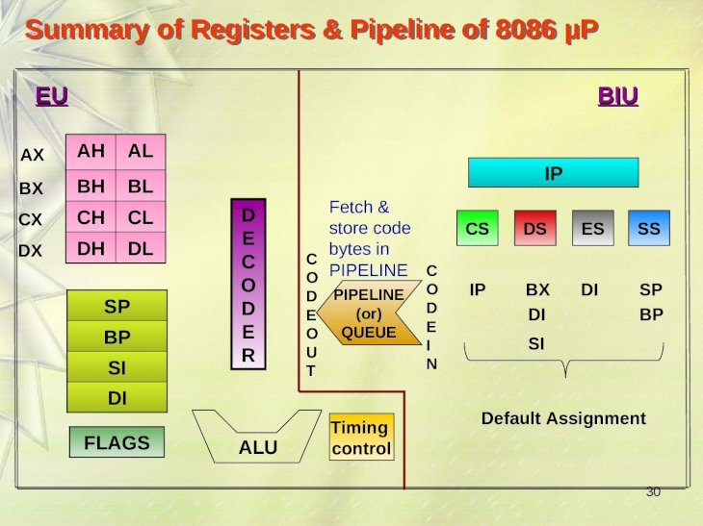

Slide 28
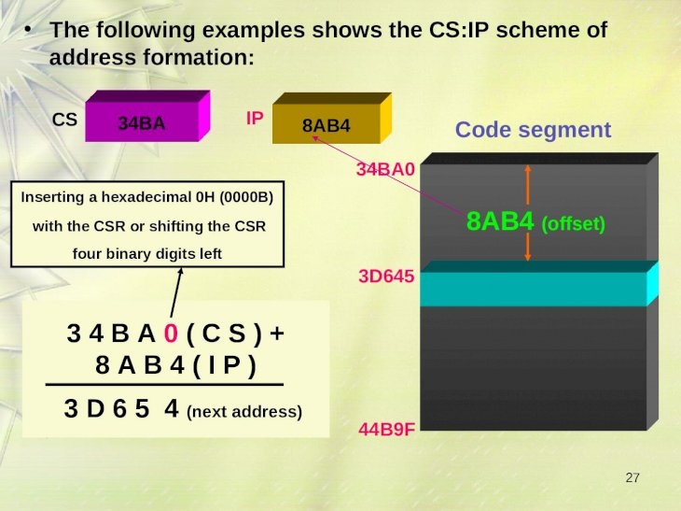

Slide 29
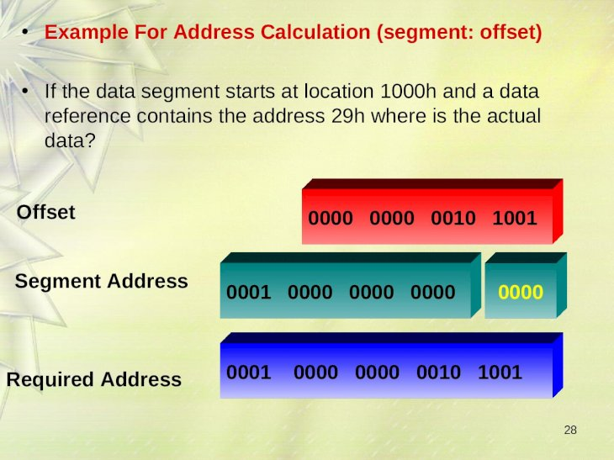

Slide 30
