Slide 1
UNIT-1
Big Data Analytics
(20CSE361)

Slide 2
INTRODUCTION TO BIG DATA
What is Data?
The quantities, characters, or symbols on which operations are performed by a computer.
which may be stored and transmitted in the form of electrical signals and recorded on magnetic, optical, or mechanical recording media.
What is Big Data?
Big Data is a collection of data that is huge in volume, yet growing exponentially with time.

Slide 3
What is Big Data?
It is a data with so large size and complexity that none of traditional data management tools can store or process it efficiently.
“Big data” is high-volume, velocity, and variety information assets that demand cost-effective, innovative forms of information processing for enhanced insight and decision making.

Slide 4
BIG DATA IN ORGANIZATIONS
'Big Data' is also a data but with a huge size.
'Big Data' is a term used to describe collection of data that is huge in size and yet growing exponentially with time.
Data which are very large in size is called Big Data.
Normally we work on data of size MB(Word Doc, Excel) or maximum GB(Movies, Codes) but data in Peta bytes
i.e. 10^15 byte size is called Big Data.

Slide 5
WHAT IS BIG DATA?
“Big Data” is a term for datasets that are so large or complex that traditional data processing software are inadequate to deal with them.
To extract value and hidden knowledge
  It requires new architecture, techniques, algorithms, and analytics .
Massive Volume

Slide 6
WHAT IS BIG DATA?
“Big Data” is a term for datasets that are so large or complex that traditional data processing software are inadequate to deal with them.
To extract value and hidden knowledge
  It requires new architecture, techniques, algorithms, and analytics to manage.
Massive Volume
Complex data formats

Slide 7
WHAT IS BIG DATA?
“Big Data” is a term for datasets that are so large or complex that traditional data processing software are inadequate to deal with them.
To extract value and hidden knowledge
  It requires new architecture, techniques, algorithms, and analytics to manage.
Massive Volume
Complex data formats
Not possible to process using traditional techniques

Slide 8
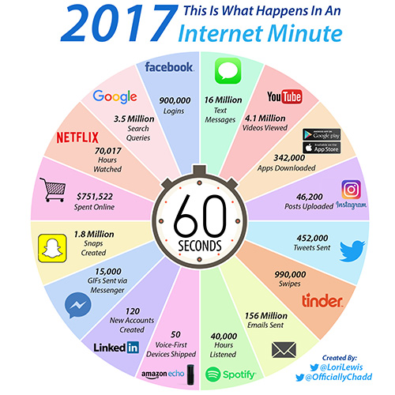
What makes data as “Big” Data?

Slide 9
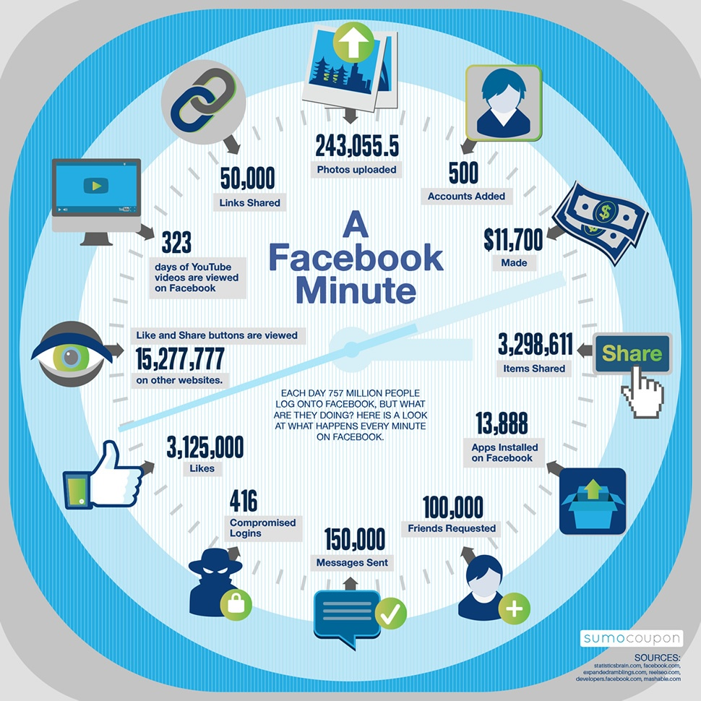
What makes data as “Big” Data?

Slide 10
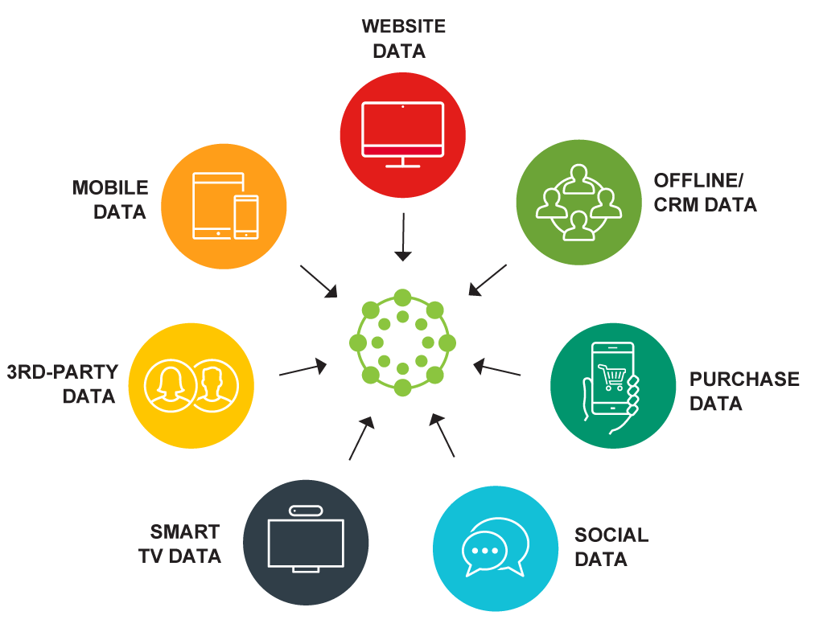
Big Data Sources

Slide 11
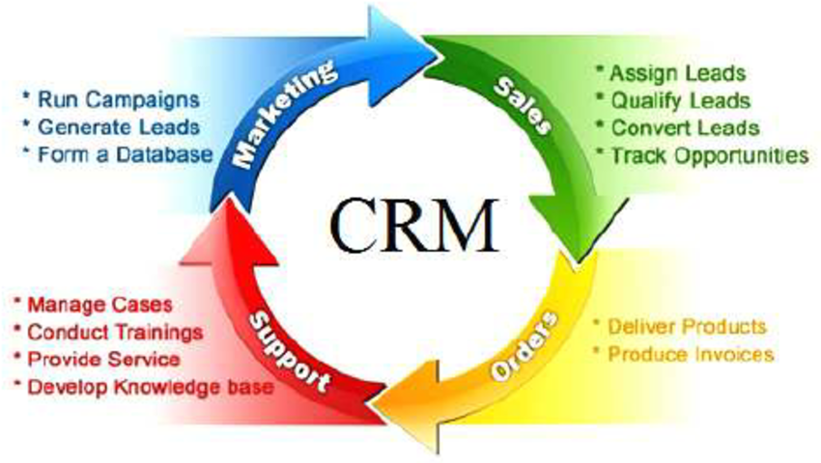
CRM (Customer Relationship Management)

Slide 12
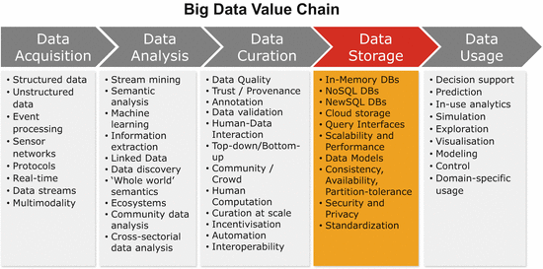
Big Data Acquisition

Slide 13
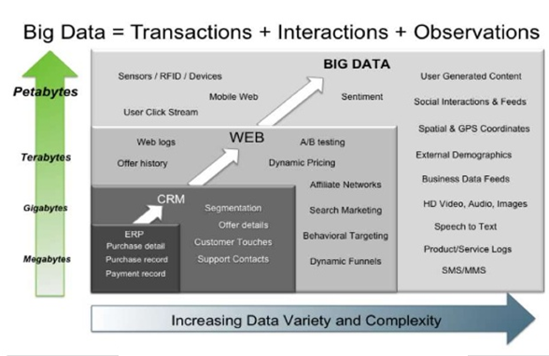
Sources of Big Data

Slide 14
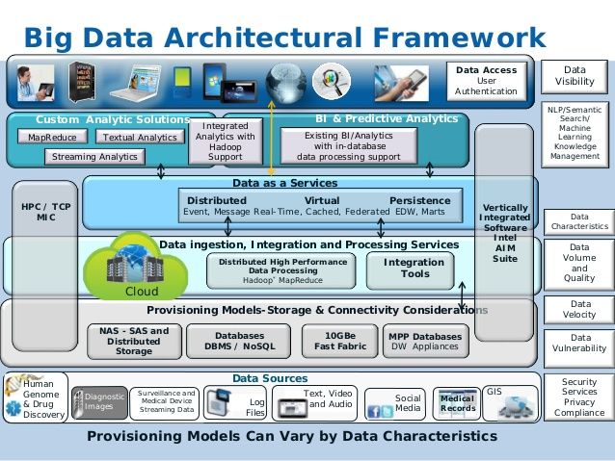

Slide 15
CHARACTERISTICS OF BIG DATA
3Vs of Big Data

Slide 16
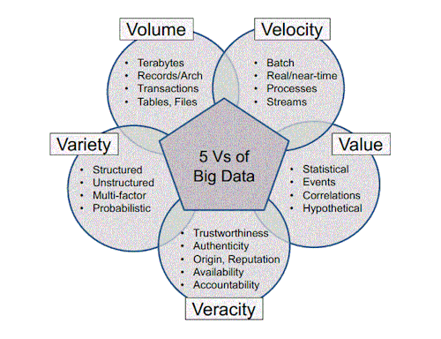
CHARACTERISTICS OF BIG DATA
5Vs of Big Data

Slide 17
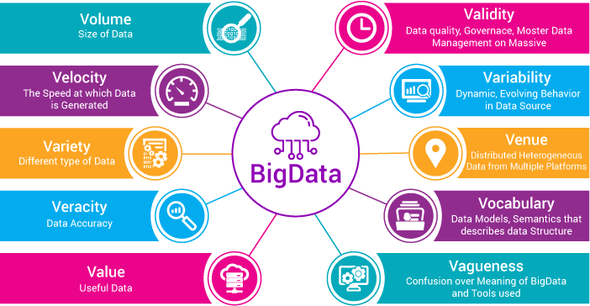
Characteristics of Big Data

Slide 18
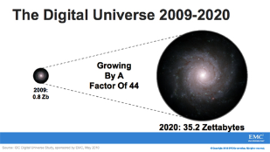
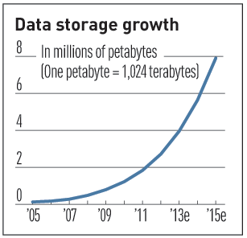

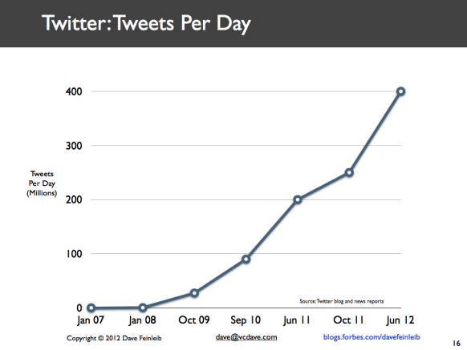
Characteristics of Big Data
Data Volume
  44x increase from 2009 - 2020
  From 0.8 zettabytes to 35zb
Data volume is increasing exponentially
Exponential increase in collected/generated data

Slide 19
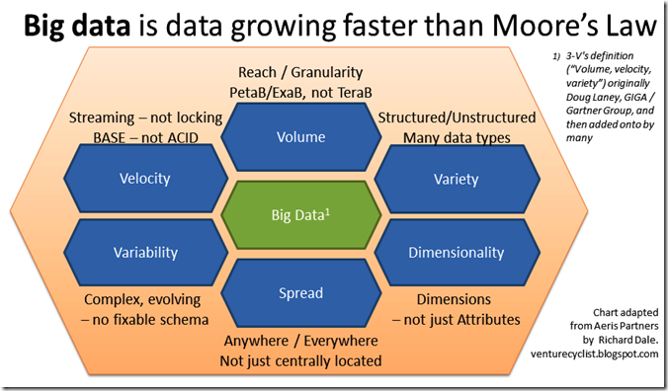
Data Volume (cont…)

Slide 20
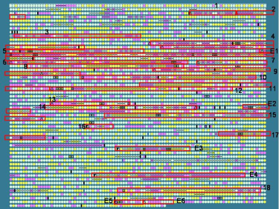

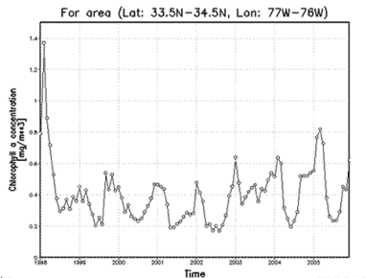

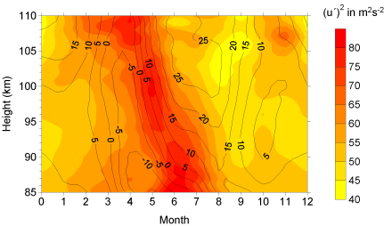

Characteristics of Big Data
Varity(Complexity)
Various formats, types, and structures
Text, numerical, images, audio, video, sequences, time series, social media data, multi-dim arrays, etc…
Static data vs. Streaming data
A single application can be generating/collecting many types of data

Slide 21
Characteristics of Big Data
Varity(Complexity)
Various formats, types, and structures
Text, numerical, images, audio, video, sequences, time series, social media data, multi-dim arrays, etc…
Static data vs. streaming data
A single application can be generating/collecting many types of data
Challenge?

Slide 22
Characteristics of Big Data
Varity(Complexity)
Various formats, types, and structures
  Structured, Unstructured,
Text, numerical, images, audio, video, sequences, time series, social media data, multi-dim arrays, etc…
Static data vs. Streaming data
A single application can be generating/collecting many types of data
Challenge?
To extract knowledge➔ all these types of data need to be linked together

Slide 23

Characteristics of Big Data
Velocity (Speed)
Data is begin generated fast and need to be processed fast
Online Data Analytics
Late decisions ➔ missing opportunities
Examples
  E-Promotions:
    Based on your current location, your purchase history,
  Healthcare monitoring:
  sensors monitoring your activities and body.
  ➔ any abnormal measurements

Slide 24
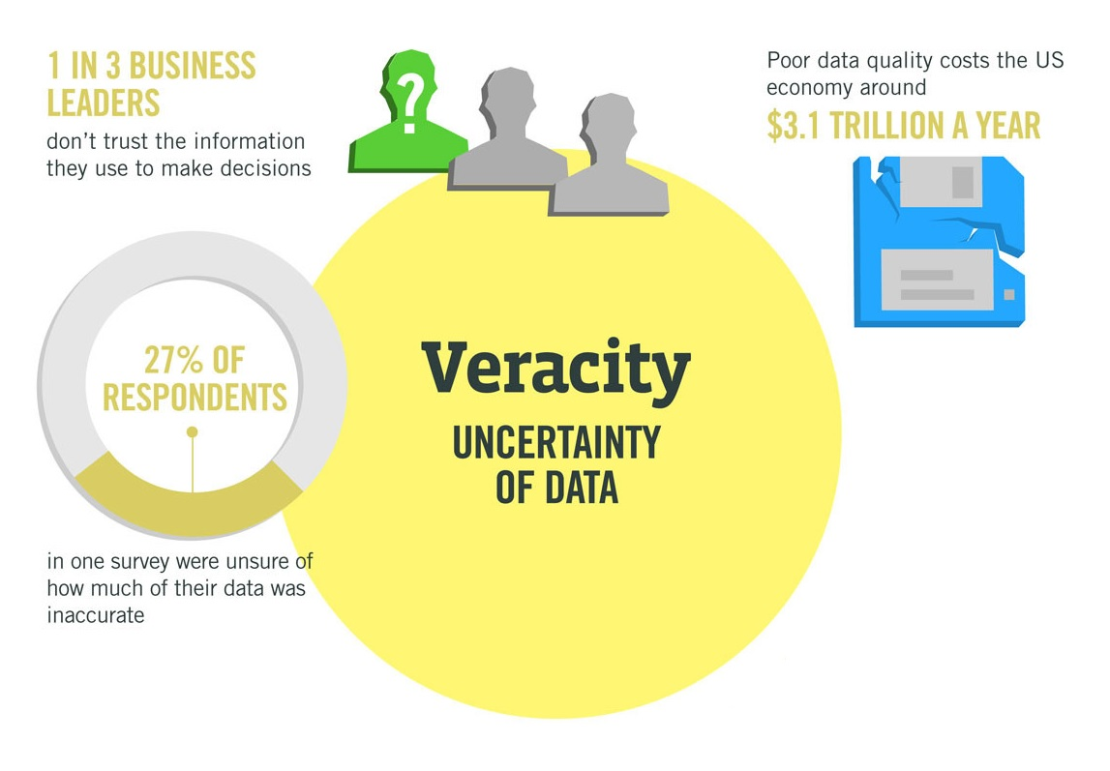
Characteristics of Big Data
Veracity (Uncertainty of Data)
Big Data Veracity refers to the noise and abnormality in data.
The data is being stored, and mined meaningful to the problem being analyzed.
veracity in data analysis is the biggest challenge
In scoping out your big data strategy
  you need to processes your data with techniques like text analytics (process of converting unstructured data into meaning full data for analysis).

Slide 25
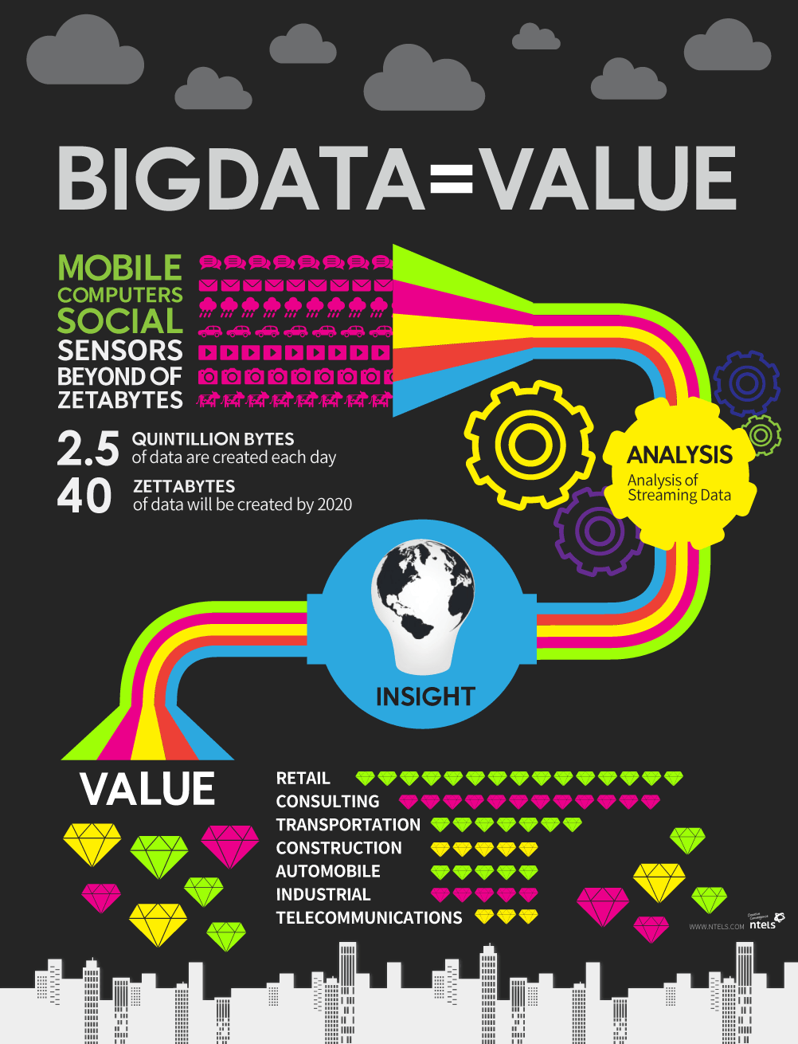
Characteristics of Big Data
Value (Business Value)
Value starts and ends with the business use case.
Business must define the analytic application of the data and its potential associated value to the business.

Slide 26
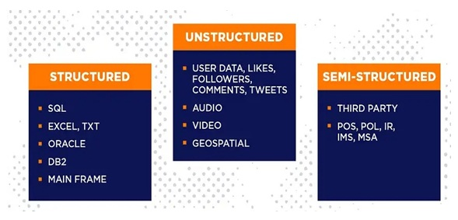
TYPES OF BIG DATA

Slide 27
Structured Data
Structured data is one of the types of big data
Structured data can be processed, stored, and retrieved in a fixed format.
It refers to highly organized information that can be readily and seamlessly stored and accessed from a database by simple search engine algorithms.

Slide 28
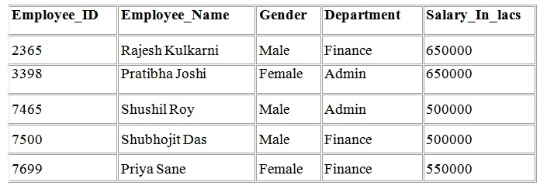
Example:
The employee table in a company database will be structured as the employee details, their job positions, their salaries, etc., will be present in an organized manner.

Slide 29
Unstructured Data
Unstructured data refers to the data that lacks any specific form or structure whatsoever.
Its make very difficult and time-consuming to process and analyze unstructured data.
Email is an example of unstructured data.
Structured and unstructured are two important types of big data.

Slide 30
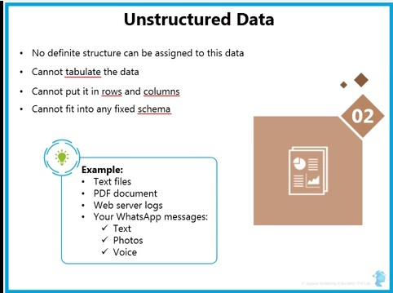
Example,

Slide 31
Semi-Structured Data
Semi structured is the third type of big data.
Semi-structured data containing both the formats ie., structured and unstructured data.
It refers the data that although has not been classified under a particular repository (database, describe various ways to collect and store the data), yet contains vital information or tags.

Slide 32
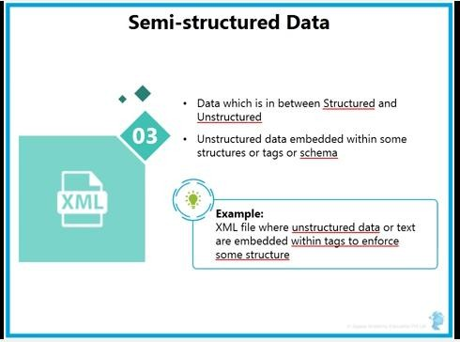
Example,

Slide 33
Challenges of Big Data
Rapid Data Growth:
The growth velocity at such a high rate creates a problem to look for insights using it.
There no 100% efficient way to filter out relevant data.
Storage:
The generation of massive amount of data needs space for storage.
An Organizations face challenges to handle such, extensive data without suitable tools and technologies.

Slide 34
Challenges of Big Data
Unreliable Data:
It cannot be guaranteed that the big data collected and analyzed are totally (100%) accurate.
Ex: Redundant data, contradicting data
(differing), or incomplete data are challenges that remain
within it.
Data Security:
Firms and organizations storing such massive data (of users) can be a target of Cyber Criminals.
There is a risk of data getting stolen.
Hence, encrypting such colossal data is also a challenge for firms and organizations.

Slide 35
  Evolution of Big Data
1970s and before was the era of mainframes.
This data was essentially primitive and structured.
Relational Databases evolved in 1980s and 1990s.
This era was of data intensive applications( social media platforms and its provides like PayPal, payU).
World Wide Web (WWW) and the Internet Of Things (IOT) have led to an offensive of structured, unstructured, and multimedia data.

Slide 36
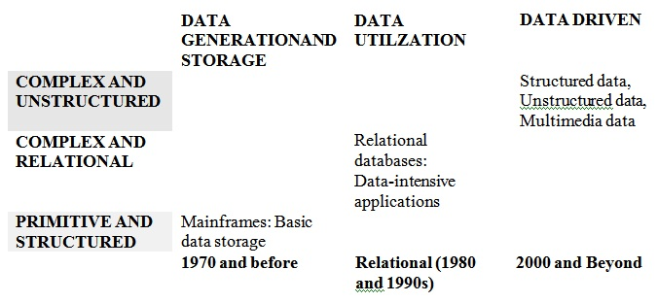
Example,

Slide 37
Case Study
The people affected by diabetes worldwide is expected to rise to 330 million by 2025, by 2035 this may raise to 592 million.
52 million of them are Indians. This is largely due to urbanization, unhealthy eating habits, sedentary lifestyle.
In the International Diabetes Federation conference held in Paris, India was described as “Diabetes Capital of the World”.
Diabetes caused 5.1 Million deaths in 2016.

Slide 38
Case Study
ATTRIBUTES | MIN VALUE | MAX VALUE
Plasma Glucose | 56 | 198
Diastolic B.P | 24 | 110
Skin Fold thickness | 7 | 63
2-Hr Serum Insulin | 14 | 846
BMI | 18.2 | 67.1
Diabetes Pedigree | 0.085 | 2.42
Age | 21 | 81
Class | 0 | 1

Slide 39
Big Data Vs Traditional Data Processing

Slide 40
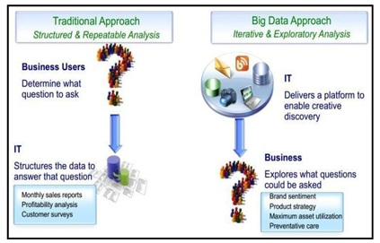
Cont…

Slide 41
Big Data Vs Traditional Business Intelligence (BI)
Traditional BI environment, all the enterprise’s data is stored in a Central Server, where as in big data environment data is reside over distributed file system.
Distributed file system scales by scaling in or out horizontally as compared to typical database server that scales vertically.

Slide 42
Big Data Vs Traditional Business Intelligence (BI)
Traditional BI data is analyzed in offline mode where as in big data it is analyzed in both real time and offline mode.
Traditional BI structured data is taken to processing functions where as in big data is about variety i.e. structured, unstructured, and semi-structured data is taken to processing functions.

Slide 43


Slide 44
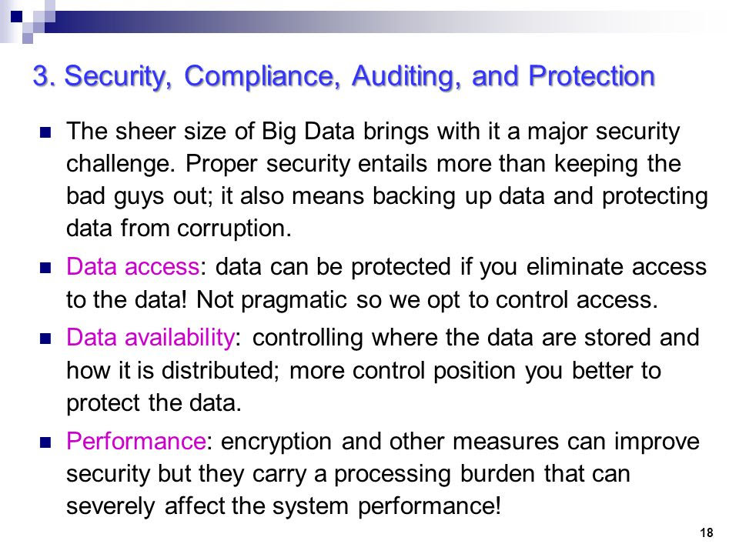

Slide 45
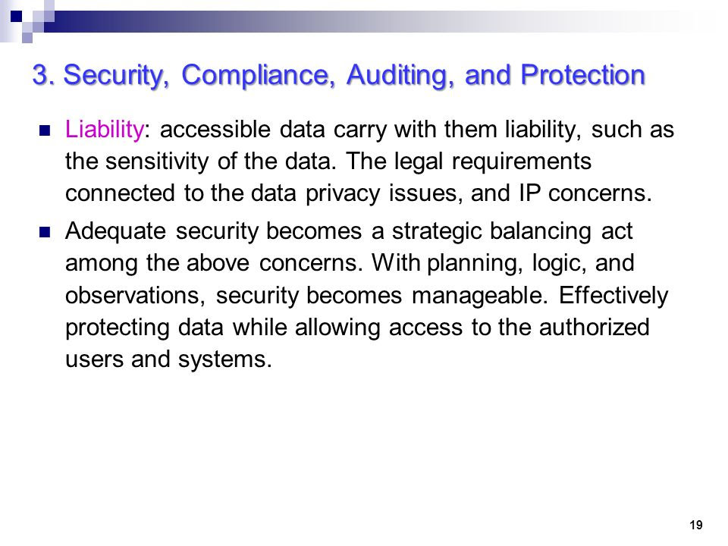

Slide 46
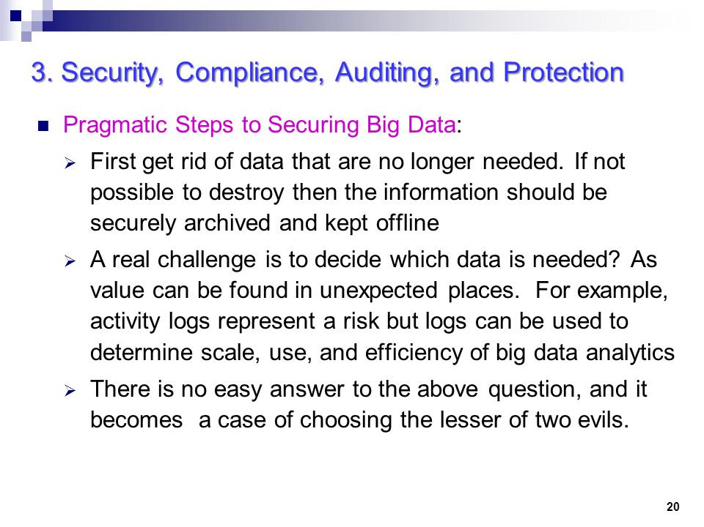

Slide 47
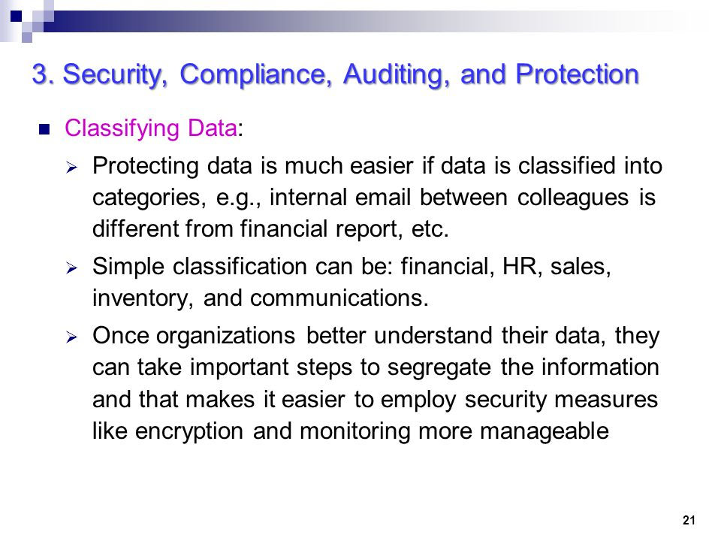

Slide 48
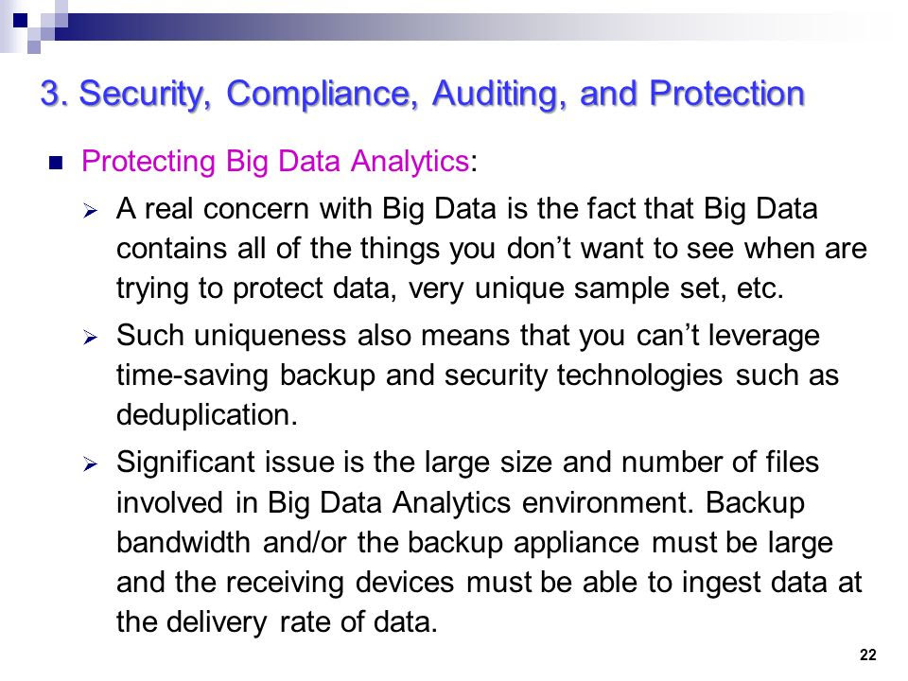

Slide 49
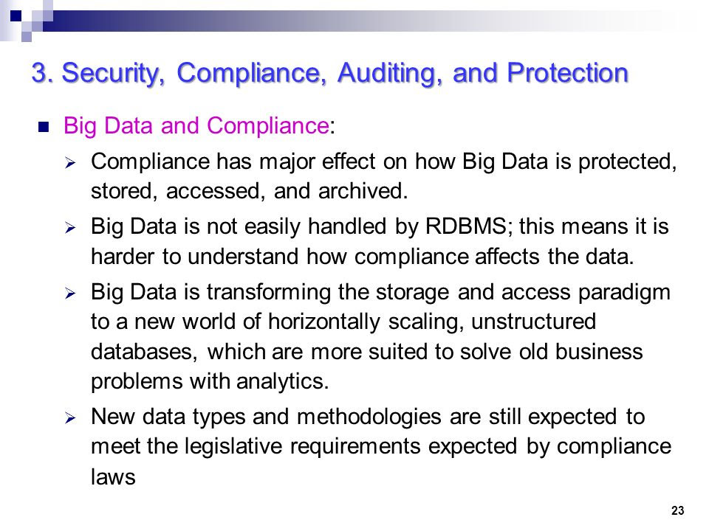

Slide 50
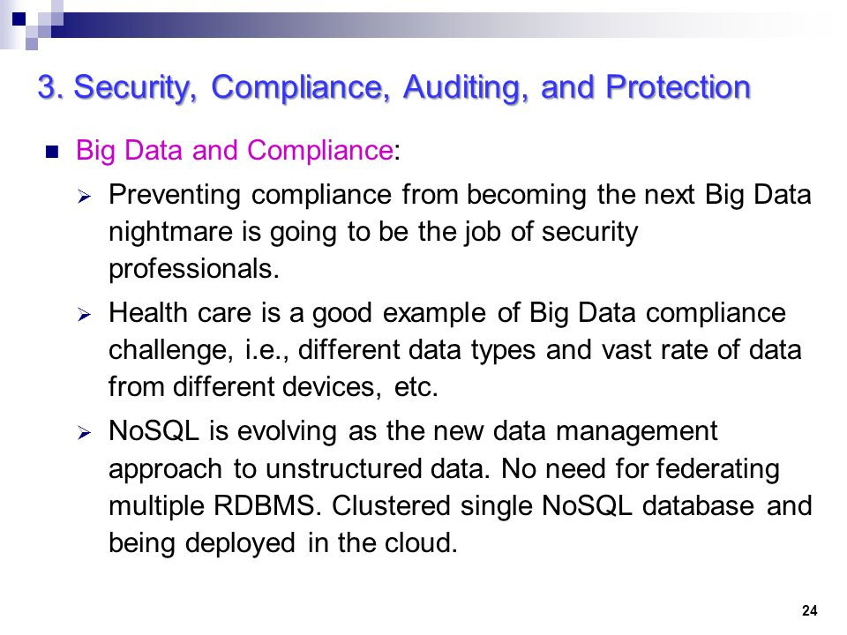

Slide 51
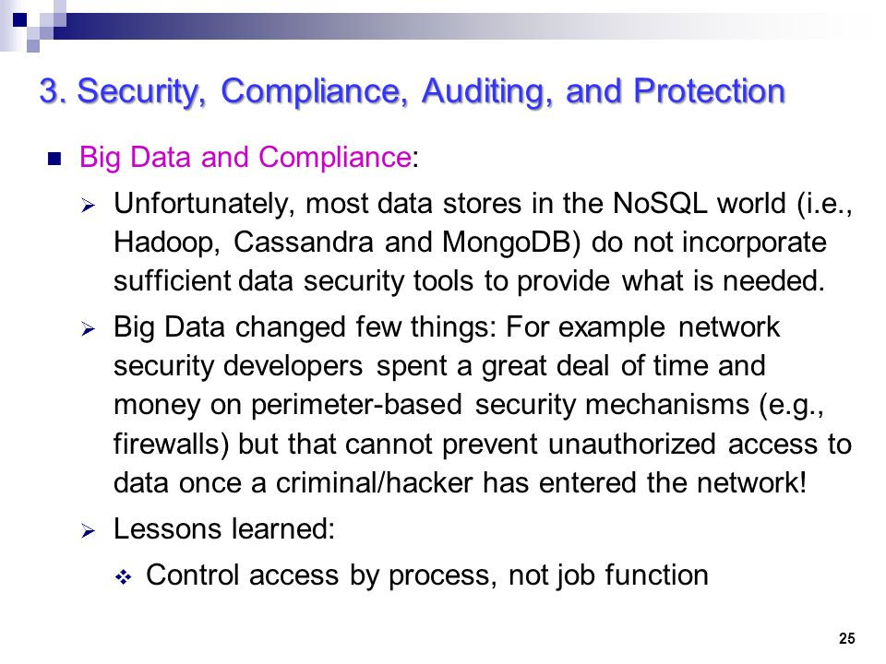

Slide 52
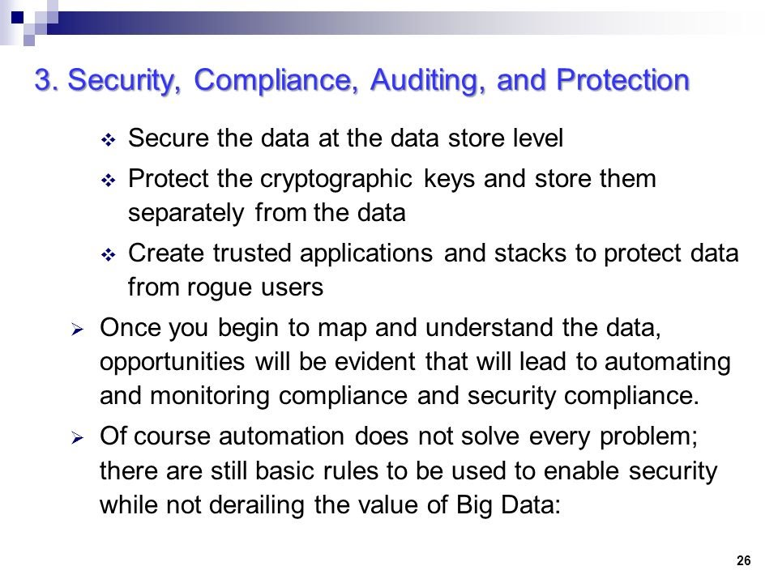

Slide 53
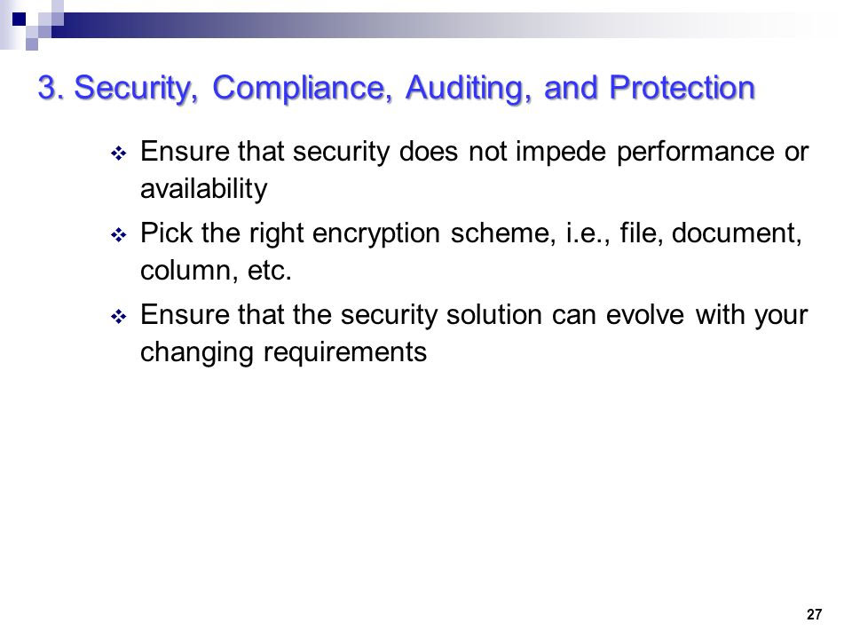

Slide 54
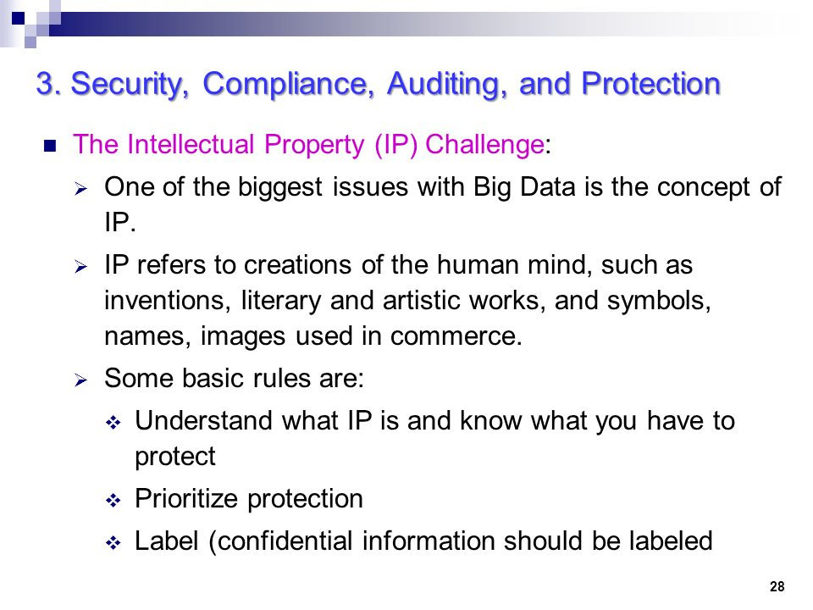

Slide 55
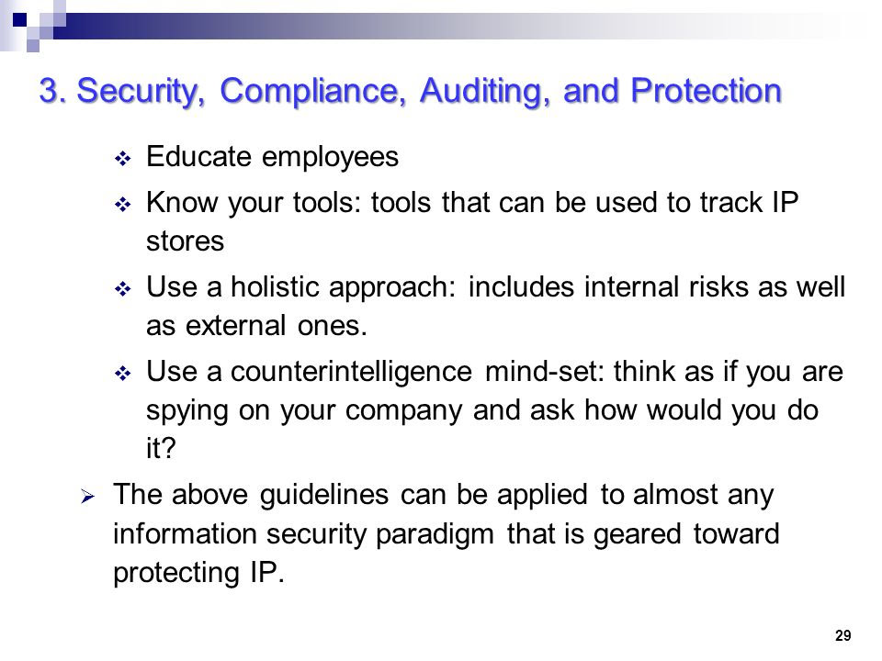

Slide 56
Explore the Opportunities with Bigdata
1. Enhanced information management:
Big Data enables enhanced discovery, access, availability, exploitation, and provisioning of information within companies.
It can enable the discovery of new data sets that are not yet being used to drive value.

Slide 57
2. Increased supply chain visibility and transparency:
Big Data can increase supply chain visibility and transparency through real-time control, and multi-tier (process, decision, and financial) visibility irrespective of data location.
3. Greater responsiveness:
With Big Data, companies are able to react quicker to changing market conditions, reduce time-to-market, and increase the robustness of supply chains.

Slide 58
4. Enhance product and market strategy:
Big Data analytics can enhance customer segmentation, allowing for better scalability.
It can improve customer service levels, enhance customer acquisition and sales strategies (through web and social).
5. Improved demand management and production planning:
Big analytics can provide insights for product launch and release planning, and increased granularity of planning levels allows for optimized, shorter planning cycles.

Slide 59
6. Innovation and product design benefits:
A wide variety of data streams can aid innovation and product design.
These include utilizable product usage data, point-of-sales data, field data from devices, customer data, and supplier suggestions to drive product and process innovation.
7. Positive financial implications:
Big Data can reduce long-term costs, increase ability to invest, and improve understanding of cost drivers and impacts.

Slide 60
8. More integration and collaboration:
Adopting cross-functional integration and collaboration approaches with key partners.
9. Enhanced logistics:
It can enable real-time rescheduling, route planning, re-routing and road-side service planning.

Slide 61
10. More efficient inventory management:
Vital information becomes more transparent and available at a much higher frequency as parties cooperate.
11. Improved risk management
Big Data can enhance risk evaluation, aiding continuity management at industry and supply chain level to reduce the impact of disruptions.

Slide 62
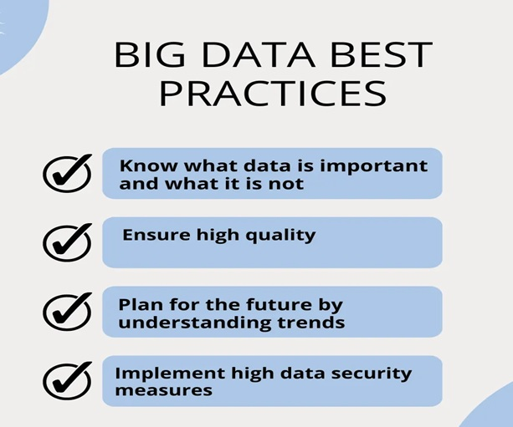
Best Practices with Big Data

Slide 63
Best Practices with Big Data
What are the key big data best practices?
Big data best practices is to ensure that the data is not just collected, but also analyzed and stored in a way that it can be retrieved when needed.

Slide 64
Best Practices with Big Data
1- Know what data is important and what it is not
2- Ensure high quality
3- Commit to proper data labeling
4- Choose proper big data storage locations
5- Simplify backup procedures
6- Implement high data security measures
7- Plan for the future by understanding trends
8- Use your tools effectively, they will make your life easier
9- Find ways to make your data more accessible

Slide 65
1- Know what data is important and what it is not
The first step in using big data is knowing what data is important and what it is not.
This will allow you to choose the best data for your business..

Slide 66
2- Ensure high quality
Data quality is an important issue in the digital era.
It is high quality in healthcare to social media, data quality needs to be controlled and checked for accuracy.
  Data is accurate, complete, and up-to-date
  Data is complete, meaning that it includes all records for a particular variable.
  Related data is linked to the appropriate variable in the database
  Ensuring high-quality data should be on top of the list of big data best practices

Slide 67
3- Commit to proper data labeling
With the increasing popularity of big data labeling, it is imperative to understand the importance of different types of datasets. A good dataset is one that has been properly labeled and can be used for a variety of purposes.

Slide 68
4- Choose proper big data storage locations
Cloud storage is a very popular option for companies, since it’s accessible from multiple devices and can be scaled up or down as needed.
Keep your data in close proximity to where it is used and referenced
Place your metadata (information about your data) with the physical file that contains the
actual raw data
Store your data in multiple physical locations for redundancy
Store full backups of your data and metadata on a separate system than the machine that contains the raw data

Slide 69
5- Simplify backup procedures
One of the most important tasks when managing big data is to have a backup. This is because it can be lost or corrupted, and in this age of increased cyber-security threats, your data needs to be backed up safely. The easiest way to do this is to use a cloud storage provider.
Amazon, Dropbox, Google Drive, and Microsoft OneDrive are all popular options. Alternatively, you can back up your data on an external hard drive or CD/DVD.
– Take frequent backups of your entire system
– Use free software to create backups of your files
– Create automated backup scripts for your data and metadata
– Store backups offsite
– Use remote storage services like DropBox to store additional backups of your files
– Perform regular data backups and integrity checks on the backup
– Avoid using magnetic media for storing your data, as it can degrade over time

Slide 70
6- Implement high data security measures
Data security has become a major concern for many businesses and individuals. Big data breaches can lead to identity theft, loss of trade secrets, and much more. If a company has sensitive information, it should be encrypted and stored on an isolated drive.
Encryption ensures that only the person with the decryption key has access to the big data. This means less storage capacity for one’s work and more dependence on the service provider.

Slide 71
7- Plan for the future by understanding trends
Planning can be difficult. We often have to rely on instinct and past experience to make decisions and consider the consequences of potential outcomes. The same is true with data.
In order to make the most of the information, it’s important to understand how trends evolve over time and how they impact your business. This is the most crucial big data best practices.

Slide 72
8- Use your tools effectively, they will make your life easier
The importance of data in the digital age cannot be overlooked. It is embedded into the architecture of many things. Analyzing big data can help you get ahead of the competition and make your life easier. You just need to know what to do with it, and how to interpret it.
Using BI tools can make you analyze the datasets you have to get more insights about customers behavior, product performance, and other related important subjects.

Slide 73
9- Find ways to make your data more accessible
Poor data accessibility can cripple a company’s performance. One of the most important best practices for big data is to make sure that data are accessible to others who may need it in the quickest way possible.

