Slide 1
UNIT-2 Introduction to Hadoop and its Eco Systems

Slide 2
Introduction to Apache Hadoop
It provides a software framework for distributed storage and processing of big data using the MapReduce programming model.
The Apache Hadoop is an Open Source Framework. ?Hadoop can easily handle a large amount of data on low cost, simple hardware cluster.
Hadoop is also a scalable and Fault –tolerant framework.
Hadoop is not only a storage system as well as data processing using framework.

Slide 3
Introduction to Apache Hadoop
Originally designed for computer clusters built from commodity hardware.
It is designed to scale up from single servers to thousands of machines, each offering local computation and storage.
The library itself is designed to detect and handle failures at the application layer.
If Hardware failures are common occurrences and should be automatically handled by the framework.

Slide 4
Introduction to Apache Hadoop
The Core of Apache Hadoop consists of
Storage part
Hadoop Distributed File System (HDFS),
Processing part
MapReduce programming model.

Slide 5
Hadoop Technology
Hadoop is open source tool from the Apache Software Foundation.
Hadoop codes are written by Yahoo, IBM, Cloudera etc…
Hadoop provides parallel processing through different commudity h/w simultaneously.

Slide 6
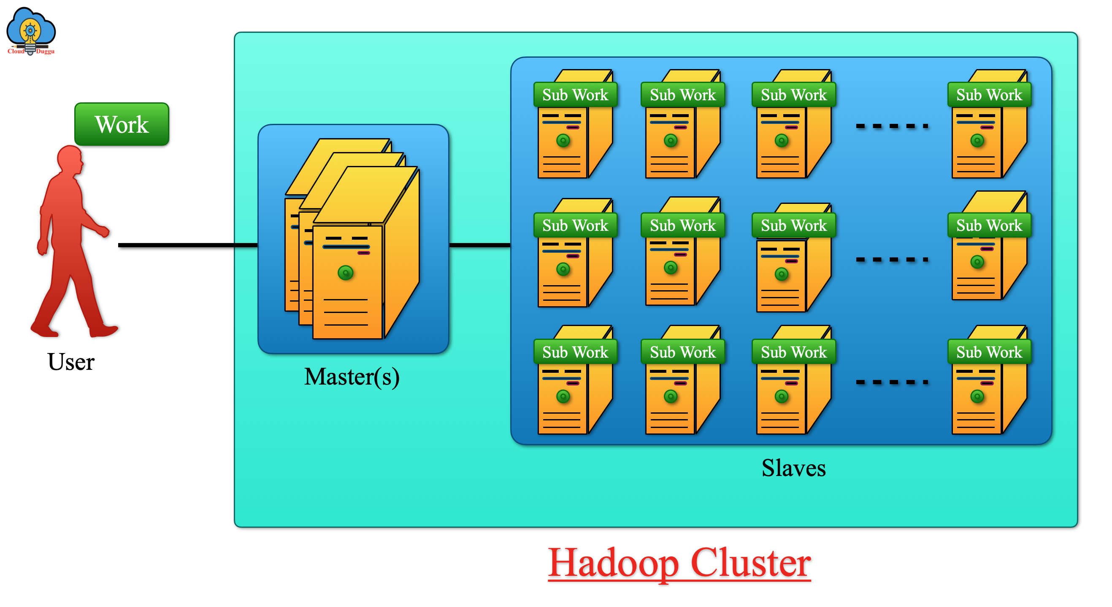
Hadoop Cluster

Slide 7
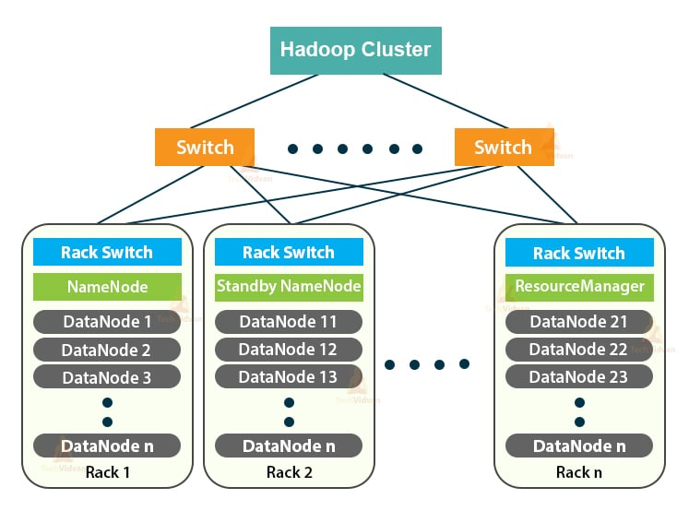
Hadoop Cluster

Slide 8
What is Hadoop?
Framework for Large-Scale Data Processing
Inspired by Google’s Architecture:
– Google File System (GFS)
– MapReduce
Open-source Apache project
– Nutch search engine project
– Apache Incubator
Written in Java and shell scripts

Slide 9
Why we should use Hadoop?
Hadoop solution is very popular. It captured at least 90% of bigdata market.
Hadoop splits files into large blocks and distributes them across nodes in a cluster.
Then, transfers packaged code into nodes to process the data in parallel.
Its fault tolerant soluction. So we can use no. of commodity h/w easily.
Data can be stored as structured, unstructured and semi-structured mode. So its more flexible.

Slide 10
Who use Hadoop?

Slide 11
When should you choose Hadoop?
Need to process a lot of unstructured data
Processing needs are easily run in parallel
It uses the concept of MapReduce which enables it to divide the query into small parts and process them in parallel.
Hadoop has ability to analyze the data present in diff. machines at diff. location very quickly and in a very cost effective way.

Slide 12
When should you avoid Hadoop?
Intense calculations with little or no data.
Processing cannot easily run in parallel.
Data is not Self-Contained.
Need interactive results.

Slide 16
Hadoop Architecture
Hadoop is a software framework developed by the Apache Software Foundation for distributed storage and processing of huge amounts of datasets.
“Hadoop is a technology to store massive datasets on a cluster of cheap machines in a distributed manner”. It was originated by Doug Cutting and Mike Cafarella.

Slide 17
Hadoop Architecture

Slide 18
Hadoop Architecture

Slide 19
Hadoop Components
Hadoop Consists Of 3 Core Components :
HDFS (Hadoop Distributed File System)
2. MapReduce
3. Yarn (Yet Another Resource Negotiator)
1. HDFS (Hadoop Distributed File System)
It is the storage layer of Hadoop.
Files in HDFS are broken into block-sized chunks.
HDFS consists of two types of nodes that is,
i. NameNode
ii. DataNodes.
NameNode stores metadata about blocks location.
DataNodes stores the block and sends block reports to
namenode in a definite time interval.

Slide 20
2. MapReduce
MapReduce is a parallel programming model for writing distributed applications at Google for efficient processing of large amounts of data (multi-terabyte data-sets), on large clusters.
3. YARN
It is the Resource Management Layer.
YARN is responsible for Resource Allocation and Job Scheduling.
To study in detail Hadoop and its component, go through the Hadoop Architecture article.

Slide 21
Hadoop Distributed File System
HDFS is a distributed file system designed to run on commodity hardware.
HDFS is like Master worker Architecture. The master is a NameNode and Slave is DataNode.
HDFS is highly Fault-Tolerant and is designed to be deployed on Low-Cost Hardware.

Slide 22
Hadoop Distributed File System
HDFS provides high Throughput access to application data and is suitable for applications that have large data sets.
HDFS is Suitable for applications with large data sets.
HDFS was originally built as infrastructure for the Apache Nutch web search engine project.

Slide 23
HDFS Architecture

Slide 25
HDFS Services
1. Name Node
2. Secondary Name Node
3. Job tracker
4. Data Node
5. Task Tracker

Slide 26
NameNode
Metadata in Memory
The entire metadata is in main memory
Types of metadata
List of files
List of Blocks for each file
List of DataNodes for each block
File attributes, e.g. creation time, replication factor
A Transaction Log
Records file creations, file deletions etc

Slide 27
DataNode
DataNodes are the main storages of data. Hadoop uses Low-Cost hardware to Store data.
DataNodes are responsible for Storing, Replication Creating, Deleting these type of jobs according to the instruction of NameNode.
These DataNodes send the health report to the NameNode periodically.
The defalult time is 3second. So after every second these send the report to the NameNode.

Slide 28
Secondary NameNode

Slide 29
Secondary NameNode
SNN is another specially dedicated node, which is used to take the checkpoints of the File-System.
The SNN is not substitute of the primary NameNode.
It helps the NameNode but not replace of NameNode.
Copies FsImage and Transaction Log from Namenode to a temporary directory
Merges FSImage and Transaction Log into a new FSImage in temporary directory
Uploads new FSImage to the NameNode
Fsimage is contains Dircetory Structure (NameSpace)

Slide 30
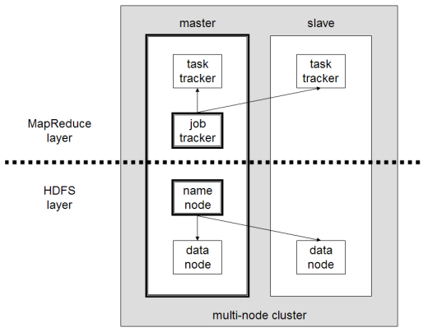
Job Tracker and Task Tracker

Slide 31
Job Tracker:
Basically Job Tracker will be useful in the Processing the data.
Job Tracker receives the requests from the client for MapReduce execution.
Job Tracker talks with Name node to know about the location of the data like Job Tracker will request the Name Node for the processing the data.
Name node in response gives the Metadata to job tracker.

Slide 32
Task Tracker
It is the Slave Node for the Job Tracker and it will take the task from the Job Tracker.
Task Tracker receives code from the Job Tracker and apply the code on the file for the process is known as Mapper.

Slide 33
Why should you use the HDFS?
It is distributed across hundreds or even thousands of servers with each node storing a part of the file system.
Storage is done on commodity hardware.
More chances of the node failing and with that the data can be lost.
HDFS gets over that problem by storing the same data in three sets.
HDFS works quite well for data loads that come in a streaming format.
It is more suited for batch processing applications rather than interactive use.
It is important to note that HDFS works for high throughput.

Slide 34
Why should you use the HDFS?
HDFS works exclusively well for large data sets.
The standard data sets could be in the range of gigabytes and even terabytes.
It is possible to scale to hundreds of nodes in a single cluster.
Tens of millions of files are supported in a single instance.
HDFS is highly portable
It can easily work on commodity hardware that are of different types without any issue of compatibility.
It is very well suited for taking advantage of cheaply and readily available commodity hardware components.

Slide 35
Design Criteria of HDFS
Very Large Files
Lots of Small Files
Petabyte-Scale data
Growing of FileSystem Metadata
Streaming Data Access
Random Data Access
Write-once, read-many-times
High Throughput
Multiple Writers, Arbitrary file update
Low Latency
Commodity Hardware
Node Failure handling

Slide 36
The Design of HDFS
HDFS is designed for storing very large files with streaming data access patterns, running on clusters of commodity hardware.
1. Very Large Files
“Very large” means files that are hundreds of Megabytes, Gigabytes, or Terabytes in size.
There are Hadoop clusters running that store Petabytes of data.

Slide 37
2. Streaming Data Access
HDFS is built an efficient Data Processing Pattern is Write-Once, Read-Many-Times Pattern.
A Dataset is typically generated or copied from source, then various analyses are performed on that dataset over time.

Slide 38
3. Commodity Hardware
Hadoop doesn’t require Expensive, Highly Reliable Hardware to run on.
It’s designed to run on clusters of commodity hardware (commonly hardware available from multiple vendors).
HDFS is designed to carry on working without interruption to the user in the face of such failure.

Slide 39
4. Low-latency data access
Applications require low-latency access to data, in the tens of milliseconds range, but, will not work well with HDFS.
Remember, HDFS is optimized for delivering a high throughput of data, and this may be at the expense of latency.
Hbase is currently a better choice for low-latency access.

Slide 40
5. Lots of Small Files
Here, each file, directory or block will takes 150 bytes of sizes.
for example, if you had one million files, each taking one block size would be need at least 300 MB of memory.

Slide 41
6. Multiple Writers, Arbitrary File Modifications
Files in HDFS may be written to by a single writer.
Writes are always made at the end of the file.
There is no support for multiple writers, or for modifications at arbitrary offsets in the file.

Slide 42
HDFS Concept
Very Large Distributed File System
10K nodes, 100 million files.
Very large means –files are in the size of hundreds of MB, GB or TB.
Hadoop running today stores PB of data.
Streaming data access
Built around the idea of most efficient data processing pattern.
Write-once, read-many pattern
Datasets are typically generated or copied from source, and then various analysis are performed on dataset.
Time to read the whole dataset in important than time to read the first record.

Slide 43
HDFS Concept
Assumes Commodity Hardware
Hadoop doesn’t requires expensive hardware,
Designed to run on clusters of commodity hardware.
Files are replicated to handle hardware failure
Detect failures and recover from them
Is also worth examining the applications for which HDFS does not works well.
Low-latency data access.
Applications in terms of 10 of milli-seconds
Optimized to provide high through-put at the expense of latency
Lost of small files.

Slide 44
HDFS Concept
Data Coherency
Write-once-read-many access model
Client can only append to existing files
Files are broken up into blocks
Typically 64MB block size in version1 and 128MB block size in version2
Each block replicated on multiple DataNodes.

Slide 45
HADOOP ECHOSYSTEM

Slide 46
Hadoop EcoSystem
Hadoop Ecosystem is neither a programming language nor a service, it is platform or framework which solves big data problems.
You can consider it as a suite which number of services (ingesting, storing, analyzing and maintaining) inside it.

Slide 48
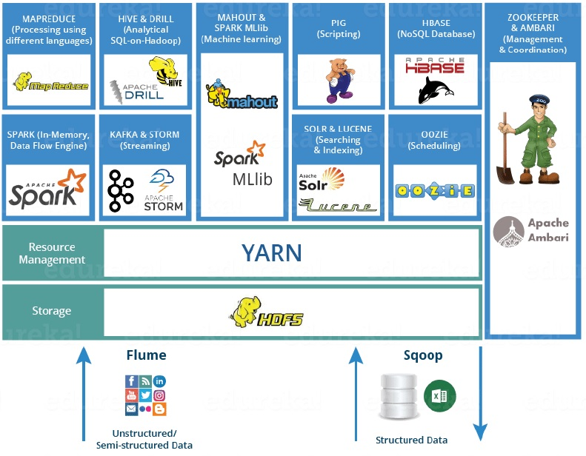

Slide 49
EchoSystem Components,
• HDFS -> Distributed Storage Management
• YARN -> Yet Another Resource Negotiator (Cluster
Resource Management)
• MapReduce -> Data processing using programming
• Spark -> In-memory Data Processing
• PIG, HIVE-> Data Processing Services using Query (SQL- like)

Slide 50
Cont…
• HBase -> NoSQL Database
• Mahout, Spark MLlib -> Machine Learning
• Apache Drill -> SQL on Hadoop
• Zookeeper -> Managing Cluster
• Oozie -> Job Scheduling
• Flume, Sqoop -> Data Ingesting Services
• Solr& Lucene -> Searching & Indexing
• Ambari -> Provision, Monitor and Maintain cluster

Slide 51
PIG
A data flow language and execution environment for exploring very large datasets. Pig runs on HDFS and MapReduce clusters.
SQOOP
It’s a tool for efficiently moving data between relational databases and HDFS.

Slide 52
APACHE DRILL is used to drill into any kind of data.
It supports different kinds NoSQL databases(mongoDB) and file systems.
The main power of Apache Drill lies in combining a variety of data stores just by using a single query.
It has a powerful scalability factor in supporting millions of users and serve their query requests over large scale data.

Slide 53
YARN Technology
An open source resource management technology.
Its allocate the resources to various applications effectively.
There are Two different tasks:
Job tracking
progress monitoring.

Slide 54
YARN Technology
These two daemons are called the resource manager and the application master.
The resource manager
allocates resources to various applications
Application master
monitors the execution of the process.

Slide 55
Oozie: Job Scheduling
--> Avro: A data serialization system.
--> Cassandra: A scalable multi-master database with no single points of failure.
--> Chukwa: A data collection system for managing large distributed systems.
--> HBase: A scalable, distributed database that supports structured data storage for large tables.

Slide 56
Oozie: Job Scheduling
--> Hive: A data warehouse infrastructure that provides data summarization and adhoc querying.
Hive has three main functions:
1. data summarization, 2. query, and 3. analysis.
Hive is called Hive Query Language (HQL), which is very similar like SQL.
Hive has 2 basic components:
1. Hive Command Line and 2. JDBC/ODBC driver.

Slide 57
Oozie: Job Scheduling
--> Mahout: A Scalable machine learning and data mining library.
--> Ozone: A scalable, redundant, and distributed object store for Hadoop.
--> Pig: A high-level data-flow language and execution framework for parallel computation.
--> Spark: A fast and general compute engine for Hadoop data.
Spark provides a simple and expressive programming model that supports a wide range of applications, including ETL, machine learning, stream processing, and graph computation.

Slide 60
a) FIFO Scheduler
First In First Out is default scheduling policy used in Hadoop.
FIFO Scheduler gives more preferences to the application first come and first serve.
It places the applications in queue and executes them in the order of their submission (FIFO).
Here, irrespective of the size and priority, the request for the first application in the queue are allocated first.
Once the first application request is satisfied, then only the next application in the queue is served.

Slide 61
Cont…
FIFO Advantage:
It is simple to understand and doesn’t need any configuration.
Jobs are executed in the order of their submission.
FIFO Disadvantage:
It is not suitable for shared clusters.
If the large application comes before the shorter one, then the large application will use all the resources in the cluster, and the shorter application has to wait for its turn. This leads to starvation.

Slide 62
b) Capacity Scheduler

Slide 63
b) Capacity Scheduler
It’s designed to run multi-tenant cluster while maximizing the throughput and the utilization of the cluster.
It supports hierarchical queues to reflect the structure of organizations or groups that utilizes the cluster resources.
A queue hierarchy contains three types of queues that are root, parent, and leaf.
The root queue represents the cluster itself, parent queue represents organization/group or sub-organization/sub-group, and leaf accepts application submission.

Slide 64
Advantages:
It maximizes the utilization of resources and throughput in the Hadoop cluster.
Provides Elasticity for groups or organizations in a cost-effective manner.
It gives capacity guarantees and safeguards to the organization utilizing cluster.
Disadvantage:
It is complex than other scheduler.

Slide 65
c) Fair Scheduler

Slide 66
FairScheduler allows YARN applications to fairly share resources in large Hadoop clusters.
There is no need for reserving set amount of capacity because it will dynamically balance resources between all running applications.
It assigns resources to applications that all applications get, on average, and an equal amount of resources.

Slide 67
The FairScheduler, by default, takes scheduling fairness decisions only on the basis of memory. (both memory and CPU.)
The FairScheduler supports hierarchical queue to reflect the structure of the long shared cluster.

Slide 68
Advantages:
It provides a reasonable way to share between the number of users in clusters.
FairScheduler can work with app priorities where the priorities are used as weights in determining the fraction of the total resources that each application should get.
Disadvantage:
It requires configuration.

Slide 69
Hadoop 2.0 High Availability

Slide 70
Hadoop 2.0 High Availability
No Data Loss on Failure/No Job Failure/No Downtime
Stand for Multiple Failures
Self Recovery from a Failure
Ease of Installation
No Demand for Additional Hardware Requirements

Slide 71
HDFS Federation

Slide 73
Even though a Hadoop Cluster can scale up to hundreds of DataNodes, the NameNode keeps all its metadata in memory (RAM). This results in the limitation on maximum number of files a Hadoop Cluster can store (typically 50-100M files). As your data size and cluster size grow this becomes a bottleneck as size of your cluster is limited by the NameNode memory.
In order to scale the name service horizontally, federation uses multiple independent Namenodes and Namespaces. The Namenodes are federated, that is, the Namenodes are independent and don’t require coordination with each other. The DataNodes are used as common storage for blocks by all the Namenodes. Each DataNode registers with all the NameNodes in the cluster. DataNodes send periodic heartbeats and block reports and handle commands from the NameNodes.

Slide 74
NameNode High Availability
In Hadoop 1.x, NameNode was single point of failure. NameNode failure makes the Hadoop Cluster inaccessible. Usually, this is a rare occurrence because of business-critical hardware with RAS features used for NameNode servers.
In case of NameNode failure, Hadoop Administrators need to manually recover the NameNode using Secondary NameNode.
Hadoop 2.0 Architecture supports multiple NameNodes to remove this bottleneck. Hadoop 2.0, NameNode High Availability feature comes with support for a Passive Standby NameNode. These Active-Passive NameNodes are configured for automatic failover.

Slide 77
All namespace edits are logged to a shared NFS storage and there is only a single writer (with fencing configuration) to this shared storage at any point of time.
The passive NodeNode reads from this storage and keeps an updated metadata information for cluster.
In case of Active NameNode failure, the passive NameNode becomes the Active NameNode and starts writing to the shared storage.
The fencing mechanism ensures that there is only one write to the shared storage at any point of time.
With Hadoop Release 2.4.0, High Availability support for Resource Manager is also available.

Slide 78
YARN – Yet Another Resource Negotiator
Large amount of Data from multiple stores is stored in HDFS but you can only run MapReduce framework jobs on to process and analyse the same (with Pig and Hive).
To process with other framework applications such as Graph or Streaming, you need to take this data out of HDFS, for example, into Cassandra or HBase.
Hadoop 2.0 provides YARN API‘s to write other frameworks to run on top of HDFS.
This enables running Non-MapReduce Big Data Applications on Hadoop.
Spark, MPI, Graph, and HAMA are few of the applications written or ported to run within YARN.

