Slide 1
DATA LINK LAYER

Slide 2
DESIGN ISSUSES:
Error detection and correction
Stop and wait protocol
Sliding window protocols
Eg : data link protocols
THE MAC SUB LAYER:
The channel allocation problem
Multiple access protocols
Wireless LANS-bridges-FDDI

Slide 3
DESIGN ISSUES
.Second layer of OSI model
.Most complicated layer and has complex functionalites

Slide 4
DLL IS DIVIDED INTO 2 SUBLAYERS
Logical link control: It deal with protocols, flows, error controls
Media access control: It deal with actual control of media

Slide 5
FUNCTIONALITY OF DATA LINK LAYER
Farming
Addressing
Synchronization
Error control
Flow control
Multi access

Slide 6
FRAMING:
It takes packets from internet layer and encapsulates them into frames
It sends each frame bit by bit to receiver.
ADDRESSING:
DLL provides addressing destination hardware address will be included in header

Slide 7
SYNCHRONIZATION:
To avoid data loose sending some check point and if any data is lost will not go with the first frame and continue with the same frame where error is occur
ERROR CONTROL:
It can occur during transmission that can be detect in data link layer. Receiver sends acknowledgement to transmit the corrupted data

Slide 8
FLOW CONTROL:
When a data frame is send from one host to other over a single medium, it is required that a sender and receiver should at a same speed
It sender is sending to fast the receiver may be over loaded
MULTIACCESS:
Multiple user can access a shared media among multiple system

Slide 9
ERROR DETECTION AND CORRECTION
There are many mesons such as noise, cross-talk etc. which may help data to get corrupted during transmission. DLL uses some error control mechanism. To understand how errors is controlled, it is essential to known what types of errors may occur.

Slide 10
TYPES OF ERROR
THREE TYPES OF ERRORS
Single bit error
Multiple bit error
Burst error

Slide 11
SINGLE BIT ERROR:
sent received
In a frame, there is only one bit, anywhere through, which is corrupt.
MULTIPLE BIT ERROR:
sent received
Frame is received with more than one bits in corrupted state
0 | 1 | 1 | 1 | 0 | 0 | 1 | 1
0 | 1 | 1 | 1 | 0 | 1 | 1 | 1
1 | 0 | 1 | 1 | 0 | 0 | 1 | 1
1 | 0 | 1 | 0 | 0 | 1 | 1 | 1

Slide 12
BURST ERROR:
sent received
Frame contains more than or consecutive bits corrupted
Error control mechanism may involve two possible ways
Error detection
Error correction
1 | 0 | 1 | 1 | 0 | 0 | 1 | 1
1 | 1 | 0 | 0 | 0 | 1 | 1 | 1

Slide 13
ERROR DETECTION
Errors in the received frames are detected by means of
Parity check
Cyclic redundancy check
Check sum

Slide 14
PARITY CHECK:
One extra bit is sent along with the original bits to make number of is either even in case of even parity or odd in case of odd parity.
Count of is should be even
1 0 1 0 0 101000 101000
sender data even parity bit receiver
This is even parity. The no. ‘1’ is in odd

Slide 15
Odd parity:
10101 101001 101011
Sender data odd parity
The no. of ‘1’ is in even.
Multiple error bits are not rectified by parity check

Slide 16
CYCLIC REDUNDANCY CHECK
Data – 1 0 1 1 0 1
CRC generator – 1 1 0 1
CRC bits = n-1 =3

Slide 17
CHECK SUM:
In check sum error detection scheme, the data is divided into ‘k’ segments each of ‘m’ bits
In the gender’s end the segments are added using 1’s complement arithmetic to get the sum. The sum is complemented to get check sum
The check sum segment is sent along with the data segments
At the receivers end, all received segments are added using is complement arithmetic to get the sum. The sum is complemented

Slide 18
If the result is zero the received data is accepted, other wise discarded original data

Slide 19
ERROR CORRECTION TECHNIQUES:
Error correction techniques find out the exact number of bits that have been corrupted and as well as their locations.
Two principle ways
Backward error correction (retransmission)
Forward error correction

Slide 20
BACKWARD ERROR:
Receiver detects an error in the incoming frame, it requests the sender to retransmit the frame
Retransmitting is not expensive as in fiber optics.
FORWARD ERROR CORRECTION:
Receiver detects some error in the incoming frame, it executes error correction code that generates the actual frame
It there are too many errors, the frames need to be retransmitted.
The two main error correction codes are
1.Hamming codes 2. binary convolution code

Slide 21
STOP AND WAIT
Two types of mechanism can be implemented to the control the flow
This flow control mechanism forces the sender after transmitting a data frame to stop and wait until the acknowledgement of the data frame send is received.

Slide 22
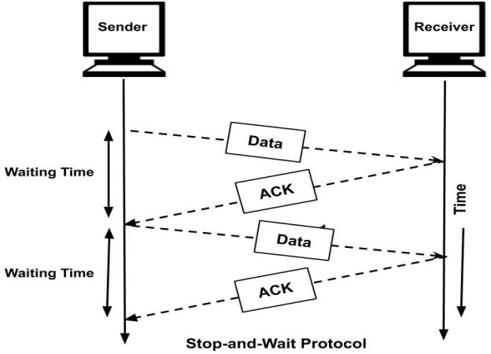

Slide 23
REQUIREMENTS FOR ERROR CONTROL MECHANISM
Error detection
Positive ack
Negative ack
Retransmission

Slide 24
ERROR DETECTION:
The sender and receiver, either both or any, must know that there is some error in transit.
POSTIVE ACK:
When the receiver receives the correct frame, it should acknowledgement it
NEGATIVE ACK:
When the receiver receives a damage frame or duplicate frame,
It send a NACK. Back to the sender and the sender must retransmit the correct frame.

Slide 25
RETRANSMISSION:
The sender maintains a clock and sets a time out period
It may acknowledgement of a data frame previously transmitted does not arrive before the time out the sender retransmit the frame, thinking the frame or it’s acknowledgement is lost in transit

Slide 26
There are three types of techniques available in DLL
Stop – and – wait (ARQ- Automatic repeat request)-
go-back-N ARQ
Selective repeat ARQ

Slide 27
SLIDING WINDOW:
In this flow control mechanism both sender and receiver agree on the number of data frames after which the acknowledgement should be sent stop and wait flow control mechanism. Wastes resource this protocol tries to make use of underlying resource as much as possible.
go-back-N
Selective repeat
Send multiple frames at a time
No of frames to be send is based on window sizes
Each frame is number sequences number.

Slide 28
Go-back-N ARQ:
Stop and wait ARQ mechanism does not utilize the resources at there best.
When the acknowledgement is received the sender sits ideal and does nothing, in go-back-N ARQ method, both sender and receiver maintain the window

Slide 29
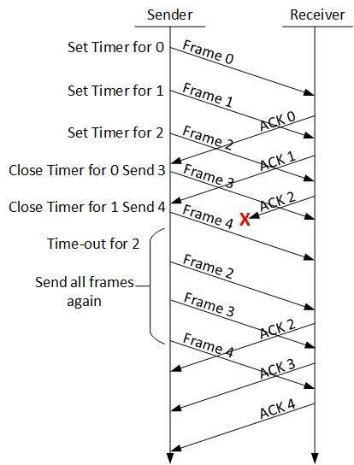

Slide 30
The sending window size enables the sender to send multiple frames without receiving the acknowledgement of the previous one. The receiving window enable the receiver to receive multiple frames and acknowledge them. The receiver keeps track of incoming frames in sequences number.
When the sender sends all the frames in window, it checks up to what’s sequences number it has receive positive acknowledgement. If all frames are positively acknowledged, the sender sends next set of frames. If sender finds that it has received “NACK” or has not receive any ack for a particular frame, it retransmits all the frames after to which does not receive any positive ack.

Slide 31
SELECTIVE REPEAT ARQ:
In Go-back-N ARQ, it is assumed that the receiver does not have any buffer space for it’s window. Size and has to process each frame as it comes. This enforces the sender to retransmit
All the frames which are not acknowledged
In selective repeat ARQ, there is receiver by keeping track of sequences number, buffer. The frame in memory and send NACK for only framed which is missing or damaged

Slide 32
The sender in this case sends only packet for which NACK is received.

Slide 33
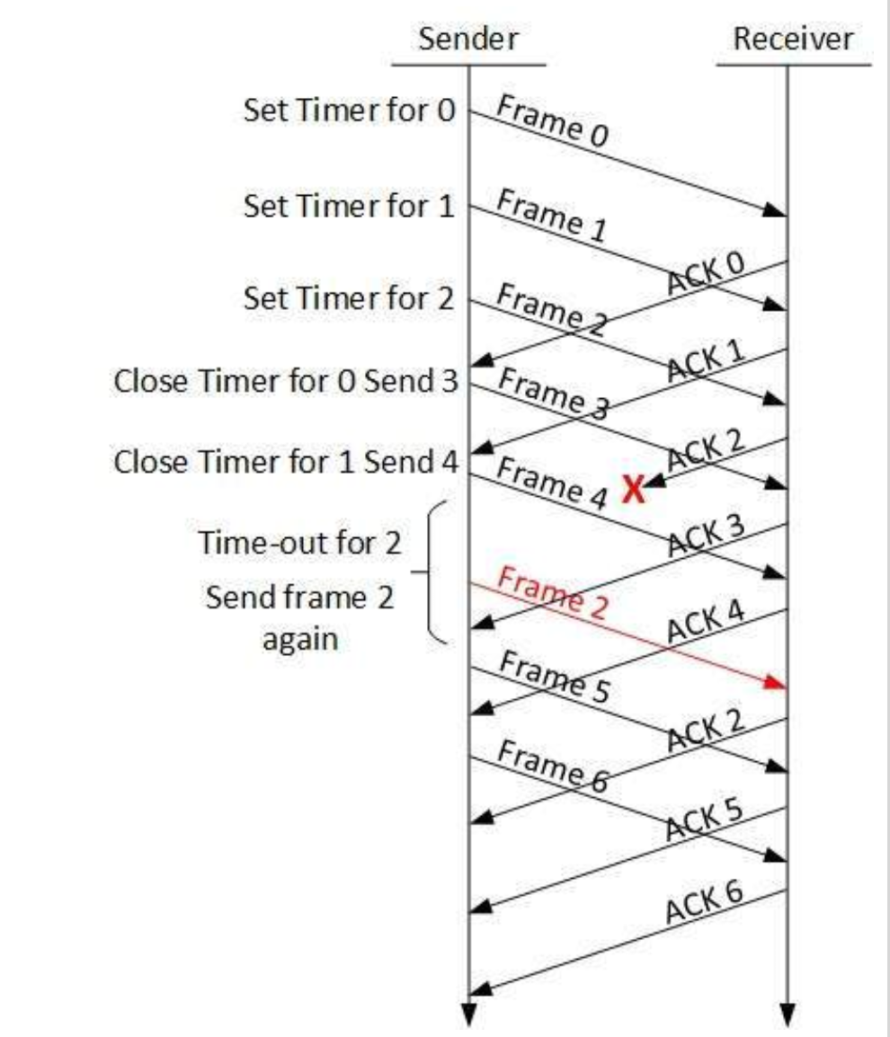

Slide 34
Example data link protocols:
HDLC [High level data link control]
The data link layer in the internet
HDLC :
Derived from SDLC used in IBM Main framing
[Synchronous Data link protocols]
Bit oriented protocol used bit stuffing
Reliable protocol / selective repeat or go-back-N
Full duplex communication
There are three different classes or Frames used in HDLC
Information frames: which carry actual information such frames can piggy back Ack.

Slide 35
Supervisory frames:
Which are used for error and flow control purpose and hence contain send and sequence numbers
Unnumbered frames:
Used in link set up and disconnection
HDLC Frames types:
Information frames
Supervisory frames
Unnumbered frames

Slide 36
FLAG | ADDRESS | CONTROL | USER INFROMATION | FCS | FLAG
INFORMATION FRAME
FLAG | ADDRESS | CONTROL | FCS | FLAG
SUPERVISORY FRAME
FLAG | ADDRESS | CONTROL | MANAGEMENT INFORMATION | FCS | FLAG
UNNUMBERED FRAME

Slide 37
FLAG FIELD:
Is 8bits of a fixed pattern (01111110)
There is one flag at the beginning and one at the end frame
The ending flag of one frame can be used as the beginning flag of the next frame
To guarantee that the flag does not appear any where else in the frame
HDLC uses a process called bit suffing
BITS
8 8 8 >0 16 8
01111110 | ADDRESS | CONTROL | DATA | CHECKSUM | 01111110

Slide 38
HDLC Control field:
Data link layer is highly responsible for hop to hop delivery
I- FRAME
I-FRAME
N(S) N(R)
S-FRAME
CODE N(R)
U-FRAME
CODE CODE
FLAG | ADDRESS | CONTROL | INFORMATION | FCS | FLAG
0 |  |  |  | PF
1 | 0 |  |  | PF
1 | 1 |  |  | PF

Slide 39
POLL/FINAL:
P/F=1 poll or final
Poll if frame is send by the primary
Final if frame is sent by the secondary
INFORMATION:
User data in an I-frame
Missing in an S-frame
Management information in a U-frame
primary
secondary

Slide 40
S-FRAMES
CODE N(R)
Code command
00 RR-receiver ready
01 REJ-reject
RNR-receiver not ready
11 SRE-selective reject
FLAG | ADDRESS | CONTROL | FCS | FLAG
1 | 0 |  |  | PF

Slide 41
RECEIVER READY (RR):
Positive ack of received I-frame
RECEIVER NON-READY (RNR):
Is RR frame with additional duties
It ack the receipt of a frame that the receiver is busy
REJECT (REJ):
This is a NAK frame that can be used in go-back-N
SELECTIVE REJECT (SREJ):
This is a NAK frame used in selective repeat ARQ

Slide 42
U-FRAMES:
EG: 11 010 – disconnect connection
FLAG | ADDRESS | CONTROL | MANAGEMENT INFORMATION | FCS | FLAG
1 | 1 |  |  | PF

Slide 43
MAC sublayer:
Is sublayer in which channel is allocation to multiple user
MAC sublayer is important in LANS
CHANNEL ALLOCATION PROBLEM:
In which a single channel is divided allotted to multiple user is order to carry a user specific tasks

Slide 44
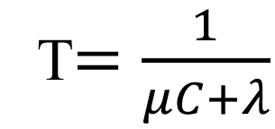
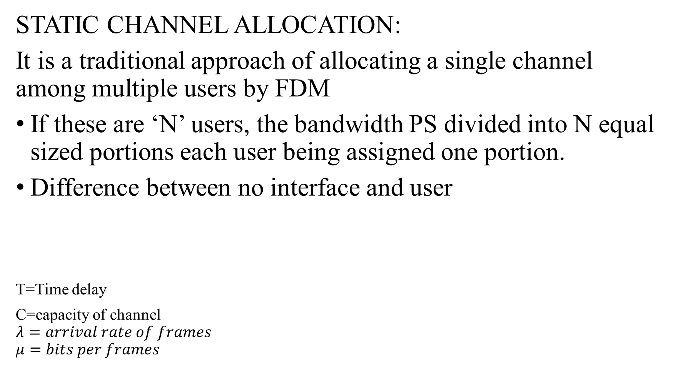
STATIC CHANNEL ALLOCATION:
It is a traditional approach of allocating a single channel among multiple users by FDM
If these are ‘N’ users, the bandwidth PS divided into N equal sized portions each user being assigned one portion.
Difference between no interface and user
T=Time delay
C=capacity of channel
$$λ=arrival rate of frames$$
$$μ=bits per frames$$
T$=\frac{1}{μC+λ}$

Slide 45
DYNAMIC CHANNEL ALLOCATION
It is based up on possible
Station model
Single channel assumption
Collision assumption
Time
Continuous
Slotted
Carrier sense
No carrier sense

Slide 46
STATION MODEL:
Model consists of N independent stations (Eg: computer, telephone or personal communication ) each with a program
Stations are sometime called terminates
A frame being generated in an interval of length t is
lamda t
Where lamda is a constant create of new frame
One frame is generated, station is blocked and does nothing until
the frame has be successfully transmitted

Slide 47
SINSLE CHANNEL ASSUMPTION
Single channel is available for all communication
All stations can transmit on it and all can receive from it
COLLISION ASSUMPTION
If two frames are transmitted simultaneously, they develop in time, tjis event is called a collision
Collision frame must be transmitted again

Slide 48
TIME:
It can be divided into two types
Continuous time
Slotted time
CONTINUOUS TIME:
frame transmission can begin at any instant. There is no matter clock dividing time into discrete intervals
SLOTTED TIME:
Time is divided into discrete intervals (slots). Frame transmissions always begin at the start of a slot.

Slide 49
CARRIER SENSE
If the channel is in use before trying to use it, if the channel is busy no station will be use
NO CARRIER SENSE
Stations cannot sense the channel before trying to use it. Time of used to sense loss data.

