Slide 1
  Unit-5
  BigData Analytics
  (20CSE361)

Slide 2
Introduction to HBse
HBase is distributed column-oriented database built on top of the Hadoop file system.
HBase an Open-Source Non-Relational Distributed DB modeled.
Its developed as part of Apache Software Foundation.
HBase is data model that provide quick random access to huge amounts of structured data.

Slide 3
Introduction to HBse
Its part of the Hadoop ecosystem that provides random real-time read/write access to data in the HDFS either data can store directly in HDFS or through HBase.
Data consumer reads/accesses the data in HDFS randomly using HBase.

Slide 4
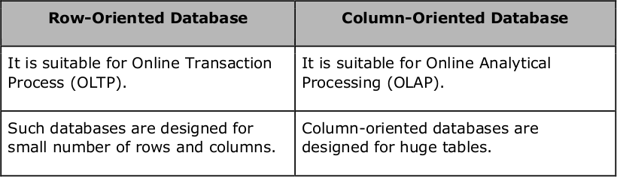
Column Oriented vs. Row Oriented

Slide 5
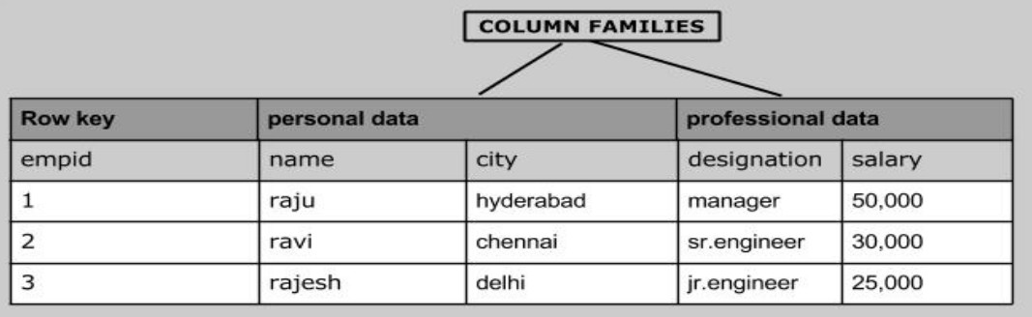
example

Slide 6
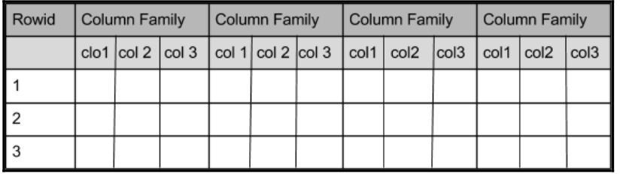
example

Slide 7
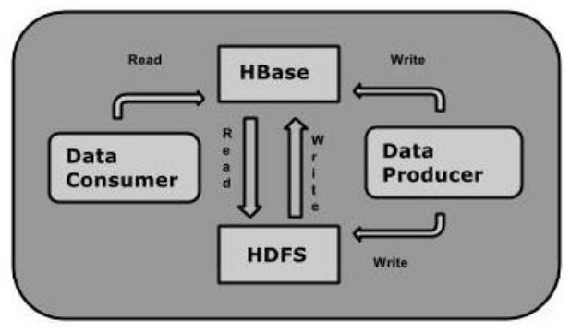

Slide 8
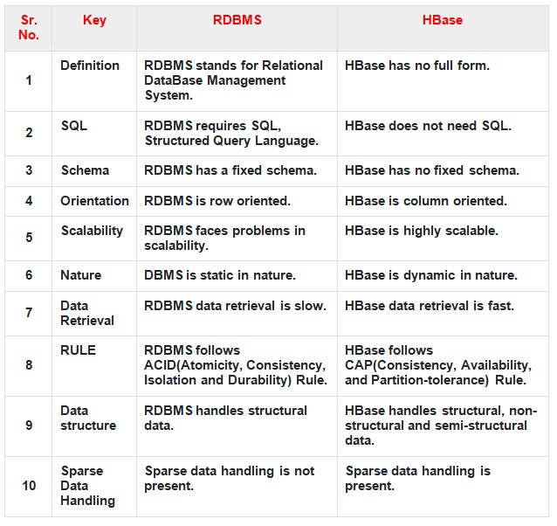
HBase vs RDBMS

Slide 9
Features of HBase
HBase is linearly scalable.
It has automatic failure support.
It provides consistent read and writes.
It integrates with Hadoop, both as a source and a destination.
It has easy java API for client.
It provides data replication across clusters.

Slide 10
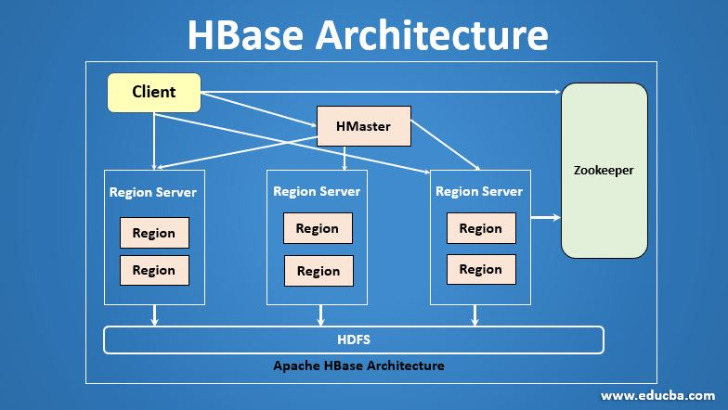

Slide 11
Master Server
HBase has mainly three different parts are HMaster, RegionServer and the Zookeeper.
HMaster: HMaster in HBase is a process which helps to assign the regions to region server. It balances the loads by assigning the regions.
HMaster helps to create, modify, and delete tables in the database.
It also cares about different tasks when the client wants to change the schema or metadata.

Slide 12
Region Server
Region Server are the main working with nodes. It handles the Read, Write, and Modify requests from the clients.
The region server runs on every node in the Hadoop clusters.
Its read cache called Block Cache, read data are stored in the read cache, and when the cache is full, recently used data is removed. Another cache is present here called MemStore.

Slide 13
Region Server
It is the write cache.
It stored new data that is not yet stored in the disks.
Each Colum-Family has differently write cache in it.
It has the actual storage file called Hfile. It stored the actual data on disk.
The default size of a region is 256 MB.

Slide 14
Zookeeper
This is an Open-Source Server which enables the reliable distributed coordination.
Zookeeper is centralized service that maintains the configuration information.
It also maintains distributed synchronization, server failure notification etc.
Zookeeper service keeps tracks on all region servers via HBase.

Slide 15
Advantages of HBase –
Can store large data sets
Database can be shared
Cost-effective from gigabytes to petabytes
High availability through failover and replication

Slide 16
Disadvantages of HBase –
No support SQL structure
No transaction support
Sorted only on key
Memory issues on the cluster

Slide 17
Introduction to ZooKeeper
ZooKeeper is an open source Apache project that provides a centralized service for providing configuration information, naming, synchronization and group services over large clusters in distributed systems.
The goal is to make these systems easier to manage with improved, more reliable.

Slide 18
Introduction to ZooKeeper
Zookeeper is used in distributed systems to coordinate distributed processes and services.
Zookeeper is designed to be highly reliable and fault-tolerant, and it can handle high levels of read and write throughput.

Slide 19
Why use ZooKeeper?
Difficulty of implementing these kinds of services reliably
  easily broken in the presence of change
  difficult to manage
  different implementations lead to management complexity when the applications are deployed

Slide 20
ZooKeeper Architecture
ZooKeeper Service
Leader
Server
Server
Server
Server
Server
Server
Client
Client
Client
Client
Client
Client
Client
All servers store a copy of the data (in memory)‏
A leader is elected at startup.
All updates go through leader
Update responses are sent when a majority of servers have persisted the change.

Slide 21
Client: Client is one of the nodes in the distributed application cluster.
It helps you to accesses information from the server.
Every client sends a message to the server at regular intervals that helps the server to know that the client is alive.

Slide 22
Server: The server sends an acknowledge(response) when any client connects.
In the case, when there is no response from the connected server, the client automatically redirects the message to another server.

Slide 23
Leader: It gives all the information to the clients as well as an acknowledgment that the server is alive.
It would performs automatic recovery if any of the connected nodes failed.

Slide 24
Follower:
Server node which follows leader instruction is called a follower (who are all follows leader’s instruction).
The Client read requests are handled by the correspondingly connected Zookeeper server.
The client writes requests are handled by the Zookeeper leader.

Slide 25
Ensemble/Cluster:
Group of Zookeeper servers which is called ensemble or a Cluster.
You can use ZooKeeper infrastructure in the cluster mode to have the system at the optimal value when you are running the Apache.

Slide 26
ZooKeeper WebUI:
If you want to work with ZooKeeper resource management, then you need to use WebUI.
It allows work with ZooKeeper using the web user interface, instead of using the command line.
It offers fast and effective communication with the ZooKeeper application.

Slide 27
Types of Zookeeper Nodes
Persistence znode:
( exists till explicitly deleted)
This type of znode is alive even after the client which created that specific znode is disconnected.
By default, in zookeeper, all nodes are persistent if it is not specified.

Slide 28
Cont…
2. Ephemeral znode:
( exists as long as the session is alive and can’t have childred )
This type of zookeeper znode are alive until the client is alive.
Therefore, when the client gets a disconnect from the zookeeper, it will also be deleted. Moreover, Ephemeral nodes are not allowed to have children.

Slide 29
Cont…
3. Sequential znode:
Sequential znodes can be either ephemeral or persistent. So when a new znode is created as a sequential znode.
You can assign the path of the znode by attaching a 10 digit sequence number to the original name.

Slide 30
Building Applications with Zookeeper
1. Configuration Management
What it means:
Keeping configuration settings (like database URLs, feature flags, etc.) in one place that all servers in your system can access and update.
Why it’s useful:
Instead of updating configs on each server manually, you update once in ZooKeeper and all nodes get it.
Example:
Imagine an app with 5 servers. You store the database connection string in ZooKeeper at /config/db_url.
If the database URL changes, you only need to update /config/db_url once.
All 5 servers watch this znode and get notified automatically when the value changes.

Slide 31
Building Applications with Zookeeper
Distributed Locking
ZooKeeper helps make sure that only one server or process can use a shared resource at a time. This avoids problems like two processes writing to the same file or database row at once.
Why it’s useful:
In distributed systems, many servers might try to do the same thing at the same time. ZooKeeper helps them take turns safely by creating a lock.
Example:
Let’s say three servers want to update a shared inventory file.
Each one tries to create a lock znode, like /locks/inventory.
Only one will succeed and hold the lock.
The others will wait.
When the first one finishes and deletes the lock, the next one gets its turn.
This makes sure the inventory file doesn’t get messed up by multiple updates happening at once.

Slide 32
Building Applications with Zookeeper
3. Leader Election:
What it means:
In a group of servers, one needs to act as the leader (like a boss). ZooKeeper helps pick that leader in a fair and automatic way.
Why it’s useful:
To avoid conflicts and make sure only one node handles sensitive tasks (e.g., sending emails or writing to a shared file).
Example:
You have 3 servers. Each creates an ephemeral sequential znode under /election.
ZooKeeper gives them names like /election/node_0001, node_0002, etc.
The one with the smallest number becomes the leader.
If that server dies, its znode disappears, and the next smallest node becomes the new leader.

Slide 33
Building Applications with Zookeeper
4. Service Discovery:
ZooKeeper helps services find each other without hardcoding IP addresses or ports. Services register themselves in ZooKeeper, and other apps can look them up when needed.
Why it’s useful:
In dynamic environments (like microservices or cloud setups), services may change IPs or ports often. ZooKeeper makes it easy to keep track of where everything is.
Example:
Let’s say you have a payment service running on Server A.
When it starts, it registers itself in ZooKeeper at:
/services/payment with value like "192.168.1.100:8080"
Now, whenever another app wants to use the payment service, it just reads from /services/payment to get the latest location.
If the payment service crashes and restarts on another server, it updates the znode again — so everyone stays in sync automatically.

Slide 34
Building Applications with Zookeeper
5. Distributed Queues: ZooKeeper can be used to implement distributed queues, where multiple processes or nodes can enqueue and dequeue elements. This is useful for scenarios where you need to distribute work among multiple workers or ensure ordered processing of tasks across multiple nodes.

Slide 35
Building Applications with Zookeeper
6. Name Services:
Mapping a name to an object or service in the system, like a phonebook for services.
Why it’s useful:
So services can find each other easily without hardcoding IPs or ports.
Example:
Your app needs to contact the "payment service".
Store its address in ZooKeeper at /services/payment_service.
When the service moves or restarts, it updates this znode.
Clients always read from /services/payment_service to get the latest address.

Slide 36
Building Applications with Zookeeper
7. Fault-tolerant Systems: ZooKeeper's fault-tolerant and highly available nature makes it well-suited for building fault-tolerant systems. Applications can rely on ZooKeeper to provide consistency and resilience, allowing them to recover from failures and continue functioning smoothly.

Slide 37
Installing and Running of Zookeeper
Before installing ZooKeeper, make sure your system is running on any of the following operating systems −
Any of Linux OS − Supports development and deployment. It is preferred for demo applications.
Windows OS − Supports only development.
Mac OS − Supports only development.
ZooKeeper server is created in Java and it runs on JVM. You need to use JDK 6 or greater.
Now, follow the steps given below to install ZooKeeper framework on your machine.
Step 1: Verifying Java Installation
We believe you already have a Java environment installed on your system. Just verify it using the following command.
$ java -version
If you have Java installed on your machine, then you could see the version of installed Java. Otherwise, follow the simple steps given below to install the latest version of Java.

Slide 38
Step 1.1: Download JDK
Download the latest version of JDK by visiting the following link and download the latest version. Java
The latest version (while writing this tutorial) is JDK 8u 60 and the file is “jdk-8u60-linuxx64.tar.gz”. Please download the file on your machine.
Step 1.2: Extract the files
Generally, files are downloaded to the downloads folder. Verify it and extract the tar setup using the following commands.
$ cd /go/to/download/path
$ tar -zxf jdk-8u60-linux-x64.gz
Step 1.3: Move to opt directory
To make Java available to all users, move the extracted java content to “/usr/local/java” folder.
$ su
password: (type password of root user)
$ mkdir /opt/jdk
$ mv jdk-1.8.0_60 /opt/jdk/
Step 1.4: Set path

Slide 39
To set path and JAVA_HOME variables, add the following commands to ~/.bashrc file.
export JAVA_HOME = /usr/jdk/jdk-1.8.0_60
export PATH=$PATH:$JAVA_HOME/bin
Now, apply all the changes into the current running system.
$ source ~/.bashrc
Step 1.5: Java alternatives
Use the following command to change Java alternatives.
update-alternatives --install /usr/bin/java java /opt/jdk/jdk1.8.0_60/bin/java 100
Step 1.6
Verify the Java installation using the verification command (java -version) explained in Step 1.
Step 2: ZooKeeper Framework Installation
Step 2.1: Download ZooKeeper
To install ZooKeeper framework on your machine, visit the following link and download the latest version of ZooKeeper. http://zookeeper.apache.org/releases.html
As of now, the latest version of ZooKeeper is 3.4.6 (ZooKeeper-3.4.6.tar.gz).

Slide 40
Step 2.2: Extract the tar file
Extract the tar file using the following commands −
$ cd opt/
$ tar -zxf zookeeper-3.4.6.tar.gz
$ cd zookeeper-3.4.6
$ mkdir data
Step 2.3: Create configuration file
Open the configuration file named conf/zoo.cfg using the command vi conf/zoo.cfg and all the following parameters to set as starting point.
$ vi conf/zoo.cfg
tickTime = 2000
dataDir = /path/to/zookeeper/data
clientPort = 2181
initLimit = 5
syncLimit = 2
Once the configuration file has been saved successfully, return to the terminal again. You can now start the zookeeper server.

Slide 41
Step 2.4: Start ZooKeeper server
Execute the following command −
$ bin/zkServer.sh start
After executing this command, you will get a response as follows −
$ JMX enabled by default
$ Using config: /Users/../zookeeper-3.4.6/bin/../conf/zoo.cfg
$ Starting zookeeper ... STARTED
Step 2.5: Start CLI
Type the following command −
$ bin/zkCli.sh
After typing the above command, you will be connected to the ZooKeeper server and you should get the following response.
Connecting to localhost:2181
................
................
................
Welcome to ZooKeeper!
................
................
WATCHER::
WatchedEvent state:SyncConnected type: None path:null
[zk: localhost:2181(CONNECTED) 0]

Slide 42
Stop ZooKeeper Server
After connecting the server and performing all the operations, you can stop the zookeeper server by using the following command.
$ bin/zkServer.sh stop
ZooKeeper Command Line Interface (CLI) is used to interact with the ZooKeeper ensemble for development purpose. It is useful for debugging and working around with different options.
To perform ZooKeeper CLI operations, first turn on your ZooKeeper server (“bin/zkServer.sh start”) and then, ZooKeeper client (“bin/zkCli.sh”). Once the client starts, you can perform the following operation −
Create znodes
Get data
Watch znode for changes
Set data
Create children of a znode
List children of a znode
Check Status
Remove / Delete a znode
Now let us see above command one by one with an example.

Slide 43
Create Znodes
Create a znode with the given path. The flag argument specifies whether the created znode will be ephemeral, persistent, or sequential. By default, all znodes are persistent.
Ephemeral znodes (flag: e) will be automatically deleted when a session expires or when the client disconnects.
Sequential znodes guaranty that the znode path will be unique.
ZooKeeper ensemble will add sequence number along with 10 digit padding to the znode path. For example, the znode path /myapp will be converted to /myapp0000000001 and the next sequence number will be /myapp0000000002. If no flags are specified, then the znode is considered as persistent.
Syntax
create /path /data
Sample
create /FirstZnode “Myfirstzookeeper-app”
Output
[zk: localhost:2181(CONNECTED) 0] create /FirstZnode “Myfirstzookeeper-app”
Created /FirstZnode

Slide 44
Installing Apache ZooKeeper
Steps for downloading and installing Zookeeper 3.4.6 with configuration for 3 nodes Zookeeper:
Download and install JDK from http://www.oracle.com/technetwork/java/javase/downloads/index.html or from http://www.guru99.com/install-java.html - if not already installed. Apache ZooKeeper server runs on JVM so this is an important prerequisite.
Go to http://zookeeper.apache.org/ and download the Zookeeper from release page.
Choose to download from mirrors and select the first mirror.
Go to stable folder and download zookeeper-3.4.6.tar.gz
Unpack the tar ball with tar –zxvf zookeeper-3.4.6.tar.gz
Make a directory using mkdir /usr/local/zookeeper/data. You can make this directory as root and then change the owner to any user needed.

Slide 45
Create a zookeeper configuration file using sudo vi / usr/local/zookeeper/conf/zoo.cfg and place the following code:
tickTime = 2000
syncLimit = 5
dataDir = /usr/local/zookeeper/data
clientPor t= 2181
server.1 = Master : 2888 : 3888
server.2 = Slave1 : 2888 : 3888
server.3 = Slave2 : 2888 : 3888
Create a file called myid in data folder using sudo vi / usr/local/zookeeper/data/myid and write “1” in this file without quotes and save it.
Do the same steps from 1 to 7 for other 2 servers but change myid data to 2 for server 2 and 3 for server 3.
Use the command zkServer.sh start to start the Zookeeper on all servers
To confirm that the Zookeeper has started type jps and check for QuorumPeerMain.
To start a client use command zkCli.sh -server Slave1:2181

Slide 46
Introduction of SQOOP
Sqoop − “SQL to Hadoop and Hadoop to SQL”
Sqoop is a data transfer tool
Sqoop transfer data between hadoop and relational DB servers
Sqoop is used to import data from relational DB such as MySQL, Oracle
Sqoop is used to export data from HDFS to relational DB
Tools -> Sqoop Import / Export

Slide 47
cont…
Sqoop is the tool to transfer the data between RDBMS and HADOOP vise versa.
Sqoop internally generate the mapreduce code to transfer the data and then run the code according to the properties mention in the command.

Slide 48
cont…
There are range connectors available to connect sqoop to traditional RDBMS such as:
Teradata (RDB Warehouse)
MySql
Oracle
Green plum
Netteza
Micro strategy

Slide 49
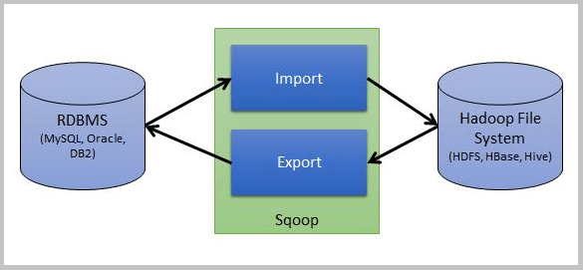
Sqoop Architecture

Slide 50
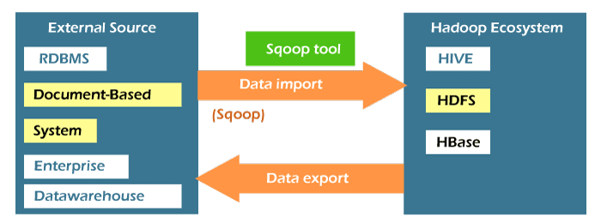
Sqoop Architecture

Slide 51
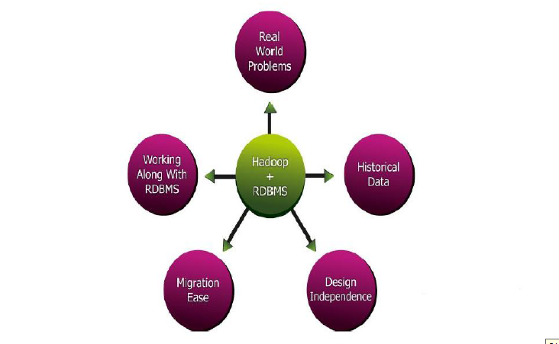
Why Sqoop?

Slide 52
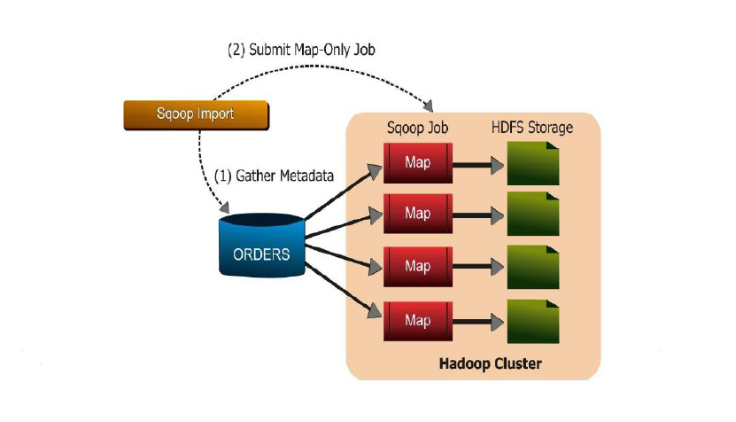
Sqoop Import

Slide 53
SQOOP Import
Import individual tables from RDBMS to HDFS
Each row in a table is treated as records in HDFS
All record are stored as text data in text files or binary files in AVRO (data serialization and data exchange service) and sequence file.

Slide 54
Syntax
The following syntax is used to import data into HDFS.
$ sqoop import (generic-args) (import-args)
$ sqoop-import (generic-args) (import-args)

Slide 55
Example
Let us take an example of three tables named as emp, emp_add, and emp_contact, which are in a database called userdb in a MySQL database server.

Slide 56
SQOOP Export
Export a set of files from HDFS back to RDBMS
Files given an input to SQOOP contains records called as rows in table
Those are read and parsed into a set of records and delimited with user-specified delimiter.

Slide 57
Syntax
The following is the syntax for the export command.
$ sqoop export (generic-args) (export-args)
$ sqoop-export (generic-args) (export-args)

Slide 58
Example
Let us take an example of the employee data in file, in HDFS. The employee data is available in emp_data file in ‘emp/’ directory in HDFS. The emp_data is as follows.
1201, gopal, manager, 50000, TP
1202, manisha, preader, 50000, TP
1203, kalil, php dev, 30000, AC
1204, prasanth, php dev, 30000, AC
1205, kranthi, admin, 20000, TP
1206, satish p, grp des, 20000, GR

Slide 59
FEATURES OF SQOOP
    Full Load.
    Incremental Load.
    Parallel import/export.
    Import results of SQL query.
    Compression.
    Connectors for all major RDBMS Databases.

Slide 60
ADVANTAGES OF SQOOP
Allows the transfer of data with a variety of structured data stores like Postgres, Oracle, Teradata, and so on.
Sqoop can execute the data transfer in parallel, so execution can be quick and more cost effective.
Helps to integrate with sequential data from the mainframe.

Slide 61
DISADVANTAGES OF SQOOP
It uses a JDBC connection to connect with RDBMS based data stores, and this can be inefficient and less performance.
For performing analysis, it executes various map-reduce jobs and, at times, this can be time consuming when there are lot of joins if the data is in a denormalized fashion.

Slide 62
Introduction of Apache Spark
Apache Spark is lightning-fast cluster computing technology, designed for fast computation.
It is based on Hadoop MapReduce and it extends the MapReduce model to efficiently use it for more types of computations, which includes interactive queries and stream processing.
The main feature of Spark is its in-memory cluster computing that increases the processing speed of an application.

Slide 63
Cont…
Spark is designed to cover a wide range of workloads such as batch applications, iterative algorithms, interactive queries and streaming.
Apart from supporting all these workload in a respective system, it reduces the management burden of maintaining separate tools.

Slide 64
Evolution of Apache Spark
Spark is one of Hadoop’s sub project developed in 2009 in UC Berkeley’s AMPLab by Matei Zaharia.
It was Open Sourced in 2010 under a BSD license.
It was donated to Apache software foundation in 2013, and now Apache Spark has become a top level Apache project from Feb-2014.

Slide 65
Features of Apache Spark
Speed − Spark helps to run an application in Hadoop cluster, up to 100 times faster in memory, and 10 times faster when running on disk.
This is possible by reducing number of read/write operations to disk.
It stores the intermediate processing data in memory.

Slide 66
Features of Apache Spark
Supports multiple languages − Spark provides built-in APIs in Java, Scala, or Python.
you can write applications in different languages.
Spark comes up with 80 high-level operators for interactive querying.
Advanced Analytics − Spark not only supports ‘Map’ and ‘reduce’.
It also supports SQL queries, Streaming data, Machine learning (ML), and Graph algorithms.

Slide 67
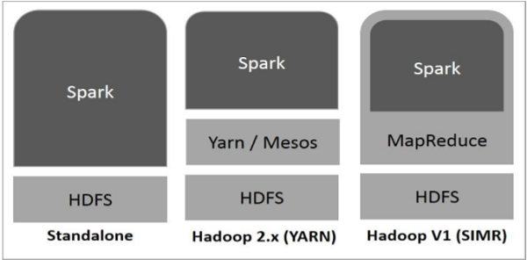
Spark Built on Hadoop

Slide 68
There are three Spark deployment ,
Standalone
Spark Standalone deployment means Spark occupies the place on top of HDFS and space is allocated for HDFS, explicitly.
Here, Spark and MapReduce will run side by side to cover all spark jobs on cluster.

Slide 69
Cont…
2. Hadoop Yarn
Hadoop Yarn deployment means, simply, spark runs on Yarn without any pre-installation or root access required.
It helps to integrate Spark into Hadoop ecosystem or Hadoop stack.
It allows other components to run on top of stack.

Slide 70
Cont…
3. Spark in MapReduce (SIMR)
Spark in MapReduce is used to launch spark job in addition to standalone deployment.
With SIMR, user can start Spark and uses its shell without any administrative access.

Slide 71
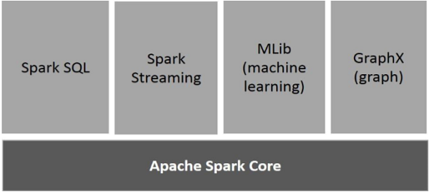
Components of Spark

Slide 72
i. Apache Spark Core
Spark Core is the underlying general execution engine for spark platform that all other functionality is built upon.
It provides In-Memory computing and referencing datasets in external storage systems.
ii. Spark SQL
Spark SQL is a component on top of Spark Core that introduces a new data abstraction called SchemaRDD, which provides support for structured and semi-structured data.

Slide 73
iii. Spark Streaming
Spark Streaming leverages Spark Core's fast scheduling capability to perform streaming analytics.
It ingests data in mini-batches and performs RDD (Resilient Distributed Datasets) transformations on those mini-batches of data.

Slide 74
iv. MLlib (Machine Learning Library)
MLlib is a distributed machine learning framework above Spark because of the distributed memory-based Spark architecture.
It is, according to benchmarks, done by the MLlib developers against the Alternating Least Squares (ALS) implementations.
Spark MLlib is nine times as fast as the Hadoop disk-based version of Apache Mahout (before Mahout gained a Spark interface).

Slide 75
v. GraphX
GraphX is a distributed graph-processing framework on top of Spark.
It provides an API for expressing graph computation that can model the user-defined graphs by using Pregel abstraction API.
It also provides an optimized runtime for this abstraction.

Slide 76
Introduction of Apache Oozie
Apache Oozie is a scheduler system to run and manage Hadoop jobs in a distributed environment.
Ooze allows to combine multiple complex jobs to be run in sequential order to achieve bigger task.
Within a sequence of task, two or more jobs can be programmed to run parallel to each other.
Advantages of Oozie is tightly integrated with Hadoop stack supporting various Hadoop jobs like Hive, Pig, Sqoop as well as system-specific jobs like Java and Shell.

Slide 77
Con…
Oozie detects completion of tasks through callback and polling.
When Oozie starts a task, it provides a unique callback HTTP URL to the task, and notifies that URL when it is complete.
If the task fails, invoke the callback URL and Oozie can poll the task for completion.
Oozie is an Open Source Java Web-Application available under Apache license 2.0.

Slide 78
Three types of jobs in Oozie
Oozie Workflow Jobs − These are represented as Directed Acyclic Graphs (DAGs) to specify a sequence of actions to be executed.
Oozie Coordinator Jobs − These consist of workflow jobs triggered by time and data availability.
Oozie Bundle − These can be referred to as a package of multiple coordinator and workflow jobs.

Slide 79
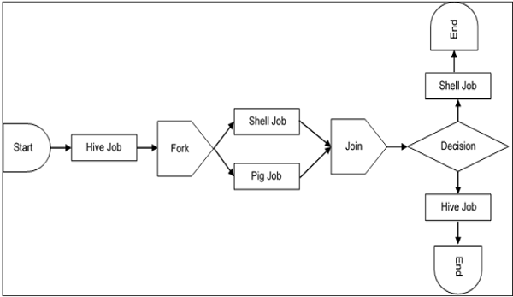
A sample workflow with Controls (Start, Decision, Fork, Join and End) and Actions (Hive, Shell, Pig)

Slide 80
Use-Cases of Apache Oozie
Apache Oozie is used by Hadoop system administrators to run complex log analysis on HDFS.
Hadoop Developer uses Oozie for performing ETL (Extract, Transform and Load) operations on data in sequential order and saving the output in specified format (Avro, ORC, etc.) in HDFS.
In an enterprise, Oozie jobs are scheduled as coordinators or bundles.

Slide 81
Introduction of Flume
Apache Flume is a tool/service/data ingestion mechanism for aggregating and transporting large amounts of streaming data such as log files, events etc… from various sources to centralized data store.
Flume is highly reliable, distributed, and configurable tool.
Flume’s principally designed to copy streaming data (log data) from various web servers to HDFS.

Slide 82
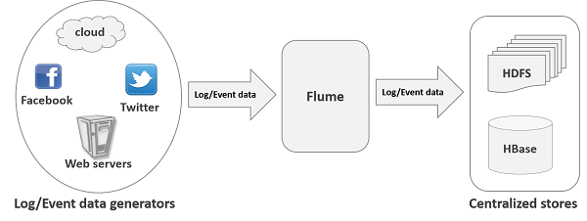
How Flume Work?

Slide 83
Applications of Flume
Flume is used to move the log data generated by application servers into HDFS at a higher speed.
Example: An E-commerce web application wants to analyze the customer behavior from particular region. So, they would need to move the available log data into Hadoop for analysis.

Slide 84
Advantages of Flume
Apache Flume can store the data into any centralized stores (HBase, HDFS).
Flume acts as a mediator between data producers and the centralized stores and provides a steady flow of data between them.
Flume are channel-based where two transactions (one sender and one receiver) are maintained for each message. It guarantees reliable message delivery.
Flume is reliable, fault tolerant, scalable, manageable, and customizable.

Slide 85
Features of Flume
Flume ingests log data from multiple web servers into a centralized store (HDFS, HBase) efficiently.
Using Flume, we can get the data from multiple servers immediately into Hadoop.
Along with the log files,
Flume used to import huge volumes of EVENT DATA produced by social networking sites like Facebook and Twitter, and e-commerce websites like Amazon and Flipkart.
Flume supports a large set of sources, multi-hop flows, fan-in, fan-out flows, contextual routing, etc.
Flume can be scaled horizontally.

Slide 86
Mahout - Introduction
Apache Mahout is an open source project that is primarily used for creating scalable machine learning algorithms.
It implements popular machine learning techniques such as:
      Recommendation
      Classification
      Clustering
Apache Mahout started as a sub-project of Apache’s Lucene in 2008. In 2010, Mahout became a top level project of Apache.

Slide 87
Features of Mahout
The primitive features of Apache Mahout are listed below.
The algorithms of Mahout are written on top of Hadoop, so it works well in distributed environment. Mahout uses the Apache Hadoop library to scale effectively in the cloud.
Mahout offers the coder a ready-to-use framework for doing data mining tasks on large volumes of data.
Mahout lets applications to analyze large sets of data effectively and in quick time.

Slide 88
Features of Mahout
Includes several MapReduce enabled clustering implementations such as k-means, fuzzy k-means, Canopy, Dirichlet, and Mean-Shift.
Supports Distributed Naive Bayes and Complementary Naive Bayes classification implementations.
Comes with distributed fitness function capabilities for evolutionary programming.
Includes matrix and vector libraries.

Slide 89
Applications of Mahout
Companies such as Adobe, Facebook, LinkedIn, Foursquare, Twitter, and Yahoo use Mahout internally.
Foursquare helps you in finding out places, food, and entertainment available in a particular area. It uses the recommender engine of Mahout.
Twitter uses Mahout for user interest modelling.
Yahoo! uses Mahout for pattern mining.

Slide 90
Mahout Workflow
Start by training a model using your input data and the algorithms of your choice.
Once you have a trained model, use it to predict new data.
You can then use these predicted values to build more complex models or incorporate them into your application as desired.

Slide 91
Mahout Workflow
Pros
User-friendly interface.
Using Mahout, we can easily analyze any Hadoop file system data directly from the file system because Mahout sits on top of Hadoop systems.
Using this software, you can deploy large-scale learning algorithms.
In the event of failure, it provides fault tolerance.
You can use Mahout to perform data preprocessing tasks, such as determining feature importance, finding outliers and correlations, or detecting anomalies.

Slide 92
Mahout Workflow
Cons
Its computing time is relatively slow compared to other frameworks such as MLlib and TensorFlow.
As an open-source framework, it does not offer enterprise support.

Slide 93
Mahout - Machine Learning
Apache Mahout is a highly scalable machine learning library that enables developers to use optimized algorithms. Mahout implements popular machine learning techniques such as recommendation, classification, and clustering.

Slide 94
What is Machine Learning?
Machine learning is a branch of science that deals with programming the systems in such a way that they automatically learn and improve with experience. Here, learning means recognizing and understanding the input data and making wise decisions based on the supplied data.
Machine learning is a vast area and it is quite beyond the scope of this tutorial to cover all its features. There are several ways to implement machine learning techniques, however the most commonly used ones are supervised and unsupervised learning

Slide 95
Supervised Learning
Supervised learning deals with learning a function from available training data. A supervised learning algorithm analyzes the training data and produces an inferred function, which can be used for mapping new examples.
examples of supervised learning include:
classifying e-mails as spam,
labeling webpages based on their content, and
voice recognition.
There are many supervised learning algorithms such as neural networks, Support Vector Machines (SVMs), and Naive Bayes classifiers. Mahout implements Naive Bayes classifier.

Slide 96
Unsupervised Learning
Unsupervised learning makes sense of unlabeled data without having any predefined dataset for its training. Unsupervised learning is an extremely powerful tool for analyzing available data and look for patterns and trends. It is most commonly used for clustering similar input into logical groups.
approaches to unsupervised learning include:
k-means
self-organizing maps, and
hierarchical clustering

