Slide 1
UNIT - III
PIG
Pig - Execution Types
An Example,
Pig Latin
3.1) Structure,
3.2) Statements
4) Types
5) Schemas,
6) Functions
7) Data Processing Operators
HIVE
Hive – An example
Tables
Managed Tables and External tables
Partitions and Buckets
Importing data
Altering Tables
Dropping Tables
Querying Data
Sorting and Aggregating
Mapreduce Scripts.

Slide 2
1) PIG
Pig is a high-level platform or tool which is used to process the large datasets.
It provides a high-level of abstraction for processing over the MapReduce.
It provides a high-level scripting language, known as Pig Latin which is used to develop the data analysis codes.
First, to process the data which is stored in the HDFS, the programmers will write the scripts using the Pig Latin Language.
Internally Pig Engine(a component of Apache Pig) converted all these scripts into a specific map and reduce task.
But these are not visible to the programmers in order to provide a high-level of abstraction.
Pig Latin and Pig Engine are the two main components of the Apache Pig tool.
The result of Pig always stored in the HDFS.

Slide 3
Need of Pig:
One limitation of MapReduce is that the development cycle is very long.
Writing the reducer and mapper, compiling packaging the code, submitting the job and retrieving the output is a time-consuming task.
Apache Pig reduces the time of development using the multi-query approach.
Also, Pig is beneficial for programmers who are not from Java background.
200 lines of Java code can be written in only 10 lines using the Pig Latin language.
Programmers who have SQL knowledge needed less effort to learn Pig Latin.

Slide 4
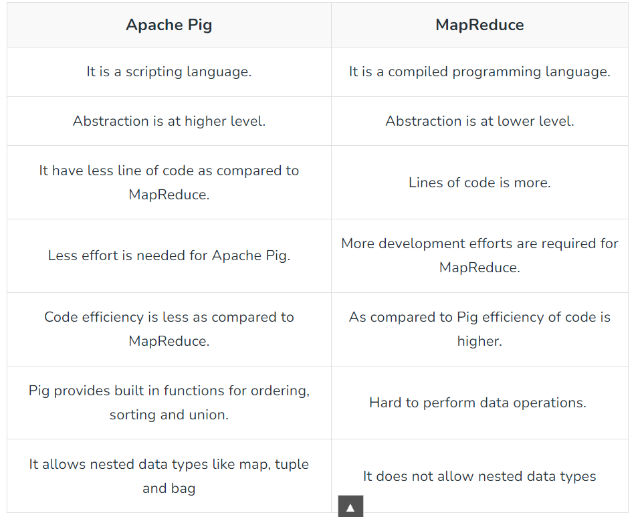
Pig vs MapReduce

Slide 5
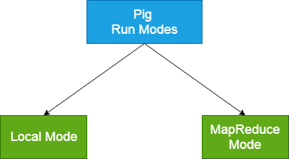
2) Pig Execution Types
Apache Pig executes in two modes:
Local Mode and
MapReduce Mode.

Slide 6
2) Pig Execution Types
Local Mode
It executes in a single JVM and is used for development experimenting and prototyping.
Here, files are installed and run using localhost.
The local mode works on a local file system. The input and output data stored in the local file system.
The command for local mode grunt shell:
$ pig-x local
Map Reduce Mode
The MapReduce mode is also known as Hadoop Mode.
It is the default mode.
In this Pig renders Pig Latin into MapReduce jobs and executes them on the cluster.
It can be executed against semi-distributed or fully distributed Hadoop installation.
Here, the input and output data are present on HDFS.
The command for Map reduce mode:
$ pig -x mapreduce

Slide 7
2) Pig Example
A = Load 'rp/WeatherDataset.txt' as (line:chararray);
B = foreach A generate SUBSTRING(line,15,19),SUBSTRING(line,88,92),SUBSTRING(line,92,93);
store B into 'rp/revised5';
E = load 'rp/revised5/part-m-00000' using PigStorage('\t') as (year:int,temp:int,quality:int);
filtered_records = FILTER E by temp!=9999 AND quality IN (0,1,4,5,9);
grouped_records = GROUP filtered_records by year;
max_temp = FOREACH grouped_records GENERATE group,MAX(filtered_records.temp);
dump max_temp;

Slide 8
A = Load 'rp/WeatherDataset.txt' as (line:chararray);
A : Relation
0067011990999991950051507004...9999999N9+00001+99999999999...
0043011990999991950051512004...9999999N9+00221+99999999999...
0043011990999991950051518004...9999999N9-00111+99999999999...
0043012650999991949032412004...0500001N9+01111+99999999999...
0043012650999991949032418004...0500001N9+00781+99999999999...
B = foreach A generate SUBSTRING(line,15,19),SUBSTRING(line,88,92),SUBSTRING(line,92,93);
B :Relation
(1950, 0,1)
(1950, 22,4)
(1950, −11,1)
(1949, 111,5)
(1949, 78,9)
E = load 'rp/revised5/part-m-00000' using PigStorage('\t') as (year:int,temp:int,quality:int);
E: Relation
Year temp Quality
1950 0 1
1950 22 4
1950 -11 1
1949 111 5
1949 78 9
filtered_records = FILTER E by temp!=9999 AND quality IN (0,1,4,5,9);
Filtered_records: Relation
Year temp Quality
1950 0 1
1950 22 4
1950 -11 1
1949 111 5
1949 78 9
grouped_records = GROUP filtered_records by year;
grouped_records : Relation
(1949, [111, 78])
(1950, [0, 22, −11])
max_temp = FOREACH grouped_records GENERATE group,MAX(filtered_records.temp);
Max_temp : Relation
1949,111
1950,22
Filtered

Slide 9
Pig Latin
Pig Latin is the Language used in Pig
Pig Latin Structure includes
3.1) Comments
3.2) Statements
3.1) Comments
Proper use of commenting can make code maintenance much easier, as well as helps finding bugs faster.
Pig Latin has two types of comment operators:
1) SQL-style single-line comments (--) and
2) Java-style multiline comments (/* */).
Filtered

Slide 10
3.2) Statements
The statements are the basic constructs while processing data using Pig Latin.
    The statements can work with relations including expressions and schemas.
    However, every statement terminate with a semicolon (;).
    We will perform different operations using Pig Latin operators.
    Pig Latin statements inputs a relation and produces some other relation as output.
    As a Pig Latin Program is executed ,each statement is parsed in turn If there are syntax errors or other problems, such as undefined aliases, the interpreter will halt and display an error message.
    The Interpreter builds a logical plan for every relational operation, which forms the core of a pig Latin program.
    The Logical Plan for the statement is added to the logical plan for the program to far, and then the interpreter moves on to the next statement
Filtered

Slide 11
Its important to note that no data processing takes place while the logical plan of the program is being constructed
When the Pig Latin interpreter sees the first line containing the load statement. It conforms that it is syntactically and semantically correct and adds it to the logical plan, but it does not load the data from the file .Indeed, where would it load it? Into memory?even if it did fit into memory, what would it do with data
Similarly , pig validates GROUP and FOREACH statements and adds them to the logical plan without executing them
The Trigger for Pig to start execution is the Dump statement
At that point, the logical plan is compiled into a physical plan and executed.
Pig Latin Statements Includes
  Operators
  Commands
  Functions

Slide 12
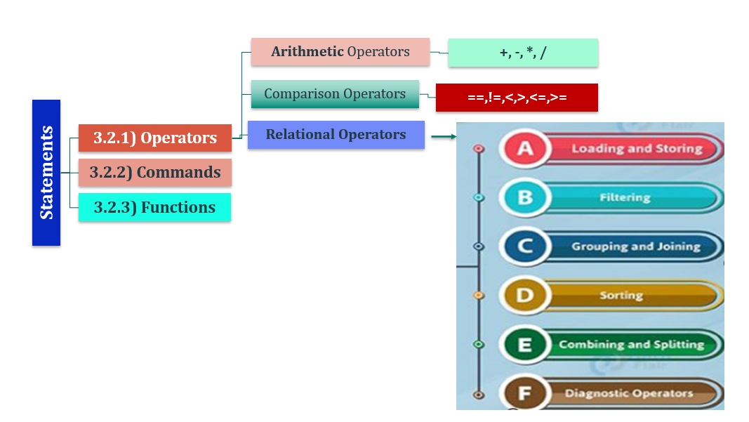

Slide 13
3 &7 Statements & operators

Slide 14
Pig Latin Relational Operators
Loading & Storing
Operators
Filtering
Operators
Grouping & Joining Operators
Sorting Operator
Combining & Splitting Operator
Diagnostic Operators
LOAD
FILTER
JOIN
ORDER
UNION
DUMP
COGROUP
LIMIT
SPLIT
DESCRIBE
STORE
FOREACH
DISTINCT
GROUP
CROSS

Slide 15
Loading and Storing
LOAD | It loads the data from a file system into a relation.
STORE | It stores a relation to the file system (local/HDFS).
Filtering
FILTER | There is a removal of unwanted rows from a relation.
DISTINCT | We can remove duplicate rows from a relation by this operator.
FOREACH, GENERATE | It transforms the data based on the columns of data.
Grouping and Joining
JOIN | We can join two or more relations.
COGROUP | There is a grouping of the data into two or more relations.
GROUP | It groups the data in a single relation.
CROSS | We can create the cross product of two or more relations.
Sorting
ORDER | It arranges a relation in an order based on one or more fields.
LIMIT | We can get a particular number of tuples from a relation.
Combining and Splitting
UNION | We can combine two or more relations into one relation.
SPLIT | To split a single relation into more relations.
Diagnostic Operators
DUMP | It prints the content of a relationship through the console.
DESCRIBE | It describes the schema of a relation.
EXPLAIN | We can view the logical, physical execution plans to evaluate a relation.

Slide 16
Loading and Storing Operator
Load Operator
  Is used to load data into Apache Pig from HDFS
Syntax
Rel_Name = LOAD ‘input file path’ using PigStorage(‘\t’) as schema
where
      Rel_Name – Name of the Relation where to store the data
      Input file path – path of the HDFS file
      Scheme – Resultant Relation schema
Eg:
A = LOAD ‘/data/sample.txt’ as PigStorage(‘\t’) as (sno:int,sname:chararray,branch:chararray)
    The Load statement consists of 2 parts by the “=“ operator
    On the left hand side, need to mention the relation name where we want to store the data and
    On the right hand side, we have to define how to store the data (schema)
NOTE : Operators (Load,Store etc..) are not case sensitive but Functions (MIN,MAX,UPPER etc.. ) are Case Sensitive

Slide 17
Loading and Storing Operator
$ cat > sample.txt
100 smith MCA
101 Jones M.Tech
102 King MCA
103 Ivan MCA
104 Korth M.Tech
Ctrl +Z
$ hadoop fs –mkdir /data → Create a Directory called data in HDFS
$ hadoop fs –put sample.txt /data → Push sample.txt from local file system to HDFS data directory
$ hadoop fs -ls /data → check sample.txt exists in data directory
$ pig → Move to Pig
grunt> student = LOAD ‘/data/sample.txt’ using PigStorage(‘\t’) as (sno:int, sname:chararray,branch:chararray);
grunt>dump student
(100 smith MCA)
(101 Jones M.Tech)
(102 King MCA)
(103 Ivan MCA)
(104 Korth M.Tech)

Slide 18
Loading and Storing Operator
Load Operator
Purpose | Syntax | Example | Output
To Load Data from HDFS to Pig latin | Rel_Name = LOAD ‘input file path’ using PigStorage(‘\t’) as schema where Rel_Name – Name of the Relation where to store the data Input file path – path of the HDFS file Scheme – Resultant Relation schema | grunt> student = LOAD ‘/data/sample.txt’ using PigStorage(‘\t’) as (sno:int, sname:chararray, branch :chararray); grunt>dump student | (100 smith MCA) (101 Jones M.Tech) (102 King MCA) (103 Ivan MCA) (104 Korth M.Tech)

Slide 19
Loading and Storing Operator
Store Operator
Purpose | Syntax | Example | Output
Is used to store data from Apache Pig to HDFS | STORE Rel_Name INTO ‘HDFS Directory’; where Rel_Name – Name of the Relation which needs to be stored from pig to HDFSc HDFS Directory – HDFS Path where to store | $ hadoop fs –mkdir /Results $ pig grunt>STORE student into ‘/Results’; | $ hadoop fs –cat /Results/part-m-00000 100 smith MCA 101 Jones M.Tech 102 King MCA 103 Ivan MCA 104 Korth M.Tech

Slide 20
Filtering Data Operators
Filter Operator
Purpose | Syntax | Example | Output
Is used FILTER Rows from the Relation Is used to get specific rows of the Relation It is equivalent to WHERE clause in SQL | Res_Relation = FILTER Rel_Name BY Condition where Rel_Name – Name of the Relation on which filter need to be performed Condition– Filter condition | Grunt>MCA_Stu = FILTER student BY branch == ‘MCA’; Grunt>M.Tech_Stu = FILTER student BY branch == ‘MCA’; | Grunt>dump MCA_Stu; (100 smith MCA) (102 King MCA) (103 Ivan MCA) Grunt>dump M.Tech_Stu ; 101 Jones M.Tech 104 Korth M.Tech

Slide 21
Filtering Data Operators
ForEach .. Generate Operator
Purpose | Syntax | Example | Output
Is used to get specific columns It is equivalent to SELECT clause in SQL | Res_Relation = FOREACH Rel_Name GENERATE COL1,COL2,…COLN where Rel_Name – Name of the Relation from which specific columns to be retreived COL1,COL2,..COLN are the specific columns to be rerived | Grunt> no_branch = FOREACH student GENERATE sno,branch; If schema is not defined then Grunt>no_branch = FOREACH student GENERATE $1,S3; | Grunt>dump no_banch; (100 MCA) (101 M.Tech) (102 MCA) (103 MCA) (104 M.Tech)

Slide 22
GROUPING & JOINING Operators
grunt>dump emp eno ename deptno 100 Smith 10 101 Jones 20 102 King 10 103 Ivan 20 104 Korth 30 | grunt>dump dept deptno dname 10 HR 20 SYSTEM 30 MARKETING
JOIN OPERATOR
Purpose | Syntax | Example | Output
Performs an inner join of two or more relations based on common field values. | Res_Relation = JOIN Rel1 by Key, Rel2 by key where Rel1 is the First Relation Rel2 is the Second Relation Key is the common field | grunt> emp_dept = JOIN emp BY deptno ,dept BY deptno | Grunt>dump emp_dept; eno ename deptno deptno dname 100 Smith 10 10 HR 101 Jones 20 20 SYSTEM 102 King 10 10 HR 103 Ivan 20 20 SYSTEM 104 Korth 30 30 MARKETING

Slide 23
GROUPING & JOINING Operators
COGROUP OPERATOR
Join always give a flat structure
The COGROUP statement is similar to join but instead creates a nested set of output tuples.
COGROUP generates a tuple for each unique grouping key
  The first field of each tuple is the key
  And the remaining fields are bags of tuples from the relations with a matching key
  The first bag contains the matching tuples from relation A with the same key.
  The second bag contains the matching tuples from relation B with the same key
grunt>dump emp eno ename deptno 100 Smith 10 101 Jones 20 102 King 10 103 Ivan 20 104 Korth 30 | grunt>dump dept deptno dname 10 HR 20 SYSTEM 30 MARKETING
Purpose | Syntax | Example | Output
Same as Join instead JOIN returns flat structure whereas COGROUP returns nested tuples | Res_Relation = COGROUP Rel1 by Key, Rel2 by key where Rel1 is the First Relation Rel2 is the Second Relation Key is the common field | grunt> emp_dept= COGROUP emp BY deptno ,dept BY deptno | Grunt>dump emp_dept; (10, {(100,Smith,10),(102,King,10)},{(10,HR)}) (20, {(101,Jones,20),(103,Ivan,20)},{(20,SYSTEM)}) (30, {(104,Korth,30)},{(30,MARKETING)})

Slide 24
GROUPING & JOINING Operators
grunt>dump emp eno ename deptno 100 Smith 10 101 Jones 20 102 King 10 103 Ivan 20 104 Korth 30 | grunt>dump dept deptno dname 10 HR 20 SYSTEM 30 MARKETING
GROUP OPERATOR
Purpose | Syntax | Example | Output
Join and Cogroup works on one or more relations whereas GROUP operator is used to group data in a single relation | Res_Relation = GROUP Rel by Field where Rel is the Relation Field is column or field on which to group the data | grunt> deptwise = GROUP emp by deptno | Grunt>dump deptwise; (10, {(100,Smith,10),(102,King,10)}) (20, {(101,Jones,20),(103,Ivan,20)}) (30, {(104,Korth,30)})

Slide 25
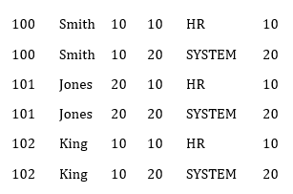
GROUPING & JOINING Operators
grunt>dump emp eno ename deptno 100 Smith 10 101 Jones 20 102 King 10 | grunt>dump dept deptno dname 10 HR 20 SYSTEM
CROSS OPERATOR
Purpose | Syntax | Example | Output
Returns Cross Product of 2 or more Relations | Res_Relation = CROSS Rel1,Rel2 where Rel1 and Rel2 are Relations on which cross product need to be applied | grunt> cp = CROSS emp,dept; | Grunt>dump cp;

Slide 26
Sorting and Limiting Data
grunt>dump emp eno ename deptno 100 Smith 10 101 Jones 20 102 King 10 103 Ivan 20 104 Korth 30 | grunt>dump dept deptno dname 10 HR 20 SYSTEM 30 MARKETING
ORDER OPERATOR
Purpose | Syntax | Example | Output
Returns data in Sorted order | Res_Relation = ORDER Rel1 by FieldName where Rel1 is the Relation FieldName is the column on which data to be sorted | grunt> sorted_names = ORDER emp BY ename; | Grunt>dump sorted_names; (103 Ivan 20) (101 Jones 20) (102 King 10) (104 Korth 30) (100 Smith 10)

Slide 27
Sorting and Limiting Data
grunt>dump emp eno ename deptno 100 Smith 10 101 Jones 20 102 King 10 103 Ivan 20 104 Korth 30 | grunt>dump dept deptno dname 10 HR 20 SYSTEM 30 MARKETING
LIMIT OPERATOR
Purpose | Syntax | Example | Output
is used to get a limited number of tuples from a relation. | Res_Relation = LIMIT Rel1 Number where Rel1 is the Relation Number is Number of tuples to be displayed | grunt>Limited_tuples = LIMIT emp 2; | Grunt>dump sorted_names; (100 Smith 10) (101 Jones 20)

Slide 28
Combining and Splitting Data
grunt>dump emp eno ename deptno 100 Smith 10 101 Jones 20 102 King 10 103 Ivan 20 104 Korth 30 | grunt>dump dept deptno dname 10 HR 20 SYSTEM 30 MARKETING
UNION OPERATOR
Purpose | Syntax | Example | Output
is used to combine 2 or more relations into one | Res_Relation = UNION Rel1,Rel2 where Rel1 is the First Relation Rel2 is the Second Relation | grunt>combined_rels = UNION emp,dept; | Grunt>dump combined_rels; (100 Smith 10) (101 Jones 20) (102 King 10) (103 Ivan 20) (104 Korth 30) (10 HR) (20 SYSTEM) (30 MARKETING)

Slide 29
Combining and Splitting Data
grunt>dump emp eno ename deptno 100 Smith 10 101 Jones 20 102 King 10 103 Ivan 20 104 Korth 30 | grunt>dump dept deptno dname 10 HR 20 SYSTEM 30 MARKETING
SPLIT OPERATOR
Purpose | Syntax | Example | Output
is used to Split single Relation into 2 or more Relations | Split Rel1 into Rel2 if condition1 , Rel3 if condition2 where Rel1, Rel2, Rel3 are Relations. Condition1 and condition 2 are conditions on which the Rel1 to be split | grunt>split emp into deptno10 if deptno ==10, deptno20 if deptno ==20; | grunt>dump deptno10; (100 Smith 10) (102 King 10) Grunt>dump deptno20; (101 Jones 20) (103 Ivan 20)

Slide 30
Diagnostic Operators
DUMP OPERATOR
grunt>dump emp eno ename deptno 100 Smith 10 101 Jones 20 102 King 10 103 Ivan 20 104 Korth 30 | grunt>dump dept deptno dname 10 HR 20 SYSTEM 30 MARKETING
Purpose | Syntax | Example | Output
is used to Display Results on the Screen | DUMP Relation_Name; where Relation_Name is the name of the Relation whose content to be printed | grunt>DUMP emp; | grunt>dump emp; (100 Smith 10) (101 Jones 20) (102 King 10) (103 Ivan 20) (104 Korth 30)

Slide 31
Diagnostic Operators
DESCRIBE OPERATOR
grunt>dump emp eno ename deptno 100 Smith 10 101 Jones 20 102 King 10 103 Ivan 20 104 Korth 30 | grunt>dump dept deptno dname 10 HR 20 SYSTEM 30 MARKETING
Purpose | Syntax | Example | Output
describes the schema of a relation. | DESCRIBE Relation_Name; where Relation_Name is the name of the Relation | grunt>DESCRIBE emp; | grunt>DESCRIBE emp; emp: { eno:int,ename:chararray,deptno:int}

Slide 32
4. Data Types

Slide 33
PIG DATA TYPES
S.N. | Data Type | Description & Example
1 | int | Represents a signed 32-bit integer. Example : 8
2 | long | Represents a signed 64-bit integer. Example : 5L
3 | float | Represents a signed 32-bit floating point. Example : 5.5F
4 | double | Represents a 64-bit floating point. Example : 10.5
5 | chararray | Represents a character array (string) in Unicode UTF-8 format. Example : ‘tutorials point’
6 | Bytearray | Represents a Byte array (blob).
7 | Boolean | Represents a Boolean value. Example : true/ false.
8 | Datetime | Represents a date-time. Example : 1970-01-01T00:00:00.000+00:00
9 | Biginteger | Represents a Java BigInteger. Example : 60708090709
10 | Bigdecimal | Represents a Java BigDecimal .Example : 185.98376256272893883
Complex Types
11 | Tuple | A tuple is an ordered set of fields. Example : (raja, 30)
12 | Bag | A bag is a collection of tuples. Example : {(raju,30),(Mohhammad,45)}
13 | Map | A Map is a set of key-value pairs. Example : [ ‘name’#’Raju’, ‘age’#30]

Slide 34
5. SCHEMAS

Slide 35
Schemas enable to assign names and types to fields .
Schemas are optional but we encourage you to use them whenever possible; type declarations result in better parse-time error checking and more efficient code execution.
Schema can be defined for both names and types of the fields
Schema can be defined only for field names, in this case, the field type defaults to bytearray. Here fields can be referred through names
Schema may not be defined ; in this case, the field is un-named and the field type defaults to bytearray. Here the fields can be referred through positional notation like $1,$2,etc..
Unknown Schema Handling
When you JOIN/COGROUP/CROSS multiple relations, if any relation has an unknown schema (or no defined schema, also referred to as a null schema), the schema for the resulting relation is null.
If you UNION two relations with incompatible schema, the schema for resulting relation is null.
Schema Merging
In Pig, no need to declare the schema for every new relation in the data flow
pig can figure out the resulting schemas for the output of a relational operation by considering the schema of the input relation
Filter , limit are the operators who resultant relation schema is same as input schema

Slide 36
6. Pig Latin Built in Functions

Slide 37
Built in Functions
Eval Functions
Math Functions
String Functions
Data/Time Functions
MAX
CEIL
UPPER
CURRENTTIME
LOWER
MIN
FLOOR
GETDAY
SUBSTRING
SUM
ABS
REPLACE
DAYSBETWEEN
INDEXOF
AVG
ROUND
WEEKSBETWEEN
UCFIRST
COUNT
SQRT
LCFIRST
GETHOUR
STARTSWITH
ENDSWITH

Slide 38
S.NO. | FUNCTION & DESCRIPTION
1 | AVG() -To compute the average of the numerical values within a bag.
2 | COUNT() -To get the number of elements in a bag, while counting the number of tuples in a bag.
3 | MAX() -To calculate the highest value for a column (numeric values or chararrays) in a single-column bag.
4 | MIN() -To get the minimum (lowest) value (numeric or chararray) for a certain column in a single-column bag.
5 | SUM() -To get the total of the numeric values of a column in a single-column bag.
$ cat > Student_details
Smith wp 67
Jones Java 78
Ivan BDA 85
Ivan java 79
Jones BDA 69
Smith Java 89
Ctrl+z
$ hadoop fs –mkdir /data
$ hadoop fs –put Student_details /data
$ pig
grunt> Student = LOAD ‘/data/Student_details’ using PigStorage(‘\t’) as sname:chararray,subject :chararray,Marks:int);
grunt>dump Student;
Sname subject Marks
Smith wp 67
Jones Java 78
Ivan BDA 85
Ivan java 79
Jones BDA 69
Smith Java 89

Slide 39
1) Find Highest Marks Obtained in each Subject
grunt> subjectwise = group student by subject;
grunt>dump subjectwise;
(wp,{(smith,wp,67)})
(Java,{(Jones,Java,78),(Ivan,Java,79)})
(BDA,{(Ivan,BDA,85),(Jones,BDA,69)})
grunt>highest = foreach subjectwise generate group,MAX(student.Marks);
grunt>dump highest;
(wp,67)
(Java,79)
(BDA,85)
Find Lowest Marks Obtained in each Subject
grunt> subjectwise = group student by subject;
grunt>dump subjectwise;
(wp,{(smith,wp,67)})
(Java,{(Jones,Java,78),(Ivan,Java,79)})
(BDA,{(Ivan,BDA,85),(Jones,BDA,69)})
grunt>lowest = foreach subjectwise generate group,MIN(student.Marks);
grunt>dump lowest;
(wp,67)
(Java,78)
(BDA,69)
3) Find No.of Students in each subject
grunt> subjectwise = group student by subject;
grunt>dump subjectwise;
(wp,{(smith,wp,67)})
(Java,{(Jones,Java,78),(Ivan,Java,79)})
(BDA,{(Ivan,BDA,85),(Jones,BDA,69)})
grunt>NoOfStudents = foreach subjectwise generate groupCOUNT(student.Marks);
grunt>dump NoOfStudents;
(wp,1)
(Java,2)
(BDA,2)
4) Find Total Marks Obtained by each Student
grunt> studentwise = GROUP student by sname;
grunt>dump studentwise;
(smith,{(smith,wp,67)})
(Jones,{(Jones,Java,78),(Jones,BDA,69)})
(Ivan,{(Ivan,Java,79),(Ivan,BDA,85)})
grunt>tot = foreach studentwise generate group,SUM(student.Marks);
grunt>dump tot;
(smith,67)
(Jones,147)
(Ivan,164)
5) Find Percentage Obtained by each Student
grunt> studentwise = GROUP student by sname;
grunt>dump studentwise;
(smith,{(smith,wp,67)})
(Jones,{(Jones,Java,78),(Jones,BDA,69)})
(Ivan,{(Ivan,Java,79),(Ivan,BDA,85)})
grunt>percentage = foreach studentwise generate group,AVG(student.Marks);
grunt>dump percentage;
(smith,67)
(Jones,73.5)
(Ivan,82)
6) Find Number of subjects taken by each student
grunt> studentwise = GROUP student by sname;
grunt>dump studentwise;
(smith,{(smith,wp,67)})
(Jones,{(Jones,Java,78),(Jones,BDA,69)})
(Ivan,{(Ivan,Java,79),(Ivan,BDA,85)})
grunt>NoOfSubjects = foreach studentwise generate group,COUNT(student.Marks);
grunt>dump NoOfSubjects;;
(smith,1)
(Jones,2)
(Ivan,2)

Slide 40
S.NO. | FUNCTIONS & DESCRIPTION
1 | ABS(expression) -To get the absolute value of an expression.
2 | CBRT(expression)-This function is used to get the cube root of an expression.
3 | CEIL(expression) -This function is used to get the value of an expression rounded up to the nearest integer.
4 | FLOOR(expression) -To get the value of an expression rounded down to the nearest integer.
5 | ROUND(expression) -To get the value of an expression rounded to an integer (if the result type is float) or rounded to a long (if the result type is double).
6 | SQRT(expression) -To get the positive square root of an expression.
$ cat > Stu_Grades
Smith 7.4
Jones 8.2
Ivan 9.6
Korth 6.9
King 5.4
Ctrl+z
$ hadoop fs –put Stu_Grades /data
$ pig
grunt> grades = load ‘/data/Stu_Grades’ using PigStorage(‘\t’) as sname:chararray,cgpa:float;
grunt>dump grades;
sname cgpa
Smith 7.4
Jones 8.2
Ivan 9.6
Korth 6.9
King 5.4
grunt> Math = ForEach grades Generate cgpa, CEIL(cgpa),FLOOR(cgpa),ABS(cgpa),ROUND(cgpa);
grunt>dump Math;
(7.4, 8, 7, 7.4, 7.4)
(8.2, 9, 8, 8.2, 8.2)
(9.6, 10, 9, 9.6, 10)
(6.9, 7, 6, 6.9, 7)
(5.4, 6, 5, 5.4, 5.4)

Slide 41
S.NO. | Functions & Description
1 | ENDSWITH(string, testAgainst) To verify whether a given string ends with a particular substring.
2 | STARTSWITH(string, substring) Accepts two string parameters and verifies whether the first string starts with the second.
3 | SUBSTRING(string, startIndex, stopIndex) Returns a substring from a given string.
4 | EqualsIgnoreCase(string1, string2) To compare two stings ignoring the case.
5 | INDEXOF(string, ‘character’, startIndex) Returns the first occurrence of a character in a string, searching forward from a start index.
6 | LAST_INDEX_OF(expression) Returns the index of the last occurrence of a character in a string, searching backward from a start index.
7 | LCFIRST(expression) Converts the first character in a string to lower case.
8 | UCFIRST(expression) Returns a string with the first character converted to upper case.
9 | UPPER(expression) UPPER(expression) Returns a string converted to upper case.
10 | LOWER(expression) Converts all characters in a string to lower case.
11 | REPLACE(string, ‘oldChar’, ‘newChar’); To replace existing characters in a string with new characters.

Slide 42
grunt>dump grades;
sname cgpa
Smith 7.4
Jones 8.2
Ivan 9.6
Korth 6.9
King 5.4
grunt> str = foreach grades generate sname, LOWER(sname),UPPER(sname),SUBSTRING(sname,1,3);
grunt> dump str;
(Smith smith SMITH mi)
(Jones jones JONES on)
(Ivan ivan IVAN va)
(Korth korth KORTH or)
(King king KING in)
grunt>str1 = foreach grades generate sname, ENDSWITH(sname,’h’),STARTSWITH(sname,’k’),LCFIRST(sname),UCFIRST(sname);
grunt>dump str1;
(Smith TRUE FALSE smith Smith)
(Jones FALSE FALSE jones Jones)
(Ivan FALSE FALSE ivan Ivan)
(Korth TRUE TRUE korth Korth)
(King FALSE TRUE king King)
grunt>str2 = foreach grades generate sname, REPLACE(sname,’i’,z’),INDEXOF(sname,’t’);
grunt>dump str2;
(Smith Smzth 3)
(Jones Jones -1)
(Ivan zvan -1)
(Korth Korth 3)
(King Kzng -1)

Slide 43
S.NO. | Functions & Description
1 | CurrentTime() :returns the date-time object of the current time.
2 | GetDay(datetime) :Returns the day of a month from the date-time object.
3 | GetHour(datetime) :Returns the hour of a day from the date-time object.
4 | GetMonth(datetime) Returns the month of a year from the date-time object.
5 | GetSecond(datetime) :Returns the second of a minute from the date-time object.
6 | GetWeek(datetime) :Returns the week of a year from the date-time object.
7 | DaysBetween(datetime1, datetime2) :Returns the number of days between the two date-time objects.
8 | HoursBetween(datetime1, datetime2) :Returns the number of hours between two date-time objects.
9 | MonthsBetween(datetime1, datetime2) :Returns the number of months between two date-time objects.
10 | SecondsBetween(datetime1, datetime2) :Returns the number of seconds between two date-time objects.
11 | WeeksBetween(datetime1, datetime2) :Returns the number of weeks between two date-time objects.
12 | YearsBetween(datetime1, datetime2): Returns the number of years between two date-time objects.

Slide 44
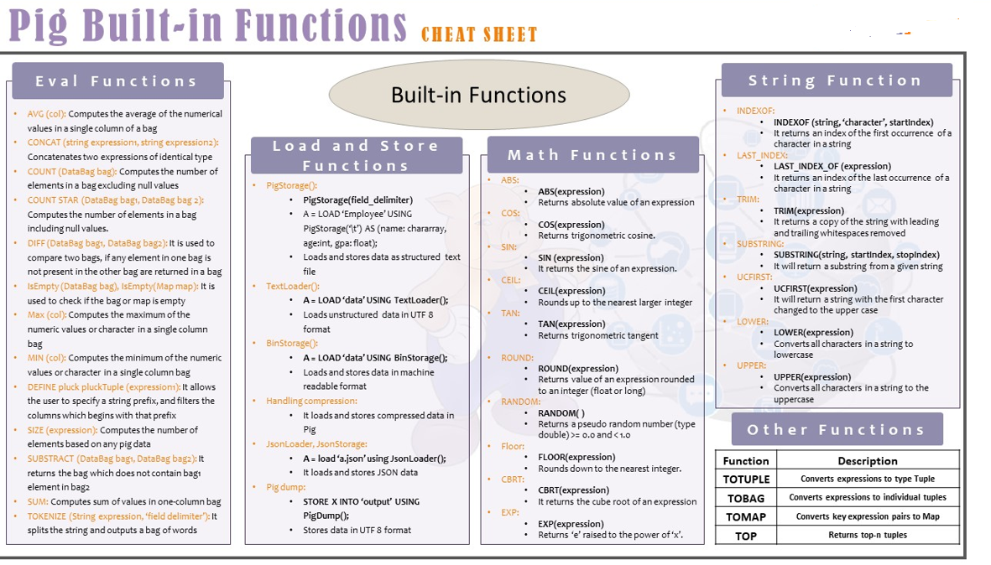
Filtered

Slide 45
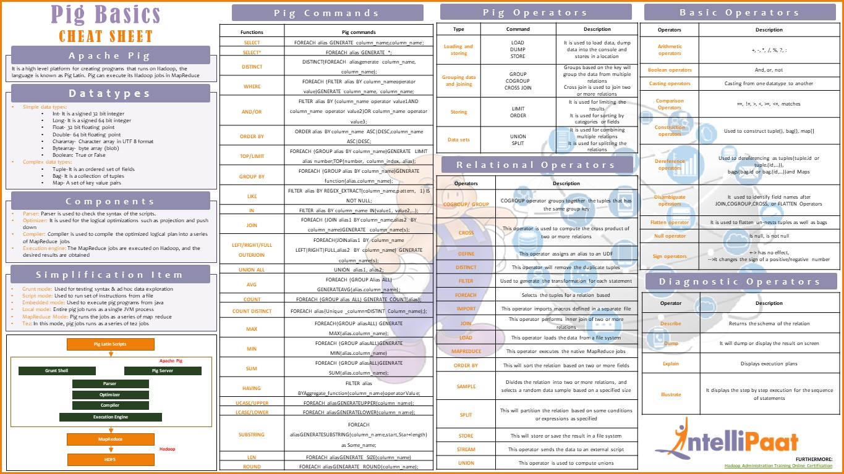
Filtered

Slide 46
HIVE

Slide 47
1) Hive
Apache Hive is a distributed, fault-tolerant data warehouse system built on top of Apache Hadoop.
It provides an SQL-like interface to query and analyze large datasets stored in various databases and file systems that integrate with Hadoop
Apache Hive | Apache Pig
SQL Like query Language | Scripting Language
Higer level of Abstraction | Higher Level of Abstraction
Comparatively less lines of Code than MapReduce and Apache Pig | Comparatively less lines of code than MapReduce
Development Effort and Code efficiency are Less | Development Effort and Code efficiency are Less
Used by Analyst | Used by Programmers
HiveQL is the language Used | Pig Latin is the Language
Works on structured data .Does not work on other types of data | Works on structured , semi structured and unstructured data
Hive has Web Interface | Pig does not have web Interface

Slide 48
1) An Example
To Analyza Weather Dataset, first it is necessary to load Hive Data
To create a table in Hive
CREATE TABLE records (year int, temp int, quality int) ROW FORMAT DELIMITED FIELDS TERMINTADE BY ',' ;
Hive expects there to be three fields in each row , corresponding to the table columns, with fields separated by tabs and rows by newlines.
Next step is to populate data to Hive Table as
LOAD DATA LOCAL INPATH ‘input/ncdc/micro-tab/sample.txt’ OVERWRITE INTO TABLE records.
Now the data is in hive, we can run the query against it as
SELECT year, MAX(temp) FROM records WHERE temp!=9999 and quality in (0,1,4,5,9) GROUP BY year
1949 | 111
1950 | 22

Slide 49
Hive Tables
HIVE :
A Hive Table is logically made up of the data being stored and the associated metadata describing the layout of the data in the table
Hive Tables are classified into 2 Types
Managed or Internal Tables
External Table
MANAGED (or) INTERNAL TABLE | EXTERNAL TABLE
Managed Tables or Internal Tables are Tables that are managed by Hive Directory | External Tables are Tables that are not managed by Hive Directory
No need specify the storage location , the table will stored in default location of the Hive | Need to specify the storage location because external tables are created outside the Hive
Other components of Hadoop other than Hive can not access the Table | Other components of Hadoop can access the table
When the managed table got dropped off Metadata will be lost from Metsstore Tabular data will be removed permanently from HDFS warehouse path | When the managed table got dropped off Only Metadata will be removed from Metastore Tabular data will be persisted on HDFSpath
CREATE TABLE <table_name>(columns datatype) ROW FORMAT DELIMITED FIELDS TER,MINATED BY ‘delimiter character’ STORED AS <fileformat> | CREATE TABLE <table_name>(columns datatype) ROW FORMAT DELIMITED FIELDS TER,MINATED BY ‘delimiter character’ STORED AS <fileformat> LOCATION ‘HDFS path’;

Slide 50
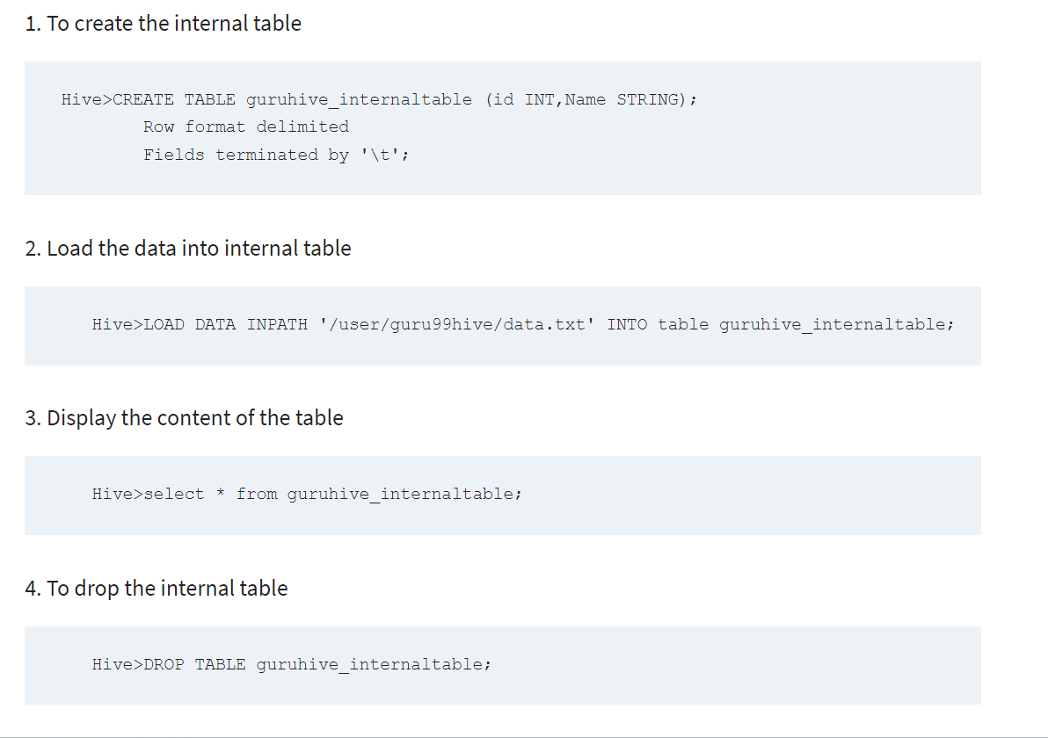
3.Managed vs External Tables

Slide 51
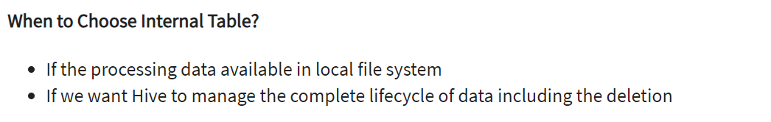
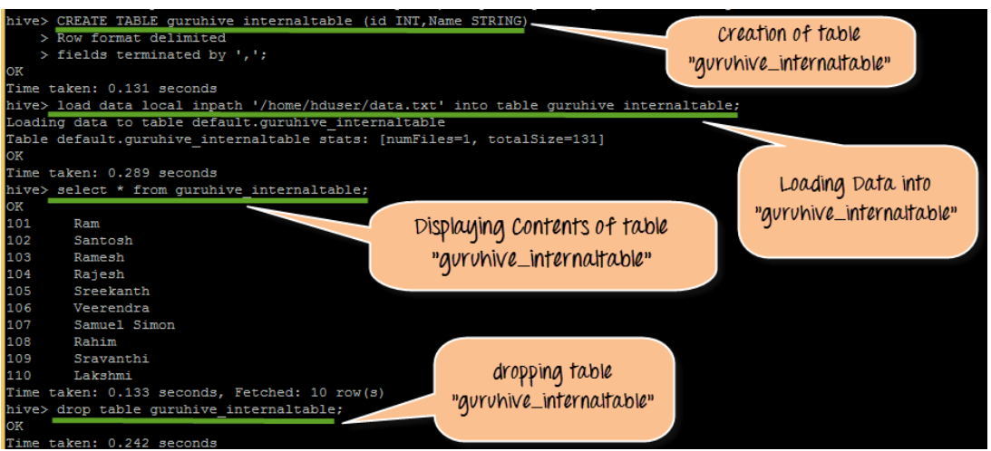
3.Managed vs External Tables

Slide 52
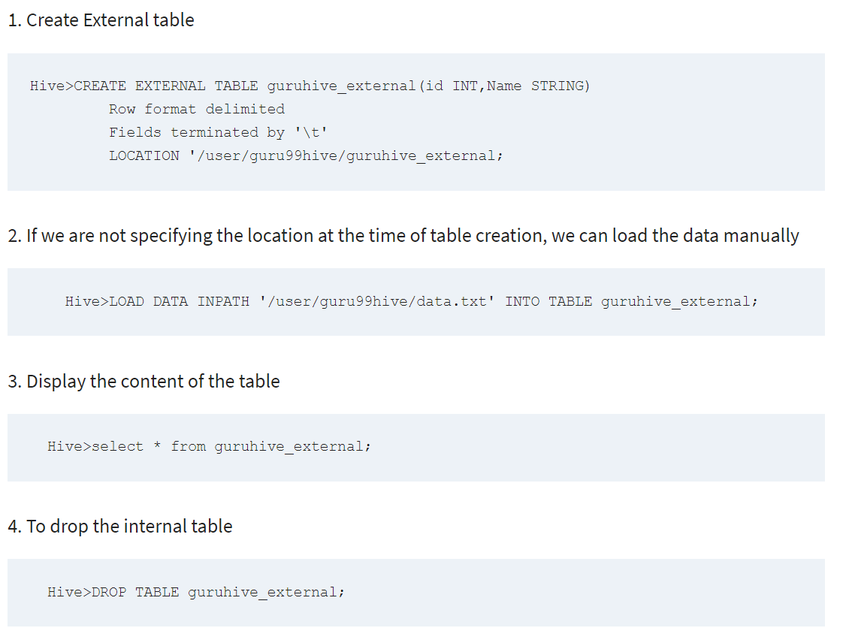
3.Managed vs External Tables

Slide 53
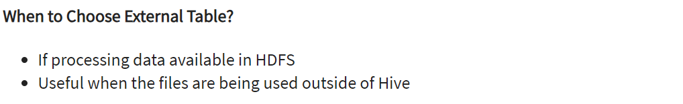
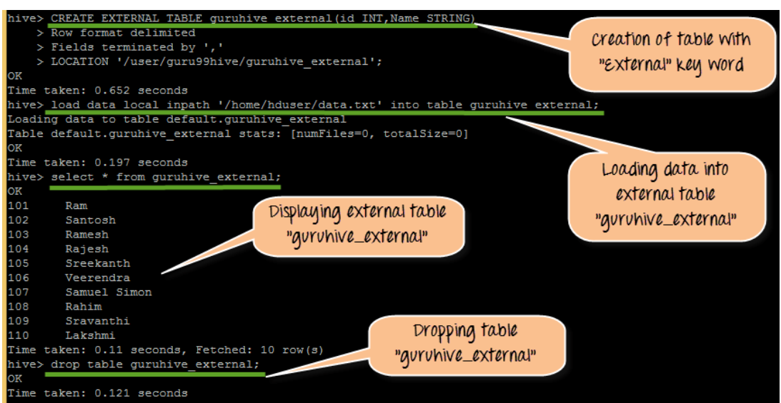
3.Managed vs External Tables

Slide 54
4. Partitions and Buckets
PARTITIONS
Hive table partition is a way to split a large table into smaller logical tables based on one or more partition keys.
These smaller logical tables are not visible to users and users still access the data from just one table.
When you load the data into the partition table, Hive internally splits the records based on the partition key and stores each partition data into a sub-directory of tables directory on HDFS.
The name of the directory would be partition key and it's value.
Partition Table Advantages
Fast accessed to the data
Provides the ability to perform an operation on a smaller dataset.

Slide 55
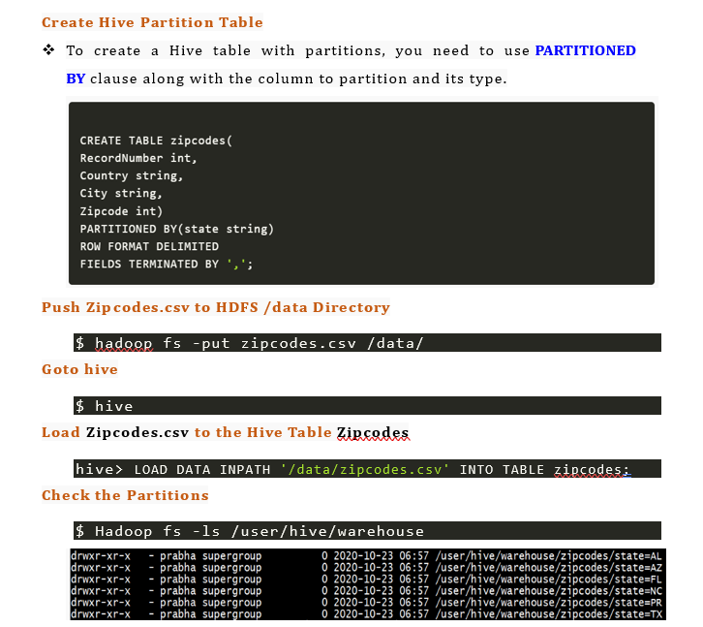
4. Partitions and Buckets

Slide 56
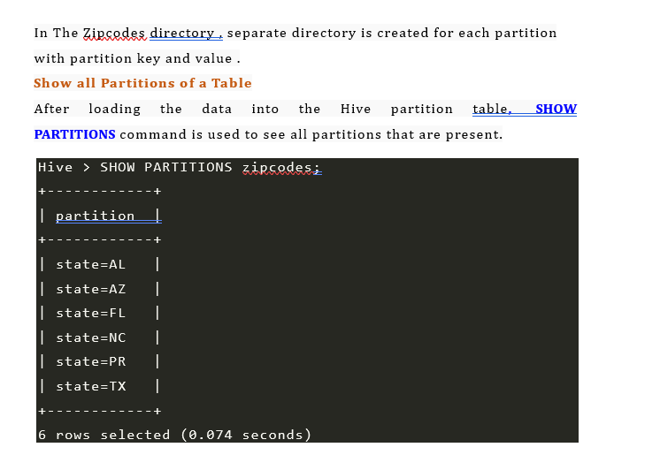
4. Partitions and Buckets

Slide 57
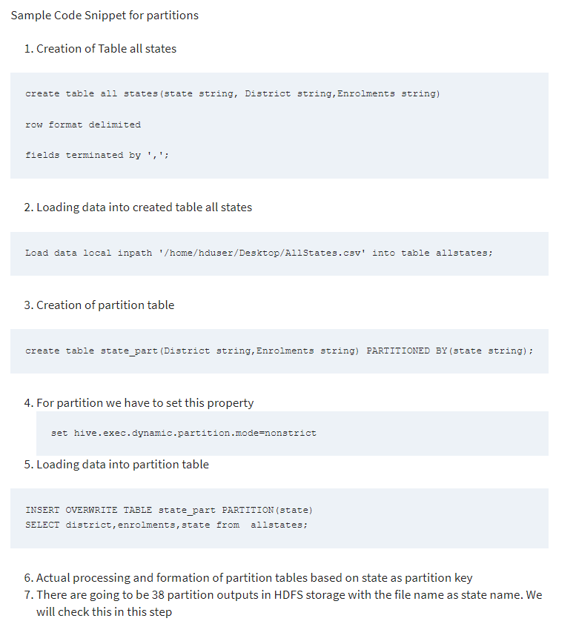

Slide 58
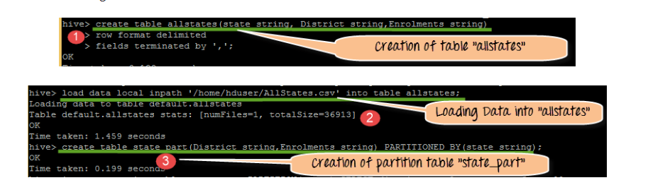
CREATING allstates TABLE , LOADING DATA INTO IT, CREATING state_part TABLE WITH PARTITION COLUMN

Slide 59
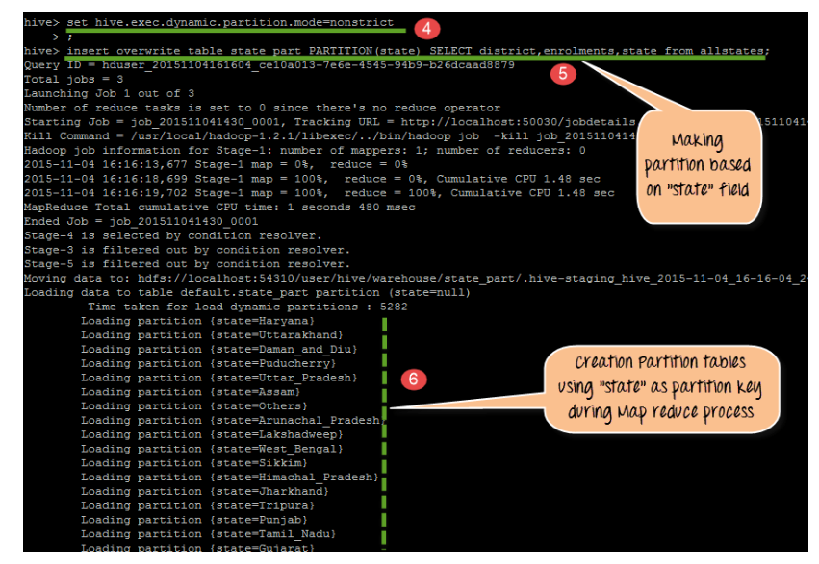

Slide 60
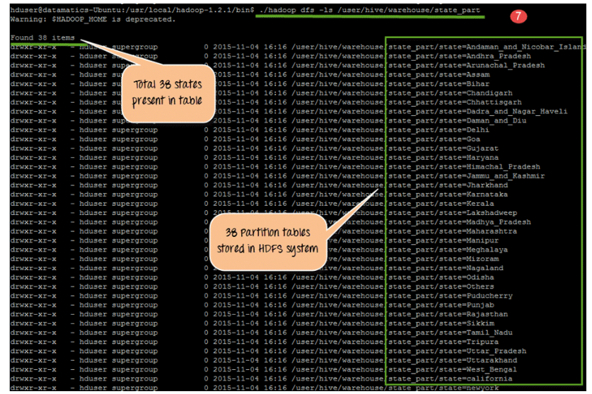

Slide 61
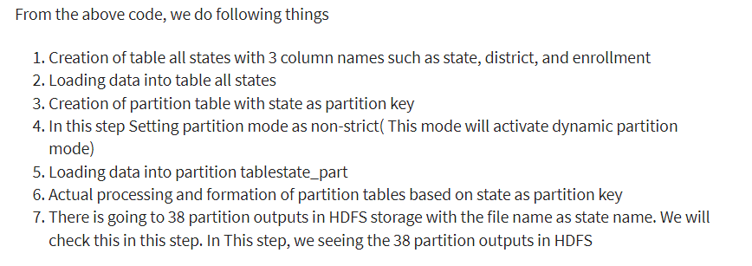

Slide 62
4. Partitions and Buckets
BUCKETS
Hive Bucketing is a way to split the table into a managed number of clusters with or without partitions.
Hive Buckets(Clustering) is a technique to split the data into more manageable files, (By specifying the number of buckets to create).
The value of the bucketing column will be hashed by a user-defined number into buckets.
Each bucket is stored as a file within the table’s directory or the partitions directories on HDFS.
Hive bucketing commonly created in two scenarios.
Create a bucket on top of the Partitioned table to further divide the table for better query performance.
Create Bucketing on the table where you cannot choose the partition column due to (too many distinct values on columns).

Slide 63
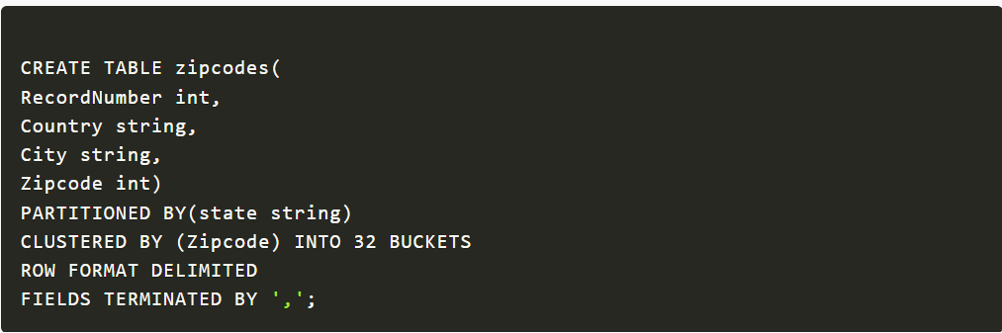
4. Partitions and Buckets
Create Hive Buckets
  To create a Hive table with bucketing, use CLUSTERED BY clause with the column name you wanted to bucket and the count of the buckets.
Load Data into Bucket
Loading/inserting data into the Bucketing table would be the same as inserting data into the table.
If Hive < 2.x version is using, then it is necessary to set the hive.enforce.bucketing property to true.
No need to set this if you are using Hive 2.x or later.
let's load the csv file into the table, since our partitioned column state is the last column on the input file we can directly load the data into the table without needing to create a temporary table.
Below examples loads the zipcodes from HDFS into Hive partitioned table where we have a bucketing on zipcode column.

Slide 64
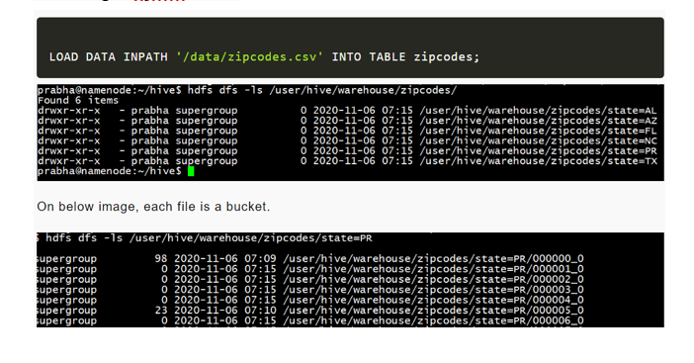
4. Partitions and Buckets

Slide 65
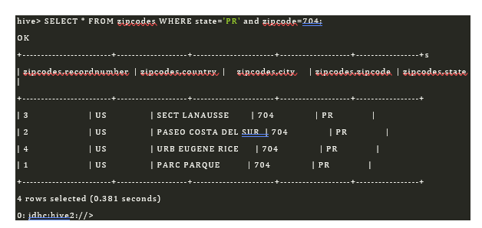
4. Partitions and Buckets
Since our zipcode is partitioned on and bucketing on , if you use these columns on where condition your query returns faster results.

Slide 66
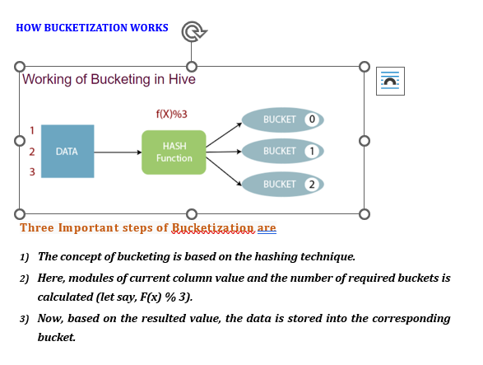
4. Partitions and Buckets

Slide 67
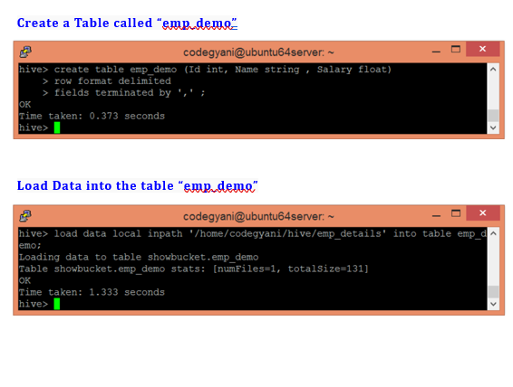
4. Partitions and Buckets

Slide 68
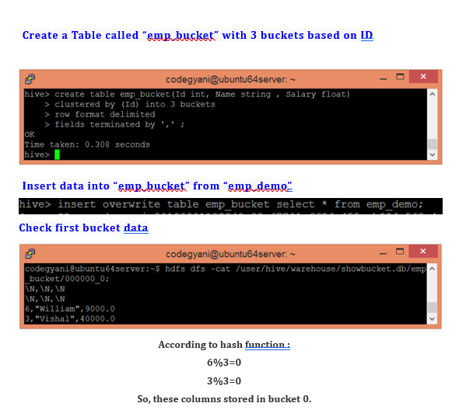
4. Partitions and Buckets

Slide 69
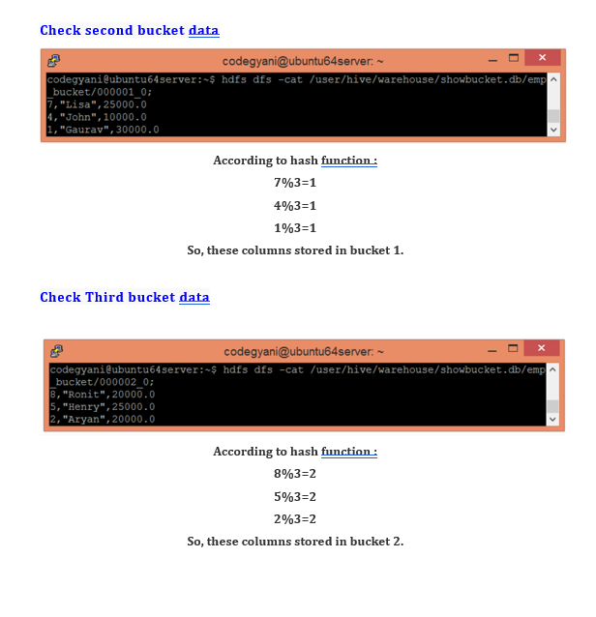
4. Partitions and Buckets

Slide 70
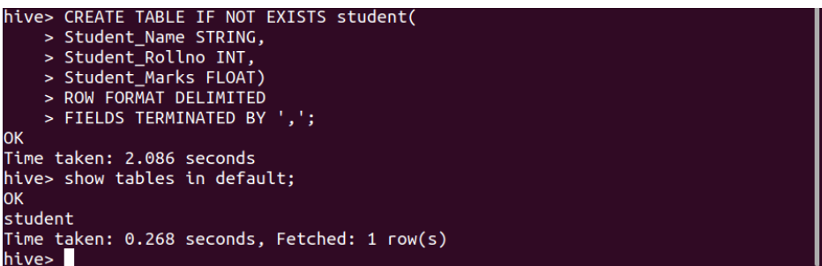
5. IMPORTING DATA
Hive provides multiple ways to add data to the tables. In hive with DML statements, we can add data to the Hive table in 2 different ways.
5.1) Using INSERT Command
5.2) Load Data Statement
5.1) Using INSERT Command
  Syntax:
  INSERT INTO TABLE <table_name> VALUES (<add values as per column entity>);
Example:
To insert data into the table let’s create a table with the name student (By default hive uses its default database to store hive tables).
Command:

Slide 71
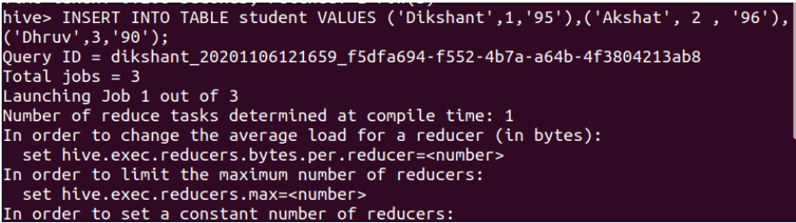
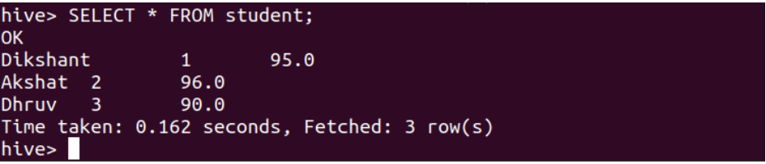
5. IMPORTING DATA
INSERT Query:
INSERT INTO TABLE student VALUES ('Dikshant',1,'95'),('Akshat', 2 , '96'),('Dhruv',3,'90');
We can check the data of the student table with the help of the below command.
SELECT * FROM student;

Slide 72
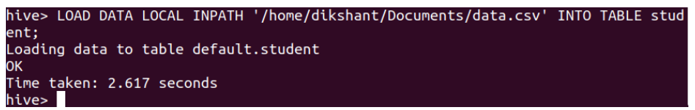
5. IMPORTING DATA
5.2) Load Data Statement
Hive provides us the functionality to load pre-created table entities either from our local file system or from HDFS. The LOAD DATA statement is used to load data into the hive table.
Syntax:
LOAD DATA [LOCAL] INPATH '<The table data location>' [OVERWRITE] INTO TABLE <table_name>;
The LOCAL Switch specifies that the data we are loading is available in our Local File System. If the LOCAL switch is not used, the hive will consider the location as an HDFS path location.
The OVERWRITE switch allows us to overwrite the table data.
LOAD DATA to the student hive table with the help of the below command.
LOAD DATA LOCAL INPATH '/home/dikshant/Documents/data.csv' INTO TABLE student;

Slide 73
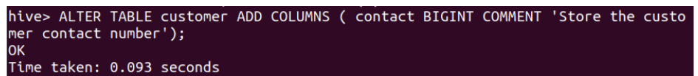
6. ALTERING TABLES
ALTER command is used to Alter the Schema of the table
ALTER command is used to
1) Add the Column
2) change the Column
3) Replace the Column Name
4) Replace the Table Name
Add the Column to the Table
  Syntax
  ALTER TABLE <table_name> ADD COLUMNS (<col-name> <data-type> COMMENT ‘ ‘, <col-name> <data-type> COMMENT ‘ ‘, ….. )
  Example
  ALTER TABLE customer ADD COLUMNS ( contact BIGINT COMMENT ‘Store the customer contact number’);

Slide 74
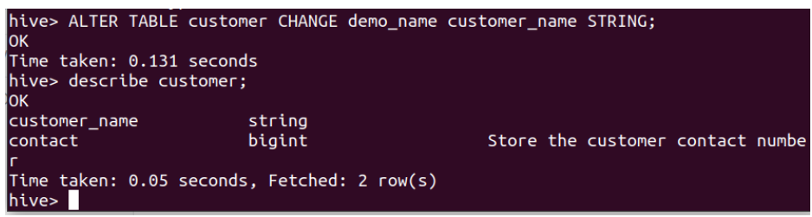
6. ALTERING THE DATA
CHANAGE Column
CHANGE in ALTER TABLE is used to change the name or data type of an existing column or attribute.
Syntax:
ALTER TABLE <table_name> CHANGE <column_name> <new_column_name> <new_data_type>;
Let’s change the demo_name attribute to customer_name.
ALTER TABLE customer CHANGE demo_name customer_name STRING;

Slide 75
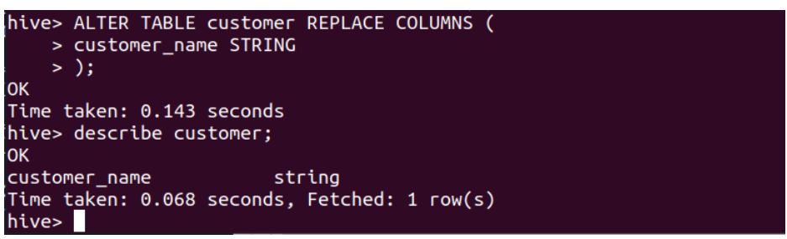
6. ALTERING THE DATA
3) REPLACE Column
The REPLACE with ALTER TABLE is used to remove all the existing columns from the table in Hive.
The attributes or columns which are added in the ALTER TABLE REPLACE statement will be replaced with the older columns.
Syntax:
ALTER TABLE <table_name> REPLACE COLUMNS ( <attribute_name> <data_type>, <attribute_name> <data_type>, . . . );
For example in our customer table, we have 2 attributes customer_name and contact. If we want to remove the contact attribute the query should be like as shown below.
Command:
ALTER TABLE customer REPLACE COLUMNS ( customer_name STRING );

Slide 76
6. ALTERING THE DATA
4) Renaming Table Name
ALTER TABLE with RENAME is used to change the name of an already existing table in the hive.
Syntax:
ALTER TABLE <current_table_name> RENAME TO <new_table_name>;
Command:
Let’s rename our table name from the demo to the customer.
ALTER TABLE demo RENAME TO customer;

Slide 77
7. DROPPING TABLES
Drop Table Statement drops the table from hive metastore.
It removes the data and their metadata
Syntax
DROP TABLE [if exists] Table_Name
Example
DROP TABLE employee;

Slide 78
8.Querying data
In Hive, querying data is performed by a SELECT statement. A SELECT statement has 6 key components
SELECT columnnames
FROM table_name
GROUP BY column_names
WHERE condition
HAVING condition
ORDER BY column_name

Slide 79
9.SORTING AND AGGREGATING
ORDER BY clause
Aggregating Functions
AVG
SUM
COUNT
MIN
MAX

Slide 80
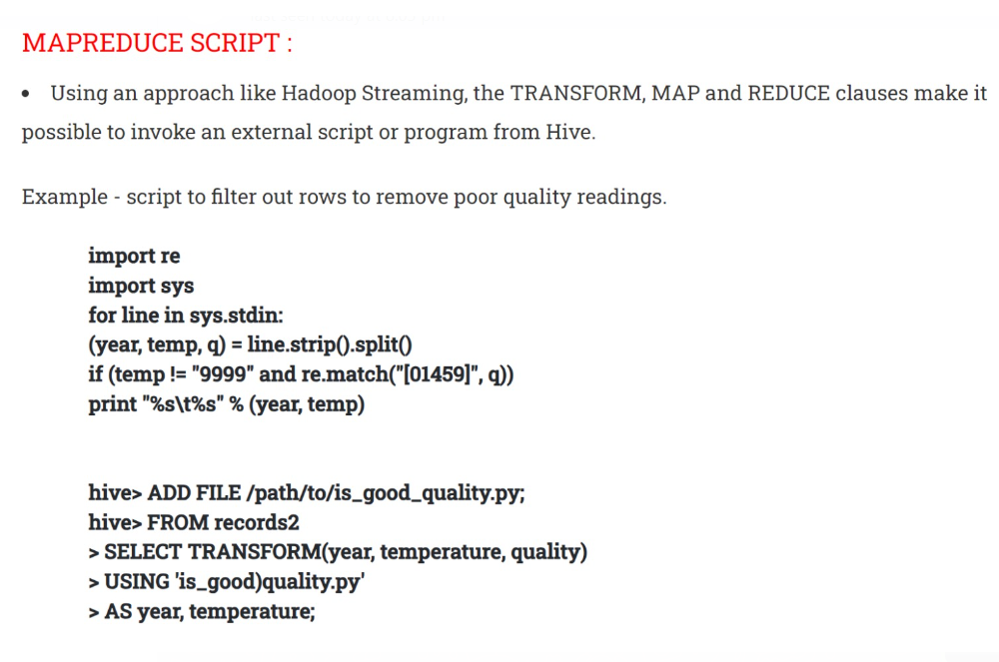
10.MapReduce Scripts

