Slide 1
unit - 1
Introduction to knowledge management

Slide 2
INTRODUCTION TO KM
INTRODUCTION: Spread, distribute Knowledge management (KM) is the process of identifying, organizing, storing and disseminating information within an organization. When knowledge is not easily accessible within an organization, it can be incredibly costly to a business as valuable time is spent seeking out relevant information versus completing outcome-focused tasks.

Slide 3
Scope of knowledge management
Knowledge management is well known to be a multidisciplinary field Contributing disciplinary areas include:
management science
Business
computer science
organizational science library and
information science
psychology social sciences planning and development

Slide 4
SIGNIFICANCE OF KM
Employee awareness
Availability
Timeliness
Adapt organizational change
Helps in decision-making
Transfer Knowledge
Reduces risk
Goal achievement
Availability of informaton

Slide 5
FUNCTIONS OF KM
Intermediation
Externalization
Internalization:
Cognition
Measurement

Slide 6
PRINCIPLES OF KNOWLEDGE MANAGEMENT
Knowledge is a Valuable Asset
Knowledge is Stored in A Central Repository
Knowledge is Retained
. Knowledge is Quality Controlled
Knowledge is Sustained
Knowledge is Decentralized
, Knowledge is Social
. Knowledge is Shared
9. Knowledge is Accessible

Slide 7
Knowledge is Secured
. Knowledge is Searchable
Work Produces Knowledge
Knowledge is Measured
Knowledge is Improved

Slide 8
Knowledge dynamics
According to Hedlund and Nonaka (1993) 'the generation and exploitation of knowledge in an organizational context revolve around two critical issues: the interplay of articulated and tacit knowledge, and the transfer and transformation of knowledge between individuals, organizational units and the surrounding environment". emerged: Based on the preliminary analysis of the interviews, three knowledge processes have

Slide 9
Benefits of Knowledge Creation for Business Success
Enhanced Innovation
Competitive Advantage
Improved problem solving
Employee Engagement &Retention
Organizational Learning and Adaptability

Slide 10
Unit 3 KNOWLEDGE MANAGEMENT TOOLS
7 ESSENTIAL KNOWLEDGE MANAGEMENT TOOLS
PERSONAL KNOWLEDGE MANAGEMENT TOOLS
KNOWLEDGE MANAGEMENT TECHNOLOGY
KNOWLEDGE MANAGEMENT TECHNOLOGY COMPONENTS
KNOWLEDGE MANAGEMENT INFRASTRUCTURE

Slide 11
7 ESSENTIAL KNOWLEDGE MANAGEMENT TOOLS
Content Repository
Knowledge Search
Communication Tool
Social Software
Knowledge Visualization
Decision Support
Big Data

Slide 12
PERSONAL KNOWLEDGE MANAGEMENT TOOLS
Information Literacy Tutorial
Wiki Software
Mind mapping software
Blogging Software
Networking

Slide 13
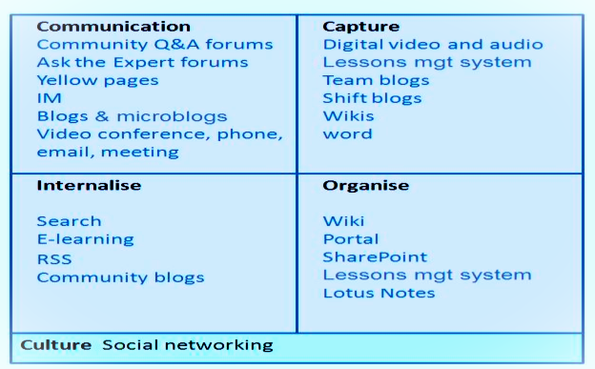
KNOWLEDGE MANAGEMENT TECHNOLOGY

Slide 14
KNOWLEDGE MANAGEMENT TECHNOLOGY COMPONENTS
User interface, User experience
Share point
Digital experience portal
Workflow application
Bogges
Wikies
Process automation

Slide 15
KNOWLEDGE MANAGEMENT INFRASTRUCTURE
Organization Culture:
Organisation Structure:
Hierarchical Structure:
Decentralization:
Matrix Structures
Communities of Practice
Specialised Structures and Roles
Information Technology Infrastructure
Common Knowledge
Physical Environment

Slide 16
Unit 5 Knowledge Management Implementation
Knowledge Management (KM) means collecting, sharing, and using information in an organization to improve work, quality, and innovation.
Example: Sharing best ideas to make teamwork better.

Slide 17
Main Elements of Knowledge Management
1. People – Employees who create and share knowledge.
2. Processes – Methods used to manage and share knowledge.
3. Technology – Tools used for storing and sharing info.
4. Structure – Team setup that supports knowledge flow.
5. Culture – Encourages learning and knowledge sharing.

Slide 18
8 Steps of KM Implementation (1–4)
1. Set Clear Goals – Define purpose and objectives.
2. Prepare for Change – Train employees, build teamwork.
3. Define Process – Plan how knowledge will be managed.
4. Choose Technology – Pick the best tools and systems.

Slide 19
8 Steps of KM Implementation (5–8)
5. Assess Current Situation – Find strengths and gaps.
6. Build Roadmap – Step-by-step plan for KM.
7. Implement – Apply plan and involve employees.
8. Measure & Improve – Track progress and update process.

Slide 20
Benefits of Knowledge Management
• Better decision-making
• More innovation
• Saves time and cost
• Improves teamwork
• Better customer service

Slide 21
Common Issues in KM Implementation
• Lack of awareness
• Not enough resources
• Resistance to change
• Poor leadership support
• No training or motivation

Slide 22
Roadblocks to Success
1. No clear goal
2. Lack of ambition
3. Negative thinking
4. Poor health
5. Lack of persistence
6. Fear of risk
7. No focus
8. No enthusiasm

Slide 23
Challenges & Future of KM
• Managing hidden (tacit) knowledge
• Motivating people to share knowledge
• Managing knowledge workers
• Using technology effectively
• Encouraging continuous learning and innovation

Slide 24
Conclusion
Knowledge Management helps organizations use their knowledge effectively to grow, make better decisions, and succeed.
When people, process, and technology work together – success follows!

