Slide 1
Unit 1
Talent Management
Meaning and Significance of Talent Management

Slide 2
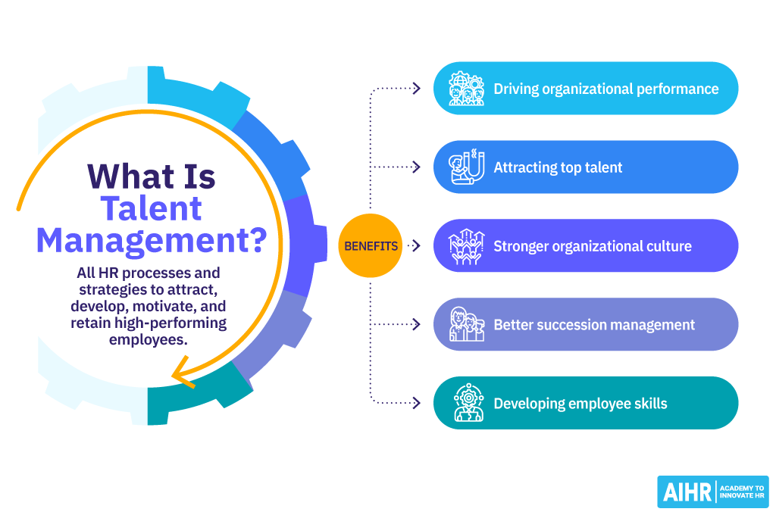

Slide 3
An employee's talent might include a variety of factors, such as their
  Educational credentials
  skills,
  Prior experience,
  Training received,
  Abilities,
  Potential and Motive,
  Traits, and Personality

Slide 4
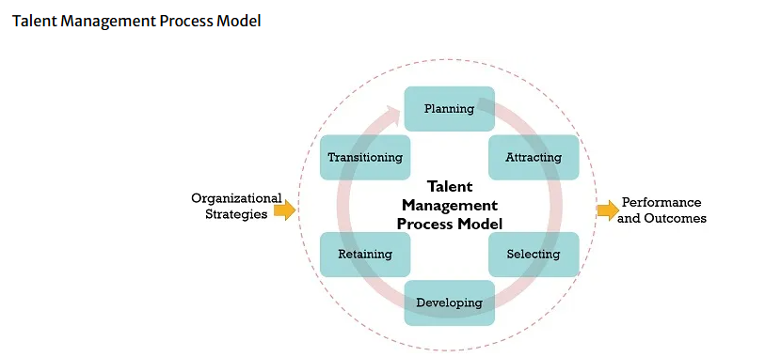

Slide 5
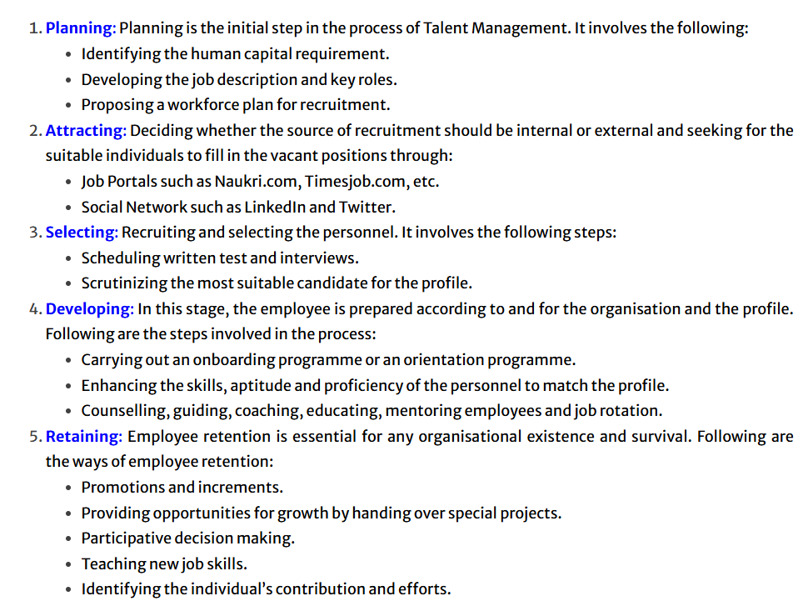

Slide 6
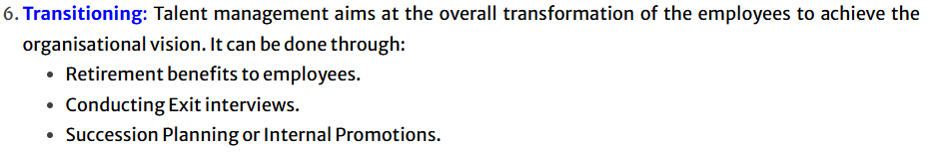

Slide 7
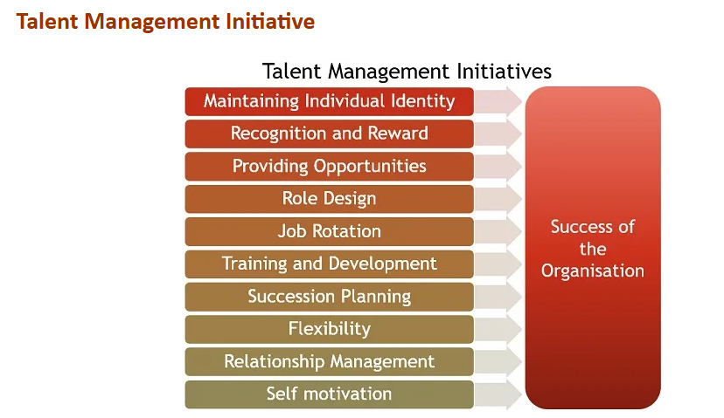

Slide 8
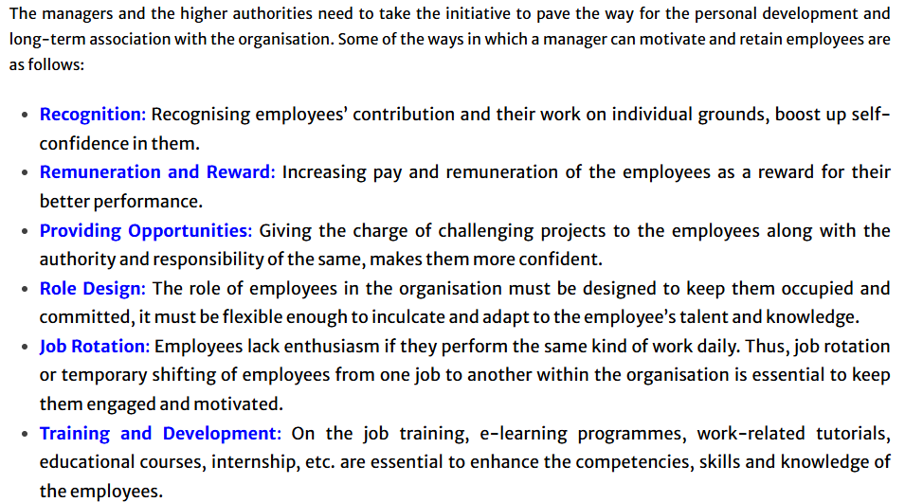

Slide 9
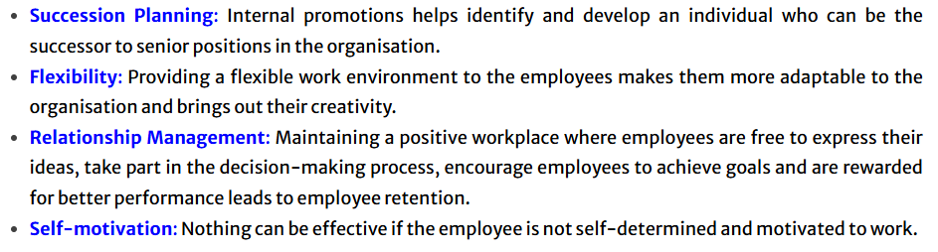

Slide 10
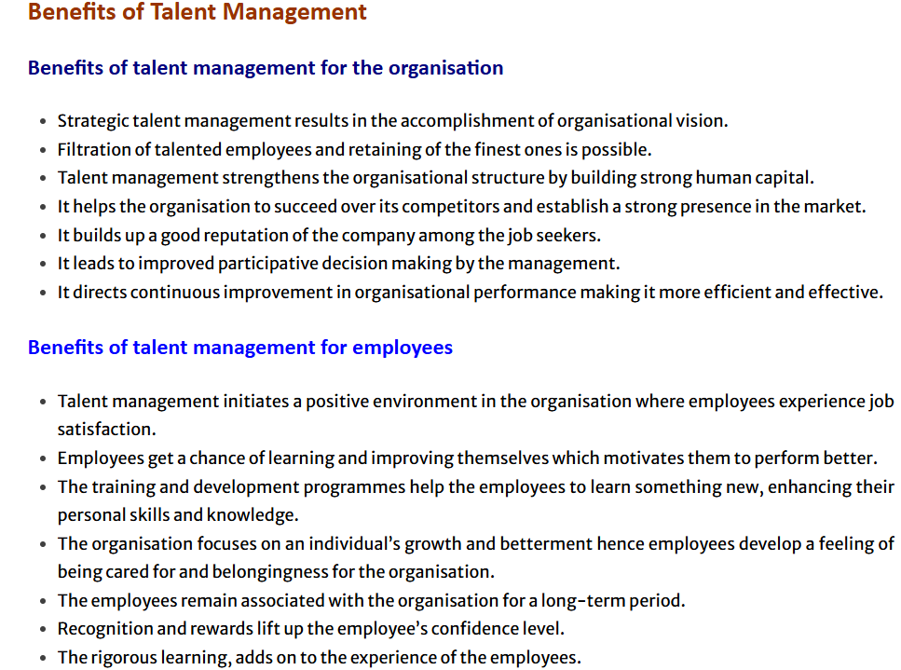

Slide 11
Importance of Talent Management
Driving organizational performance
Employees with the right skills and competencies in the correct positions are able to maximize their contribution to the organization, resulting in improved productivity and organizational performance.
By attracting and retaining top talent and creating a culture of performance excellence, organizations can achieve better results and gain a competitive advantage.
Attracting top talent
HR applies effective talent management strategies to help identify the specific skills and qualities they need in new hires, making the recruitment process more efficient and effective

Slide 12
.
Boosting the employer brand
When employees feel valued, supported, and invested in, they are more likely to speak positively about their employer. This helps organizations enhance their reputation and employer brand and attract new talent.
Stronger organizational culture
Implementing talent management practices helps foster a positive and supportive organizational culture, which boosts morale, productivity, and overall performance.
Therefore, HR professionals must prioritize talent management efforts and develop strategies that align with the company’s goals and values.
Better succession management
Effective talent management includes identifying and developing high-potential employees who will assume key roles in the organization in the future. Succession management ensures that critical positions can be filled quickly, minimizing disruptions to business operations and guaranteeing business continuity.

Slide 13
Promoting innovation
By challenging their employees to grow and develop, organizations create an environment where people can voice new ideas and innovate. This enables businesses to stay ahead of the competition by developing and improving their products and services.
Developing employee skills
According to the LinkedIn Workplace Learning Report, 94% of employees claimed they would remain at a company longer if it invested in their careers, while another report found that employees believe professional development is the number one way to improve the organization’s culture.
Talent management focuses on skill transformation through training, mentoring, and coaching. By investing in employee development, employers encourage performance and career growth. This helps them not only to fill skills gaps and build a skilled workforce but also retain it.

Slide 14
Improving employee retention
Losing top performers is costly, both in terms of recruitment and lost productivity. Talent management practices that prioritize employee engagement, recognition, and career development help retain valuable employees and reduce turnover rates.
Enhancing agility
Businesses that effectively manage talent adapt to changing business circumstances and emerging possibilities more swiftly, which is becoming increasingly important as technology transforms the way we work.
Avoiding unnecessary costs
It can be expensive to recruit and onboard new employees. According to Gallup, hiring a new employee can cost between one-half to twice an employee’s annual salary. High turnover can also disrupt business operations and lower morale. Optimizing talent management practices can lead to significant cost savings and reduce friction.

Slide 15
ATTRACTING TALENT
Talent attraction is the process of identifying and attracting individuals with the necessary skills and abilities to fill vacant positions within an organization. The purpose of talent attraction is to proactively fill job openings with qualified individuals in a timely manner.

Slide 16
Effective Strategies for Attracting Talent
Build a Strong Employer Brand:
Communicate your values and culture:
Highlight what makes your company unique and why talented individuals should choose to work there.
Showcase your mission and vision:
Attract candidates who align with your company's goals and purpose.
Leverage social media:
Share employee stories, company updates, and insights into your workplace culture to engage potential candidates

Slide 17
Offer Competitive Compensation and Benefits:
Conduct market research:
Ensure your salary and benefits packages are competitive within your industry and location.
Consider total rewards:
Offer a mix of salary, benefits, and perks that are attractive to top talent.
Provide opportunities for growth:
Include professional development, training, and mentorship opportunities
Foster a Positive Work Environment:
Encourage open communication:
Create a culture where employees feel comfortable sharing ideas and feedback.
Recognize and reward outstanding performance:
Show appreciation for employees' contributions and celebrate successes.
Promote work-life balance:
Offer flexible work arrangements, generous time off, and support for employees' personal commitments.

Slide 18
Streamline the Recruitment Process:
Make the application process easy:
Use a user-friendly online application system.
Speed up the hiring process:
Reduce the time it takes to move candidates through the stages of recruitment.
Provide timely feedback:
Keep candidates informed about their application status throughout the process.
Leverage Employee Referrals:
Implement a referral program:
Encourage your employees to refer qualified candidates.
Offer incentives for successful referrals:
Reward employees for bringing in top talent.

Slide 19
Embrace Diversity and Inclusion:
Promote a diverse and inclusive workplace:
Attract a wider pool of talent by valuing differences.
Ensure equal opportunities:
Create a fair and equitable environment for all employees.
Enhance Your Online Presence:
Optimize your career site:
Make it easy for candidates to find information about your company and job openings.
Utilize social media:
Share engaging content and connect with potential candidates on platforms like LinkedIn and other social media channels.

Slide 20
Retaining Talent (Talent Retention or Employee Retention)
Retaining talent, also known as employee retention, involves implementing strategies and practices to keep valued employees within an organization.
This is crucial for business success, as it
  Minimizes turnover
  Maintains productivity
  Fosters a positive work environment.
  Organizations strive to create a workplace where
    Employees feel engaged
    Valued
    Motivated to stay
    Which reduces the need for constant recruitment and training of new staff.
Talent retention represents an employee's lasting commitment to their employer, minimizing turnover.

Slide 21
Benefits of Retaining Talent
In addition to avoiding problems caused by high turnover rates, organizations that retain talent experience several advantages. They enhance company performance by developing experienced employees and company experts. Some of the benefits of retaining talent include:
  Improving the company culture
  Leading to better customer experience
  Increasing the revenue
  Enhancing employee engagement and satisfaction
  Building a positive company reputation

Slide 22
Key Strategies for Talent Retention
Competitive Compensation and Benefits:
Offering salaries and benefits packages that are competitive within the industry is essential to attracting and retaining talent. This includes not only base pay but also comprehensive health insurance, retirement plans, and other perks that make employees feel valued.
Employee Engagement:
Creating a work environment that fosters employee engagement is critical. This involves activities like team-building exercises, regular feedback sessions, and opportunities for social interaction to build a sense of community and belonging.
Professional Development:
Investing in employee development through training programs, mentorship opportunities, and clear career paths demonstrates a commitment to their growth and future within the company.
Work-Life Balance:
Promoting a healthy work-life balance through flexible work arrangements, generous leave policies, and a focus on employee well-being can significantly impact retention.

Slide 23
Positive Work Environment:
Building a positive and inclusive work culture that values diversity and inclusion is essential. This includes open communication, transparent leadership, and a focus on employee recognition and appreciation.
Effective On-boarding:
A well-structured on-boarding process that integrates new employees smoothly into the company culture and provides them with the necessary resources and support is crucial for their initial success and long-term commitment.
Regular Feedback and Recognition:
Providing ongoing feedback and recognizing employee achievements, both big and small, helps employees feel valued and motivated.
Leadership Development:
Training managers to effectively lead, motivate, and retain their teams is crucial. This includes equipping them with the skills to address employee concerns, provide constructive feedback, and foster a positive team environment.

Slide 24
CONSEQUENCES OF FAILURE OF TALENT MANAGEMENT
Failure in managing talent can have significant consequences for organizations. Talent management involves attracting, developing, and retaining skilled employees who can contribute to the company's success. When talent management efforts fall short, the following consequences may occur:
Loss of Competitive Advantage:
Organizations that fail to effectively manage their talent may struggle to compete in their industry. Skilled and motivated employees are often a key source of competitive advantage, and without them, companies may find it difficult to innovate, deliver high-quality products or services, and stay ahead of competitors.
Decreased Productivity:
Inadequate talent management can lead to a decrease in employee productivity. When employees are not properly trained, motivated, or engaged, their performance may suffer, resulting in lower output and efficiency.

Slide 25
High Turnover Rates:
Poor talent management can contribute to high employee turnover rates. When employees do not feel valued or see opportunities for growth within an organization, they are more likely to seek employment elsewhere. High turnover can be costly in terms of recruitment, training, and lost institutional knowledge
Increased Recruitment Costs:
Organizations that do not invest in talent management may have to spend more on recruitment to replace departing employees. This includes advertising job openings, conducting interviews, and on-boarding new hires. These costs can add up quickly.
Skills Shortages:
Failure to develop and nurture talent from within the organization can result in skills shortages. As employees retire or leave, there may be a lack of qualified individuals to fill critical roles, leading to operational disruptions and potential business risks.
Poor Employee Morale:
When employees perceive that their organization does not invest in their development or offer opportunities for advancement, their morale can suffer. Low morale can lead to decreased engagement, absenteeism, and a negative workplace culture.

Slide 26
Difficulty in Succession Planning:
Effective talent management is essential for succession planning. Without a pipeline of skilled and experienced employees ready to step into leadership roles, organizations may face leadership vacuums when key executives retire or depart.
Missed Innovation Opportunities:
Innovative ideas often come from talented and creative employees. Failing to identify and nurture these individuals can result in missed opportunities for innovation and growth.
Negative Brand Reputation:
Poor talent management can harm an organization's reputation as both an employer and a business partner. Negative employee experiences can be shared on social media, impacting how potential employees and customers perceive the company.
Legal and Compliance Risks:
In some cases, failure to manage talent effectively can lead to legal and compliance issues. This may include discrimination claims, labor disputes, or violations of employment laws.

Slide 27
TOOLS FOR MANAGING TALENT
Effective talent management involves a combination of strategies, processes, and tools to attract, develop, and retain skilled employees. There are various tools available to assist organizations in managing talent effectively.
These tools can range from software applications to assessment instruments. Here are some common tools used in talent management:
Human Resource Information System (HRIS):
HRIS software helps organizations manage employee data, including personal information, performance evaluations, training records, and more. It provides a centralized database for HR professionals to track and analyze talent related data.
Applicant Tracking System (ATS):
ATS software streamlines the recruitment process by automating job posting, resume screening, and candidate communication. It helps HR teams identify and select the best candidates efficiently.

Slide 28
Learning Management System (LMS):
LMS software facilitates employee training and development by offering online courses, tracking progress, and assessing skill development. It's essential for continuous learning and skill enhancement.
Performance Management Software:
These tools enable organizations to set goals, track employee performance, provide feedback, and conduct performance reviews. They help align individual and organizational goals.
Succession Planning Software:
Succession planning tools assist in identifying and developing future leaders within the organization. They help organizations prepare for leadership transitions.
360-Degree Feedback Tools:
These tools collect feedback from peers, managers, subordinates, and self-assessments to provide a comprehensive view of an employee's performance. They can aid in identifying areas for improvement.
Talent Assessment Tools:
Psychometric and personality assessments are used to evaluate candidates' and employees' skills, abilities, and personality traits to make more informed hiring and development decisions.

Slide 29
Unit 2
TALENT MANAGEMENT SYSTEM AND COMPETENCY MAPPING

Slide 30
Talent Management System (TMS)
An integrated software platform that supports core talent management processes including
  Recruitment,
  Employee On-boarding,
  Performance management,
  Learning and Professional Development,
  Compensation management,
  Succession planning

Slide 31
  It aims
    To streamline and optimize HR processes,
    Improve employee engagement, and
    Ultimately drive business performance
  A talent management system (TMS) is an integrated software suite that addresses the "four pillars" of talent management: recruitment; performance management; learning and development; and compensation management.

Slide 32
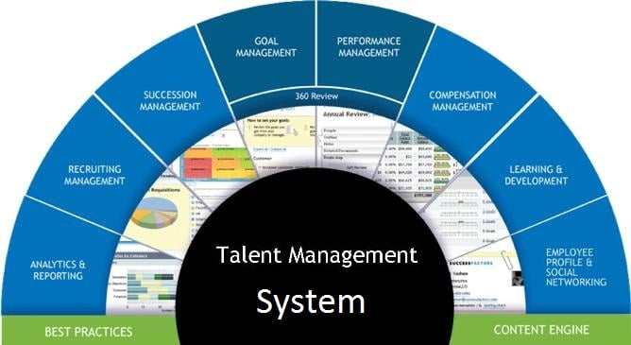

Slide 33
Core Components and Functions
Recruitment and Onboarding:
TMS helps automate and optimize the recruitment process, from job postings to candidate selection and on-boarding new hires.
Performance Management:
These systems track employee performance, provide feedback, and facilitate goal setting and performance reviews.
Learning and Development:
TMS offers tools for identifying skill gaps, suggesting training programs, and managing employee development plans.

Slide 34
Compensation Management:
They can help manage salary structures, bonus plans, and other forms of compensation.
Succession Planning:
TMS supports identifying and developing high-potential employees for future leadership roles.

Slide 35
Benefits of Using a TMS
Improved Efficiency:
Automation of HR processes saves time and resources.
Better Employee Experience:
Centralized access to information and career development opportunities enhances employee satisfaction.
Data-Driven Decisions:
TMS provides valuable insights into employee performance and talent trends, enabling more informed decision-making.
Enhanced Performance:
By aligning individual goals with organizational objectives, TMS can drive better overall performance.
Increased Retention:
By supporting employee development and engagement, TMS can contribute to lower employee turnover.

Slide 36
From a business perspective, a talent management system provides a range of benefits that include:
  An integrated and centralized data model for all talent management activities
  Recruitment strategies that align with the objectives of the business
  Improved employee on-boarding, retention, and development
  Better engagement between managers and employees, including processes for compensation, reviews, and rewards

Slide 37
Specific user-based benefits include
Recruiters:
Better manage end-to-end, using career websites, job postings, applications, candidate screening, and employment offers. Applicants can access and explore career websites, apply for roles of interest, and engage within a dedicated candidate portal for interviews and employment offers.
Applicants:
Easily find postings through career Web sites, apply for roles of interest, and engage within a dedicated candidate portal for interviews and employment offers.

Slide 38
Human resources:
Seamlessly coordinate all talent management tasks. Use powerful data analytics to inform business decisions. Generate detailed reports to share statuses and results. Create compensation plans and easily prove compliance with government and industry regulations.
Managers:
Work collaboratively with recruiters for greater efficiency. Welcome new hires and help them ramp up quickly. Manage compensation across entire teams. Use streamlined processes to help track activities, performance, and ongoing feedback for all assigned employees. Align individual performance goals with business objectives. Use reward and recognition tools to optimize employee engagement.
Employees:
Easily access information and tasks, including goals, rewards, performance reviews, compensation and benefits information, and learning paths tied to individual career goals. Recognize peers and redeem rewards and other benefits related to exceptional performance and results.

Slide 39
How does a talent management system work?
Talent management systems typically run in the cloud. A cloud platform provides a range of benefits, including larger data storage capacities, more robust security, and easier integration with complementary applications such as payroll, training programmes, career planning, and other systems, as well as the secure storage of employee data (such as personal information, demographics, and compensation)

Slide 40
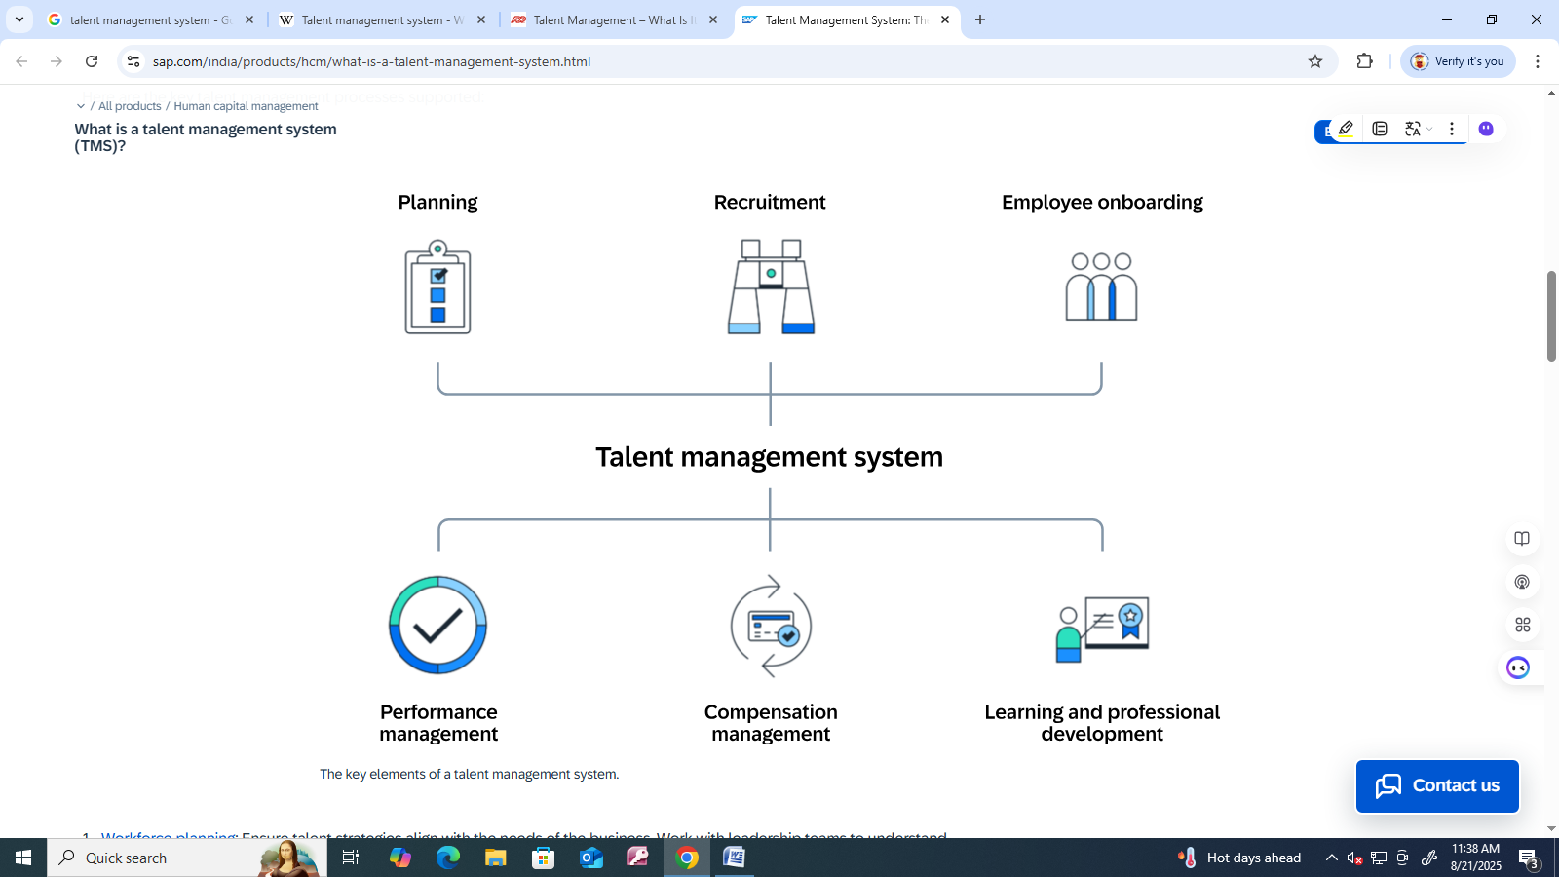

Slide 41
Workforce planning: Ensure talent strategies align with the needs of the business. Work with leadership teams to understand business objectives, then ensure the talent strategy supports these outcomes.
Recruit candidates: Source talent globally, nurture candidates throughout the recruitment process, and leverage the efficiencies of a comprehensive applicant management and tracking system.
Onboard employees: Optimize new hire engagement with a dedicated on-boarding portal. Ramp employees quickly with paperless new hire processes. Automate workflows for on, off, and cross-boarding.

Slide 42
Manage employee performance: Help employees manage their goals. Use guided action planning for continuous performance management.
Plan and design compensation models: Reward and recognize strong performers.
Develop and retain employees through learning programmes: Provide modern and engaging learner experiences. Schedule learning and carry out compliance training. Develop proactive succession plans and actively develop leaders.

Slide 43
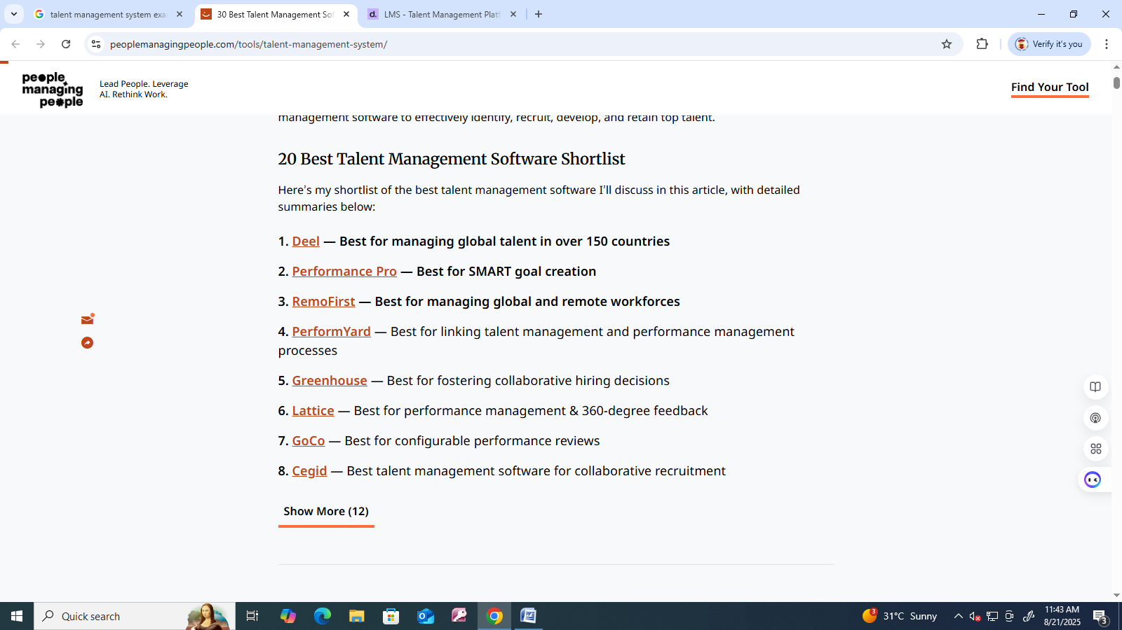

Slide 45
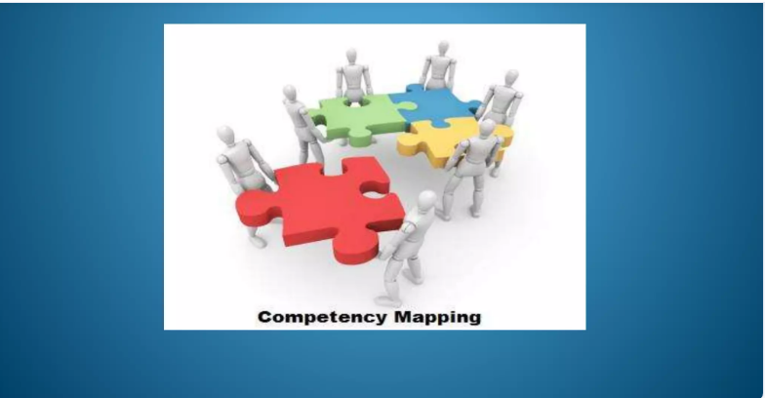

Slide 46
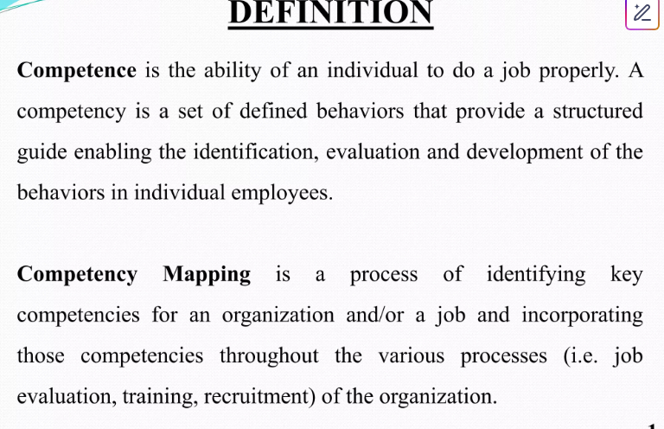

Slide 47
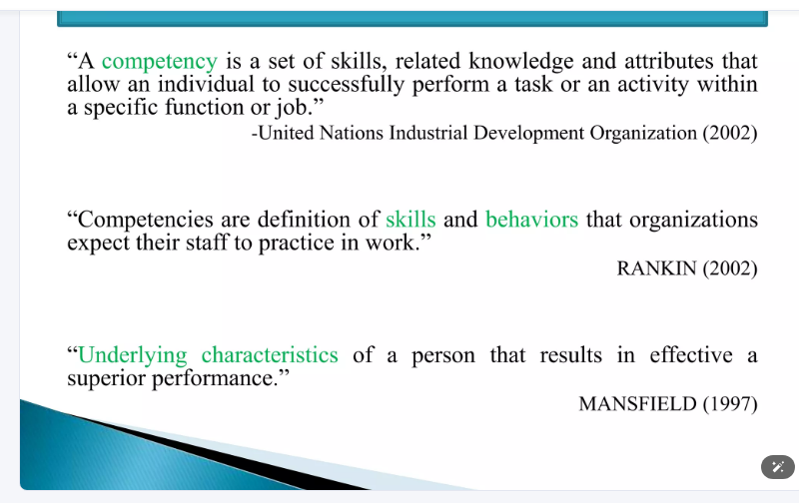

Slide 48
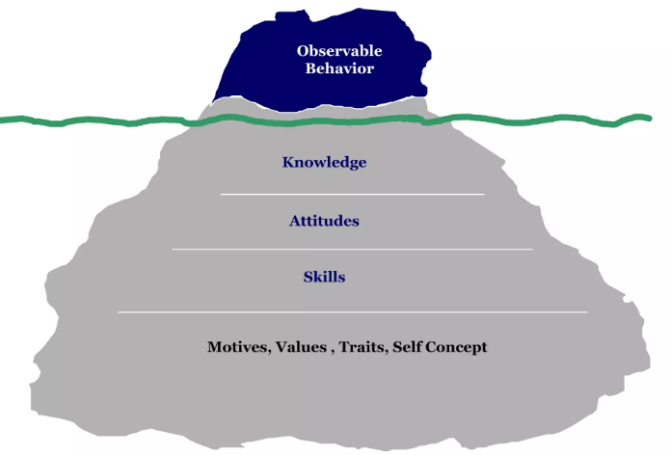

Slide 49
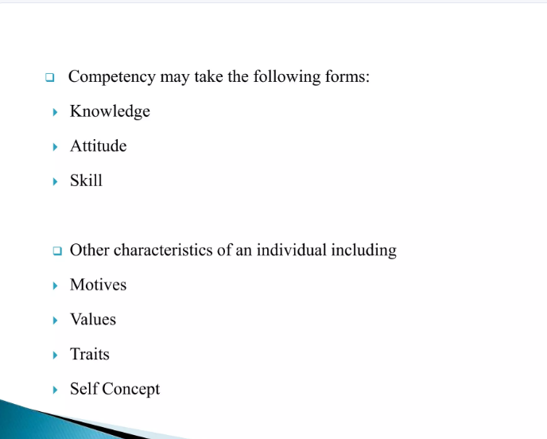

Slide 50
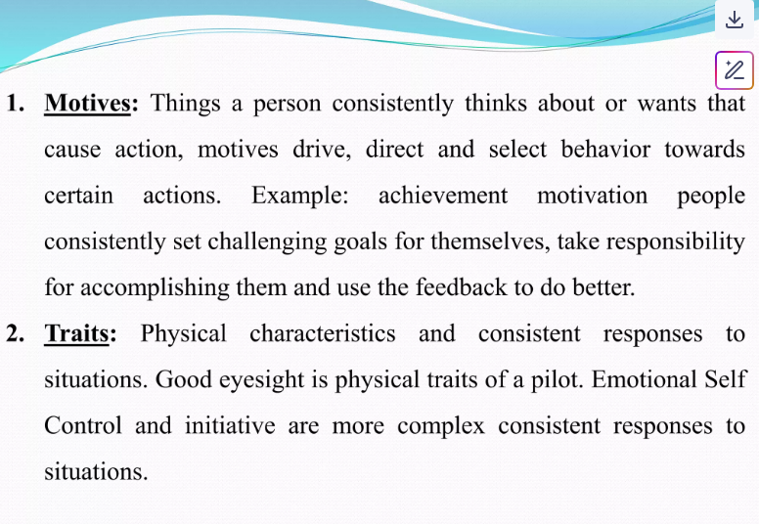

Slide 51
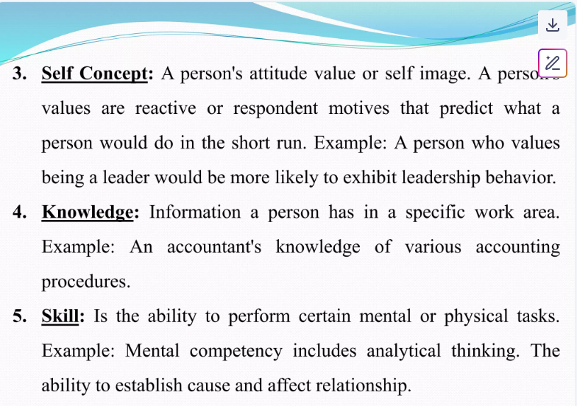

Slide 52
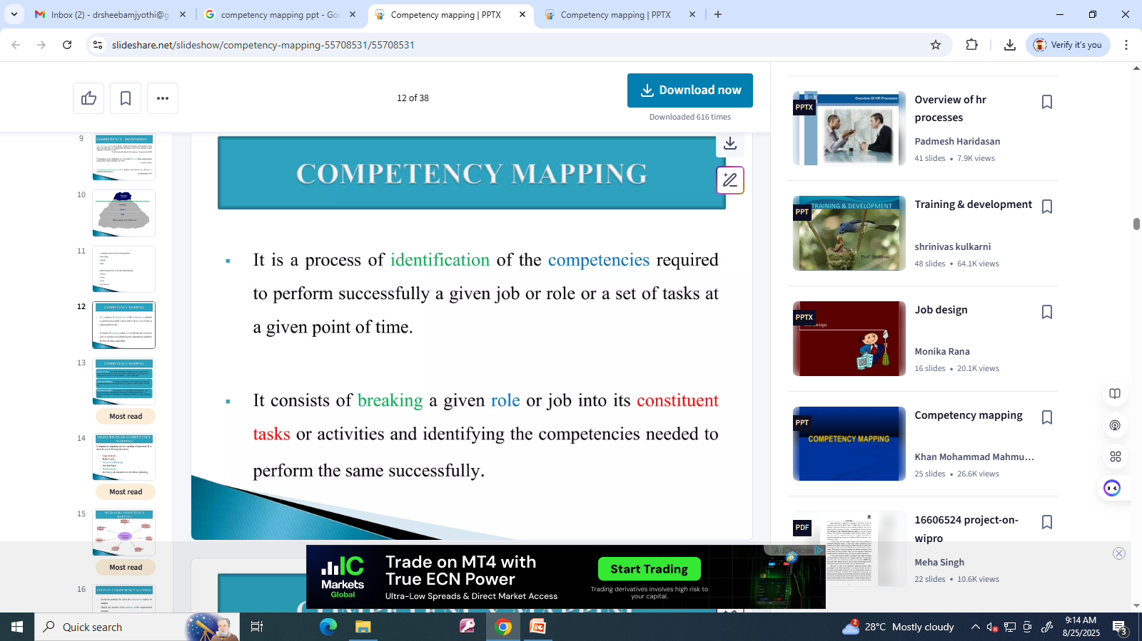

Slide 53
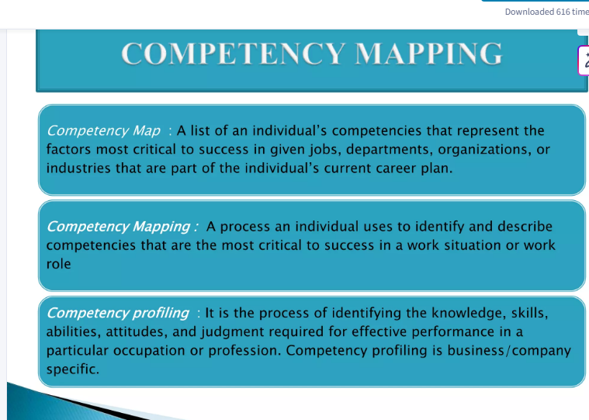

Slide 54
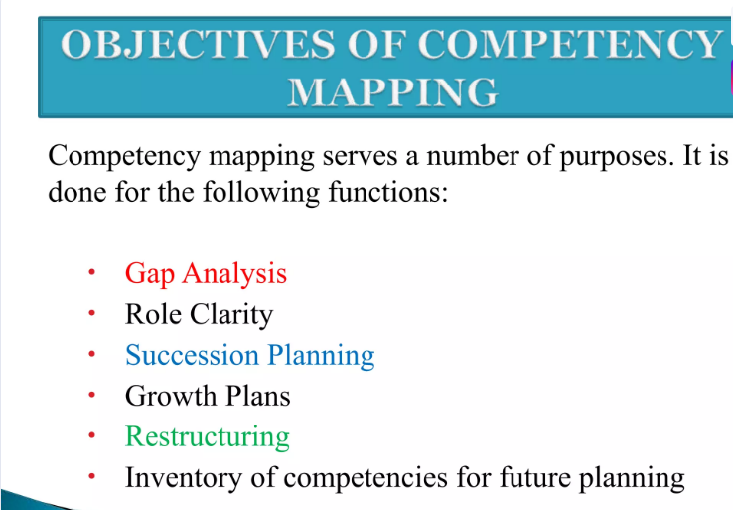

Slide 55
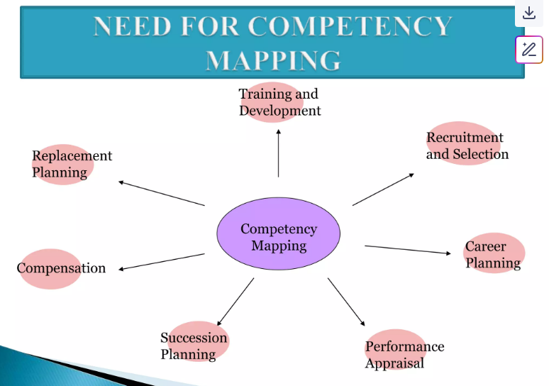

Slide 56
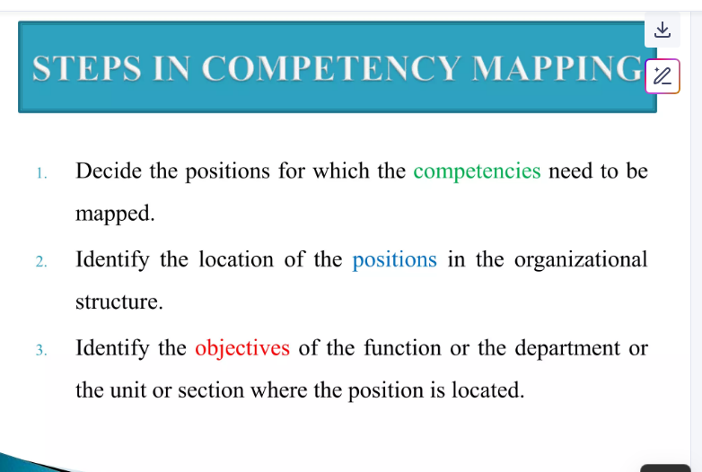

Slide 57
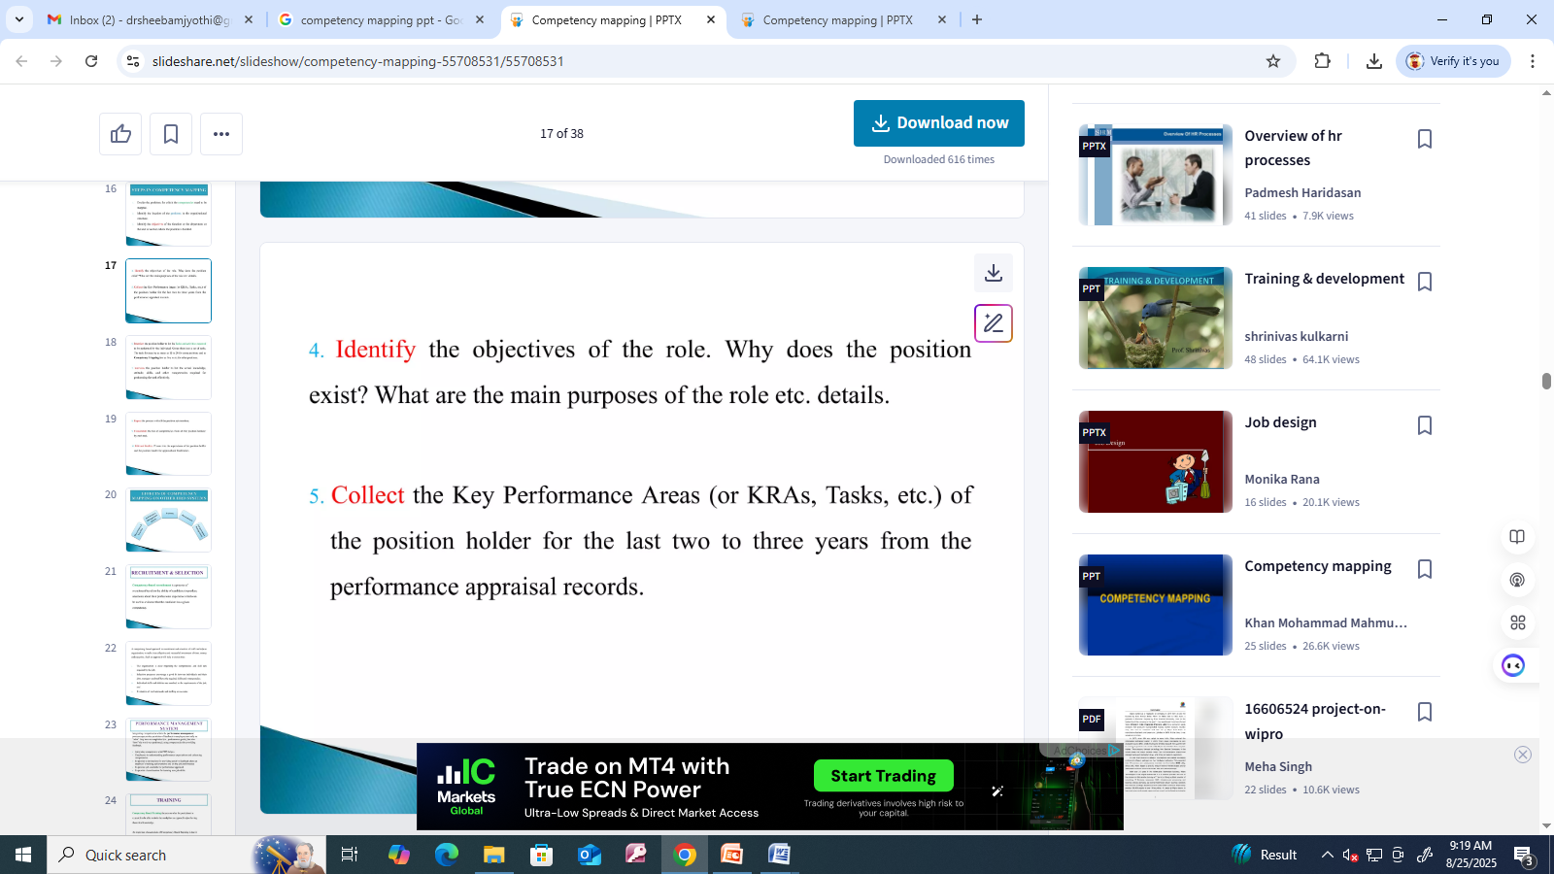
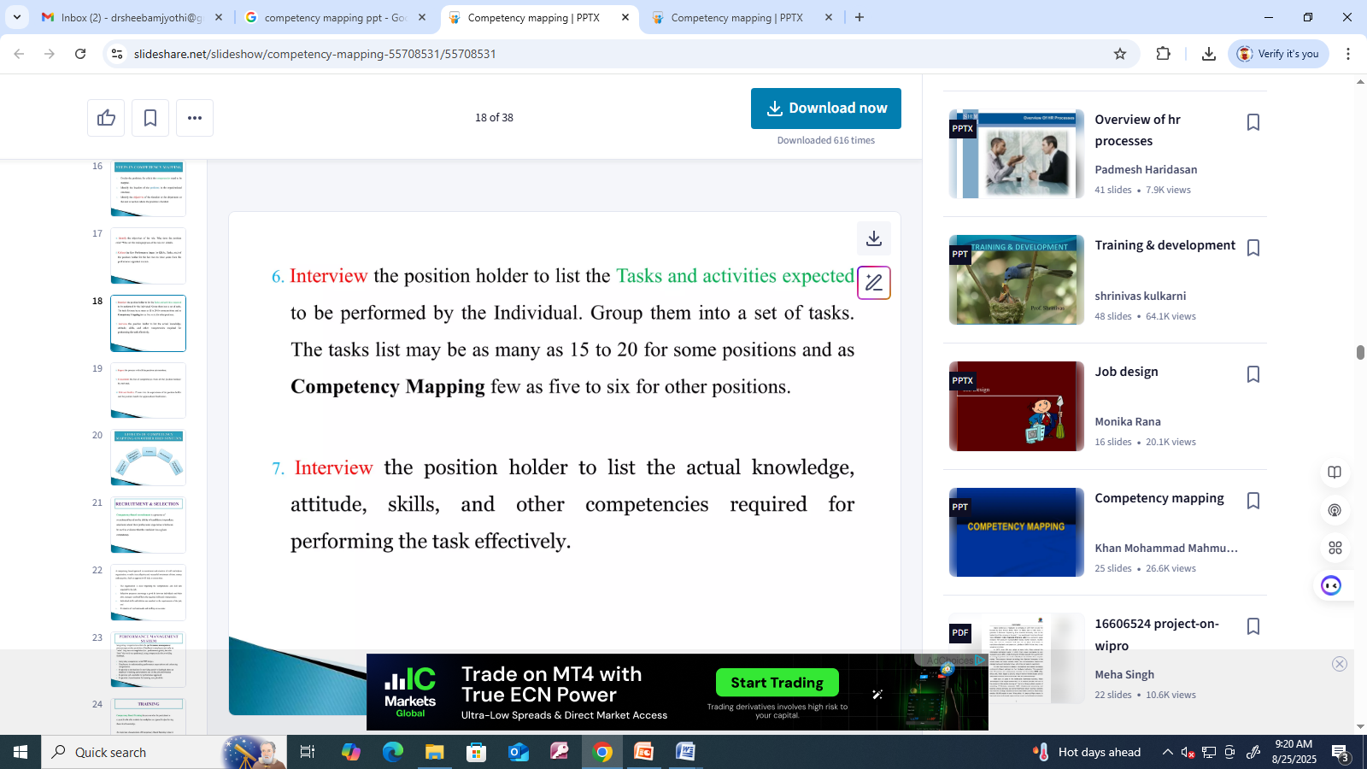

Slide 58
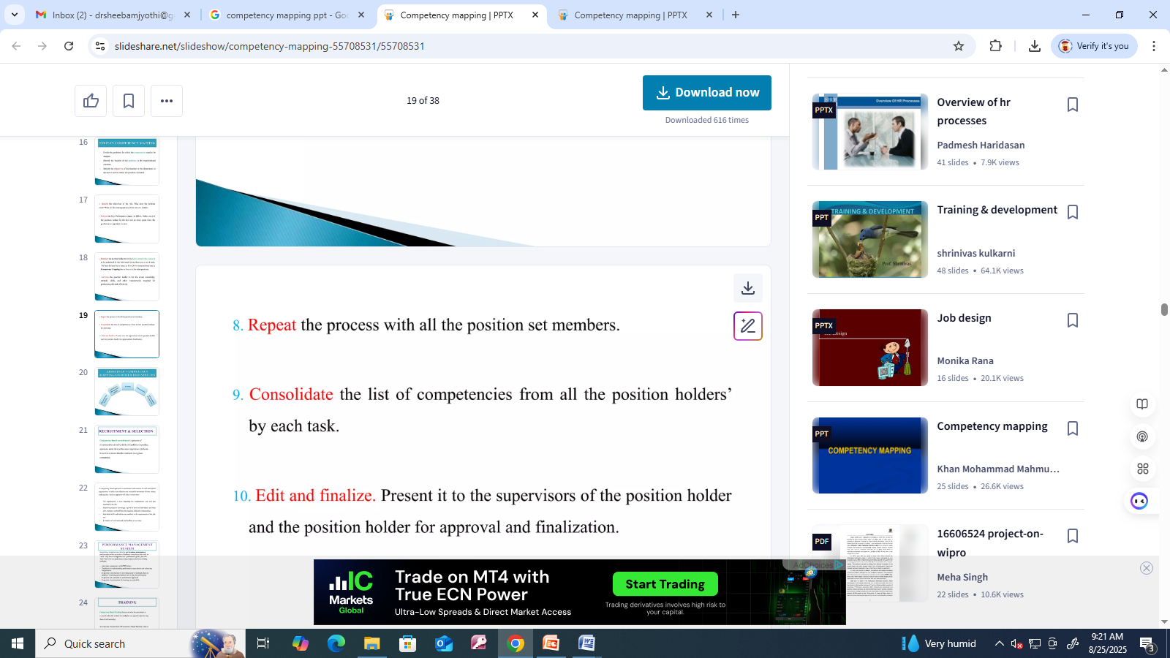

Slide 59
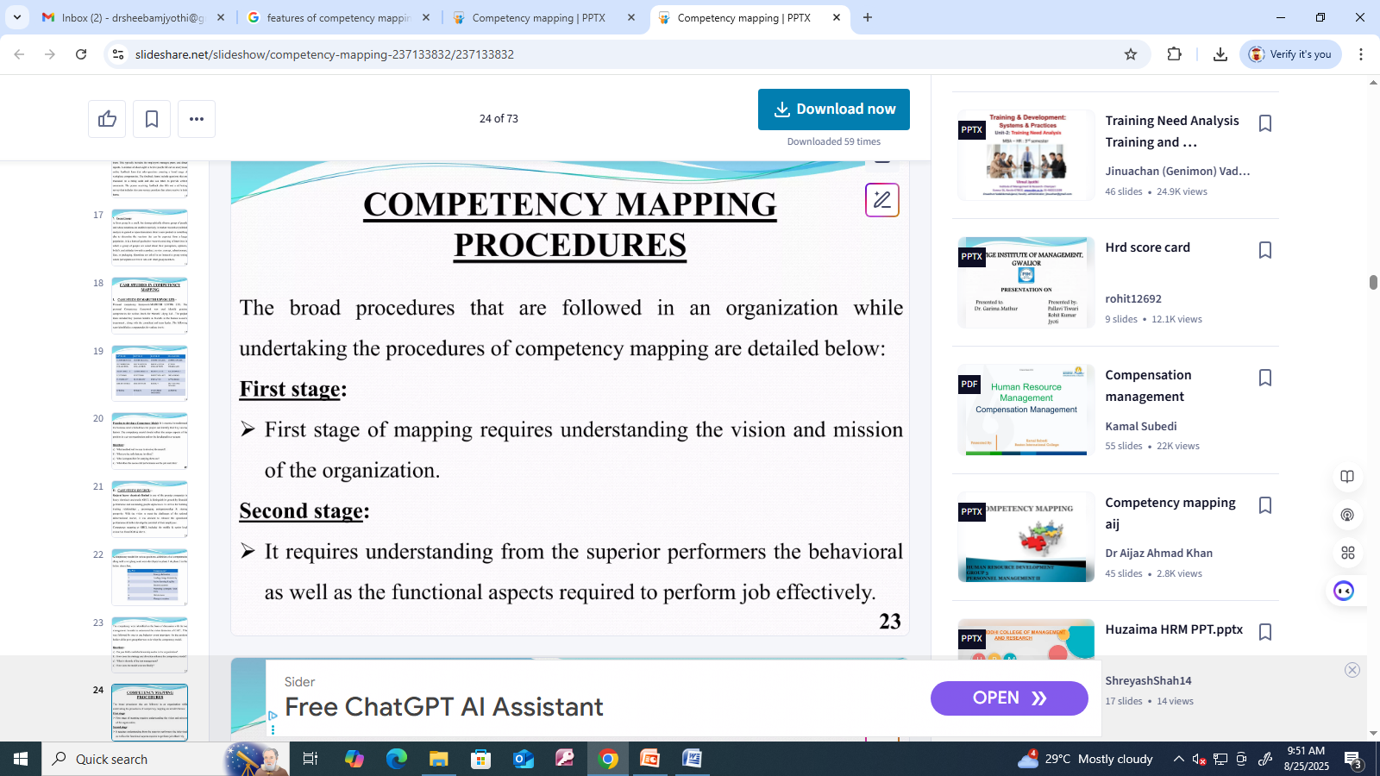

Slide 60
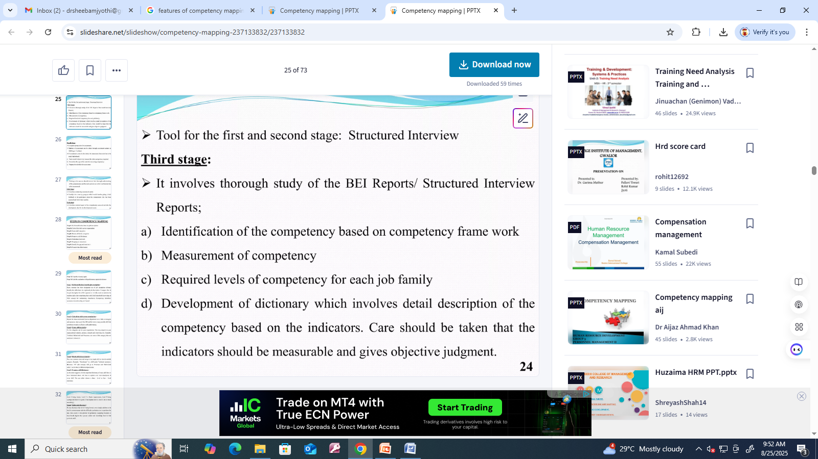

Slide 61
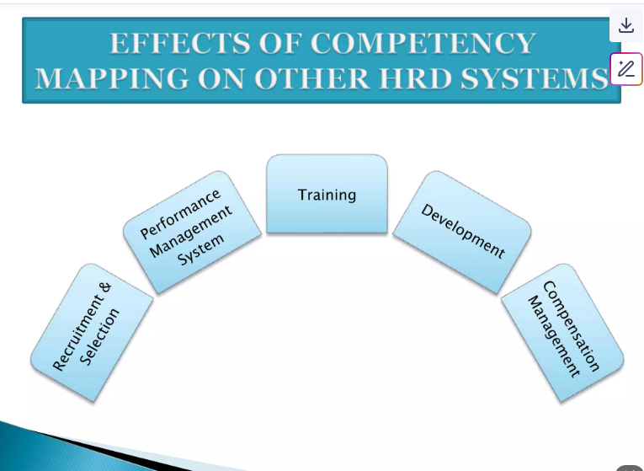

Slide 62
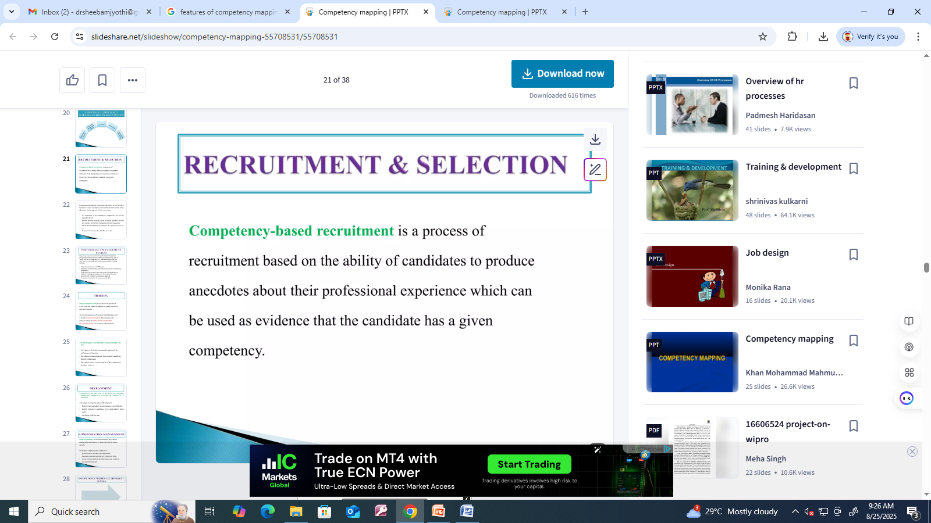
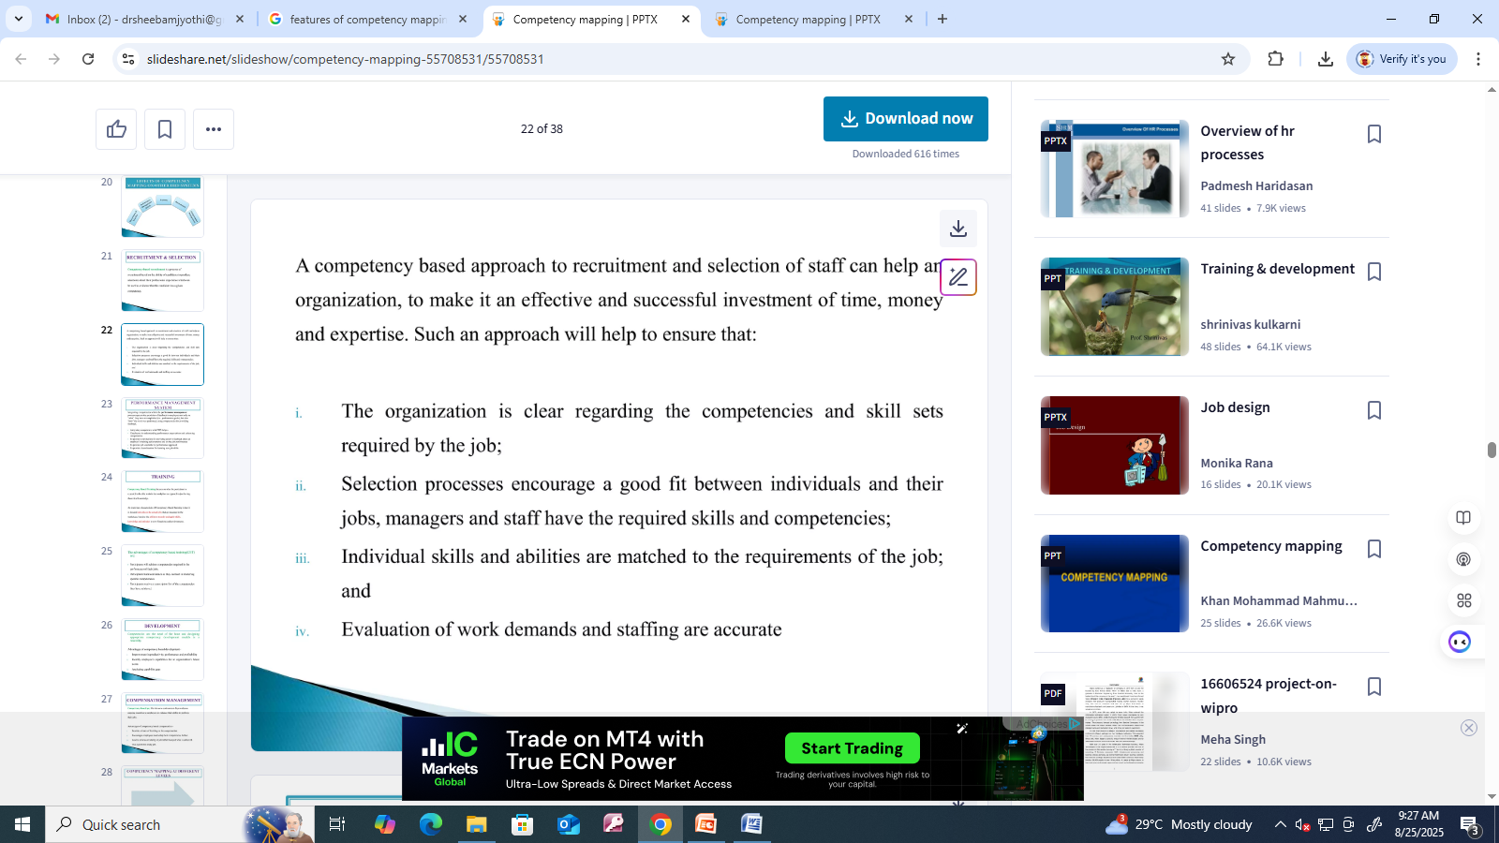

Slide 63
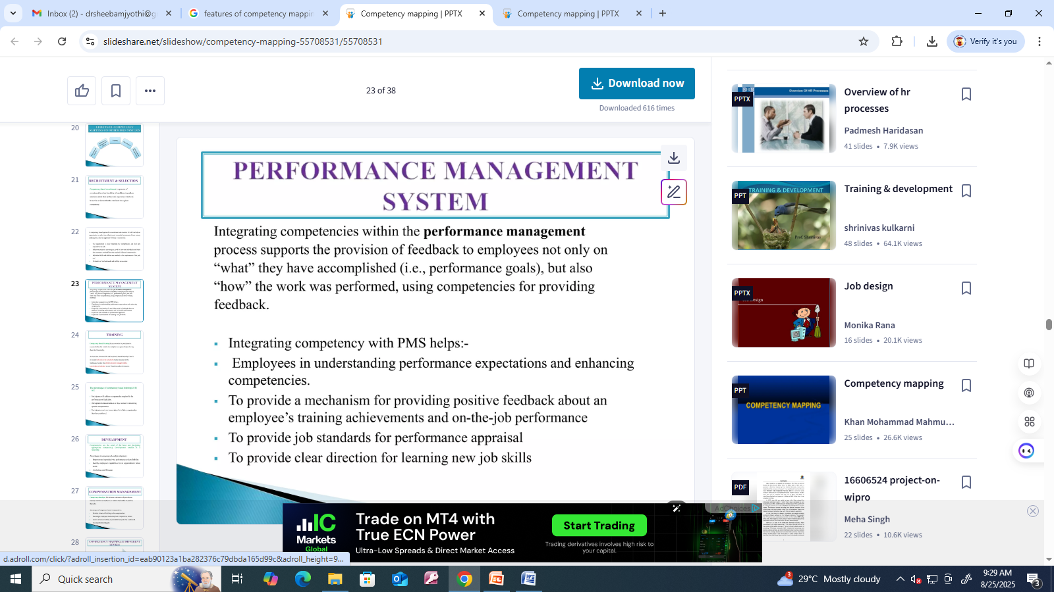

Slide 64
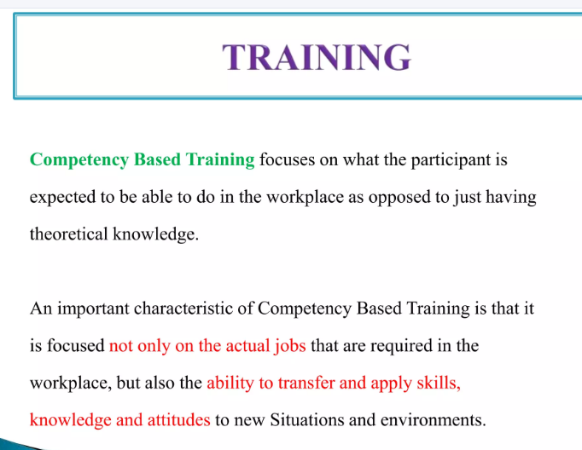

Slide 65


Slide 66


Slide 67


Slide 68
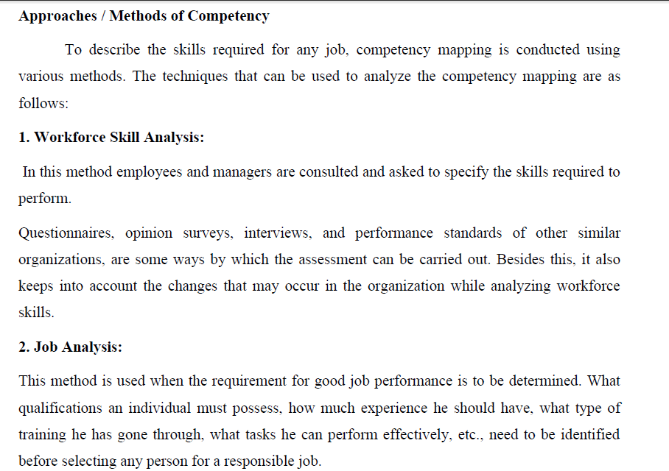

Slide 69
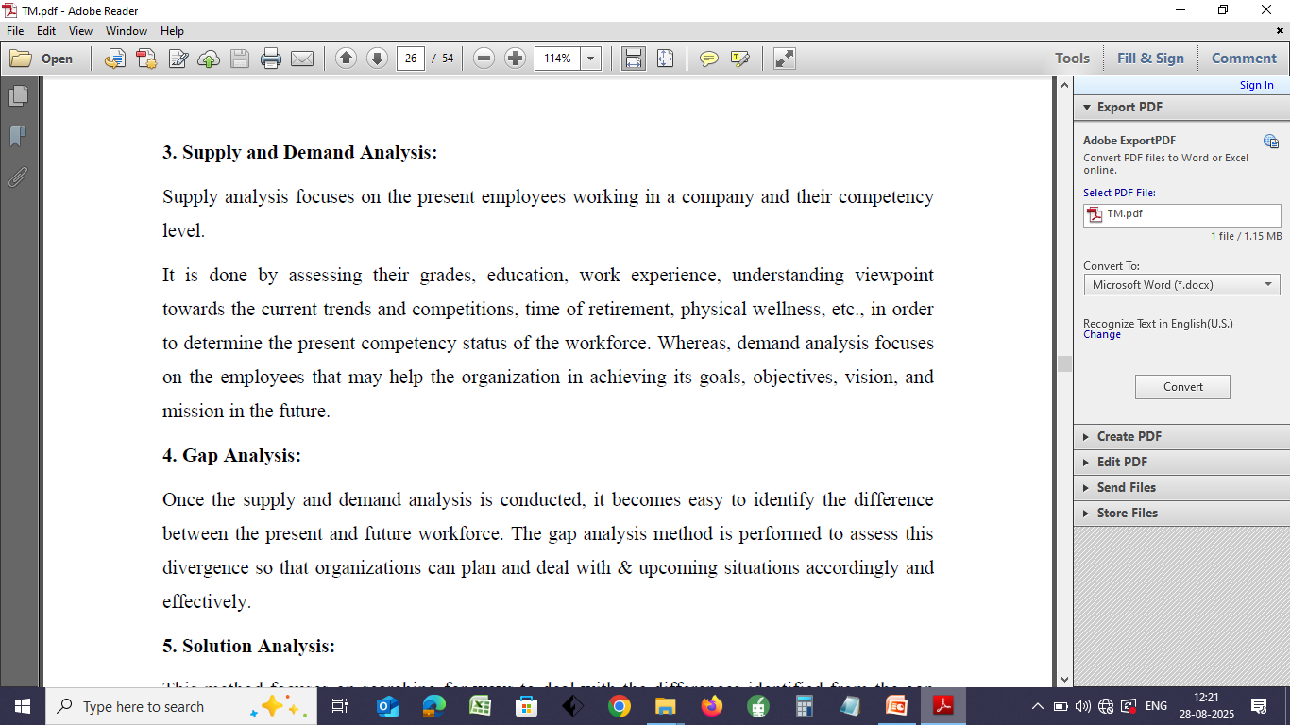

Slide 70
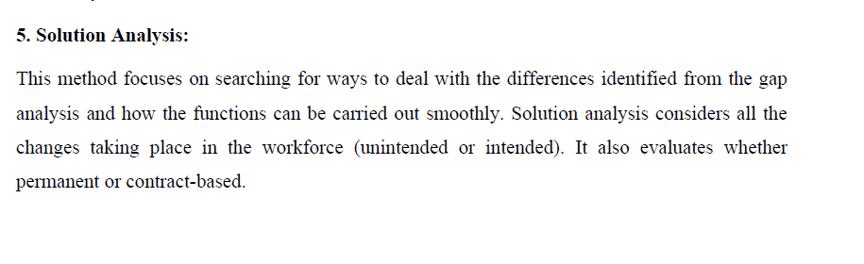

Slide 71
Unit 3
Life cycle of Talent Management

Slide 72
TALENT MANAGEMENT PROCESS
The talent management process is a strategic cycle that includes workforce planning, talent acquisition (attracting and selecting), talent development (onboarding, training, and engagement), performance management, succession planning, and talent retention.
This continuous process aligns with business goals to ensure organizations have the right people with the right skills in the right roles to drive success and maintain a competitive edge.

Slide 73
Key Stages of the Talent Management Process
Workforce Planning & Strategy:
Identify Talent Gaps:
  Determine current and future skill needs aligned with organizational goals.
Strategic Alignment:
  Connect talent needs directly to the company's strategic business objectives.
Talent Acquisition:
Sourcing & Attraction:
  Utilize internal and external channels (job boards, referrals) to find candidates.
Selection:
  Employ interviews, tests, and screenings to identify and hire the most qualified candidates.

Slide 74
Talent Development:
Onboarding:
  Efficiently integrate new hires into the organization and their roles.
Training & Development:
  Provide opportunities for employees to gain and enhance skills required for their roles and future growth.
Coaching & Feedback:
  Offer ongoing guidance and performance feedback to support employee growth.
Performance Management:
Set Goals:
  Establish clear performance goals for employees.
Monitor & Evaluate:
  Track performance, provide feedback, and conduct regular evaluations.

Slide 75
Talent Retention & Engagement:
Rewards & Incentives:
  Offer compensation, benefits, and other incentives to motivate and retain employees.
Engagement:
  Foster a positive work environment that keeps employees connected and committed.
Succession Planning:
Develop Leaders:
  Identify and prepare employees for future leadership roles to ensure a strong internal pipeline.
Transition & Exit:
Promotions & Transfers:
  Move employees to new roles based on their performance and development.
Exit Strategy:
  Manage employee departures, including conducting exit interviews to gather insights for improvement.

Slide 76
Benefits of an Effective Talent Management Process
Optimizes Workforce:
Ensures the right talent is in the right roles.
Boosts Performance:
Drives overall business performance and productivity.
Reduces Turnover:
Creates a motivated workforce that stays with the company longer.
Builds a Strong Employer Brand:
Enhances the organization's reputation and ability to attract top talent.
Fosters a Learning Culture:
Encourages continuous growth and development.

Slide 77
Linkage between Talent Management Process and Workforce
Better Onboarding Link
A powerful on boarding program introduces talented candidates to the business’ engagement culture immediately. The individual can actually engage in on boarding activities rather than sitting at a desk and thumbing through a binder.
Competitive Advantage Link
Competition for talent is fierce because talent is a leading factor in a company’s competitive advantage. Recruiting, developing and retaining talent are the tools that build competitive advantage. Talent management starts with recruiting.

Slide 78
Performance Improvement Link
Talent joins a company appreciating the company and its product. As talent engages more fully in company operations, assignments, projects, that appreciation grows. The greater the appreciation, the greater one’s commitment to performing with quality
Customer Satisfaction Link
Customers naturally prefer to experience quality product and quality service. Research says it is the people with whom customers interact that determine the customer’s opinion of that quality. Talent management looks for quality candidates. Employee engagement turns up that quality.
Reduced Turnover, Increased Retention Link
If intense effort is made to hire talent, equally intense effort should be expended to retain talent. Employee engagement is a specific element of talent management insofar as it boosts a company’s ability to hold on to talented employees. People stay with companies they value. The more an employee is allowed and encouraged to engage in job, team, and company efforts, the more one sees the value.

Slide 79
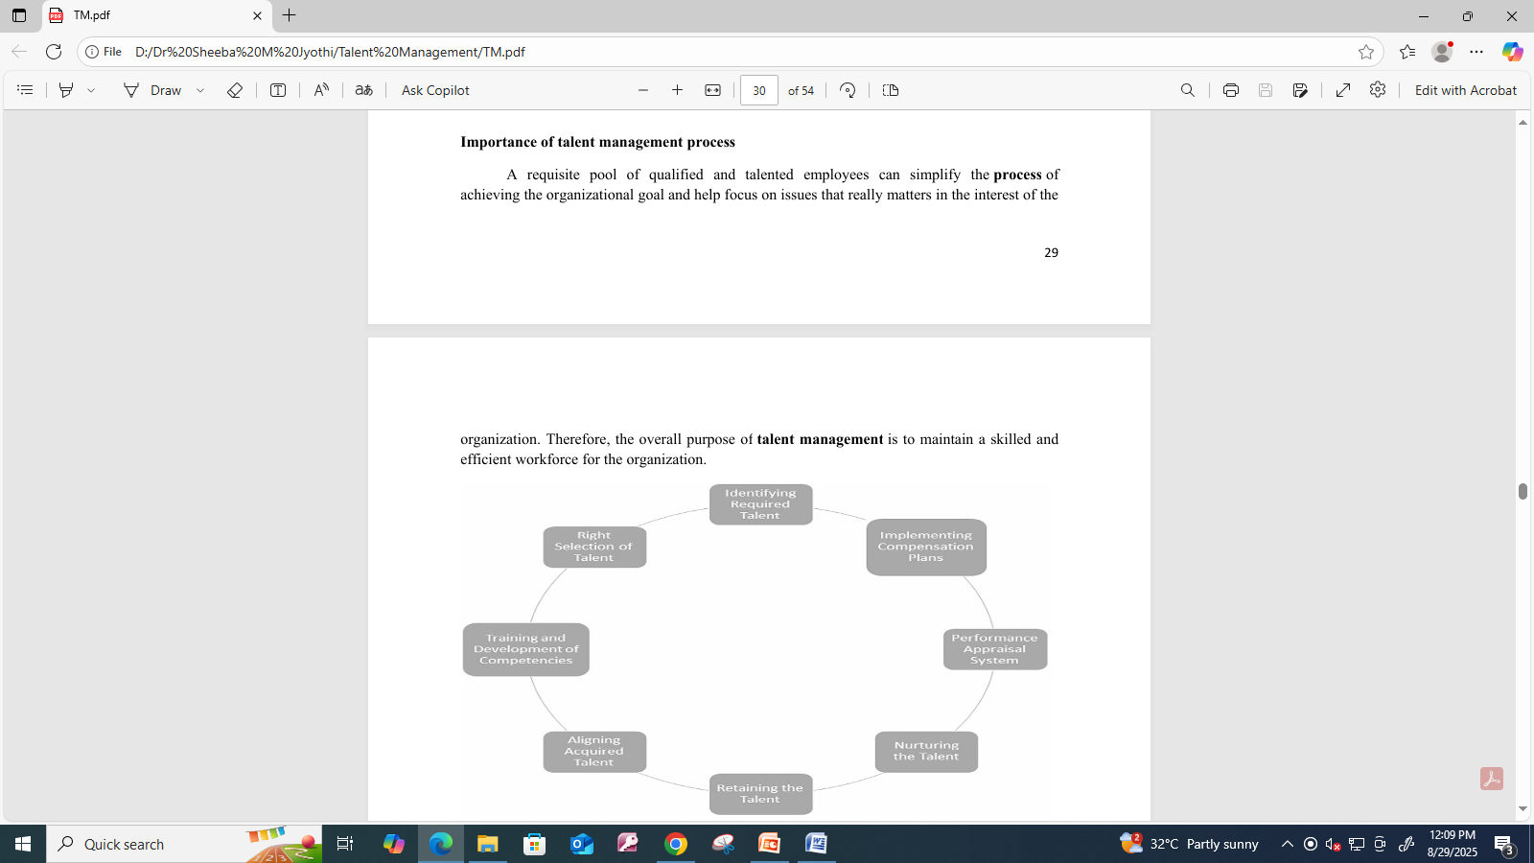

Slide 80
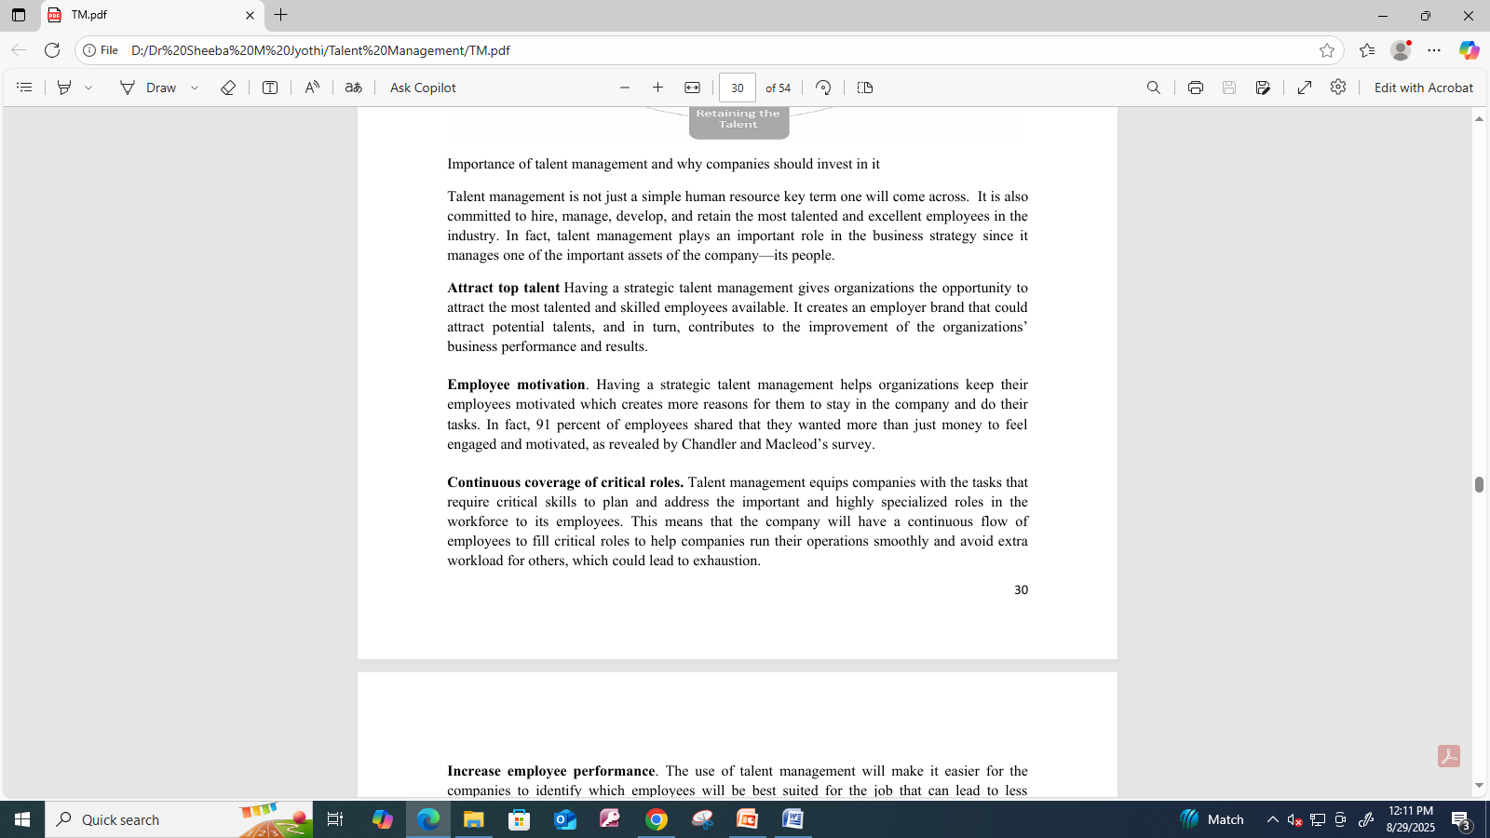

Slide 81
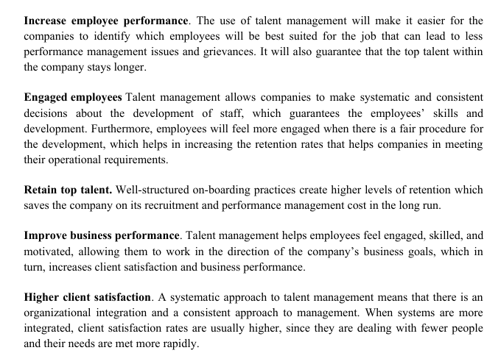

Slide 82
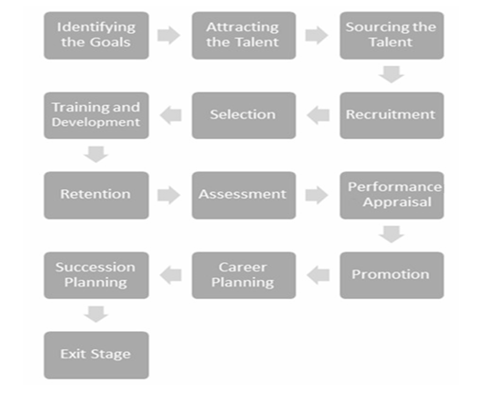

Slide 83
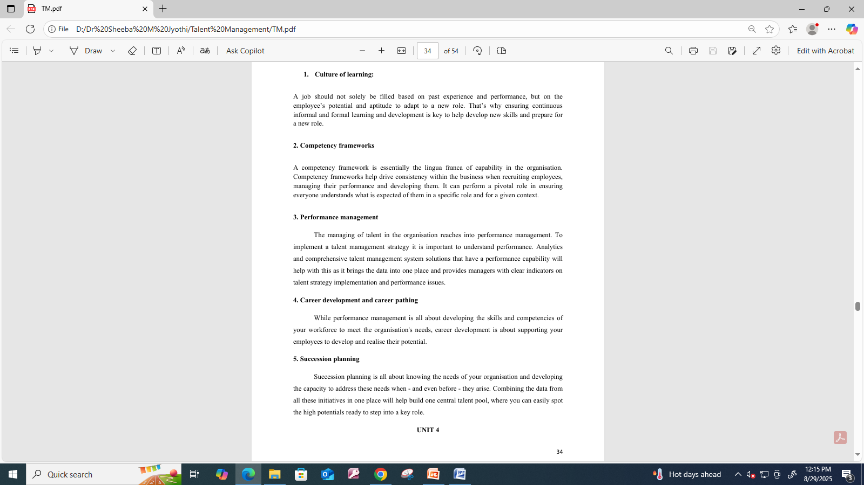
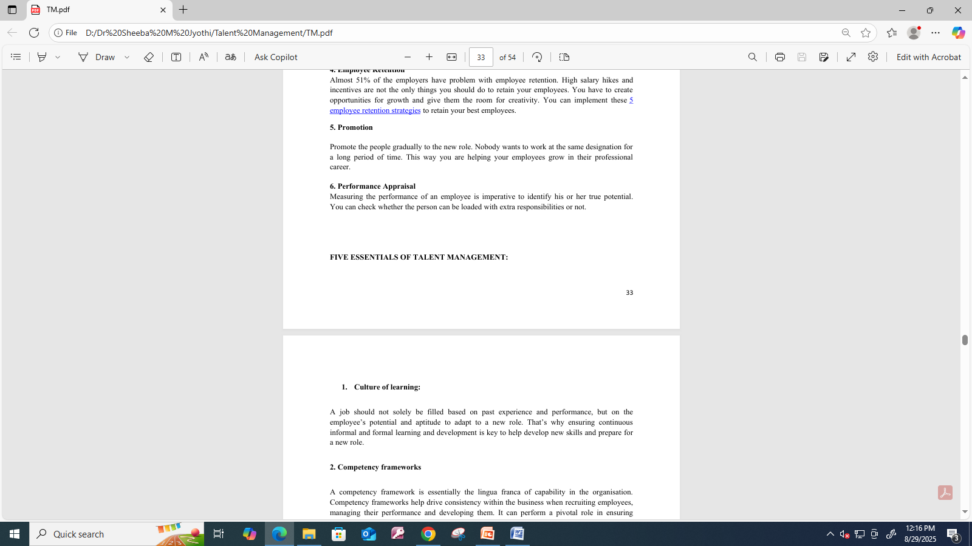

Slide 84
Performance linked Career Planning
Performance linked career planning integrates employee performance evaluation with career development to create clear, structured career paths, fostering employee engagement, motivation, and organizational growth.
Key steps include:
  Self-assessment of strengths and weaknesses,
  Setting clear goals that align with organizational needs,
  Developing individualized learning and development plans, and
  Providing continuous, constructive feedback.
This integrated approach helps identify skill gaps, promotes skill acquisition, and ultimately connects individual performance to career advancement and organizational objectives.

Slide 85
Why it's important
Boosts motivation and morale:
Employees are more engaged when they see a clear link between their performance and opportunities for advancement.
Improves performance:
Regular feedback and the ability to identify strengths and weaknesses help employees stay on track to achieve their career aspirations.
Aligns individual goals with organizational goals:
Performance management data informs career paths, ensuring that employee development supports the broader needs of the business.
Fosters a culture of learning:
It encourages continuous skill development, knowledge acquisition, and a commitment to personal growth.

Slide 86
Key Steps for Implementation
Self-Assessment:
Employees and managers assess current skills, interests, and long-term career goals, often using performance reviews to identify strengths and weaknesses.
Goal Setting:
Establish clear, measurable, achievable, relevant, and time-bound (SMART) goals that align with organizational objectives.
Career Pathing:
Define structured pathways for career advancement within different roles and departments, often creating a comprehensive career progression framework.
Skill Identification:
Determine the specific skills, experiences, and qualifications needed for advancement along defined career paths.

Slide 87
Learning and Development Plan:
Create a plan that includes training, mentorship, on-the-job experiences, challenging assignments, and other developmental opportunities to acquire necessary skills.
Regular Feedback and Review:
Provide consistent, constructive feedback to help employees stay on track, and conduct regular reviews to track progress and adjust the plan as needed.
Integration:
Integrate the performance-linked career planning framework with other HR processes, such as succession planning, compensation, and recruitment, to create a cohesive talent management system.

Slide 88
Unit 5
Talent Acquisition – Building the Right Workforce for the Future
An Overview of Strategy, Process & Importance
Presented by: [A. Jagadeeswar]
Course / Department: [MBA]
Date: [15-10-2025]

Slide 89
What is Talent Acquisition?
Talent Acquisition (TA) is the strategic process of identifying, attracting, and hiring skilled individuals to meet organizational goals.
Key Focus Areas:
- Workforce planning
- Employer branding
- Candidate experience
- Long-term recruitment strategy
Difference from Recruitment:
Recruitment = Filling immediate vacancies
Talent Acquisition = Building future-ready teams

Slide 90
Talent Acquisition Process
1. Workforce Planning – Assessing future talent needs
2. Sourcing Candidates – Job portals, LinkedIn, campus drives, referrals
3. Screening & Assessment – Tests, interviews, background checks
4. Selection & Hiring – Offer and onboarding
5. Retention Strategy – Career development, culture, engagement

Slide 91
Importance of Talent Acquisition
- Builds a strong organizational culture
- Helps achieve competitive advantage
- Reduces turnover and hiring costs
- Supports diversity and innovation
- Ensures business continuity and growth
Example:
Google’s TA strategy focuses on culture fit, innovation, and data-driven decisions.

Slide 92
Challenges & Future Trends
Challenges:
- Skill shortages
- High competition for talent
- Remote hiring and hybrid work models
Future Trends:
- AI & analytics in hiring
- Employer branding via social media
- Focus on candidate experience
- Diversity, Equity & Inclusion (DEI) initiatives
Conclusion:
Talent Acquisition isn’t just about hiring—it’s about creating a sustainable pipeline of future leaders.

Slide 93
Strategic Trends in Talent Acquisition
in Talent Management
Presented by: Leelakumar

Slide 94
Introduction
• Talent acquisition is the process of attracting and hiring skilled people.
• It plays a key role in overall talent management strategy.
• Modern methods use technology, data, and strategic planning.

Slide 95
1. Artificial Intelligence (AI) and Automation
• AI helps screen resumes and schedule interviews automatically.
• Reduces hiring time and human bias.

Slide 96
2. Employer Branding
• Building a strong company image attracts top talent.
• Social media and websites show company culture.

Slide 97
3. Data-Driven Recruitment
• Analytics improve hiring quality and speed.
• HR uses data to identify best recruitment sources.

Slide 98
4. Social Media Recruiting
• LinkedIn and Instagram are used to find candidates.
• Helps engage with young and digital-savvy talent.

Slide 99
5. Diversity and Inclusion Hiring
• Hiring from varied backgrounds ensures creativity and fairness.
• Promotes equal opportunity and innovation.

Slide 100
6. Candidate Experience
• Simple, respectful, and transparent hiring process.
• Quick feedback and clear communication improve satisfaction.

Slide 101
7. Internal Mobility
• Encourages promoting current employees to new roles.
• Builds loyalty and reduces external hiring costs.

Slide 102
8. Remote and Global Hiring
• Companies hire talent from any location using digital tools.
• Expands access to global skills.

Slide 103
9. Talent Pooling and Pipelines
• Maintaining a list of potential candidates for future roles.
• Helps fill vacancies faster when openings arise.

Slide 104
10. Strategic Partnerships and Campus Hiring
• Collaboration with colleges and institutes for fresh talent.
• Internship and placement drives attract young professionals.

Slide 105
Conclusion
• Talent acquisition is evolving with technology and strategy.
• Focus is shifting to diversity, data, and digital transformation.
• Strategic hiring builds a stronger and more adaptable workforce.

Slide 106
IMPROVING EMPLOYEE RETENTION
K.JAGADEESH KUMAR
2ND MBA
SITAMS

Slide 107
INTRODUCTION
Improving Employee Retention Is The Organizational Goal
Of Keeping talented Employees by creating a positive work
environment that promotes engagement and reduces turnover.

Slide 108
Key components of improving
employee retention
1.Positive work environment
2.Career development
3.Recognition and appreciation
4.Competitive compensation and benefits
5.Work life balance

Slide 109
Positive work environment
Cultivating a culture where employees feel
valued supported and
Have a sense of belonging.

Slide 110
Career development
Offering opportunities for growth
such as training ,mentorship and
Clear promotion paths.

Slide 111
Recognition and appreciation
Acknowledging employee
Contributions through public praise,
Bonuses other forms of appreciation.

Slide 112
Competitive compensation and benefits
Providing salaries, health insurance ,
and retirement plans that
are competitive within the industry.

Slide 113

Work-life balance

Slide 114
RETAINING AND ENGAGING WORKERS
PRESENTED BY
k Charan kumar

Slide 115
RETAINING
Retention means keeping employees in the company for a long period by ensuring they are happy, motivated ,and satisfied with their job
ENGAGING WORKERS
Employee engagement means making workers feel emotionally connected, motivated and enthusiastic about their job and companys goals

Slide 116
Importance of retaining
Reduces hiring and training costs
Keeps experienced and skilled employees
Improves company performance and productivity

Slide 117
Importance of engaging
Increases productivity and creativity
Improves teamwork and communication
Builds loyalty and commitment to the organization

Slide 118
Strategies for Retaining Workers
Offer competitive compensation and benefits
Provide opportunities for growth and development
Foster a positive work culture
Recognize and reward employees' contributions

Slide 119
Engaging Workers
give employees autonomy and ownership
Encourage feedback and suggestions
Provide regular feedback and coaching
Celebrate milestones and achievements

Slide 120
Creating a Positive Work Culture
- Promote work-life balance
Foster open communication and transparency
Encourage teamwork and collaboration
Recognize and reward employees' contributions

Slide 121
Summary
Retaining and engaging workers leads to:
• Happier employees
• Higher productivity
• Stronger, more successful companies
Invest in your people — it’s the key to success!

Slide 122
Conclusion
Implement these strategies to improve employee retention and engagement!

Slide 123


