Slide 1

Training & Development: Unlocking Potential
Investing in your workforce through comprehensive training and development programs is crucial for long-term organizational success.

Slide 2
Training and Development in HRM
In Human Resource Management (HRM), training and development refers to a systematic approach to employee education. It involves a range of resources, guidelines, and exercises designed to enhance employee performance by improving their:
Abilities and skills
Behaviors and attitudes
Expertise and knowledge
Training is a transforming process that requires some input and in turn it produces output in the form of
knowledge, skills, and attitudes (KSAs).
This process is a key tool for cultivating a skilled and productive workforce, ensuring continuous improvement and adaptation to evolving business needs.

Slide 3
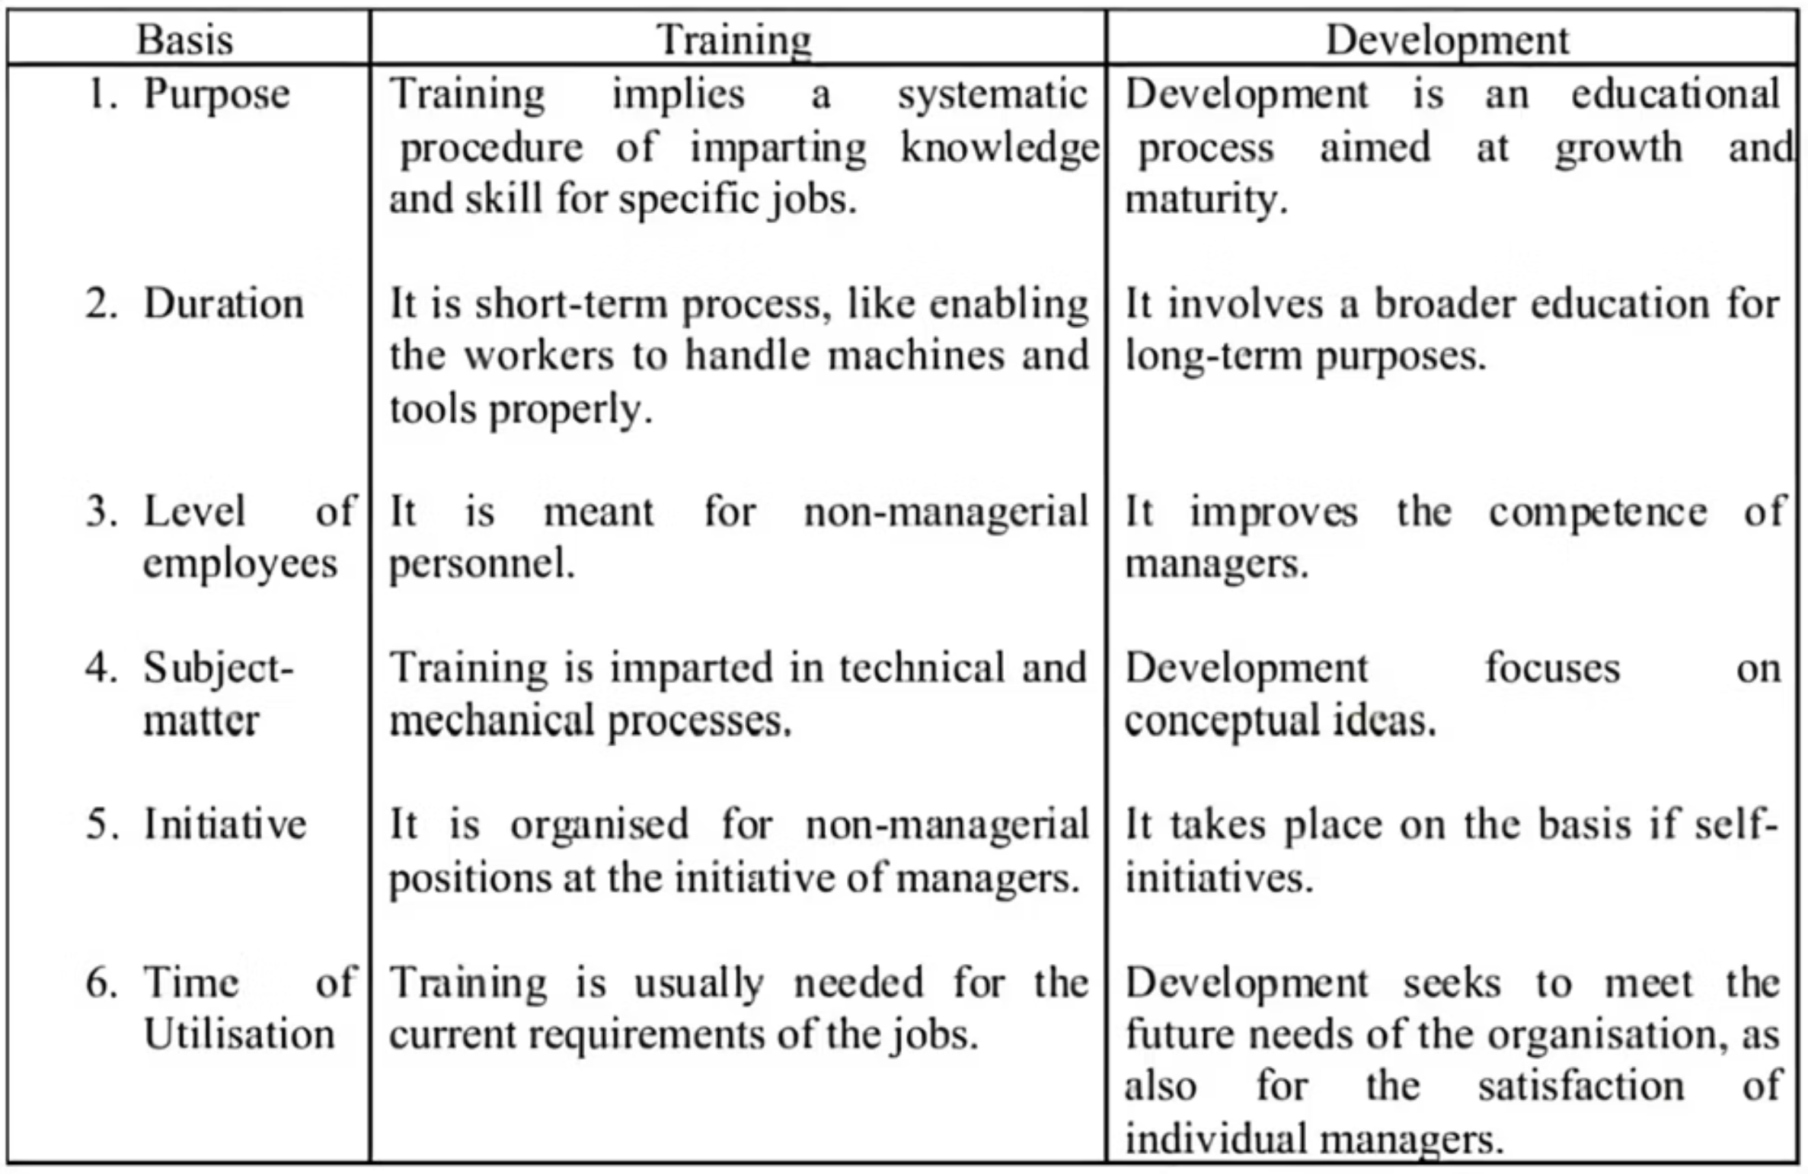
Training vs. Development: A Clear Distinction
While often used interchangeably, training and development have distinct goals within HRM:

Slide 4
Importance of Training and Development
Competition and the business environment keeps changing, and hence it is critical to keep learning and pick up new skills.
The importance of training and development is as follows:
1. Optimum utilization of resources
2. Development of skills like time management, leadership, team management etc.
3. To increase the performance, productivity and motivation
4. To imbibe the team spirit
5. For improvement of organization culture
6. To improve quality
7. To increase profitability and bottom line by acquiring new skills
8. Improving brand image by having well trained employees

Slide 5

The HR Role in Training & Development
Human Resources plays a pivotal role in nurturing employee potential and fostering a culture of continuous learning. HR responsibilities include:
Guidance & Mentoring: Providing support and direction for individual career paths.
Performance Monitoring: Regularly assessing employee performance to identify development areas.
Feedback Analysis: Gathering and analyzing feedback to refine training strategies.
Educational Opportunities: Facilitating access to relevant learning and improvement activities.
On-the-Job Training: Ensuring adequate practical training within the work environment.
Motivation & Well-being: Boosting employee morale and ensuring overall staff well-being through developmental initiatives.

Slide 6
The Training and Development Process
An effective training and development strategy is a continuous, cyclical process involving several key steps:
1. Needs Assessment
Identify specific training needs for individuals or teams, aligning them with organizational goals.
2. Objective Setting
Establish clear, measurable goals and objectives for the training program.
3. Method Selection
Choose appropriate training methods (e.g., classroom, online, certifications, instructor-led).
4. Program Implementation
Execute the planned training programs for employees, partners, or vendors.
5. Performance Evaluation
Assess the output and performance post-training through feedback, certifications, or scores.
6. Continuous Monitoring
Regularly monitor performance and evaluate the ongoing need for further training and development.

Slide 7
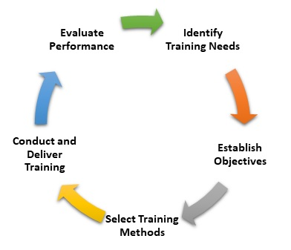

Slide 8

Models of Training
Systematic approach to Training
Transitional Training
System Model Training
Explore systematic and transitional training approaches to foster a skilled and adaptable workforce, driving organizational success.

Slide 9
Systematic Approach to Training
Training is the deliberate application of formal processes to impart knowledge and help people acquire the necessary skills to perform their jobs satisfactorily. This structured methodology ensures consistent employee development, aligning with organizational goals and fostering a competent workforce.
Stage 1: Identify and define training needs
Stage 2: Design learning and development programme
Stage 3: Implementing learning events and programmes
Stage 4: Systematically evaluate training
1
2
4

Slide 11





Benefits of Systematic Training
Improved Performance
Higher Engagement
Goal Alignment
Employees gain relevant, up-to-date skills, boosting efficiency and job effectiveness.
Regular training fosters job satisfaction, motivation, and increased retention rates.
Training initiatives align with strategic objectives, creating a focused workforce.
Cost-Effectiveness
Easier Evaluation
Optimized budgets and efficient resource allocation maximize ROI from training.
Clear objectives simplify measuring effectiveness and data-driven decisions.

Slide 12

Challenges in Systematic Training Implementation
Implementing systematic training can face hurdles such as limited resources and employee resistance. Overcoming these challenges requires strategic planning, fostering a learning culture, and continuous adaptation.
Resource Constraints: Time and financial limitations for needs analysis and custom programs.
Lack of Expertise: Need for specialized knowledge in designing and implementing effective training.
Resistance to Change: Employee reluctance to adopt new skills or adapt to new learning initiatives.
Keeping training Content up to date : Difficulty in keeping training materials current with rapid industry changes.

Slide 13
Transitional Training: Adapting to Change
Transitional training equips employees with skills for workplace or career shifts, like promotions or cross-functional moves. It focuses on individual skill development, addressing gaps proactively for smooth adaptation.
1
2
3
Identify Skills Gap
Customize Programs
Continuous Support
Assess new role requirements versus existing employee competencies.
Develop tailored training with on-the-job, mentoring, and courses.
Provide ongoing feedback, check-ins, and evaluations post-transition.

Slide 14
Importance or Benefits of Transitional Training
Reduces resistance to change
Enhances organizational agility
Improves employee retention
Boost productivity
Identification of skill gap
Customised training programs

Slide 15
Key Components of Transitional Training
Transitional training focuses on change management, skill development, communication, support systems, and feedback mechanisms. These elements ensure employees navigate transitions successfully.
Change Management
Skill Development
Communication
Help employees understand and adapt to organizational changes.
Provide training for new skills required in revised roles.
Ensure clear, transparent information about changes and support.
Support Systems
Feedback Mechanisms
Establish mentors, coaches, or peer networks for assistance.
Encourage open channels for concerns and input.

Slide 16
Developing a Transitional Training Program
Conduct a Needs Assessment: Identify the specific changes occurring in the workplace. Determine the training needs of employees based on the upcoming transition.
Set Clear Objectives: Define the goals of the training program. Ensure that objectives are specific, measurable, achievable, relevant, and time-bound (SMART).
Design the Curriculum: Develop a structured training plan that covers all necessary topics. Include various training methods to cater to different learning styles.
Engage Stakeholders: Involve key stakeholders in the planning process. Gather input from managers, employees, and subject matter experts.
Allocate Resources: Ensure that adequate resources, such as budget, time, and personnel, are available for the training program. Invest in necessary tools and technologies to support the training.
Implement the Training Program: Roll out the training program according to the planned schedule. Monitor participation and engagement throughout the training process.
Evaluate and Revise

Slide 17
ON-GOING TRAINING CHECKLIST
Identify Key Roles and Responsibilities
List all positions affected by the transition.
Clearly define new responsibilities and tasks for each role.
Assess Skills and Competencies
Conduct a skills gap analysis to determine training needs.
Identify both technical and soft skills required for the new roles.
Develop Training Materials
Create comprehensive training manuals, guides, and e-learning modules.
Incorporate a variety of formats, such as videos, quizzes, and interactive simulations
Schedule Training Sessions
Set a timeline for training delivery, including deadlines and milestones.
Assign Mentors or Coaches
Pair employees with experienced mentors for guidance and support.
Measure Training Effectiveness
Establish metrics to evaluate the success of the training program.
Collect feedback from participants to identify areas for improvement.
Provide Ongoing Support
Offer continuous learning opportunities and refresher courses.

Slide 18
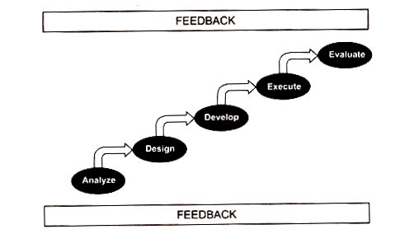
SYSTEM MODEL TRAINING

Slide 19

CAREER MANAGEMENT
Shaping Futures: The Power of Career Management
This unit explores career management, a vital process for individual and organizational success. We'll delve into its core components, benefits, and why it's more crucial than ever in today's dynamic professional landscape.

Slide 20
What is a Career?
A career is the general course of action an individual chooses to pursue throughout their working life, encompassing all occupational positions held over many years.
It's a journey of professional growth, skill development, and the pursuit of personal and professional fulfillment.
Career Definition
Fulfillment & Potential
The "occupational positions a person has had over many years," reflecting a journey of professional roles and experiences.
Many achieve their career goals, while others may feel unfulfilled, highlighting the importance of deliberate career management.

Slide 21




Defining Career Management
Career management is a strategic process designed to empower employees in understanding and developing their skills and interests, ensuring their effective utilization both within the company and beyond.
Lifelong, self-monitored process of career planning that involves choosing and setting personal goals, and formulating strategies for achieving them".
Self-Discovery
Opportunity Exploration
Understand personal skills, interests, knowledge, and motivations.
Acquire information about career choices and opportunities.
Goal Setting
Action Planning
Identify clear, career-related objectives and
aspirations.
Establish concrete steps and strategies to achieve specific goals.

Slide 22
CAREER MANAGEMENT
Career Management as a process for enabling employees to better understand and develop their career skills and interests and to use these skills and interests most effectively both within the company and after they leave the firm.
Specific career management activities might include providing realis­tic career-oriented appraisals, posting open jobs, and offering formal career development activities.
Career development is the lifelong series of activities (such as workshops) that contribute to a person's career exploration, establishment, success, and fulfilment.
CAREER PLANNING
Carrer Planning is the deliberate process through which someone becomes aware of his or her personal skills, interests, knowledge, motivations.

Slide 23
Key Elements of Career Management Programs
Career Planning
Career Pathing
Career Development
Career Planning
An intentional process involving goal setting, understanding opportunities and constraints, and making decisions. It typically involves assessing skills and discussing pathways with supervisors.
Determining career goals
Understanding opportunities and constraints
Assessing skills and experience

Slide 24
Key Elements of Career Management Programs (Cont.)
Career Pathing
Career Development
A roadmap illustrating progress opportunities within an organization. It helps employees monitor their advancement based on career expectations. Organizations often establish clear structures to guide and encourage employees.
A continuous, lifelong process that aligns individual career goals with organizational needs. It involves providing training and development programs to help employees progress.
Monitoring progress within an organization
Ongoing process for each employee
Clear career development structure
Training and development programs
Specific objectives and role models
Upskilling and proficiency improvement

Slide 25




Why Career Management Matters
Effective career management is crucial for both individuals and organizations, driving professional growth, fostering job satisfaction, and optimizing talent utilization.
Enhances Organizational Support
Identifies Employee Skills & Interests
Aligns individual career goals with company objectives, fostering mutual support and a favorable work environment.
Reveals strengths, weaknesses, and passions, leading to roles that maximize satisfaction and performance.
Boosts Employee Commitment & Morale
Decreases Turnover & Recruitment Costs
Empowers ownership of growth, increasing productivity and engagement through recognition and clear paths.
Retains skilled employees, preserving institutional knowledge and reducing hiring expenses.

Slide 26
BENEFITS OF CAREER MANAGEMENT
1) Enhances organisational support
2) Identifies employee skills and interests
3) Boosts employee commitment
4) Increases morale
5) Decreases turnover
6) Minimises recruitment costs
ORGANISATION'S ROLE IN CAREER MANAGEMENT
1) Skill application
2) Learning and development
3) Activities and resources

Slide 27
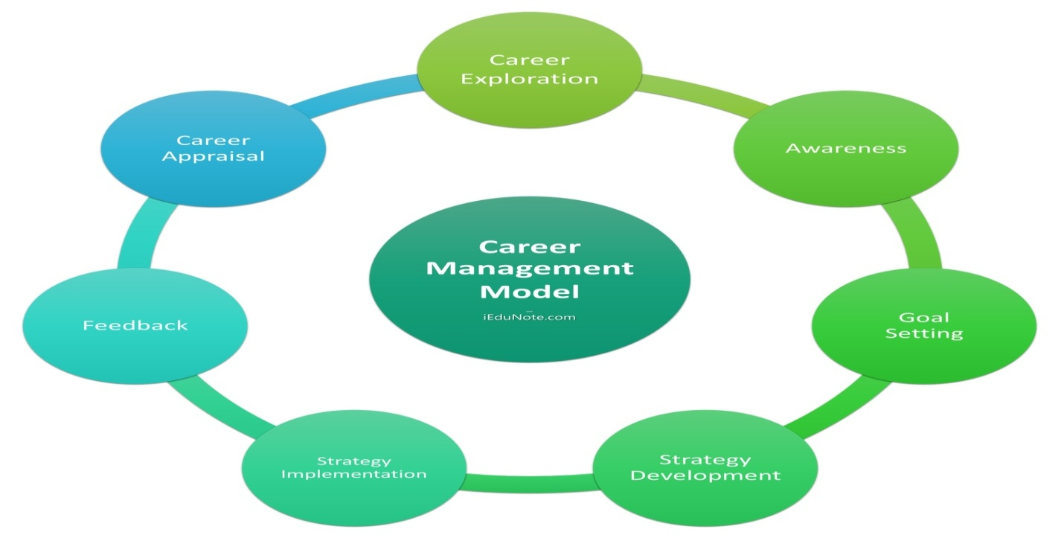
CAREER MANAGEMENT MODEL: 7 COMPONENTS

Slide 28
The Foundation: Career Exploration and Self-Awareness
Self-Exploration
Environmental Exploration
Identify values, interests, and talents (work/non-work).
Research occupations, industries, and required skills.
Understand job options, requirements, and opportunities.
Explore job alternatives within or outside the organization.
Assess strengths, weaknesses, and limitations.
Understand career progression and impact of family.
Clarify work-life balance preferences.
Gain insight into organizational structures and cultures.
Career exploration involves gathering and analyzing information about career-related issues, promoting deep self-awareness and understanding of the external environment. As Socrates wisely stated, "Know thyself" – a crucial step in career development.

Slide 29






Setting Your S.M.A.R.T. Career Goals
Specific
Measurable
Achievable
Clearly defined, with no ambiguity. What exactly do you want to achieve?
Quantifiable metrics to track progress. How will you know when you've reached it?
Realistic and attainable within your capabilities. Is it possible?
Relevant
Time-bound
Aligned with your long-term aspirations. Does it truly matter to you?
A deadline for completion. When do you want to achieve it by?
Effective career goals are specific, measurable, achievable, relevant, and time-bound. For example, an MBA student might aim to "pursue a highly rewarding career in a challenging and healthy work environment, utilizing skills and knowledge efficiently for organizational growth."

Slide 30
Developing and Implementing Your Career Strategy
Strategy Development
Strategy Implementation
A career strategy is a sequence of activities designed to help you attain a career goal. It's a structured approach to developing capabilities, tools, and resources for your career journey. Key strategies include:
Putting plans into action to reach your goals. This requires priority, time, and a commitment to lifelong learning. Steps may include:
Seeking supervisor advice for skill gaps
Engaging in short-term development training
Competence in present job
Enrolling in formal studies
Extended work involvement
Investigating hidden opportunities
Skill development through training
Developing strong professional networks
Opportunity development
Negotiating salary or conditions effectively
Supportive relationships (mentors, sponsors, peers)
Image building
Organizational politics
Successful career management relies on a well-defined strategy and consistent implementation, adapting to feedback and new opportunities.

Slide 31






The Continuous Cycle: Feedback and Appraisal
Career Appraisal
Monitoring your career progress by acquiring and using feedback. This allows you to determine if your goals and strategies remain appropriate. It may lead to re-examining goals or revising strategies, fostering continuous growth.
Feedback
Timely, specific, and sincere feedback is crucial. It confirms goal accomplishment and highlights areas for improvement. Effective feedback from supervisors can significantly enhance employee performance and skill development.
Re-Exploration
Additional information from appraisal becomes a tool for ongoing career exploration. This problem-solving process allows individuals to gather more insights about themselves and the work world, restarting the cycle.
The career management cycle is a dynamic process of setting goals, implementing strategies, obtaining feedback, and appraising progress, continually driving personal and professional evolution.

Slide 32



HR's Pivotal Role in Career Development
Talent Acquisition & Onboarding
Training & Development Programs
Performance Management & Feedback
Identifying and acquiring talent aligned with goals, followed by structured onboarding to integrate new hires and set career foundations.
Facilitating continuous learning to enhance skills, ensuring employees stay current and are prepared for future roles.
Regular evaluations provide constructive feedback, aligning individual aspirations with organizational objectives for growth.
HR management extends beyond administrative tasks, strategically enhancing employee skills, satisfaction, and career progression. It's crucial for both individual success and organizational competitiveness.

Slide 33
Career Pathing & Succession PlanningMapping potential trajectories and ensuring a pipeline of qualified candidates for key roles.
Mentorship & CoachingProviding guidance from experienced professionals to help employees navigate challenges and achieve goals.
Employee Engagement & RetentionFostering loyalty and belonging by investing in employee growth, reducing turnover, and retaining top talent.
Work-Life Balance & Well-beingImplementing policies for a healthy environment, ensuring employees are equipped physically and mentally for career pursuits.
HR's comprehensive approach creates an environment where employees can thrive, contributing to both individual aspirations and the organization's strategic goals.

Slide 34
ROLE OF EMPLOYEES AND COMPANY IN CAREER DEVELOPMENT
EMPLOYEE'S ROLE:
Self-Assessment and Goal Setting:
Employees should regularly assess their skills, interests, and career aspirations, setting both short-term and long-term goals.
Seeking Opportunities:
Employees should actively seek out opportunities for training, development, and advancement within the company.
Taking Initiative:
Employees should take ownership of their career development, proactively seeking out information, resources, and guidance.
Developing Skills:
Employees should focus on developing the skills and knowledge needed for their current role and future career aspirations.
Seeking Feedback:
Employees should actively seek feedback from managers and peers to understand their strengths and areas for improvement.
Communicating Goals:
Employees should communicate their career goals and aspirations to their managers, allowing for better alignment and support
COMPANY'S ROLE:
Providing Resources and Support:
Companies should provide resources such as training programs, mentorship opportunities, and access to career development tools.
Creating a Supportive Culture:
Companies should foster a culture that values learning, development, and career progression.
Offering Career Paths:
Companies should create clear career paths and opportunities for advancement within the organization.
Providing Feedback and Coaching:
Managers should provide regular feedback, coaching, and guidance to employees on their career development.
Recognizing and Rewarding Growth:
Companies should recognize and reward employees who demonstrate a commitment to career development and progression.
Aligning Business Needs with Employee Goals:
Companies should align their business needs with employee development goals, ensuring that employee growth contributes to the overall success of the organization.

