Slide 1
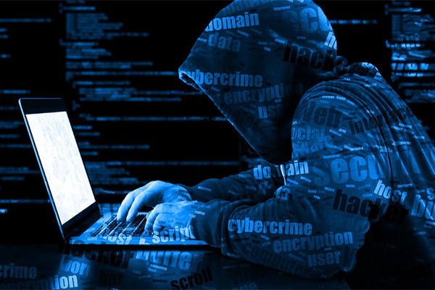
The Concept of Cyberspace

Slide 2










CYBER SECURITY & LAW
Book Authors & Editorial Team Members
Rashmi Gori
Deegesh Gala
Devika Satare
Bhakti Bheda
Surbhi Desai
Dr. Nilakshi Jain
Mr. Ramesh Menon
Chaitanya Gada
Yash Rane

Slide 3
“There are cyber threats out there, this is a dangerous world, and we have to be safe, we have to be secure no matter the cost.” — Edward Snowden

Slide 4
Learning Objectives
Understand the concept of cyberspace.
Explain E-commerce and its types.
Discuss Electronic Contracts and the related laws in India.
Discuss Digital Signatures and their validity in India.
Discuss types of Intellectual Property and laws in India to protect them.
Discuss Digital Evidence and its admissibility in India.
Discuss about various Global initiatives for the development of Cyber laws.
Explain the Electronic Data Interchange and its process.
Discuss Electronic Banking in India.
Discuss about the need for an Indian Cyber law.

Slide 5

Chapter 4 Topic 1

Slide 6

E-Commerce
1

Slide 7

What is Cyber Space?
Cyberspace is a technical term for the use of computers and electronic medium of communication using computer networks.

Slide 8
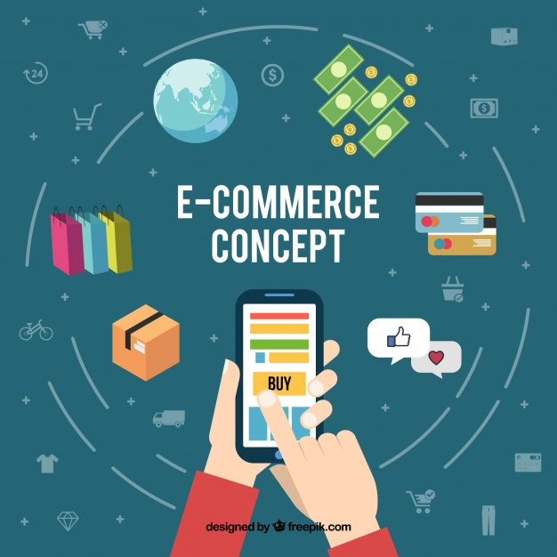
What is E-Commerce?
E-Commerce or electronic commerce is defined as buying and selling of goods, products or services over the internet. Online transaction of money, funds transfer and data are also included in the process of e-commerce.

Slide 9

Advantages of E-Commerce
Sellers are able to grow their markets to larger areas, nationally or internationally and even to remote areas.
It promotes quicker transactions between businesses.
24/7 buying or selling of products or services is possible.
It gives clients more choices and insights concerning the item and services.
It reduces the use of paper.
Clients can easily choose items from various suppliers without moving around truly.

Slide 10
Disadvantages of E-Commerce
Late Delivery
Security
No possibility of tried and tested products
Some products are difficult to buy online
Lack of privacy
Tax issue
Legal issues
Lack of personal touch

Slide 11
Types of E-Commerce
Business-to-Consumer (B2C) :-
This category is related to transactions between a business and the end consumer or end customer.
Business-to-Business (B2B) :-
This category is related to transactions between two business.
Consumer-to-Consumer (C2C) :-
This category is related to transactions between two end consumers.
Consumer-to-Business (C2B) :-
This category is related to transactions when an individual consumer provides a service or a good to business and get paid for it.
Government-to-Citizen (G2C) :-
This category is related to transactions between the government organizations and the citizens.

Slide 12
Types of E-Commerce Transactions
02. Interpersonal communication
01. Information Access
03. Shopping services
04. Virtual enterprises
It allows the customer to find and buy goods on the internet or to benefit the services through the internet.
These are the business plans where exchanging accomplices who are isolated by topography and expertise can participate in joint business activities.
It provides the customer search and reclaim facility.
It gives the technique to exchange data, talk about thoughts and improve their co-operation

Slide 13
Chapter 4 Topic 2

Slide 14

What is a Contract?
A contract is a legally-binding agreement amongst two or more parties making come into existence a legal obligation for both the parties to act the specific promised duties.

Slide 15
A contract involves two parties: originator and addressee.
Originator
Addressee
Originator is an individual who sends, produces, stores or passes on any electronic message to be sent, made, put away, or passed on to some other individual and does include a mediator.
An address is an individual who is proposed by the original to get the electronic record however doesn’t comprise of any mediator.
Contract

Slide 16
01.
02.
Offer
Acceptance
Elements of contract are
04.
03.
Lawful consideration
Lawful object
05.
06.
Competent parties
Free consent

Slide 17

What is an E-Contract?
An e-contract is an agreement created and "signed" in electronic form—no paper is used.

Slide 18

Contracts play a very important role in the world economics. Almost all business activities, trade between businesses, governments and individuals depend on contracts.
04.
There are no physical limits, no handwritten signature and in many occasions no handwriting is needed.
03.
05.
Digital signatures are used.
Electronic documents are made use of as evidence in the court.
02.
06.
Jurisdictional issues are a significant difficulty on contracts in the event of breach.
There is no one to screen the breach of the process.
The important points in an e-contract are
01.
07.
The parties don't meet physically in the majority of the cases.
Three main methods of contracting electronically are email, World Wide Web and cyber contracts.

Slide 19
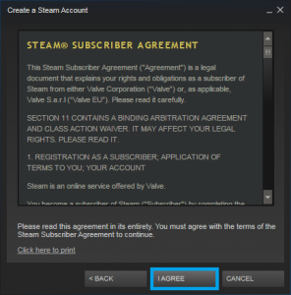
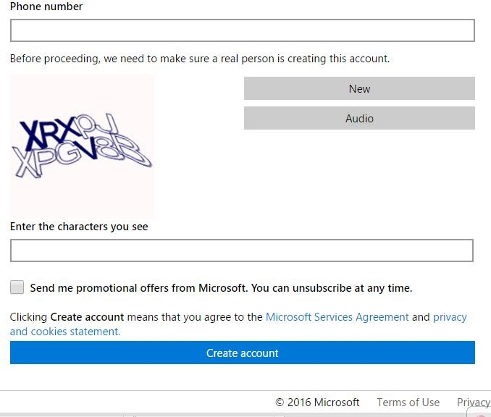
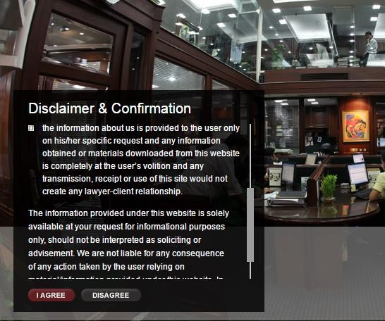
Types of E-Contracts
Shrink Wrap Contracts:
These contracts are originally packed with the products and the license agreement can be read and accepted only after opening the packet.
Click Wrap Contracts:
These are also known as “click through” contracts. These contracts are found as a part of the software. To accept or to decline the terms and conditions of the agreement are the two options which the users get.
Browse Wrap Contracts:
These contracts are found on a website or on home page of a downloadable product. The terms and conditions must be accepted first by the user in order to further browse the website or to download a resource or software.

Slide 20

Indian Contract Act, 1872
The Indian Contract Act, 1872 defines the term "Contract" under Section 2 (h) as "An agreement enforceable by law. The Act administers the way in which contracts are made and executed in India. It gives a system of rules and regulations which govern the formation and execution of the contract. The rights and duties of parties entering into the contract and their terms of the agreement is decided by the parties themselves.

Slide 21
Legal Prerequisites of an E-contract
The concepts of originator and addressee
The concept of acknowledgment of receipt of record/data information as part of the legal process
The concept of time and place of dispatch and receipt
1
2
3

Slide 22
Chapter 4 Topic 3

Slide 23
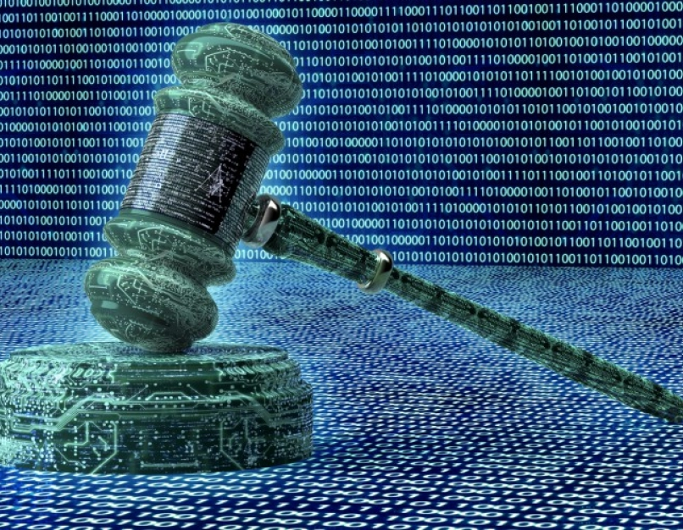
Security Aspect of Cyber Law
1

Slide 24

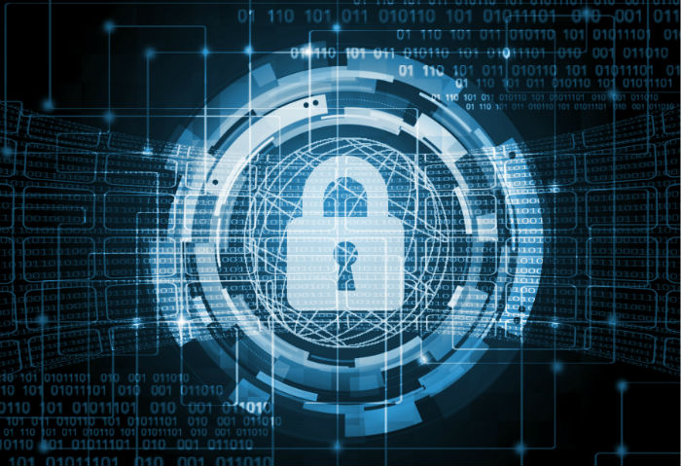
Encryption
1
The information transmitted over the system can be ensured by coding this procedure is known as encryption.
2
To ensure the information on internet cryptography is utilized.
Cryptography is a science and art of secret writing which keeps the data confidential. . Cryptography is anything which is written as a cipher.
3
4
Encryption is done by utilizing the algorithms
5
There are two sort of encryption algorithm:
Private key cryptography
Public key cryptography

Slide 25
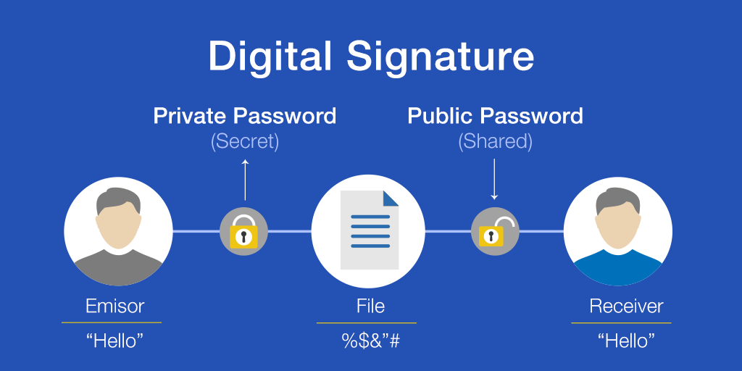
Digital Signature:
A Digital signature is a code generated using public key cryptography, also called, asymmetric key cryptography. This code is connected to the electronic document which promises the receiver of the electronic document about the authenticity of the sender.

Slide 26
Chapter 4 Topic 4

Slide 27
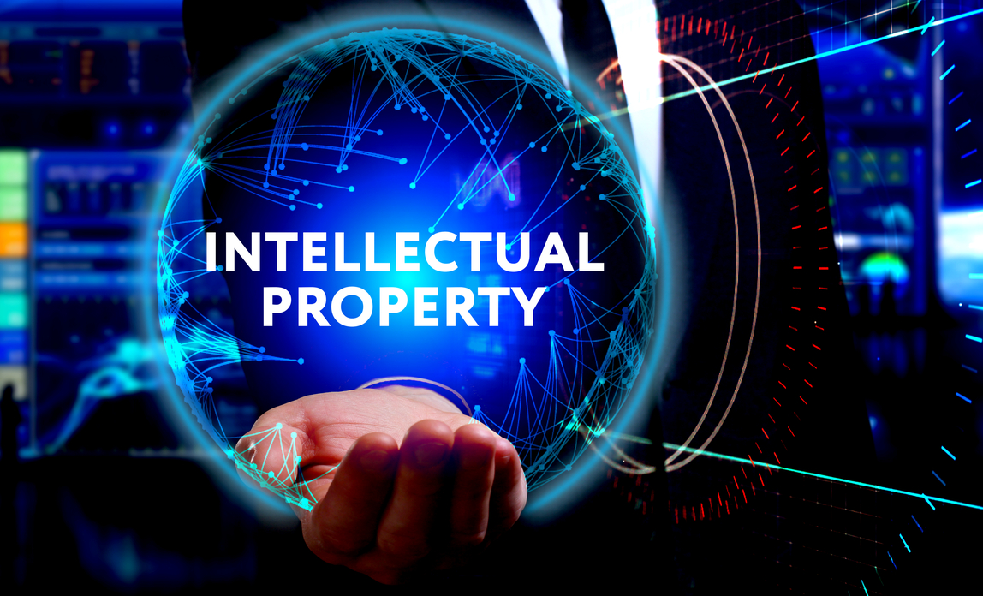
What is Intellectual Property?
Intellectual property (IP) refers to the immaterial property that is a creation of the human mind.

Slide 28
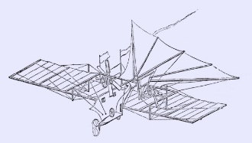

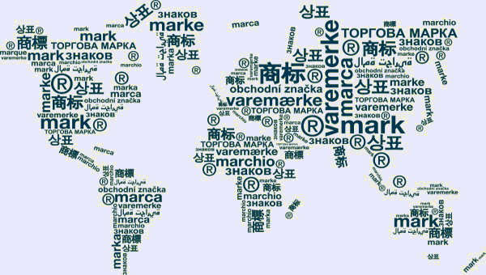
Types of Intellectual Property
Patents:
A patent is a selective right, allowed by government to its innovator, which grants him/her to reject all others from making, utilizing, selling and bringing in the creation, for a constrained time of years, in return for the public disclosure of the development.
Trade Secrets:
Is an intellectual property in the form of a formula, practice, process, design, instrument, pattern, business technique or compilation of information which is commonly not known public and using which a business can obtain economic benefits over to the competitors or clients.
Trademarks:
A trademark is a recognizable sign, plan or expression by which a client can recognize an item or the source of an item individually.

Slide 29

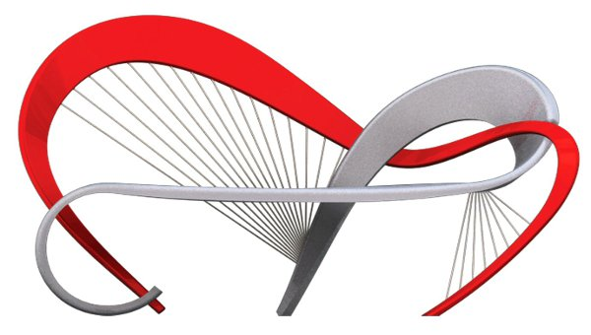

Types of Intellectual Property
Geographical Indication:
A geographical indication (GI) is a name or a sign utilized on items which relates to a particular geographical area or origin specifying the source of the product.
Industrial Designs:
An industrial design comprises the ornamental or aesthetic part of an article. It comprises highlights of the article.
Copyright:
Copyright is a legal method for securing the original creative work of the creator.

Slide 30
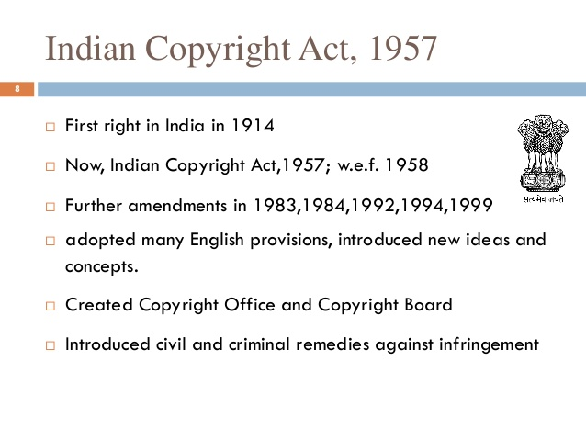

Slide 31
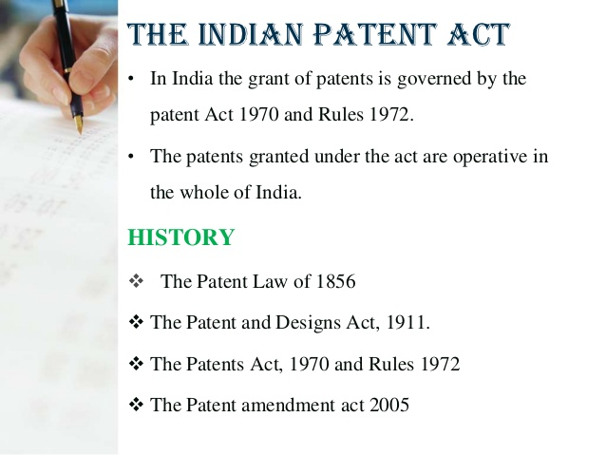

Slide 32

What is an Evidence?
In legal terms, evidence refers to a proof legally introduced in the court of law to find out reality of an issue.

Slide 33
Types Of Evidence
Testimony
Real Evidence(Physical Evidence)
Demonstrative
Documentary Material
Eg. Oral or written statements, affidavit
Eg. Tangible things like a weapon, other objects
Eg. Pictures, X-rays, diagrams, maps, drawings, graphs, animation, simulations, models
Eg. Letter, invoice, contract, will, blog post, or any other document
1
2
3
3

Slide 34
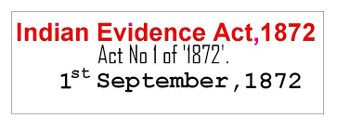

In India, the Indian Evidence Act was established by the Imperial Legislative Council in 1872 during the British rule, which contained a lot of rules and partnered issues administering the acceptability of proof in the Indian courts of law. The Indian Evidence Act is identified as Act no. 7 of 1872 and called the Indian Evidence Act, 1872. It came into power on 1 September 1872 and to time from that point forward it has held its unique for with exception of certain changes from time to time.

Slide 35
Chapter 4 Topic 5

Slide 36

What is Crime and Criminology?
Disobeying of criminal law is called crime. Some examples of crimes are murder, assault, forgery, stealing, etc. These crimes threaten the general public.
The study of criminal behavior is called Criminology.

Slide 37
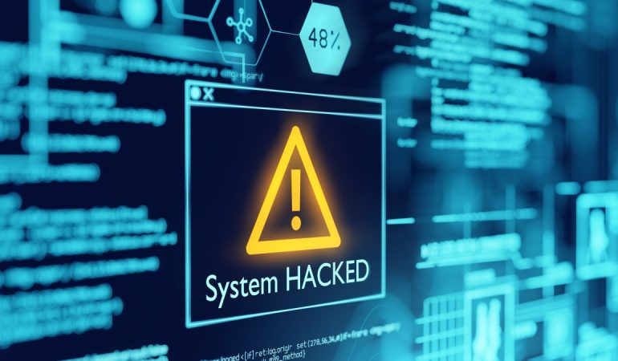
What is Computer Crime?
Any illegal action in which a computer is a device of a crime is known as computer crime or any crime in which the strategies or explanation behind which is to impact the limit of computer.
Any event related with computer innovation in which a casualty endured or could have endured misfortune and an offender, by Intention, made or likely to have made a pain.
Computer crime is any criminal offense, action or Issue that Involves computers.
Computer is used in illegal activities: child pornography, threatening letters, e-mail spam or harassment, extortion, fraud and robbery of Intellectual property, theft.

Slide 38

Reasons for the vulnerability of computers
Easy to access: The issue behind defending a computer system from unapproved access is that there are numerous possibilities of breach because of the complex technology.
Capacity to store data in comparatively small space: The computer has the remarkable characteristic of putting away information in a very small space. This makes it a much simpler for the people to steal information from any other storage and use it for own benefit.
Complex: The computers run on operating systems and these operating systems are customized of millions of codes. The human brain is imperfect, so they can make mistakes at any stage. The cyber criminals take benefits of these gaps
Negligence: Negligence is one of the characteristics of human conduct. So, there might be a possibility that protecting the computer system we may make any negligence which gives a cyber-criminal the access and authority over the computer system
Loss of evidence: The information related to the crime can be simply destroyed. So, Loss of these proofs has become a very common and clear issue which paralyzes the framework behind the Investigation of cyber-crime.

Slide 39
Strategy for Preventing Computer Crime
To prevent the crime there are 2 main aspects of the strategy.
Systemic methodology
Legal deterrents

Slide 40
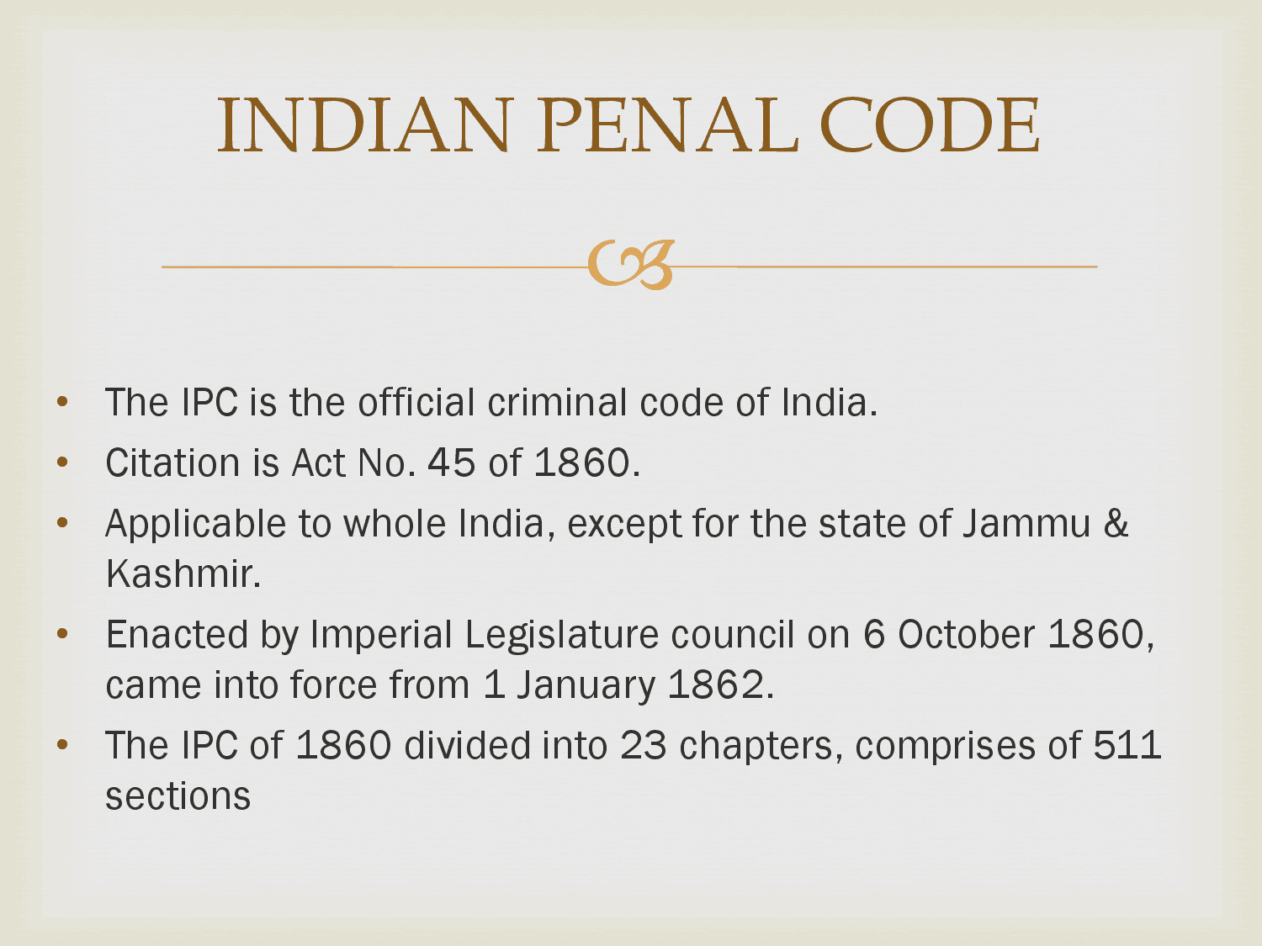

Slide 41
Chapter 4 Topic 6

Slide 42

What is WIPO?
The World Intellectual Property Organization (WIPO) is a professional agency of the United Nations (UN) It was made in 1967 “to encourage creative activity, to promote the protection of intellectual property throughout the world”.

Slide 43
WIPO Treaties
WIPO Internet Treaties
WIPO Copyright Treaty
WIPO Performances and Phonograms Treaty

Slide 44
Chapter 4 Topic 7

Slide 45
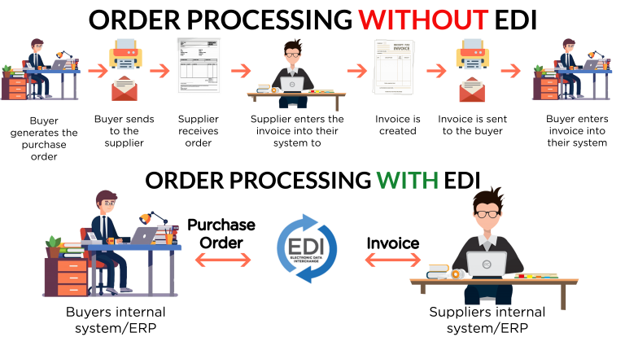
What is Electronic Data Interchange?
“Electronic data interchange means the electronic transfer from computer to computer of information using an agreed standard to structure the information.”

Slide 46
Chapter 4 Topic 8

Slide 47

The Need for an Indian Cyber law.
In todays techno-savvy environment, the world is becoming more and more digitally sophisticated and so are the crimes. Internet was initially developed as a research and information sharing tool and was in an unregulated manner. As the time passed by it became more transactional with e-business, e-commerce, e-governance and e-procurement etc. All legal issues related to internet crime are dealt with through cyber laws. As the number of internet users is on the rise, the need for cyber laws and their application has also gathered great momentum.
In todays highly digitalized world, almost everyone is affected by cyber law.

