Slide 1
20CSE471A DEEP LEARNING
N VIJAYA KUMAR M.E(CSE), M.B.A

Slide 2
UNIT3: MODERN PRACTICES IN DEEP NETWORKS
Introductions to Simple DNN
Platform for Deep Learning
Deep Learning Software Libraries
Deep Feed forward networks
Gradient-Based Learning
Architecture Design
Various Activation Functions, ReLU, Sigmoid
Error Functions
Regularization methods for Deep Learning
Early Stopping
Drop Out
Optimization methods for Neural Networks
Adagrad, Adam.

Slide 3
Introduction to Deep Neural Networks
A deep neural network (DNN) is an ANN with multiple hidden layers between the input and output layers. Similar to shallow ANNs, DNNs can model complex non-linear relationships.
These networks usually consist of an input layer, one to two hidden layers, and an output layer.
While it is possible to solve easy mathematical questions, and computer problems, including basic gate structures with their respective truth tables, it is tough for these networks to solve complicated image processing, computer vision, and natural language processing tasks.

Slide 4
For these problems, we utilize deep neural networks, which often have a complex hidden layer structure with a wide variety of different layers, such as a convolutional layer, max-pooling layer, dense layer, and other unique layers.
These additional layers help the model to understand problems better and provide optimal solutions to complex projects.
A deep neural network has more layers (more depth) than ANN and each layer adds complexity to the model while enabling the model to process the inputs concisely for outputting the ideal solution.

Slide 5
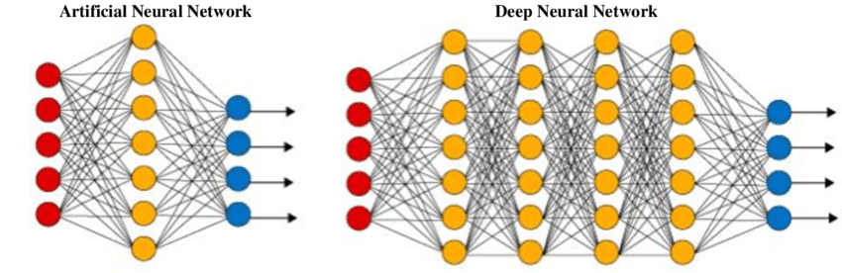

Slide 6
Deep neural networks have garnered extremely high traction due to their high efficiency in achieving numerous varieties of deep learning projects. Explore the differences between machine learning vs deep learning in a separate article.
Need of DNN: After training a well-built deep neural network, they can achieve the desired results with high accuracy scores. They are popular in all aspects of deep learning, including computer vision, natural language processing, and transfer learning.

Slide 7
The premier examples of the prominence of deep neural networks are their utility in object detection with models such as YOLO (You Only Look Once), language translation tasks with BERT (Bidirectional Encoder Representations from Transformers) models, transfer learning models, such as VGG-19, RESNET-50, efficient net, and other similar networks for image processing projects.

Slide 8
APPLICATIONS FOR DEEP LEARNING SOFTWARE
Image recognition.
Natural language processing (NLP).
OCR (Optical Character Recognition).
Rossum uses deep learning.

Slide 9
Image recognition is one of the most common applications for deep learning software. By training a system on a large dataset of images, it can learn to recognize objects within them. This technology is being used in facial recognition systems as well as to enable object detection in autonomous vehicles.
Natural language processing (NLP) is another popular application for deep learning software. NLP allows computers to understand human language and respond appropriately to text or voice commands entered by users. This technology is behind virtual assistants such as Alexa and Siri, as well as many automated customer service agents.

Slide 10
OCR (Optical Character Recognition) is a technology that is capable of recognizing text from an image or video by matching it to stored templates. Businesses can use OCR to process large amounts of data very quickly.
Rossum uses deep learning. to expand the capabilities of OCR and provide businesses with a more efficient and accurate method of capturing data from invoices or other documents.
By training a neural network to “read” a document like a human can, Rossum offers AI that is capable of accurately extracting the needed information from various document formats without requiring pre-programmed parameters.

Slide 11
DEEP LEARNING PLATFORMS
A deep learning platform typically consists of several components, such as an artificial intelligence (AI) engine, data management tools, development frameworks for building custom models from scratch or fine-tuning existing ones, and deployment options for deploying trained models into production.
Data management tools provide an efficient way of managing the datasets used to train deep learning models.
Development frameworks allow users to easily build custom models from scratch or fine-tune existing ones according to their specific needs.
Deployment options enable users to deploy their trained models into production environments such as cloud services or on-premise servers.

Slide 12
Deep learning platforms also include libraries of pre-trained models containing ready-to-use neural networks that are ready to deploy without any further training or customization.
This makes it easy for developers and researchers to get started quickly without worrying about building their own model from the ground up.

Slide 13
As deep learning has become more popular and widely used, a number of different platforms have emerged to facilitate its development. The most popular deep learning platforms include:
Google’s TensorFlow – ideal for large-scale machine learning projects due to its scalability and flexibility
Microsoft’s Cognitive Toolkit (CNTK) – commercial-grade distributed deep learning
Amazon Web Services (AWS) Deep Learning AMIs – optimized for cloud computing
Apache MXNet – supports a wide range of programming languages
PyTorch – designed specifically for research purposes

Slide 14
DEEP LEARNING TOOLS AND LIBRARIES
Constructing neural networks from scratch helps programmers to understand concepts and solve trivial tasks by manipulating these networks.
However, building these networks from scratch is time-consuming and requires enormous effort.
To make deep learning simpler, we have several tools and libraries at our disposal to yield an effective deep neural network model capable of solving complex problems with a few lines of code.

Slide 15
In recent years, Python has proven to be an incredible tool for deep learning.
Because the code is concise and readable, it makes it a perfect match for deep learning applications.
Its simple syntax also enables applications to be developed faster when compared to other programming languages.
Another major reason for using Python for deep learning is that the language can be integrated with other systems coded in different programming languages.
This makes it easier to blend it with AI projects written in other languages.

Slide 16
DEEP LEARNING LIBRARIES
PANDAS- DATA ANALYSIS AND MANUPLATION
Data is an excel or sql.
NUMPY - MATHAMATICAL FUNCTION
Numerical value in data's or trigonometric function.
MATPLOTLIB – DATA VISULAZATION
Map or chart or graphical format.
SEEBORN - DATA VISULAZATION
Map or chart or graphical format in 3D.

Slide 17
TENSORFLOW – impotent for ML.
KEARS - advanced from ML so used in DL.
SCIPY - used for scientific research
PYTORCH – some advanced in machine learning.
SCRAPY - web crawling.
SQL MODEL – connect database and get details.
SCI KIT LEARN – scientific kit used in ML and DL.

Slide 18
The most popular deep learning libraries and tools utilized for constructing deep neural networks are TensorFlow, Keras, and PyTorch.
The Keras and TensorFlow libraries have been linked synonymously since the start of TensorFlow 2.0.
This integration allows users to develop complex neural networks with high-level code structures using Keras within the TensorFlow network etc.

Slide 19
TensorFlow
TensorFlow is widely considered one of the best Python libraries for deep learning applications. Developed by the Google Brain Team, it provides a wide range of flexible tools, libraries, and community resources. Beginners and professionals alike can use TensorFlow to construct deep learning models, as well as neural networks.
TensorFlow has an architecture and framework that are flexible, enabling it to run on various computational platforms like CPU and GPU. With that said, it performs best when operated on a tensor processing unit (TPU). The Python library is often used to implement reinforcement learning in deep learning models, and you can directly visualize the machine learning models.
Some of the main features of TensorFlow:
Flexible architecture and framework.
Runs on a variety of computational platforms.
Abstraction capabilities
Manages deep neural networks.

Slide 20
Pytorch
Another one of the most popular Python libraries for deep learning is Pytorch, which is an open-source library created by Facebook’s AI research team in 2016.
The name of the library is derived from Torch, which is a deep learning framework written in the Lua programming language.
PyTorch enables you to carry out many tasks, and it is especially useful for deep learning applications like NLP and computer vision.
Some of the best aspects of PyTorch include its high speed of execution, which it can achieve even when handling heavy graphs. It is also a flexible library, capable of operating on simplified processors or CPUs and GPUs. PyTorch has powerful APIs that enable you to expand on the library, as well as a natural language toolkit.
Some of the main features of PyTorch:
Statistical distribution and operations
Control over datasets
Development of deep learning models
Highly flexible

Slide 21
NumPy
One of the other well-known Python libraries, NumPy can be seamlessly utilized for large multi-dimensional array and matrix processing. It relies on a large set of high-level mathematical functions, which makes it especially useful for efficient fundamental scientific computations in deep learning.
NumPy arrays require a lot less storage area than other Python lists, and they are faster and more convenient to use. The data can be manipulated in the matrix, transposed, and reshaped with the library. NumPy is a great option to increase the performance of deep learning models without too much complex work required.
Some of the main features of NumPy:
Shape manipulation
High-performance N-dimensional array object
Data cleaning/manipulation
Statistical operations and linear algebra

Slide 22
Scikit-Learn
Scikit-Learn was originally a third-party extension to the SciPy library, but it is now a standalone Python library on Github. Scikit-Learn includes DBSCAN, gradient boosting, support vector machines, and random forests within the classification, regression, and clustering methods.
One of the greatest aspects of Scikit-Learn is that it’s easily interoperable with other SciPy stacks. It is also user-friendly and consistent, making it easier to share and use data.
Some of the main features of Scikit-learn:
Data classification and modeling
End-to-end machine learning algorithms
Pre-processing of data
Model selection

Slide 23
SciPy
SciPy is one of the best Python libraries out there thanks to its ability to perform scientific and technical computing on large datasets. It is accompanied by embedded modules for array optimization and linear algebra.
The programming language includes all of NumPy’s functions, but it turns them into user-friendly, scientific tools. It is often used for image manipulation and provides basic processing features for high-level, non-scientific mathematical functions.
Some of the main features of SciPy:
User-friendly
Data visualization and manipulation
Scientific and technical analysis
Computes large data sets

Slide 24
Pandas
One of the open-source Python libraries mainly used in data science and deep learning subjects is Pandas. The library provides data manipulation and analysis tools, which are used for analyzing data. The library relies on its powerful data structures for manipulating numerical tables and time series analysis.
The Pandas library offers a fast and efficient way to manage and explore data by providing Series and DataFrames, which represent data efficiently while also manipulating it in different ways.
Some of the main features Pandas:
Indexing of data
Data alignment
Merging/joining of datasets
Data manipulation and analysis

Slide 25
Microsoft CNTK
Another Python library for deep learning applications is Microsoft CNTK (Cognitive Toolkit), which is formerly known as Computational Network ToolKit. The open-source deep-learning library is used to implement distributed deep learning and machine learning tasks.
CNTK enables you to combine predictive models like convolutional neural networks (CNNs), feed-forward deep neural networks (DNNs), and recurrent neural networks (RNNs), with the CNTK framework. This enables the effective implementation of end-to-end deep learning tasks.
Some of the main features of CNTK:
Open-source
Implement distributed deep learning tasks
Combine predictive models with CNTK framework
End-to-end deep learning tasks

Slide 26
Keras
Kears is yet another notable open-source Python library used for deep learning tasks, allowing for rapid deep neural network testing. Keras provides you with the tools needed to construct models, visualize graphs, and analyze datasets. On top of that, it also includes prelabeled datasets that can be directly imported and loaded.
The Keras library is often preferred due to it being modular, extensible, and flexible. This makes it a user-friendly option for beginners. It can also integrate with objectives, layers, optimizers, and activation functions. Keras operates in various environments and can run on CPUs and GPUs. It also offers one of the widest ranges for data types.
Some of the main features of Keras:
Developing neural layers
Data pooling
Builds deep learning and machine learning models
Activation and cost functions

Slide 27
Theano
Theano, a numerical computation Python library specifically developed for machine learning and deep libraries. With this tool, you will achieve efficient definition, optimization, and evaluation of mathematical expressions and matrix calculations. All of this enables Theano to be used for the employment of dimensional arrays to construct deep learning models.
Theano is used by a lot of deep learning developers and programmers thanks to it being a highly specific library. It can be used with a graphics processing unit (GPU) instead of a central processing unit (CPU).
Some of the main features of Theano:
Built-in validation and unit testing tools
High-performing mathematical computations
Fast and stable evaluations
Data-intensive calculations

Slide 28
MXNet
Closing out our list of the 10 best Python libraries for deep learning is MXNet, which is a highly scalable open-source deep learning framework. MXNet was designed to train and deploy deep neural networks, and it can train models extremely fast.
MXNet supports many programming languages, such as Python, Julia, C, C++, and more. One of the best aspects of MXNet is that it offers incredibly fast calculation speeds and resource utilization on GPU.
Some of the main features of MXNet:
Highly-scalable
Open-source
Train and deploy deep learning neural networks
Trains models fast
Fast calculation speeds

Slide 29
TENSORFLOW FOR DEEP LEARNING
TensorFlow is a powerful and versatile open-source software library for machine learning.
It was developed by Google and released under the Apache 2.0 open-source license in 2015.
TensorFlow provides an extensive set of APIs for building and training neural networks, as well as tools for deploying models into production systems.
TensorFlow deep learning is used by many large organizations. It’s also popular among individual developers who are interested in creating their own applications or exploring the possibilities of artificial intelligence.
When it was first released, TensorFlow quickly became one of the most popular deep learning platforms, with the number of TensorFlow deep learning GitHub commits far surpassing other popular deep learning platforms.

Slide 30
To use TensorFlow, you need to first install it on your computer or server. Once installed, you can start coding with Python using the TensorFlow API to create your own neural networks. You can also access TensorFlow deep learning tutorials from the official website or GitHub repository to get started quickly.
The official TensorFlow GitHub repository contains many TensorFlow deep learning example projects, which can help users get up to speed quickly with how to use the library’s API functions and classes correctly when developing their own projects.
There are also plenty of tutorials available online which explain how to build basic models step-by-step, so even those without much experience in AI development can get started quickly with deep learning projects using TensorFlow.

Slide 31
DEEP FEEDFORWARD NETWORK
Deep feedforward networks, also often called feedforward neural networks, or multilayer perceptrons (MLPs) are the quintessential deep learning models.
The goal of a feedforward network is to approximate some function f ∗. For example, for a classiﬁer, y = f ∗(x) maps an input x to a category y.
A feedforward network deﬁnes a mapping y = f (x; θ) and learns the value of the parameters θ that result in the best function approximation.

Slide 32
These models are called feedforward because information ﬂows through the function being evaluated from x, through the intermediate computations used to deﬁne f , and ﬁnally to the output y.
There are no feedback connections in which outputs of the model are fed back into itself. When feedforward neural networks are extended to include feedback connections, they are called recurrent neural networks.

Slide 33
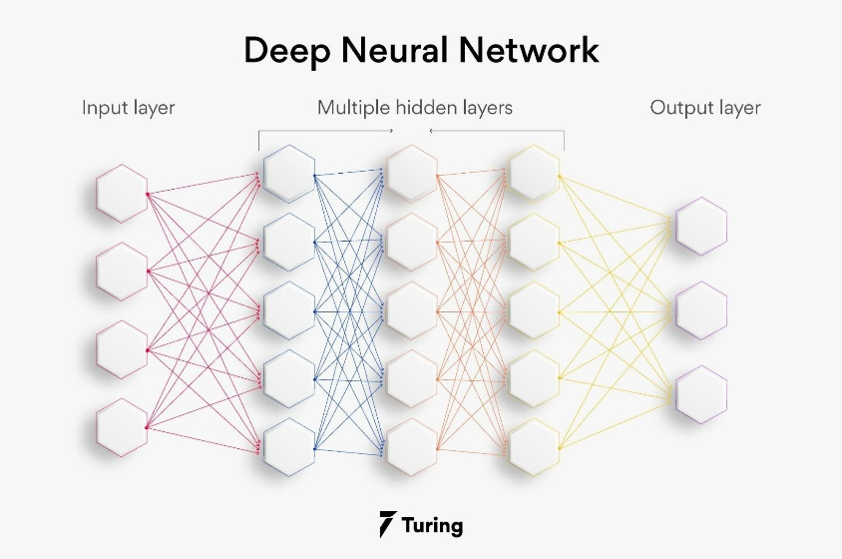

Slide 34
Feedforward networks are of extreme importance to machine learning practioners.
They form the basis of many important commercial applications. For example, the convolutional networks used for object recognition from photos are a specialized kind of feedforward network.
Feedforward networks are a conceptual stepping stone on the path to recurrent networks, which power many natural language applications.
Feedforward neural networks are called networks because they are typically represented by composing together many diﬀerent functions.
The model is associated with a directed acyclic graph describing how the functions are composed together.
For example, we might have three functions f (1), f (2), and f (3) connected in a chain, to form
f(x) = f(3)(f (2)(f(1) (x ))).
These chain structures are the most commonly used structures of neural networks

Slide 35
In this case, f (1) is called the ﬁrst layer of the network, f (2) is called the second layer, and so on.
The overall length of the chain gives the depth of the model. It is from this terminology that the name “deep learning” arises.
The ﬁnal layer of a feedforward network is called the output layer. During neural network training, we drive f(x) to match f∗ (x).
The training data provides us with noisy, approximate examples of f ∗(x) evaluated at diﬀerent training points.
Each example x is accompanied by a label y ≈ f ∗ (x). The training examples specify directly what the output layer must do at each point x;
it must produce a value that is close to y.
The behavior of the other layers is not directly speciﬁed by the training data.
The learning algorithm must decide how to use those layers to produce the desired output, but the training data does not say what each individual layer should do.

Slide 36
Instead, the learning algorithm must decide how to use these layers to best implement an approximation of f∗ . Because the training data does not show the desired output for each of these layers, these layers are called hidden layers.
Finally, these networks are called neural because they are loosely inspired by neuroscience. Each hidden layer of the network is typically vector-valued.
The dimensionality of these hidden layers determines the width of the model. Each element of the vector may be interpreted as playing a role analogous to a neuron.
Rather than thinking of the layer as representing a single vector-to-vector function, we can also think of the layer as consisting of many units that act in parallel, each representing a vector-to-scalar function.

Slide 37
Each unit resembles a neuron in the sense that it receives input from many other units and computes its own activation value. The idea of using many layers of vector-valued representation is drawn from neuroscience.
The choice of the functions f(i) (x) used to compute these representations is also loosely guided by neuroscientiﬁc observations about the functions that biological neurons compute. However, modern neural network research is guided by many mathematical and engineering disciplines, and the goal of neural networks is not to perfectly model the brain. It is best to think of feedforward networks as function approximation machines that are designed to achieve statistical generalization, occasionally drawing some insights from what we know about the brain, rather than as models of brain function.

Slide 38
One way to understand feedforward networks is to begin with linear models and consider how to overcome their limitations. Linear models, such as logistic regression and linear regression, are appealing because they may be ﬁt eﬃciently and reliably, either in closed form or with convex optimization.
Linear models also have the obvious defect that the model capacity is limited to linear functions, so the model cannot understand the interaction between any two input variables.

Slide 39
To extend linear models to represent nonlinear functions of x, we can apply the linear model not to x itself but to a transformed input φ(x ), where φ is a nonlinear transformation.

Slide 40
ADVANTAGES OF DEEP FEED FORWARD NETWORKS
Machine learning can be boosted with feed forward neural networks' simplified architecture.
Multi-network in the feed forward networks operate independently, with a moderated intermediary.
Complex tasks need several neurons in the network.
Neural networks can handle and process nonlinear data easily compared to perceptrons and sigmoid neurons, which are otherwise complex.
A neural network deals with the complicated problem of decision boundaries.
Depending on the data, the neural network architecture can vary. For example, convolutional neural networks (CNNs) perform exceptionally well in image processing, whereas recurrent neural networks (RNNs) perform well in text and voice processing.
Neural networks need graphics processing units (GPUs) to handle large datasets for massive computational and hardware performance. Several GPUs get used widely in the market, including Kaggle Notebooks and Google Collab Notebooks.

Slide 41
APPLICATIONS OF FEED FORWARD NEURAL NETWORKS
Physiological feed forward system: It is possible to identify feed forward management in this situation because the central involuntary regulates the heartbeat before exercise.
Gene regulation and feed forward: Detecting non-temporary changes to the atmosphere is a function of this motif as a feed forward system. You can find the majority of this pattern in the illustrious networks.
Automation and machine management: Automation control using feed forward is one of the disciplines in automation.
Parallel feed forward compensation with derivative: An open-loop transfer converts non-minimum part systems into minimum part systems using this technique

Slide 42
WORKING DEEP FEED FORWARD NETWORKS
The process of receiving an input to produce some kind of output to make some kind of prediction is known as Feed Forward." Feed Forward neural network is the core of many other important neural networks such as convolution neural network.
In the feed-forward neural network, there are not any feedback loops or connections in the network. Here is simply an input layer, a hidden layer, and an output layer.

Slide 43
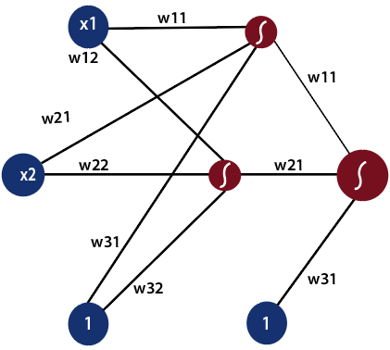

Slide 44
There can be multiple hidden layers which depend on what kind of data you are dealing with.
The number of hidden layers is known as the depth of the neural network.
The deep neural network can learn from more functions.
Input layer first provides the neural network with data and the output layer then make predictions on that data which is based on a series of functions.
ReLU Function is the most commonly used activation function in the deep neural network.

Slide 45

To gain a solid understanding of the feed-forward process, let's see this mathematically.
1) The first input is fed to the network, which is represented as matrix x1, x2, and one where one is the bias value.
2) Each input is multiplied by weight with respect to the first and second model to obtain their probability of being in the positive region in each model.

Slide 47
Regularization in DNN?
Any modification we make to a learning algorithm that is intended to reduce its generalization error but not its training error.
There are many regularization strategies.
In the context of deep learning, most regularization strategies are based on regularizing estimators.
Regularization of an estimator works by trading increased bias for reduced variance.
An eﬀective regularize is one that makes a profitable trade, reducing variance significantly while not overly increasing the bias.

Slide 48
Types of regularization techniques: Regularization is a technique used to address overfitting by directly changing the architecture of the model by modifying the model’s training process.
The following are the commonly used regularization techniques:
L2 regularization
L1 regularization
Dropout regularization.
Early Stopping

Slide 49
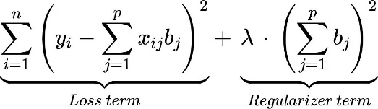
L2 regularization: According to regression analysis, L2 regularization is also called ridge regression.
In this type of regularization, the squared magnitude of the coefficients or weights multiplied with a regularizer term is added to the loss or cost function.
L2 regression can be represented with the following mathematical equation.

Slide 50
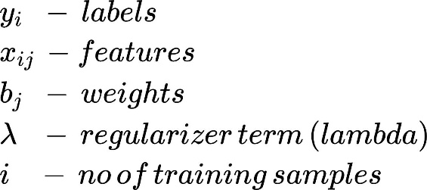

Slide 51
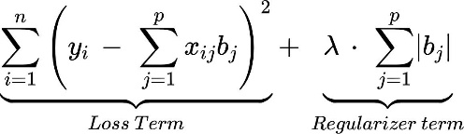
L1 regularization: L1 regularization is also referred to as lasso regression. In this type of regularization, the absolute value of the magnitude of coefficients or weights multiplied with a regularizer term is added to the loss or cost function. It can be represented with the following equation.
Loss:

Slide 52
Dropout regularization:
Dropout regularization is the technique in which some of the neurons are randomly disabled during the training such that the model can extract more useful robust features from the model.
Early Stopping:
we stop training the model when the performance on the validation set is getting worse- increasing loss decreasing accuracy, or poorer scores of the scoring metric.
By plotting the error on the training dataset and the validation dataset together, both the errors decrease with a number of iterations until the point where the model starts to overfit.
After this point, the training error still decreases but the validation error increases.

Slide 53
ADAGARD AND ADAM OPTIMIZERS
In deep learning, optimizers are algorithms that adjust the model’s parameters during training to minimize a loss function.
They enable neural networks to learn from data by iteratively updating weights and biases Each optimizer has specific update rules, learning rates, and momentum to find optimal model parameters for improved performance.

Slide 54
Adagrad (Adaptive Gradient Descent) Deep Learning Optimizer:
The adaptive gradient descent algorithm is slightly different from other gradient descent algorithms.
This is because it uses different learning rates for each iteration.
The change in learning rate depends upon the difference in the parameters during training.
The more the parameters get changed, the more minor the learning rate changes.
This modification is highly beneficial because real-world datasets contain sparse as well as dense features.
So it is unfair to have the same value of learning rate for all the features.

Slide 55


The Adagrad algorithm uses the below formula to update the weights. Here the alpha(t) denotes the different learning rates at each iteration, n is a constant, and E is a small positive to avoid division by 0.

Slide 56
Adam Optimizer in Deep Learning
Adam optimizer, short for Adaptive Moment Estimation optimizer, is an optimization algorithm commonly used in deep learning.
It is an extension of the stochastic gradient descent (SGD) algorithm and is designed to update the weights of a neural network during training.

Slide 57
Adam Optimizer Formula: The adam optimizer has several benefits, due to which it is used widely.
It is adapted as a benchmark for deep learning papers and recommended as a default optimization algorithm.
Moreover, the algorithm is straightforward to implement, has a faster running time, low memory requirements, and requires less tuning than any other optimization algorithm.

