Slide 1
20CSE471A DEEP LEARNING
N VIJAYA KUMAR M.E(CSE), M.B.A

Slide 2
UNIT 4: DEEP LEARNING MODELS
Convolutional Neural Networks (CNNs):
CNN Fundamentals – Architectures – Pooling – Visualization –
Sequence Modeling: Recurrent Neural Networks (RNN) –
Long-Short Term Memory (LSTM) –
Bidirectional LSTMs-
Bidirectional RNNs –
Deep Unsupervised Learning: Autoencoders – Auto Encoder Applications –
Deep Boltzmann Machine (DBM).

Slide 3
Convolutional Neural Networks (CNNs):
CNN's popularly known as ConvNets majorly consists of several layers and are specifically used for image processing and detection of objects.
It was developed in 1998 by Yann LeCun and was first called LeNet.
Back then, it was developed to recognize digits and zip code characters.
CNNs have wide usage in identifying the image of the satellites, medical image processing, series forecasting, and anomaly detection.

Slide 4
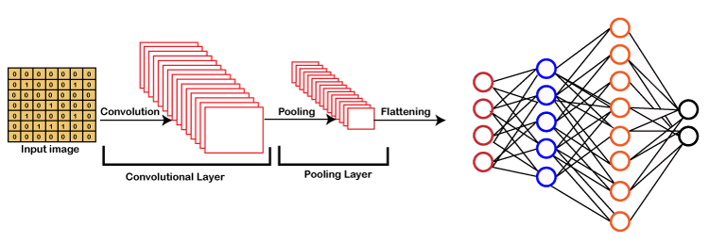

Slide 5
Working of CNN
Generally, a Convolutional Neural Network has three layers, which are as follows;
Input: If the image consists of 32 widths, 32 height encompassing three R, G, B channels, then it will hold the raw pixel([32x32x3]) values of an image.
Convolution: It computes the output of those neurons, which are associated with input's local regions, such that each neuron will calculate a dot product in between weights and a small region to which they are actually linked to in the input volume. For example, if we choose to incorporate 12 filters, then it will result in a volume of [32x32x12].
ReLU Layer: It is specially used to apply an activation function elementwise, like as max (0, x) thresholding at zero. It results in ([32x32x12]), which relates to an unchanged size of the volume.
Pooling: This layer is used to perform a downsampling operation along the spatial dimensions (width, height) that results in [16x16x12] volume.

Slide 6
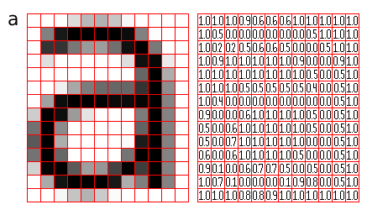

Slide 7
Convolutional operation:
Convolution is a mathematical operation where we have an input I, and an argument, kernel K to produce an output that expresses how the shape of one is modified by another.
For example, We have an image “x”, which is a 2D array of pixels with different color channels (Red,Green and Blue-RGB) and we have a feature detector or kernel “w” then the output we get after applying a mathematical operation is called a feature map

Slide 8
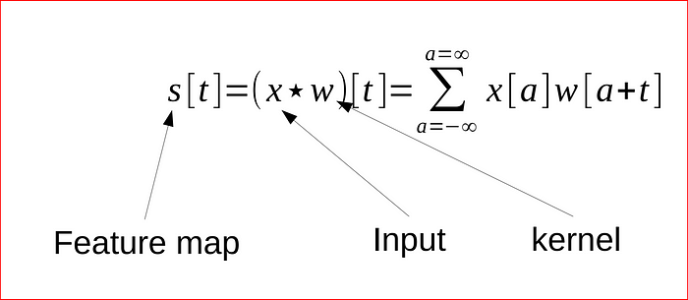
Convolution function

Slide 9
The mathematical operation helps compute similarity of two signals. we may have a feature detector or filter for identifying edges in the image, so convolution operation will help us identify the edges in the image when we use such a filter on the image.
we usually assume that convolution functions are zero everywhere but the ﬁnite set of points for which we store the values.
This means that in practice we can implement the inﬁnite summation as a summation over a ﬁnite number of array elements.

Slide 10


I is 2D array and K is kernel-Convolution function
Since convolution is commutative, we can rewrite the equation pictured above as shown below. We do this for ease of implementation in Machine Learning, as there is less variation in range of valid values for m and n. This is cross correlation function which most neural networks use.
Cross Correlation function

Slide 11
Implementing in CNN:
The way we implement this is through Convolutional Layer. Convolutional layer is core building block of CNN, it helps with feature detection. Kernel K is a set of learnable filters and is small spatially compared to the image but extends through the full depth of the input image.
An easy way to understand this is if you were a detective and you are came across a large image or a picture in dark, you will use you flashlight and scan across the entire image. This is exactly what we do in convolutional layer.

Slide 12
Kernel K, which is a feature detector is equivalent of the flashlight on image I, and we are trying to detect feature and create multiple feature maps to help us identify or classify the image.
we have multiple feature detector to help with things like edge detection, identifying different shapes, bends or different colors etc.
After every convolution operation which is a linear function, we apply ReLU activation function.
ReLU activation function introduces non linearity in convolutional layer.
It replaces all negative pixel values with zero values in the feature map. Below figure shows the feature map transformation after applying the ReLU activation function.

Slide 13
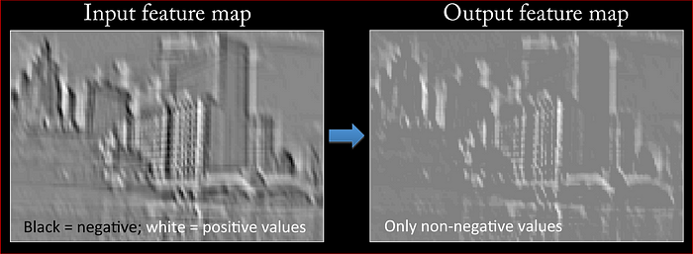

Slide 14
CONVOLUTIONAL ARCHITECTURE
Convolutional Neural Network Architecture: A CNN typically has three layers:
convolutional layer
pooling layer,
fully connected layer.

Slide 15
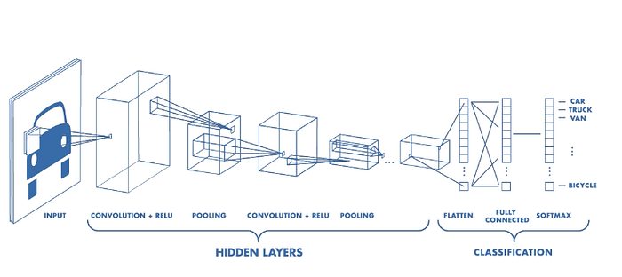

Slide 16
CONVOLUTION LAYER :
The convolution layer is the core building block of the CNN.
It carries the main portion of the network’s computational load.
This layer performs a dot product between two matrices, where one matrix is the set of learnable parameters otherwise known as a kernel, and the other matrix is the restricted portion of the receptive field.
The kernel is spatially smaller than an image but is more in-depth. This means that, if the image is composed of three (RGB) channels, the kernel height and width will be spatially small, but the depth extends up to all three channels.

Slide 17
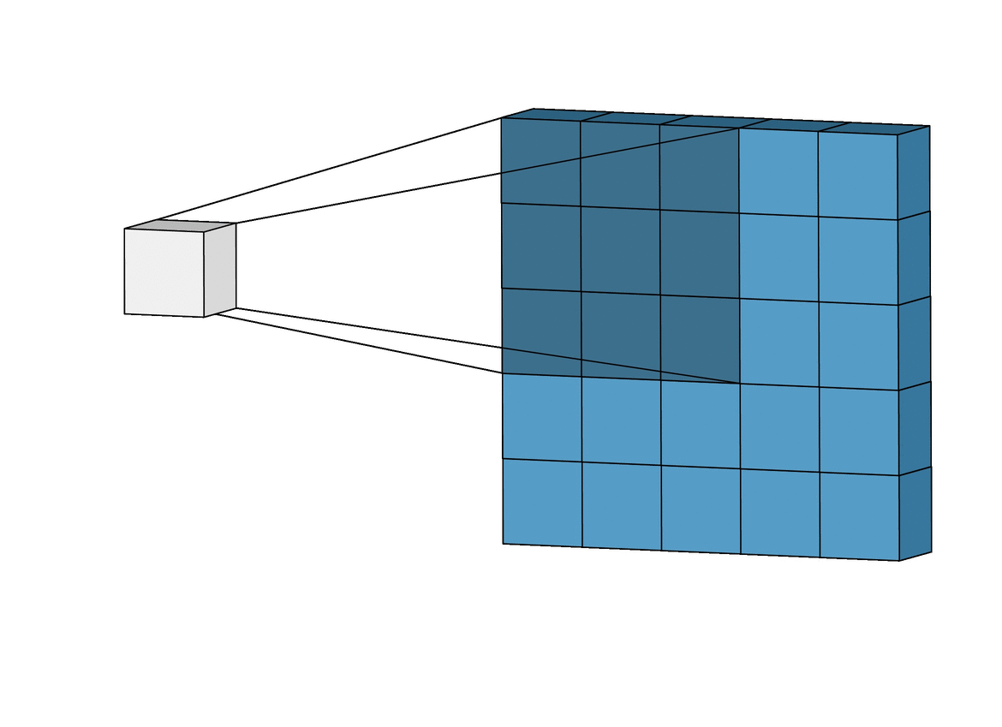
Convolution Operation

Slide 18
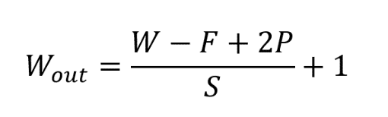
If we have an input of size W x W x D and Dout number of kernels with a spatial size of F with stride S and amount of padding P, then the size of output volume can be determined by the following formula:
This will yield an output volume of size Wout x Wout x Dout.

Slide 19
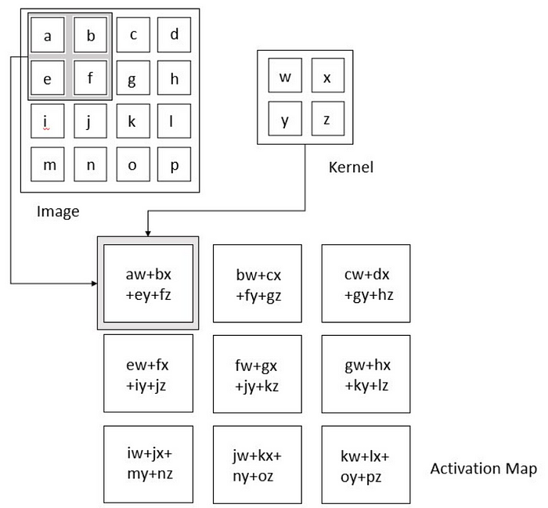

Slide 20
POOLING LAYER:
The pooling layer replaces the output of the network at certain locations by deriving a summary statistic of the nearby outputs.
This helps in reducing the spatial size of the representation, which decreases the required amount of computation and weights.
The pooling operation is processed on every slice of the representation individually.
There are several pooling functions such as the average of the rectangular neighborhood, L2 norm of the rectangular neighborhood, and a weighted average based on the distance from the central pixel. However, the most popular process is max pooling, which reports the maximum output from the neighborhood.

Slide 21
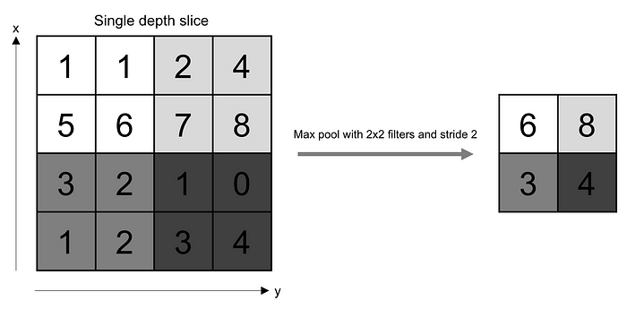

Slide 22
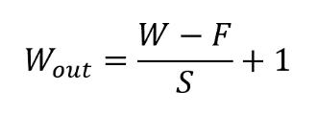
If we have an activation map of size W x W x D, a pooling kernel of spatial size F, and stride S, then the size of output volume can be determined by the following formula:

Slide 23
FULLY CONNECTED LAYER:
Neurons in this layer have full connectivity with all neurons in the preceding and succeeding layer as seen in regular FCNN.
This is why it can be computed as usual by a matrix multiplication followed by a bias effect.
The FC layer helps to map the representation between the input and the output.
Since convolution is a linear operation and images are far from linear, non-linearity layers are often placed directly after the convolutional layer to introduce non-linearity to the activation map.
There are several types of non-linear operations, the popular ones being:
1. Sigmoid, 2. Tanh, 3. ReLU

Slide 24
POOLING IN CNN
In convolutional neural networks (CNNs), the pooling layer is a common type of layer that is typically added after convolutional layers.
The pooling layer is used to reduce the spatial dimensions (i.e., the width and height) of the feature maps, while preserving the depth (i.e., the number of channels).
. There are four types of pooling layers –
Max pooling
Min pooling
Average pooling
Global Pooling.

Slide 25
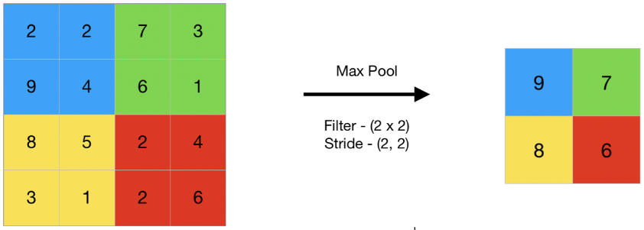
Max Pooling:
In max pooling, the output value for each pooling region is simply the maximum value of the input values within that region. This has the effect of preserving the most salient features in each pooling region, while discarding less relevant information. Max pooling is often used in CNNs for object recognition tasks, as it helps to identify the most distinctive features of an object, such as its edges and corners.

Slide 26
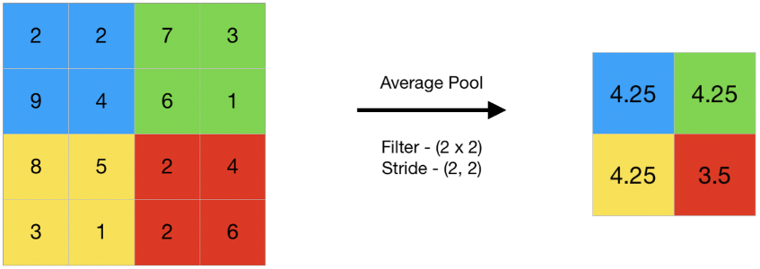
Average Pooling: In average pooling, the output value for each pooling region is the average of the input values within that region. This has the effect of preserving more information than max pooling, but may also dilute the most salient features. Average pooling is often used in CNNs for tasks such as image segmentation and object detection, where a more fine-grained representation of the input is required

Slide 27
Min Pooling: The Min Pooling layer summarizes the features in a region represented by the minimum value in that region. Contrary to Max Pooling in CNN, this type is mainly used for images with a light background to focus on darker pixels.
Global Pooling: The pooling technique reduces each feature map channel to a single value. This value depends on the type of global pooling, which can be any of the previously explained pooling types. In other words, applying global pooling is similar to using a filter of the exact dimensions of the feature map.

Slide 28
Advantages of Pooling Layer:
Dimensionality reduction: The main advantage of pooling layers is that they help in reducing the spatial dimensions of the feature maps. This reduces the computational cost and also helps in avoiding overfitting by reducing the number of parameters in the model.
Translation invariance: Pooling layers are also useful in achieving translation invariance in the feature maps. This means that the position of an object in the image does not affect the classification result, as the same features are detected regardless of the position of the object.
Feature selection: Pooling layers can also help in selecting the most important features from the input, as max pooling selects the most salient features and average pooling preserves more information.

Slide 29
Disadvantages of Pooling Layer:
Information loss: One of the main disadvantages of pooling layers is that they discard some information from the input feature maps, which can be important for the final classification or regression task.
Over-smoothing: Pooling layers can also cause over-smoothing of the feature maps, which can result in the loss of some fine-grained details that are important for the final classification or regression task.
Hyperparameter tuning: Pooling layers also introduce hyperparameters such as the size of the pooling regions and the stride, which need to be tuned in order to achieve optimal performance. This can be time-consuming and requires some expertise in model building.

Slide 30
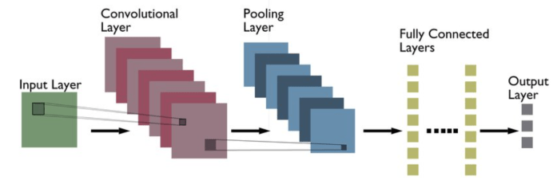
CNN architectures

Slide 31
Different types of CNN Architectures:
The following is a list of different types of CNN architectures:
LeNet
AlexNet
ZF Net
GoogLeNet
VGGNet
ResNet
MobileNets
GoogLeNet_DeepDream

Slide 32
CNN VISUALIZATION TECHNIQUES
Convolutional Neural Network (CNN) visualizations refer to techniques for visually representing the learned features or patterns captured by different layers of a CNN.
These visualizations can help to gain insights into how the network is processing and classifying input images.
Types
Feature maps show the output of each filter in a given layer of the network for a particular input image. These visualizations can help to understand the features that the network is detecting at each layer.
Activation maximization involves generating an image that maximally activates a particular neuron or group of neurons in a given layer of the network. This technique can be used to visualize the features learned by the network at different levels of abstraction.
Integrated Gradients is a technique used to measure the importance of each input feature (e.g., pixel values) for a given output class of a deep neural network. The technique involves computing the gradient of the output class with respect to the input features, and then integrating this gradient over a path from a baseline input (e.g., an all-zero image) to the actual input image. The resulting integrated gradient map highlights the important input features that contributed to the output class.
Saliency maps highlight the regions of an input image that are most important for a particular output class. This technique can help to identify which parts of the input image the network is focusing on when making its classification decision.

Slide 33
RECURRENT NEURAL NETWORKS:
Neural networks imitate the function of the human brain in the fields of AI, machine learning, and deep learning, allowing computer programs to recognize patterns and solve common issues.
RNNs are a type of neural network that can be used to model sequence data. RNNs, which are formed from feedforward networks, are similar to human brains in their behavior. Simply said, recurrent neural networks can anticipate sequential data in a way that other algorithms can’t.

Slide 34
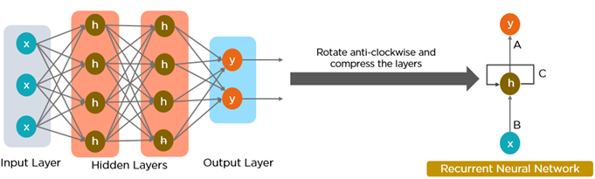

Slide 35
All of the inputs and outputs in standard neural networks are independent of one another, however in some circumstances, such as when predicting the next word of a phrase, the prior words are necessary, and so the previous words must be remembered. As a result, RNN was created, which used a Hidden Layer to overcome the problem.
The most important component of RNN is the Hidden state, which remembers specific information about a sequence.

Slide 36
Architecture Of Recurrent Neural Network :
RNNs have the same input and output architecture as any other deep neural architecture.
However, differences arise in the way information flows from input to output.
Unlike Deep neural networks where we have different weight matrices for each Dense network in RNN, the weight across the network remains the same.
It calculates state hidden state H_{i} for every input X_{i .} By using the following formulas:

Slide 37
h= σ(UX + Wh₋₁ + B)
Y = O(Vh + C) Hence
Y = f (X, h , W, U, V, B, C)
Here S is the State matrix which has element si as the state of the network at timestep i The parameters in the network are W, U, V, c, b which are shared across timestep

Slide 38
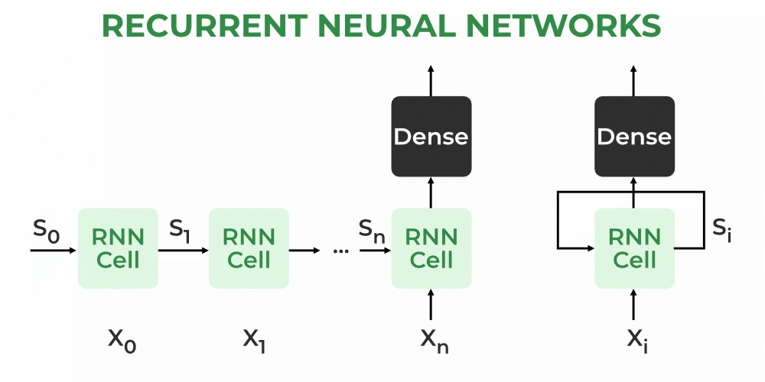

Slide 39
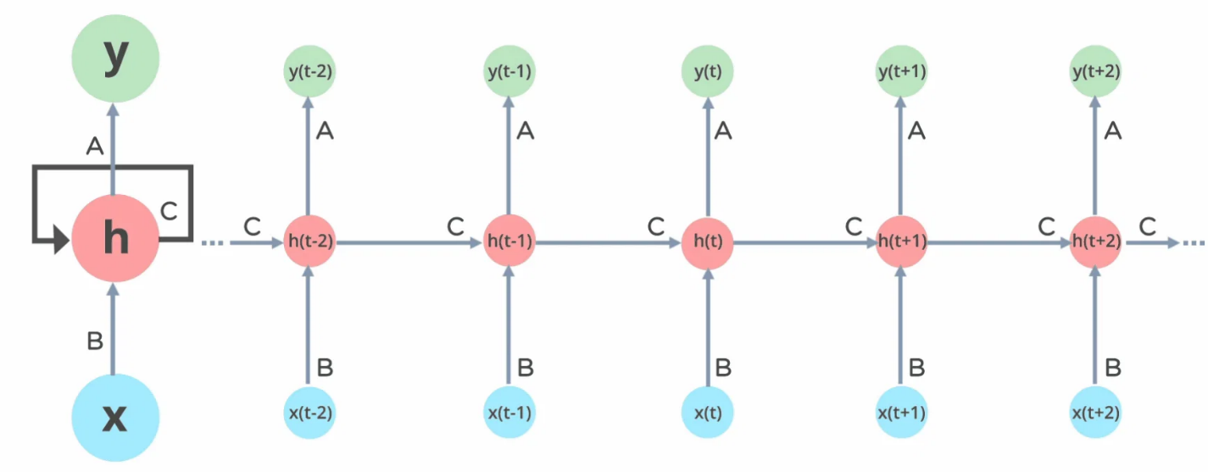
RNN working: In Recurrent Neural networks, the information cycles through a loop to the middle hidden layer.

Slide 40
The input layer ‘x’ takes in the input to the neural network and processes it and passes it onto the middle layer. The middle layer ‘h’ can consist of multiple hidden layers, each with its own activation functions and weights and biases. If you have a neural network where the various parameters of different hidden layers are not affected by the previous layer, ie: the neural network does not have memory, then you can use a recurrent neural network.
The Recurrent Neural Network consists of multiple fixed activation function units, one for each time step. Each unit has an internal state which is called the hidden state of the unit. This hidden state signifies the past knowledge that the network currently holds at a given time step. This hidden state is updated at every time step to signify the change in the knowledge of the network about the past. The hidden state is updated using the following recurrence relation:-

Slide 41


The formula for calculating the current state:
where:
h_{t} -> current state
h_{t-1} -> previous state
x_{t} -> input state
Formula for applying Activation function(tanh):
where:
w_{hh} -> weight at recurrent neuron
w_{xh} -> weight at input neuron

Slide 42

The formula for calculating output:
Y_{t} -> output
W_{hy} -> weight at output layer

Slide 43
Training through RNN:
A single-time step of the input is provided to the network.
Then calculate its current state using a set of current input and the previous state.
The current ht becomes ht-1 for the next time step.
One can go as many time steps according to the problem and join the information from all the previous states.
Once all the time steps are completed the final current state is used to calculate the output.
The output is then compared to the actual output i.e the target output and the error is generated.
The error is then back-propagated to the network to update the weights and hence the network (RNN) is trained using Backpropagation through time.

Slide 44
Recurrent connection
Hidden state
Backpropagation training time (BTT)
Vanishing/Exploding Gradient
Applivation :
Text generation
Speech recognition
Weather farecasting

Slide 45
Advantages of Recurrent Neural Network
An RNN remembers each and every piece of information through time. It is useful in time series prediction only because of the feature to remember previous inputs as well. This is called Long Short-Term Memory.
Recurrent neural networks are even used with convolutional layers to extend the effective pixel neighborhood.

Slide 46
Disadvantages of Recurrent Neural Network
Gradient vanishing and exploding problems.
Training an RNN is a very difficult task.
It cannot process very long sequences if using tanh or relu as an activation function.

Slide 47
Applications of Recurrent Neural Network
Language Modelling and Generating Text
Speech Recognition
Machine Translation
Image Recognition, Face detection
Time series Forecasting

Slide 48
Types Of RNN: There are four types of RNNs based on the number of inputs and outputs in the network.
One to One
One to Many
Many to One
Many to Many

Slide 49
LSTM
Long Short-Term Memory (LSTM): LSTM is a type of Neural Network used in the field of Deep Learning. LSTM stands for Long-Short-term-Memory. LSTM is an improved version of the RNN (Recurrent Neural Network). LSTM is mainly used in Time series and Sequence data because RNN doesn't perform efficiently as the gap length rises. LSTM differs from conventional Feedforward Networks as it uses previous data and its output to affect the current predictions. LSTM is also better at retaining information for longer periods when compared with RNN. Long Short-Term Memory uses Gated Cells to remember or forget previous information.

Slide 50
LSTM was designed by Hochreiter & Schmidhuber. It's a challenging task to get your head around LSTM as it belongs to the complex area of Deep Learning. LSTM deals with algorithms to uncover the underlying relationships in the given sequential data. The chain structure LSTM contains four neural networks and different memory blocks called cells. The LSTM may keep information for a long time by default, and information is retained by the cells, and the three gates do the memory manipulations.

Slide 51
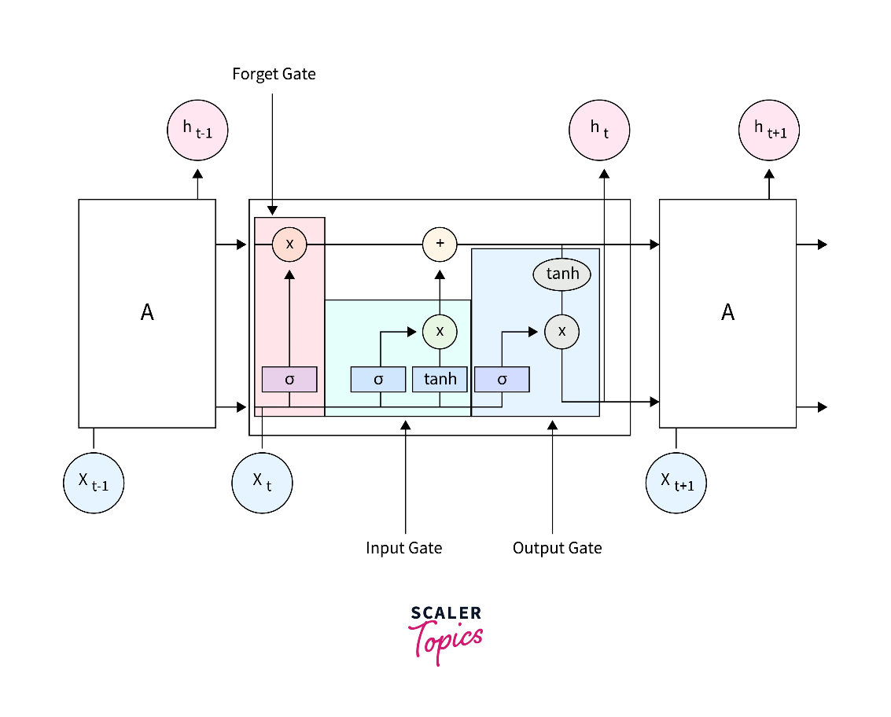

Slide 52
Need of LSTM: LSTM was introduced to tackle the problems and challenges in Recurrent Neural Networks. It touches on the topic of RNN. RNN is a type of Neural Network that stores the previous output to help improve its future predictions. Vanilla RNN has a “short-term” memory. The input at the beginning of the sequence doesn’t affect the output of the Network after a while, maybe 3 or 4 inputs. This is called a long-term dependency issue.
Example:
Let’s take this sentence.
The Sun rises in the ______.
An RNN could easily return the correct output that the sun rises in the East as all the necessary information is nearby.

Slide 53
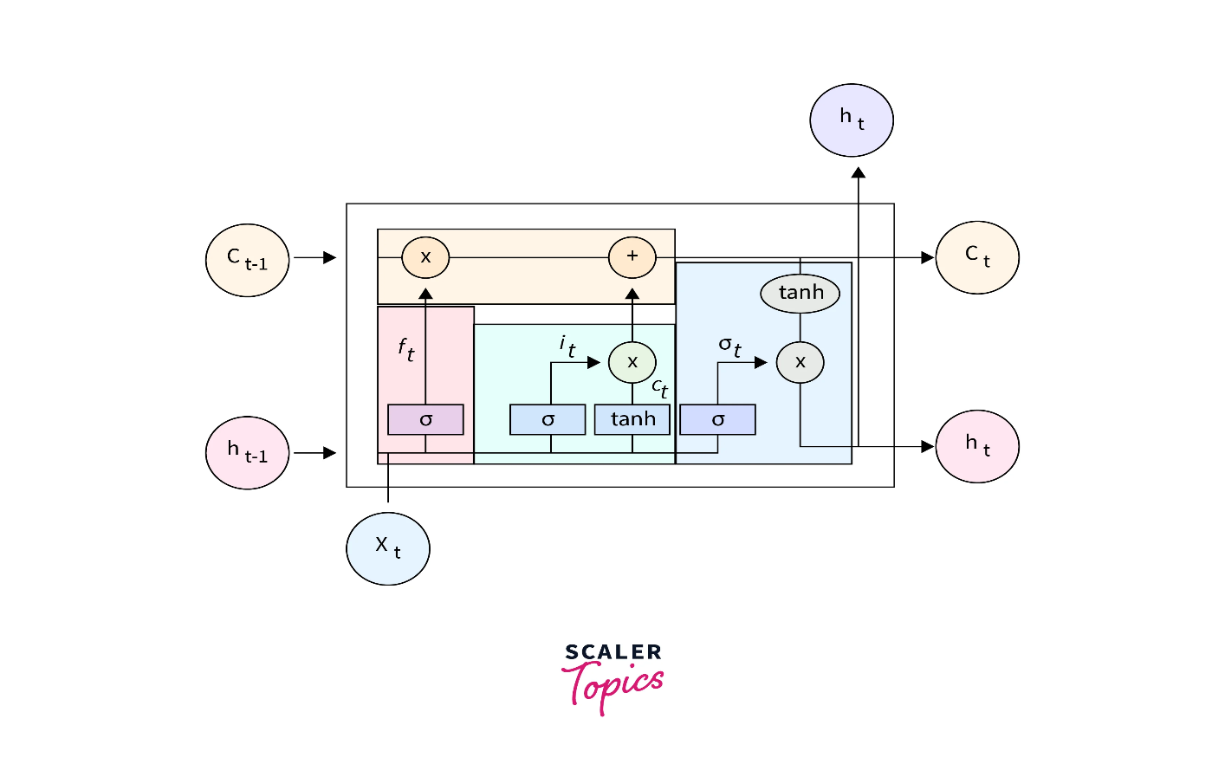
Structure of LSTM: LSTM is a cell that consists of 3 gates. A forget gate, input gate, and output gate. The gates decide which information is important and which information can be forgotten. The cell has two states Cell State and Hidden State. They are continuously updated and carry the information from the previous to the current time steps. The cell state is the “long-term” memory, while the hidden state is the “short-term” memory.

Slide 54
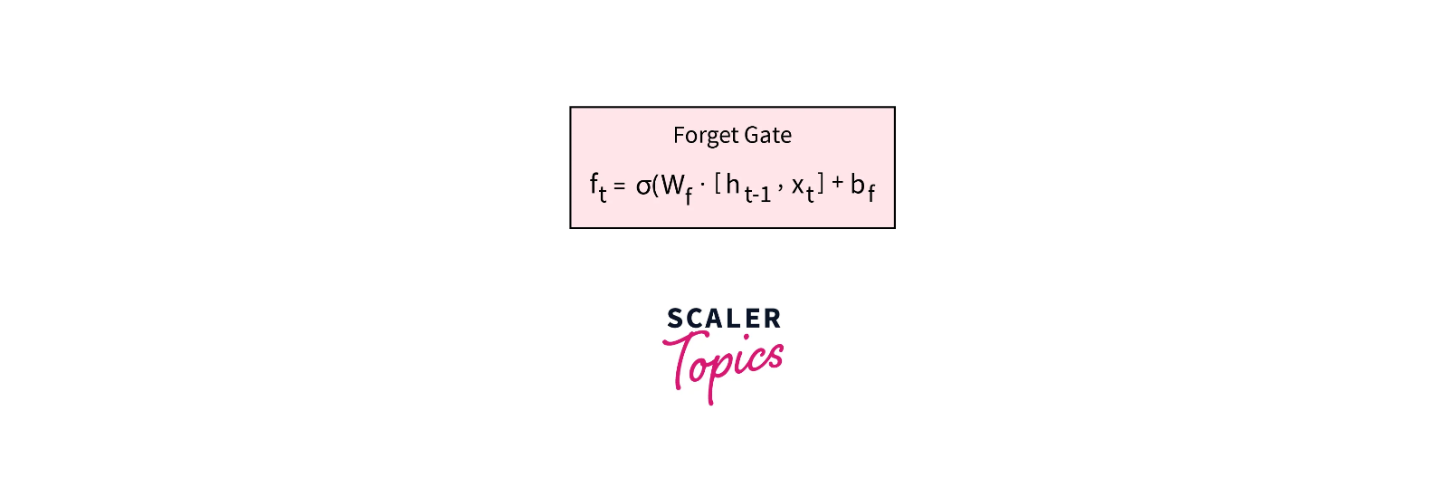
Forget Gate: Forget gate is responsible for deciding what information should be removed from the cell state. It takes in the hidden state of the previous time-step and the current input and passes it to a Sigma Activation Function, which outputs a value between 0 and 1, where 0 means forget and 1 means keep

Slide 55
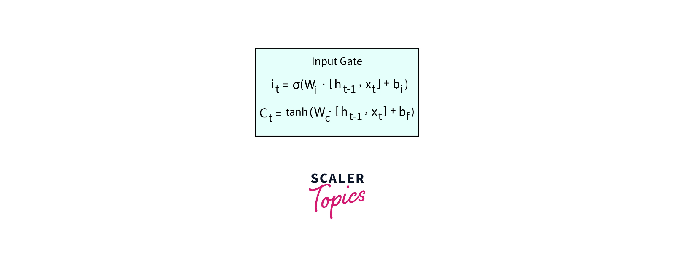
Input Gate: The Input Gate considers the current input and the hidden state of the previous time step. The input gate is used to update the cell state value. It has two parts. The first part contains the Sigma activation function. Its purpose is to decide what percent of the information is required. The second part passes the two values to a Tanh activation function. It aims to map the data between -1 and 1. To obtain the relevant information required from the output of Tanh, we multiply it by the output of the Sigma function. This is the output of the Input gate, which updates the cell state.

Slide 56
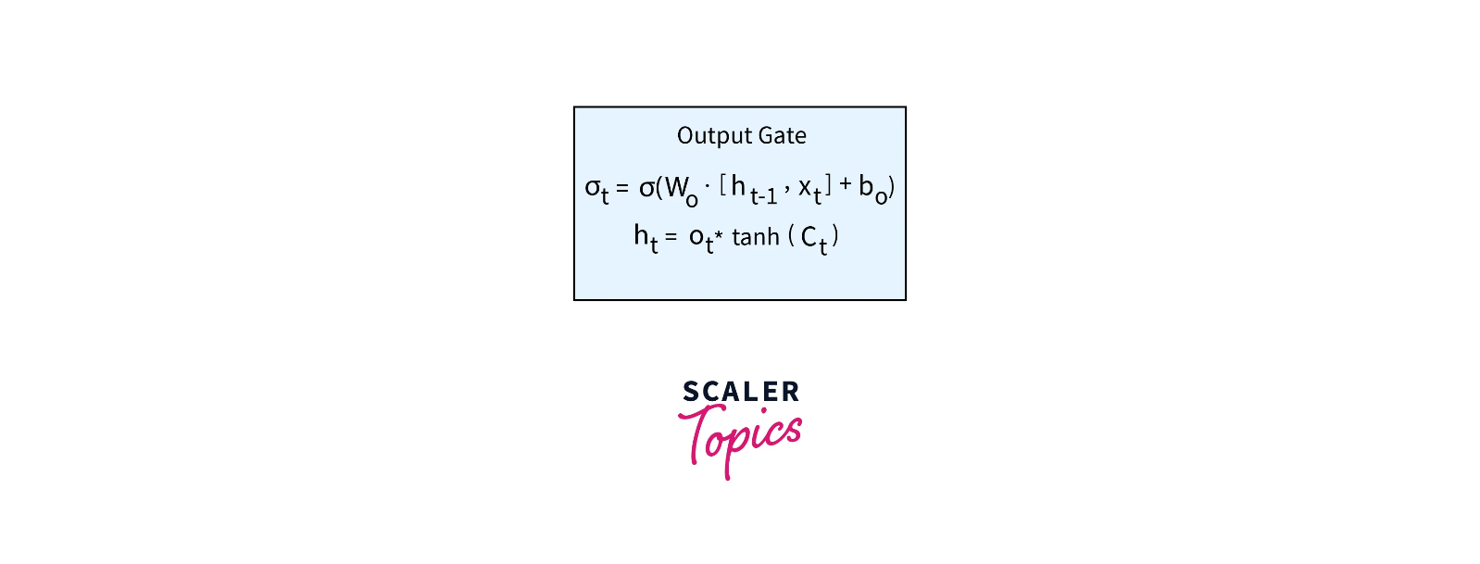
Output Gate: The output gate returns the hidden state for the next time stamp. The output gate has two parts. The first part is a Sigma function, which serves the same purpose as the other two gates, to decide the percent of the relevant information required. Next, the newly updated cell state is passed through a Tanh function and multiplied by the output from the sigma function. This is now the new hidden state.

Slide 57
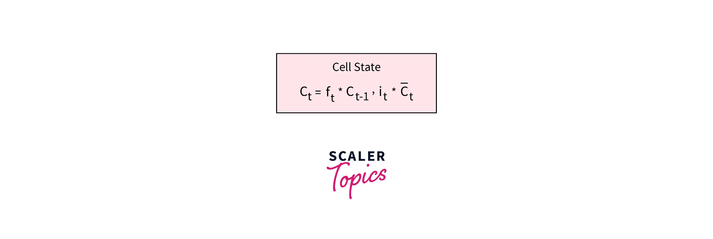
Cell State: The forget gate and input gate update the cell state. The cell state of the previous state is multiplied by the output of the forget gate. The output of this state is then summed with the output of the input gate. This value is then used to calculate hidden state in the output gate.

Slide 58
LSTM Working: The LSTM architecture is similar to RNN, but instead of the feedback loop has an LSTM cell. The sequence of LSTM cells in each layer is fed with the output of the last cell. This enables the cell to get the previous inputs and sequence information. A cyclic set of steps happens in each LSTM cell
The Forget gate is computed.
The Input gate value is computed.
The Cell state is updated using the above two outputs.
The output (hidden state) is computed using the output gate.

Slide 59
Applications of LSTM:
Language Modeling: LSTMs have been used to build language models that can generate natural language text, such as in machine translation systems or chatbots.
Time series prediction: LSTMs have been used to model time series data and predict future values in the series. For example, LSTMs have been used to predict stock prices or traffic patterns.
Sentiment analysis: LSTMs have been used to analyze text sentiments, such as in social media posts or customer reviews.
Speech recognition: LSTMs have been used to build speech recognition systems that can transcribe spoken language into text.
Image captioning: LSTMs have been used to generate descriptive captions for images, such as in image search engines or automated image annotation systems.

Slide 60
BIDIRECTIONAL RNN AND BIDIRECTIONAL LSTM
Bi-directional Recurrent Neural Network:
An architecture of a neural network called a bidirectional recurrent neural network (BRNN) is made to process sequential data.
In order for the network to use information from both the past and future context in its predictions, BRNNs process input sequences in both the forward and backward directions.
This is the main distinction between BRNNs and conventional recurrent neural networks.

Slide 61
A BRNN has two distinct recurrent hidden layers, one of which processes the input sequence forward and the other of which processes it backward. After that, the results from these hidden layers are collected and input into a prediction-making final layer. Any recurrent neural network cell, such as Long Short-Term Memory (LSTM) or Gated Recurrent Unit, can be used to create the recurrent hidden layers.
The BRNN functions similarly to conventional recurrent neural networks in the forward direction, updating the hidden state depending on the current input and the prior hidden state at each time step. The backward hidden layer, on the other hand, analyses the input sequence in the opposite manner, updating the hidden state based on the current input and the hidden state of the next time step.
In order to update the model parameters, the gradients are computed for both the forward and backward passes of the backpropagation through the time technique that is typically used to train BRNNs. The input sequence is processed by the BRNN in a single forward pass at inference time, and predictions are made based on the combined outputs of the two hidden layers. layers.

Slide 62
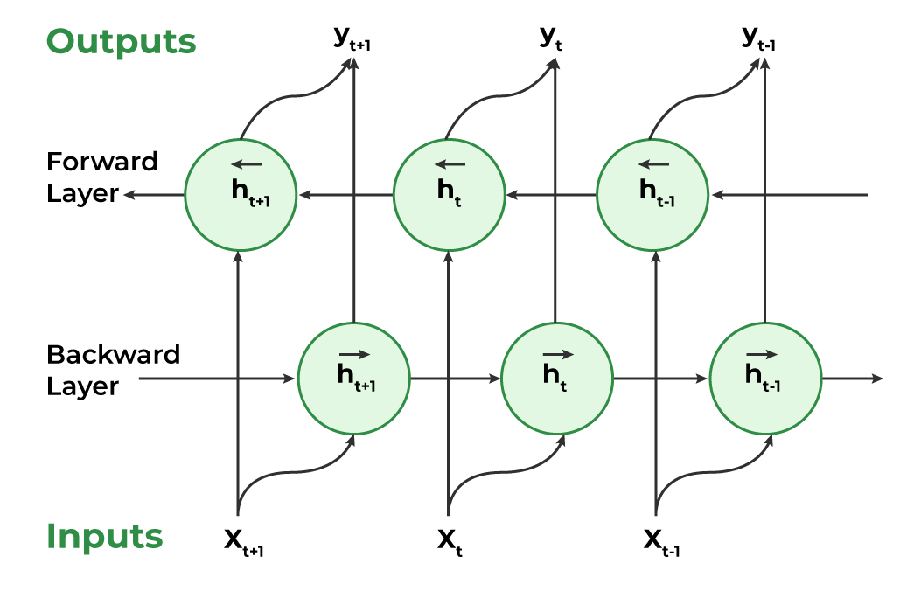

Slide 63
Working of Bidirectional Recurrent Neural Network
Inputting a sequence: A sequence of data points, each represented as a vector with the same dimensionality, are fed into a BRNN. The sequence might have different lengths.
Dual Processing: Both the forward and backward directions are used to process the data. On the basis of the input at that step and the hidden state at step t-1, the hidden state at time step t is determined in the forward direction. The input at step t and the hidden state at step t+1 are used to calculate the hidden state at step t in a reverse way.
Computing the hidden state: A non-linear activation function on the weighted sum of the input and previous hidden state is used to calculate the hidden state at each step. This creates a memory mechanism that enables the network to remember data from earlier steps in the process.
Determining the output: A non-linear activation function is used to determine the output at each step from the weighted sum of the hidden state and a number of output weights. This output has two options: it can be the final output or input for another layer in the network.
Training: The network is trained through a supervised learning approach where the goal is to minimize the discrepancy between the predicted output and the actual output. The network adjusts its weights in the input-to-hidden and hidden-to-output connections during training through backpropagation.

Slide 64
To calculate the output from an RNN unit, we use the following formula:
H_{t} (Forward) = A(X_{t} * W_{XH} (forward) + H_{t-1} (Forward) * W_{HH} (Forward) + b_{H} (Forward)
H_{t} (Backward) = A(X_{t} * W_{XH} (Backward) + H_{t+1} (Backward) * W_{HH} (Backward) + b_{H} (Backward)
where,
A = activation function,
W = weight matrix
b = bias
The hidden state at time t is given by a combination of H_{t} (Forward) and H_{t} (Backward). The output at any given hidden state is :
Y_{t} = H_{t} * W_{AY} + b_{y}

Slide 65
Applications of Bidirectional Recurrent Neural Network
Bi-RNNs have been applied to various natural language processing (NLP) tasks, including:
Sentiment Analysis: By taking into account both the prior and subsequent context, BRNNs can be utilized to categorize the sentiment of a particular sentence.
Named Entity Recognition: By considering the context both before and after the stated thing, BRNNs can be utilized to identify those entities in a sentence.
Part-of-Speech Tagging: The classification of words in a phrase into their corresponding parts of speech, such as nouns, verbs, adjectives, etc., can be done using BRNNs.
Machine Translation: BRNNs can be used in encoder-decoder models for machine translation, where the decoder creates the target sentence and the encoder analyses the source sentence in both directions to capture its context.
Speech Recognition: When the input voice signal is processed in both directions to capture the contextual information, BRNNs can be used in automatic speech recognition systems.

Slide 66
Advantages of Bidirectional RNN
Context from both past and future: With the ability to process sequential input both forward and backward, BRNNs provide a thorough grasp of the full context of a sequence. Because of this, BRNNs are effective at tasks like sentiment analysis and speech recognition.
Enhanced accuracy: BRNNs frequently yield more precise answers since they take both historical and upcoming data into account.
Efficient handling of variable-length sequences: When compared to conventional RNNs, which require padding to have a constant length, BRNNs are better equipped to handle variable-length sequences.
Resilience to noise and irrelevant information: BRNNs may be resistant to noise and irrelevant data that are present in the data. This is so because both the forward and backward paths offer useful information that supports the predictions made by the network.
Ability to handle sequential dependencies: BRNNs can capture long-term links between sequence pieces, making them extremely adept at handling complicated sequential dependencies.

Slide 67
Disadvantages of Bidirectional RNN
Computational complexity: Given that they analyze data both forward and backward, BRNNs can be computationally expensive due to the increased amount of calculations needed.
Long training time: BRNNs can also take a while to train because there are many parameters to optimize, especially when using huge datasets.
Difficulty in parallelization: Due to the requirement for sequential processing in both the forward and backward directions, BRNNs can be challenging to parallelize.
Overfitting: BRNNs are prone to overfitting since they include many parameters that might result in too complicated models, especially when trained on short datasets.
Interpretability: Due to the processing of data in both forward and backward directions, BRNNs can be tricky to interpret since it can be difficult to comprehend what the model is doing and how it is producing predictions.

Slide 68
Bidirectional LSTM (BiLSTM):
Bidirectional LSTM or BiLSTM is a term used for a sequence model which contains two LSTM layers, one for processing input in the forward direction and the other for processing in the backward direction. It is usually used in NLP-related tasks.
The intuition behind this approach is that by processing data in both directions, the model is able to better understand the relationship between sequences (e.g. knowing the following and preceding words in a sentence).

Slide 69
For example, The first statement is “Server can you bring me this dish” and the second statement is “He crashed the server”. In both these statements, the word server has different meanings and this relationship depends on the following and preceding words in the statement. The bidirectional LSTM helps the machine to understand this relationship better than compared with unidirectional LSTM. This ability of BiLSTM makes it a suitable architecture for tasks like sentiment analysis, text classification, and machine translation.

Slide 70
Architecture: The architecture of bidirectional LSTM comprises of two unidirectional LSTMs which process the sequence in both forward and backward directions. This architecture can be interpreted as having two separate LSTM networks, one gets the sequence of tokens as it is while the other gets in the reverse order. Both of these LSTM network returns a probability vector as output and the final output is the combination of both of these probabilities. It can be represented as:
++
where,
: Final probability vector of the network.
: Probability vector from the forward LSTM network.

Slide 71
AUTOENCODER
An autoencoder is a type of artificial neural network used to learn data encodings in an unsupervised manner.
The aim of an autoencoder is to learn a lower-dimensional representation (encoding) for a higher-dimensional data, typically for dimensionality reduction, by training the network to capture the most important parts of the input

Slide 72
Autoencoders are self-supervised machine learning models which are used to reduce the size of input data by recreating it. These models are trained as supervised machine learning models and during inference, they work as unsupervised models that’s why they are called self-supervised models. Autoencoder is made up of 3 components namely,
1. Encoder: A module that compresses the train-validate-test set input data into an encoded representation that is typically several orders of magnitude smaller than the input data.
2. Bottleneck: A module that contains the compressed knowledge representations and is therefore the most important part of the network.
3. Decoder: A module that helps the network “decompress” the knowledge representations and reconstructs the data back from its encoded form. The output is then compared with a ground truth.

Slide 73
Training autoencoders: we need to set 4 hyperparameters before training an autoencoder:
Code size: The code size or the size of the bottleneck is the most important hyperparameter used to tune the autoencoder. The bottleneck size decides how much the data has to be compressed. This can also act as a regularization term.
Number of layers: Like all neural networks, an important hyperparameter to tune autoencoders is the depth of the encoder and the decoder. While a higher depth increases model complexity, a lower depth is faster to process.
Number of nodes per layer: The number of nodes per layer defines the weights we use per layer. Typically, the number of nodes decreases with each subsequent layer in the autoencoder as the input to each of these layers becomes smaller across the layers.
Reconstruction Loss: The loss function we use to train the autoencoder is highly dependent on the type of input and output we want the autoencoder to adapt to. If we are working with image data, the most popular loss functions for reconstruction are MSE Loss and L1 Loss. In case the inputs and outputs are within the range [0,1], as in MNIST, we can also make use of Binary Cross Entropy as the reconstruction loss.

Slide 74
Types of Autoencoders
Under Complete Autoencoders:
Sparse Autoencoders.
Contractive Autoencoders.
Denoising Autoencoders.
Variational Autoencoders.

Slide 75
DEEP BOLTZMANN MACHINES (DBM)
A Boltzmann machine is an unsupervised deep learning model in which every node is connected to every other node. It is a type of recurrent neural network, and the nodes make binary decisions with some level of bias. These machines are not deterministic deep learning models, they are stochastic or generative deep learning models. They are representations of a system.
A Boltzmann machine has two kinds of nodes
Visible nodes: These are nodes that can be measured and are measured.
Hidden nodes: These are nodes that cannot be measured or are not measured.

Slide 76
A Boltzmann machine is made up of a learning algorithm that enables it to discover interesting features in datasets composed of binary vectors. The learning algorithm tends to be slow in networks that have many layers of feature detectors but it is possible to make it faster by implementing a learning layer of feature detectors.
They use stochastic binary units to reach probability distribution equilibrium (to minimize energy). It is possible to get multiple Boltzmann machines to collaborate together to form far more sophisticated systems like deep belief networks.

Slide 77
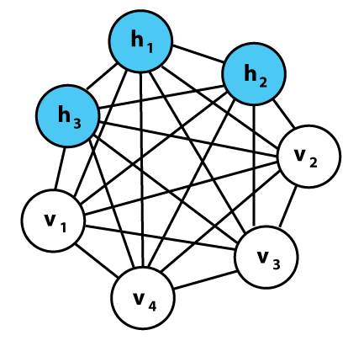
The Boltzmann machine is named after Ludwig Boltzmann, an Austrian scientist who came up with the Boltzmann distribution. However, this type of network was first developed by ​​Geoff Hinton, a Stanford Scientist.

Slide 78
Working of Boltzmann machine: Boltzmann machines are non-deterministic (stochastic) generative Deep Learning models that only have two kinds of nodes - hidden and visible nodes.
They don’t have any output nodes, and that’s what gives them the non-deterministic feature.
They learn patterns without the typical 1 or 0 type output through which patterns are learned and optimized using Stochastic Gradient Descent.
A major difference is that unlike other traditional networks (A/C/R) which don’t have any connections between the input nodes, Boltzmann Machines have connections among the input nodes.
Every node is connected to all other nodes irrespective of whether they are input or hidden nodes. This enables them to share information among themselves and self-generate subsequent data.
You’d only measure what’s on the visible nodes and not what’s on the hidden nodes. After the input is provided, the Boltzmann machines are able to capture all the parameters, patterns and correlations among the data. It is because of this that they are known as deep generative models and they fall into the class of Unsupervised Deep Learning.

Slide 79
Types of Boltzmann machines: There are three types of Boltzmann machines. These are:
Restricted Boltzmann Machines (RBMs)
Deep Belief Networks (DBNs)
Deep Boltzmann Machines (DBMs)

