Slide 1

UNIT -I
FULL STACK WEB DEVELOPMENT
By
Mrs. R.Padmaja
Assistant Professor
MCA Departement , sitams

Slide 2
HTML5:
Introduction to HTML5,
Browsers and HTML5,
Editor’s Offline and Online,
Tags, Attribute and Elements,
  Doctype Element,
  Comments,
  Headings,
  Paragraphs,
  Formatting Text,
  Lists
  Links
  Images
  Tables
CSS:
  Introduction CSS,
  Applying CSS to HTML5,
  Selectors,
  Properties and Values,
  CSS Colors and Backgrounds,
  CSS Box Model,
  CSS Margins,
  Padding, and Borders,
  CSS Text and Font Properties,
  CSS General Topics

Slide 3
Headings
Headings also helps to structure the document.
Html offers six levels of headings which use the elements <h1>, <h2>, <h3>, <h4>, <h5>, <h6>.
While browsers can display headings differently, they tend to display the <h1> element as the largest of the size and <h6> as the smallest
General form:
<h1 [align=”left”/”right”/”center”]> </h1>
Eg:
    <html>
    <head></head>
    <body>
    <h1>Aidan’s Airplanes (h1)</h1>
    <h2>The best is used Airplanes (h2)</h2>
    <h3>we’ve got them by the hangar ful (h3)</h3>
    <h4>we’re the guys to see for a good used airplane (h4)</h4>
    <h5>we offer great prices on great planes(h5)</h5>
    <h6> Noreturns, no guarantees, no refunds, all sales are final(h6)</h6>
    </body>
    </html>

Slide 4
Paragraphs
Paragraph <p> element offers a way to structure the text in the web page.
Each paragraph of text should go in between an opening <p> and closing </p> tag.
General form of paragraph tag
<p [align=”left”/”right”/”center”]> </p>
when a browser displays a paragraph it usually inserts a new line before the next paragraph and adds a little bit of extra virtual space.
Each paragraph can be aligned on the screen either to the left, the right or centered.
Html processors ignore all white spaces in source documents except for spacing words.
That is tabs, newlines, paragraphs are not formatted as we expect. In fact all these that are encountered in the source code get converted into a single space characters.
Any space that are placed between the words will get converted into a single space in the displayed document.
Escape sequences are used to display more than one space.

Slide 5
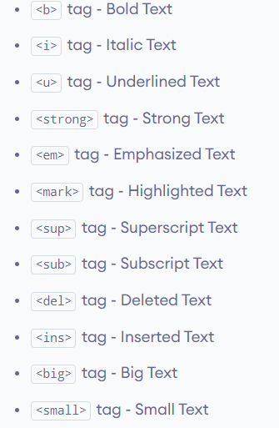
Formatting Text
HTML text formatting refers to the use of specific HTML tags to modify the appearance and structure of text on a webpage.
It allows you to style text in different ways, such as making it bold, italic, underlined, highlighted, or struck-through.
Below are listed the formatting tags available in the latest version of HTML.

Slide 6
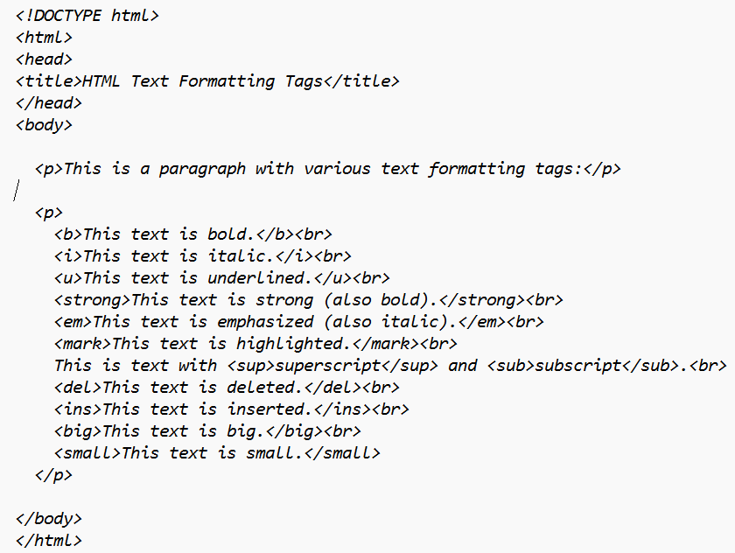
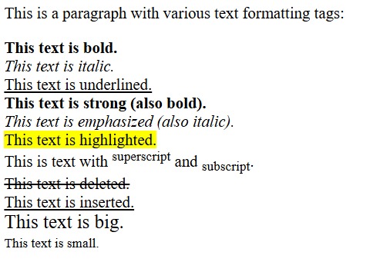
Formatting Text

Slide 7
Lists- Unordered List
One of the most effective way of structuring a website or its contents is to use as List.
In addition to the headings and paragraphs Lists help to organize and present information for easy reading.
Itemized lists helps to highlight important points.
HTML provides 3 types of lists:
Unordered or Bulleted list
Ordered or Numbered list
Definition List
The ordered and unordered lists are each made up of sets of list item <li>
1) Unordered List:
The basic unordered list has a bullet in front of each list item.
Every thing between the tags must be encapsulated within <li> </li>tags.
Each item in the list must encoded between <li>--</li>

Slide 8
Unordered List
Syntax: <ul [type= “disc”/”square”/”circle”][compact]> …….. </ul>
Type attribute sets the style of a list item.
The bullet can be disc or square or circle
  Disc: causes each bullet to appear as a solid round disc.
  Square: causes each bullet to appear as a solid square.
  Circle: causes each bullet to appear as an empty circle.
Compact attribute is used to minimize the amount of space that a list uses.
Disc is the default bullet on some browsers and circle on some browsers.
Type attribute will not work if it is written in upper case letters.
Unordered lists may be nested inside same or other type of lists.
A line space automatically is inserted before and after an unordered list except for a list nested written another list.

Slide 9
Ordered List
2. Ordered List:
An ordered list has a number instead of a bullet in front of each list item.
Ordered lists are used to define a list whose items are in sequential, numerical order.
General form:
Syntax: <ol [type= “1”/”i”/”a”/”A”] [start=”n”][compact]> ……</ol>
Type attribute sets the style of a list item ;
“I” causes the items to be numbered as I, II, III.......
“A” causes the items to be numbered as A, B, C......
“a” causes the items to be numbered as a, b, c........
“1” (default) causes the items to be numbered as 1, 2, 3......
“i” causes the items to be numbered as i, ii, iii......
Compact attribute to minimize the amount of space that a list uses.
Start attribute specifies the starting number of the first item in an ordered list.
The default starting number for type “1” is 1

Slide 10
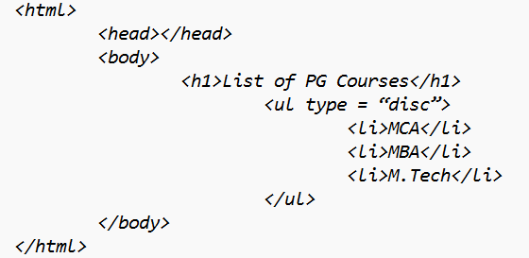

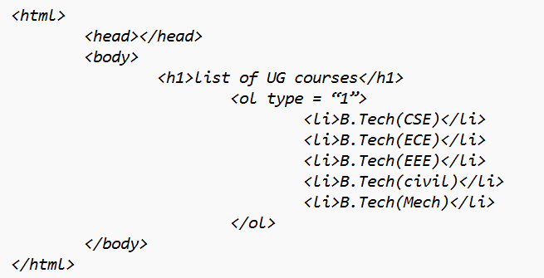
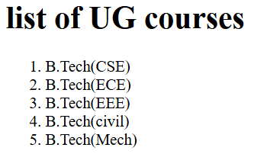
Ordered and unordered List examples
Unordered List
Ordered List

Slide 11
Definition List
<dl> , <dt>, <dd> are the tags used to list definitions .
DL is used to provide a list of items with associated definitions.
Each item should be placed in a DT and its definition goes into DD directly following it.
<dl> tag:
Elements within a definition lists are either items being defined or their definitions.
General form
<dl [compact]> </dl>
<dt> tag:
Definition terms mark items whose definition will be provided by the next data definition.
General form
<dt> </dt>
<dd> tag:
Definitions of terms are enclosed within these tags .
The definition can include any text or block formatting text.
General form
<dd> …</dd>

Slide 12
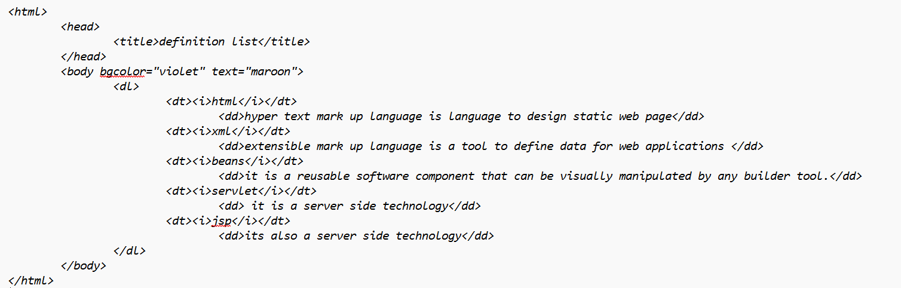
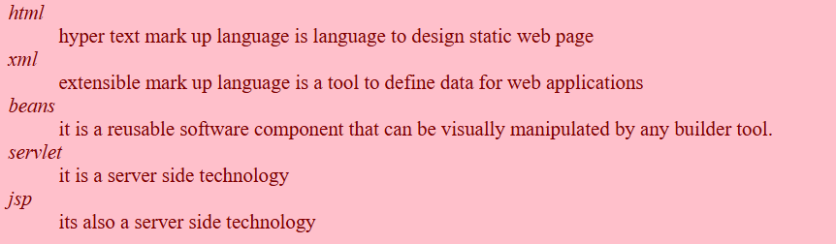
Definition list -example
Definition List

Slide 13
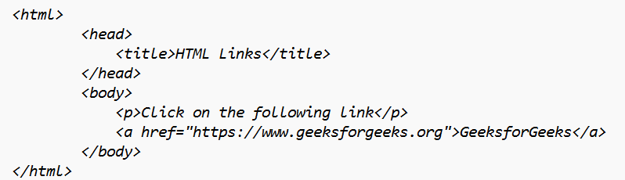
links
HTML Links, also known as hyperlinks, are defined by the <a> tag in HTML, which stands for “anchor.”
These links are essential for navigating between web pages and directing users to different sites, documents, or sections within the same page.
The basic attributes of the <a> tag include href, title, and target, among others.
Basic Syntax of an HTML Link:
A Simple HTML link example
<a href="https://www.example.com">Visit Example</a>

Slide 14
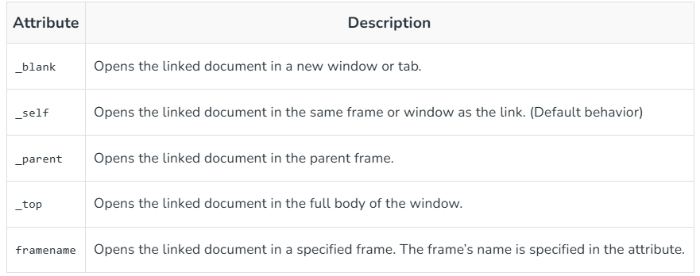
links
By default, links will appear as follows in all browsers:
  An unvisited link is underlined and blue.
  A visited link is underlined and purple.
  An active link is underlined and red.
HTML Links – Target Attribute
The target attribute in the <a> tag specifies where to open the linked document. It controls whether the link opens in the same window, a new window, or a specific frame.

Slide 15
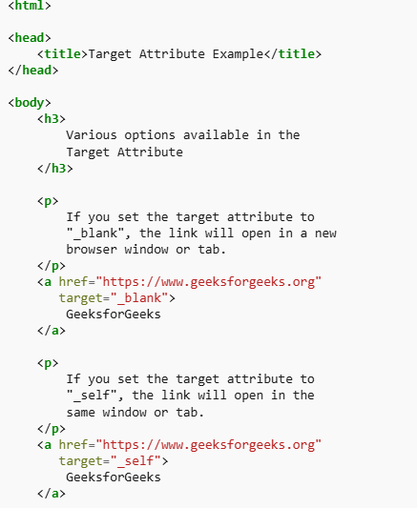
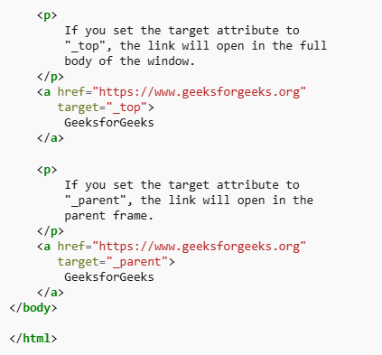
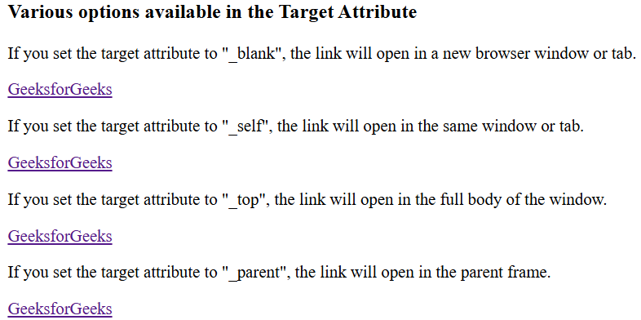
links

Slide 16
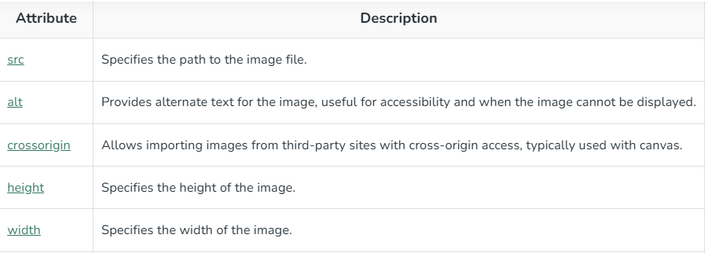
images
The HTML <img> tag is used to embed an image in web pages by linking them. It creates a placeholder for the image, defined by attributes like src, width, height, and alt, and does not require a closing tag.
There are two ways to insert the images into a webpage:
  By providing a full path or address (URL) to access an internet file.
  By providing the file path relative to the location of the current web page file.

Slide 17

images

Slide 18
tables
HTML Tables allow you to arrange data into rows and columns on a web page, making it easy to display information like schedules, statistics, or other structured data in a clear format.
What is an HTML Table?
An HTML table is created using the <table> tag. Inside this tag, you use
  <tr> to define table rows,
  <th> for table headers, and
  <td> for table data cells
Each <tr> represents a row, and within each row, <th> or <td> tags represent the cells in that row, which can contain text, images, lists, or even another table.

Slide 19

tables
Syntax of <table> tag:
<table [align=”center”/”right”/”left”] [border=”n”]
[cellpadding=”n”] [width=”nn%”] [cellspacing=”n”]
[bgcolor=”colorname”]>
………………………………………………………………
</table>

Slide 20
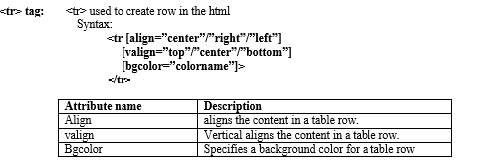
tables

Slide 21
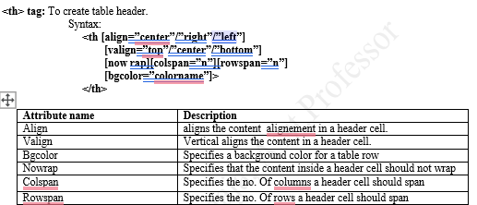
tables

Slide 22
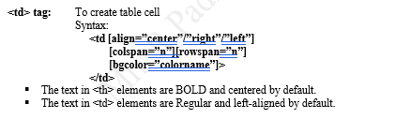
tables

Slide 23
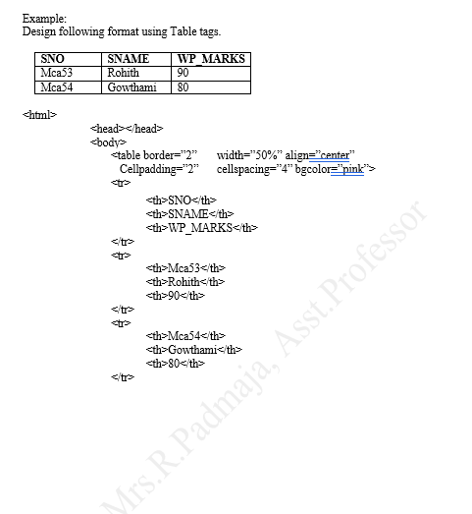
tables

Slide 24
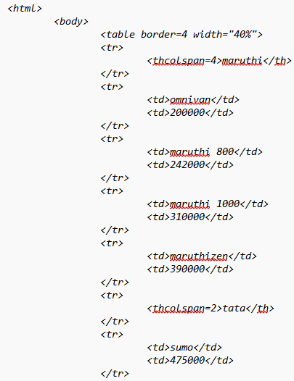
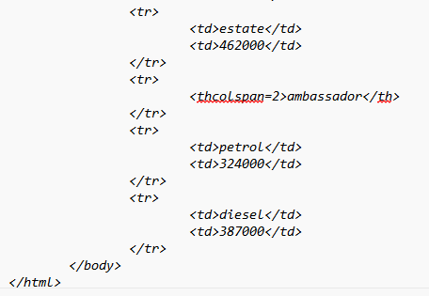
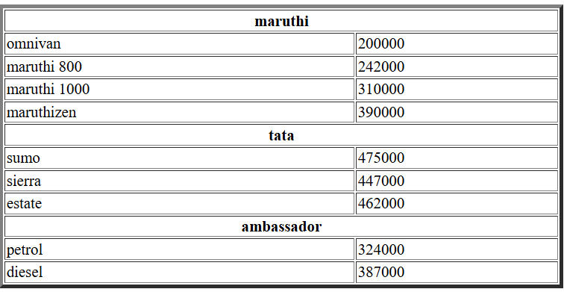
tables

Slide 25
INTRODUCTION TO CSS
CSS stands for Cascading Style Sheets.
It is a stylesheet language used to describe the presentation of a document written in a markup language like HTML or XML.
As HTML is used to structure the content of a webpage, and CSS as the styling that makes it visually appealing.
The Stylesheets of the elements can be cascaded (overwritten) in 3 ways
  Inline
  Internal and
  External

Slide 26
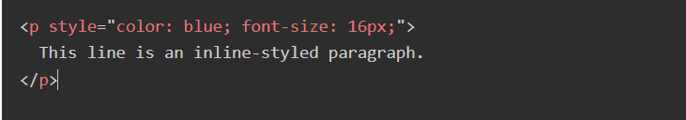
INTRODUCTION TO CSS
1) Inline CSS:
This involves applying styles directly to individual HTML elements using the style attribute.
The CSS rules are written within the opening tag of the element.
Example:

Slide 27
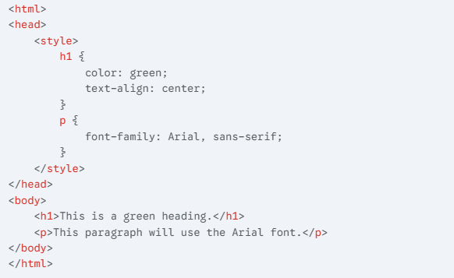
INTRODUCTION TO CSS
2) Internal/Embedded CSS:
This involves embedding CSS rules directly within the <head> section of your HTML document using the <style> tag.
The CSS rules apply to all the HTML elements within that specific document.
Example:

Slide 28
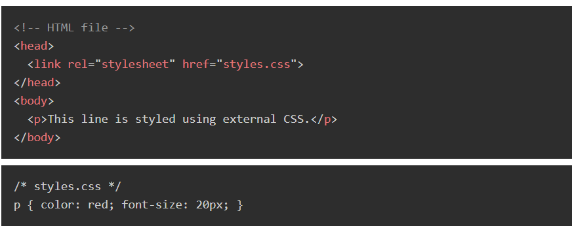
INTRODUCTION TO CSS
3) External CSS
Writing CSS rules in one or more separate External files with a .css extension.
These CSS files are then linked to your HTML documents using the <link> tag within the <head> section.
Example:

Slide 29
components TO CSS

Slide 30
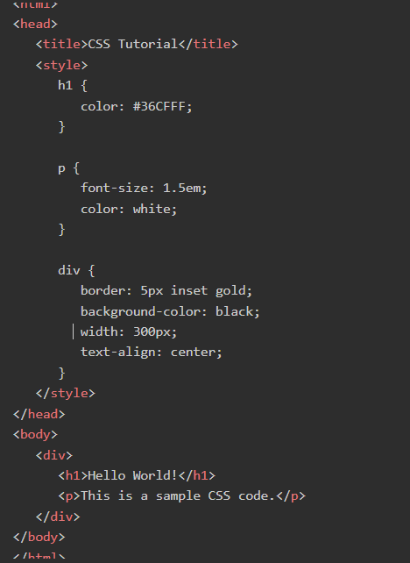
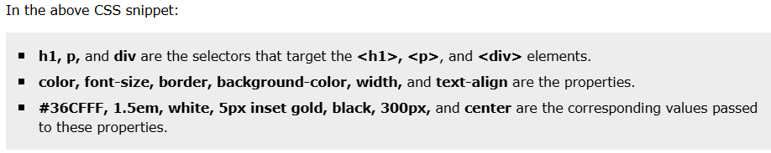
components TO CSS

Slide 31
Css colors and background

Slide 32
Css Bcolor
color: Sets the color of an element.
color : default | color | hexvalue | rgbvalue
transparent (default):
  The background is transparent, showing whatever is behind the element.
<color>:
CSS provides a set of predefined color names (keywords) that you can use directly
Any valid CSS color value, such as: Named colors: red, blue, green, black, white, etc.

Slide 33
Css color
Hexadecimal values:
Hexadecimal color codes are a way to represent colors using a six-digit hexadecimal number (base-16).
The format is #RRGGBB, where RR represents the red component, GG represents the green component, and BB represents the blue component. Each component is 1 a two-digit hexadecimal value ranging from 00 (lowest intensity) to FF (highest intensity).
#ff0000 (red), #00ff00 (green), #0000ff (blue), etc.
RGB values:
RGB (Red, Green, Blue) colors are defined using the rgb() function, which takes three integer values (0-255) representing the intensity of red, green, and blue light, respectively.
rgb(255, 0, 0), rgb(0, 255, 0), rgb(0, 0, 255), etc.

Slide 34
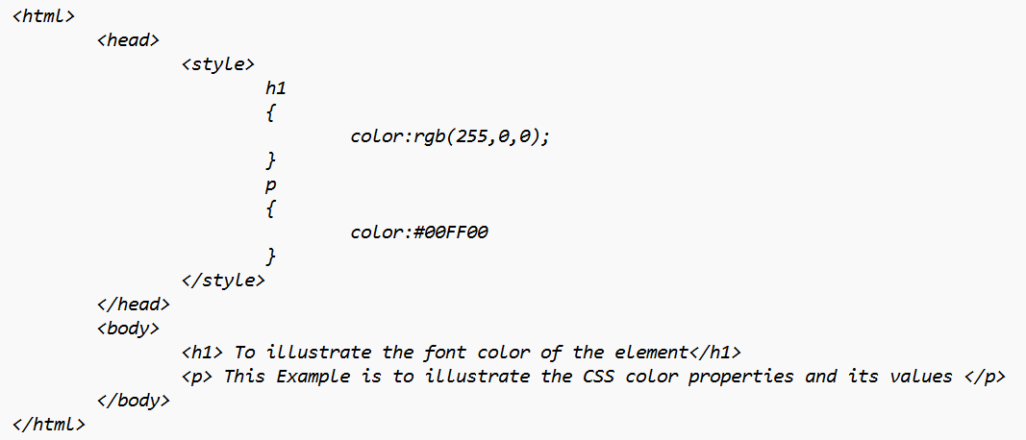
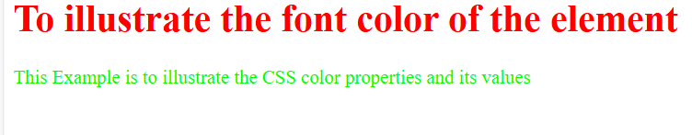
Css color

Slide 35
Css background-color
Background-color: Sets the background color of an element.
Background-color : default | color | hexvalue | rgbvalue
transparent (default):
  The background is transparent, showing whatever is behind the element.
<color>:
CSS provides a set of predefined color names (keywords) that you can use directly
Any valid CSS color value, such as: Named colors: red, blue, green, black, white, etc.

Slide 36
Css background-color
Hexadecimal values:
Hexadecimal color codes are a way to represent colors using a six-digit hexadecimal number (base-16).
The format is #RRGGBB, where RR represents the red component, GG represents the green component, and BB represents the blue component. Each component is 1 a two-digit hexadecimal value ranging from 00 (lowest intensity) to FF (highest intensity).
#ff0000 (red), #00ff00 (green), #0000ff (blue), etc.
RGB values:
RGB (Red, Green, Blue) colors are defined using the rgb() function, which takes three integer values (0-255) representing the intensity of red, green, and blue light, respectively.
rgb(255, 0, 0), rgb(0, 255, 0), rgb(0, 0, 255), etc.

Slide 37
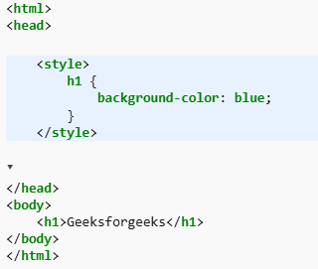

Css background-color

Slide 38
Css background-image and background-repeat
2) background-image: Sets one or more background images for an element.
background-image : none | url
none (default): No background image is displayed.
url("path/to/image.jpg"): Specifies the path to an image file. The path can be absolute or relative.
3) background-repeat: controls how a background image can be controlled .
background-repeat : repeat | no-repeat | repeat-x | repeat-y
repeat (default): The image is repeated both horizontally and vertically to cover the entire background.
repeat-x: The image is repeated only horizontally.
repeat-y: The image is repeated only vertically.
no-repeat: The image is not repeated; it is displayed only once.

Slide 39
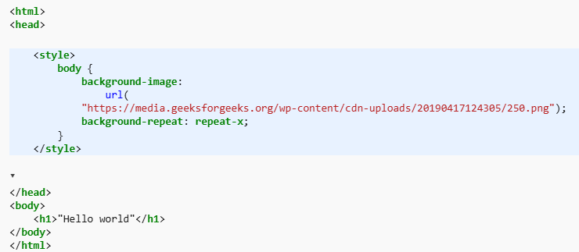

Css background-image and background-repeat

Slide 40
Css text and font properties

Slide 41
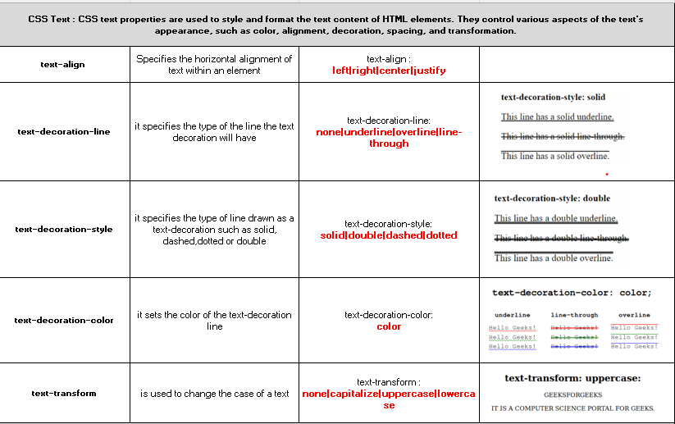
Css text

Slide 42
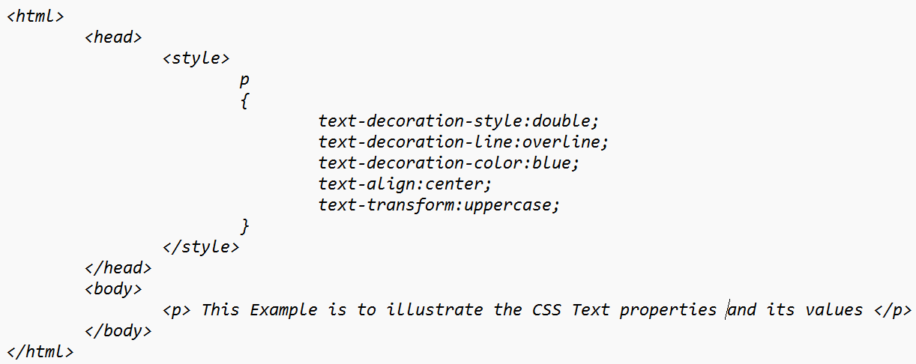
Css text

Slide 43
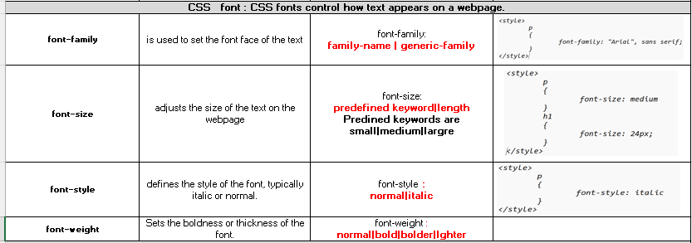
Css font

Slide 44
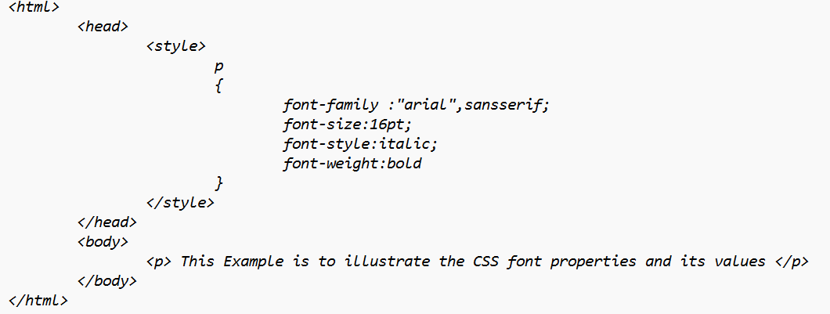
Css font

Slide 45
Css box model

Slide 46
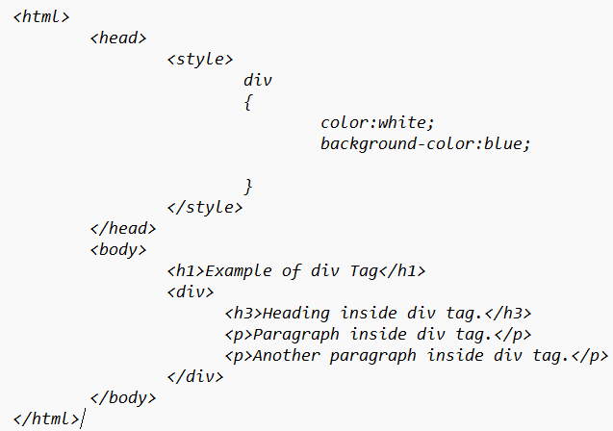
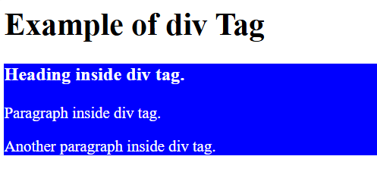
Div tag
The HTML <div> tag is used to define sections in web pages.
Developers use this tag to group HTML elements, allowing them to apply CSS styles to multiple <div> elements continuously.
Syntax : <div> ..... </div>
This HTML code shows grouping a heading and two paragraphs within a section of a webpage using the <div> tag.

Slide 47
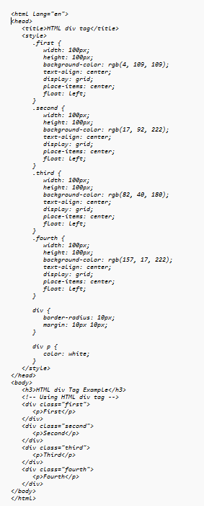
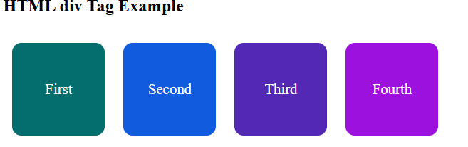

Slide 48
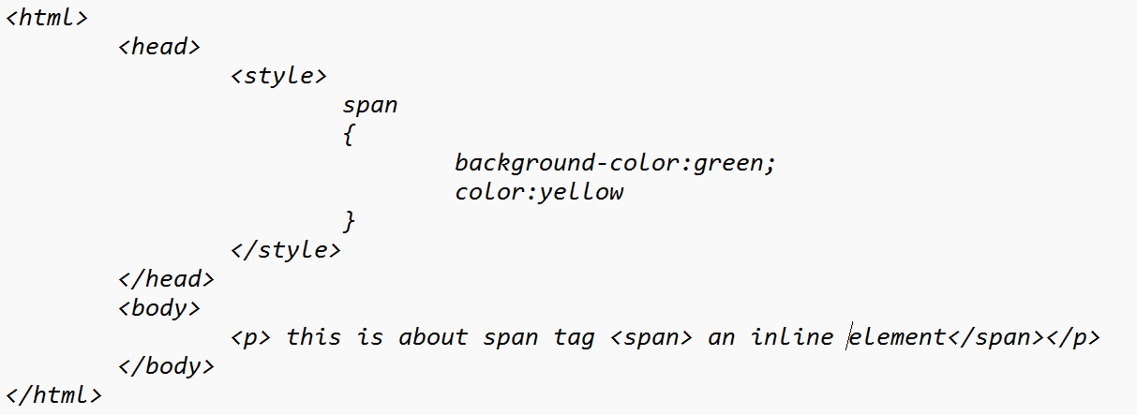

span tag
The HTML <span> tag is used to define css to an inline element or apply style th part of the text
Syntax : <span> ..... </span>

Slide 49
Block level vs inline level
1. Block-Level Elements
  Block-level elements take up the full width of the container, starting on a new line. These elements are primarily used to structure large sections of content.
Examples:
  <div>: A container for HTML elements that doesn’t affect the content’s appearance.
  <p>: Defines a paragraph of text.
  <h1> to <h6>: Used for headings.
  <section>, <article>, <footer>, etc.: Semantic tags used to organize content.
Characteristics:
  Always starts on a new line.
  Occupies the full width available (by default).
  Can contain other block-level and inline elements.

Slide 50
Block level vs inline level
2. Inline Elements
  Inline elements only take up as much width as their content and stay within the flow of the surrounding text.
  These are great for styling parts of text or embedding small elements within blocks of content.
Examples:
  <span>: A generic container for inline elements or text.
  <a>: Defines a hyperlink.
  <img>: Embeds an image.
  <strong>, <em>, <br>, etc.: Used for formatting text.
Characteristics:
  Does not start on a new line.
  Takes up only as much width as needed.
  Can only contain other inline elements or text, not block-level elements.
  <p>This is a paragraph with an <a href="#">inline link</a> to another page.</p>

Slide 51
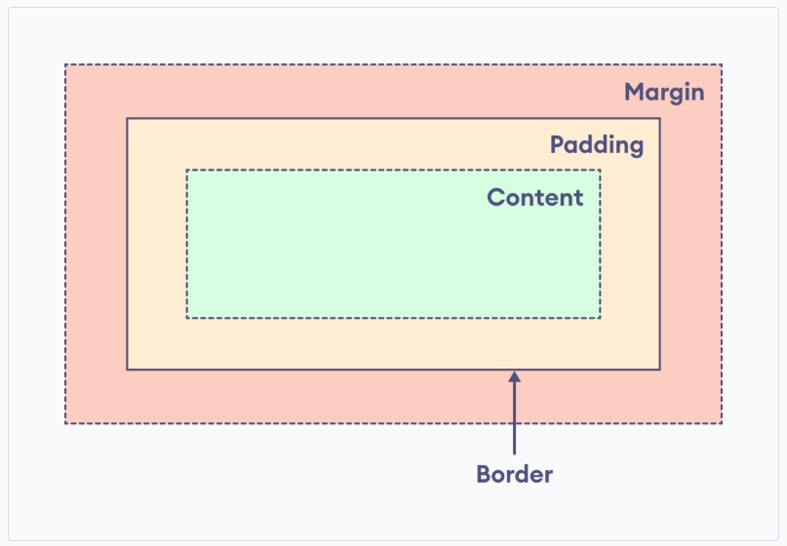
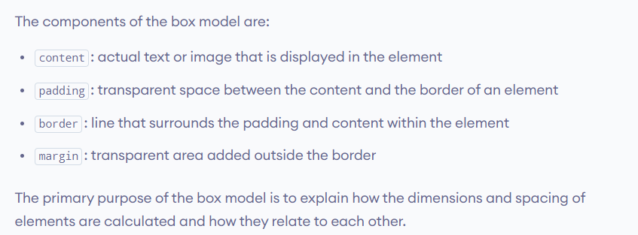
Css box model
The box model treats every HTML element as a rectangular box consisting of content, padding, border, and margin.
The box model defines the layout of an HTML element in the following way:

Slide 52
Css box model
Box Model can be applied to both Block level and inline elements .
While applying for block level element, we can specify height, width, top and bottom , left, right
Where as with inline , even we specify, it will ignore
To make it work , the display property should be changed to either inline-block or block.

Slide 53
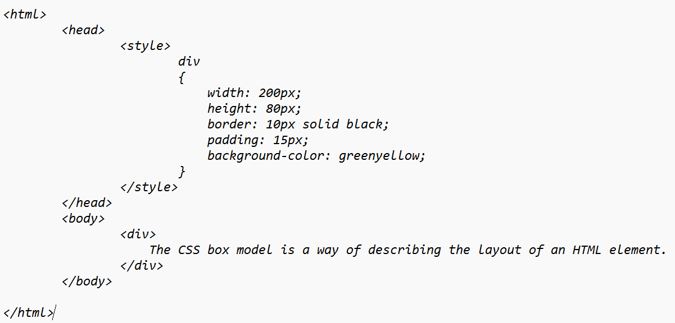
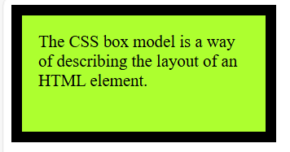
Css box model

Slide 54
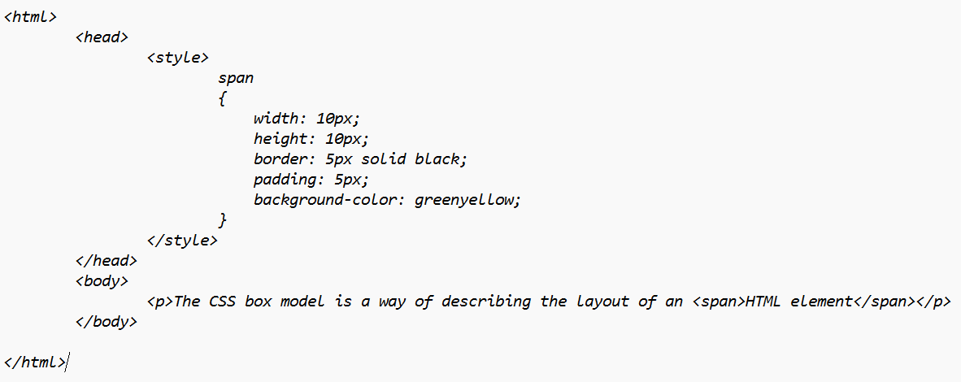
Css box model

Slide 55
Css box model
In the above example,
  The height and width are ignored.
  The top and bottom margins are also ignored, and only the left and right margins work.
  The padding works for all four sides of the elements.
Hence, we cannot calculate the actual dimensions of the inline element.
In order to apply the box model in the inline elements, the display property should be changed to either inline-block or block.
Let's see an example with inline-block,

Slide 56
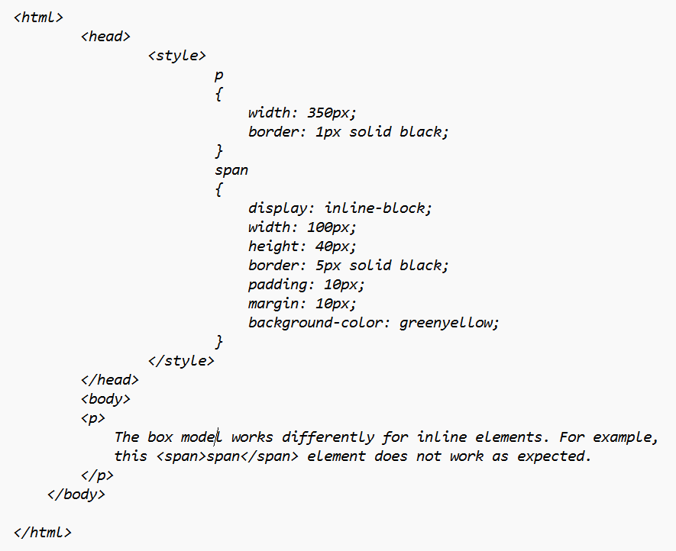
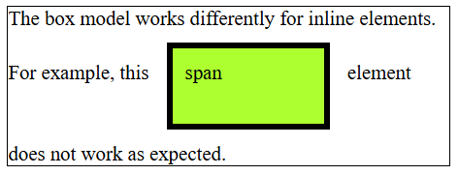
Css box model

