Slide 1

UNIT -II
FULL STACK WEB DEVELOPMENT
By
Mrs. R.Padmaja
Assistant Professor
MCA Departement , sitams

Slide 2
JAVASCRIPT
Introduction to JavaScript,
Applying JavaScript (internal and external),
Understanding JS Syntax,
Introduction to Document and Window Object,
Variables and Operators,
Data Types and
Num Type Conversion,
Math and String Manipulation,
Objects and Arrays,
Date and Time,
Conditional Statements,
Switch Case,
Looping in JS and
Functions.

Slide 3
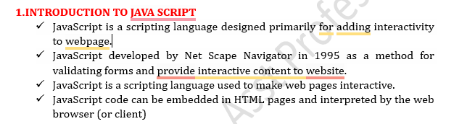
Introduction to javascript

Slide 4
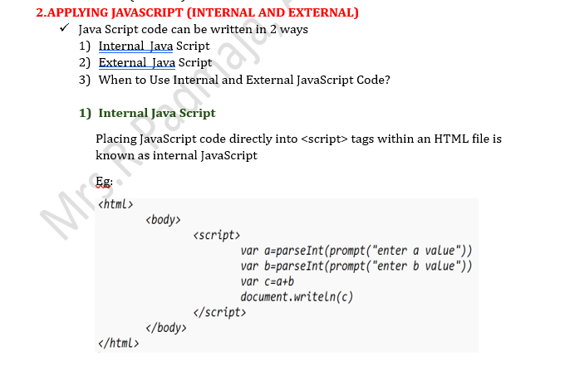
Applying Javascript(Internal and External)

Slide 5
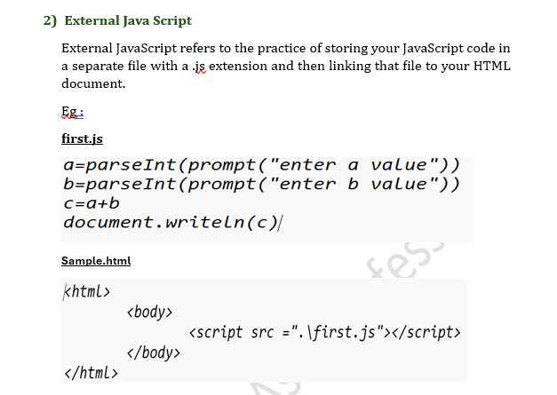
Applying Javascript(Internal and External)

Slide 6
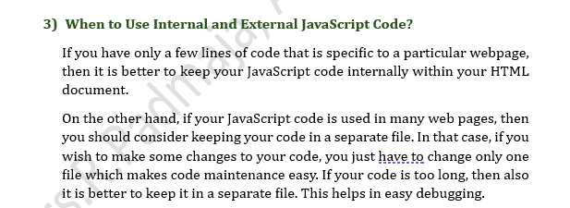
Applying Javascript(Internal and External)

Slide 7
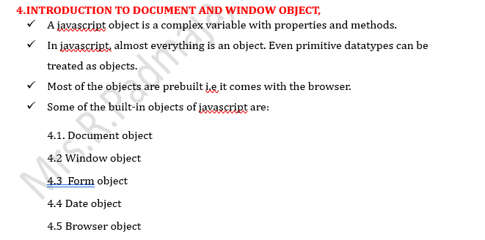
Introduction to document and window object

Slide 8
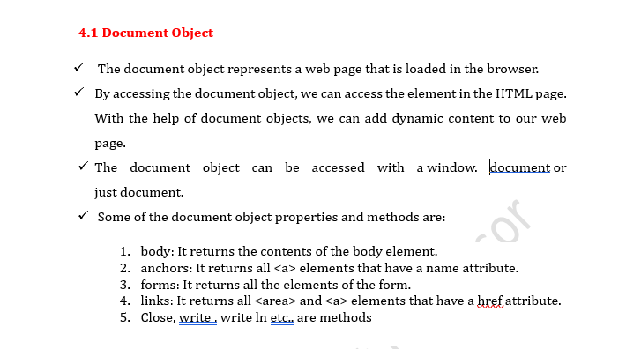
Introduction to document and window object

Slide 9
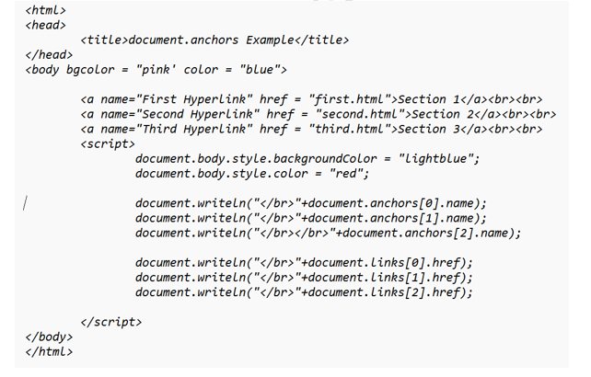
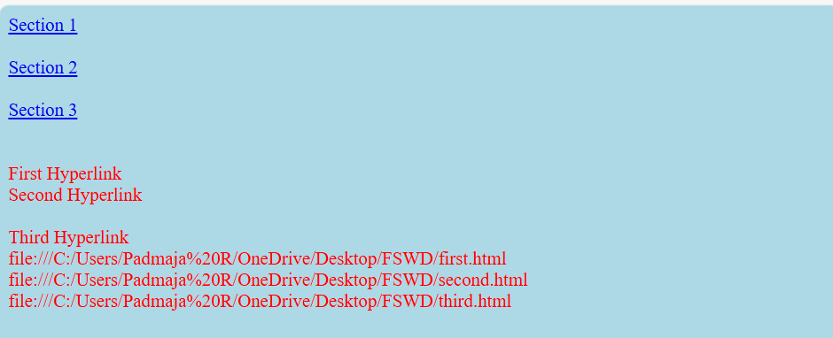
Introduction to document and window object

Slide 10
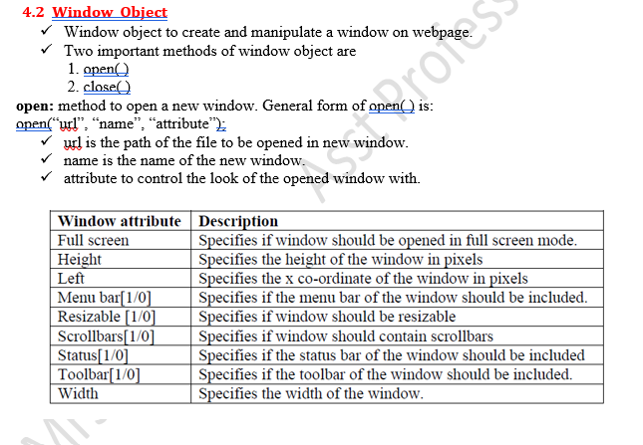
Introduction to document and window object

Slide 11
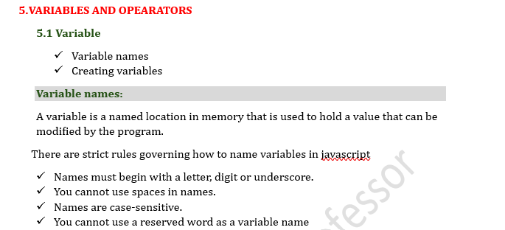
Variables and operators

Slide 12
3.4) OPERATORS
In java script Operators are symbols that are used to perform some operations on the operands.
Combination of operands and operators are known as Expressions.
Java provides, a rich set of operators to manipulate the variables. There are three types of operators in java.
1. Unary operators
2. Binary operators
3. Ternary operators

Slide 13
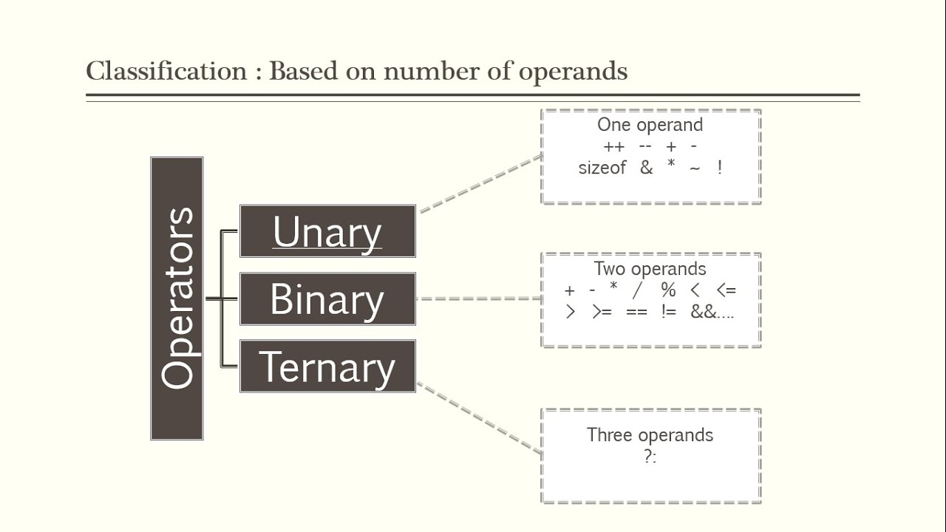
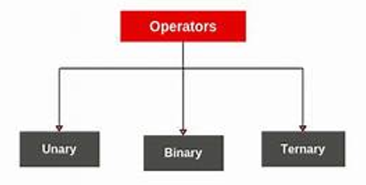
OPERAORS
Types of Operators

Slide 14
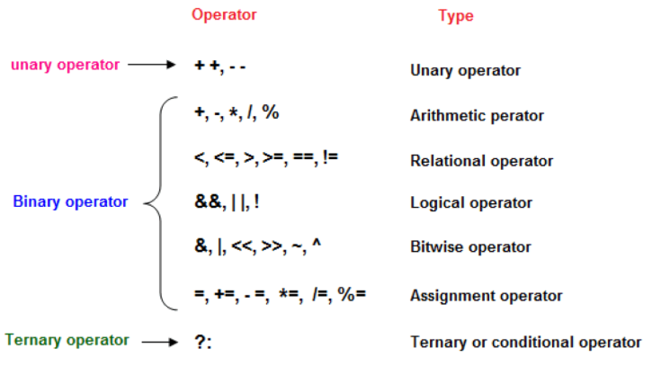
OPERAtORS

Slide 15
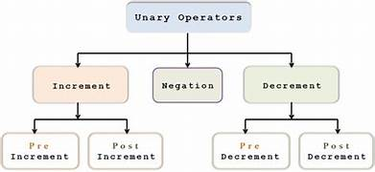
UNARY OPERAtORS
UNARY OPERATOR
Operator that operates on single operand is called Unary Operator
Java supports 2 Unary Operators
Increment Operator( ++)
Decrement Operator (--)

Slide 16
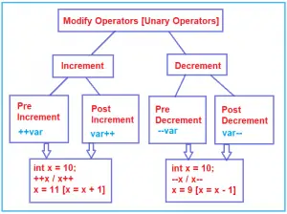
UNARY OPERAtORS
UNARY OPERAORS
Pre Increment and Post Increment increases the variable value by 1
Pre Decrement and Post Decrement decreases the variable value by 1
Both pre and post increment does nt show difference if it is not used in an Expression.
It shows difference only if it is used in expression

Slide 17
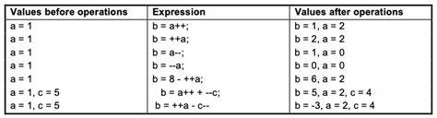
UNARY OPERAtORS
In the Pre-Increment, value is first incremented and then used inside the expression.
In the Post-Increment, value is first used in an expression and then incremented.

Slide 18
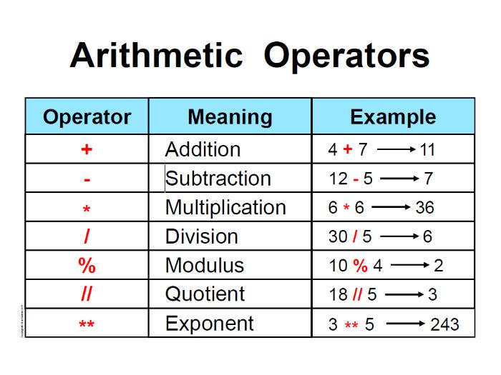
binary OPERAtORS – arithmetic operators
In Java, arithmetic operators are used to perform various mathematical operations on numerical data types, such as integers and floating-point numbers.
These operators allow you to perform addition, subtraction, multiplication, division, and more

Slide 19
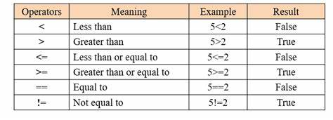
binary Operators – relational operators
The Relational Operators are used to determine whether 2 numbers are equal, or if one is greater or less than the other.
Every Relational Statement evaluates to either True or False

Slide 20
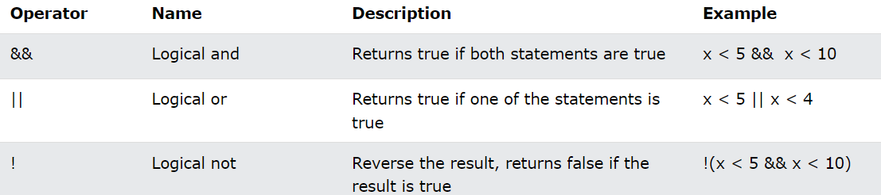
binary Operators – logical operators
The Java Logical Operators work on the Boolean operand.
It's also called Boolean logical operators.
It operates on two Boolean values, which return Boolean values as a result.

Slide 21
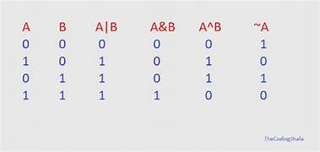
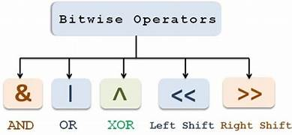
binary Operators – bitwise operators

Slide 22
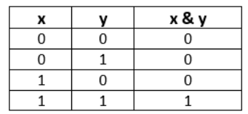
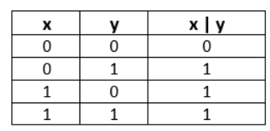
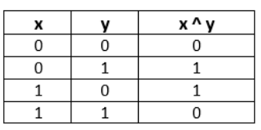
binary Operators – bitwise operators
Bitwise AND Operator (&)
Bitwise binary AND operator is denoted by the symbol &.
It returns 1 if and only if both bits are 1, else returns 0.
Bitwise OR Operator (|)
Bitwise binary OR operator is denoted by the symbol |.
It returns 1 if either of the bit is 1, else returns 0.
Bitwise XOR Operator (^)
Bitwise binary XOR operator is denoted by the symbol ^.
It returns 0 if both bits are the same, else returns 1..

Slide 23

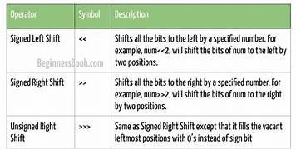
binary Operators – bitwise operators
binary Operators – bitwise operators
Bitwise NOT Operator (~)
Bitwise binary NOT operator is denoted by the symbol ~.
It returns the inverse or complement of the bit. It makes every 0 a 1 and every 1 a 0..

Slide 24
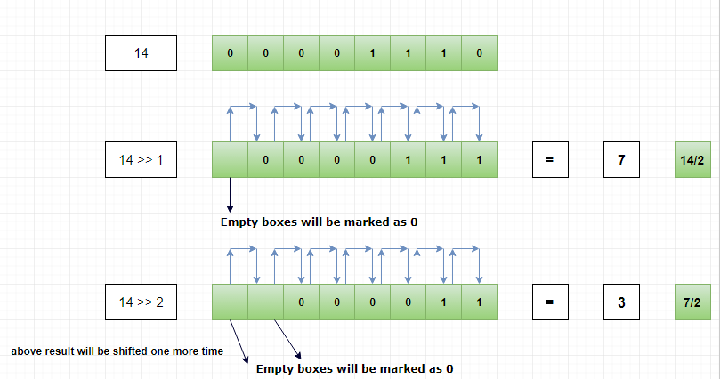
binary Operators – bitwise operators – Right Shift Operator
Each Right Shift is equivalent to division by 2

Slide 25
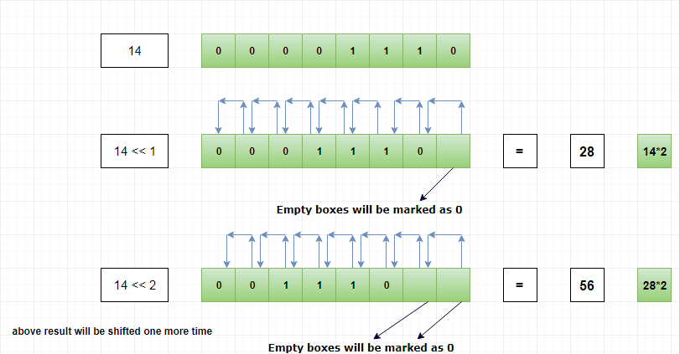
binary Operators – bitwise operators – left Shift Operator
Each left Shift is equivalent to Multiply by 2

Slide 26
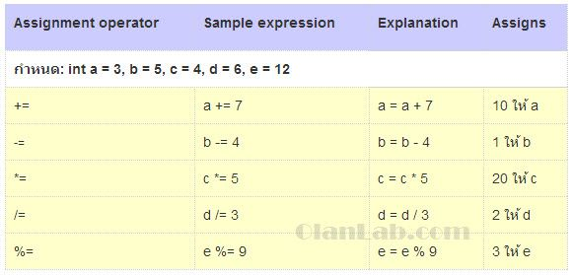
binary Operators – Assignment /compound assignment operators

Slide 27
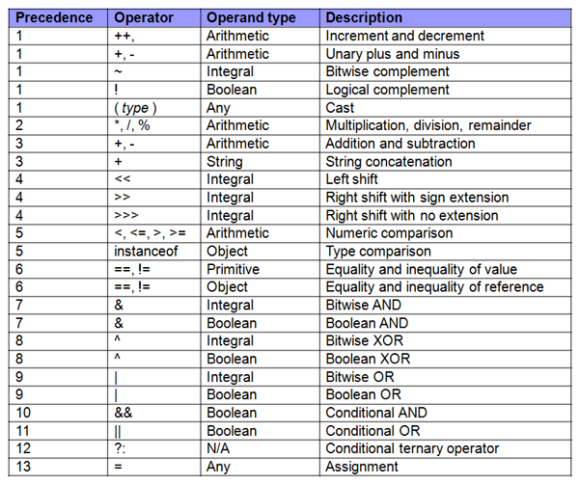
Operator precedence

Slide 28
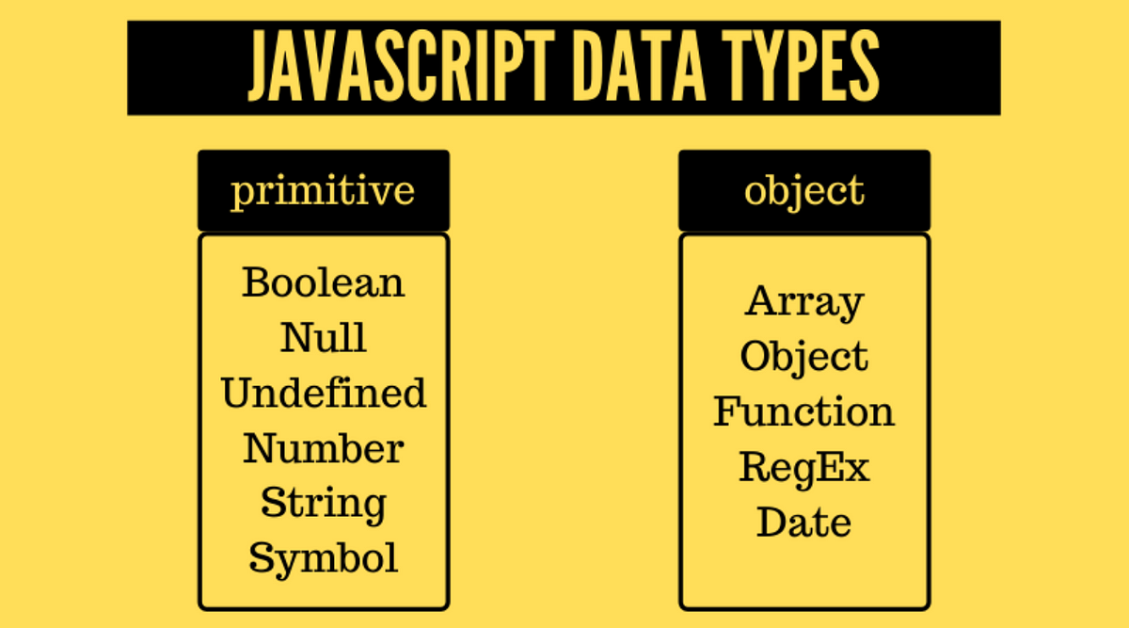
Data types

Slide 29
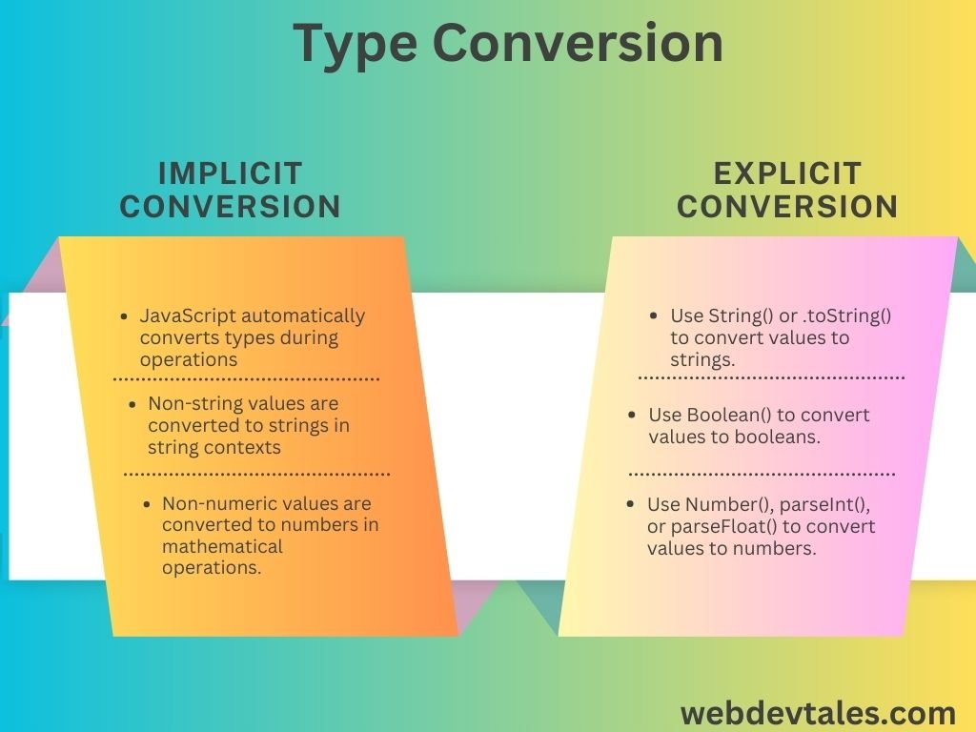
Number type conversions

Slide 30
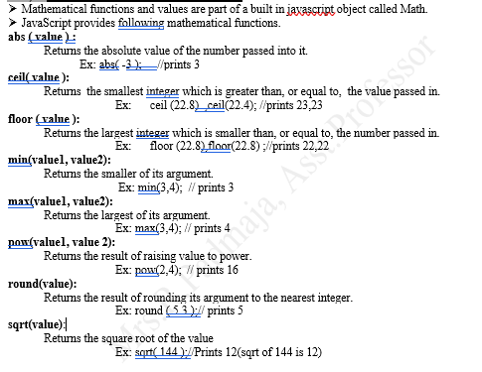
Math Functions

Slide 31
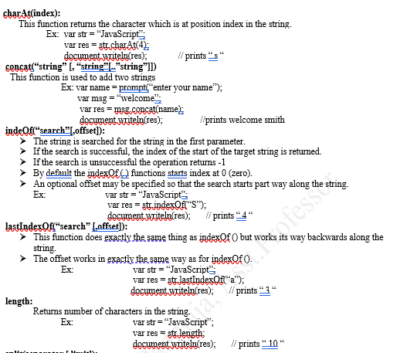
String Functions

Slide 32
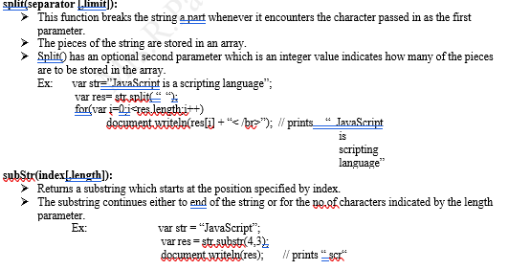
String Functions

Slide 33
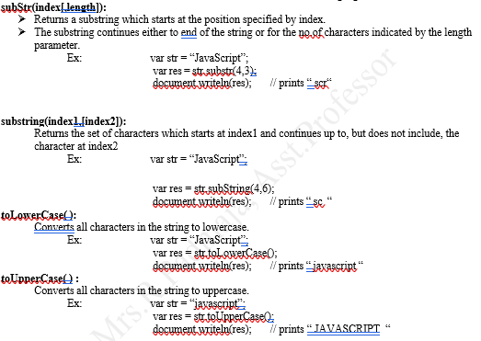
String Functions

Slide 34
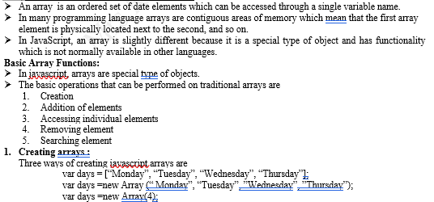
Arrays and its functions

Slide 35
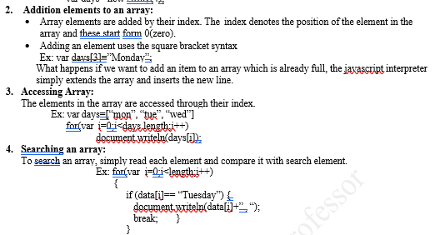
Arrays and its functions

Slide 36
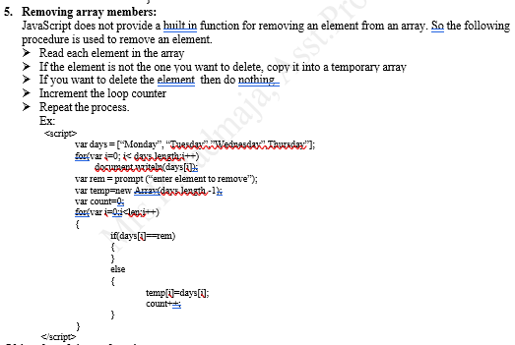
Arrays and its functions

Slide 37
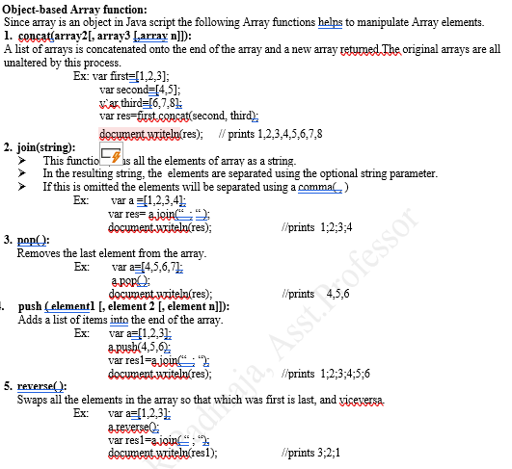
Arrays and its functions

Slide 38
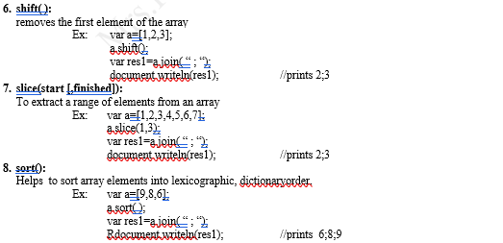
Arrays and its functions

Slide 39
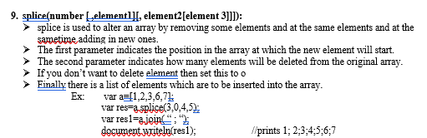
Arrays and its functions

Slide 40
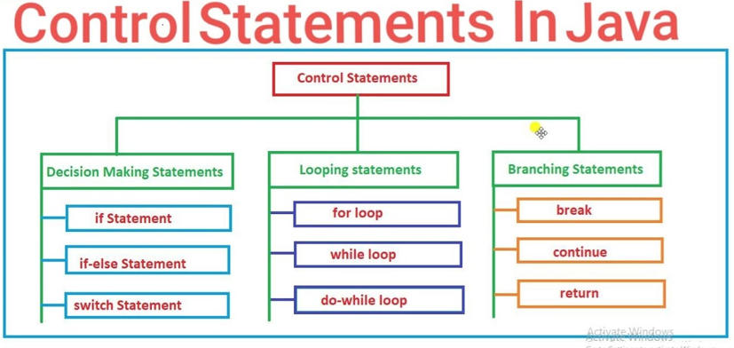
Control statements

Slide 41
Control Statements
Statements that control the flow of program is called Control Statements
In Java script, control statements can be divided into the following three categories:
  Selection Statements
  Iteration Statements
  Jump Statements

Slide 42
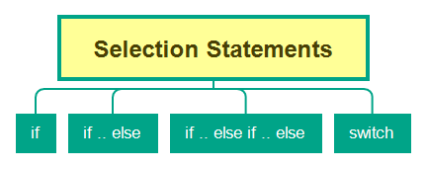
Selection Statements
Selection Statements
  Selection statements allow you to control the flow of program execution on the basis of the outcome of an expression or state of a variable known during runtime
  Selection statements can be divided into the following categories:
      The Simple if
      if-else statements
      The if-else-if statements
      The switch statements

Slide 43
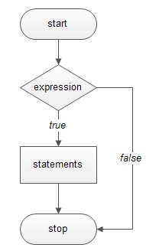
Simple If
Simple If
    Simple If construct of Java consist of one if condition with one block of statements.
    When condition becomes true then executes the block given below it.
Syntax:
if ( condition):
…………………..
Flowchart

Slide 44
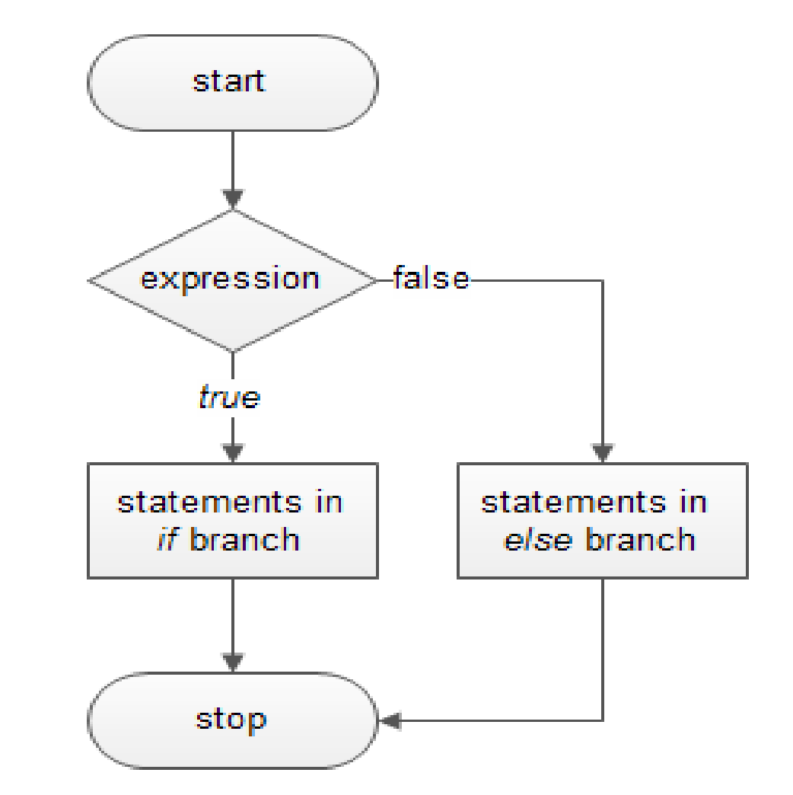
If.. Else
if - else statements
This construct of Java program consist of one if condition with two blocks.
When condition becomes true then executes the block given below it.
If condition evaluates result as false, it will executes the block given below else.
Syntax:
if ( condition):
…………………..
e
lse:
…………………..
Flowchart

Slide 45
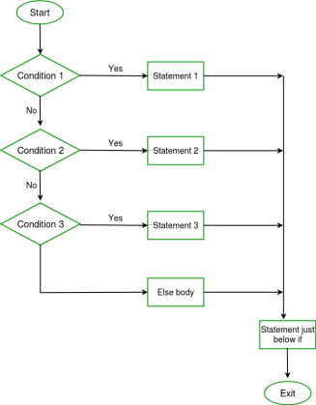
If.. Else if .. else
Java Ladder if else statements (if-elif-else)
    This construct of Java program consist of more than one if condition.
    When first condition evaluates result as true then executes the block given below it.
    If condition evaluates result as false, it transfer the control at else part to test another condition.
    So, it is multi-decision making construct.
if ( condition-1):
…………………..
…………………..
elif (condition-2):
…………………..
…………………..
elif (condition-3):
…………………..
…………………..
else:
…………………..
…………………..

Slide 46
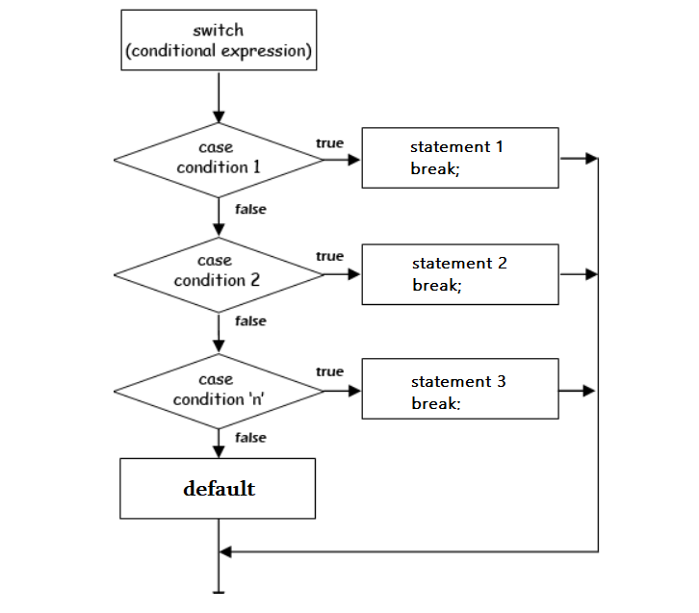
Switch Statement
Java n Switch Case is a selection control statement.
The switch expression is evaluated once. The value of the expression is compared with the values of each case; if there is a match, the associated block of code is executed.
Then it makes a decision based on whether the condition is true or not.
If the condition is true, it evaluates the indented expression; however, if the condition is false, the indented expression under else will be evaluated.
When we need to run several conditions, you can place as many elif conditions as necessary between the if condition and the else condition.
Switch case statements are a substitute for long if statements that compare a variable to several integral values
The switch statement is a multiway branch statement. It provides an easy way to dispatch execution to different parts of code based on the value of the expression.

Slide 47
Iterative/Looping Statements
The flow of the programs written in any programming language is sequential by default.
The first statement of the program is executed first, followed by the second, and so on.
There may be a situation when the programmer needs to execute a block of code several times.
For this purpose, The programming languages provide various kinds of loops that are able to repeat some particular code numerous numbers of times.
Looping simplifies complicated problems into smooth ones.
It allows programmers to modify the flow of the program so that rather than writing the same code, again and again, programmers are able to repeat the code a finite number of times.
In Python, there are three different types of loops:
For Loop
While Loop and
Nested Loop.

Slide 48
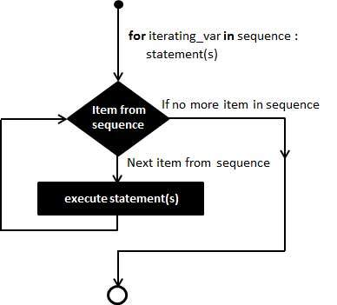
For Statement
For Loop
The for loop is used in the case where a programmer needs to execute a part of the code until the given condition is satisfied.
The for loop is also called a pre-tested loop.
It is best to use for loop if the number of iterations is known in advance.
for (statement 1; statement 2; statement 3)
{ // code block to be executed }
Statement 1 is executed (one time) before the execution of the code block.
Statement 2 defines the condition for executing the code block.
Statement 3 is executed (every time) after the code block has been executed.

Slide 49
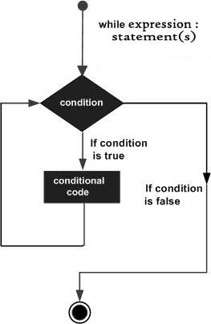
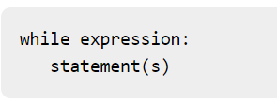
While Statement
A while loop statement in Python programming language repeatedly executes a target statement as long as a given condition is true.
The syntax of a while loop in Python programming language is
Here, statement(s) may be a single statement or a block of statements. The loop iterates while the condition is true.
When the condition becomes false, program control passes to the line immediately following the loop.
In Python, all the statements indented by the same number of character spaces after a programming construct are considered to be part of a single block of code.
Python uses indentation as its method of grouping statements.

Slide 50


Do..While Statement
The Java do-while loop is used to iterate a part of the program repeatedly, until the specified condition is true.
If the number of iteration is not fixed and you must have to execute the loop at least once, it is recommended to use a do-while loop.

Slide 51

FUNCTIONS

