Slide 1
From the Internet of Things to the Web of Things:
Resource Oriented Architecture and Best Practices

Slide 2
5.1From the Internet of Things to the Web of Things
As more and more devices are getting connected to the Internet, the next logical step is to use the World Wide Web and its associated technologies as a platform for smart things.
Cool Town project, Kindberg et al. (2002) proposed to link physical objects with Web pages containing information and associated services. Using infrared interfaces or bar codes on objects, users could retrieve the URI of the associated page simply by interacting with the object.
Another way to use the Web for real-world objects is to incorporate smart things into a standardized Web service architecture (using standards, such as SOAP, WSDL(Web Services Description language), UDDI(Universal Description, Discovery, and Integration )a way to publish and discover information)
Instead of these heavyweight Web services ((SOAP/WSDL, etc)often referred to as WS-* technologies, recent “Web of Things” projects have explored simple embedded Hypertext Transfer Protocol (HTTP) servers and Web 2.0 technologies.

Slide 3
In fact, recent embedded Web servers with advanced features can be implemented with only 8 KB of memory and no operating system support, and can therefore run on tiny embedded systems, such as smart cards.
So far, projects and initiatives, subsumed here under the umbrella term “Internet of Things”, have focused mainly on establishing connectivity in a variety of challenging and constrained networking environments.
A promising next step is to build scalable interaction models on top of this basic network connectivity and thus focus on the application layer.
In the WOT concept, tiny Web servers are embedded into smart things and the REST architectural style is applied to resources in the physical world.
Notes:
REST is the architectural style of the Web (implemented by URIs, HTTP and standardized media types, such as HTML and Extensible Markup Language (XML)) and uses URIs for identifying resources on the Web. It abstracts services in a uniform interface (HTTP’s methods) from their application-specific semantics and provides mechanisms for clients to select the best possible representations for interactions.

Slide 4
The essence of REST is to focus on creating loosely coupled services on the Web, so that they can be easily reused.
The services that smart things expose on the Web usually take the form of a structured XML document or a JavaScript Object Notation (JSON) object, which are directly machine-readable.
These formats can be understood not only by machines, but are also reasonably accessible to people.
With this smart things can not only communicate on the Web, but also provide a user-friendly representation of themselves.
This makes it possible to interact with them via Web browsers and thus explore the world of smart things with its many relationships.

Slide 5
Web Of Things definition:
Web of Things is all about making devices accessible over the web using web protocols like HTTP, Web Socket, JSON etc. agnostic to any thing below the application layer, so that any device can be part of the universal WOT regardless of what protocols it uses to connect to internet.
IoT | WoT
Devices can be connected with any form of internet | WoT is made to handle and use the potential of IoT
It deals with actuators, sensors, computation, communication Interfaces. | It deals with web servers and Protocols.
Digitally Augmented objects make IoT | WoT is made up of the applications that are made for Io Devices.
Every IoT devices have a different Protocol | A single protocol is used for multiple/various IoT devices.
Programming is difficult because of multiple protocols | Programming is easy so it doesn’t have multiple protocols.
All the protocols and standard are private and it cannot be accessed publicly | WoT can be accessed freely by anyone, anytime.

Slide 6
Dynamically generated real-world data on smart objects can be displayed on such “representative” Web pages, and then processed with Web 2.0 tools.
For example, things can be indexed like Web pages via their representations, users can “google” for them, and their URI can be emailed to friends or it can be bookmarked.
The physical objects themselves can become active and publish blogs or inform each other using services, such as Twitter.

Slide 7
5.2 Designing RESTful Smart Things
The “Web of Things” can be realized by applying principles of Web architecture, so that real-world objects and embedded devices can blend seamlessly into the Web.
The main contribution of the “Web of Things” approach is to offer a foundation for the next step beyond basic network connectivity.
Now, the use of REST as a universal interaction architecture, that interacts with smart things can be built around universally supported methods and a set of guidelines to Web-enable smart things and illustrate them with concrete examples of implemented prototypes.

Slide 8
5.2.1 Modeling Functionality as Linked Resources
The central idea of REST revolves around the notion of a resource as any component of an application that is worth being uniquely identified and linked to.
On the Web, the identification of resources relies on Uniform Resource Identifiers (URIs), and representations retrieved through resource interactions contain links to other resources, so that applications can follow links through an interconnected web of resources.
Clients of RESTful services are supposed to follow these links, just like one browses Web pages, in order to find resources to interact with.
In the case of the Sun SPOT, each node has a few sensors (light, temperature, accelerometer, etc.), actuators (digital outputs, LEDs, etc.), and a number of internal components (radio, battery). Each of these components is modeled as a resource and assigned a URI.
For instance, typing a URI such as
http://.../sunspots/spot1/sensors/light
in a browser requests a representation of
resource light of the resource sensors of spot1

Slide 9
Resources are primarily structured hierarchically and each resource also provides links back to its parent and forward to its children.
As an example, the resource
http://.../sunspots/spot1/sensors/
provides a list of links to all the sensors offered by spot1.
This interlinking of resources that is established through both, resource links and hierarchical URI, is not strictly necessary, but well-designed URIs make it easier for developers to “understand” resource relationship and even allow non-link based “ad-hoc interactions”.
In a nutshell, the first step when Web-enabling a smart thing is to design its resource network, Identification of resources and their relationships are the two important aspects

Slide 10
5.5 Advanced Concepts: The Future Web of Things
Even though there are many web standards and design principles that are leveraged for smart things, there are many open challenges remain.
Three such challenges discussed are
  Needs for real-time data of many smart things applications.
  Finding and understanding services available in a global Web of Things.
  Mechanisms for sharing smart things.

Slide 11
5.5.1 Real-Time Web of Things
HTTP is a stateless client/server protocol, This interaction model is well-suited for control-oriented applications where clients read/write data from/to embedded devices.
However, this client initiated interaction models seem inappropriate for bi-directional event-based and streaming systems, where data must be sent asynchronously to the clients as soon as it is produced.
Many scenarios must deal with real-time information to combine stored or streaming data from various sources to detect spatial or temporal patterns, as is the case in many environmental monitoring applications.
As mentioned before, using syndication protocols, such as Atom, improves the model when monitoring, since devices can publish data asynchronously using AtomPub on an intermediate server or Smart Gateway.

Slide 12
Nevertheless, clients still have to pull data from Atom servers. Web streaming media protocols have enabled transmission of potentially infinite data objects, such as Internet radio stations.
Sensor streams are similar to streaming media in this respect. However, streaming media mainly support play and pause commands, which is insufficient for sensor streams where more elaborate control commands are needed.
The Extensible Messaging and Presence Protocol (XMPP) is an open standard for real-time communication based on exchanges of XML messages, and powers a wide range of applications including instant messaging.
Although widely used and successful, XMPP is a fairly complex standard, which is often too heavy for the limited resources of embedded devices used in sensor networks.
An alternative type of Web applications that attempt to eliminate the limitations of the traditional HTTP polling has become increasingly popular.

Slide 13
This model, called Comet (also called HTTP streaming or server push), enables a Web server to push data back to the browser without the client requesting it explicitly.
Since browsers are not designed with server-sent events in mind, Web application developers have tried to work around several specification loopholes to implement Comet-like behavior, each with different benefits and drawbacks.
One general idea is that a Web server does not terminate the TCP connection after response data has been served to a client, but leaves the connection open to send further events.
The recent developments in Web techniques have allowed to build efficient and scalable publish/subscribe systems, It is suggested that a Web-based pub/sub model could be used to connect sensor networks with applications. PubSubHubbub (PuSH) is a simple, open pub/sub protocol as an extension to Atom and RSS.
Parties (servers) speaking the PuSH protocol can get near-instant notifications (via callbacks) when a feed they are interested in is updated.

Slide 14
5.5.2 Finding and Describing Smart Things
Another major challenge for a global Web of Things is searching and finding relevant devices among billions of smart things that will be connected to the Web.
Finding them by browsing HTML pages with hyperlinks is literally impossible in this case, hence the idea of searching for smart things.
Searching for things is significantly more complicated than searching for documents, as things are tightly bound to contextual information, such as location, are often moving from one context to another, and have no obvious easily indexable properties, such as human readable text in the case of documents.
Beyond location, smart things need a mechanism to describe themselves and their services to be (automatically) discovered and used.
But what is the best way to describe a thing on the Web so that both, humans and machines, can understand what services it provides?

Slide 15
To overcome the limited descriptive power of resources on the Web, several languages have been proposed, such as RDF(Resource Description Format) or Microformats, designed for both, human and machines.
Microformats provide a simple way to add semantics to Web resources.
There is not one single Microformat, but rather a number of them, each one for a particular domain; a “geo” and “adr” microformat for describing places or an “hProduct” and “hReview” microformat for describing products.
Each Microformat undergoes a “standardization” process that ensures its content to be widely understood and used, if accepted.
Microformats are especially interesting in a Web of Things for two reasons; first they are directly embedded into Web pages and thus can be used to semantically annotate the HTML representation of a thing’s RESTful API.

Slide 16
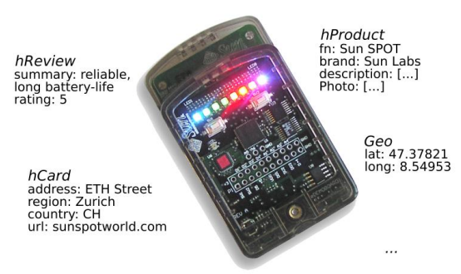
Secondly, Microformats (as well as RDFa) are increasingly supported by search engines, such as Google and Yahoo, where it is used to enhance the search results.
For example, the “Geo” microformat could be used to localize search results close to you or, in our context, to localize smart things in your direct vicinity.
As an example, in Figure we use 5 microformats to describe a Sun SPOT and embed this semantic information directly in the HTML representation of the SPOT resources localize smart things in your direct vicinity.
Compound Microformats for Describing a Sun SPOT Using the Geo, hCard, hProduct and hReview Microformats

Slide 17
5.5.3 Sharing Smart Things
Mashup developers often share their mashups on the Web and expose them through open APIs as well, making the service ecosystem grow with each application and mashup.
The following Figure shows the simplified component architecture of a Social Access Controller (SAC), which serves as authentication proxy between clients and smart things.
However, enabling such an open model for a Web of Things requires a sharing mechanism for physical things supporting access control to the RESTful services provided by devices.
For example, one could share the energy consumption sensors in one’s house with the community.
However, this is a potentially risky process, given that these devices are part of our everyday life and their public sharing might result in serious privacy implications.

Slide 18
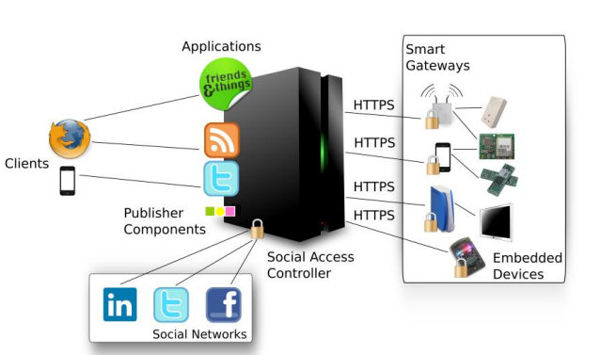

Slide 19
A promising solution is to leverage existing social structures of social networks (e.g., Facebook, Linkedin, Twitter, etc.) and their (open) APIs to share things.
Using social networks enables users to share things with people they know and trust (e.g., relatives, friends, colleagues, fellow researchers, etc.), without the need to recreate yet another social network or user database from scratch on a new online service.
you can use various well-known social networks to inform your friends about the sensors you shared with them by automatically posting messages to their profile or newsfeed.
The sharing process occurs in three phases.
    1. First, the smart things owner accesses SAC by logging in, using at least one of his social networks credentials. SAC then uses delegated authentication with the social network to identify the owner.

Slide 20
    2. Afterwards, the smart thing to be shared has to be crawled in order to identify the resources and capabilities of its RESTful services, i.e., which functionalities can be shared for that thing.
    3. Finally, the user generates the access control list of the smart thing by selecting which friends can interact with what resource.
In case of Twitter it simply tweets a message to the trusted connection (e.g., “Rachel shared her Ploggs Energy sensors with you”).
The posted message also contains a link that redirects to the shared resource.
The link does not point to the smart thing directly but to an instance of SAC that acts as the authentication proxy.

Slide 21
5.6 Discussing the Future Web of Things
RESTful applications have rapidly become one of the most practical integration architectures, This makes it desirable to use Web standards for interacting with smart things.
Although HTTP introduces a communication overhead and increases average response latency, it is still sufficient for many pervasive scenarios where longer delays do not affect user experience.
Caching techniques can significantly improve the performance of concurrent sensor data reading by using tools used for massively scalable Web sites
These techniques can be directly applied to Web devices, given that devices have on-board HTTP support.
Web 2.0 mashups have significantly lowered the entry barrier for the development of Web applications, which is now accessible to non-programmers.

Slide 22
Web standards allow any device to speak the same language as other services on the Web.
This makes the integration of the real-world with any other Web content much easier, so that physical things can be bookmarked, browsed, searched for, and used just like any other Web resource.
The developers mentioned a learning curve for REST but emphasized the fact that it was still rather simple and that once it was learnt, the same principles could be used to interact with a large number of services.
They finally noted the direct integration to HTML and Web browsers as one of the most prevalent benefits.

Slide 23
Semantic Web

Slide 24
Definition
The Semantic web is an evolving extension of the web in which the semantics of information and services on the web is defined, making it possible for the web to understand and satisfy the requests of people and machines to use the web content
The Semantic Web envisions an intelligent internet where the published content and data are adjoined with an additional set of machine-interpretable data - metadata and Linked Open Data - to provide semantics - meaning - as well as establish context - relationships between the data and content. These two types of data (semantic metadata and Linked Open Data) form the basis of the Semantic Web.

Slide 25
5.7 Semantic Web Services
The Semantic Web Services vision wants to combine the ideas behind the Semantic Web and the already available technologies for Web Services.
This will enable automatic and dynamic interaction between software systems and, therefore, enable the implementation of the Internet of Things and Services.
Current Web Services technology provides only support for a standard interface description, without machine-interpretable information about the software system’s functionality.
This issue is addressed by the concepts of Semantic Web Services by adding semantic information to Web Services.
The goal is to describe them in machine-interpretable form, providing information on what the software does for a potential user and how it is done.

Slide 26
This semantic information allows more sophisticated possibilities for discovering services than it is currently possible with UDDI.
The combination of these technologies will support the development of more sophisticated applications, as services can be advertised and discovered more automatically and at high speed.
“Semantic Web Services allow the semi-automatic and automatic annotation, advertisement, discovery, selection, composition, and execution of inter-organization business logic, making the Internet become a global common platform where organizations and individuals communicate among each other to carry out various commercial activities and provide value-added services.” (Cardoso and Sheth 2005)

Slide 27
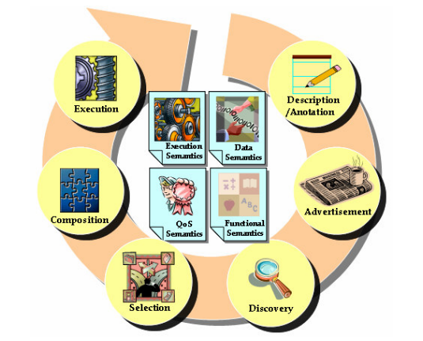
5.8 Semantic Web Services Processes and Lifecycle
Adding semantics to the web services can play an important role, as shown in the web process lifecycle

Slide 28
According to Cardoso and Sheth (2005), the semantics for the Web Services can be differentiated into:
1. Functional semantics are describing the aims of the services and the operations, including information about the required inputs and outputs.
2. Data Semantics are descriptions of the input and output data format for discovery issues and a common understanding in communication, in which data format the data has to be sent and how the receiving data can be semantically interpreted.
3. Quality of Service (QoS) Semantics are necessary for the selection of the most suitable service. Services can have different quality aspects, e.g. cheapest offer, fastest delivery, etc., and this provides possibilities to locate and select the service which matches best a required quality criterion in terms of QoS.
4. Execution Semantics are describing the flow of message exchange (message sequences) and provide a conversation pattern for the web service execution, flow of actions, preconditions, and effects on web service invocation, etc.

Slide 29
For the success of the web process, these stages are all significant and should follow the next described steps
1. Semantic Web Service Annotation:
Description of the Web Services with the different required types of semantics for Web Services
2. Semantic Web Service Advertisement
Publication of the service’s capabilities on syntactical and operational level, using semantics in a repository (different technologies are available, centralised, e.g. UDDI, and even peer-to-peer)
3. Semantic Web Service Discovery
Process of discovering appropriate services before selection, based on syntactic information, data, functional and QoS semantics

Slide 30
4. Semantic Web Services Selection
Selection of the most suitable service matching defined QoS metrics and resulting in the best quality criteria match
5. Semantic Process Composition
Web Services are highly autonomous and heterogeneous; therefore, composition is an important stage. Semantics enhance interoperability of Web Services, and in the web process composition (automatic, semi-automatic or manually)
6. Execution of Web Process
Execution of the services and the whole process based on the execution semantics, the sequential or parallel invocations of services and operations, specified by the flow of messages and data based on the defined semantics

Slide 31
For the implementation of Semantic Web Services a complete framework is necessary, consisting of three components:
1. A conceptual model (ontology)
2. A formal language to provide formal syntax and semantics for the conceptual model
3. An execution environment combining all components and carrying out the tasks for eventually service and process automation.
As the idea of Semantic Web Services is relatively new, there currently exist different approaches for the realization of Semantic Web Services, Example
    Web Service Modeling Ontology (WSMO)
    Web Ontology Language for Web Services (OWL-S)
    or Semantic Web Services Framework (SWSF)

Slide 32
The most promising approach for the realization of a system of Semantic Web Services seems to be the WSMO approach, as it consists of an extensible ontology modeling language, a Web Services Modeling Language and an execution environment.
On the Operational Level, Semantic Web Services and Semantic Web Processes are the enabling technologies, which could fulfill the requirements of the Internet of Things and Services.

Slide 33
Ontology

Slide 34
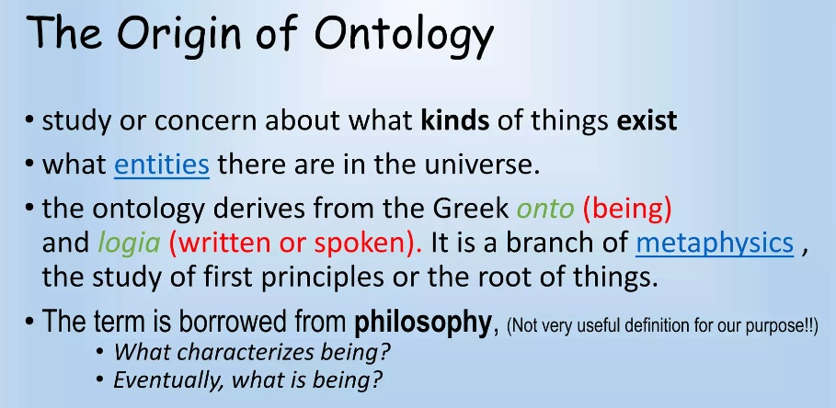
Notes:
Metaphysics is the study of reality and existence, who we are, and what our purpose is.

Slide 35
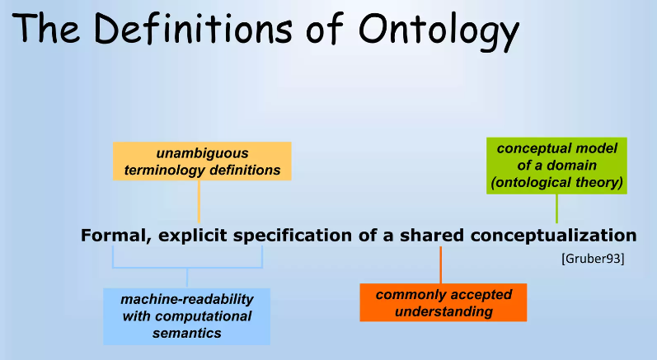

Slide 36
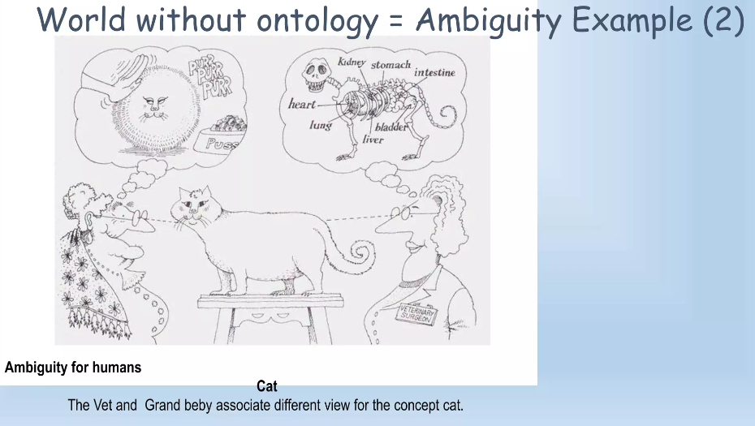

Slide 37
5.9 Ontology
Ontology, as a discipline, is the branch of philosophy that is concerned with the nature of things that exist in the universe.
More specifically, it is the science that aims to provide an exhaustive and definitive classification of things based on their similarities and differences.
By exhaustive, we mean that it provides an explanation for everything that is ongoing in the universe.
By definitive, we mean that every type of things should be included in the classification.
In this sense, the ontology discipline tries to provide answers to the question: What are the features common to all things?

Slide 38
In computing science, an ontology is commonly defined as: “a formal, explicit specification of a shared conceptualization”.
More specifically, an ontology is an engineering artefact composed of
  (i) a vocabulary specific to a domain of discourse, and
  (ii) a set of explicit assumptions regarding the intended meaning of the terms in the vocabulary for that domain.
This set of assumptions is generally expressed in terms of unary and binary predicates, by which concepts and the relations between them are expressed.

Slide 39


What is a conceptualisation
Conceptualisation: the formal structure of reality as perceived and organized by an agent, independently of:
  the vocabulary used (i.e., the language used)
  the actual occurrence of a specific situation
Different situations involving the same objects, described by different vocabularies, may share the same conceptualisation.
apple
mela

Slide 40


Ontological commitment
Agreement on the meaning of the vocabulary used to share knowledge.
We need a pipe
A pipe ?!?

Slide 41
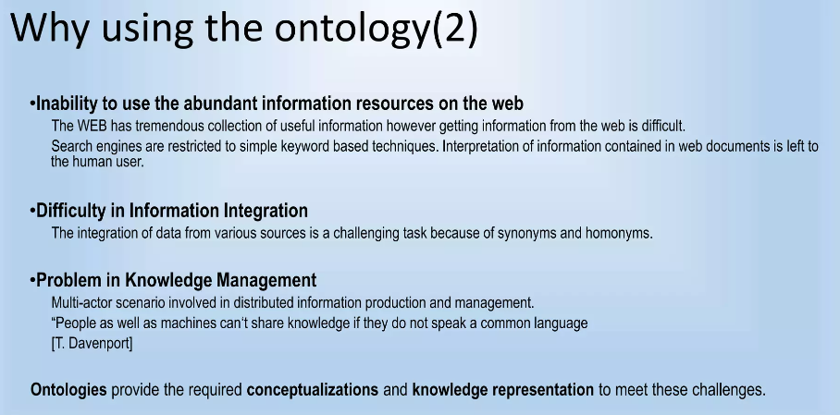

Slide 42
Historical context
  Artificial Intelligence
  Philosophy
  Ontology
  Knowledge Representation and logic

Slide 43
Different languages have been developed over the last two decades to represent ontologies.
Simple HTML Ontology Extension (SHOE) was developed to annotate web pages with semantics.
Ontology Exchange Language (XOL) was primarily developed to exchange ontologies in the bioinformatics domain.
Resource Description Framework (RDF) allows users to describe the relation between different web resources,
Web Ontology Language (OWL) extends on the RDF vocabulary to provide precise meaning through formal semantics.

Slide 44
5.10. Ontology Engineering Methodologies
What Is “Ontology Engineering”?
Defining terms in the domain and relations among them
  Defining concepts in the domain (classes)
  Arranging the concepts in a hierarchy (subclass-superclass hierarchy)
  Defining which attributes and properties (slots) classes can have and constraints on their values
  Defining individuals and filling in slot values
What Is “Knowledge Engineering”?
  Knowledge engineering is the application of logic and ontology to the task of building computable models of some domain for some purpose.

Slide 45
Over the last two decades, several ontology engineering methodologies have been developed.
1. Gruninger and Fox (1995) propose a method inspired by knowledge based development using first order logic.
2. Uschold and King (1995) propose a method for building ontologies based on their experience with the Enterprise Ontology for system interoperation.
3. Fernandez et al. (1997) builds Methontology on the main activities of software development and knowledge engineering methods, proposing an ontology development life cycle based on evolving prototypes.
4. CommonKADS (Schreiber et al. 1999) is a methodology for knowledge engineering in general, which is used to design and analyze knowledge-intensive, structured systems.
Notes:
First-order logic uses quantified variables over non-logical objects, and allows the use of sentences that contain variables,
so that rather than propositions such as "Socrates is a man", one can have expressions in the form
"there exists x such that x is Socrates and x is a man", where "there exists" is a quantifier,
Axiom: an established rule or principle or a self-evident truth
cites the axiom "no one gives what he does not have"

Slide 46
5. Alternatively, the Developing Ontology Grounded Methods and Applications framework (DOGMA) is a formal ontology engineering framework inspired by various scientific disciplines, such as database semantics and natural language processing.
Although DOGMA partly draws on the best practice of the other methodologies, it differs from these approaches by providing a strict separation between the lexical representation of concepts and their relationships and the semantic constraints.
The Meaning Evolution Support System (DOGMA-MESS) is STAR Lab’s methodology and tool to support community-driven ontology engineering.

Slide 47
The following Figure illustrates how a domain ontology is created through the interaction among three different types of stakeholders, namely the domain expert, the core domain expert and the knowledge engineer.
The domain expert is a professional within the domain of discourse,
while the core domain expert has a deep understanding of the domain across different organizations.
The knowledge engineer, who has excellent expertise in representing and analyzing formal semantics, is responsible to assist the domain experts and core domain experts in the processes of ontology creation, validation and evolution.

Slide 48
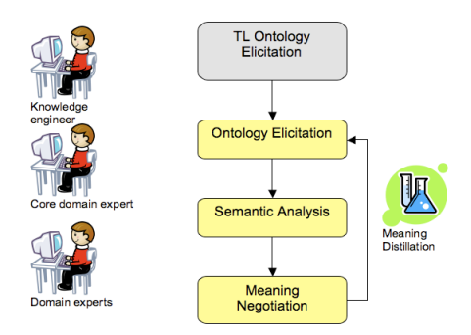
Fig. DOGMA-MESS Iterative Process
Notes:
TL- Top Layer
Elicitation: Producing Information

Slide 49
5.11. Application of Ontology Engineering in the Internet of Things
Three ontology-based services have been described, that would enable three different areas of interoperability as needed for DiY (Do-it-Yourself) application creation in the Internet of Things.
  Knowledge Integration and Sharing
  Ontology-based Search
  Context-aware Computing
Notes:
Recently, Do-it-Yourself as a phenomenon has, again, started to take the central stage in research and development. To understand why this is the case, several things can be learned from the history of DiY and can be projected onto how the phenomenon could be perceived in the future.

Slide 50
Knowledge Integration and Sharing
As the Web has changed from a mere repository of documents to a highly distributed platform where new types of resources can be discovered and even easily shared.
One can extrapolate the Web as an Internet of Things making everyday objects addressable via IPv6 as well as an Internet of Services making services easy to implement, consume, and trade.
Making knowledge transparent to users and services thus requires the development of a formal and precise vocabulary that (i) defines concepts shared by a community and (ii) can be processed by machines.
The following figure shows how a semantic layer can be used to facilitate knowledge integration and sharing on the Web.

Slide 51
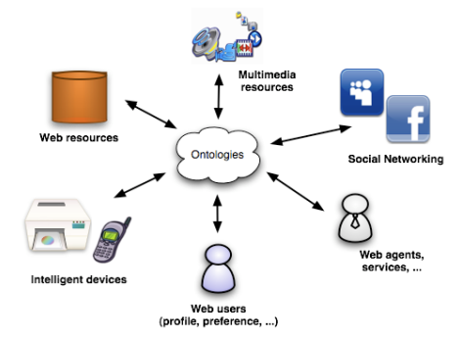
Ontology-based Knowledge Integration and Sharing

Slide 52
Similarly, Eid et al. (2007) have developed an ontology to discover sensor data like GPS or temperature, consisting of three components:
the Suggested Upper Merged Ontology (SUMO) is an upper level ontology developed by the IEEE to promote interoperability, information search and retrieval, automatic inference, and extendibility;
the Sensor Hierarchy Ontology (SHO) includes models for data acquisition units and data processing and transmitting units; whereas
the Sensor Data Ontology (SDO) describes the context of a sensor with regard to spatial and/or temporal observations.
Alternatively, the Web Service Modeling Ontology (WSMO), provides a conceptualisation for the core elements of Web Services.

Slide 53
5.11.1 Ontology-based Search
The DiYSE (Do-it-Yourself Smart Experiences) project aims to develop a framework to enable communities to create and exchange applications (i.e. software components) for ubiquitous computing and ambient intelligence, leveraging the Internet of Things.
In practice, these applications are likely to come from a number of repositories and in a variety of formats.
However, different repositories are likely to use different terminologies for the indexing.
This is where ontology-based search comes in as a solution, as in that approach the indexes are expressed in terms of an ontology which translates and hides the different repositories that have committed to it.

Slide 54
In DiYSE, the ontology-based search needs to serve two types of users. Technical users are likely to use technical terms to define the capabilities of a hardware or software component, whereas non-technical users will use other non-technical terms that are meaningful to them.
As a result, semantic ‘translation’ methodologies are researched that resolve the differences between technical and nontechnical terminologies in order to get to a true DiY ecosystem on top of the Internet of Things.

Slide 55
5.11.2. Context-aware Computing
Therefore, context-aware computing (Schilit et al. 1994) focuses on gathering information about users, like status, location, preferences and profile, next to environment factors such as lighting conditions, noise level, network connectivity, nearby things and even social aspects.
This information is then used to adjust the behaviour of an application to suit user needs and preferences.
As is done in the DiYSE framework, context management can be supported semantically by two core elements, namely the contextual ontology and the context model.
The contextual ontology provides a conceptualisation of the characteristics of real world objects, while the context model provides access to the contextual knowledge.
So, based on for example this ontology, agents and users are able to interoperate to provide context-aware services in the dynamically changing smart environments.

Slide 56
5.12. Ontology and the Organizational Perspective
An ontological representation of a real-world domain requires a conceptualization of the reality.
A conceptualization of the real world domain involves two steps,
  First, the selection of relevant parts (e.g. concepts, properties) and the relations between them.
  Second, The representation is accomplished by defining the vocabulary for the model which means to name the elements (concepts, classes, properties, relations…) of the model.
When revising the problem from the organizational perspective, we can see that the technical implementation, or the used languages, encodings or data formats are not as crucial to this point.

Slide 57
Applications that label themselves as compliant to the Internet of Things and Services must be aware of this organizational problem, first.
There are an infinite number of possible conceptualizations of a real world domain.
Two organizations can conceptualize the same real-world domain in a different way or conceptualize two different real-world domains to the same model.
Both scenarios would lead to serious interoperability problems that are very often hard to detect.
Interoperable systems, or Internet of Things applications that must obtain openness must use the concepts of ontology to state their understanding of the real world domain.
This allows other applications or organizations to adjust their own vision in order to correctly interoperate.

Slide 58
5.12.2. Ontology and the IT-System Perspective
The IT-system perspective requires a more technical approach to guarantee the ability for cooperation to enable an Internet of Things and Service.
Standard technologies like, for example, the SOA are able to provide open and accessible interfaces for applications.
Ontology concepts already found their way into the world of SOA.
Semantic Web Services are assisted by ontologies to fully semantically describe and understand the interfaces they offer and use.
Computer programs can automatically discover and choose appropriate services, interfaces and data-structures to consume particular web resources.

Slide 59
5.12.3. Ontology and the Data Perspective
When talking about interoperability with respect to the Data Perspective in the meaning of the ability to cooperate and to exchange data, one must consider the interoperability of the domain models used by them.
Basically, there are the possibilities that the same representation of some data has a different intentional meaning or that there is a different representation of the same intentional meaning that cannot be translated offhand.
Anyway, different representations of the same information can be an interoperability issue.
The following figure shows how ontologies can be used to model an open and transparent data model.

Slide 60
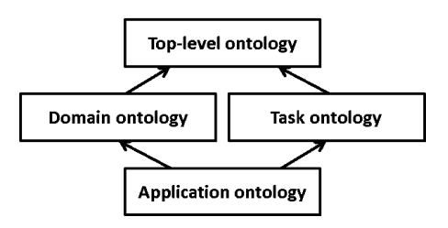

Slide 61
The data models are designed as follows:
  1. A Top-level ontology represents very common and general concepts like space, time, object, matter, event, action, etc., which are independent of a particular application domain.
  2. The Domain ontology and the Task ontology specialize the terms defined in the top-level ontology for a certain problem domain (e.g. logistics). These ontologies differ between the concepts inside the domain (e.g. cargo, vehicle, route…) and the tasks (load, unload, convey goods…) performed there.
  3. The Application ontology describes concepts that depend on both, the domain concepts of a domain and the tasks that are performed. Typically, it is a specialisation of both ontologies. Usually, this ontology contains domain entities playing a certain role while performing a certain task (e.g. a cargo item which arrives in time at its destination).

Slide 62
Thank You

