Slide 1
Why India is still developing but not developed

Slide 2
Dawn of India
TEHNOLOGY
AGRICULTURE
DEFENCE
EDUCATION
ECONOMY

Slide 3
DEVELOPMENT OF TECHNOLOGY
Since independence,we have accelerated our speed & efforts in Technology & have established many research laboratories,institutes of higher learning & technical education.
Technology has been developed in the areas like aircrafts,navy,software etc..

Slide 4
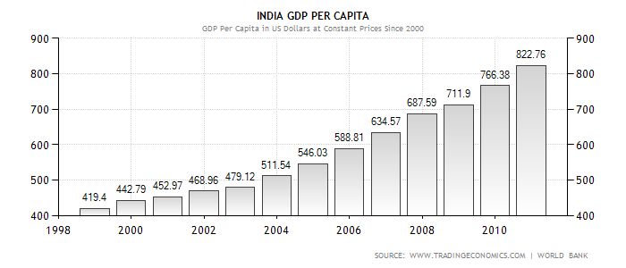

Slide 5



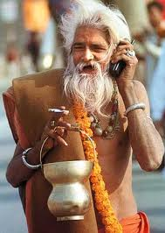
Software technology

Slide 6


Slide 7

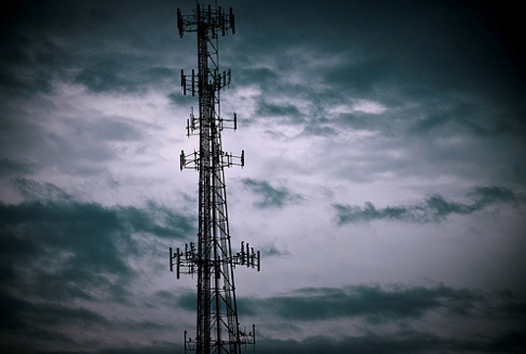
Samsung was the first cell phone company to introduce solar cell phones in India.
Solar powered cell phone
tower of India.

Slide 8
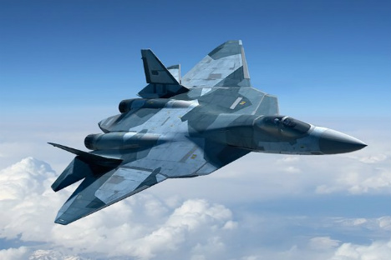
Aircrafts of India
FGFA(Fifth generation Fighter aircraft).
Developed by HAL.
Recently it is being developed by India & Russia.

Slide 9


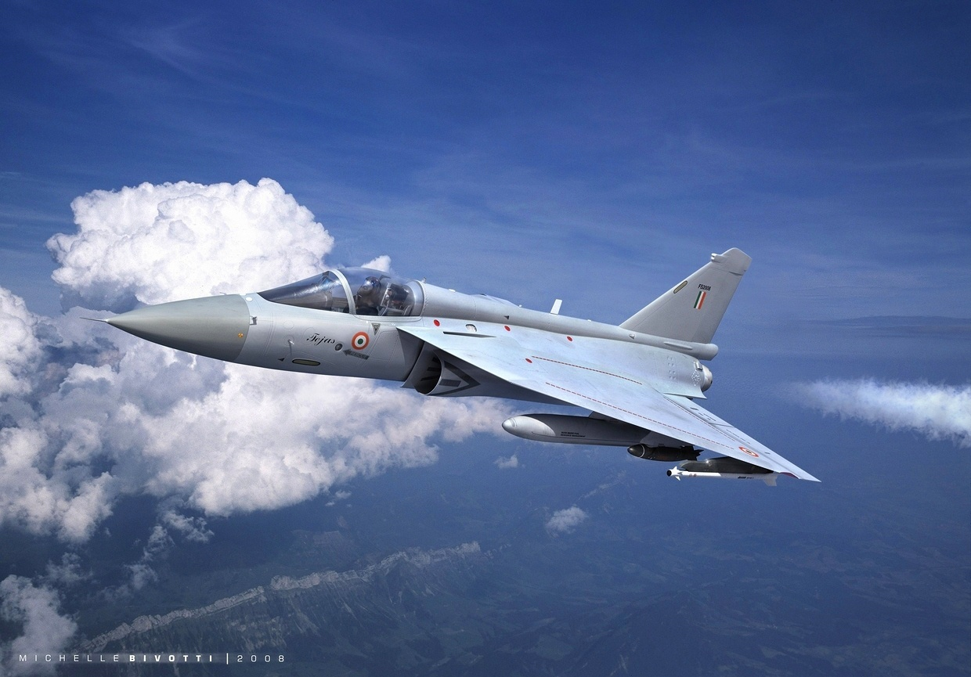

Slide 10
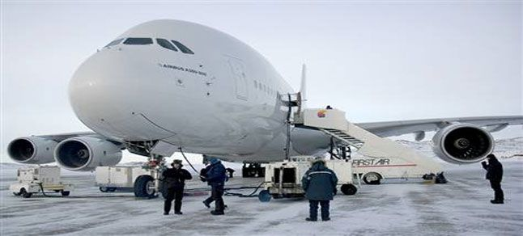
The country’s first indigenous aircraft prototype ,developed by
$11.2 billion by Mahindra &Mahindra group.

Slide 11
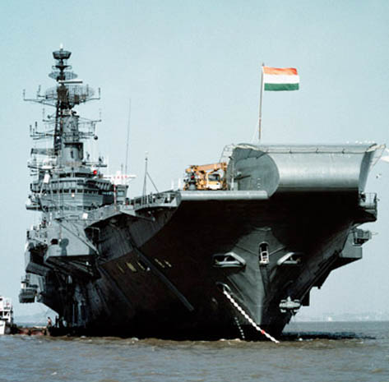
Indian navy

Slide 12

Cruise ship
Operated in international waters & Indian territorial waters.
Operation-confirm laws & regulations of the country concerned.

Slide 13
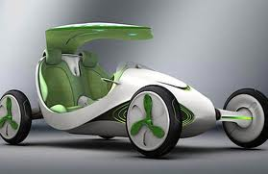
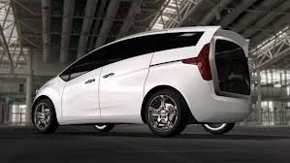
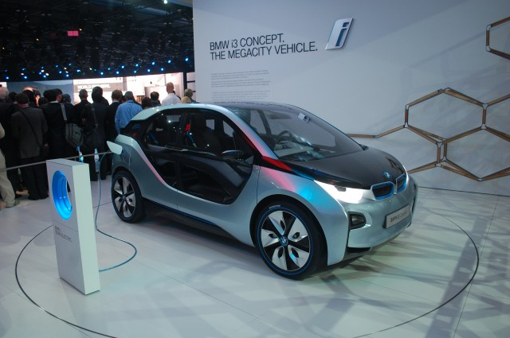
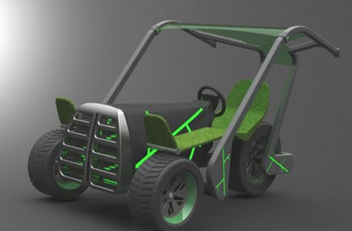
Hybrid cars-Release o2

Slide 14
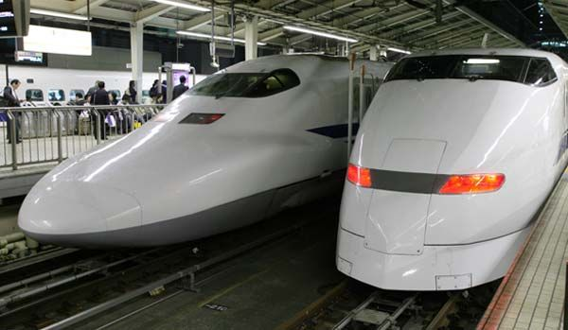
Bullet Trains

Slide 15
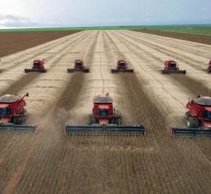
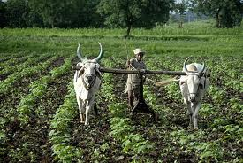

DEVELOPMENT OF AGRICULTURE

Slide 16
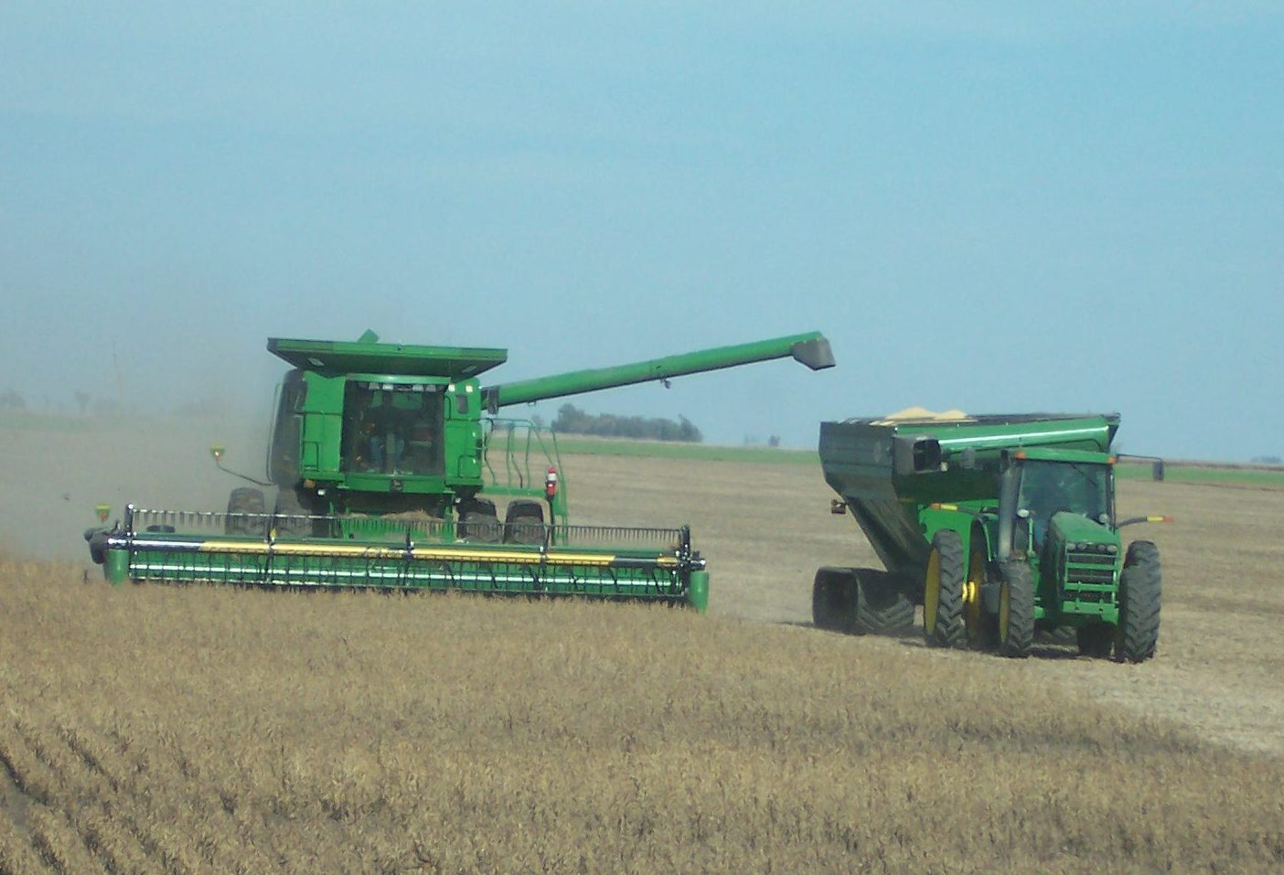

Slide 17
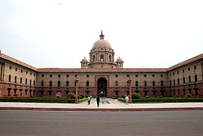
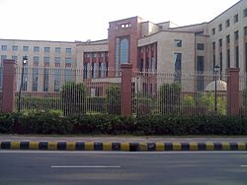
DEVELOPMENT OF DEFENCE
Ministry of defence is charged with responsible for internal & external security of Republic of India.
DRDO is an agency of Republic of India.

Slide 18
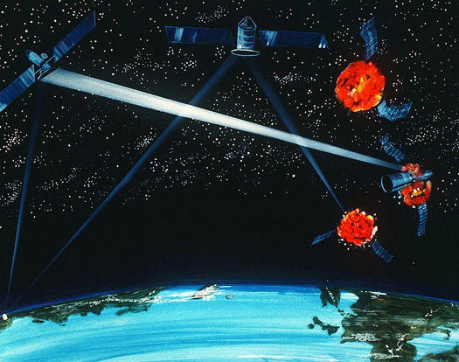

Kill vehicle

Slide 19
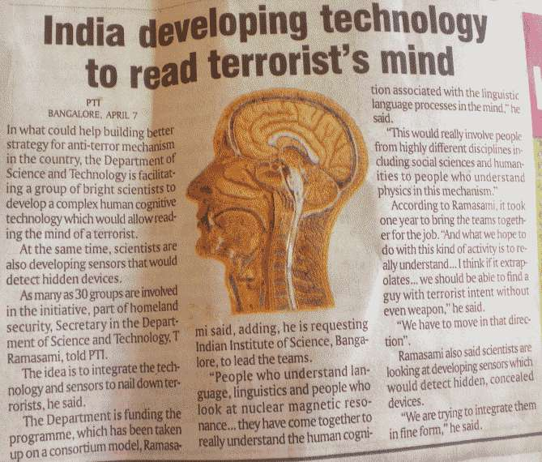

Technology to read terrorists mind

Slide 20
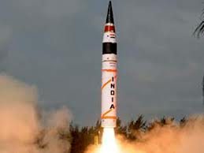
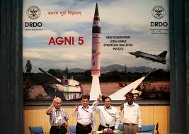
AGNI5

Slide 21
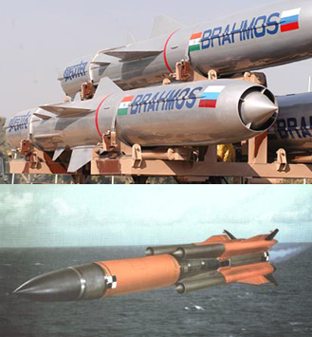
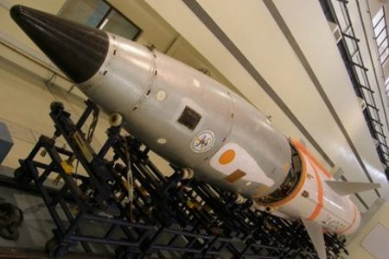
BRAHMOS

Slide 22
DEVELOPMENT OF EDUCATION
Behind the growth of country there are various factors involved,but Education is one factor which leads all others.
Some world famous universities are….
IIT
AIMS
IIM

Slide 23
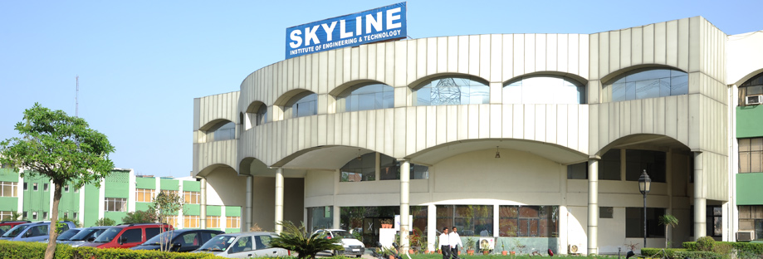
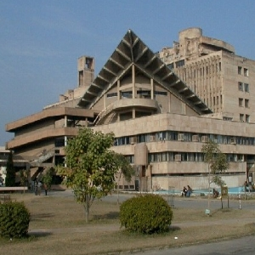
Educational institutions

Slide 24
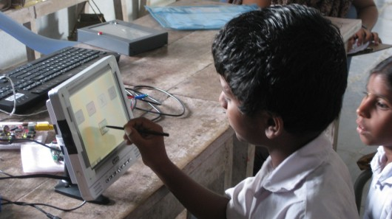
I -SLATE
It is a solar powered tablet for rural Indian students.
This enables 100 million Indian rural students to study through this electronic slates.

Slide 25
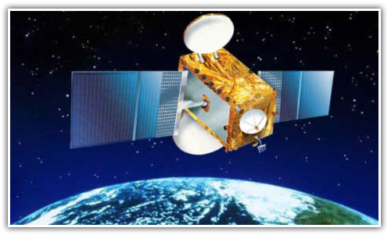
EDUSAT
It is launched from SDSC.
EDUSAT is developed for Distance education.

Slide 26


ECONOMY DEVELOPMENT
India has the world’s second fastest growing economy.
Many nations are moving to forge better relationship with India.

Slide 27
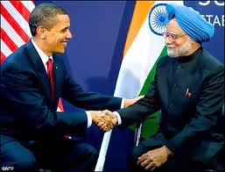

Slide 28
Why India is not developed
Corruption
Irresponsibility
Illiteracy
Lack of unity among people
People below poverty line
Brain drain
Over population

Slide 29
CORRUPTION
Corruption became profession for all politicians
& administrative departments.
Britishers ruled our country for 200 years & eaten up 50 lakh crores.
Some of our politicians has ruled only 64 years but eaten up 2000 lakh crores.
Our politicians all over India loot people’s hard earned economy.

Slide 30

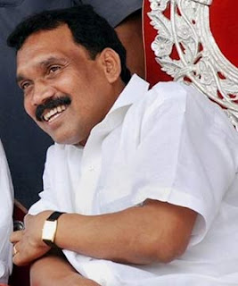

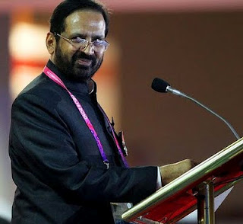
corrupted politicians of India

Slide 31

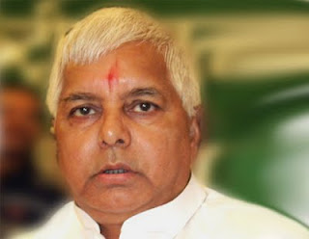


Slide 32
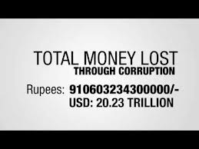
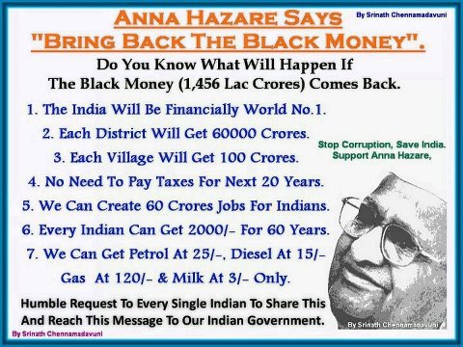

Slide 33

Irresponsibility
Indians stop India growing.
Many of us will waste water and electricity and also other resources.
We are responsible for the garbage surrounding us.

Slide 34
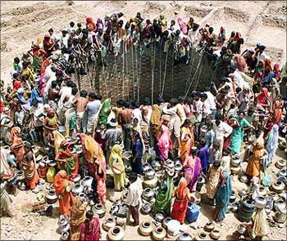
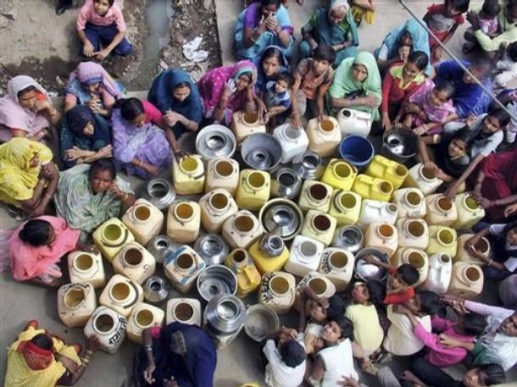

Slide 35

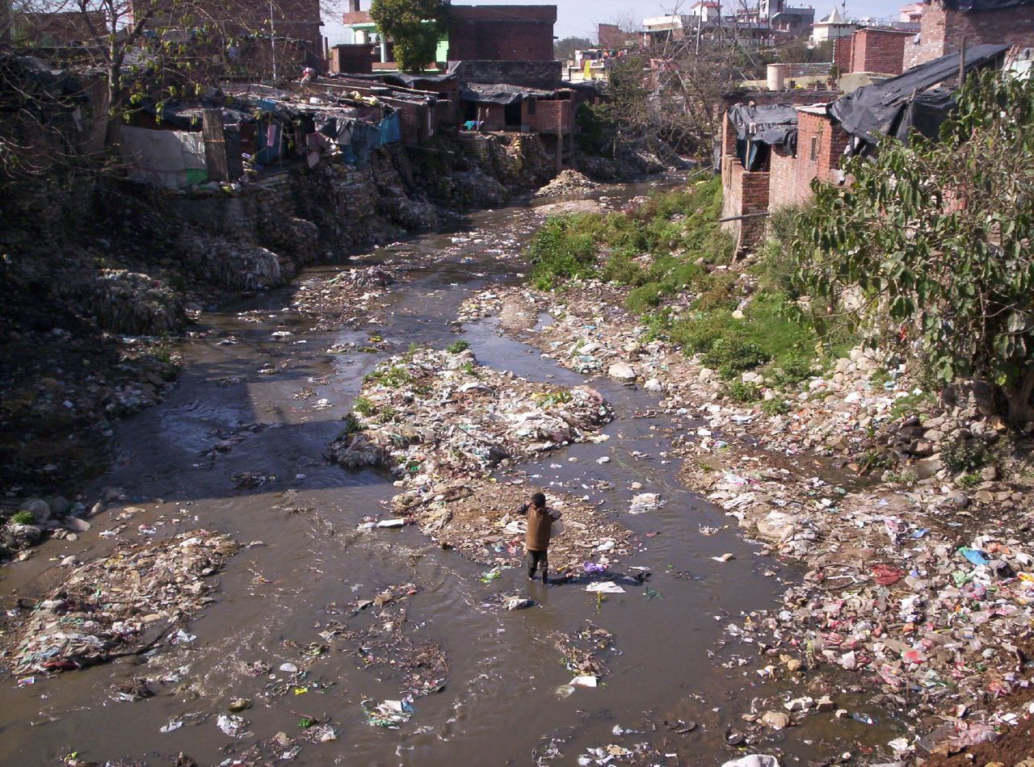
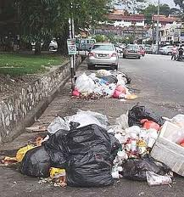

Slide 36
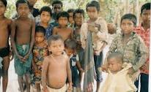
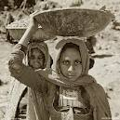
Illiteracy
35% of Indian people are illiterates.
75% of people below poverty line doesn’t know the value of education and they send their children to work for daily wages.

Slide 37

Lack of unity among people
Unity is strength of any nation.
Our country people are divided among them with a great thing called language,religion and caste.

Slide 38

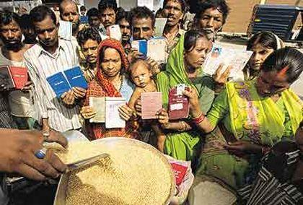
People below poverty line
Rich gets richer and the poor gets poorer.
There still many families in India who are not having money for their one time food in a day.

Slide 39
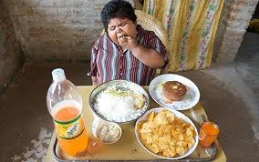
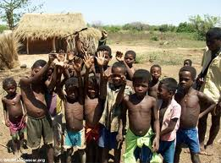
Under nutrition-over nutrition

Slide 40
Brain drain
People of India mostly use all the resources from India to gain lots of knowledge & then finally they get themselves settled in the foreign countries.
Indians working in America have average income of $60,000 for their sharpness where as an American earns $40,000 in his own country.
There is thought that Indian brains are the most powerful brains in the world.

Slide 41
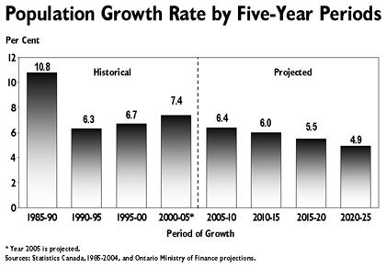
Over population

Slide 42
Compare to other countries
Average percapita income of America is $40,000 where as in India it was $822.76.
America persue politics for the wealth creation,where as India persue politics for the wealth redistribution.
A farmer of America produces foods for itself along with food for more 50 people .But in India??

Slide 43
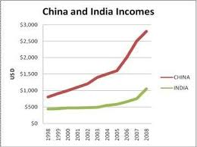
Though china leads in its population than India,it’s growth rate is increasing rapidly.

Slide 44
CONCLUSION
So for next 60 years also India will be a developing country because
Who encourage corruption ??
we
Who dump garbage in streets???
we
Who waste water & electricity????
we
Who migrate to other countries?????
we

Slide 45
Who lack unity??????
we
So everything we have to change in ourselves.The development of our country is in our hands.So
BE HONEST
AND
PATRIOTIC

Slide 46


