Slide 1
UNIT: –3 INNOVATION MANAGEMENT
By
N NAVENDRA KUMAR
Assistant Professor
Dept. Of. Civil Engineering

Slide 2

Importance and overview of innovation process

Slide 3

Innovation in an organizational context

Slide 4
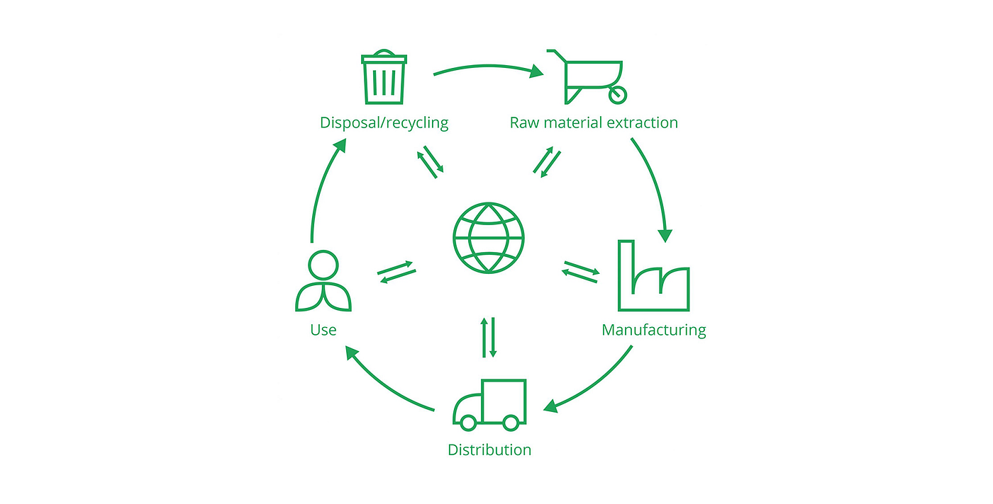
Development activities and design environment
.

Slide 5

Innovation and invention

Slide 6

Successful and unsuccessful innovation

Slide 7
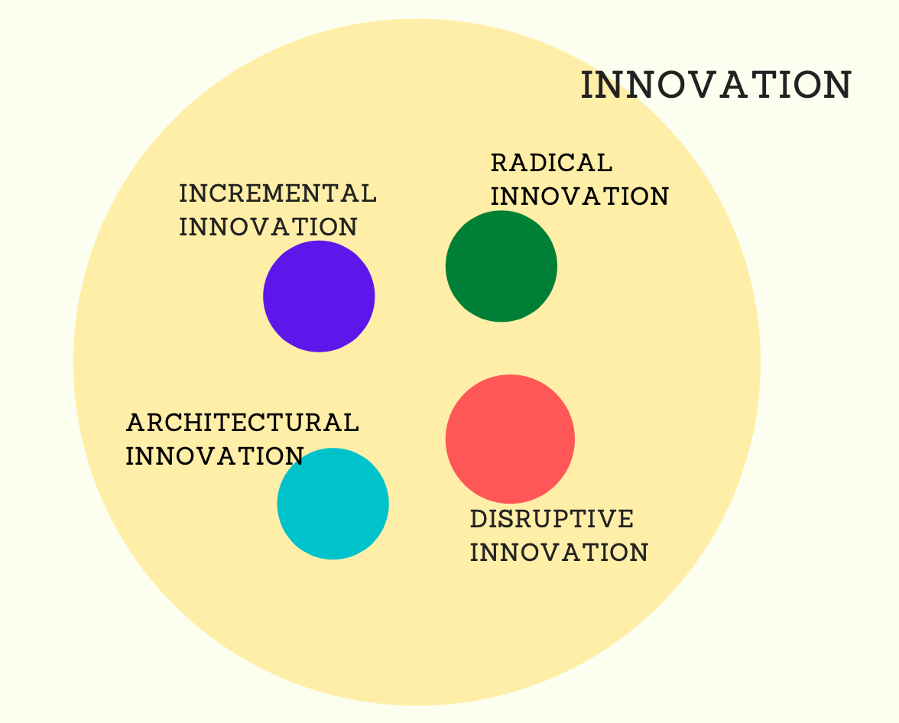
Different types of innovation

Slide 8
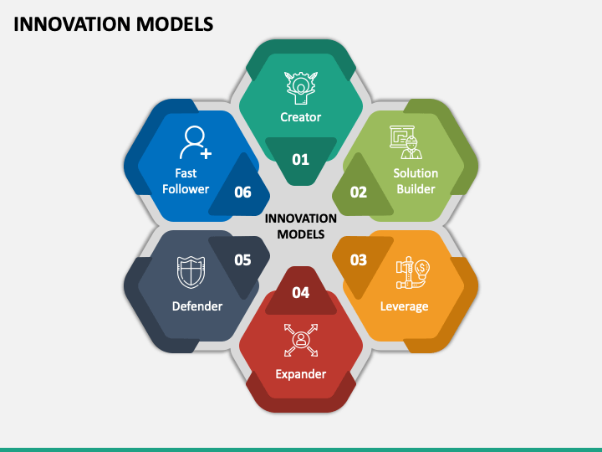
Models of innovation

Slide 9

Disruptive innovations

Slide 10
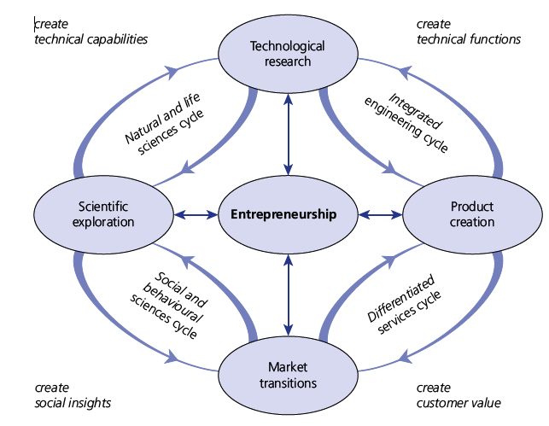
Cyclic model of innovation with interconnected cycles

Slide 11


