Slide 1
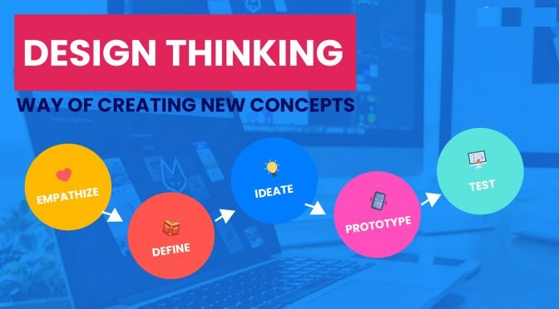

Slide 2
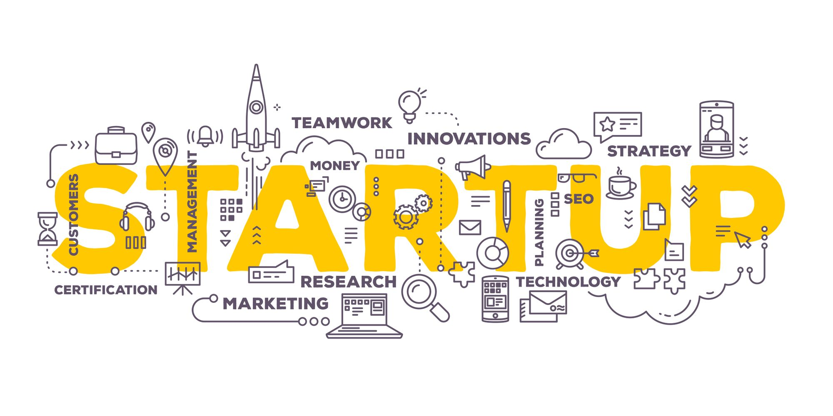
Emerging start-up culture

Slide 3
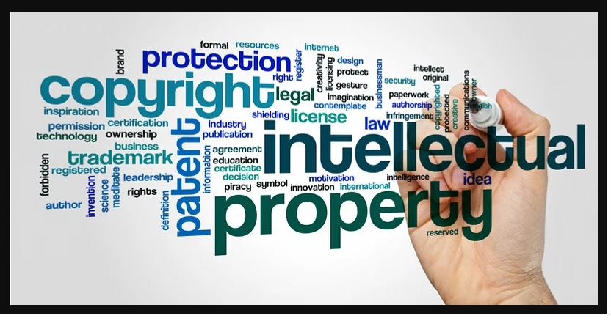
IPR(INTELLECTUAL PROPERTY RIGHTS) TO PROTECT INNOVATION

Slide 4
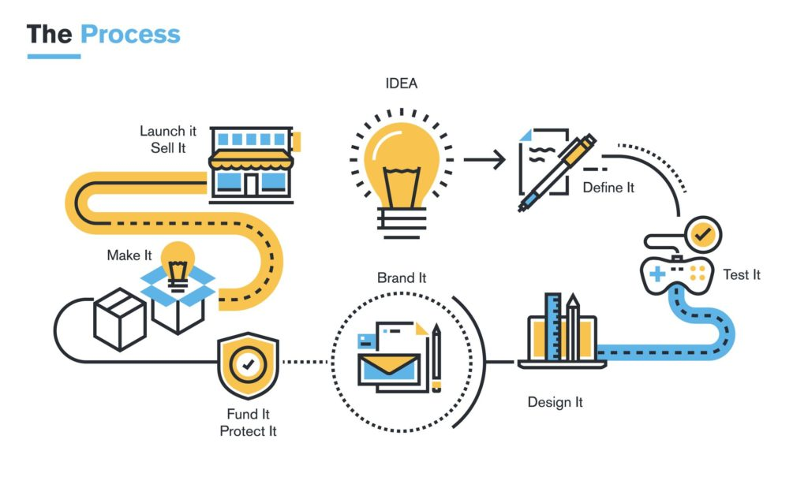
Path from idea to product

Slide 5
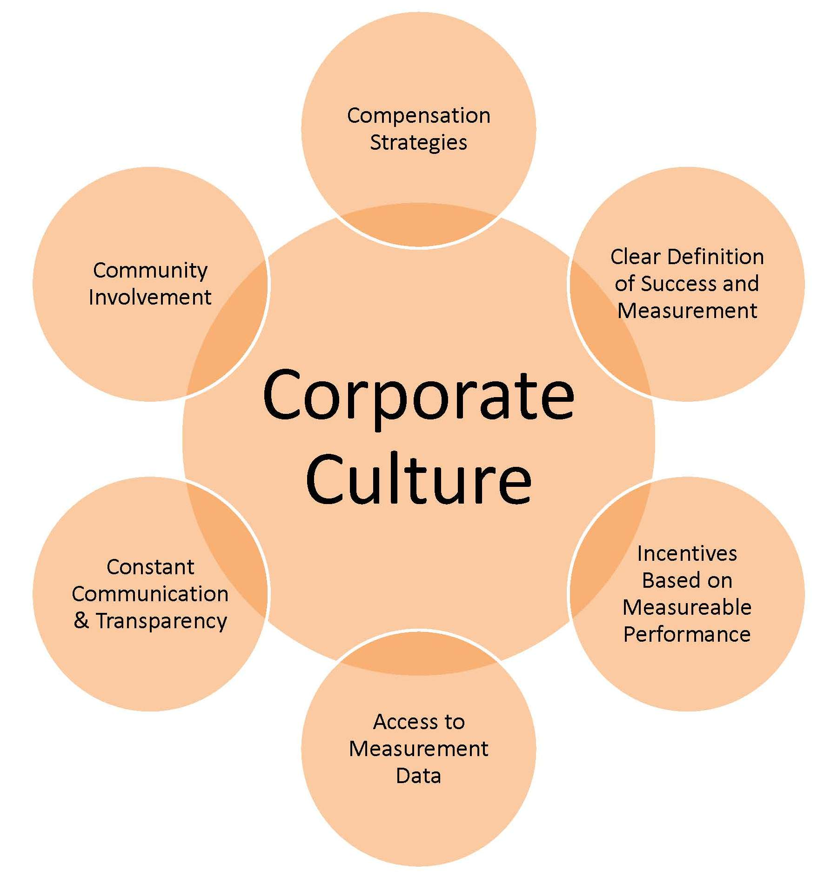
Impact of corporate culture and forces

Slide 6
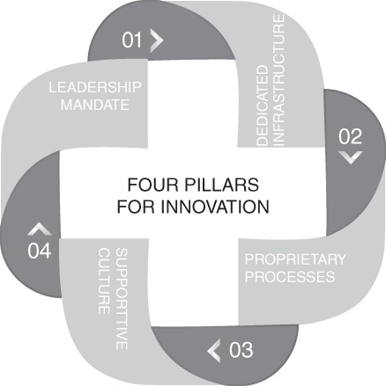
Pillars of innovation
PEOPLE
CULTURE AND CLIMATE
STRUCTURES AND PROCESSES, AND
LEADERSHIP.

Slide 7
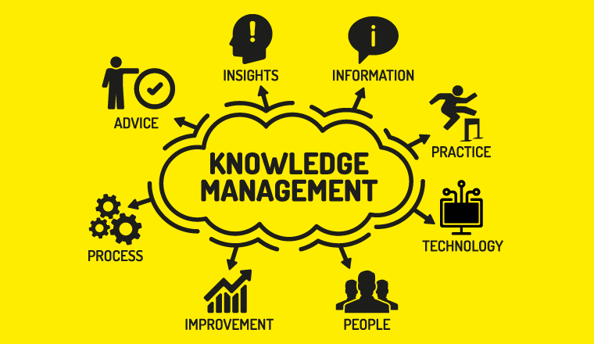
Knowledge management as intelligence and task

Slide 8

Designing amidst uncertainty

Slide 9
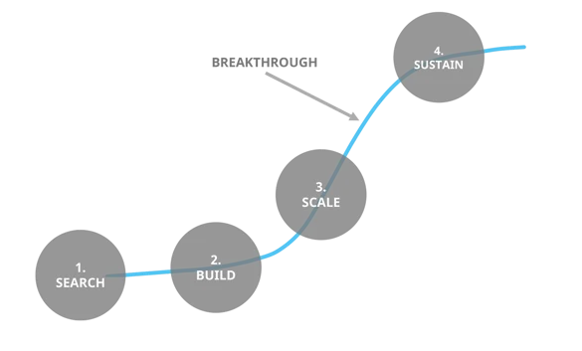
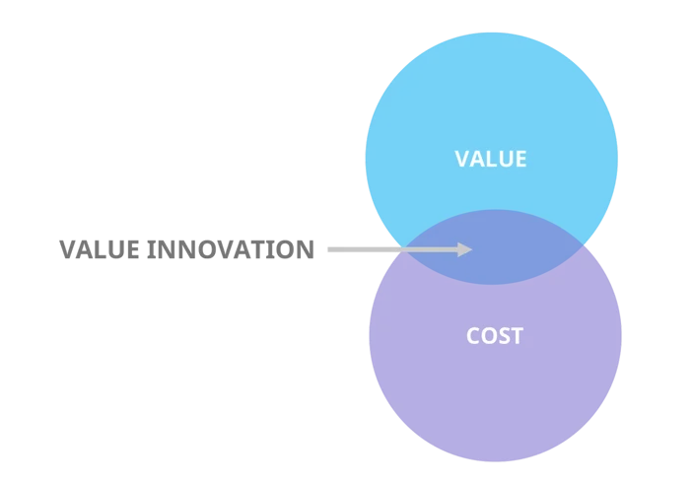
Selected tools for breakthrough innovation

Slide 10
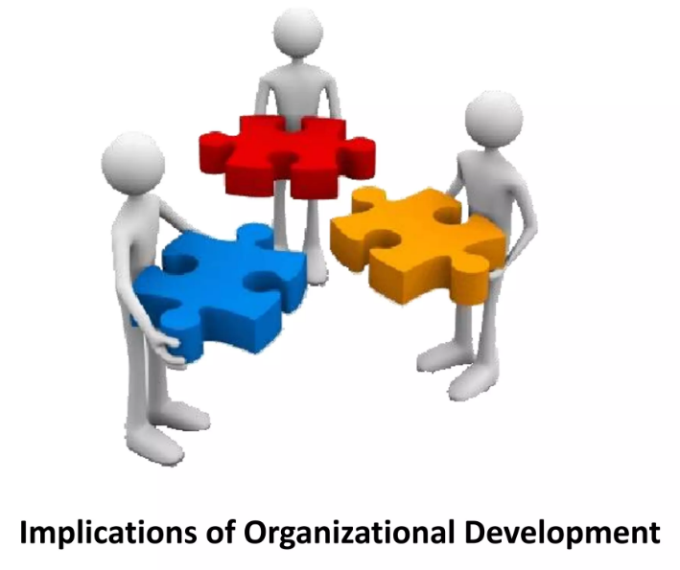
Organizational implications

Slide 11
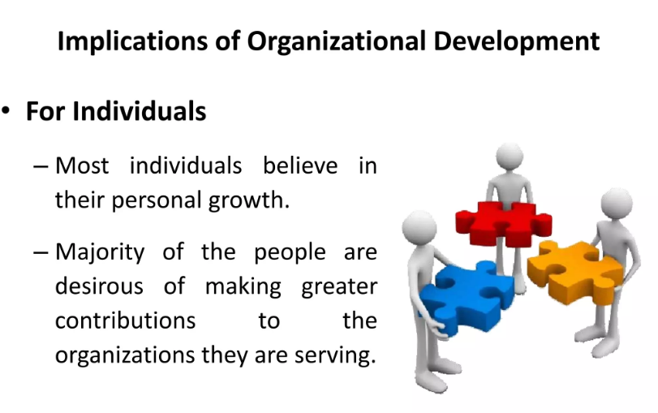
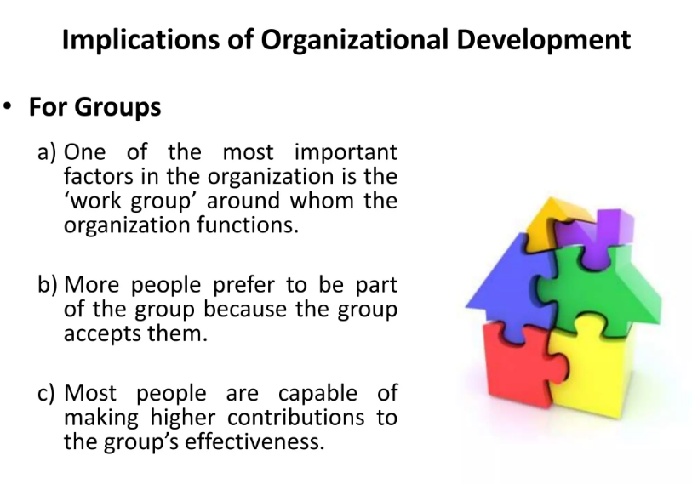
Organizational implications

Slide 12
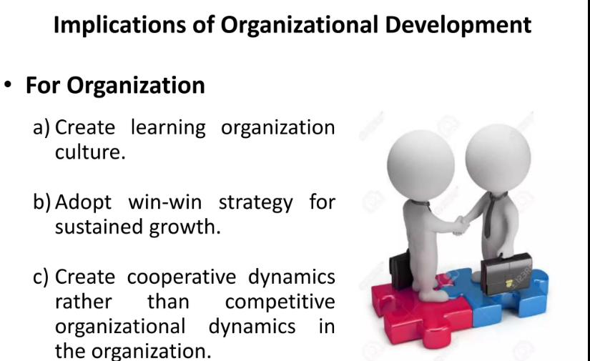
Organizational implications

Slide 13
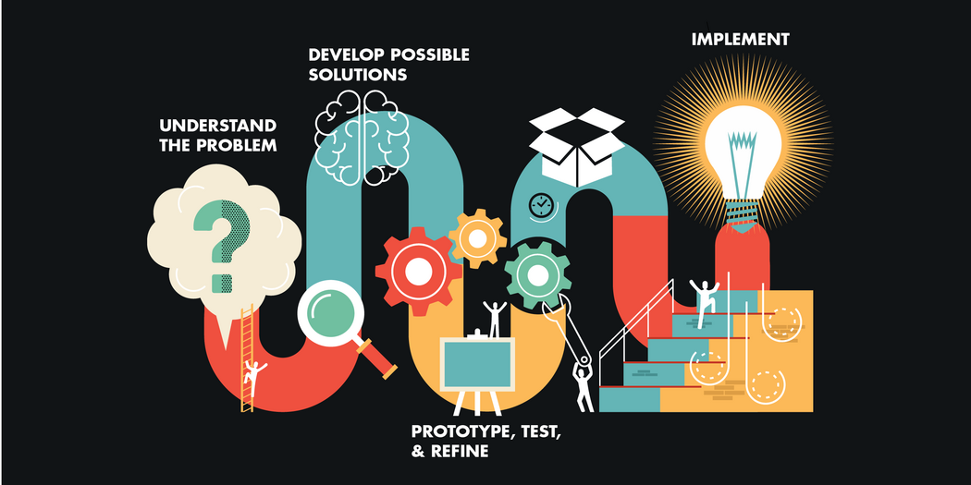
Design thinking within the firm

Slide 14


Role of key personnel

Slide 15

Organizational practices and culture

Slide 16

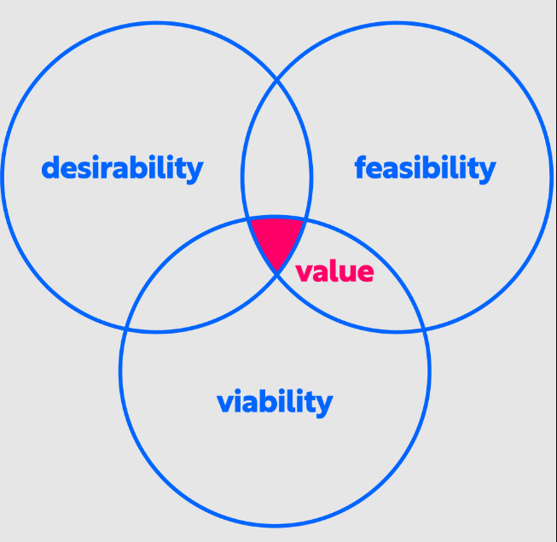
Value of design thinking

Slide 17


