Slide 1
Unit-2
ARM MICROCONTROLLERS ARCHITECTURE AND PROGRAMMING

Slide 2
Syllabus
Architecture, Pin Diagram, Register Set & Modes, Memory Organization, Instruction set, Programming ports, Timer/Counter, Serial communication, I/O System, Development Tools, interrupts in C, Introduction ARM mBed platform.

Slide 3
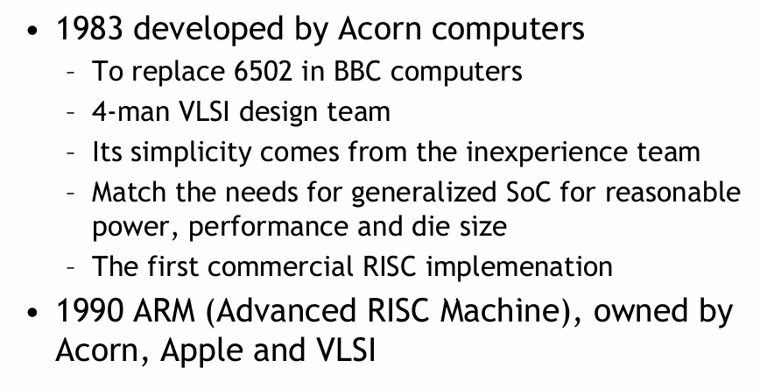
ARM HISTORY

Slide 4


Slide 5


Slide 6
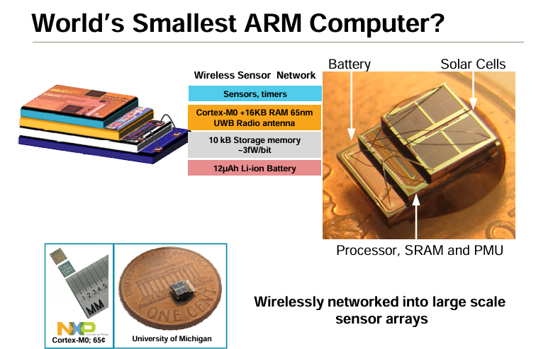

Slide 7


Slide 8
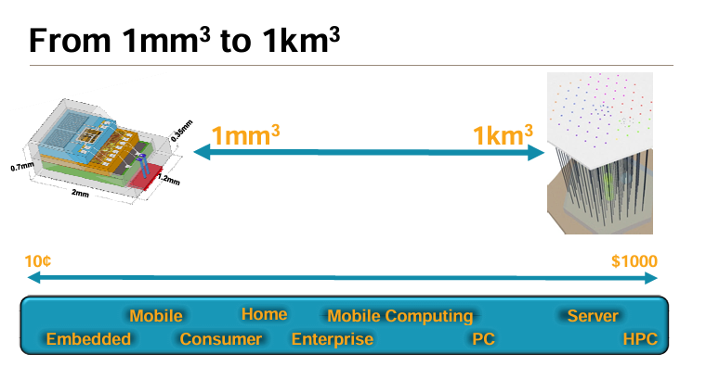

Slide 9
ARM Architecture
ARM means Advanced RISC Machines.
ARM machines have a 32-bit Reduced Instruction Set Computer (RISC) Load Store Architecture.
It is first RISC microprocessor for commercial use and market-leader for low power and cost-sensitive embedded applications.
The ARM is a Von Neumann, load/store architecture
i.e. only 32-bit data bus for both instruction and data.
Also for the load/store instruction access memory.

Slide 10
ARM Architecture
In 1990, the research section of Acorn separated from the parent company and formed : Advanced RISC Machines Limited.
• The ARM is a 32-bit architecture. When used in relation to the ARM :
1. Byte means 8 bits
2. Halfword means 16 bits.
3. Word means 32 bits.
• Most ARM's implement two instruction sets
1. 32-bit ARM Instruction Set
2. 16-bit Thumb Instruction Set

Slide 11
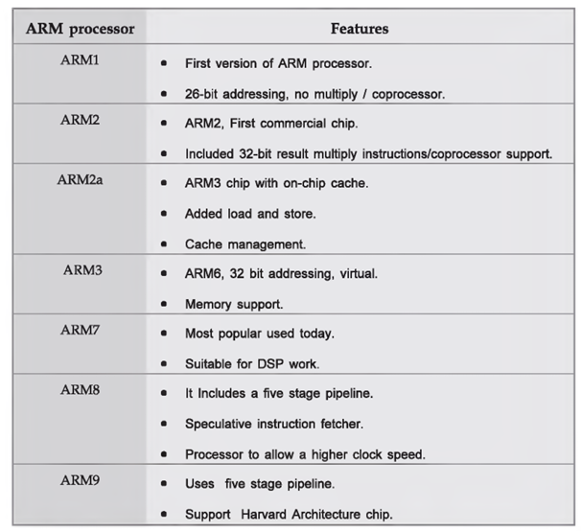

Slide 12
ARM Architecture
The ARM architecture processor is an advanced reduced instruction set computing [RISC] machine and it's a 32 bit RISC microcontroller.
• The ARM cortex is a complicated microcontroller within the ARM family that has ARMv7 design. There are 3 subfamilies within the ARM cortex family:
a) ARM Cortex Ax-series
b) ARM Cortex Rx-series
c) ARM Cortex Mx-series

Slide 13
ARM Architecture
The ARM Architecture consists of following:
a) Arithmetic Logic Unit
b) Booth multiplier
c) Barrel shifter
d) Control unit
e) Register file

Slide 14
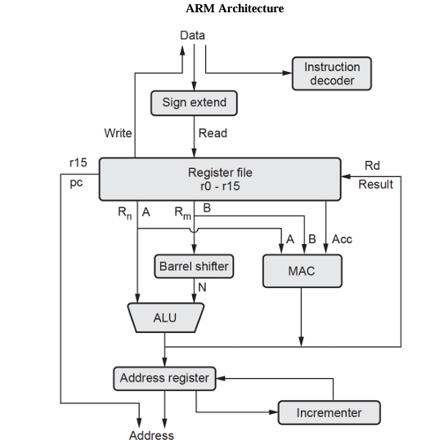

Slide 15
ARM Architecture
1. Priority encoder : The encoder is used in the multiple load and store instruction to point which register within the register file to be loaded or kept.
2. Multiplexers : Several multiplexers are accustomed to the management operation of the processor buses.

Slide 16
3. Arithmetic Logic Unit (ALU) :
The ALU has two 32-bits inputs.
The primary comes from the register file, whereas the other comes from the shifter. Status registers flags modified by the ALU outputs.
The V-bit output goes to the V flag as well as the Count goes to the C flag.
Whereas the foremost significant bit really represents the S flag, the ALU output operation is done by NORed to get the Z flag.
The ALU has a 4-bit function bus that permits up to 16 opcode to be implemented.

Slide 17
Booth multiplier factor
The multiplier factor has 3 32-bit inputs and the inputs return from the register file.
The multiplier output is barely 32-Least Significant Bits of the merchandise.
The entity representation of the multiplier factor is shown in the above block diagram.
The multiplication starts whenever the beginning 04 input goes active.
Fin of the output goes high when finishing.

Slide 18
Barrel shifter
The barrel shifter features a 32-bit input to be shifted.
This input is coming back from the register file or it might be immediate data.
The shifter has different control inputs coming back from the instruction register.
The Shift field within the instruction controls the operation of the barrel shifter. This field indicates the kind of shift to be performed.
The quantity by which the register thought to be shifted is contained in an immediate field within the instruction or it might be the lower 6 bits of a register within the register file.

Slide 19
Control unit
The control unit is sometimes a pure combinational circuit design. Here, the control unit is implemented by easy state machine.
The processor timing is additionally included within the control unit.
Signals from the control unit are connected to each component within the processor to supervise its operation.

Slide 20
Incremented :
• For load and store instructions, the incremented updates the contents of the address register before the processor core reads or writes the next register value from or to the consecutive memory location.
• The processor core continues the execution of instruction. Only when an exception or interrupt occurs, the normal execution flow is changed.

Slide 21
Address Register : This holds the address generated by the load and store instructions and places it on the address bus.
9. Instruction decoder : It decodes the instruction opcode read from the memory and then the instruction is executed.
10. Register file : This is a bank of 32-bit registers used for storing data items.

Slide 22
ARM7 Based (LPC2148) Microcontroller Pin Configuration
The LPC2148 microcontroller is designed by Philips (NXP Semiconductor) with several in-built features & peripherals.
Due to these reasons, it will make more reliable as well as the efficient option for an application developer.
LPC2148 is a 16-bit or 32-bit microcontroller based on ARM7 family.

Slide 23
Classification of ARM Pins
Power supply pins
Clock and reset pins
GPIO pins
Communication interface pins
Analog pins
PWM, Timer and Debug pins

Slide 24
Power Supply Pins
VDD – 3.3V main supply
VSS – Ground
VBAT – Battery supply for RTC
VREF – Reference voltage for ADC operation

Slide 25
Clock and Reset Pins
XTAL1 and XTAL2 are used to connect external crystal
PLL pins are used for frequency multiplication
RESET pin initializes the system during power-up or fault

Slide 26
GPIO Pins
Port 0: P0.0 to P0.31
Port 1: P1.16 to P1.31
Pins can be configured as input or output
Each pin supports alternate peripheral functions

Slide 27
Communication Interface Pins
UART pins are used for serial communication
SPI pins support high-speed data transfer
I2C pins are used for two-wire communication
USB pins enable USB device communication

Slide 28
Analog Pins
ADC pins convert analog signals to digital values
LPC2148 has 10-bit ADC channels
DAC pin converts digital data to analog output

Slide 29
PWM and Timer Pins
PWM pins generate pulse width modulated signals
Used in motor control and power control
Timer pins include capture and match functions

Slide 30
JTAG / Debug Pins
TCK – Test Clock
TMS – Test Mode Select
TDI – Test Data Input
TDO – Test Data Output
Used for debugging and programming

Slide 31
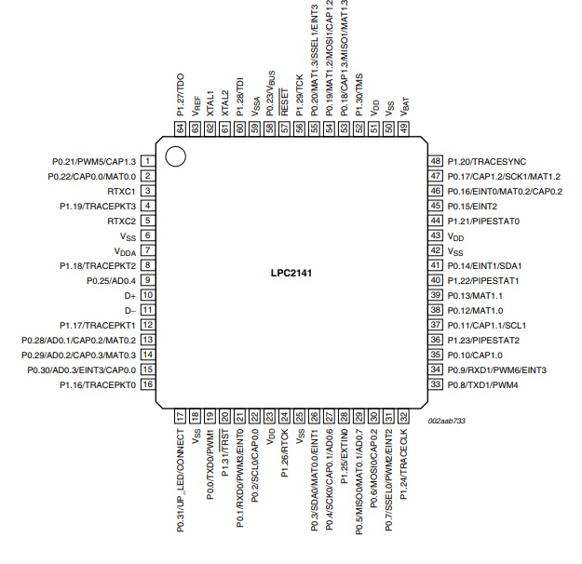

Slide 32
Pin1-(P0.21/ PWM5CAP1.3/ AD1.6)
P0.21 is a GPIO pin (general purpose I/O pin)
AD1.6 is obtainable in LPC2144/46/48 microcontrollers only where an AD1.6 denotes ADC-1, i/p-6.
PWM5 is a pulse width modulator output-5.
CAP1.3 is a Capture i/p for Timer-1, channel-3

Slide 33
Pin2-(P0.22/ CAP0.0/AD1.7/ MAT0.0 2
P0.22 is a GPIO digital pin
AD1.7 pin is available in LPC2144/46/48 only where an AD1.7 denotes ADC-1, input-7
CAP0.0 is a capture input pin for Timer-0, channel-0.
MAT0.0 is a match o/p for Timer-0, channel-0

Slide 34
Pin3-RTXC1 3
It is an I/p to the RTC-oscillator circuit
Pin4- TRACEPKT3/ P1.19
TRACEPKT3 is a trace packet, bit-3, standard input/output port by the inner pull-up.
P1.19 is a GPIO digital pin
Pin5-RTXC2
This is an output pin from the RTC oscillator circuit
Pin6, Pin18, Pin25, Pin42, and Pin50
These pins are a ground reference
Pin7-VDDA
This pin is an analog voltage power supply (3.3V), and this voltage is very useful for the on-chip analog to digital converters and digital to analog converters.

Slide 35
Pin8- P1.18/TRACEPKT2
P1.18 is a GPIO digital pin
TRACEPKT2 is a trace packet, bit-2, standard input/output port by the inner pull-up.
Pin9- P0.25/AOUT/AD0.4
P0.25 is a GPIO digital pin I
AD0.4 denotes ADC-0, input-4
Aout- the output of DAC and that is accessible only in LPC2142/ LPC2144/ LPC2146/ LPC2148
Pin10- D+
This pin is a USB bidirectional D+ line
Pin11- D-
This pin is a USB bidirectional D- line

Slide 36
Pin12-P1.17/TRACEPKT1
P1.17 is a GPIO digital pin
TRACEPKT1 is a trace packet, bit-1, standard input/output port by the inner pull-up.
Pin13-P0.28/ CAP0.2/ AD0.1/MAT0.2
P0.28 is a GPIO digital pin
AD0.1 denotes ADC-0, input-1
CAP0.2 is a capture i/p for Timer-0, channel-2.
MAT0.2 is a match o/p for Timer-0, channel-2
Pin14-P0.29/ CAP0.3/ AD0.2/MAT0.3
P0.29 is a GPIO digital pin
AD0.2 denotes ADC-0, input-2
CAP0.3 is a capture i/p for Timer-0, channel-3.
MAT0.3 is a match o/p for Timer-0, channel-3

Slide 37
Pin15-P0.30/ EINT3/ AD0.3/CAP0.0
P0.30 is a GPIO digital pin
AD0.3 denotes ADC-0, input-3
EINT3 is an external interrupt 3-input.
CAP0.3 is a capture i/p for Timer-0, channel-0.
Pin16- P1.16/TRACEPKT0
P1.16 is a GPIO digital pin
TRACEPKT1 is a trace packet, bit-0, standard input/output port by inner pull-up
Pin17-P0.31/UP_LED/CONNECT
P0.31 is a GPIO digital pin
UP_LED is a USB good link LED indicator. When the device is arranged then it is low and when the device is not arranged, then it is high.
CONNECT- This signal is used to control an exterior resistor (1.5 kΩ) under the control of a software control, and it is used by the feature of Soft Connect

Slide 38
Pin19- P0.0/PWM/TXD0
P0.0 is a GPIO digital pin
TXD0 is a transmitter o/p for UART0.
PWM1 is a pulse width modulator o/p-1.
Pin20- P1.31/TRST
P1.31 is a GPIO digital pin
TRST is a test reset for JTAG interface.
Pin21-P0.1/ PWM3/ RXD0/EINT0
P0.1 is a GPIO digital pin
RXD0 is a receiver i/p for UART0.
PWM3 is a pulse width modulator o/p-3.
EINT0 is an external interrupt 0-input
Pin22- P0.2/ CAP0.0/ SCL0
P0.2 is a GPIO digital pin
SCL0 is an I2C0 clock I/O, and open-drain o/p
CAP0.0 is a capture i/p for Timer-0, channel-0.

Slide 39
Pin 23, 43, and 51- VDD
These pins are power supply voltage for the I/O ports as well as the core.
Pin24- P1.26/RTCK
P1.26 is a GPIO digital pin
RTCK is a returned test CLK o/p, an additional signal added to the JTAG-port. When the frequency of processor changes then it helps debugger synchronization.
Pin26- P0.3/ SDA0/ MAT0.0/EINT1
P0.3 is a GPIO digital pin
SDA0 is an I2C0 data I/O and open drain o/p for I2C bus observance.
MAT0.0 is matched o/p for timer-0, channel-0.
EINT1 is an external interrupt 1-i/p.

Slide 40
Pin27-P0.4/ CAP0.1/ SCK0/AD0.6
P0.4 is a GPIO digital pin I/O
SCK0 is a serial CLK for SPI0 and SPI CLK o/p from master/ i/p to slave.
CAP0.1 is a capture i/p for timer-0, channel-0.
IAD0.6 denotes ADC-0, input-6
Pin28-P1.25/EXTIN0
P1.25 is a GPIO digital pin I/O
EXTIN0 is an external trigger i/p, and standard input/output with inner pull-up
Pin29- P0.5/MAT0.1/MISO0/AD0.7
P0.5 is a GPIO digital pin I/O
MISO0 is a master in slave out for SPI0, data i/p to SPI-master/data o/p from SPI slave.
MAT0.1 is a match o/p for timer-0, channel-1.
AD0.7 denotes ADC-0, input-7.

Slide 41
Pin30-P0.6/MOSI0/CAP0.2/AD1.0
P0.6 is a GPIO digital pin I/O
MOSI0 is a master out slave in for SPI0, and data o/p from SPI master/ data i/p to SPI slave.
CAP0.2 is a capture i/p for Timer-0, channel-2.
Pin31-P0.7/ PWM2/ SSEL0/EINT2
P0.7 is a GPIO digital pin I/O
SSEL0 is a slave select for SPI0 and chooses the SPI-interface as a slave.
PWM2 is a pulse width modulator output-2.
EINT2 is an external interrupt 2-input.
Pin32-P1.24/TRACECLK
P1.24 is a GPIO digital pin I/O.
TRACECLK is a trace CLK and standard input/output port with inner pull-up

Slide 42
Pin33-P0.8/TXD1/PWM4/AD1.1
P0.8 is a GPIO digital pin I/O
TXD1 is a transmitter o/p for UART1.
PWM4 is a pulse width modulator o/p-4.
AD1.1 denotes ADC-1, input-1, and it is obtainable only in LPC2144/46/48.
Pin34- P0.9/PWM6/RXD1/EINT3
P0.9 is a GPIO digital pin I/O
RXD1 is a receiver i/p for UART1.
PWM6 is a pulse width modulator o/p-6.
EINT3 is an external interrupt 3-input
Pin35-P0.10/RTS1/CAP1.0/AD1.2
P0.10 is a GPIO digital pin I/O
RTS1 is requesting to send o/p for UART1 and LPC2144/46/48.
CAP1.0 is a capture i/p for timer-1, channel-0.
AD1.2 denotes ADC-1, input-2, and it is obtainable only in LPC2144/46/48

Slide 43
Pin36-P1.23/PIPESTAT2
P1.23 is a GPIO digital pin I/O
PIPESTAT2 is a pipeline status, bit-2., and standard Input/Output port with inner pull-up
Pin37-P0.11/ CAP1.1/CTS1/ SCL1
P0.11 is a GPIO digital pin I/O
CTS1 is clear to send i/p for UART1, and these are accessible only in LPC2144/46/48
CAP1.1 is a capture i/p for timer-1, channel-1.
SCL1 — I2C1 CLK I/O, and open drain o/p for the I2C-bus observance
Pin38-P0.12/ MAT1.0/AD1.3/ DSR1
P0.12 is a GPIO digital pin I/O
DSR1 is a data set ready i/p for UART1, and these are accessible only in LPC2144/46/48.
MAT1.0 is a match o/p for timer-1, channel-0.
AD1.3 denotes ADC input-3, and it is accessible only in LPC2144/46/48.

Slide 44
ARM Processor Modes and Registers
There were six privileged modes and a non-privileged user mode.
Privilege is the ability to perform certain tasks that cannot be done from User (Unprivileged) mode.
In User mode, there are limitations on operations that affect overall system configuration, for example, MMU configuration and cache operations.
Modes are associated with exception events, which are described in Exception Handling.

Slide 45
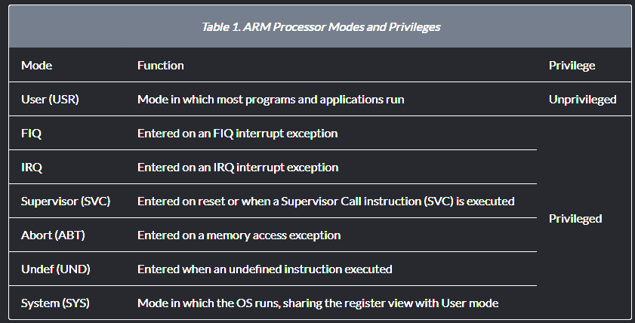

Slide 46
ARM Processor Modes and Registers
The ARM microcontroller architecture (ARM7/9/11) utilizes a 32-bit RISC design with 37 registers (31 general-purpose, 6 status) and 7 operating modes.
16 directly accessible registers (r0-r15).
with banked registers(r8-r14) for fast interrupt (FIQ) and privileged modes.

Slide 47
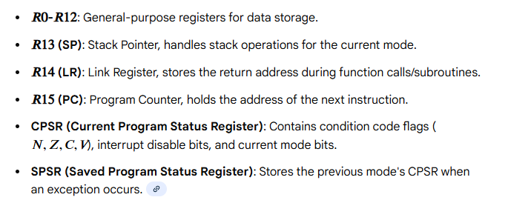
ARM Register Set (32-bit)
ARM processors have 16 visible registers (r0-r15).
one or two Program Status Registers (CPSR, SPSR).

Slide 48
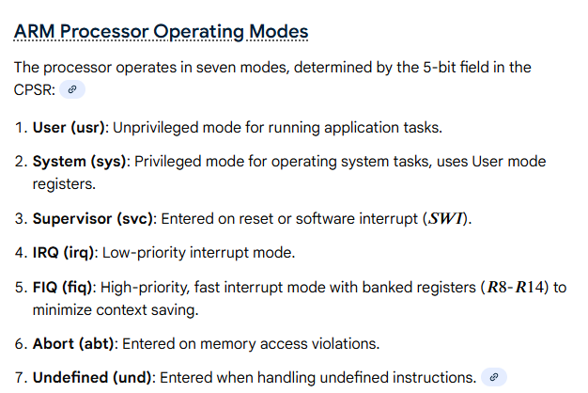

Slide 49
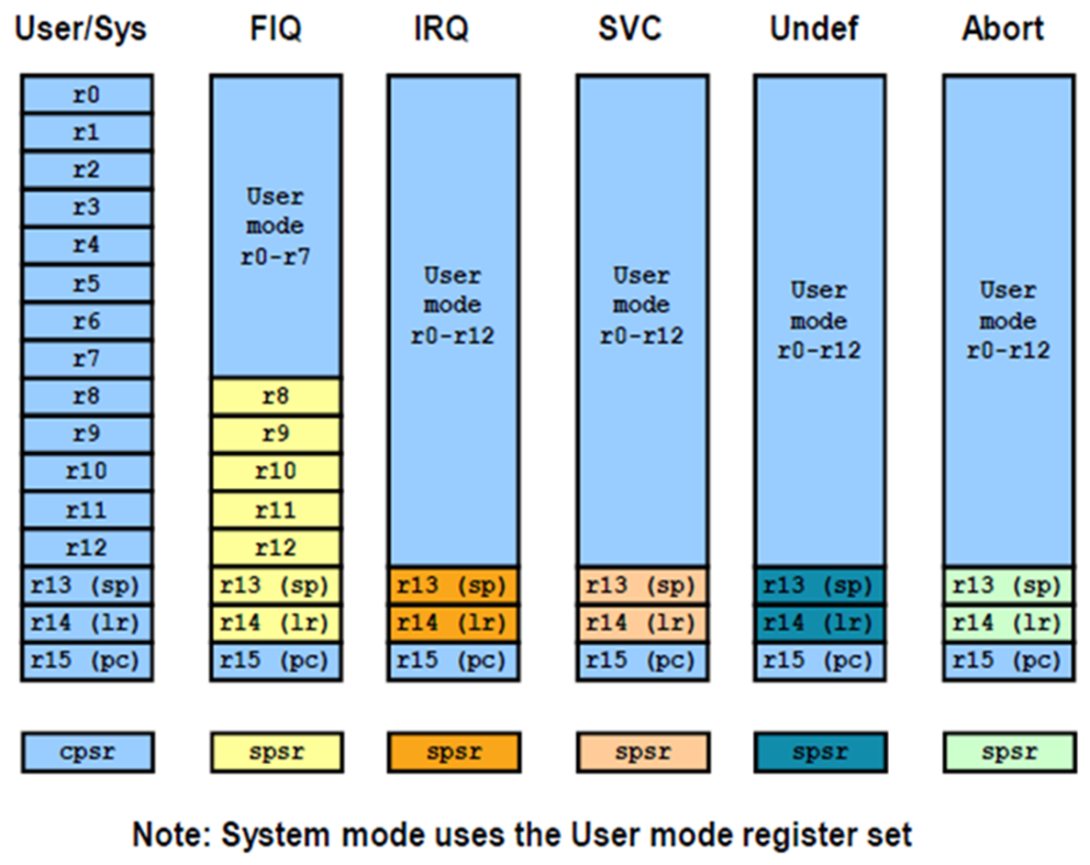

Slide 50
Instruction Set
Instruction set defines the operations that can change the state. ARM instructions are all 32bit long are all 32-bit long (except for Thumb mode) There are 232 possible machine instructions.

Slide 51
Features of ARM instruction set
1. Load-store architecture
2. 3-address instructions
3. Conditional execution of every instruction
4. Possible to load/store multiple registers at once
5. Possible to combine shift and ALU operations in a single instruction

Slide 52
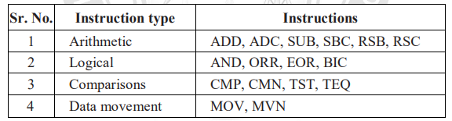
Data Processing Instruction
Data processing instructions are move, arithmetic, logical, comparison and multiply instructions. The load / store instruction only work on registers, NOT memory. They each perform a specific operation on one or two operands.

Slide 53
MOV and MVN Instruction
MOV instruction move the data from one register to another register.
Format is as follows :
MOV destination_reg , source_reg
Registers R1 to R12 can be used for data movement. These are the general purpose registers. The register R13, R14 and R15 are also used for data movement.
The "MVN" stands for "MOVE Negated". Toggling is done by using MVN instruction.
Toggling means switching between 0 and 1. The easiest type of toggling is just switching all the bits in a register. This is easily done with a MVN instruction.

Slide 54
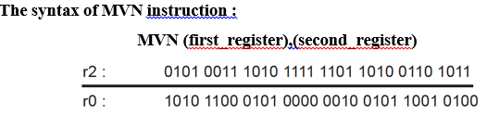
MVN instruction

Slide 55
Example : MVN rO, r2
Move the complemented value of r2 to rO
All the bits in the second_register will switch (1 to 0 or 0 to 1) and then the result will be stuck in the first_register.
Example :
MOV R5, R7 ; copy content of R7 to R5 MOV R9, R3 ; copy content of R3 to R9
MVN Rl, R4 ; move the complemented value of R4 to R1

Slide 56
Shift and Rotate
Logical and arithmetic are the two shift types. There are six mnemonics for the different shift types :
Logical Shift Left (LSL)
Arithmetic Shift Left (ASL)
Logical Shift Right (LSR)
Arithmetic Shift Right (ASR)
Rotate Right (ROR)
Rotate Right with Extend (RRX)

Slide 57
Logical Shift Left
Shifts left by the specified amount. LSL means "logical shift left by the specified number of bits." This instruction is executed in a single clock cycle.
Example : LSL # n
Here n is the number of bit positions by which the value is shifted. Shifting left by n-bit on a signed or unsigned binary number has the effect of multiplying it by 2n

Slide 58
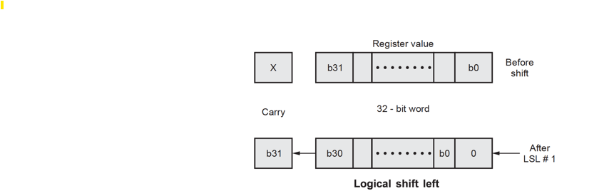
Logical Shift Left

Slide 59
Logical Shift Right (LSR)
LSR by 0 to 32 places, fill the vacated bits at the most significant end of the word with zeros.
Logical shifts can be useful as efficient ways of performing multiplication or division of unsigned integers by powers of two.
Shifting right by n-bit on an unsigned binary number has the effect of dividing it by 2^{n}.

Slide 60
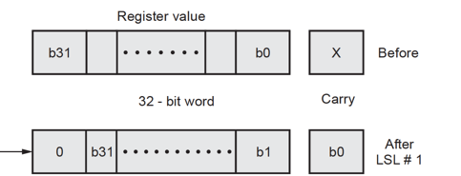

Slide 61
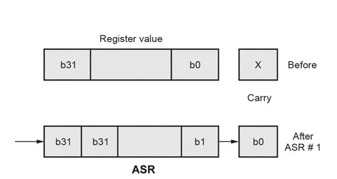
Arithmetic Shift Left and Right
Arithmetic Shift Left (ASL) is same as logical shift left.
Arithmetic Shift Right (ASR) by 0 to 32 places, fill the vacated bits at the most significant end of the word with zeros if the source operand was positive and with ones it is negative.

Slide 62
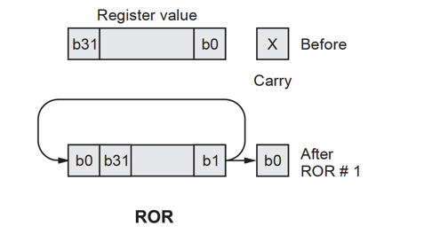
Rotate Right (ROR)
Rotate right by 0 to 32 places. The last bit rotated out is available in the carry flag. Rotate left instruction is not used in ARM processor.
Rotate left by "n" positions is the same as a rotate right by (32 - n).

Slide 63
Conditional Code Instruction
ARM processor supports for conditional execution. The instruction is executed only when condition is true. Any data processing instruction is used for this purpose.
Most instruction sets only allow branches to be executed conditionally. However by reusing the condition evaluation hardware, ARM effectively increase number of instruction. All instructions contain a condition field which determines whether the CPU will execute them.
Bits 28 to 31 of each ARM instruction provide a condition field that defines whether the current instruction is to be executed.

Slide 64
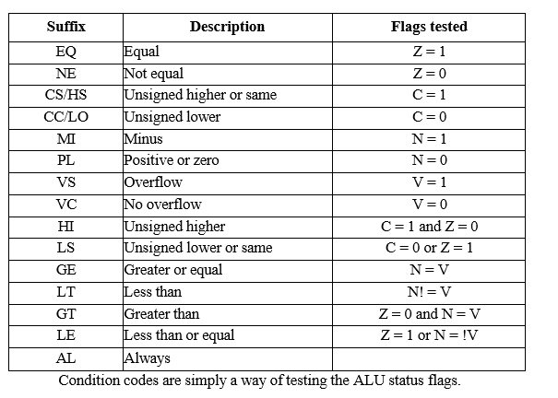

Slide 65
Compare Instruction
These four instructions set the status bits/flags (N, Z, C, V) in the PSR according to the results of their operations.
CMP : Compare, using subtraction
CMN : Compare negated, using addition
TEQ : Test for equality, using XOR - does not affect V flag
TST : Test bit(s), using AND - does not affect V flag
Comparison is done by using subtraction operation. Source and destination value is not changed only conditional flags are affected.

Slide 66
Multiplication Instruction
Multiplication instruction takes more than one cycle. it also requires hardware to perform operation.
Multiply
Syntax : MUL Rd, Rm, Rs where Rd = Destination register Rm, Rs = Source register
Example : MUL RO, R1, R2 @ RO = R1 x R2
Features :
Second operand cannot be immediate.
The result register must be different from the first operand.
if S bit is set, C flag is meaningless.

Slide 67
Multiple Register Load and Store
These instructions transfer large quantities of data more efficiently. It is used for procedure entry and exit for saving and restoring workspace registers and the return address.

Slide 68
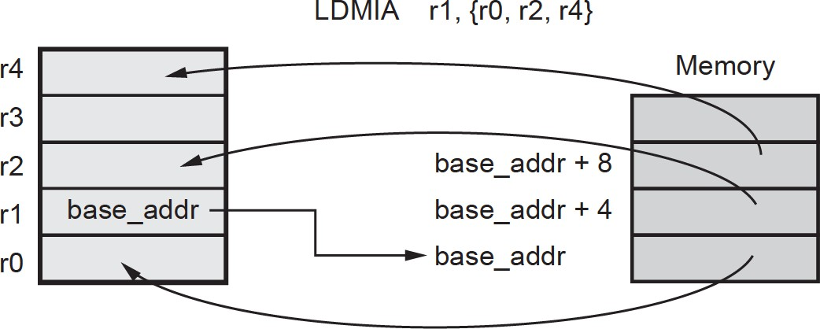
LDM Instruction
LDR and STR instructions only load/store a single 32-bit word. ARM processor can load/store ANY subset of the 16 registers in a single instruction.

Slide 69
STM Instruction
Any registers can be specified. However, beware that if you include rl5 (PC), you are effectively forcing a branch in the program flow.
The complementary instruction to LDMIA is the STMIA instruction :
STMIA rl, {rO, r2, r4} ; mem32[rl] : = rO
; mem32[rl + 4] : = r2
; mem32[rl + 8] : = r4

Slide 70
STM Instruction
The Load and Store Multiple Instructions (LDM/STM) allow between 1 and 16 registers to be transferred to or from memory. The order of register transfer cannot be specified, order in the list is insignificant.
The lowest register number is always transferred to/from lowest memory location accessed. The transferred registers can be either :
Any subset of the current bank of registers (default)
Any subset of the user mode bank of registers when in a privileged mode (postfix instruction with a "A")

Slide 71
Branch Instruction
The branch instructions cause the processor to execute instructions from a different address. Two branch instruction are available B and BL. These instructions are only executed if the condition is true.
The BL instruction in addition to branching, also stores the return address in the lr register, and hence can be used for sub-routine invocation.
A simple branch or branch with link instruction :
B{condition} <address> BL{condition} <address>
Bits [27:25] identify this as a B or BL instruction, they have values 101 only for these instructions.

Slide 72
ARM Memory Organization
ARM Cortex-M microcontrollers use a 32-bit linear address space (4 GB) divided into fixed regions for code, data, peripherals, and system control. The architecture supports memory-mapped I/O and bit-banding for efficient bit manipulation.
Unified Address Space (4 GB):
ARM processors use a 32-bit architecture, supporting a flat memory space from 0x00000000 - 0x1FFFFFFF.
Memory-Mapped Peripherals: Peripherals are not accessed via special I/O instructions but rather mapped directly into the address space, treating registers (e.g., GPIO, UART) like memory locations.

Slide 73
Memory Regions (Cortex-M Example)
Code Region (0x00000000 - 0x1FFFFFFF): Typically stores executable code (Flash).
SRAM Region (0x20000000 - 0x3FFFFFFF): Used for data, stack, and heap.
Peripheral Region (0x40000000 - 0x5FFFFFFF): Reserved for on-chip peripherals.
System/External Region: External RAM, device, and private peripheral bus (PPB) for debug components.

Slide 74
ARM Memory Organization
Load-Store Architecture: Only load and store instructions can access memory; all data manipulation occurs within the large register file (R0-R15), minimizing memory access time.
Endianness: Supports both Little-Endian and Big-Endian, though most ARM systems use Little-Endian.
Memory Types:
Normal: Used for RAM/Flash, allows buffering and reordering.
Device: Used for peripherals, ensures strict access ordering.
Strongly Ordered: Ensures strict access order for critical system controls.
Hierarchy: Features fast, local cache memory (L1/L2) close to the core, with slower main memory (SRAM/Flash) further away.

Slide 75
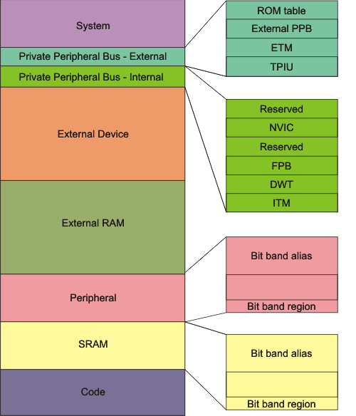

Slide 76
ARM Memory Organization
Private Peripheral Bus - External - Provides access to :
the Trace Port Interface Unit (TPIU),
the Embedded Trace Macrocell (ETM),
the ROM table,
implementation-specific areas of the PPB memory map.
Private Peripheral Bus - External - Provides access to :
the Instrumentation Trace Macrocell (ITM),
the Data Watchpoint and Trace (DWT),
the Flashpatch and Breakpoint (FPB),
the System Control Space (SCS), including the MPU and the Nested Vectored Interrupt Controller (NVIC).

Slide 77
ARM Memory Organization
External Device - This region is used for external device memory.
External RAM - This region is used for data.
Peripheral - This region includes bit band and bit band alias areas.
Peripheral Bit-band alias - Direct accesses to this memory range behave as peripheral memory accesses, but this region is also bit addressable through bit-band alias.
Peripheral bit-band region - Data accesses to this region are remapped to bit band region. A write operation is performed as read-modify-write.

Slide 78
ARM Memory Organization
SRAM - This executable region is for data storage. Code can also be stored here. This region includes bit band and bit band alias areas.
SRAM Bit-band alias - Direct accesses to this memory range behave as SRAM memory accesses, but this region is also bit addressable through bit-band alias.
SRAM bit-band region - Data accesses to this region are remapped to bit band region. A write operation is performed as read-modify-write.
Code - This executable region is for program code. Data can also be stored here.

Slide 79
Programming ports
ARM microcontrollers, such as the common LPC2148 (ARM7), utilize specialized ports for programming, debugging, and general-purpose I/O (GPIO). The primary methods include Joint Test Action Group (JTAG) for debugging, In-System Programming (ISP) via UART for flashing code, and versatile GPIO pins (e.g., P0, P1) for peripheral interfacing.

Slide 80
Programming ports
JTAG Port (Joint Test Action Group):
Typically a 5-pin interface (TDI, TDO, TMS, TCK, TRST) used for debugging and programming, allowing full control over the ARM core, including halting and stepping through code.
ISP (In-System Programming) Port:
Uses UART0 or UART1, allowing the flash memory to be reprogrammed through a serial connection (COM port) without removing the microcontroller from the circuit.

Slide 81
Programming ports
GPIO Ports (General Purpose Input/Output)
Port 0 (P0): A 32-bit port (P0.0–P0.31) where most pins are configurable as inputs or outputs.
Port 1 (P1): A 32-bit port (P1.16–P1.31 commonly used in LPC2148).
These pins are configured using PINSEL0/PINSEL1 registers to choose between GPIO or alternate functions (UART, PWM, ADC).

Slide 82
Key Registers for Port Configuration
PINSEL0/1: Pin Select registers to configure multiplexed pins.
IODIR: Input/Output Direction register, where 1 sets a pin as output and 0 as input.
IOSET/IOCLR: Used to set (high) or clear (low) output pins.
Programming Sequence
Connect via JTAG or UART (ISP).
Configure PINSEL registers to define pin functionality.
Set direction using IODIR.
Write/Read data using IOSET/IOCLR or IOPIN.

Slide 83
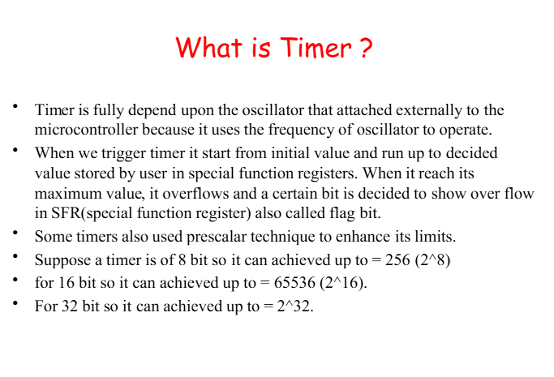

Slide 84
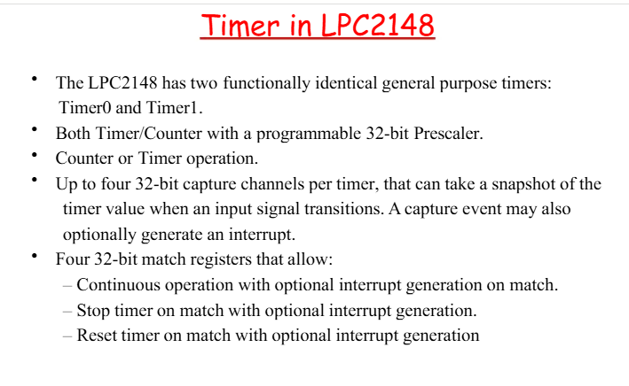

Slide 85
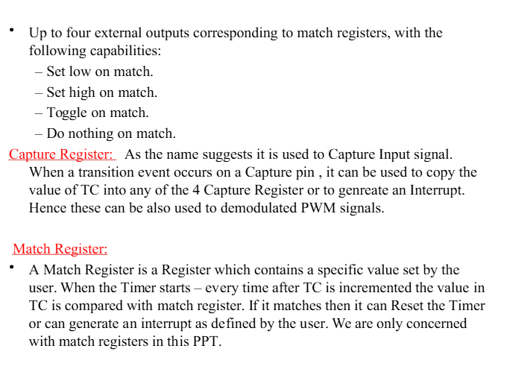

Slide 86
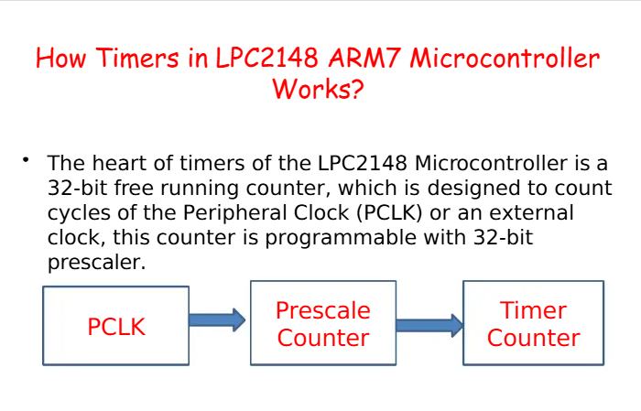

Slide 87
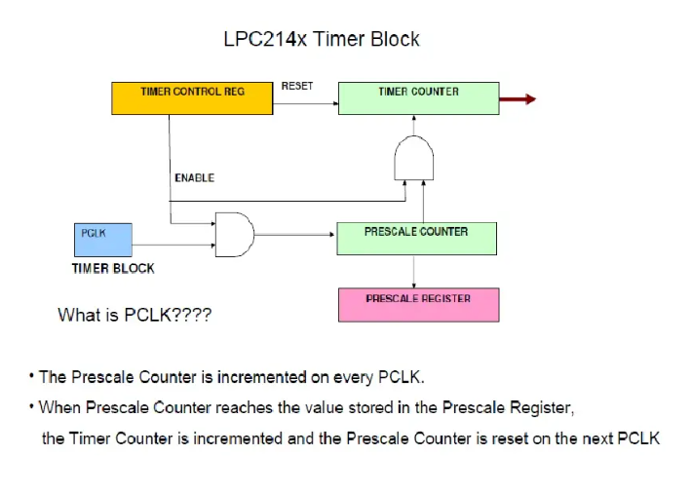

Slide 88
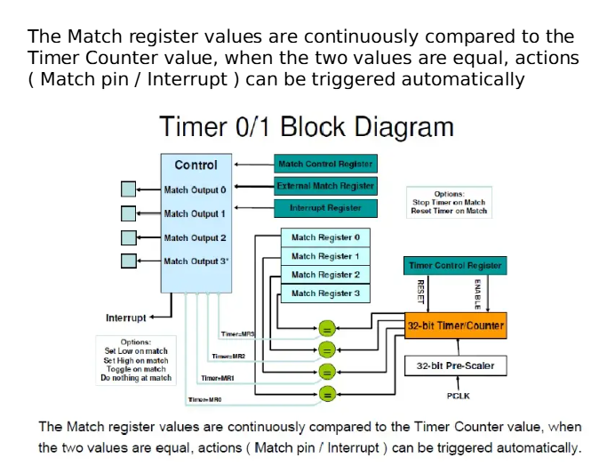

Slide 89
