Slide 1
UNIT III
FUNDAMENTALS OF PYTHON PROGRAMMING & RASPBERRY PI

Slide 2
syllabus
Introduction to python programming, Data Types & Data Structures, working with functions, Modules & Packages, File Handling, classes, REST full Web Services, Client Libraries, Introduction & programming Raspberry Pi3, Interfaces, Integrating Input Output devices with Raspberry Pi3.

Slide 3
Introduction to python programming
Python is a very popular general-purpose interpreted, interactive, object-oriented, and high-level programming language.
Python is a high-level, interpreted language used in embedded systems for scripting, rapid development, and interfacing with hardware like the Raspberry Pi and ESP32 microcontrollers.
Why to Learn Python?
Python is consistently rated as one of the world's most popular programming languages.
Python is fairly easy to learn, so if you are starting to learn any programming language then Python could be your great choice.
Today various Schools, Colleges and Universities are teaching Python as their primary programming language.

Slide 4
Introduction to python programming
Python is Open Source which means its available free of cost.
Python is simple and so easy to learn
Python is versatile and can be used to create many different things.
Python has powerful development libraries include AI, ML etc.
Python is much in demand and ensures high salary.

Slide 5
Applications of Python
Python is used in:
Web development
Data Science
Artificial Intelligence
Machine Learning
Embedded Systems
Automation
Game development

Slide 6
Applications of Python
The latest release of Python is 3.x. As mentioned before, Python is one of the most widely used language over the web.
Easy-to-learn − Python has few keywords, simple structure, and a clearly defined syntax. This allows the student to pick up the language quickly.
Easy-to-read − Python code is more clearly defined and visible to the
eyes.
Easy-to-maintain − Python's source code is fairly easy-to-maintain.
A broad standard library − Python's bulk of the library is very portable and cross-platform compatible on UNIX, Windows, and Macintosh.

Slide 7
Applications of Python
Interactive Mode − Python has support for an interactive mode which allows interactive testing and debugging of snippets of code.
Portable − Python can run on a wide variety of hardware platforms and has the same interface on all platforms.
Extendable − You can add low-level modules to the Python interpreter. These modules enable programmers to add to or customize their tools to be more efficient.
Databases − Python provides interfaces to all major commercial databases.

Slide 8
Basic Python Example
print("Hello, World!")
Hello, World!
Python Variables Example
a = 10
b = 20
c = a + b
print(c)
30

Slide 9
Why Python is Popular
Simple syntax
Used in modern technologies like AI and IoT
High demand in industry

Slide 10
Data Types & Data Structures
Data types define the type of data a variable can store. Data structures are used to organize and store data efficiently.
Data Types
Python has built-in data types:
1. Numeric
int → 10
float → 10.5
complex → 3+2j
Example
a = 10
b = 3.5
a = 10
b = 3.5

Slide 11
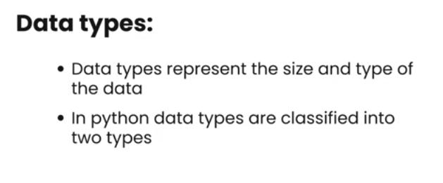

Slide 12
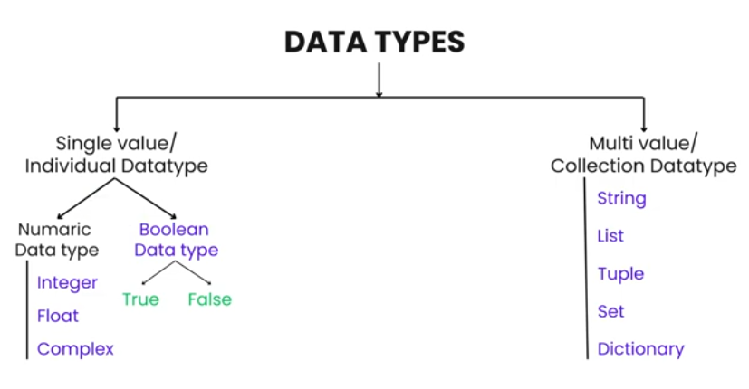

Slide 13
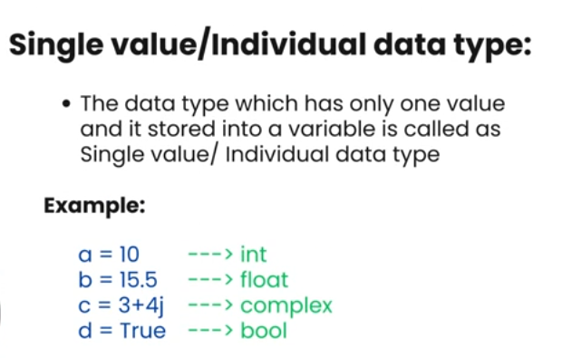

Slide 14
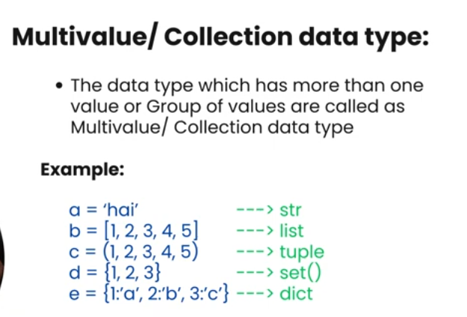

Slide 15
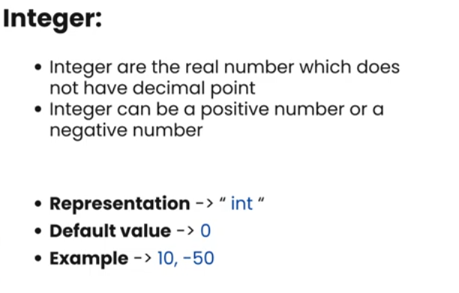

Slide 16
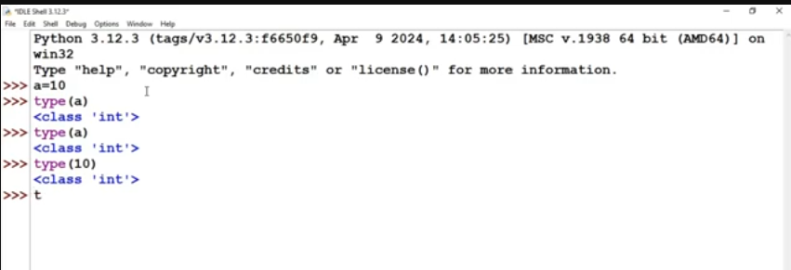

Slide 17
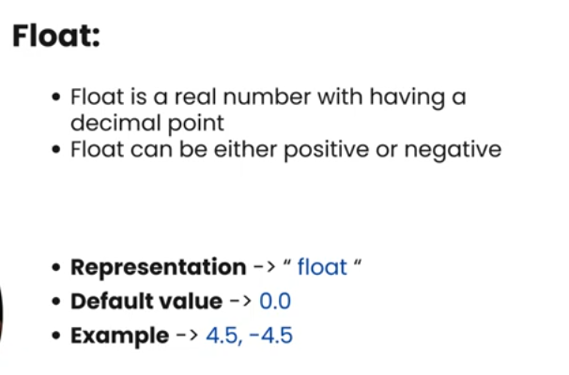

Slide 18
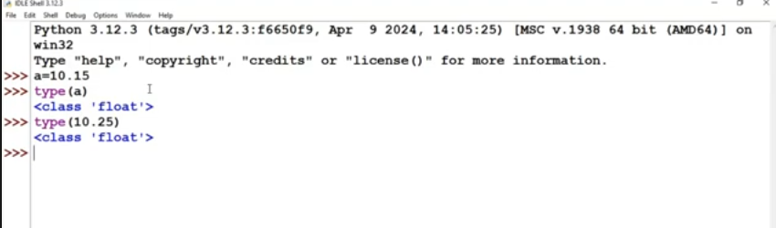

Slide 19
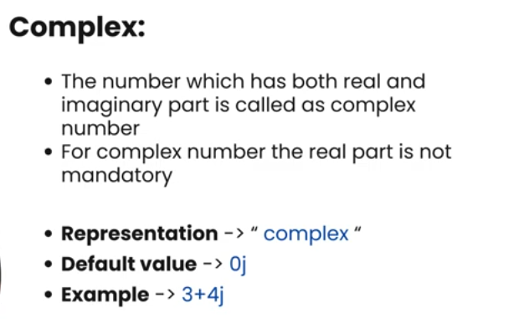

Slide 20
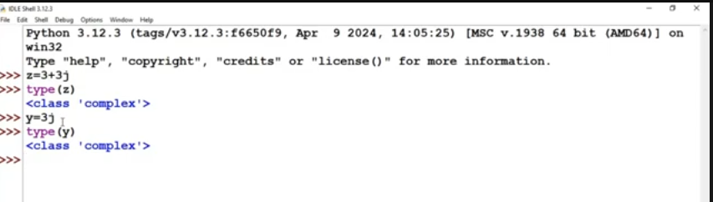

Slide 21
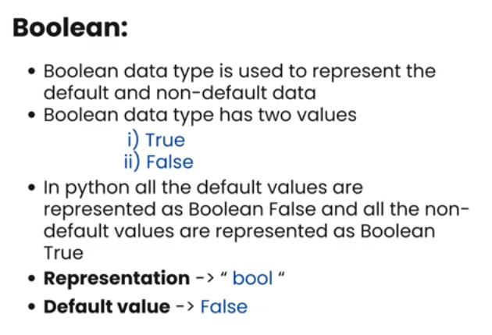

Slide 22
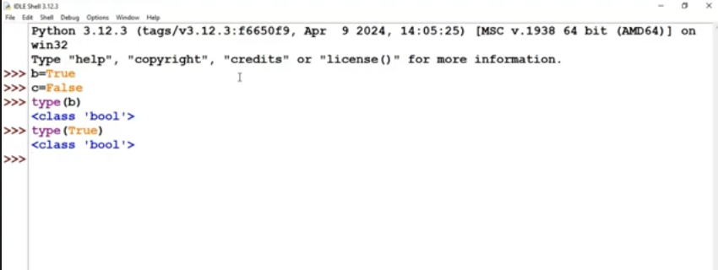

Slide 23
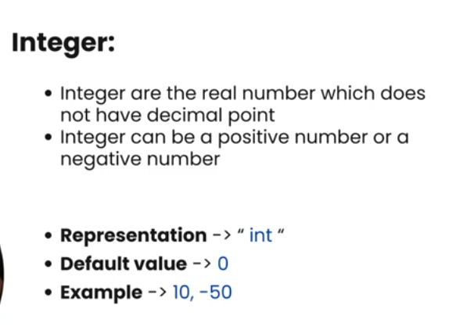

Slide 24
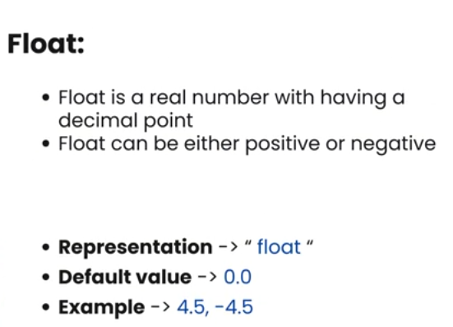

Slide 25
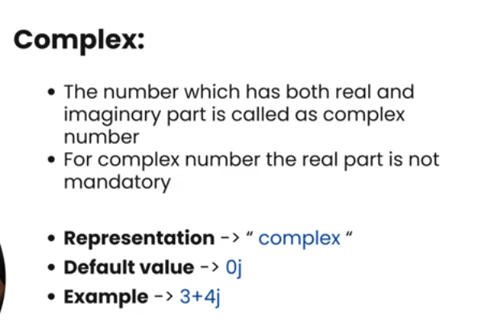

Slide 26
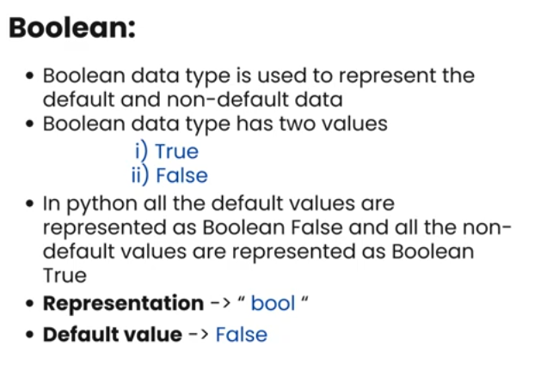

Slide 27
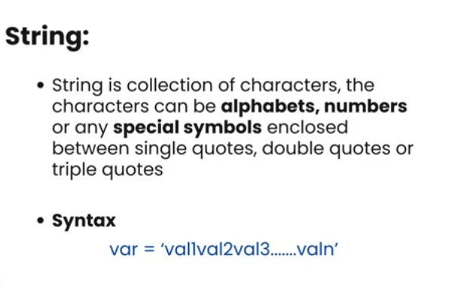

Slide 28
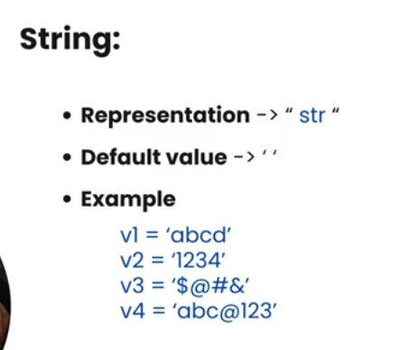

Slide 29
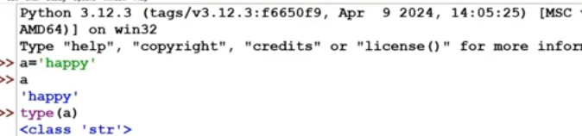

Slide 30
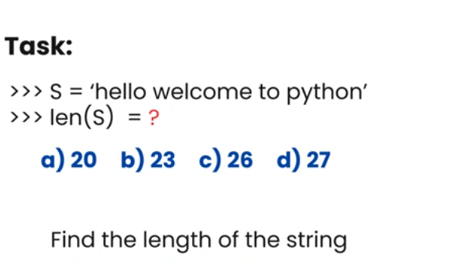

Slide 31
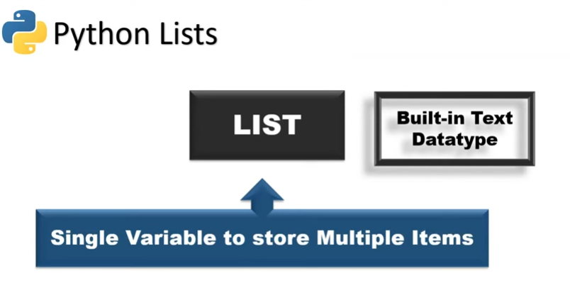

Slide 32
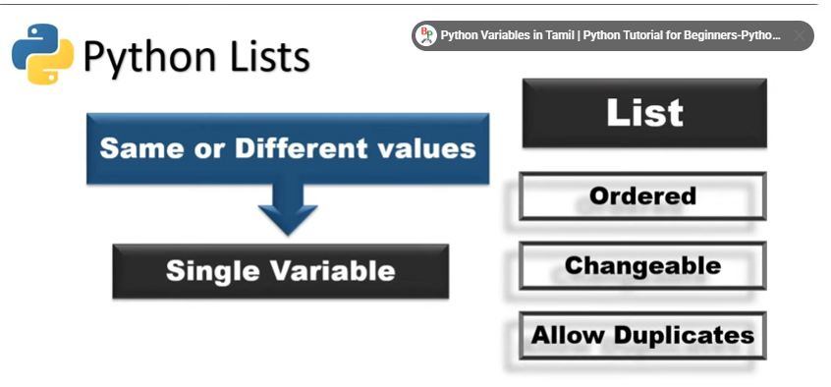

Slide 33
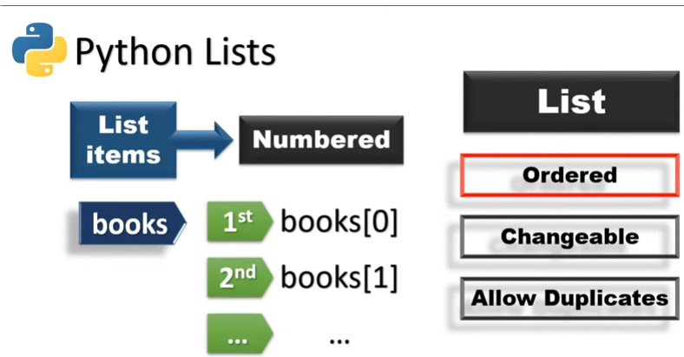

Slide 34
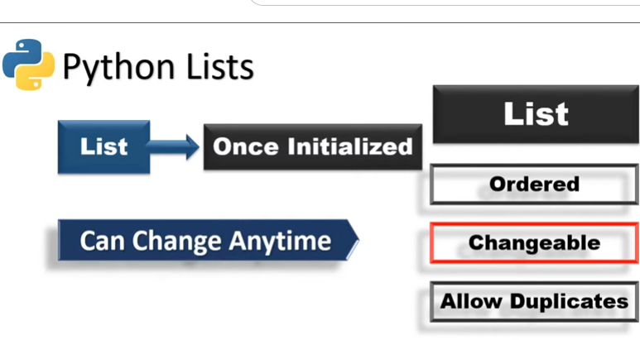

Slide 35
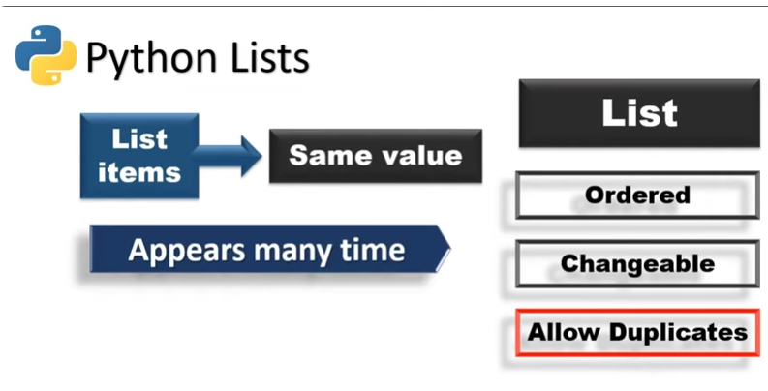

Slide 36
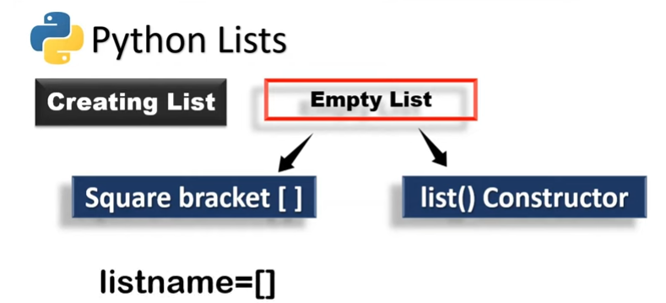

Slide 37
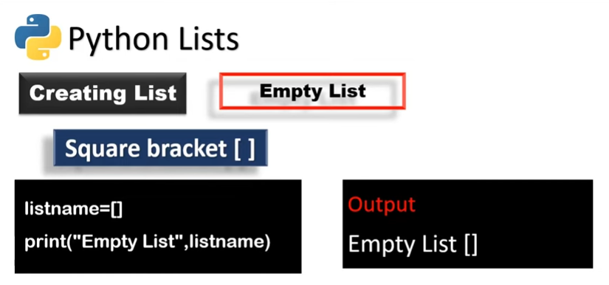

Slide 38
1. List Operations
List is a sequence of values, which can be of different types.
The values in list are called "elements" or ''items''
Each elements in list is assigned a number called "position" or "index”.
A list that contains no elements is called an empty list. They are created with empty brackets[]
A list within another list is called nested list.
LIST OPERATIONS:
1.Concatenation of list
2.Repetition of list

Slide 39
Concatenation:
the '+' operator concatenates the list
a = [1,2,3]
b = [4,5,6]
c = a+b
print (c)
Repetition:
the '*' operator repeats a list a given number of times
>>> a = [1,2,3]
>>> print (a*2)= [1,2,3,1,2,3]

Slide 40
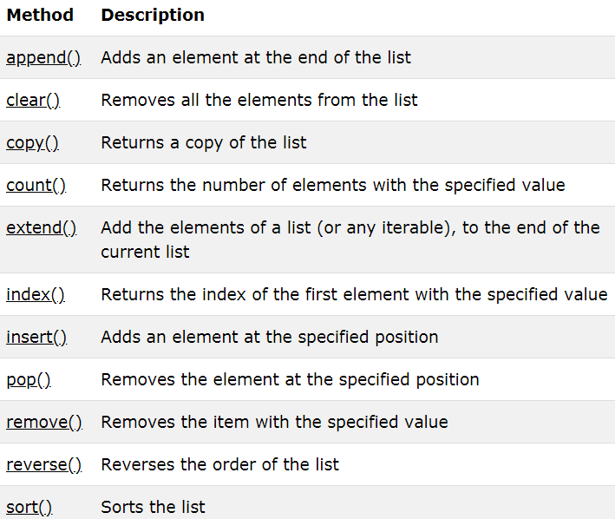
List Methods

Slide 41
#List Methods
Example for clear method:
a=[10,20.3,'c',"hello"]
print(a)
a.clear()
Example for copy,count method:
a=[10,20.3,'c',"hello"]
print(a)
b=a.copy()
print(b)
x=b.count(10)
print(x)
y=b.count("hello")
print(y)
Output:
[10, 20.3, 'c', 'hello']
[10, 20.3, 'c', 'hello']
1
1

Slide 42
Example1:
fruits = ['apple', 'banana', 'cherry']
cars = ['Ford', 'BMW', 'Volvo']
fruits.extend(cars)
print(fruits)
Output:
['apple', 'banana', 'cherry', 'Ford', 'BMW', 'Volvo']
Example 2:
fruits = ['apple', 'banana', 'cherry', ‘banana’]
fruits.remove("banana") # removes only the first occurrence of "banana" in the list
print(fruits)
Output:
['apple', 'cherry',’banana’]

Slide 43
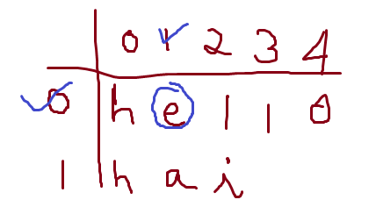
Example 3
cars = ['Ford', 'BMW', 'Volvo']
cars.sort()
print(cars)
Output:
['BMW', 'Ford', 'Volvo']
Example 4:
subjects=[‘Eng’ , ’Tamil’ , ’Maths’]
del subjects[0]
print(subjects)
Output:
Tamil , Maths
Example 5:
a=[ “hello” , ”hai” ]
print(a[0][1])
Output:
e

Slide 44
# Common Elements in two list
fruits1=['apple','mango']
fruits2=['orange','banana','apple']
s1=set(fruits1) #convert into sets
s2=set(fruits2)
s3=s1.intersection(s2)
common=list(s3)
print(common)
Output:
['apple']
Reverse Example:
a=[1,2,3,4]
a.reverse()
print(“reversed list is”,a)
Output:
Reversed list is [4,3,2,1]

Slide 45
2. Tuples
A tuple is a collection of elements of dissimilar datatype.
Values in tuple are enclosed in parentheses and separated by comma.
The elements in the tuple cannot be modified as in list (i.e) tuple are immutable objects.
t1 = ('a','b','c','d')
t2=()
t3=(10,)
print(t3)
print(t1[0:2])

Slide 46
Tuple Assignment
Each value is assigned to its respective variable.
All expressions on right side are evaluated before any of assignments.
Example:
student=('AAA',123)
name,roll=student[0],student[1]
print(name)
print(roll)
Output:
AAA
123

Slide 47
Tuple Built in functions
Methods | Description
len() | Returns number of items
max() | Maximum item
min() | Minimum item
sum() | Sum of items
any() | Returns true if there exists any item, checks if at least one element in an iterable evaluates to True
sorted() | Sort elements in tuple
reversed() | Sort elements in reverse order
enumerate() | Provides index to each elements in a tuple

Slide 48
3. Dictionaries
A dictionary is an unordered set of key: value pair.
In a list, the indices have to be integers; but, in a dictionary, it can be any type.
A dictionary contains a collection of indices, which are called keys, and a collection of values.
Each key is associated with a single value.
The association of a key and a value is called a key-value pair.
Dictionary is created by enclosing with curly braces {}.

Slide 49
Example
>>>dictionary={"RollNo":101,2:(1,2,3),"Name":"Ramesh",20:20.50,”Loc":['Chennai']}
>>> dictionary
{'RollNo': 101, 2: (1, 2, 3), 'Name': 'Ramesh', 20: 20.5, 'Loc': ['Chennai']}

Slide 50
Dictionary Methods
Method | Description
clear() | Removes all the elements from the dictionary
copy() | Returns a copy of the dictionary
fromkeys() | Returns a dictionary with the specified keys and value
get() | Returns the value of the specified key
items() | Returns a list containing a tuple for each key value pair
keys() | Returns a list containing the dictionary's keys
pop() | Removes the element with the specified key
popitem() | Removes the last inserted key-value pair
update() | Updates the dictionary with the specified key-value pairs
values() | Returns a list of all the values in the dictionary

Slide 51
Creating a dictionary
Syntax:
dict={} # empty dictionary
dict={key1:value1,key2:value2…..,keyn:valuen}
Key: user defined variable names
Value: values assigned for the key
Example:
member_1={'Name':‘AAA','Dept':'IT'}

Slide 52
Accessing Elements on a dictionary
member={'Name':‘AAA','Dept':'IT'}
x=member['Name']
print(x)
Output AAA

Slide 53
Get method
member={'Name': 'AAA','Dept':'IT'}
x=member.get('Dept')
print(x)
Output
IT
- member.get('Dept') retrieves the value associated with the key 'Dept', which is 'IT'.

Slide 54
Adding Dictionary Entries
dict={'name’:’XXX','age':24,'ranking':'5th‘}
print(dict)
dict['status']='regular‘
print(dict)
Output:
{'name': ‘XXX', 'age': 24, 'ranking': '5th'}
{'name': ‘XXX', 'age': 24, 'ranking': '5th', 'status': 'regular'}

Slide 55
Modifying Dictionaries Entry
dict={'name’:’xxx','age':24,'ranking':'5th'}
print(dict)
dict['ranking']='3rd‘
print(dict)
Output
{'name': ‘xxx', 'age': 24, 'ranking': '5th'}
{'name': ‘xxx', 'age': 24, 'ranking': ‘3rd'}

Slide 56
Removing or deleting elements from a dictionary
dict={'name’:’xxx','age':24,'ranking':'5th'}
print(dict)
dict.pop('age')
print(dict)
Output:
{'name': ‘xxx', 'age': 24, 'ranking': '5th'}
{'name': ‘xxx', 'ranking': '5th'}

Slide 57
Popitem()
dict={'name’:’xxx','age':24,'ranking':'5th'}
print(dict)
dict.popitem()
print(dict)
Output
{'name': ‘xxx', 'age': 24, 'ranking': '5th'}
{'name': ‘xxx', 'age': 24}

Slide 58
Clear()
dict={'name’:’xxx','age':24,'ranking':'5th'}
dict.clear()
print(dict)
Output
{} # empty dictionary

Slide 59
Deleting a dictionary
dict={'name’:’xxx','age':24,'ranking':'5th'}
del dict
print(dict)
Output:
Traceback error

Slide 60
Modules and Packages
Python Modules
A python module can be defined as a python program file which contains a python code including python functions, class, or variables. In other words, we can say that our python code file saved with the extension (.py) is treated as the module. We may have a runnable code inside the python module.
Modules in Python provides us the flexibility to organize the code in a logical way.

Slide 61
Example:
In this example, we will create a module named as file.py which contains a function func that contains a code to print some message on the console.
Let's create the module named as file.py.
#displayMsg prints a message to the name being passed.
def displayMsg(name) print("Hi "+name);

Slide 62
Loading the module in our python code
The import statement
The from-import statement
The import statement
The import statement is used to import all the functionality of one module into another. Here, we must notice that we can use the functionality of any python source file by importing that file as the module into another python source file.

Slide 63
We can import multiple modules with a single import statement, but a module is loaded once regardless of the number of times, it has been imported into our file.
The syntax to use the import statement is given below.
import module1,module2,........ module n

Slide 64
Example:
import file;
name = input("Enter the name?") file.displayMsg(name)
Output:
Enter the name?John
Hi John

Slide 65
The from-import statement
Instead of importing the whole module into the namespace, python provides the flexibility to import only the specific attributes of a module. This can be done by using from? import statement. The syntax to use the from-import statement is given below.
from < module-name> import <name 1>, <name 2>..,<name n>

Slide 66
calculation.py:
#place the code in the calculation.py
def summation(a,b): return a+b
def multiplication(a,b): return a*b;
def divide(a,b): return a/b;

Slide 67

Main.py:
from calculation import summation
#it will import only the summation() from calculation.py
a = int(input("Enter the first number"))
b = int(input("Enter the second number"))
print("Sum = ",summation(a,b))
‘’’we do not need to specify the module name while accessing summation()’’’

Slide 68
Output:
Enter the first number10
Enter the second number20
Sum = 30

Slide 69
File Handling in Python
File handling refers to the process of performing operations on a file, such as creating, opening, reading, writing and closing it through a programming interface.
It involves managing the data flow between the program and the file system on the storage device, ensuring that data is handled

Slide 70
Why do we need File Handling
To store data permanently, even after the program ends.
To access external files like .txt, .csv, .json, etc.
To process large files efficiently without using much memory.
To automate tasks like reading configs or saving outputs.

Slide 71
Opening a File
To open a file, we can use open() function, which requires file-path and mode as arguments.
file = open('filename.txt', 'mode')
Closing a File
The file.close() method closes the file and releases the system resources. If the file was opened in write or append mode, closing ensures that all changes are properly saved.
file = open("geek.txt", "r")
# Perform file operations
file.close()

Slide 73
Libraries in Python
In Python, a library is a group of modules that contain functions, classes and methods to perform common tasks like data manipulation, math operations, web scraping and more.
Python libraries make coding faster, cleaner and more efficient by providing ready-to-use solutions for different domains such as data science, web development, machine learning and automation.

Slide 74
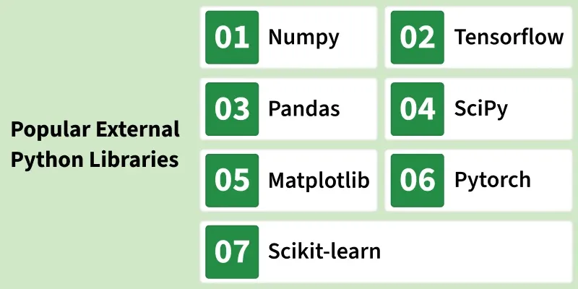

Slide 75
Working of Python Library
When you import a library in Python, it gives access to pre-written code stored in separate modules. In simple terms instead of writing the logic for a task, you import the library that already has it.
For example, on Windows, libraries are stored as .dll (Dynamic Link Libraries) and on Linux/macOS as .so files. When you run your code, Python automatically loads these modules and makes their functions available to use.

Slide 76
Types of Python Library
Python libraries are divided into two main types:
1. Built-in Python Standard Library
2. External Python Libraries

Slide 77
1. Built-in Python Standard Library
It is a collection of modules that come bundled with every Python installation, we don’t need to install anything separately. Most of these modules are written in C for better performance.
Examples of built-in modules:
math: Mathematical operations
os: Interact with the operating system
datetime: Date and time operations
random: Generate random numbers
json: Handles JSON data encoding and decoding.

Slide 78
2. External Python Libraries
External (third-party) libraries are not included with Python by default. You can install them easily using the pip package manager. Popular External Python Libraries:
NumPy: It, short for Numerical Python, is the core library for numerical and scientific computing in Python. It provides powerful tools for creating and manipulating arrays, matrices and multidimensional data.
Pandas: It is a data analysis and manipulation library built on top of NumPy. It introduces data structures like DataFrame and Series that make it easy to handle structured data efficiently.

Slide 79
External Python Libraries
Matplotlib: It is a data visualization library that helps you create a wide variety of static, animated and interactive plots. It supports charts such as bar graphs, line charts, histograms and scatter plots.
SciPy: It, short for Scientific Python, extends the functionality of NumPy by providing tools for advanced mathematical, scientific and engineering computations. It includes modules for optimization, integration, signal processing and linear algebra.
TensorFlow: It is an open-source machine learning and deep learning framework developed by Google. It allows developers to build and train neural networks for tasks such as image recognition, natural language processing and predictive modeling.

Slide 80
Scikit-learn: It is a popular machine learning library built on top of NumPy and SciPy. It offers simple and efficient tools for classification, regression, clustering and dimensionality reduction.
Scrapy: It is a web scraping and data extraction library designed to efficiently crawl websites and gather structured information. It allows developers to create spiders that automatically navigate web pages and collect data.
PyTorch: It, developed by Facebook’s AI Research Lab, is a deep learning framework that provides dynamic computation graphs and easy debugging. It supports GPU acceleration, making it suitable for high-performance training of neural networks.

Slide 81
PyGame: It is a cross-platform library used for developing 2D games and multimedia applications. It provides modules for handling graphics, sound and user input with ease.
PyBrain: It, short for Python-Based Reinforcement Learning, Artificial Intelligence and Neural Network, is a beginner-friendly machine learning library. It offers pre-built algorithms and flexible tools for training neural networks and reinforcement learning models.

Slide 82
Using Libraries in Python Programs
To use any library, it first needs to be imported into your Python program using the import statement. Once imported, you can directly call the functions or methods defined inside that library. You can import libraries in three main ways:
Import the entire library: import library_name for example, import math
Import a specific function or class: from library_name import function_name for example, from math import sqrt
Import a library with an alias: import library_name as alias for example, import pandas as pd

Slide 83
Example 1:
import math
A = 16
print(math.sqrt(A))
4.0

Slide 84
Example 2:
from numpy import array, mean
a = array([10, 20, 30, 40, 50])
print(mean(a))
30

Slide 85
RESTful Web Services
RESTful Web Services are a way of designing and developing web services that use REST (Representational State Transfer) principles.
They enable applications to communicate over the web using standard HTTP methods, such as GET, POST, PUT and DELETE.

Slide 86
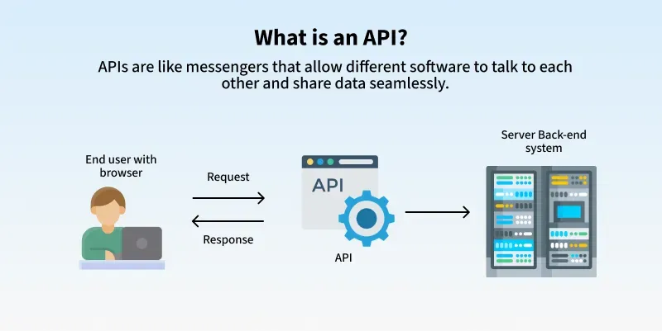

Slide 87
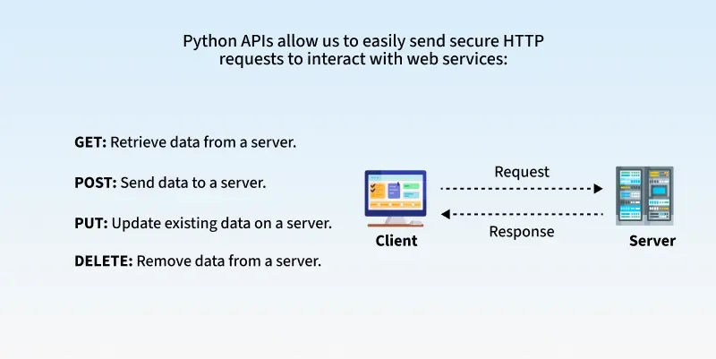

Slide 88
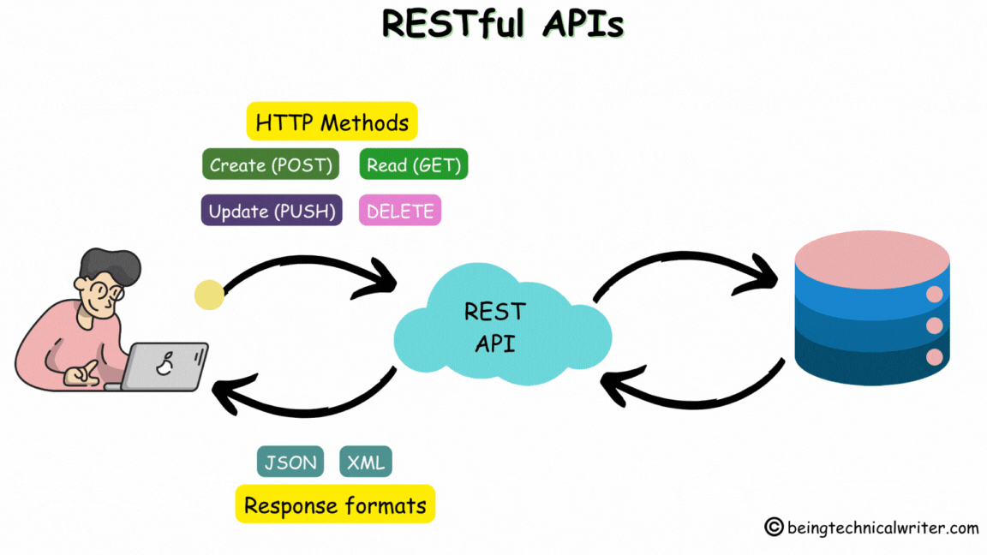

Slide 89
What is an API?
An application programming interface (API) defines the rules that you must follow to communicate with other software systems. Developers expose or create APIs so that other applications can communicate with their applications programmatically.

Slide 90
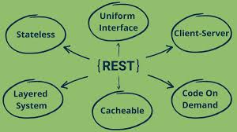
REST architectural style

Slide 91
uniform interface
The uniform interface is fundamental to the design of any RESTful webservice. It indicates that the server transfers information in a standard format.
The formatted resource is called a representation in REST.
This format can be different from the internal representation of the resource on the server application.

Slide 92
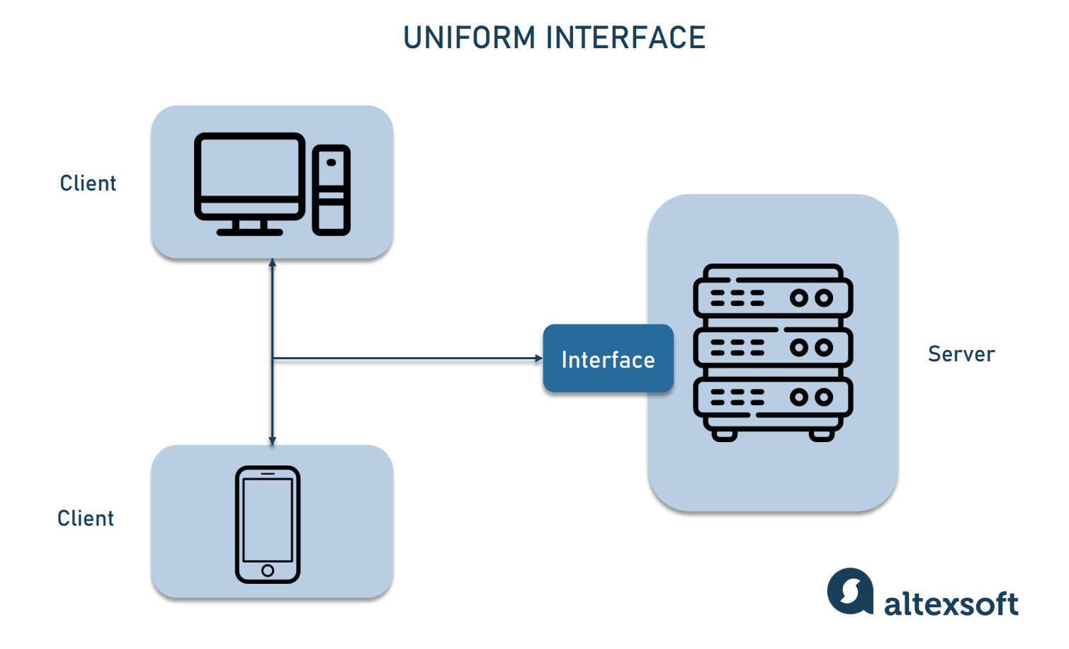

Slide 93
statelessness
statelessness refers to a communication method in which the server completes every client request independently of all previous requests.
Clients can request resources in any order, and every request is stateless or isolated from other requests.

Slide 94
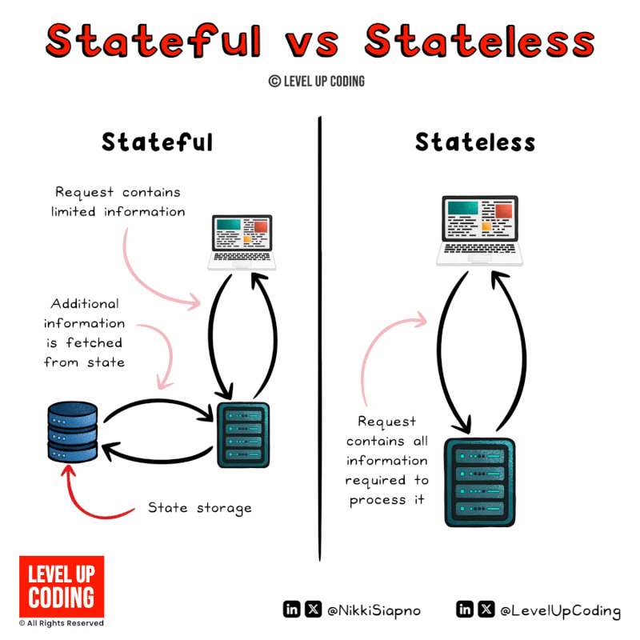

Slide 95
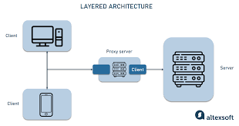
layered system architecture
The client can connect to other authorized intermediaries between the client and server, and it will still receive responses from the server.

Slide 96
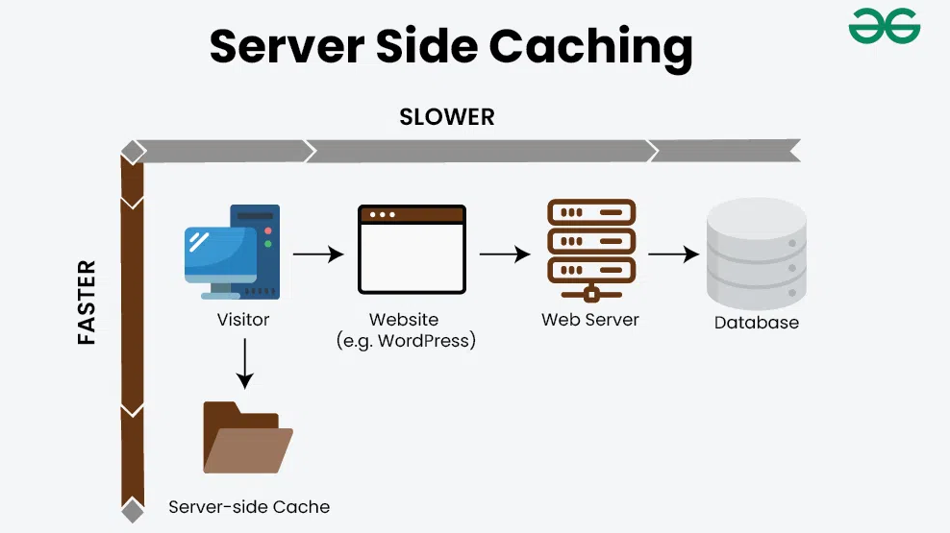
Cacheability
RESTful web services support caching, which is the process of storing some responses on the client or on an intermediary to improve server response time.

Slide 97
Code on demand
In REST architectural style, servers can temporarily extend or customize client functionality by transferring software programming code to the client.

Slide 98
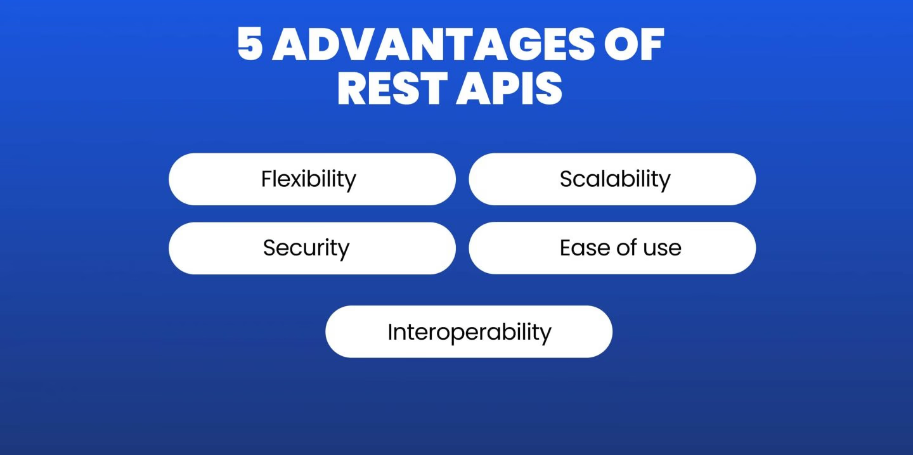

Slide 99
Raspberry-Pi a computer
What is a Raspberry Pi?
Raspberry pi is the name of the “credit card-sized computer board” developed by the Raspberry pi foundation, based in the U.K. It gets plugged in a TV or monitor and provides a fully functional computer capability.
It is aimed at imparting knowledge about computing to even younger students at the cheapest possible price. Although it is aimed at teaching computing to kids, but can be used by everyone willing to learn programming, the basics of computing, and building different projects by utilizing its versatility.
Raspberry Pi is developed by Raspberry Pi Foundation in the United Kingdom. The Raspberry Pi is a series of powerful, small single-board computers.
Raspberry Pi is launched in 2012 and there have been several iterations and variations released since then.

Slide 100
Raspberry-Pi a computer
Various versions of Raspberry Pi have been out till date. All versions consist of a Broadcom system on a chip (SoC) with an integrated ARM-compatible CPU and on-chip graphics processing unit (GPU).
The original device had a single-core Processor speed of device ranges from 700 MHz to 1.2 GHz and a memory range from 256 MB to 1 GB RAM.
To store the operating system and program memory Secure Digital (SD) cards are used. Raspbian OS which is a Linux operating system is recommended OS by Raspberry Pi Foundation. Some other third party operating systems like RISC OS Pi. Diet Pi, Kali, Linux can also be run on Raspberry Pi.

Slide 101
Used:
It also provides a set of general purpose input/output pins allowing you to control electronic components for physical computing and explore the Internet of Things (IOT).

Slide 102
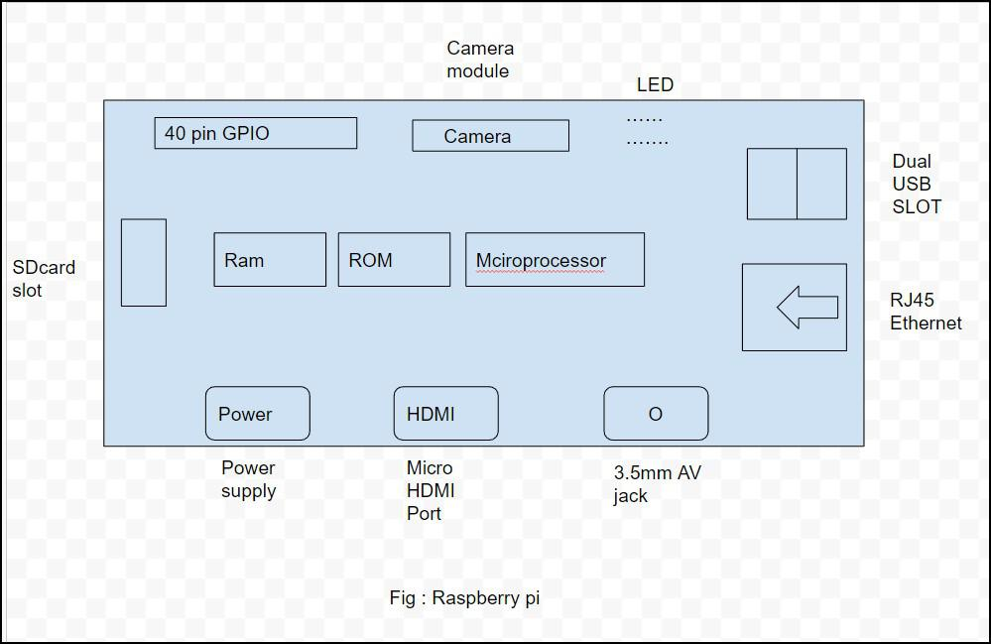

Slide 103
Raspberry Pi model -
There have been many generations of raspberry Pi from Pi 1 to Pi 4. There is generally a model A and model B. Model A is a less expensive variant and it trends to have reduce RAM and dual cores such as USB and Ethernet.
List of Raspberry pi models and releases year:
pi 1 model B - 2012
pi 1 model A - 2013
pi 1 model B+ -2014
pi 1 model A+ - 2014
Pi 2 Model B - 2015
Pi 3 Model B- 2016
Pi 3 Model B+ -2018
Pi 3 Model A+ -2019
Pi 4 Model A - 2019
Pi Model B - 2020
Pi 400 - 2021

Slide 104
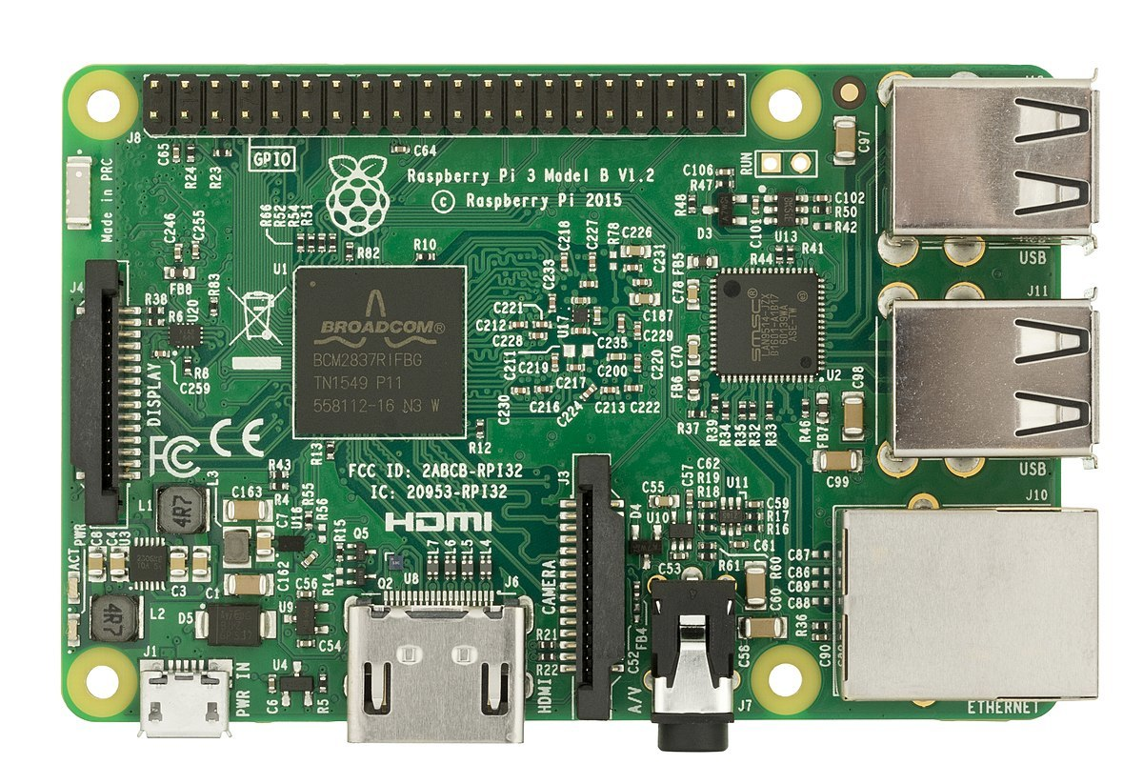

Slide 105
Specs of the Computer: - The computer has a quad-core ARM processor that doesn’t support the same instruction as an X86 desktop CPU.
It has 1GB of RAM, One HDMI port, four USB ports, one Ethernet connection, Micro SD slot for storage, one combined 3.5mm audio/video port, and a Bluetooth connection.
It has got a series of input and output pins that are used for making projects like - home security cameras, Encrypted Door lock, etc.

Slide 106
Versatility of Raspberry Pi: - It is indeed a versatile computer and can be utilized by people from all age groups, it can be used for watching videos on YouTube, watching movies, and programming in languages like Python, Scratch, and many more. As mentioned above it has a series of I/O pins that give this board the ability to interact with its environment and hence can be utilized to build really cool and interactive projects.

Slide 107
Examples of projects: - It can be turned into a weather station by connecting some instruments to it for check the temperature, wind speed, humidity etc... It can be turned into a home surveillance system due to its small size; by adding some cameras to it the security network will be ready. If you love reading books it can also become a storage device for storing thousands of eBooks and also you can access them through the internet by using this device.

Slide 108
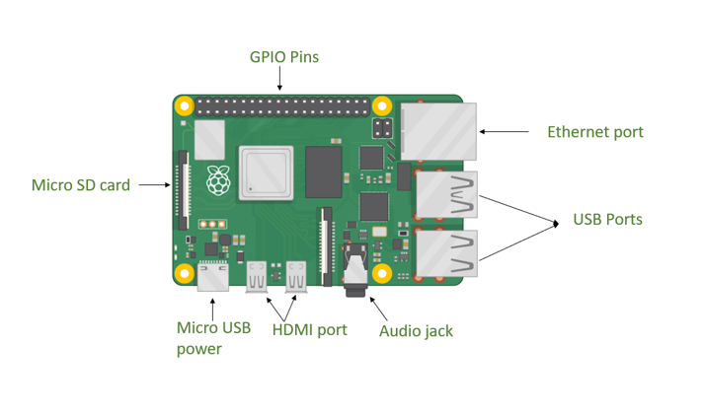

Slide 109
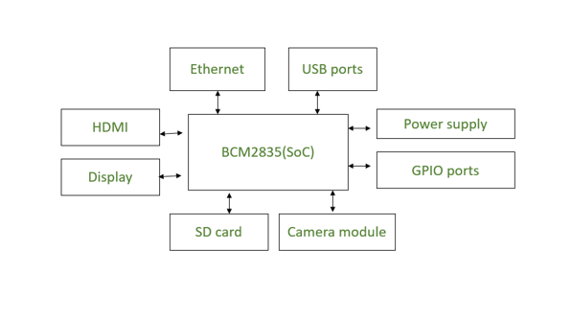

Slide 110
Processor: Raspberry Pi uses Broadcom BCM2835 system on chip which is an ARM processor and Video core Graphics Processing Unit (GPU). It is the heart of the Raspberry Pi which controls the operations of all the connected devices and handles all the required computations.
HDMI: High Definition Multimedia Interface is used for transmitting video or digital audio data to a computer monitor or to digital TV. This HDMI port helps Raspberry Pi to connect its signals to any digital device such as a monitor digital TV or display through an HDMI cable.

Slide 111
GPIO ports: General Purpose Input Output ports are available on Raspberry Pi which allows the user to interface various I/P devices.
Audio output: An audio connector is available for connecting audio output devices such as headphones and speakers.
USB ports: This is a common port available for various peripherals such as a mouse, keyboard, or any other I/P device. With the help of a USB port, the system can be expanded by connecting more peripherals.

Slide 112
SD card: The SD card slot is available on Raspberry Pi. An SD card with an operating system installed is required for booting the device.
Ethernet: The ethernet connector allows access to the wired network, it is available only on the model B of Raspberry Pi.
Power supply: A micro USB power connector is available onto which a 5V power supply can be connected.
Camera module: Camera Serial Interface (CSI) connects the Broadcom processor to the Pi camera.
Display: Display Serial Interface (DSI) is used for connecting LCD to Raspberry Pi using 15 15-pin ribbon cables. DSI provides a high-resolution display interface that is specifically used for sending video data.

Slide 113
Interface a Raspberry Pi with an Arduino
A moving target, as technology changes –
serial (RS-232), USB, I2C, SPI are common.
Raspberry Pi does these, plus GPIO (Gen. Purp. Input/Output) – GPIB, CAMAC, VME/VXI, PCI cards (DAQ) for lab environ.

Slide 114
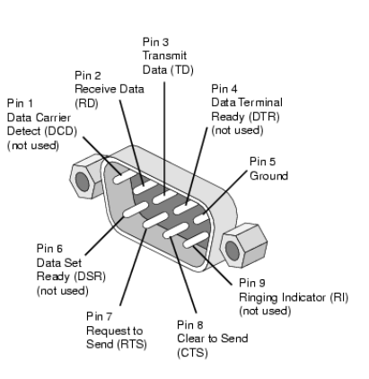
Serial Communication
Most PCs have a DB9 male plug for RS-232 serial asynchronous communications
In most cases, it is sufficient to use a 2- or 3-wire connect.
ground (pin 5) and either or both receive and transmit (pins 2 and 3).
Slow-ish (most common is 9600 bits/sec).

Slide 115
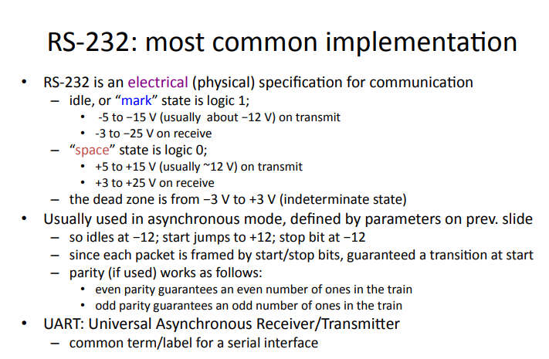

Slide 116
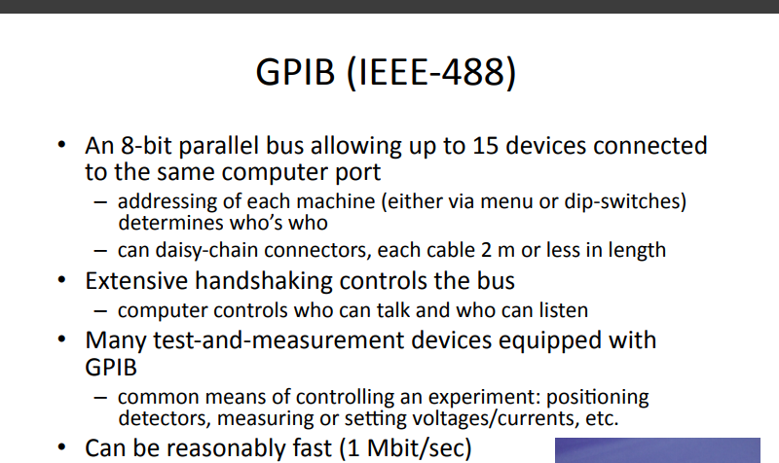

Slide 117
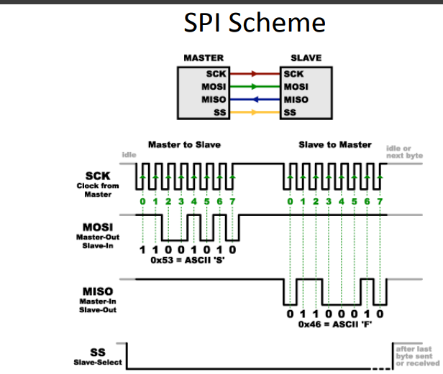

Slide 118
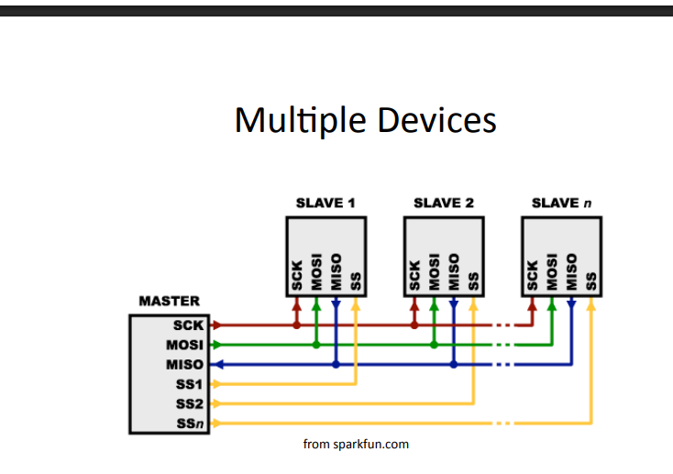

Slide 119
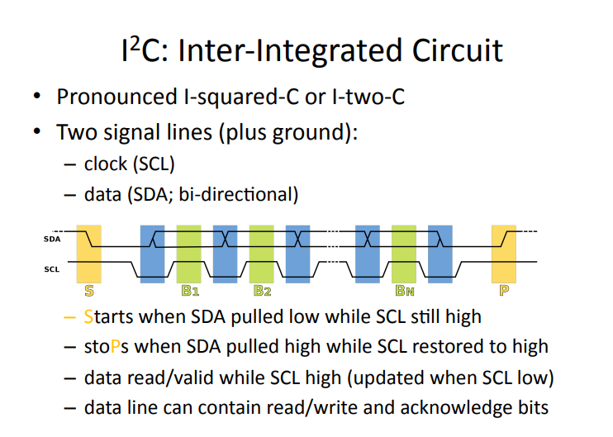

Slide 120
Raspberry Pi GPIO Access
GPIO (General Purpose Input Output) pins can be used as input or output and allows raspberry pito connect with general purpose I/O devices.
Raspberry pi 3 model B took out 26 GPIO pins on board.
Raspberry pi can control many external I/O devices using these GPIO’s.
These pins are a physical interface between the Pi and the outside world.

Slide 121
We can program these pins according to our needs to interact with external devices.
For example, if we want to read the state of a physical switch, we can configure any of the available GPIO pins as input and read the switch status to make decisions.
We can also configure any GPIO pin as an output to control LED ON/OFF.
Raspberry Pi can connect to the Internet using on-board Wi-Fi or Wi-Fi USB adapter.
Once the Raspberry Pi is connected to the Internet then we can control devices, which are connected to the Raspberry Pi, remotely

Slide 122
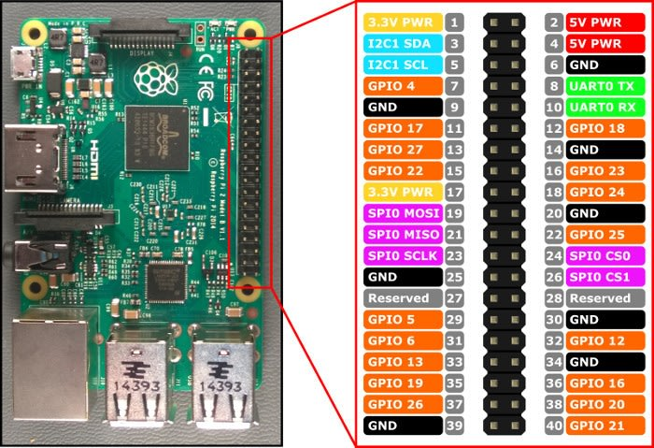

Slide 123

Control LED with Push Button using Raspberry Pi

