Slide 1

LECTURE NOTES
Programme Name : B.Tech
Course Name : Generative AI
Course code : 23CAI471T
Year / Branch: IV / CSE(AI) Regulation : R23
Prepared By : M E Palanivel

Slide 2
SYLLABUS
UNIT-I: INTRODUCTION TO GENERATIVE AI (9)
Overview of Generative AI and Applications, Generative vs Discriminative Models, Latent Space and Data Generation Concepts, Architectures: GANs, VAEs, Auto regressive Models, Generative AI in Text, Image, Audio, and Video, LLMs: Pretrained Transformers as, Generators, Training Challenges and Evaluation of Generative Models, Case Studies: Image Synthesis, Text Generation.
UNIT-II: PROMPT ENGINEERING FUNDAMENTALS (9)
Introduction to Prompt Engineering, Prompt Formats: Zero-shot, One-shot, Few-shot, Prompt Tuning vs Prompt Programming, In-Context Learning & Chain-of-Thought Prompting, Role of Instructions and Examples in Prompts, Controlling Output Style, Tone, and Format, Prompt Failure Cases and Debugging, Prompt Engineering for Coding, Text Completion, Q&A.

Slide 3
UNIT-III: GENERATIVE MODELS IN NLP (9)
Transformer Architecture Recap (BERT,GPT),GPT-3/4,PaLM,Claude,andLLaMA Architectures, Text Generation Pipelines and APIs (OpenAI, HuggingFace),Prompt Engineering with GPT Models, Fine-tuning vs Instruct Tuning, Retrieval-Augmented Generation (RAG), Evaluation Metrics: BLEU, ROUGE, Perplexity, Building LLM-based Apps with Lang Chain.
UNIT-IV: ADVANCED PROMPT ENGINEERING & TOOLS (9)
Role of Temperature, Top-k, Top-p Sampling, Structured Outputs: Tables, JSON, Function Calls, Agentic Prompting and Multi-step Reasoning, Prompt Chaining and Memory Handling, Prompt Templates for Automation(Lang Chain, Llama Index),Prompt Engineering for Multimodal Models (DALL· E, Gemini, Sora),Safety Layers & Guardrails in Prompting, Auto GPT, Baby AGI, and Agentic Workflow Building. .

Slide 4
UNIT-V: ETHICS, RISKS, AND APPLICATIONS OF GENERATIVE AI (9)
Risks: Hallucination, Toxicity, Bias, Deepfakes and Misinformation Challenges, Copyright, IP, and Data Privacy in Generated Content, Evaluation of Responsible AI Outputs, Red Teaming and Safety Testing, Applications in Education, Medicine, Art, and Law, Regulatory Landscape for Generative AI, Future Trends and Research Directions
TEXT BOOKS
Deep Learning with Python, François Chollet, Manning, 2ndEdition
Generative Deep Learning", David Foster, O‘Reilly, 2ndEdition
Building Systems with ChatGPT, Emmanuel Ameisen (O‘Reilly ShortReads)
The Art of Prompt Engineering, Nathan Hunter (Free online eBook)

Slide 5
REFERENCE BOOKS:
Vaswani etal., Attention is All You Need
OpenAI Technical Reports on GPT Models
Papers from Neur IPS, ACL, ICML related to XAI and LLMs
Lang Chain Documentation
ONLINE LEARNING RESOURCES
https://academy.openai.com
https://ai.google.dev
https://www.deeplearning.ai
https://learn.microsoft.com/training/ai/

Slide 6
Course Objectives
The main objective of the course is to provide a comprehensive understanding of Generative AI techniques and models, enabling them to develop intelligent systems capable of generating human-like text, images, audio, video, and other forms of content while addressing practical applications and ethical considerations.
Understand the Fundamentals of Generative AI
Introduce the concepts, principles, and evolution of Generative Artificial Intelligence.
Understand how generative models differ from traditional machine learning models.
Learn Core Generative Modelling Techniques
Study the architectures and working principles of Generative Adversarial Networks (GANs), Variational Autoencoders (VAEs), Diffusion Models, and Transformer-based models.

Slide 7
Explore Large Language Models (LLMs)
Understand the architecture, training, and applications of transformer-based Large Language Models such as ChatGPT, Gemini, and Claude.
Develop Skills in AI-Based Content Generation
Learn how AI generates text, images, audio, video, and code using generative techniques.
Apply Prompt Engineering and Fine-Tuning Techniques
Design effective prompts and explore methods for adapting pre-trained models to specific applications.
Analyse Training and Evaluation Methods
Understand model training procedures, performance evaluation metrics, and quality assessment techniques for generative models.

Slide 8
Investigate Real-World Applications
Explore the use of Generative AI in healthcare, education, finance, entertainment, cybersecurity, and software development.
Address Ethical and Responsible AI Practices
Understand challenges related to bias, hallucinations, privacy, copyright, security, and responsible deployment of Generative AI systems.
Build Practical Generative AI Solutions
Gain hands-on experience in developing AI applications using modern generative AI frameworks and tools.

Slide 9
Definition
Artificial Intelligence is the science and engineering of creating intelligent machines that can think, learn, reason, and make decisions similar to humans.
AI is a branch of science and engineering which makes machines that “Think like human and Act like human”
Examples
Siri and Google Assistant
Self-driving cars
Face recognition systems
Recommendation systems
Medical diagnosis systems

Slide 10
What is Generative AI
Generative Artificial Intelligence (Generative AI) is a subset of AI that creates new content instead of simply analysing existing data.
The generated content may include:
Text
Images
Audio
Video

Slide 11
Music
Code
3D Objects
Scientific Designs
Unlike traditional AI, Generative AI does not simply classify or predict—it creates something entirely new based on patterns learned from massive datasets.

Slide 12
Definition
Generative AI refers to machine learning models capable of generating new data that resembles the data on which they were trained.
Example1
Input: "Generate an image of a futuristic smart city."
Output: An AI-generated city image with flying cars, green buildings, robots, and smart transportation.
Example 2
Input: "Write a poem about rain."
Output: A completely new poem generated by AI.

Slide 13
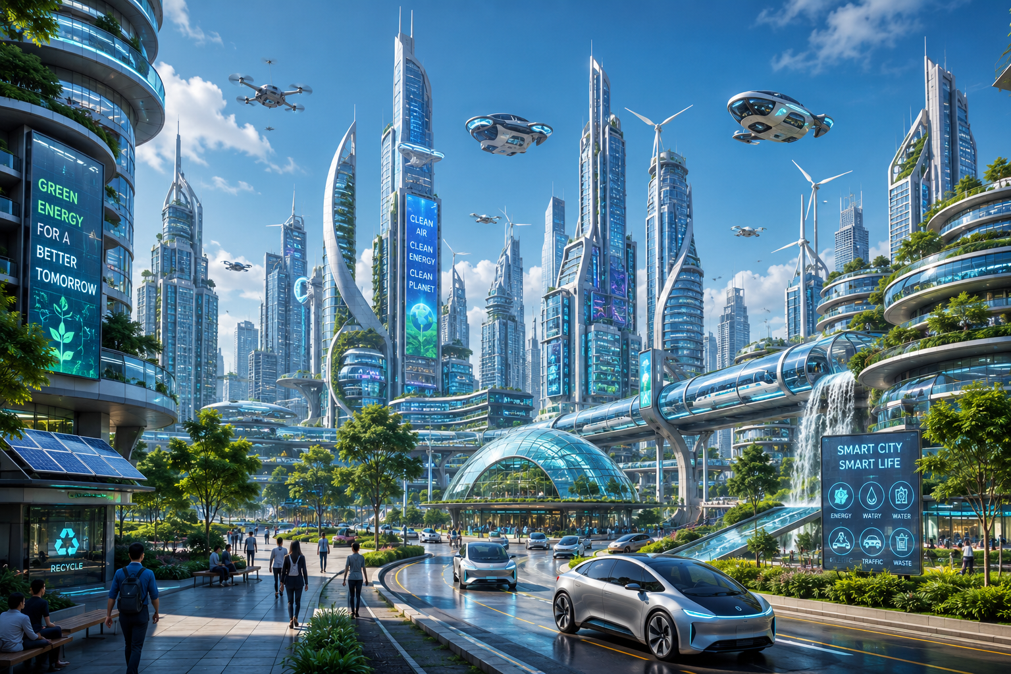

Slide 14
Rain's Gentle Song
The clouds arrive on silent wings,
With whispered dreams and silver strings.
A drop, a dance, a soothing tune,
Beneath the sky's embracing moon.
The thirsty earth begins to smile,
As rivers wake in gentle style.
Each leaf is washed, each flower glows,
With nature's grace the cool wind flows.
The rooftops sing a rhythmic beat,
As raindrops kiss the waiting street.
The air is fresh, the world renewed,
A masterpiece in changing mood.

Slide 15

Example 3
Input: “Give me a brochure for farewell day celebrations with images ."
Output: A brochure generated by AI.

Slide 16
The trees applaud with swaying hands,
The mist drifts softly through the lands.
A rainbow waits beyond the gray,
To paint the end of every day.
So let the rain inspire the heart,
For every storm's a work of art.
From every cloud that fills the sky,
New hopes are born as drops fall by.

Slide 17
Why is Generative AI Important?
Generative AI is transforming industries because it can automate creativity.
Benefits include:
Content generation
Faster software development
Personalized education
Drug discovery
Digital art creation
Business automation
Research assistance

Slide 18
Evolution of Generative AI
Early AI (1950–1980)
Rule-based systems
Expert systems
Symbolic AI
Problems:
No learning capability
Required manual programming

Slide 19
Machine Learning Era (1980–2010)
Machines started learning from data.
Algorithms:
Decision Trees
Support Vector Machines
Naïve Bayes
K-Means
Still limited to prediction.

Slide 20
Deep Learning Era (2012–2017)
Breakthrough due to:
GPUs
Large datasets
Neural Networks
Applications:
Image recognition
Speech recognition
Translation

Slide 21
Generative AI Era (2017–Present)
Major breakthroughs:
GANs
VAEs
Transformers
Large Language Models
Capabilities:
Human-like conversations
Image generation
Video generation
Music creation
Coding assistance

Slide 22
Characteristics of Generative AI
A Generative AI model can:
Learn patterns from large datasets
Generate new content
Mimic human creativity
Understand context
Produce multiple variations
Improve through training

Slide 23
How Generative AI Works
Step 1: Data Collection
Large datasets are collected.
Examples: Books , Images, Music, Videos, Websites, Research papers
Step 2: Data Preprocessing
Data is cleaned by: Removing duplicates, Fixing errors,Tokenization
Normalization
Step 3: Model Training
Deep neural networks learn relationships within the data.
Popular models: Transformer, GAN, VAE, Diffusion Models

Slide 24
Step 4: Pattern Learning
The model learns: Grammar, Style, Structure, Shapes, Colours, Sounds
instead of memorizing the data.
Step 5: Content Generation
Given a prompt,
Example:
"Write a story about Mars"
The model predicts the next word repeatedly until a complete story is generated.

Slide 25
Workflow Diagram
Training Data
│
▼
Preprocessing
│
▼
Deep Learning Model
│
▼
Pattern Learning
│
▼
User Prompt
│
▼
Generated Output

Slide 26
Types of Content Generated
Text
Examples: Articles, Emails, Essays , Reports, Code
Models: GPT, Llama, Claude
Images
Examples: Paintings, Logos, Posters, Photographs
Models: DALL·E, Midjourney, Stable Diffusion
Code
Examples: Python, Java, HTML, SQL
Models: GitHub Copilot, Code Llama

Slide 27
Audio
Examples: Speech, Voice cloning, Music, Podcasts
Models: Music Gen, Bark, AudioLM
Video
Examples: Animation, Movies, Virtual avatars
Models: Sora, Runway ,Pika

Slide 28
Components of Generative AI
Dataset
Provides learning material.
Examples: Wikipedia, ImageNet, Common Crawl
Neural Network
Learns patterns.
Examples: CNN , RNN, Transformer
Training Algorithm : Optimizes model parameters using gradient descent.

Slide 29
Loss Function
Measures prediction error.
Examples: Cross Entropy Loss , Mean Squared Error
Optimizer
Updates model weights.
Examples: Adam , SGD , RMSProp

Slide 30
Applications of Generative AI
Education
Automatic question generation
Personalized tutoring
Course material preparation
Healthcare
Drug discovery
Medical image generation
Disease diagnosis assistance
Business
Marketing content
Customer support
Report generation

Slide 31
Software Development
Code completion
Bug fixing
Documentation
Entertainment
Story writing
Music generation
Movie production

Slide 32
Manufacturing
Product design
Digital twins
Simulation
Agriculture
Crop monitoring
Disease prediction
Farm automation

Slide 33
Advantages of Generative AI
Saves time
Improves productivity
Reduces cost
Supports creativity
Generates multiple ideas quickly
Personalized content
Available 24/7
Automates repetitive tasks

Slide 34
Limitations of Generative AI
Can generate incorrect information (hallucinations)
Bias from training data
High computational cost
Privacy concerns
Copyright issues
Ethical misuse (deepfakes, misinformation)
Lack of true reasoning and common sense
Requires large datasets and powerful hardware

Slide 35
Challenges
Data quality
Explainability
Fairness and bias
Security risks
Copyright protection
Responsible AI governance
High energy consumption
Regulatory compliance

Slide 36
Real-World Examples of Generative AI
Application | Example
Chatbot | Chatbot
Image Generation | DALL·E, Midjourney
Video Generation | Sora, Runway
Music Generation | MusicGen
Code Generation | GitHub Copilot
Presentation Generation | Gamma AI
Website Creation | Wix AI
Design | Canva AI
Voice Generation | ElevenLabs
Research Assistance | Elicit

Slide 37
Future of Generative AI
The future of Generative AI includes:
AI-powered personal assistants
AI doctors
AI teachers
Autonomous scientific discovery
Intelligent robots
Personalized education
AI-generated films and games
Human-AI collaborative creativity
Multimodal AI systems that seamlessly understand and generate text, images, audio, and video

Slide 38
What is generative AI
Generative modeling is a branch of machine learning that involves training a model to produce new data that is similar to a given dataset.
Generative AI, sometimes called gen AI, is artificial intelligence (AI) that can create original content such as text, images, video, audio or software code in response to a user’s prompt or request.
Suppose we have a dataset containing photos of horses. We can train a generative model on this dataset to capture the rules that govern the complex relationships between pixels in images of horses. Then we can sample from this model to create novel, realistic images of horses that did not exist in the original dataset.
This process is illustrated in Figure 1.

Slide 39
Figure 1-1. A generative model trained to generate realistic photos of horses

Slide 40
In order to build a generative model, we require a dataset consisting of many examples of the entity we are trying to generate.
This is known as the training data, and one such data point is called an observation.
Each observation consists of many features. For an image generation problem, the features are usually the individual pixel values; for a text generation problem, the features could be individual words or groups of letters.
It is our goal to build a model that can generate new sets of features that look as if they have been created using the same rules as the original data.
Conceptually, for image generation this is an incredibly difficult task, considering the vast number of ways that individual pixel values can be assigned and the relatively tiny number of such arrangements that constitute an image of the entity we are trying to generate.

Slide 41
A generative model must also be probabilistic rather than deterministic, because we want to be able to sample many different variations of the output, rather than get the same output every time.
If our model is merely a fixed calculation, such as taking the average value of each pixel in the training dataset, it is not generative.
A generative model must include a random component that influences the individual samples generated by the model. In other words, we can imagine that there is some unknown probabilistic distribution that explains why some images are likely to be found in the training dataset and other images are not.
It is our job to build a model that mimics this distribution as closely as possible and then sample from it to generate new, distinct observations that look as if they could have been included in the original training set.

Slide 42
Generative Versus Discriminative Modeling
In order to truly understand what generative modeling aims to achieve and why this is important, it is useful to compare it to its counterpart, discriminative modeling.
If you have studied machine learning, most problems you will have faced will have most likely been discriminative in nature.
To understand the difference, let’s look at an example.
Suppose we have a dataset of paintings, some painted by Van Gogh and some by other artists. With enough data, we could train a discriminative model to predict if a given painting was painted by Van Gogh.
Our model would learn that certain colors, shapes, and textures are more likely to indicate that a painting is by the Dutch master, and for paintings with these features, the model would upweight its prediction accordingly. Figure 2 shows the discriminative modeling process—note how it differs from the generative modeling process shown in Figure 1.

Slide 43
Figure 2. A discriminative model trained to predict if a given image is painted by Van Gogh

Slide 44
When performing discriminative modeling, each observation in the training data has a label.
For a binary classification problem such as our artist discriminator, Van Gogh paintings would be labeled 1 and non–Van Gogh paintings labeled 0. Our model then learns how to discriminate between these two groups and outputs the probability that a new observation has label 1—i.e., that it was painted by Van Gogh.
In contrast, generative modeling doesn’t require the dataset to be labeled because it concerns itself with generating entirely new images, rather than trying to predict a label of a given image.
Let’s define these types of modeling formally, using mathematical notation:

Slide 45
Discriminative modeling estimates p(y|x). That is, discriminative modeling aims to model the probability of a label y given some observation x.
Generative modeling estimates p(x). That is, generative modeling aims to model the probability of observing an observation x. Sampling from this distribution allows us to generate new observations.
CONDITIONAL GENERATIVE MODELS
we can also build a generative model to model the conditional probability p(x|y)—the probability of seeing an observation x with a specific label y.
For example, if our dataset contains different types of fruit, we could tell our generative
model to specifically generate an image of an apple.

Slide 46
The Rise of Generative Modeling
Until recently, discriminative modeling has been the driving force behind most progress in machine learning.
This is because for any discriminative problem, the corresponding generative modeling problem is typically much more difficult to tackle.
For example, it is much easier to train a model to predict if a painting is by Van Gogh than it is to train a model to generate a Van Gogh–style painting from scratch. Similarly, it is much easier to train a model to predict if a page of text was written by Charles Dickens than it is to build a model to generate a set of paragraphs in the style of Dickens.
Until recently, most generative challenges were simply out of reach and many doubted that they could ever be solved. Creativity was considered a purely human capability that couldn’t be rivaled by AI.

Slide 47
However, as machine learning technologies have matured, this assumption has gradually weakened.
In the last 10 years many of the most interesting advancements in the field have come through novel applications of machine learning to generative modeling tasks.
For example, Figure 1-3 shows the striking progress that has already been made in facial image generation since 2014.
As well as being easier to tackle, discriminative modeling has historically been more readily applicable to practical problems across industry than generative modeling.
For example, a doctor may benefit from a model that predicts if a given retinal image shows signs of glaucoma, but wouldn’t necessarily benefit from a model that can generate novel pictures of the back of an eye.

Slide 48
Figure 1-3. Face generation using generative modeling has improved significantly over the last decade (adapted from Brundage et al., 2018)1

Slide 49
Generative Modeling and AI
As well as the practical uses of generative modeling (many of which are yet to be discovered), there are three deeper reasons why generative modeling can be considered the key to unlocking a far more sophisticated form of artificial intelligence that goes beyond what discriminative modeling alone can achieve.
Firstly, purely from a theoretical point of view, we shouldn’t limit our machine training to simply categorizing data. For completeness, we should also be concerned with training models that capture a more complete understanding of the data distribution, beyond any particular label.
This is undoubtedly a more difficult problem to solve, due to the high dimensionality of the space of feasible outputs and the relatively small number of creations that we would class as belonging to the dataset.
However, as we shall see, many of the same techniques that have driven development in discriminative modeling, such as deep learning, can be utilized by generative models too.

Slide 50
Secondly, generative modeling is now being used to drive progress in other fields of AI, such as reinforcement learning (the study of teaching agents to optimize a goal in an environment through trial and error).
Suppose we want to train a robot to walk across a given terrain. A traditional approach would be to run many experiments where the agent tries out different strategies in the terrain, or a computer simulation of the terrain.
Over time the agent would learn which strategies are more successful than others and therefore gradually improve.
A challenge with this approach is that it is fairly inflexible because it is trained to optimize the policy for one particular task.
An alternative approach that has recently gained traction is to instead train the agent to learn a world model of the environment using a generative model, independent of any particular task.
The agent can quickly adapt to new tasks by testing strategies in its own world model, rather than in the real environment, which is often computationally more efficient and does not require retraining from scratch for each new task.

Slide 51
Latent Space and Data Generation Concepts
Introduction
One of the most important concepts in Generative AI is the Latent Space.
Generative AI models do not memorize the training data. Instead, they learn a compressed representation of the data, known as the latent space, from which they can generate entirely new and realistic samples.
For example, after learning thousands of human face images, a model does not store every face individually. Instead, it learns the essential characteristics of faces—such as eye shape, nose size, hair style, skin tone, and facial structure—and represents them in a latent space. By sampling from this space, the model can create completely new faces that never existed before.

Slide 52
What is Latent Space
A latent space is a low-dimensional mathematical representation that captures the essential features of complex data.
Instead of representing data directly (such as millions of image pixels), the model encodes it into a compact vector containing meaningful information.
Definition
Latent Space is a compressed feature space where similar data points are located close together, allowing Generative AI models to efficiently represent and generate new data.

Slide 53
Introduction
Before understanding Latent Space, let us understand how humans recognize objects.
Suppose you look at the picture of a dog. Immediately your brain identifies
Four legs, Tail , Fur, Eyes, Nose, Ears
Your brain does not memorize every pixel.
Instead, your brain extracts only the important characteristics.
Exactly the same idea is used in Generative AI.
Instead of remembering millions of pixels, the model learns only the important hidden characteristics.
These hidden characteristics are called Latent Features

Slide 54
The mathematical space containing these hidden features is called Latent Space
Definition
Latent Space is a lower-dimensional mathematical representation of high-dimensional data where only the essential information is stored.
The word Latent means Hidden Therefore, Latent Space means Hidden Feature Space
Suppose we have a face image.
Original Image 64 × 64 × 3
Number of values 64×64×3 = 12288
Instead of storing 12,288 numbers,
Generative AI compresses it into 128 numbers
These 128 numbers are called the Latent Vector

Slide 55
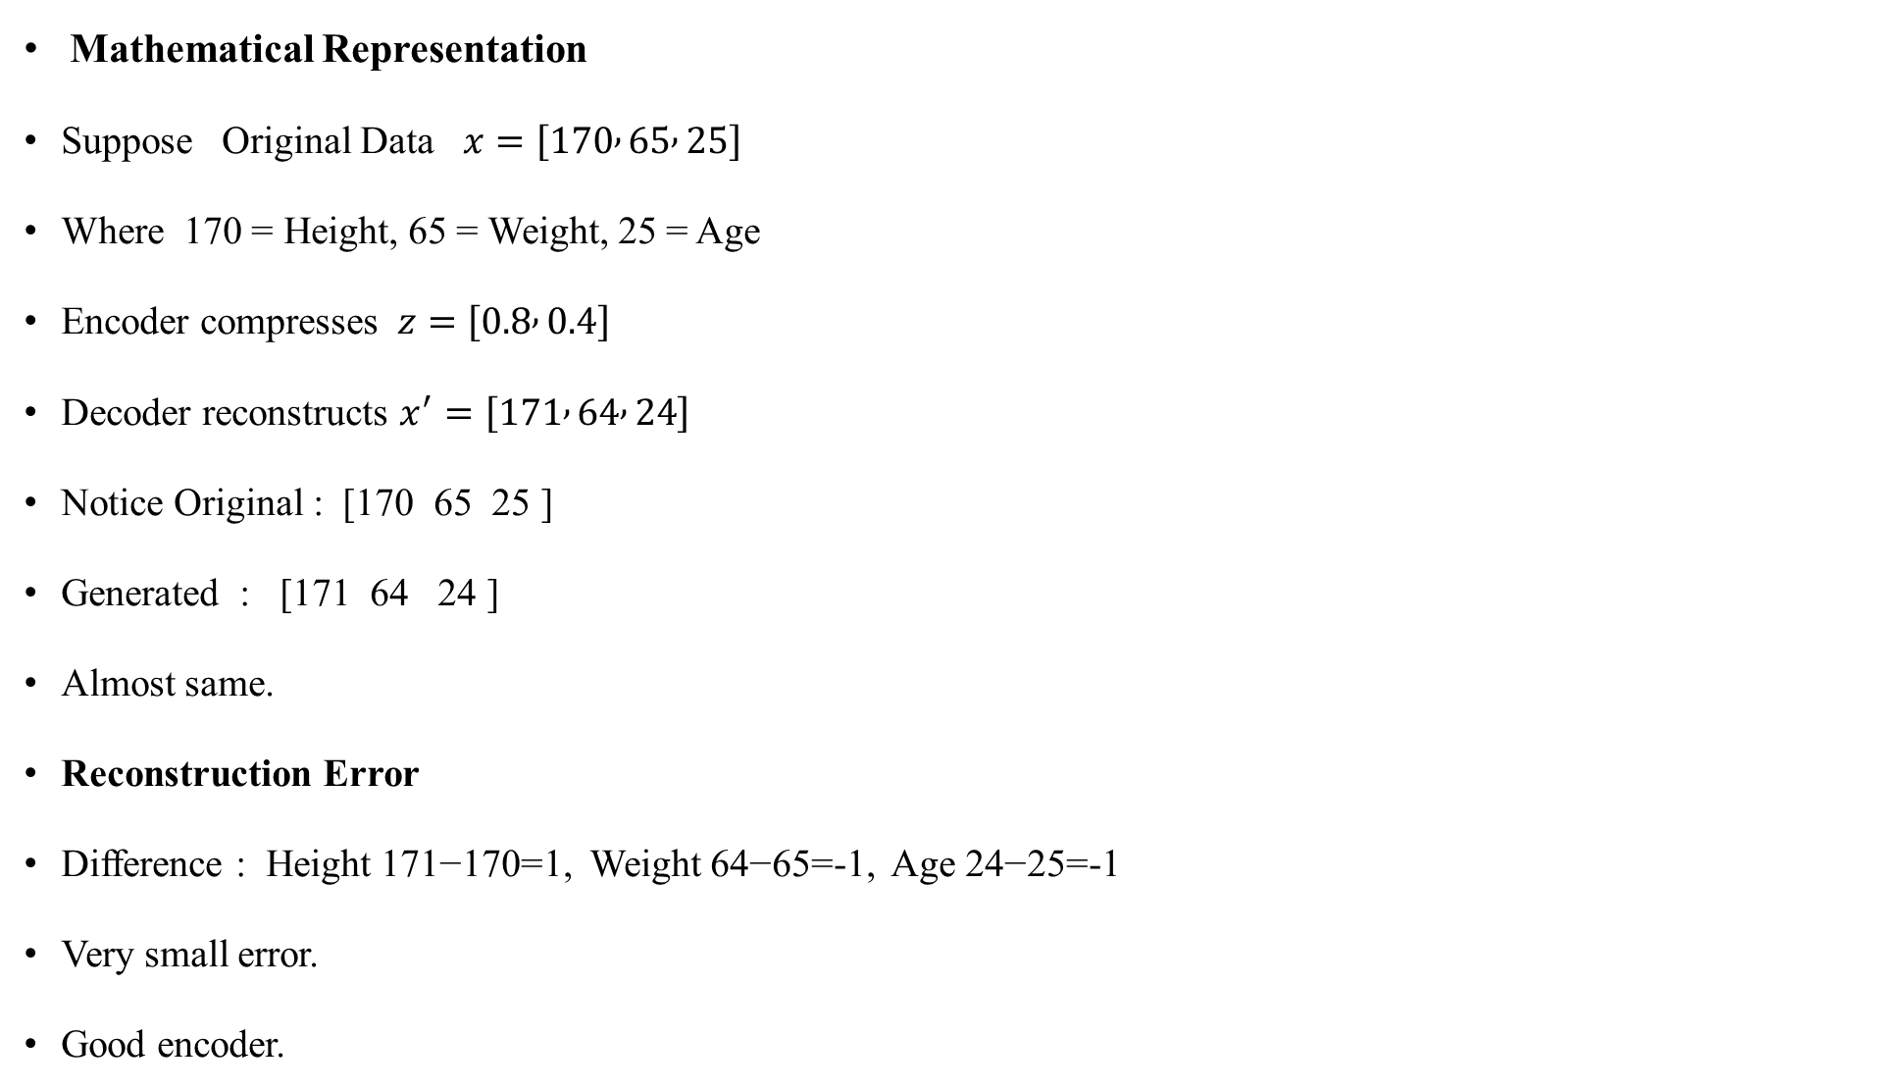
Mathematical Representation
Suppose Original Data $x=\left[170 , 65 , 25\right]$
Where 170 = Height, 65 = Weight, 25 = Age
Encoder compresses $z=\left[0.8 , 0.4\right]$
Decoder reconstructs $x^{′}=\left[171 , 64 , 24\right]$
Notice Original : [170 65 25 ]
Generated : [171 64 24 ]
Almost same.
Reconstruction Error
Difference : Height 171−170=1, Weight 64−65=-1, Age 24−25=-1
Very small error.
Good encoder.

Slide 56

Data Generation
Suppose we randomly choose
$z=\left[0.6 , 0.2 , 0.9\right]$
Generator
creates
Young Girl
Smiling
Long Hair
Another vector
[0.2,0.8,0.1]
produces
Old Man
Beard
Short Hair
Different vectors
produce different images.

Slide 57

Numerical Example (Detailed)
Suppose
Generator equation
$x_{1}=3z_{1}+2z_{2}$
$x_{2}=5z_{1}−z_{2}$
Given
$z=\left[2 , 4\right]$
Find generated output.
Solution
Step 1
Calculate
$x_{1}=3\left(2\right)+2\left(4\right)$ $=6+8=14$

Slide 58
Architecture of Generative Adversarial Networks (GANs)
Introduction to GANs:
Generative Adversarial Networks (GANs) are one of the most influential deep learning architectures for generating realistic synthetic data. They were introduced by Ian Goodfellow and his colleagues in 2014.
GANs consist of two neural networks that compete with each other in a game-like setting:
Generator (G) – Creates fake (synthetic) data.
Discriminator (D) – Distinguishes between real and fake data.
Through this competition, the Generator learns to create increasingly realistic data.

Slide 59
Definition
A Generative Adversarial Network (GAN) is a deep learning architecture consisting of two neural networks—a Generator and a Discriminator—that are trained simultaneously in an adversarial manner to generate realistic synthetic data.
Basic Idea of GAN
Imagine a counterfeit money maker and a police officer.
The counterfeit maker (Generator) tries to produce fake currency.
The police officer (Discriminator) tries to identify fake notes.
As both improve over time:
The Generator creates better counterfeit notes.
The Discriminator becomes better at detecting them.
Eventually, the counterfeit notes become so realistic that they are difficult to distinguish from genuine ones.

Slide 60
GAN Architecture

Slide 61
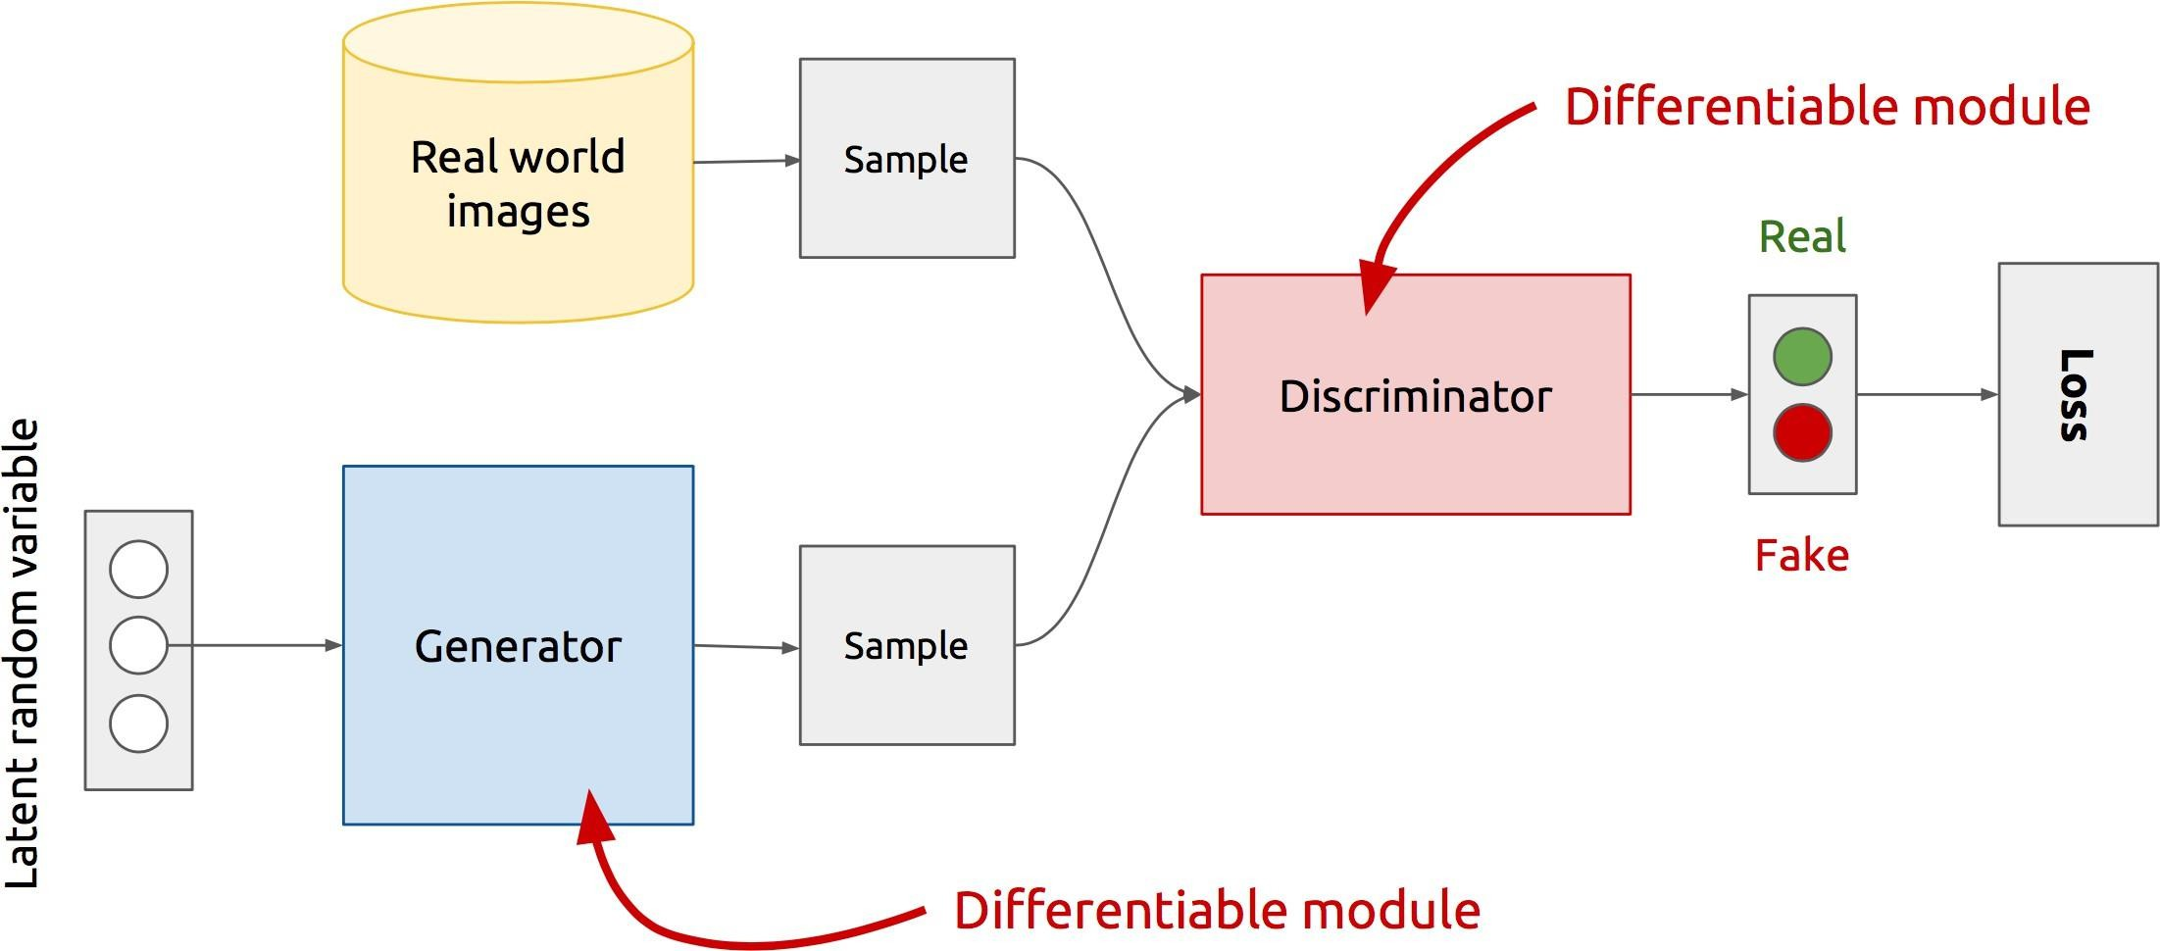
GAN’sArchitecture
x
D
D(x)
G
z
G(z)
D(G(z))
Z is some random noise(Gaussian/Uniform).
Z can be thought as the latent representation of the image.

Slide 62
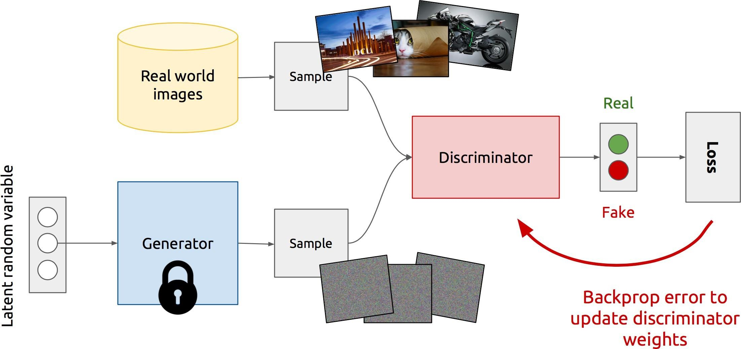
Training Discriminator

Slide 63
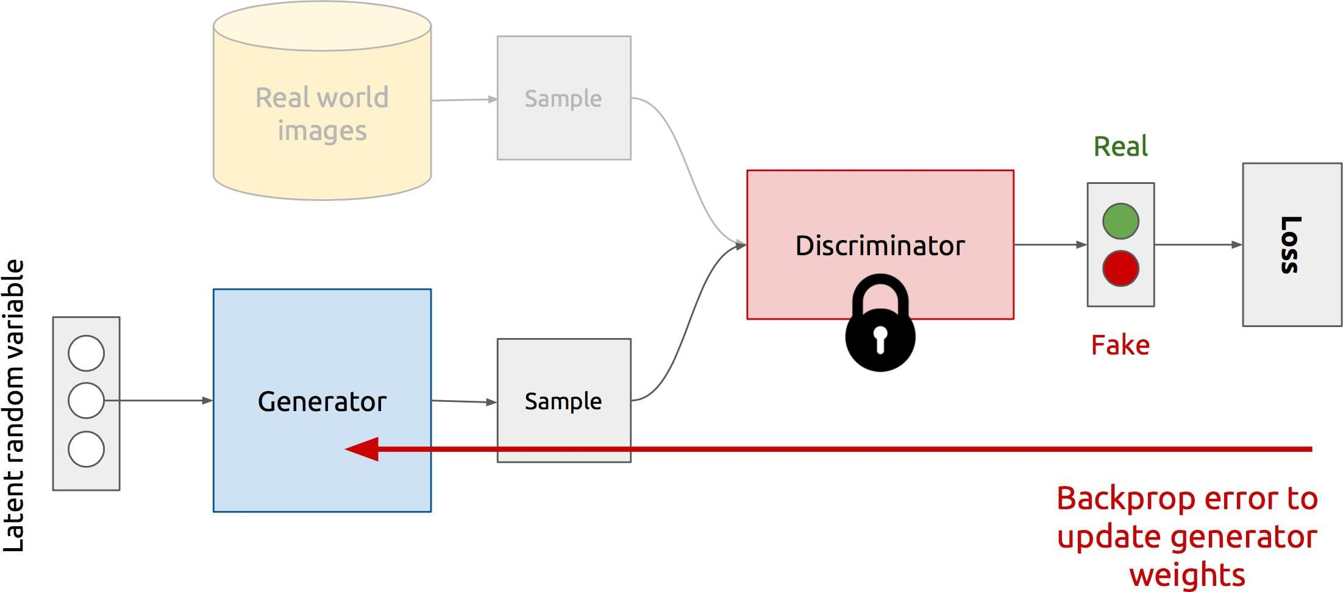
Training Generator

Slide 64
Generative Adversarial Networks
Learn about the architectural design of a generative adversarial network (GAN).
Build and train a deep convolutional GAN (DCGAN) from scratch using Keras.
Use the DCGAN to generate new images.
Understand some of the common problems faced when training a DCGAN.
Learn how the Wasserstein GAN (WGAN) architecture addresses these problems.
Understand additional enhancements that can be made to the WGAN, such as incorporating a gradient penalty (GP) term into the loss function.
Build a WGAN-GP from scratch using Keras.
Use the WGAN-GP to generate faces.

Slide 65
In 2014, Ian Goodfellow et al. presented a paper entitled “Generative Adversarial Nets”1 at the Neural Information Processing Systems conference (NeurIPS) in Montreal.
The introduction of generative adversarial networks (or GANs, as they are more commonly known) is now regarded as a key turning point in the history of generative modeling, as the
core ideas presented in this paper have spawned some of the most successful and impressive generative models ever created.
A GAN is a battle between two adversaries, the generator and the discriminator. The generator tries to convert random noise into observations that look as if they have been sampled from the original dataset, and the discriminator tries to predict whether an observation comes from the original dataset or is one of the generator’s forgeries.
Examples of the inputs and outputs to the two networks are shown in Figure 4-2.

Slide 66
Generative adversarial networks (GANs) are a class of machine learning models designed to generate new data that is similar to a given dataset.
GANs consist of two main components: a generator and a discriminator.
The generator creates synthetic data samples, while the discriminator evaluates these samples and tries to distinguish between real and generated data.
The two components are trained together in a competitive process, leading to the refinement of both the generator’s ability to create realistic data and the discriminator’s ability to differentiate between real and fake data:
1. Generator (G): The generator takes random noise as input and transforms it into data that should resemble the target dataset. Initially, its output might not resemble the real data much.
2. Discriminator (D): The discriminator acts as a binary classifier. It takes both real data from the target dataset and generated data from the generator as input and tries to determine whether the input is real (from the dataset) or fake (generated by the generator).

Slide 67
3.Training Process: The training of GANs involves an adversarial process. The generator and discriminator are trained iteratively. During each iteration:
–The generator generates fake data from random noise.
–The discriminator is given real data and the generated fake data, and it learns to distinguish between them.
–The generator’s parameters are adjusted to produce better fake data that the discriminator struggles to differentiate from real data.
4.Objective: The goal of the generator is to improve its ability to produce data that is so convincing that the discriminator cannot distinguish it from real data. The goal of the discriminator is to become better at correctly classifying real and fake data.

Slide 68
5.Equilibrium: As training progresses, the generator and discriminator reach a point of equilibrium where the generator generates data that is increasingly difficult for the discriminator to distinguish from real data. This results in the generation of high-quality synthetic data.
GANs have been used for various applications, including image synthesis, style transfer, super-resolution, data augmentation, and more.
They have shown the capability to create highly realistic data samples and have been responsible for impressive advancements in generative modeling and computer vision. However, GANs can be challenging to train due to issues like mode collapse (when the generator focuses on a limited subset of the target data) and training instability.

Slide 69
Figure 4-2. Inputs and outputs of the two networks in a GAN

Slide 70
At the start of the process, the generator outputs noisy images and the discriminator predicts randomly.
The key to GANs lies in how we alternate the training of the two networks, so that as the generator becomes more adept at fooling the discriminator, the discriminator must adapt in order to maintain its ability to correctly identify which observations are fake.
This drives the generator to find new ways to fool the discriminator, and so the cycle continues.

Slide 71
The Technology Behind Midjourney
Midjourney employs a sophisticated technology to facilitate its text-to-image generation capabilities. Let’s delve into the underlying technology behind Midjourney:
Generative Adversarial Networks (GANs)
GANs consist of two components: a generator and a discriminator. The generator crafts images based on random noise, while the discriminator attempts to differentiate between real images and those generated by the generator.
This adversarial process compels the generator to continually improve its image generation to fool the discriminator.

Slide 72
Text-to-Image Synthesis with GANs
Midjourney leverages the GAN architecture to synthesize images from textual descriptions.
The generator is conditioned on text inputs, ensuring that the generated images align with the provided descriptions.
The text input is usually encoded into a latent representation that guides the image generation process.
Conditional GANs
Midjourney employs a variant of GANs known as conditional GANs (cGANs).
In cGANs, both the generator and discriminator are conditioned on additional information (in this case, the text description).
The conditioning enhances the generator’s ability to create images that correspond to specific text prompts.
Training Process
Midjourney’s training process involves iteratively updating the generator and discriminator components.
The generator aims to create images that the discriminator cannot distinguish from real ones, while the discriminator aims to improve its discrimination ability.

Slide 73
Training Process
Midjourney’s training process involves iteratively updating the generator and discriminator components.
The generator aims to create images that the discriminator cannot distinguish from real ones, while the discriminator aims to improve its discrimination ability.
Loss Functions and Optimization
Loss functions play a crucial role in guiding the training process.
The generator and discriminator are optimized using specific loss functions that capture the quality of generated images and the discriminator’s discrimination accuracy

Slide 74
Attention Mechanisms
Midjourney’s technology might incorporate attention mechanisms to enhance the generator’s focus on relevant parts of the image.
Attention mechanisms enable the model to selectively emphasize certain regions based on the input text, contributing to more contextually relevant image generation.
Data Augmentation and Preprocessing
Midjourney might employ data augmentation techniques to expand the training dataset and improve generalization.
Preprocessing of textual descriptions might involve techniques like tokenization and embedding to convert text into a format suitable for the model.
Benefits and Applications
Midjourney’s technology enables the creation of realistic images based on textual descriptions, making it valuable for various applications like design, content creation, and visualization.
In essence, Midjourney’s technology capitalizes on the power of GANs, especially conditional GANs, to transform textual inputs into compelling and contextually relevant images. This approach showcases the synergy between language and image synthesis, opening up avenues for innovative applications in the realm of generative A

Slide 75
Deep Convolutional GAN (DCGAN)

Slide 76
Applying GAI models – image generation using GANs, diffusers, and transformers
Working with Jupyter Notebook and Google Colab
!pip install pytorch-fid torch diffusers clip transformers accelerate
Next, we import the libraries we’ve just installed to make them available to our Python program
from typing import List
import torch
import matplotlib.pyplot as plt
from diffusers import StableDiffusionPipeline, DDPMScheduler
Now, we’re ready for our three functions, which will execute the three tasks – loading the pre-trained
model, generating the images based on prompting, and rendering the images:

Slide 79
Variational Auto Encoder (VAE)
In 2013, Diederik P. Kingma and Max Welling published a paper that laid the foundations for a type of neural network known as a variational autoencoder (VAE).
This is now one of the most fundamental and well known deep learning architectures for generative modeling and an excellent place to start our journey into generative deep learning.
we shall start by building a standard autoencoder and then see how we can extend this framework to develop a variational autoencoder.
Along the way, we will pick apart both types of models, to understand how they work at a granular level.

Slide 80
Autoencoders
A diagram of the process described by the story is shown in Figure 3-2. You
play the part of the encoder, moving each item of clothing to a location in
the wardrobe. This process is called encoding.
Brian plays the part of the decoder, taking a location in the wardrobe and attempting to re-create the item. This process is called decoding.
Each location in the wardrobe is represented by two numbers (i.e., a 2D vector).
For example, the trousers in Figure 3-2 are encoded to the point [6.3, –0.9].
This vector is also known as an embedding because the encoder attempts to embed as much information into it as possible, so that the decoder can produce an accurate reconstruction.

Slide 82
An autoencoder is simply a neural network that is trained to perform the task of encoding and decoding an item, such that the output from this process is as close to the original item as possible.
Crucially, it can be used as a generative model, because we can decode any point in the 2D space that we want (in particular, those that are not embeddings of original items) to produce a novel item of clothing.

Slide 83
The Autoencoder Architecture
An autoencoder is a neural network made up of two parts:
An encoder network that compresses high-dimensional input data such as an image into a lower-dimensional embedding vector
A decoder network that decompresses a given embedding vector back
to the original domain (e.g., back to an image)
A diagram of the network architecture is shown in Figure 3-4. An input image is encoded to a latent embedding vector z, which is then decoded back to the original pixel space.

Slide 85
The autoencoder is trained to reconstruct an image, after it has passed
through the encoder and back out through the decoder.
This may seem strange at first—why would you want to reconstruct a set of images that you already have available to you? However, as we shall see, it is the embedding space (also called the latent space) that is the interesting part of the autoencoder, as sampling from this space will allow us to generate new images.
Let’s first define what we mean by an embedding. The embedding (z) is a
compression of the original image into a lower-dimensional latent space.

Slide 86
The idea is that by choosing any point in the latent space, we can generate novel images by passing this point through the decoder, since the decoder has learned how to convert points in the latent space into viable images.
In our example, we will embed images into a two-dimensional latent space.
This will help us to visualize the latent space, since we can easily plot points in 2D.
In practice, the latent space of an autoencoder will usually have more than two dimensions in order to have more freedom to capture greater nuance in the images.
Autoencoders can be used to clean noisy images, since the encoder learns that it is not useful to capture the position of the random noise inside the latent space in order to reconstruct the original.
For tasks such as this, a 2D latent space is probably too small to encode sufficient relevant information from the input. However, as we shall see, increasing the dimensionality of the latent space quickly leads to problems if we want to use the autoencoder as a generative model.

Slide 87
The Encoder

Slide 88
Variational Autoencoders
The Encoder
In an autoencoder, each image is mapped directly to one point in the latent space.
In a variational autoencoder, each image is instead mapped to a multivariate normal distribution around a point in the latent space, as shown in Figure 3-10.

Slide 89
The encoder only needs to map each input to a mean vector and a variance vector and does not need to worry about covariance between dimensions.
Variational autoencoders assume that there is no correlation between dimensions in the latent space.
Variance values are always positive, so we actually choose to map to the logarithm of the variance, as this can take any real number in the range ( −∞, ∞).
This way we can use a neural network as the encoder to perform the mapping from the input image to the mean and log variance vectors.
To summarize, the encoder will take each input image and encode it to two vectors that together define a multivariate normal distribution in the latent space:
z_mean
The mean point of the distribution
z_log_var
The logarithm of the variance of each dimension

Slide 90
We can sample a point z from the distribution defined by these values using the following equation:
z = z_mean + z_sigma * epsilon
where:
z_sigma = exp(z_log_var * 0.5)
epsilon ~ N(0,I)
The decoder of a variational autoencoder is identical to the decoder of a
plain autoencoder, giving the overall architecture shown in Figure 3-12.

Slide 92
Building the VAE encoder

Slide 93
Case Study 1: Image Generation using GANs
Topic : Overview of Generative AI, GAN Architecture, Image Synthesis
Problem Statement
A fashion company wants to generate new clothing designs without manually designing every product.
Existing Approach
Human designers create designs.
Time consuming.
Expensive.
Generative AI Solution
Train a Generative Adversarial Network (GAN) using thousands of clothing images.
Dataset
Fashion-MNIST
DeepFashion Dataset
Working
Generator
Creates fake clothing images.
Discriminator
Distinguishes between real and fake images.
Both networks compete until realistic images are produced.

Slide 94
Workflow
Training Images
│
▼
Discriminator
▲
│
Fake Images ← Generator ← Random Noise
Results
Generates unlimited clothing designs.
Reduces design cost.
Helps fashion designers.
Learning Outcomes
Students learn
GAN Architecture
Generator
Discriminator
Loss Function
Image Synthesis

Slide 95
Case Study 2: AI-Based Medical Image Generation
Topic
GANs + Image Synthesis
Problem
Hospitals lack sufficient MRI scans to train AI models.
Solution
Generate synthetic MRI images using GANs.
Dataset
Brain MRI Images
Chest X-ray Dataset
Advantages
Improves dataset size
Preserves patient privacy
Improves disease detection
Engineering Perspective
Hospitals can train diagnostic AI models using synthetic images.

Slide 96
Case Study 3: Text Generation using Large Language Models
Topic
Text Generation
Pretrained Transformers
Problem
An educational institute wants an automatic question paper generator.
Existing Method
Faculty manually prepare questions.
AI Solution
Fine-tune an LLM on previous university papers.
Input
Subject: Machine Learning
Unit: Neural Networks
Difficulty: Medium

Slide 97
Generated Output
Explain Backpropagation.
Compare CNN and RNN.
Design a neural network for digit recognition.
Benefits
Saves faculty time
Generates multiple question sets
Reduces repetition
Technologies
GPT
Llama
Transformer

Slide 98
Case Study 4: Chatbot for College Admission
Topic LLMs Transformers
Problem
Students ask thousands of admission-related queries every day.
AI Solution
Develop an AI chatbot.
Functions
Fee details
Eligibility
Hostel information
Placement statistics
Scholarship information

Slide 99
Architecture
Student
│
▼
Chat Interface
│
▼
Large Language Model
│
▼
Knowledge Base
Expected Outcome
24×7 support
Faster responses
Reduced staff workload

Slide 100
Case Study 5: Image Caption Generator
Topic : Image + Text Generation
Problem : Generate captions automatically for uploaded images.
Example
Input Image
Dog playing with a ball.
Generated Caption
"A brown dog is playing happily with a football."

Slide 101
Architecture
CNN → Transformer
Image
│
CNN Feature Extraction
│
Transformer Decoder
│
Caption
Applications
Google Photos
Social Media
Accessibility

Slide 102
Case Study 6: Music Generation using Generative AI
Topic : Audio Generation
Problem : Generate background music for games.
Dataset
MIDI Music Files
AI Model
Music Transformer
Workflow
Music Dataset
│
▼
Transformer
│
▼
New Music
Applications
Video Games
Movies
Advertisement

Slide 103
Case Study 7: Code Generation using LLMs
Topic : Pretrained Transformers
Problem : Generate Python code from natural language.
Input
Write Python code to sort a list.
Output
numbers=[5,3,7,2]
numbers.sort()
print(numbers)
Applications
GitHub Copilot-like assistants
Software Engineering
Education

Slide 104
Case Study 8: Fake Face Generation
Topic : GANs
Problem : Need profile images without using real people's photos.
Solution
Train StyleGAN.
Applications
Game Characters
Movie Animation
Privacy Protection
Discussion
Ethical issues
Deepfakes
Identity misuse
Fake social media accounts

Slide 105
Case Study 9: Handwritten Digit Generation
Topic : VAE
Problem : Generate handwritten digits for OCR training.
Dataset
MNIST
Architecture
Image
│
Encoder
│
Latent Vector
│
Decoder
│
Generated Digit
Applications
OCR
Postal Automation
Bank Cheque Processing

Slide 106
Case Study 10: AI Story Generator
Topic : Text Generation
Problem : Automatically generate children's stories.
Input
Hero:
Rabbit
Theme:
Friendship
Output
An original story about a rabbit helping its friends.
Applications
Education
Publishing
Entertainment

Slide 107
Mini Project (Integrating All Topics)
Project Title : Smart AI Content Generation System
Objective : Develop a web application that can generate multiple types of content using Generative AI models.
Modules
Text generation using a Transformer-based LLM.
Image generation using a GAN or diffusion model.
Image caption generation using a CNN–Transformer pipeline.
Music generation using a Music Transformer.
AI chatbot for user interaction.
Evaluation using BLEU (text), FID (images), and human feedback.

Slide 108
Technologies
Python
TensorFlow / PyTorch
Hugging Face Transformers
OpenCV Flask
FastAPI
Streamlit

Slide 109
Course Outcomes (COs)
Explain the fundamental concepts of Generative AI, distinguish between generative and discriminative models, and describe latent space representations and data generation principles.
Illustrate the architectures and working principles of Generative Adversarial Networks (GANs), Variational Autoencoders (VAEs), and Autoregressive Models for generating synthetic data.
Analyse the applications of Generative AI in text, image, audio, and video generation, and demonstrate the role of pretrained Transformer-based Large Language Models (LLMs) in content generation.
Evaluate the performance of generative models using appropriate evaluation metrics, identify training challenges, and propose suitable techniques to improve model quality and reliability.
Develop and analyse Generative AI solutions for real-world engineering applications through case studies involving image synthesis, text generation, and other AI-generated content.

Slide 110
Standard Quote
Generative AI empowers machines not just to learn from data, but to create new ideas, designs, images, code, and knowledge—transforming artificial intelligence from prediction to creation.“
“Artificial Intelligence predicts the future; Generative AI creates it.“
"Generative AI does not simply analyse data—it learns its underlying distribution to create entirely new possibilities.“
“The true power of Generative AI lies in transforming imagination into intelligent creation.“
"Data teaches, latent space understands, and Generative AI creates.“
"Generative AI converts random noise into meaningful intelligence through deep learning."

Slide 111
Quotes for Engineering Students
"An engineer who understands Generative AI will build the intelligent systems of tomorrow.“
"Learning Generative AI is not just about building models; it is about designing intelligent creators.“
"Future engineers will not only solve problems—they will teach machines to generate solutions.“
"Today's Generative AI is tomorrow's intelligent designer.“
"The greatest innovation in Artificial Intelligence is no longer teaching machines to recognize the world—it is teaching them to create one."

