Slide 1
DEPARTMENT OF CIVIL
Geotechnical Engineering
23CIV352T

Slide 2
Text Books
Geotechnical Engineering by Dr C. Venkatramaiah
Soil Mechanics and Foundation Engineering by Dr K. R. Arora
Soil Mechanics and Foundation Engineering by Dr P. N. Modi

Slide 3
Reference Books:
Soil Mechanics and Foundations by B.C. Punmia
Soil Mechanics and Foundation Engineering by V.N.S Mur
Fundamentals of Geotechnical Engineering by Braja M Da

Slide 4
Course Objectives:
The course should enable the students :
About the index properties of the soil and classify the soil.
About the permeability of soils using various methods.
About the seepage of water discharge through soil.
About the compaction and consolidation of soils and the consolidation settlement
About the shear strength of soils

Slide 5
UNIT – 01
SOIL CLASSIFICATION AND COMPACTION
SITAMS
N. Navendra kumar, Asst. Professor Department of Civil Engineering

Slide 6

Soil formation, Soil structure, Adsorbed water,
Mass - Volume relationships, Relative density,
Index properties of soils, Moisture content, Specific gravity,
In-situ density, Grain size analysis, Sieve and Hydrometer methods, Consistency limits and indices, I.S. Classification of soils.

Slide 7
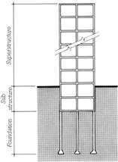

Major Building Parts
Superstructure
Substructure Foundation

Slide 8
Geotechnical Engineering
Soil Engineering
Rock Mechanics
Geology

Slide 9
Origin of Soils
Soils are formed by weathering of rocks due to Mechanical Disintegration or Chemical Decomposition.
When the rock surface gets exposed to atmosphere for an appreciable time, it disintegrates
(or) decomposes into small particles and thus the soils are formed.
Soil may be considered as an incidental material obtained from the Geological Cycle
which goes on continuously in nature.

Slide 10
Geological Cycle
consists of
Erosion
Transportation
Deposition and
Upheaval of soil.

Slide 11
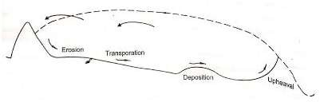

Slide 12
Terminology of Different Types of Soils
The geotechnical engineer should be well versed with the nomenclature and terminology
of different types of soils.
The following list gives the names and salient characteristics of different types of soils.

Slide 13
Boulders
Boulders are rock fragments of large size more than 300 mm in size.
Cobbles
Cobbles are large size particles in the range of 80 mm to 300 mm.
Gravel
Gravel is a type of coarse grained soil. The particle size ranges from 4.75 mm to 80 mm.
It is a cohesionless soil.

Slide 14
Sand
It is coarse grained soil, having particle size between 0.075 mm to 4.75 mm. The particles
are visible to naked eyes. The sand is cohesionless and pervious.
Silt
It is a fine grained soil, with particle size in between 0.002 mm and 0.075 mm. The particles
are not visible to naked eyes.
Inorganic silt consists of bulky, equidimensional grains of quartz. It has little or no plasticity
and is cohesionless.
Organic silt contains an admixture of organic matter. It is a plastic soil and is cohesive.

Slide 15
6). Clay
Clay is a fine grained soil. It is cohesive soil. The particle size is less than 0,002 mm.
Clay consists of microscopic and sub-microscopic particles derived from the chemical
decomposition of rocks. It contains large quantity of clay minerals.
It can be plastic by adjusting the water content. It exhibits considerable strength when it is dry.

Slide 16
Soil Structures
The geometrical arrangement of soil particles with respect to one another is known as
soil structure.
The soils in nature have different structures depending upon the particle size and mode of
formation.

Slide 17
The following types of soil structures are usually found in nature.
Single grained structure
Honey - comb structure
Flocculated structure
Dispersed structure
Coarse – grained skeleton
Clay – matrix structure

Slide 18
Single grained structure and Honey comb structure are developed in coarse grained soils.
Flocculated structure and dispersed structure are developed in clayey soils.
Coarse – grained skeleton and Clay matrix structure are developed in mixed soils.

Slide 19
1). Single Grained Structure
The coarse grained cohesionless soils such as gravel and sand are composed of bulky
grains in which the gravitational forces are more predominant than the surface forces.
When the deposition of these soils occurs the particles settle under gravitational forces
and take an equilibrium position as shown in figure.

Slide 20
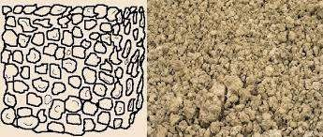

Slide 21
Each particle is in contact with those surrounding it. The soil structure so formed is
known as the single grained structure.
In single grained structure, depending upon the relative position of the particles, the soil may have a loose structure or dense structure.

Slide 22
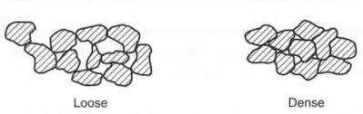

Slide 23
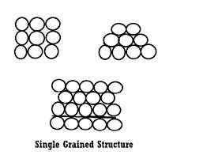

Slide 24
The figure shows spherical particles in the loosest condition and those in the densest
condition.
In the loosest condition the void ratio is 0.90 and in densest condition the void ratio is 0.35. The engineering properties of sands improve considerably with a decrease in void ratio.
In general, the smaller the void ratio the higher is the shear strength and the lower is the
compressibility and permeability.

Slide 25
Loose sands are inherently more unstable. When subjected to vibration the particles in loose sand compressed into dense state. Dense sands are quite stable as they are not affected by vibrations.

Slide 26
2). Honey – comb Structure
The honey – comb structure develops when the particle size is between 0.002 mm and
0.02 mm. The honey – comb structure exists in silt and rock flour.
Due to relatively smaller size, when these particles settle under gravity, the particle surface
forces play an important role.

Slide 27
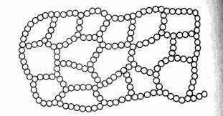

Slide 28
In silt and rock flour, the particles when settling develop a particle to particle contact
that bridges over large voids in the soil mass.
The particles wedge between one another into a stable condition and form a skeleton
like an arch to carry the weight of the overlying materials.
The structure so formed is known as Honey – comb structure.

Slide 29
As shown in figure, the soils with honey- comb structure are in loose condition.
They can support loads only under static conditions.
When subjected to vibrations and shocks the honey – comb structure collapses and large deformation takes place.

Slide 30
3). Flocculated Structure
The flocculated structure occurs in clays. The clay particles have larger surface area and
the electrical forces are important in such soils.
The clay particles have negative charge on the surfaces and a positive charge on the
edges.
Due to this the inter particle contact develops between the positively charged edges and
the negatively charged surfaces. This results in a flocculated structure.
The flocculated structure is formed when there is a net attractive force between the
particles.

Slide 31
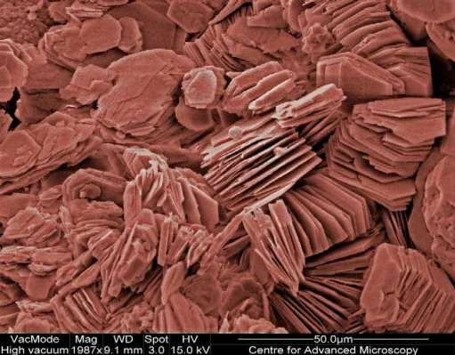

Slide 32
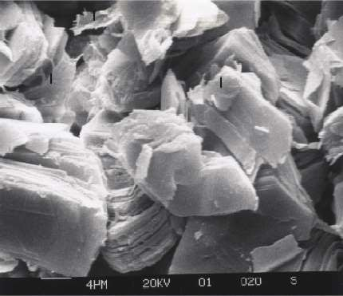

Slide 33
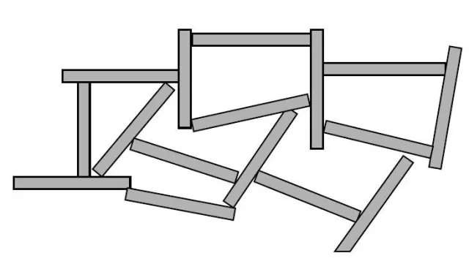

Slide 34
When clay particles settle in water, the deposits formed have the flocculated structure.
The degree of flocculation of a clay deposit depends upon the type and concentration of
clay particles and the presence of salts in water.
Clays settling out in salt water solution have more flocculent structure than those settling
out in a fresh water solution.
Salt water acts as an electrolyte and reduces the repulsive forces between the clay
particles.

Slide 35
Soils with a flocculated structure are light in weight and have high void ratio and water
content.
However these soils are quite strong and can resist the external forces effectively because
of the strong bond due to attraction between the clay particles.
In general, the soils with flocculated structure have low compressibility, high permeability and high shear strength. These soils are insensitive to vibrations.

Slide 36
4). Dispersed Structure
Dispersed structure develops in clays that have been reworked or remoulded.
The clay deposits with flocculated structure when transported to other places by nature or
man get remoulded.
The remoulding converts the edge-to-face orientation to face-to-face orientation.
In face-to-face orientation, the clay particles are arranged in more or less the parallel
orientation known as the dispersed structure.

Slide 37
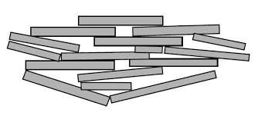

Slide 38
The soils in dispersed structure generally have low shear strength, high compressibility and
low permeability.
Remoulding causes a loss of shear strength in cohesive soils. However with the passage of
time the soils may regain some of its shear strength.
This phenomenon of regain of strength of soil with the passage of time with no change in
water content is known as “Thixotrophy”.

Slide 39
5). Coarse Grained Skeleton
The coarse grained skeleton is composite structure which is formed when the soil
contains particles of different types.
When the amount of bulky, cohesionless soil particles are large with that of fine
grained clayey particles then the bulky grains are in particle-to-particle contact.
These bulky soil particles form a framework or skeleton as shown in figure known as the coarse grained skeleton.
The space between the bulky grains is occupied by clayey particles known as
binders.

Slide 40
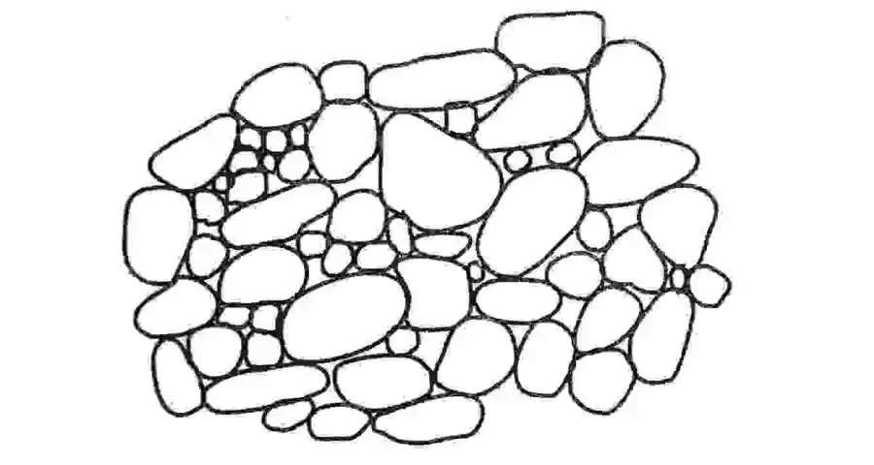

Slide 41
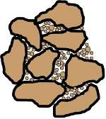

Slide 42
As long as the soil structure is not disturbed, the coarse grained skeleton can take heavy loads
without much deformation.
However, when the soil structure is disturbed then the load is transformed from coarse-grained particles to clayey particles. Due to this the supporting power and also the stability of soil is considerably reduced.

Slide 43
6). Clay Matrix Structure
The clay matrix structure is also a composite structure formed by soils of different
types.
However, in this case the amount of clay particles is very large as compared with the
bulky coarse grained particles.
The clay forms a matrix in which bulky grains were floating without touching one
another.

Slide 44


Slide 45
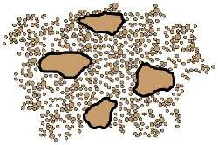

Slide 46
The soils with clay matrix structure have almost the same properties as clay. Their
behaviour is similar to that of an ordinary clay deposit.
However they are more stable, as disturbances have very little effect on the soil
formation with a clay matrix structure.

Slide 47
UNIT – 02
PERMEABILITY

Slide 48
Darcy’s Law
The flow of water through soil is governed by Darcy’s law.
According to Darcy’s law
For laminar free water flow in a homogeneous soil, the velocity of flow (V) is directly proportional to the hydraulic gradient (i).
∴ V ∝ i ⇰ V = K i ---------------- (1)
Here K = The coefficient of permeability of soil
The velocity of flow (V) is also known as the discharge velocity (or) the superficial velocity.

Slide 49
Now if ‘A’ is the cross-sectional area of the soil normal to the direction of flow, then
The discharge of flow through the soil = q = VA = K i A ----------- (2)
The area ‘A’ includes both the soil solids and also the voids. Now from equation (1)
If the hydraulic gradient ‘i’ is unity then V = 1 x K = K
Thus the coefficient of permeability ‘K’ is defined as
“The velocity of flow which would occurs through the soil under unit hydraulic gradient”.
The coefficient of permeability (K) has the dimensions of velocity M^{O} L¹T⁻¹
The SI unit of coefficient of permeability is ms⁻¹

Slide 50
According to USBR, the soil having the coefficient of permeability greater than 10⁻³ mm/s are classified as pervious. The soils having the coefficient of permeability less than 10⁻⁵ mm/s are impervious. The soils having coefficient of permeability in between 10⁻³ to 10⁻⁵ mm/s are designated as semi-pervious.

Slide 51
Validity of Darcy’s Law
The Darcy’s law is valid if the flow of water through soils is laminar.
The flow of water through soils depends upon the dimensions of the interstices which in turn depends upon the particle size.
In fine grained soils, the dimensions of the interstices are very small and hence the flow of water is laminar. In coarse grained soils also the flow of water is generally laminar.
However in very coarse grained soils such as coarse gravel the flow of water may be turbulent.

Slide 52
Allen Hazen established that the maximum diameter of soil particle for the flow of water to be laminar is about 0.5 mm.
The flow of water through the pipes is laminar when Reynold’s number is less than 2000.
In soils, the Reynold’s number = R =
ρ V D_{a}
e
μ
Here
D_{a} = The mean diameter of the soil particle
𝜌 = The density of water
V = The velocity of water flow and
𝜇 = The dynamic viscosity of water

Slide 53
It has been proved experimentally that, the flow of water through soil remains laminar and Darcy’s law is valid so long as the Reynold’s number is equal to (or) less than unity.
ρ V D_{a}
∴ R_{e} =
≤ 1
μ
It has been observed that Darcy’s law is valid for the flow of water in clays, silts and fine sands.

Slide 54
For the flow of water through coarse sands, gravels and boulders the relationship between the velocity of water flow (V) and the hydraulic gradient (i) is non-uniform.
In coarse sands, gravels and boulders the water flow may be turbulent and Darcy’s law may not be applicable.
Hough gave the following equation for the velocity when the flow of water through soils is turbulent.
V = K (i)^{n} Here
n = An exponent = 0.65

Slide 55
Determination of Coefficient of Permeability
The coefficient of permeability of a soil can be determined by using the following methods
1). Laboratory Methods
In the laboratory the coefficient of permeability soil can be determined by using the following methods
a). Constant head permeability test and b). Variable head permeability test The instruments used in laboratories are known as the permeameters.
The constant head permeability test is suitable for relatively more pervious soils and the falling head permeability test is suitable for less pervious soils.

Slide 56
2). Field Methods
The coefficient of permeability of the insitu soil deposit can be determined by using the following methods
a). Pumping out test and b). Pumping in test
The pumping out test influence the large area around the pumping well and gives an overall value of the coefficient of permeability of the soil deposit.
The pumping in test influence small area around the pumping well and gives the value of coefficient of permeability of the soil surrounding the pumping well.

Slide 57
3). Indirect Methods
The coefficient of permeability of the soil can also be determined indirectly by using
The effective size of soil particle (D₁₀) or its specific surface
The coefficient of volume change (C_{V}) from the consolidation test.
4). Capillarity – Permeability Test
The coefficient of permeability of an unsaturated soil can be determined by using Capillarity-Permeability test.

Slide 58
Constant Head Permeability Test
The constant head permeability test is used for determining the coefficient of permeability of relatively more pervious soil.
The apparatus used in this test is known as the constant head permeameter and it is as shown in the figure.

Slide 59
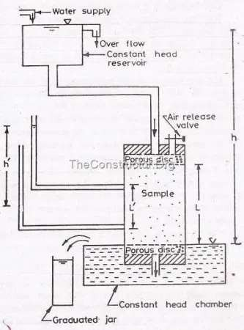

Slide 60
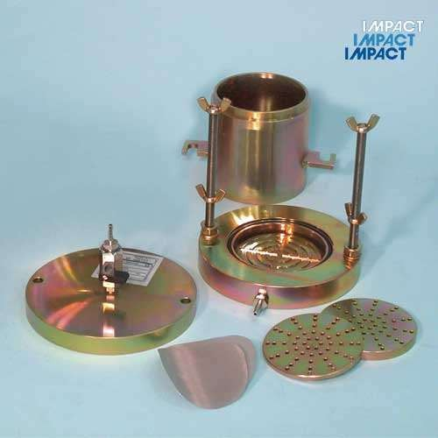

Slide 61
The constant head permeameter consists of a metallic mould with an internal diameter of 100 mm and an internal effective height of 127.3 mm.
The mould is provided with a removable extension collar 100 mm internal diameter and 60 mm height, which is required during the compaction of the soil.
At the bottom the mould is fitted with a detachable base plate called drainage base which is having a provision for inserting 12 mm thick porous disc and a water outlet valve.

Slide 62
The drainage base is also provided with a dummy plate of 12 mm thick which is to be used in the place of porous disc when the soil sample is compacted in the mould.
At the top the mould is fitted with a detachable drainage cap with an inserted porous disc 12 mm thick and having an inlet water valve and also an air release valve.
The porous disc should have permeability more than 10 times the expected permeability of soil sample.
The mould assembly is connected through the top inlet valve to a constant head over head tank and it is placed in a constant level bottom tank as shown in figure.

Slide 63
Preparation of Test Soil sample
About 2.5 Kg of an air dried soil sample is to be taken.
The soil is mixed uniformly with the required quantity of water so that its water content
is equal to the optimum moisture content of the soil determined by Proctors test.
The mould is clamped between the compaction base plate and the extension collar. The inside of mould is lightly greased. Arrange the dummy plate over the base plate.

Slide 64
The soil sample is filled into the mould assembly and compacted to achieve the maximum dry density.
After compacting the collar is removed and the excess soil is trimmed level upto the top of mould. Also detach the base plate and remove the dummy plate.
The mould with compacted soil is assembled to the drainage base and drainage cap having the porous discs as shown in the figure.
The porous discs should be completely saturated in order to deair them before assembling to the mould.

Slide 65
Test Procedure
In constant head permeability test, it is essential that the soil sample in the mould
should be fully saturated.
This is done by attaching the constant level over head tank to the outlet valve of drainage base and allowing water to flow upwards from the base to the top of the soil sample in the mould.
The upward flow is maintained sufficient time till all the air has been expelled out
from the soil sample.

Slide 66
After the soil sample has been fully saturated, the constant level overhead tank is
connected to the inlet valve of the drainage cap.
The water in the constant level overhead tank flows through the soil sample in the
mould from top to bottom and reaches the drainage base.
From the outlet valve of drainage base the water flow into the constant level
bottom tank.
At the start of the experiment the constant level bottom tank is filled with water up
to the level of its overflow tube.

Slide 67
The water enters into the constant level bottom tank (after flowing through the soil sample) flows out through the over flow tube.
When study state is established, the water flows out through the over flow tube is collected in a graduated jar for a convenient time (t).
Now, the discharge of water flowing through the soil sample (Q) is equal to the volume of water collected divided by the time (t).

Slide 68
The head (h) causing the flow of water through the soil sample is equal to the difference in water levels between the constant level over head tank and the constant level bottom tank.
If ‘A’ is the cross-sectional area of soil sample
Then for Darcy’s law
The discharge of water flow through the soil sample = Q = K i A
h
∴ Q = K i A = K _{L} A

Slide 69
The discharge of water flow through the soil sample = Q = K i A
h
∴ Q = K i A = K _{L} A
Q L
∴ K =
h A
Here
L = The length of soil sample and
K = The coefficient of permeability of soil sample

Slide 70
1). Water flow parallel to the planes of stratification
Consider the stratified soil deposit having the water flow parallel to the planes of stratification as shown in figure.
Let
Z₁ = The thickness of soil layer (1)
K₁ = The coefficient of permeability of soil layer (1) Z₂, K₂ = The corresponding values of soil layer (2) and Z₃, K₃ = The corresponding values of soil layer (3)

Slide 71
For water flow parallel to the planes of stratification the hydraulic gradient ‘i’ is same for all the soil layers.
However since the coefficient of permeability (K) is different for each layer, the velocity of water flow (V) is different in each soil layer.

Slide 72
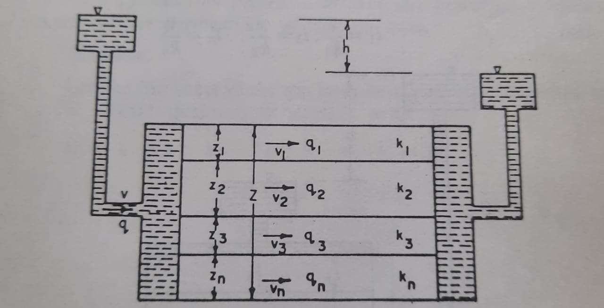

Slide 73
Let
V₁ = The velocity of water flow through soil layer (1) = K₁ i
V₂ = The velocity of water flow through soil layer (2) = K₂ i and V₃ = The velocity of water flow through soil layer (3) = K₃ i

Slide 74
Consider the unit width of soil deposit
Now
The cross-sectional area of soil layer (1) = A₁ = B₁ Z₁ = 1 x Z₁ = Z₁
The discharge of water flow through soil layer (1) = Q₁ = V₁ x A₁ = K₁ i Z₁

Slide 75
Similarly
The discharge of water flow through soil layer (2) = Q₂ = V₂ x A₂ = V₂ x B₂ x Z₂
= K₂ i x 1x Z₂ = K₂ i Z₂ and
The discharge of water flow through soil layer (3) = Q₃ = V₃ x A₃ = V₃ x B₃ x Z₃
= K₃ i x 1x Z₃ = K₃ i Z₃

Slide 76
Now
The total discharge of water flow through the soil deposit = Q = Q₁ + Q₂ + Q₃
∴ Q = K₁ i Z₁ + K₂ i Z₂ + K₃ i Z₃ = i ( K₁Z₁ + K₂Z₂ + K₃Z₃ ) -------------- (1)
Let K_{P} is the average coefficient of permeability of the entire layered soil deposit The total thickness of soil deposit = Z = Z₁ + Z₂ + Z₃
The hydraulic gradient of soil deposit = i

Slide 77
Now
The velocity of water flow though he soil deposit = V = K_{P} i
The cross- sectional area of soil deposit = A = B x Z = 1 x (Z₁ + Z₂ + Z₃) = (Z₁ + Z₂ + Z₃)
∴ The total discharge of water flow through the soil deposit = Q = V x A
= K_{P} i (Z₁ + Z₂ + Z₃) ------ (2)

Slide 78
From the equations (1) and (2) we get
K_{P} i (Z₁ + Z₂ + Z₃) = i ( K₁Z₁ + K₂Z₂ + K₃Z₃ )
K₁Z₁ + K₂Z₂ + K₃Z₃
∴ K_{P} =
Z₁ + Z₂ + Z
3

Slide 79
2). Water flow perpendicular to the planes of stratification
Consider the stratified soil deposit having the water flow perpendicular to the planes of stratification as shown in figure.
Let
Z₁ = The thickness of soil layer (1)
K₁ = The coefficient of permeability of soil layer (1) Z₂, K₂ = The corresponding values of soil layer (2) and Z₃, K₃ = The corresponding values of soil layer (3)

Slide 80
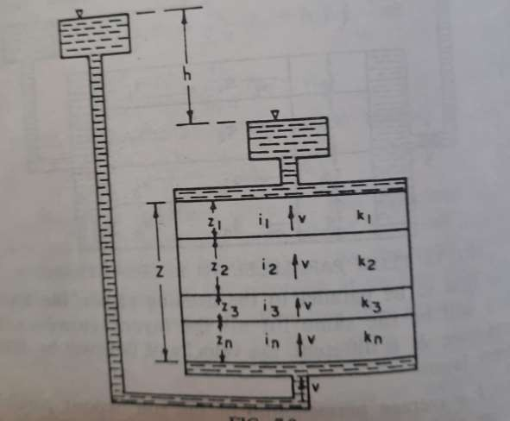

Slide 81
For water flow perpendicular to the planes of stratification, the velocity of water flow (V) and the discharge of water flow (Q) is same for each layer.
However the coefficient of permeability and the thickness is different for each soil layer.
Hence the hydraulic gradient ‘i’ and the loss of head (h) are different for each soil layer.

Slide 82
Let h₁, h₂ and h₃ are the loss of heads in soil layers (1), (2) and (3) respectively
Now
The head lost = h = h₁ + h₂ + h₃
Let i₁, i₂ and i₃ are the hydraulic gradients developed in soil layers (1), (2) and (3) respectively
Here
𝐡_{𝟐}
𝐙_{𝟐}
𝐡_{𝟑}
𝐙_{𝟑}
𝐢 = ^{𝐡𝟏} , 𝐢
=
and 𝐢 =
𝟏
𝐙_{𝟏}
𝟐
𝟑

Slide 83
The velocity of water flow (V) through the soil layers is given by
V = K₁ i₁ = K₂ i₂ = K₃ i₃
h₁ Z
V Z₁
∴ V = K₁i₁ = K₁
⇰ h₁ =
K
1
1
Similarly
V Z₂
V Z₃
h₂ =
and h₃ =
K
K
2
3

Slide 84
The total loss of head = h = h₁ + h₂ + h₃
Now
∴ h =
V Z₁ V Z₂
V Z₃
+ +
K₁ K₂ K₃
Z₂ ₊ Z_{3 ]}
K₂ K₃
∴ h = V [^{Z1} +
--------- (1)
K₁

Slide 85
Let ‘K_{V}’ is the average coefficient of permeability of the entire soil deposit
The total thickness of soil deposit = Z = Z₁ + Z₂ + Z₃ The loss of head = h
h Z
h
∴ The hydraulic gradient = i =
=
Z₁ + Z₂ + Z₃
Now
[ h
]
The velocity of water flowing through the soil deposit = V = K i = K
V
V
Z₁+ Z₂+ Z₃
∴ h = V [^{Z1+ Z2+ Z3} ]
------------- (2)
K_{V}

Slide 86
Z₁ Z₂ Z₃
From equations (1) and (2) we get
Z₁ + Z₂ + Z₃
V [
] = V [
+ + ]
K_{V}
K₁ K₂ K₃
Z₁ + Z₂ + Z₃
∴ K =
V
Z₁ ₊ Z₂ ₊ Z₃
K₁
K₂
K₃

